Slide 1



資料探勘
(Data Mining)
資料科學與資料探勘：
發現，分析，可視化和呈現數據
(Data Science and Data Mining: Discovering, Analyzing, Visualizing and Presenting Data)
1092DM04
MBA, IM, NTPU (M5026) (Spring 2021)
Tue 2, 3, 4 (9:10-12:00) (B8F40)
Min-Yuh Day
戴敏育
Associate Professor
副教授
Institute of Information Management, National Taipei University
國立臺北大學 資訊管理研究所
https://web.ntpu.edu.tw/~myday
2021-03-16

Slide 2
課程大綱 (Syllabus)
週次 (Week) 日期 (Date) 內容 (Subject/Topics)
1 2021/02/23 資料探勘介紹 (Introduction to data mining)
2 2021/03/02 ABC：人工智慧，大數據，雲端運算
(ABC: AI, Big Data, Cloud Computing)
3 2021/03/09 Python資料探勘的基礎
(Foundations of Data Mining in Python)
4 2021/03/16 資料科學與資料探勘：發現，分析，可視化和呈現數據
(Data Science and Data Mining:
Discovering, Analyzing, Visualizing and Presenting Data)
5 2021/03/23 非監督學習：關聯分析，購物籃分析
(Unsupervised Learning: Association Analysis,
Market Basket Analysis)
6 2021/03/30 資料探勘個案研究 I
(Case Study on Data Mining I)

Slide 3
課程大綱 (Syllabus)
週次 (Week) 日期 (Date) 內容 (Subject/Topics)
7 2021/04/06 非監督學習：集群分析，行銷市場區隔
(Unsupervised Learning: Cluster Analysis, Market Segmentation)
8 2021/04/13 監督學習：分類和預測
(Supervised Learning: Classification and Prediction)
9 2021/04/20 期中報告 (Midterm Project Report)
10 2021/04/27 監督學習：分類和預測
(Supervised Learning: Classification and Prediction)
11 2021/05/04 機器學習和深度學習
(Machine Learning and Deep Learning)
12 2021/05/11 卷積神經網絡
(Convolutional Neural Networks)

Slide 4
課程大綱 (Syllabus)
週次 (Week) 日期 (Date) 內容 (Subject/Topics)
13 2021/05/18 資料探勘個案研究 II
(Case Study on Data Mining II)
14 2021/05/25 遞歸神經網絡
(Recurrent Neural Networks)
15 2021/06/01 強化學習
(Reinforcement Learning)
16 2021/06/08 社交網絡分析
(Social Network Analysis)
17 2021/06/15 期末報告 I (Final Project Report I)
18 2021/06/22 期末報告 II (Final Project Report II)

Slide 5
Data Science and Data Mining: Discovering, Analyzing, Visualizing and Presenting Data

Slide 6
Outline
Data Science and Data Mining
Discovering, Analyzing, Visualizing and Presenting Data with Python
  Pandas
  Matplotlib
  Seaborn
  Plotly
  Bokeh, Altair

Slide 7
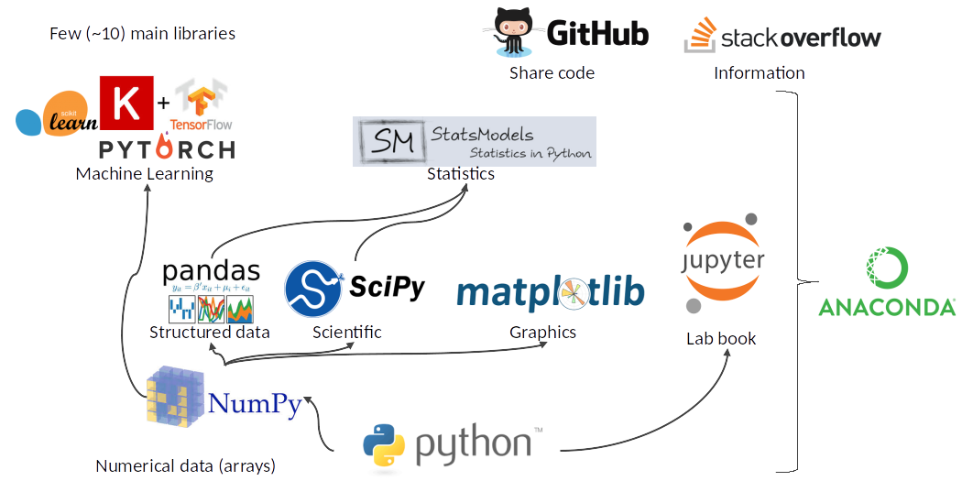
Python Ecosystem for Data Science
Source: https://medium.com/pyfinance/why-python-is-best-choice-for-financial-data-modeling-in-2019-c0d0d1858c45

Slide 8
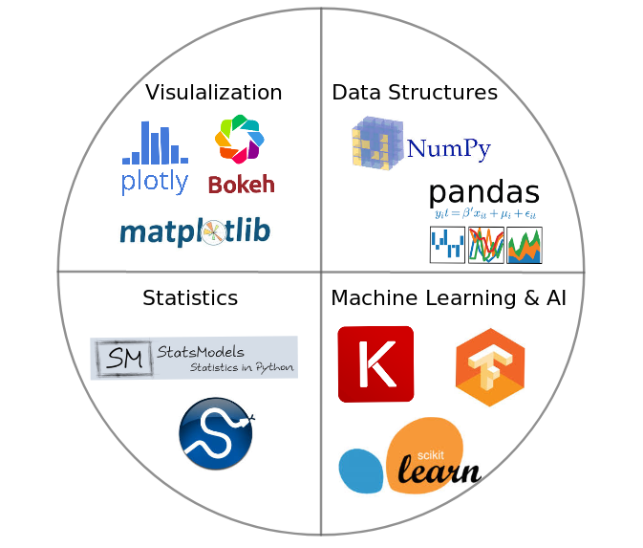

Python Ecosystem for Data Science
Source:https://duchesnay.github.io/pystatsml/introduction/python_ecosystem.html

Slide 9
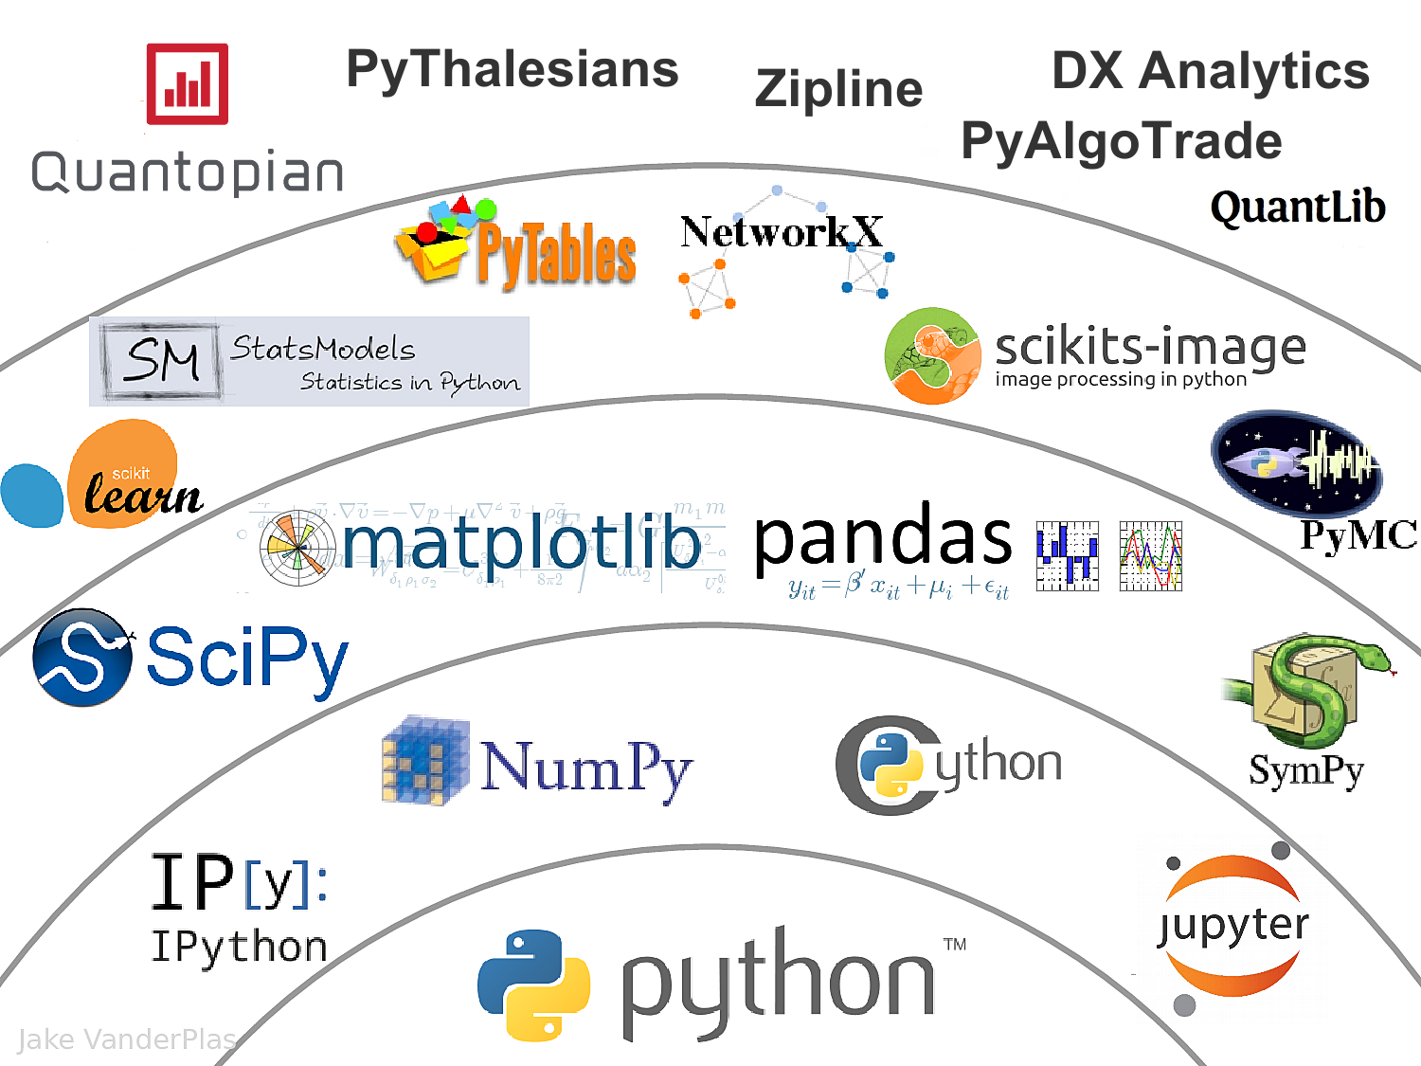

The Quant Finance PyData Stack
Source: http://nbviewer.jupyter.org/format/slides/github/quantopian/pyfolio/blob/master/pyfolio/examples/overview_slides.ipynb#/5

Slide 10
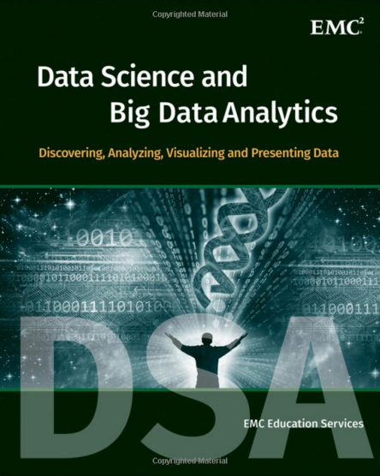
EMC Education Services,
Data Science and Big Data Analytics:
Discovering, Analyzing, Visualizing and Presenting Data,
Wiley, 2015
Source: http://www.amazon.com/Data-Science-Big-Analytics-Discovering/dp/111887613X

Slide 11
Data Science

Slide 12
Data Analyst
Data analyst is just another term for professionals who were doing BI in the form of data compilation, cleaning, reporting, and perhaps some visualization.
Their skill sets included Excel, some SQL knowledge, and reporting.
You would recognize those capabilities as descriptive or reporting analytics.
Source: Ramesh Sharda, Dursun Delen, and Efraim Turban (2017), Business Intelligence, Analytics, and Data Science: A Managerial Perspective, 4th Edition, Pearson

Slide 13
Data Scientist
Data scientist is responsible for predictive analysis, statistical analysis, and more advanced analytical tools and algorithms.
They may have a deeper knowledge of algorithms and may recognize them under various labels—data mining, knowledge discovery, or machine learning.
Some of these professionals may also need deeper programming knowledge to be able to write code for data cleaning/analysis in current Web-oriented languages such as Java or Python and statistical languages such as R.
Many analytics professionals also need to build significant expertise in statistical modeling, experimentation, and analysis.
Source: Ramesh Sharda, Dursun Delen, and Efraim Turban (2017), Business Intelligence, Analytics, and Data Science: A Managerial Perspective, 4th Edition, Pearson

Slide 14
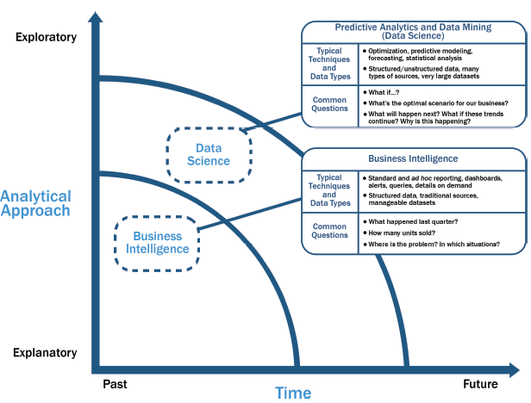
Data Science and
Business Intelligence
Source: EMC Education Services, Data Science and Big Data Analytics: Discovering, Analyzing, Visualizing and Presenting Data, Wiley, 2015

Slide 15
Data Science and
Business Intelligence
Predictive Analytics
and Data Mining
(Data Science)
Source: EMC Education Services, Data Science and Big Data Analytics: Discovering, Analyzing, Visualizing and Presenting Data, Wiley, 2015

Slide 16
Data Science and
Business Intelligence
Predictive Analytics
and Data Mining
(Data Science)
Structured/unstructured data, many types of sources,
very large datasets
Optimization, predictive modeling, forecasting statistical analysis
What if…?
What’s the optimal scenario for our business?
What will happen next?
What if these trends countinue?
Why is this happening?
Source: EMC Education Services, Data Science and Big Data Analytics: Discovering, Analyzing, Visualizing and Presenting Data, Wiley, 2015

Slide 17
Profile of a Data Scientist
Quantitative
  mathematics or statistics
Technical
  software engineering,
  machine learning,
  and programming skills
Skeptical mind-set and critical thinking
Curious and creative
Communicative and collaborative
Source: EMC Education Services, Data Science and Big Data Analytics: Discovering, Analyzing, Visualizing and Presenting Data, Wiley, 2015

Slide 18
Data Scientist Profile
Quantitative
Technical
Curious
and
Creative
Data Scientist
Skeptical
Communicative
and
Collaborative
Source: EMC Education Services, Data Science and Big Data Analytics: Discovering, Analyzing, Visualizing and Presenting Data, Wiley, 2015

Slide 19
Big Data Analytics Lifecycle

Slide 20
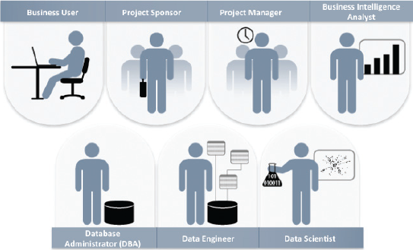
Key Roles for a
Successful Analytics Project
Source: EMC Education Services, Data Science and Big Data Analytics: Discovering, Analyzing, Visualizing and Presenting Data, Wiley, 2015

Slide 21
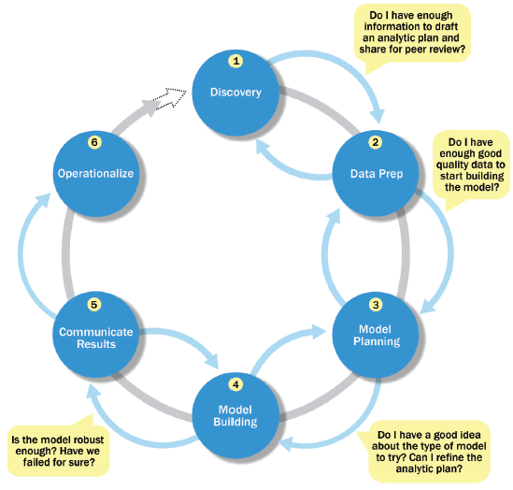
Overview of Data Analytics Lifecycle
Source: EMC Education Services, Data Science and Big Data Analytics: Discovering, Analyzing, Visualizing and Presenting Data, Wiley, 2015

Slide 22
Overview of Data Analytics Lifecycle
1. Discovery
2. Data preparation
3. Model planning
4. Model building
5. Communicate results
6. Operationalize
Source: EMC Education Services, Data Science and Big Data Analytics: Discovering, Analyzing, Visualizing and Presenting Data, Wiley, 2015

Slide 23
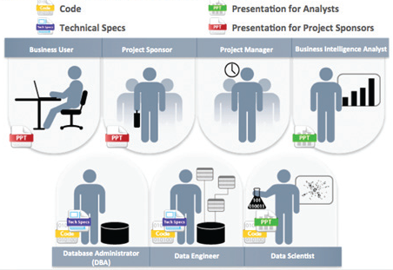
Key Outputs from a
Successful Analytics Project
Source: EMC Education Services, Data Science and Big Data Analytics: Discovering, Analyzing, Visualizing and Presenting Data, Wiley, 2015

Slide 24
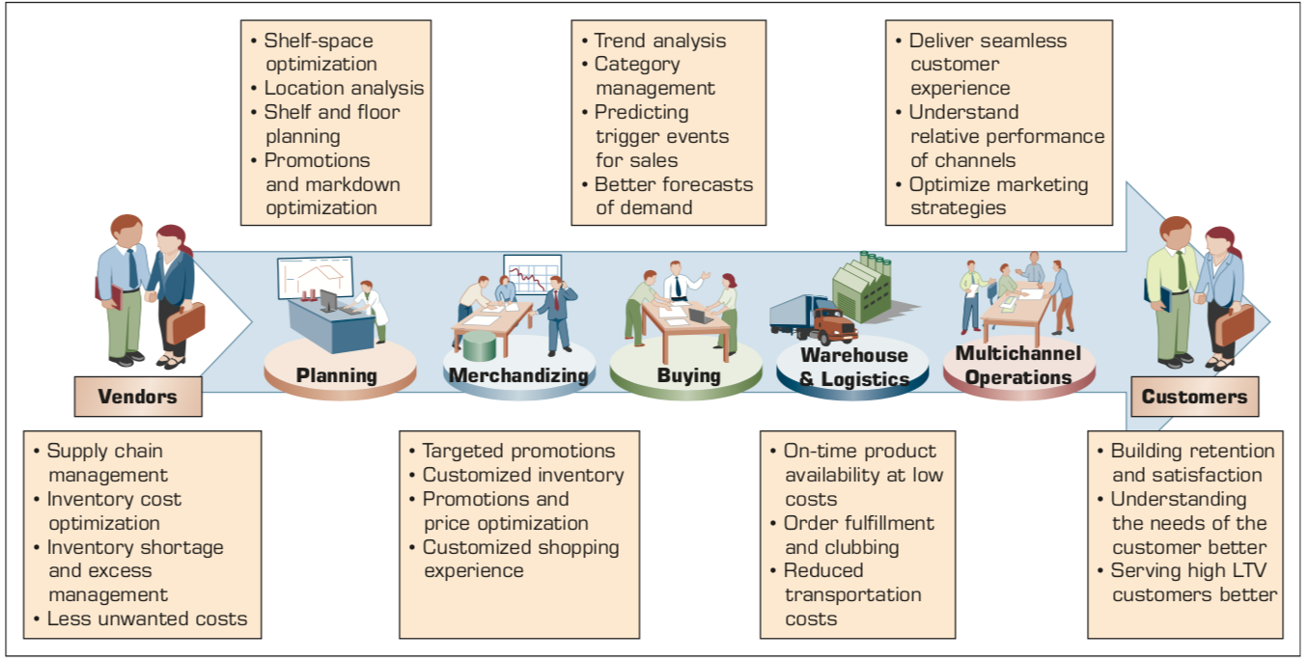
Example of Analytics Applications in a Retail Value Chain
Retail Value Chain
Critical needs at every touch point of the Retail Value Chain
Source: Ramesh Sharda, Dursun Delen, and Efraim Turban (2017), Business Intelligence, Analytics, and Data Science: A Managerial Perspective, 4th Edition, Pearson

Slide 25
Analytics Ecosystem
Source: Ramesh Sharda, Dursun Delen, and Efraim Turban (2017), Business Intelligence, Analytics, and Data Science: A Managerial Perspective, 4th Edition, Pearson

Slide 26
Job Titles of Analytics
Source: Ramesh Sharda, Dursun Delen, and Efraim Turban (2017), Business Intelligence, Analytics, and Data Science: A Managerial Perspective, 4th Edition, Pearson

Slide 27
Three Types of Analytics
Source: Ramesh Sharda, Dursun Delen, and Efraim Turban (2017), Business Intelligence, Analytics, and Data Science: A Managerial Perspective, 4th Edition, Pearson

Slide 28
A Data to Knowledge Continuum
Source: Ramesh Sharda, Dursun Delen, and Efraim Turban (2017), Business Intelligence, Analytics, and Data Science: A Managerial Perspective, 4th Edition, Pearson

Slide 29
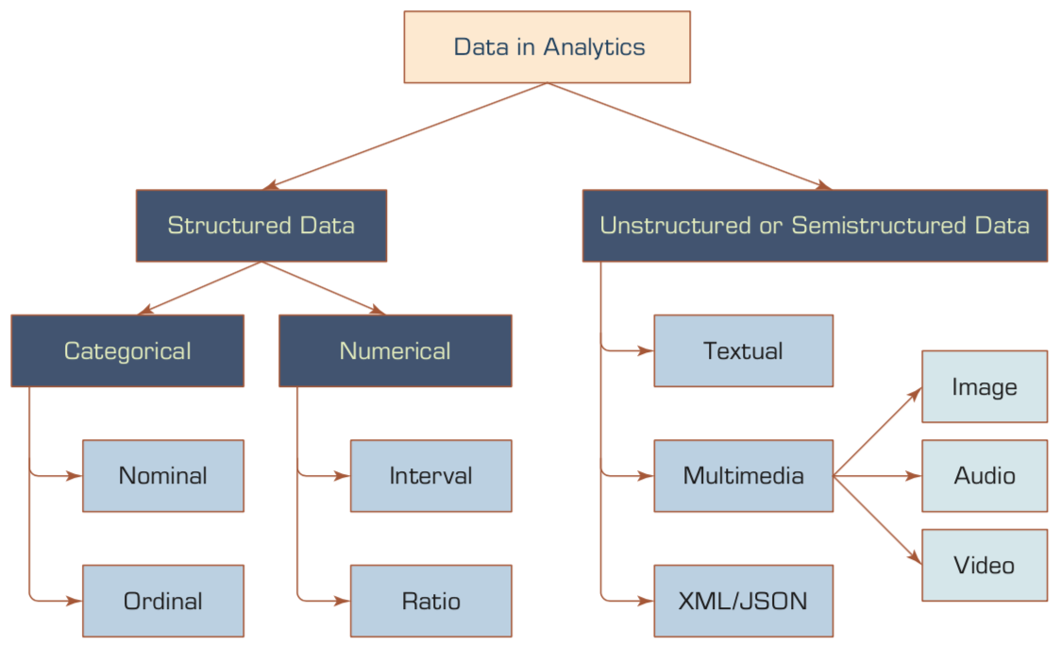
A Simple Taxonomy of Data
Source: Ramesh Sharda, Dursun Delen, and Efraim Turban (2017), Business Intelligence, Analytics, and Data Science: A Managerial Perspective, 4th Edition, Pearson

Slide 30
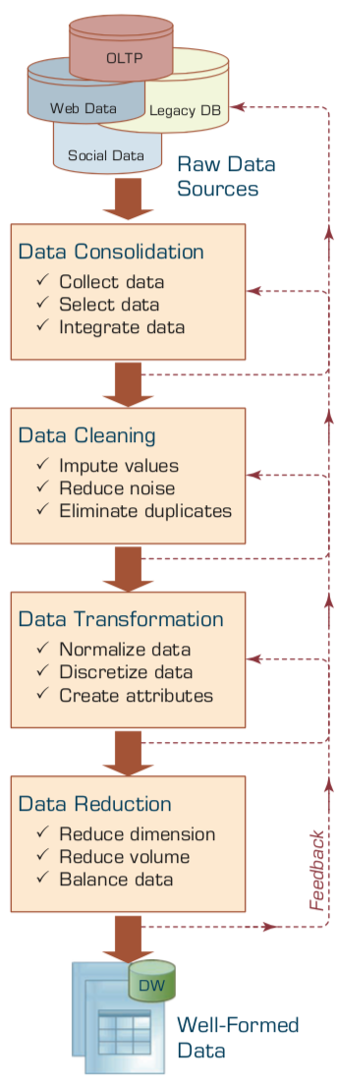
Data Preprocessing Steps
Source: Ramesh Sharda, Dursun Delen, and Efraim Turban (2017), Business Intelligence, Analytics, and Data Science: A Managerial Perspective, 4th Edition, Pearson

Slide 31
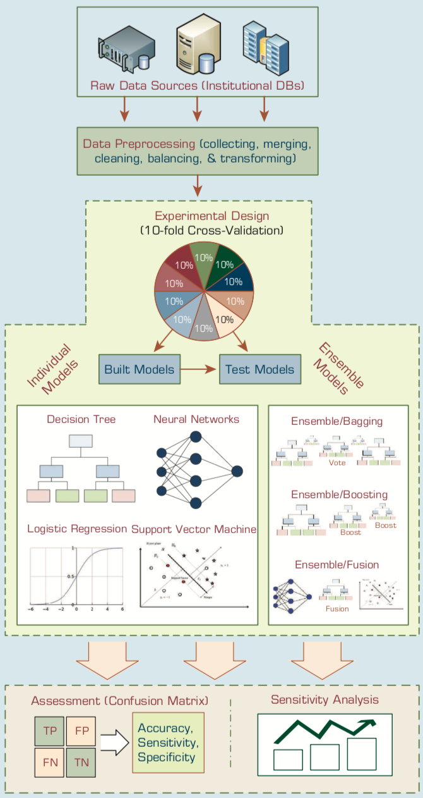
An Analytics Approach to Predicting Student Attrition
Source: Ramesh Sharda, Dursun Delen, and Efraim Turban (2017), Business Intelligence, Analytics, and Data Science: A Managerial Perspective, 4th Edition, Pearson

Slide 32
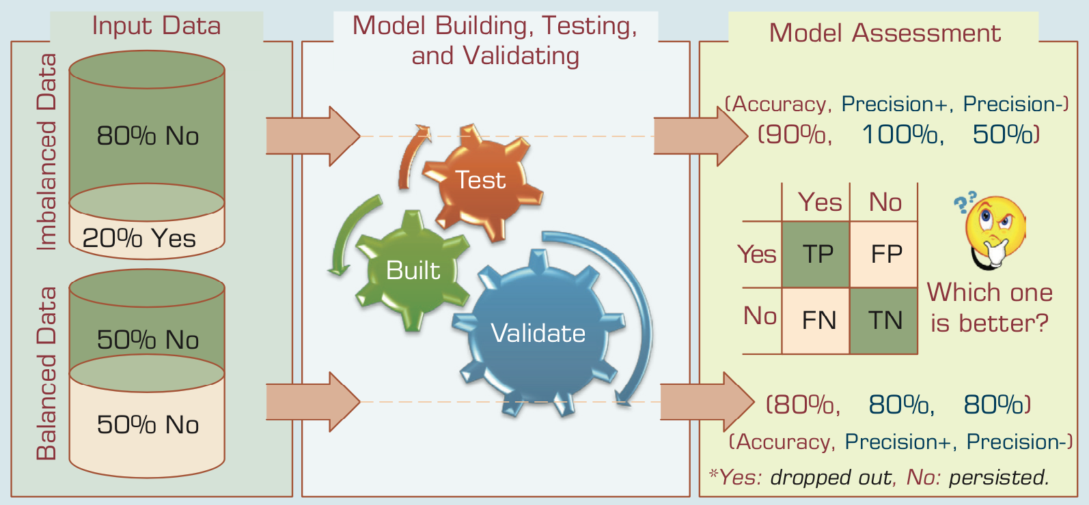
A Graphical Depiction of the
Class Imbalance Problem
Source: Ramesh Sharda, Dursun Delen, and Efraim Turban (2017), Business Intelligence, Analytics, and Data Science: A Managerial Perspective, 4th Edition, Pearson

Slide 33
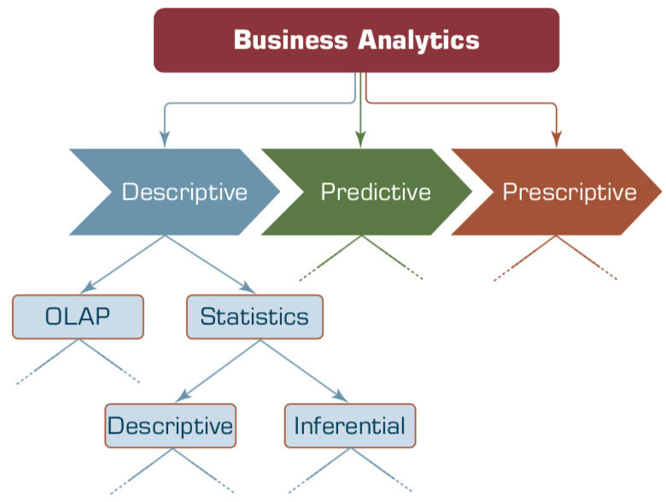
Relationship between Statistics and Descriptive Analytics
Source: Ramesh Sharda, Dursun Delen, and Efraim Turban (2017), Business Intelligence, Analytics, and Data Science: A Managerial Perspective, 4th Edition, Pearson

Slide 34
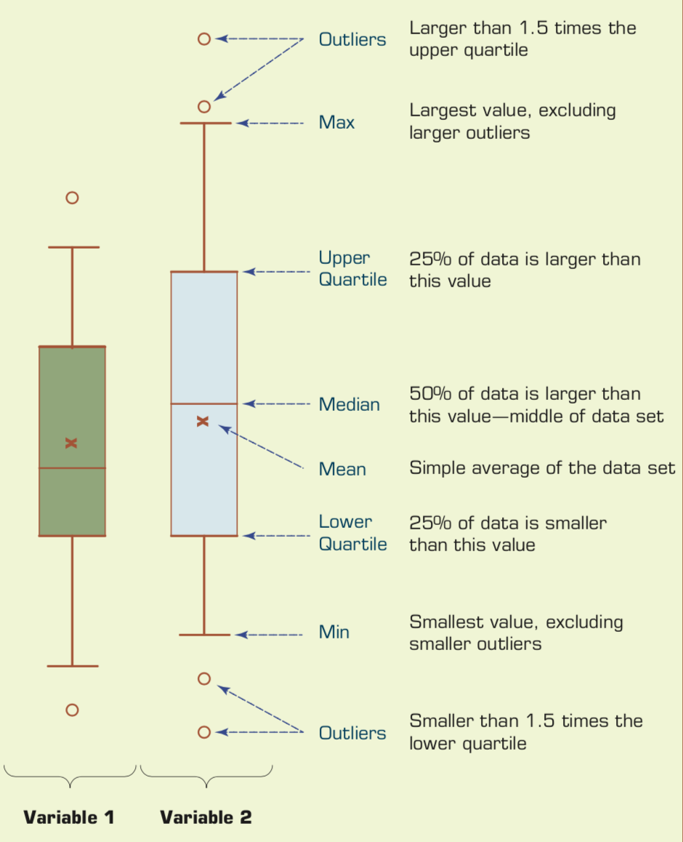
Understanding the Specifics about
Box-and-Whiskers Plots
Source: Ramesh Sharda, Dursun Delen, and Efraim Turban (2017), Business Intelligence, Analytics, and Data Science: A Managerial Perspective, 4th Edition, Pearson

Slide 35
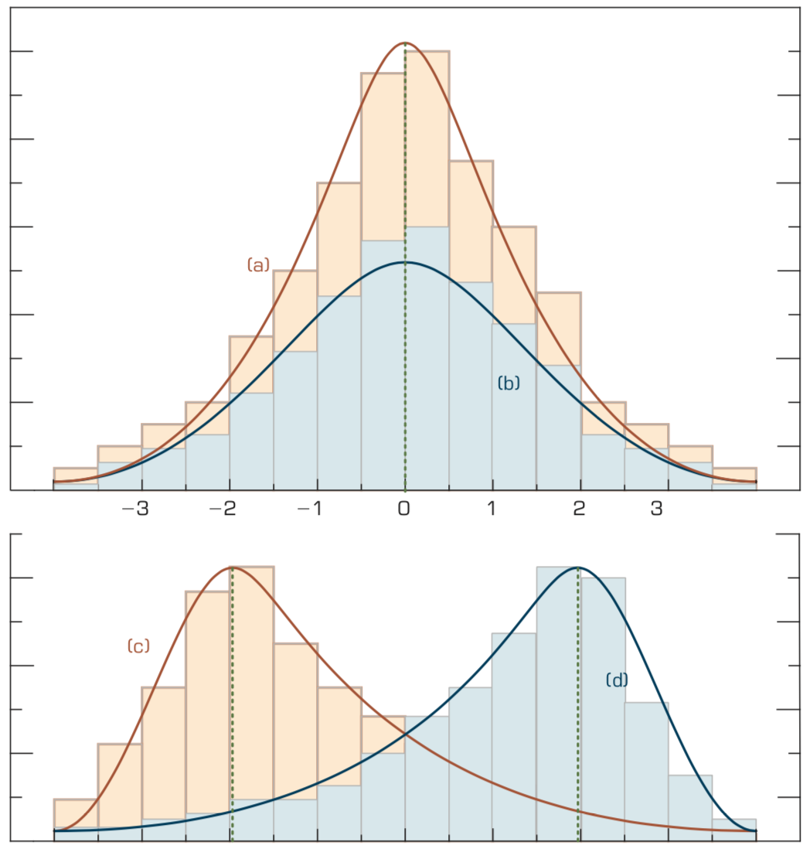
Relationship between
Dispersion and Shape Properties.
Source: Ramesh Sharda, Dursun Delen, and Efraim Turban (2017), Business Intelligence, Analytics, and Data Science: A Managerial Perspective, 4th Edition, Pearson

Slide 36
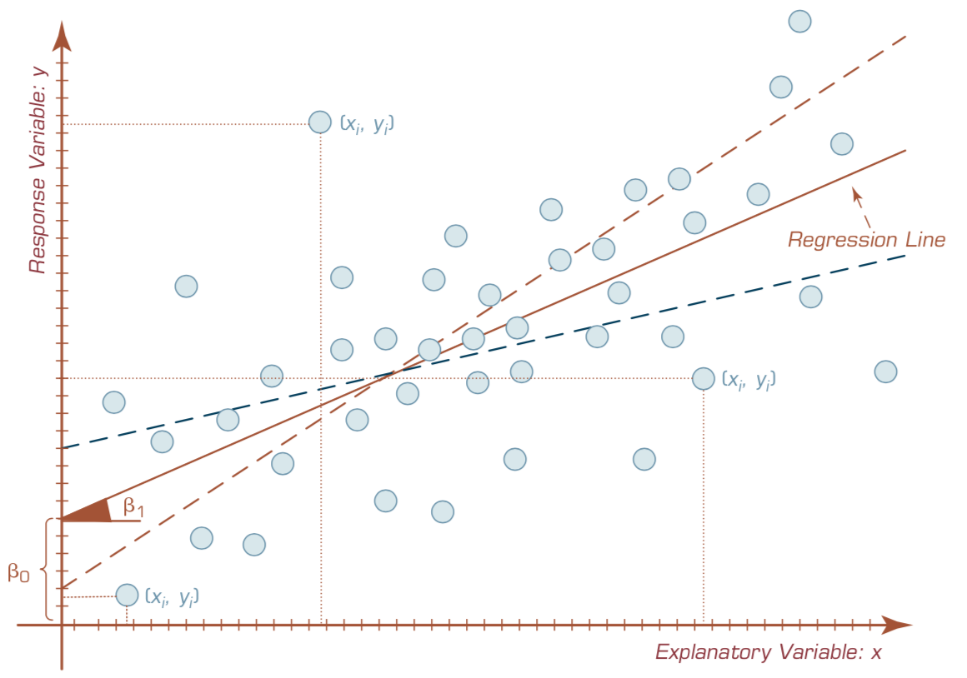
A Scatter Plot and a Linear Regression Line
Source: Ramesh Sharda, Dursun Delen, and Efraim Turban (2017), Business Intelligence, Analytics, and Data Science: A Managerial Perspective, 4th Edition, Pearson

Slide 37
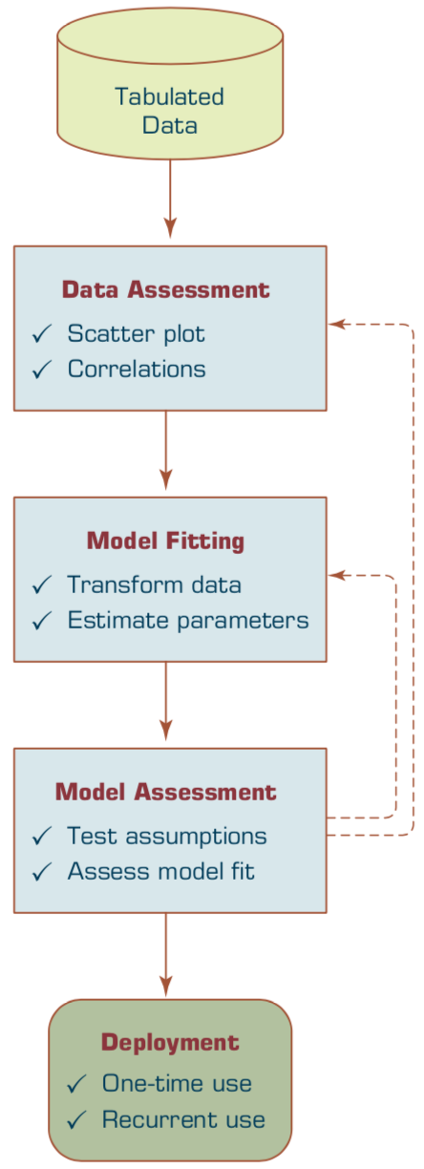
A Process Flow for Developing Regression Models.
Source: Ramesh Sharda, Dursun Delen, and Efraim Turban (2017), Business Intelligence, Analytics, and Data Science: A Managerial Perspective, 4th Edition, Pearson

Slide 38

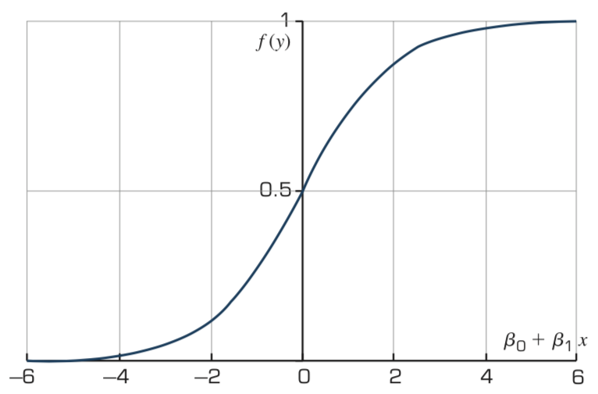
The Logistic Function
Source: Ramesh Sharda, Dursun Delen, and Efraim Turban (2017), Business Intelligence, Analytics, and Data Science: A Managerial Perspective, 4th Edition, Pearson

Slide 39
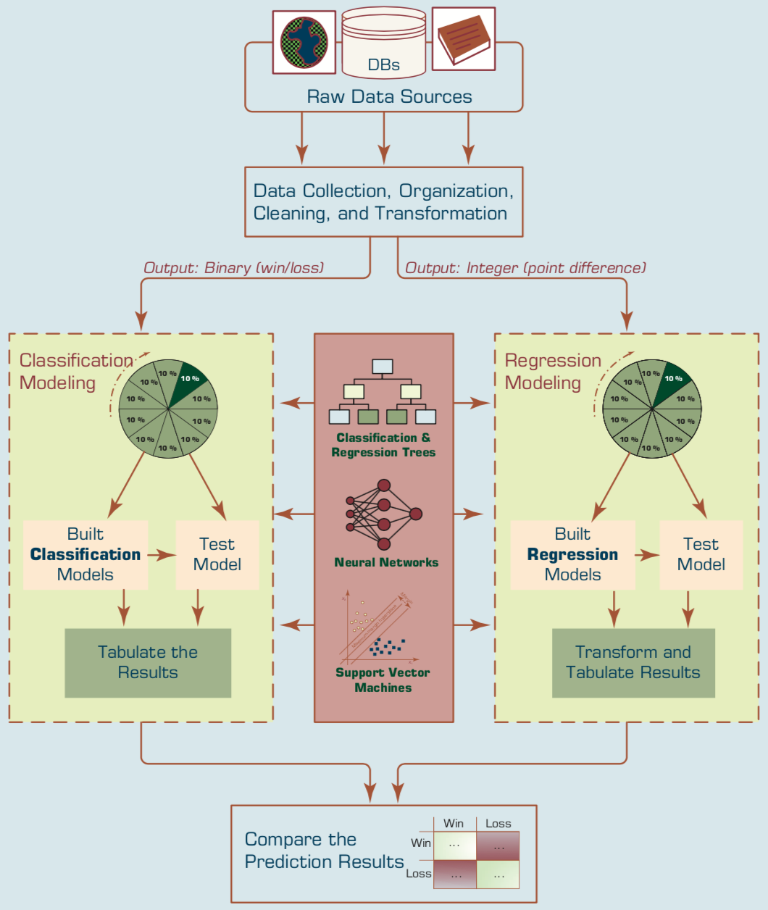
Predicting NCAA Bowl Game Outcomes
Source: Ramesh Sharda, Dursun Delen, and Efraim Turban (2017), Business Intelligence, Analytics, and Data Science: A Managerial Perspective, 4th Edition, Pearson

Slide 40
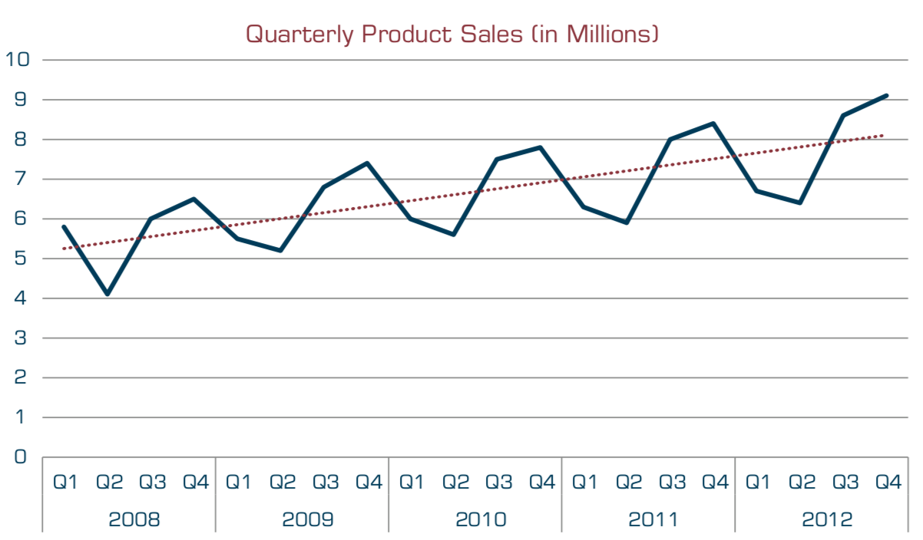
A Sample Time Series of Data on Quarterly Sales Volumes
Source: Ramesh Sharda, Dursun Delen, and Efraim Turban (2017), Business Intelligence, Analytics, and Data Science: A Managerial Perspective, 4th Edition, Pearson

Slide 41
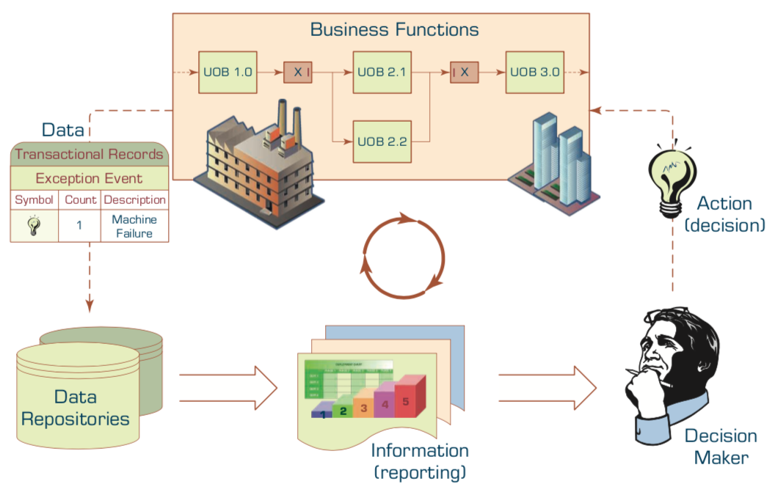
The Role of Information Reporting in Managerial Decision Making
Source: Ramesh Sharda, Dursun Delen, and Efraim Turban (2017), Business Intelligence, Analytics, and Data Science: A Managerial Perspective, 4th Edition, Pearson

Slide 42
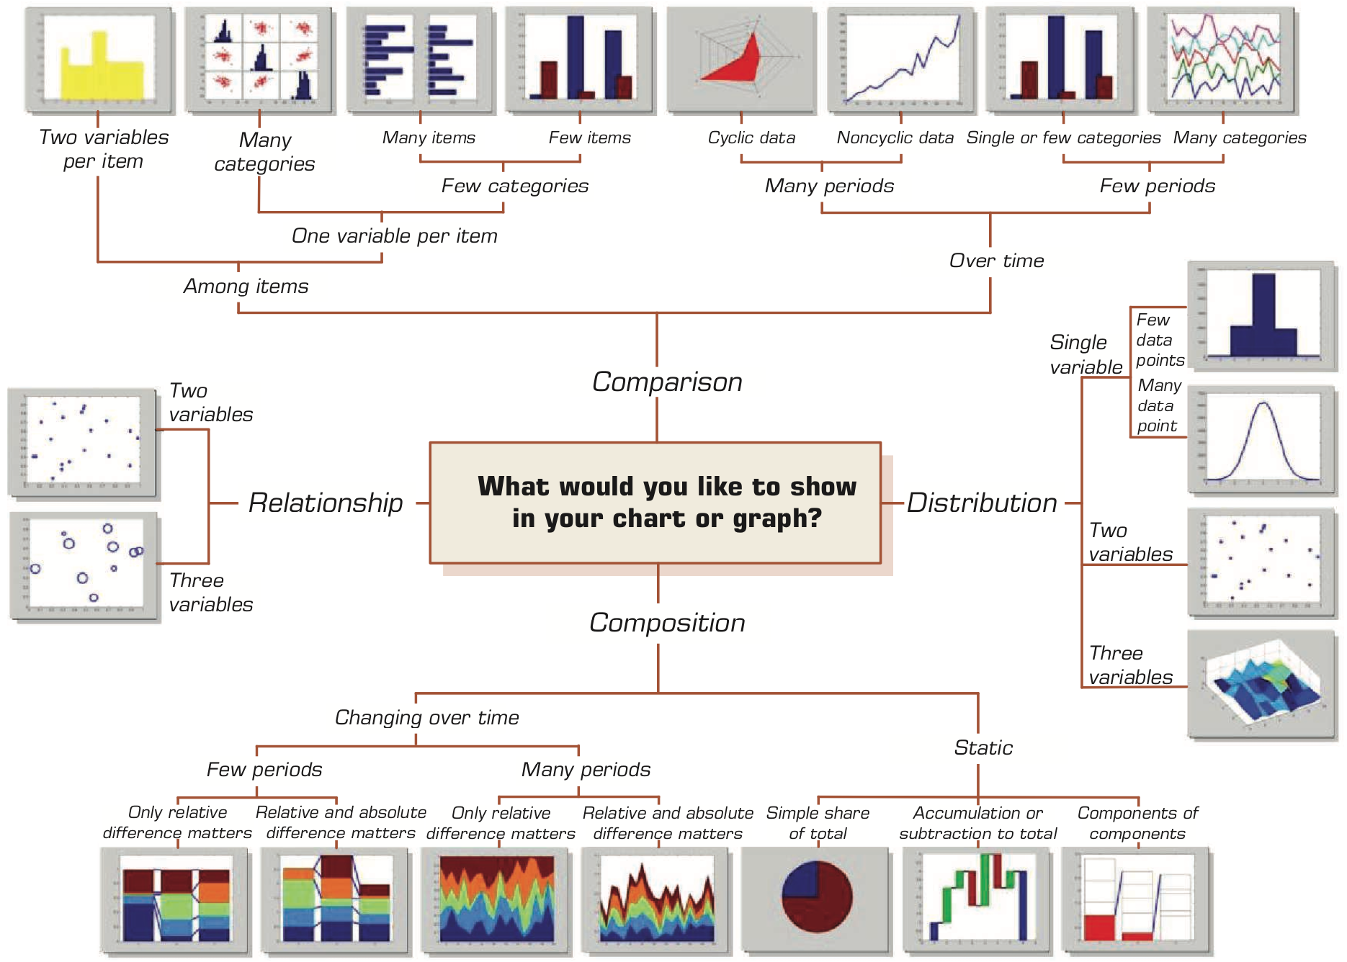
A Taxonomy of Charts and Graphs
Source: Ramesh Sharda, Dursun Delen, and Efraim Turban (2017), Business Intelligence, Analytics, and Data Science: A Managerial Perspective, 4th Edition, Pearson

Slide 43
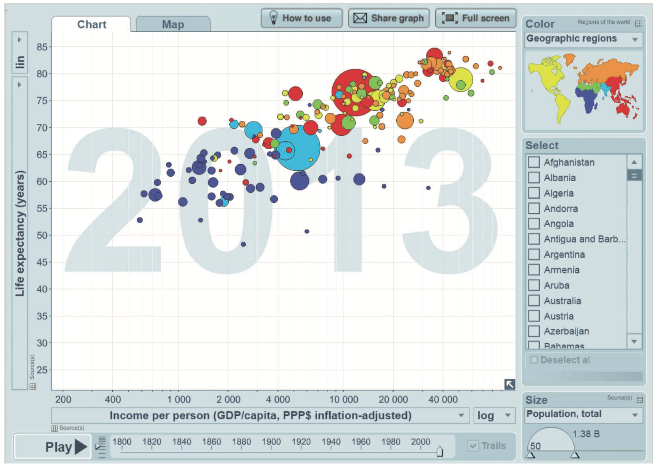
A Gapminder Chart That Shows the Wealth and Health of Nations
Source: Ramesh Sharda, Dursun Delen, and Efraim Turban (2017), Business Intelligence, Analytics, and Data Science: A Managerial Perspective, 4th Edition, Pearson

Slide 44
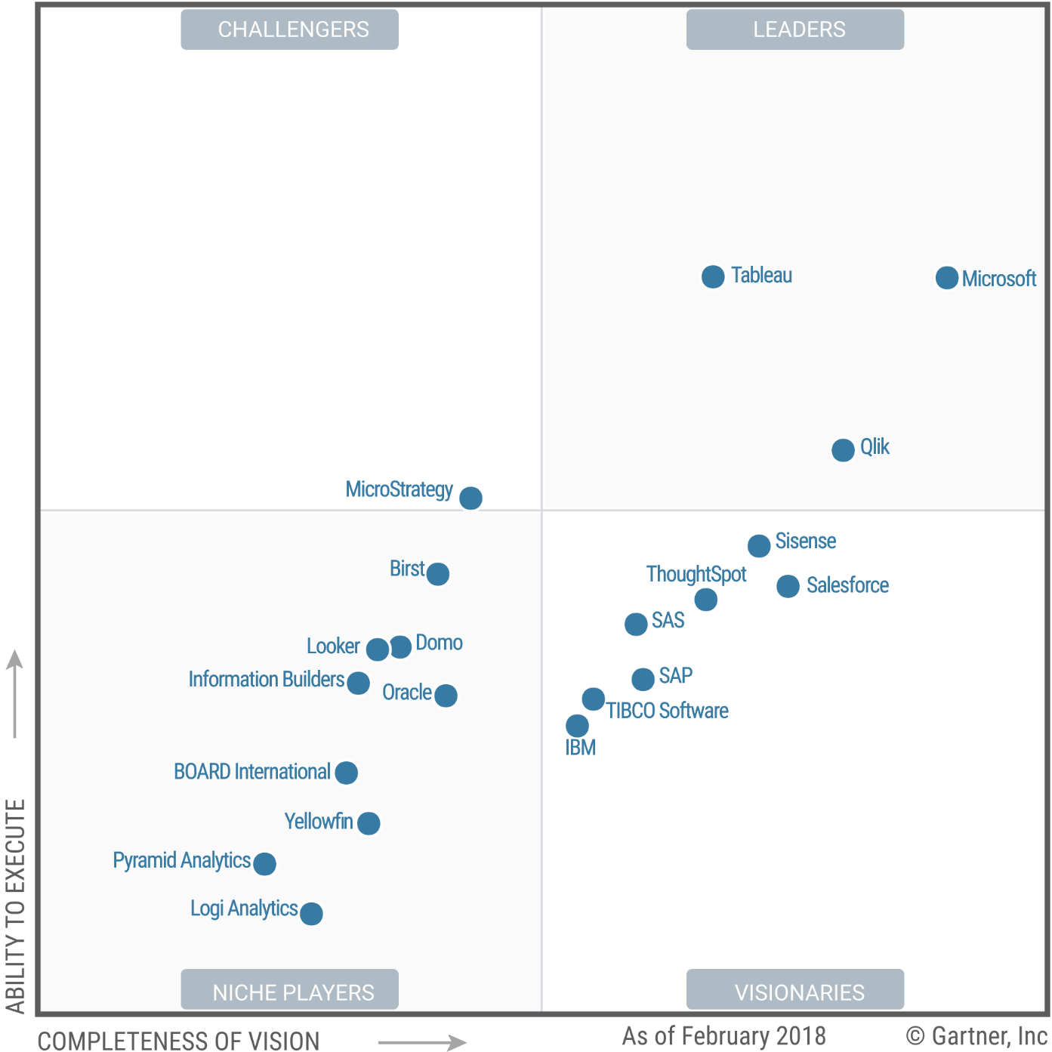
Magic Quadrant for Business Intelligence and Analytics Platforms
Source: https://www.tableau.com/reports/gartner

Slide 45
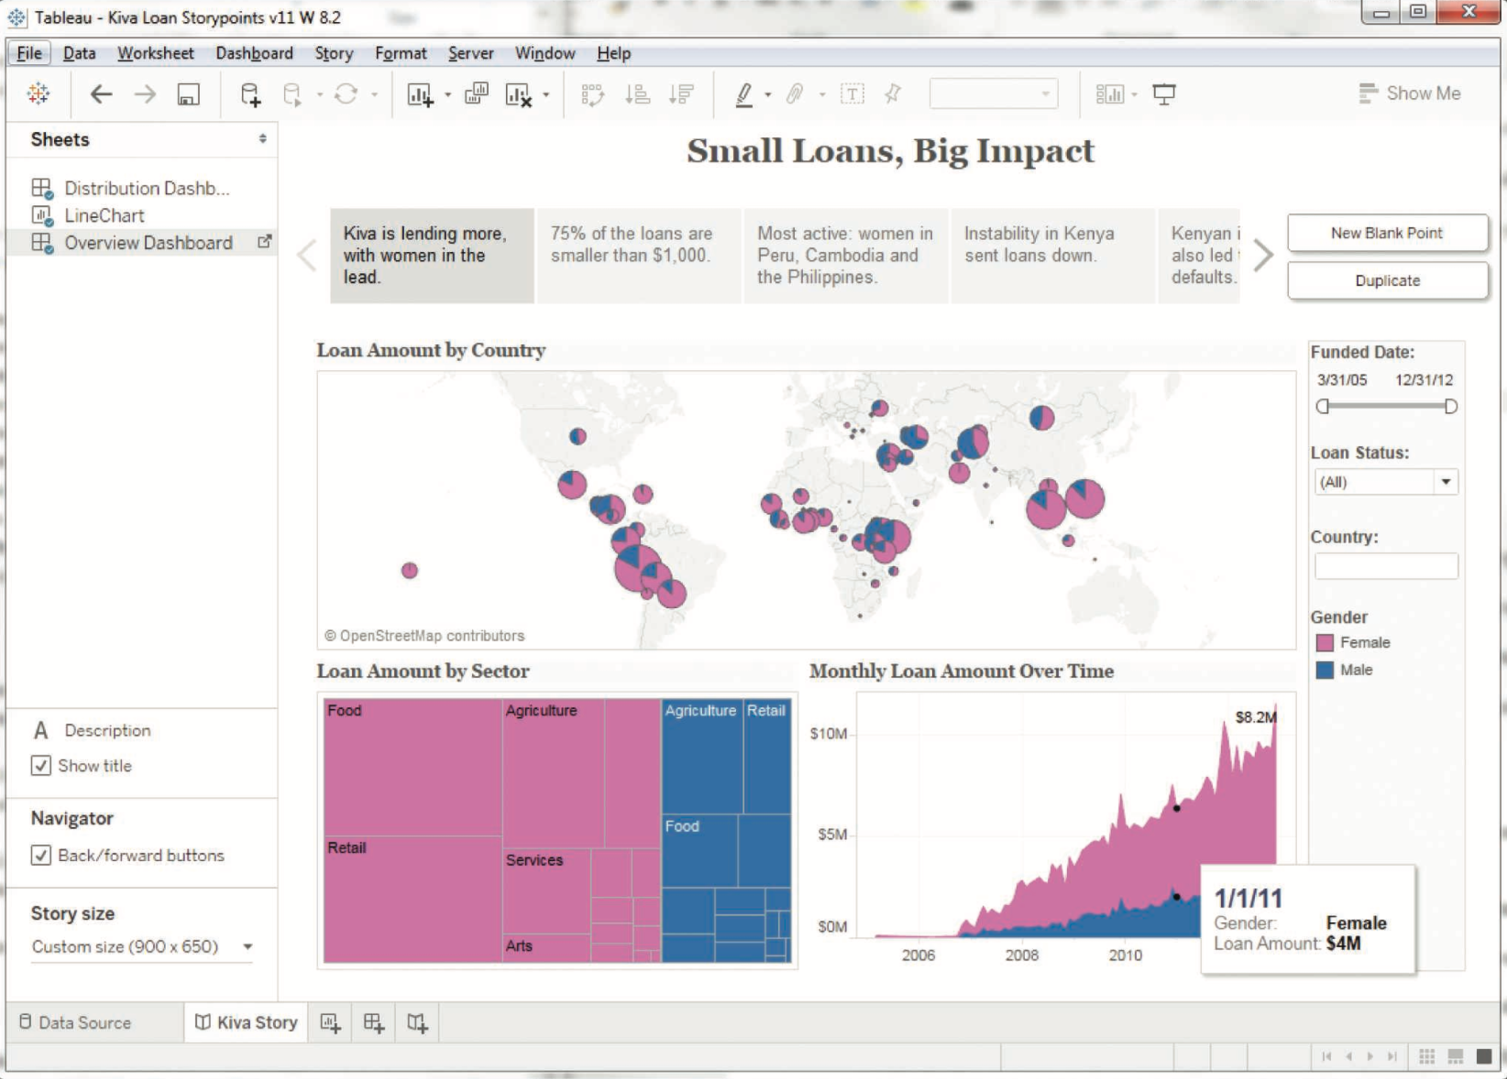
A Storyline Visualization in Tableau Software
Source: Ramesh Sharda, Dursun Delen, and Efraim Turban (2017), Business Intelligence, Analytics, and Data Science: A Managerial Perspective, 4th Edition, Pearson

Slide 46
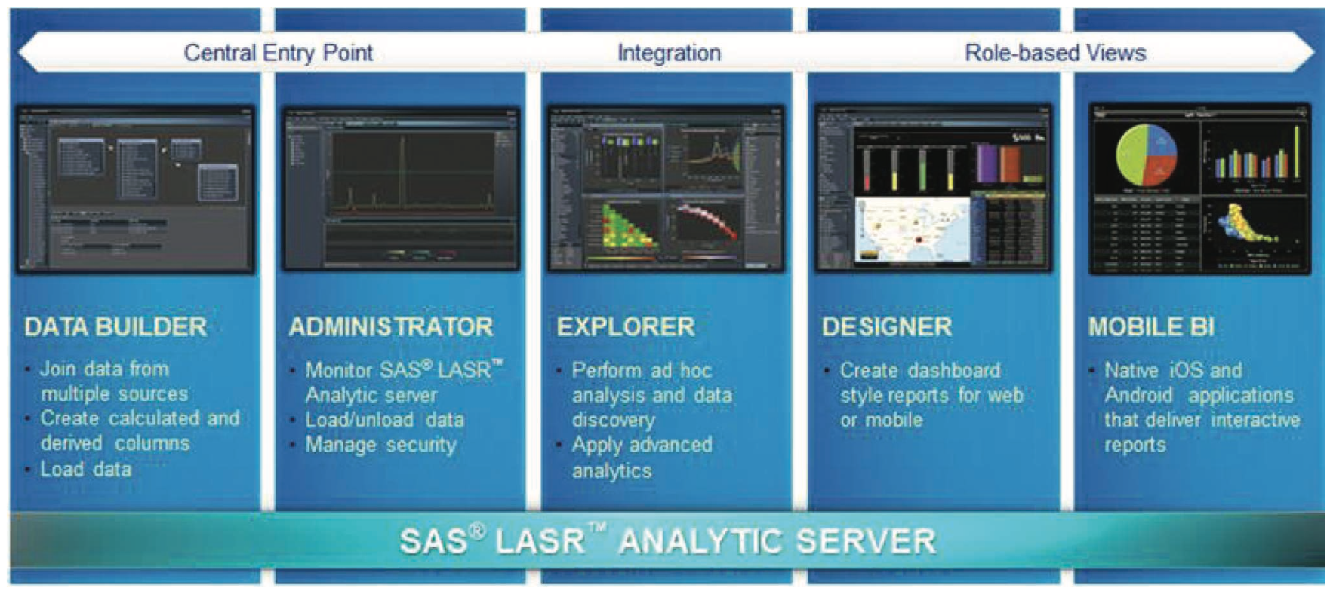
An Overview of SAS
Visual Analytics Architecture
Source: Ramesh Sharda, Dursun Delen, and Efraim Turban (2017), Business Intelligence, Analytics, and Data Science: A Managerial Perspective, 4th Edition, Pearson

Slide 47
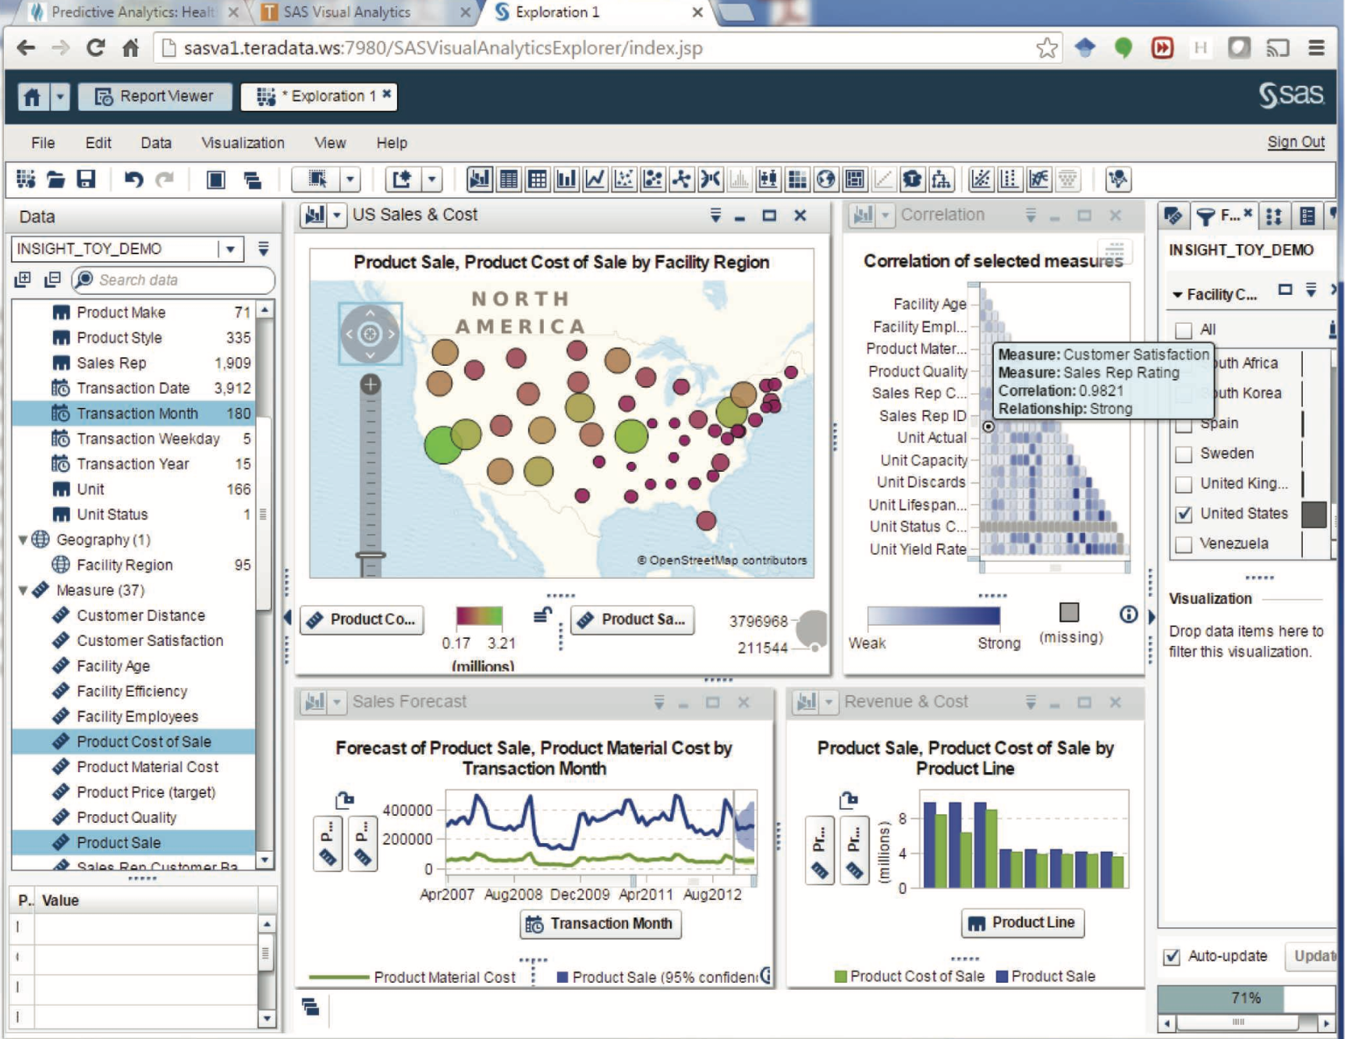
A Screenshot from SAS Visual Analytics
Source: Ramesh Sharda, Dursun Delen, and Efraim Turban (2017), Business Intelligence, Analytics, and Data Science: A Managerial Perspective, 4th Edition, Pearson

Slide 48
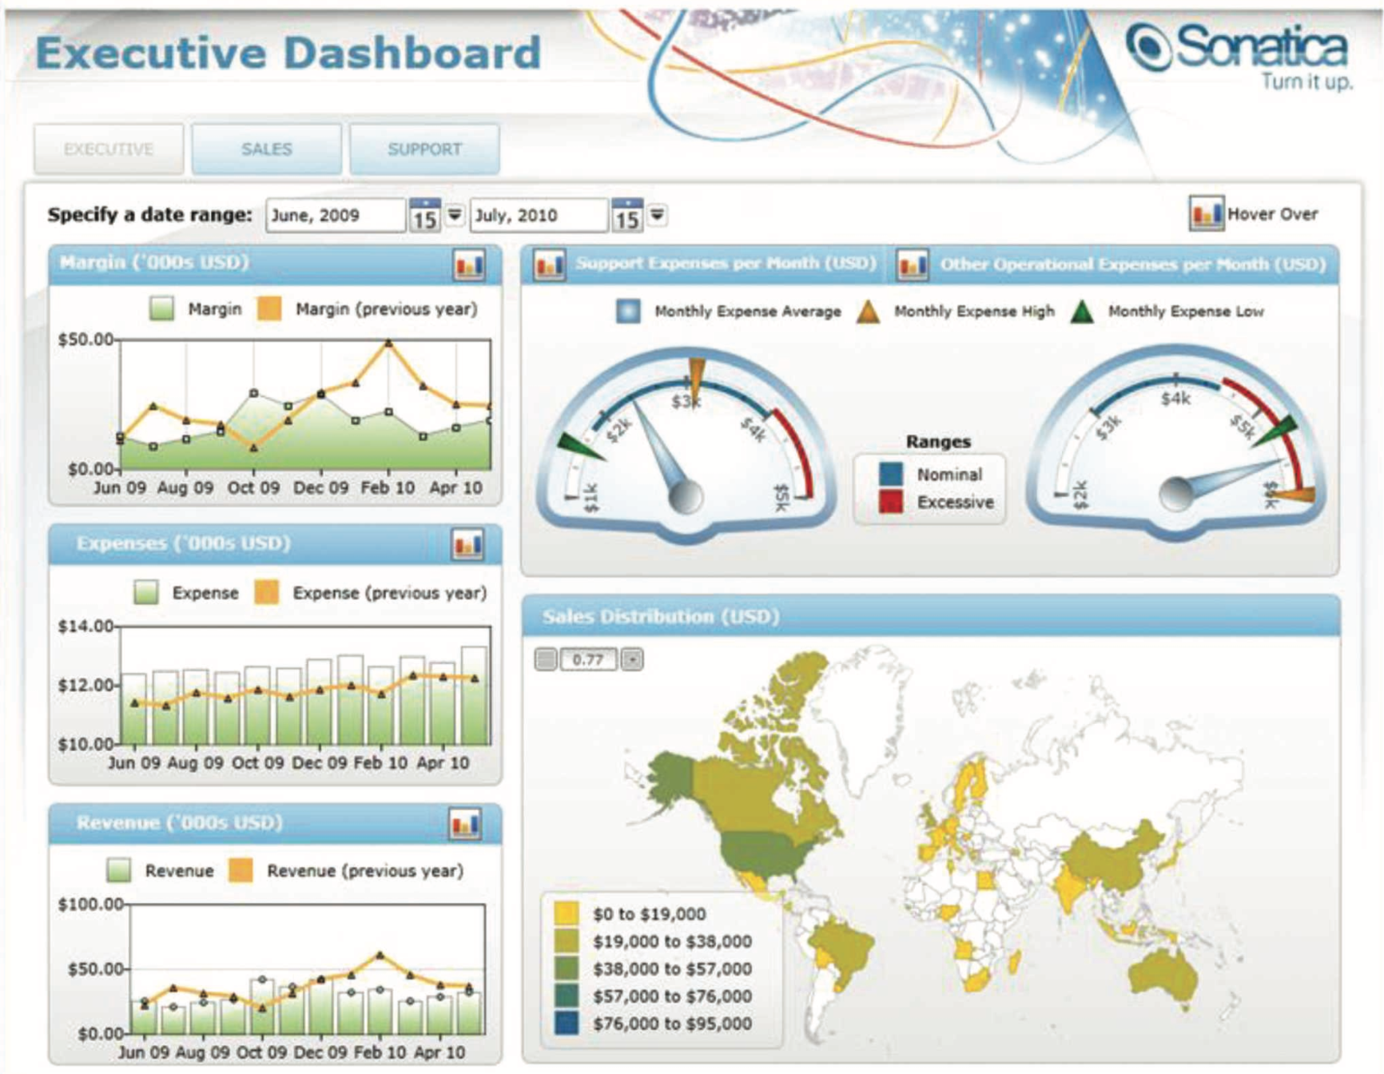
A Sample Executive Dashboard
Source: Ramesh Sharda, Dursun Delen, and Efraim Turban (2017), Business Intelligence, Analytics, and Data Science: A Managerial Perspective, 4th Edition, Pearson

Slide 49
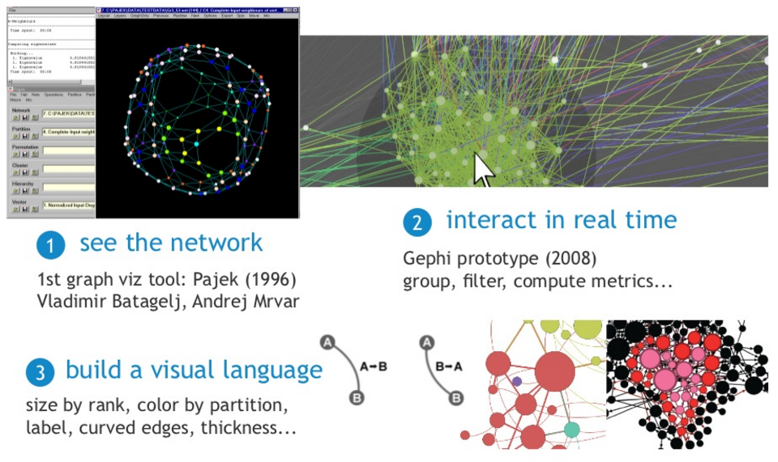
Exploratory Network Analysis
Source: http://sebastien.pro/gephi-icwsm-tutorial.pdf

Slide 50
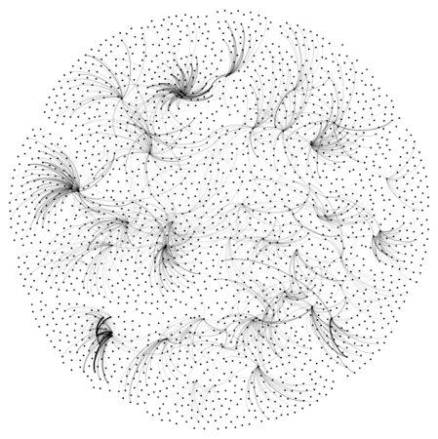
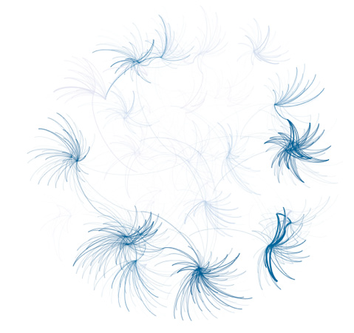
Looking for a “Simple Small Truth”?
What Data Visualization Should Do?
1. Make complex things simple
2. Extract small information from large data
3. Present truth, do not deceive
Source: http://sebastien.pro/gephi-icwsm-tutorial.pdf

Slide 51
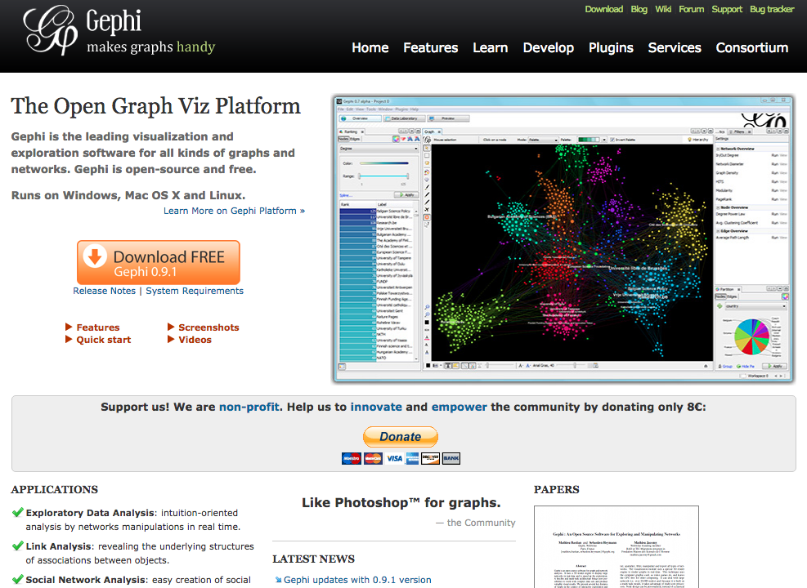
Gephi
https://gephi.org/

Slide 52
Discovering,
Analyzing,
Visualizing and
Presenting Data with Python in Google Colab

Slide 53




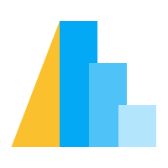

Python Data Analysis and Visualization
Altair

Slide 54
Python Pandas
http://pandas.pydata.org/

Slide 55
Python matplotlib
Source: https://matplotlib.org/

Slide 56
Python seaborn
Source: https://seaborn.pydata.org/

Slide 57
Python plotly
Source: https://plotly.com/python/

Slide 58
Python bokeh
Source: https://bokeh.org/

Slide 59
Python
Altair
Altair
Source: https://altair-viz.github.io/

Slide 60
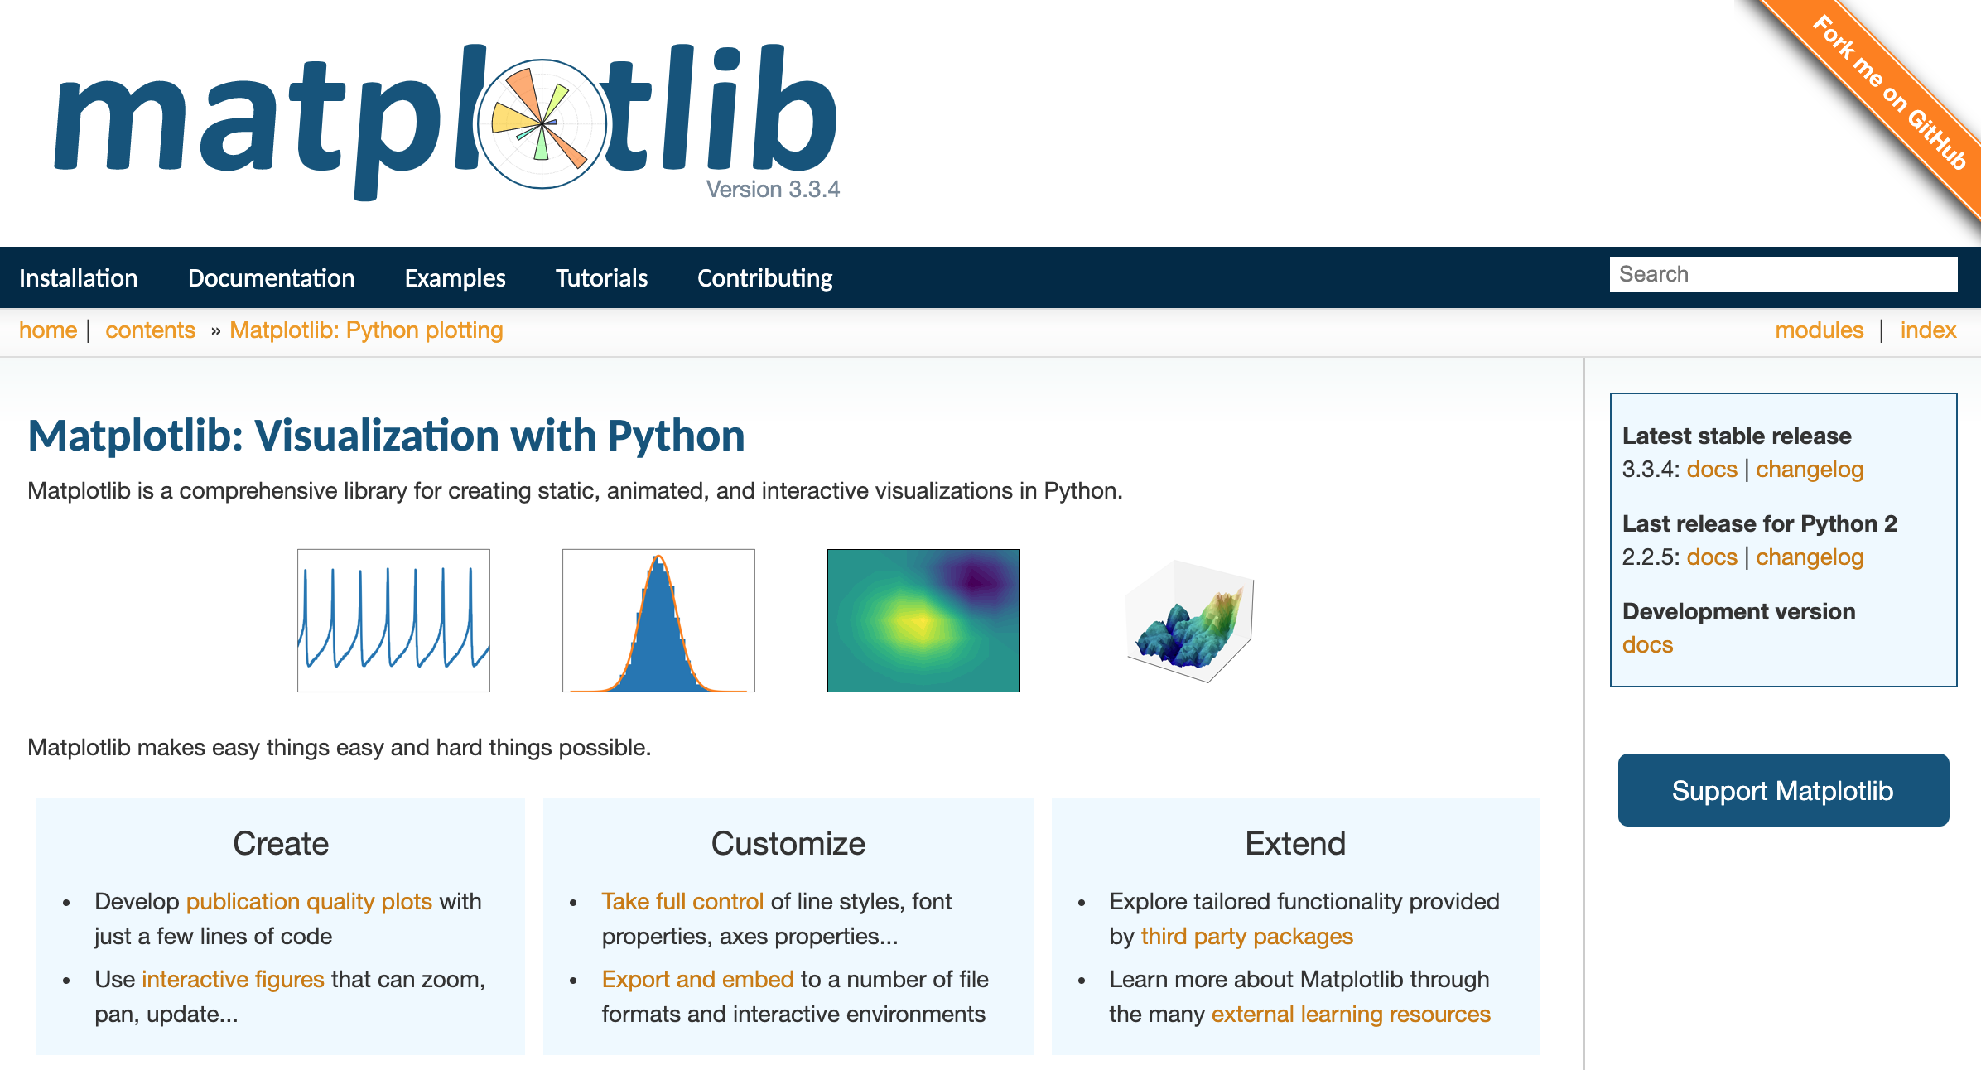
Python matplotlib
https://matplotlib.org/

Slide 61
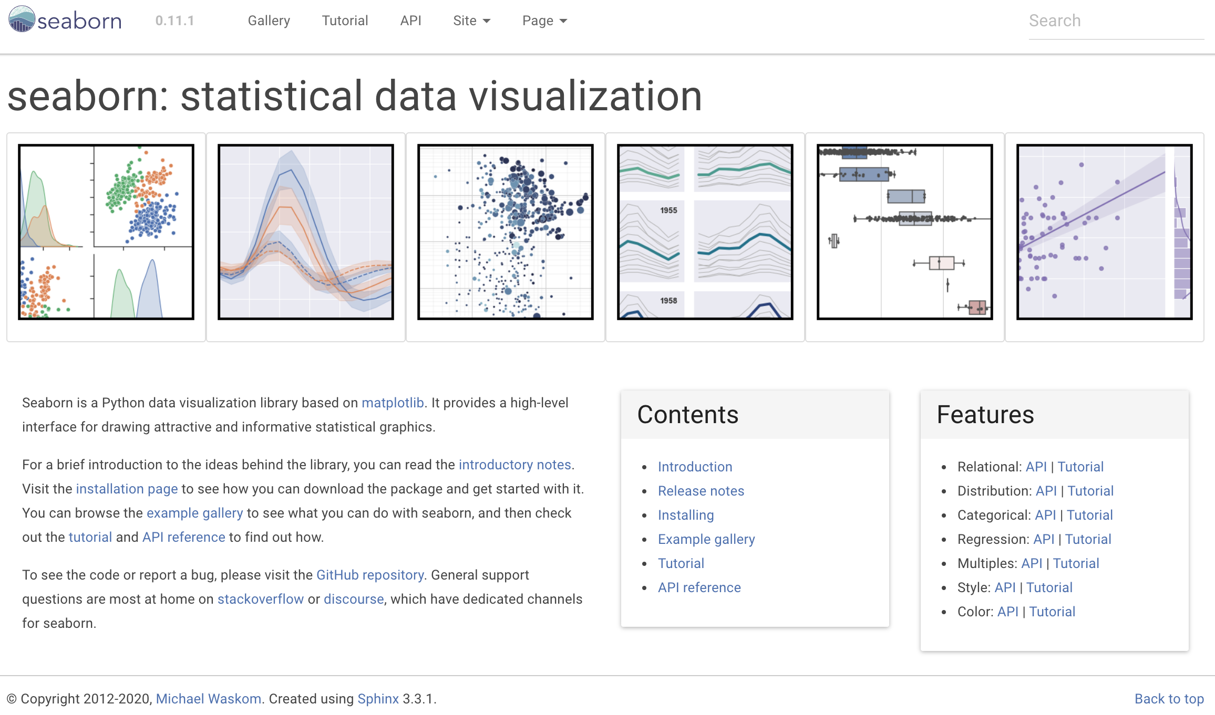
Python Seaborn
https://seaborn.pydata.org/

Slide 62
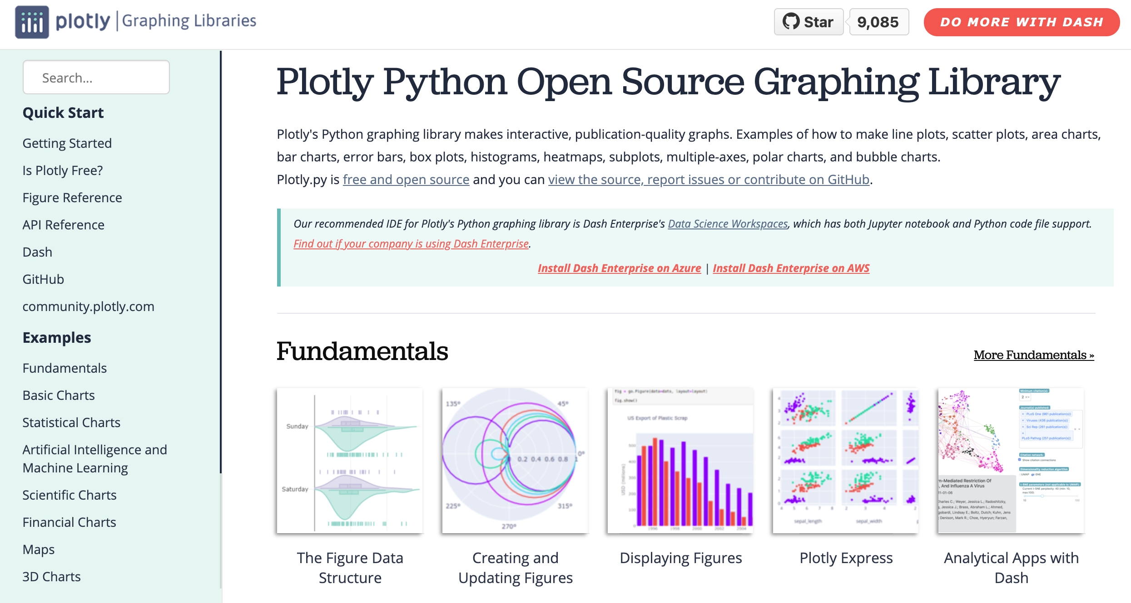
Python Plotly Graphing Library
https://plotly.com/python/

Slide 63
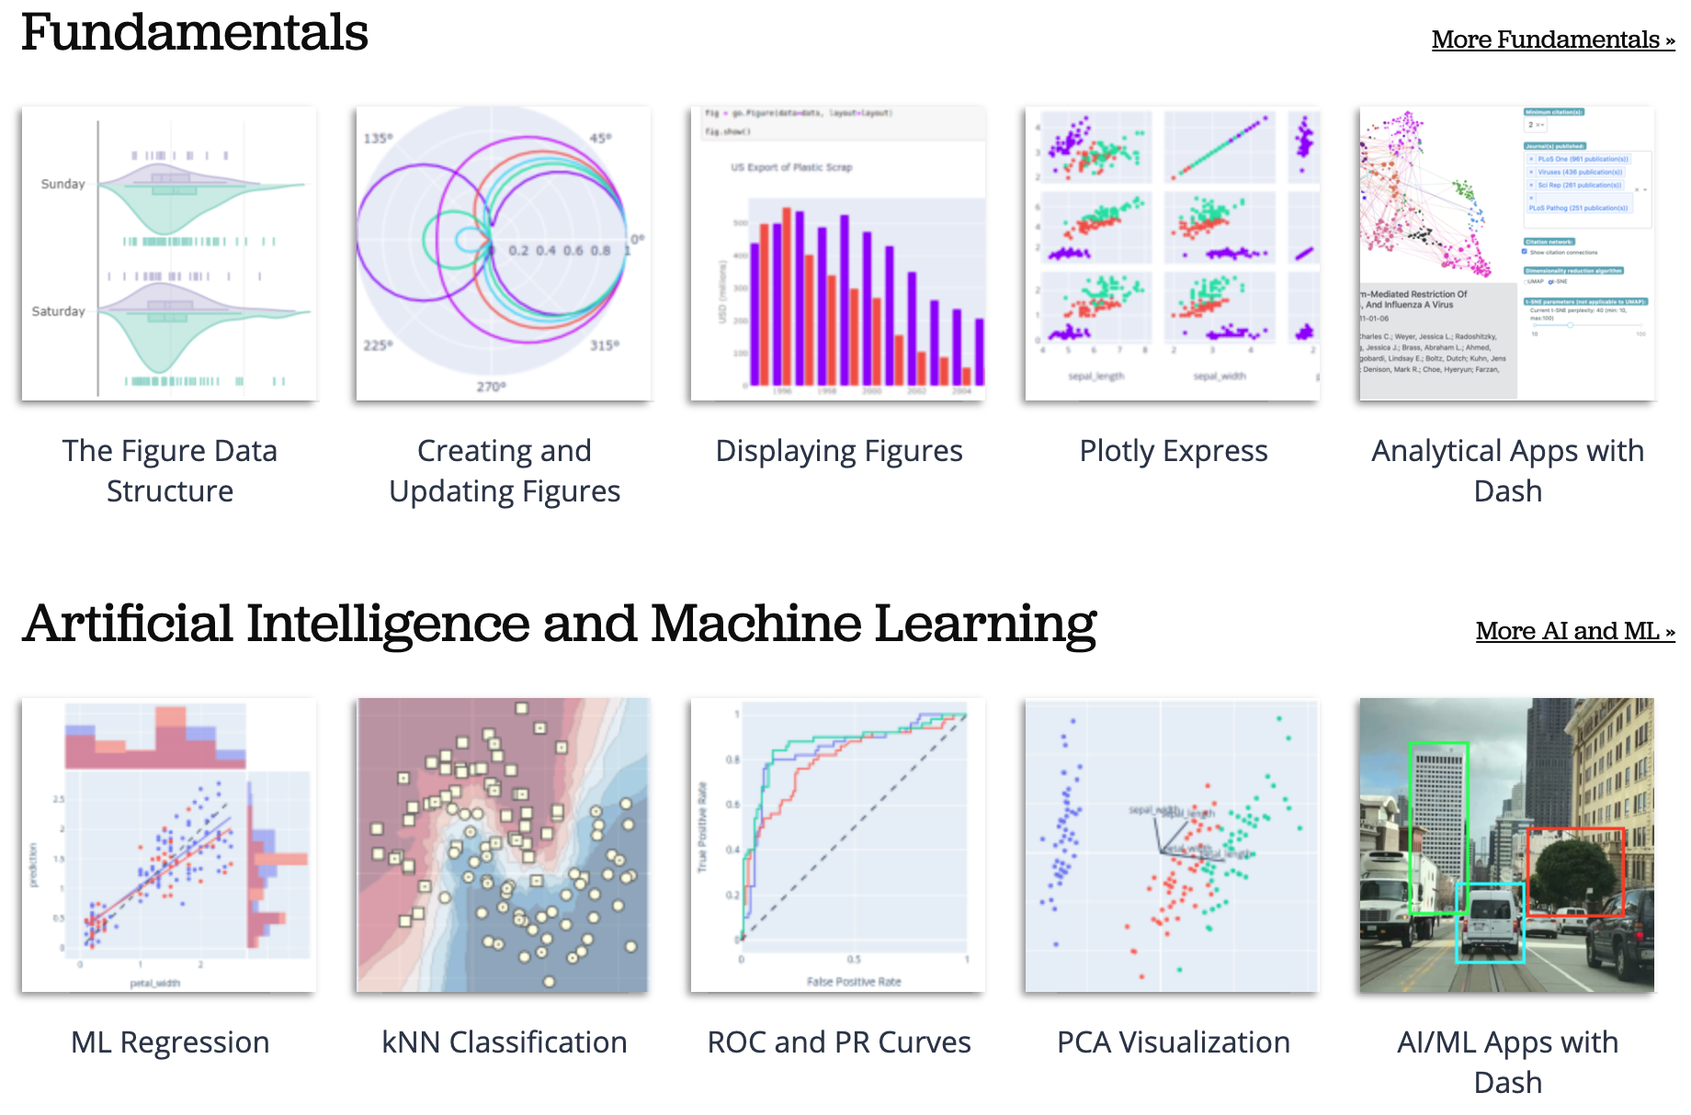
Python Plotly Graphing Library
https://plotly.com/python/

Slide 64
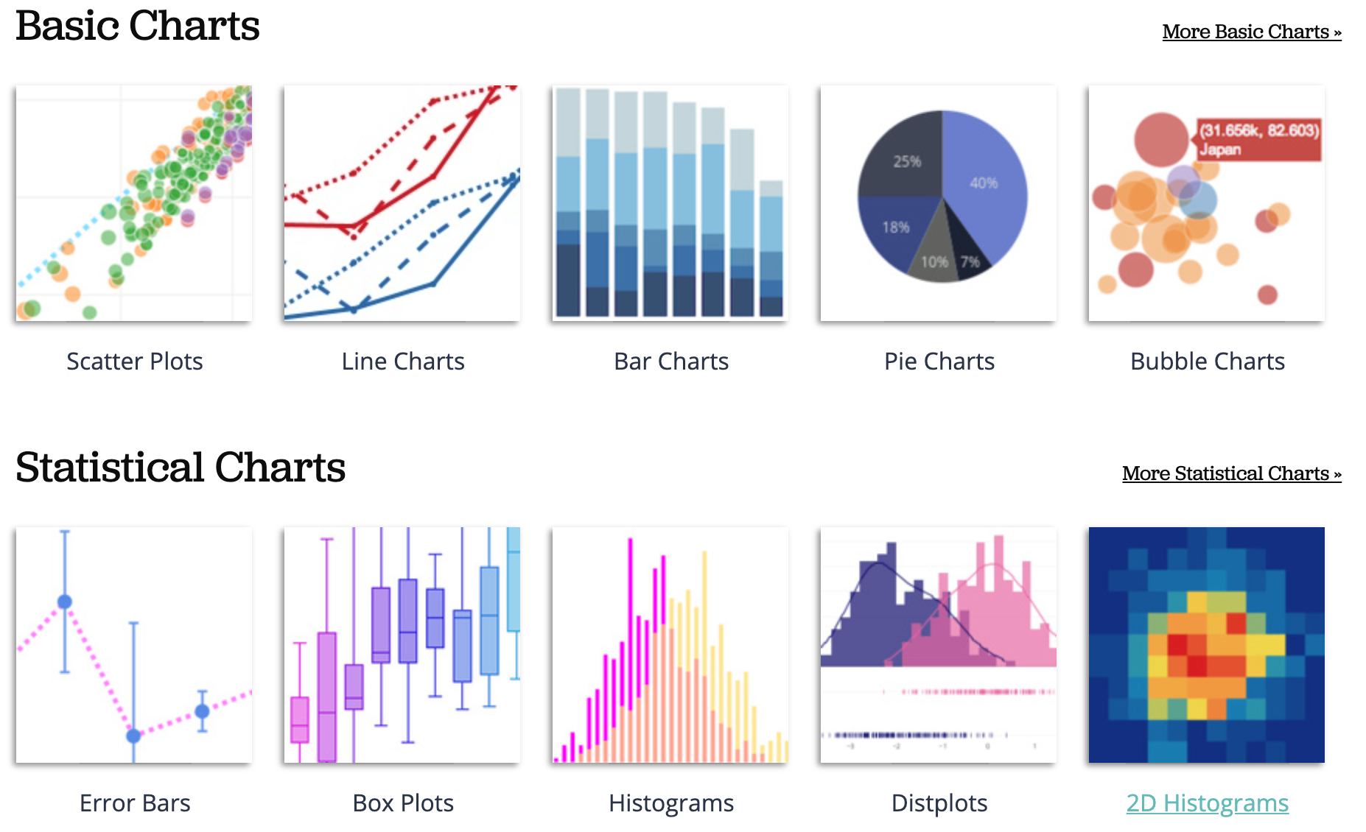
Python Plotly Graphing Library
https://plotly.com/python/

Slide 65
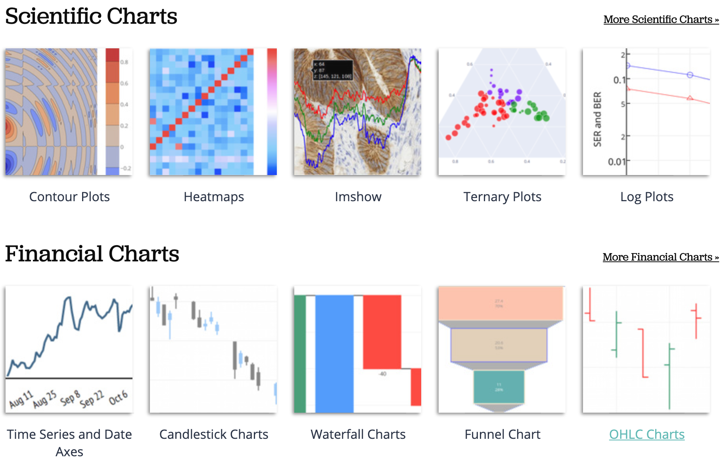
Python Plotly Graphing Library
https://plotly.com/python/

Slide 66
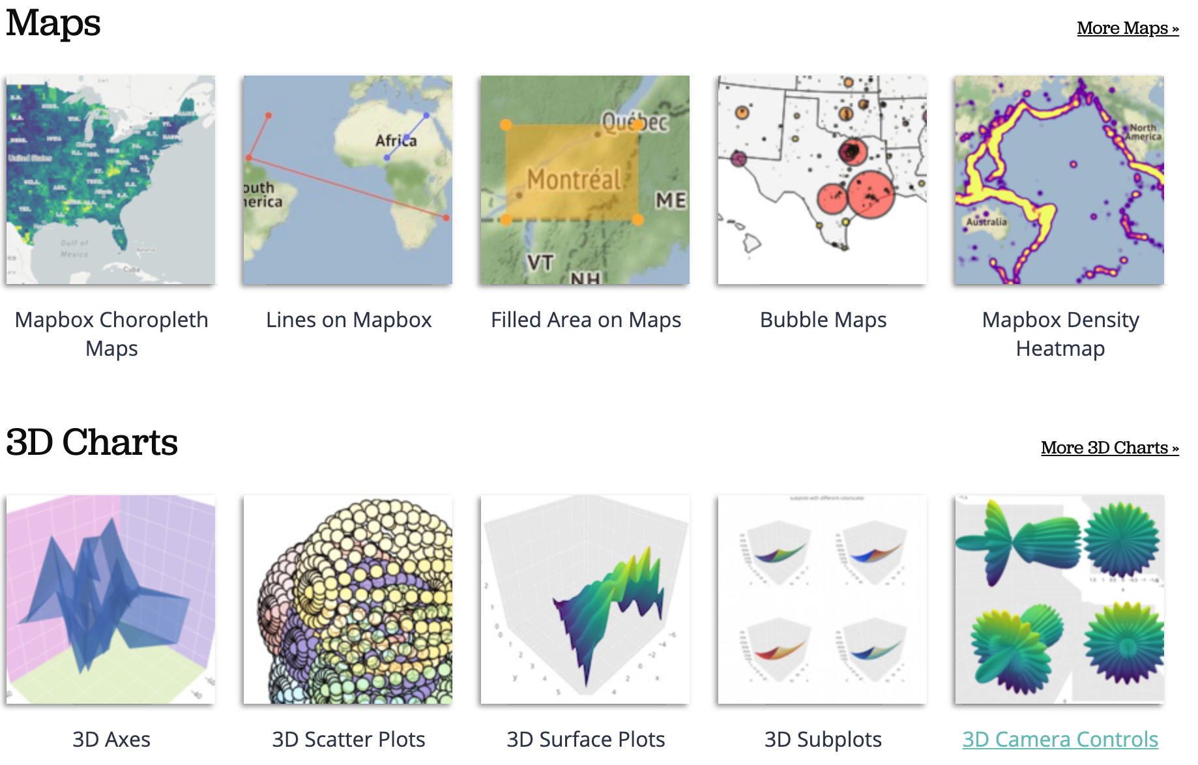
Python Plotly Graphing Library
https://plotly.com/python/

Slide 67
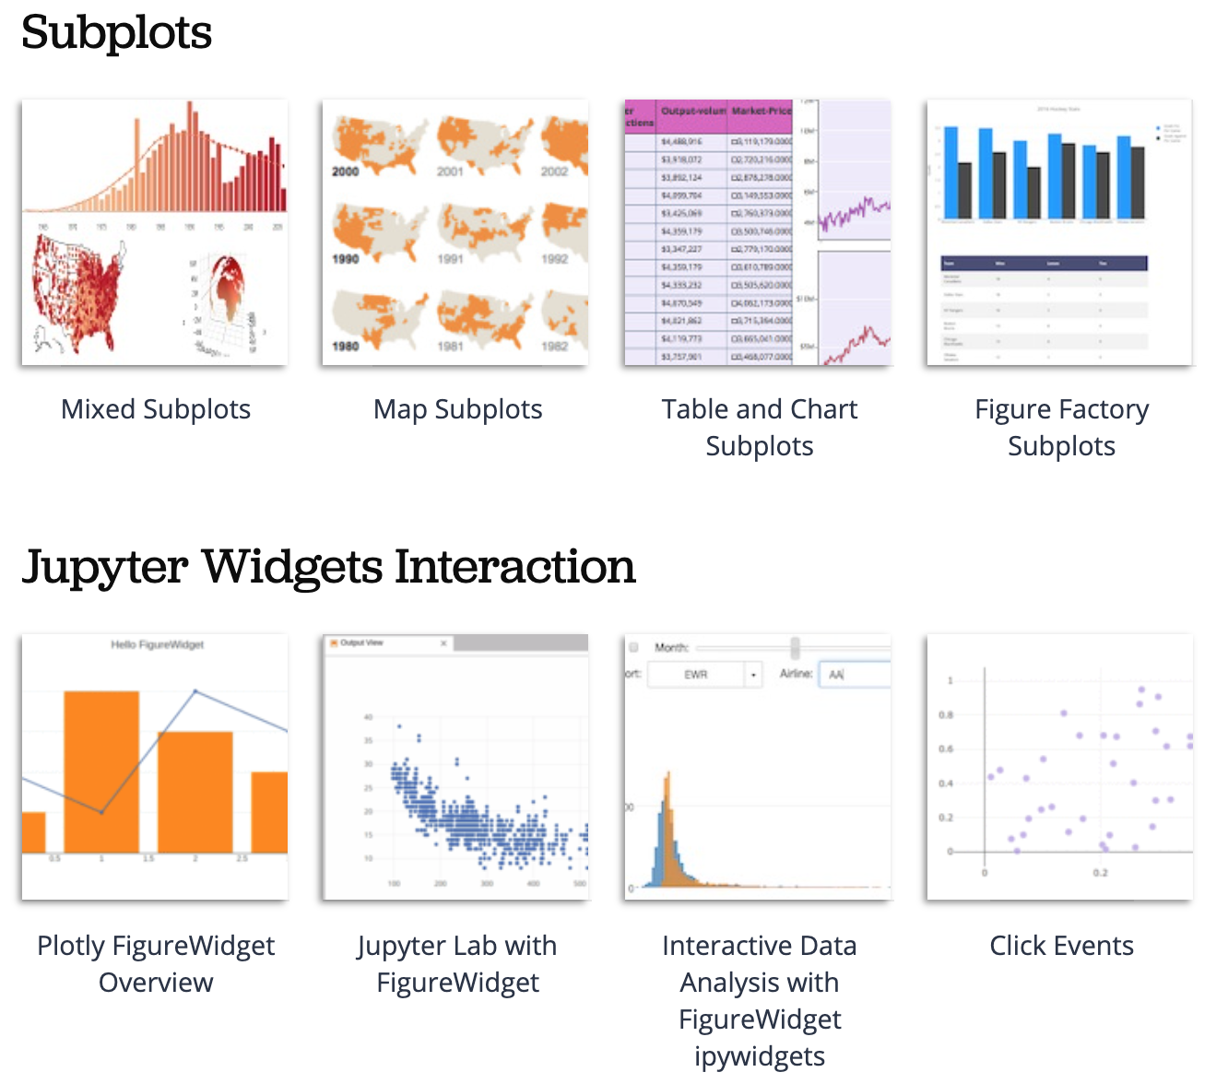
Python Plotly Graphing Library
https://plotly.com/python/

Slide 68
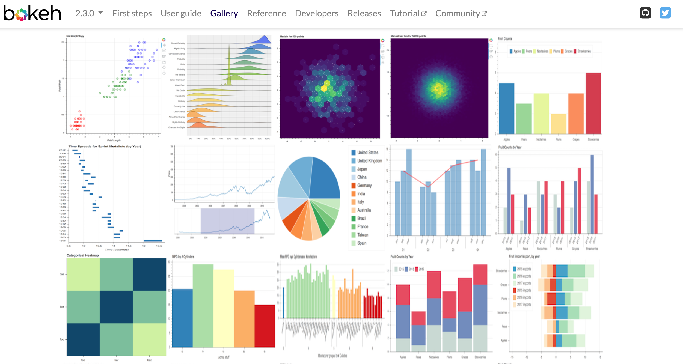
Python Bokeh
https://bokeh.org/

Slide 69
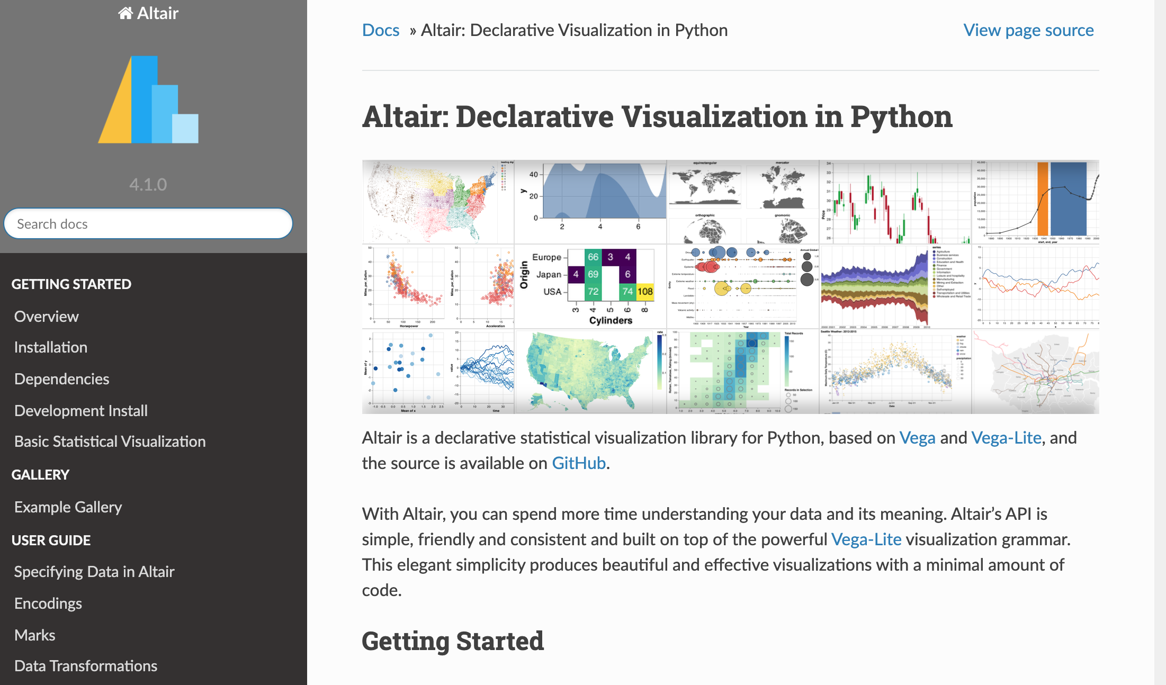
Python Altair
https://altair-viz.github.io/

Slide 70
Iris flower data set
setosa
versicolor
virginica
Source: https://en.wikipedia.org/wiki/Iris_flower_data_set
Source: http://suruchifialoke.com/2016-10-13-machine-learning-tutorial-iris-classification/

Slide 71
Iris Classfication
Source: http://suruchifialoke.com/2016-10-13-machine-learning-tutorial-iris-classification/

Slide 72
iris.data
https://archive.ics.uci.edu/ml/machine-learning-databases/iris/iris.data
5.1,3.5,1.4,0.2,Iris-setosa 4.9,3.0,1.4,0.2,Iris-setosa 4.7,3.2,1.3,0.2,Iris-setosa 4.6,3.1,1.5,0.2,Iris-setosa 5.0,3.6,1.4,0.2,Iris-setosa 5.4,3.9,1.7,0.4,Iris-setosa 4.6,3.4,1.4,0.3,Iris-setosa 5.0,3.4,1.5,0.2,Iris-setosa 4.4,2.9,1.4,0.2,Iris-setosa 4.9,3.1,1.5,0.1,Iris-setosa 5.4,3.7,1.5,0.2,Iris-setosa 4.8,3.4,1.6,0.2,Iris-setosa 4.8,3.0,1.4,0.1,Iris-setosa 4.3,3.0,1.1,0.1,Iris-setosa 5.8,4.0,1.2,0.2,Iris-setosa 5.7,4.4,1.5,0.4,Iris-setosa 5.4,3.9,1.3,0.4,Iris-setosa 5.1,3.5,1.4,0.3,Iris-setosa 5.7,3.8,1.7,0.3,Iris-setosa 5.1,3.8,1.5,0.3,Iris-setosa 5.4,3.4,1.7,0.2,Iris-setosa 5.1,3.7,1.5,0.4,Iris-setosa 4.6,3.6,1.0,0.2,Iris-setosa 5.1,3.3,1.7,0.5,Iris-setosa 4.8,3.4,1.9,0.2,Iris-setosa 5.0,3.0,1.6,0.2,Iris-setosa 5.0,3.4,1.6,0.4,Iris-setosa 5.2,3.5,1.5,0.2,Iris-setosa 5.2,3.4,1.4,0.2,Iris-setosa 4.7,3.2,1.6,0.2,Iris-setosa 4.8,3.1,1.6,0.2,Iris-setosa 5.4,3.4,1.5,0.4,Iris-setosa 5.2,4.1,1.5,0.1,Iris-setosa 5.5,4.2,1.4,0.2,Iris-setosa 4.9,3.1,1.5,0.1,Iris-setosa 5.0,3.2,1.2,0.2,Iris-setosa 5.5,3.5,1.3,0.2,Iris-setosa 4.9,3.1,1.5,0.1,Iris-setosa 4.4,3.0,1.3,0.2,Iris-setosa 5.1,3.4,1.5,0.2,Iris-setosa 5.0,3.5,1.3,0.3,Iris-setosa 4.5,2.3,1.3,0.3,Iris-setosa 4.4,3.2,1.3,0.2,Iris-setosa 5.0,3.5,1.6,0.6,Iris-setosa 5.1,3.8,1.9,0.4,Iris-setosa 4.8,3.0,1.4,0.3,Iris-setosa 5.1,3.8,1.6,0.2,Iris-setosa 4.6,3.2,1.4,0.2,Iris-setosa 5.3,3.7,1.5,0.2,Iris-setosa 5.0,3.3,1.4,0.2,Iris-setosa 7.0,3.2,4.7,1.4,Iris-versicolor 6.4,3.2,4.5,1.5,Iris-versicolor 6.9,3.1,4.9,1.5,Iris-versicolor 5.5,2.3,4.0,1.3,Iris-versicolor 6.5,2.8,4.6,1.5,Iris-versicolor 5.7,2.8,4.5,1.3,Iris-versicolor 6.3,3.3,4.7,1.6,Iris-versicolor 4.9,2.4,3.3,1.0,Iris-versicolor 6.6,2.9,4.6,1.3,Iris-versicolor 5.2,2.7,3.9,1.4,Iris-versicolor 5.0,2.0,3.5,1.0,Iris-versicolor 5.9,3.0,4.2,1.5,Iris-versicolor 6.0,2.2,4.0,1.0,Iris-versicolor 6.1,2.9,4.7,1.4,Iris-versicolor 5.6,2.9,3.6,1.3,Iris-versicolor 6.7,3.1,4.4,1.4,Iris-versicolor 5.6,3.0,4.5,1.5,Iris-versicolor 5.8,2.7,4.1,1.0,Iris-versicolor 6.2,2.2,4.5,1.5,Iris-versicolor 5.6,2.5,3.9,1.1,Iris-versicolor 5.9,3.2,4.8,1.8,Iris-versicolor 6.1,2.8,4.0,1.3,Iris-versicolor 6.3,2.5,4.9,1.5,Iris-versicolor 6.1,2.8,4.7,1.2,Iris-versicolor 6.4,2.9,4.3,1.3,Iris-versicolor 6.6,3.0,4.4,1.4,Iris-versicolor 6.8,2.8,4.8,1.4,Iris-versicolor 6.7,3.0,5.0,1.7,Iris-versicolor 6.0,2.9,4.5,1.5,Iris-versicolor 5.7,2.6,3.5,1.0,Iris-versicolor 5.5,2.4,3.8,1.1,Iris-versicolor 5.5,2.4,3.7,1.0,Iris-versicolor 5.8,2.7,3.9,1.2,Iris-versicolor 6.0,2.7,5.1,1.6,Iris-versicolor 5.4,3.0,4.5,1.5,Iris-versicolor 6.0,3.4,4.5,1.6,Iris-versicolor 6.7,3.1,4.7,1.5,Iris-versicolor 6.3,2.3,4.4,1.3,Iris-versicolor 5.6,3.0,4.1,1.3,Iris-versicolor 5.5,2.5,4.0,1.3,Iris-versicolor 5.5,2.6,4.4,1.2,Iris-versicolor 6.1,3.0,4.6,1.4,Iris-versicolor 5.8,2.6,4.0,1.2,Iris-versicolor 5.0,2.3,3.3,1.0,Iris-versicolor 5.6,2.7,4.2,1.3,Iris-versicolor 5.7,3.0,4.2,1.2,Iris-versicolor 5.7,2.9,4.2,1.3,Iris-versicolor 6.2,2.9,4.3,1.3,Iris-versicolor 5.1,2.5,3.0,1.1,Iris-versicolor 5.7,2.8,4.1,1.3,Iris-versicolor 6.3,3.3,6.0,2.5,Iris-virginica 5.8,2.7,5.1,1.9,Iris-virginica 7.1,3.0,5.9,2.1,Iris-virginica 6.3,2.9,5.6,1.8,Iris-virginica 6.5,3.0,5.8,2.2,Iris-virginica 7.6,3.0,6.6,2.1,Iris-virginica 4.9,2.5,4.5,1.7,Iris-virginica 7.3,2.9,6.3,1.8,Iris-virginica 6.7,2.5,5.8,1.8,Iris-virginica 7.2,3.6,6.1,2.5,Iris-virginica 6.5,3.2,5.1,2.0,Iris-virginica 6.4,2.7,5.3,1.9,Iris-virginica 6.8,3.0,5.5,2.1,Iris-virginica 5.7,2.5,5.0,2.0,Iris-virginica 5.8,2.8,5.1,2.4,Iris-virginica 6.4,3.2,5.3,2.3,Iris-virginica 6.5,3.0,5.5,1.8,Iris-virginica 7.7,3.8,6.7,2.2,Iris-virginica 7.7,2.6,6.9,2.3,Iris-virginica 6.0,2.2,5.0,1.5,Iris-virginica 6.9,3.2,5.7,2.3,Iris-virginica 5.6,2.8,4.9,2.0,Iris-virginica 7.7,2.8,6.7,2.0,Iris-virginica 6.3,2.7,4.9,1.8,Iris-virginica 6.7,3.3,5.7,2.1,Iris-virginica 7.2,3.2,6.0,1.8,Iris-virginica 6.2,2.8,4.8,1.8,Iris-virginica 6.1,3.0,4.9,1.8,Iris-virginica 6.4,2.8,5.6,2.1,Iris-virginica 7.2,3.0,5.8,1.6,Iris-virginica 7.4,2.8,6.1,1.9,Iris-virginica 7.9,3.8,6.4,2.0,Iris-virginica 6.4,2.8,5.6,2.2,Iris-virginica 6.3,2.8,5.1,1.5,Iris-virginica 6.1,2.6,5.6,1.4,Iris-virginica 7.7,3.0,6.1,2.3,Iris-virginica 6.3,3.4,5.6,2.4,Iris-virginica 6.4,3.1,5.5,1.8,Iris-virginica 6.0,3.0,4.8,1.8,Iris-virginica 6.9,3.1,5.4,2.1,Iris-virginica 6.7,3.1,5.6,2.4,Iris-virginica 6.9,3.1,5.1,2.3,Iris-virginica 5.8,2.7,5.1,1.9,Iris-virginica 6.8,3.2,5.9,2.3,Iris-virginica 6.7,3.3,5.7,2.5,Iris-virginica 6.7,3.0,5.2,2.3,Iris-virginica 6.3,2.5,5.0,1.9,Iris-virginica 6.5,3.0,5.2,2.0,Iris-virginica 6.2,3.4,5.4,2.3,Iris-virginica 5.9,3.0,5.1,1.8,Iris-virginica
setosa
virginica
versicolor

Slide 73
Iris Data Visualization
Source: https://seaborn.pydata.org/generated/seaborn.pairplot.html

Slide 74
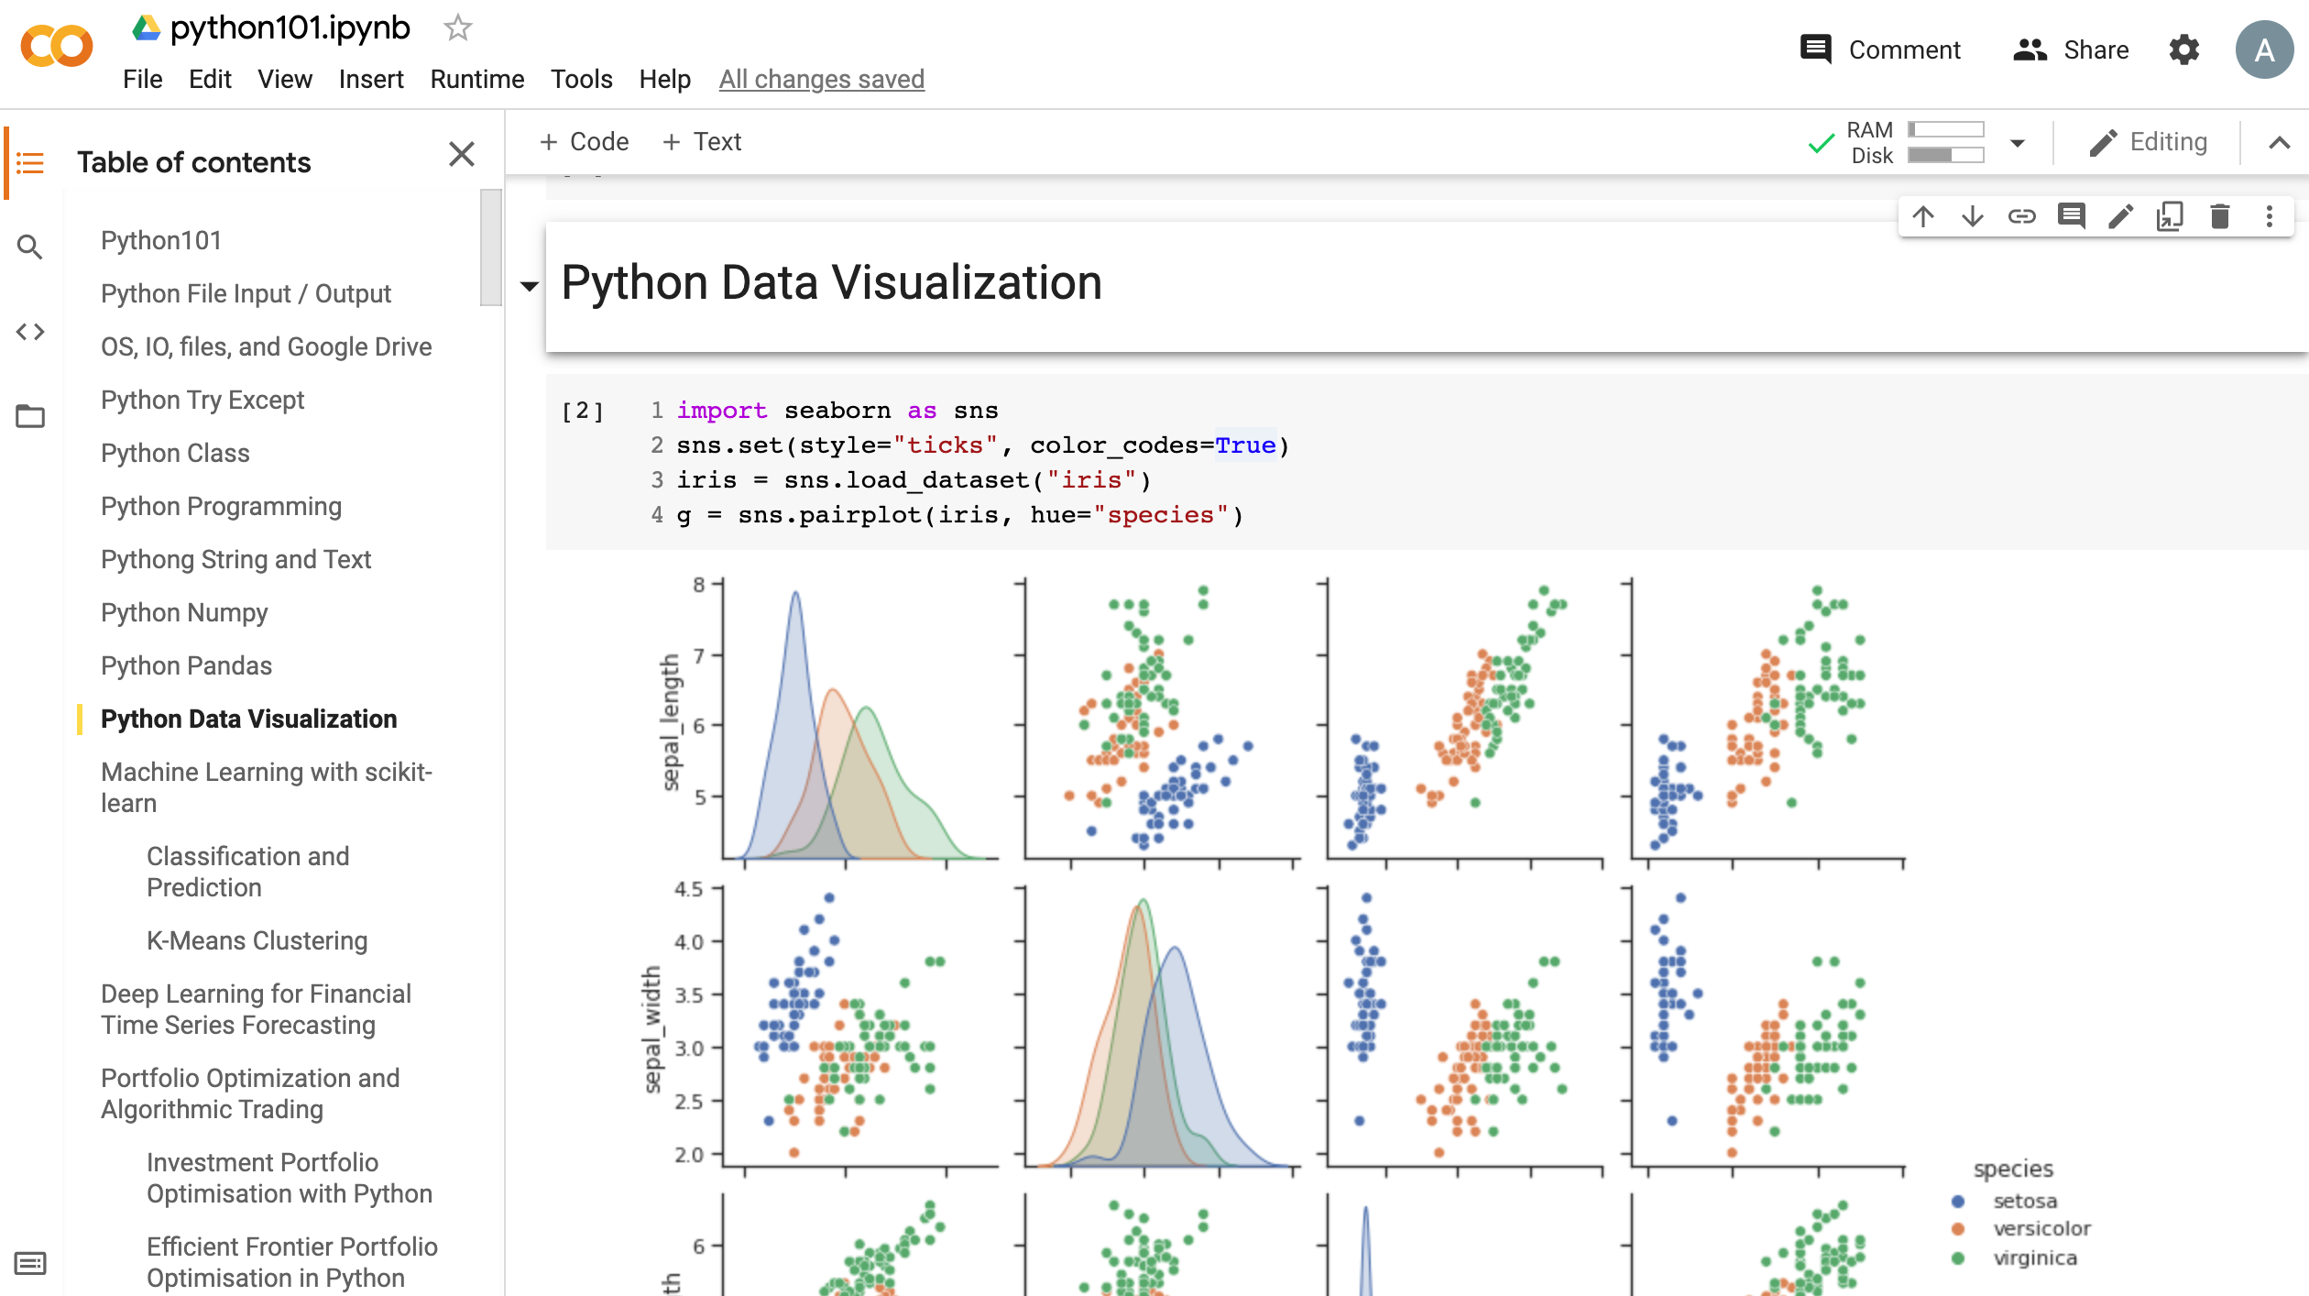
Data Visualization in Google Colab
https://tinyurl.com/aintpupython101

Slide 75
import seaborn as sns
sns.set(style="ticks", color_codes=True)
iris = sns.load_dataset("iris")
g = sns.pairplot(iris, hue="species")
Source: https://seaborn.pydata.org/generated/seaborn.pairplot.html

Slide 76
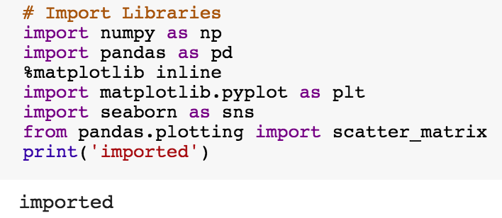
import numpy as np
import pandas as pd
%matplotlib inline
import matplotlib.pyplot as plt
import seaborn as sns
from pandas.plotting import scatter_matrix

Slide 77
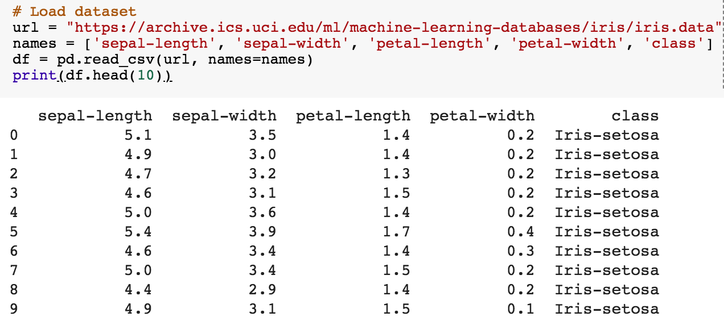
url = "https://archive.ics.uci.edu/ml/machine-learning-databases/iris/iris.data"
names = ['sepal-length', 'sepal-width', 'petal-length', 'petal-width', 'class']
df = pd.read_csv(url, names=names)
print(df.head(10))

Slide 78
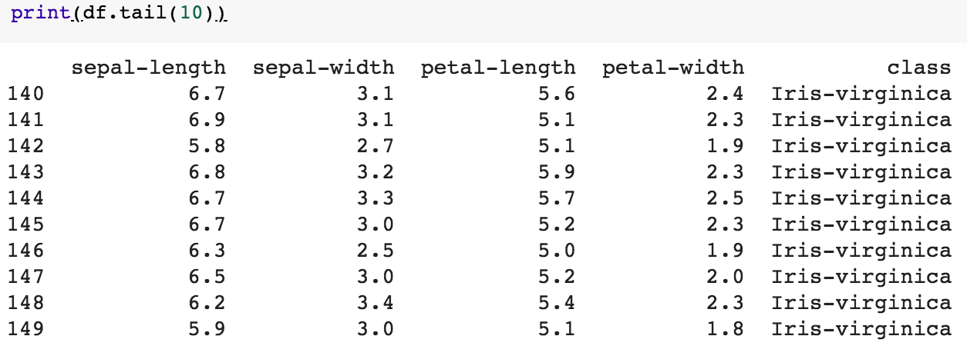
df.tail(10)

Slide 79
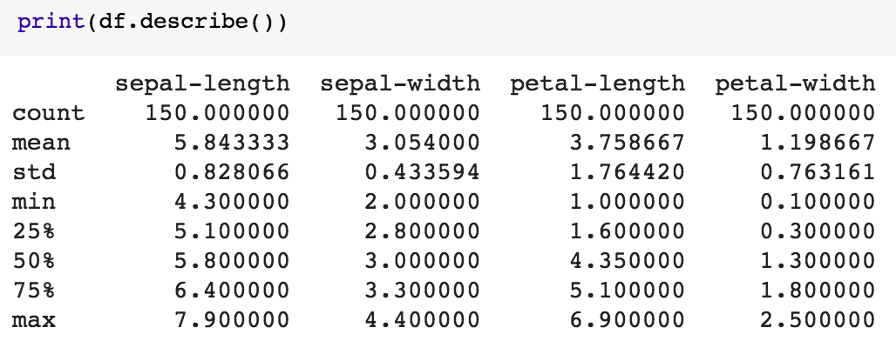
df.describe()

Slide 80
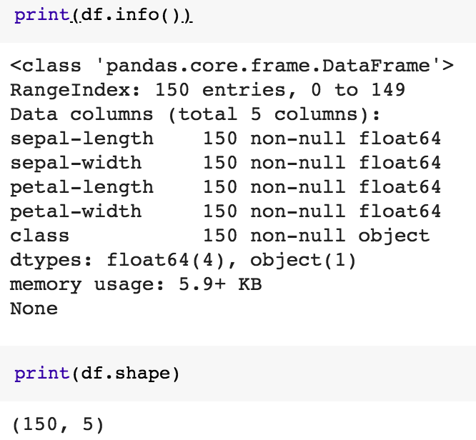
print(df.info())
print(df.shape)

Slide 81

df.groupby('class').size()

Slide 82

plt.rcParams["figure.figsize"] = (10,8)
df.plot(kind='box', subplots=True, layout=(2,2), sharex=False, sharey=False)
plt.show()

Slide 83

df.hist()
plt.show()

Slide 84

scatter_matrix(df)
plt.show()

Slide 85

sns.pairplot(df, hue="class", size=2)

Slide 86


Wes McKinney (2017), "Python for Data Analysis: Data Wrangling with Pandas, NumPy, and IPython", 2nd Edition, O'Reilly Media.
https://github.com/wesm/pydata-book

Slide 87

Aurélien Géron (2019),
Hands-On Machine Learning with Scikit-Learn, Keras, and TensorFlow: Concepts, Tools, and Techniques to Build Intelligent Systems, 2nd Edition
O’Reilly Media, 2019
https://github.com/ageron/handson-ml2
Source: https://www.amazon.com/Hands-Machine-Learning-Scikit-Learn-TensorFlow/dp/1492032646/

Slide 88

Hands-On Machine Learning with
Scikit-Learn, Keras, and TensorFlow
Notebooks
The Machine Learning landscape
End-to-end Machine Learning project
Classification
Training Models
Support Vector Machines
Decision Trees
Ensemble Learning and Random Forests
Dimensionality Reduction
Unsupervised Learning Techniques
Artificial Neural Nets with Keras
Training Deep Neural Networks
Custom Models and Training with TensorFlow
Loading and Preprocessing Data
Deep Computer Vision Using Convolutional Neural Networks
Processing Sequences Using RNNs and CNNs
Natural Language Processing with RNNs and Attention
Representation Learning Using Autoencoders
Reinforcement Learning
Training and Deploying TensorFlow Models at Scale
https://github.com/ageron/handson-ml2

Slide 89
Python in Google Colab (Python101)
https://colab.research.google.com/drive/1FEG6DnGvwfUbeo4zJ1zTunjMqf2RkCrT
https://tinyurl.com/aintpupython101

Slide 90
Summary
Data Science and Data Mining
Discovering, Analyzing, Visualizing and Presenting Data with Python
  Pandas
  Matplotlib
  Seaborn
  Plotly
  Bokeh, Altair

Slide 91
References
EMC Education Services (2015),
Data Science and Big Data Analytics: Discovering, Analyzing, Visualizing and Presenting Data, Wiley
Ramesh Sharda, Dursun Delen, and Efraim Turban (2017), Business Intelligence, Analytics, and Data Science: A Managerial Perspective, 4th Edition, Pearson.
Robert Layton (2017), Learning Data Mining with Python - Second Edition, Packt Publishing.
Wes McKinney (2017), "Python for Data Analysis: Data Wrangling with Pandas, NumPy, and IPython", 2nd Edition, O'Reilly Media.
Aurélien Géron (2019), Hands-On Machine Learning with Scikit-Learn, Keras, and TensorFlow: Concepts, Tools, and Techniques to Build Intelligent Systems, 2nd Edition, O’Reilly Media.
https://github.com/wesm/pydata-book
Pandas, http://pandas.pydata.org/
Matplotlib, https://matplotlib.org/
Seaborn, https://seaborn.pydata.org/
Plotly, https://plotly.com/python/
Bokeh, https://bokeh.org/
Altair, https://altair-viz.github.io/
Min-Yuh Day (2021), Python 101, https://tinyurl.com/aintpupython101

