Slide 1
資料探勘 (Data Mining)
卷積神經網絡 (Convolutional Neural Networks)
1092DM09
MBA, IM, NTPU (M5026) (Spring 2021) Tue 2, 3, 4 (9:10-12:00) (B8F40)
Min-Yuh Day
戴敏育
Associate Professor
副教授
Institute of Information Management, National Taipei University
國立臺北大學 資訊管理研究所
https://web.ntpu.edu.tw/~myday
2021-05-11

Slide 2
課程大綱 (Syllabus)
週次 (Week) 日期 (Date) 內容 (Subject/Topics)
1 2021/02/23 資料探勘介紹 (Introduction to data mining)
2 2021/03/02 ABC：人工智慧，大數據，雲端運算 (ABC: AI, Big Data, Cloud Computing)
3 2021/03/09 Python資料探勘的基礎 (Foundations of Data Mining in Python)
4 2021/03/16 資料科學與資料探勘：發現，分析，可視化和呈現數據 (Data Science and Data Mining: Discovering, Analyzing, Visualizing and Presenting Data)
5 2021/03/23 非監督學習：關聯分析，購物籃分析 (Unsupervised Learning: Association Analysis, Market Basket Analysis)
6 2021/03/30 資料探勘個案研究 I (Case Study on Data Mining I)

Slide 3
課程大綱 (Syllabus)
週次 (Week) 日期 (Date) 內容 (Subject/Topics)
7 2021/04/06 放假一天 (Day off)
8 2021/04/13 非監督學習：集群分析，行銷市場區隔 (Unsupervised Learning: Cluster Analysis, Market Segmentation)
9 2021/04/20 期中報告 (Midterm Project Report)
10 2021/04/27 監督學習：分類和預測 (Supervised Learning: Classification and Prediction)
11 2021/05/04 機器學習和深度學習 (Machine Learning and Deep Learning)
12 2021/05/11 卷積神經網絡 (Convolutional Neural Networks)

Slide 4
課程大綱 (Syllabus)
週次 (Week) 日期 (Date) 內容 (Subject/Topics)
13 2021/05/18 資料探勘個案研究 II (Case Study on Data Mining II)
14 2021/05/25 遞歸神經網絡 (Recurrent Neural Networks)
15 2021/06/01 強化學習 (Reinforcement Learning)
16 2021/06/08 社交網絡分析 (Social Network Analysis)
17 2021/06/15 期末報告 I (Final Project Report I)
18 2021/06/22 期末報告 II (Final Project Report II)

Slide 5
Convolutional Neural Networks (CNN)

Slide 6
Outline
Convolutional Neural Networks (CNN)
Convolution
Pooling
Fully Connection (FC) (Flattening)
Computer Vision
Image Classification
Object Detection

Slide 7
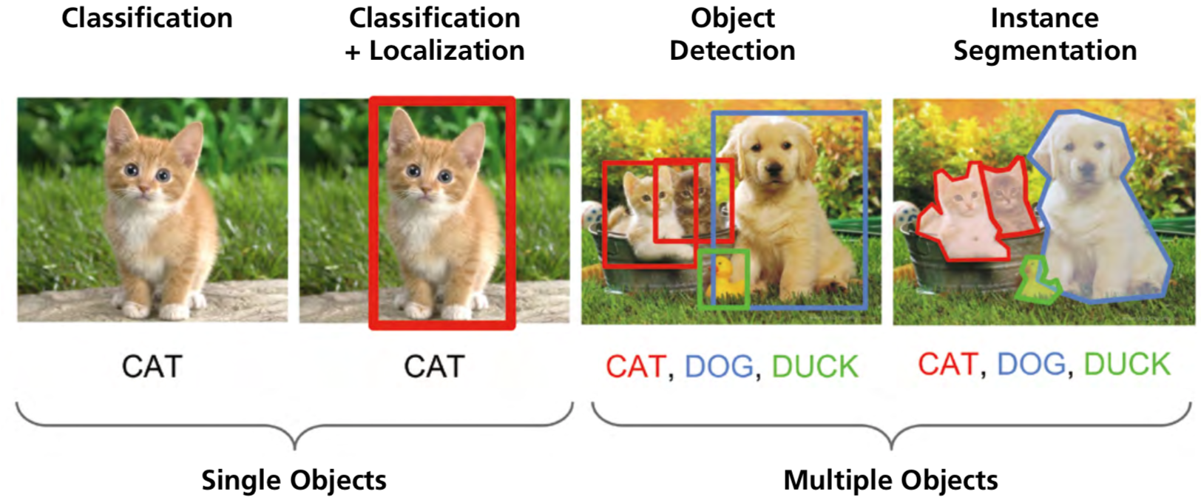
Computer Vision: Image Classification, Object Detection, Object Instance Segmentation
Source: DHL (2018), Artificial Intelligence in Logistics, http://www.globalhha.com/doclib/data/upload/doc_con/5e50c53c5bf67.pdf/

Slide 8
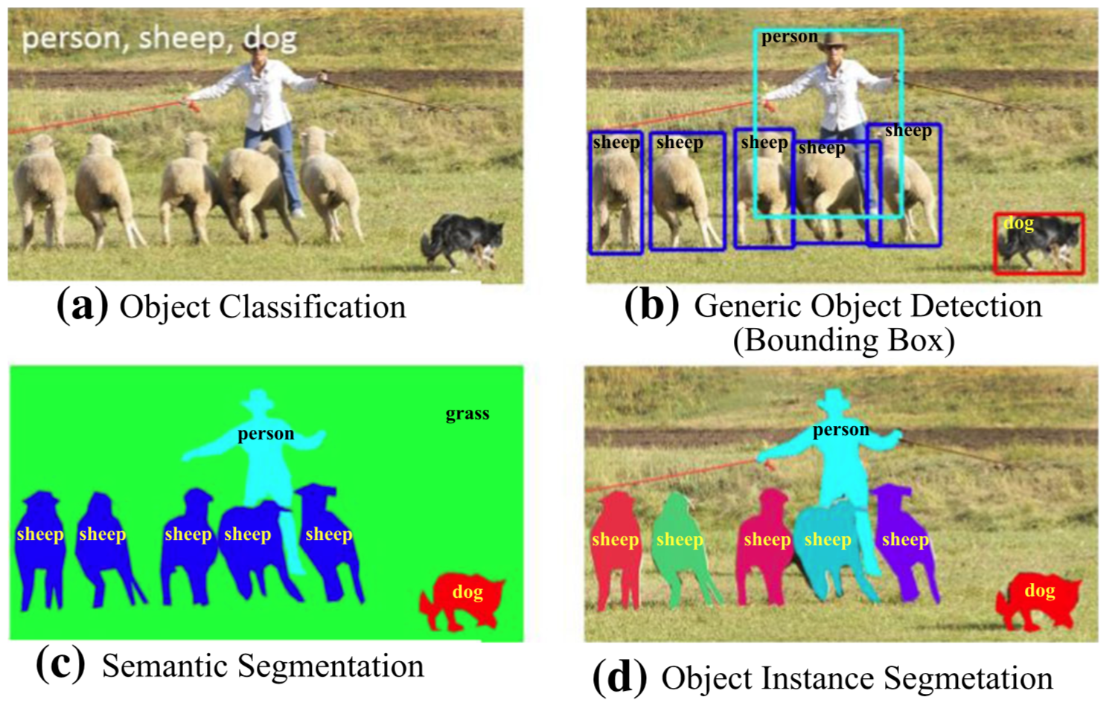
Computer Vision: Object Detection
Source: Li Liu, Wanli Ouyang, Xiaogang Wang, Paul Fieguth, Jie Chen, Xinwang Liu, and Matti Pietikäinen. "Deep learning for generic object detection: A survey." International journal of computer vision 128, no. 2 (2020): 261-318.

Slide 9
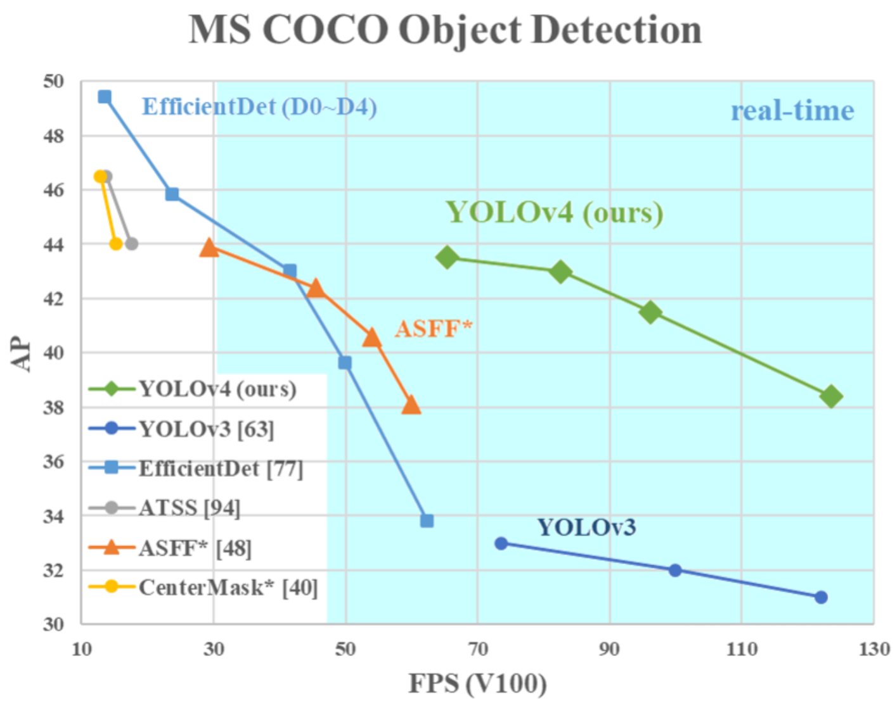
YOLOv4: Optimal Speed and Accuracy of Object Detection
Source: Alexey Bochkovskiy, Chien-Yao Wang, and Hong-Yuan Mark Liao. "YOLOv4: Optimal Speed and Accuracy of Object Detection." arXiv preprint arXiv:2004.10934 (2020).

Slide 10
Convolutional Neural Networks (CNN)

Slide 11
Convolutional Neural Networks (CNN)
Architecture of LeNet-5 (7 Layers)
(LeCun et al., 1998)
Source: http://yann.lecun.com/exdb/publis/pdf/lecun-01a.pdf
Source: LeCun, Yann, Léon Bottou, Yoshua Bengio, and Patrick Haffner. "Gradient-based learning applied to document recognition." Proceedings of the IEEE 86, no. 11 (1998): 2278-2324.

Slide 12
Convolutional Neural Networks (CNN)
Convolution
Pooling
Fully Connection (FC) (Flattening)

Slide 13
A friendly introduction to Convolutional Neural Networks and Image Recognition
+
-
4
-4
-
+
-4
4
1
-1
1
-1
1
-1
1
-1
1
-
+
-4
4
+
-
4
-4
Convolution Layer
Pooling Layer
Source: Luis Serrano (2017), A friendly introduction to Convolutional Neural Networks and Image Recognition,
https://www.youtube.com/watch?v=2-Ol7ZB0MmU

Slide 14
A friendly introduction to Convolutional Neural Networks and Image Recognition
1
-1
1
1
-1
-1
1
-1
1
-1
1
-1
-1
1
1
-1
1
-1
1
-1
1
-1
1
-1
1
1
-1
-1
1
-1
1
-1
-1
1
-1
-1
1
-1
1
-1
-1
-1
-1
-1
1
-1
-1
-1
1
1
-1
1
-1
-1
-1
1
-1
1
-1
-1
1
-1
-1
1
-1
-1
-1
-1
Source: Luis Serrano (2017), A friendly introduction to Convolutional Neural Networks and Image Recognition,
https://www.youtube.com/watch?v=2-Ol7ZB0MmU

Slide 15
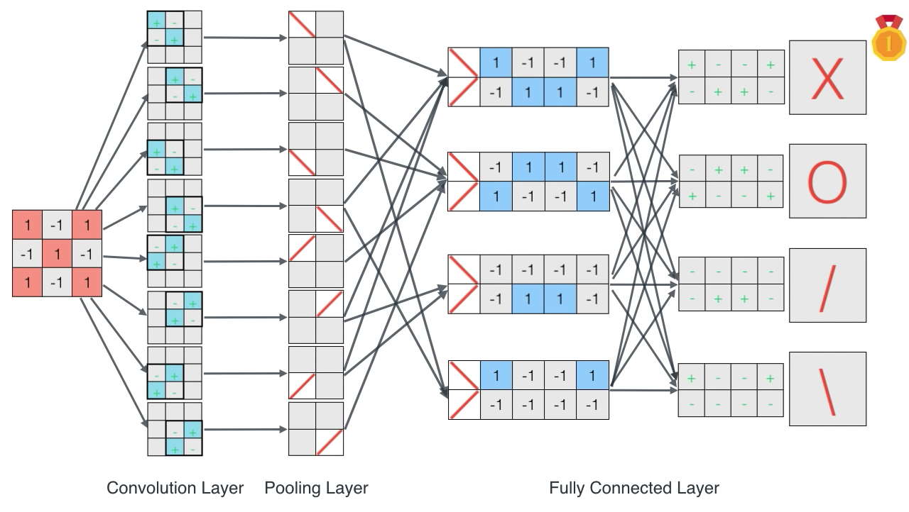
A friendly introduction to Convolutional Neural Networks and Image Recognition
Source: Luis Serrano (2017), A friendly introduction to Convolutional Neural Networks and Image Recognition,
https://www.youtube.com/watch?v=2-Ol7ZB0MmU

Slide 16
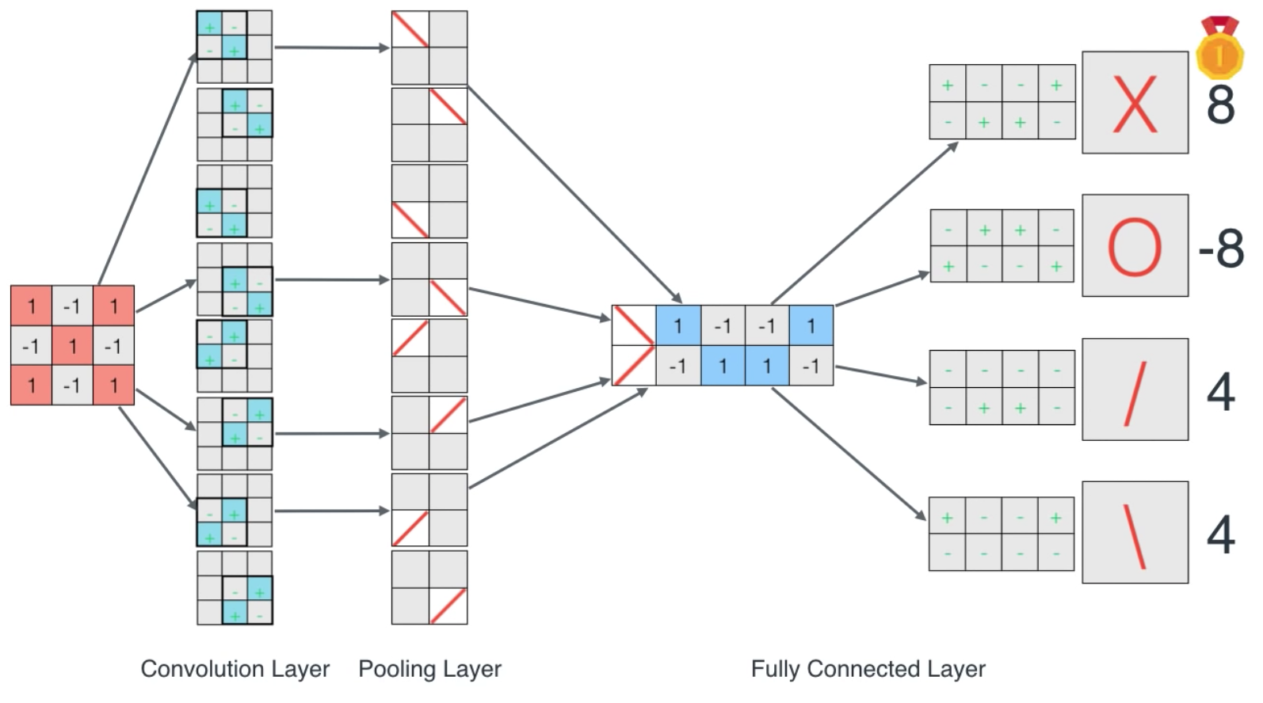
A friendly introduction to Convolutional Neural Networks and Image Recognition
Source: Luis Serrano (2017), A friendly introduction to Convolutional Neural Networks and Image Recognition,
https://www.youtube.com/watch?v=2-Ol7ZB0MmU

Slide 17
CNN Architecture
Source: Arden Dertat (2017), Applied Deep Learning - Part 4: Convolutional Neural Networks, https://towardsdatascience.com/applied-deep-learning-part-4-convolutional-neural-networks-584bc134c1e2

Slide 18
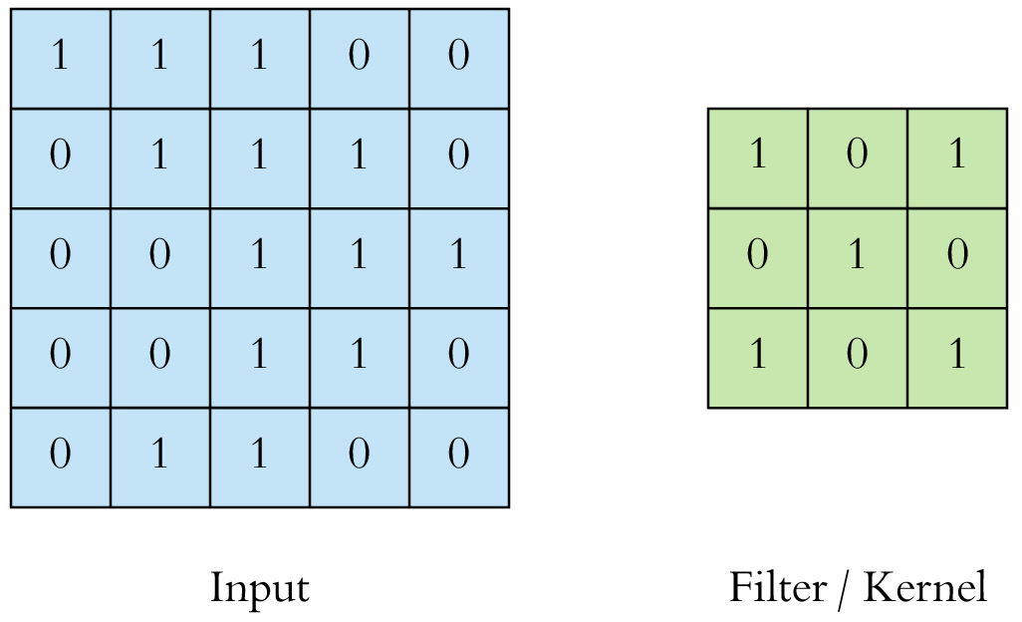
CNN Convolution Layer
Convolution is a mathematical operation to merge two sets of information
3x3 convolution
Source: Arden Dertat (2017), Applied Deep Learning - Part 4: Convolutional Neural Networks, https://towardsdatascience.com/applied-deep-learning-part-4-convolutional-neural-networks-584bc134c1e2

Slide 19
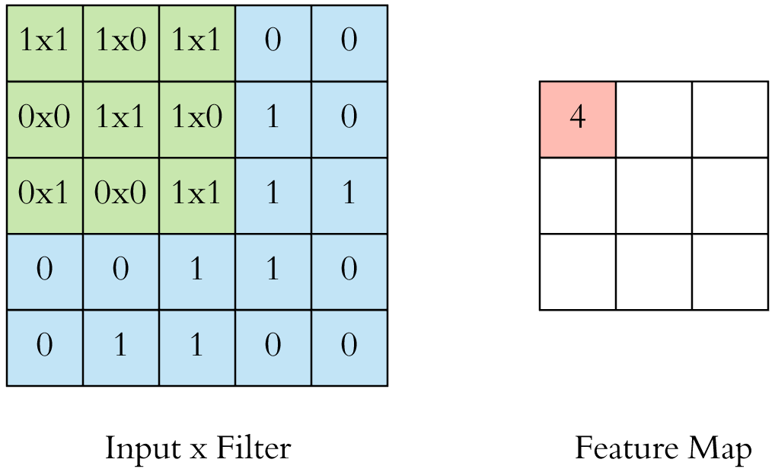
CNN Convolution Layer Input x Filter --> Feature Map
receptive field: 3x3
Source: Arden Dertat (2017), Applied Deep Learning - Part 4: Convolutional Neural Networks, https://towardsdatascience.com/applied-deep-learning-part-4-convolutional-neural-networks-584bc134c1e2

Slide 20
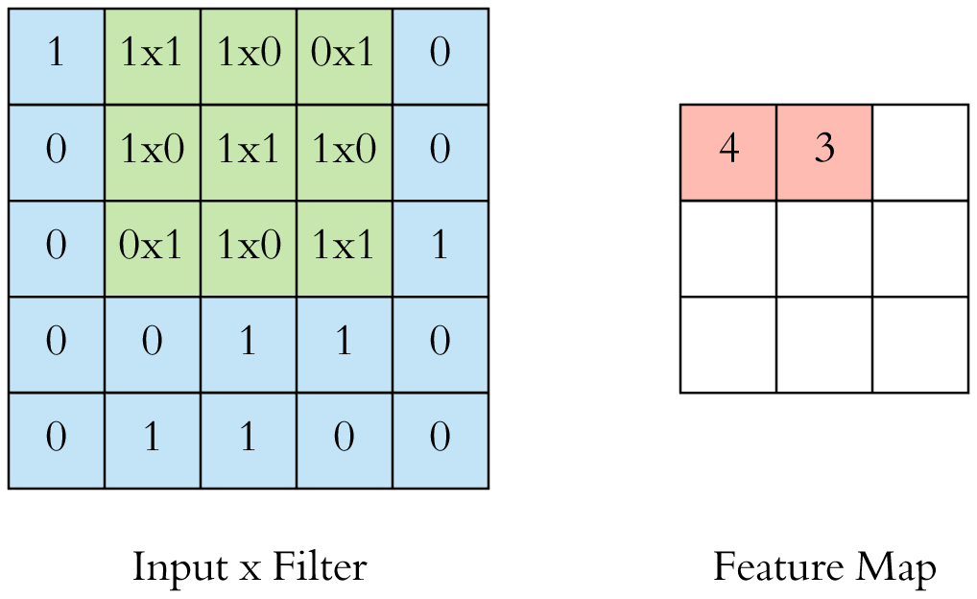
CNN Convolution Layer Input x Filter --> Feature Map
receptive field: 3x3
Source: Arden Dertat (2017), Applied Deep Learning - Part 4: Convolutional Neural Networks, https://towardsdatascience.com/applied-deep-learning-part-4-convolutional-neural-networks-584bc134c1e2

Slide 21
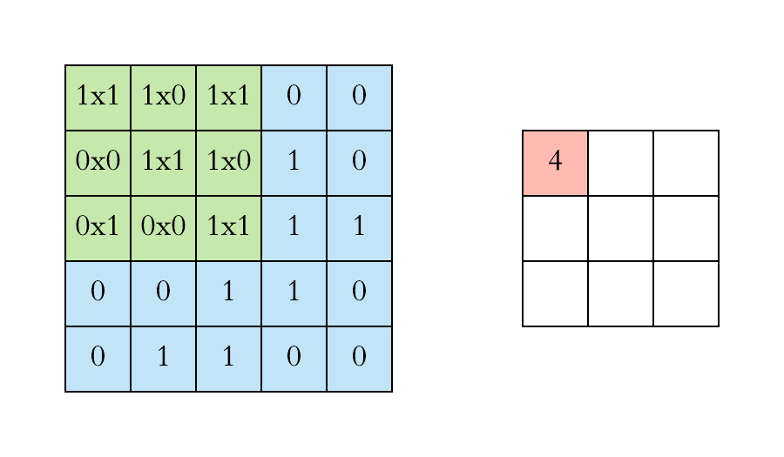
CNN Convolution Layer
Example convolution operation shown in 2D using a 3x3 filter
Source: Arden Dertat (2017), Applied Deep Learning - Part 4: Convolutional Neural Networks, https://towardsdatascience.com/applied-deep-learning-part-4-convolutional-neural-networks-584bc134c1e2

Slide 22
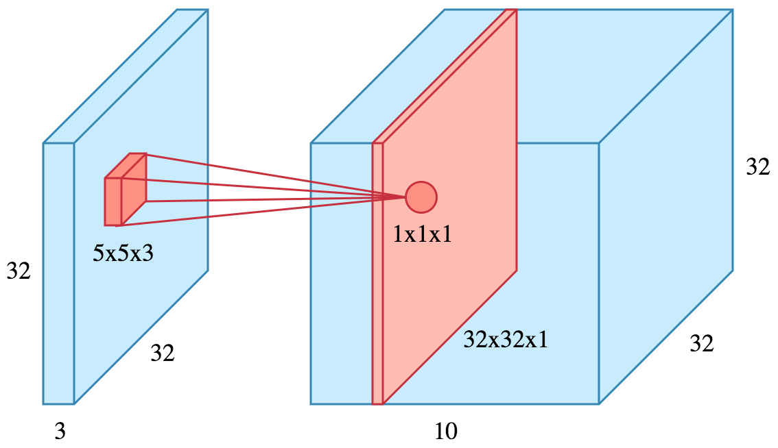
CNN Convolution Layer
10 different filters
10 feature maps of size 32x32x1
final output of the convolution layer: a volume of size 32x32x10
Source: Arden Dertat (2017), Applied Deep Learning - Part 4: Convolutional Neural Networks, https://towardsdatascience.com/applied-deep-learning-part-4-convolutional-neural-networks-584bc134c1e2

Slide 23
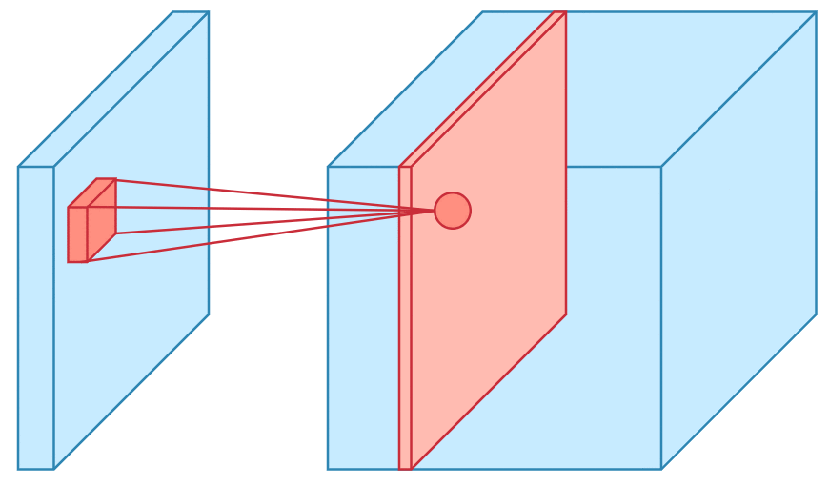
CNN Convolution Layer
Sliding operation at 4 locations
Source: Arden Dertat (2017), Applied Deep Learning - Part 4: Convolutional Neural Networks, https://towardsdatascience.com/applied-deep-learning-part-4-convolutional-neural-networks-584bc134c1e2

Slide 24
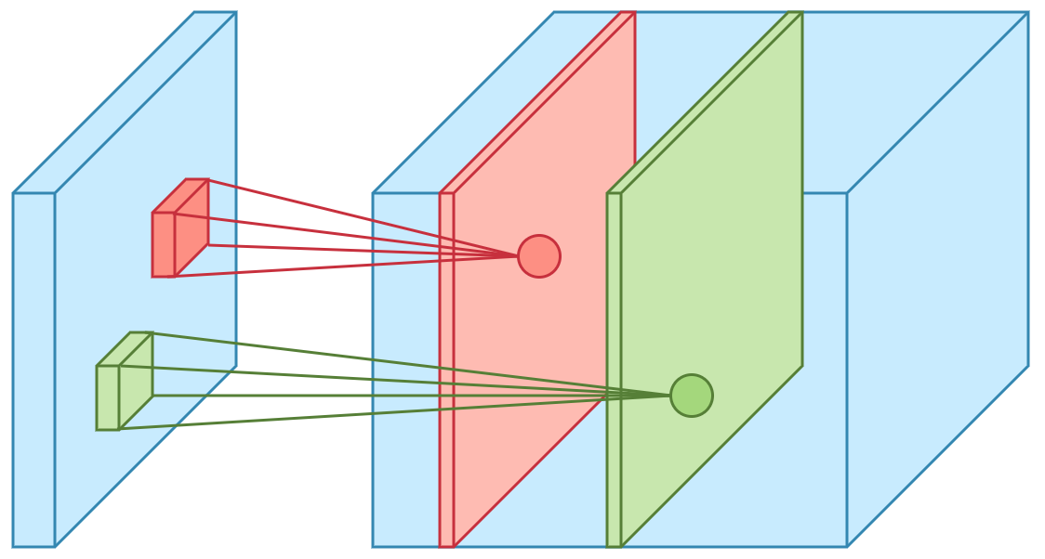
CNN Convolution Layer
two feature maps
Source: Arden Dertat (2017), Applied Deep Learning - Part 4: Convolutional Neural Networks, https://towardsdatascience.com/applied-deep-learning-part-4-convolutional-neural-networks-584bc134c1e2

Slide 25
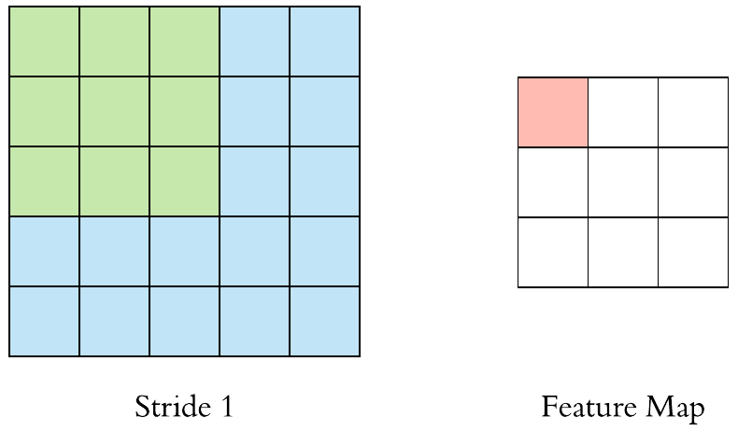
CNN Convolution Layer
Stride specifies how much we move the convolution filter at each step
Source: Arden Dertat (2017), Applied Deep Learning - Part 4: Convolutional Neural Networks, https://towardsdatascience.com/applied-deep-learning-part-4-convolutional-neural-networks-584bc134c1e2

Slide 26
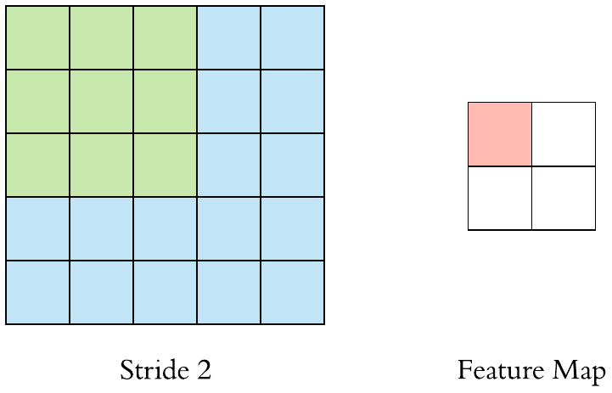
CNN Convolution Layer
Stride specifies how much we move the convolution filter at each step
Source: Arden Dertat (2017), Applied Deep Learning - Part 4: Convolutional Neural Networks, https://towardsdatascience.com/applied-deep-learning-part-4-convolutional-neural-networks-584bc134c1e2

Slide 27
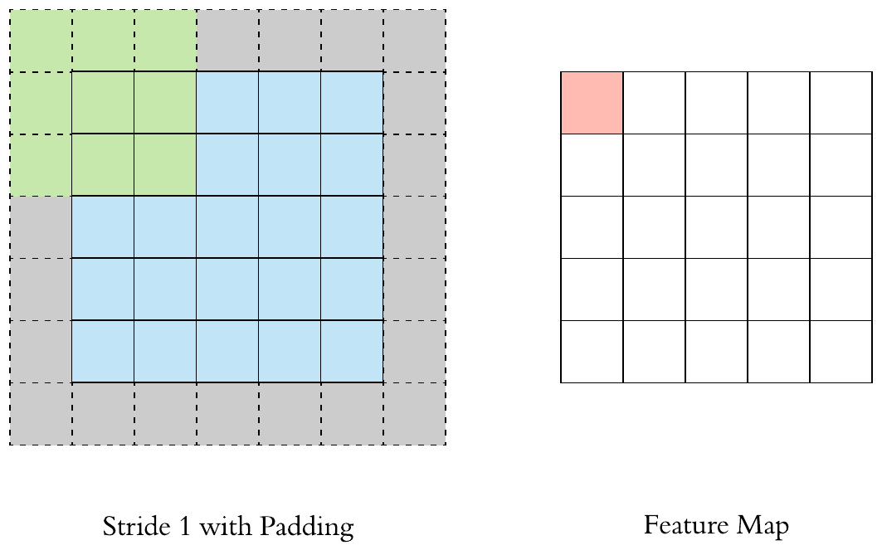
CNN Convolution Layer
Stride 1 with Padding
Source: Arden Dertat (2017), Applied Deep Learning - Part 4: Convolutional Neural Networks, https://towardsdatascience.com/applied-deep-learning-part-4-convolutional-neural-networks-584bc134c1e2

Slide 28
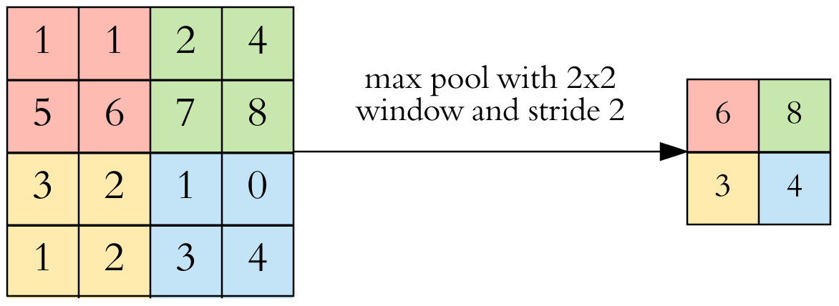
CNN Pooling Layer
Max Pooling
Source: Arden Dertat (2017), Applied Deep Learning - Part 4: Convolutional Neural Networks, https://towardsdatascience.com/applied-deep-learning-part-4-convolutional-neural-networks-584bc134c1e2

Slide 29
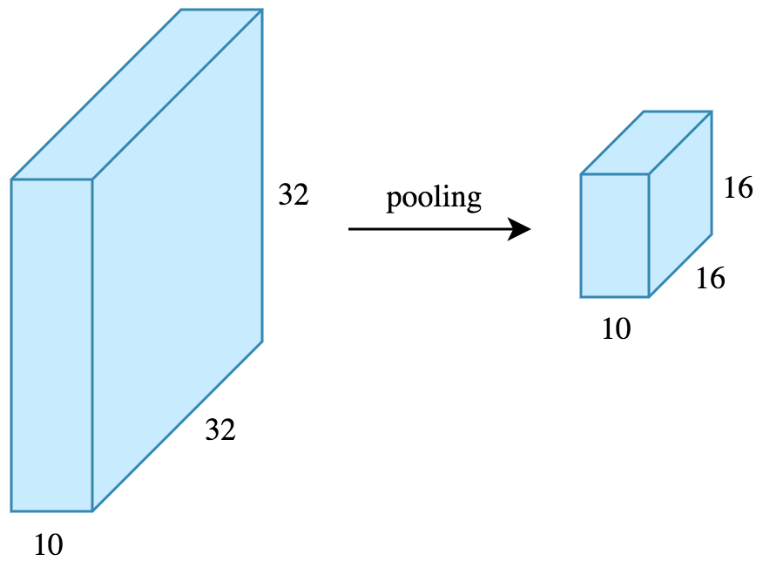
CNN Pooling Layer
Source: Arden Dertat (2017), Applied Deep Learning - Part 4: Convolutional Neural Networks, https://towardsdatascience.com/applied-deep-learning-part-4-convolutional-neural-networks-584bc134c1e2

Slide 30
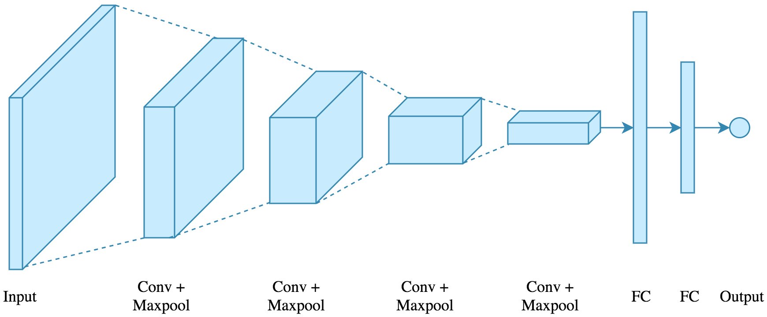
CNN Architecture
4 convolution + pooling layers, followed by 2 fully connected layers
Source: Arden Dertat (2017), Applied Deep Learning - Part 4: Convolutional Neural Networks, https://towardsdatascience.com/applied-deep-learning-part-4-convolutional-neural-networks-584bc134c1e2

Slide 31
CNN Architecture
4 convolution + pooling layers, followed by 2 fully connected layers
https://gist.github.com/ardendertat/0fc5515057c47e7386fe04e9334504e3
model = Sequential()
model.add(Conv2D(32, (3, 3), activation='relu', padding='same', name='conv_1',
input_shape=(150, 150, 3)))
model.add(MaxPooling2D((2, 2), name='maxpool_1'))
model.add(Conv2D(64, (3, 3), activation='relu', padding='same', name='conv_2'))
model.add(MaxPooling2D((2, 2), name='maxpool_2'))
model.add(Conv2D(128, (3, 3), activation='relu', padding='same', name='conv_3'))
model.add(MaxPooling2D((2, 2), name='maxpool_3'))
model.add(Conv2D(128, (3, 3), activation='relu', padding='same', name='conv_4'))
model.add(MaxPooling2D((2, 2), name='maxpool_4'))
model.add(Flatten())
model.add(Dropout(0.5))
model.add(Dense(512, activation='relu', name='dense_1'))
model.add(Dense(128, activation='relu', name='dense_2'))
model.add(Dense(1, activation='sigmoid', name='output'))
Source: Arden Dertat (2017), Applied Deep Learning - Part 4: Convolutional Neural Networks, https://towardsdatascience.com/applied-deep-learning-part-4-convolutional-neural-networks-584bc134c1e2

Slide 32
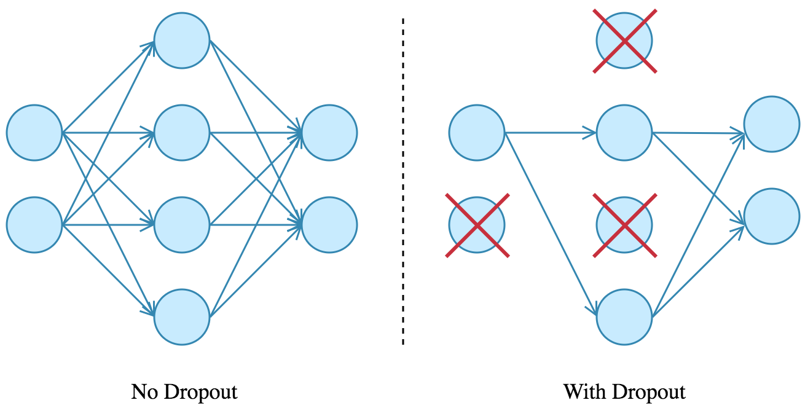
Dropout
Source: Arden Dertat (2017), Applied Deep Learning - Part 4: Convolutional Neural Networks, https://towardsdatascience.com/applied-deep-learning-part-4-convolutional-neural-networks-584bc134c1e2

Slide 33
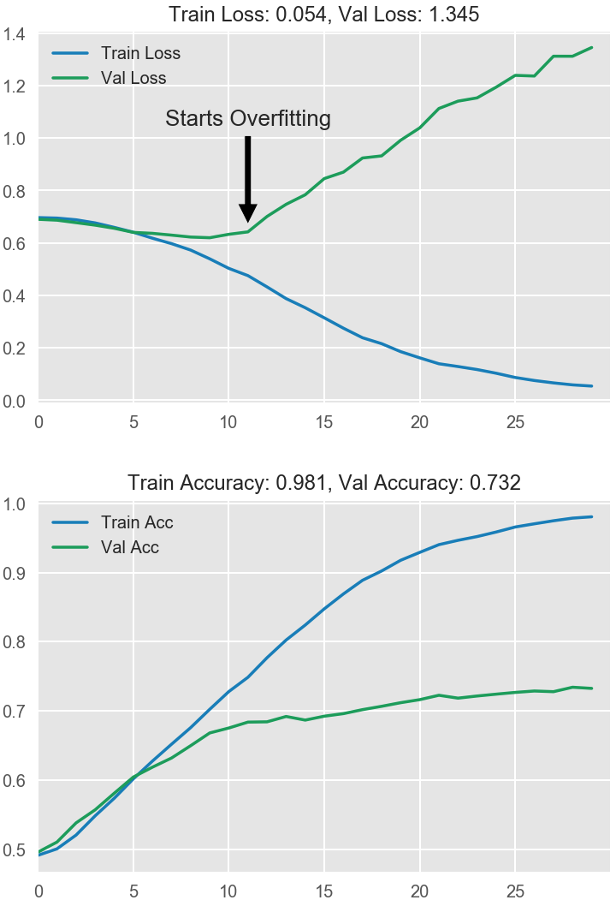
Model Performance
Source: Arden Dertat (2017), Applied Deep Learning - Part 4: Convolutional Neural Networks, https://towardsdatascience.com/applied-deep-learning-part-4-convolutional-neural-networks-584bc134c1e2

Slide 34
Visual Recognition Image Classification

Slide 35
Source: Jeff Dean (2016), Large-Scale Deep Learning For Building Intelligent Computer Systems, WSDM 2016

Slide 36
Convolutional Neural Networks (CNNs / ConvNets)
http://cs231n.github.io/convolutional-networks/

Slide 37
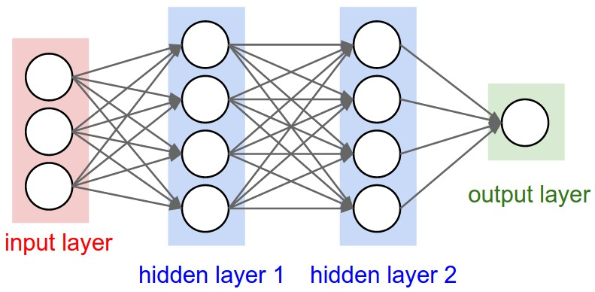
A regular 3-layer Neural Network
http://cs231n.github.io/convolutional-networks/

Slide 38
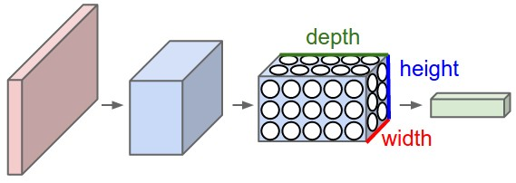
A ConvNet arranges its neurons in three dimensions (width, height, depth)
http://cs231n.github.io/convolutional-networks/

Slide 39
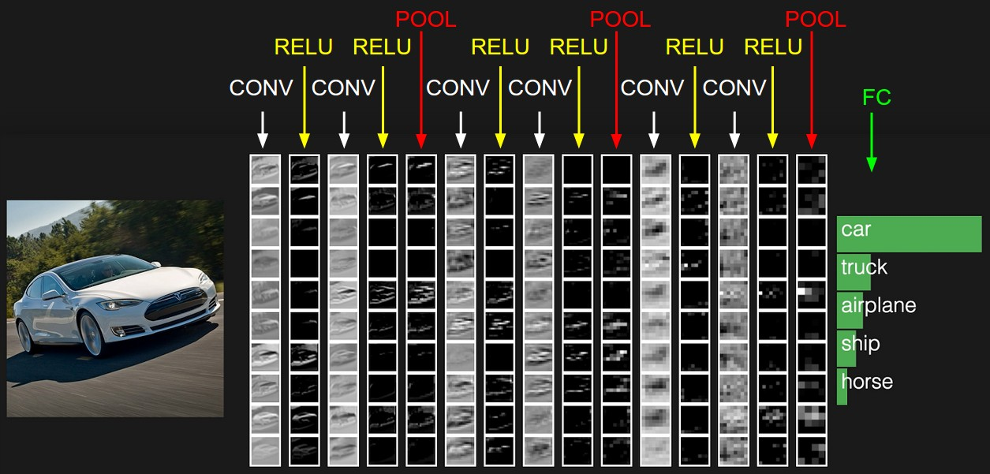
The activations of an example ConvNet architecture.
http://cs231n.github.io/convolutional-networks/

Slide 40
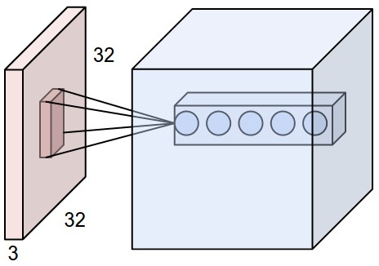
ConvNets
32x32x3 CIFAR-10 image
first Convolutional layer
http://cs231n.github.io/convolutional-networks/

Slide 41
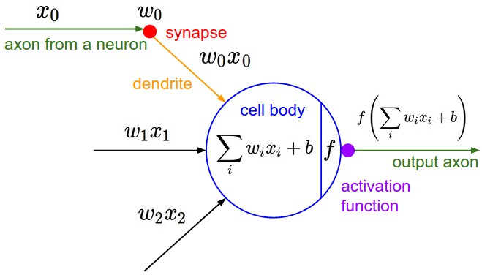
ConvNets
http://cs231n.github.io/convolutional-networks/

Slide 42
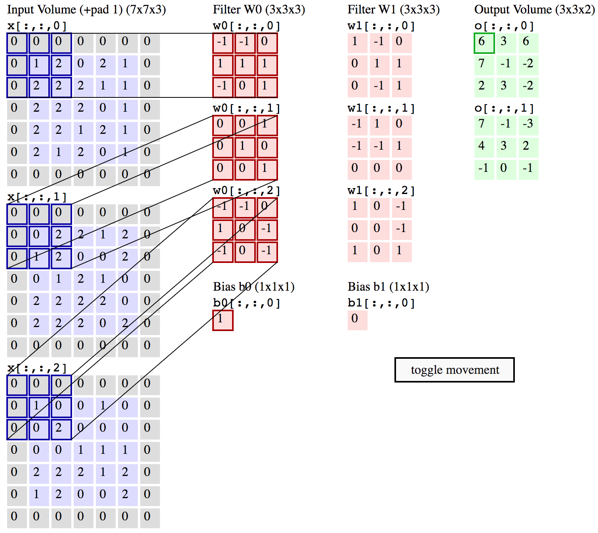
Convolution Demo
http://cs231n.github.io/convolutional-networks/

Slide 43
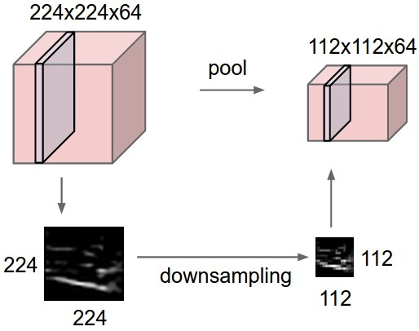
ConvNets
input volume of size [224x224x64] is pooled with filter size 2, stride 2 into output volume of size [112x112x64]
http://cs231n.github.io/convolutional-networks/

Slide 44
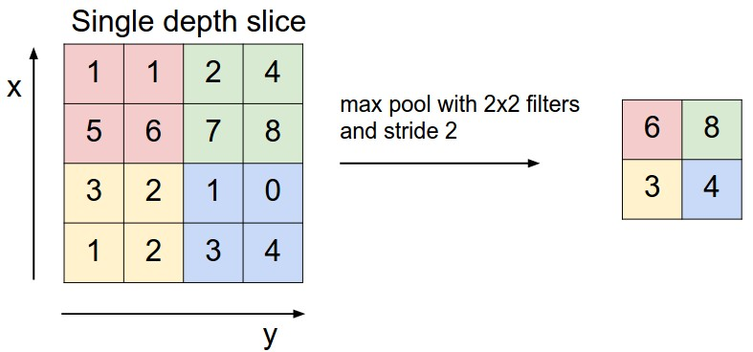
ConvNets max pooling
http://cs231n.github.io/convolutional-networks/

Slide 45
Convolutional Neural Networks (CNN) (LeNet)
Source: http://deeplearning.net/tutorial/lenet.html

Slide 46
You Only Look Once YOLO
Source: Joseph Redmon, Santosh Divvala, Ross Girshick, and Ali Farhadi (2016). "You only look once: Unified, real-time object detection." In Proceedings of the IEEE conference on computer vision and pattern recognition, pp. 779-788. 2016.

Slide 47
You Only Look Once YOLO The YOLO Detection System
(1) resizes the input image to 448 × 448, (2) runs a single convolutional network on the image
(3) thresholds the resulting detections by the model’s confidence.
Source: Joseph Redmon, Santosh Divvala, Ross Girshick, and Ali Farhadi (2016). "You only look once: Unified, real-time object detection." In Proceedings of the IEEE conference on computer vision and pattern recognition, pp. 779-788. 2016.

Slide 48
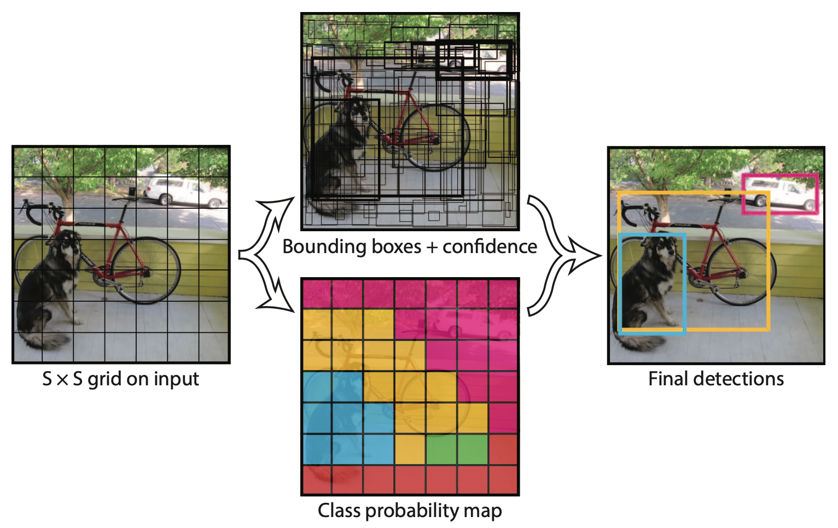
You Only Look Once (YOLO) Model
Source: Joseph Redmon, Santosh Divvala, Ross Girshick, and Ali Farhadi (2016). "You only look once: Unified, real-time object detection." In Proceedings of the IEEE conference on computer vision and pattern recognition, pp. 779-788. 2016.

Slide 49
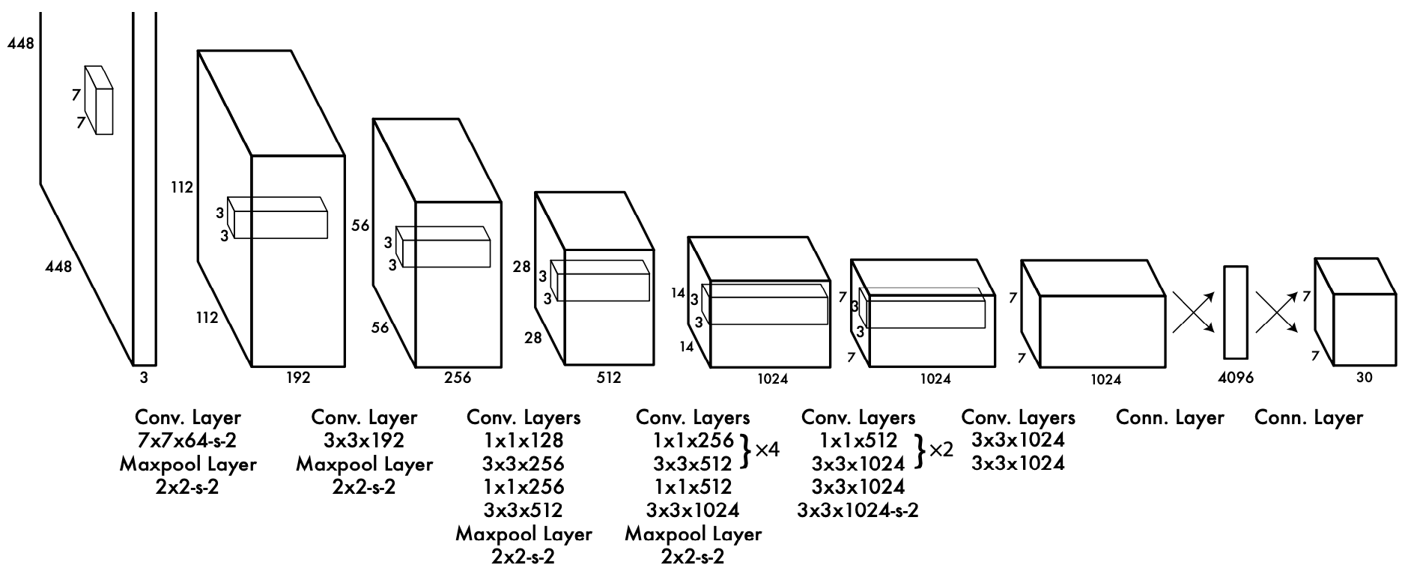
You Only Look Once (YOLO) Unified, Real-Time Object Detection Architecture
Source: Joseph Redmon, Santosh Divvala, Ross Girshick, and Ali Farhadi (2016). "You only look once: Unified, real-time object detection." In Proceedings of the IEEE conference on computer vision and pattern recognition, pp. 779-788. 2016.

Slide 50
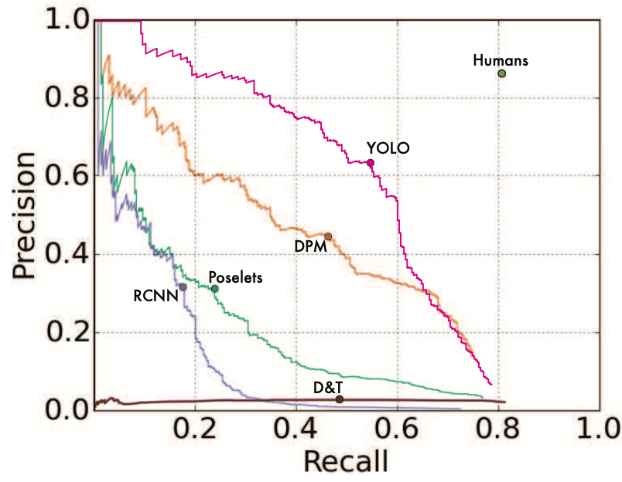
You Only Look Once (YOLO) Picasso Dataset precision-recall curves
Source: Joseph Redmon, Santosh Divvala, Ross Girshick, and Ali Farhadi (2016). "You only look once: Unified, real-time object detection." In Proceedings of the IEEE conference on computer vision and pattern recognition, pp. 779-788. 2016.

Slide 51
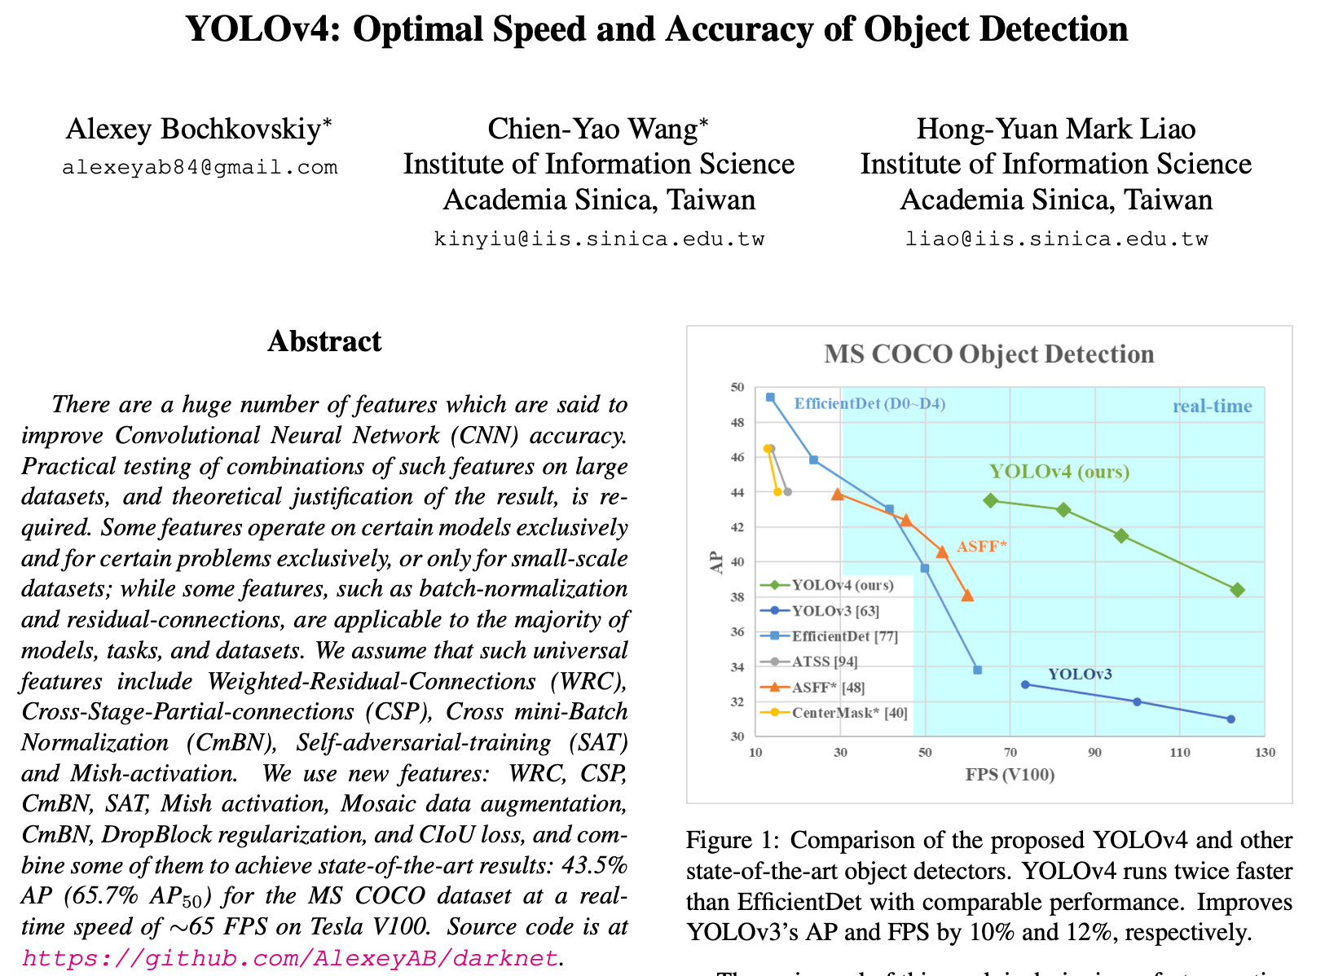
YOLOv4
Source: Alexey Bochkovskiy, Chien-Yao Wang, and Hong-Yuan Mark Liao (2020). "Yolov4: Optimal speed and accuracy of object detection." arXiv preprint arXiv:2004.10934 (2020).

Slide 52
YOLOv4
Source: Alexey Bochkovskiy, Chien-Yao Wang, and Hong-Yuan Mark Liao (2020). "Yolov4: Optimal speed and accuracy of object detection." arXiv preprint arXiv:2004.10934 (2020).

Slide 53
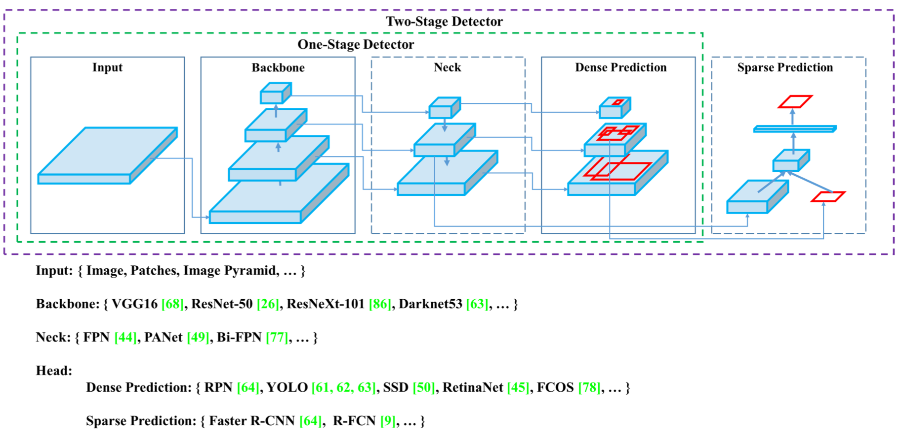
YOLOv4: Optimal speed and accuracy of object detection
Source: Alexey Bochkovskiy, Chien-Yao Wang, and Hong-Yuan Mark Liao (2020). "Yolov4: Optimal speed and accuracy of object detection." arXiv preprint arXiv:2004.10934 (2020).

Slide 54
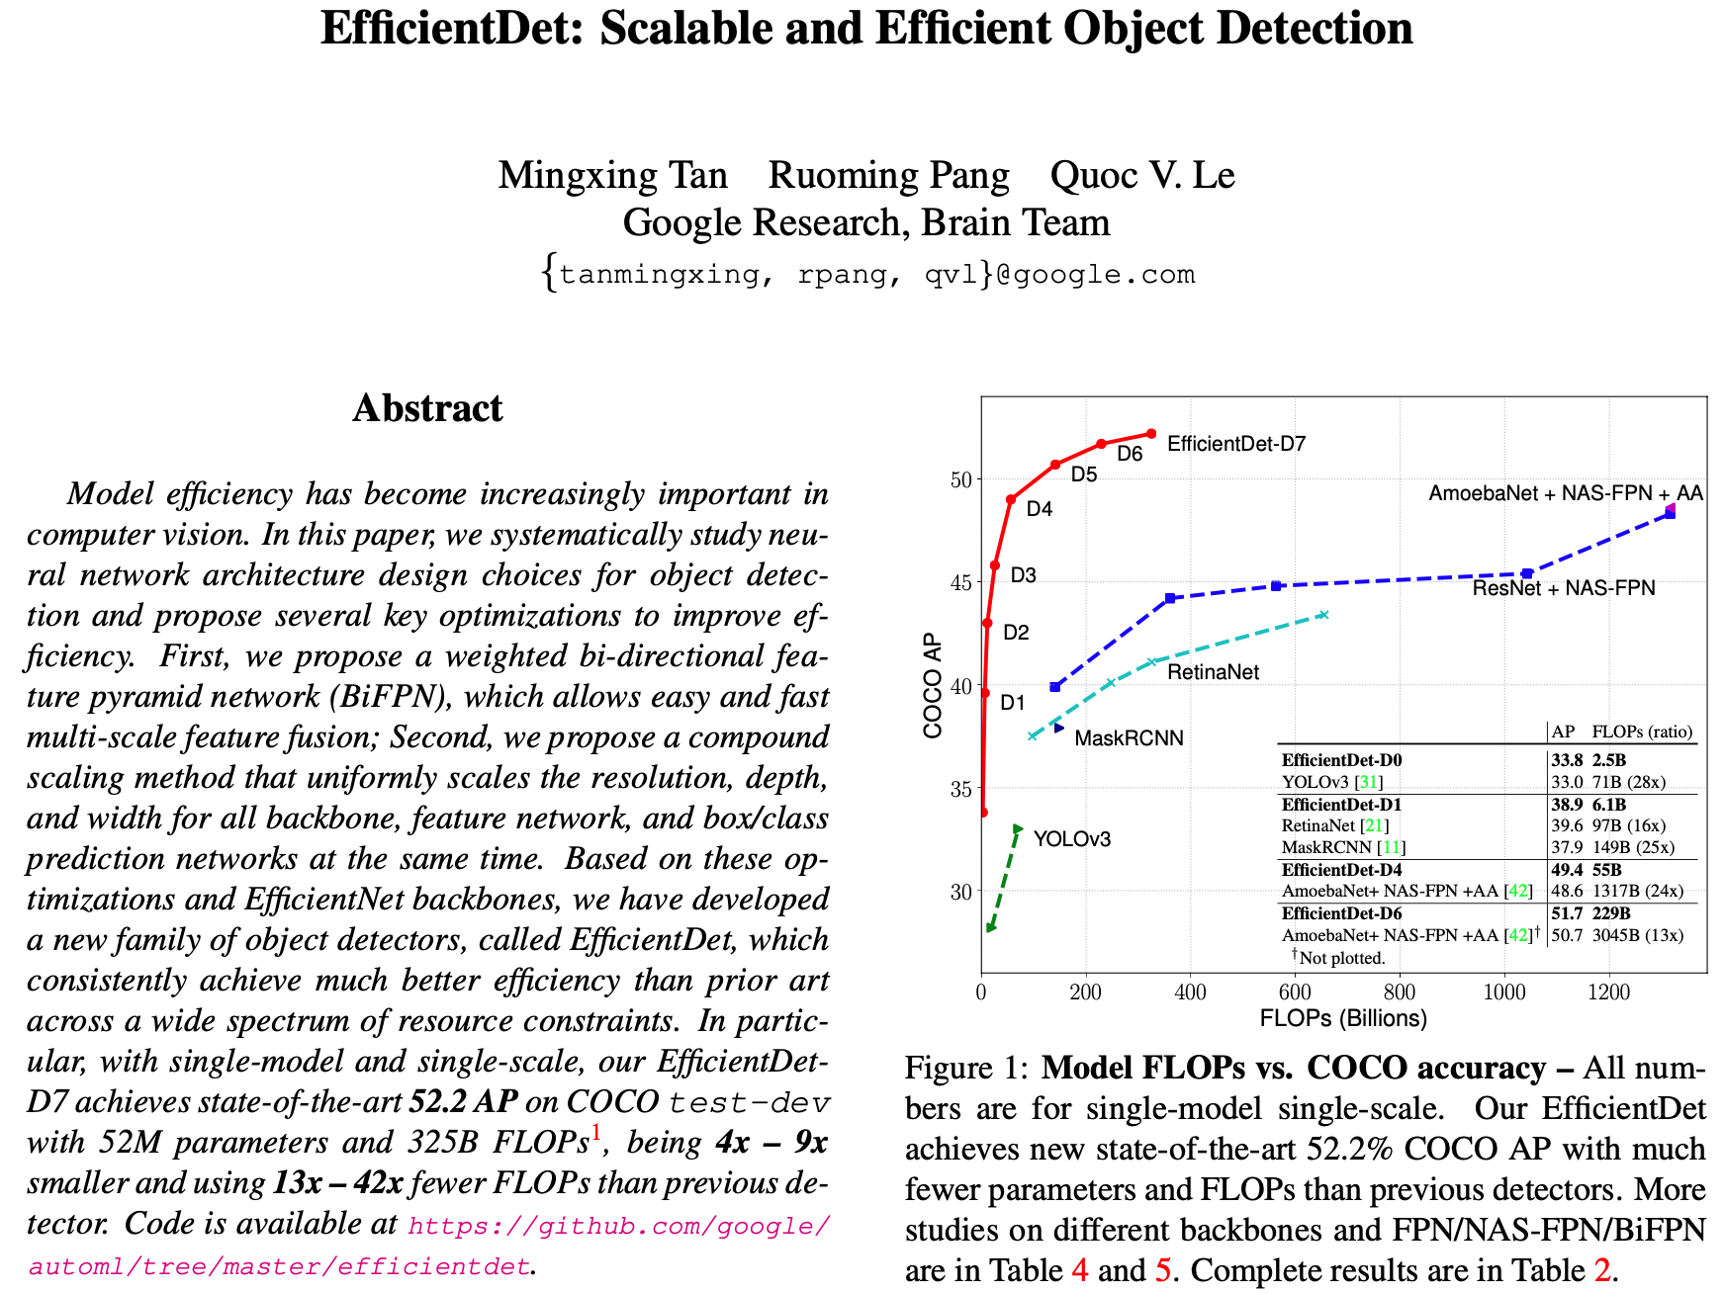
EfficientDet
Source: Mingxing Tan, Ruoming Pang, and Quoc V. Le (2020). "Efficientdet: Scalable and efficient object detection." In Proceedings of the IEEE/CVF conference on computer vision and pattern recognition, pp. 10781-10790. 2020.

Slide 55
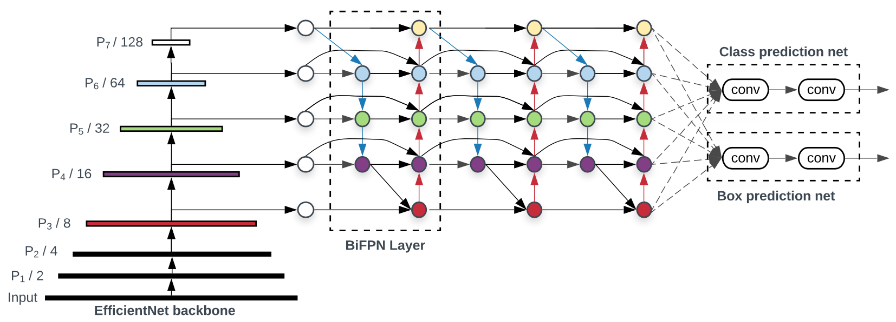
EfficientDet: Scalable and Efficient Object Detection
Source: Mingxing Tan, Ruoming Pang, and Quoc V. Le (2020). "Efficientdet: Scalable and efficient object detection." In Proceedings of the IEEE/CVF conference on computer vision and pattern recognition, pp. 10781-10790. 2020.

Slide 56
YOLOv5
Source: https://github.com/ultralytics/yolov5

Slide 57
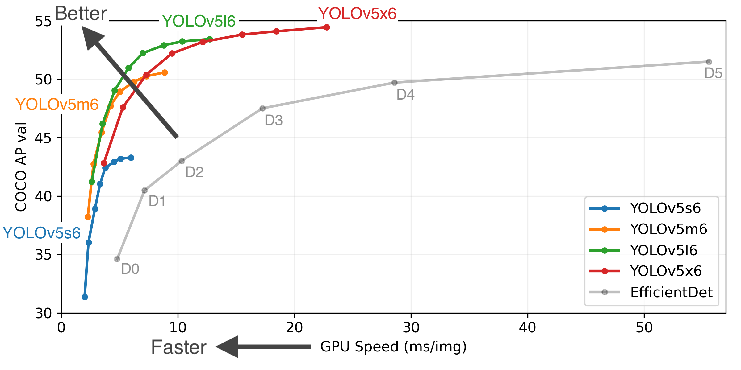
YOLOv5
Source: https://github.com/ultralytics/yolov5

Slide 58
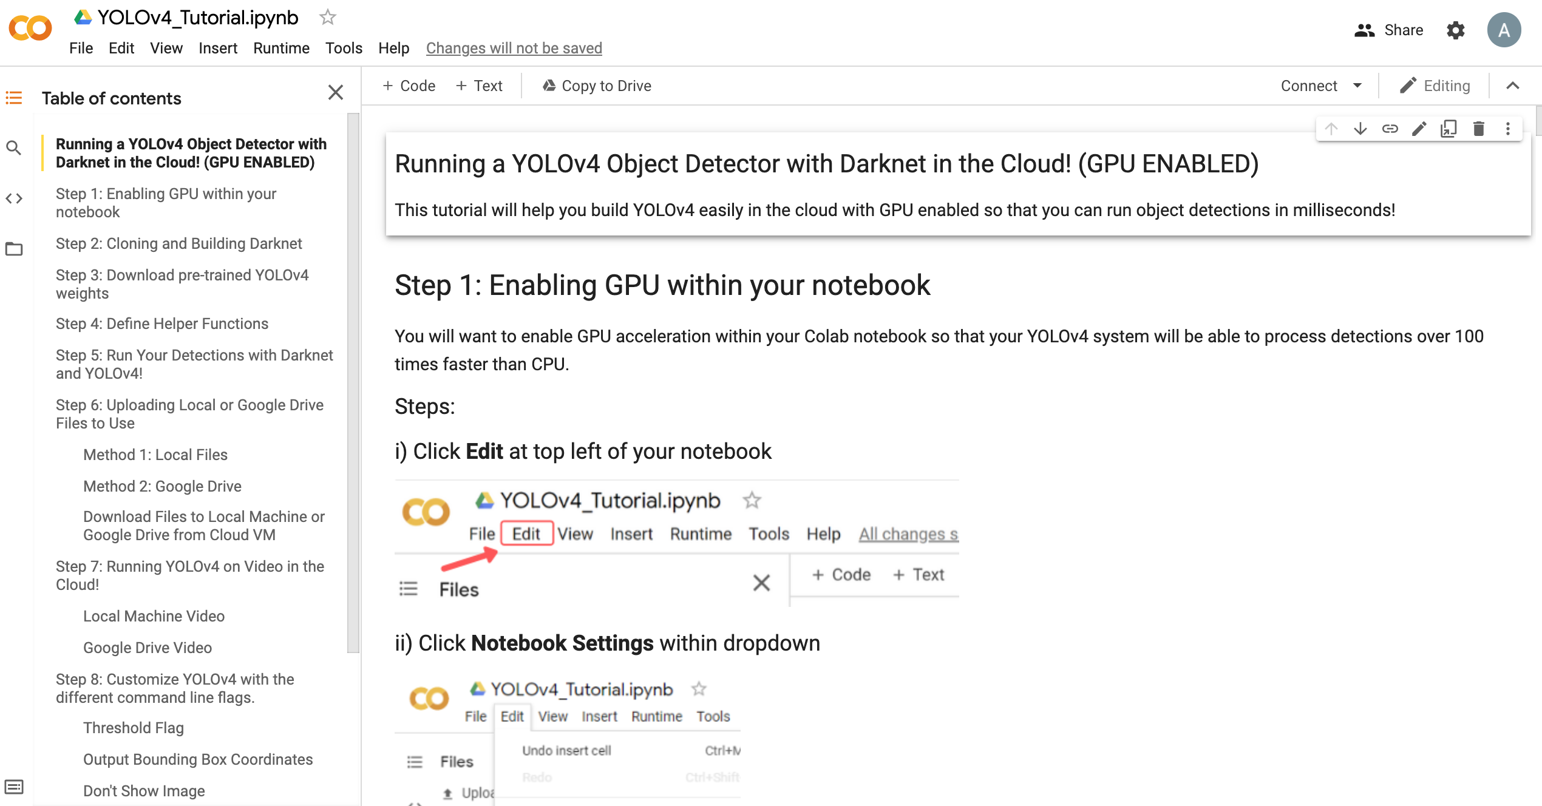
YOLOv4 Object Detector in Google Colab
Source: theAIGuysCode, YOLOv4 Cloud Tutorial, https://github.com/theAIGuysCode/YOLOv4-Cloud-Tutorial

Slide 59
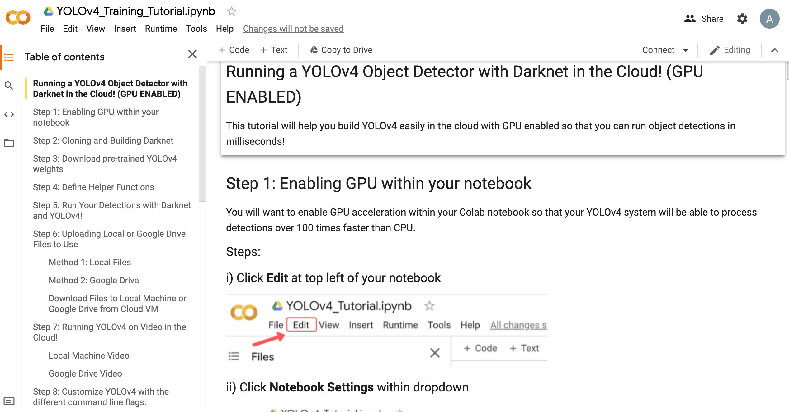
Train Custom YOLOv4 Model in Google Colab
Source: theAIGuysCode, YOLOv4 Cloud Tutorial, https://github.com/theAIGuysCode/YOLOv4-Cloud-Tutorial

Slide 60
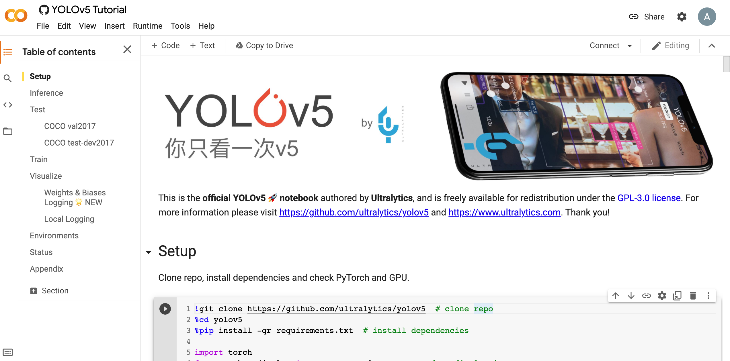
YOLOv5 Tutorial
Source: https://colab.research.google.com/github/ultralytics/yolov5/blob/master/tutorial.ipynb

Slide 61
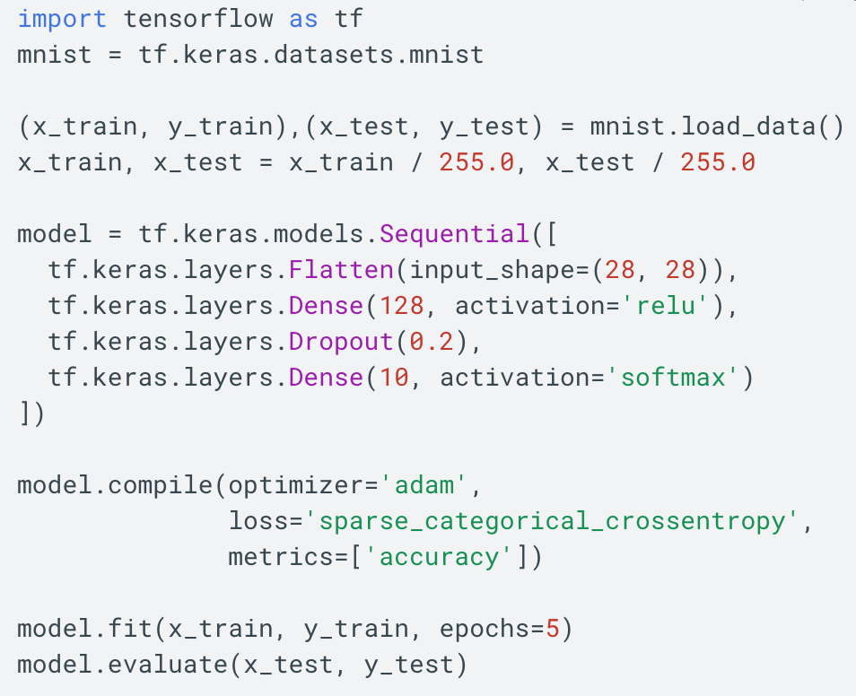
TensorFlow 2.0 MNIST
https://www.tensorflow.org/overview/

Slide 62
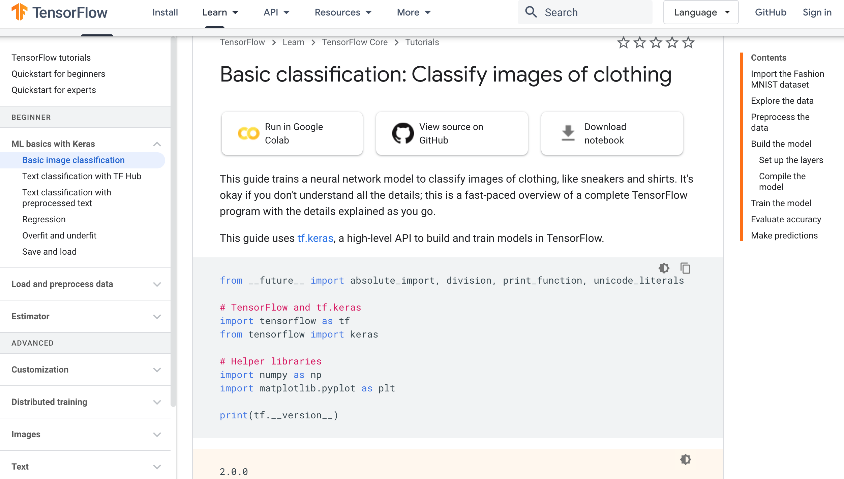
TensorFlow Image Classification
https://www.tensorflow.org/tutorials/keras/classification

Slide 63
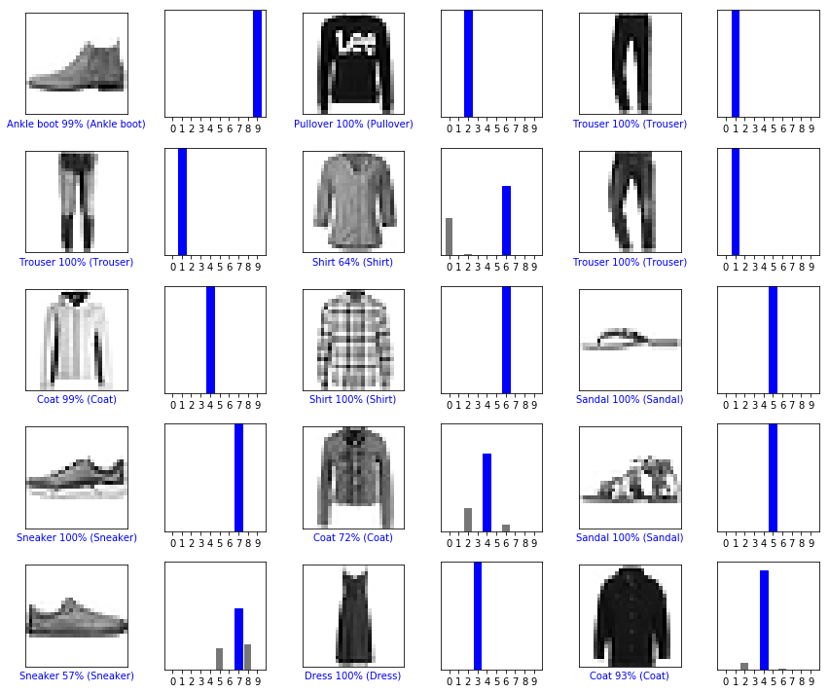
Image Classification Fashion MNIST dataset
https://www.tensorflow.org/tutorials/keras/classification

Slide 64
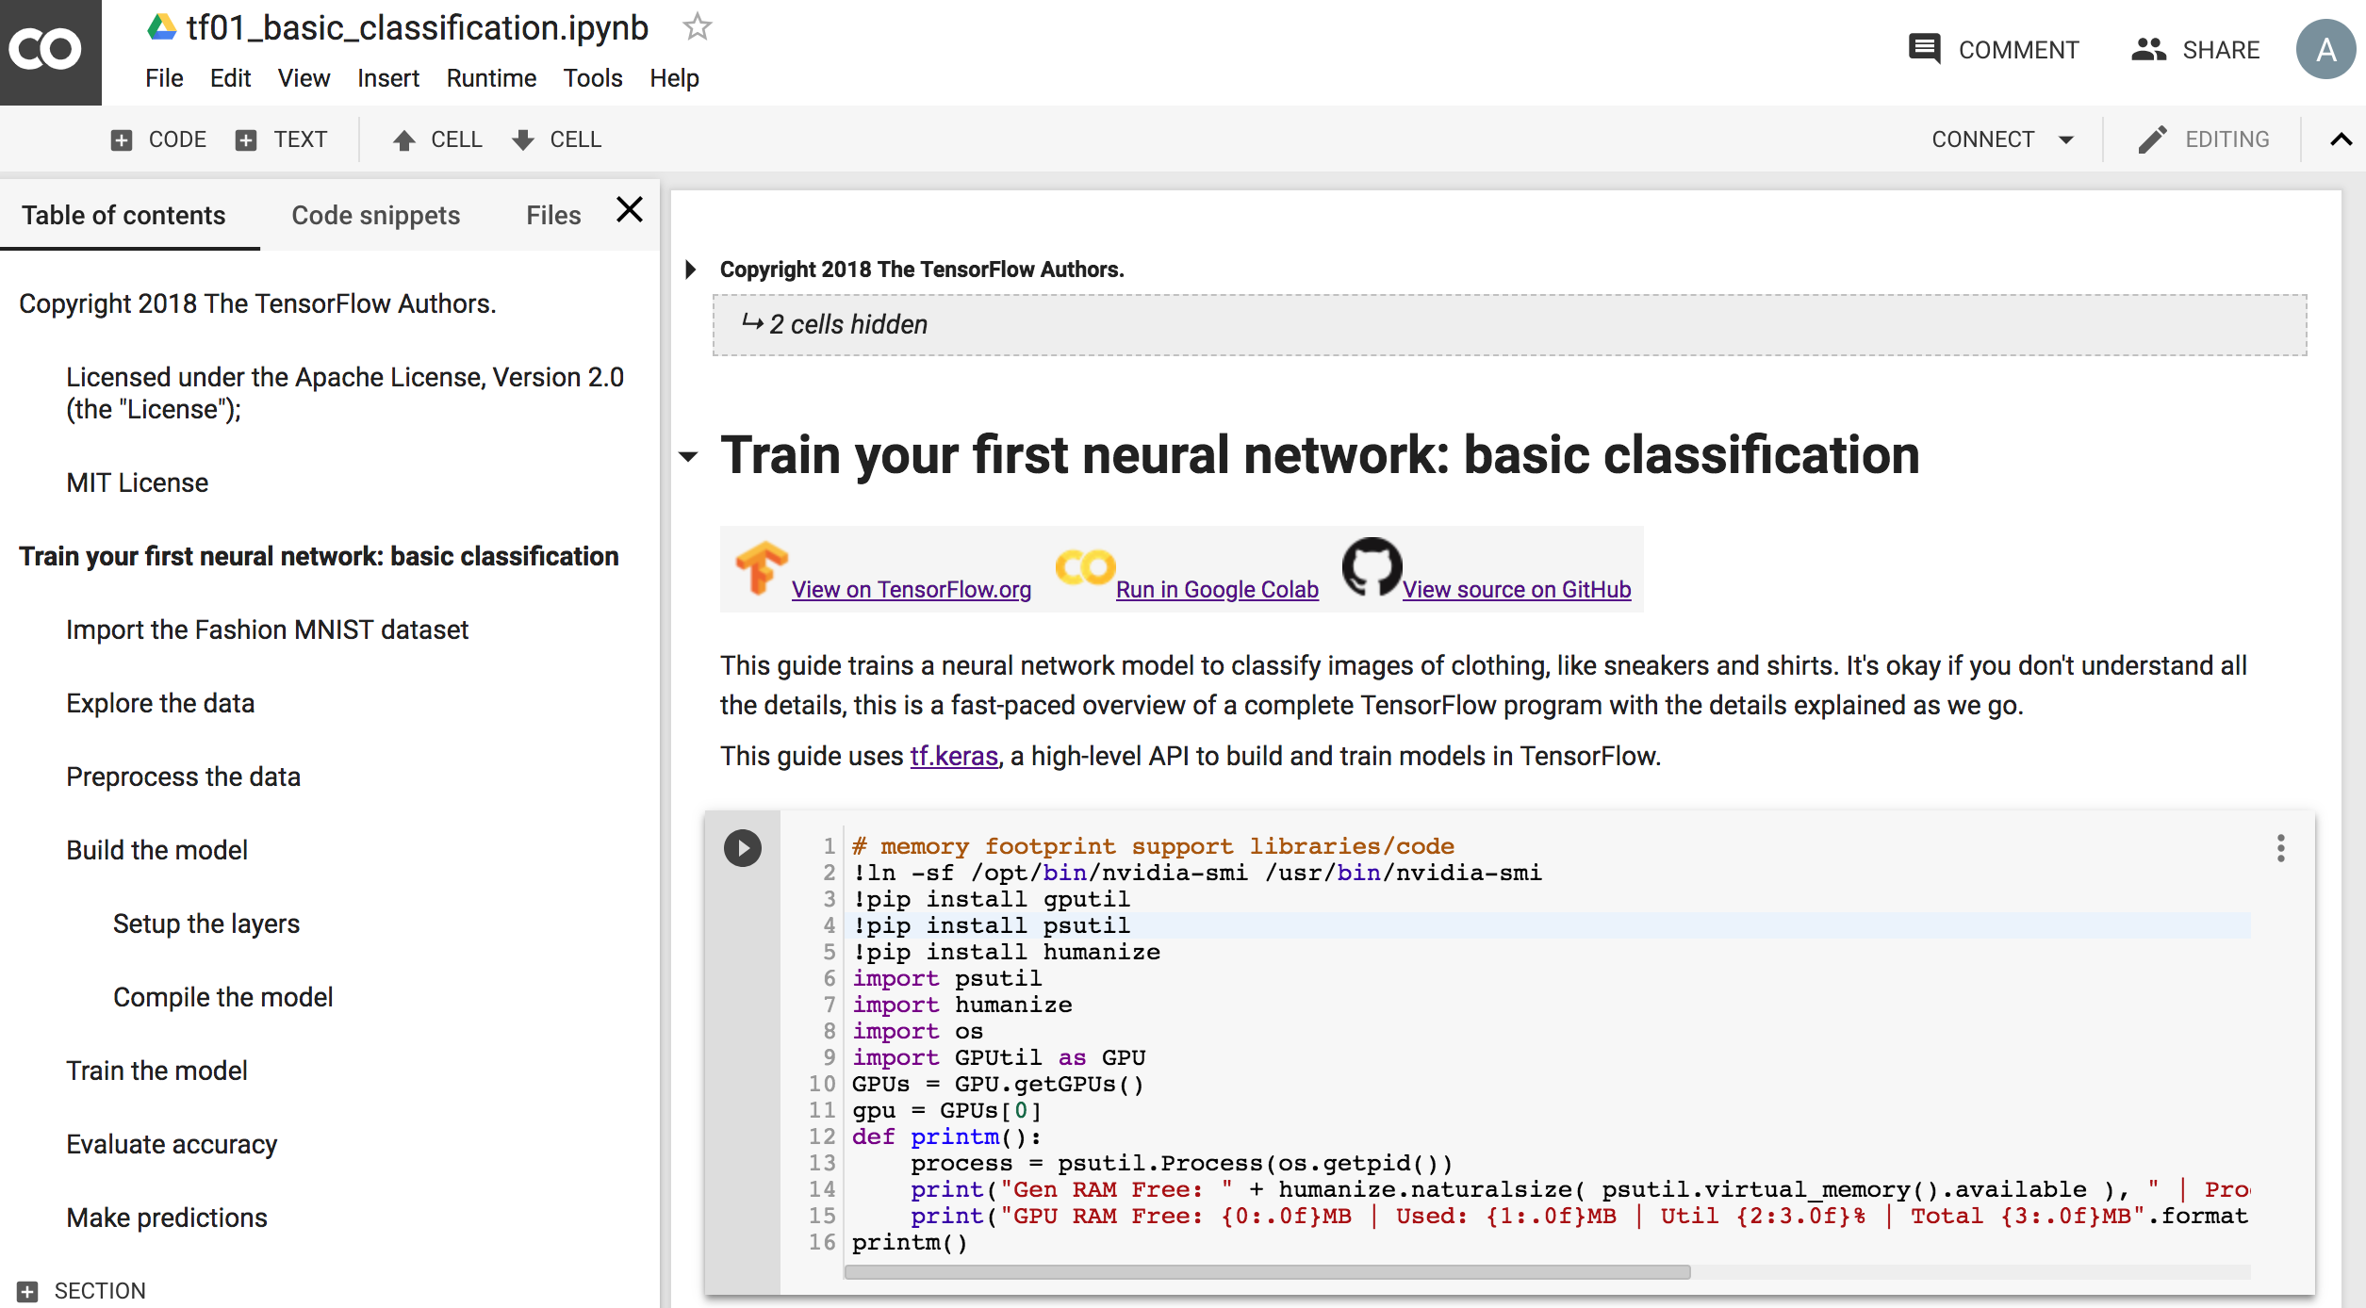
Basic Classification Fashion MNIST Image Classification
https://colab.research.google.com/drive/19PJOJi1vn1kjcutlzNHjRSLbeVl4kd5z
Source: https://colab.research.google.com/github/tensorflow/docs/blob/master/site/en/tutorials/keras/basic_classification.ipynb

Slide 65
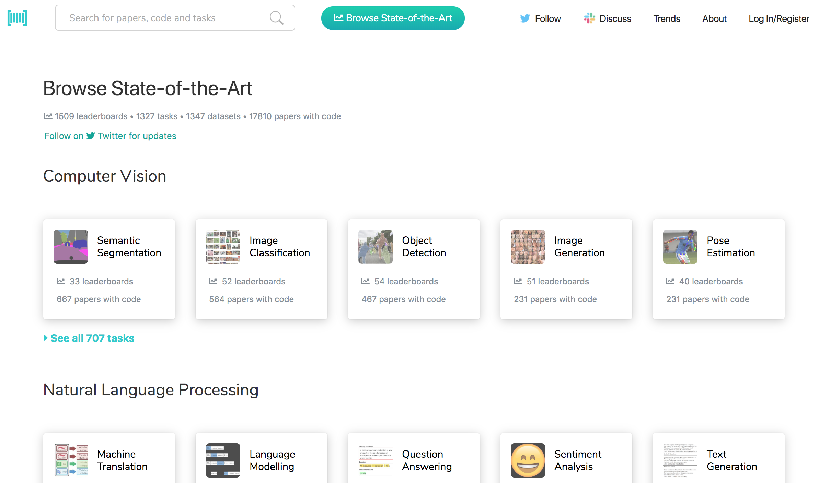
Papers with Code State-of-the-Art (SOTA)
https://paperswithcode.com/sota

Slide 66
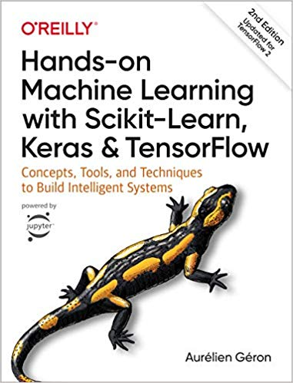
Aurélien Géron (2019), Hands-On Machine Learning with Scikit-Learn, Keras, and TensorFlow: Concepts, Tools, and Techniques to Build Intelligent Systems, 2nd Edition O’Reilly Media, 2019
https://github.com/ageron/handson-ml2
Source: https://www.amazon.com/Hands-Machine-Learning-Scikit-Learn-TensorFlow/dp/1492032646/

Slide 67
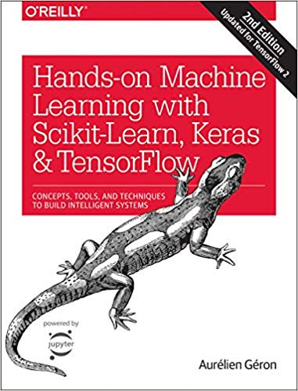
Hands-On Machine Learning with Scikit-Learn, Keras, and TensorFlow
Notebooks
The Machine Learning landscape
End-to-end Machine Learning project
Classification
Training Models
Support Vector Machines
Decision Trees
Ensemble Learning and Random Forests
Dimensionality Reduction
Unsupervised Learning Techniques
Artificial Neural Nets with Keras
Training Deep Neural Networks
Custom Models and Training with TensorFlow
Loading and Preprocessing Data
Deep Computer Vision Using Convolutional Neural Networks
Processing Sequences Using RNNs and CNNs
Natural Language Processing with RNNs and Attention
Representation Learning Using Autoencoders
Reinforcement Learning
Training and Deploying TensorFlow Models at Scale
https://github.com/ageron/handson-ml2

Slide 68
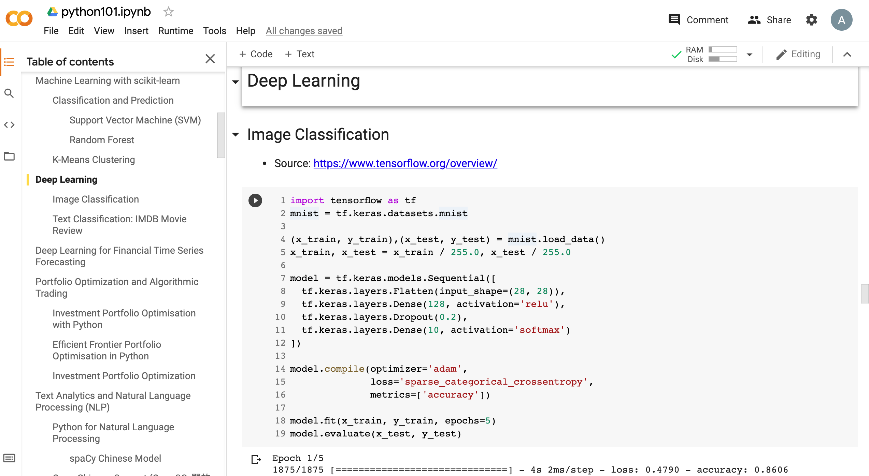
Python in Google Colab (Python101)
https://colab.research.google.com/drive/1FEG6DnGvwfUbeo4zJ1zTunjMqf2RkCrT
https://tinyurl.com/aintpupython101

Slide 69
Summary
Convolutional Neural Networks (CNN)
Convolution
Pooling
Fully Connection (FC) (Flattening)
Computer Vision
Image Classification
Object Detection

Slide 70
References
Aurélien Géron (2019), Hands-On Machine Learning with Scikit-Learn, Keras, and TensorFlow: Concepts, Tools, and Techniques to Build Intelligent Systems, 2nd Edition, O’Reilly Media. https://github.com/wesm/pydata-book
Stuart Russell and Peter Norvig (2020), Artificial Intelligence: A Modern Approach, 4th Edition, Pearson.
Luis Serrano (2017), A friendly introduction to Convolutional Neural Networks and Image Recognition, https://www.youtube.com/watch?v=2-Ol7ZB0MmU
Arden Dertat (2017), Applied Deep Learning - Part 4: Convolutional Neural Networks, https://towardsdatascience.com/applied-deep-learning-part-4-convolutional-neural-networks-584bc134c1e2
CS231n: Convolutional Neural Networks for Visual Recognition, https://cs231n.github.io/convolutional-networks/
Chien-Yao Wang, Alexey Bochkovskiy, and Hong-Yuan Mark Liao (2020). "Scaled-YOLOv4: Scaling Cross Stage Partial Network." arXiv preprint arXiv:2011.08036 (2020).
Alexey Bochkovskiy, Chien-Yao Wang, and Hong-Yuan Mark Liao (2020). "Yolov4: Optimal speed and accuracy of object detection." arXiv preprint arXiv:2004.10934 (2020).
Joseph Redmon, Santosh Divvala, Ross Girshick, and Ali Farhadi (2016). "You only look once: Unified, real-time object detection." In Proceedings of the IEEE conference on computer vision and pattern recognition, pp. 779-788. 2016.
Mingxing Tan, Ruoming Pang, and Quoc V. Le (2020). "EfficientDet: Scalable and efficient object detection." In Proceedings of the IEEE/CVF conference on computer vision and pattern recognition, pp. 10781-10790. 2020.
theAIGuysCode, YOLOv4 Cloud Tutorial, https://github.com/theAIGuysCode/YOLOv4-Cloud-Tutorial
YOLOv5, https://github.com/ultralytics/yolov5
Min-Yuh Day (2021), Python 101, https://tinyurl.com/aintpupython101

