Slide 1
資料探勘 (Data Mining)
社交網絡分析 (Social Network Analysis)
1092DM12
MBA, IM, NTPU (M5026) (Spring 2021) Tue 2, 3, 4 (9:10-12:00) (B8F40)
Min-Yuh Day
戴敏育
Associate Professor
副教授
Institute of Information Management, National Taipei University
國立臺北大學 資訊管理研究所
https://web.ntpu.edu.tw/~myday
2021-06-08

Slide 2
課程大綱 (Syllabus)
週次 (Week) 日期 (Date) 內容 (Subject/Topics)
1 2021/02/23 資料探勘介紹 (Introduction to data mining)
2 2021/03/02 ABC：人工智慧，大數據，雲端運算 (ABC: AI, Big Data, Cloud Computing)
3 2021/03/09 Python資料探勘的基礎 (Foundations of Data Mining in Python)
4 2021/03/16 資料科學與資料探勘：發現，分析，可視化和呈現數據 (Data Science and Data Mining: Discovering, Analyzing, Visualizing and Presenting Data)
5 2021/03/23 非監督學習：關聯分析，購物籃分析 (Unsupervised Learning: Association Analysis, Market Basket Analysis)
6 2021/03/30 資料探勘個案研究 I (Case Study on Data Mining I)

Slide 3
課程大綱 (Syllabus)
週次 (Week) 日期 (Date) 內容 (Subject/Topics)
7 2021/04/06 放假一天 (Day off)
8 2021/04/13 非監督學習：集群分析，行銷市場區隔 (Unsupervised Learning: Cluster Analysis, Market Segmentation)
9 2021/04/20 期中報告 (Midterm Project Report)
10 2021/04/27 監督學習：分類和預測 (Supervised Learning: Classification and Prediction)
11 2021/05/04 機器學習和深度學習 (Machine Learning and Deep Learning)
12 2021/05/11 卷積神經網絡 (Convolutional Neural Networks)

Slide 4
課程大綱 (Syllabus)
週次 (Week) 日期 (Date) 內容 (Subject/Topics)
13 2021/05/18 資料探勘個案研究 II (Case Study on Data Mining II)
14 2021/05/25 遞歸神經網絡 (Recurrent Neural Networks)
15 2021/06/01 強化學習 (Reinforcement Learning)
16 2021/06/08 社交網絡分析 (Social Network Analysis)
17 2021/06/15 期末報告 I (Final Project Report I)
18 2021/06/22 期末報告 II (Final Project Report II)

Slide 5
Social Network Analysis (SNA)

Slide 6
Outline
Social Computing and Social Network Analysis (SNA)
Social Network Analysis with Gephi
Applications of SNA

Slide 7
Social Computing

Slide 8
Social Network Analysis (SNA)

Slide 9
Social Computing
Social Network Analysis
Link mining
Community Detection
Social Recommendation

Slide 10
Mehmet Kaya, Jalal Kawash, Suheil Khoury, Min-Yuh Day (2018), Social Network Based Big Data Analysis and Applications, Springer
Source: https://www.amazon.com/Network-Analysis-Applications-Lecture-Networks/dp/3319781952

Slide 11
Business Insights with Social Analytics

Slide 12
Analyzing the Social Web: Social Network Analysis

Slide 13
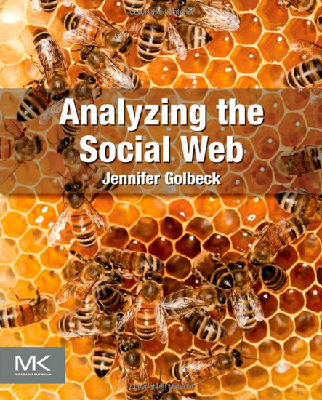
Jennifer Golbeck (2013), Analyzing the Social Web, Morgan Kaufmann
Source: http://www.amazon.com/Analyzing-Social-Web-Jennifer-Golbeck/dp/0124055311

Slide 14
Devangana Khokhar (2015), Gephi Cookbook, Packt Publishing
Source: http://www.amazon.com/Gephi-Cookbook-Devangana-Khokhar/dp/1783987405
Notes:
Devangana Khokhar (2015), Gephi Cookbook, Packt Publishing

Slide 15
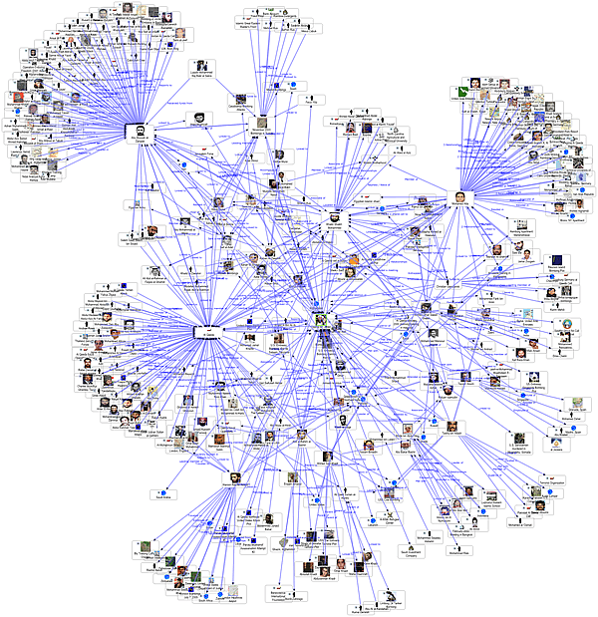
Social Network Analysis
Source: http://www.fmsasg.com/SocialNetworkAnalysis/

Slide 16
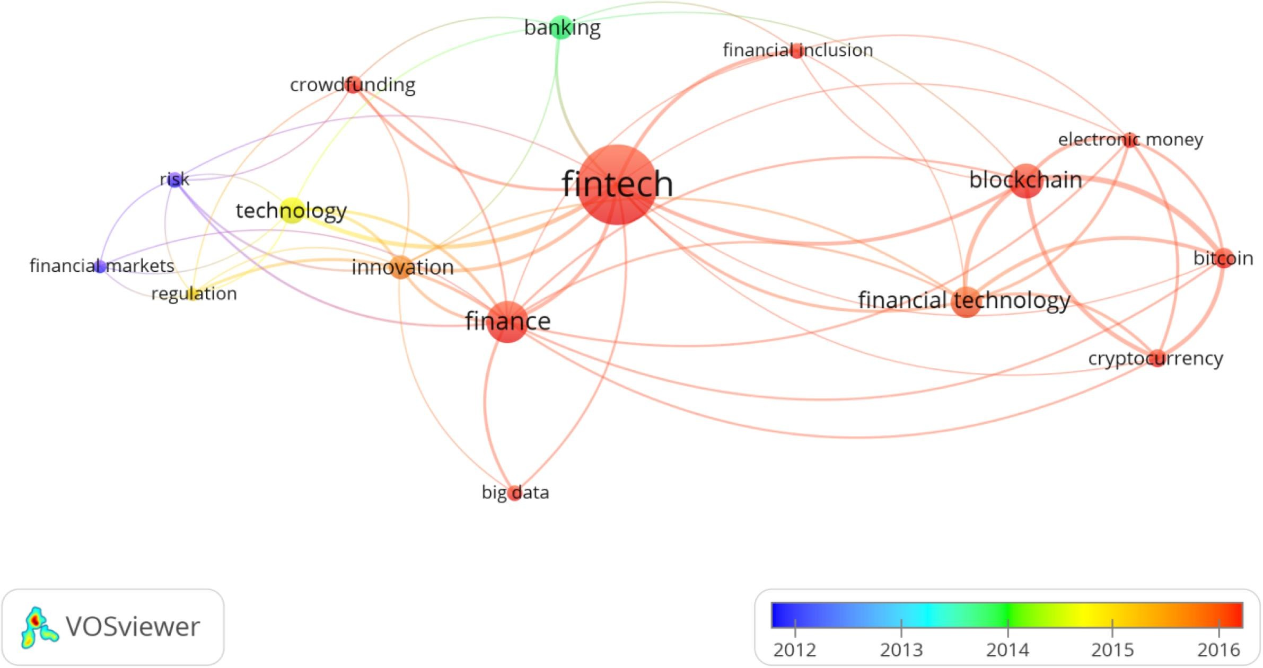
SNA in Fintech Research VOSviewer – Network Visualization of the Occurrences of Keywords
Source: Eduardo Z. Milian, Mauro de M. Spinola, and Marly M. de Carvalho (2019). "Fintechs: A literature review and research agenda." Electronic Commerce Research and Applications, 34, 100833.

Slide 17
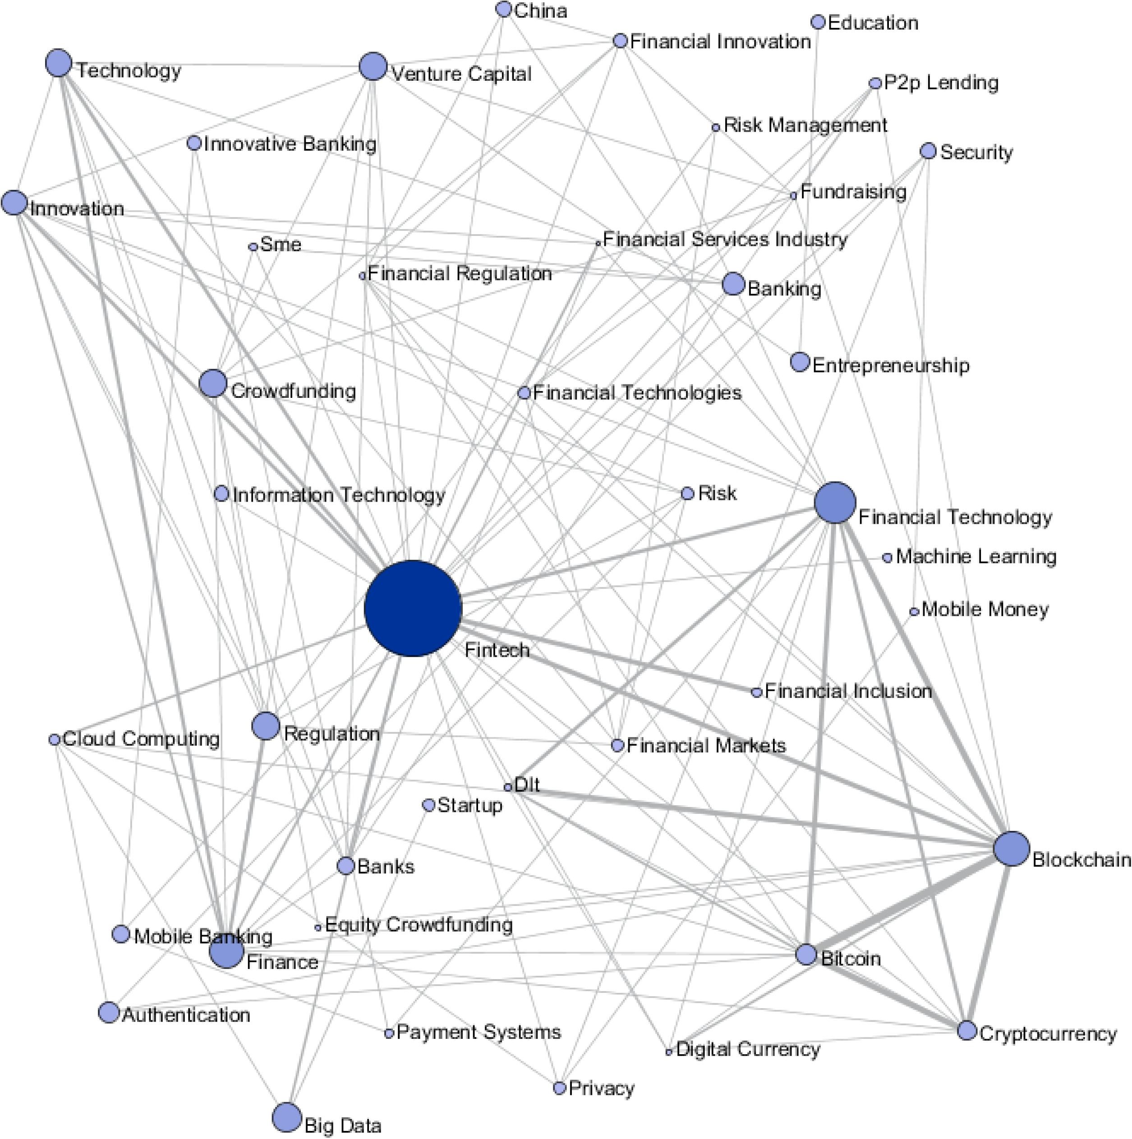
SNA in Fintech Research
Sci2 Tool – Keyword Co-occurrence Network
Source: Eduardo Z. Milian, Mauro de M. Spinola, and Marly M. de Carvalho (2019). "Fintechs: A literature review and research agenda." Electronic Commerce Research and Applications, 34, 100833.

Slide 18
Social Network Analysis
A social network is a social structure of people, related (directly or indirectly) to each other through a common relation or interest
Social network analysis (SNA) is the study of social networks to understand their structure and behavior

Slide 19
Graph Theory

Slide 20
Graph
C
A
D
B
E

Slide 21
Graph g = (V, E)

Slide 22
Vertex (Node)

Slide 23
Vertices (Nodes)

Slide 24
Edge

Slide 25
Edges

Slide 26
Arc

Slide 27
Arcs

Slide 28
Undirected Graph
C
A
D
B
E
Source: https://www.youtube.com/watch?v=89mxOdwPfxA

Slide 29
Directed Graph
C
A
D
B
E
Source: https://www.youtube.com/watch?v=89mxOdwPfxA

Slide 30
Measurements of Social Network Analysis

Slide 31
Exploratory Network Analysis
Source: http://sebastien.pro/gephi-icwsm-tutorial.pdf

Slide 32
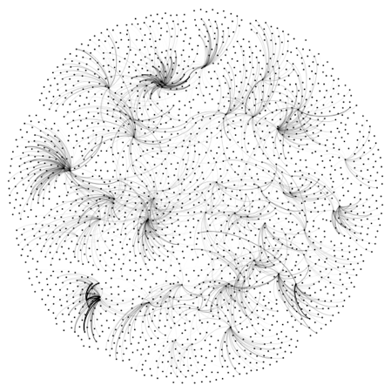
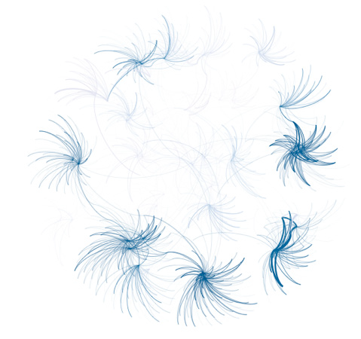
Looking for a “Simple Small Truth”? What Data Visualization Should Do?
1. Make complex things simple
2. Extract small information from large data
3. Present truth, do not deceive
Source: http://sebastien.pro/gephi-icwsm-tutorial.pdf

Slide 33
Measurements

Slide 34
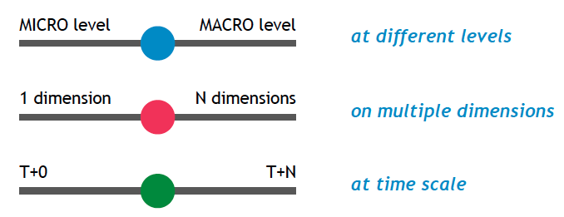
Looking for Orderness in Data
Make varying 3 cursors simultaneously to extract meaningful patterns
Source: http://sebastien.pro/gephi-icwsm-tutorial.pdf

Slide 35
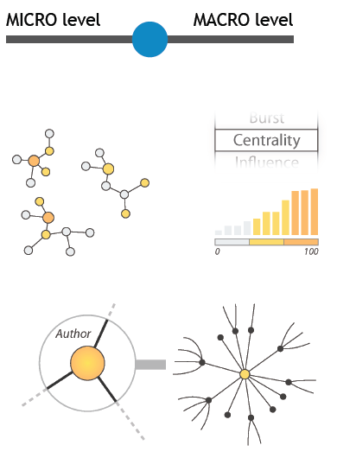
“Zoom” cursor on Quantitative Data
Global
- connectivity
- density
- centralization
Local
- communities
- bridges between communities
- local centers vs periphery
Individual
- centrality
- distances
- neighborhood
- location
- local authority vs hub
Source: http://sebastien.pro/gephi-icwsm-tutorial.pdf

Slide 36
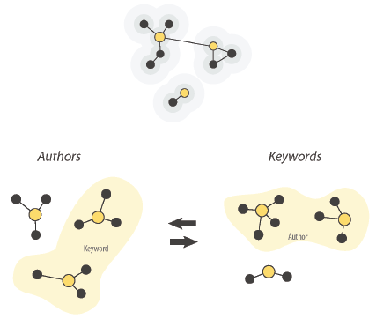
“Crossing” cursor on Quantitative Data
Social
- who with whom
- communities
- brokerage
- influence and power
- homophily
Semantic
- topics
- thematic clusters
Geographic
- spatial phenomena
Source: http://sebastien.pro/gephi-icwsm-tutorial.pdf

Slide 37
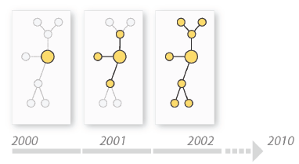
“Timeline” cursor on Temporal Data
Evolution of social ties
Evolution of communities
Evolution of topics
Source: http://sebastien.pro/gephi-icwsm-tutorial.pdf

Slide 38
SNA Guideline
Source: http://sebastien.pro/gephi-icwsm-tutorial.pdf

Slide 39
Degree
C
A
D
B
E
Source: https://www.youtube.com/watch?v=89mxOdwPfxA

Slide 40
Degree
C
A: 2
B: 4
C: 2
D:1
E: 1
A
D
B
E
Source: https://www.youtube.com/watch?v=89mxOdwPfxA

Slide 41
Density
C
A
D
B
E
Source: https://www.youtube.com/watch?v=89mxOdwPfxA

Slide 42
Density
Edges (Links): 5
Total Possible Edges: 10
Density: 5/10 = 0.5
C
A
D
B
E
Source: https://www.youtube.com/watch?v=89mxOdwPfxA

Slide 43
Density
A
E
I
C
G
H
B
J
D
F
Nodes (n): 10
Edges (Links): 13
Total Possible Edges: (n * (n-1)) / 2 = (10 * 9) / 2 = 45
Density: 13/45 = 0.29

Slide 44
Diameter
radius (r)
diameter (d)

Slide 45
Diameter
A
E
I
C
G
H
B
J
D
F

Slide 46
Diameter Geodesic Path (Shortest Path)
A
E
I
C
G
H
B
J
D
F
A→ I : Diameter = 4

Slide 47
Which Node is Most Important?
A
E
I
C
G
H
B
J
D
F

Slide 48
Centrality
Important or prominent actors are those that are linked or involved with other actors extensively.
A person with extensive contacts (links) or communications with many other people in the organization is considered more important than a person with relatively fewer contacts.
The links can also be called ties. A central actor is one involved in many ties.
Source: Bing Liu (2011) , “Web Data Mining: Exploring Hyperlinks, Contents, and Usage Data”

Slide 49
Social Network Analysis (SNA)
Degree Centrality
Betweenness Centrality
Closeness Centrality

Slide 50
Degree Centrality

Slide 51
Social Network Analysis: Degree Centrality
A
E
I
C
G
H
B
J
D
F

Slide 52
Social Network Analysis: Degree Centrality
Node | Score | Standardized Score
A | 2 | 2/10 = 0.2
B | 2 | 2/10 = 0.2
C | 5 | 5/10 = 0.5
D | 3 | 3/10 = 0.3
E | 3 | 3/10 = 0.3
F | 2 | 2/10 = 0.2
G | 4 | 4/10 = 0.4
H | 3 | 3/10 = 0.3
I | 1 | 1/10 = 0.1
J | 1 | 1/10 = 0.1
A
E
I
C
G
H
B
J
D
F

Slide 53
Betweenness Centrality

Slide 54
Betweenness centrality:
Connectivity
Number of shortest paths going through the actor

Slide 55
Betweenness Centrality
Where g_{jk} = the number of shortest paths connecting jk
g_{jk}(i) = the number that actor i is on.
Normalized Betweenness Centrality
Number of pairs of vertices excluding the vertex itself
Source: https://www.youtube.com/watch?v=RXohUeNCJiU

Slide 56
Betweenness Centrality
C
A:
B→C: 0/1 = 0
B→D: 0/1 = 0
B→E: 0/1 = 0
C→D: 0/1 = 0
C→E: 0/1 = 0
D→E: 0/1 = 0
Total: 0
A
D
B
E
A: Betweenness Centrality = 0

Slide 57
Betweenness Centrality
C
B:
A→C: 0/1 = 0
A→D: 1/1 = 1
A→E: 1/1 = 1
C→D: 1/1 = 1
C→E: 1/1 = 1
D→E: 1/1 = 1
Total: 5
A
D
B
E
B: Betweenness Centrality = 5

Slide 58
Betweenness Centrality
C
C:
A→B: 0/1 = 0
A→D: 0/1 = 0
A→E: 0/1 = 0
B→D: 0/1 = 0
B→E: 0/1 = 0
D→E: 0/1 = 0
Total: 0
A
D
B
E
C: Betweenness Centrality = 0

Slide 59
Betweenness Centrality
C
A: 0
B: 5
C: 0
D: 0
E: 0
A
D
B
E

Slide 60
Which Node is Most Important?
F
G
H
B
E
A
C
I
D
J
F
H
B
E
A
C
D
J

Slide 61
Which Node is Most Important?
F
G
H
B
E
A
C
I
D
J
F
G
H
E
A
I
D
J

Slide 62
Betweenness Centrality
B
E
A
C
D

Slide 63
Betweenness Centrality
C
A:
B→C: 0/1 = 0
B→D: 0/1 = 0
B→E: 0/1 = 0
C→D: 0/1 = 0
C→E: 0/1 = 0
D→E: 0/1 = 0
Total: 0
A
D
B
E
A: Betweenness Centrality = 0

Slide 64
Closeness Centrality

Slide 65
Social Network Analysis: Closeness Centrality
C→A: 1
C→B: 1
C→D: 1
C→E: 1
C→F: 2
C→G: 1
C→H: 2
C→I: 3
C→J: 3
Total=15
A
E
I
C
G
H
B
J
D
F
C: Closeness Centrality = 15/9 = 1.67

Slide 66
Social Network Analysis: Closeness Centrality
G→A: 2
G→B: 2
G→C: 1
G→D: 2
G→E: 1
G→F: 1
G→H: 1
G→I: 2
G→J: 2
Total=14
A
E
I
C
G
H
B
J
D
F
G: Closeness Centrality = 14/9 = 1.56

Slide 67
Social Network Analysis: Closeness Centrality
H→A: 3
H→B: 3
H→C: 2
H→D: 2
H→E: 2
H→F: 2
H→G: 1
H→I: 1
H→J: 1
Total=17
A
E
I
C
G
H
B
J
D
F
H: Closeness Centrality = 17/9 = 1.89

Slide 68
Social Network Analysis: Closeness Centrality
A
E
I
C
G
H
B
J
D
F
G: Closeness Centrality = 14/9 = 1.56
1
C: Closeness Centrality = 15/9 = 1.67
2
H: Closeness Centrality = 17/9 = 1.89
3

Slide 69
Social Network Analysis (SNA) importance of neighbors
Eigenvector centrality

Slide 70
Eigenvector centrality:
Importance of a node depends on the importance of its neighbors

Slide 71
Social Network Analysis: Closeness Centrality
Sum of the reciprocal distances
where d(p_{j}, p_{k}) is the geodesic distance (shortest paths) linking p_{j}, p_{k}

Slide 72
Social Network Analysis: Betweenness Centrality
where g_{ij} is the geodesic distance (shortest paths) linking p_{i} and p_{j} and g_{ij} (p_{k} ) is the geodesic distance linking p_{i} and p_{j} that contains p_{k}.
Source: Abbasi, A., Hossain, L., & Leydesdorff, L. (2012). Betweenness centrality as a driver of preferential attachment in the evolution of research collaboration networks. Journal of Informetrics, 6(3), 403-412.

Slide 73
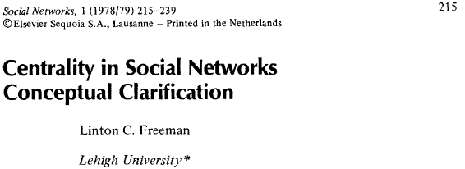
Social Network Analysis: Degree Centrality
where a(p_{i}, p_{k}) = 1 if and only if p_{i} and p_{k} are connected by a line
0 otherwise

Slide 74
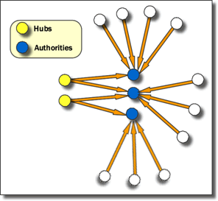
Social Network Analysis: Hub and Authority
Hubs are entities that point to a relatively large number of authorities. They are essentially the mutually reinforcing analogues to authorities. Authorities point to high hubs. Hubs point to high authorities. You cannot have one without the other.
Source: http://www.fmsasg.com/SocialNetworkAnalysis/

Slide 75
Tools of Social Network Analysis

Slide 76
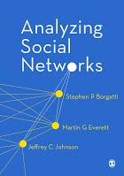
Social Network Analysis (SNA) Tools
NetworkX
igraph
Gephi
UCINet
Pajek

Slide 77
Tools of Social Network Analysis
Focused Desktop Tools
Gephi
Ucinet
Pajek
NodeXL
Cytoscape
Source: https://www.researchgate.net/post/Which_open_source_software_is_best_for_network_data_analysis

Slide 78
Tools of Social Network Analysis
Developer Tools
NetworkX
iGraph
SNAP
sigma.js
Source: https://www.researchgate.net/post/Which_open_source_software_is_best_for_network_data_analysis

Slide 79
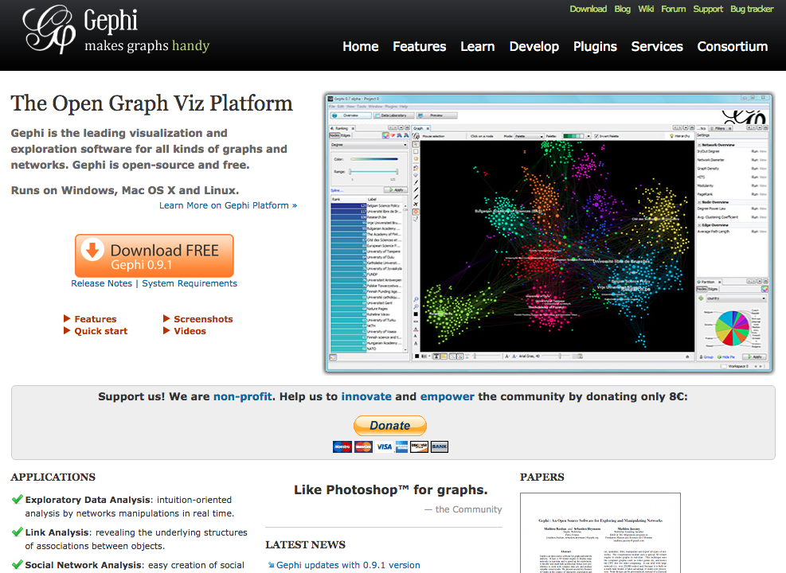
Gephi
https://gephi.org/

Slide 80
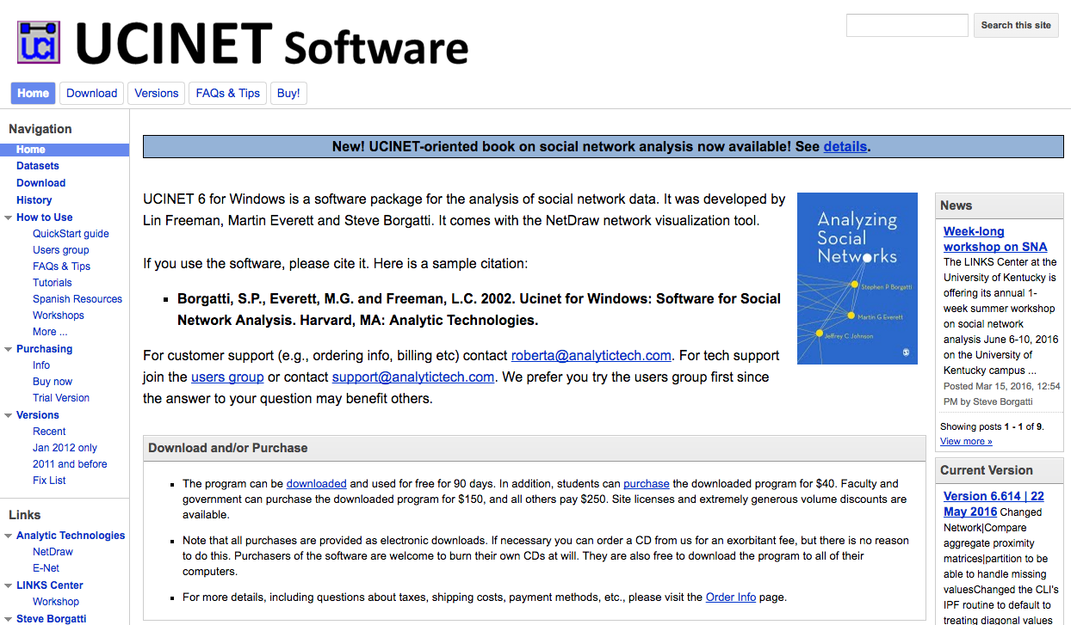
UCINET
https://sites.google.com/site/ucinetsoftware/home

Slide 81
Pajek
http://vlado.fmf.uni-lj.si/pub/networks/pajek/

Slide 82
Pajek
http://mrvar.fdv.uni-lj.si/pajek/

Slide 83
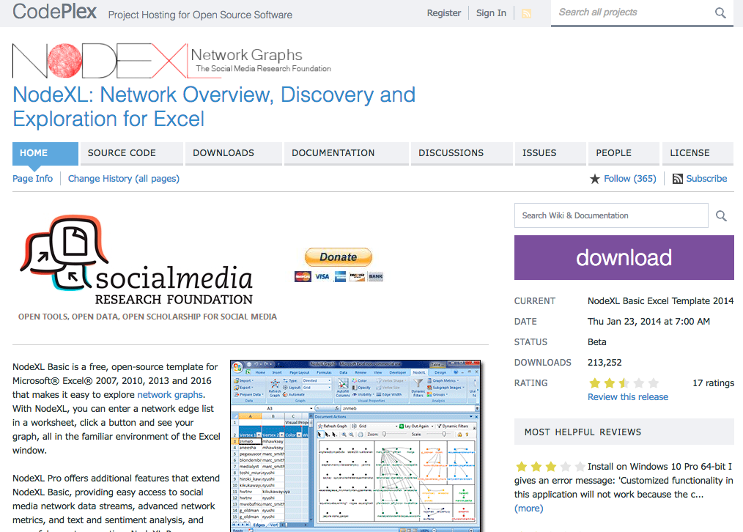
NodeXL
https://nodexl.codeplex.com/

Slide 84
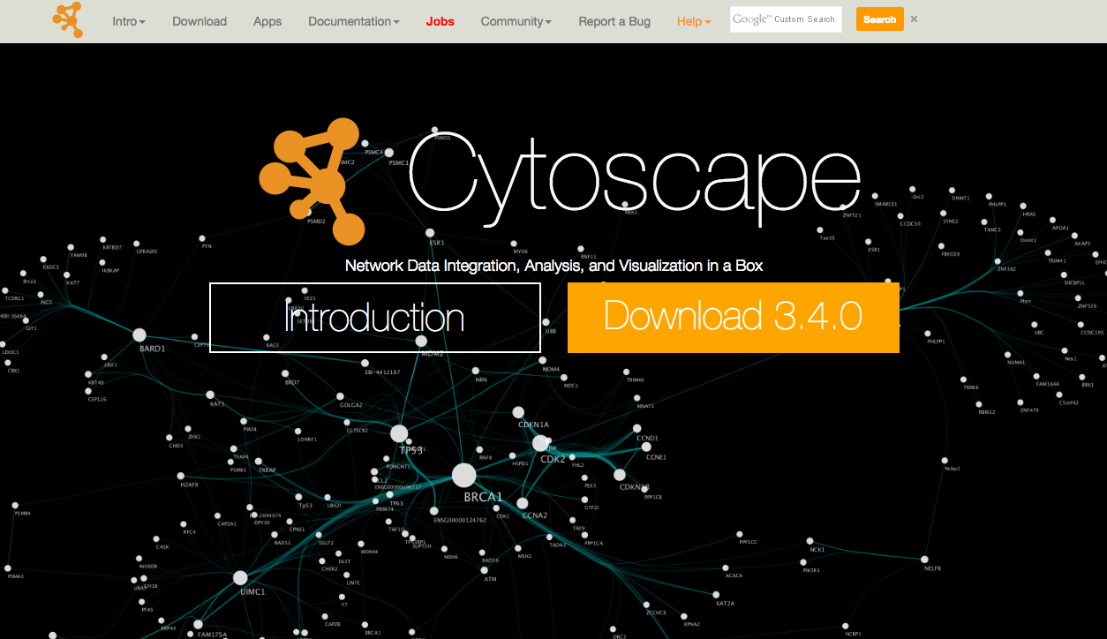
Cytoscape
http://www.cytoscape.org/

Slide 85
NetworkX
https://networkx.github.io/

Slide 86
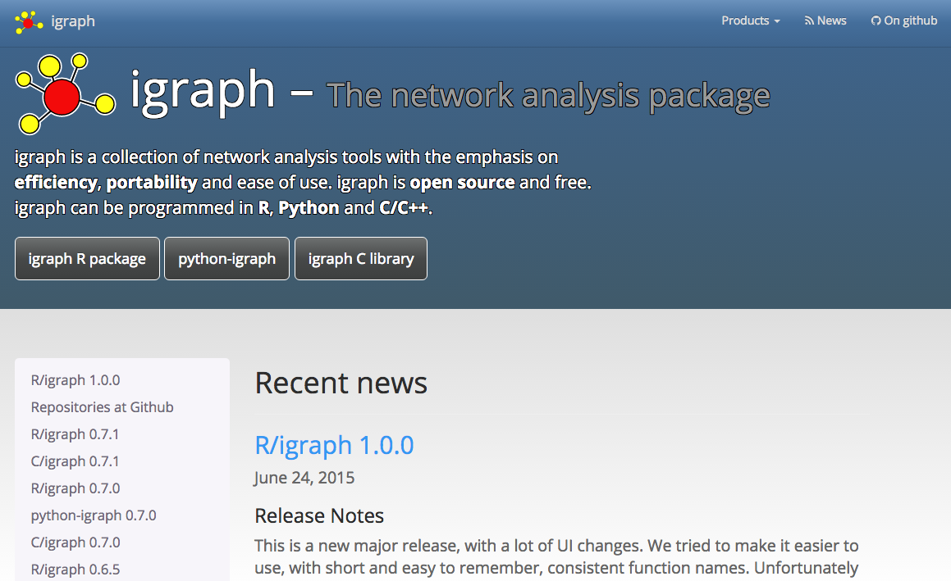
igraph
http://igraph.org/redirect.html

Slide 87
SNAP
http://snap.stanford.edu/

Slide 88
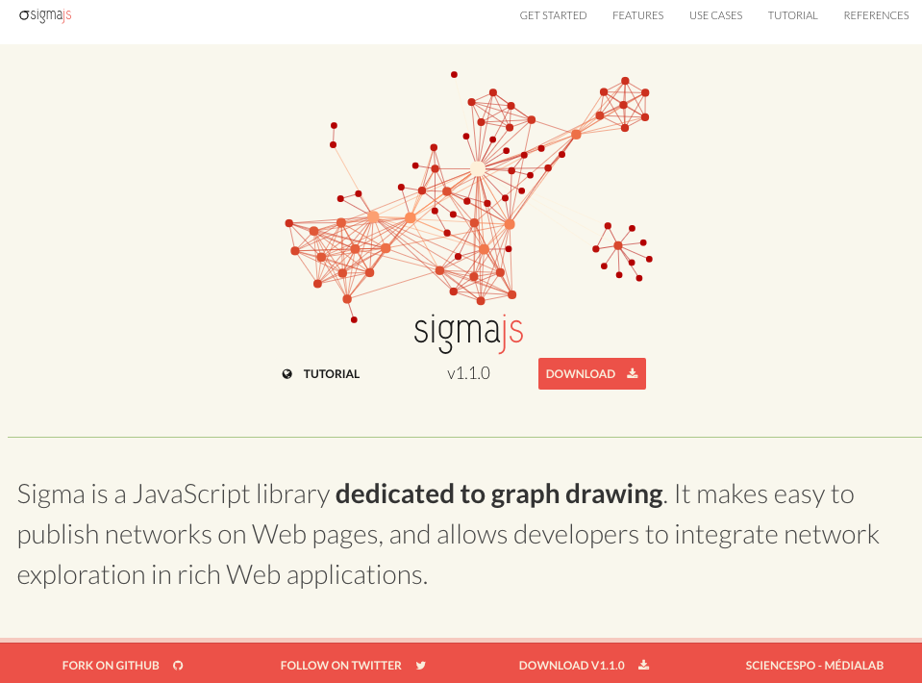
sigma.js
http://sigmajs.org/

Slide 89
Comparison of Social Network Analysis (SNA) Tools

Slide 90
General Comparison of SNA Tools
Naheed Akhtar (2014)
Source: Naheed Akhtar (2014), "Social network analysis tools." In 2014 Fourth International Conference on Communication Systems and Network Technologies (CSNT)

Slide 91
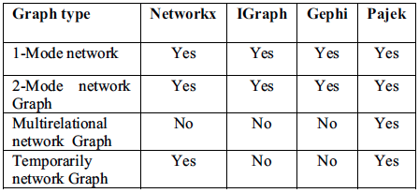
Network Types Supported by SNA Tools
Naheed Akhtar (2014)
Source: Naheed Akhtar (2014), "Social network analysis tools." In 2014 Fourth International Conference on Communication Systems and Network Technologies (CSNT)

Slide 92
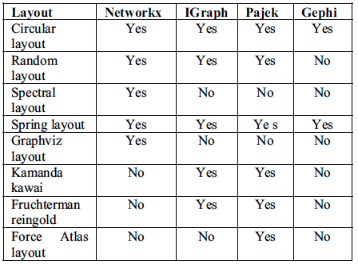
Graph Layout Supported by SNA Tools
Naheed Akhtar (2014)
Source: Naheed Akhtar (2014), "Social network analysis tools." In 2014 Fourth International Conference on Communication Systems and Network Technologies (CSNT)

Slide 93
Execution Time for SNA Features
Naheed Akhtar (2014)
Source: Naheed Akhtar (2014), "Social network analysis tools." In 2014 Fourth International Conference on Communication Systems and Network Technologies (CSNT)

Slide 94
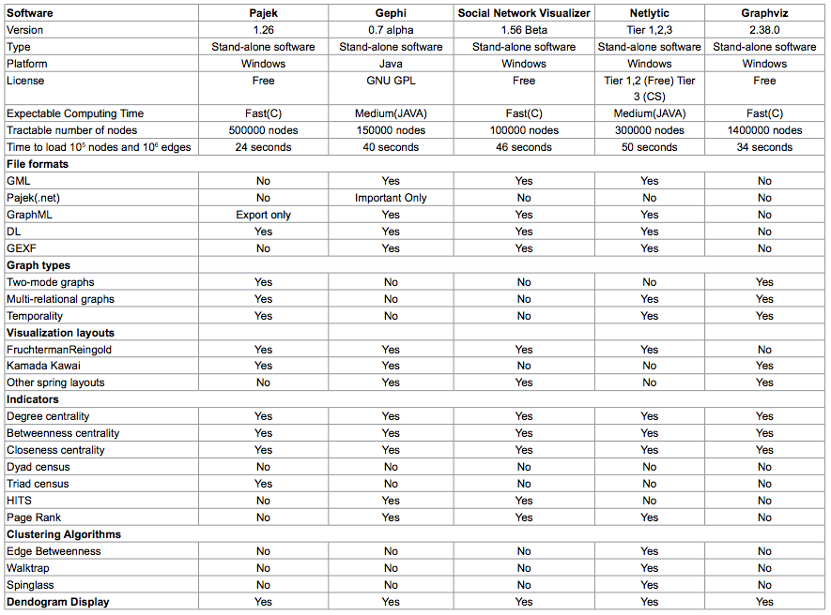
Comparative analysis of Social Networking Analysis tools
Source: Agrawal, H., Thakur, A., Slathia, R., & Sumangali, K. (2015). A Comparative Analysis of Social Networking Analysis Tools. J Inform Tech Softw Eng, 5(157), 2.

Slide 95
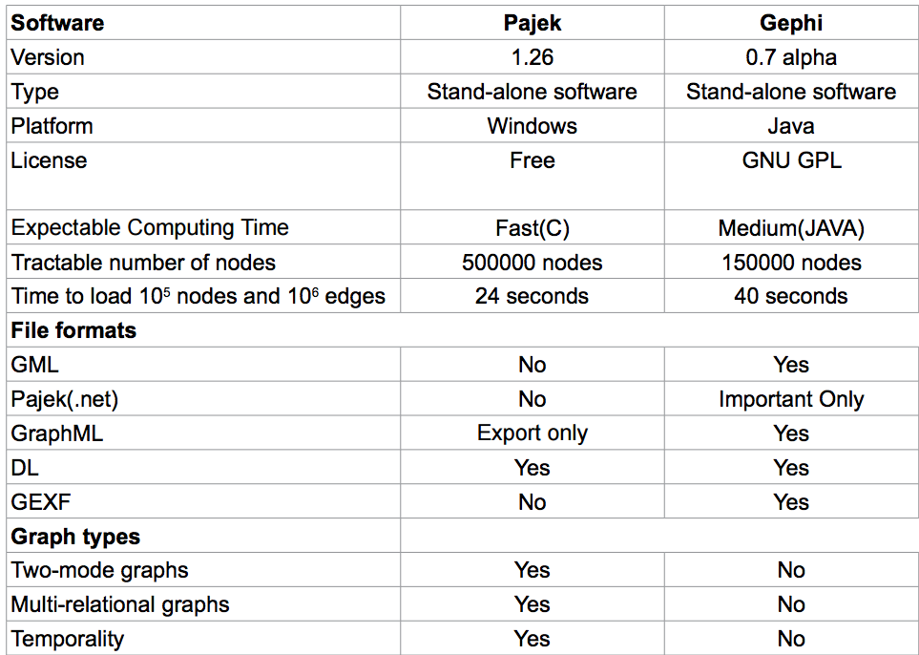
Comparative analysis of Social Networking Analysis tools
Source: Agrawal, H., Thakur, A., Slathia, R., & Sumangali, K. (2015). A Comparative Analysis of Social Networking Analysis Tools. J Inform Tech Softw Eng, 5(157), 2.

Slide 96
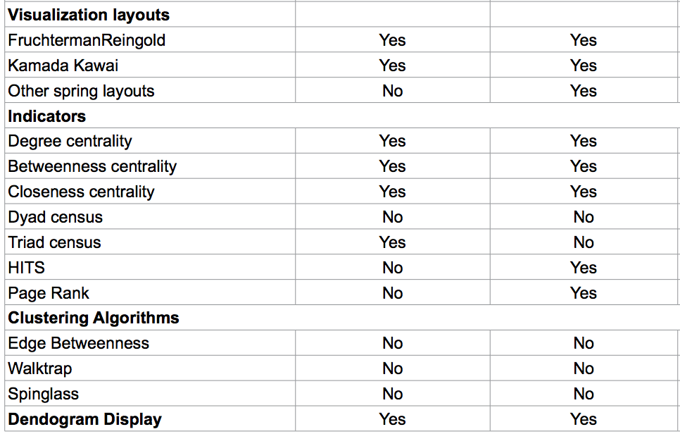
Comparative analysis of Social Networking Analysis tools
Source: Agrawal, H., Thakur, A., Slathia, R., & Sumangali, K. (2015). A Comparative Analysis of Social Networking Analysis Tools. J Inform Tech Softw Eng, 5(157), 2.

Slide 97
A Survey of Tools for Community Detection and Mining in Social Networks
(Maivizhi et al., 2016)
Tools | Pajek | Gephi | igraph
Version | 4.1 | 0.9.1 | 1.0.1
Website | vlado.fmf.uni­lj.si/pub/networks/pajek/ | gephi.org | igraph.org
Type | Software | Software | Library
Platform | Windows | Windows, Mac OS X, Linux | R, Python, C/C++
License | Free and Commercial | Open source and free | Open source and free
Number of nodes | 1 Billion | 0.6 Million | >1 Million
Computing Time | Medium | Fast | Fast
Source: Maivizhi, R., S. Sendhilkumar, and G. S. Mahalakshmi. "A Survey of Tools for Community Detection and Mining in Social Networks." In Proceedings of the International Conference on Informatics and Analytics, p. 71. ACM, 2016.

Slide 98
A Survey of Tools for Community Detection and Mining in Social Networks
(Maivizhi et al., 2016)
Network Type | Pajek | Gephi | igraph
1-mode network | Yes | Yes | Yes
2-mode network | Yes | Yes | Yes
Multi-relational network | Yes | No | No
Temporal (dynamic) network | Yes | No | No
Source: Maivizhi, R., S. Sendhilkumar, and G. S. Mahalakshmi. "A Survey of Tools for Community Detection and Mining in Social Networks." In Proceedings of the International Conference on Informatics and Analytics, p. 71. ACM, 2016.

Slide 99
A Survey of Tools for Community Detection and Mining in Social Networks
(Maivizhi et al., 2016)
File Format | Pajek | Gephi | igraph
.net | Yes | Yes | No
.gml | No | Yes | Yes
.graphml | No | Yes | Yes
.txt | No | No | Yes
.csv | No | Yes | Yes
.pajek | Yes | Import only | Yes
.dl | No | Yes | Import only
.graphdb | No | No | Yes
.dot | No | Yes | Export only
Source: Maivizhi, R., S. Sendhilkumar, and G. S. Mahalakshmi. "A Survey of Tools for Community Detection and Mining in Social Networks." In Proceedings of the International Conference on Informatics and Analytics, p. 71. ACM, 2016.

Slide 100
A Survey of Tools for Community Detection and Mining in Social Networks
(Maivizhi et al., 2016)
Visualization Layout | Pajek | Gephi | igraph
Kamada-kawai | Yes | No | Yes
Fruchterman-Reingold | Yes | Yes | Yes
Other spring layout | Yes | No | Yes
Circular layout | Yes | No | Yes
Random layout | Yes | Yes | Yes
Force atlas layout | Yes | Yes | Yes
Spectral layout | No | No | No
Tree layout | No | No | Yes
Source: Maivizhi, R., S. Sendhilkumar, and G. S. Mahalakshmi. "A Survey of Tools for Community Detection and Mining in Social Networks." In Proceedings of the International Conference on Informatics and Analytics, p. 71. ACM, 2016.

Slide 101
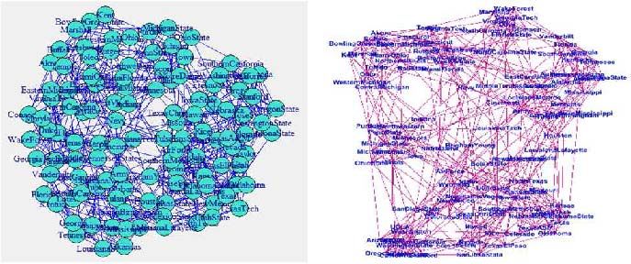
Visualization using igraph and Gephi
Visualization of American College Football using igraph with kamada-kawai layout.
Visualization of American College Football using Gephi with force-directed layout.
Source: Maivizhi, R., S. Sendhilkumar, and G. S. Mahalakshmi. "A Survey of Tools for Community Detection and Mining in Social Networks." In Proceedings of the International Conference on Informatics and Analytics, p. 71. ACM, 2016.

Slide 102
A Survey of Tools for Community Detection and Mining in Social Networks
(Maivizhi et al., 2016)
Network Metrics | Pajek | Gephi | igraph
Degree Centrality | Yes | Yes | Yes
Betweenness Centrality | Yes | Yes | Yes
Closeness Centrality | Yes | Yes | Yes
Network Diameter | Yes | Yes | Yes
Dyad Census | No | No | Yes
Triad Census | Yes | No | Yes
HITS | No | No | Yes
Page Rank | No | Yes | Yes
Source: Maivizhi, R., S. Sendhilkumar, and G. S. Mahalakshmi. "A Survey of Tools for Community Detection and Mining in Social Networks." In Proceedings of the International Conference on Informatics and Analytics, p. 71. ACM, 2016.

Slide 103
A Survey of Tools for Community Detection and Mining in Social Networks
(Maivizhi et al., 2016)
Community Algorithms | Pajek | Gephi | igraph
Louvain Method | Yes | Yes | Yes
Edge Betweenness | No | No | Yes
Greedy Method | No | No | Yes
Modularity Method | No | No | No
Clique Percolation Method | No | No | No
Label Propagation | No | No | Yes
Eigen Vector | No | No | Yes
Random Walk | No | No | Yes
Statistical Method | No | No | Yes
Source: Maivizhi, R., S. Sendhilkumar, and G. S. Mahalakshmi. "A Survey of Tools for Community Detection and Mining in Social Networks." In Proceedings of the International Conference on Informatics and Analytics, p. 71. ACM, 2016.

Slide 104
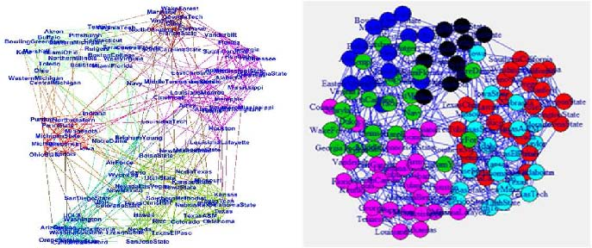
Community Detection using Gephi and igraph
Community detection using Gephi with Louvain method.
Community detection using igraph with Fast Greedy Algorithm.
Source: Maivizhi, R., S. Sendhilkumar, and G. S. Mahalakshmi. "A Survey of Tools for Community Detection and Mining in Social Networks." In Proceedings of the International Conference on Informatics and Analytics, p. 71. ACM, 2016.

Slide 105
Gephi

Slide 106
Gephi: Social Network Analysis and Visualization

Slide 107
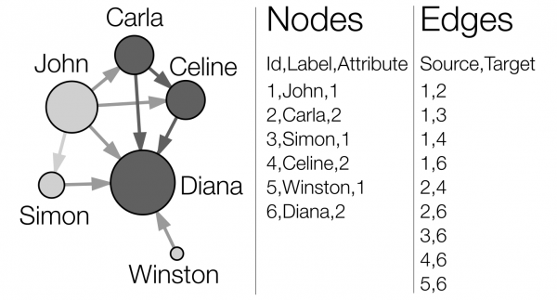
Network Analysis and Visualization with Gephi
Source: http://www.martingrandjean.ch/gephi-introduction/

Slide 108
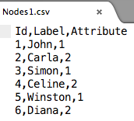
Nodes and Edges CSV Text Data for Gephi
Nodes1.csv
Edges1.csv
Id,Label,Attribute
1,John,1
2,Carla,2
3,Simon,1
4,Celine,2
5,Winston,1
6,Diana,2
Source,Target
1,2
1,3
1,4
1,6
2,4
2,6
3,6
4,6
5,6
Source: http://www.martingrandjean.ch/gephi-introduction/

Slide 109
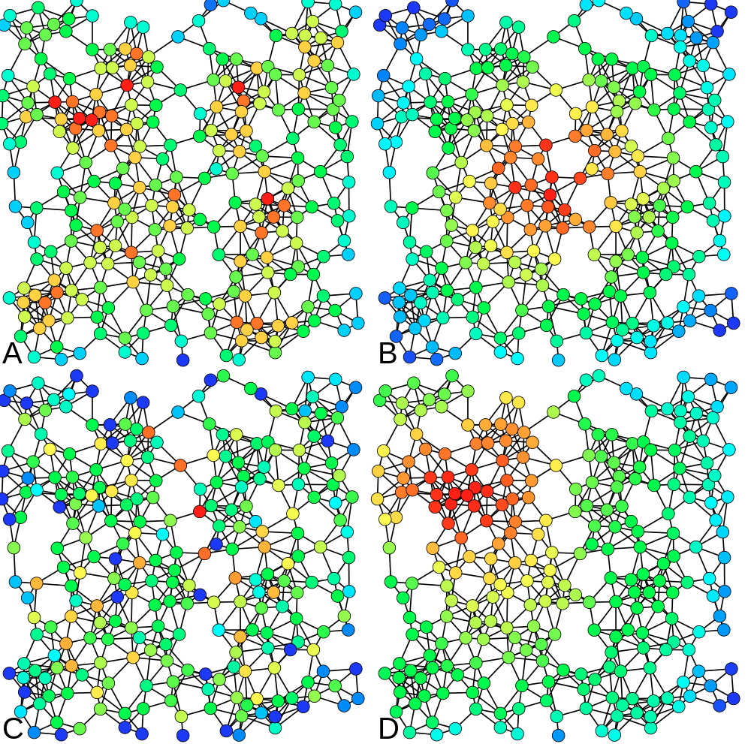
A = Degree centrality
number of connexions
B = Closeness centrality
closeness to the entire network
C = Betweenness centrality
bridges nodes
D = Eigenvector centrality
connection to well-connected nodes
Source: http://www.martingrandjean.ch/gephi-introduction/

Slide 110
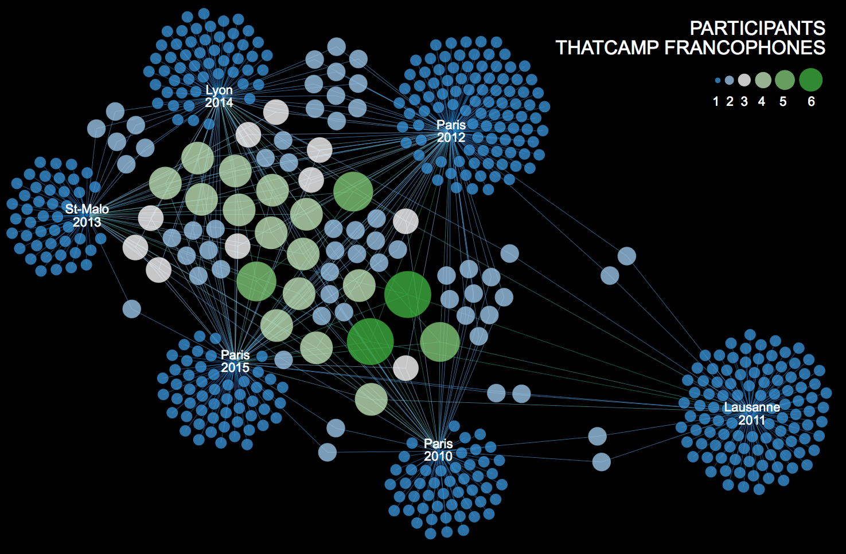
Conference Participants
Source: http://www.martingrandjean.ch/analyse-de-reseau-thatcamp-et-communaute-des-humanites-numeriques-francophones/

Slide 111
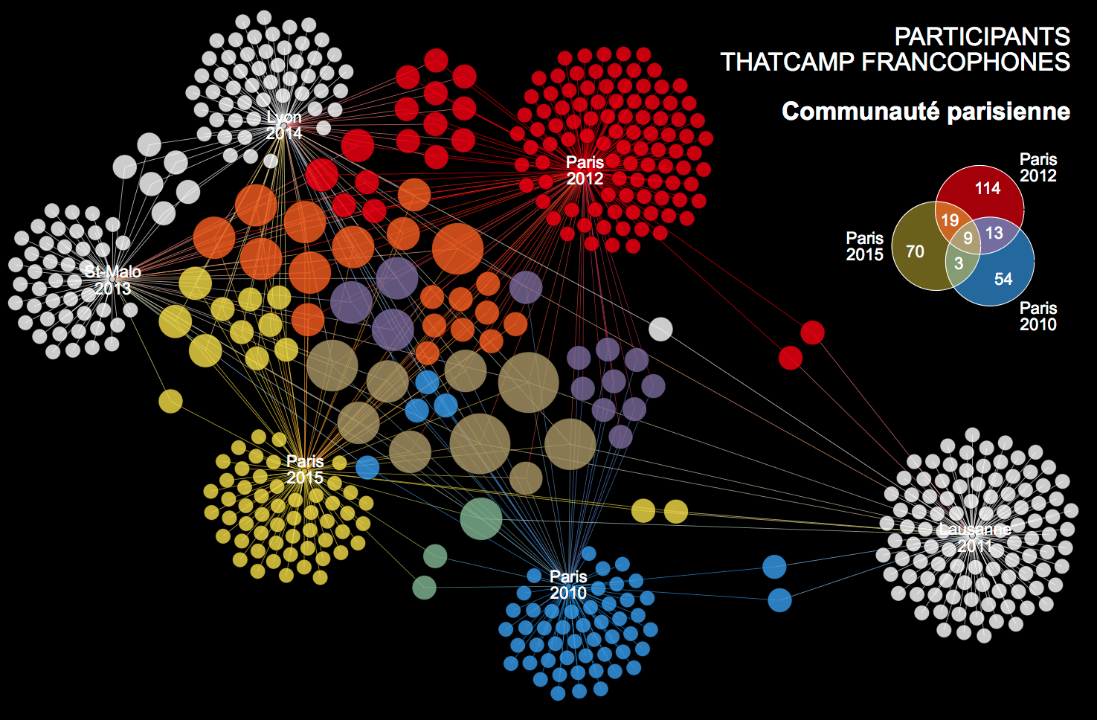
Conference Participants
Source: http://www.martingrandjean.ch/analyse-de-reseau-thatcamp-et-communaute-des-humanites-numeriques-francophones/

Slide 112
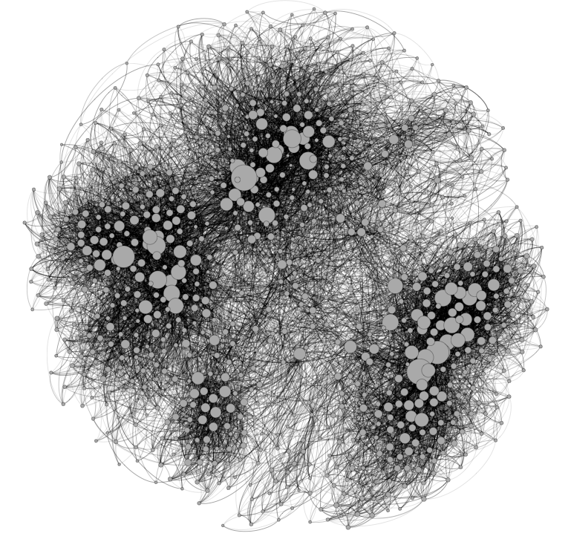
Fruchterman Reingold
Source: http://www.martingrandjean.ch/gephi-introduction/

Slide 113
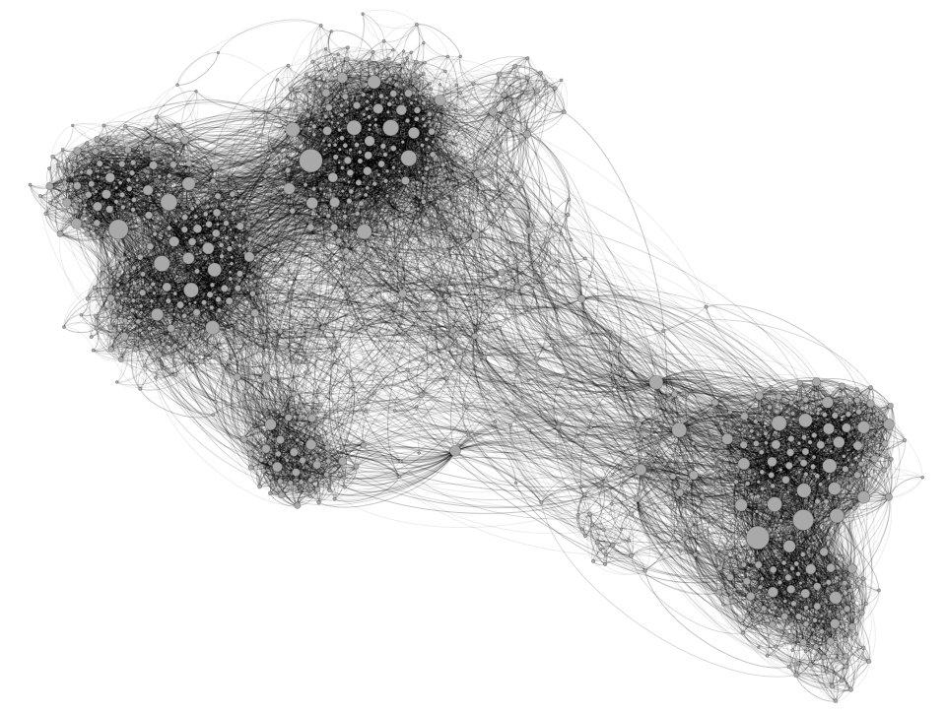
Force Atlas 2
Source: http://www.martingrandjean.ch/gephi-introduction/

Slide 114
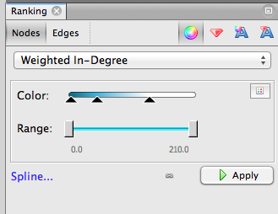
Nodes’ color Weighted In-Degree
Source: http://www.martingrandjean.ch/gephi-introduction/

Slide 115
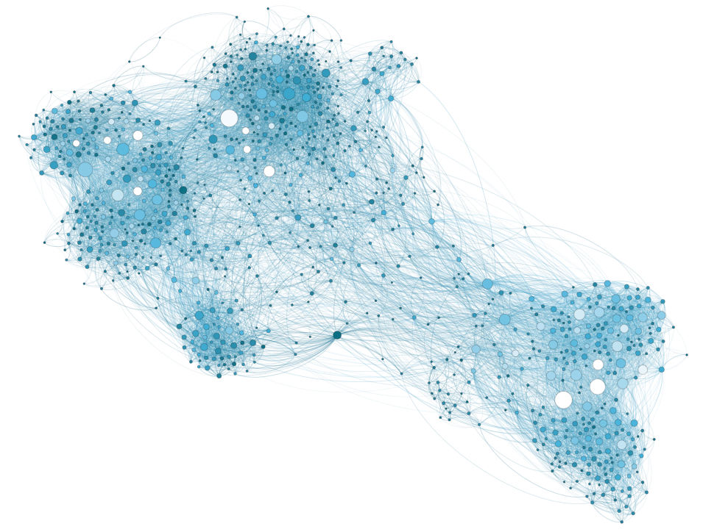
Weighted In-Degree
Source: http://www.martingrandjean.ch/gephi-introduction/

Slide 116
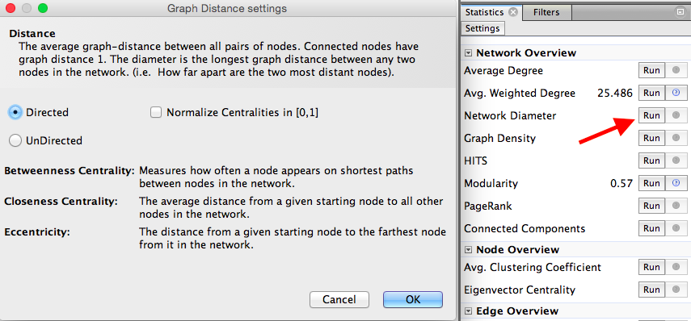
Network Diameter Betweenness Centrality Closeness Centrality
Source: http://www.martingrandjean.ch/gephi-introduction/

Slide 117
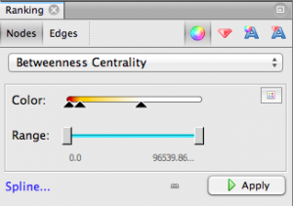
Nodes’ color Betweenness Centrality
Source: http://www.martingrandjean.ch/gephi-introduction/

Slide 118
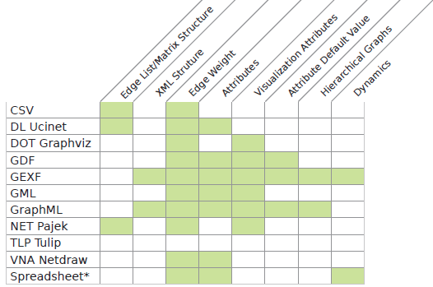
Gephi Supported Graph Formats
Source: https://gephi.org/users/supported-graph-formats/

Slide 119
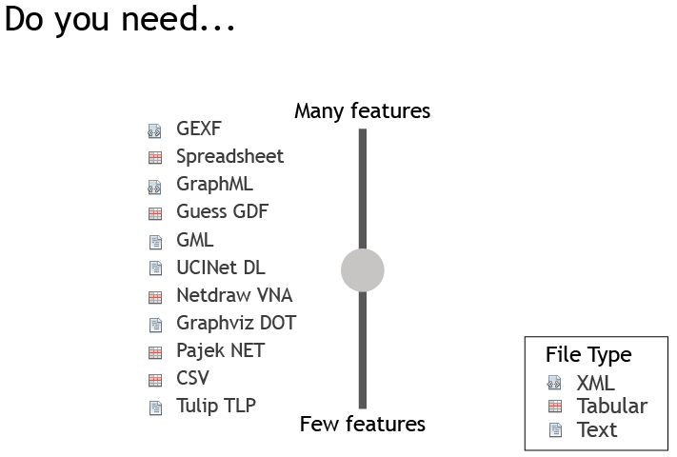
Gephi Supported Graph Formats
Source: https://gephi.org/users/supported-graph-formats/

Slide 120
Gephi
https://gephi.org/

Slide 121
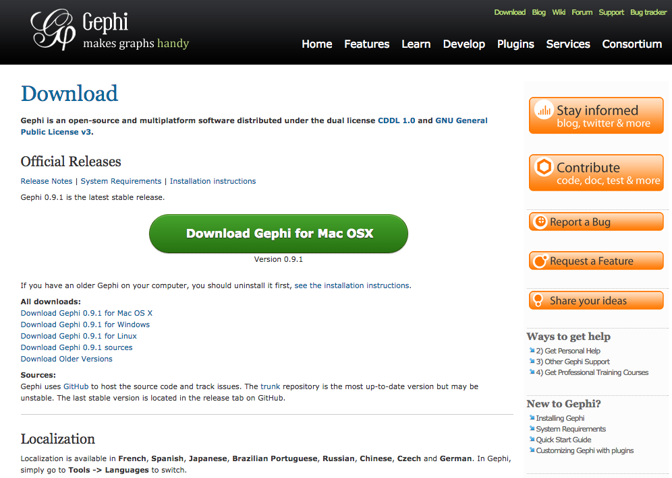
Download Gephi
https://gephi.org/users/download/

Slide 122
Download Gephi

Slide 123
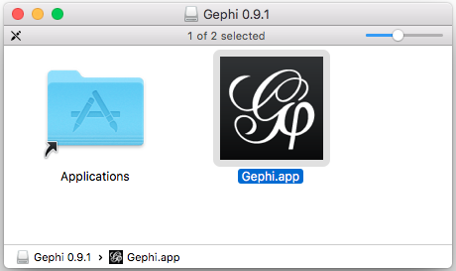
Gephi 0.9.1

Slide 124
Gephi

Slide 125
Gephi: New Project Import Nodes1.csv and Edges1.csv to Gephi

Slide 126
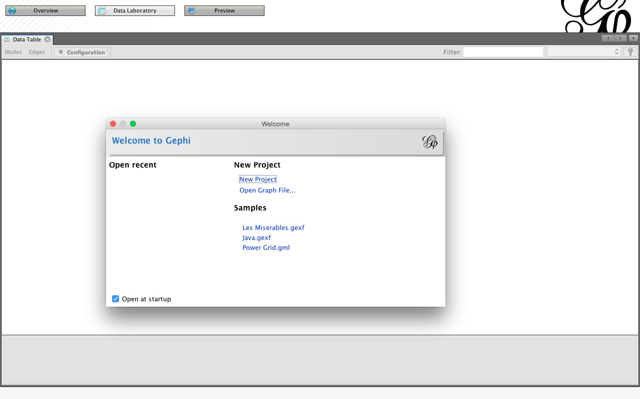
Gephi New Project

Slide 127
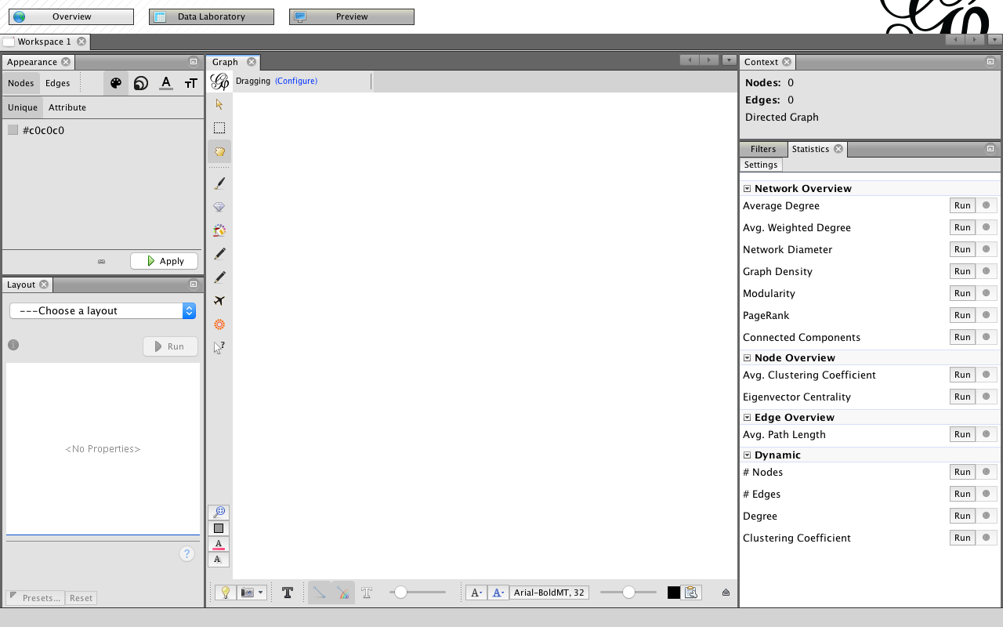
Gephi Overview
4. Context
1. Appearance
Nodes
Edges
3. Graph
2. Layout
5. Statistics
Filters

Slide 128
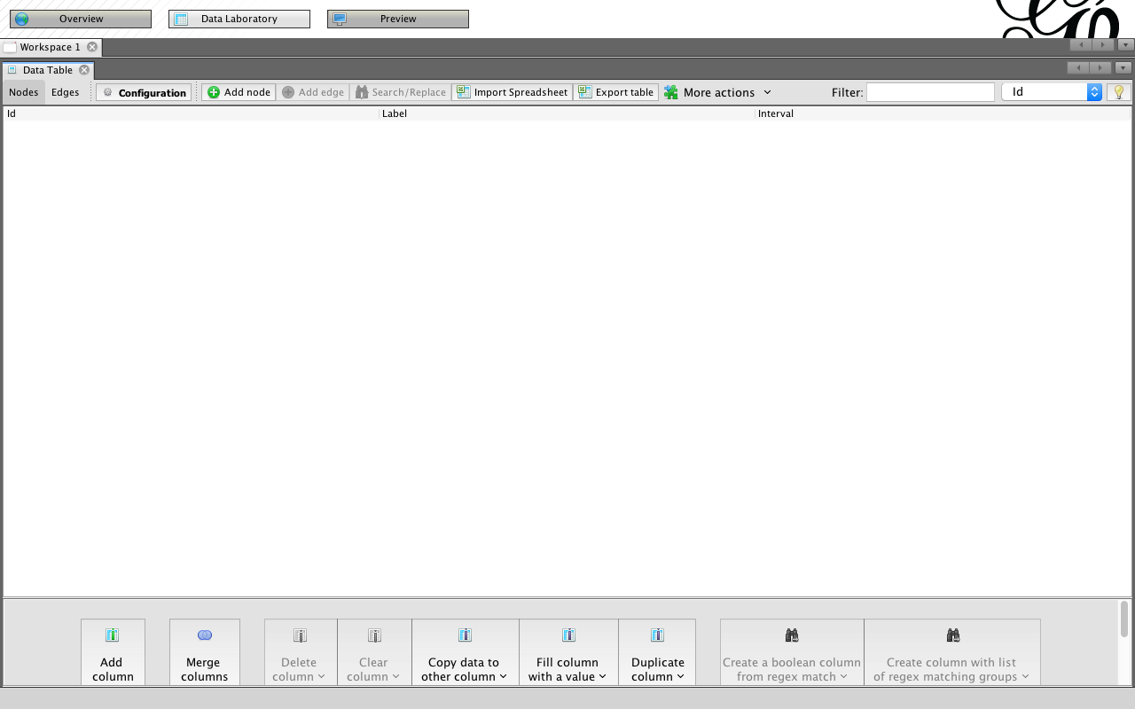
Gephi Data Laboratory: Import Spreadsheet

Slide 129
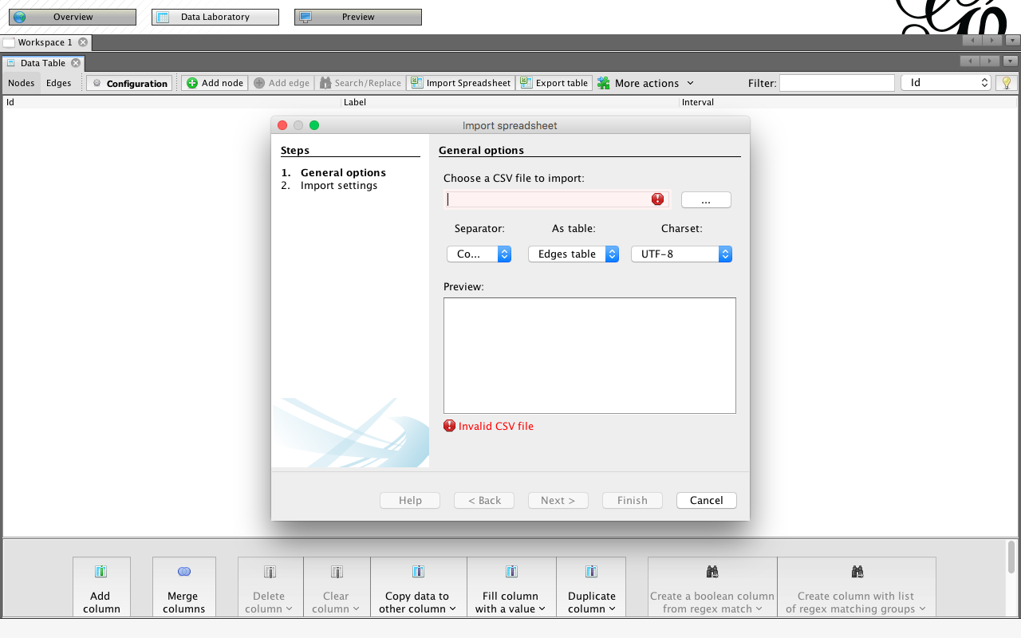
Gephi Data Laboratory: Import Spreadsheet

Slide 130
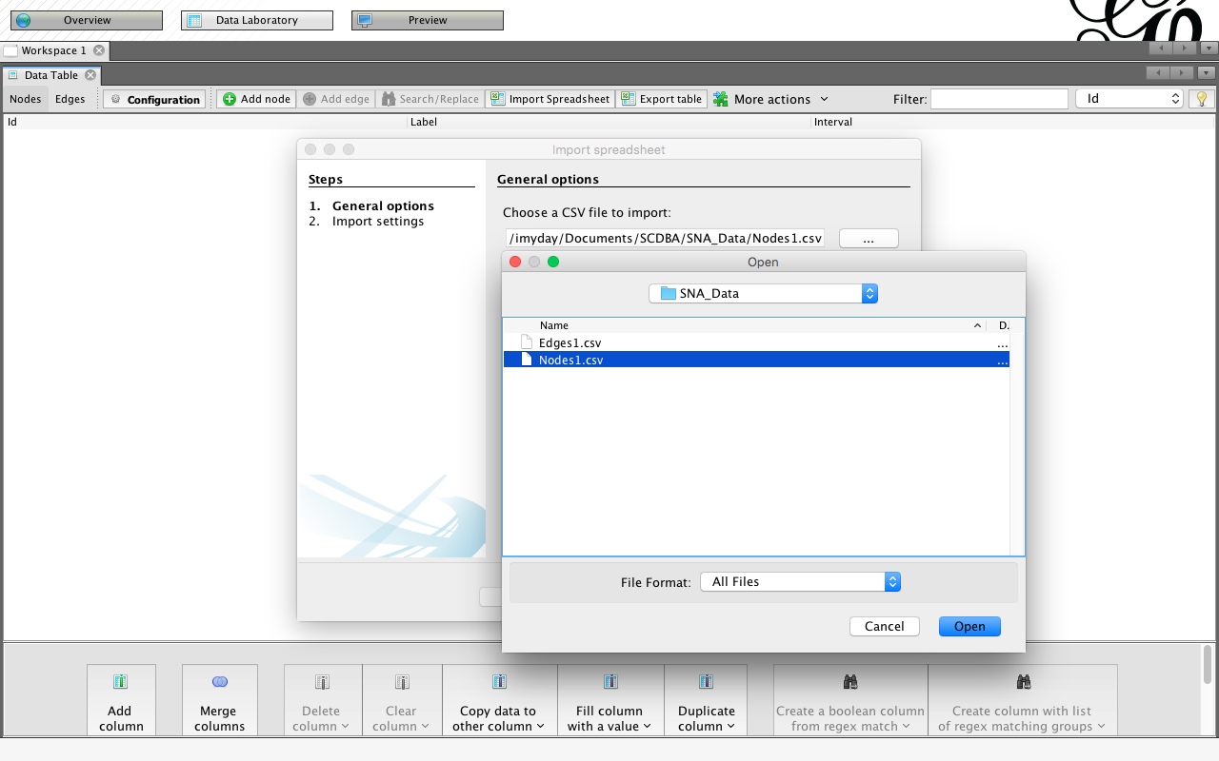
Import Nodes1.csv to Gephi
Nodes1.csv
Id,Label,Attribute
1,John,1
2,Carla,2
3,Simon,1
4,Celine,2
5,Winston,1
6,Diana,2

Slide 131
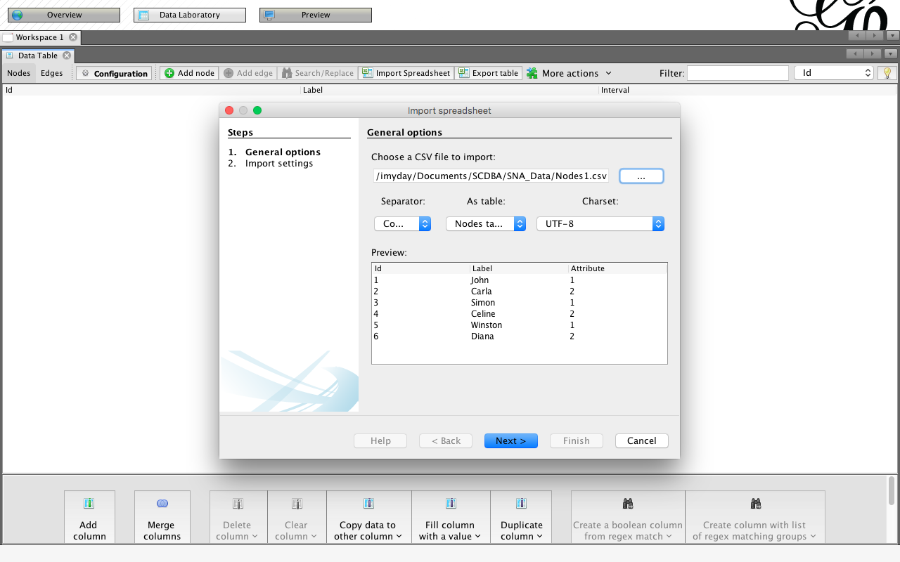
Import Nodes1.csv to Gephi

Slide 132
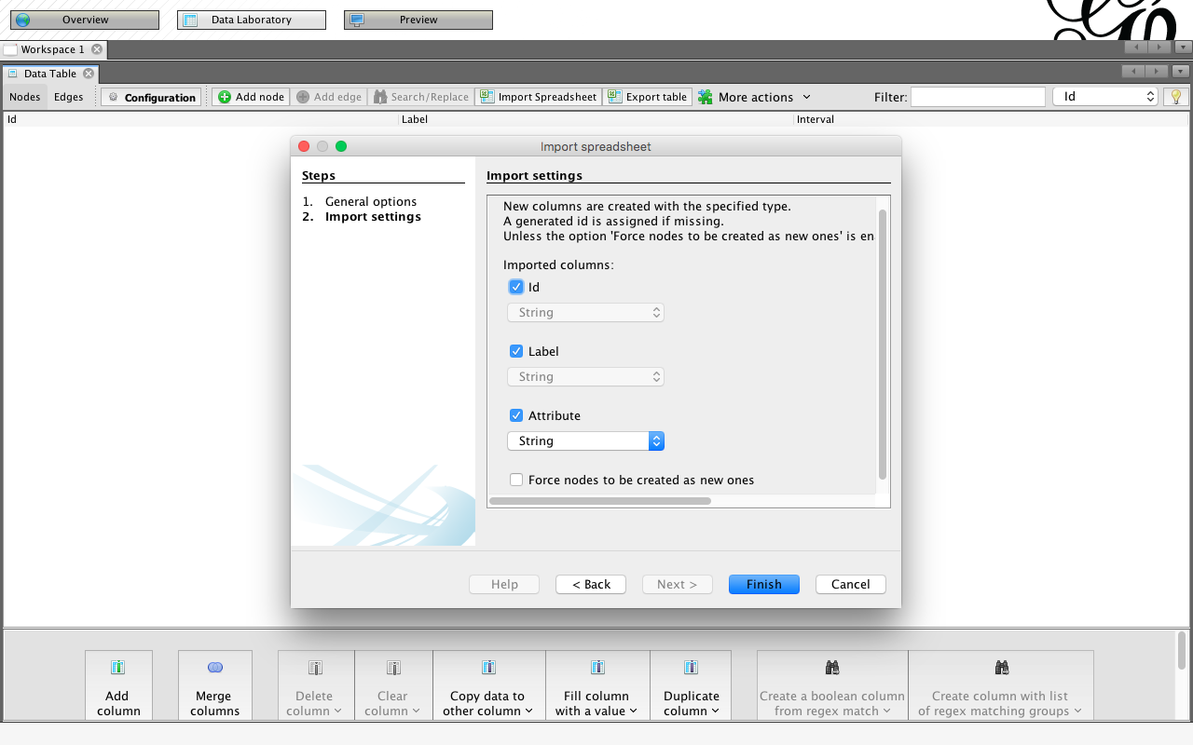
Import Nodes1.csv to Gephi

Slide 133
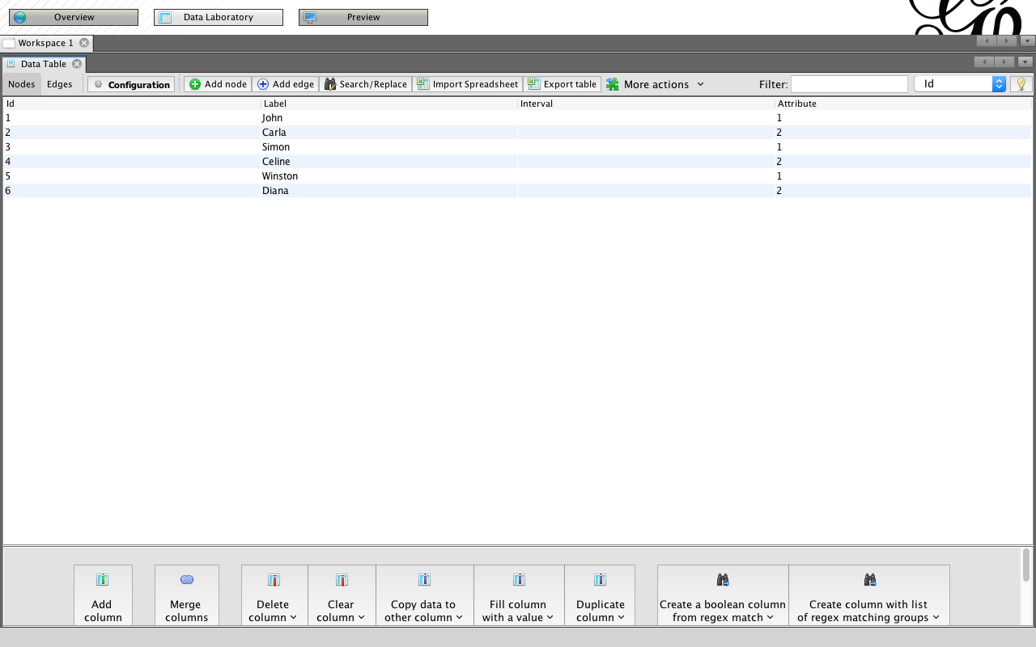
Import Nodes1.csv to Gephi
Nodes1.csv
Id,Label,Attribute
1,John,1
2,Carla,2
3,Simon,1
4,Celine,2
5,Winston,1
6,Diana,2

Slide 134
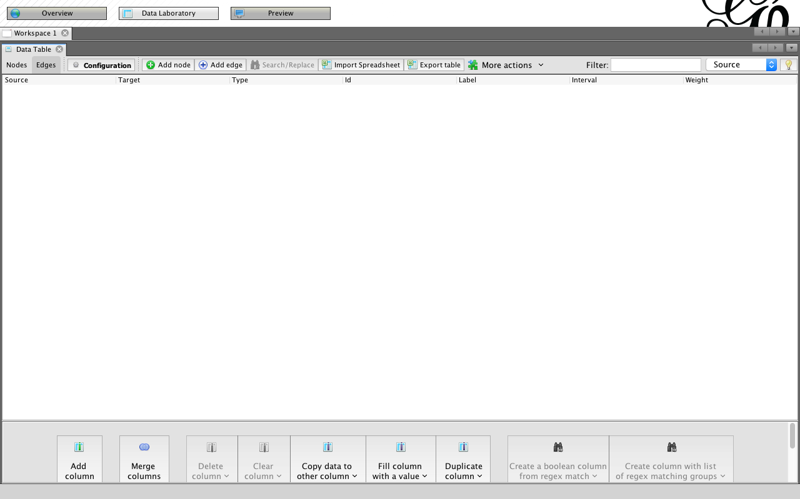
Import Edges1.csv to Gephi

Slide 135
Import Edges1.csv to Gephi
Edges1.csv
Source,Target
1,2
1,3
1,4
1,6
2,4
2,6
3,6
4,6
5,6

Slide 136
Import Edges1.csv to Gephi
Edges table

Slide 137
Import Edges1.csv to Gephi
Edges table

Slide 138
Import Edges1.csv to Gephi

Slide 139
Import Edges1.csv to Gephi

Slide 140
Gephi Overview

Slide 141
Gephi Overview: Graph

Slide 142
Gephi Overview: Layout

Slide 143
Gephi Overview: Layout Yifan Hu Proportional

Slide 144
Gephi Overview: Layout Yifan Hu

Slide 145
Appearance: Nodes Color

Slide 146
Nodes Color / Attribute / Apply

Slide 147
Show Node Labels

Slide 148
Show Node Labels

Slide 149
Show Labels

Slide 150
Global Edges Labels

Slide 151
Labels

Slide 152
Labels Node Size

Slide 153
Labels Node Font Size

Slide 154
Labels Node Size

Slide 155
Labels Scaled

Slide 156
Labels Color

Slide 157
Labels Color

Slide 158
Gephi Statistics: Average Degree

Slide 159
Gephi Statistics: Average Degree

Slide 160
Gephi Statistics: Avg. Weighted Degree

Slide 161
Gephi Statistics: Network Diameter

Slide 162
Gephi Statistics: Network Diameter

Slide 163
Gephi Statistics: Graph Density

Slide 164
Gephi Statistics: Modularity

Slide 165
Gephi Statistics: Modularity

Slide 166
Gephi Statistics: Connected Components

Slide 167
Gephi Statistics: Connected Components

Slide 168
Appearance Nodes Size

Slide 169
Appearance Nodes Size
Attribute / In-Degree

Slide 170
Appearance Nodes Size
Attribute / In-Degree / Min size / Max size / Apply

Slide 171
Appearance Edges
Attribute / Weight / Color

Slide 172
Appearance Edges
Attribute / Weight / Color / Apply

Slide 173
Gephi Data Laboratory

Slide 174
Gephi Preview

Slide 175
Gephi Preview: Show Labels

Slide 176
Gephi Preview: Default Straight

Slide 177
Gephi Preview: Default Straight

Slide 178
Gephi Preview: Export SVG/PDF/PNG

Slide 179
Open Gephi Samples

Slide 180
Gephi Samples

Slide 181
Gephi Samples Les Miserables.gexf

Slide 182
Gephi Import Report

Slide 183
Gephi Overview

Slide 184
Gephi Layout

Slide 185
Gephi Layout: Force Atlas

Slide 186
Gephi Layout: Contraction

Slide 187
Gephi Layout: Expansion

Slide 188
Gephi Layout: ForceAtlas 2

Slide 189
Gephi Layout: Fruchterman Reingold

Slide 190
Gephi Layout: OpenOrd

Slide 191
Gephi Layout: Yifan Hu

Slide 192
Gephi Layout: Yifan Hu Proportional

Slide 193
Gephi Data Laboratory: Nodes

Slide 194
Gephi Data Laboratory: Edges

Slide 195
Gephi Data Laboratory: Export table to CSV file

Slide 196
Gephi Preview

Slide 197
Gephi Preview: Export SVG/PDF/PNG

Slide 198
Gephi Overview: Text Labels

Slide 199
Gephi Overview: Text Labels

Slide 200
Application of SNA
Social Network Analysis of Research Collaboration in Information Reuse and Integration
Source: Min-Yuh Day, Sheng-Pao Shih, Weide Chang (2011), "Social Network Analysis of Research Collaboration in Information Reuse and Integration"

Slide 201
Example of SNA Data Source
Source: http://www.informatik.uni-trier.de/~ley/db/conf/iri/iri2010.html

Slide 202
Research Question
RQ1: What are the scientific collaboration patterns in the IRI research community?
RQ2: Who are the prominent researchers in the IRI community?
Source: Min-Yuh Day, Sheng-Pao Shih, Weide Chang (2011), "Social Network Analysis of Research Collaboration in Information Reuse and Integration"

Slide 203
Methodology
Developed a simple web focused crawler program to download literature information about all IRI papers published between 2003 and 2010 from IEEE Xplore and DBLP.
767 paper
1599 distinct author
Developed a program to convert the list of coauthors into the format of a network file which can be readable by social network analysis software.
UCINet and Pajek were used in this study for the social network analysis.
Source: Min-Yuh Day, Sheng-Pao Shih, Weide Chang (2011), "Social Network Analysis of Research Collaboration in Information Reuse and Integration"

Slide 204
Top10 prolific authors (IRI 2003-2010)
Stuart Harvey Rubin
Taghi M. Khoshgoftaar
Shu-Ching Chen
Mei-Ling Shyu
Mohamed E. Fayad
Reda Alhajj
Du Zhang
Wen-Lian Hsu
Jason Van Hulse
Min-Yuh Day
Source: Min-Yuh Day, Sheng-Pao Shih, Weide Chang (2011), "Social Network Analysis of Research Collaboration in Information Reuse and Integration"

Slide 205
Data Analysis and Discussion
Closeness Centrality
Collaborated widely
Betweenness Centrality
Collaborated diversely
Degree Centrality
Collaborated frequently
Visualization of Social Network Analysis
Insight into the structural characteristics of research collaboration networks
Source: Min-Yuh Day, Sheng-Pao Shih, Weide Chang (2011), "Social Network Analysis of Research Collaboration in Information Reuse and Integration"

Slide 206
Top 20 authors with the highest closeness scores
Rank | ID | Closeness | Author
1 | 3 | 0.024675 | Shu-Ching Chen
2 | 1 | 0.022830 | Stuart Harvey Rubin
3 | 4 | 0.022207 | Mei-Ling Shyu
4 | 6 | 0.020013 | Reda Alhajj
5 | 61 | 0.019700 | Na Zhao
6 | 260 | 0.018936 | Min Chen
7 | 151 | 0.018230 | Gordon K. Lee
8 | 19 | 0.017962 | Chengcui Zhang
9 | 1043 | 0.017962 | Isai Michel Lombera
10 | 1027 | 0.017962 | Michael Armella
11 | 443 | 0.017448 | James B. Law
12 | 157 | 0.017082 | Keqi Zhang
13 | 253 | 0.016731 | Shahid Hamid
14 | 1038 | 0.016618 | Walter Z. Tang
15 | 959 | 0.016285 | Chengjun Zhan
16 | 957 | 0.016285 | Lin Luo
17 | 956 | 0.016285 | Guo Chen
18 | 955 | 0.016285 | Xin Huang
19 | 943 | 0.016285 | Sneh Gulati
20 | 960 | 0.016071 | Sheng-Tun Li
Source: Min-Yuh Day, Sheng-Pao Shih, Weide Chang (2011), "Social Network Analysis of Research Collaboration in Information Reuse and Integration"

Slide 207
Top 20 authors with the highest betweeness scores
Rank | ID | Betweenness | Author
1 | 1 | 0.000752 | Stuart Harvey Rubin
2 | 3 | 0.000741 | Shu-Ching Chen
3 | 2 | 0.000406 | Taghi M. Khoshgoftaar
4 | 66 | 0.000385 | Xingquan Zhu
5 | 4 | 0.000376 | Mei-Ling Shyu
6 | 6 | 0.000296 | Reda Alhajj
7 | 65 | 0.000256 | Xindong Wu
8 | 19 | 0.000194 | Chengcui Zhang
9 | 39 | 0.000185 | Wei Dai
10 | 15 | 0.000107 | Narayan C. Debnath
11 | 31 | 0.000094 | Qianhui Althea Liang
12 | 151 | 0.000094 | Gordon K. Lee
13 | 7 | 0.000085 | Du Zhang
14 | 30 | 0.000072 | Baowen Xu
15 | 41 | 0.000067 | Hongji Yang
16 | 270 | 0.000060 | Zhiwei Xu
17 | 5 | 0.000043 | Mohamed E. Fayad
18 | 110 | 0.000042 | Abhijit S. Pandya
19 | 106 | 0.000042 | Sam Hsu
20 | 8 | 0.000042 | Wen-Lian Hsu
Source: Min-Yuh Day, Sheng-Pao Shih, Weide Chang (2011), "Social Network Analysis of Research Collaboration in Information Reuse and Integration"

Slide 208
Top 20 authors with the highest degree scores
Rank | ID | Degree | Author
1 | 3 | 0.035044 | Shu-Ching Chen
2 | 1 | 0.034418 | Stuart Harvey Rubin
3 | 2 | 0.030663 | Taghi M. Khoshgoftaar
4 | 6 | 0.028786 | Reda Alhajj
5 | 8 | 0.028786 | Wen-Lian Hsu
6 | 10 | 0.024406 | Min-Yuh Day
7 | 4 | 0.022528 | Mei-Ling Shyu
8 | 17 | 0.021277 | Richard Tzong-Han Tsai
9 | 14 | 0.017522 | Eduardo Santana de Almeida
10 | 16 | 0.017522 | Roumen Kountchev
11 | 40 | 0.016896 | Hong-Jie Dai
12 | 15 | 0.015645 | Narayan C. Debnath
13 | 9 | 0.015019 | Jason Van Hulse
14 | 25 | 0.013767 | Roumiana Kountcheva
15 | 28 | 0.013141 | Silvio Romero de Lemos Meira
16 | 24 | 0.013141 | Vladimir Todorov
17 | 23 | 0.013141 | Mariofanna G. Milanova
18 | 5 | 0.013141 | Mohamed E. Fayad
19 | 19 | 0.012516 | Chengcui Zhang
20 | 18 | 0.011890 | Waleed W. Smari
Source: Min-Yuh Day, Sheng-Pao Shih, Weide Chang (2011), "Social Network Analysis of Research Collaboration in Information Reuse and Integration"

Slide 209
Visualization of IRI (IEEE IRI 2003-2010) co-authorship network (global view)
Source: Min-Yuh Day, Sheng-Pao Shih, Weide Chang (2011), "Social Network Analysis of Research Collaboration in Information Reuse and Integration"

Slide 210
Source: Min-Yuh Day, Sheng-Pao Shih, Weide Chang (2011), "Social Network Analysis of Research Collaboration in Information Reuse and Integration"

Slide 211
Visualization of Social Network Analysis
Source: Min-Yuh Day, Sheng-Pao Shih, Weide Chang (2011), "Social Network Analysis of Research Collaboration in Information Reuse and Integration"

Slide 212
Visualization of Social Network Analysis
Source: Min-Yuh Day, Sheng-Pao Shih, Weide Chang (2011), "Social Network Analysis of Research Collaboration in Information Reuse and Integration"

Slide 213
Visualization of Social Network Analysis
Source: Min-Yuh Day, Sheng-Pao Shih, Weide Chang (2011), "Social Network Analysis of Research Collaboration in Information Reuse and Integration"

Slide 214
Summary
Social Computing and Social Network Analysis (SNA)
Social Network Analysis with Gephi
Applications of SNA

Slide 215
References
Jennifer Golbeck (2013), Analyzing the Social Web, Morgan Kaufmann http://analyzingthesocialweb.com/course-materials.shtml
Devangana Khokhar (2015), Gephi Cookbook, Packt Publishing
Mehmet Kaya, Jalal Kawash, Suheil Khoury, Min-Yuh Day (2018), Social Network Based Big Data Analysis and Applications, Springer
Sentinel Visualizer, http://www.fmsasg.com/SocialNetworkAnalysis/
Eduardo Z. Milian, Mauro de M. Spinola, and Marly M. de Carvalho (2019). "Fintechs: A literature review and research agenda." Electronic Commerce Research and Applications, 34, 100833.
Min-Yuh Day, Sheng-Pao Shih, Weide Chang (2011), "Social Network Analysis of Research Collaboration in Information Reuse and Integration," The First International Workshop on Issues and Challenges in Social Computing (WICSOC 2011), August 2, 2011, in Proceedings of the IEEE International Conference on Information Reuse and Integration (IEEE IRI 2011), Las Vegas, Nevada, USA, August 3-5, 2011, pp. 551-556.
Bastian M., Heymann S., Jacomy M. (2009), “Gephi: an open source software for exploring and manipulating networks”, International AAAI Conference on Weblogs and Social Media.
Agrawal, H., Thakur, A., Slathia, R., & Sumangali, K. (2015). A Comparative Analysis of Social Networking Analysis Tools. J Inform Tech Softw Eng, 5(157), 2.
Naheed Akhtar (2014), "Social network analysis tools." In 2014 Fourth International Conference on Communication Systems and Network Technologies (CSNT)
Maivizhi, R., S. Sendhilkumar, G. S. Mahalakshmi (2016), "A Survey of Tools for Community Detection and Mining in Social Networks." In Proceedings of the International Conference on Informatics and Analytics, p. 71. ACM, 2016.
Aurélien Géron (2019), Hands-On Machine Learning with Scikit-Learn, Keras, and TensorFlow: Concepts, Tools, and Techniques to Build Intelligent Systems, 2nd Edition, O’Reilly Media.
Min-Yuh Day (2021), Python 101, https://tinyurl.com/aintpupython101

