Slide 1
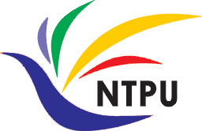
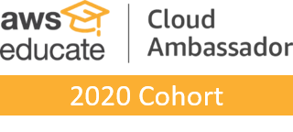
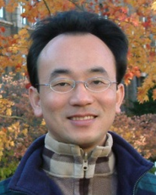
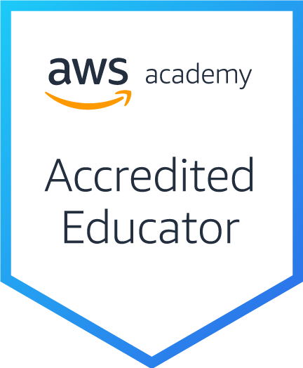
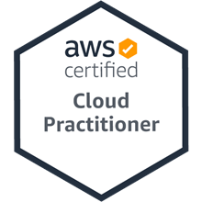
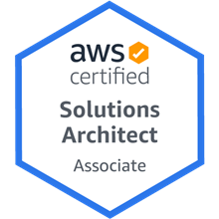
軟體工程 (Software Engineering)
基於雲的軟體： 虛擬化和容器、軟體即服務 (Cloud-Based Software: Virtualization and containers, Everything as a service, Software as a service)
1101SE06
MBA, IM, NTPU (M6131) (Fall 2021) Thu 11, 12, 13 (19:25-22:10) (209)
Min-Yuh Day
戴敏育
Associate Professor
副教授
Institute of Information Management, National Taipei University
國立臺北大學 資訊管理研究所
https://web.ntpu.edu.tw/~myday
2021/11/04

Slide 2
課程大綱 (Syllabus)
週次 (Week) 日期 (Date) 內容 (Subject/Topics)
1 2021/09/23 軟體工程概論 (Introduction to Software Engineering)
2 2021/09/30 軟體產品與專案管理：軟體產品管理，原型設計 (Software Products and Project Management: Software product management and prototyping)
3 2021/10/07 敏捷軟體工程：敏捷方法、Scrum、極限程式設計 (Agile Software Engineering: Agile methods, Scrum, and Extreme Programming)
4 2021/10/14 功能、場景和故事 (Features, Scenarios, and Stories)
5 2021/10/21 軟體工程個案研究 I (Case Study on Software Engineering I)
6 2021/10/28 軟體架構：架構設計、系統分解、分散式架構 (Software Architecture: Architectural design, System decomposition, and Distribution architecture)

Slide 3
課程大綱 (Syllabus)
週次 (Week) 日期 (Date) 內容 (Subject/Topics)
7 2021/11/04 基於雲的軟體：虛擬化和容器、軟體即服務 (Cloud-Based Software: Virtualization and containers, Everything as a service, Software as a service)
8 2021/11/11 期中報告 (Midterm Project Report)
9 2021/11/18 雲端運算與雲軟體架構 (Cloud Computing and Cloud Software Architecture)
10 2021/11/25 微服務架構：RESTful服務、服務部署 (Microservices Architecture, RESTful services, Service deployment)
11 2021/12/02 軟體工程產業實務 (Industry Practices of Software Engineering)
12 2021/12/09 軟體工程個案研究 II (Case Study on Software Engineering II)

Slide 4
課程大綱 (Syllabus)
週次 (Week) 日期 (Date) 內容 (Subject/Topics)
13 2021/12/16 安全和隱私 (Security and Privacy); 可靠的程式設計 (Reliable Programming)
14 2021/12/23 測試：功能測試、測試自動化、 測試驅動的開發、程式碼審查 (Testing: Functional testing, Test automation, Test-driven development, and Code reviews); DevOps和程式碼管理：程式碼管理和DevOps自動化 (DevOps and Code Management: Code management and DevOps automation)
15 2021/12/30 期末報告 I (Final Project Report I)
16 2022/01/06 期末報告 II (Final Project Report II)
17 2022/01/13 學生自主學習 (Self-learning)
18 2022/01/20 學生自主學習 (Self-learning)

Slide 5
Software Engineering and Project Management
Analyze
Requirements definition
Design
System and Software design
Build
Implementation and
unit testing
Test
Integration and system testing
Deliver
Operation and maintenance
Project Management

Slide 6
Project-based software engineering
CUSTOMER
Problem
generates
helps-with
Requirements
implemented-by
Software
1
CUSTOMER and DEVELOPER
DEVELOPER

Slide 7
Product software engineering
DEVELOPER
Opportunity
1
inspires
realizes
Product features
implemented-by
Software
DEVELOPER
DEVELOPER

Slide 8
Software execution models
Stand-alone execution
Hybrid execution
Software as a service
User’s computer
User’s computer
User’s computer
User interface
Product functionality
User data
User interface
Partial functionality
User data
User interface
(browser or app)
Product updates
Additional functionality
User data backups
Product updates
Product functionality
User data
Vendor’s servers
Vendor’s servers
Vendor’s servers

Slide 9
Product management concerns
Business needs
Product manager
Technology constraints
Customer experience

Slide 10
Technical interactions of product managers
Product vision management
Product backlog management
User stories and scenarios
Product manager
Acceptance testing
Customer testing
User interface design

Slide 11
Software Development Life Cycle (SDLC) The waterfall model
Requirements definition
System and Software design
Implementation and unit testing
Integration and system testing
Operation and maintenance

Slide 12
Plan-based and Agile development
Plan-based development
Requirements engineering
Requirements specification
Design and implementation
Requirements change requests
Agile development
Requirements engineering
Design and implementation

Slide 13
The Continuum of Life Cycles
High
Incremental
Agile
Frequency of Delivery
Predictive
Iterative
Low
Low
High
Degree of Change

Slide 14
Predictive Life Cycle
Analyze
Design
Build
Test
Deliver

Slide 15
Iterative Life Cycle
Prototype
Refine
Analyze
Analyze
Design
Build
Test
Deliver

Slide 16
A Life Cycle of Varying-Sized Increments
Analyze
Design
Build
Test
Deliver
Analyze
Design
Build
Test
Deliver
Analyze
Design
Build
Test
Deliver

Slide 17
Iteration-Based and Flow-Based Agile Life Cycles
Iteration-Based Agile
Requirements
Analysis
Design
Build
Test
Requirements
Analysis
Design
Build
Test
Requirements
Analysis
Design
Build
Test
Requirements
Analysis
Design
Build
Test
Repeat as needed
…
Requirements
Analysis
Design
Build
Test
Requirements
Analysis
Design
Build
Test
Flow-Based Agile
Requirements
Analysis
Design
Build
Test
the number of features in the WIP limit
Requirements
Analysis
Design
Build
Test
the number of features in the WIP limit
Requirements
Analysis
Design
Build
Test
the number of features in the WIP limit
Repeat as needed
…
Requirements
Analysis
Design
Build
Test
the number of features in the WIP limit
Requirements
Analysis
Design
Build
Test
the number of features in the WIP limit

Slide 18
From personas to features
1
Personas
A way of representing users
inspire
Natural language descriptions of a user interacting with a software product
2
Scenarios
are-developed-into
3
inspire
Stories
Natural language descriptions of something that is needed or wanted by users
4
Features
define
Fragments of product functionality

Slide 19
Multi-tier client-server architecture
Client 1
Client 2
Web Server
Application Server
Database Server
Client 3
Client …

Slide 20
Service-oriented Architecture
Client 1
S1
S2
Client 2
S3
Web Server
Service gateway
S4
Client 3
S5
Client …
S6
Services

Slide 21
VM
Container
Virtual web server
Virtual mail server
User 1 Container 1
User 2 Container 2
Server software
Server software
Application software
Application software
Guest OS
Guest OS
Server software
Server software
Hypervisor
Container manager
Host OS
Host OS
Server Hardware
Server Hardware

Slide 22
Everything as a service
Photo editing
Software as a service (SaaS)
Logistics management
Cloud management Monitoring
Platform as a service (PaaS)
Database
Software development
Storage Network
Infrastructure as a service (IaaS)
Computing Virtualization
Cloud data center

Slide 23
Software as a service
Software customers
Software provider
Software services
Cloud Infrastructure
Cloud provider

Slide 24
Microservices architecture – key design questions
What are the microservices that make up the system?
How should data be distributed and shared?
How should microservices communicate with each other?
Microservices architecture
design
How should the microservices in the system be coordinated?
How should service failure be detected, reported and managed?

Slide 25
Types of security threat
An attacker attempts to deny access to the system for legitimate users
An attacker attempts to damage the system or its data
Availability
threats
Integrity
threats
SOFTWARE PRODUCT
PROGRAM
Distributed denial of service (DDoS) attack
Virus
DATA
Ransomware
Data theft
Confidentiality threats
An attacker tries to gain access to private information held by the system

Slide 26
Software product quality attributes
Reliability
Availability
1
2
Software product quality attributes
Security
Resilience
7
3
Usability
Maintainability
6
4
Responsiveness
5

Slide 27
A refactoring process
1
2
Start
Identify code ‘smell’
Identify refactoring strategy
4
3
Run automated code tests
Make small
improvement until strategy completed

Slide 28
Functional testing
Start
1
Unit Testing
4
2
Release Testing
Feature Testing
3
System Testing

Slide 29
Test-driven development (TDD)
Start
1
Identify new functionality
2
Identify partial implementation
of functionality
3
Write code stub that will fail test
Functionality complete
Functionality incomplete
4
Run all automated test
7
Refactor code if required
5
Implement code that should cause failing test to pass
Test failure
6
Run all automated test
All tests pass

Slide 30
DevOps
Development
Deployment
Support
Multi-skilled DevOps team

Slide 31
Code management and DevOps
DevOps automation
Continuous integration
Continuous deployment
Continuous delivery
Infrastructure as code
Code management system
Branching and merging
Recover version information
Code repository
Save and retrieve versions
Transfer code to/from developer’s filestore
DevOps measurement
Data collection
Data analysis
Report generation

Slide 32
Cloud-Based Software: Virtualization and containers, Everything as a service, Software as a service

Slide 33
The cloud
The cloud is made up of very large number of remote servers that are offered for rent by companies that own these servers.
Cloud-based servers are ‘virtual servers’, which means that they are implemented in software rather than hardware.

Slide 34
The cloud
You can rent as many servers as you need, run your software on these servers and make them available to your customers.
Cloud servers can be started up and shut down as demand changes.
You may rent a server and install your own software, or you may pay for access to software products that are available on the cloud.

Slide 35
Cloud Software: Scaleability, elasticity and resilience
Scaleability
Maintain performance as load increases
Elasticity
Adapt the server configuration to changing demands
Cloud software
characteristics
Resilience
Maintain service in the event of server failure

Slide 36
Scaleability
Scaleability reflects the ability of your software to cope with increasing numbers of users.
As the load on your software increases, your software automatically adapts so that the system performance and response time is maintained.

Slide 37
Elasticity
Elasticity is related to scaleability but also allows for scaling-down as well as scaling-up.
You can monitor the demand on your application and add or remove servers dynamically as the number of users change.

Slide 38
Resilience
Resilience means that you can design your software architecture to tolerate server failures.
You can make several copies of your software concurrently available. If one of these fails, the others continue to provide a service.

Slide 39
Benefits of using the cloud for software development
Cost You avoid the initial capital costs of hardware procurement
Startup time Using the cloud, you can have servers up and running in a few minutes.
Server choice If you find that the servers you are renting are not powerful enough, you can upgrade to more powerful systems. You can add servers for short-term requirements, such as load testing.
Distributed development If you have a distributed development team, working from different locations, all team members have the same development environment and can seamlessly share all information.

Slide 40
Virtual cloud servers
A virtual server runs on an underlying physical computer and is made up of an operating system plus a set of software packages that provide the server functionality required.
A virtual server is a stand-alone system that can run on any hardware in the cloud.
This ‘run anywhere’ characteristic is possible because the virtual server has no external dependencies.

Slide 41
Virtual cloud servers
Virtual machines (VMs), running on physical server hardware, can be used to implement virtual servers.
A hypervisor provides hardware emulation that simulates the operation of the underlying hardware.
If you use a virtual machine to implement virtual servers, you have exactly the same hardware platform as a physical server.

Slide 42
Implementing a virtual server as a Virtual Machine (VM)
Virtual web server
Virtual mail server
Apache
Web Server
Server software
Server software
Outlook
Guest OS
Guest OS
Linux
Windows Server
Hypervisor
Host OS
Server Hardware

Slide 43
Container-based virtualization
If you are running a cloud-based system with many instances of applications or services, these all use the same operating system, you can use a simpler virtualization technology called ‘containers’.
Using containers accelerates the process of deploying virtual servers on the cloud.
Containers are usually megabytes in size whereas VMs are gigabytes.
Containers can be started and shut down in a few seconds rather than the few minutes required for a VM.

Slide 44
Container-based virtualization
Containers are an operating system virtualization technology that allows independent servers to share a single operating system.
They are particularly useful for providing isolated application services where each user sees their own version of an application.

Slide 45
Using containers to provide isolated services
User 1 Container 1
User 2 Container 2
Graphic design Software
Application software
Application software
Graphic design Software
Graphics libraries Photo Manager
Graphics libraries Photo Manager
Server software
Server software
Container manager
Host OS
Server Hardware

Slide 46
VM
Container
Virtual web server
Virtual mail server
User 1 Container 1
User 2 Container 2
Server software
Server software
Application software
Application software
Guest OS
Guest OS
Server software
Server software
Hypervisor
Container manager
Host OS
Host OS
Server Hardware
Server Hardware

Slide 47
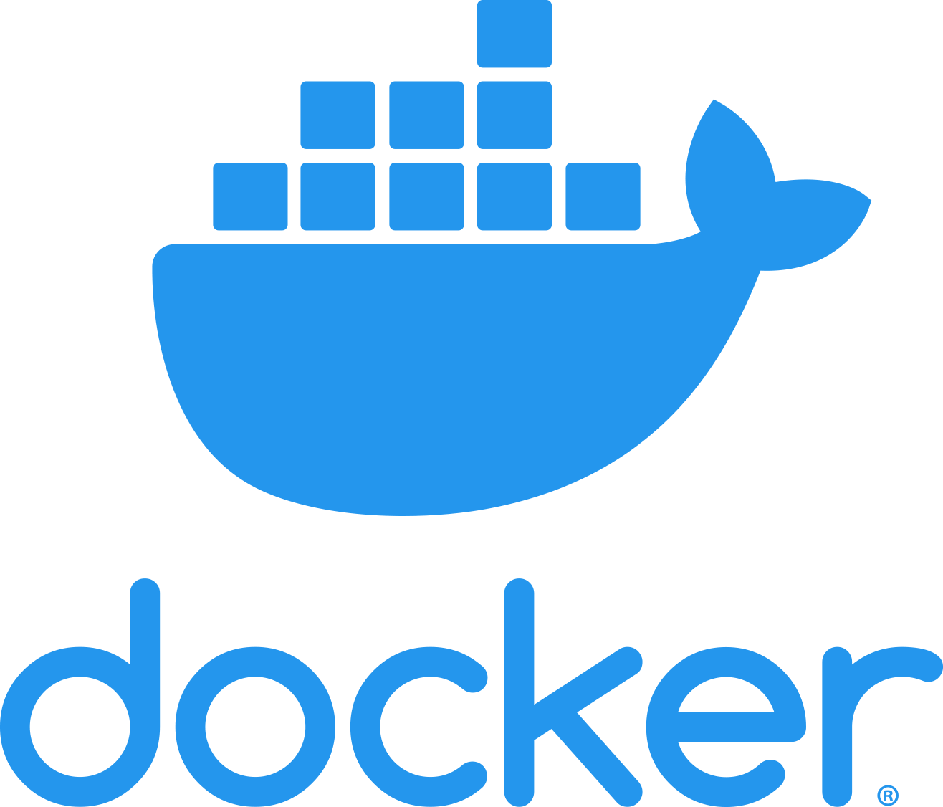
Docker
Containers were developed by Google around 2007 but containers became a mainstream technology around 2015.
An open-source project called Docker provided a standard means of container management that is fast and easy to use.
Docker is a container management system that allows users to define the software to be included in a container as a Docker image.
It also includes a run-time system that can create and manage containers using these Docker images.

Slide 48
The Docker container system
Registries
Docker hub
Images
Images
Images
Docker client
Docker Daemon
Containers
Dockerfiles
Docker host

Slide 49
The elements of the Docker container system
Docker daemon This is a process that runs on a host server and is used to setup, start, stop, and monitor containers, as well as building and managing local images.
Docker client This software is used by developers and system managers to define and control containers

Slide 50
The elements of the Docker container system
Dockerfiles Dockerfiles define runnable applications (images) as a series of setup commands that specify the software to be included in a container. Each container must be defined by an associated Dockerfile.
Image A Dockerfile is interpreted to create a Docker image, which is a set of directories with the specified software and data installed in the right places. Images are set up to be runnable Docker applications.

Slide 51
The elements of the Docker container system
Docker hub This is a registry of images that has been created. These may be reused to setup containers or as a starting point for defining new images.
Containers Containers are executing images. An image is loaded into a container and the application defined bby the image starts execution. Containers may be moved from server to server without modification and replicated across many servers. You can make changes to a Docker container (e.g. by modifying files) but you then must commit these changes to create a new image and restart the container.

Slide 52
Docker images
Docker images are directories that can be archived, shared and run on different Docker hosts. Everything that’s needed to run a software system - binaries, libraries, system tools, etc. is included in the directory.
A Docker image is a base layer, usually taken from the Docker registry, with your own software and data added as a layer on top of this.
The layered model means that updating Docker applications is fast and efficient. Each update to the filesystem is a layer on top of the existing system.
To change an application, all you have to do is to ship the changes that you have made to its image, often just a small number of files.

Slide 53
Benefits of containers
They solve the problem of software dependencies.
You don’t have to worry about the libraries and other software on the application server being different from those on your development server.
Instead of shipping your product as stand-alone software, you can ship a container that includes all of the support software that your product needs.

Slide 54
Benefits of containers
They provide a mechanism for software portability across different clouds.
Docker containers can run on any system or cloud provider where the Docker daemon is available
They provide an efficient mechanism for implementing software services and so support the development of service-oriented architectures.
They simplify the adoption of DevOps.
This is an approach to software support where the same team are responsible for both developing and supporting operational software.

Slide 55
Everything as a service
Photo editing
Software as a service (SaaS)
Logistics management
Cloud management Monitoring
Platform as a service (PaaS)
Database
Software development
Storage Network
Infrastructure as a service (IaaS)
Computing Virtualization
Cloud data center

Slide 56
Everything as a service
The idea of a service that is rented rather than owned is fundamental to cloud computing.
Infrastructure as a service (IaaS)
Platform as a service (PaaS)
Software as a service (SaaS)

Slide 57
Infrastructure as a service (IaaS)
Infrastructure as a service (IaaS)
Cloud providers offer different kinds of infrastructure service such as a compute service, a network service and a storage service that you can use to implement virtual servers.

Slide 58
Platform as a service (PaaS)
Platform as a service (PaaS)
This is an intermediate level where you use libraries and frameworks provided by the cloud provider to implement your software. These provide access to a range of functions, including SQL and NoSQL databases.

Slide 59
Software as a service (SaaS)
Software as a service (SaaS)
Your software product runs on the cloud and is accessed by users through a web browser or mobile app.

Slide 60
Management responsibilities for IaaS and PaaS
Managed by software provider
Software as a Service
(SaaS)
Managed by software provider
Managed by software provider
Application Services
(database etc.)
Application Services
(database etc.)
Managed by Cloud vendor
Managed by software provider
Cloud management Services
Cloud management Services
Managed by Cloud vendor
Managed by Cloud vendor
Basic Computational Services
Basic Computational Services
Managed by Cloud vendor
Infrastructure as a Service
(IaaS)
Platform as a Service
(PaaS)

Slide 61
Software as a service
Increasingly, software products are being delivered as a service, rather than installed on the buyer’s computers.
If you deliver your software product as a service, you run the software on your servers, which you may rent from a cloud provider.
Customers don’t have to install software and they access the remote system through a web browser or dedicated mobile app.
The payment model for software as a service is usually a subscription model.
Users pay a monthly fee to use the software rather than buy it outright.

Slide 62
Software as a service
Software customers
Software provider
Software services
Cloud Infrastructure
Cloud provider

Slide 63
Benefits of SaaS for software product providers
Cash flow Customers either pay a regular subscription or pay as they use the software. This means you have a regular cash flow, with payments throughout the year. You don’t have a situation where you have a large cash injection when products are purchased but very little income between product releases.
Update management You are in control of updates to your product and all customers receive the update at the same time. You avoid the issue of several versions being simultaneously used and maintained. This reduces your costs and makes it easier to maintain a consistent software code base.
Continuous deployment You can deploy new versions of your software as soon as changes have been made and tested. This means you can fix bugs quickly so that your software reliability can continuously improve.

Slide 64
Benefits of SaaS for software product providers
Payment flexibility You can have several different payment options so that you can attract a wider range of customers. Small companies or individuals need not be discouraged by having to pay large upfront software costs.
Try before you buy You can make early free or low-cost versions of the software available quickly with the aim of getting customer feedback on bugs and how the product could be approved.
Data collection You can easily collect data on how the product is used and so identify areas for improvement. You may also be able to collect customer data that allows you to market other products to these customers.

Slide 65
Advantages and disadvantages of SaaS for customers
Advantages
No upfront costs
for software or servers
Reduced software management costs
Mobile, laptop and desktop access
Immediate software updates
Software customer
Disadvantages
Privacy regulation conformance
Network constraints
Lost of control over updates
Service lock-in
Security concerns
Data exchange

Slide 66
Data storage and management issues for SaaS
Regulation Some countries, such as EU countries, have strict laws on the storage of personal information. These may be incompatible with the laws and regulations of the country where the SaaS provider is based. If a SaaS provider cannot guarantee that their storage locations conform to the laws of the customer’s country, businesses may be reluctant to use their product.
Data transfer If software use involves a lot of data transfer, the software response time may be limited by the network speed. This is a problem for individuals and smaller companies who can’t afford to pay for very high speed network connections.

Slide 67
Data storage and management issues for SaaS
Data security Companies dealing with sensitive information may be unwilling to hand over the control of their data to an external software provider. As we have seen from a number of high profile cases, even large cloud providers have had security breaches. You can’t assume that they always provide better security than the customer’s own servers.
Data exchange If you need to exchange data between a cloud service and other services or local software applications, this can be difficult unless the cloud service provides an API that is accessible for external use.

Slide 68
Design issues for software delivered as a service
Local/remote
processing
Authentication
SaaS
design issue
Information leakage
Multitenant or
multi-instance
database
management

Slide 69
Multi-tenant systems
A multi-tenant database is partitioned so that customer companies have their own space and can store and access their own data.
There is a single database schema, defined by the SaaS provider, that is shared by all of the system’s users.
Items in the database are tagged with a tenant identifier, representing a company that has stored data in the system. The database access software uses this tenant identifier to provide ‘logical isolation’, which means that users seem to be working with their own database.

Slide 70
Possible customisations for SaaS
Authentication Businesses may want users to authenticate using their business credentials rather than the account credentials set up by the software provider.
Branding Businesses may want a user interface that is branded to reflect their own organisation.

Slide 71
Possible customisations for SaaS
Business rules Businesses may want to be able to define their own business rules and workflows that apply to their own data.
Data schemas Businesses may want to be able to extend the standard data model used in the system database to meet their own business needs.
Access control Businesses may want to be able to define their own access control model that sets out the data that specific users or user groups can access and the allowed operations on that data.

Slide 72
Advantages of multi-tenant databases
Resource utilization The SaaS provider has control of all the resources used by the software and can optimize the software to make effective use of these resources.
Security Multitenant databases have to be designed for security because the data for all customers is held in the same database. They are, therefore, likely to have fewer security vulnerabilities than standard database products. Security management is simplified as there is only a single copy of the database software to be patched if a security vulnerability is discovered.
Update management It is easier to update a single instance of software rather than multiple instances. Updates are delivered to all customers at the same time so all use the latest version of the software.

Slide 73
Disadvantages of multi-tenant databases
Inflexibility Customers must all use the same database schema with limited scope for adapting this schema to individual needs. I explain possible database adaptations later in this section.
Security As data for all customers is maintained in the same database, then there is a theoretical possibility that data will leak from one customer to another. In fact, there are very few instances of this happening. More seriously, perhaps, if there is a database security breach then it affects all customers.
Complexity Multitenant systems are usually more complex than multi-instance systems because of the need to manage many users. There is, therefore, an increased likelihood of bugs in the database software.

Slide 74
User profiles for SaaS access
co1 user
co1 user
co1 user
Profile co1
co6 user
Profile co2
Profile co6
co6 user
SaaS
application
co3 user
Profile co3
Profile co5
co3 user
Profile co4
co3 user
co4 user
co4 user
co4 user
co4 user

Slide 75
Architectural decisions for cloud software engineering
Database organization
Scalability and resilience
Software structure
Should the software use a multitenant or multi-instance database?
What are the software scalability and resilience requirements?
Should the software structure be monolithic or service-oriented?
What cloud platform should be used for development and delivery?
Cloud platform

Slide 76
Questions to ask when choosing a database organization
Target customers
Transaction requirements
Database size and connectivity
Database interoperability
System structure

Slide 77
Questions to ask when choosing a database organization
Target customers Do customers require different database schemas and database personalization? Do customers have security concerns about database sharing? If so, use a multi-instance database.
Transaction requirements Is it critical that your products support ACID transactions where the data is guaranteed to be consistent at all times? If so, use a multi-tenant database or a VM-based multi-instance database.

Slide 78
Questions to ask when choosing a database organization
Database size and connectivity How large is the typical database used by customers? How many relationships are there between database items? A multi-tenant model is usually best for very large databases as you can focus effort on optimizing performance.
Database interoperability Will customers wish to transfer information from existing databases? What are the differences in schemas between these and a possible multitenant database? What software support will they expect to do the data transfer? If customers have many different schemas, a multi-instance database should be used.

Slide 79
Questions to ask when choosing a database organization
System structure Are you using a service-oriented architecture for your system? Can customer databases be split into a set of individual service databases? If so, use containerized, multi-instance databases.

Slide 80
Scalability and resilience
The scalability of a system reflects its ability to adapt automatically to changes in the load on that system.
The resilience of a system reflects its ability to continue to deliver critical services in the event of system failure or malicious system use.

Slide 81
Scalability and resilience
You achieve scalability in a system by making it possible to add new virtual servers (scaling-out) or increase the power of a system server (scaling-up) in response to increasing load.
In cloud-based systems, scaling-out rather than scaling-up is the normal approach used. Your software has to be organized so that individual software components can be replicated and run in parallel.
To achieve resilience, you need to be able to restart your software quickly after a hardware or software failure.

Slide 82
Using a standby system to provide resilience
System monitor
Location A
Location B
Active system
Standby system
Database mirror
Database 1
Database 2

Slide 83
Resilience
Resilience relies on redundancy:
Replicas of the software and data are maintained in different locations.
Database updates are mirrored so that the standby database is a working copy of the operational database.
A system monitor continually checks the system status. It can switch to the standby system automatically if the operational system fails.

Slide 84
Resilience
You should use redundant virtual servers that are not hosted on the same physical computer and locate servers in different locations.
Ideally, these servers should be located in different data centers.
If a physical server fails or if there is a wider data center failure, then operation can be switched automatically to the software copies elsewhere.

Slide 85
System structure
An object-oriented approach to software engineering has been that been extensively used for the development of client-server systems built around a shared database.
The system itself is, logically, a monolithic system with distribution across multiple servers running large software components. The traditional multi-tier client server architecture is based on this distributed system model.

Slide 86
System structure
The alternative to a monolithic approach to software organization is a service-oriented approach where the system is decomposed into fine-grain, stateless services.
Because it is stateless, each service is independent and can be replicated, distributed and migrated from one server to another.
The service-oriented approach is particularly suitable for cloud-based software, with services deployed in containers.

Slide 87
Cloud platform
Cloud platforms include general-purpose clouds such as Amazon Web Services or lesser known platforms oriented around a specific application, such as the SAP Cloud Platform. There are also smaller national providers that provide more limited services but who may be more willing to adapt their services to the needs of different customers.
There is no ‘best’ platform and you should choose a cloud provider based on your background and experience, the type of product that you are developing and the expectations of your customers.
You need to consider both technical issues and business issues when choosing a cloud platform for your product.

Slide 88
Technical issues in cloud platform choice
Expected load and load predictability
Resilience
Cloud
platform
choice
Supported cloud services
Privacy and data protection

Slide 89
Business issues in cloud platform choice
Cost
Business issues
Developer experience
Target customers
Service-level agreements
Portability and cloud migration

Slide 90
Summary
The cloud is made up of a large number of virtual servers that you can rent for your own use. You and your customers access these servers remotely over the internet and pay for the amount of server time used.
Virtualization is a technology that allows multiple server instances to be run on the same physical computer. This means that you can create isolated instances of your software for deployment on the cloud.

Slide 91
Summary
Virtual machines are physical server replicas on which you run your own operating system, technology stack and applications.
Containers are a lightweight virtualization technology that allow rapid replication and deployment of virtual servers. All containers run the same operating system. Docker is currently the most widely used container technology.

Slide 92
Summary
A fundamental feature of the cloud is that ‘everything’ can be delivered as a service and accessed over the internet. A service is rented rather than owned and is shared with other users.

Slide 93
Summary
Infrastructure as a service (IaaS) means computing, storage and other services are available over the cloud. There is no need to run your own physical servers.
Platform as a service (PaaS) means using services provided by a cloud platform vendor to make it possible to auto-scale your software in response to demand.
Software as a service (SaaS) means that application software is delivered as a service to users. This has important benefits for users, such as lower capital costs, and software vendors, such as simpler deployment of new software releases.

Slide 94
Summary
Multitenant systems are SaaS systems where all users share the same database, which may be adapted at run-time to their individual needs. Multi-instance systems are SaaS applications where each user has their own separate database.
The key architectural issues for cloud-based software are the cloud platform to be used, whether to use a multitenant or multi-instance database, the scaleability and resilience requirements, and whether to use objects or services as the basic components in the system.

Slide 95
References
Ian Sommerville (2019), Engineering Software Products: An Introduction to Modern Software Engineering, Pearson.
Ian Sommerville (2015), Software Engineering, 10th Edition, Pearson.
Titus Winters, Tom Manshreck, and Hyrum Wright (2020), Software Engineering at Google: Lessons Learned from Programming Over Time, O'Reilly Media.
Project Management Institute (2021), A Guide to the Project Management Body of Knowledge (PMBOK Guide) – Seventh Edition and The Standard for Project Management, PMI
Project Management Institute (2017), A Guide to the Project Management Body of Knowledge (PMBOK Guide), Sixth Edition, Project Management Institute
Project Management Institute (2017), Agile Practice Guide, Project Management Institute

