Slide 1
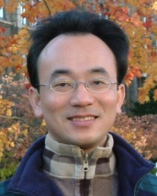
Natural Language Processing with Transformers
Artificial Intelligence for Text Analytics
1102AITA04
MBA, IM, NTPU (M5026) (Spring 2022) Tue 2, 3, 4 (9:10-12:00) (B8F40)
Min-Yuh Day, Ph.D, Associate Professor
Institute of Information Management, National Taipei University
https://web.ntpu.edu.tw/~myday
https://meet.google.com/paj-zhhj-mya
2022-03-15

Slide 2
Syllabus
Week Date Subject/Topics
1 2022/02/22 Introduction to Artificial Intelligence for Text Analytics
2 2022/03/01 Foundations of Text Analytics: Natural Language Processing (NLP)
3 2022/03/08 Python for Natural Language Processing
4 2022/03/15 Natural Language Processing with Transformers
5 2022/03/22 Case Study on Artificial Intelligence for Text Analytics I
6 2022/03/29 Text Classification and Sentiment Analysis

Slide 3
Syllabus
Week Date Subject/Topics
7 2022/04/05 Tomb-Sweeping Day (Holiday, No Classes)
8 2022/04/12 Midterm Project Report
9 2022/04/19 Multilingual Named Entity Recognition (NER), Text Similarity and Clustering
10 2022/04/26 Text Summarization and Topic Models
11 2022/05/03 Text Generation
12 2022/05/10 Case Study on Artificial Intelligence for Text Analytics II

Slide 4
Syllabus
Week Date Subject/Topics
13 2022/05/17 Question Answering and Dialogue Systems
14 2022/05/24 Deep Learning, Transfer Learning, Zero-Shot, and Few-Shot Learning for Text Analytics
15 2022/05/31 Final Project Report I
16 2022/06/07 Final Project Report II
17 2022/06/14 Self-learning
18 2022/06/21 Self-learning

Slide 5
Natural Language Processing with Transformers

Slide 6
Outline
Natural Language Processing with Transformers
Transformer (Attention is All You Need)
Encoder-Decoder
Attention Mechanisms
Transfer Learning in NLP
BERT: Pre-training of Deep Bidirectional Transformers for Language Understanding

Slide 7
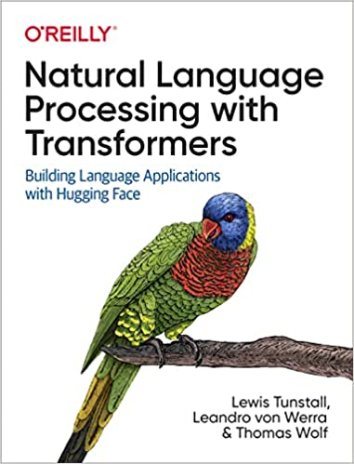
Lewis Tunstall, Leandro von Werra, and Thomas Wolf (2022), Natural Language Processing with Transformers: Building Language Applications with Hugging Face, O'Reilly Media.
Source: https://www.amazon.com/Natural-Language-Processing-Transformers-Applications/dp/1098103246

Slide 8
The Transformers Timeline
ULMFit
BERT
RoBERTa
XLM-R
DeBERTa
GPT-Neo
T5
Transformer
GPT
GPT-2
DistrilBERT
GPT-3
GPT-J
2017
2018
2019
2020
2021
2022
Source: Lewis Tunstall, Leandro von Werra, and Thomas Wolf (2022), Natural Language Processing with Transformers: Building Language Applications with Hugging Face, O'Reilly Media.

Slide 9
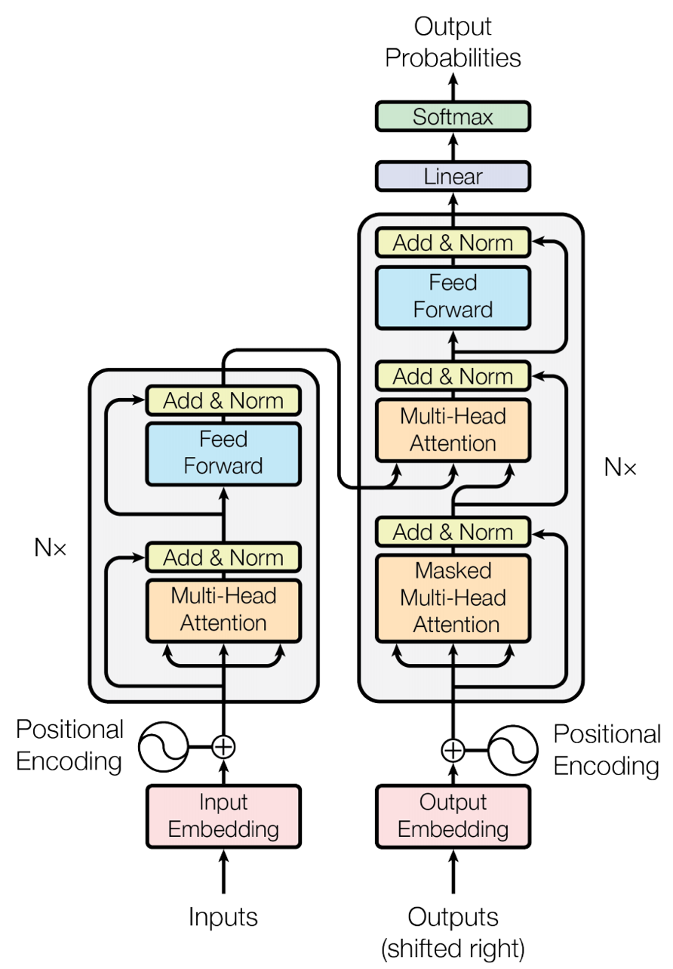
Transformer (Attention is All You Need) (Vaswani et al., 2017)
Source: Vaswani, Ashish, Noam Shazeer, Niki Parmar, Jakob Uszkoreit, Llion Jones, Aidan N. Gomez, Łukasz Kaiser, and Illia Polosukhin. "Attention is all you need." In Advances in neural information processing systems, pp. 5998-6008. 2017.

Slide 10
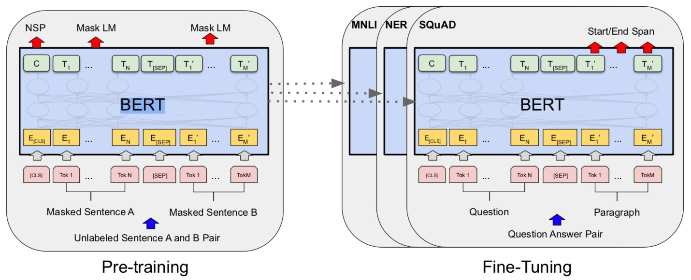
BERT: Pre-training of Deep Bidirectional Transformers for Language Understanding
BERT (Bidirectional Encoder Representations from Transformers)
Overall pre-training and fine-tuning procedures for BERT
Source: Devlin, Jacob, Ming-Wei Chang, Kenton Lee, and Kristina Toutanova (2018). "Bert: Pre-training of deep bidirectional transformers for language understanding." arXiv preprint arXiv:1810.04805.

Slide 11
BERT: Pre-training of Deep Bidirectional Transformers for Language Understanding
Source: Devlin, Jacob, Ming-Wei Chang, Kenton Lee, and Kristina Toutanova (2018). "BERT: Pre-training of Deep Bidirectional Transformers for Language Understanding." arXiv preprint arXiv:1810.04805

Slide 12
BERT Bidirectional Encoder Representations from Transformers
Pre-training model architectures
BERT uses a bidirectional Transformer.
OpenAI GPT uses a left-to-right Transformer.
ELMo uses the concatenation of independently trained left-to-right and right- to-left LSTM to generate features for downstream tasks.
Among three, only BERT representations are jointly conditioned on both left and right context in all layers.
Source: Devlin, Jacob, Ming-Wei Chang, Kenton Lee, and Kristina Toutanova (2018). "BERT: Pre-training of Deep Bidirectional Transformers for Language Understanding." arXiv preprint arXiv:1810.04805

Slide 13
BERT: Pre-training of Deep Bidirectional Transformers for Language Understanding
BERT (Bidirectional Encoder Representations from Transformers)
BERT input representation
The input embeddings is the sum of the token embeddings, the segmentation embeddings and the position embeddings.
Source: Devlin, Jacob, Ming-Wei Chang, Kenton Lee, and Kristina Toutanova (2018). "Bert: Pre-training of deep bidirectional transformers for language understanding." arXiv preprint arXiv:1810.04805.

Slide 14
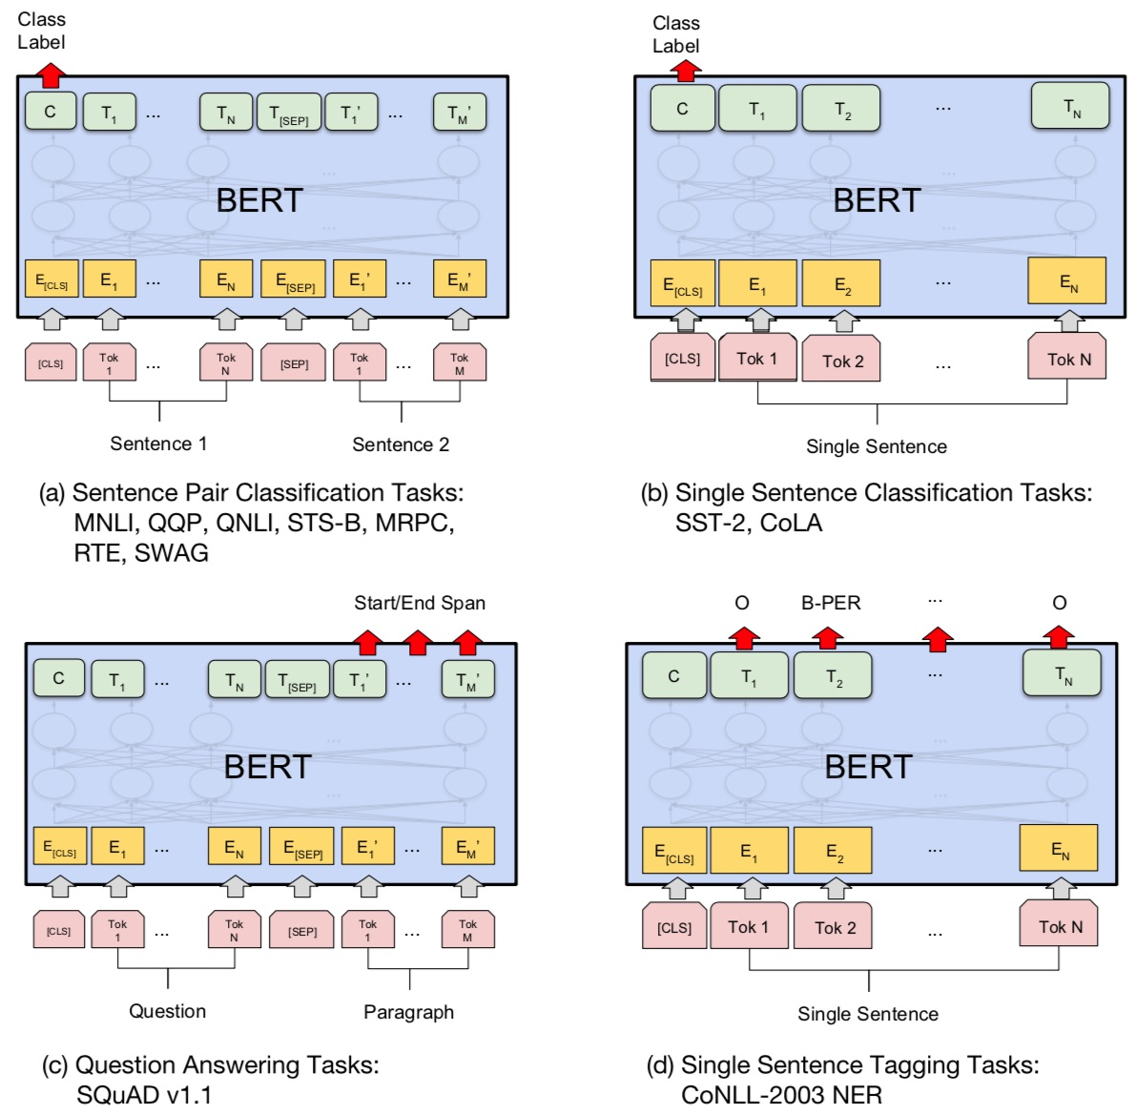
Fine-tuning BERT on NLP Tasks
Source: Devlin, Jacob, Ming-Wei Chang, Kenton Lee, and Kristina Toutanova (2018). "BERT: Pre-training of Deep Bidirectional Transformers for Language Understanding." arXiv preprint arXiv:1810.04805

Slide 15
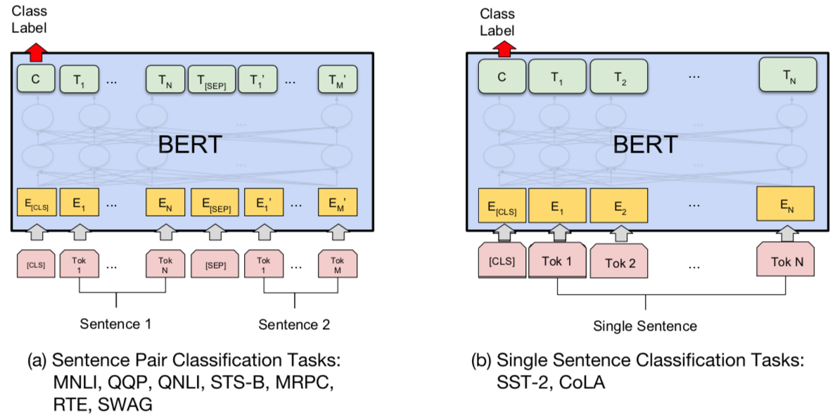
BERT Sequence-level tasks
Source: Devlin, Jacob, Ming-Wei Chang, Kenton Lee, and Kristina Toutanova (2018). "BERT: Pre-training of Deep Bidirectional Transformers for Language Understanding." arXiv preprint arXiv:1810.04805

Slide 16
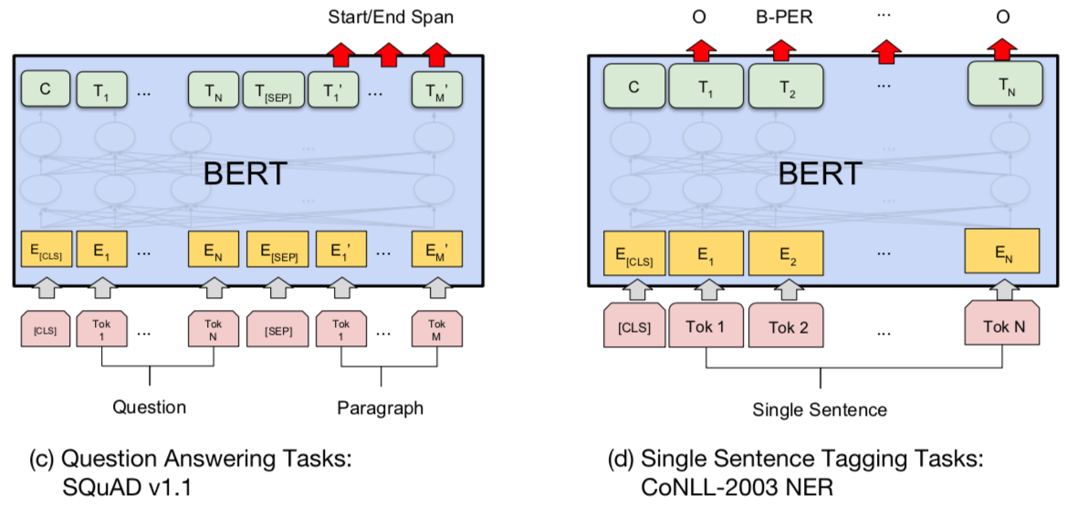
BERT Token-level tasks
Source: Devlin, Jacob, Ming-Wei Chang, Kenton Lee, and Kristina Toutanova (2018). "BERT: Pre-training of Deep Bidirectional Transformers for Language Understanding." arXiv preprint arXiv:1810.04805

Slide 17
Sentiment Analysis: Single Sentence Classification
Source: Devlin, Jacob, Ming-Wei Chang, Kenton Lee, and Kristina Toutanova (2018). "BERT: Pre-training of Deep Bidirectional Transformers for Language Understanding." arXiv preprint arXiv:1810.04805

Slide 18
Transformer Models
Transformer
Encoder
Decoder
DistilBERT
BERT
T5
GPT
RoBERTa
BART
GPT-2
CTRL
XLM-R
XLM
M2M-100
GPT-3
ALBERT
BIgBird
GPT-Neo
GPT-J
ELECTRA
DeBERTa
Source: Lewis Tunstall, Leandro von Werra, and Thomas Wolf (2022), Natural Language Processing with Transformers: Building Language Applications with Hugging Face, O'Reilly Media.

Slide 19
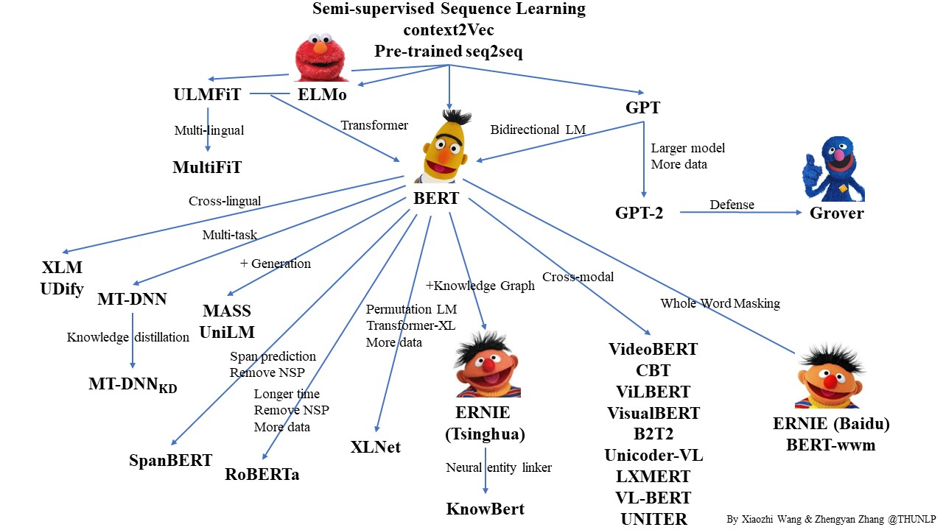
Pre-trained Language Model (PLM)
Source: https://github.com/thunlp/PLMpapers

Slide 20
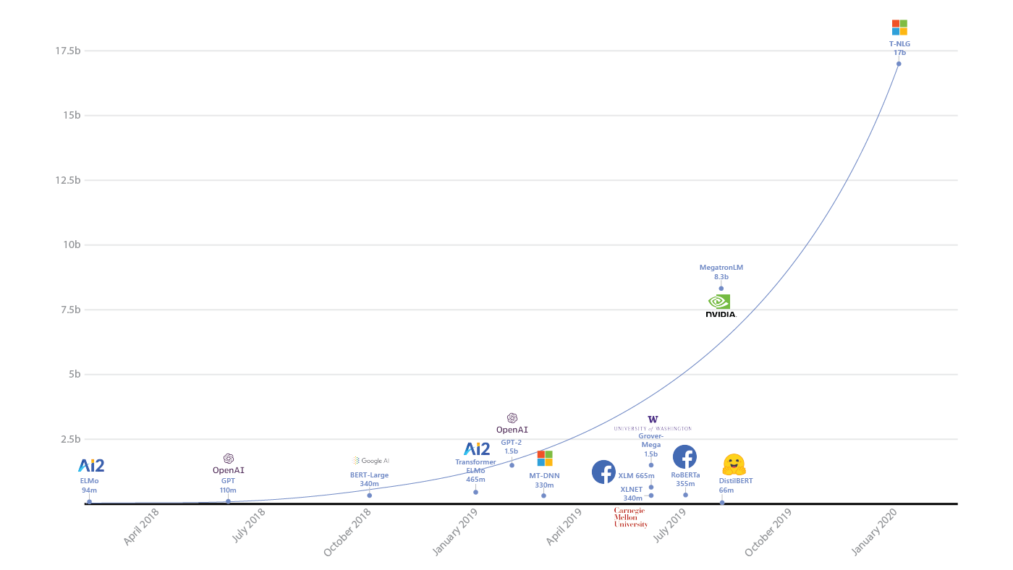
Transformers Pre-trained Language Model
T-NLG
17b
90+ Models
MegatronLM
8.3b
GPT-2
1.5b
BERT-Large
340m
RoBERTa
355m
DistilBERT
66m
2018
2019
2020
2021
2022
Source: https://www.microsoft.com/en-us/research/blog/turing-nlg-a-17-billion-parameter-language-model-by-microsoft/

Slide 21
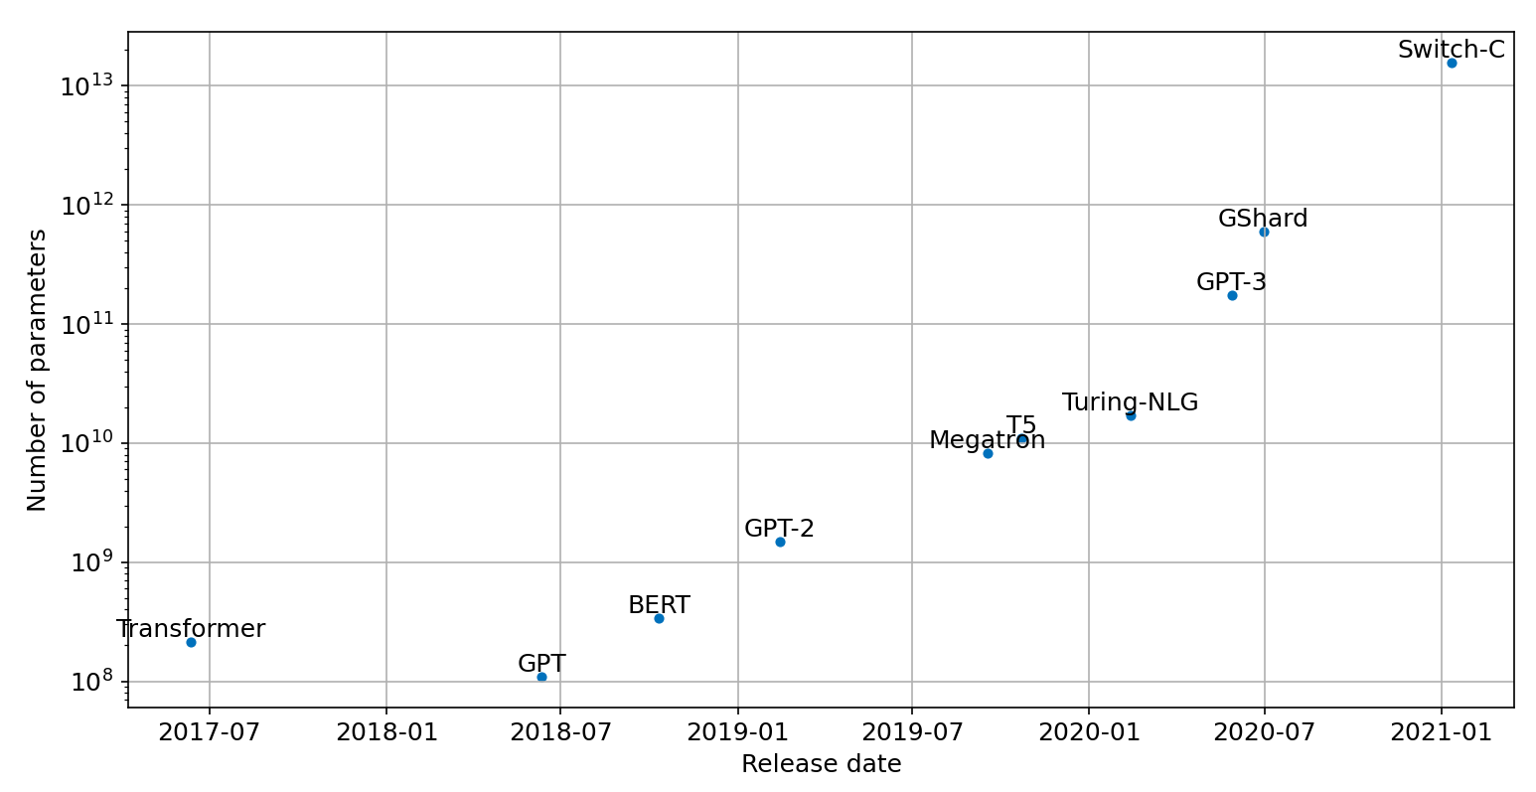
Scaling Transformers

Slide 22
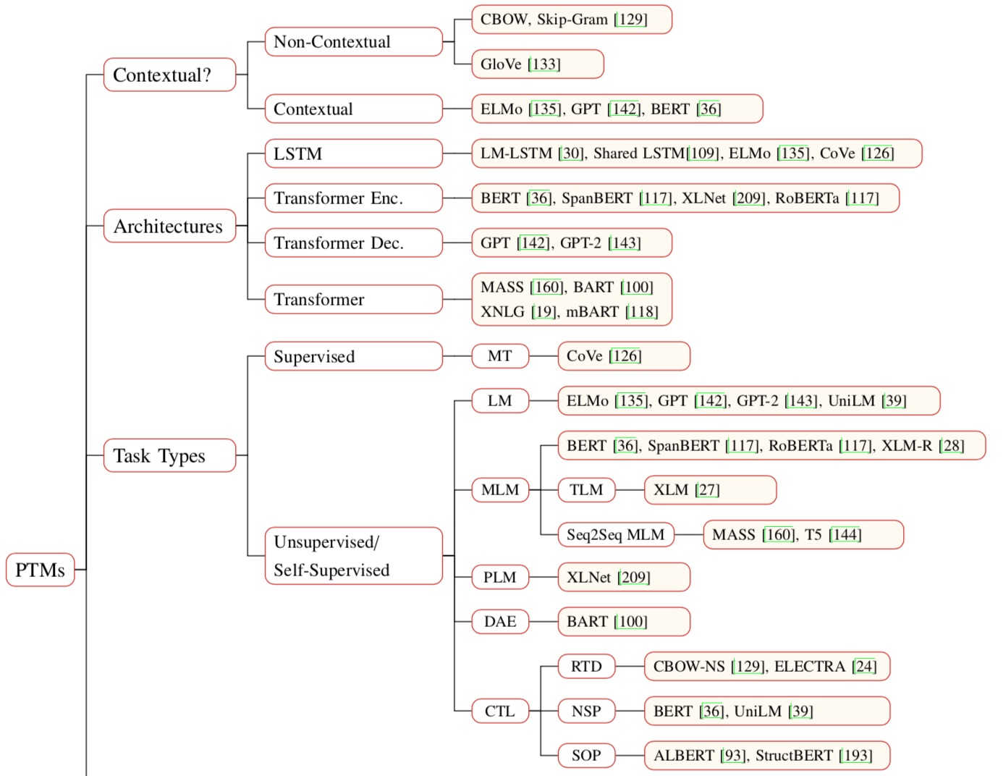
Pre-trained Models (PTM)
Source: Qiu, Xipeng, Tianxiang Sun, Yige Xu, Yunfan Shao, Ning Dai, and Xuanjing Huang. "Pre-trained Models for Natural Language Processing: A Survey." arXiv preprint arXiv:2003.08271 (2020).

Slide 23
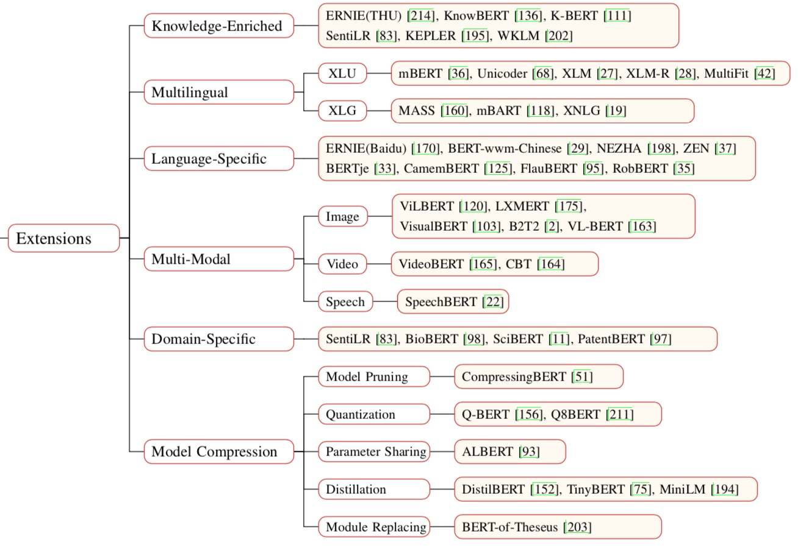
Pre-trained Models (PTM)
Source: Qiu, Xipeng, Tianxiang Sun, Yige Xu, Yunfan Shao, Ning Dai, and Xuanjing Huang. "Pre-trained Models for Natural Language Processing: A Survey." arXiv preprint arXiv:2003.08271 (2020).

Slide 24
The Encoder-Decoder Framework
The encoder-decoder framework
Attention Mechanisms
Transfer Learning in NLP
Source: Lewis Tunstall, Leandro von Werra, and Thomas Wolf (2022), Natural Language Processing with Transformers: Building Language Applications with Hugging Face, O'Reilly Media.

Slide 25
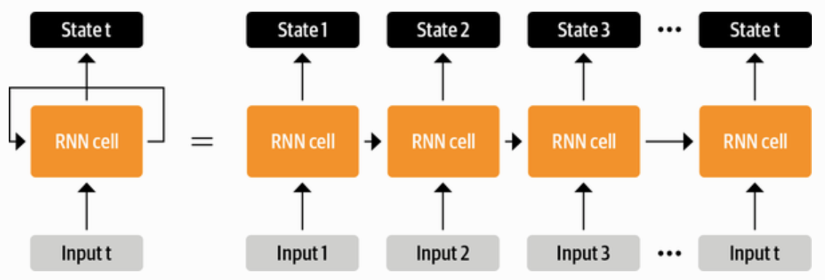
RNN
Source: Lewis Tunstall, Leandro von Werra, and Thomas Wolf (2022), Natural Language Processing with Transformers: Building Language Applications with Hugging Face, O'Reilly Media.

Slide 26
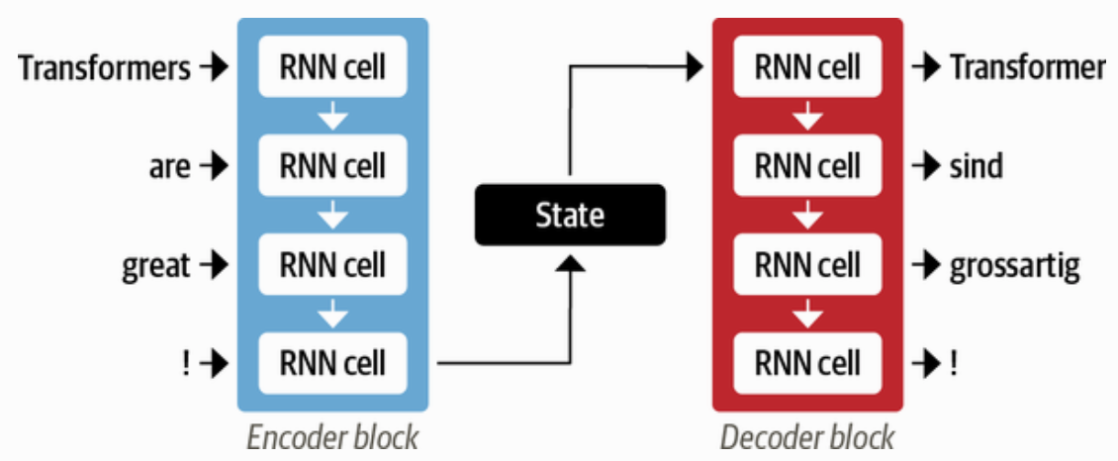
An encoder-decoder architecture with a pair of RNN
Source: Lewis Tunstall, Leandro von Werra, and Thomas Wolf (2022), Natural Language Processing with Transformers: Building Language Applications with Hugging Face, O'Reilly Media.

Slide 27
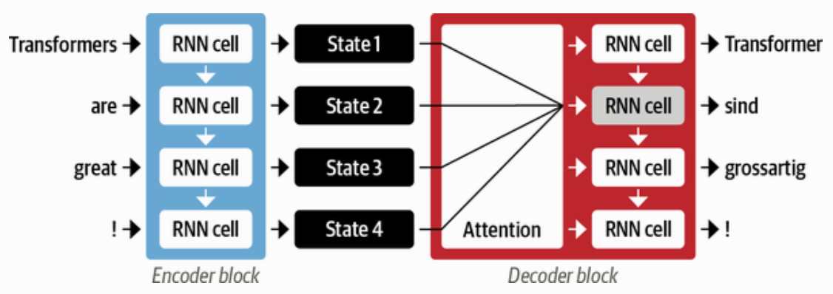
Attention Mechanisms
An encoder-decoder architecture with an attention mechanism
Source: Lewis Tunstall, Leandro von Werra, and Thomas Wolf (2022), Natural Language Processing with Transformers: Building Language Applications with Hugging Face, O'Reilly Media.

Slide 28
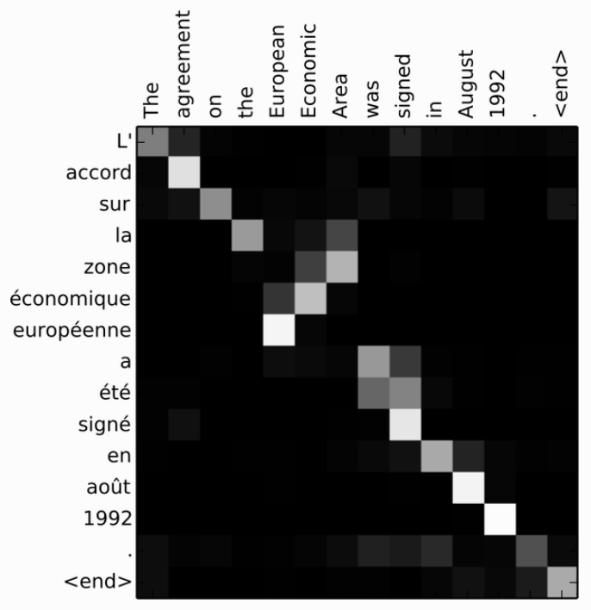
RNN Encoder-Decoder alignment of words in English and the generated translation in French
Source: Lewis Tunstall, Leandro von Werra, and Thomas Wolf (2022), Natural Language Processing with Transformers: Building Language Applications with Hugging Face, O'Reilly Media.

Slide 29
Encoder-Decoder Architecture of the Original Transformer
Source: Lewis Tunstall, Leandro von Werra, and Thomas Wolf (2022), Natural Language Processing with Transformers: Building Language Applications with Hugging Face, O'Reilly Media.

Slide 30
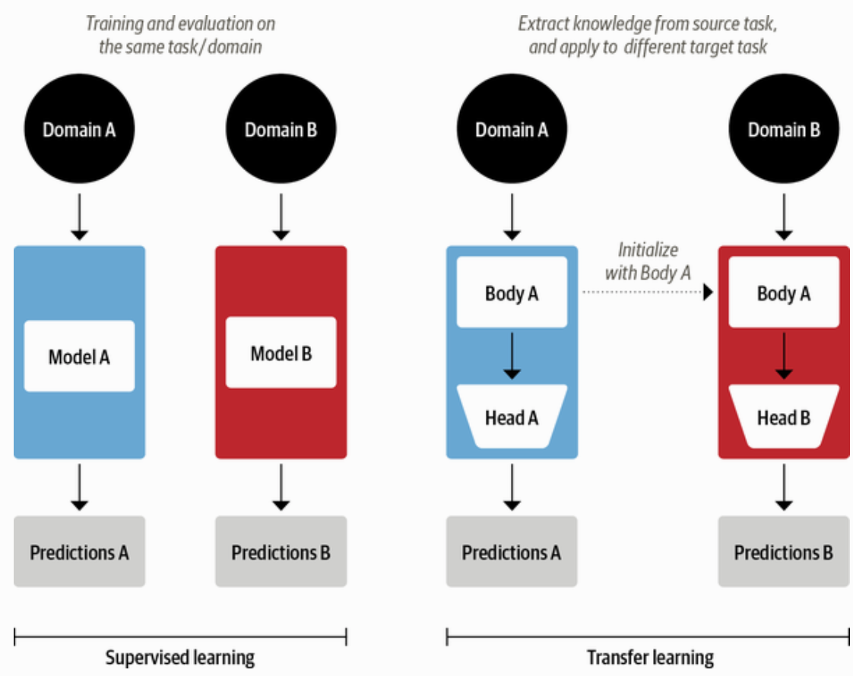
Comparison of Traditional Supervised Learning and Transfer Learning
Source: Lewis Tunstall, Leandro von Werra, and Thomas Wolf (2022), Natural Language Processing with Transformers: Building Language Applications with Hugging Face, O'Reilly Media.

Slide 31
ULMFiT: 3 Steps Transfer Learning in NLP
Wikitet
103
IMDB
IMDB
Language Model
Language Model
Classifier
1. Pretraining
2. Domain adaptation
3. Fine-tuning
Source: Lewis Tunstall, Leandro von Werra, and Thomas Wolf (2022), Natural Language Processing with Transformers: Building Language Applications with Hugging Face, O'Reilly Media.

Slide 32
An overview of the Hugging Face Ecosystem
Hugging Face Hub
Models
Datasets
Metrics
Docs
Tokenizers
Transformers
Datasets
Accelerate
Source: Lewis Tunstall, Leandro von Werra, and Thomas Wolf (2022), Natural Language Processing with Transformers: Building Language Applications with Hugging Face, O'Reilly Media.

Slide 33
A typical pipeline for training transformer models with the Datasets, Tokenizers, and Transformers libraries
Datasets
Tokenizers
Transformers
Datasets
Load and process datasets
Tokenize input texts
Load models, train and infer
Load metrics evaluate models
Source: Lewis Tunstall, Leandro von Werra, and Thomas Wolf (2022), Natural Language Processing with Transformers: Building Language Applications with Hugging Face, O'Reilly Media.
https://github.com/nlp-with-transformers/notebooks

Slide 34
The Illustrated Transformer Jay Alammar (2018)
Source: Jay Alammar (2018), The Illustrated Transformer, http://jalammar.github.io/illustrated-transformer/

Slide 35
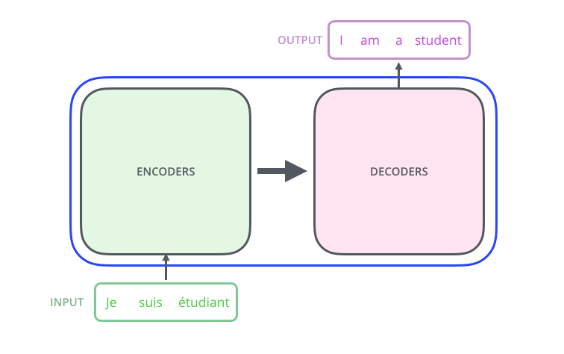
The Illustrated Transformer Jay Alammar (2018)
Source: Jay Alammar (2018), The Illustrated Transformer, http://jalammar.github.io/illustrated-transformer/

Slide 36
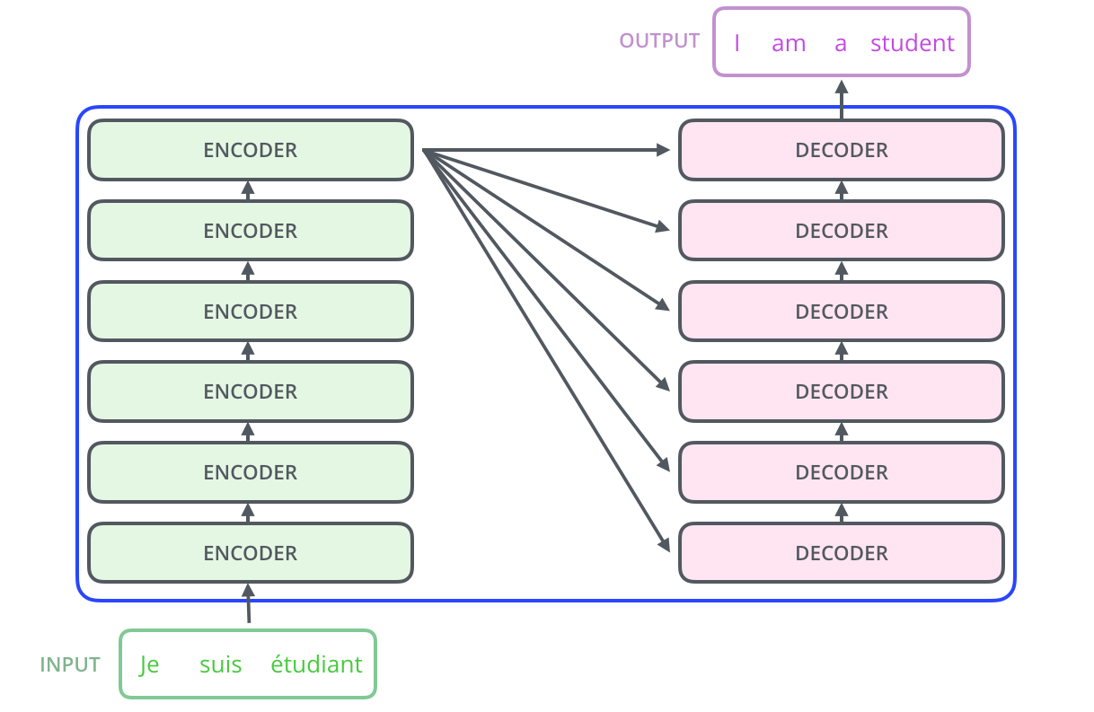
The Illustrated Transformer Jay Alammar (2018)
Source: Jay Alammar (2018), The Illustrated Transformer, http://jalammar.github.io/illustrated-transformer/

Slide 37
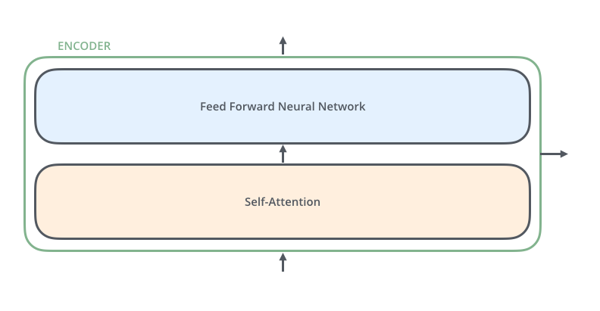
The Illustrated Transformer Jay Alammar (2018)
Source: Jay Alammar (2018), The Illustrated Transformer, http://jalammar.github.io/illustrated-transformer/

Slide 38
The Illustrated Transformer Jay Alammar (2018)
Source: Jay Alammar (2018), The Illustrated Transformer, http://jalammar.github.io/illustrated-transformer/

Slide 39
The Illustrated Transformer Jay Alammar (2018)
Each word is embedded into a vector of size 512.
Source: Jay Alammar (2018), The Illustrated Transformer, http://jalammar.github.io/illustrated-transformer/

Slide 40
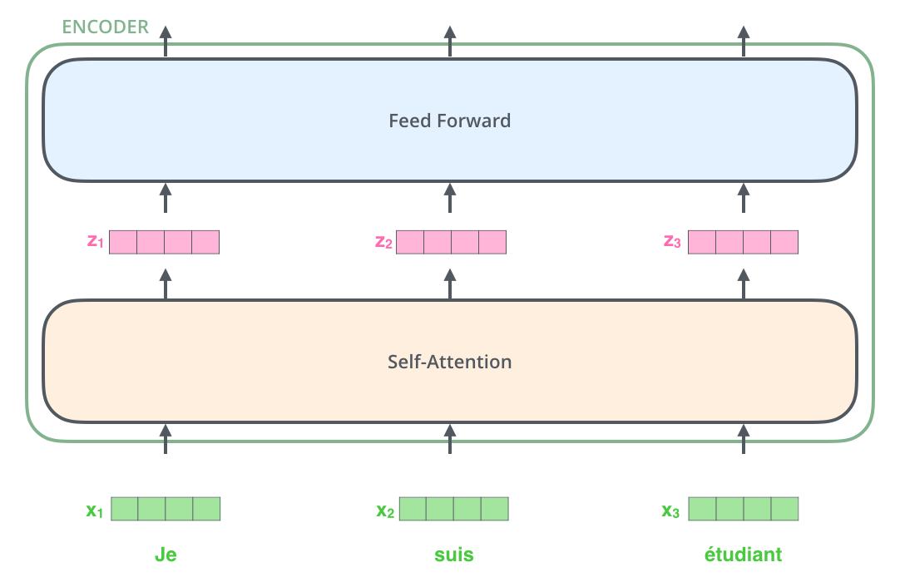
The Illustrated Transformer Jay Alammar (2018)
Source: Jay Alammar (2018), The Illustrated Transformer, http://jalammar.github.io/illustrated-transformer/

Slide 41
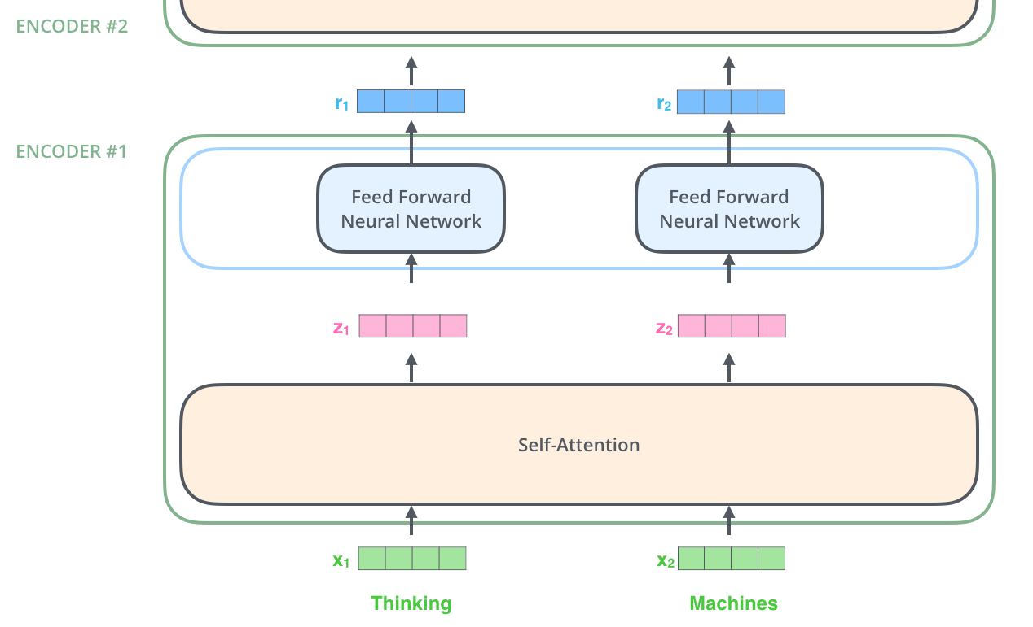
The Illustrated Transformer Jay Alammar (2018)
Source: Jay Alammar (2018), The Illustrated Transformer, http://jalammar.github.io/illustrated-transformer/

Slide 42
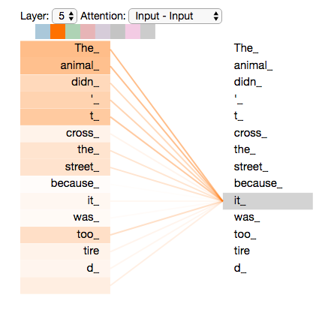
The Illustrated Transformer Jay Alammar (2018)
Source: Jay Alammar (2018), The Illustrated Transformer, http://jalammar.github.io/illustrated-transformer/

Slide 43
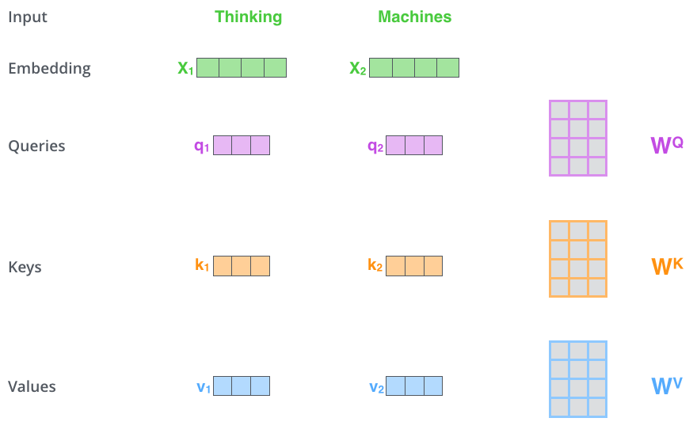
Multiplying x1 by the WQ weight matrix produces q1, the "query" vector associated with that word. We end up creating a "query", a "key", and a "value" projection of each word in the input sentence.
Source: Jay Alammar (2018), The Illustrated Transformer, http://jalammar.github.io/illustrated-transformer/

Slide 44
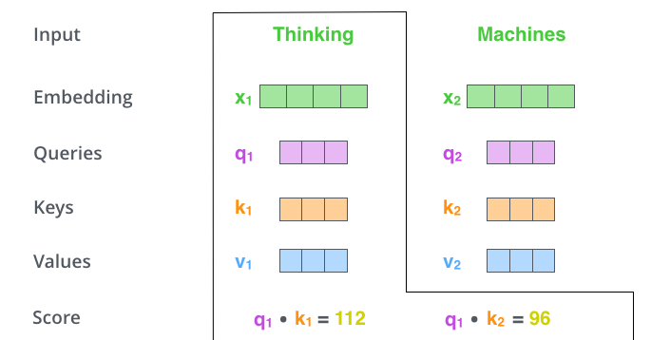
The Illustrated Transformer Jay Alammar (2018)
Source: Jay Alammar (2018), The Illustrated Transformer, http://jalammar.github.io/illustrated-transformer/

Slide 45
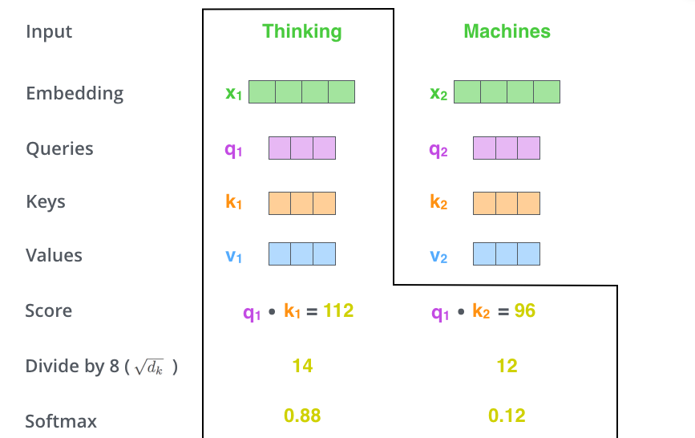
The Illustrated Transformer Jay Alammar (2018)
Source: Jay Alammar (2018), The Illustrated Transformer, http://jalammar.github.io/illustrated-transformer/

Slide 46
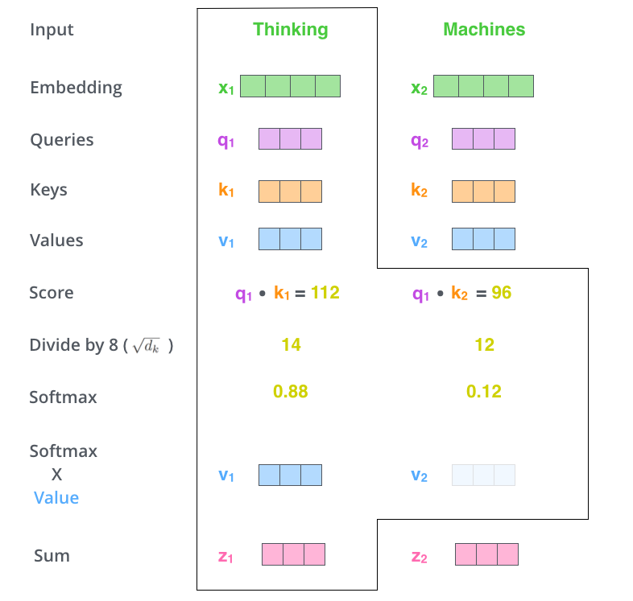
Source: Jay Alammar (2018), The Illustrated Transformer, http://jalammar.github.io/illustrated-transformer/

Slide 47
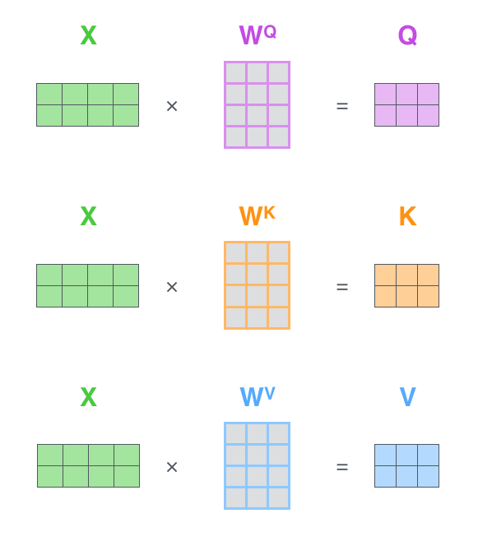
Matrix Calculation of Self-Attention
Source: Jay Alammar (2018), The Illustrated Transformer, http://jalammar.github.io/illustrated-transformer/

Slide 48
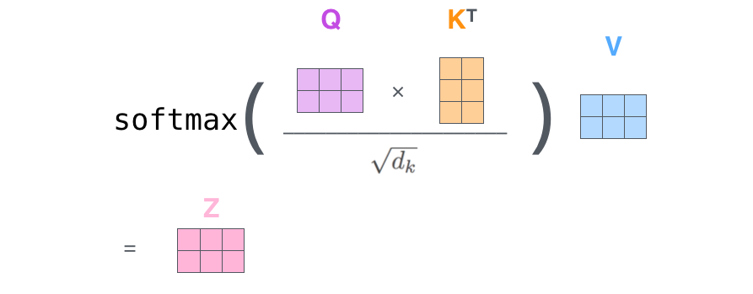
The self-attention calculation in matrix form
Source: Jay Alammar (2018), The Illustrated Transformer, http://jalammar.github.io/illustrated-transformer/

Slide 49
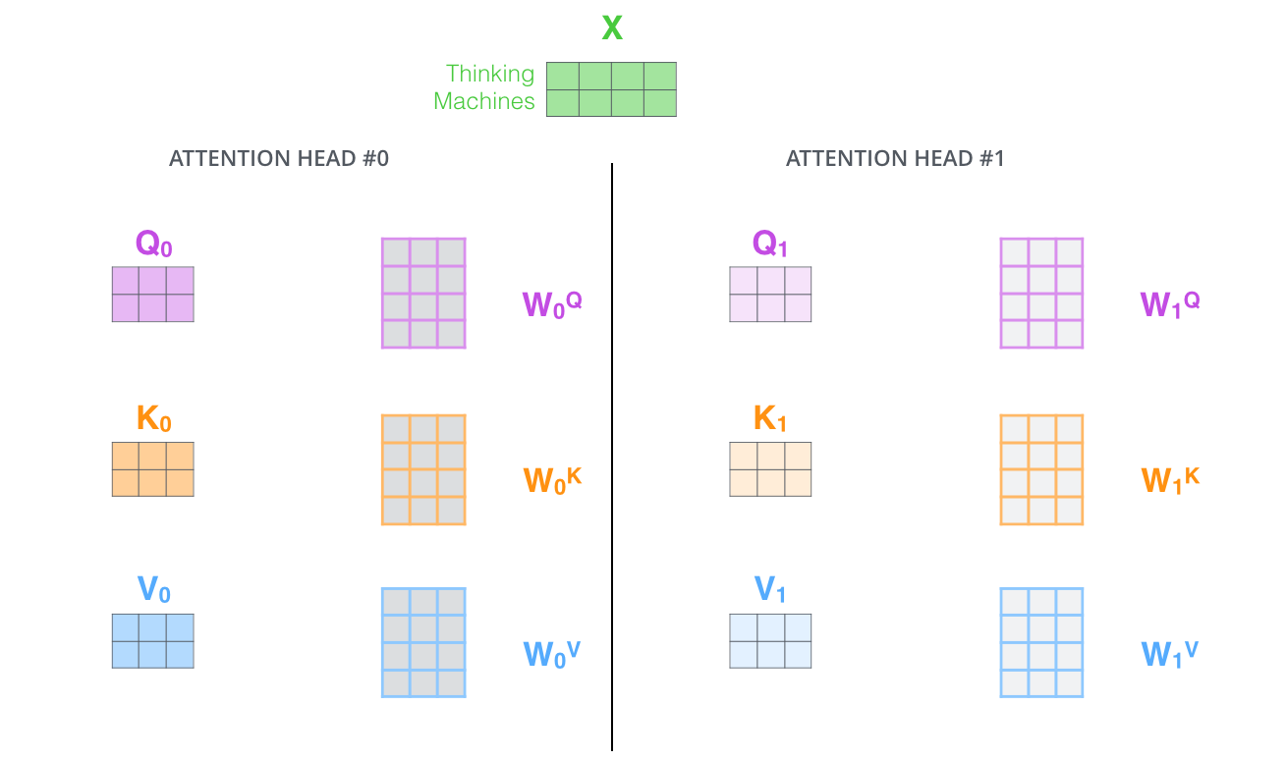
Multi-headed Attention
Source: Jay Alammar (2018), The Illustrated Transformer, http://jalammar.github.io/illustrated-transformer/

Slide 50
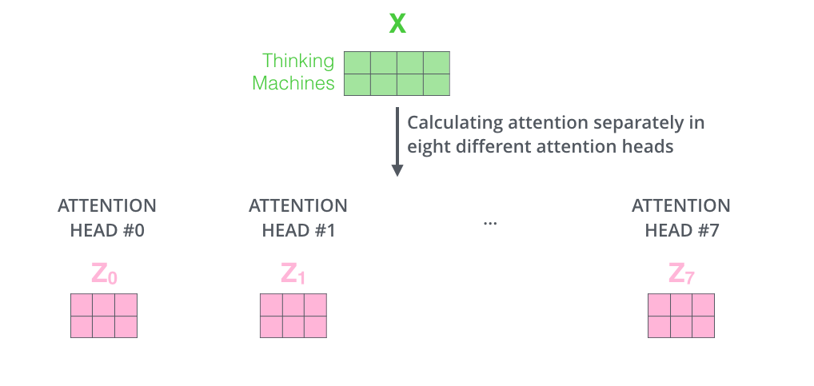
Multi-headed Attention
Source: Jay Alammar (2018), The Illustrated Transformer, http://jalammar.github.io/illustrated-transformer/

Slide 51
Multi-headed Attention
Source: Jay Alammar (2018), The Illustrated Transformer, http://jalammar.github.io/illustrated-transformer/

Slide 52
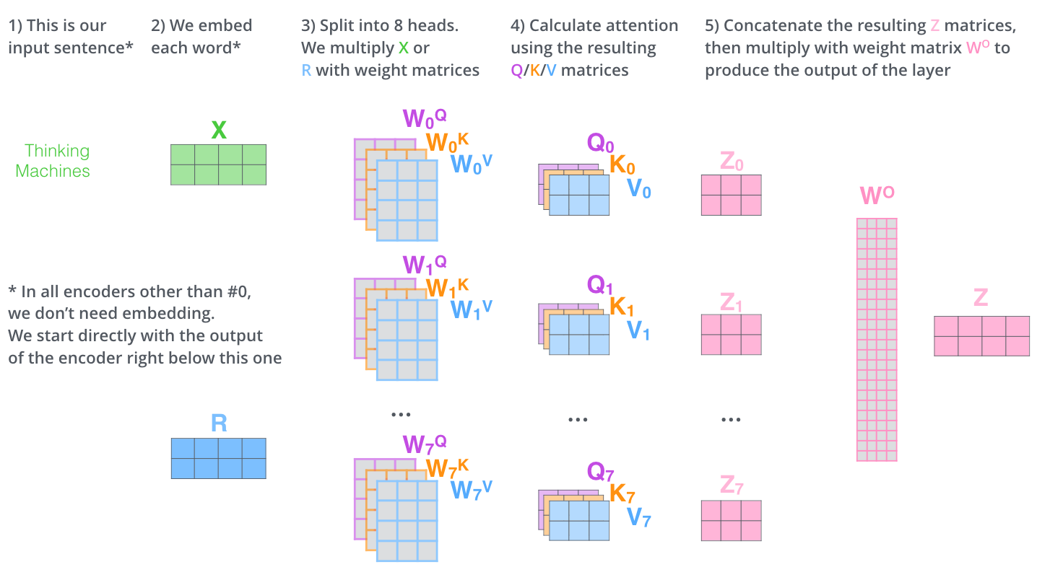
Multi-headed Attention
Source: Jay Alammar (2018), The Illustrated Transformer, http://jalammar.github.io/illustrated-transformer/

Slide 53
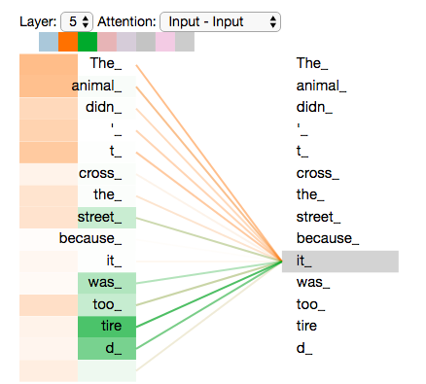
As we encode the word "it", one attention head is focusing most on "the animal", while another is focusing on "tired" -- in a sense, the model's representation of the word "it" bakes in some of the representation of both "animal" and "tired".
Source: Jay Alammar (2018), The Illustrated Transformer, http://jalammar.github.io/illustrated-transformer/

Slide 54
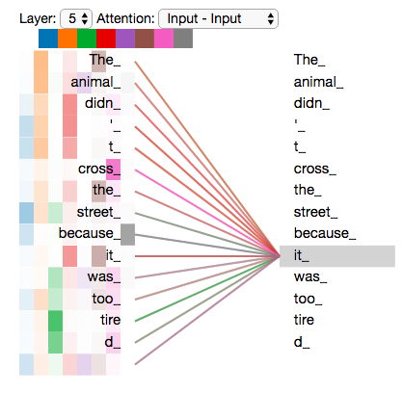
Add all the attention heads
Source: Jay Alammar (2018), The Illustrated Transformer, http://jalammar.github.io/illustrated-transformer/

Slide 55
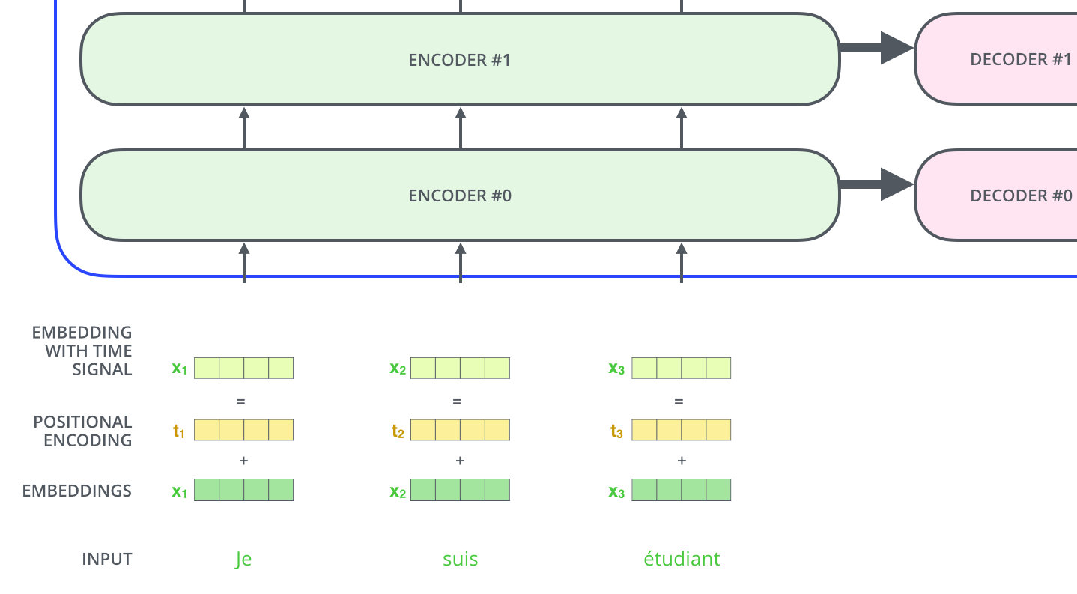
Positional Encoding
To give the model a sense of the order of the words, we add positional encoding vectors -- the values of which follow a specific pattern.
Source: Jay Alammar (2018), The Illustrated Transformer, http://jalammar.github.io/illustrated-transformer/

Slide 56
Positional Encoding
Positional encoding with a toy embedding size of 4
Source: Jay Alammar (2018), The Illustrated Transformer, http://jalammar.github.io/illustrated-transformer/

Slide 57
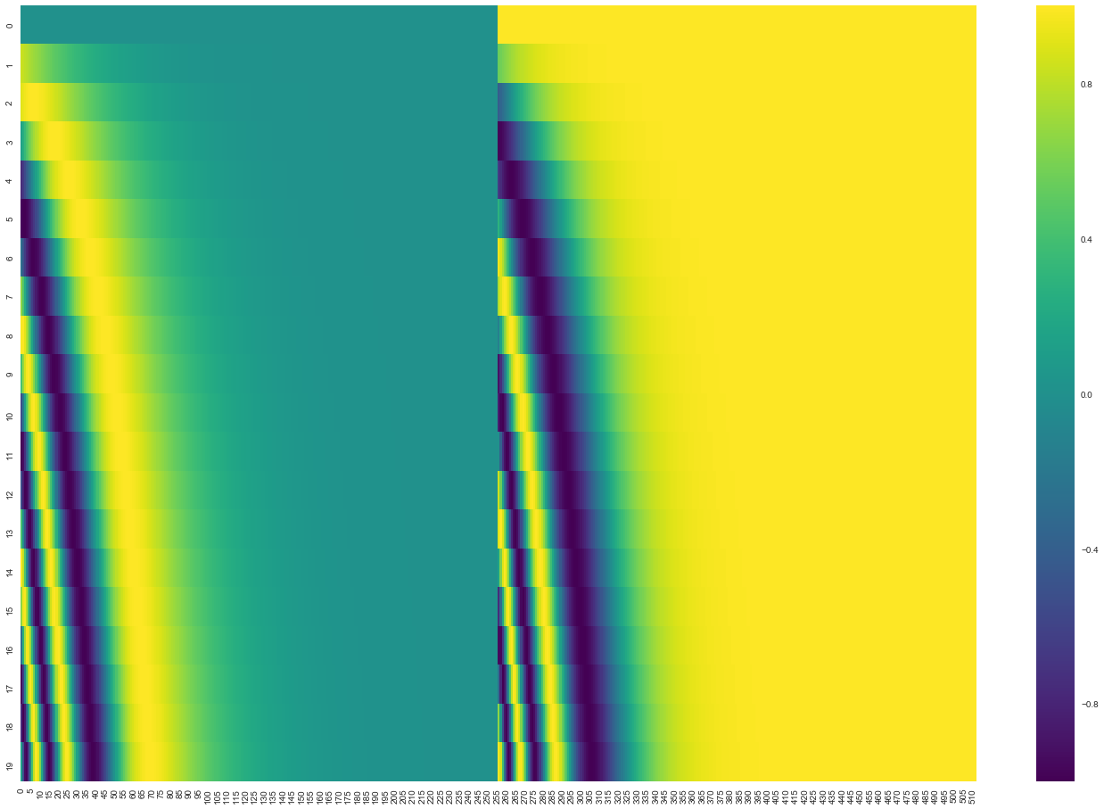
Positional encoding for 20 words (rows) with an embedding size of 512 (columns)
You can see that it appears split in half down the center. That's because the values of the left half are generated by one function (which uses sine), and the right half is generated by another function (which uses cosine). They're then concatenated to form each of the positional encoding vectors.
Source: Jay Alammar (2018), The Illustrated Transformer, http://jalammar.github.io/illustrated-transformer/

Slide 58
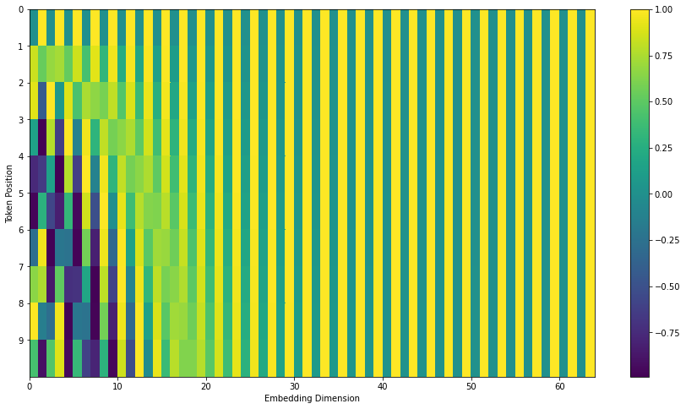
Transformers Positional Encoding
Source: Jay Alammar (2018), The Illustrated Transformer, http://jalammar.github.io/illustrated-transformer/

Slide 59
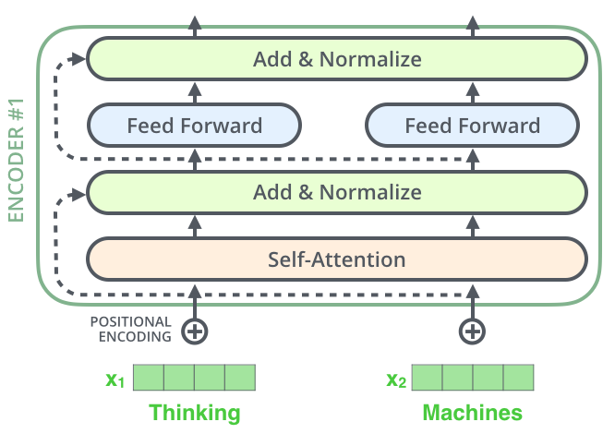
The Residuals
Source: Jay Alammar (2018), The Illustrated Transformer, http://jalammar.github.io/illustrated-transformer/

Slide 60
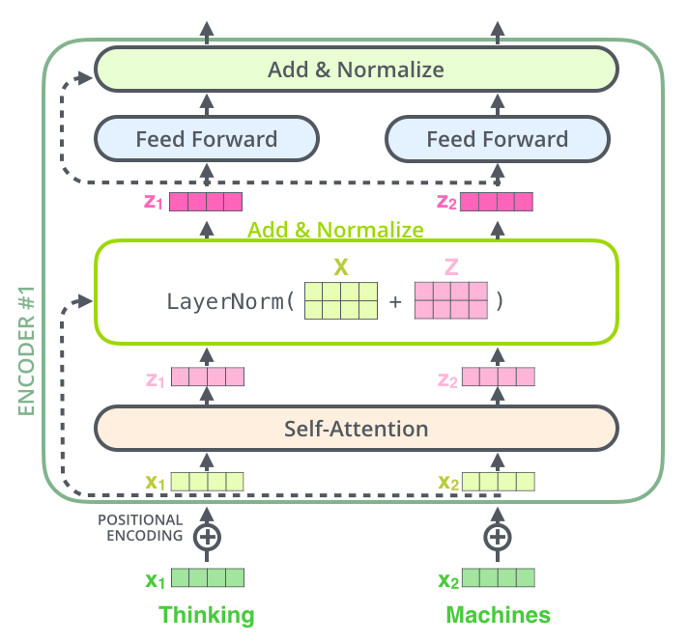
Source: Jay Alammar (2018), The Illustrated Transformer, http://jalammar.github.io/illustrated-transformer/

Slide 61
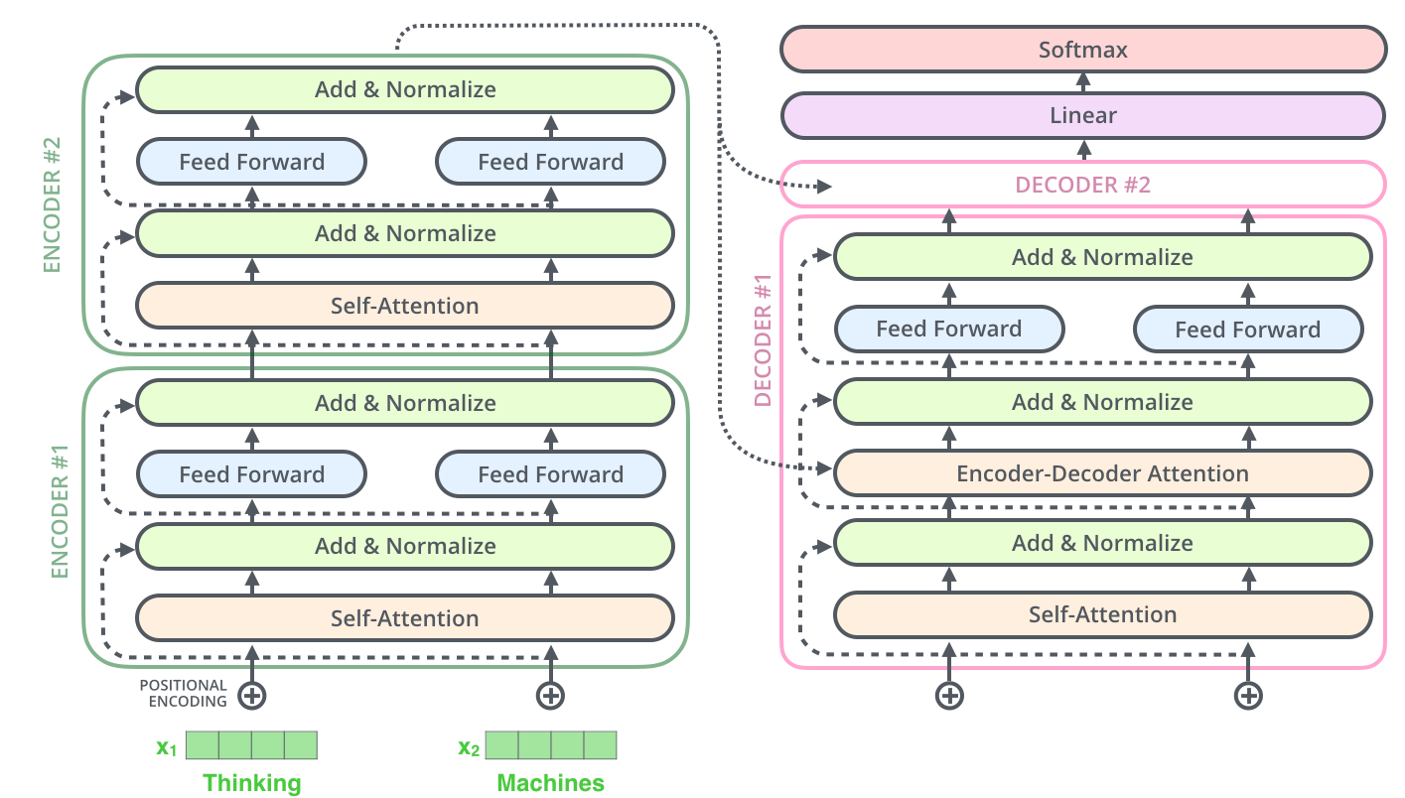
Source: Jay Alammar (2018), The Illustrated Transformer, http://jalammar.github.io/illustrated-transformer/

Slide 62
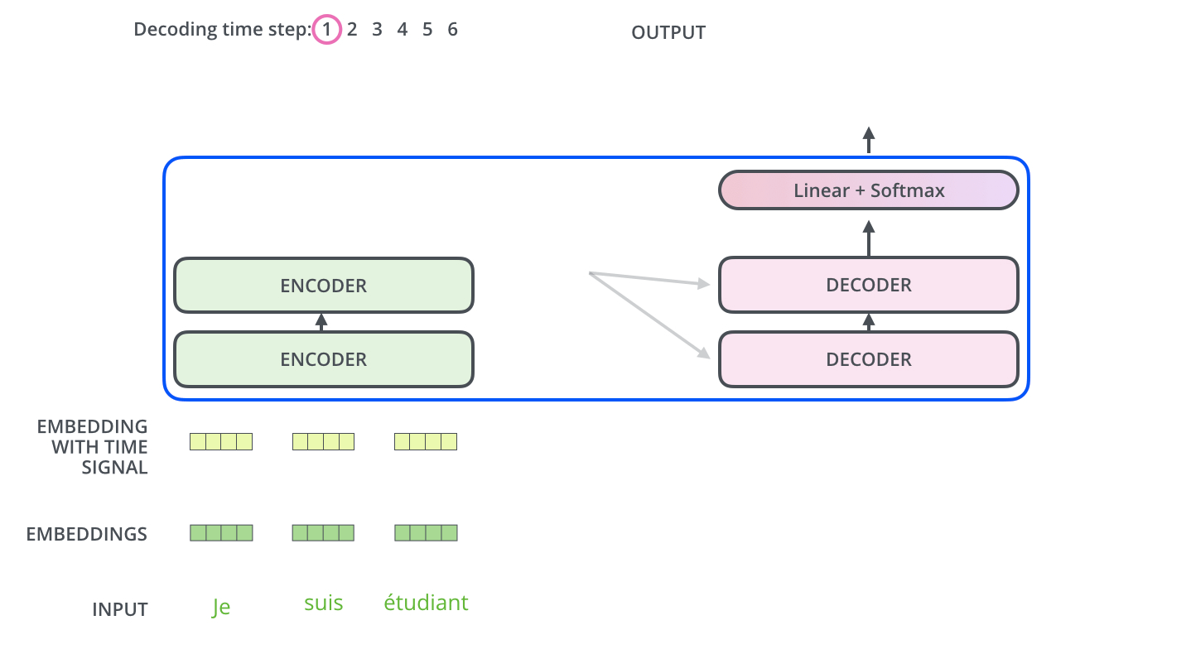
The Decoder Side
Source: Jay Alammar (2018), The Illustrated Transformer, http://jalammar.github.io/illustrated-transformer/

Slide 63
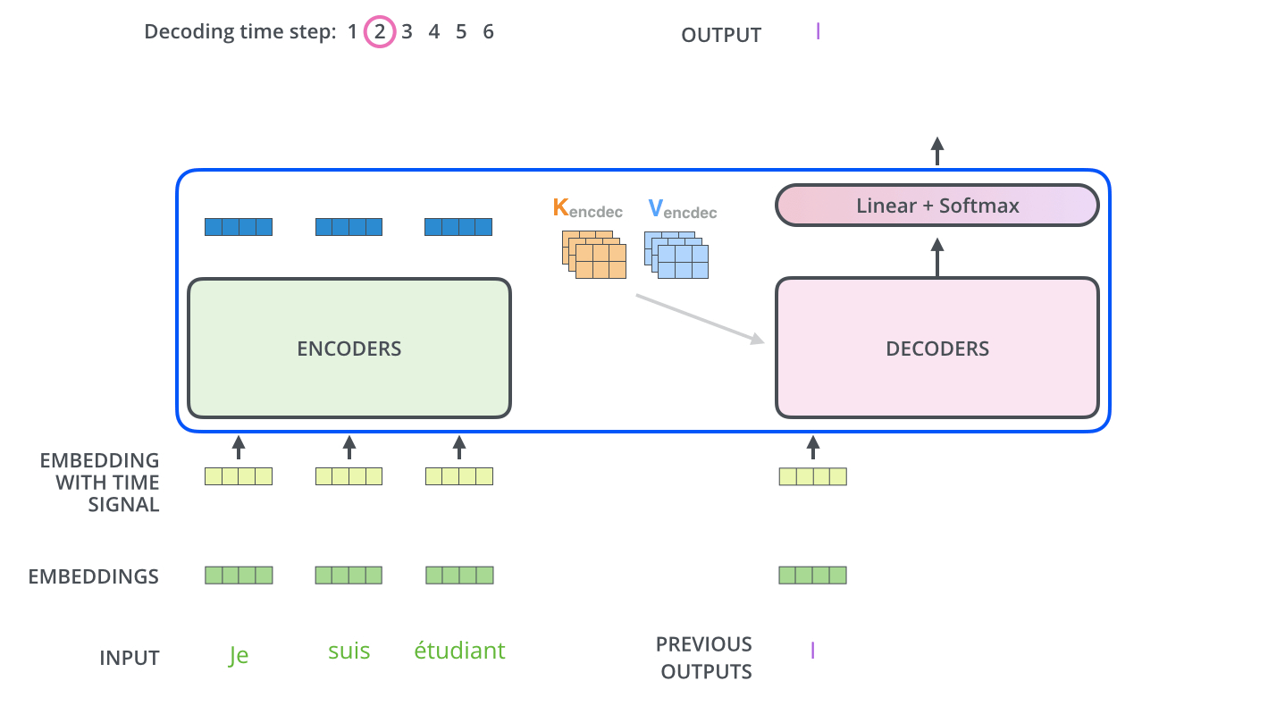
The Decoder Side
Source: Jay Alammar (2018), The Illustrated Transformer, http://jalammar.github.io/illustrated-transformer/

Slide 64
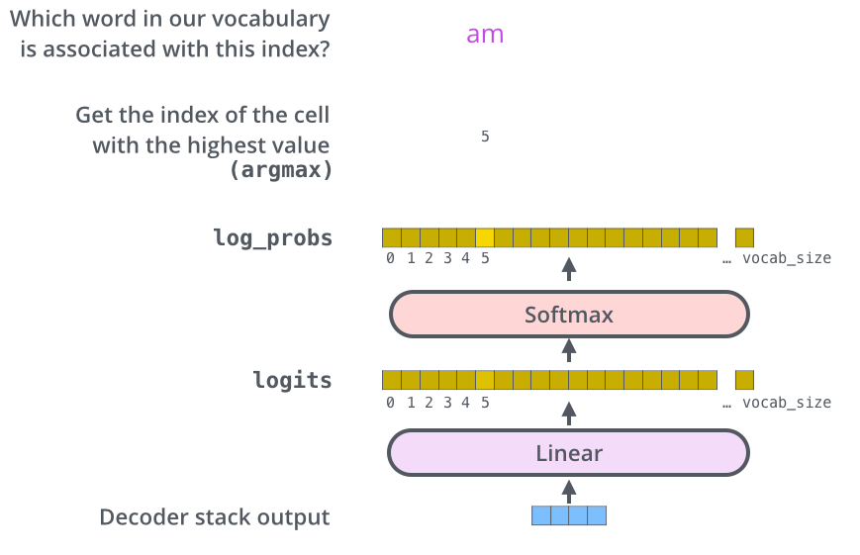
The Final Linear and Softmax Layer
Source: Jay Alammar (2018), The Illustrated Transformer, http://jalammar.github.io/illustrated-transformer/

Slide 65
The output vocabulary
The output vocabulary of our model is created in the preprocessing phase before we even begin training.
Source: Jay Alammar (2018), The Illustrated Transformer, http://jalammar.github.io/illustrated-transformer/

Slide 66
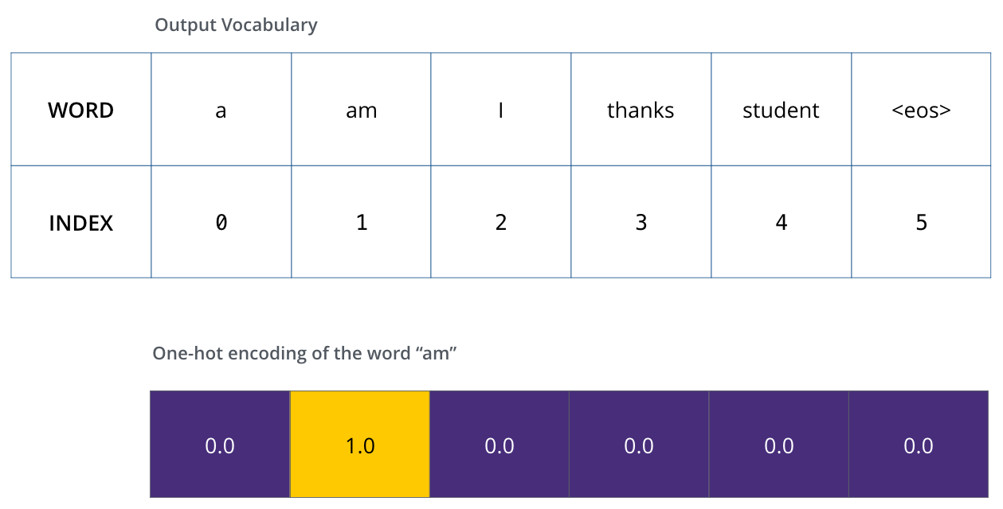
Example: one-hot encoding of output vocabulary
Source: Jay Alammar (2018), The Illustrated Transformer, http://jalammar.github.io/illustrated-transformer/

Slide 67
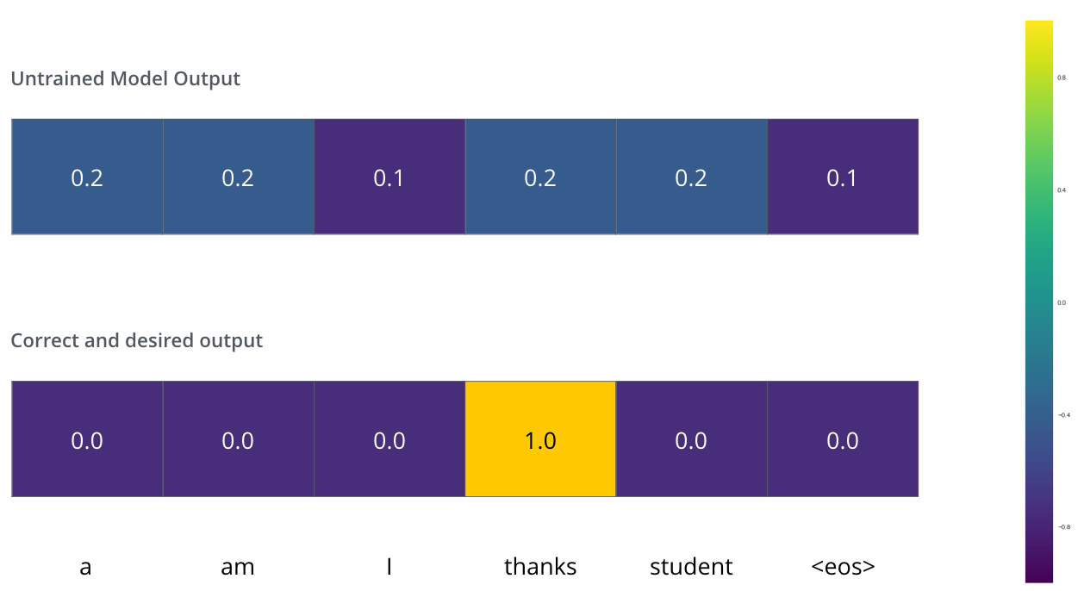
The Loss Function
Source: Jay Alammar (2018), The Illustrated Transformer, http://jalammar.github.io/illustrated-transformer/

Slide 68
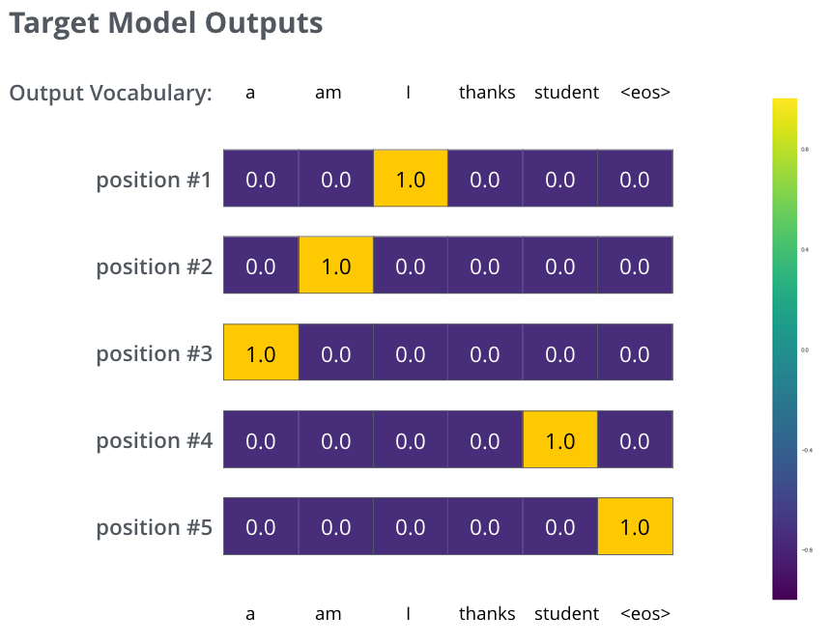
Source: Jay Alammar (2018), The Illustrated Transformer, http://jalammar.github.io/illustrated-transformer/

Slide 69
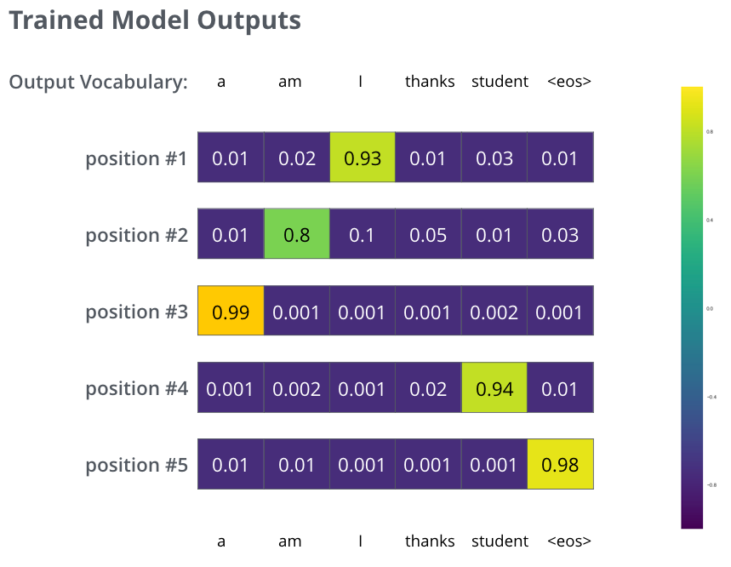
Source: Jay Alammar (2018), The Illustrated Transformer, http://jalammar.github.io/illustrated-transformer/

Slide 70
Transformers State-of-the-art Natural Language Processing for TensorFlow 2.0 and PyTorch
Transformers
pytorch-transformers
pytorch-pretrained-bert
provides state-of-the-art general-purpose architectures
(BERT, GPT-2, RoBERTa, XLM, DistilBert, XLNet, CTRL...)
for Natural Language Understanding (NLU) and Natural Language Generation (NLG) with over 32+ pretrained models in 100+ languages and deep interoperability between TensorFlow 2.0 and PyTorch.
Source: https://github.com/huggingface/transformers

Slide 71
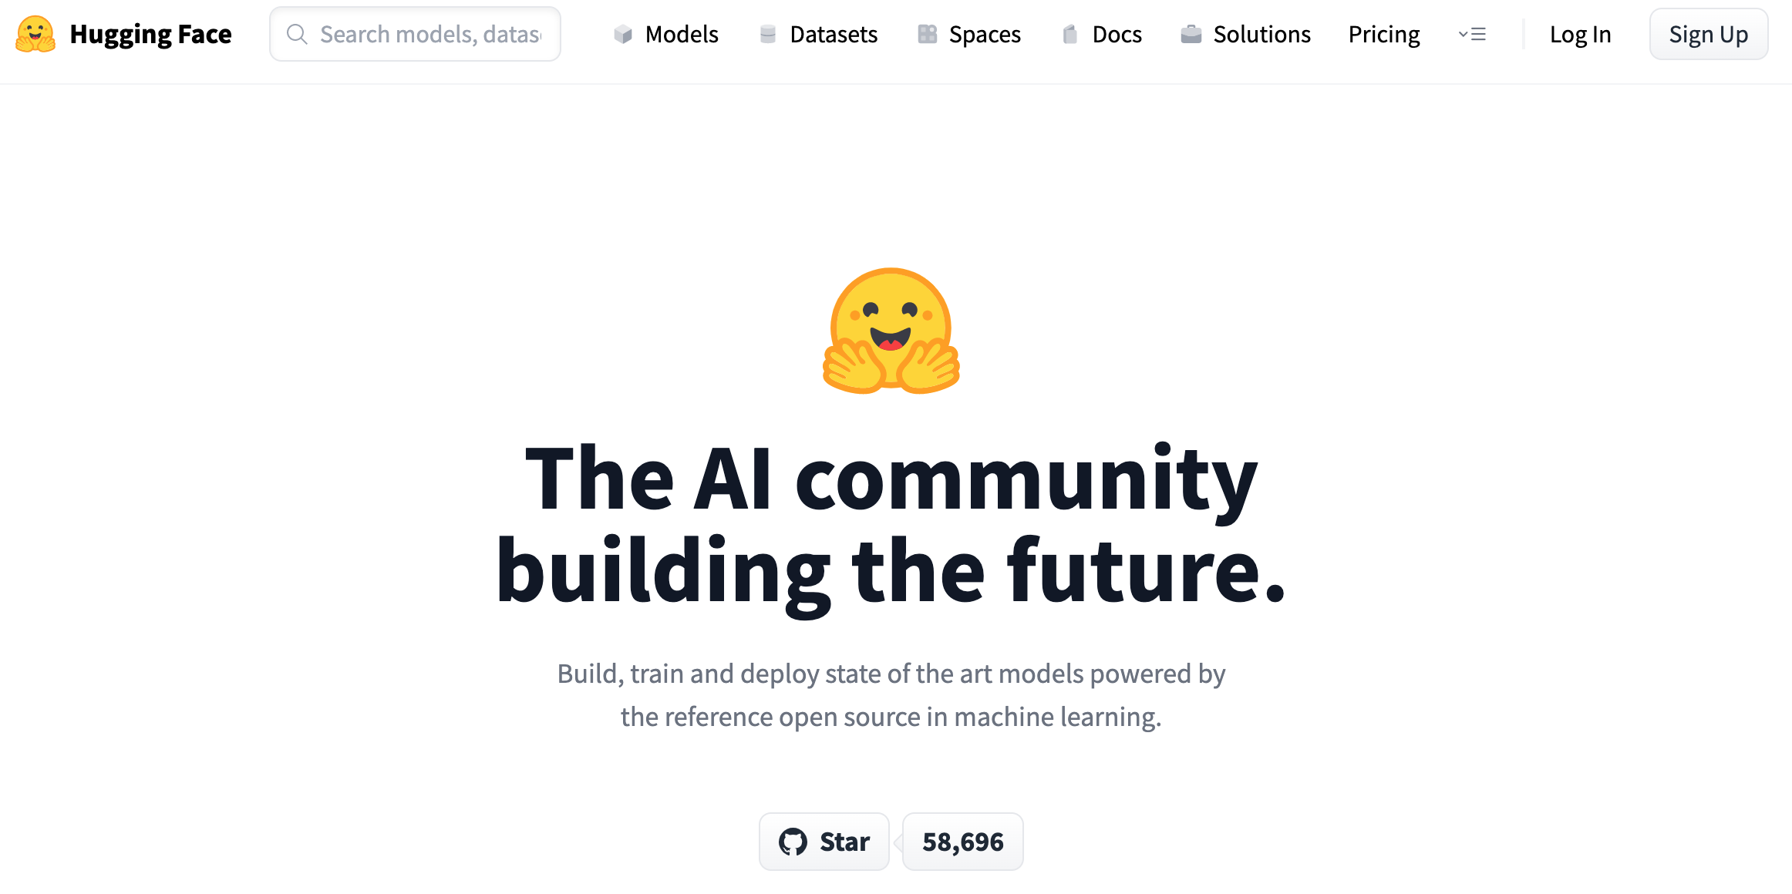
Hugging Face
https://huggingface.co/

Slide 72
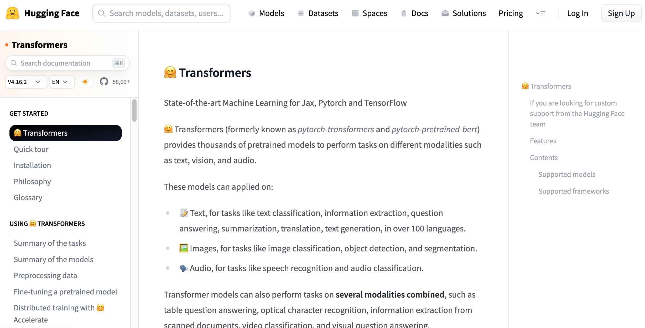
Hugging Face Transformers
https://huggingface.co/docs/transformers/index

Slide 73
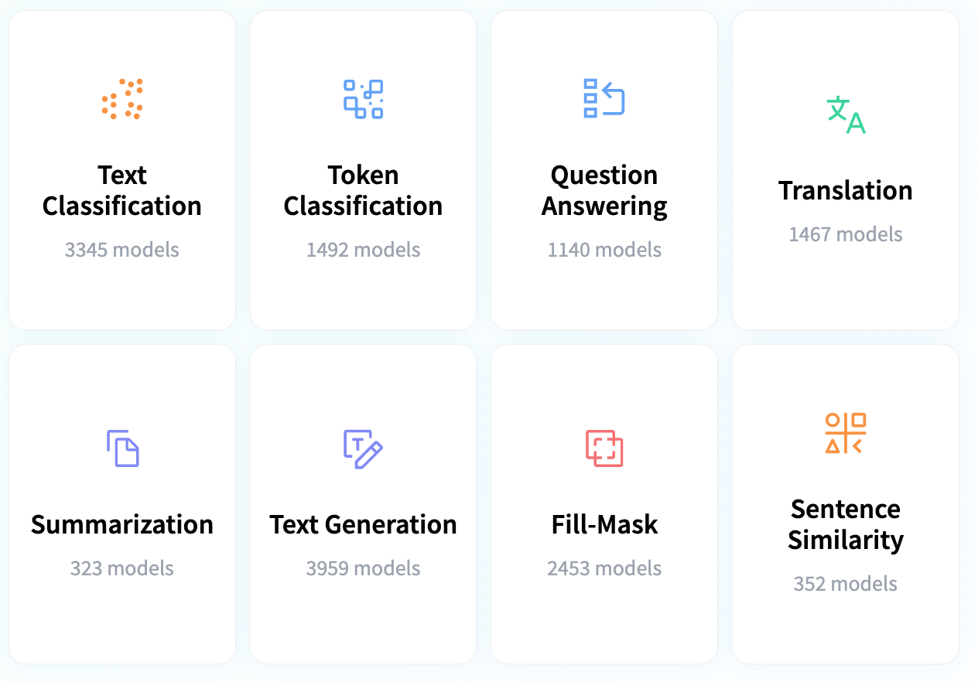
Hugging Face Tasks Natural Language Processing
https://huggingface.co/tasks

Slide 74
NLP with Transformers Github
https://github.com/nlp-with-transformers/notebooks

Slide 75
NLP with Transformers Github Notebooks
https://github.com/nlp-with-transformers/notebooks

Slide 76
NLP with Transformers
!git clone https://github.com/nlp-with-transformers/notebooks.git
%cd notebooks
from install import *
install_requirements()
from utils import *
setup_chapter()
Source: Lewis Tunstall, Leandro von Werra, and Thomas Wolf (2022), Natural Language Processing with Transformers: Building Language Applications with Hugging Face, O'Reilly Media.
https://github.com/nlp-with-transformers/notebooks

Slide 77
Text Classification
text = """Dear Amazon, last week I ordered an Optimus Prime action figure \
from your online store in Germany. Unfortunately, when I opened the package, \
I discovered to my horror that I had been sent an action figure of Megatron \
instead! As a lifelong enemy of the Decepticons, I hope you can understand my \
dilemma. To resolve the issue, I demand an exchange of Megatron for the \
Optimus Prime figure I ordered. Enclosed are copies of my records concerning \
this purchase. I expect to hear from you soon. Sincerely, Bumblebee."""
Source: Lewis Tunstall, Leandro von Werra, and Thomas Wolf (2022), Natural Language Processing with Transformers: Building Language Applications with Hugging Face, O'Reilly Media.
https://github.com/nlp-with-transformers/notebooks

Slide 78
Text Classification
text = """Dear Amazon, last week I ordered an Optimus Prime action figure \
from your online store in Germany. Unfortunately, when I opened the package, \
I discovered to my horror that I had been sent an action figure of Megatron \
instead! As a lifelong enemy of the Decepticons, I hope you can understand my \
dilemma. To resolve the issue, I demand an exchange of Megatron for the \
Optimus Prime figure I ordered. Enclosed are copies of my records concerning \
this purchase. I expect to hear from you soon. Sincerely, Bumblebee."""
from transformers import pipeline classifier = pipeline("text-classification")
import pandas as pd outputs = classifier(text)
pd.DataFrame(outputs)
 | label | score
0 | NEGATIVE | 0.901546
Source: Lewis Tunstall, Leandro von Werra, and Thomas Wolf (2022), Natural Language Processing with Transformers: Building Language Applications with Hugging Face, O'Reilly Media.
https://github.com/nlp-with-transformers/notebooks

Slide 79
Text Classification
from transformers import pipeline classifier = pipeline("text-classification")
import pandas as pd outputs = classifier(text)
pd.DataFrame(outputs)
 | label | score
0 | NEGATIVE | 0.901546
Source: Lewis Tunstall, Leandro von Werra, and Thomas Wolf (2022), Natural Language Processing with Transformers: Building Language Applications with Hugging Face, O'Reilly Media.
https://github.com/nlp-with-transformers/notebooks

Slide 80
Named Entity Recognition
ner_tagger = pipeline("ner", aggregation_strategy="simple")
outputs = ner_tagger(text)
pd.DataFrame(outputs)
Source: Lewis Tunstall, Leandro von Werra, and Thomas Wolf (2022), Natural Language Processing with Transformers: Building Language Applications with Hugging Face, O'Reilly Media.
https://github.com/nlp-with-transformers/notebooks

Slide 81
Question Answering
reader = pipeline("question-answering")
question = "What does the customer want?"
outputs = reader(question=question, context=text)
pd.DataFrame([outputs])
 | score | start | end | answer
0 | 0.631292 | 335 | 358 | an exchange of Megatron
Source: Lewis Tunstall, Leandro von Werra, and Thomas Wolf (2022), Natural Language Processing with Transformers: Building Language Applications with Hugging Face, O'Reilly Media.
https://github.com/nlp-with-transformers/notebooks

Slide 82
Summarization
summarizer = pipeline("summarization")
outputs = summarizer(text, max_length=45, clean_up_tokenization_spaces=True)
print(outputs[0]['summary_text'])
Bumblebee ordered an Optimus Prime action figure from your online store in Germany. Unfortunately, when I opened the package, I discovered to my horror that I had been sent an action figure of Megatron instead.
Source: Lewis Tunstall, Leandro von Werra, and Thomas Wolf (2022), Natural Language Processing with Transformers: Building Language Applications with Hugging Face, O'Reilly Media.
https://github.com/nlp-with-transformers/notebooks

Slide 83
Translation
translator = pipeline("translation_en_to_de",
model="Helsinki-NLP/opus-mt-en-de")
outputs = translator(text, clean_up_tokenization_spaces=True, min_length=100)
print(outputs[0]['translation_text'])
Sehr geehrter Amazon, letzte Woche habe ich eine Optimus Prime Action Figur aus Ihrem Online-Shop in Deutschland bestellt. Leider, als ich das Paket öffnete, entdeckte ich zu meinem Entsetzen, dass ich stattdessen eine Action Figur von Megatron geschickt worden war! Als lebenslanger Feind der Decepticons, Ich hoffe, Sie können mein Dilemma verstehen. Um das Problem zu lösen, Ich fordere einen Austausch von Megatron für die Optimus Prime Figur habe ich bestellt. Anbei sind Kopien meiner Aufzeichnungen über diesen Kauf. Ich erwarte, bald von Ihnen zu hören. Aufrichtig, Bumblebee.
Source: Lewis Tunstall, Leandro von Werra, and Thomas Wolf (2022), Natural Language Processing with Transformers: Building Language Applications with Hugging Face, O'Reilly Media.
https://github.com/nlp-with-transformers/notebooks

Slide 84
Text Generation
from transformers import set_seed
set_seed(42) # Set the seed to get reproducible results
generator = pipeline("text-generation")
response = "Dear Bumblebee, I am sorry to hear that your order was mixed up."
prompt = text + "\n\nCustomer service response:\n" + response
outputs = generator(prompt, max_length=200)
print(outputs[0]['generated_text'])
Customer service response:
Dear Bumblebee, I am sorry to hear that your order was mixed up. The order was completely mislabeled, which is very common in our online store, but I can appreciate it because it was my understanding from this site and our customer service of the previous day that your order was not made correct in our mind and that we are in a process of resolving this matter. We can assure you that your order
Source: Lewis Tunstall, Leandro von Werra, and Thomas Wolf (2022), Natural Language Processing with Transformers: Building Language Applications with Hugging Face, O'Reilly Media.
https://github.com/nlp-with-transformers/notebooks

Slide 85
Text Generation
Dear Amazon, last week I ordered an Optimus Prime action figure from your online store in Germany. Unfortunately, when I opened the package, I discovered to my horror that I had been sent an action figure of Megatron instead! As a lifelong enemy of the Decepticons, I hope you can understand my dilemma. To resolve the issue, I demand an exchange of Megatron for the Optimus Prime figure I ordered. Enclosed are copies of my records concerning this purchase. I expect to hear from you soon. Sincerely, Bumblebee.
Customer service response:
Dear Bumblebee, I am sorry to hear that your order was mixed up. The order was completely mislabeled, which is very common in our online store, but I can appreciate it because it was my understanding from this site and our customer service of the previous day that your order was not made correct in our mind and that we are in a process of resolving this matter. We can assure you that your order
Source: Lewis Tunstall, Leandro von Werra, and Thomas Wolf (2022), Natural Language Processing with Transformers: Building Language Applications with Hugging Face, O'Reilly Media.
https://github.com/nlp-with-transformers/notebooks

Slide 86
Python in Google Colab (Python101)
https://colab.research.google.com/drive/1FEG6DnGvwfUbeo4zJ1zTunjMqf2RkCrT
https://tinyurl.com/aintpupython101

Slide 87
Summary
Natural Language Processing with Transformers
Transformer (Attention is All You Need)
Encoder-Decoder
Attention Mechanisms
Transfer Learning in NLP
BERT: Pre-training of Deep Bidirectional Transformers for Language Understanding

Slide 88
References
Lewis Tunstall, Leandro von Werra, and Thomas Wolf (2022), Natural Language Processing with Transformers: Building Language Applications with Hugging Face, O'Reilly Media.
Denis Rothman (2021), Transformers for Natural Language Processing: Build innovative deep neural network architectures for NLP with Python, PyTorch, TensorFlow, BERT, RoBERTa, and more, Packt Publishing.
Savaş Yıldırım and Meysam Asgari-Chenaghlu (2021), Mastering Transformers: Build state-of-the-art models from scratch with advanced natural language processing techniques, Packt Publishing.
Sowmya Vajjala, Bodhisattwa Majumder, Anuj Gupta (2020), Practical Natural Language Processing: A Comprehensive Guide to Building Real-World NLP Systems, O'Reilly Media.
Ramesh Sharda, Dursun Delen, and Efraim Turban (2017), Business Intelligence, Analytics, and Data Science: A Managerial Perspective, 4th Edition, Pearson.
Dipanjan Sarkar (2019), Text Analytics with Python: A Practitioner’s Guide to Natural Language Processing, Second Edition. APress.
Benjamin Bengfort, Rebecca Bilbro, and Tony Ojeda (2018), Applied Text Analysis with Python: Enabling Language-Aware Data Products with Machine Learning, O’Reilly.
Charu C. Aggarwal (2018), Machine Learning for Text, Springer.
Gabe Ignatow and Rada F. Mihalcea (2017), An Introduction to Text Mining: Research Design, Data Collection, and Analysis, SAGE Publications.
Rajesh Arumugam (2018), Hands-On Natural Language Processing with Python: A practical guide to applying deep learning architectures to your NLP applications, Packt.
Jake VanderPlas (2016), Python Data Science Handbook: Essential Tools for Working with Data, O'Reilly Media.
Devlin, Jacob, Ming-Wei Chang, Kenton Lee, and Kristina Toutanova (2018). "BERT: Pre-training of Deep Bidirectional Transformers for Language Understanding." arXiv preprint arXiv:1810.04805.
The Super Duper NLP Repo, https://notebooks.quantumstat.com/
Jay Alammar (2018), The Illustrated Transformer, http://jalammar.github.io/illustrated-transformer/
Jay Alammar (2019), A Visual Guide to Using BERT for the First Time, http://jalammar.github.io/a-visual-guide-to-using-bert-for-the-first-time/
NLP with Transformer, https://github.com/nlp-with-transformers/notebooks
Min-Yuh Day (2022), Python 101, https://tinyurl.com/aintpupython101

