Slide 1








Deep Learning for
Natural Language Processing
Artificial Intelligence
1111AI08
MBA, IM, NTPU (M6132) (Fall 2022)
Wed 2, 3, 4 (9:10-12:00) (B8F40)
Min-Yuh Day, Ph.D,
Associate Professor
Institute of Information Management, National Taipei University
https://web.ntpu.edu.tw/~myday
https://meet.google.com/miy-fbif-max
2022-11-16

Slide 2
Syllabus
Week Date Subject/Topics
1 2022/09/14 Introduction to Artificial Intelligence
2 2022/09/21 Artificial Intelligence and Intelligent Agents
3 2022/09/28 Problem Solving
4 2022/10/05 Knowledge, Reasoning and Knowledge Representation;
Uncertain Knowledge and Reasoning
5 2022/10/12 Case Study on Artificial Intelligence I
6 2022/10/19 Machine Learning: Supervised and Unsupervised Learning

Slide 3
Syllabus
Week Date Subject/Topics
7 2022/10/26 The Theory of Learning and Ensemble Learning
8 2022/11/02 Midterm Project Report
9 2022/11/09 Deep Learning and Reinforcement Learning
10 2022/11/16 Deep Learning for Natural Language Processing
11 2022/11/23 Invited Talk: AI for Information Retrieval
12 2022/11/30 Case Study on Artificial Intelligence II

Slide 4
Syllabus
Week Date Subject/Topics
13 2022/12/07 Computer Vision and Robotics
14 2022/12/14 Philosophy and Ethics of AI and the Future of AI
15 2022/12/21 Final Project Report I
16 2022/12/28 Final Project Report II
17 2023/01/04 Self-learning
18 2023/01/11 Self-learning

Slide 5
Deep Learning for
Natural Language Processing

Slide 6
Outline
Word Embeddings
Recurrent Neural Networks for NLP
Sequence-to-Sequence Models
The Transformer Architecture
Pretraining and Transfer Learning
State of the art (SOTA)

Slide 7
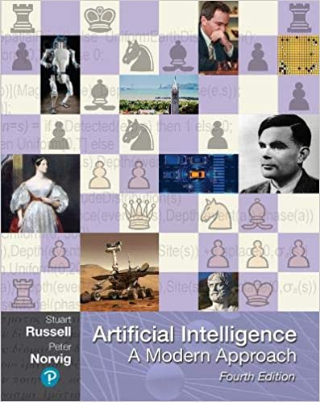
Stuart Russell and Peter Norvig (2020),
Artificial Intelligence: A Modern Approach,
4th Edition, Pearson
Source: Stuart Russell and Peter Norvig (2020), Artificial Intelligence: A Modern Approach, 4th Edition, Pearson
https://www.amazon.com/Artificial-Intelligence-A-Modern-Approach/dp/0134610997/

Slide 8
Artificial Intelligence:
A Modern Approach
Artificial Intelligence
Problem Solving
Knowledge and Reasoning
Uncertain Knowledge and Reasoning
Machine Learning
Communicating, Perceiving, and Acting
Philosophy and Ethics of AI
Source: Stuart Russell and Peter Norvig (2020), Artificial Intelligence: A Modern Approach, 4th Edition, Pearson

Slide 9
Artificial Intelligence:
Communicating, perceiving, and acting
Source: Stuart Russell and Peter Norvig (2020), Artificial Intelligence: A Modern Approach, 4th Edition, Pearson

Slide 10
Artificial Intelligence:
6. Communicating, Perceiving, and Acting
Natural Language Processing
Deep Learning for Natural Language Processing
Computer Vision
Robotics
Source: Stuart Russell and Peter Norvig (2020), Artificial Intelligence: A Modern Approach, 4th Edition, Pearson

Slide 11
Artificial Intelligence:
Natural Language Processing
Language Models
Grammar
Parsing
Augmented Grammars
Complications of Real Natural Language
Natural Language Tasks
Source: Stuart Russell and Peter Norvig (2020), Artificial Intelligence: A Modern Approach, 4th Edition, Pearson

Slide 12
Artificial Intelligence:
Deep Learning for
Natural Language Processing
Word Embeddings
Recurrent Neural Networks for NLP
Sequence-to-Sequence Models
The Transformer Architecture
Pretraining and Transfer Learning
State of the art (SOTA)
Source: Stuart Russell and Peter Norvig (2020), Artificial Intelligence: A Modern Approach, 4th Edition, Pearson

Slide 13
Reinforcement Learning (DL)
Agent
Environment
Source: Richard S. Sutton & Andrew G. Barto (2018), Reinforcement Learning: An Introduction, 2nd Edition, A Bradford Book.

Slide 14
Reinforcement Learning (DL)
1
2
observation
Agent
action
3
reward
Environment
Source: Richard S. Sutton & Andrew G. Barto (2018), Reinforcement Learning: An Introduction, 2nd Edition, A Bradford Book.

Slide 15
Reinforcement Learning (DL)
1
2
observation
Agent
action
O_{t}
A_{t}
3
reward
R_{t}
Environment
Source: Richard S. Sutton & Andrew G. Barto (2018), Reinforcement Learning: An Introduction, 2nd Edition, A Bradford Book.

Slide 16
Agents interact with environments through sensors and actuators
Source: Stuart Russell and Peter Norvig (2020), Artificial Intelligence: A Modern Approach, 4th Edition, Pearson

Slide 17
AI Acting Humanly:
The Turing Test Approach
(Alan Turing, 1950)
Knowledge Representation
Automated Reasoning
Machine Learning (ML)
  Deep Learning (DL)
Computer Vision (Image, Video)
Natural Language Processing (NLP)
Robotics
Source: Stuart Russell and Peter Norvig (2020), Artificial Intelligence: A Modern Approach, 4th Edition, Pearson

Slide 18
Deep Learning for
Natural Language Processing

Slide 19
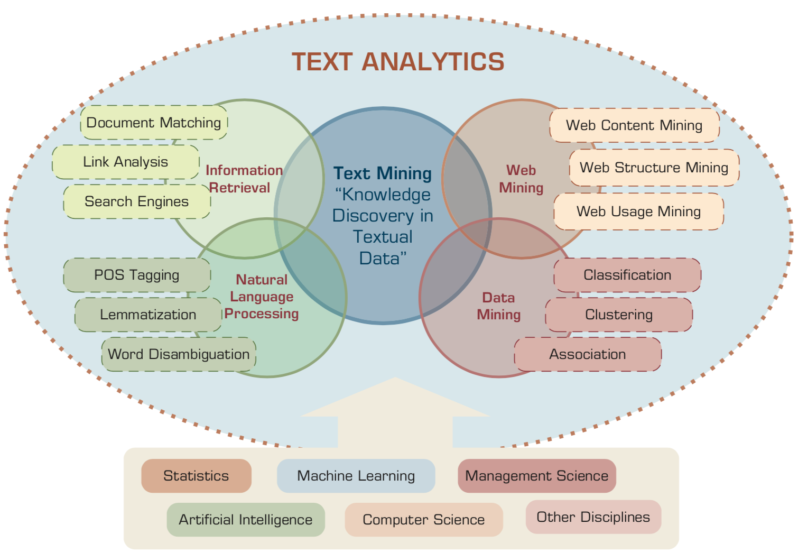
AI for Text Analytics
Source: Ramesh Sharda, Dursun Delen, and Efraim Turban (2017), Business Intelligence, Analytics, and Data Science: A Managerial Perspective, 4th Edition, Pearson

Slide 20
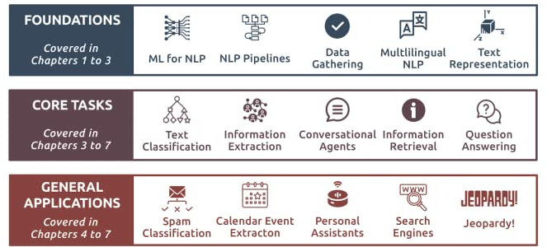
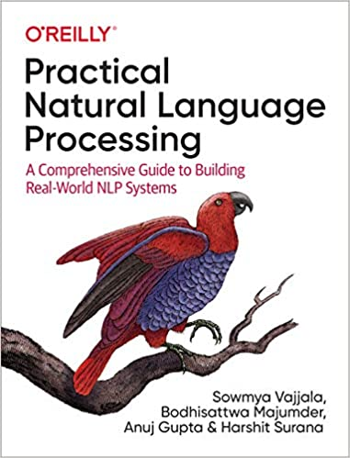
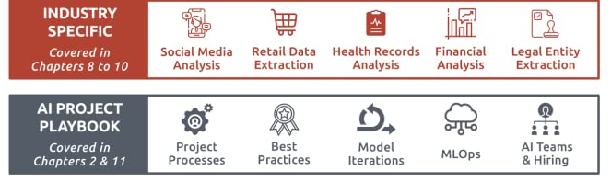
Source: Sowmya Vajjala, Bodhisattwa Majumder, Anuj Gupta (2020), Practical Natural Language Processing: A Comprehensive Guide to Building Real-World NLP Systems, O'Reilly Media.
Source: https://www.amazon.com/Practical-Natural-Language-Processing-Pragmatic/dp/1492054054

Slide 21
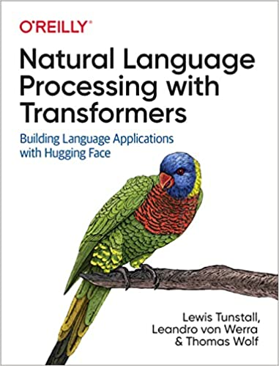
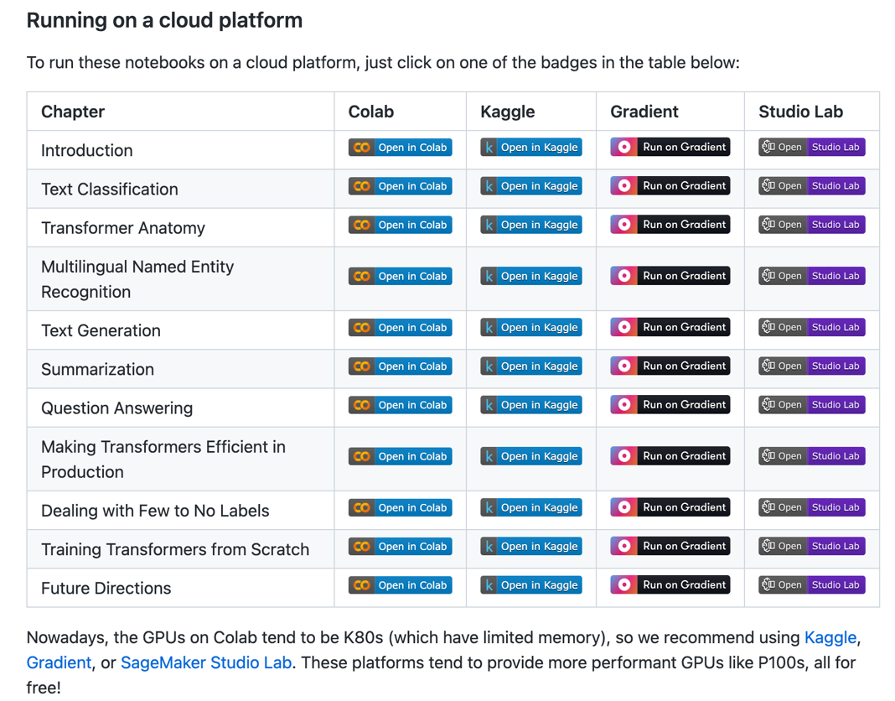
NLP with Transformers Github Notebooks
https://github.com/nlp-with-transformers/notebooks

Slide 22
The Transformers Timeline
ULMFit
BERT
RoBERTa
XLM-R
DeBERTa
GPT-Neo
BLOOM
DistrilBERT
T5
PaLM
Transformer
GPT
GPT-2
GPT-3
GPT-J
OPT-175B
2017
2018
2019
2020
2021
2022
Source: Lewis Tunstall, Leandro von Werra, and Thomas Wolf (2022), Natural Language Processing with Transformers: Building Language Applications with Hugging Face, O'Reilly Media.

Slide 23
Transformer Models
Transformer
Encoder
Decoder
DistilBERT
BERT
T5
GPT
RoBERTa
BART
GPT-2
CTRL
XLM-R
XLM
M2M-100
GPT-3
ALBERT
BigBird
GPT-Neo
GPT-J
ELECTRA
BLOOM
DeBERTa
Source: Lewis Tunstall, Leandro von Werra, and Thomas Wolf (2022), Natural Language Processing with Transformers: Building Language Applications with Hugging Face, O'Reilly Media.

Slide 24
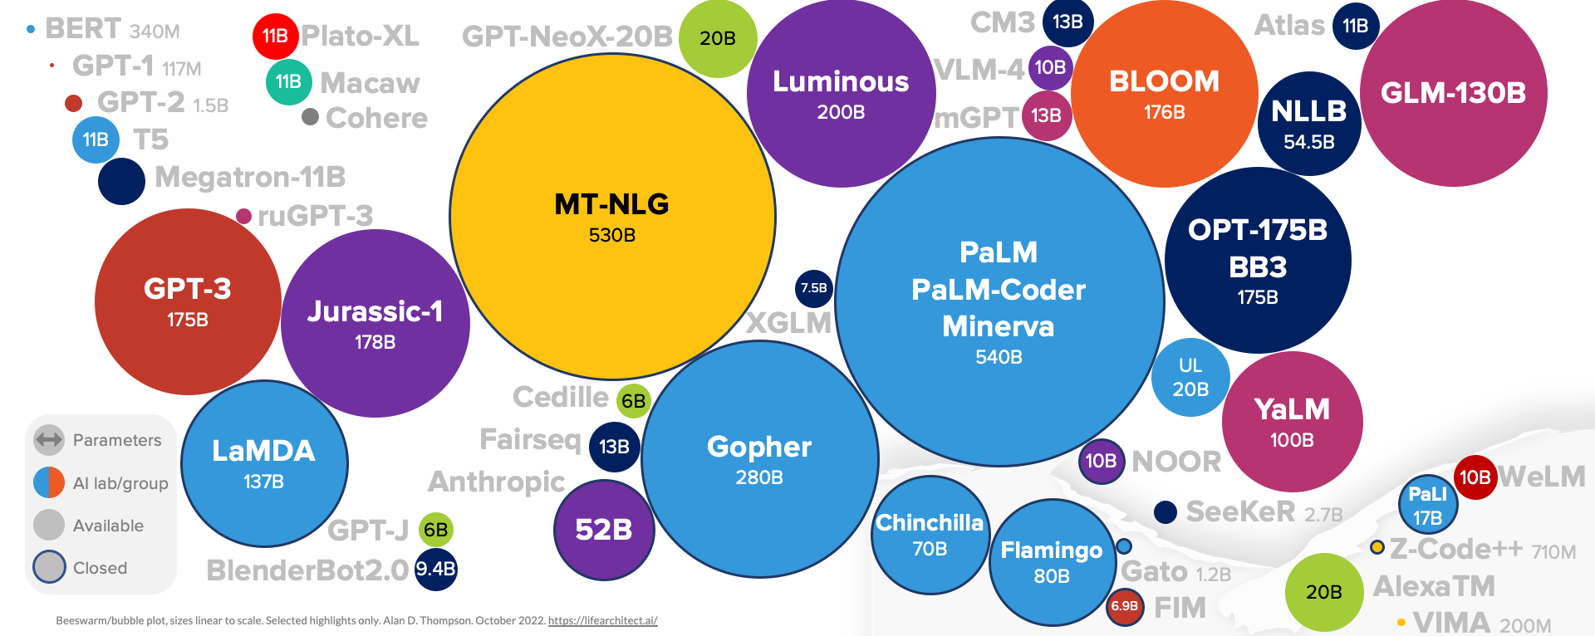
Language Models Sizes
(GPT-3, PaLM, BLOOM)
Source: https://lifearchitect.ai/models/

Slide 25
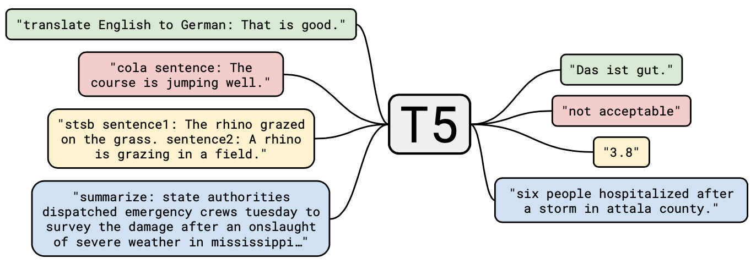
T5
Text-to-Text Transfer Transformer
Source: JColin Raffel, Noam Shazeer, Adam Roberts, Katherine Lee, Sharan Narang, Michael Matena, Yanqi Zhou, Wei Li, and Peter J. Liu (2019). "Exploring the limits of transfer learning with a unified text-to-text transformer." arXiv preprint arXiv:1910.10683 (2019).

Slide 26
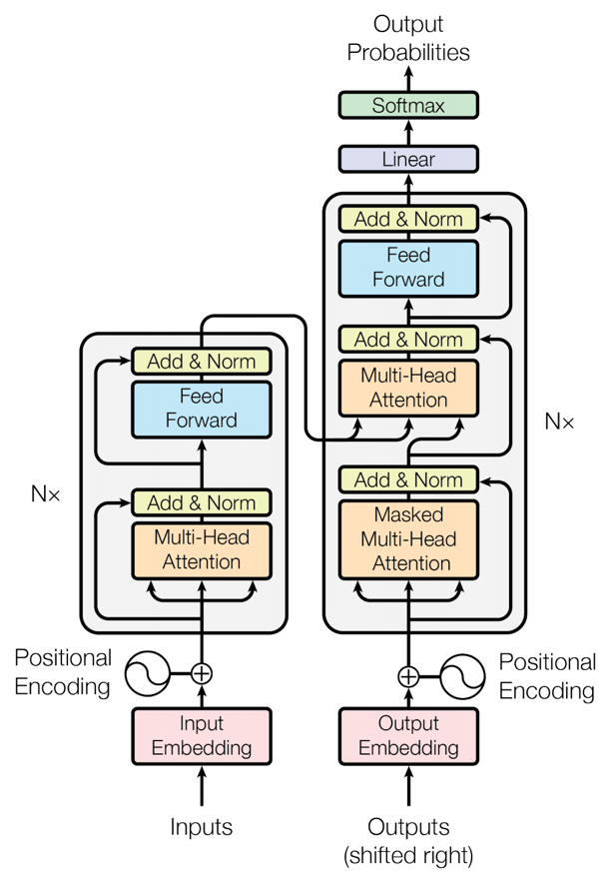
Transformer (Attention is All You Need)
(Vaswani et al., 2017)
Source: Vaswani, Ashish, Noam Shazeer, Niki Parmar, Jakob Uszkoreit, Llion Jones, Aidan N. Gomez, Łukasz Kaiser, and Illia Polosukhin. "Attention is all you need." In Advances in neural information processing systems, pp. 5998-6008. 2017.

Slide 27
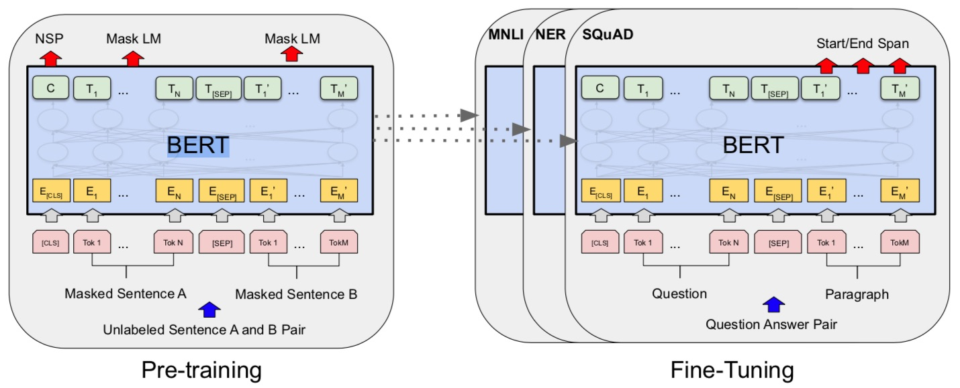
BERT: Pre-training of Deep Bidirectional Transformers for Language Understanding
BERT (Bidirectional Encoder Representations from Transformers)
Overall pre-training and fine-tuning procedures for BERT
Source: Devlin, Jacob, Ming-Wei Chang, Kenton Lee, and Kristina Toutanova (2018).
"Bert: Pre-training of deep bidirectional transformers for language understanding." arXiv preprint arXiv:1810.04805.

Slide 28
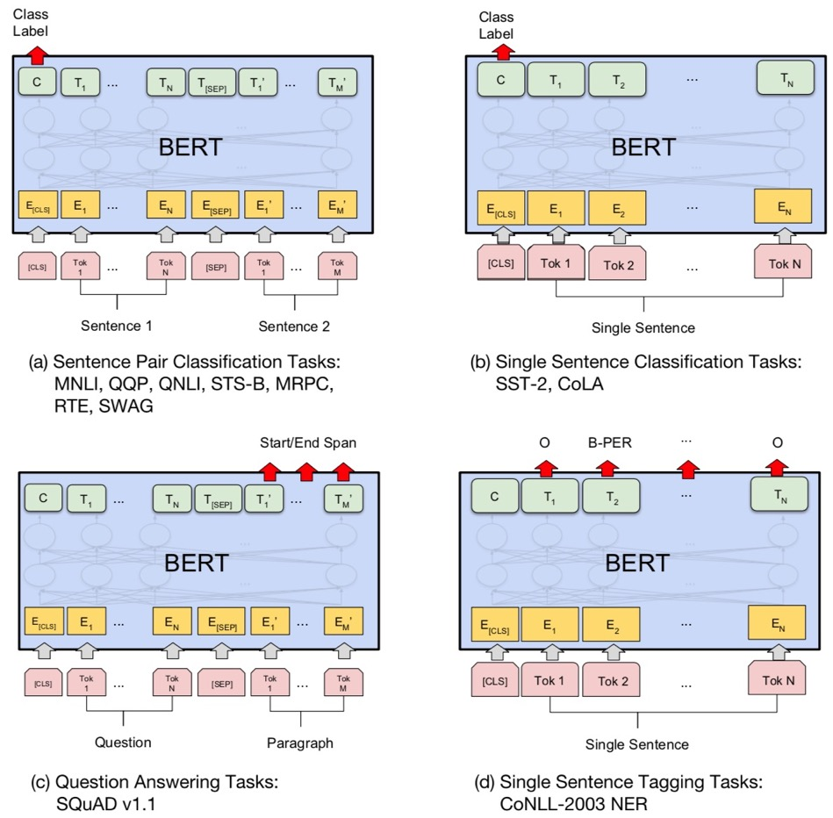
Fine-tuning BERT on Different Tasks
Source: Devlin, Jacob, Ming-Wei Chang, Kenton Lee, and Kristina Toutanova (2018).
"Bert: Pre-training of deep bidirectional transformers for language understanding." arXiv preprint arXiv:1810.04805.

Slide 29
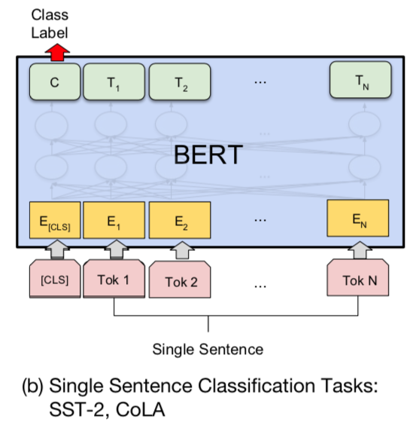
Sentiment Analysis:
Single Sentence Classification
Source: Devlin, Jacob, Ming-Wei Chang, Kenton Lee, and Kristina Toutanova (2018).
"BERT: Pre-training of Deep Bidirectional Transformers for Language Understanding." arXiv preprint arXiv:1810.04805

Slide 30
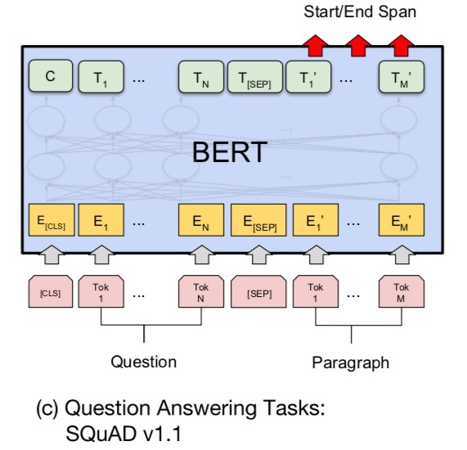
Fine-tuning BERT on
Question Answering (QA)
Source: Devlin, Jacob, Ming-Wei Chang, Kenton Lee, and Kristina Toutanova (2018).
"Bert: Pre-training of deep bidirectional transformers for language understanding." arXiv preprint arXiv:1810.04805.

Slide 31
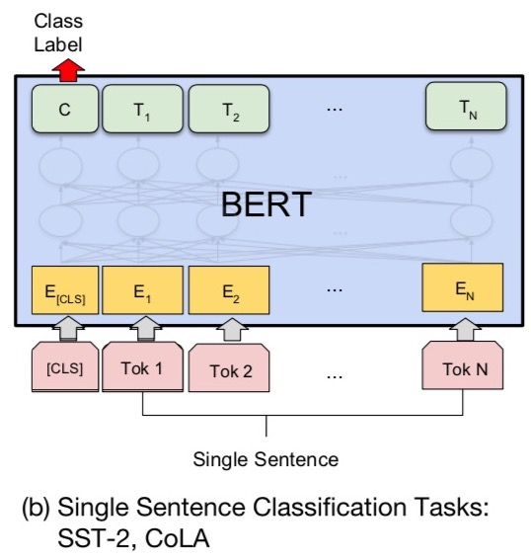
Fine-tuning BERT on Dialogue
Intent Detection (ID; Classification)
Source: Devlin, Jacob, Ming-Wei Chang, Kenton Lee, and Kristina Toutanova (2018).
"Bert: Pre-training of deep bidirectional transformers for language understanding." arXiv preprint arXiv:1810.04805.

Slide 32
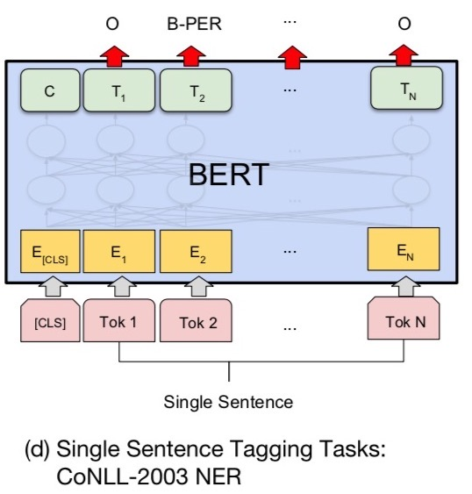
Fine-tuning BERT on Dialogue
Slot Filling (SF)
Source: Devlin, Jacob, Ming-Wei Chang, Kenton Lee, and Kristina Toutanova (2018).
"Bert: Pre-training of deep bidirectional transformers for language understanding." arXiv preprint arXiv:1810.04805.

Slide 33
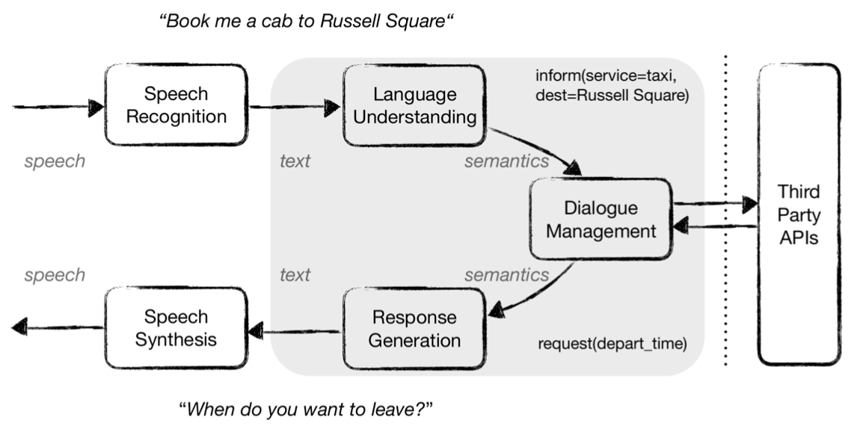
Task-Oriented Dialogue (ToD) System
Speech, Text, NLP
Source: Razumovskaia, Evgeniia, Goran Glavas, Olga Majewska, Edoardo M. Ponti, Anna Korhonen, and Ivan Vulic.
"Crossing the conversational chasm: A primer on natural language processing for multilingual task-oriented dialogue systems." Journal of Artificial Intelligence Research 74 (2022): 1351-1402.

Slide 34
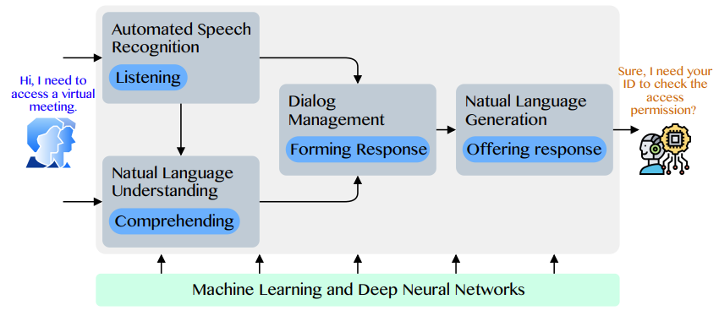
Conversational AI to deliver contextual and personal experience to users
Source: Huynh-The, Thien, Quoc-Viet Pham, Xuan-Qui Pham, Thanh Thi Nguyen, Zhu Han, and Dong-Seong Kim (2022).
"Artificial Intelligence for the Metaverse: A Survey." arXiv preprint arXiv:2202.10336.

Slide 35
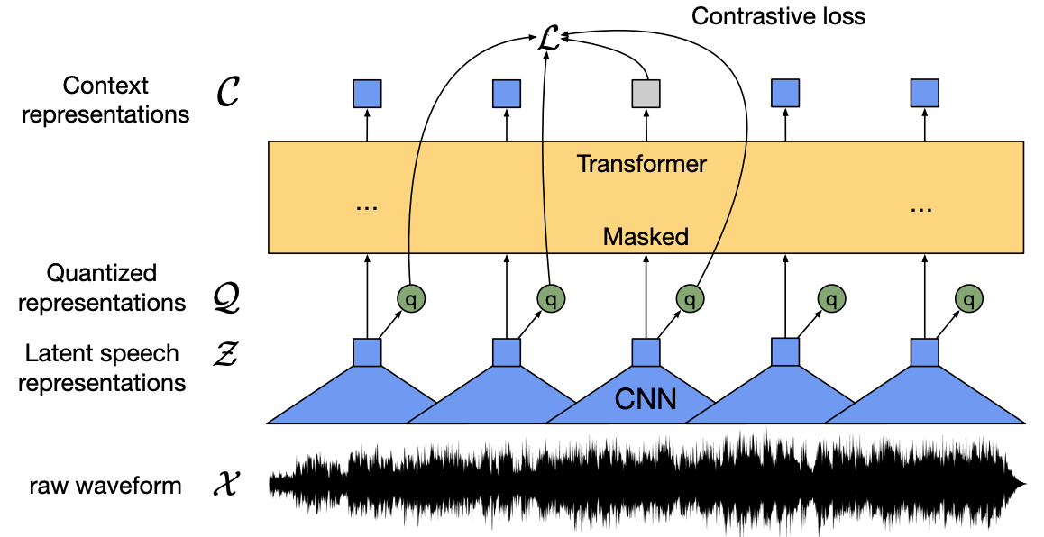
wav2vec 2.0:
A framework for self-supervised learning of speech representations
Source: Baevski, Alexei, Yuhao Zhou, Abdelrahman Mohamed, and Michael Auli.
"wav2vec 2.0: A framework for self-supervised learning of speech representations." Advances in Neural Information Processing Systems 33 (2020): 12449-12460.

Slide 36
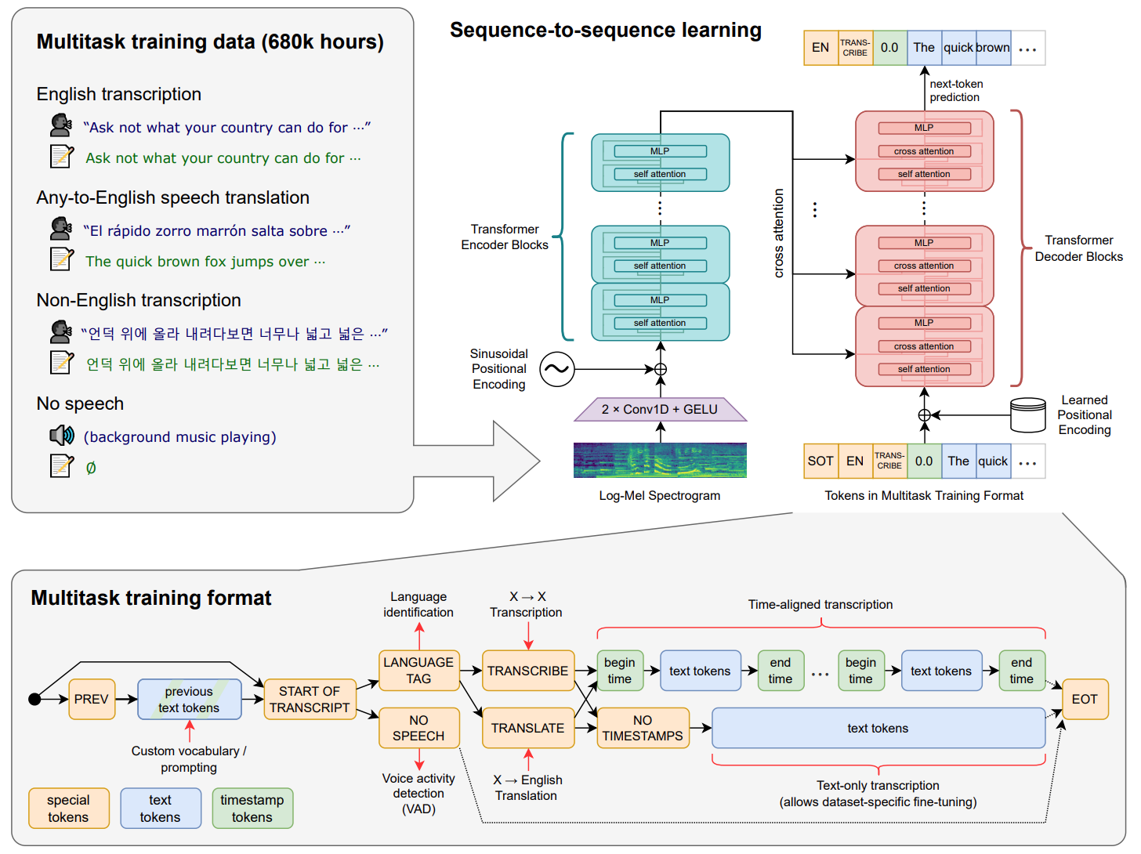
Whisper:
Robust Speech Recognition via Large-Scale Weak Supervision
Source: Radford, Alec, Jong Wook Kim, Tao Xu, Greg Brockman, Christine McLeavey, and Ilya Sutskever. Robust speech recognition via large-scale weak supervision. Tech. Rep., Technical report, OpenAI, 2022.

Slide 37
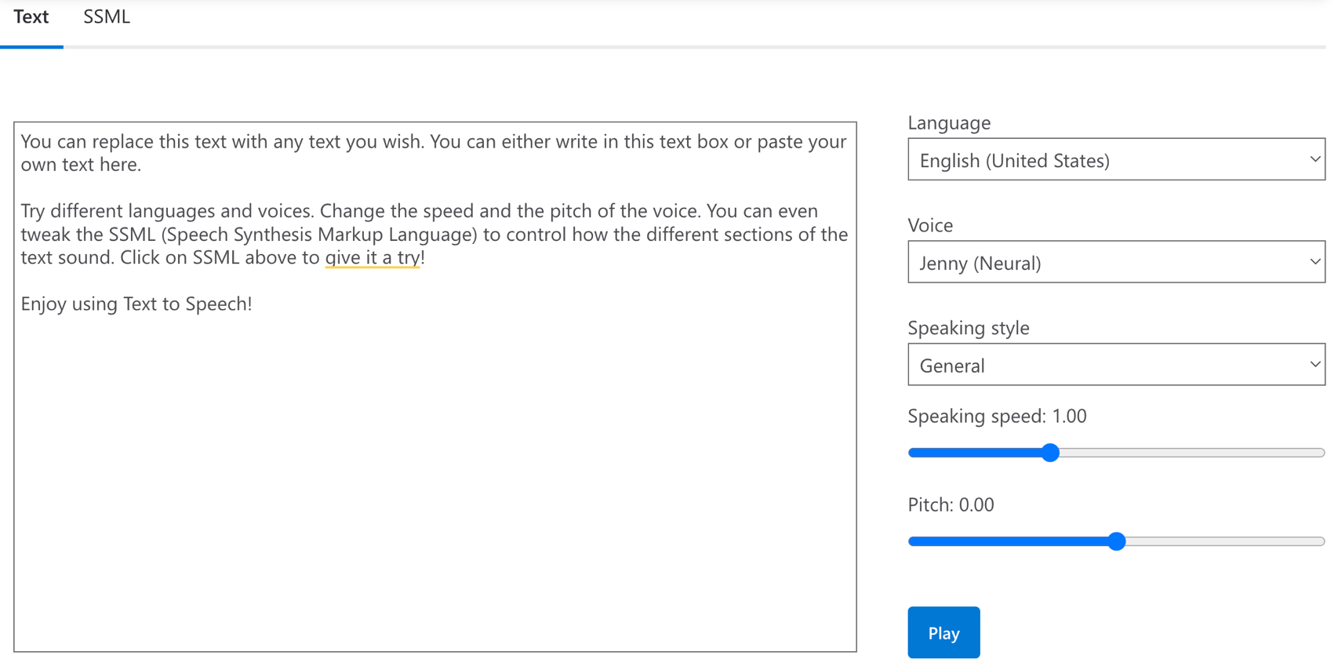
Microsoft Azure
Text to Speech (TTS)
Source: https://azure.microsoft.com/en-gb/products/cognitive-services/text-to-speech/

Slide 38
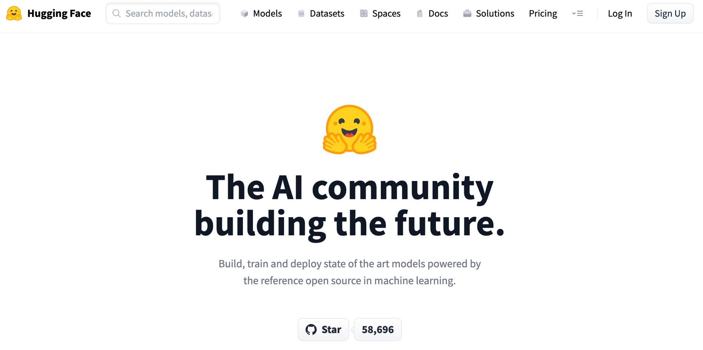
Hugging Face
https://huggingface.co/

Slide 39
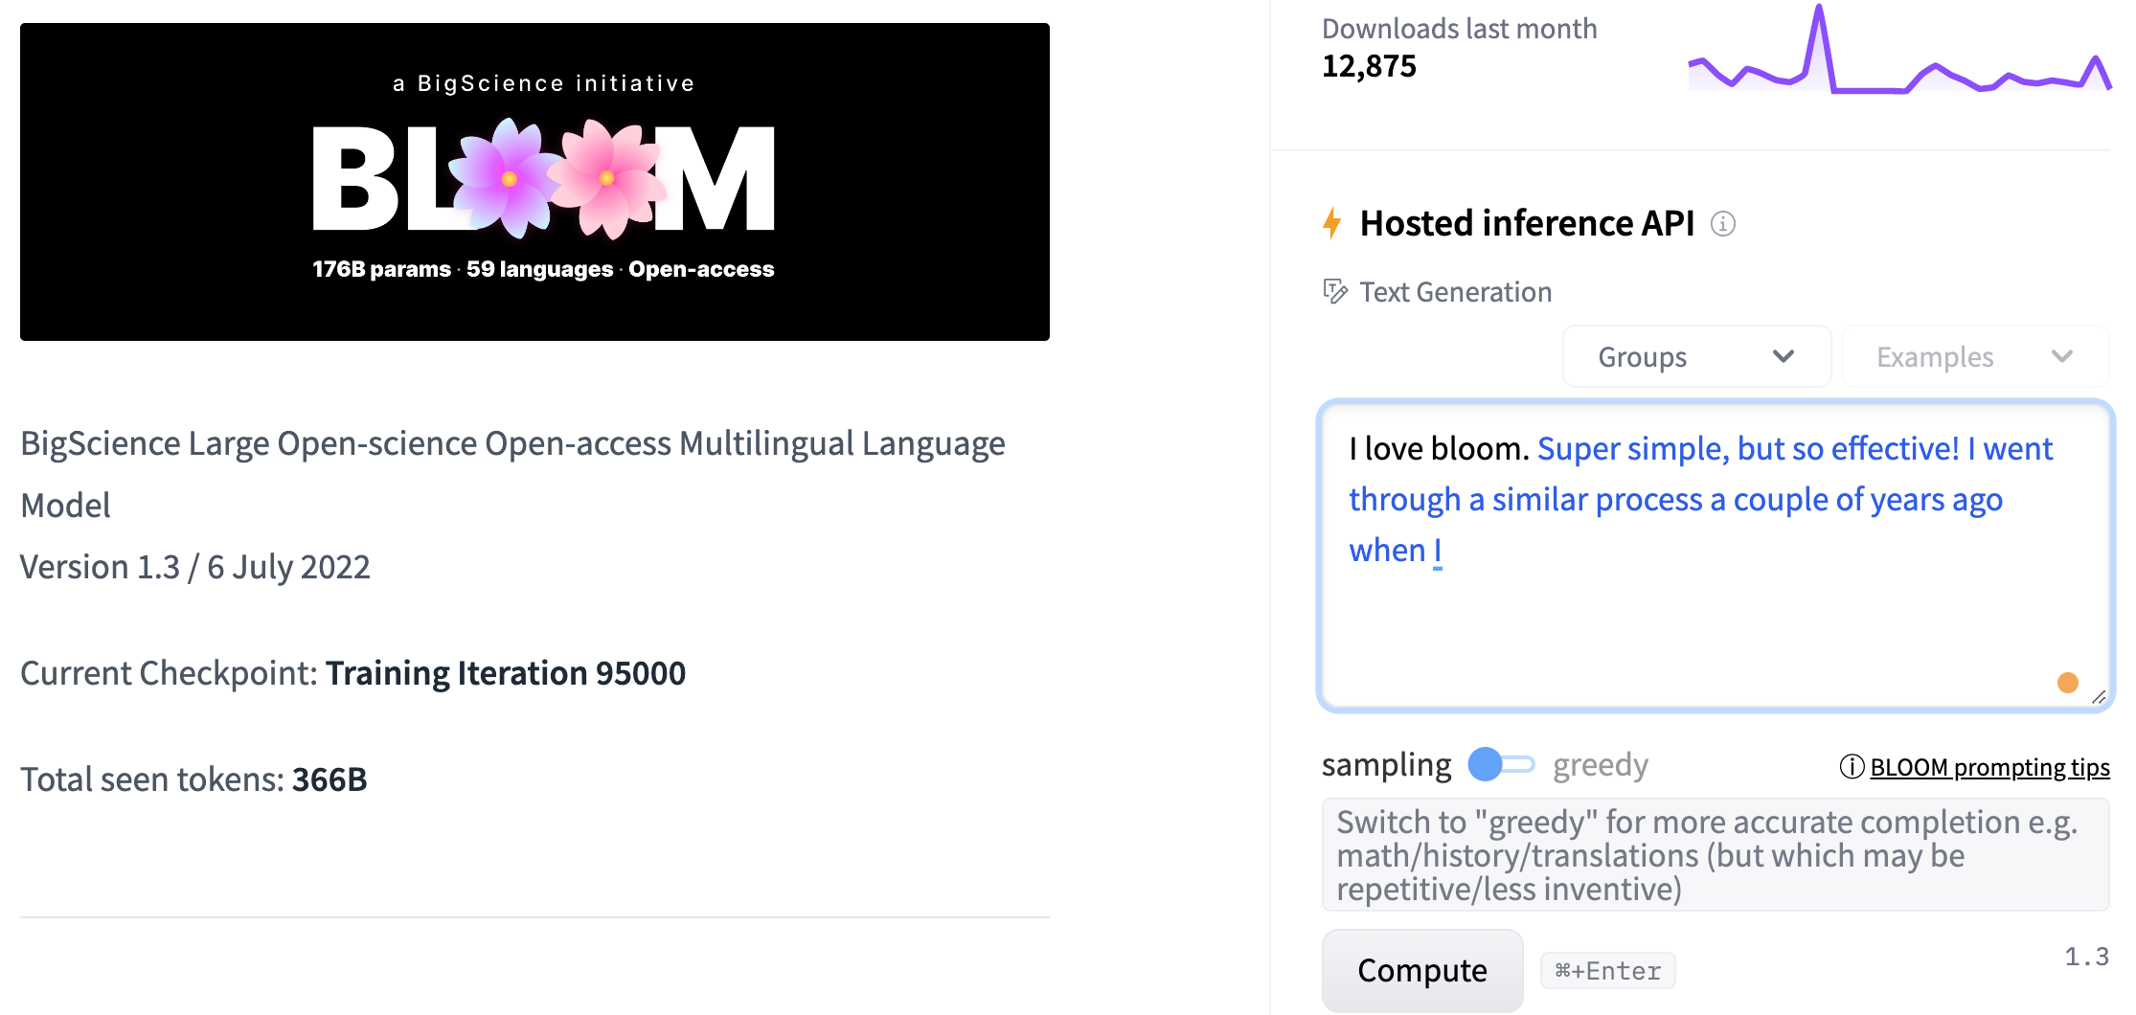
BLOOM
BigScience Large Open-science Open-access Multilingual Language Model
Source: https://huggingface.co/bigscience/bloom

Slide 40
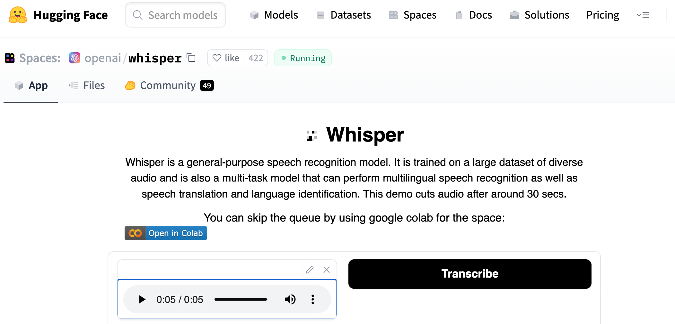
OpenAI Whisper
Source: https://huggingface.co/spaces/openai/whisper

Slide 41
Text Classification
text = """Dear Amazon, last week I ordered an Optimus Prime action figure \
from your online store in Germany. Unfortunately, when I opened the package, \
I discovered to my horror that I had been sent an action figure of Megatron \
instead! As a lifelong enemy of the Decepticons, I hope you can understand my \
dilemma. To resolve the issue, I demand an exchange of Megatron for the \
Optimus Prime figure I ordered. Enclosed are copies of my records concerning \
this purchase. I expect to hear from you soon. Sincerely, Bumblebee."""
Source: Lewis Tunstall, Leandro von Werra, and Thomas Wolf (2022), Natural Language Processing with Transformers: Building Language Applications with Hugging Face, O'Reilly Media.
https://github.com/nlp-with-transformers/notebooks

Slide 42
Text Classification
text = """Dear Amazon, last week I ordered an Optimus Prime action figure \
from your online store in Germany. Unfortunately, when I opened the package, \
I discovered to my horror that I had been sent an action figure of Megatron \
instead! As a lifelong enemy of the Decepticons, I hope you can understand my \
dilemma. To resolve the issue, I demand an exchange of Megatron for the \
Optimus Prime figure I ordered. Enclosed are copies of my records concerning \
this purchase. I expect to hear from you soon. Sincerely, Bumblebee."""
from transformers import pipeline
classifier = pipeline("text-classification")
import pandas as pd
outputs = classifier(text)
pd.DataFrame(outputs)
 | label | score
0 | NEGATIVE | 0.901546
Source: Lewis Tunstall, Leandro von Werra, and Thomas Wolf (2022), Natural Language Processing with Transformers: Building Language Applications with Hugging Face, O'Reilly Media.
https://github.com/nlp-with-transformers/notebooks

Slide 43
Text Classification
from transformers import pipeline
classifier = pipeline("text-classification")
import pandas as pd
outputs = classifier(text)
pd.DataFrame(outputs)
 | label | score
0 | NEGATIVE | 0.901546
Source: Lewis Tunstall, Leandro von Werra, and Thomas Wolf (2022), Natural Language Processing with Transformers: Building Language Applications with Hugging Face, O'Reilly Media.
https://github.com/nlp-with-transformers/notebooks

Slide 44
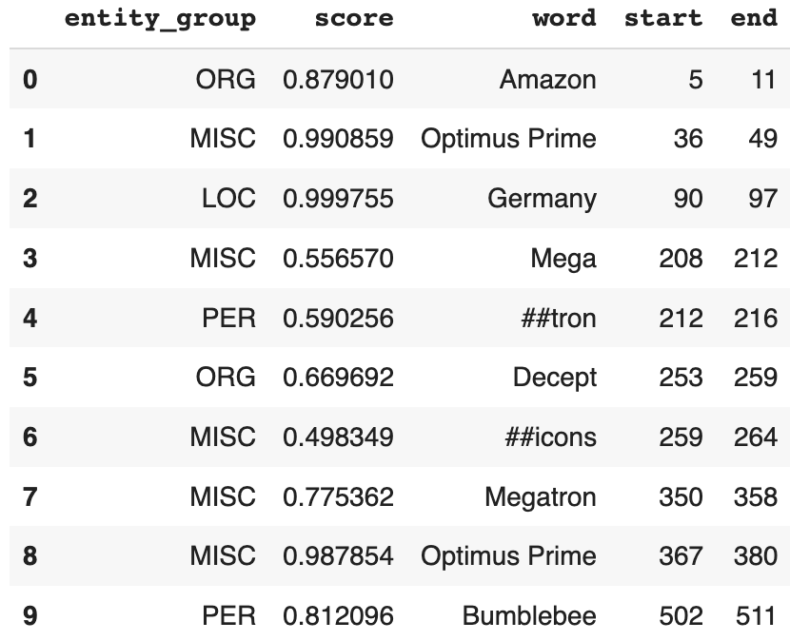
Named Entity Recognition
ner_tagger = pipeline("ner", aggregation_strategy="simple")
outputs = ner_tagger(text)
pd.DataFrame(outputs)
Source: Lewis Tunstall, Leandro von Werra, and Thomas Wolf (2022), Natural Language Processing with Transformers: Building Language Applications with Hugging Face, O'Reilly Media.
https://github.com/nlp-with-transformers/notebooks

Slide 45
Question Answering
reader = pipeline("question-answering")
question = "What does the customer want?"
outputs = reader(question=question, context=text)
pd.DataFrame([outputs])
 | score | start | end | answer
0 | 0.631292 | 335 | 358 | an exchange of Megatron
Source: Lewis Tunstall, Leandro von Werra, and Thomas Wolf (2022), Natural Language Processing with Transformers: Building Language Applications with Hugging Face, O'Reilly Media.
https://github.com/nlp-with-transformers/notebooks

Slide 46
Summarization
summarizer = pipeline("summarization")
outputs = summarizer(text, max_length=45, clean_up_tokenization_spaces=True)
print(outputs[0]['summary_text'])
Bumblebee ordered an Optimus Prime action figure from your online store in Germany. Unfortunately, when I opened the package, I discovered to my horror that I had been sent an action figure of Megatron instead.
Source: Lewis Tunstall, Leandro von Werra, and Thomas Wolf (2022), Natural Language Processing with Transformers: Building Language Applications with Hugging Face, O'Reilly Media.
https://github.com/nlp-with-transformers/notebooks

Slide 47
Translation
translator = pipeline("translation_en_to_de",
model="Helsinki-NLP/opus-mt-en-de")
outputs = translator(text, clean_up_tokenization_spaces=True, min_length=100)
print(outputs[0]['translation_text'])
Sehr geehrter Amazon, letzte Woche habe ich eine Optimus Prime Action Figur aus Ihrem Online-Shop in Deutschland bestellt. Leider, als ich das Paket öffnete, entdeckte ich zu meinem Entsetzen, dass ich stattdessen eine Action Figur von Megatron geschickt worden war! Als lebenslanger Feind der Decepticons, Ich hoffe, Sie können mein Dilemma verstehen. Um das Problem zu lösen, Ich fordere einen Austausch von Megatron für die Optimus Prime Figur habe ich bestellt. Anbei sind Kopien meiner Aufzeichnungen über diesen Kauf. Ich erwarte, bald von Ihnen zu hören. Aufrichtig, Bumblebee.
Source: Lewis Tunstall, Leandro von Werra, and Thomas Wolf (2022), Natural Language Processing with Transformers: Building Language Applications with Hugging Face, O'Reilly Media.
https://github.com/nlp-with-transformers/notebooks

Slide 48
Text Generation
from transformers import set_seed
set_seed(42) # Set the seed to get reproducible results
generator = pipeline("text-generation")
response = "Dear Bumblebee, I am sorry to hear that your order was mixed up."
prompt = text + "\n\nCustomer service response:\n" + response
outputs = generator(prompt, max_length=200)
print(outputs[0]['generated_text'])
Customer service response:
Dear Bumblebee, I am sorry to hear that your order was mixed up. The order was completely mislabeled, which is very common in our online store, but I can appreciate it because it was my understanding from this site and our customer service of the previous day that your order was not made correct in our mind and that we are in a process of resolving this matter. We can assure you that your order
Source: Lewis Tunstall, Leandro von Werra, and Thomas Wolf (2022), Natural Language Processing with Transformers: Building Language Applications with Hugging Face, O'Reilly Media.
https://github.com/nlp-with-transformers/notebooks

Slide 49
Text Generation
Dear Amazon, last week I ordered an Optimus Prime action figure from your online store in Germany. Unfortunately, when I opened the package, I discovered to my horror that I had been sent an action figure of Megatron instead! As a lifelong enemy of the Decepticons, I hope you can understand my dilemma. To resolve the issue, I demand an exchange of Megatron for the Optimus Prime figure I ordered. Enclosed are copies of my records concerning this purchase. I expect to hear from you soon. Sincerely, Bumblebee.
Customer service response:
Dear Bumblebee, I am sorry to hear that your order was mixed up. The order was completely mislabeled, which is very common in our online store, but I can appreciate it because it was my understanding from this site and our customer service of the previous day that your order was not made correct in our mind and that we are in a process of resolving this matter. We can assure you that your order
Source: Lewis Tunstall, Leandro von Werra, and Thomas Wolf (2022), Natural Language Processing with Transformers: Building Language Applications with Hugging Face, O'Reilly Media.
https://github.com/nlp-with-transformers/notebooks

Slide 50
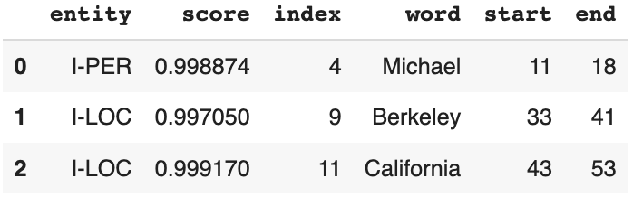
Named Entity Recognition (NER)
from transformers import pipeline
import pandas as pd
classifier = pipeline("ner")
text = "My name is Michael and I live in Berkeley, California."
outputs = classifier(text)
pd.DataFrame(outputs)
https://tinyurl.com/aintpupython101

Slide 51
Question Answering
!pip install transformers
from transformers import pipeline
qamodel = pipeline("question-answering")
question = "Where do I live?"
context = "My name is Michael and I live in Taipei."
qamodel(question = question, context = context)
{'answer': 'Taipei', 'end': 39, 'score': 0.9730741381645203, 'start': 33}
https://tinyurl.com/aintpupython101

Slide 52
Question Answering
from transformers import pipeline
qamodel = pipeline("question-answering", model ='deepset/roberta-base-squad2')
question = "Where do I live?"
context = "My name is Michael and I live in Taipei."
output = qamodel(question = question, context = context)
print(output['answer’])
Taipei
https://tinyurl.com/aintpupython101

Slide 53
Question Answering
from transformers import pipeline
qamodel = pipeline("question-answering", model ='deepset/roberta-base-squad2')
question = "What causes precipitation to fall?"
context = """In meteorology, precipitation is any product of the condensation of atmospheric water vapor that falls under gravity. The main forms of precipitation include drizzle, rain, sleet, snow, graupel and hail... Precipitation forms as smaller droplets coalesce via collision with other rain drops or ice crystals within a cloud. Short, intense periods of rain in scattered locations are called "showers"."""
output = qamodel(question = question, context = context)
print(output['answer'])
gravity
https://tinyurl.com/aintpupython101

Slide 54
Text Generation
!pip install transformers
from transformers import pipeline
generator = pipeline('text-generation', model = 'gpt2')
generator("Hello, I'm a language model", max_length = 30, num_return_sequences=3)
[{'generated_text': "Hello, I'm a language model. It's like looking at it, where is each word of the sentence? That's what I mean. Like"},
{'generated_text': "Hello, I'm a language modeler. I'm using this for two purposes: I'm having a lot fewer bugs and faster performance. If I"},
{'generated_text': 'Hello, I\'m a language model, and I was born to code."\n\nNow, I am thinking about this from a different perspective with a'}]
https://tinyurl.com/aintpupython101

Slide 55
Text Generation
from transformers import pipeline
generator = pipeline('text-generation', model = 'gpt2')
outputs = generator("Once upon a time", max_length = 30)
print(outputs[0]['generated_text'])
Once upon a time, every person who ever saw Jesus, knew that He was Christ. And even though he might not have known Him, He was
https://tinyurl.com/aintpupython101

Slide 56
Text Generation
from transformers import pipeline
generator = pipeline('text-generation', model = 'gpt2')
outputs = generator("Once upon a time", max_length = 100)
print(outputs[0]['generated_text'])
Once upon a time we should be able to speak to people who have lost children, so we try to take those that have lost the children to our institutions — but the first time is very hard for us because of our institutions. To me, it's important to acknowledge that in an institution of faith and love they are not children. And that there are many people who are still hurting the child and there are many in need of help, if not a system. So I'm very curious
https://tinyurl.com/aintpupython101

Slide 57
Text2Text Generation
from transformers import pipeline
text2text_generator = pipeline("text2text-generation", model = 't5-base')
outputs = text2text_generator("translate from English to French: I am a student")
print(outputs[0]['generated_text'])
I am a student
Je suis un étudiant
https://tinyurl.com/aintpupython101

Slide 58
Text2Text Generation
from transformers import pipeline
text2text_generator = pipeline("text2text-generation")
text2text_generator("question: What is 42 ? context: 42 is the answer to life, the universe and everything")
[{'generated_text': 'the answer to life, the universe and everything'}]
https://tinyurl.com/aintpupython101

Slide 59
NLP
Source: http://blog.aylien.com/leveraging-deep-learning-for-multilingual/

Slide 60
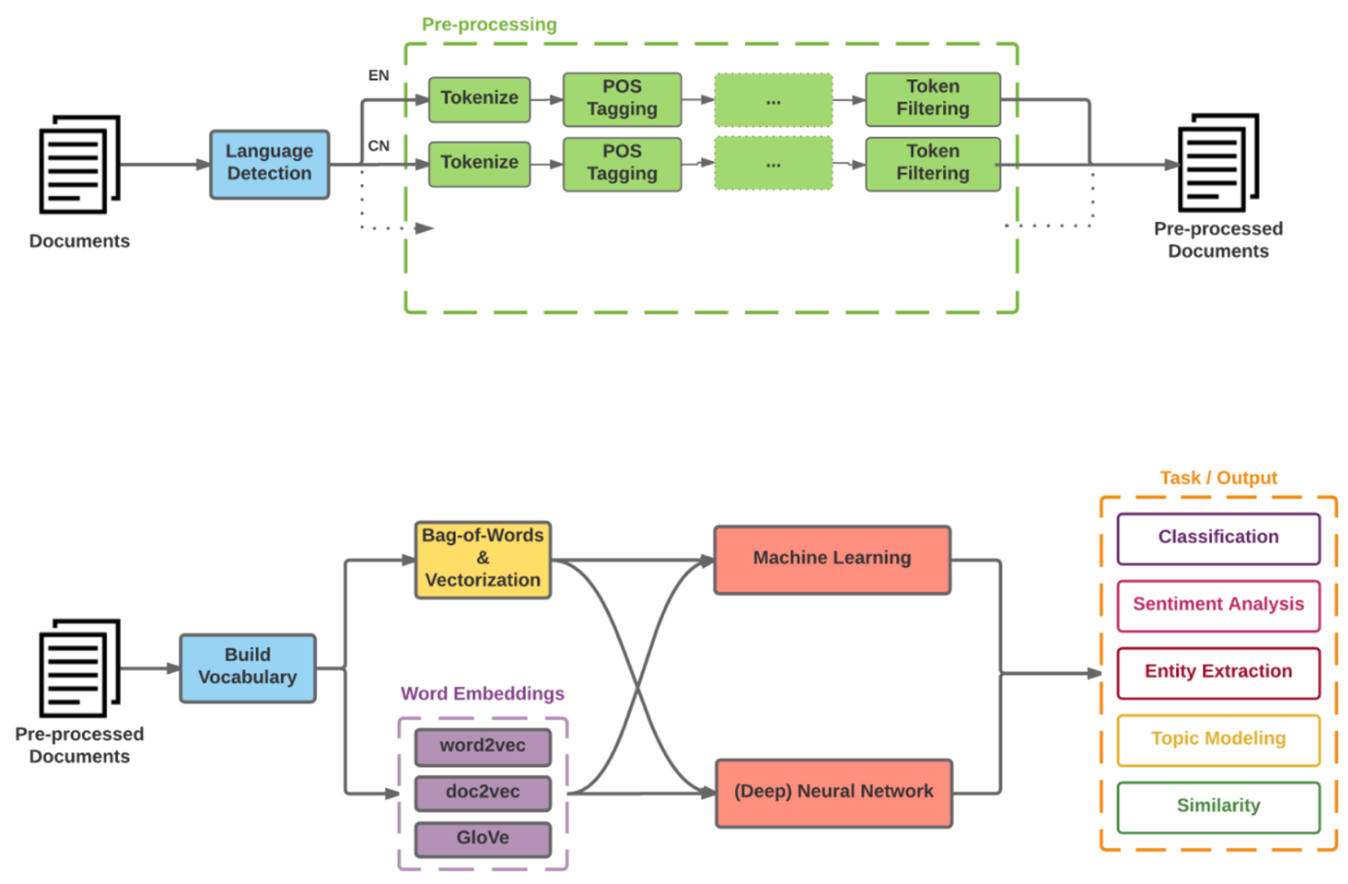
Modern NLP Pipeline
Source: https://github.com/fortiema/talks/blob/master/opendata2016sh/pragmatic-nlp-opendata2016sh.pdf

Slide 61
Modern NLP Pipeline
Source: http://mattfortier.me/2017/01/31/nlp-intro-pt-1-overview/

Slide 62
Deep Learning NLP
Source: http://mattfortier.me/2017/01/31/nlp-intro-pt-1-overview/

Slide 63
Natural Language Processing (NLP) and Text Mining
Raw text
Sentence Segmentation
Tokenization
Part-of-Speech (POS)
Stop word removal
word’s stem
am → am
having → hav
word’s lemma
am → be
having → have
Stemming / Lemmatization
Dependency Parser
String Metrics & Matching
Source: Nitin Hardeniya (2015), NLTK Essentials, Packt Publishing; Florian Leitner (2015), Text mining - from Bayes rule to dependency parsing

Slide 64
Outline
Word Embeddings
Recurrent Neural Networks for NLP
Sequence-to-Sequence Models
The Transformer Architecture
Pretraining and Transfer Learning
State of the art (SOTA)

Slide 65
One-hot encoding
'The mouse ran up the clock’ =
[ [0, 1, 0, 0, 0, 0, 0],
[0, 0, 1, 0, 0, 0, 0],
[0, 0, 0, 1, 0, 0, 0],
[0, 0, 0, 0, 1, 0, 0],
[0, 1, 0, 0, 0, 0, 0],
[0, 0, 0, 0, 0, 1, 0] ]
The
mouse
ran
up
the
clock
1
2
3
4
1
5
[0, 1, 2, 3, 4, 5, 6]
Source: https://developers.google.com/machine-learning/guides/text-classification/step-3

Slide 66
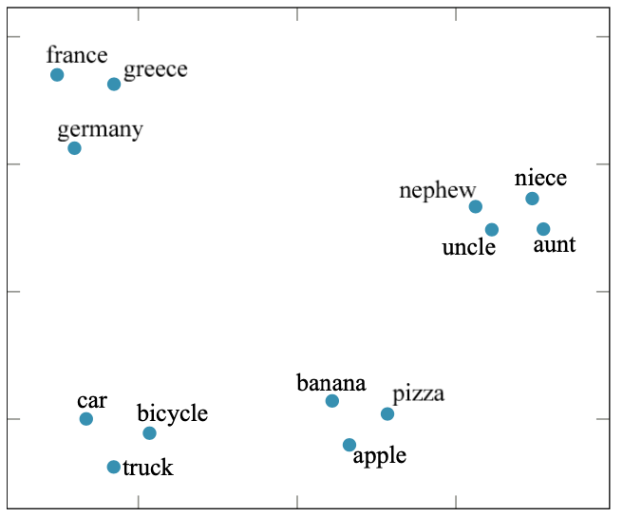
Word embedding
GloVe (trained on 6 billion words of text)
100-dimensional word vectors are projected down onto two dimensions
Source: Stuart Russell and Peter Norvig (2020), Artificial Intelligence: A Modern Approach, 4th Edition, Pearson

Slide 67
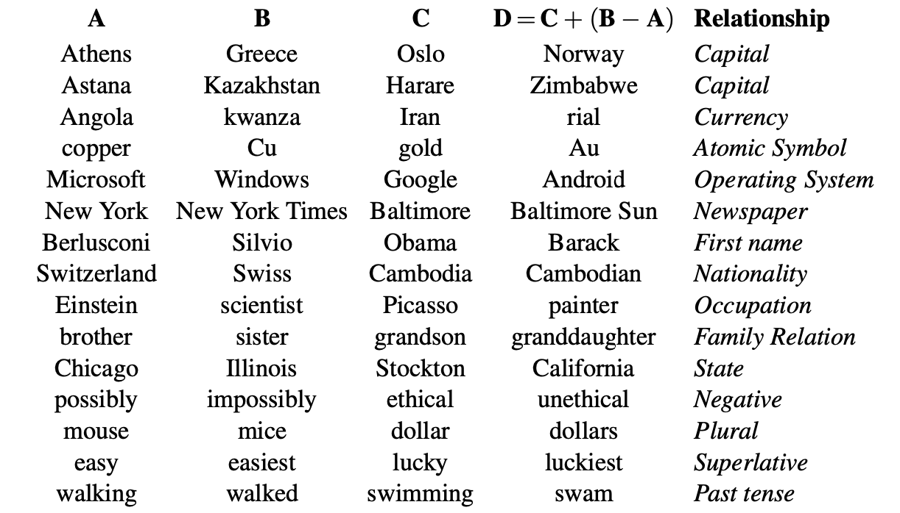
Word Embedding model answer the question “A is to B as C is to [what]?”
Source: Stuart Russell and Peter Norvig (2020), Artificial Intelligence: A Modern Approach, 4th Edition, Pearson

Slide 68
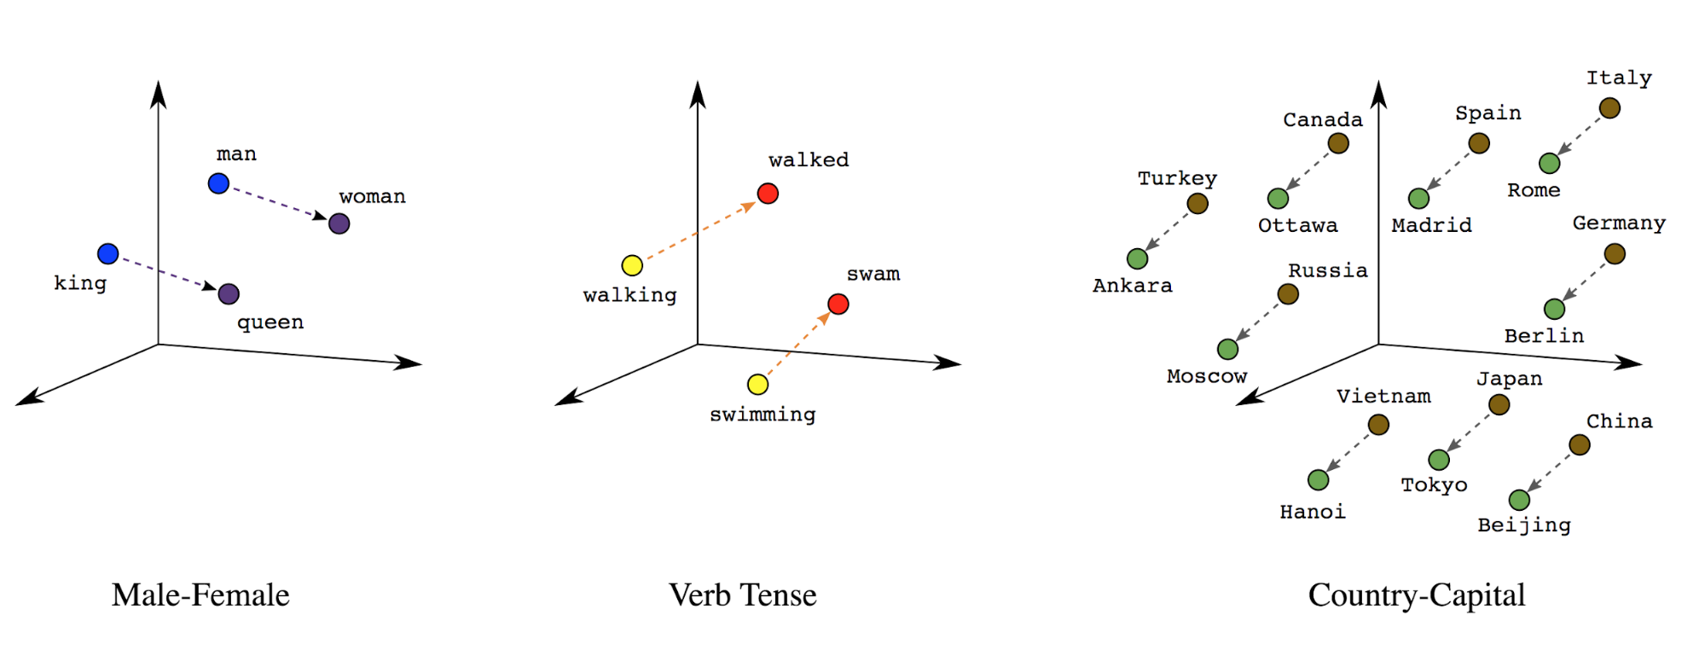
Word embeddings
Source: https://developers.google.com/machine-learning/guides/text-classification/step-3

Slide 69
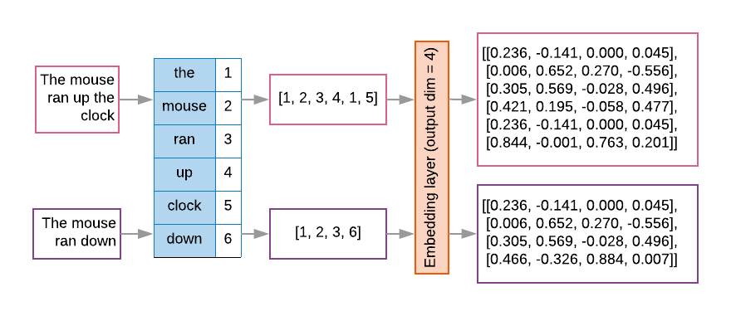
Word embeddings
Source: https://developers.google.com/machine-learning/guides/text-classification/step-3

Slide 70
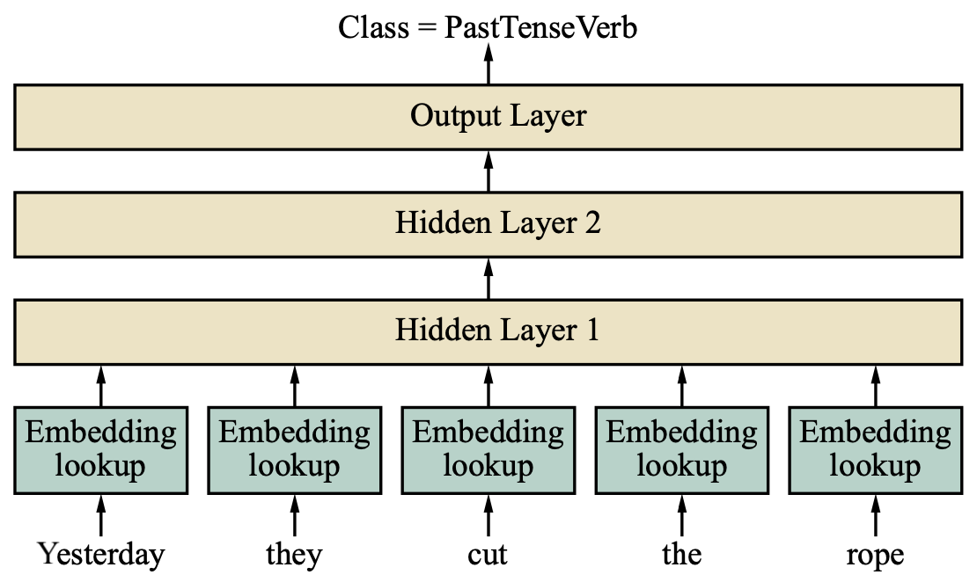
Feedforward part-of-speech (POS) tagging model
Source: Stuart Russell and Peter Norvig (2020), Artificial Intelligence: A Modern Approach, 4th Edition, Pearson

Slide 71
Universal Sentence Encoder (USE)
The Universal Sentence Encoder
encodes text into high-dimensional vectors that can be used for
text classification,
semantic similarity,
clustering and
other natural language tasks.
The universal-sentence-encoder model is trained with a deep averaging network (DAN) encoder.
Source: https://tfhub.dev/google/universal-sentence-encoder/4

Slide 72
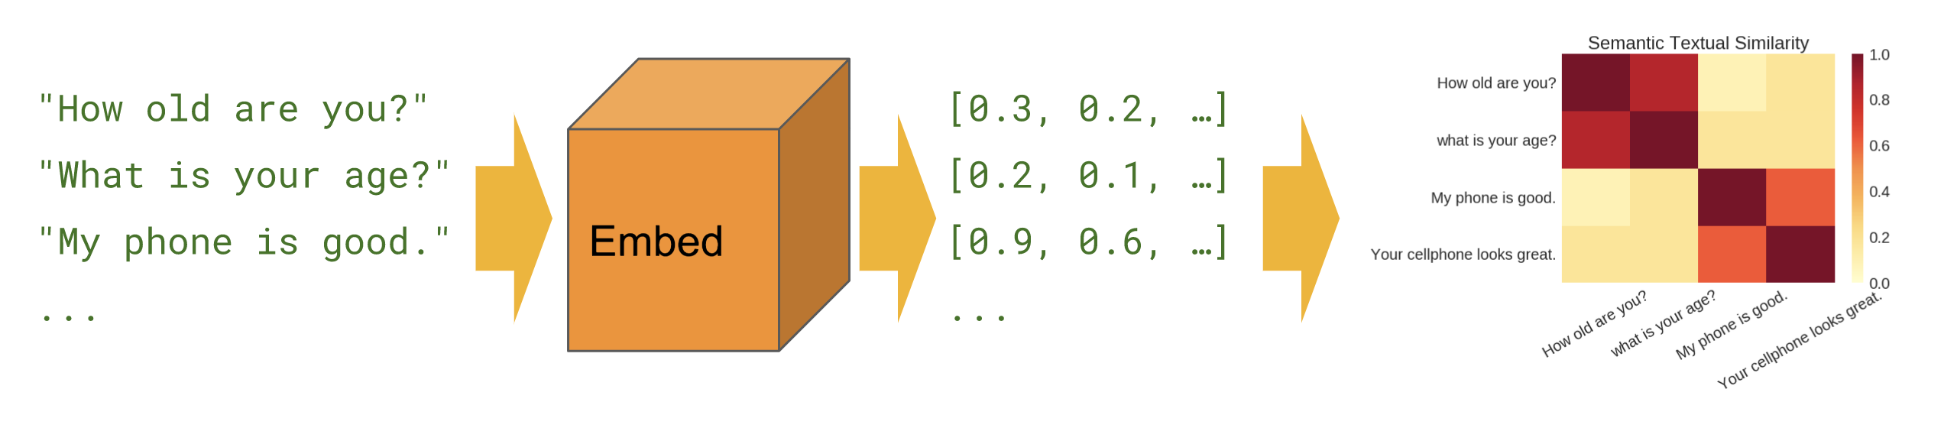
Universal Sentence Encoder (USE)
Semantic Similarity
Source: https://tfhub.dev/google/universal-sentence-encoder/4

Slide 73
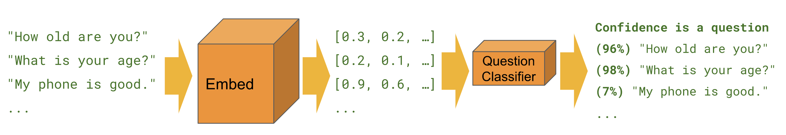
Universal Sentence Encoder (USE)
Classification
Source: https://tfhub.dev/google/universal-sentence-encoder/4

Slide 74
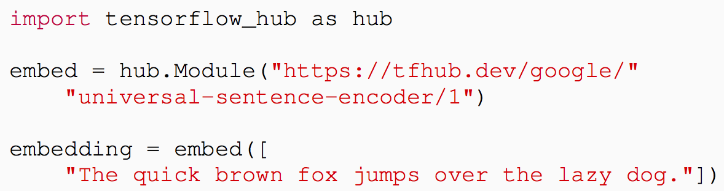
Universal Sentence Encoder (USE)
Source: Daniel Cer, Yinfei Yang, Sheng-yi Kong, Nan Hua, Nicole Limtiaco, Rhomni St. John, Noah Constant, Mario Guajardo-Céspedes, Steve Yuan, Chris Tar, Yun-Hsuan Sung, Brian Strope, Ray Kurzweil. Universal Sentence Encoder. arXiv:1803.11175, 2018.

Slide 75
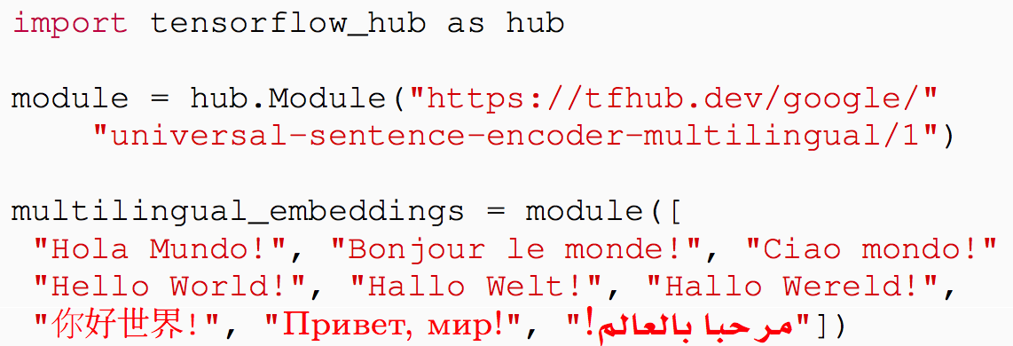
Multilingual
Universal Sentence Encoder (MUSE)
Source: Yinfei Yang, Daniel Cer, Amin Ahmad, Mandy Guo, Jax Law, Noah Constant, Gustavo Hernandez Abrego , Steve Yuan, Chris Tar, Yun-hsuan Sung, Ray Kurzweil. Multilingual Universal Sentence Encoder for Semantic Retrieval. July 2019

Slide 76
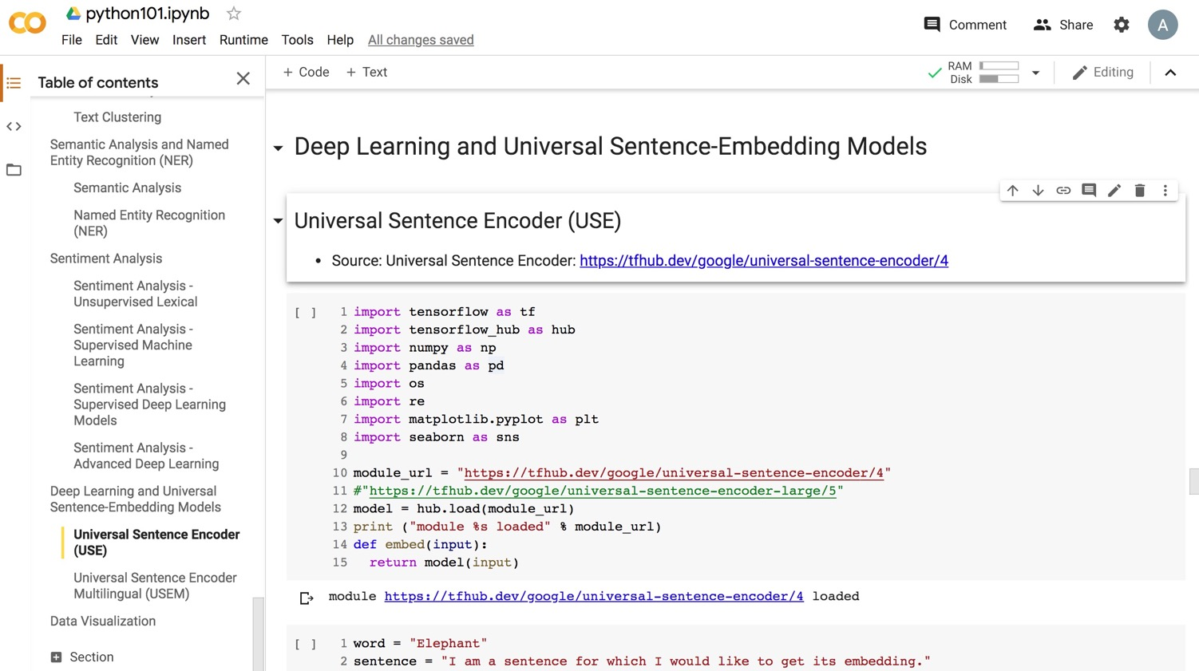
Python in Google Colab (Python101)
https://colab.research.google.com/drive/1FEG6DnGvwfUbeo4zJ1zTunjMqf2RkCrT
https://tinyurl.com/aintpupython101

Slide 77
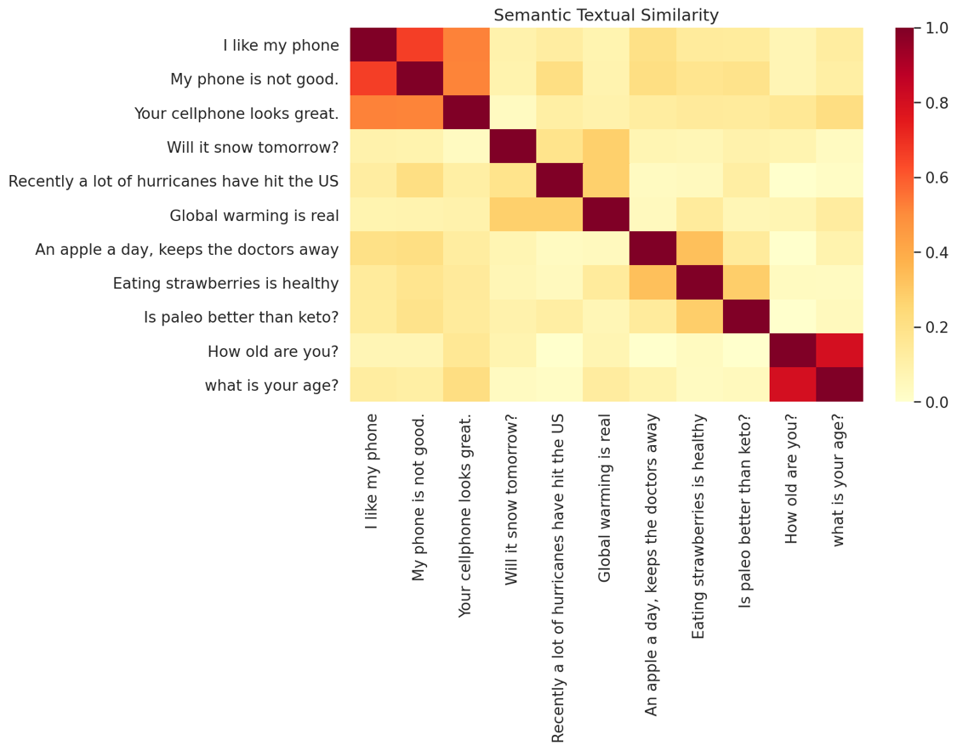
Python in Google Colab (Python101)
https://colab.research.google.com/drive/1FEG6DnGvwfUbeo4zJ1zTunjMqf2RkCrT
https://tinyurl.com/aintpupython101

Slide 78
Outline
Word Embeddings
Recurrent Neural Networks for NLP
Sequence-to-Sequence Models
The Transformer Architecture
Pretraining and Transfer Learning
State of the art (SOTA)

Slide 79
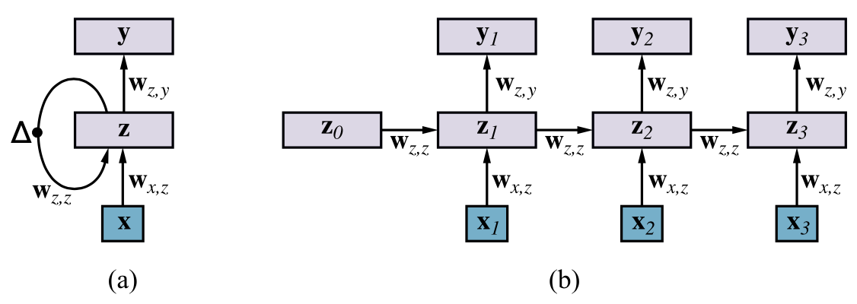
RNN
Source: Stuart Russell and Peter Norvig (2020), Artificial Intelligence: A Modern Approach, 4th Edition, Pearson

Slide 80
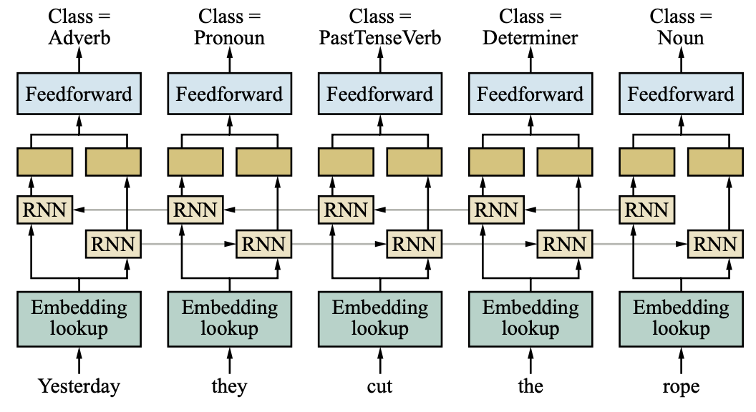
Bidirectional RNN network for POS tagging
Source: Stuart Russell and Peter Norvig (2020), Artificial Intelligence: A Modern Approach, 4th Edition, Pearson

Slide 81
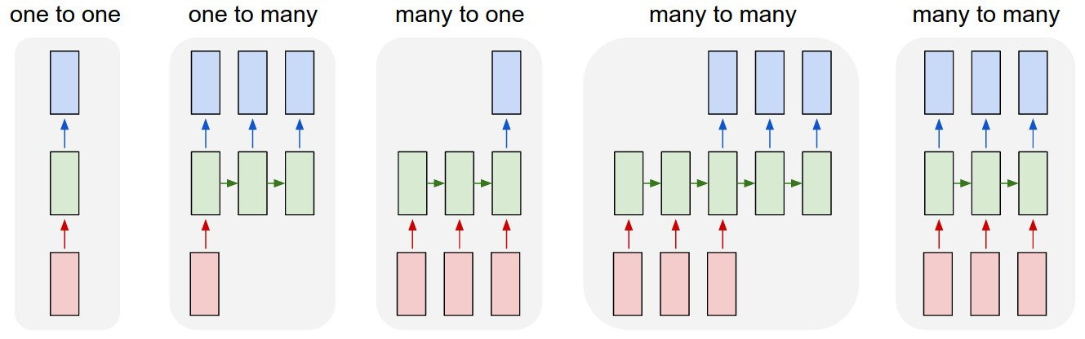
LSTM Recurrent Neural Network
Traditional Neural Network
Music
Generation
Sentiment
Classification
Name
Entity
Recognition
Machine
Translation
Source: https://github.com/Vict0rSch/deep_learning/tree/master/keras/recurrent

Slide 82
Outline
Word Embeddings
Recurrent Neural Networks for NLP
Sequence-to-Sequence Models
The Transformer Architecture
Pretraining and Transfer Learning
State of the art (SOTA)

Slide 83
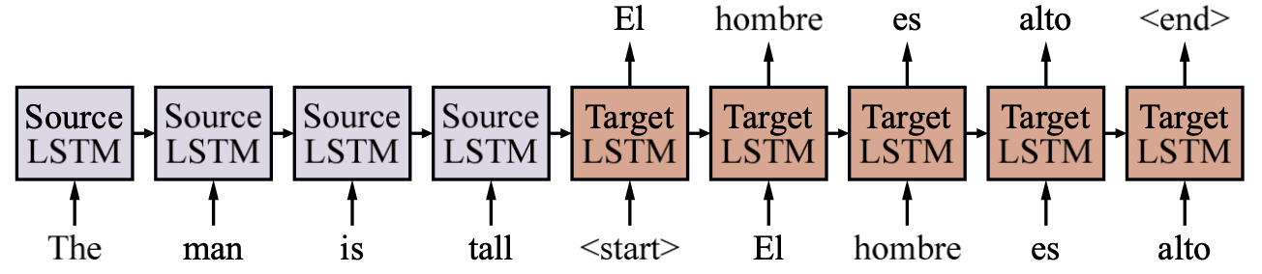
Sequence-to-Sequence model
Source: Stuart Russell and Peter Norvig (2020), Artificial Intelligence: A Modern Approach, 4th Edition, Pearson

Slide 84
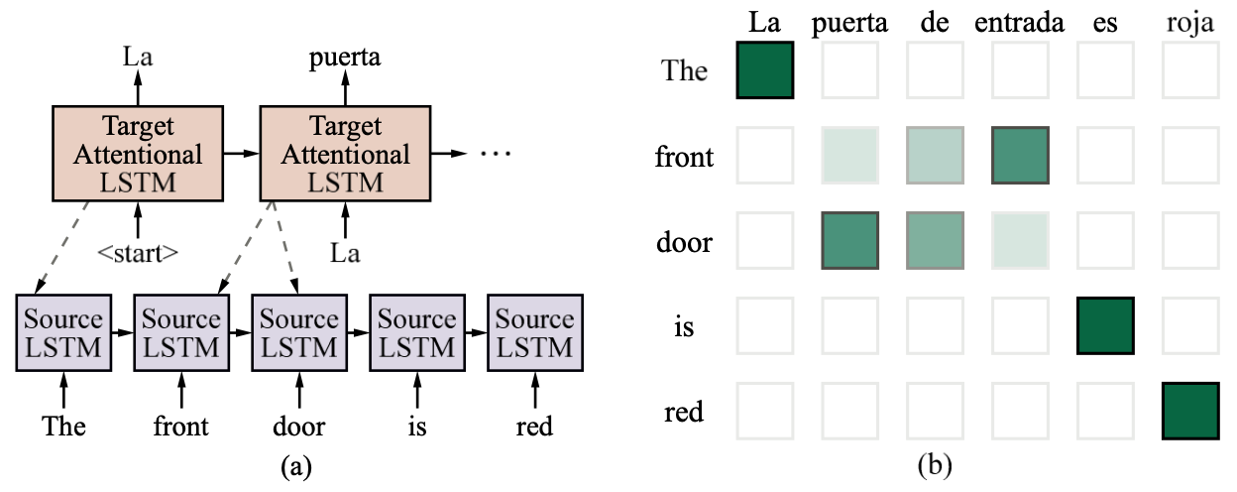
Attentional Sequence-to-Sequence model for English-to-Spanish translation
Source: Stuart Russell and Peter Norvig (2020), Artificial Intelligence: A Modern Approach, 4th Edition, Pearson

Slide 85
The Sequence to Sequence model (seq2seq)
Source: http://suriyadeepan.github.io/2016-12-31-practical-seq2seq/

Slide 86
Sequence to Sequence
(Seq2Seq)
Source: https://google.github.io/seq2seq/

Slide 87
Outline
Word Embeddings
Recurrent Neural Networks for NLP
Sequence-to-Sequence Models
The Transformer Architecture
Pretraining and Transfer Learning
State of the art (SOTA)

Slide 88
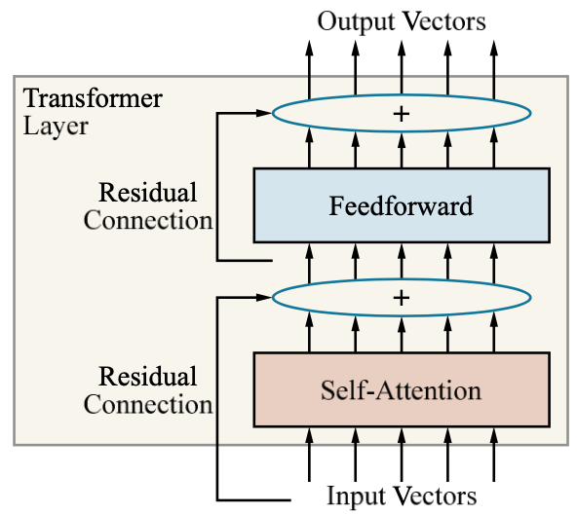
Single-layer Transformer consists of self-attention, a feedforward network, and residual connection
Source: Stuart Russell and Peter Norvig (2020), Artificial Intelligence: A Modern Approach, 4th Edition, Pearson

Slide 89
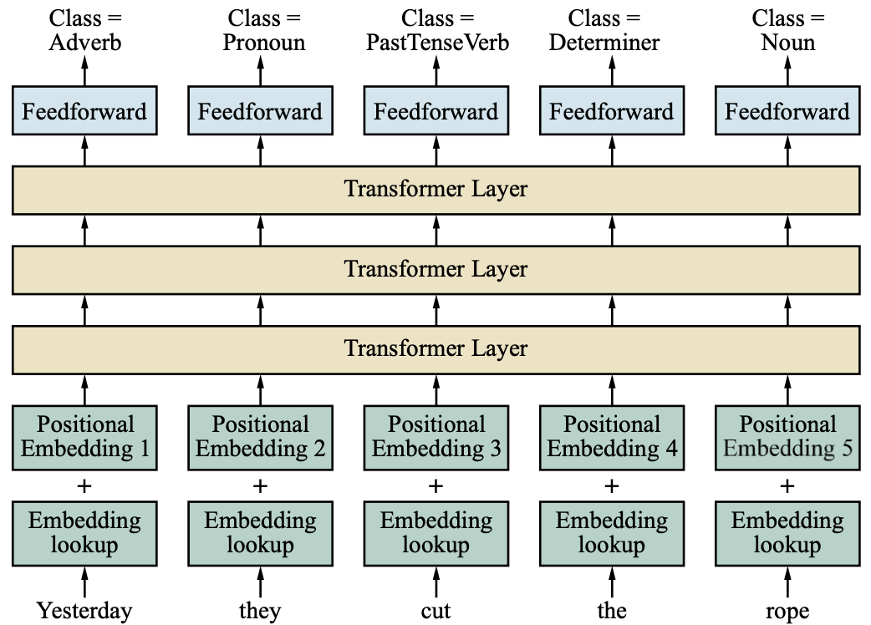
Transformer Architecture for POS Tagging
Source: Stuart Russell and Peter Norvig (2020), Artificial Intelligence: A Modern Approach, 4th Edition, Pearson

Slide 90
Transformer (Attention is All You Need)
(Vaswani et al., 2017)
Source: Vaswani, Ashish, Noam Shazeer, Niki Parmar, Jakob Uszkoreit, Llion Jones, Aidan N. Gomez, Łukasz Kaiser, and Illia Polosukhin. "Attention is all you need." In Advances in neural information processing systems, pp. 5998-6008. 2017.

Slide 91
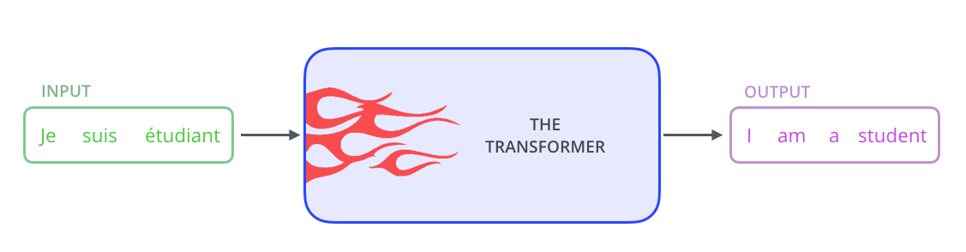
Transformer
Source: Jay Alammar (2019), The Illustrated Transformer, http://jalammar.github.io/illustrated-transformer/

Slide 92
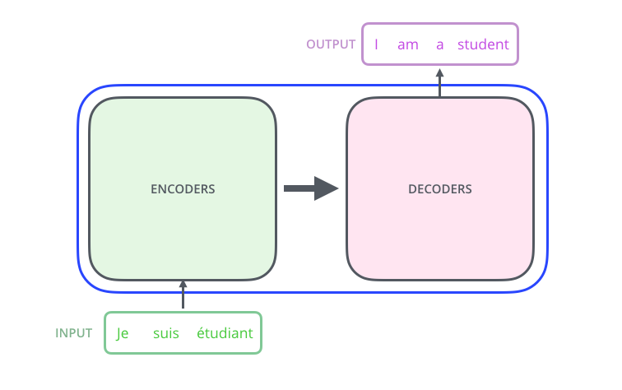
Transformer
Encoder Decoder
Source: Jay Alammar (2019), The Illustrated Transformer, http://jalammar.github.io/illustrated-transformer/

Slide 93
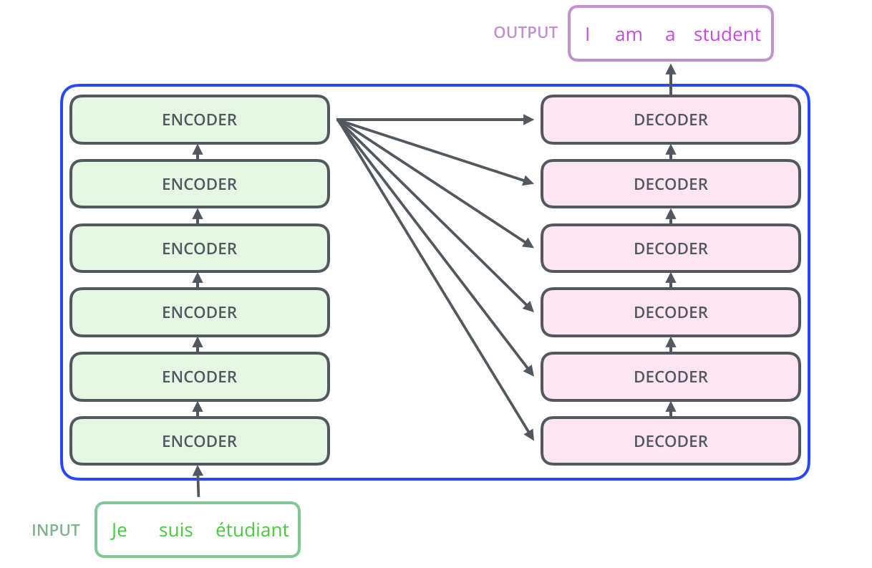
Transformer
Encoder Decoder Stack
Source: Jay Alammar (2019), The Illustrated Transformer, http://jalammar.github.io/illustrated-transformer/

Slide 94
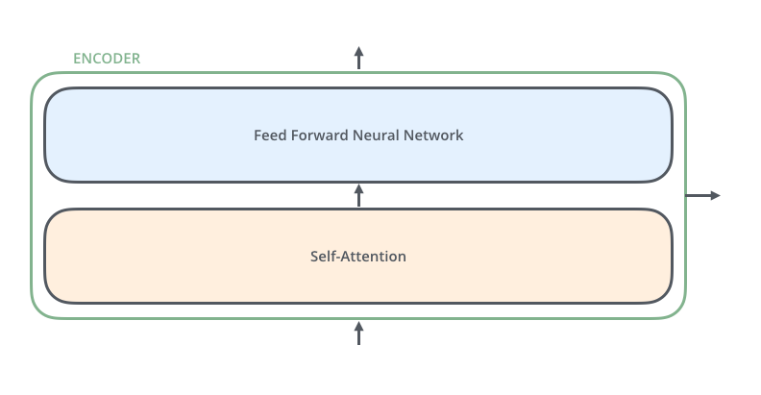
Transformer
Encoder Self-Attention
Source: Jay Alammar (2019), The Illustrated Transformer, http://jalammar.github.io/illustrated-transformer/

Slide 95
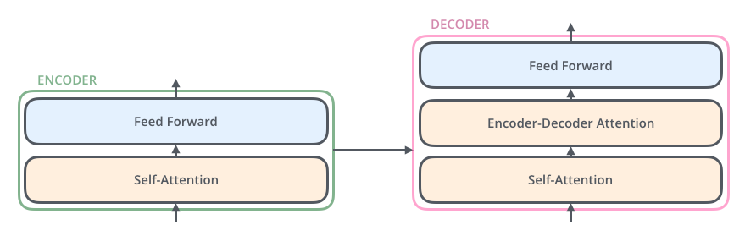
Transformer
Decoder
Source: Jay Alammar (2019), The Illustrated Transformer, http://jalammar.github.io/illustrated-transformer/

Slide 96

Transformer
Encoder with Tensors
Word Embeddings
Source: Jay Alammar (2019), The Illustrated Transformer, http://jalammar.github.io/illustrated-transformer/

Slide 97

Transformer
Self-Attention Visualization
Source: Jay Alammar (2019), The Illustrated Transformer, http://jalammar.github.io/illustrated-transformer/

Slide 98

Transformer
Positional Encoding Vectors
Source: Jay Alammar (2019), The Illustrated Transformer, http://jalammar.github.io/illustrated-transformer/

Slide 99

Transformer
Self-Attention Softmax Output
Source: Jay Alammar (2019), The Illustrated Transformer, http://jalammar.github.io/illustrated-transformer/

Slide 100
Outline
Word Embeddings
Recurrent Neural Networks for NLP
Sequence-to-Sequence Models
The Transformer Architecture
Pretraining and Transfer Learning
State of the art (SOTA)

Slide 101

BERT:
Pre-training of Deep
Bidirectional Transformers for Language Understanding
Source: Devlin, Jacob, Ming-Wei Chang, Kenton Lee, and Kristina Toutanova (2018).
"BERT: Pre-training of Deep Bidirectional Transformers for Language Understanding." arXiv preprint arXiv:1810.04805

Slide 102

BERT
Bidirectional Encoder Representations from Transformers
Pre-training model architectures
BERT uses a bidirectional Transformer.
OpenAI GPT uses a left-to-right Transformer.
ELMo uses the concatenation of independently trained left-to-right and right- to-left LSTM to generate features for downstream tasks.
Among three, only BERT representations are jointly conditioned on both left and right context in all layers.
Source: Devlin, Jacob, Ming-Wei Chang, Kenton Lee, and Kristina Toutanova (2018).
"BERT: Pre-training of Deep Bidirectional Transformers for Language Understanding." arXiv preprint arXiv:1810.04805

Slide 103
BERT: Pre-training of Deep Bidirectional Transformers for Language Understanding
BERT
(Bidirectional Encoder Representations from Transformers)
Overall pre-training and fine-tuning procedures for BERT
Source: Devlin, Jacob, Ming-Wei Chang, Kenton Lee, and Kristina Toutanova (2018).
"Bert: Pre-training of deep bidirectional transformers for language understanding." arXiv preprint arXiv:1810.04805.

Slide 104

BERT: Pre-training of Deep Bidirectional Transformers for Language Understanding
BERT (Bidirectional Encoder Representations from Transformers)
BERT input representation
The input embeddings is the sum of the token embeddings, the segmentation embeddings and the position embeddings.
Source: Devlin, Jacob, Ming-Wei Chang, Kenton Lee, and Kristina Toutanova (2018).
"Bert: Pre-training of deep bidirectional transformers for language understanding." arXiv preprint arXiv:1810.04805.

Slide 105
Fine-tuning BERT on Different Tasks
Source: Devlin, Jacob, Ming-Wei Chang, Kenton Lee, and Kristina Toutanova (2018).
"Bert: Pre-training of deep bidirectional transformers for language understanding." arXiv preprint arXiv:1810.04805.

Slide 106

BERT Sequence-level tasks
Source: Devlin, Jacob, Ming-Wei Chang, Kenton Lee, and Kristina Toutanova (2018).
"BERT: Pre-training of Deep Bidirectional Transformers for Language Understanding." arXiv preprint arXiv:1810.04805

Slide 107

BERT Token-level tasks
Source: Devlin, Jacob, Ming-Wei Chang, Kenton Lee, and Kristina Toutanova (2018).
"BERT: Pre-training of Deep Bidirectional Transformers for Language Understanding." arXiv preprint arXiv:1810.04805

Slide 108
Fine-tuning BERT on
Question Answering (QA)
Source: Devlin, Jacob, Ming-Wei Chang, Kenton Lee, and Kristina Toutanova (2018).
"Bert: Pre-training of deep bidirectional transformers for language understanding." arXiv preprint arXiv:1810.04805.

Slide 109
Fine-tuning BERT on Dialogue
Intent Detection (ID; Classification)
Source: Devlin, Jacob, Ming-Wei Chang, Kenton Lee, and Kristina Toutanova (2018).
"Bert: Pre-training of deep bidirectional transformers for language understanding." arXiv preprint arXiv:1810.04805.

Slide 110
Fine-tuning BERT on Dialogue
Slot Filling (SF)
Source: Devlin, Jacob, Ming-Wei Chang, Kenton Lee, and Kristina Toutanova (2018).
"Bert: Pre-training of deep bidirectional transformers for language understanding." arXiv preprint arXiv:1810.04805.

Slide 111

General Language Understanding Evaluation (GLUE) benchmark
GLUE Test results
MNLI: Multi-Genre Natural Language Inference
QQP: Quora Question Pairs
QNLI: Question Natural Language Inference
SST-2: The Stanford Sentiment Treebank
CoLA: The Corpus of Linguistic Acceptability
STS-B:The Semantic Textual Similarity Benchmark
MRPC: Microsoft Research Paraphrase Corpus
RTE: Recognizing Textual Entailment
Source: Devlin, Jacob, Ming-Wei Chang, Kenton Lee, and Kristina Toutanova (2018).
"BERT: Pre-training of Deep Bidirectional Transformers for Language Understanding." arXiv preprint arXiv:1810.04805

Slide 112

Training Contextual Representations using a left-to-right Language Model
Source: Stuart Russell and Peter Norvig (2020), Artificial Intelligence: A Modern Approach, 4th Edition, Pearson

Slide 113

Masked Language Modeling:
Pretrain a Bidirectional Model
Source: Stuart Russell and Peter Norvig (2020), Artificial Intelligence: A Modern Approach, 4th Edition, Pearson

Slide 114

Illustrated BERT
Source: Jay Alammar (2019), The Illustrated BERT, ELMo, and co. (How NLP Cracked Transfer Learning), http://jalammar.github.io/illustrated-bert/

Slide 115

BERT Classification Input Output
Source: Jay Alammar (2019), The Illustrated BERT, ELMo, and co. (How NLP Cracked Transfer Learning), http://jalammar.github.io/illustrated-bert/

Slide 116

BERT Encoder Input
Source: Jay Alammar (2019), The Illustrated BERT, ELMo, and co. (How NLP Cracked Transfer Learning), http://jalammar.github.io/illustrated-bert/

Slide 117

BERT Classifier
Source: Jay Alammar (2019), The Illustrated BERT, ELMo, and co. (How NLP Cracked Transfer Learning), http://jalammar.github.io/illustrated-bert/

Slide 118
Sentiment Analysis:
Single Sentence Classification
Source: Devlin, Jacob, Ming-Wei Chang, Kenton Lee, and Kristina Toutanova (2018).
"BERT: Pre-training of Deep Bidirectional Transformers for Language Understanding." arXiv preprint arXiv:1810.04805

Slide 119

A Visual Guide to
Using BERT for the First Time
(Jay Alammar, 2019)
Source: Jay Alammar (2019), A Visual Guide to Using BERT for the First Time,
http://jalammar.github.io/a-visual-guide-to-using-bert-for-the-first-time/

Slide 120
Sentiment Classification: SST2
Sentences from movie reviews
sentence | label
a stirring , funny and finally transporting re imagining of beauty and the beast and 1930s horror films | 1
apparently reassembled from the cutting room floor of any given daytime soap | 0
they presume their audience won't sit still for a sociology lesson | 0
this is a visually stunning rumination on love , memory , history and the war between art and commerce | 1
jonathan parker 's bartleby should have been the be all end all of the modern office anomie films | 1
Source: Jay Alammar (2019), A Visual Guide to Using BERT for the First Time,
http://jalammar.github.io/a-visual-guide-to-using-bert-for-the-first-time/

Slide 121

Movie Review Sentiment Classifier
Source: Jay Alammar (2019), A Visual Guide to Using BERT for the First Time,
http://jalammar.github.io/a-visual-guide-to-using-bert-for-the-first-time/

Slide 122

Movie Review Sentiment Classifier
Source: Jay Alammar (2019), A Visual Guide to Using BERT for the First Time,
http://jalammar.github.io/a-visual-guide-to-using-bert-for-the-first-time/

Slide 123

Movie Review Sentiment Classifier
Model Training
Source: Jay Alammar (2019), A Visual Guide to Using BERT for the First Time,
http://jalammar.github.io/a-visual-guide-to-using-bert-for-the-first-time/

Slide 124

Step # 1 Use distilBERT to Generate Sentence Embeddings
Source: Jay Alammar (2019), A Visual Guide to Using BERT for the First Time,
http://jalammar.github.io/a-visual-guide-to-using-bert-for-the-first-time/

Slide 125

Step #2:Test/Train Split for
Model #2, Logistic Regression
Source: Jay Alammar (2019), A Visual Guide to Using BERT for the First Time,
http://jalammar.github.io/a-visual-guide-to-using-bert-for-the-first-time/

Slide 126

Step #3 Train the logistic regression model using the training set
Source: Jay Alammar (2019), A Visual Guide to Using BERT for the First Time,
http://jalammar.github.io/a-visual-guide-to-using-bert-for-the-first-time/

Slide 127

Tokenization
[CLS] a visually stunning rum ##ination on love [SEP]
a visually stunning rumination on love
Source: Jay Alammar (2019), A Visual Guide to Using BERT for the First Time,
http://jalammar.github.io/a-visual-guide-to-using-bert-for-the-first-time/

Slide 128

Tokenization
tokenizer.encode("a visually stunning rumination on love", add_special_tokens=True)
Source: Jay Alammar (2019), A Visual Guide to Using BERT for the First Time,
http://jalammar.github.io/a-visual-guide-to-using-bert-for-the-first-time/

Slide 129

Tokenization for BERT Model
Source: Jay Alammar (2019), A Visual Guide to Using BERT for the First Time,
http://jalammar.github.io/a-visual-guide-to-using-bert-for-the-first-time/

Slide 130

Flowing Through DistilBERT
(768 features)
Source: Jay Alammar (2019), A Visual Guide to Using BERT for the First Time,
http://jalammar.github.io/a-visual-guide-to-using-bert-for-the-first-time/

Slide 131

Model #1 Output Class vector as
Model #2 Input
Source: Jay Alammar (2019), A Visual Guide to Using BERT for the First Time,
http://jalammar.github.io/a-visual-guide-to-using-bert-for-the-first-time/

Slide 132

Fine-tuning BERT on
Single Sentence Classification Tasks
Source: Devlin, Jacob, Ming-Wei Chang, Kenton Lee, and Kristina Toutanova (2018).
"Bert: Pre-training of deep bidirectional transformers for language understanding." arXiv preprint arXiv:1810.04805.

Slide 133

Model #1 Output Class vector as
Model #2 Input
Source: Jay Alammar (2019), A Visual Guide to Using BERT for the First Time,
http://jalammar.github.io/a-visual-guide-to-using-bert-for-the-first-time/

Slide 134

Logistic Regression Model to classify Class vector
Source: Jay Alammar (2019), A Visual Guide to Using BERT for the First Time,
http://jalammar.github.io/a-visual-guide-to-using-bert-for-the-first-time/

Slide 135

df = pd.read_csv('https://github.com/clairett/pytorch-sentiment-classification/raw/master/data/SST2/train.tsv', delimiter='\t', header=None)
df.head()
Source: Jay Alammar (2019), A Visual Guide to Using BERT for the First Time,
http://jalammar.github.io/a-visual-guide-to-using-bert-for-the-first-time/

Slide 136

Tokenization
tokenized = df[0].apply((lambda x: tokenizer.encode(x, add_special_tokens=True)))
Source: Jay Alammar (2019), A Visual Guide to Using BERT for the First Time,
http://jalammar.github.io/a-visual-guide-to-using-bert-for-the-first-time/

Slide 137

BERT Input Tensor
Source: Jay Alammar (2019), A Visual Guide to Using BERT for the First Time,
http://jalammar.github.io/a-visual-guide-to-using-bert-for-the-first-time/

Slide 138

Processing with DistilBERT
input_ids = torch.tensor(np.array(padded))
last_hidden_states = model(input_ids)
Source: Jay Alammar (2019), A Visual Guide to Using BERT for the First Time,
http://jalammar.github.io/a-visual-guide-to-using-bert-for-the-first-time/

Slide 139

Unpacking the BERT output tensor
Source: Jay Alammar (2019), A Visual Guide to Using BERT for the First Time,
http://jalammar.github.io/a-visual-guide-to-using-bert-for-the-first-time/

Slide 140

Sentence to last_hidden_state[0]
Source: Jay Alammar (2019), A Visual Guide to Using BERT for the First Time,
http://jalammar.github.io/a-visual-guide-to-using-bert-for-the-first-time/

Slide 141

BERT’s output for the [CLS] tokens
# Slice the output for the first position for all the sequences, take all hidden unit outputs
features = last_hidden_states[0][:,0,:].numpy()
Source: Jay Alammar (2019), A Visual Guide to Using BERT for the First Time,
http://jalammar.github.io/a-visual-guide-to-using-bert-for-the-first-time/

Slide 142

The tensor sliced from BERT's output
Sentence Embeddings
Source: Jay Alammar (2019), A Visual Guide to Using BERT for the First Time,
http://jalammar.github.io/a-visual-guide-to-using-bert-for-the-first-time/

Slide 143

Dataset for Logistic Regression
(768 Features)
The features are the output vectors of BERT for the [CLS] token (position #0)
Source: Jay Alammar (2019), A Visual Guide to Using BERT for the First Time,
http://jalammar.github.io/a-visual-guide-to-using-bert-for-the-first-time/

Slide 144

labels = df[1]
train_features, test_features, train_labels, test_labels = train_test_split(features, labels)
Source: Jay Alammar (2019), A Visual Guide to Using BERT for the First Time,
http://jalammar.github.io/a-visual-guide-to-using-bert-for-the-first-time/

Slide 145
Score Benchmarks
Logistic Regression Model on SST-2 Dataset
# Training
lr_clf = LogisticRegression()
lr_clf.fit(train_features, train_labels)
#Testing
lr_clf.score(test_features, test_labels)
# Accuracy: 81%
# Highest accuracy: 96.8%
# Fine-tuned DistilBERT: 90.7%
# Full size BERT model: 94.9%
Source: Jay Alammar (2019), A Visual Guide to Using BERT for the First Time,
http://jalammar.github.io/a-visual-guide-to-using-bert-for-the-first-time/

Slide 146
Sentiment Classification: SST2
Sentences from movie reviews
sentence | label
a stirring , funny and finally transporting re imagining of beauty and the beast and 1930s horror films | 1
apparently reassembled from the cutting room floor of any given daytime soap | 0
they presume their audience won't sit still for a sociology lesson | 0
this is a visually stunning rumination on love , memory , history and the war between art and commerce | 1
jonathan parker 's bartleby should have been the be all end all of the modern office anomie films | 1
Source: Jay Alammar (2019), A Visual Guide to Using BERT for the First Time,
http://jalammar.github.io/a-visual-guide-to-using-bert-for-the-first-time/

Slide 147

A Visual Notebook to
Using BERT for the First Time
https://colab.research.google.com/github/jalammar/jalammar.github.io/blob/master/notebooks/bert/A_Visual_Notebook_to_Using_BERT_for_the_First_Time.ipynb

Slide 148

Pre-trained Language Model (PLM)
Source: https://github.com/thunlp/PLMpapers

Slide 149
Outline
Word Embeddings
Recurrent Neural Networks for NLP
Sequence-to-Sequence Models
The Transformer Architecture
Pretraining and Transfer Learning
State of the art (SOTA)

Slide 150
The Transformers Timeline
ULMFit
BERT
RoBERTa
XLM-R
DeBERTa
GPT-Neo
BLOOM
DistrilBERT
T5
PaLM
Transformer
GPT
GPT-2
GPT-3
GPT-J
OPT-175B
2017
2018
2019
2020
2021
2022
Source: Lewis Tunstall, Leandro von Werra, and Thomas Wolf (2022), Natural Language Processing with Transformers: Building Language Applications with Hugging Face, O'Reilly Media.

Slide 151
Transformer Models
Transformer
Encoder
Decoder
DistilBERT
BERT
T5
GPT
RoBERTa
BART
GPT-2
CTRL
XLM-R
XLM
M2M-100
GPT-3
ALBERT
BigBird
GPT-Neo
GPT-J
ELECTRA
BLOOM
DeBERTa
Source: Lewis Tunstall, Leandro von Werra, and Thomas Wolf (2022), Natural Language Processing with Transformers: Building Language Applications with Hugging Face, O'Reilly Media.

Slide 152
Language Models Sizes
(GPT-3, PaLM, BLOOM)
Source: https://lifearchitect.ai/models/

Slide 153

Pre-trained Models (PTM)
Source: Qiu, Xipeng, Tianxiang Sun, Yige Xu, Yunfan Shao, Ning Dai, and Xuanjing Huang. "Pre-trained Models for Natural Language Processing: A Survey." arXiv preprint arXiv:2003.08271 (2020).

Slide 154

Pre-trained Models (PTM)
Source: Qiu, Xipeng, Tianxiang Sun, Yige Xu, Yunfan Shao, Ning Dai, and Xuanjing Huang. "Pre-trained Models for Natural Language Processing: A Survey." arXiv preprint arXiv:2003.08271 (2020).

Slide 155
Transformers
State-of-the-art Natural Language Processing for TensorFlow 2.0 and PyTorch
Transformers
  pytorch-transformers
  pytorch-pretrained-bert
provides state-of-the-art general-purpose architectures
  (BERT, GPT-2, RoBERTa, XLM, DistilBert, XLNet, CTRL...)
  for Natural Language Understanding (NLU) and
  Natural Language Generation (NLG)
  with over 32+ pretrained models
  in 100+ languages
  and deep interoperability between
  TensorFlow 2.0 and
  PyTorch.
Source: https://github.com/huggingface/transformers

Slide 156

NLP Benchmark Datasets
Source: Amirsina Torfi, Rouzbeh A. Shirvani, Yaser Keneshloo, Nader Tavvaf, and Edward A. Fox (2020).
"Natural Language Processing Advancements By Deep Learning: A Survey." arXiv preprint arXiv:2003.01200.

Slide 157
Question Answering
(QA)
SQuAD
Stanford Question Answering Dataset

Slide 158

SQuAD
https://rajpurkar.github.io/SQuAD-explorer/

Slide 159

SQuAD
Source: Rajpurkar, Pranav, Jian Zhang, Konstantin Lopyrev, and Percy Liang.
"Squad: 100,000+ questions for machine comprehension of text." arXiv preprint arXiv:1606.05250 (2016).

Slide 160

SQuAD (Question Answering)
Q: What causes precipitation to fall?
https://en.wikipedia.org/wiki/Precipitation

Slide 161
SQuAD (Question Answering)
Paragraph
In meteorology, precipitation is any product of the condensation of atmospheric water vapor that falls under gravity. The main forms of precipitation include drizzle, rain, sleet, snow, graupel and hail... Precipitation forms as smaller droplets coalesce via collision with other rain drops or ice crystals within a cloud. Short, intense periods of rain in scattered locations are called “showers”.
Q: What causes precipitation to fall?

Slide 162
SQuAD (Question Answering)
In meteorology, precipitation is any product of the condensation of atmospheric water vapor that falls under gravity. The main forms of precipitation include drizzle, rain, sleet, snow, graupel and hail... Precipitation forms as smaller droplets coalesce via collision with other rain drops or ice crystals within a cloud. Short, intense periods of rain in scattered locations are called “showers”.
Q: What causes precipitation to fall?
A: gravity

Slide 163
SQuAD (Question Answering)
In meteorology, precipitation is any product of the condensation of atmospheric water vapor that falls under gravity. The main forms of precipitation include drizzle, rain, sleet, snow, graupel and hail... Precipitation forms as smaller droplets coalesce via collision with other rain drops or ice crystals within a cloud. Short, intense periods of rain in scattered locations are called “showers”.
Q: What is another main form of precipitation besides drizzle, rain, snow, sleet and hail?
A: graupel

Slide 164
SQuAD (Question Answering)
In meteorology, precipitation is any product of the condensation of atmospheric water vapor that falls under gravity. The main forms of precipitation include drizzle, rain, sleet, snow, graupel and hail... Precipitation forms as smaller droplets coalesce via collision with other rain drops or ice crystals within a cloud. Short, intense periods of rain in scattered locations are called “showers”.
Q: Where do water droplets collide with ice crystals to form precipitation?
A: within a cloud

Slide 165
SQuAD (Question Answering)
In meteorology, precipitation is any product of the condensation of atmospheric water vapor that falls under gravity. The main forms of precipitation include drizzle, rain, sleet, snow, graupel and hail... Precipitation forms as smaller droplets coalesce via collision with other rain drops or ice crystals within a cloud. Short, intense periods of rain in scattered locations are called “showers”.
Q: What causes precipitation to fall?
A: gravity
Q: What is another main form of precipitation besides drizzle, rain, snow, sleet and hail?
A: graupel
Q: Where do water droplets collide with ice crystals to form precipitation?
A: within a cloud

Slide 166

Natural Language Processing with Python
– Analyzing Text with the Natural Language Toolkit
NLTK
http://www.nltk.org/book/

Slide 167

spaCy
https://spacy.io/

Slide 168

gensim
https://radimrehurek.com/gensim/

Slide 169

TextBlob
https://textblob.readthedocs.io

Slide 170

Polyglot
https://polyglot.readthedocs.io/

Slide 171

Hugging Face Tasks
Natural Language Processing
https://huggingface.co/tasks

Slide 172

NLP with Transformers Github
https://github.com/nlp-with-transformers/notebooks

Slide 173
NLP with Transformers Github Notebooks
https://github.com/nlp-with-transformers/notebooks

Slide 174

Python in Google Colab (Python101)
https://colab.research.google.com/drive/1FEG6DnGvwfUbeo4zJ1zTunjMqf2RkCrT
NLP with Transformers
https://tinyurl.com/aintpupython101

Slide 175

Python in Google Colab (Python101)
https://colab.research.google.com/drive/1FEG6DnGvwfUbeo4zJ1zTunjMqf2RkCrT
Text Classification
https://tinyurl.com/aintpupython101

Slide 176

Python in Google Colab (Python101)
https://colab.research.google.com/drive/1FEG6DnGvwfUbeo4zJ1zTunjMqf2RkCrT
Named Entity Recognition (NER)
https://tinyurl.com/aintpupython101

Slide 177

Python in Google Colab (Python101)
https://colab.research.google.com/drive/1FEG6DnGvwfUbeo4zJ1zTunjMqf2RkCrT
Text Summarization
https://tinyurl.com/aintpupython101

Slide 178

Python in Google Colab (Python101)
https://colab.research.google.com/drive/1FEG6DnGvwfUbeo4zJ1zTunjMqf2RkCrT
Text Generation
https://tinyurl.com/aintpupython101

Slide 179

Python in Google Colab (Python101)
https://colab.research.google.com/drive/1FEG6DnGvwfUbeo4zJ1zTunjMqf2RkCrT
Question Answering and Dialogue Systems
https://tinyurl.com/aintpupython101

Slide 180

Python in Google Colab (Python101)
https://colab.research.google.com/drive/1FEG6DnGvwfUbeo4zJ1zTunjMqf2RkCrT
Question Answering
https://tinyurl.com/aintpupython101

Slide 181

Python in Google Colab (Python101)
https://colab.research.google.com/drive/1FEG6DnGvwfUbeo4zJ1zTunjMqf2RkCrT
Question Answering and
Dialogue Systems
https://tinyurl.com/aintpupython101

Slide 182

Python in Google Colab (Python101)
https://colab.research.google.com/drive/1FEG6DnGvwfUbeo4zJ1zTunjMqf2RkCrT
https://tinyurl.com/aintpupython101

Slide 183

Python in Google Colab (Python101)
https://colab.research.google.com/drive/1FEG6DnGvwfUbeo4zJ1zTunjMqf2RkCrT
Dialogue Systems
https://tinyurl.com/aintpupython101

Slide 184

Python in Google Colab (Python101)
https://colab.research.google.com/drive/1FEG6DnGvwfUbeo4zJ1zTunjMqf2RkCrT
https://tinyurl.com/aintpupython101

Slide 185

Python in Google Colab (Python101)
https://colab.research.google.com/drive/1FEG6DnGvwfUbeo4zJ1zTunjMqf2RkCrT
https://tinyurl.com/aintpupython101

Slide 186

Python in Google Colab (Python101)
https://colab.research.google.com/drive/1FEG6DnGvwfUbeo4zJ1zTunjMqf2RkCrT
https://tinyurl.com/aintpupython101

Slide 187

Python in Google Colab (Python101)
https://colab.research.google.com/drive/1FEG6DnGvwfUbeo4zJ1zTunjMqf2RkCrT
https://tinyurl.com/aintpupython101

Slide 188

Python in Google Colab (Python101)
https://colab.research.google.com/drive/1FEG6DnGvwfUbeo4zJ1zTunjMqf2RkCrT
https://tinyurl.com/aintpupython101

Slide 189
Python in Google Colab (Python101)
https://colab.research.google.com/drive/1FEG6DnGvwfUbeo4zJ1zTunjMqf2RkCrT
https://tinyurl.com/aintpupython101

Slide 190
Python in Google Colab (Python101)
https://colab.research.google.com/drive/1FEG6DnGvwfUbeo4zJ1zTunjMqf2RkCrT
https://tinyurl.com/aintpupython101

Slide 191

Python in Google Colab (Python101)
https://colab.research.google.com/drive/1FEG6DnGvwfUbeo4zJ1zTunjMqf2RkCrT
https://tinyurl.com/aintpupython101

Slide 192

Python in Google Colab (Python101)
https://colab.research.google.com/drive/1FEG6DnGvwfUbeo4zJ1zTunjMqf2RkCrT
https://tinyurl.com/aintpupython101

Slide 193

Python in Google Colab (Python101)
https://colab.research.google.com/drive/1FEG6DnGvwfUbeo4zJ1zTunjMqf2RkCrT
https://tinyurl.com/aintpupython101

Slide 194

Python in Google Colab (Python101)
https://colab.research.google.com/drive/1FEG6DnGvwfUbeo4zJ1zTunjMqf2RkCrT
https://tinyurl.com/aintpupython101

Slide 195

Python in Google Colab (Python101)
https://colab.research.google.com/drive/1FEG6DnGvwfUbeo4zJ1zTunjMqf2RkCrT
https://tinyurl.com/aintpupython101

Slide 196

Python in Google Colab (Python101)
https://colab.research.google.com/drive/1FEG6DnGvwfUbeo4zJ1zTunjMqf2RkCrT
https://tinyurl.com/aintpupython101

Slide 197
Python in Google Colab (Python101)
https://colab.research.google.com/drive/1FEG6DnGvwfUbeo4zJ1zTunjMqf2RkCrT
https://tinyurl.com/aintpupython101

Slide 198
Summary
Word Embeddings
Recurrent Neural Networks for NLP
Sequence-to-Sequence Models
The Transformer Architecture
Pretraining and Transfer Learning
State of the art (SOTA)

Slide 199
References
Stuart Russell and Peter Norvig (2020), Artificial Intelligence: A Modern Approach, 4th Edition, Pearson.
Aurélien Géron (2019), Hands-On Machine Learning with Scikit-Learn, Keras, and TensorFlow: Concepts, Tools, and Techniques to Build Intelligent Systems, 2nd Edition, O’Reilly Media.
Steven D'Ascoli (2022), Artificial Intelligence and Deep Learning with Python: Every Line of Code Explained For Readers New to AI and New to Python, Independently published.
Nithin Buduma, Nikhil Buduma, Joe Papa (2022), Fundamentals of Deep Learning: Designing Next-Generation Machine Intelligence Algorithms, 2nd Edition, ‎O'Reilly Media.
Dipanjan Sarkar (2019), Text Analytics with Python: A Practitioner’s Guide to Natural Language Processing, Second Edition. APress. https://github.com/Apress/text-analytics-w-python-2e
Benjamin Bengfort, Rebecca Bilbro, and Tony Ojeda (2018),
Applied Text Analysis with Python, O'Reilly Media.
https://www.oreilly.com/library/view/applied-text-analysis/9781491963036/
Daniel Cer, Yinfei Yang, Sheng-yi Kong, Nan Hua, Nicole Limtiaco, Rhomni St. John, Noah Constant, Mario Guajardo-Céspedes, Steve Yuan, Chris Tar, Yun-Hsuan Sung, Brian Strope, Ray Kurzweil (2018). Universal Sentence Encoder. arXiv:1803.11175.
Yinfei Yang, Daniel Cer, Amin Ahmad, Mandy Guo, Jax Law, Noah Constant, Gustavo Hernandez Abrego , Steve Yuan, Chris Tar, Yun-hsuan Sung, Ray Kurzweil (2019). Multilingual Universal Sentence Encoder for Semantic Retrieval.
Xipeng Qiu, Tianxiang Sun, Yige Xu, Yunfan Shao, Ning Dai, and Xuanjing Huang (2020). "Pre-trained Models for Natural Language Processing: A Survey." arXiv preprint arXiv:2003.08271.
Jacob Devlin, Ming-Wei Chang, Kenton Lee, and Kristina Toutanova (2018). "Bert: Pre-training of deep bidirectional transformers for language understanding." arXiv preprint arXiv:1810.04805.
Jay Alammar (2019), The Illustrated Transformer, http://jalammar.github.io/illustrated-transformer/
Jay Alammar (2019), A Visual Guide to Using BERT for the First Time,
http://jalammar.github.io/a-visual-guide-to-using-bert-for-the-first-time/
Christopher Olah, (2015) Understanding LSTM Networks, http://colah.github.io/posts/2015-08-Understanding-LSTMs/
HuggingFace (2020), Transformers Notebook, https://huggingface.co/transformers/notebooks.html
The Super Duper NLP Repo, https://notebooks.quantumstat.com/
Min-Yuh Day (2022), Python 101, https://tinyurl.com/aintpupython101

