Slide 1








Financial Econometrics and Machine Learning
Artificial Intelligence in Finance and Quantitative Analysis
1111AIFQA07
MBA, IM, NTPU (M6132) (Fall 2022)
Tue 2, 3, 4 (9:10-12:00) (B8F40)
Min-Yuh Day, Ph.D,
Associate Professor
Institute of Information Management, National Taipei University
https://web.ntpu.edu.tw/~myday
https://meet.google.com/paj-zhhj-mya
2022-11-08

Slide 2
Syllabus
Week Date Subject/Topics
1 2022/09/13 Introduction to Artificial Intelligence in Finance and
Quantitative Analysis
2 2022/09/20 AI in FinTech: Metaverse, Web3, DeFi, NFT,
Financial Services Innovation and Applications
3 2022/09/27 Investing Psychology and Behavioral Finance
4 2022/10/04 Event Studies in Finance
5 2022/10/11 Case Study on AI in Finance and Quantitative Analysis I
6 2022/10/18 Finance Theory

Slide 3
Syllabus
Week Date Subject/Topics
7 2022/10/25 Data-Driven Finance
8 2022/11/01 Midterm Project Report
9 2022/11/08 Financial Econometrics and Machine Learning
10 2022/11/15 AI-First Finance
11 2022/11/22 Industry Practices of AI in Finance and Quantitative
Analysis
12 2022/11/29 Case Study on AI in Finance and Quantitative Analysis II

Slide 4
Syllabus
Week Date Subject/Topics
13 2022/12/06 Deep Learning in Finance;
Reinforcement Learning in Finance
14 2022/12/13 Algorithmic Trading; Risk Management;
Trading Bot and Event-Based Backtesting
15 2022/12/20 Final Project Report I
16 2022/12/27 Final Project Report II
17 2023/01/03 Self-learning
18 2023/01/10 Self-learning

Slide 5
Financial Econometrics and
Machine Learning

Slide 6
Outline
Financial Econometrics
  Financial Theories
  OLS Regression
Machine Learning
  Learning
  Evaluation
  Bias and variance
  Cross-validation
Source: Yves Hilpisch (2020), Artificial Intelligence in Finance: A Python-Based Guide, O’Reilly Media.

Slide 7
Financial Econometrics

Slide 8
Financial Econometrics
The discipline at the intersection of
mathematics, statistics, and finance
that applies such methods to financial market data
is typically called financial econometrics.
Finance
Mathematics
Statistics
Financial Econometrics
Source: Yves Hilpisch (2020), Artificial Intelligence in Finance: A Python-Based Guide, O’Reilly Media.

Slide 9
Financial Econometrics
(Chris Brooks, 2019)
Financial econometrics
  the application of statistical techniques to problems in finance
Financial econometrics can be useful for
testing theories in finance,
determining asset prices or returns,
testing hypotheses concerning the relationships between variables,
examining the effect on financial markets of changes in economic conditions,
forecasting future values of financial variables and for financial decision-making.
Source: Chris Brooks (2019), Introductory Econometrics for Finance, 4th Edition, Cambridge University Press

Slide 10
Financial Econometrics
[Financial] econometrics is the quantitative application of statistical and mathematical models using [financial] data to develop financial theories or test existing hypotheses in finance and to forecast future trends from historical data.
It subjects real-world [financial] data to statistical trials and then compares and contrasts the results against the [financial] theory or theories being tested.
Source: Yves Hilpisch (2020), Artificial Intelligence in Finance: A Python-Based Guide, O’Reilly Media.

Slide 11
Topics of Financial Econometrics
(Oliver Linton, 2019)
Econometric
Return Predictability and the Efficient Markets Hypothesis
Robust Tests and Tests of Nonlinear Predictability of Returns
Empirical Market Microstructure
Event Study Analysis
Portfolio Choice and Testing the Capital Asset Pricing Model
Multifactor Pricing Models
Source: Oliver Linton (2019), Financial Econometrics: Models and Methods, Cambridge University Press

Slide 12
Topics of Financial Econometrics
(Oliver Linton, 2019)
Present Value Relations
Intertemporal Equilibrium Pricing
Volatility
Continuous Time Processes
Yield Curve
Risk Management and Tail Estimation
Source: Oliver Linton (2019), Financial Econometrics: Models and Methods, Cambridge University Press

Slide 13
Applications of Financial Econometrics
(Chris Brooks, 2019)
Testing whether financial markets are weak-form informationally efficient
Testing whether the capital asset pricing model (CAPM) or arbitrage pricing theory (APT) represent superior models for the determination of returns on risky assets
Measuring and forecasting the volatility of bond returns
Explaining the determinants of bond credit ratings used by the ratings agencies
Modelling long-term relationships between prices and exchange rates
Source: Chris Brooks (2019), Introductory Econometrics for Finance, 4th Edition, Cambridge University Press

Slide 14
Applications of Financial Econometrics
(Chris Brooks, 2019)
Determining the optimal hedge ratio for a spot position in oil
Testing technical trading rules to determine which makes the most money
Testing the hypothesis that earnings or dividend announcements have no effect on stock prices
Testing whether spot or futures markets react more rapidly to news
Forecasting the correlation between the stock indices of two countries
Source: Chris Brooks (2019), Introductory Econometrics for Finance, 4th Edition, Cambridge University Press

Slide 15
Machine Learning and Financial Econometrics
ML and DL methods are able to
discover statistical inefficiencies and even
economic inefficiencies
that are not discoverable by
traditional econometric methods,
such as multivariate OLS regression.
Source: Yves Hilpisch (2020), Artificial Intelligence in Finance: A Python-Based Guide, O’Reilly Media.

Slide 16
Normative Financial Theories
Normative financial theories mostly rely on assumptions and axioms in combination with deduction as the major analytical method to arrive at their central results.
  Expected utility theory (EUT) assumes that agents have the same utility function no matter what state of the world unfolds and that they maximize expected utility under conditions of uncertainty.
  Mean-variance portfolio (MVP) theory describes how investors should invest under conditions of uncertainty assuming that only the expected return and the expected volatility of a portfolio over one period count.
Source: Yves Hilpisch (2020), Artificial Intelligence in Finance: A Python-Based Guide, O’Reilly Media.

Slide 17
Normative Financial Theories
The capital asset pricing model (CAPM) assumes that only the nondiversifiable market risk explains the expected return and the expected volatility of a stock over one period.
Arbitrage pricing theory (APT) assumes that a number of identifiable risk factors explains the expected return and the expected volatility of a stock over time; admittedly, compared to the other theories, the formulation of APT is rather broad and allows for wide-ranging interpretations.
Source: Yves Hilpisch (2020), Artificial Intelligence in Finance: A Python-Based Guide, O’Reilly Media.

Slide 18
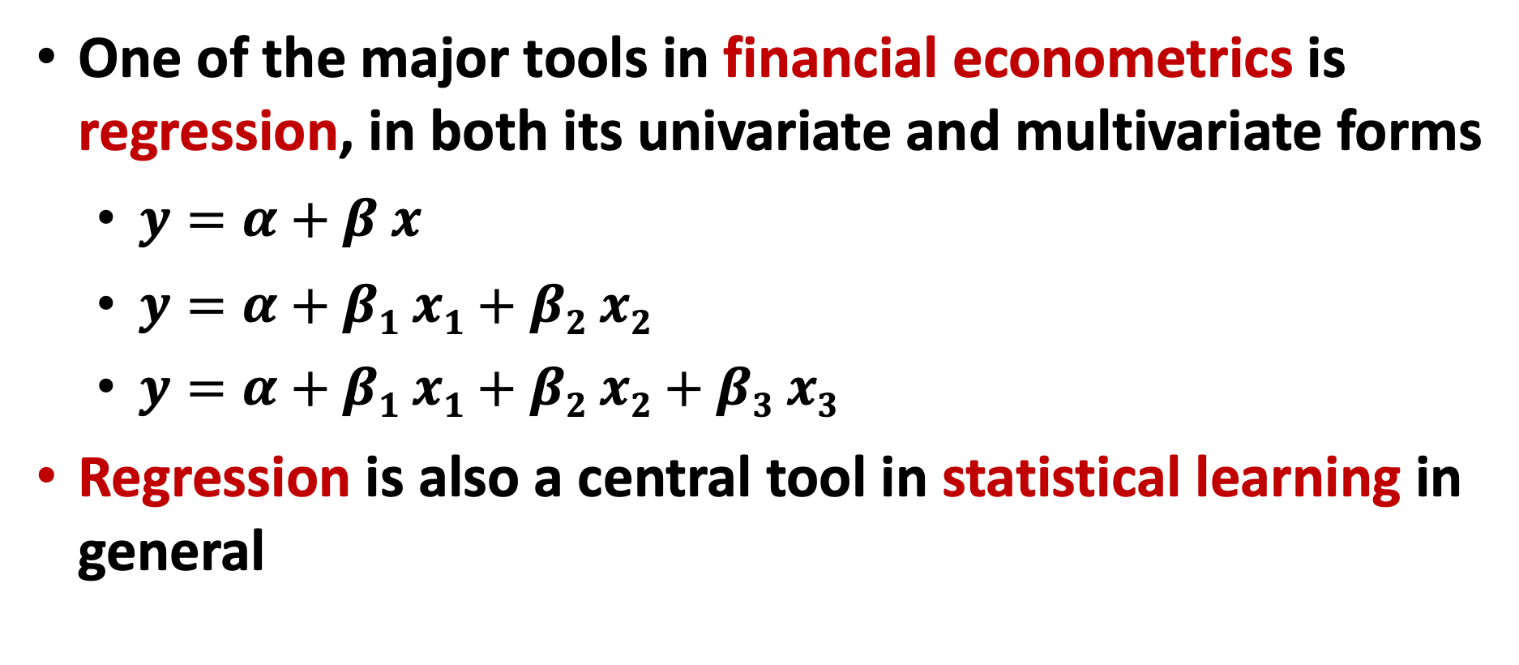
Financial Econometrics and Regression
One of the major tools in financial econometrics is regression, in both its univariate and multivariate forms
  $y=α+β x$
  $y=α+β1 x1+β2 x2$
  $y=α+β1 x1+β2 x2+β3 x3$
Regression is also a central tool in statistical learning in general
Source: Yves Hilpisch (2020), Artificial Intelligence in Finance: A Python-Based Guide, O’Reilly Media.

Slide 19
CAPM and APT
OLS regression
Both the CAPM and the APT
relate the output variables
with the relevant input factors in linear fashion.
From an econometric point of view,
both models are implemented based on
linear ordinary least-squares (OLS) regression.
CAPM: univariate linear OLS regression
APT: multivariate OLS regression
Source: Yves Hilpisch (2020), Artificial Intelligence in Finance: A Python-Based Guide, O’Reilly Media.

Slide 20
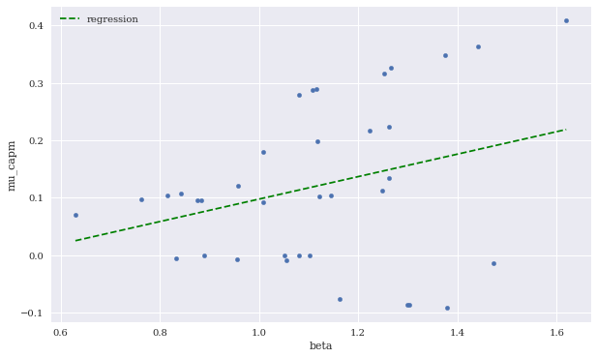
Expected CAPM return versus beta
(including linear regression)
Source: Yves Hilpisch (2020), Artificial Intelligence in Finance: A Python-Based Guide, O’Reilly Media.

Slide 21
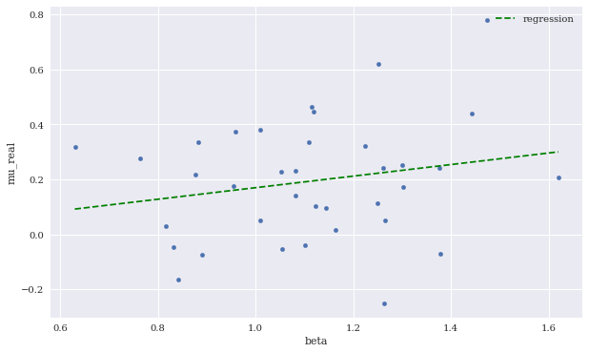
Expected CAPM return versus beta
(including linear regression)
Source: Yves Hilpisch (2020), Artificial Intelligence in Finance: A Python-Based Guide, O’Reilly Media.

Slide 22
Machine Learning

Slide 23
Artificial Intelligence
Machine Learning & Deep Learning
Source: https://blogs.nvidia.com/blog/2016/07/29/whats-difference-artificial-intelligence-machine-learning-deep-learning-ai/

Slide 24
AI, ML, DL
Artificial Intelligence (AI)
Machine Learning (ML)
Supervised
Learning
Unsupervised Learning
Deep Learning (DL)
CNN
RNN LSTM GRU
GAN
Semi-supervised Learning
Reinforcement Learning
Source: https://leonardoaraujosantos.gitbooks.io/artificial-inteligence/content/deep_learning.html

Slide 25
3 Machine Learning Algorithms
Source: Enrico Galimberti, http://blogs.teradata.com/data-points/tree-machine-learning-algorithms/

Slide 26
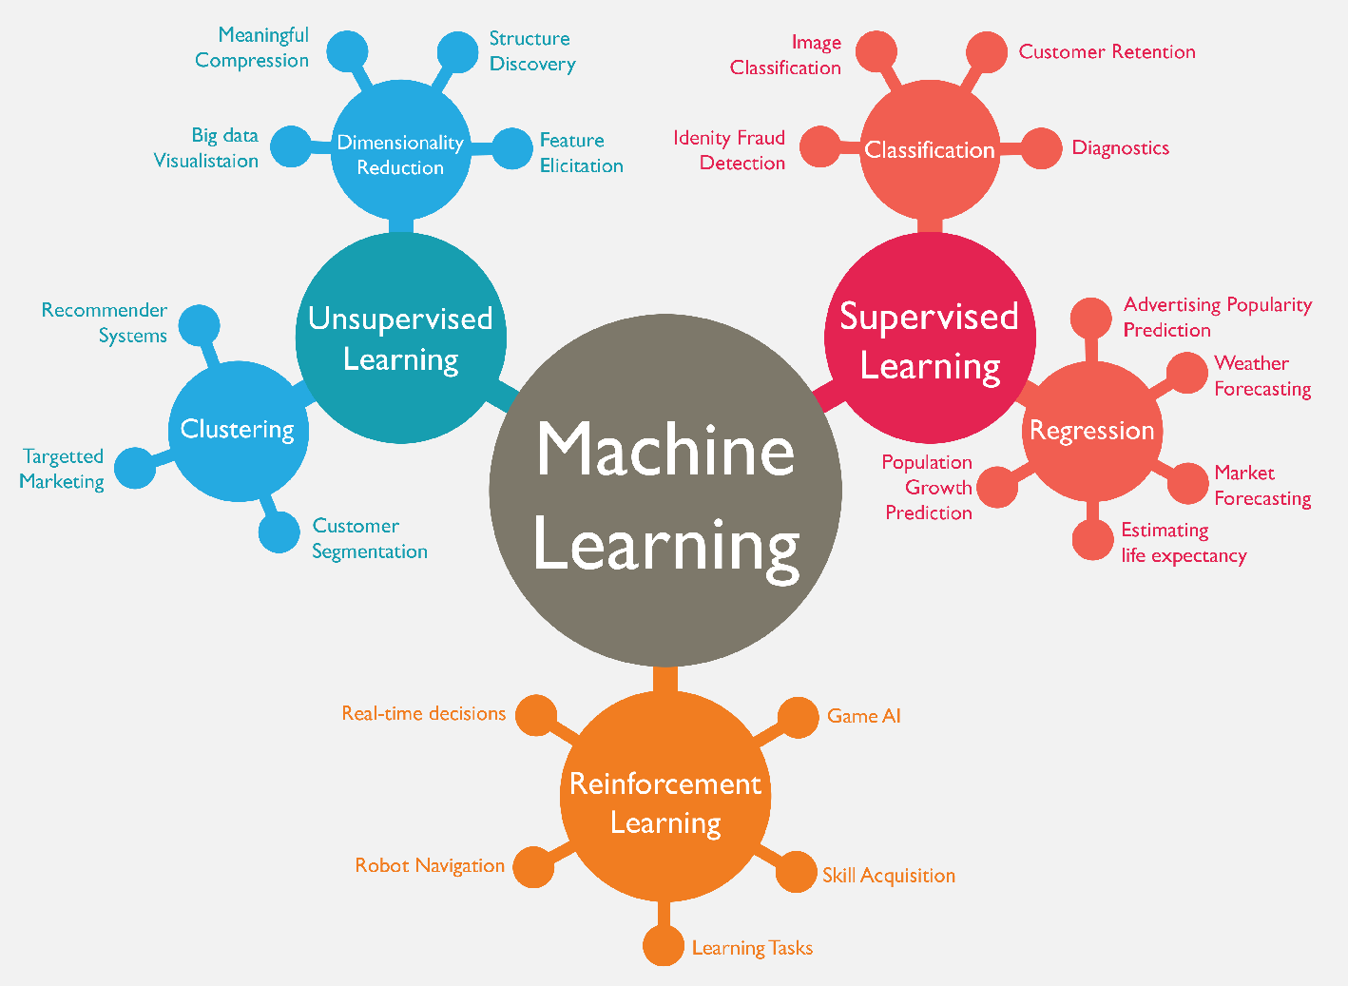
Machine Learning (ML)
Source: https://www.mactores.com/services/aws-big-data-machine-learning-cognitive-services/

Slide 27
Stock Market Movement Forecast:
ML Phases of the stock market modeling
Source: O. Bustos and A. Pomares-Quimbaya (2020), "Stock Market Movement Forecast: A Systematic Review." Expert Systems with Applications (2020): 113464.

Slide 28
Machine Learning
Learning
Data: Features, Labels
Success (Loss Function): MSE
Capacity (Model Fit)
Evaluation
Bias and variance
Cross-validation
Source: Yves Hilpisch (2020), Artificial Intelligence in Finance: A Python-Based Guide, O’Reilly Media.

Slide 29
Learning
(Mitchell, 1997)
A computer program is said
to learn from experience E
with respect to some class of tasks T
and performance measure P,
if its performance at tasks in T,
as measured by P,
improves with experience E.
Source: Yves Hilpisch (2020), Artificial Intelligence in Finance: A Python-Based Guide, O’Reilly Media.

Slide 30
Machine Learning
Supervised Learning (Classification)
Learning from Examples
y = f(x)
x
y

Slide 31
Machine Learning
Supervised Learning (Classification)
Learning from Examples
y = f(x)
x
y
input
Output
label

Slide 32
Machine Learning
Supervised Learning (Classification)
Learning from Examples
y = f(x)
5.1,3.5,1.4,0.2,Iris-setosa 4.9,3.0,1.4,0.2,Iris-setosa 4.7,3.2,1.3,0.2,Iris-setosa 7.0,3.2,4.7,1.4,Iris-versicolor 6.4,3.2,4.5,1.5,Iris-versicolor 6.9,3.1,4.9,1.5,Iris-versicolor 6.3,3.3,6.0,2.5,Iris-virginica 5.8,2.7,5.1,1.9,Iris-virginica 7.1,3.0,5.9,2.1,Iris-virginica

Slide 33
Machine Learning
Supervised Learning (Classification)
Learning from Examples
y = f(x)
Example
5.1,3.5,1.4,0.2,Iris-setosa 4.9,3.0,1.4,0.2,Iris-setosa 4.7,3.2,1.3,0.2,Iris-setosa 7.0,3.2,4.7,1.4,Iris-versicolor 6.4,3.2,4.5,1.5,Iris-versicolor 6.9,3.1,4.9,1.5,Iris-versicolor 6.3,3.3,6.0,2.5,Iris-virginica 5.8,2.7,5.1,1.9,Iris-virginica 7.1,3.0,5.9,2.1,Iris-virginica

Slide 34
Machine Learning
Supervised Learning (Classification)
Learning from Examples
y = f(x)
Example
5.1,3.5,1.4,0.2,Iris-setosa 4.9,3.0,1.4,0.2,Iris-setosa 4.7,3.2,1.3,0.2,Iris-setosa 7.0,3.2,4.7,1.4,Iris-versicolor 6.4,3.2,4.5,1.5,Iris-versicolor 6.9,3.1,4.9,1.5,Iris-versicolor 6.3,3.3,6.0,2.5,Iris-virginica 5.8,2.7,5.1,1.9,Iris-virginica 7.1,3.0,5.9,2.1,Iris-virginica
y
x

Slide 35
Time Series Data
[10, 20, 30, 40, 50, 60, 70, 80, 90]
X
Y
[10 20 30] 40
[20 30 40] 50
[30 40 50] 60
[40 50 60] 70
[50 60 70] 80
[60 70 80] 90

Slide 36
Time Series Data
[100, 110, 120, 130, 140, 150]
Y
X
Y
[100 110 120 130 140] 150
X_{t1}
X_{t2}
X_{t3}
X_{t4}
X_{t5}

Slide 37
The Theory of Learning
How can we be sure that our learned hypothesis will predict well for previously unseen inputs?
  How do we know that the hypothesis h is close to the target function f
  if we don’t know what is?
How many examples do we need to get a good h?
What hypothesis space should we use?
If the hypothesis space is very complex,
can we even find the best h or do we have to settle for a local maximum?
How complex should h be?
How do we avoid overfitting?

Slide 38
Linear function
y = f(x)
y = w₁x + w₀
h_{w}(x) = w₁x + w₀
Source: Stuart Russell and Peter Norvig (2020), Artificial Intelligence: A Modern Approach, 4th Edition, Pearson

Slide 39
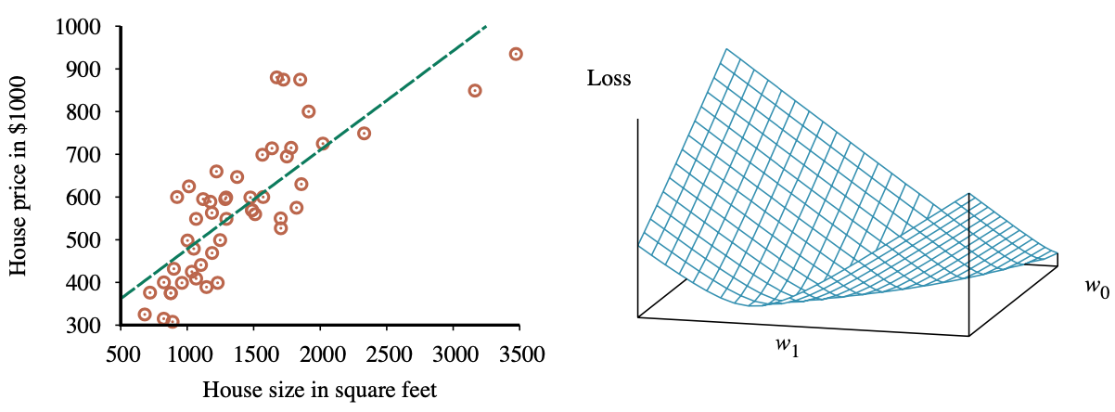
Linear Regression Weight Space
h_{w}(x) = w₁x + w₀
w* = argmin_{w} Loss(h_{w})
y = 0.232 x + 246
Loss function for Weights (w₁, w₀)
Source: Stuart Russell and Peter Norvig (2020), Artificial Intelligence: A Modern Approach, 4th Edition, Pearson

Slide 40
Performance Measure
The measure of success for estimation problems
  mean-squared error (MSE)
Classification problems
  accuracy ratio
Source: Yves Hilpisch (2020), Artificial Intelligence in Finance: A Python-Based Guide, O’Reilly Media.

Slide 41
Evaluation
(Accuracy of Classification Model)

Slide 42
Assessing the Classification Model
Predictive accuracy
  Hit rate
Speed
  Model building; predicting
Robustness
Scalability
Interpretability
  Transparency, explainability
Source: Ramesh Sharda, Dursun Delen, and Efraim Turban (2017), Business Intelligence, Analytics, and Data Science: A Managerial Perspective, 4th Edition, Pearson

Slide 43
Accuracy
Precision
Validity
Reliability

Slide 45
Accuracy vs. Precision
A
B
High Accuracy
High Precision
Low Accuracy
High Precision
C
D
High Accuracy
Low Precision
Low Accuracy
Low Precision

Slide 46
Accuracy vs. Precision
A
B
High Accuracy
High Precision
Low Accuracy
High Precision
High Validity
High Reliability
Low Validity
High Reliability
C
D
High Accuracy
Low Precision
Low Accuracy
Low Precision
High Validity
Low Reliability
Low Validity
Low Reliability

Slide 47
Accuracy vs. Precision
A
B
High Accuracy
High Precision
Low Accuracy
High Precision
High Validity
High Reliability
Low Validity
High Reliability
C
D
High Accuracy
Low Precision
Low Accuracy
Low Precision
High Validity
Low Reliability
Low Validity
Low Reliability

Slide 48
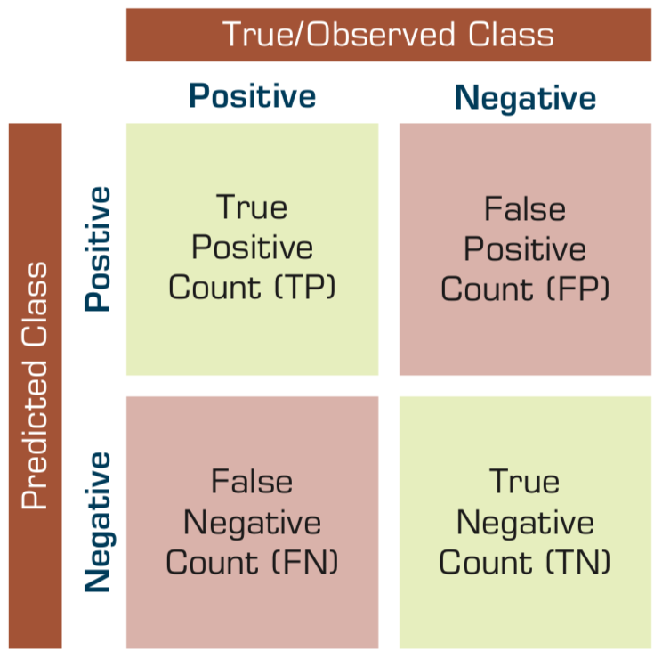
Confusion Matrix for Tabulation of Two-Class Classification Results
Source: Ramesh Sharda, Dursun Delen, and Efraim Turban (2017), Business Intelligence, Analytics, and Data Science: A Managerial Perspective, 4th Edition, Pearson

Slide 49
Sensitivity
Specificity
=True Positive Rate
=True Negative Rate

Slide 50
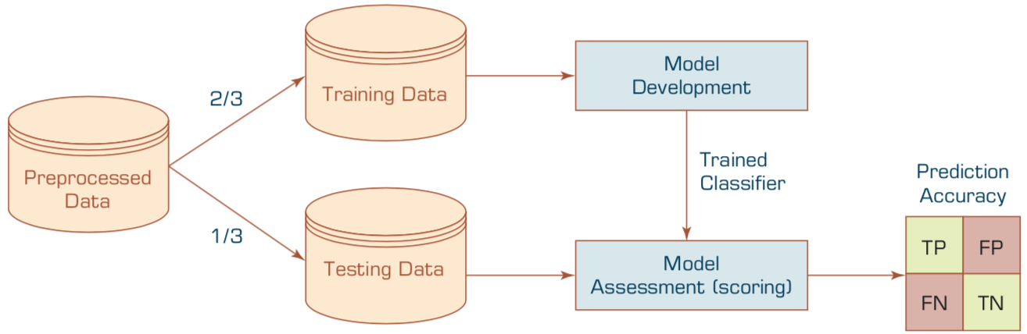
Estimation Methodologies for Classification
Simple split (or holdout or test sample estimation)
  Split the data into 2 mutually exclusive sets
  training (~70%) and testing (30%)
  For ANN, the data is split into three sub-sets
  (training [~60%], validation [~20%], testing [~20%])
Source: Ramesh Sharda, Dursun Delen, and Efraim Turban (2017), Business Intelligence, Analytics, and Data Science: A Managerial Perspective, 4th Edition, Pearson

Slide 51
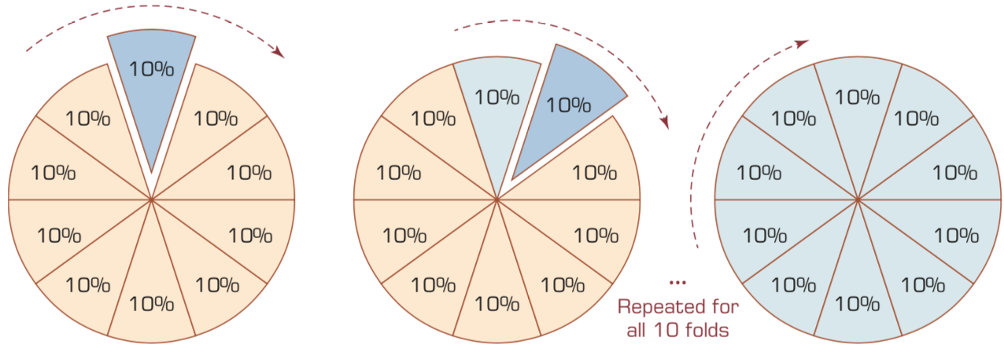
k-Fold Cross-Validation
Source: Ramesh Sharda, Dursun Delen, and Efraim Turban (2017), Business Intelligence, Analytics, and Data Science: A Managerial Perspective, 4th Edition, Pearson

Slide 52
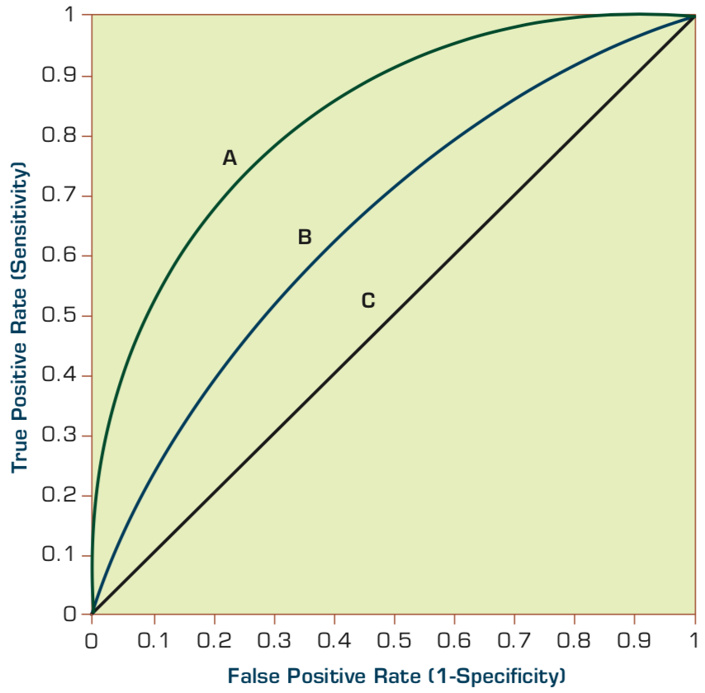
Estimation Methodologies for Classification
Area under the ROC curve
Source: Ramesh Sharda, Dursun Delen, and Efraim Turban (2017), Business Intelligence, Analytics, and Data Science: A Managerial Perspective, 4th Edition, Pearson

Slide 53
True Class
(actual value)
Positive
Negative
total
True
Positive
(TP)
False
Positive
(FP)
Positive
P’
Predictive Class
(prediction outcome)
False
Negative
(FN)
True
Negative
(TN)
Negative
N’
total
P
N
Source: http://en.wikipedia.org/wiki/Receiver_operating_characteristic

Slide 54
True Class
(actual value)
Positive
Negative
total
True
Positive
(TP)
False
Positive
(FP)
Positive
P’
Predictive Class
(prediction outcome)
False
Negative
(FN)
True
Negative
(TN)
Negative
N’
total
P
N
Sensitivity
= True Positive Rate
= Recall
= Hit rate
= TP / (TP + FN)
Source: http://en.wikipedia.org/wiki/Receiver_operating_characteristic

Slide 55
True Class
(actual value)
Positive
Negative
total
True
Positive
(TP)
False
Positive
(FP)
Positive
P’
Predictive Class
(prediction outcome)
False
Negative
(FN)
True
Negative
(TN)
Negative
N’
total
P
N
Specificity
= True Negative Rate
= TN / N
= TN / (TN+ FP)
Source: http://en.wikipedia.org/wiki/Receiver_operating_characteristic

Slide 56
True Class
(actual value)
Precision
= Positive Predictive Value (PPV)
Positive
Negative
total
True
Positive
(TP)
False
Positive
(FP)
Positive
P’
Recall
= True Positive Rate (TPR)
= Sensitivity
= Hit Rate
Predictive Class
(prediction outcome)
False
Negative
(FN)
True
Negative
(TN)
Negative
N’
total
P
N
F1 score (F-score)(F-measure)
is the harmonic mean of precision and recall
= 2TP / (P + P’)
= 2TP / (2TP + FP + FN)
Source: http://en.wikipedia.org/wiki/Receiver_operating_characteristic

Slide 57
A
63
(TP)
28
(FP)
Recall
= True Positive Rate (TPR)
= Sensitivity
= Hit Rate
= TP / (TP + FN)
Specificity
= True Negative Rate
= TN / N
= TN / (TN + FP)
91
37
(FN)
72
(TN)
109
100
100
200
TPR = 0.63
FPR = 0.28
PPV = 0.69
=63/(63+28)
=63/91
Precision
= Positive Predictive Value (PPV)
F1 = 0.66
= 2*(0.63*0.69)/(0.63+0.69)
= (2 * 63) /(100 + 91)
= (0.63 + 0.69) / 2 =1.32 / 2 =0.66
F1 score (F-score)
(F-measure)
is the harmonic mean of precision and recall
= 2TP / (P + P’)
= 2TP / (2TP + FP + FN)
ACC = 0.68
= (63 + 72) / 200
= 135/200 = 67.5
Source: http://en.wikipedia.org/wiki/Receiver_operating_characteristic

Slide 58
A
B
63
(TP)
28
(FP)
77
(TP)
77
(FP)
91
154
37
(FN)
72
(TN)
109
23
(FN)
23
(TN)
46
100
100
200
100
100
200
TPR = 0.63
TPR = 0.77
FPR = 0.77
PPV = 0.50
F1 = 0.61
ACC = 0.50
FPR = 0.28
PPV = 0.69
=63/(63+28)
=63/91
F1 = 0.66
= 2*(0.63*0.69)/(0.63+0.69)
= (2 * 63) /(100 + 91)
= (0.63 + 0.69) / 2 =1.32 / 2 =0.66
Recall
= True Positive Rate (TPR)
= Sensitivity
= Hit Rate
ACC = 0.68
= (63 + 72) / 200
= 135/200 = 67.5
Precision
= Positive Predictive Value (PPV)
Source: http://en.wikipedia.org/wiki/Receiver_operating_characteristic

Slide 59
C
C’
24
(TP)
88
(FP)
76
(TP)
12
(FP)
112
88
76
(FN)
12
(TN)
88
24
(FN)
88
(TN)
112
100
100
200
100
100
200
TPR = 0.24
FPR = 0.88
PPV = 0.21
F1 = 0.22
ACC = 0.18
TPR = 0.76
FPR = 0.12
PPV = 0.86
F1 = 0.81
ACC = 0.82
Recall
= True Positive Rate (TPR)
= Sensitivity
= Hit Rate
Precision
= Positive Predictive Value (PPV)
Source: http://en.wikipedia.org/wiki/Receiver_operating_characteristic

Slide 60
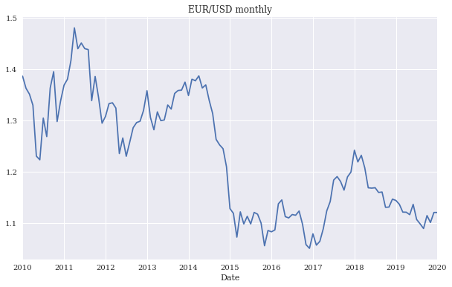
EUR/USD exchange rate as time series
(monthly)
Source: Yves Hilpisch (2020), Artificial Intelligence in Finance: A Python-Based Guide, O’Reilly Media.

Slide 61
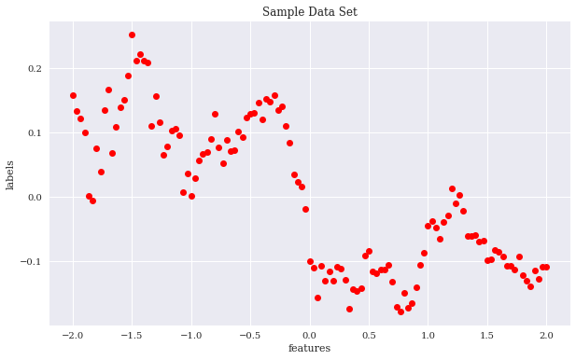
Sample data set
Source: Yves Hilpisch (2020), Artificial Intelligence in Finance: A Python-Based Guide, O’Reilly Media.

Slide 62
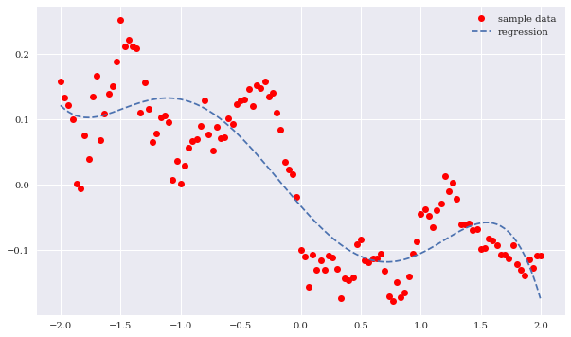
Sample data and cubic regression line
Source: Yves Hilpisch (2020), Artificial Intelligence in Finance: A Python-Based Guide, O’Reilly Media.

Slide 63
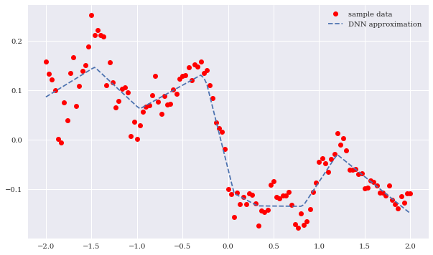
Sample data and neural network approximation
Source: Yves Hilpisch (2020), Artificial Intelligence in Finance: A Python-Based Guide, O’Reilly Media.

Slide 64
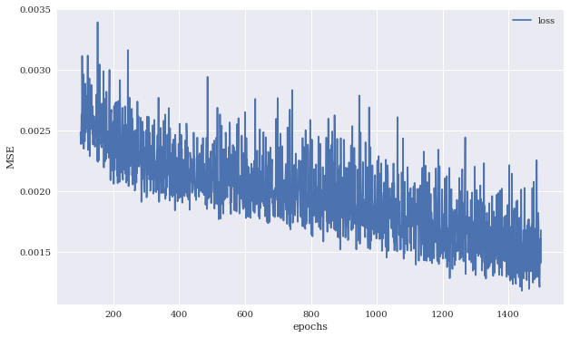
MSE values against number of training epochs
Source: Yves Hilpisch (2020), Artificial Intelligence in Finance: A Python-Based Guide, O’Reilly Media.

Slide 65
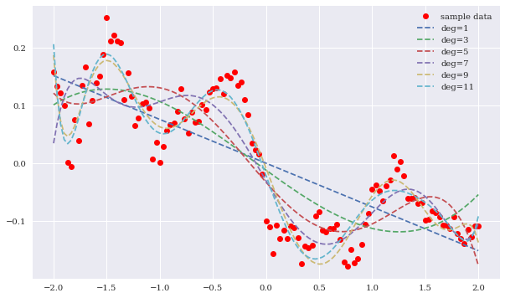
Regression lines for different highest degrees
Source: Yves Hilpisch (2020), Artificial Intelligence in Finance: A Python-Based Guide, O’Reilly Media.

Slide 66
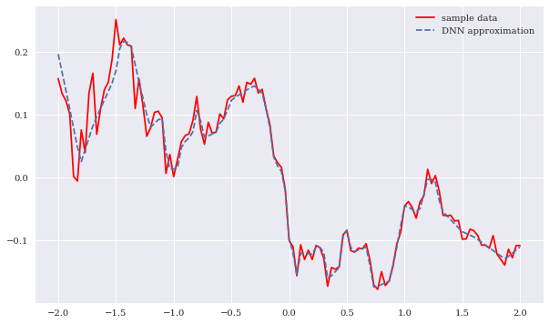
Sample data and DNN approximation
(higher capacity)
Source: Yves Hilpisch (2020), Artificial Intelligence in Finance: A Python-Based Guide, O’Reilly Media.

Slide 67
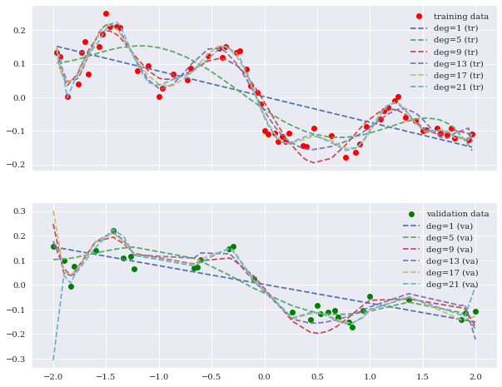
Training and validation data including regression fits
Source: Yves Hilpisch (2020), Artificial Intelligence in Finance: A Python-Based Guide, O’Reilly Media.

Slide 68
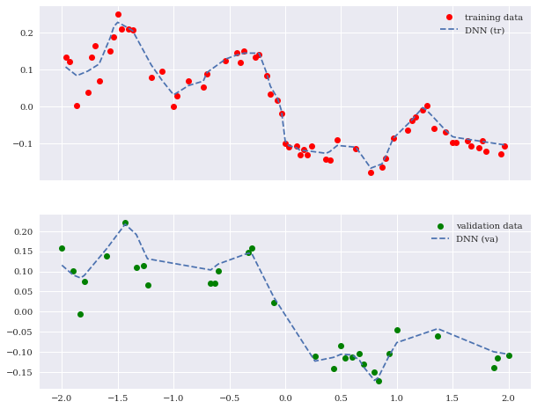
Training and validation data including DNN predictions
Source: Yves Hilpisch (2020), Artificial Intelligence in Finance: A Python-Based Guide, O’Reilly Media.

Slide 69
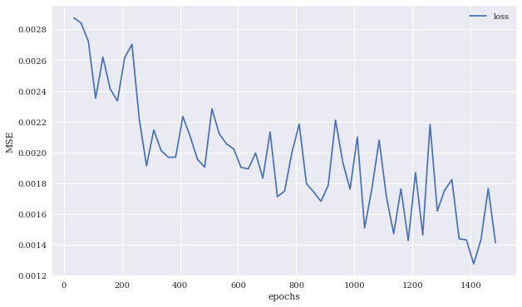
MSE values for DNN model on the training and validation data sets
Source: Yves Hilpisch (2020), Artificial Intelligence in Finance: A Python-Based Guide, O’Reilly Media.

Slide 70
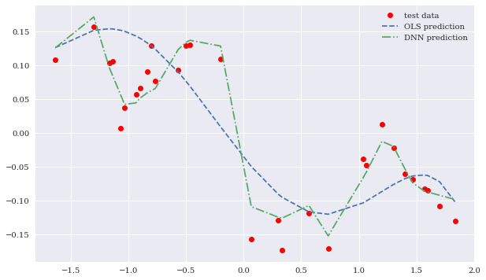
Test data and predictions from OLS regression and the DNN model
Source: Yves Hilpisch (2020), Artificial Intelligence in Finance: A Python-Based Guide, O’Reilly Media.

Slide 71
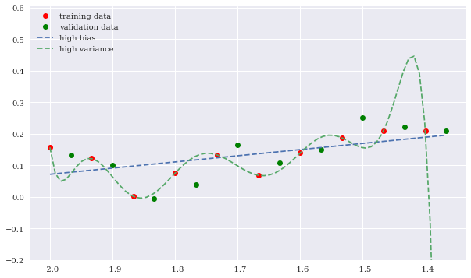
High bias and high variance OLS regression fits
Source: Yves Hilpisch (2020), Artificial Intelligence in Finance: A Python-Based Guide, O’Reilly Media.

Slide 72
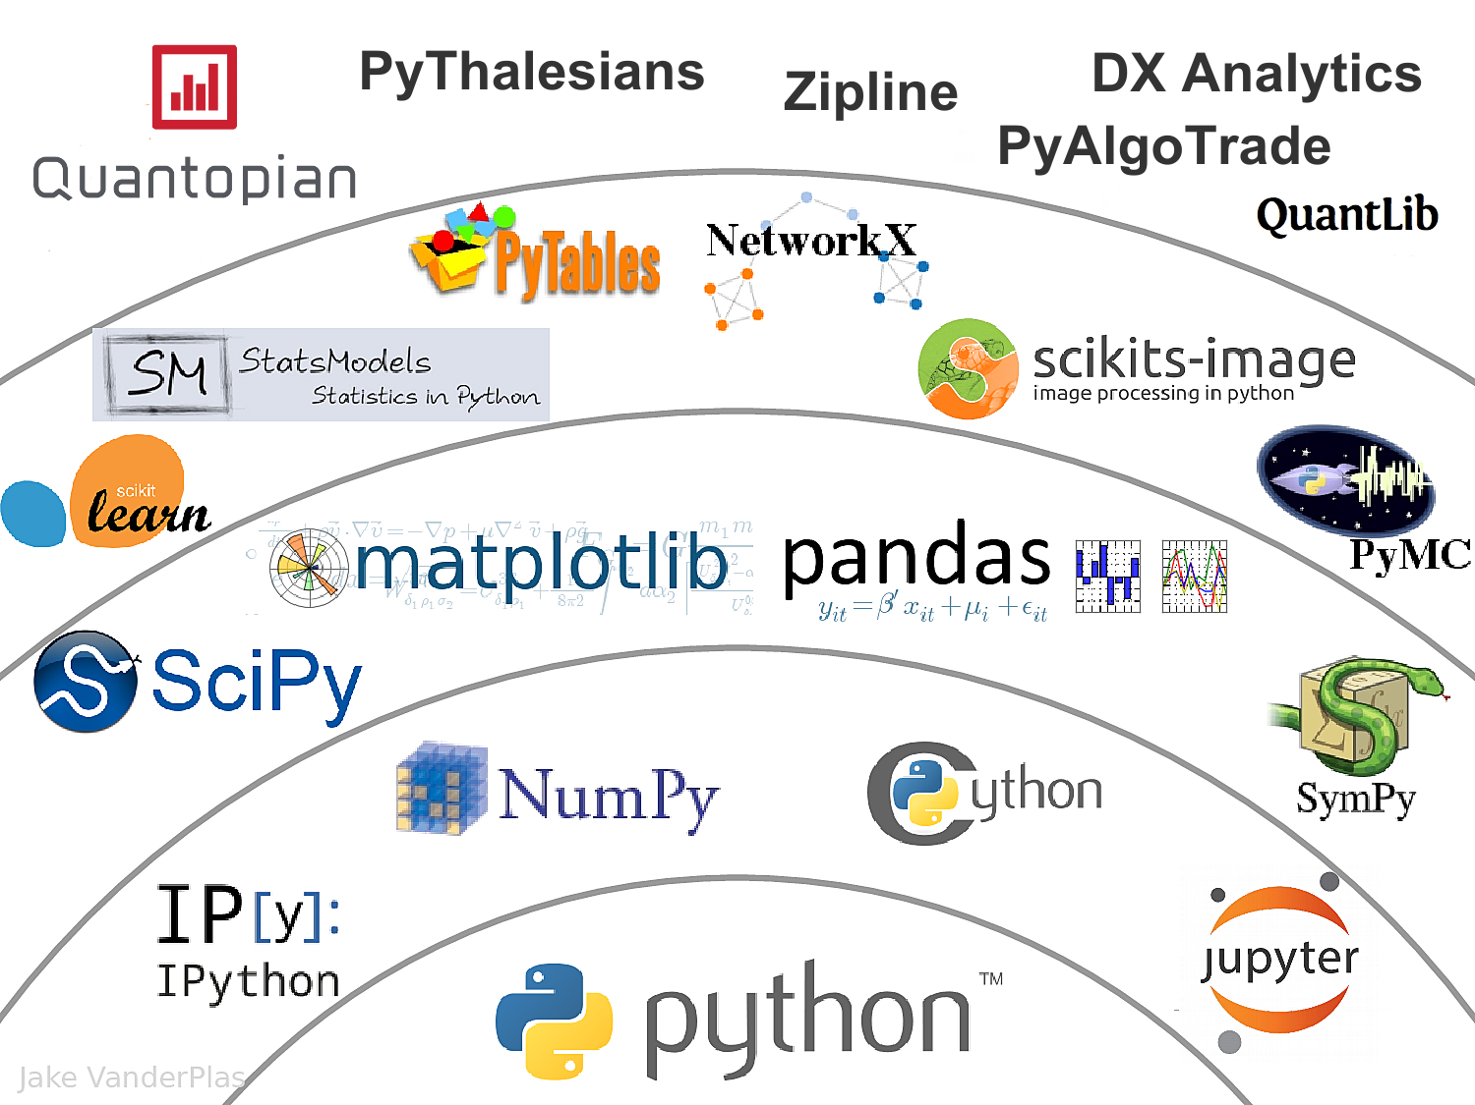
The Quant Finance PyData Stack
Source: http://nbviewer.jupyter.org/format/slides/github/quantopian/pyfolio/blob/master/pyfolio/examples/overview_slides.ipynb#/5

Slide 73
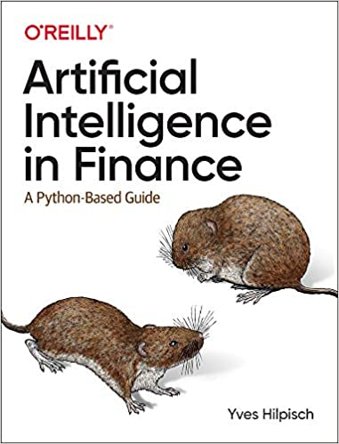
Yves Hilpisch (2020),
Artificial Intelligence in Finance:
A Python-Based Guide,
O’Reilly
Source: https://www.amazon.com/Artificial-Intelligence-Finance-Python-Based-Guide/dp/1492055433

Slide 74
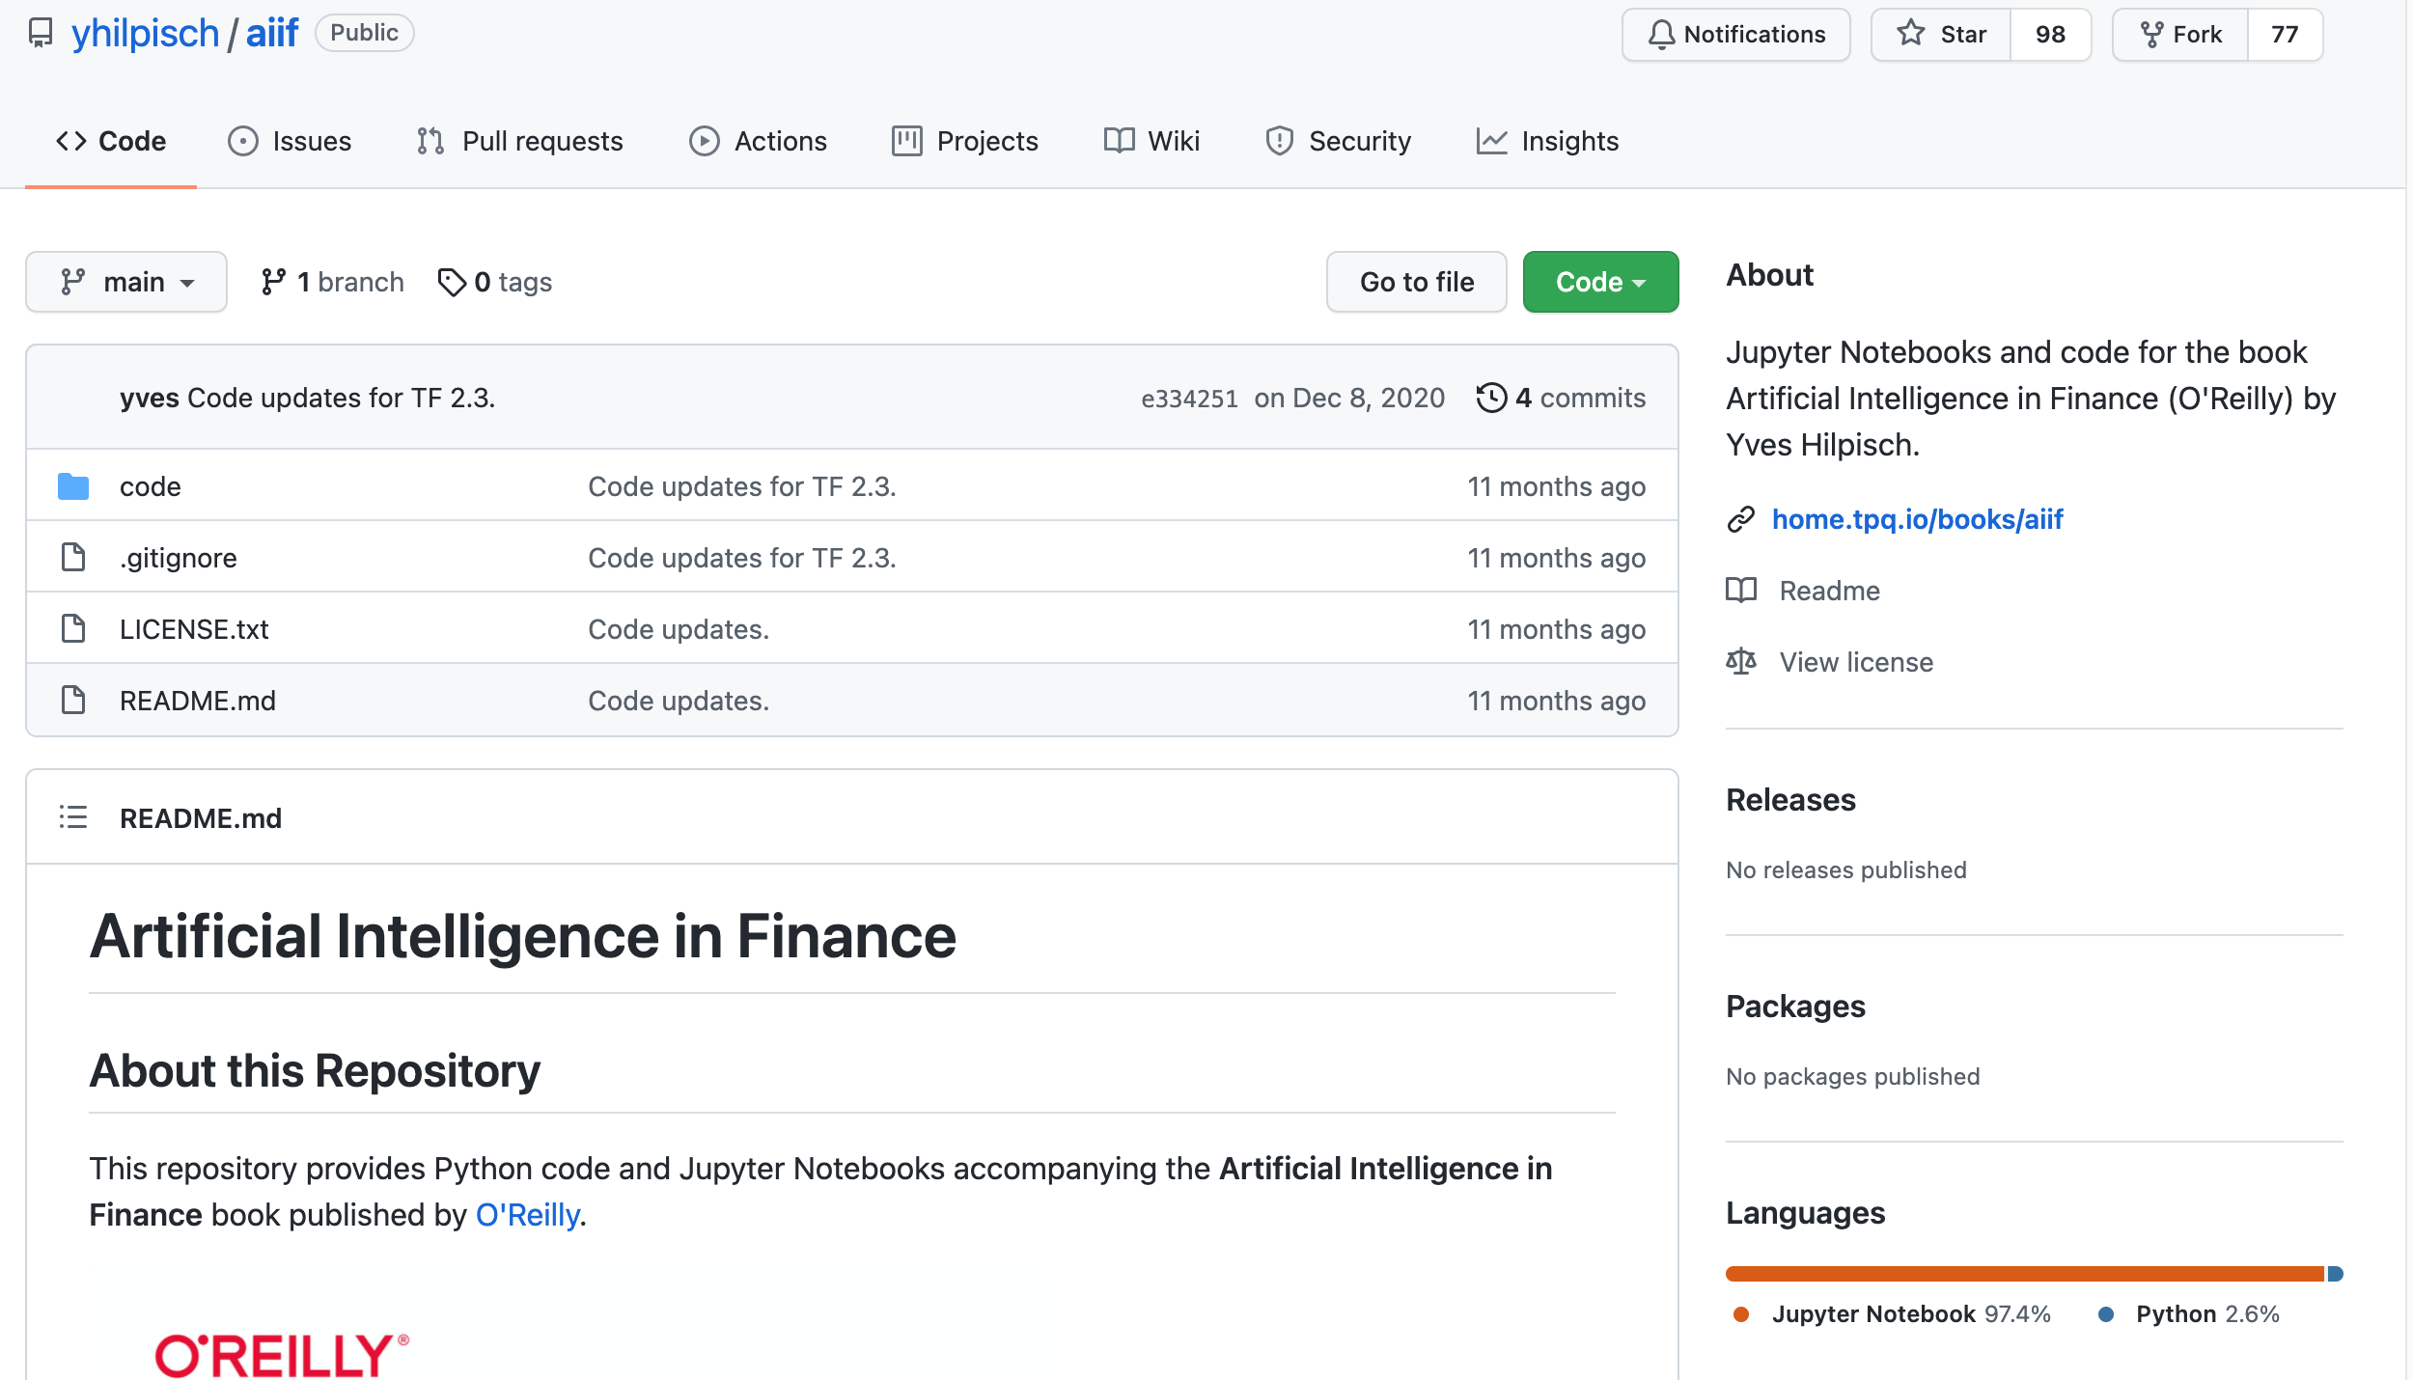
Yves Hilpisch (2020), Artificial Intelligence in Finance: A Python-Based Guide, O’Reilly
https://github.com/yhilpisch/aiif
Source: https://github.com/yhilpisch/aiif

Slide 75
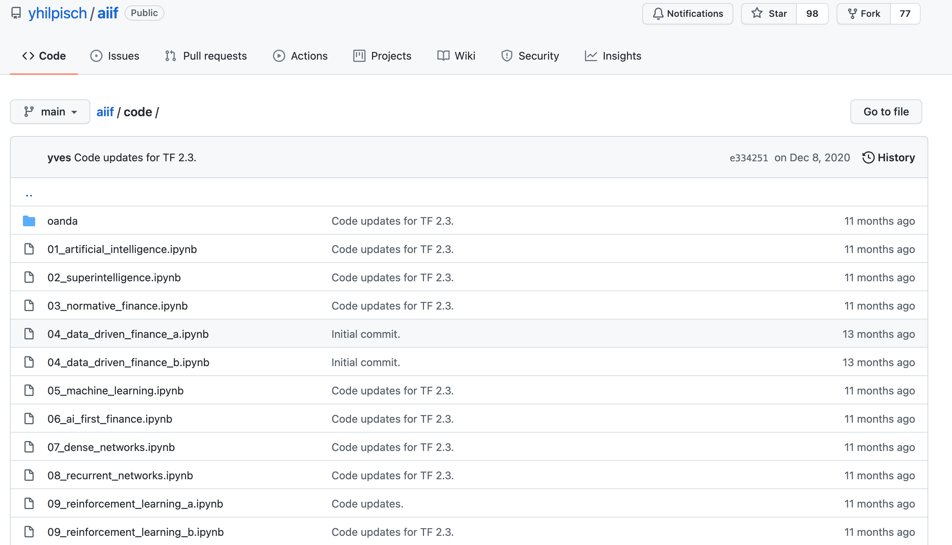
Yves Hilpisch (2020), Artificial Intelligence in Finance: A Python-Based Guide, O’Reilly
https://github.com/yhilpisch/aiif/tree/main/code
Source: https://github.com/yhilpisch/aiif/tree/main/code

Slide 76

Python in Google Colab (Python101)
https://colab.research.google.com/drive/1FEG6DnGvwfUbeo4zJ1zTunjMqf2RkCrT
https://tinyurl.com/aintpupython101

Slide 77
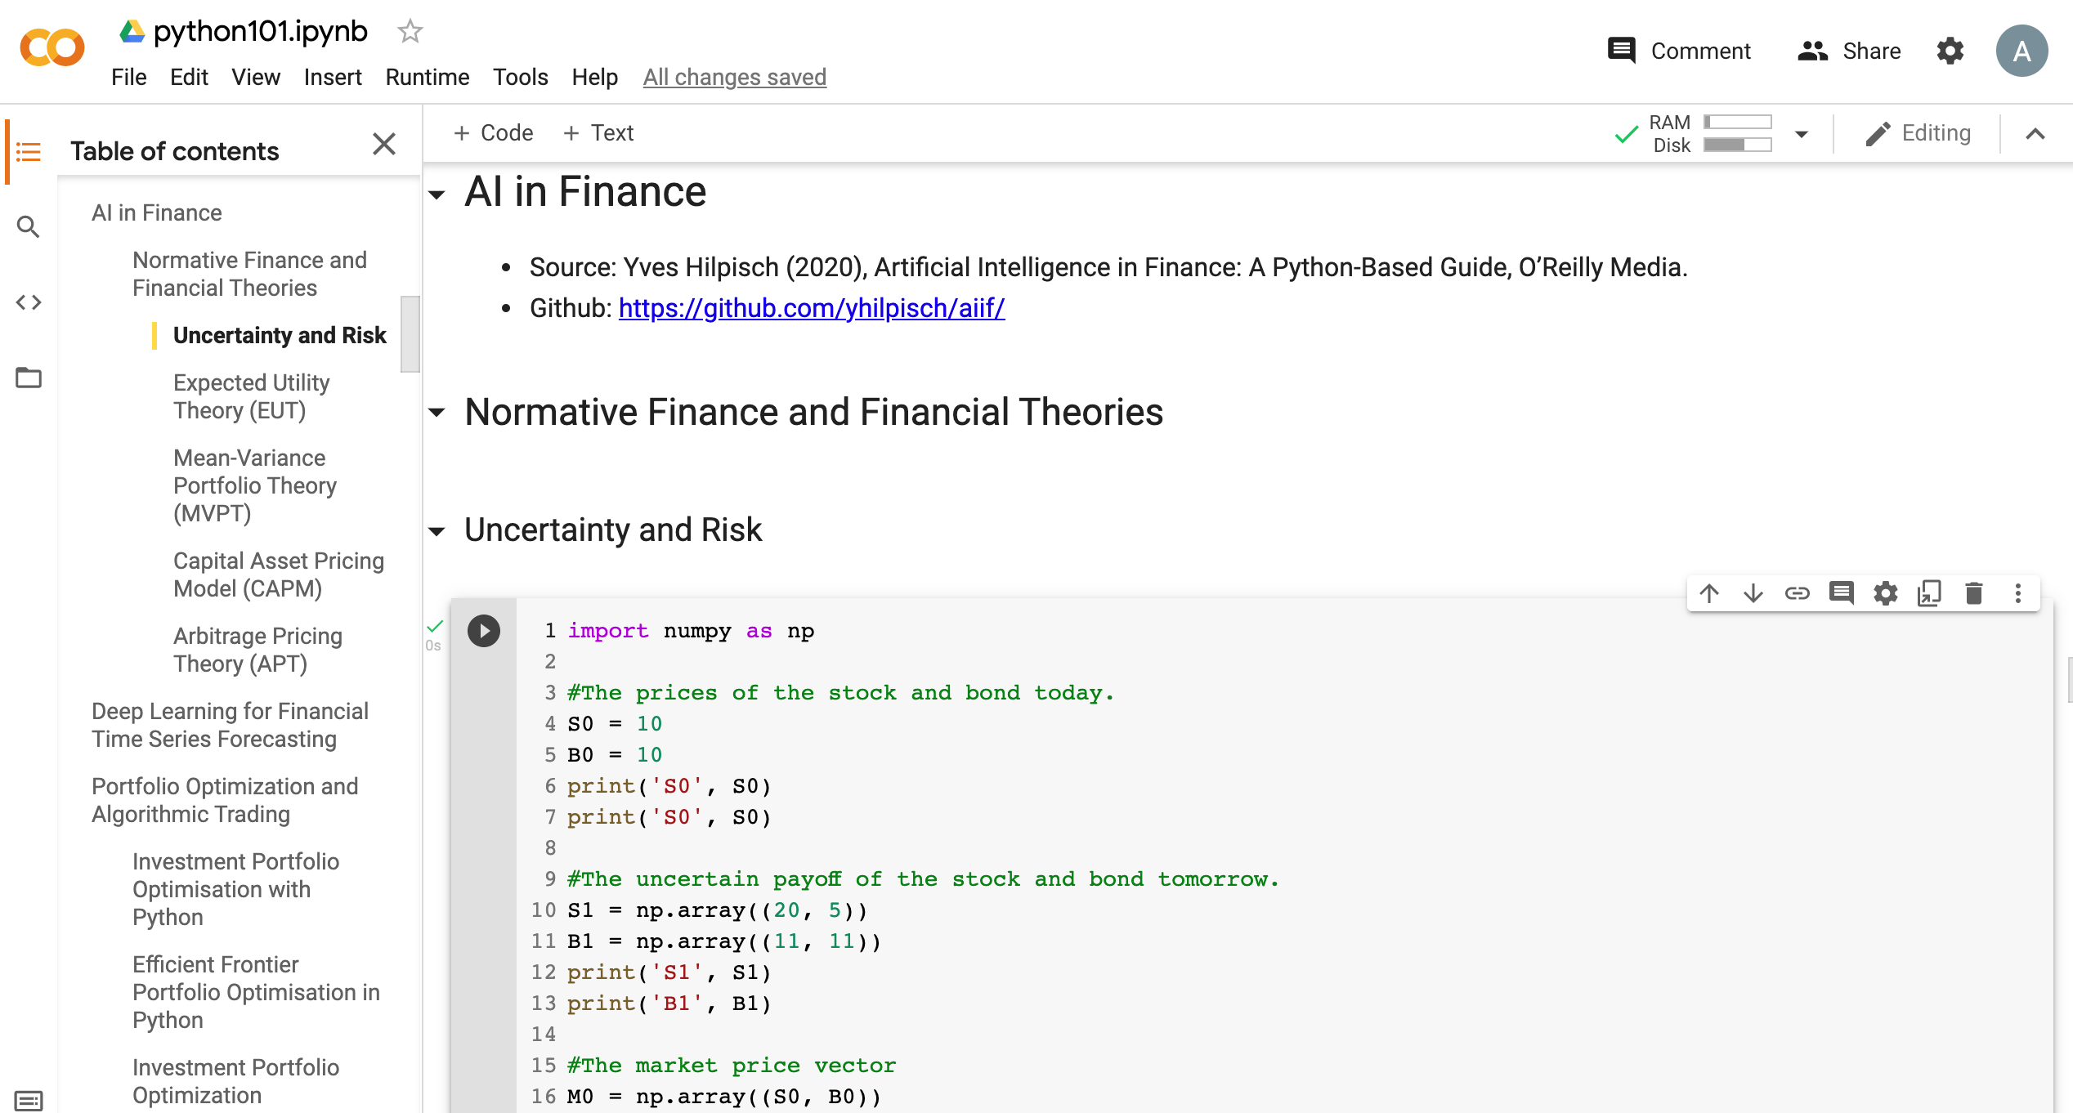
Python in Google Colab (Python101)
https://colab.research.google.com/drive/1FEG6DnGvwfUbeo4zJ1zTunjMqf2RkCrT
https://tinyurl.com/aintpupython101

Slide 78
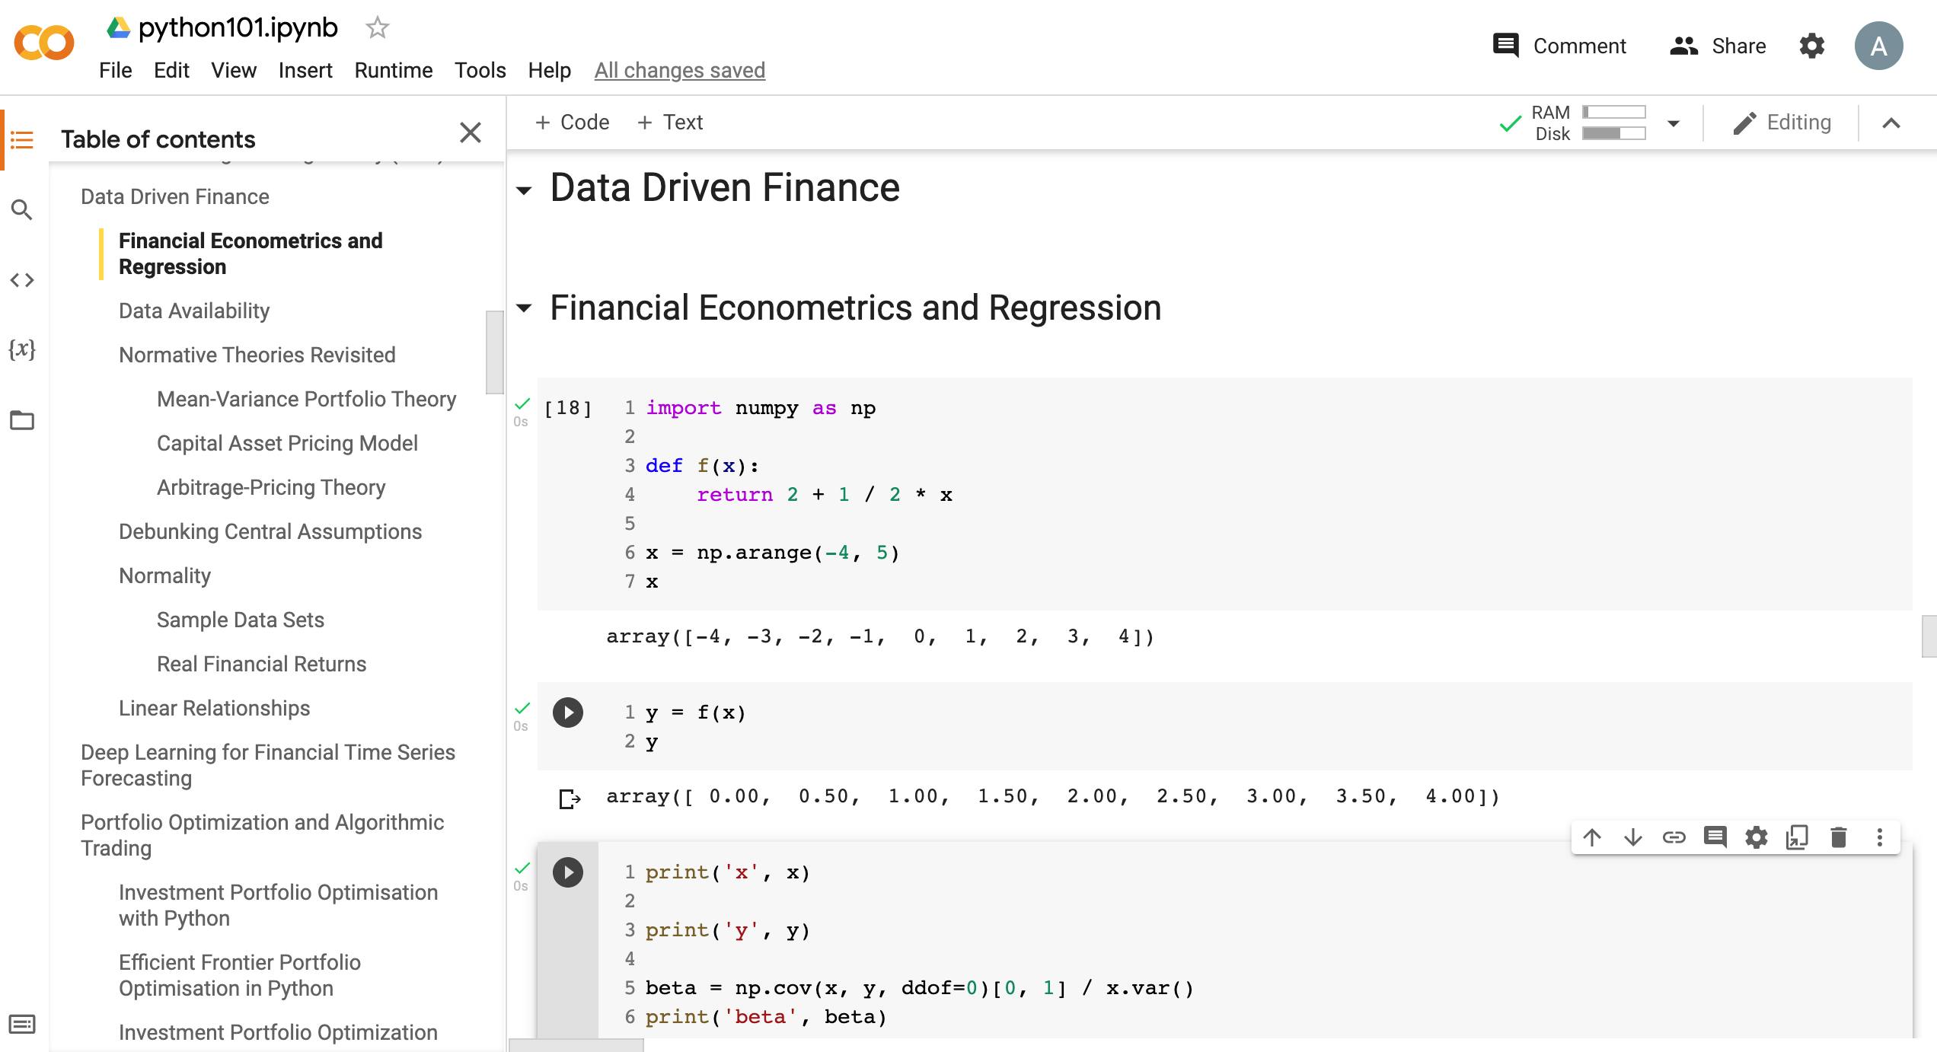
Python in Google Colab (Python101)
https://tinyurl.com/aintpupython101

Slide 79
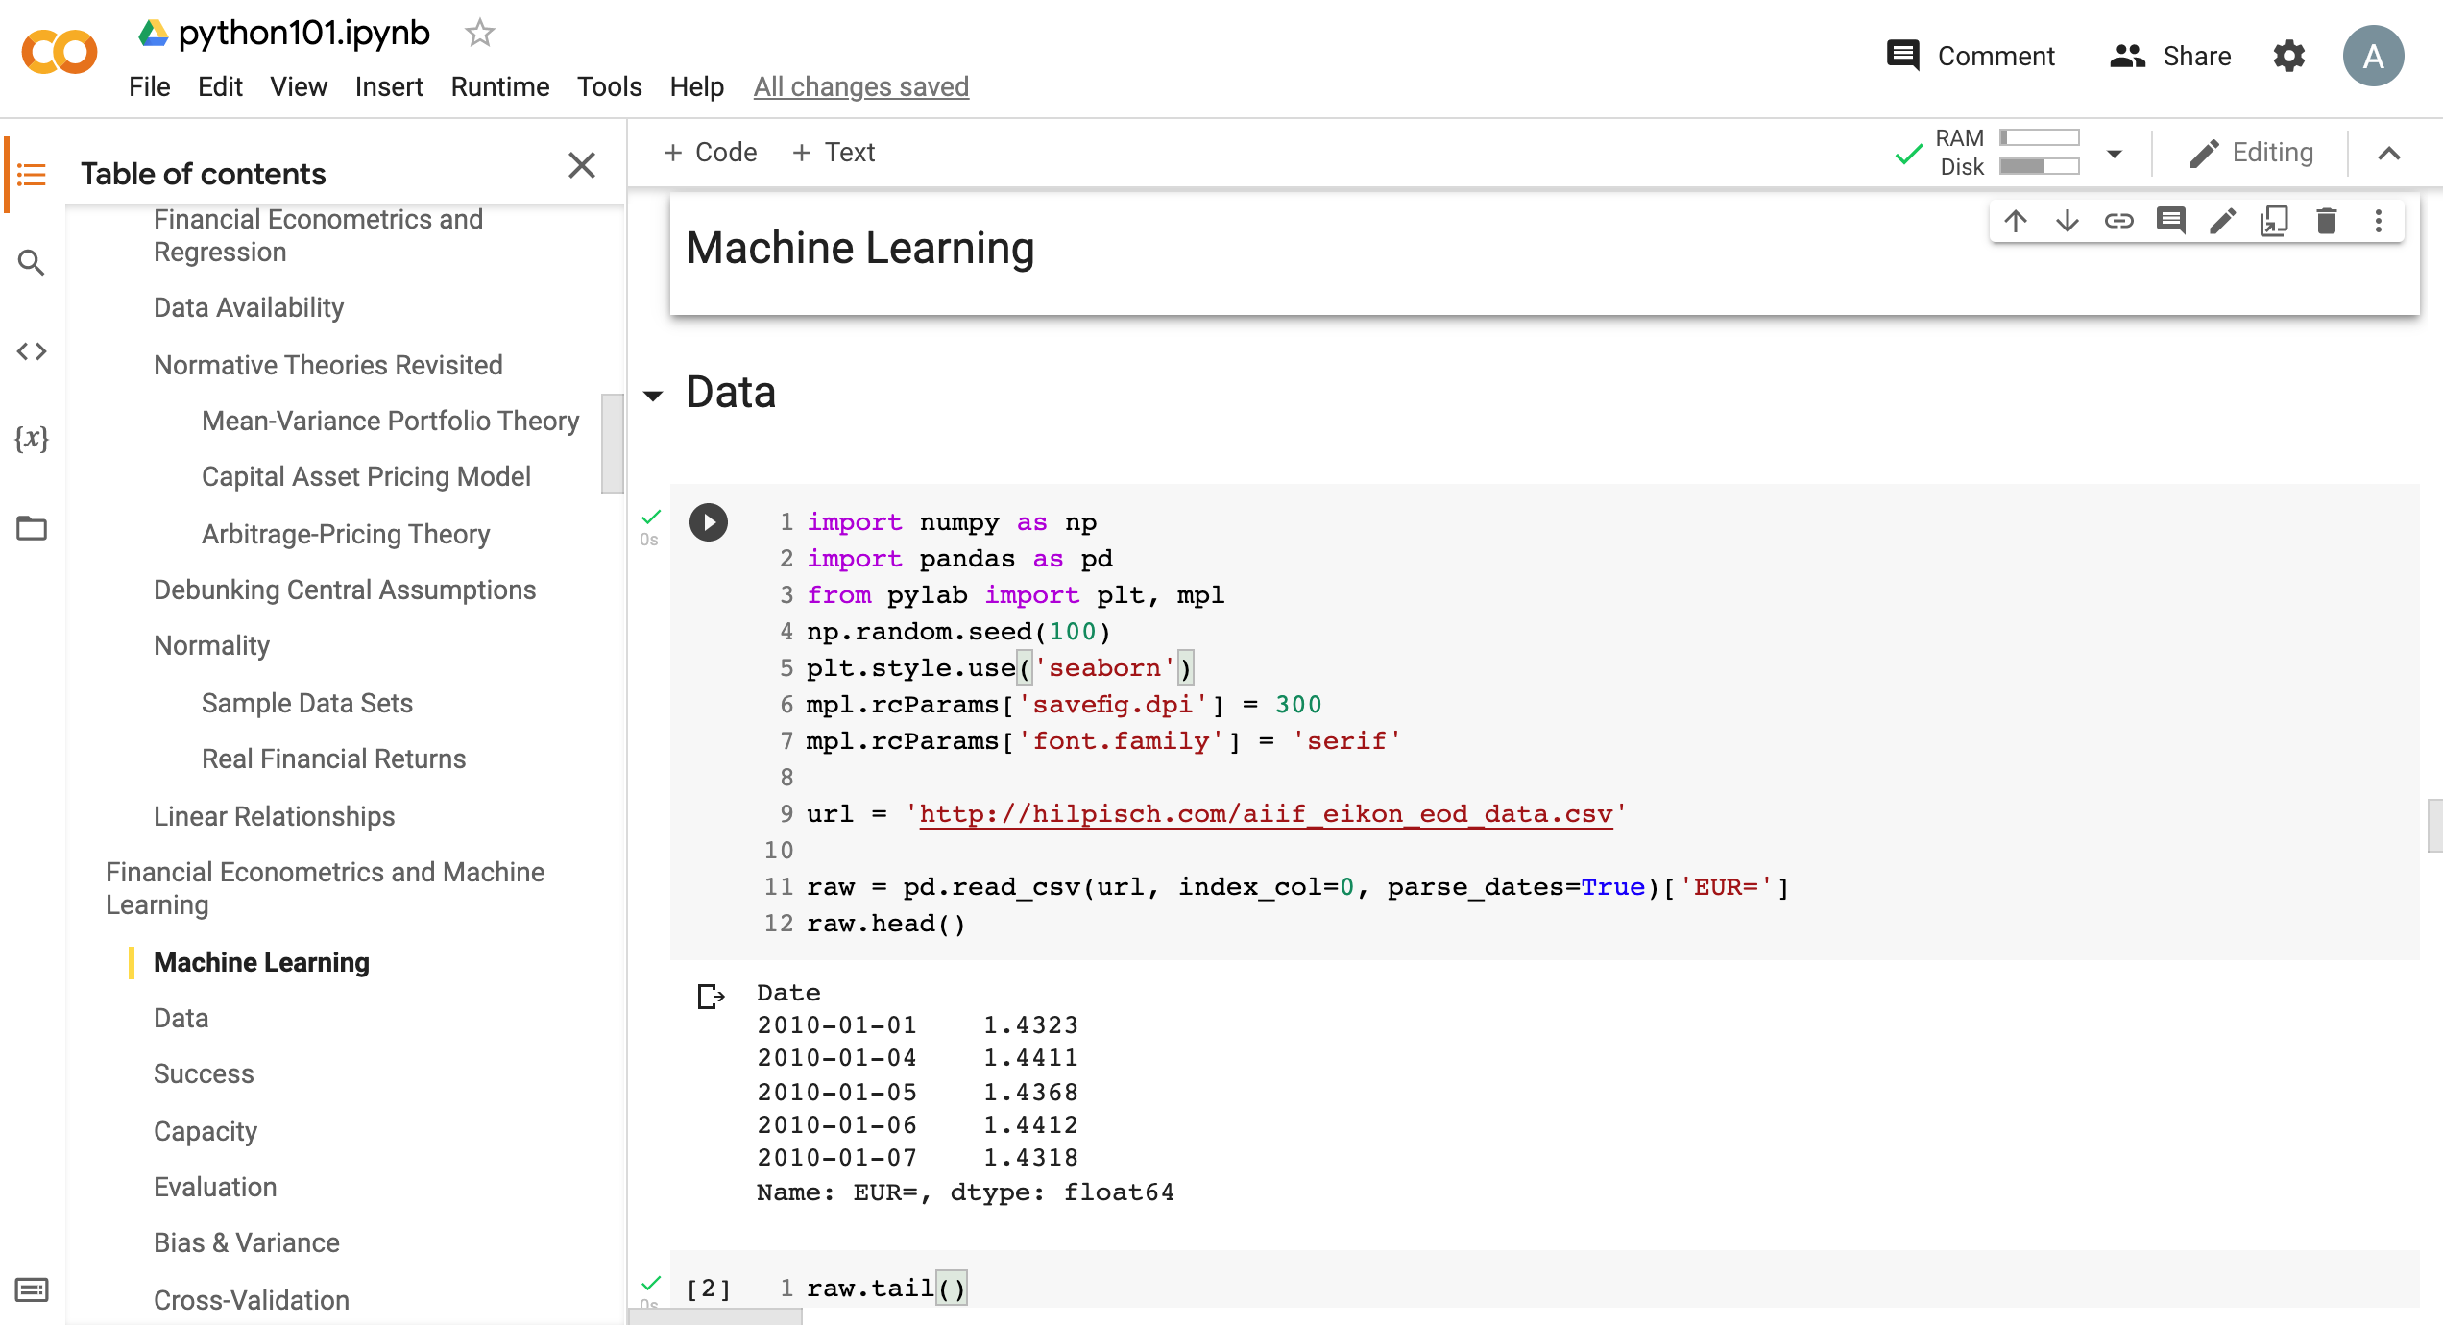
Python in Google Colab (Python101)
https://tinyurl.com/aintpupython101

Slide 80
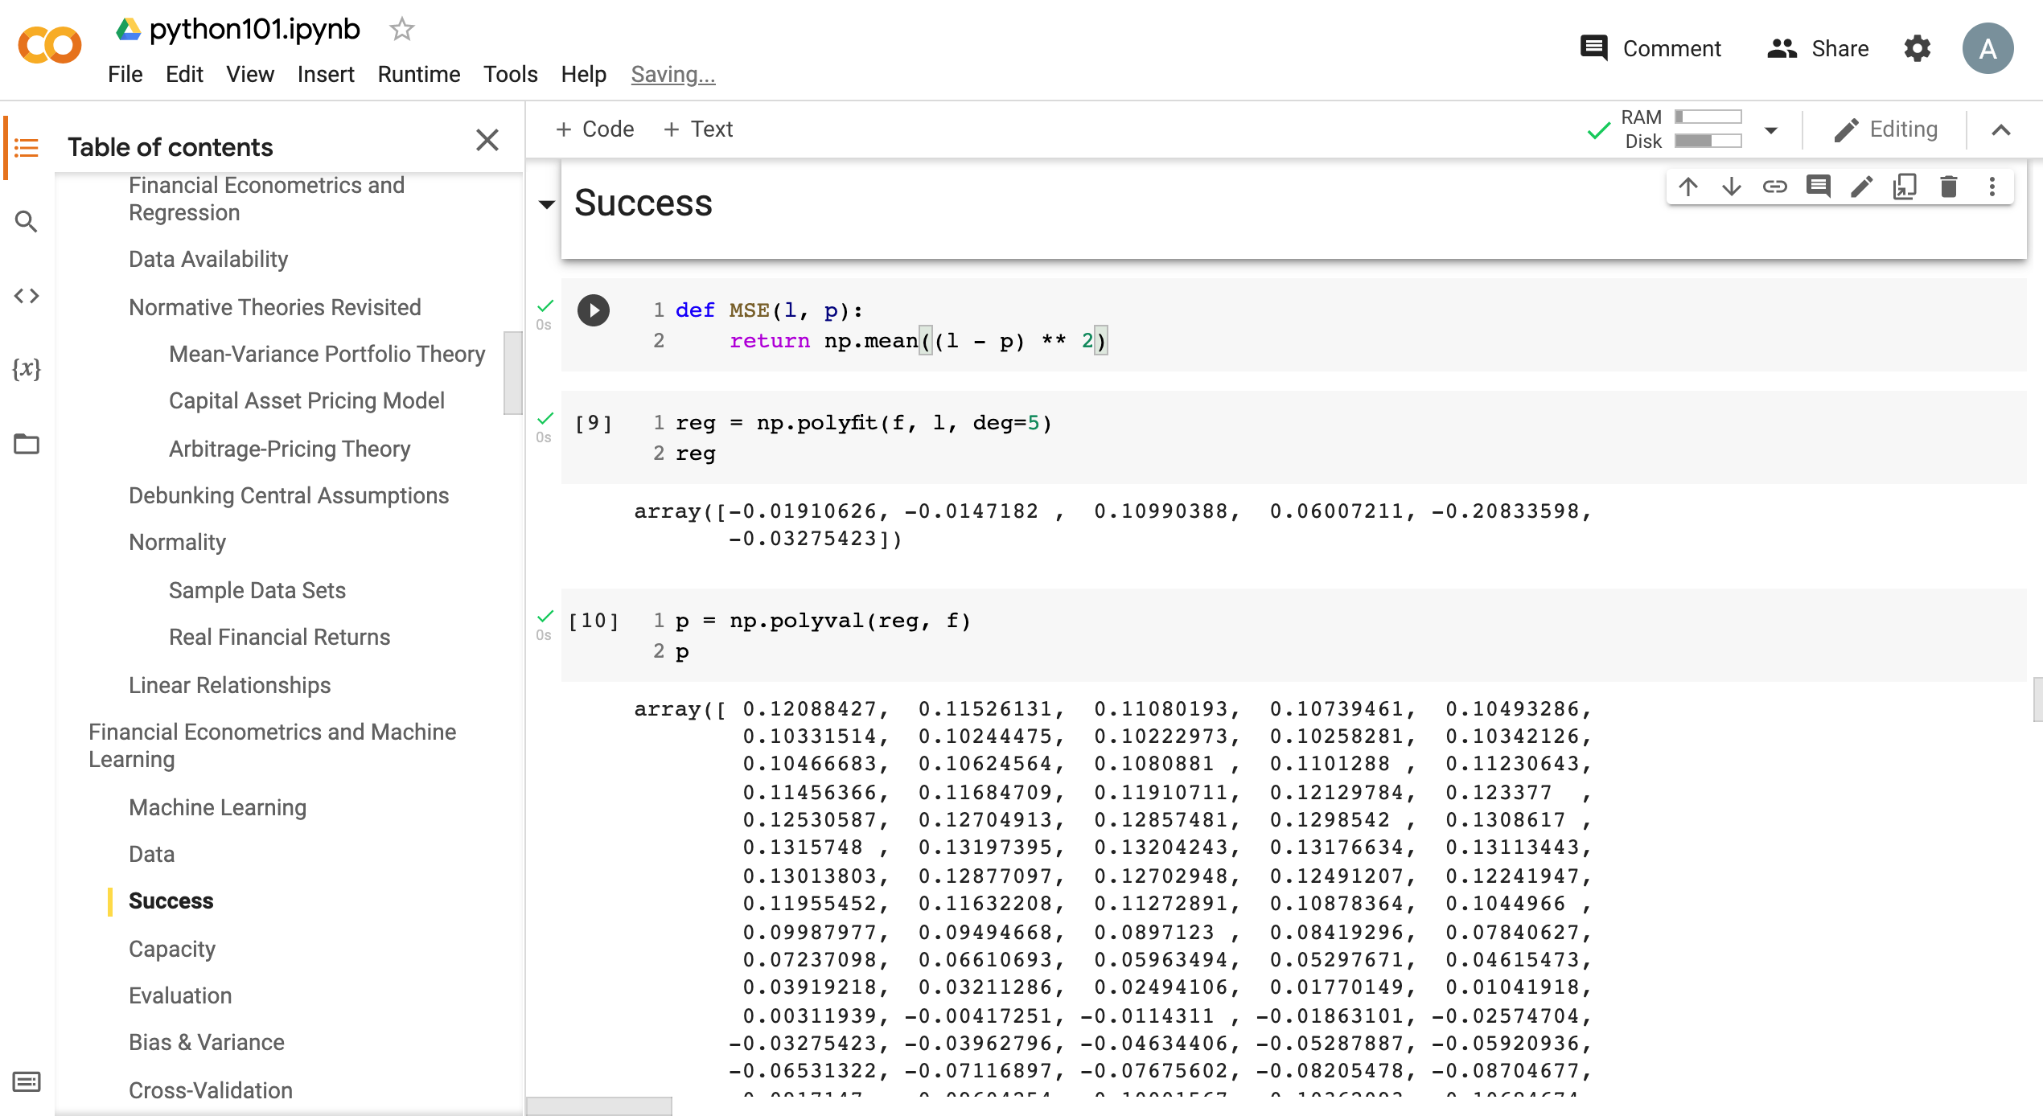
Python in Google Colab (Python101)
https://tinyurl.com/aintpupython101

Slide 81
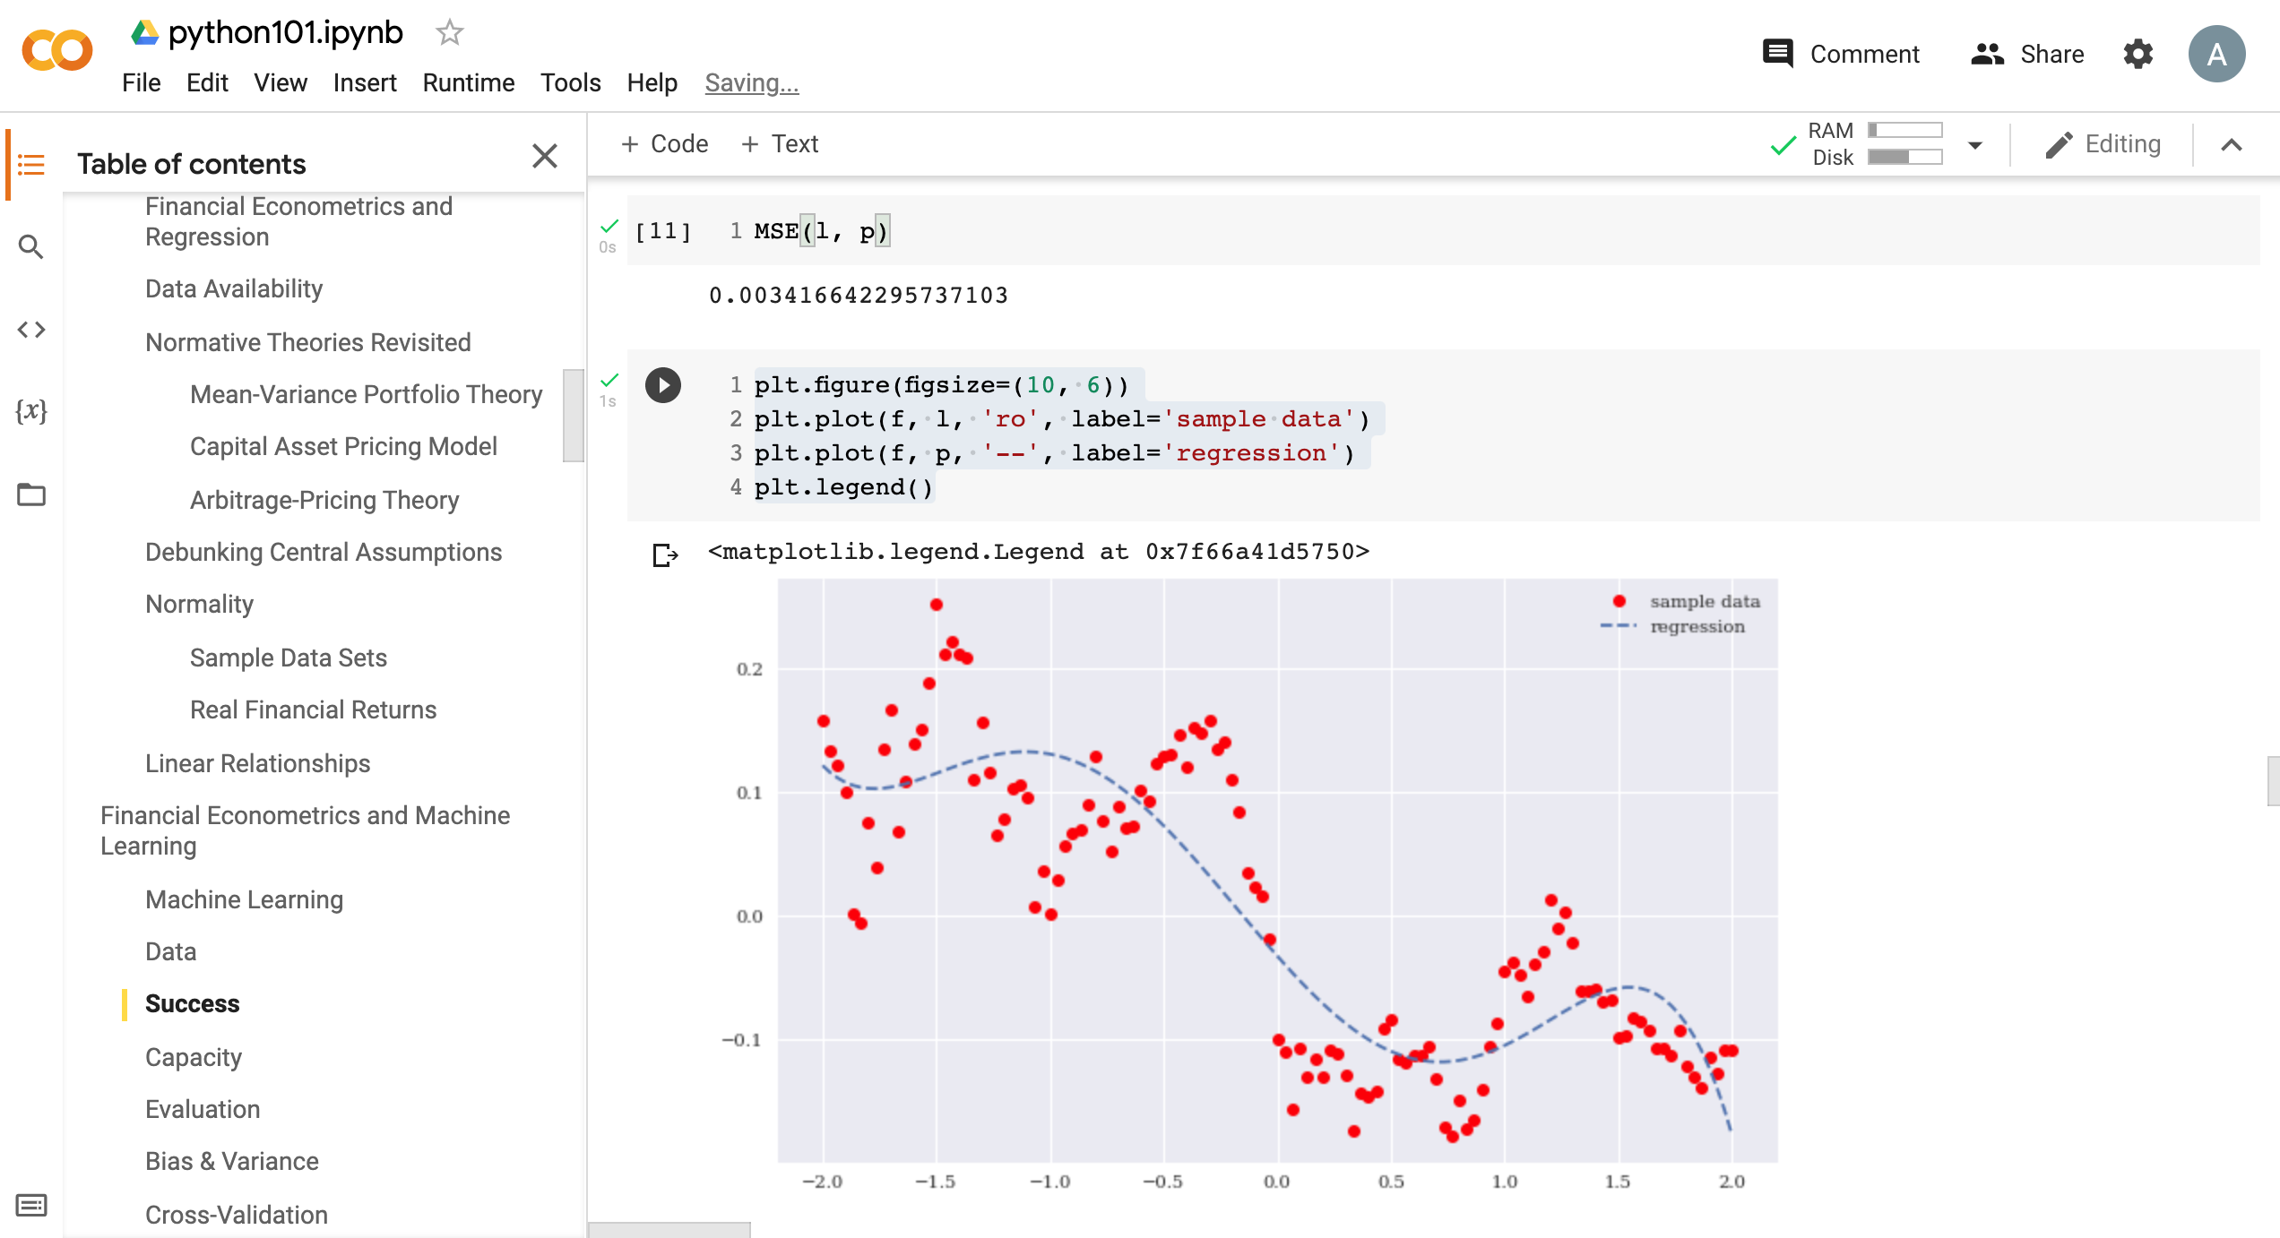
Python in Google Colab (Python101)
https://tinyurl.com/aintpupython101

Slide 82
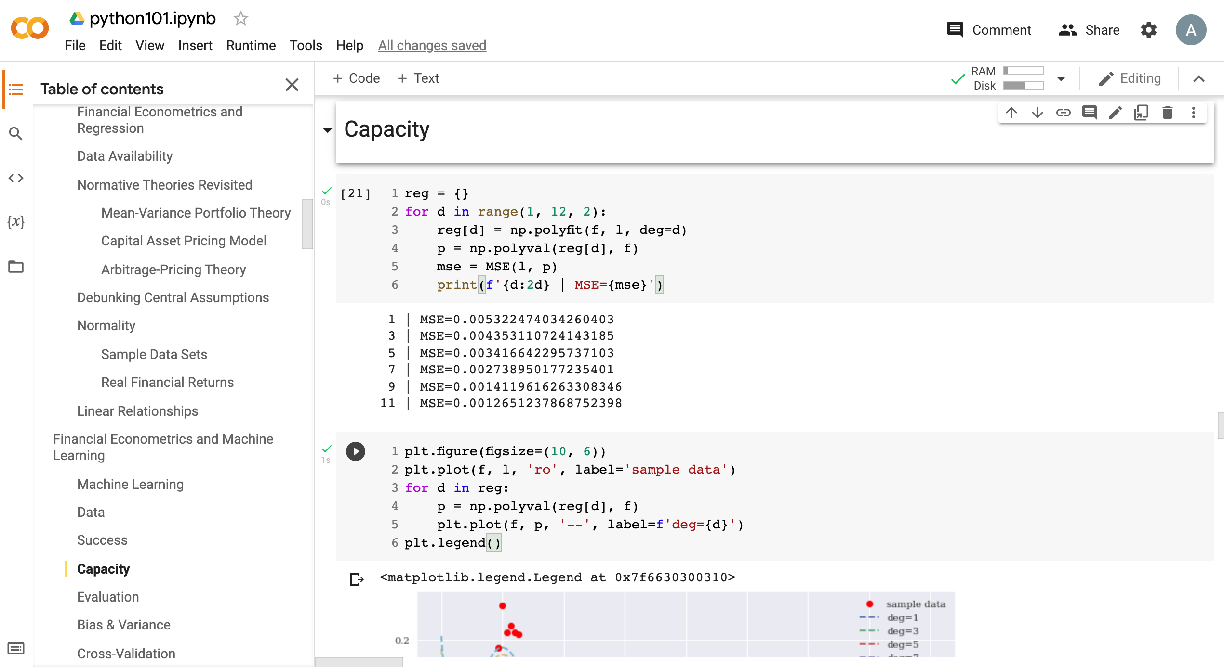
Python in Google Colab (Python101)
https://tinyurl.com/aintpupython101

Slide 83
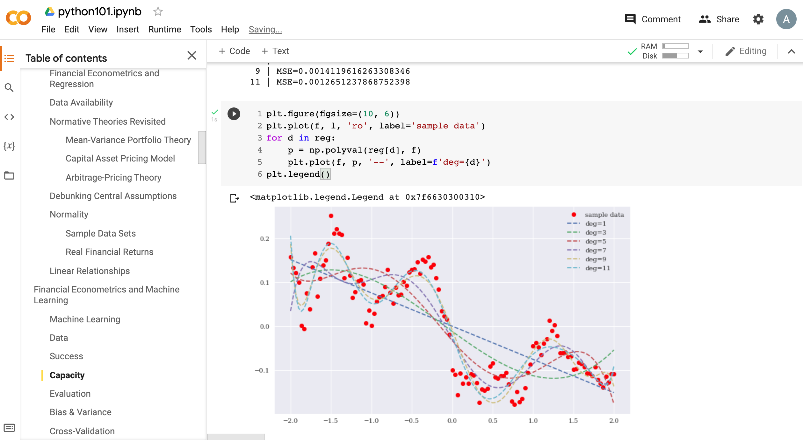
Python in Google Colab (Python101)
https://tinyurl.com/aintpupython101

Slide 84
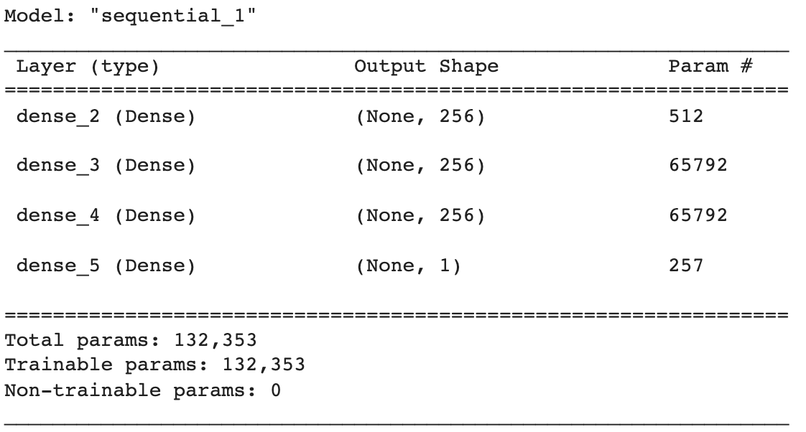
Python in Google Colab (Python101)
def create_dnn_model(hl=1, hu=256):
  ''' Function to create Keras DNN model.
  Parameters
  ==========
  hl: int
  number of hidden layers
  hu: int
  number of hidden units (per layer)
  '''
  model = Sequential()
  for _ in range(hl):
    model.add(Dense(hu, activation='relu', input_dim=1))
  model.add(Dense(1, activation='linear'))
  model.compile(loss='mse', optimizer='rmsprop')
  return model
model = create_dnn_model(3)
model.summary()
https://tinyurl.com/aintpupython101

Slide 85
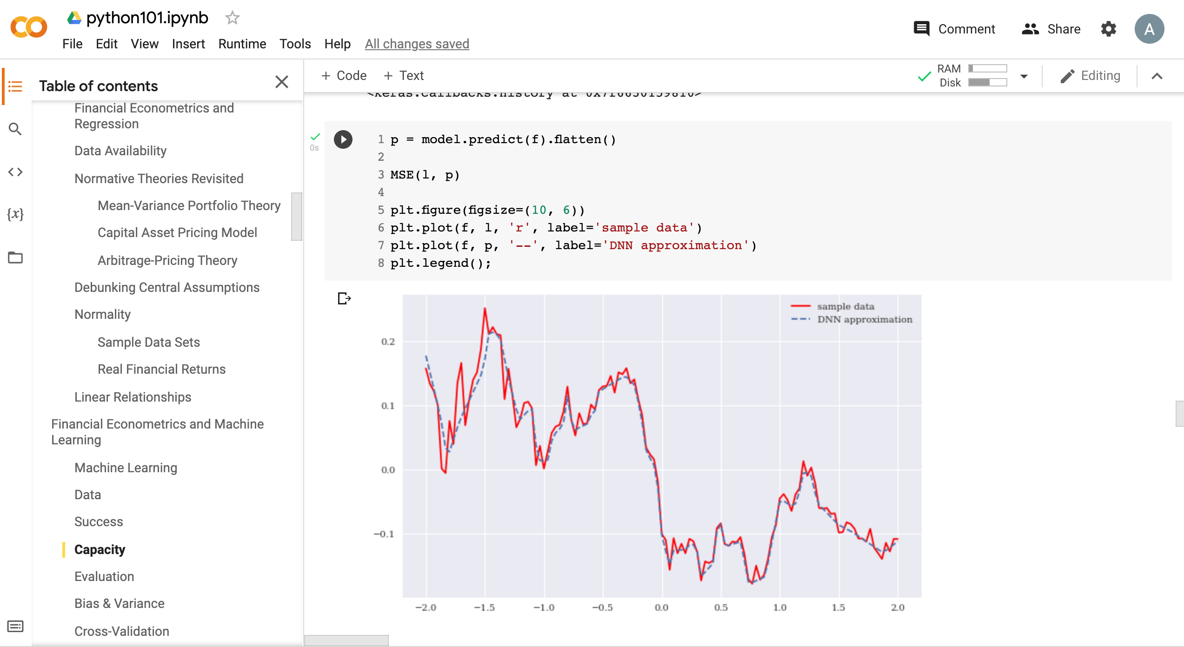
Python in Google Colab (Python101)
https://tinyurl.com/aintpupython101

Slide 86
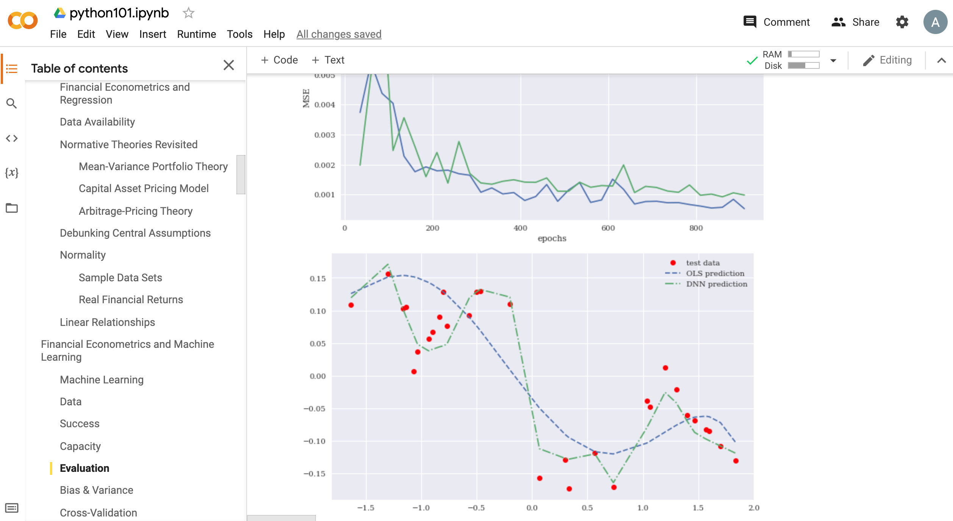
Python in Google Colab (Python101)
https://tinyurl.com/aintpupython101

Slide 87
Summary
Financial Econometrics
  Financial Theories
  OLS Regression
Machine Learning
  Learning
  Evaluation
  Bias and variance
  Cross-validation
Source: Yves Hilpisch (2020), Artificial Intelligence in Finance: A Python-Based Guide, O’Reilly Media.

Slide 88
References
Yves Hilpisch (2020), Artificial Intelligence in Finance: A Python-Based Guide, O’Reilly Media, https://github.com/yhilpisch/aiif .
Chris Brooks (2019), Introductory Econometrics for Finance, 4th Edition, Cambridge University Press
Oliver Linton (2019), Financial Econometrics: Models and Methods, Cambridge University Press
Tom Mitchell (1997), Machine Learning, McGraw-Hill.
Min-Yuh Day (2022), Python 101, https://tinyurl.com/aintpupython101

