Slide 1
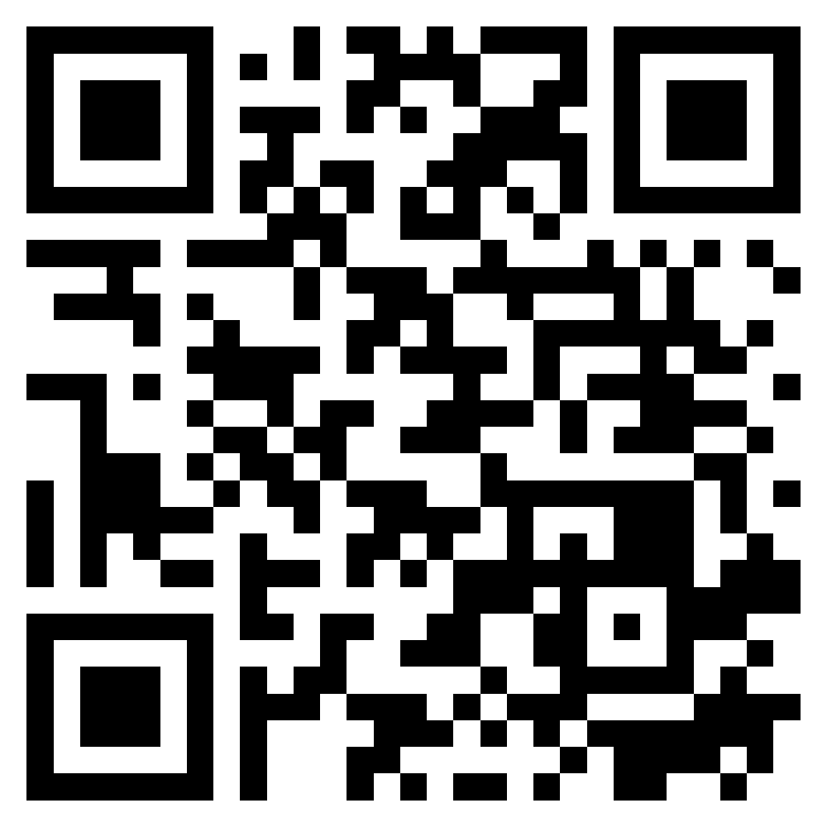
Software Products and Project Management: Software product management and prototyping
Software Engineering
1112SE02
MBA, IM, NTPU (M5010) (Spring 2023) Wed 2, 3, 4 (9:10-12:00) (B8F40)
Min-Yuh Day, Ph.D, Associate Professor
Institute of Information Management, National Taipei University
https://web.ntpu.edu.tw/~myday
https://meet.google.com/ish-gzmy-pmo
2023-03-01

Slide 2
Syllabus
Week Date Subject/Topics
1 2023/02/22 Introduction to Software Engineering
2 2023/03/01 Software Products and Project Management: Software product management and prototyping
3 2023/03/08 Agile Software Engineering: Agile methods, Scrum, and Extreme Programming
4 2023/03/15 Features, Scenarios, and Stories
5 2023/03/22 Case Study on Software Engineering I
6 2023/03/29 Software Architecture: Architectural design, System decomposition, and Distribution architecture

Slide 3
Syllabus
Week Date Subject/Topics
7 2023/04/05 Tomb-Sweeping Day (Holiday, No Classes)
8 2023/04/12 Midterm Project Report
9 2023/04/19 Cloud-Based Software: Virtualization and containers, Everything as a service, Software as a service
10 2023/04/26 Cloud Computing and Cloud Software Architecture
11 2023/05/03 Microservices Architecture, RESTful services, Service deployment
12 2023/05/10 Security and Privacy; Reliable Programming; Testing: Test-driven development, and Code reviews; DevOps and Code Management: DevOps automation

Slide 4
Syllabus
Week Date Subject/Topics
13 2023/05/17 Industry Practices of Software Engineering
[Agile Principles Patterns and Practices using AI and ChatGPT, Invited Speaker: Shihyu (Alex) Chu, Division Director, Software Industry Research Center, Market Intelligence & Consulting Institute (MIC)]
14 2023/05/24 Case Study on Software Engineering II
15 2023/05/31 Final Project Report I
16 2023/06/07 Final Project Report II
17 2023/06/14 Self-learning
18 2023/06/21 Self-learning

Slide 5
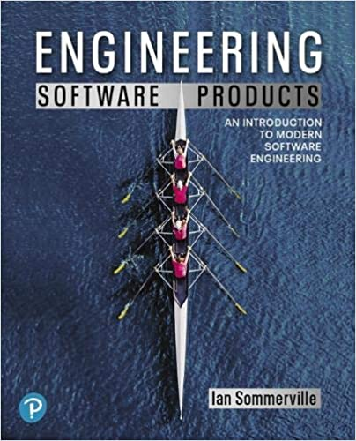
Ian Sommerville (2019), Engineering Software Products: An Introduction to Modern Software Engineering, Pearson.

Slide 6
Ian Sommerville (2015), Software Engineering, 10th Edition, Pearson.

Slide 7
Titus Winters, Tom Manshreck, and Hyrum Wright (2020), Software Engineering at Google: Lessons Learned from Programming Over Time, O'Reilly Media.

Slide 8
Project Management Institute (2017), Agile Practice Guide PMI

Slide 9
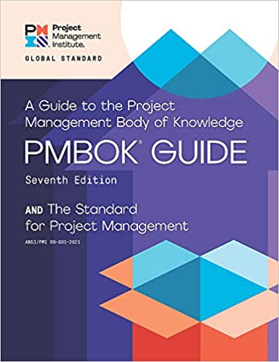
Project Management Institute (2021), A Guide to the Project Management Body of Knowledge (PMBOK Guide) – Seventh Edition and The Standard for Project Management

Slide 10
John Doerr (2018), Measure What Matters: How Google, Bono, and the Gates Foundation Rock the World with OKRs, Portfolio

Slide 11
Software Engineering

Slide 12
Software Engineering and Project Management
Analyze
Requirements definition
Design
System and Software design
Build
Implementation and
unit testing
Test
Integration and system testing
Deliver
Operation and maintenance
Project Management

Slide 13
Information Management Management Information Systems (MIS) Information Systems

Slide 14
Information Management (MIS) Information Systems
Organizations
Technology
Information Systems
Management

Slide 15
Fundamental MIS Concepts
Business Challenges
Management
Organization
Information System
Business Solutions
Technology

Slide 16
Project-based software engineering
CUSTOMER
Problem
generates
helps-with
Requirements
implemented-by
Software
1
CUSTOMER and DEVELOPER
DEVELOPER

Slide 17
Project-based software engineering
The starting point for the software development is a set of ‘software requirements’ that are owned by an external client and which set out what they want a software system to do to support their business processes.
The software is developed by a software company (the contractor) who design and implement a system that delivers functionality to meet the requirements.
The customer may change the requirements at any time in response to business changes (they usually do). The contractor must change the software to reflect these requirements changes.
Custom software usually has a long-lifetime (10 years or more) and it must be supported over that lifetime.

Slide 18
Product software engineering
DEVELOPER
Opportunity
1
inspires
realizes
Product features
implemented-by
Software
DEVELOPER
DEVELOPER

Slide 19
Product software engineering
The starting point for product development is a business opportunity that is identified by individuals or a company. They develop a software product to take advantage of this opportunity and sell this to customers.
The company who identified the opportunity design and implement a set of software features that realize the opportunity and that will be useful to customers.
The software development company are responsible for deciding on the development timescale, what features to include and when the product should change.
Rapid delivery of software products is essential to capture the market for that type of product.

Slide 20
Software execution models
Stand-alone execution
Hybrid execution
Software as a service
User’s computer
User’s computer
User’s computer
User interface
Product functionality
User data
User interface
Partial functionality
User data
User interface
(browser or app)
Product updates
Additional functionality
User data backups
Product updates
Product functionality
User data
Vendor’s servers
Vendor’s servers
Vendor’s servers

Slide 21
Product management concerns
Business needs
Product manager
Technology constraints
Customer experience

Slide 22
Technical interactions of product managers
Product vision management
Product backlog management
User stories and scenarios
Product manager
Acceptance testing
Customer testing
User interface design

Slide 23
Software Development Life Cycle (SDLC) The waterfall model
Requirements definition
System and Software design
Implementation and unit testing
Integration and system testing
Operation and maintenance

Slide 24
Plan-based and Agile development
Plan-based development
Requirements engineering
Requirements specification
Design and implementation
Requirements change requests
Agile development
Requirements engineering
Design and implementation

Slide 25
The Continuum of Life Cycles
High
Incremental
Agile
Frequency of Delivery
Predictive
Iterative
Low
Low
High
Degree of Change

Slide 26
Predictive Life Cycle
Analyze
Design
Build
Test
Deliver

Slide 27
Iterative Life Cycle
Prototype
Refine
Analyze
Analyze
Design
Build
Test
Deliver

Slide 28
A Life Cycle of Varying-Sized Increments
Analyze
Design
Build
Test
Deliver
Analyze
Design
Build
Test
Deliver
Analyze
Design
Build
Test
Deliver

Slide 29
Iteration-Based and Flow-Based Agile Life Cycles
Iteration-Based Agile
Requirements
Analysis
Design
Build
Test
Requirements
Analysis
Design
Build
Test
Requirements
Analysis
Design
Build
Test
Requirements
Analysis
Design
Build
Test
Repeat as needed
…
Requirements
Analysis
Design
Build
Test
Requirements
Analysis
Design
Build
Test
Flow-Based Agile
Requirements
Analysis
Design
Build
Test
the number of features in the WIP limit
Requirements
Analysis
Design
Build
Test
the number of features in the WIP limit
Requirements
Analysis
Design
Build
Test
the number of features in the WIP limit
Repeat as needed
…
Requirements
Analysis
Design
Build
Test
the number of features in the WIP limit
Requirements
Analysis
Design
Build
Test
the number of features in the WIP limit

Slide 30
From personas to features
1
Personas
A way of representing users
inspire
Natural language descriptions of a user interacting with a software product
2
Scenarios
are-developed-into
3
inspire
Stories
Natural language descriptions of something that is needed or wanted by users
4
Features
define
Fragments of product functionality

Slide 31
Multi-tier client-server architecture
Client 1
Client 2
Web Server
Application Server
Database Server
Client 3
Client …

Slide 32
Service-oriented Architecture
Client 1
S1
S2
Client 2
S3
Web Server
Service gateway
S4
Client 3
S5
Client …
S6
Services

Slide 33
VM
Container
Virtual web server
Virtual mail server
User 1 Container 1
User 2 Container 2
Server software
Server software
Application software
Application software
Guest OS
Guest OS
Server software
Server software
Hypervisor
Container manager
Host OS
Host OS
Server Hardware
Server Hardware

Slide 34
Everything as a service
Photo editing
Software as a service (SaaS)
Logistics management
Cloud management Monitoring
Platform as a service (PaaS)
Database
Software development
Storage Network
Infrastructure as a service (IaaS)
Computing Virtualization
Cloud data center

Slide 35
Software as a service
Software customers
Software provider
Software services
Cloud Infrastructure
Cloud provider

Slide 36
Microservices architecture – key design questions
What are the microservices that make up the system?
How should data be distributed and shared?
How should microservices communicate with each other?
Microservices architecture
design
How should the microservices in the system be coordinated?
How should service failure be detected, reported and managed?

Slide 37
Types of security threat
An attacker attempts to deny access to the system for legitimate users
An attacker attempts to damage the system or its data
Availability
threats
Integrity
threats
SOFTWARE PRODUCT
PROGRAM
Distributed denial of service (DDoS) attack
Virus
DATA
Ransomware
Data theft
Confidentiality threats
An attacker tries to gain access to private information held by the system

Slide 38
Software product quality attributes
Reliability
Availability
1
2
Software product quality attributes
Security
Resilience
7
3
Usability
Maintainability
6
4
Responsiveness
5

Slide 39
A refactoring process
1
2
Start
Identify code ‘smell’
Identify refactoring strategy
4
3
Run automated code tests
Make small
improvement until strategy completed

Slide 40
Functional testing
Start
1
Unit Testing
4
2
Release Testing
Feature Testing
3
System Testing

Slide 41
Test-driven development (TDD)
Start
1
Identify new functionality
2
Identify partial implementation
of functionality
3
Write code stub that will fail test
Functionality complete
Functionality incomplete
4
Run all automated test
7
Refactor code if required
5
Implement code that should cause failing test to pass
Test failure
6
Run all automated test
All tests pass

Slide 42
DevOps
Development
Deployment
Support
Multi-skilled DevOps team

Slide 43
Code management and DevOps
DevOps automation
Continuous integration
Continuous deployment
Continuous delivery
Infrastructure as code
Code management system
Branching and merging
Recover version information
Code repository
Save and retrieve versions
Transfer code to/from developer’s filestore
DevOps measurement
Data collection
Data analysis
Report generation

Slide 44
Marketing

Slide 45
Marketing
“Meeting needs profitably”

Slide 46
Marketing
“Marketing is an organizational function and a set of processes for creating, communicating, and delivering value to customers and for managing customer relationships in ways that benefit the organization and its stakeholders.”

Slide 47
Marketing Management

Slide 48
Marketing Management
“Marketing management is the art and science of choosing target markets and getting, keeping, and growing customers through creating, delivering, and communicating superior customer value.”

Slide 49
Marketing Management
1
Understanding Marketing Management
2
Capturing Marketing Insights
3
Connecting with Customers
4
Building Strong Brands
5
Creating Value
6
Delivering Value
7
Communicating Value
8
Conducting Marketing Responsibly for Long-term Success

Slide 50
OKRs, CFRs, KPIs Agile Performance Management
OKRs
Objectives and Key Results
CFRs
Conversations, Feedback, Recognition
KPIs
Key Performance Indicators

Slide 51
Software Engineering

Slide 52
Software Engineering and Project Management
Analyze
Requirements definition
Design
System and Software design
Build
Implementation and
unit testing
Test
Integration and system testing
Deliver
Operation and maintenance
Project Management

Slide 53
Software Engineering
Software engineering is an engineering discipline that is concerned with all aspects of software production from the early stages of system specification through to maintaining the system after it has gone into use.

Slide 54
What is software?
Computer programs and associated documentation. Software products may be developed for a particular customer or may be developed for a general market.

Slide 55
What are the attributes of good software?
Good software should deliver the required functionality and performance to the user and should be maintainable, dependable and usable.

Slide 56
What is software engineering?
Software engineering is an engineering discipline that is concerned with all aspects of software production from initial conception to operation and maintenance.

Slide 57
What are the fundamental software engineering activities?
Software specification, software development, software validation and software evolution.

Slide 58
What is the difference between software engineering and computer science?
Computer science focuses on theory and fundamentals; software engineering is concerned with the practicalities of developing and delivering useful software.

Slide 59
What are the best software engineering techniques and methods?
While all software projects have to be professionally managed and developed, different techniques are appropriate for different types of system.
For example, games should always be developed using a series of prototypes whereas safety critical control systems require a complete and analyzable specification to be developed.
There are no methods and techniques that are good for everything.

Slide 60
What are the costs of software engineering?
Roughly 60% of software costs are development costs, 40% are testing costs.
For custom software, evolution costs often exceed development costs.

Slide 61
Information Management Management Information Systems (MIS) Information Systems

Slide 62
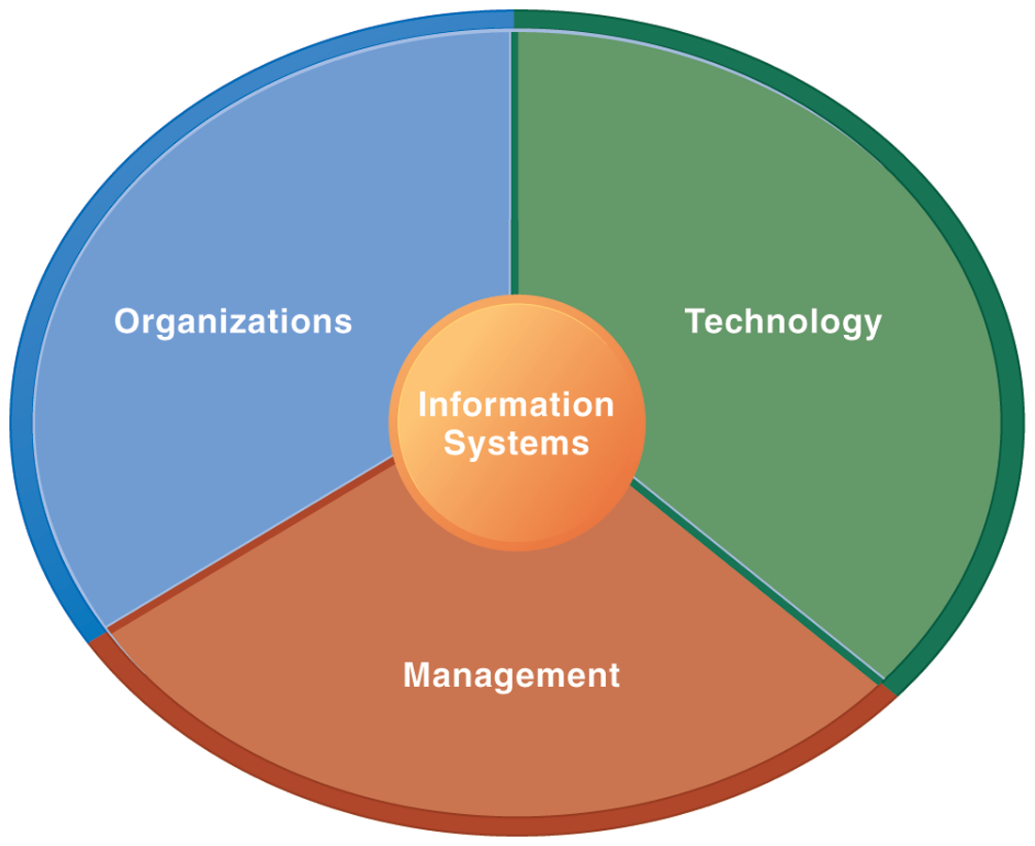
Information Management (MIS) Information Systems

Slide 63
Fundamental MIS Concepts
Business Challenges
Management
Organization
Information System
Business Solutions
Technology

Slide 64
Software products
Software products are generic software systems that provide functionality that is useful to a range of customers.
Software products:
Large-scale business systems (e.g. MS Excel)
Personal products (e.g. Evernote)
Simple mobile phone apps and games (e.g. Suduko).

Slide 65
Software product engineering
Software product engineering methods and techniques have evolved from software engineering techniques that support the development of one-off, custom software systems.

Slide 66
Software projects
Custom software systems are still important for large businesses, government and public bodies.
They are developed in dedicated software projects.

Slide 67
Project
A project is a temporary endeavor undertaken to create a unique product, service, or result.

Slide 68
Project Management Body of Knowledge (PMBOK Guide) PMBOK v6 vs. PMBOK v7
PMBOK Guide v6
PMBOK Guide v7
Project Management Body of Knowledge:
Introduction
Project Environment
Role of the Project Manager
10 Knowledge Areas
Integration
Scope
Schedule
Cost
Quality
Resources
Communications
Risk
Procurement
Stakeholders
The Standard for Project Management :
Introduction
System for Value Delivery
12 Project Management Principles:
1. Stewardship, 2. Team
3. Stakeholders, 4. Value
5. Systems Thinking, 5. Leadership
7. Tailoring, 8. Quality
9. Complexity, 10, Risk
11. Adaptability and Resiliency
12. Change
The Standard for Project Management (5 Process Groups):
Initiating
Planning
Executing
Monitoring and Controlling
Closing
Project Management Body of Knowledge:
8 Project Performance Domains:
1. Stakeholders, 2. Team,
3. Development approach and Life Cycle
4. Planning, 5. Project Work, 6. Delivery,
7. Measurement, 8. Uncertainty
Tailoring
Models, Methods, and Artifacts

Slide 69
Project Management Knowledge Areas (PMBOK v6)
Project Integration Management
Project Scope Management
Project Schedule Management
Project Cost Management
Project Quality Management
Project Resource Management
Project Communications Management
Project Risk Management
Project Procurement Management
Project Stakeholder Management

Slide 70
Project Management Process Groups (PMBOK v6)
Initiating Process Group
Planning Process Group
Executing Process Group
Monitoring and Controlling Process Group
Closing Process Group

Slide 71
Project Management 12 Principles (PMBOK v7)
Stewardship
Team
Stakeholders
Value
Systems Thinking
Leadership
Tailoring
Quality
Complexity
Risk
Adaptability and Resiliency
Change

Slide 72
Project Management 8 Project Performance Domains (PMBOK v7)
Stakeholders
Team
Development Approach and Life Cycle
Planning
Project Work
Delivery
Measurement
Uncertainty

Slide 73
Project-based software engineering
CUSTOMER
Problem
generates
helps-with
Requirements
implemented-by
Software
1
CUSTOMER and DEVELOPER
DEVELOPER

Slide 74
Project-based software engineering
The starting point for the software development is a set of ‘software requirements’ that are owned by an external client and which set out what they want a software system to do to support their business processes.
The software is developed by a software company (the contractor) who design and implement a system that delivers functionality to meet the requirements.
The customer may change the requirements at any time in response to business changes (they usually do). The contractor must change the software to reflect these requirements changes.
Custom software usually has a long-lifetime (10 years or more) and it must be supported over that lifetime.

Slide 75
Product software engineering
DEVELOPER
Opportunity
1
inspires
realizes
Product features
implemented-by
Software
DEVELOPER
DEVELOPER

Slide 76
Product software engineering
The starting point for product development is a business opportunity that is identified by individuals or a company. They develop a software product to take advantage of this opportunity and sell this to customers.
The company who identified the opportunity design and implement a set of software features that realize the opportunity and that will be useful to customers.
The software development company are responsible for deciding on the development timescale, what features to include and when the product should change.
Rapid delivery of software products is essential to capture the market for that type of product.

Slide 77
Software product line
A set of software products that share a common core.
Each member of the product line includes customer-specific adaptations and additions.
Software product lines may be used to implement a custom system for a customer with specific needs that can’t be met by a generic product.

Slide 78
Platform
A software (or software + hardware) product that includes functionality so that new applications can be built on it.
An example of a platform that you probably use is Facebook.
It provides an extensive set of product functionality but also provides support for creating ‘Facebook apps’.
These add new features that may be used by a business or a Facebook interest group.

Slide 79
Software execution models
Stand-alone execution
Hybrid execution
Software as a service
User’s computer
User’s computer
User’s computer
User interface
Product functionality
User data
User interface
Partial functionality
User data
User interface
(browser or app)
Product updates
Additional functionality
User data backups
Product updates
Product functionality
User data
Vendor’s servers
Vendor’s servers
Vendor’s servers

Slide 80
Software execution models
Stand-alone
The software executes entirely on the customer’s computers.
Hybrid
Part of the software’s functionality is implemented on the customer’s computer but some features are implemented on the product developer’s servers.
Software service
All of the product’s features are implemented on the developer’s servers and the customer accesses these through a browser or a mobile app.

Slide 81
Comparable software development
The key feature of product development is that there is no external customer that generates requirements and pays for the software.
Student projects
Individuals or student groups develop software as part of their course. Given an assignment, they decide what features to include in the software.
Research software
Researchers develop software to help them answer questions that are relevant to their research.
Internal tool development

Slide 82
The product vision
The starting point for software product development is a ‘product vision’.
Product visions are simple statements that define the essence of the product to be developed.
The product vision should answer three fundamental questions:
What is the product to be developed?
Who are the target customers and users?
Why should customers buy this product?

Slide 83
Moore’s vision template
FOR (target customer)
WHO (statement of the need or opportunity)
The (PRODUCT NAME) is a (product category)
THAT (key benefit, compelling reason to buy)
UNLIKE (primary competitive alternative)
OUR PRODUCT (statement of primary differentiation)

Slide 84
Vision template example
“FOR a mid-sized company's marketing and sales departments WHO need basic CRM functionality, THE CRM-Innovator is a Web-based service THAT provides sales tracking, lead generation, and sales representative support features that improve customer relationships at critical touch points. UNLIKE other services or package software products, OUR product provides very capable services at a moderate cost.”

Slide 85
Information sources for developing a product vision
Domain experience
Product experience
Customer experience
Prototyping and playing around

Slide 86
Information sources for developing a product vision
Domain experience
The product developers may work in a particular area (say marketing and sales) and understand the software support that they need.
They may be frustrated by the deficiencies in the software they use and see opportunities for an improved system.

Slide 87
Information sources for developing a product vision
Product experience
Users of existing software (such as word processing software) may see simpler and better ways of providing comparable functionality and propose a new system that implements this.
New products can take advantage of recent technological developments such as speech interfaces.

Slide 88
Information sources for developing a product vision
Customer experience
The software developers may have extensive discussions with prospective customers of the product to understand the problems that they face, constraints, such as interoperability, that limit their flexibility to buy new software, and the critical attributes of the software that they need.

Slide 89
Information sources for developing a product vision
Prototyping and playing around
Developers may have an idea for software but need to develop a better understanding of that idea and what might be involved in developing it into a product.
They may develop a prototype system as an experiment and ‘play around’ with ideas and variations using that prototype system as a platform.

Slide 90
A vision statement for the iLearn system
FOR teachers and educators WHO need a way to help students use web-based learning resources and applications, THE iLearn system is an open learning environment THAT allows the set of resources used by classes and students to be easily configured for these students and classes by teachers themselves. UNLIKE Virtual Learning Environments, such as Moodle, the focus of iLearn is the learning process rather than the administration and management of materials, assessments and coursework. OUR product enables teachers to create subject and age-specific environments for their students using any web-based resources, such as videos, simulations and written materials that are appropriate.
Schools and universities are the target customers for the iLearn system as it will significantly improve the learning experience of students at relatively low cost. It will collect and process learner analytics that will reduce the costs of progress tracking and reporting.

Slide 91
The Essence of Strategic Marketing (STP)
Segmentation
Targeting
Positioning

Slide 92
Customer Value

Slide 93
Value
the sum of the tangible and intangible benefits and costs

Slide 94
Value
Total customer benefit
Customer perceived value
Total customer cost

Slide 95
Customer Perceived Value
Product benefit
Total customer benefit
Customer perceived value
Services benefit
Personnel benefit
Image benefit
Monetary cost
Total customer cost
Time cost
Energy cost
Psychological cost

Slide 96
Business Model
8
7
2
4
1
Key Partners
Key Activities
Value Proposition
Customer Relationships
Customer Segments
6
3
Key Resources
Channels
9
5
Cost Structure
Revenue Streams
Source: Alexander Osterwalder & Yves Pigneur, Business Model Generation: A Handbook for Visionaries, Game Changers, and Challengers, Wiley, 2010.

Slide 97
Software product management
Software product management is a business activity that focuses on the software products developed and sold by the business.
Product managers (PMs) take overall responsibility for the product and are involved in planning, development and product marketing.
Product managers are the interface between the organization, its customers and the software development team. They are involved at all stages of a product’s lifetime from initial conception through to withdrawal of the product from the market.
Product managers must look outward to customers and potential customers rather than focus on the software being developed

Slide 98
Product management concerns
Business needs
Product manager
Technology constraints
Customer experience

Slide 99
Product management concerns
Business needs
PMs have to ensure that the software being developed meets the business goals of the software development company.
Technology constraints
PMs must make developers aware of technology issues that are important to customers.
Customer experience
PMs should be in regular contact with customers and potential customers to understand what they are looking for in a product, the types of users and their backgrounds and the ways that the product may be used.

Slide 100
Technical interactions of product managers
Product vision management
Product backlog management
User stories and scenarios
Product manager
Acceptance testing
Customer testing
User interface design

Slide 101
Technical interactions of product managers
Product vision management
The product manager may be responsible for helping with the development of the product vision.
The should always be responsible for managing the vision, which involves assessing and evaluating proposed changes against the product vision.
They should ensure that there is no ‘vision drift’

Slide 102
Technical interactions of product managers
Product roadmap development
A product roadmap is a plan for the development, release and marketing of the software.
The PM should lead roadmap development and should be the ultimate authority in deciding if changes to the roadmap should be made.

Slide 103
Technical interactions of product managers
User story and scenario development
User stories and scenarios are used to refine a product vision and identify product features.
Based on his or her knowledge of customers, the PM should lead the development of stories and scenarios.

Slide 104
Technical interactions of product managers
Product backlog creation and management
The product backlog is a prioritized ‘to-do’ list of what has to be developed.
PMs should be involved in creating and refining the backlog and deciding on the priority of product features to be developed.

Slide 105
Technical interactions of product managers
Acceptance testing
Acceptance testing is the process of verifying that a software release meets the goals set out in the product roadmap and that the product is efficient and reliable.
The PM should be involved in developing tests of the product features that reflect how customers use the product.

Slide 106
Technical interactions of product managers
Customer testing
Customer testing involves taking a release of a product to customers and getting feedback on the product’s features, usability and business.
PMs are involved in selecting customers to be involved in the customer testing process and working with them during that process.

Slide 107
Technical interactions of product managers
User interface design
Product managers should understand user limitations and act as surrogate users in their interactions with the development team.
They should evaluate user interface features as they are developed to check that these features are not unnecessarily complex or force users to work in an unnatural way.

Slide 108
Product prototyping
Product prototyping is the process of developing an early version of a product to test your ideas and to convince yourself and company funders that your product has real market potential.

Slide 109
Product prototyping
You may be able to write an inspiring product vision, but your potential users can only really relate to your product when they see a working version of your software.
They can point out what they like and don’t like about it and make suggestions for new features.
A prototype may be also used to help identify fundamental software components or services and to test technology.

Slide 110
Product prototyping
Building a prototype should be the first thing that you do when developing a software product.
Your aim should be to have a working version of your software that can be used to demonstrate its key features.
You should always plan to throw-away the prototype after development and to re-implement the software, taking account of issues such as security and reliability.

Slide 111
Two-stage prototyping
1. Feasibility demonstration
You create an executable system that demonstrates the new ideas in your product.
The aims at this stage are to see if your ideas actually work and to show funders and/or company management the original product features that are better than those in competing products.
2. Customer demonstration

Slide 112
Two-stage prototyping
1. Feasibility demonstration
2. Customer demonstration
You take an existing prototype created to demonstrate feasibility and extend this with your ideas for specific customer features and how these can be realized.
Before you develop this type of prototype, you need to do some user studies and have a clearer idea of your potential users and scenarios of use.

Slide 113
Software process models
The waterfall model
This takes the fundamental process activities of specification, development, validation, and evolution and represents them as separate process phases such as requirements specification, software design, implementation, and testing.
Incremental development
This approach interleaves the activities of specification, development, and validation. The system is developed as a series of versions (increments), with each version adding functionality to the previous version.
Integration and configuration
This approach relies on the availability of reusable components or systems. The system development process focuses on configuring these components for use in a new setting and integrating them into a system.

Slide 114
Software Development Life Cycle (SDLC) The waterfall model
Requirements definition
System and Software design
Implementation and unit testing
Integration and system testing
Operation and maintenance

Slide 115
Incremental development
Concurrent activities
Specification
Initial version
Outline description
Development
Intermediate versions
Intermediate versions
Intermediate versions
Validation
Final version

Slide 116
Reuse-oriented software engineering
Application system available
Configure application system
Software discovery
Requirements specification
Requirements refinement
Adapt components
Software evaluation
Integrate system
Components available
Develop new components

Slide 117
Prototype development
Establish prototype objectives
Define prototype functionality
Develop prototype
Evaluate prototype
Prototyping plan
Outline definition
Executable
Prototyping
Evaluation report

Slide 118
Incremental delivery
Define outline requirements
Assign requirements to increments
Design system architecture
Develop system increment
System incomplete ?
Validate increment
Integrate increment
Validate system
Deploy increment
System complete ?
Final system

Slide 119
The process improvement model
Process
Measure
Process
Change
Process
Analyze

Slide 120
Capability maturity levels
Level 5
Optimizing
Level 4
Quantitatively
Defined
Level 3
Defined
Level 2
Managed
Level 1
Initial

Slide 121
Plan-based and Agile development
Plan-based development
Requirements engineering
Requirements specification
Design and implementation
Requirements change requests
Agile development
Requirements engineering
Design and implementation

Slide 122
Uncertainty and Complexity Model Inspired by the Stacey Complexity Model
Chaos
Fundamentally risky
High Uncertainty
Complex
Requirements Uncertainty
Adaptive approaches work well here
Complicated
Simple
Linear approaches work well here
Low Uncertainty
Low Uncertainty
High Uncertainty
Technical Degree of Uncertainty

Slide 123
Characteristics of Four Categories of Life Cycles
Approach
Requirements
Activities
Delivery
Goal
Predictive
Fixed
Performed once for the entire project
Single delivery
Manage cost
Iterative
Dynamic
Repeated until correct
Single delivery
Correctness of solution
Incremental
Dynamic
Performed once for a given increment
Frequent smaller deliveries
Speed
Agile
Dynamic
Repeated until correct
Frequent smaller deliveries
Customer value via frequent deliveries and feedback

Slide 124
The Continuum of Life Cycles
High
Incremental
Agile
Frequency of Delivery
Predictive
Iterative
Low
Low
High
Degree of Change

Slide 125
Predictive Life Cycle
Analyze
Design
Build
Test
Deliver

Slide 126
Iterative Life Cycle
Prototype
Refine
Analyze
Analyze
Design
Build
Test
Deliver

Slide 127
A Life Cycle of Varying-Sized Increments
Analyze
Design
Build
Test
Deliver
Analyze
Design
Build
Test
Deliver
Analyze
Design
Build
Test
Deliver

Slide 128
Iteration-Based and Flow-Based Agile Life Cycles
Iteration-Based Agile
Requirements
Analysis
Design
Build
Test
Requirements
Analysis
Design
Build
Test
Requirements
Analysis
Design
Build
Test
Requirements
Analysis
Design
Build
Test
Repeat as needed
…
Requirements
Analysis
Design
Build
Test
Requirements
Analysis
Design
Build
Test
Flow-Based Agile
Requirements
Analysis
Design
Build
Test
the number of features in the WIP limit
Requirements
Analysis
Design
Build
Test
the number of features in the WIP limit
Requirements
Analysis
Design
Build
Test
the number of features in the WIP limit
Repeat as needed
…
Requirements
Analysis
Design
Build
Test
the number of features in the WIP limit
Requirements
Analysis
Design
Build
Test
the number of features in the WIP limit

Slide 129
Summary
Software products are software systems that include general functionality that is likely to be useful to a wide range of customers.
In product software engineering, the same company is responsible for deciding on the features that should be part of the product and the implementation of these features.

Slide 130
Summary
Software products may be delivered as stand-alone systems running on the customer’s computers, hybrid systems or service-based systems.
In hybrid systems, some features are implemented locally and others are accessed over the Internet.
All product features are remotely accessed in service-based products.

Slide 131
Summary
A product vision should succinctly describe what is to be developed, who are the target customers for the product and why they should buy the product that you are developing.
Domain experience, product experience, customer experience and an experimental software prototype may all contribute to the development of the product vision.

Slide 132
Summary
Key responsibilities of product managers are product vision ownership, product roadmap development, creating user stories and the product backlog, customer and acceptance testing and user interface design.
Product managers work at the interface between the business, the software development team and the product customers.
They facilitate communications between these groups.

Slide 133
Summary
You should always develop a product prototype to refine your own ideas and to demonstrate the planned product features to potential customers

Slide 134
References
Ian Sommerville (2019), Engineering Software Products: An Introduction to Modern Software Engineering, Pearson.
Ian Sommerville (2015), Software Engineering, 10th Edition, Pearson.
Titus Winters, Tom Manshreck, and Hyrum Wright (2020), Software Engineering at Google: Lessons Learned from Programming Over Time, O'Reilly Media.
Project Management Institute (2021), A Guide to the Project Management Body of Knowledge (PMBOK Guide) – Seventh Edition and The Standard for Project Management, PMI.
Project Management Institute (2017), A Guide to the Project Management Body of Knowledge (PMBOK Guide), Sixth Edition, Project Management Institute.
Project Management Institute (2017), Agile Practice Guide, Project Management Institute.

