Slide 1
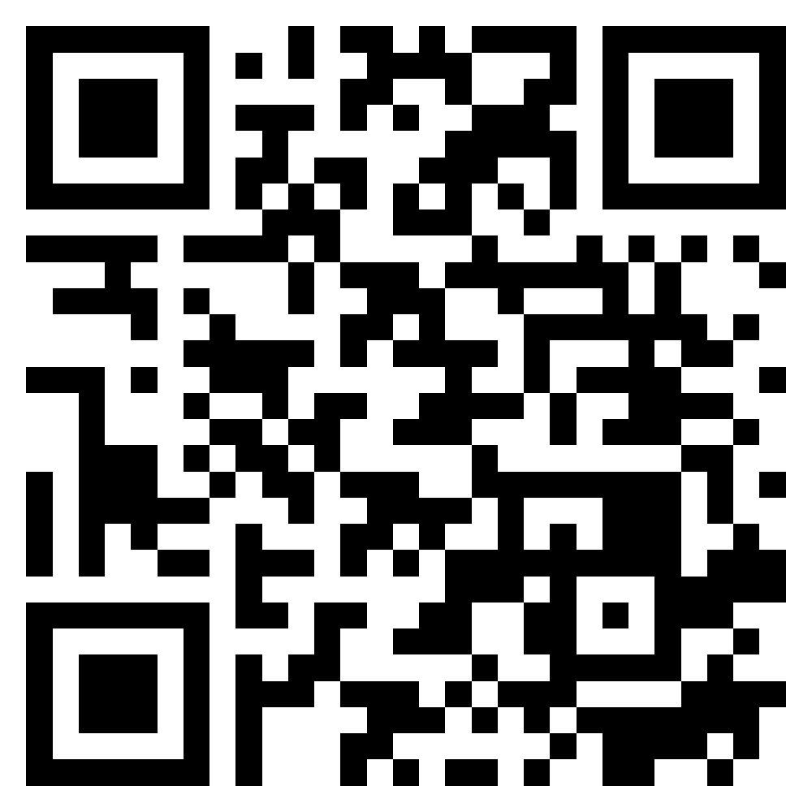
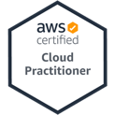
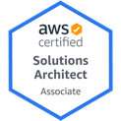
Cloud Computing and Cloud Software Architecture
Software Engineering
1112SE07
MBA, IM, NTPU (M5010) (Spring 2023) Wed 2, 3, 4 (9:10-12:00) (B8F40)
Min-Yuh Day, Ph.D, Associate Professor
Institute of Information Management, National Taipei University
https://web.ntpu.edu.tw/~myday
https://meet.google.com/ish-gzmy-pmo
2023-04-26

Slide 2
Syllabus
Week Date Subject/Topics
1 2023/02/22 Introduction to Software Engineering
2 2023/03/01 Software Products and Project Management: Software product management and prototyping
3 2023/03/08 Agile Software Engineering: Agile methods, Scrum, and Extreme Programming
4 2023/03/15 Features, Scenarios, and Stories
5 2023/03/22 Case Study on Software Engineering I
6 2023/03/29 Software Architecture: Architectural design, System decomposition, and Distribution architecture

Slide 3
Syllabus
Week Date Subject/Topics
7 2023/04/05 Tomb-Sweeping Day (Holiday, No Classes)
8 2023/04/12 Midterm Project Report
9 2023/04/19 Cloud-Based Software: Virtualization and containers, Everything as a service, Software as a service
10 2023/04/26 Cloud Computing and Cloud Software Architecture
11 2023/05/03 Microservices Architecture, RESTful services, Service deployment
12 2023/05/10 Security and Privacy; Reliable Programming; Testing: Test-driven development, and Code reviews; DevOps and Code Management: DevOps automation

Slide 4
Syllabus
Week Date Subject/Topics
13 2023/05/17 Industry Practices of Software Engineering
[Agile Principles Patterns and Practices using AI and ChatGPT, Invited Speaker: Shihyu (Alex) Chu, Division Director, Software Industry Research Center, Market Intelligence & Consulting Institute (MIC)]
14 2023/05/24 Case Study on Software Engineering II
15 2023/05/31 Final Project Report I
16 2023/06/07 Final Project Report II
17 2023/06/14 Self-learning
18 2023/06/21 Self-learning

Slide 5
Cloud Computing and Cloud Software Architecture

Slide 6
Software Engineering and Project Management
Analyze
Requirements definition
Design
System and Software design
Build
Implementation and
unit testing
Test
Integration and system testing
Deliver
Operation and maintenance
Project Management

Slide 7
Information Management (MIS) Information Systems
Organizations
Technology
Information Systems
Management

Slide 8
Fundamental MIS Concepts
Business Challenges
Management
Organization
Information System
Business Solutions
Technology

Slide 9
Project-based software engineering
CUSTOMER
Problem
generates
helps-with
Requirements
implemented-by
Software
1
CUSTOMER and DEVELOPER
DEVELOPER

Slide 10
Product software engineering
DEVELOPER
Opportunity
1
inspires
realizes
Product features
implemented-by
Software
DEVELOPER
DEVELOPER

Slide 11
Software execution models
Stand-alone execution
Hybrid execution
Software as a service
User’s computer
User’s computer
User’s computer
User interface
Product functionality
User data
User interface
Partial functionality
User data
User interface
(browser or app)
Product updates
Additional functionality
User data backups
Product updates
Product functionality
User data
Vendor’s servers
Vendor’s servers
Vendor’s servers

Slide 12
Product management concerns
Business needs
Product manager
Technology constraints
Customer experience

Slide 13
Technical interactions of product managers
Product vision management
Product backlog management
User stories and scenarios
Product manager
Acceptance testing
Customer testing
User interface design

Slide 14
Software Development Life Cycle (SDLC) The waterfall model
Requirements definition
System and Software design
Implementation and unit testing
Integration and system testing
Operation and maintenance

Slide 15
Plan-based and Agile development
Plan-based development
Requirements engineering
Requirements specification
Design and implementation
Requirements change requests
Agile development
Requirements engineering
Design and implementation

Slide 16
The Continuum of Life Cycles
High
Incremental
Agile
Frequency of Delivery
Predictive
Iterative
Low
Low
High
Degree of Change

Slide 17
Predictive Life Cycle
Analyze
Design
Build
Test
Deliver

Slide 18
Iterative Life Cycle
Prototype
Refine
Analyze
Analyze
Design
Build
Test
Deliver

Slide 19
A Life Cycle of Varying-Sized Increments
Analyze
Design
Build
Test
Deliver
Analyze
Design
Build
Test
Deliver
Analyze
Design
Build
Test
Deliver

Slide 20
Iteration-Based and Flow-Based Agile Life Cycles
Iteration-Based Agile
Requirements
Analysis
Design
Build
Test
Requirements
Analysis
Design
Build
Test
Requirements
Analysis
Design
Build
Test
Requirements
Analysis
Design
Build
Test
Repeat as needed
…
Requirements
Analysis
Design
Build
Test
Requirements
Analysis
Design
Build
Test
Flow-Based Agile
Requirements
Analysis
Design
Build
Test
the number of features in the WIP limit
Requirements
Analysis
Design
Build
Test
the number of features in the WIP limit
Requirements
Analysis
Design
Build
Test
the number of features in the WIP limit
Repeat as needed
…
Requirements
Analysis
Design
Build
Test
the number of features in the WIP limit
Requirements
Analysis
Design
Build
Test
the number of features in the WIP limit

Slide 21
From personas to features
1
Personas
A way of representing users
inspire
Natural language descriptions of a user interacting with a software product
2
Scenarios
are-developed-into
3
inspire
Stories
Natural language descriptions of something that is needed or wanted by users
4
Features
define
Fragments of product functionality

Slide 22
Multi-tier client-server architecture
Client 1
Client 2
Web Server
Application Server
Database Server
Client 3
Client …

Slide 23
Service-oriented Architecture
Client 1
S1
S2
Client 2
S3
Web Server
Service gateway
S4
Client 3
S5
Client …
S6
Services

Slide 24
VM
Container
Virtual web server
Virtual mail server
User 1 Container 1
User 2 Container 2
Server software
Server software
Application software
Application software
Guest OS
Guest OS
Server software
Server software
Hypervisor
Container manager
Host OS
Host OS
Server Hardware
Server Hardware

Slide 25
Everything as a service
Photo editing
Software as a service (SaaS)
Logistics management
Cloud management Monitoring
Platform as a service (PaaS)
Database
Software development
Storage Network
Infrastructure as a service (IaaS)
Computing Virtualization
Cloud data center

Slide 26
Software as a service
Software customers
Software provider
Software services
Cloud Infrastructure
Cloud provider

Slide 27
Microservices architecture – key design questions
What are the microservices that make up the system?
How should data be distributed and shared?
How should microservices communicate with each other?
Microservices architecture
design
How should the microservices in the system be coordinated?
How should service failure be detected, reported and managed?

Slide 28
Types of security threat
An attacker attempts to deny access to the system for legitimate users
An attacker attempts to damage the system or its data
Availability
threats
Integrity
threats
SOFTWARE PRODUCT
PROGRAM
Distributed denial of service (DDoS) attack
Virus
DATA
Ransomware
Data theft
Confidentiality threats
An attacker tries to gain access to private information held by the system

Slide 29
Software product quality attributes
Reliability
Availability
1
2
Software product quality attributes
Security
Resilience
7
3
Usability
Maintainability
6
4
Responsiveness
5

Slide 30
A refactoring process
1
2
Start
Identify code ‘smell’
Identify refactoring strategy
4
3
Run automated code tests
Make small
improvement until strategy completed

Slide 31
Functional testing
Start
1
Unit Testing
4
2
Release Testing
Feature Testing
3
System Testing

Slide 32
Test-driven development (TDD)
Start
1
Identify new functionality
2
Identify partial implementation
of functionality
3
Write code stub that will fail test
Functionality complete
Functionality incomplete
4
Run all automated test
7
Refactor code if required
5
Implement code that should cause failing test to pass
Test failure
6
Run all automated test
All tests pass

Slide 33
DevOps
Development
Deployment
Support
Multi-skilled DevOps team

Slide 34
Code management and DevOps
DevOps automation
Continuous integration
Continuous deployment
Continuous delivery
Infrastructure as code
Code management system
Branching and merging
Recover version information
Code repository
Save and retrieve versions
Transfer code to/from developer’s filestore
DevOps measurement
Data collection
Data analysis
Report generation

Slide 35
Cloud Computing and Cloud Software Architecture

Slide 36
Outline
Cloud Computing and Cloud Software Architecture
AWS Certified Cloud Practitioner (CLF-C01)
AWS Certified Solutions Architect – Associate (SAA-C02)
Web Application with AWS Core Services
AWS Serverless Architecture
Build a Serverless Web Application with Amazon S3, AWS Lambda, Amazon API Gateway, Amazon DynamoDB, and Amazon Cognito

Slide 37
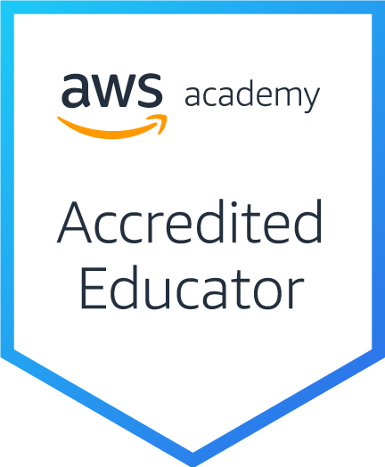
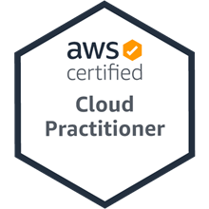
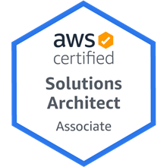
AWS Certifications

Slide 38
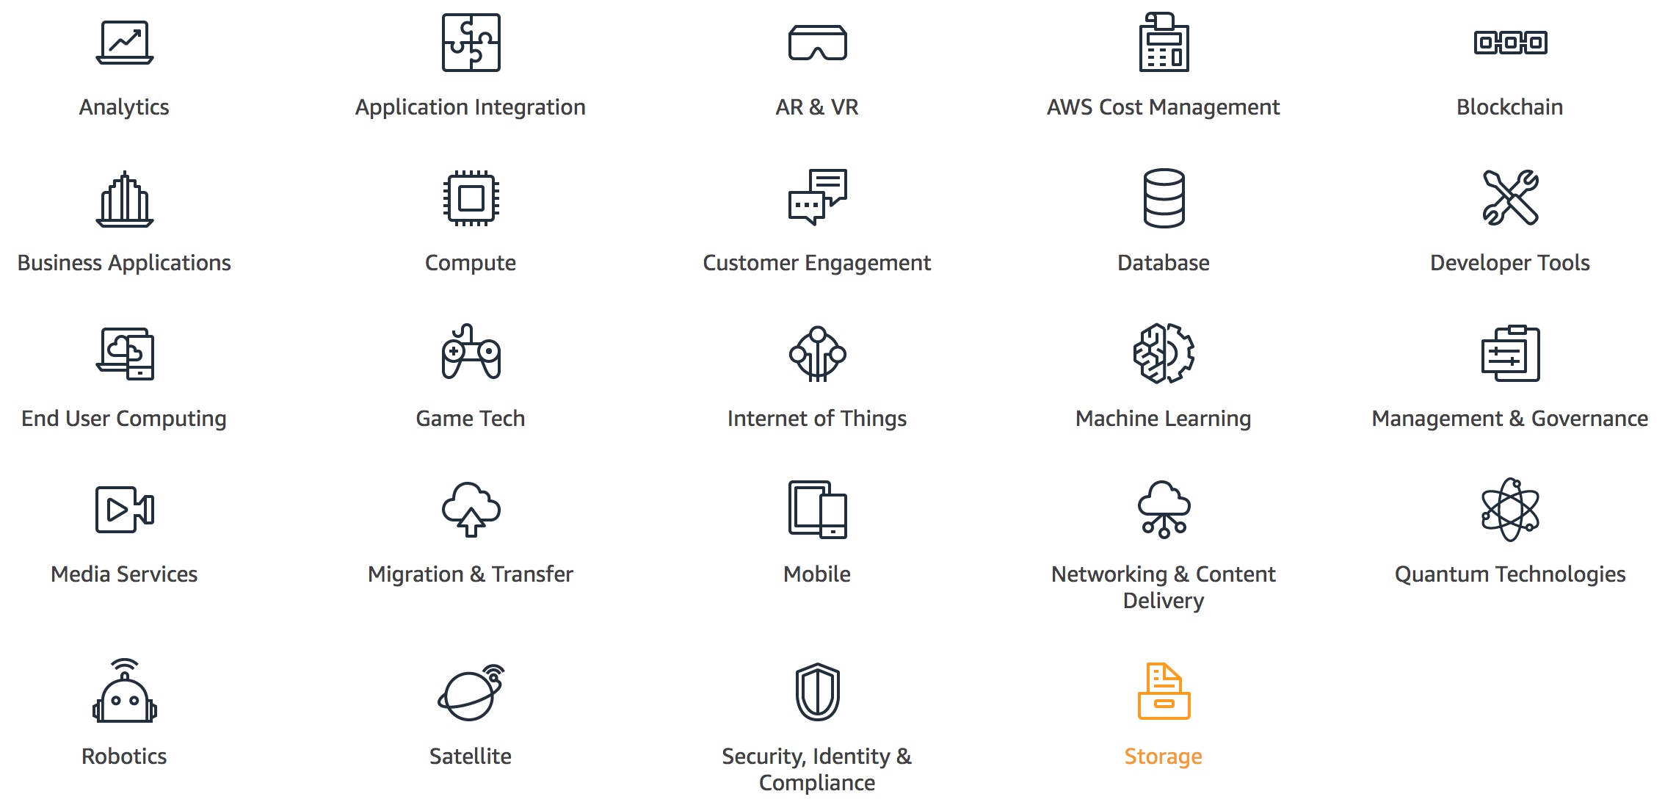
AWS Products and Services
Source: https://aws.amazon.com/

Slide 39
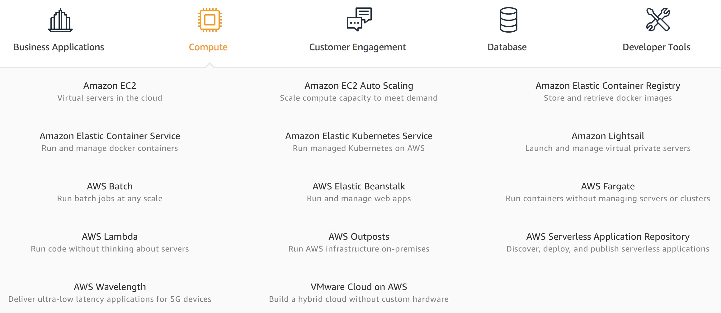
AWS Compute
Source: https://aws.amazon.com/

Slide 40
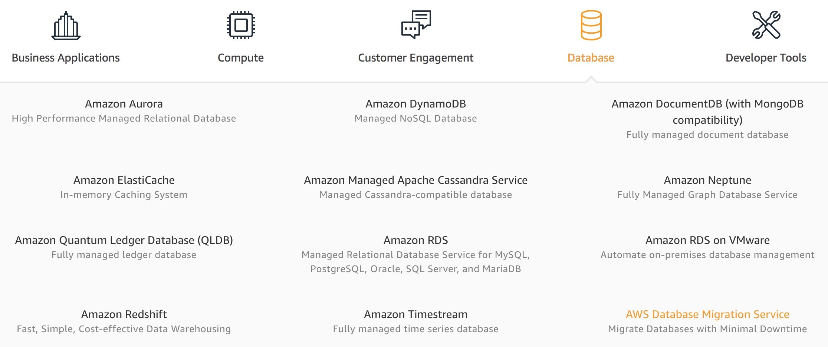
AWS Database
Source: https://aws.amazon.com/

Slide 41
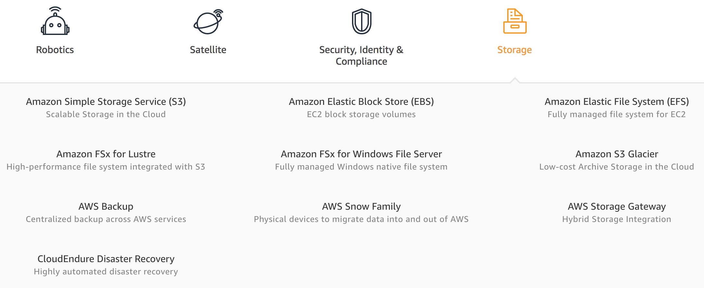
AWS Storage
Source: https://aws.amazon.com/

Slide 42
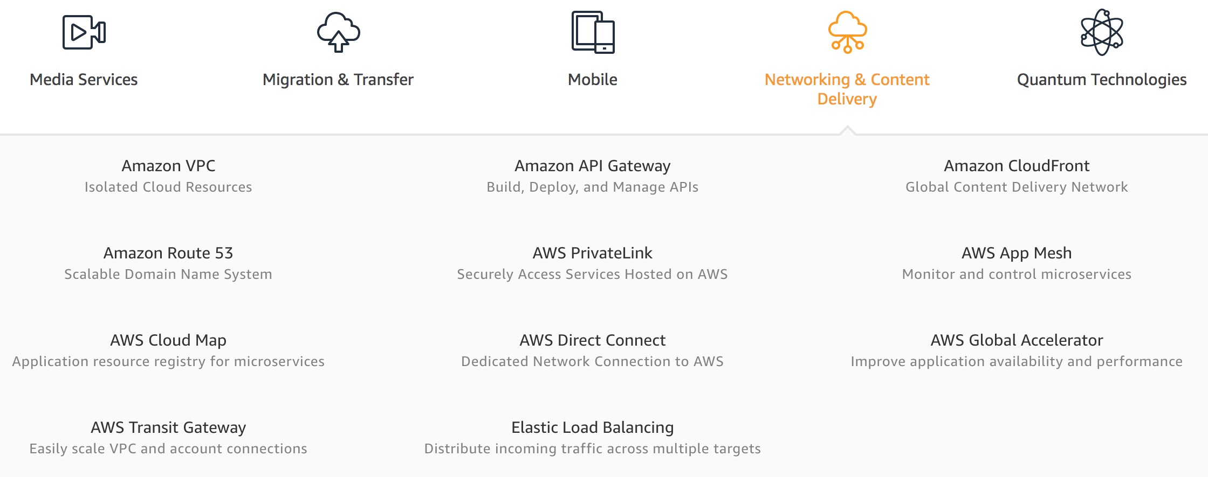
AWS Networking & Content Dilivery
Source: https://aws.amazon.com/

Slide 43
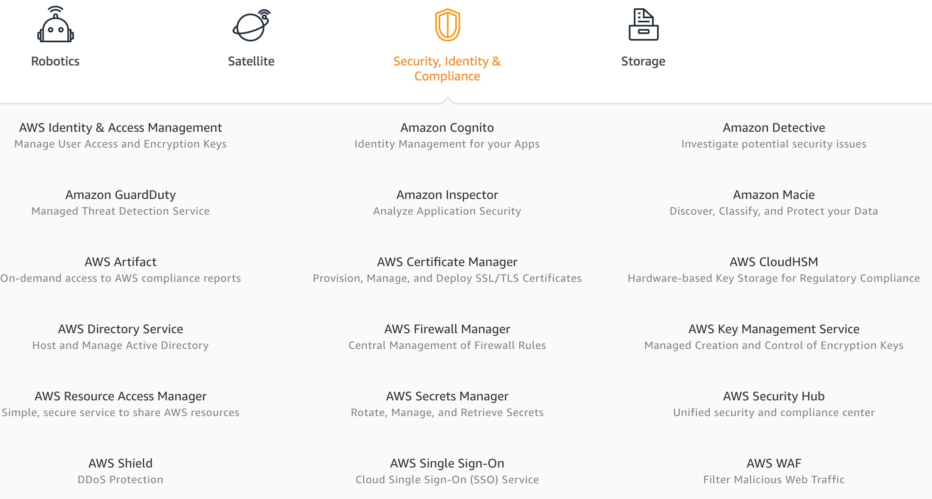
AWS Security, Identity & Compliance
Source: https://aws.amazon.com/

Slide 44
AWS Cost Management
Source: https://aws.amazon.com/

Slide 45
AWS Services
Amazon EC2
Virtual servers in the cloud
Amazon Simple Storage Service (S3)
Scalable storage in the cloud
Amazon Aurora
High performance managed relational database
Amazon DynamoDB
Managed NoSQL database
Amazon RDS
Managed relational database service for MySQL, PostgreSQL, Oracle, SQL Server, and MariaDB
Source: https://aws.amazon.com/

Slide 46
AWS Services
AWS Lambda
Run code without thinking about servers
AWS Elastic Beanstalk
Run and manage web apps
Amazon VPC
Isolated cloud resources
Amazon Lightsail
Launch and manage virtual private servers
Amazon SageMaker
Build, train, and deploy machine learning models at scale
Source: https://aws.amazon.com/

Slide 47
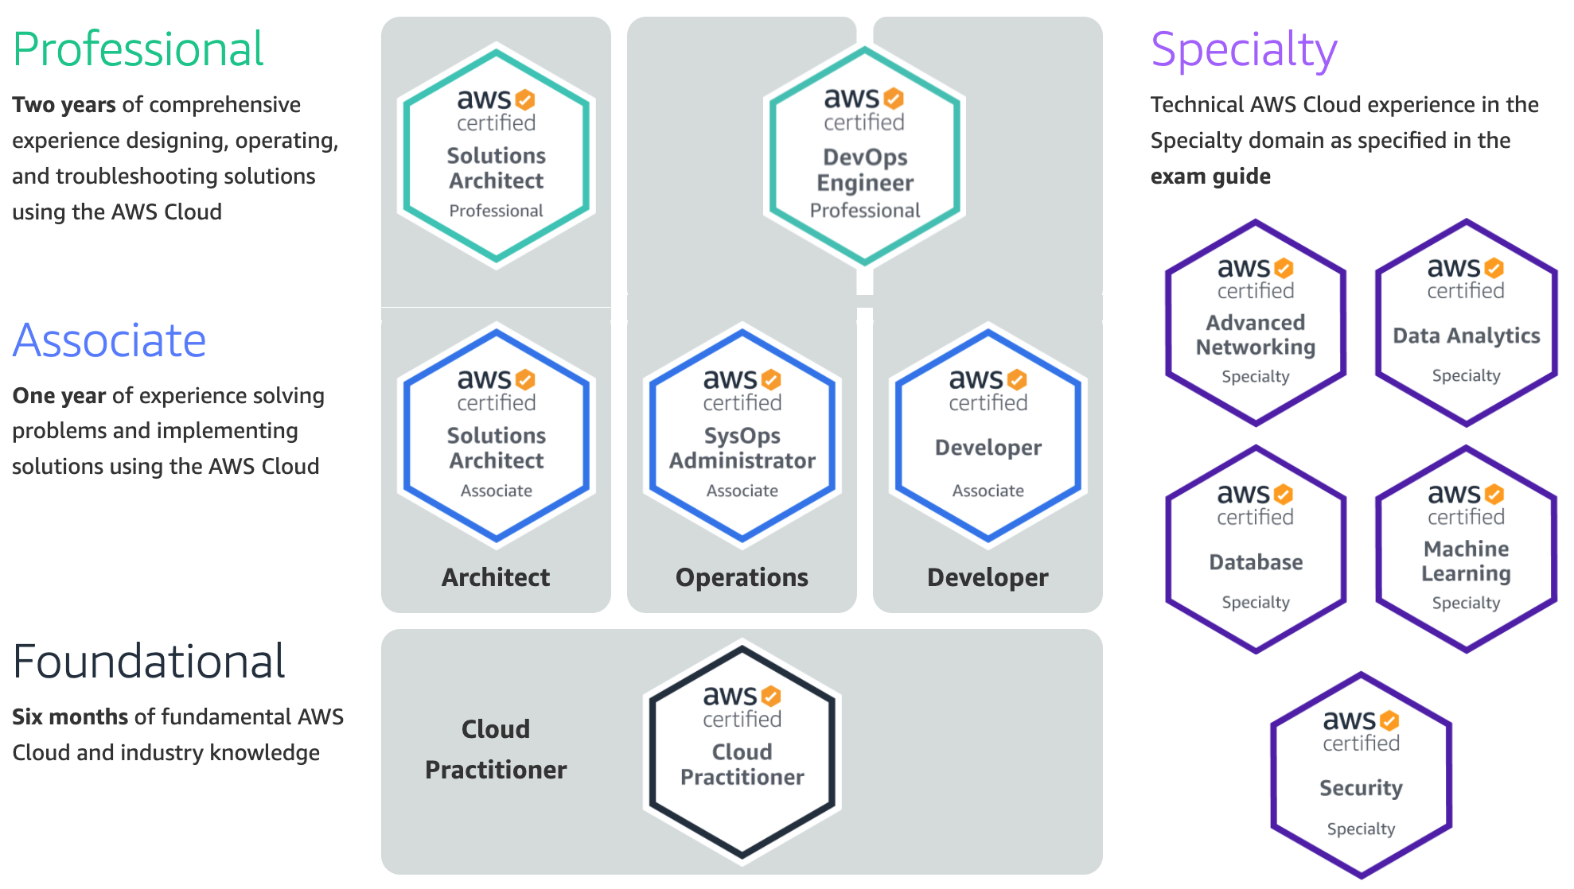
Available AWS Certifications
3
SAP
2
SAA
1
CLF
https://aws.amazon.com/certification/

Slide 48
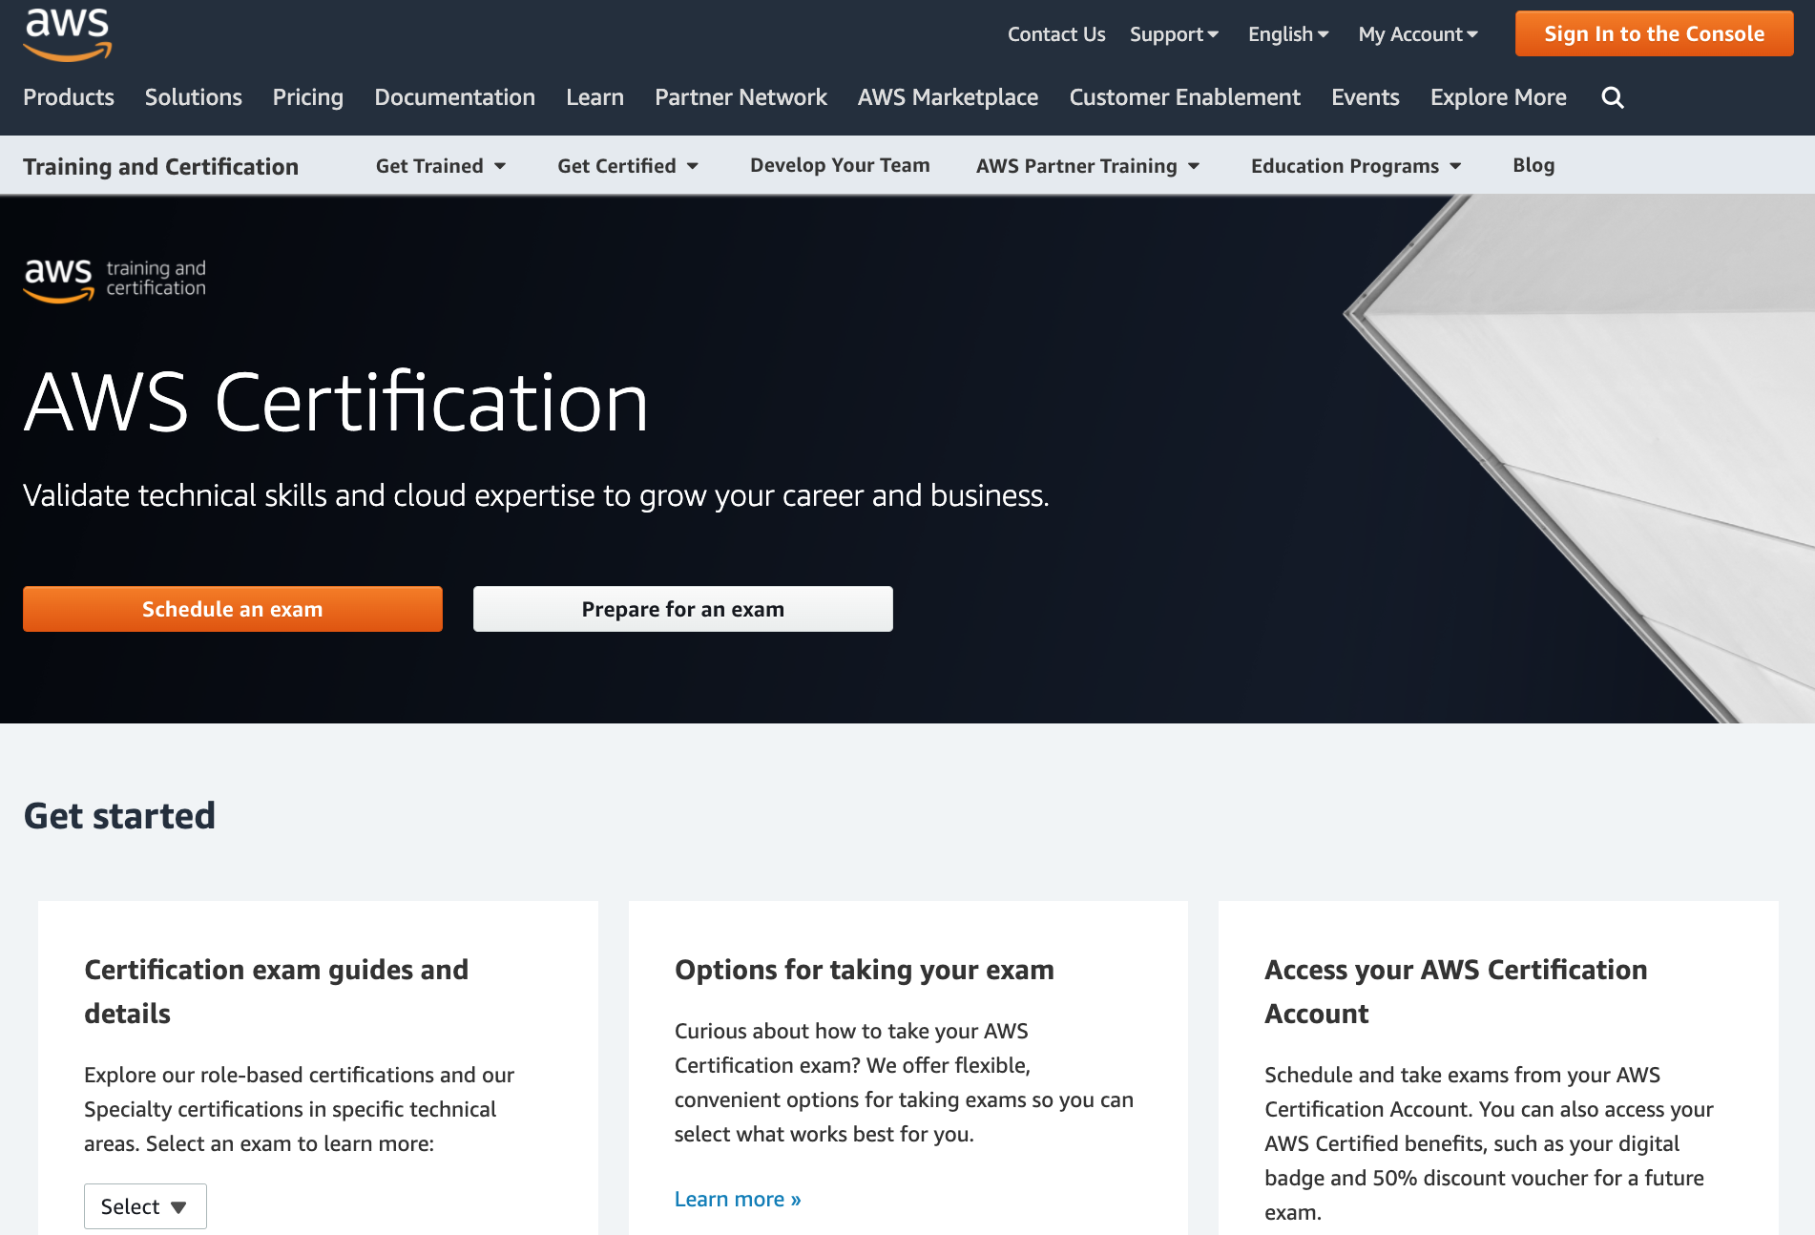
AWS Certification
https://aws.amazon.com/certification/

Slide 49
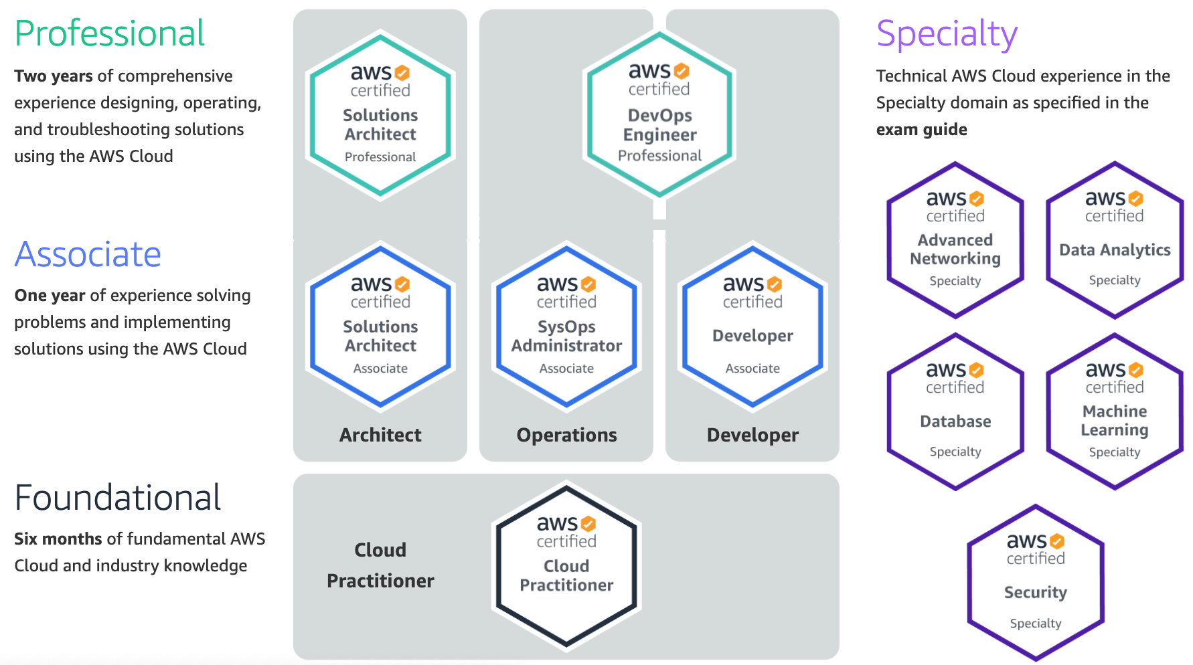
AWS Certification
2
SAA
1
CLF
https://aws.amazon.com/certification/

Slide 50
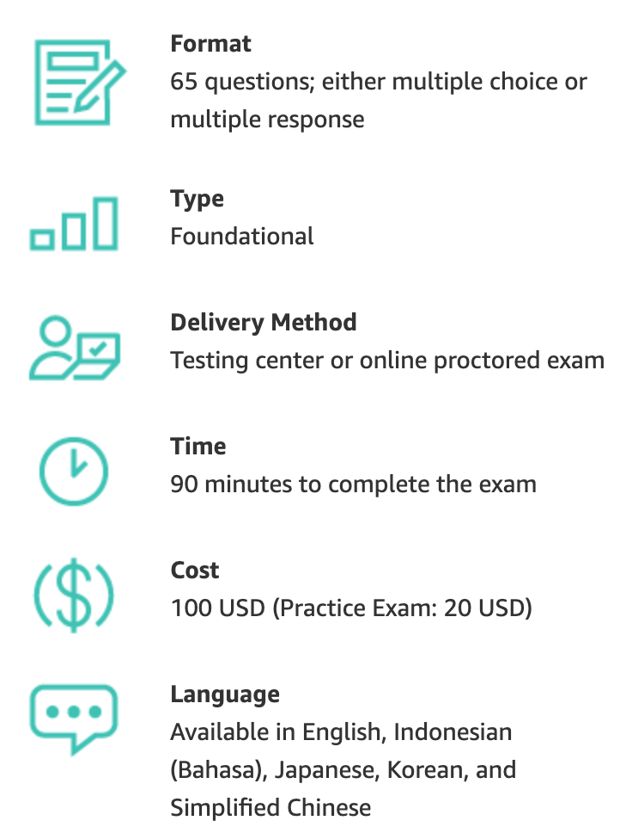
AWS Certification
https://aws.amazon.com/certification/

Slide 51
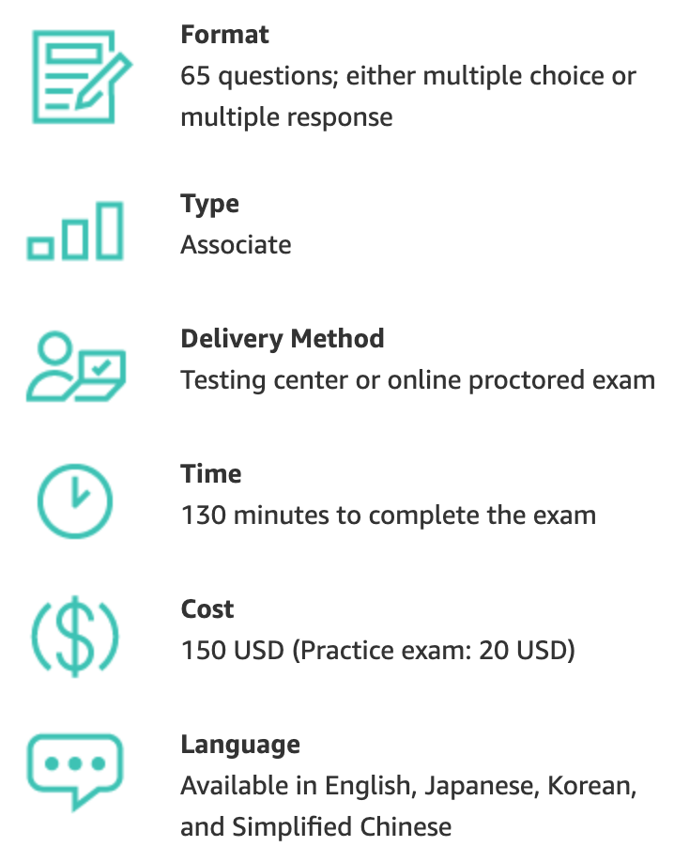
AWS Certification
https://aws.amazon.com/certification/

Slide 52
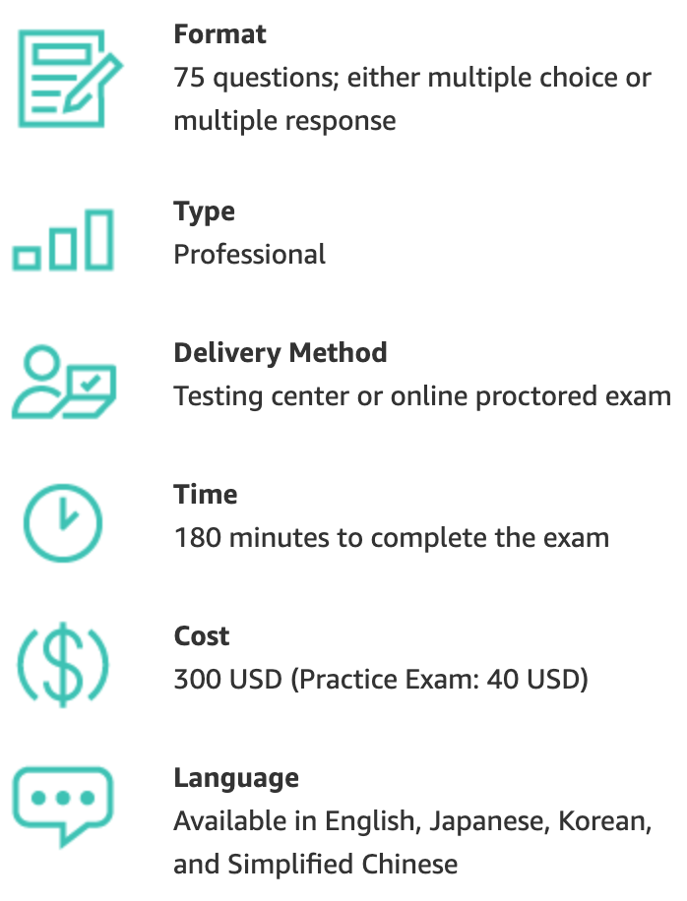
AWS Certification
https://aws.amazon.com/certification/

Slide 53
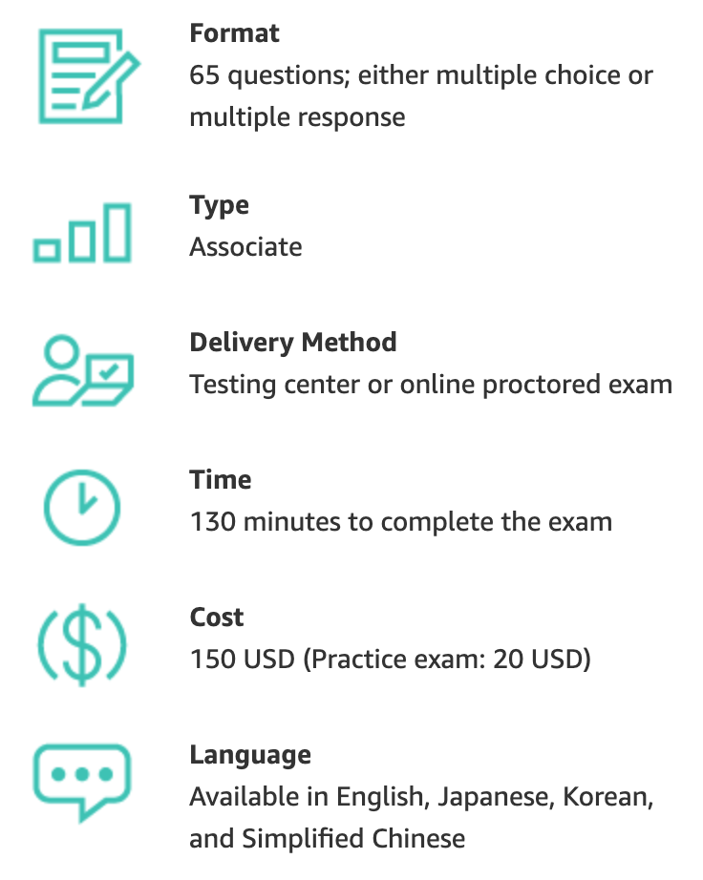
AWS Certification
https://aws.amazon.com/certification/

Slide 54
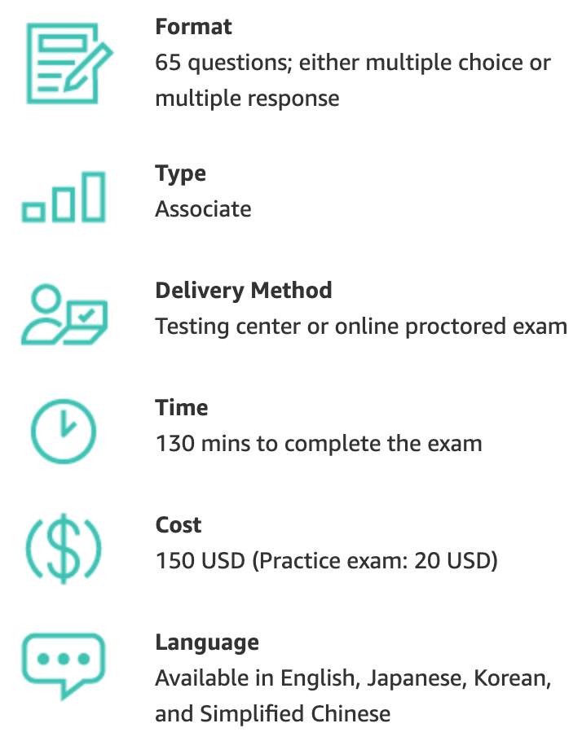
AWS Certification
https://aws.amazon.com/certification/

Slide 55
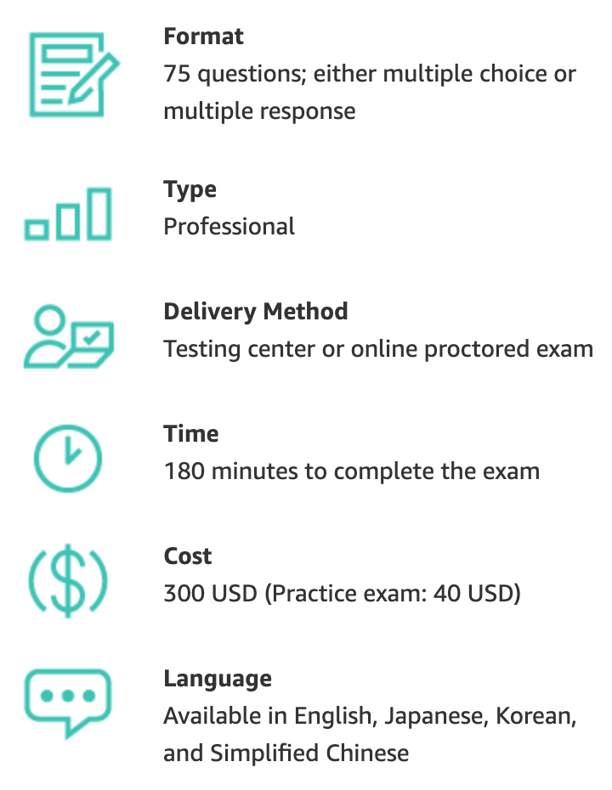
AWS Certification
https://aws.amazon.com/certification/

Slide 56
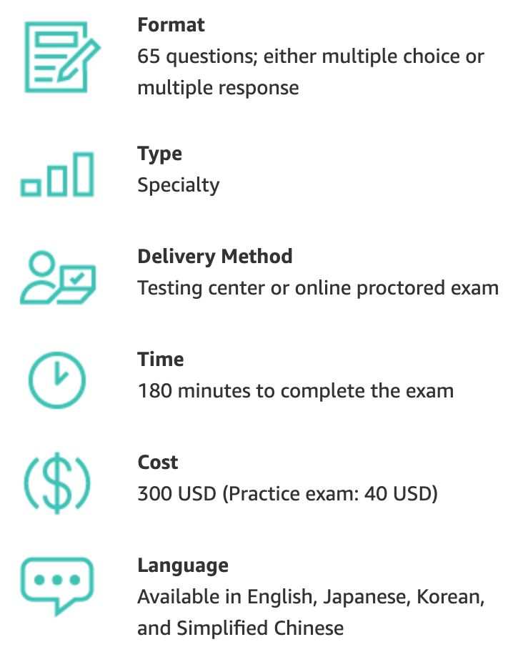
AWS Certification
https://aws.amazon.com/certification/

Slide 57
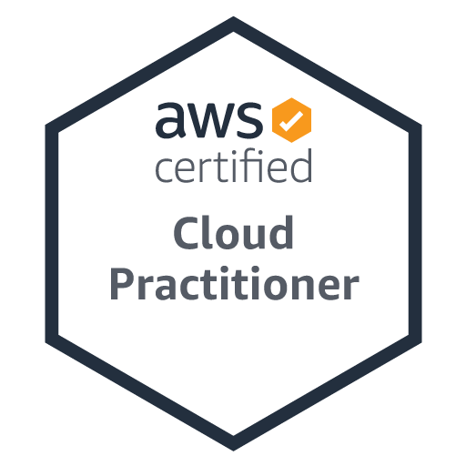
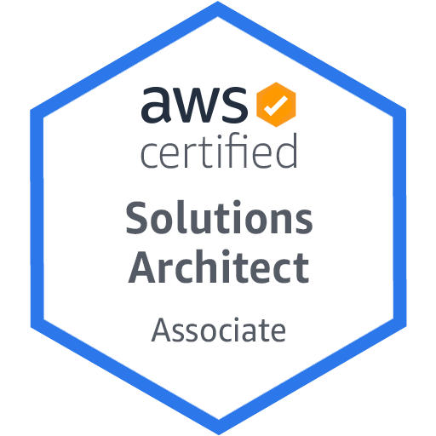
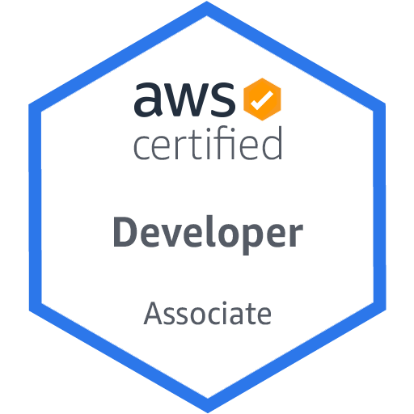
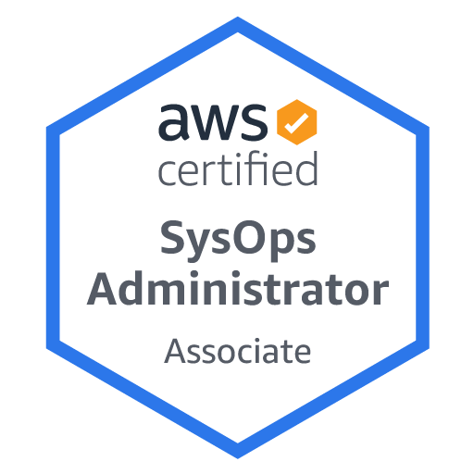
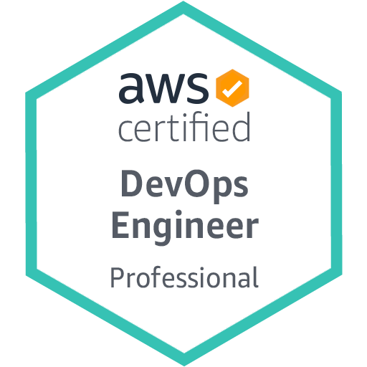
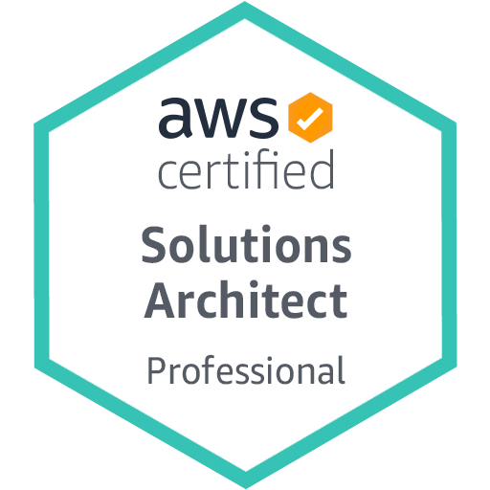
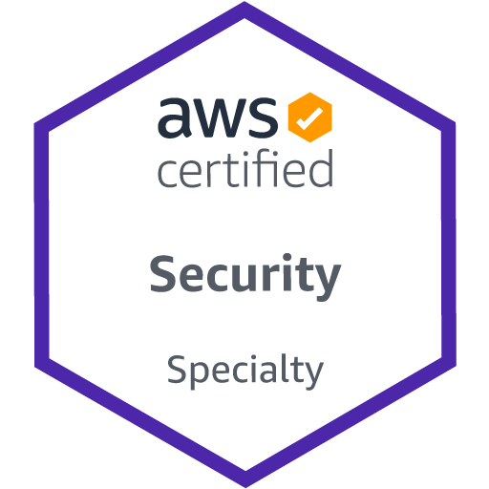
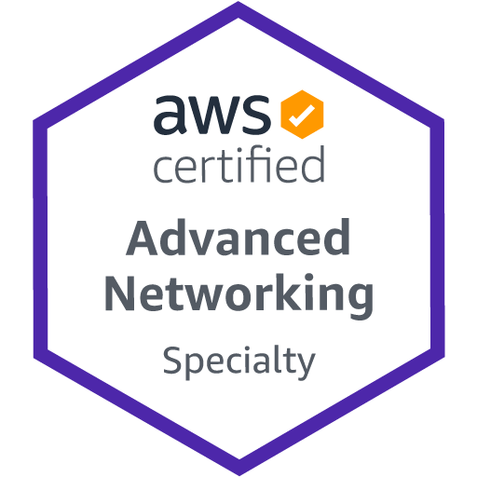
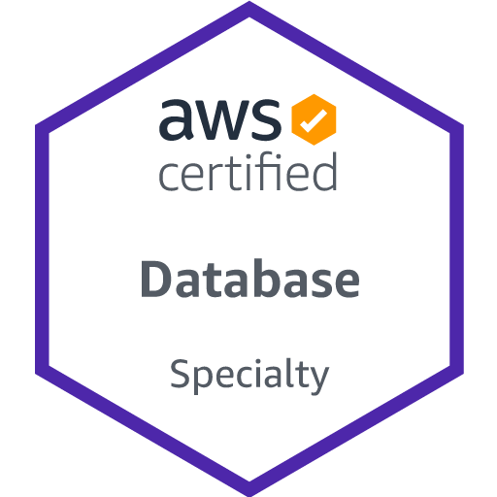
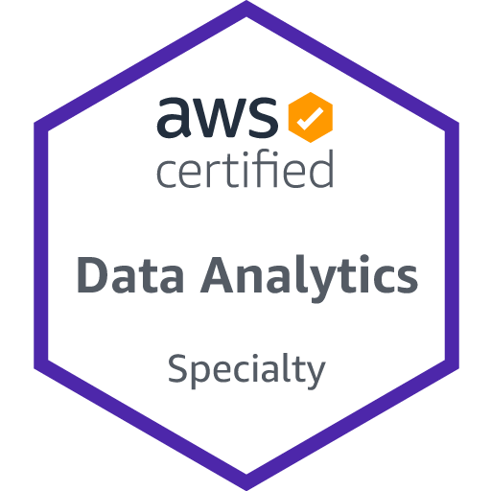
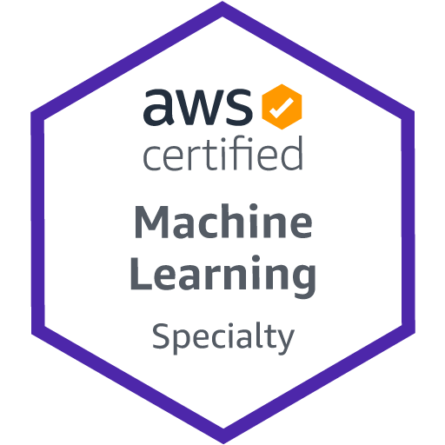
AWS Certifications Roadmap
https://aws.amazon.com/certification/

Slide 58
AWS Certifications Roadmap Cloud Architect
https://aws.amazon.com/certification/

Slide 59
AWS Certifications Roadmap Cloud Developer
https://aws.amazon.com/certification/

Slide 60
AWS Certifications Roadmap DevOps
https://aws.amazon.com/certification/

Slide 61
AWS Certifications Roadmap Data Analytics / Machine Learning
https://aws.amazon.com/certification/

Slide 62
AWS Certifications Roadmap Security
https://aws.amazon.com/certification/

Slide 63
AWS Certified Cloud Practitioner (CLF-C01)
Source: https://aws.amazon.com/certification/certified-cloud-practitioner/

Slide 64
AWS Certified Cloud Practitioner
This certification provides individuals in a larger variety of cloud and technology roles with a way to validate their AWS Cloud knowledge and enhance their professional credibility.
This exam covers four domains, including cloud concepts, security, technology, and billing and pricing.
https://aws.amazon.com/certification/certified-cloud-practitioner/

Slide 65
AWS Certified Solutions Architect – Associate (SAA-C02)
Source: https://aws.amazon.com/certification/certified-solutions-architect-associate

Slide 66
AWS Certified Solutions Architect – Associate
This certification validates your ability to effectively demonstrate knowledge of how to architect and deploy secure and robust applications on AWS technologies.
This exam is for anyone with at least one year of hands-on experience designing available, cost-efficient, fault-tolerant, and scalable and distributed systems on AWS.
https://aws.amazon.com/certification/certified-solutions-architect-associate/

Slide 67
AWS Academy and Certifications
1
AWS Academy Cloud Foundations (ACF)
AWS Certified Cloud Practitioner (CLF-C01)
https://aws.amazon.com/certification/certified-cloud-practitioner/
AWS Academy Cloud Architecting (ACA)
AWS Certified Solutions Architect – Associate (SAA-C02)
https://aws.amazon.com/certification/certified-solutions-architect-associate/
2
https://aws.amazon.com/training/awsacademy/

Slide 68
AWS Certified Cloud Practitioner (CLF-C01)
Domain | % of Examination
Domain 1: Cloud Concepts | 26%
Domain 2: Security and Compliance | 25%
Domain 3: Technology | 33%
Domain 4: Billing and Pricing | 16%
TOTAL | 100%
Source: https://aws.amazon.com/certification/certified-cloud-practitioner/

Slide 69
AWS Certified Solutions Architect – Associate (SAA-C02)
Domain | % of Examination
Domain 1: Design Resilient Architectures | 30%
Domain 2: Design High-Performing Architectures | 28%
Domain 3: Specify Secure Applications and Architectures | 24%
Domain 4: Design Cost-Optimized Architectures | 18%
TOTAL | 100%
Source: https://aws.amazon.com/certification/certified-solutions-architect-associate

Slide 70
AWS Certified Cloud Practitioner (CLF-C01)
Source: https://aws.amazon.com/certification/certified-cloud-practitioner/

Slide 71
AWS Certified Cloud Practitioner (CLF-C01)
Domain 1: Cloud Concepts
1.1 Define the AWS Cloud and its value proposition
1.2 Identify aspects of AWS Cloud economics
1.3 List the different cloud architecture design principles
Source: https://aws.amazon.com/certification/certified-cloud-practitioner/

Slide 72
AWS Certified Cloud Practitioner (CLF-C01)
Domain 2: Security and Compliance
2.1 Define the AWS shared responsibility model
2.2 Define AWS Cloud security and compliance concepts
2.3 Identify AWS access management capabilities
2.4 Identify resources for security support
Source: https://aws.amazon.com/certification/certified-cloud-practitioner/

Slide 73
AWS Certified Cloud Practitioner (CLF-C01)
Domain 3: Technology
3.1 Define methods of deploying and operating in the AWS Cloud
3.2 Define the AWS global infrastructure
3.3 Identify the core AWS services
3.4 Identify resources for technology support
Source: https://aws.amazon.com/certification/certified-cloud-practitioner/

Slide 74
AWS Certified Cloud Practitioner (CLF-C01)
Domain 4: Billing and Pricing
4.1 Compare and contrast the various pricing models for AWS
4.2 Recognize the various account structures in relation to AWS billing and pricing
4.3 Identify resources available for billing support
Source: https://aws.amazon.com/certification/certified-cloud-practitioner/

Slide 75
AWS Certified Solutions Architect – Associate (SAA-C02)
Source: https://aws.amazon.com/certification/certified-solutions-architect-associate

Slide 76
AWS Certified Solutions Architect – Associate (SAA-C02)
Domain 1: Design Resilient Architectures
1.1 Design a multi-tier architecture solution
1.2 Design highly available and/or fault-tolerant architectures
1.3 Design decoupling mechanisms using AWS services
1.4 Choose appropriate resilient storage
Source: https://aws.amazon.com/certification/certified-solutions-architect-associate

Slide 77
AWS Certified Solutions Architect – Associate (SAA-C02)
Domain 2: Design High-Performing Architectures
2.1 Identify elastic and scalable compute solutions for a workload
2.2 Select high-performing and scalable storage solutions for a workload
2.3 Select high-performing networking solutions for a workload
2.4 Choose high-performing database solutions for a workload
Source: https://aws.amazon.com/certification/certified-solutions-architect-associate

Slide 78
AWS Certified Solutions Architect – Associate (SAA-C02)
Domain 3: Design Secure Applications and Architectures
3.1 Design secure access to AWS resources
3.2 Design secure application tiers
3.3 Select appropriate data security options
Source: https://aws.amazon.com/certification/certified-solutions-architect-associate

Slide 79
AWS Certified Solutions Architect – Associate (SAA-C02)
Domain 4: Design Cost-Optimized Architectures
4.1 Identify cost-effective storage solutions
4.2 Identify cost-effective compute and database services
4.3 Design cost-optimized network architectures
Source: https://aws.amazon.com/certification/certified-solutions-architect-associate

Slide 80
AWS Certifications Exam Pricing
Exam Type | Price in USD
Foundational | $100
Associate | $150
Professional | $300
Specialty | $300

Slide 81
AWS Certified Security – Specialty validates expertise in securing data and workloads in the AWS Cloud

Slide 82
AWS Certified Security - Specialty
AWS Certified Security – Specialty is intended for individuals who perform a security role and have at least two years of hands-on experience securing AWS workloads.
Five years of IT security experience in designing and implementing security solutions and at least two years of hands-on experience in securing AWS workloads
Working knowledge of AWS security services and features of services to provide a secure production environment and an understanding of security operations and risks
Knowledge of the AWS shared responsibility model and its application; security controls for workloads on AWS; logging and monitoring strategies; cloud security threat models; patch management and security automation; ways to enhance AWS security services with third-party tools and services; and disaster recovery controls, including BCP and backups, encryption, access control, and data retention
Understanding of specialized data classifications and AWS data protection mechanisms, data-encryption methods and AWS mechanisms to implement them, and secure internet protocols and AWS mechanisms to implement them
Ability to make tradeoff decisions with regard to cost, security, and deployment complexity to meet a set of application requirements
https://aws.amazon.com/certification/certified-security-specialty

Slide 83
AWS Certified Cloud Practitioner
This certification provides individuals in a larger variety of cloud and technology roles with a way to validate their AWS Cloud knowledge and enhance their professional credibility.
This exam covers four domains, including cloud concepts, security, technology, and billing and pricing.
https://aws.amazon.com/certification/certified-cloud-practitioner/

Slide 84
AWS Certified Solutions Architect – Associate
This certification validates your ability to effectively demonstrate knowledge of how to architect and deploy secure and robust applications on AWS technologies.
This exam is for anyone with at least one year of hands-on experience designing available, cost-efficient, fault-tolerant, and scalable and distributed systems on AWS.
https://aws.amazon.com/certification/certified-solutions-architect-associate/

Slide 85
Web Application with AWS Core Services

Slide 86
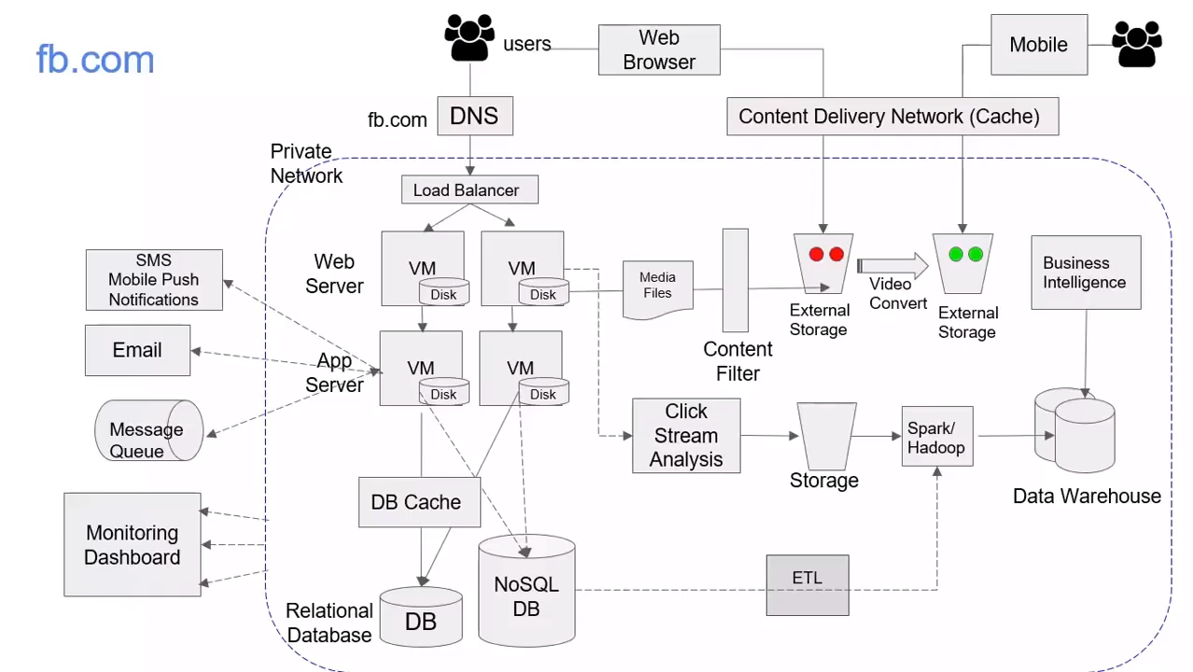
Source: AWS Training Center (2019), Introduction to AWS Services, https://youtu.be/Z3SYDTMP3ME

Slide 87
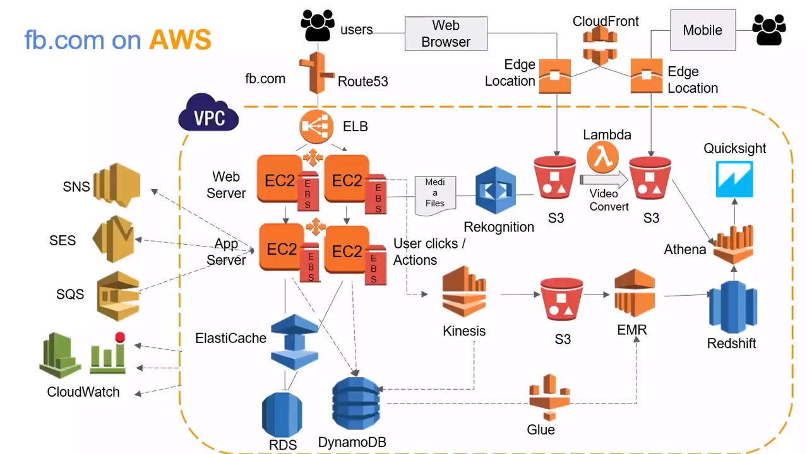
Source: AWS Training Center (2019), Introduction to AWS Services, https://youtu.be/Z3SYDTMP3ME

Slide 88
Source: AWS Training Center (2019), Introduction to AWS Services, https://youtu.be/Z3SYDTMP3ME

Slide 89
Source: AWS Training Center (2019), Introduction to AWS Services, https://youtu.be/Z3SYDTMP3ME

Slide 90
Source: AWS Training Center (2019), Introduction to AWS Services, https://youtu.be/Z3SYDTMP3ME

Slide 91
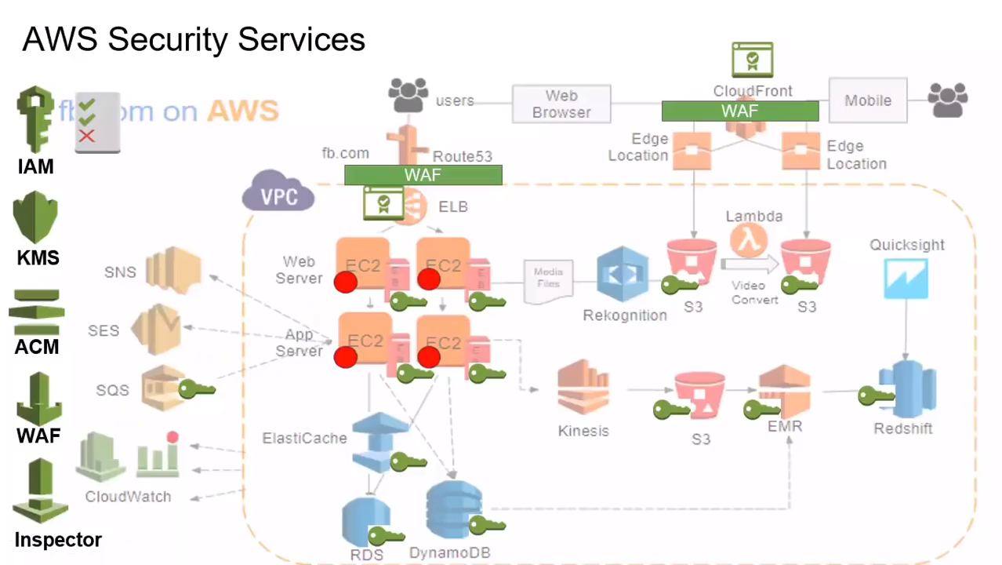
Source: AWS Training Center (2019), Introduction to AWS Services, https://youtu.be/Z3SYDTMP3ME

Slide 92
Source: AWS Training Center (2019), Introduction to AWS Services, https://youtu.be/Z3SYDTMP3ME

Slide 93
AWS Serverless Architecture

Slide 94
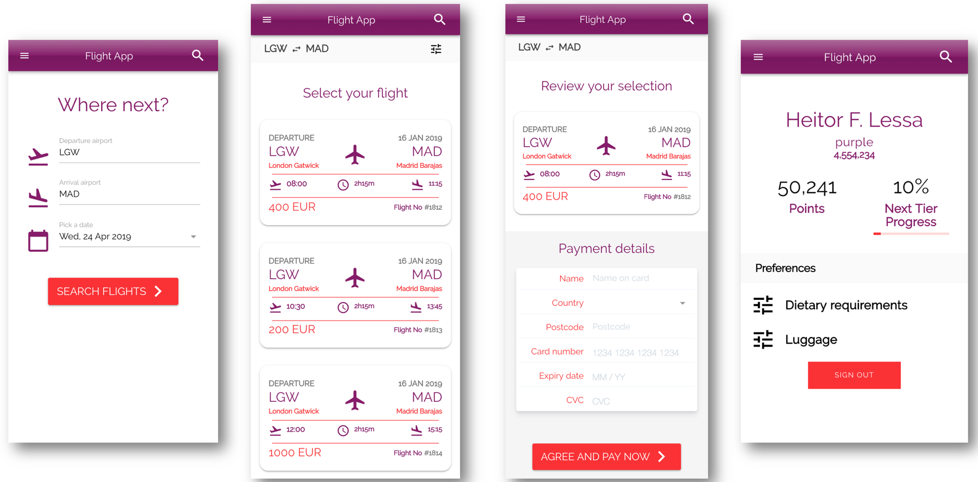
AWS Serverless Airline Booking
Source: https://github.com/aws-samples/aws-serverless-airline-booking

Slide 95
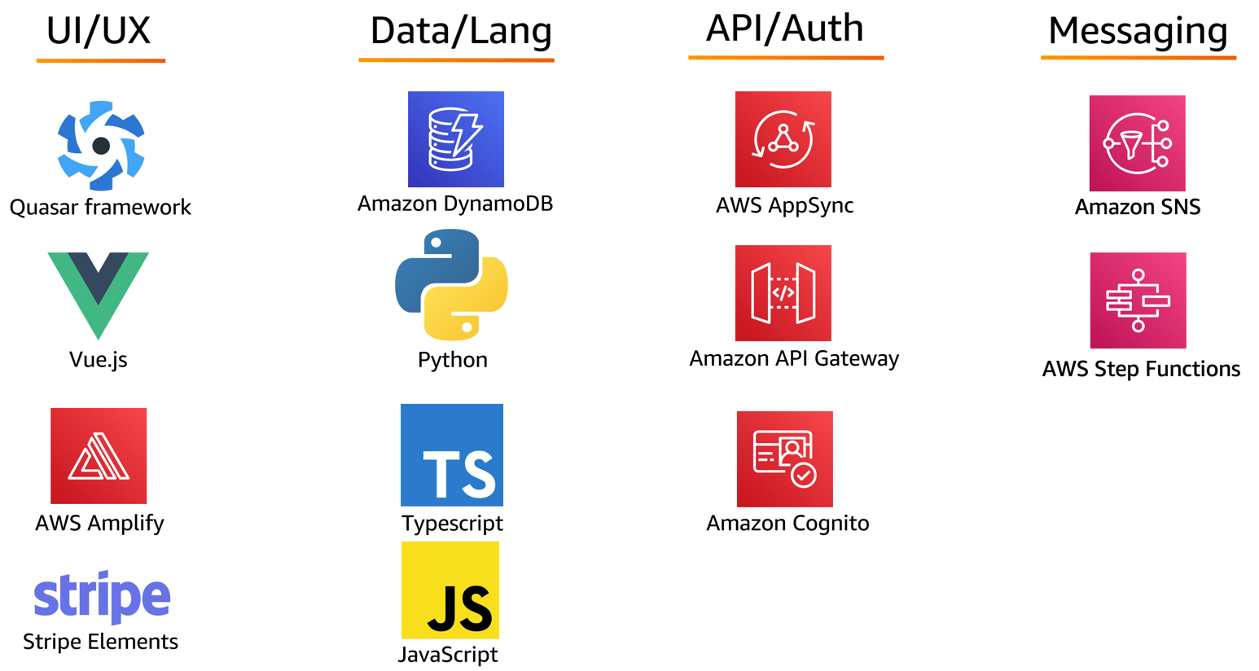
AWS Serverless Airline Booking Stack
Source: https://github.com/aws-samples/aws-serverless-airline-booking

Slide 96
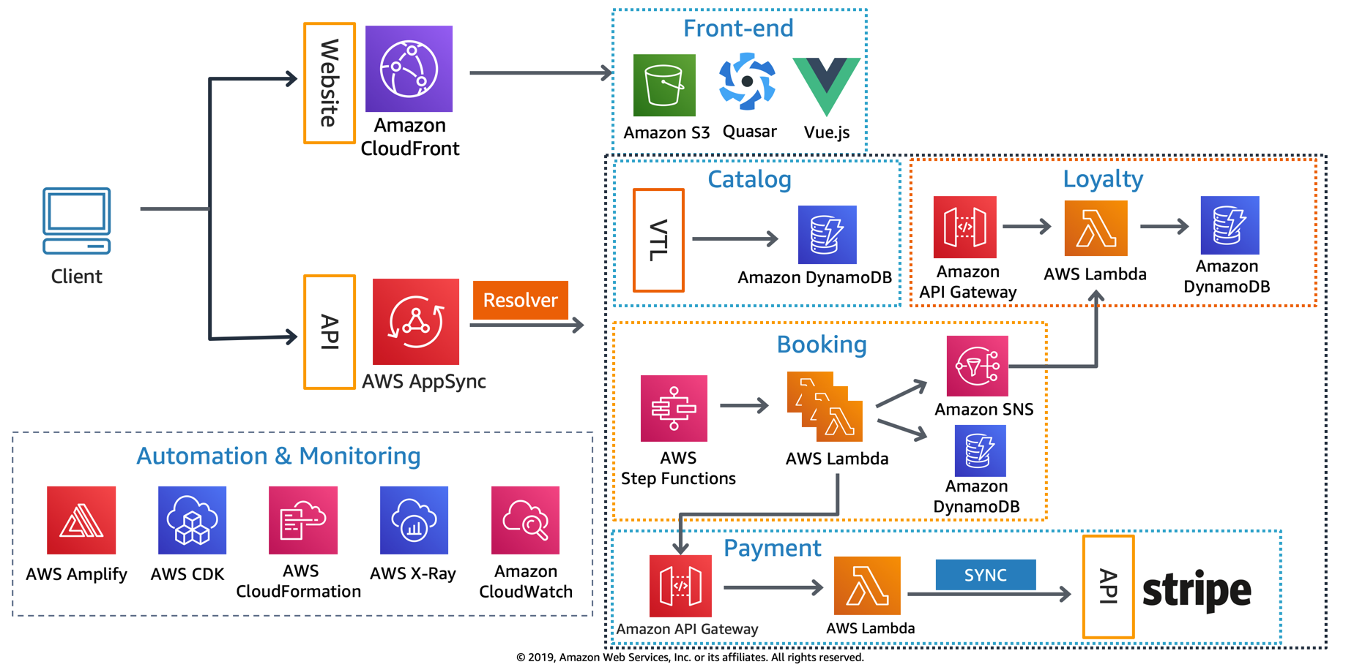
AWS Serverless Airline Booking High level infrastructure architecture
Source: https://github.com/aws-samples/aws-serverless-airline-booking

Slide 97
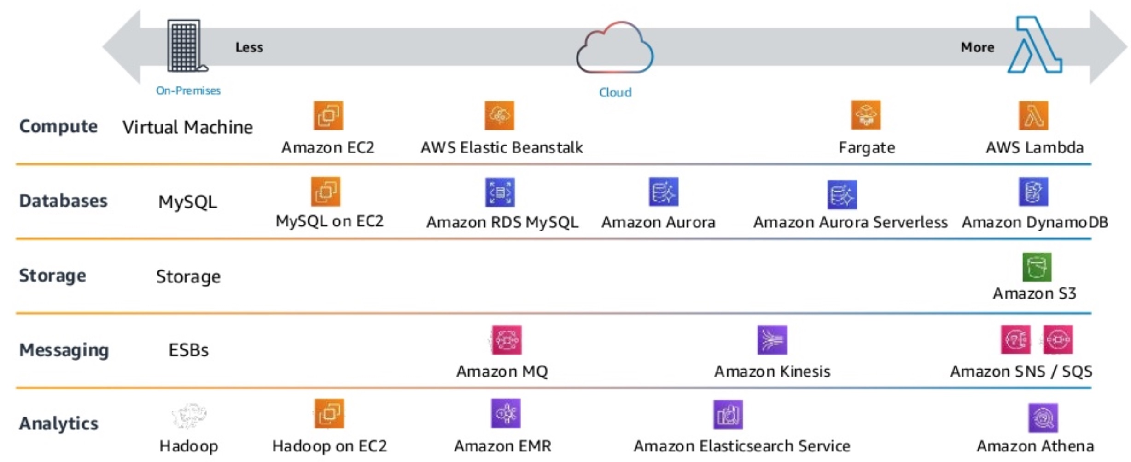
AWS Serverless Architecture AWS Operational Responsibility Models
Source: Heitor Lessa (2019), How to build a full stack serverless airline ticketing web app, https://www.youtube.com/watch?v=MyoOeHTp2pg

Slide 98
Build a Serverless Web Application

Slide 99
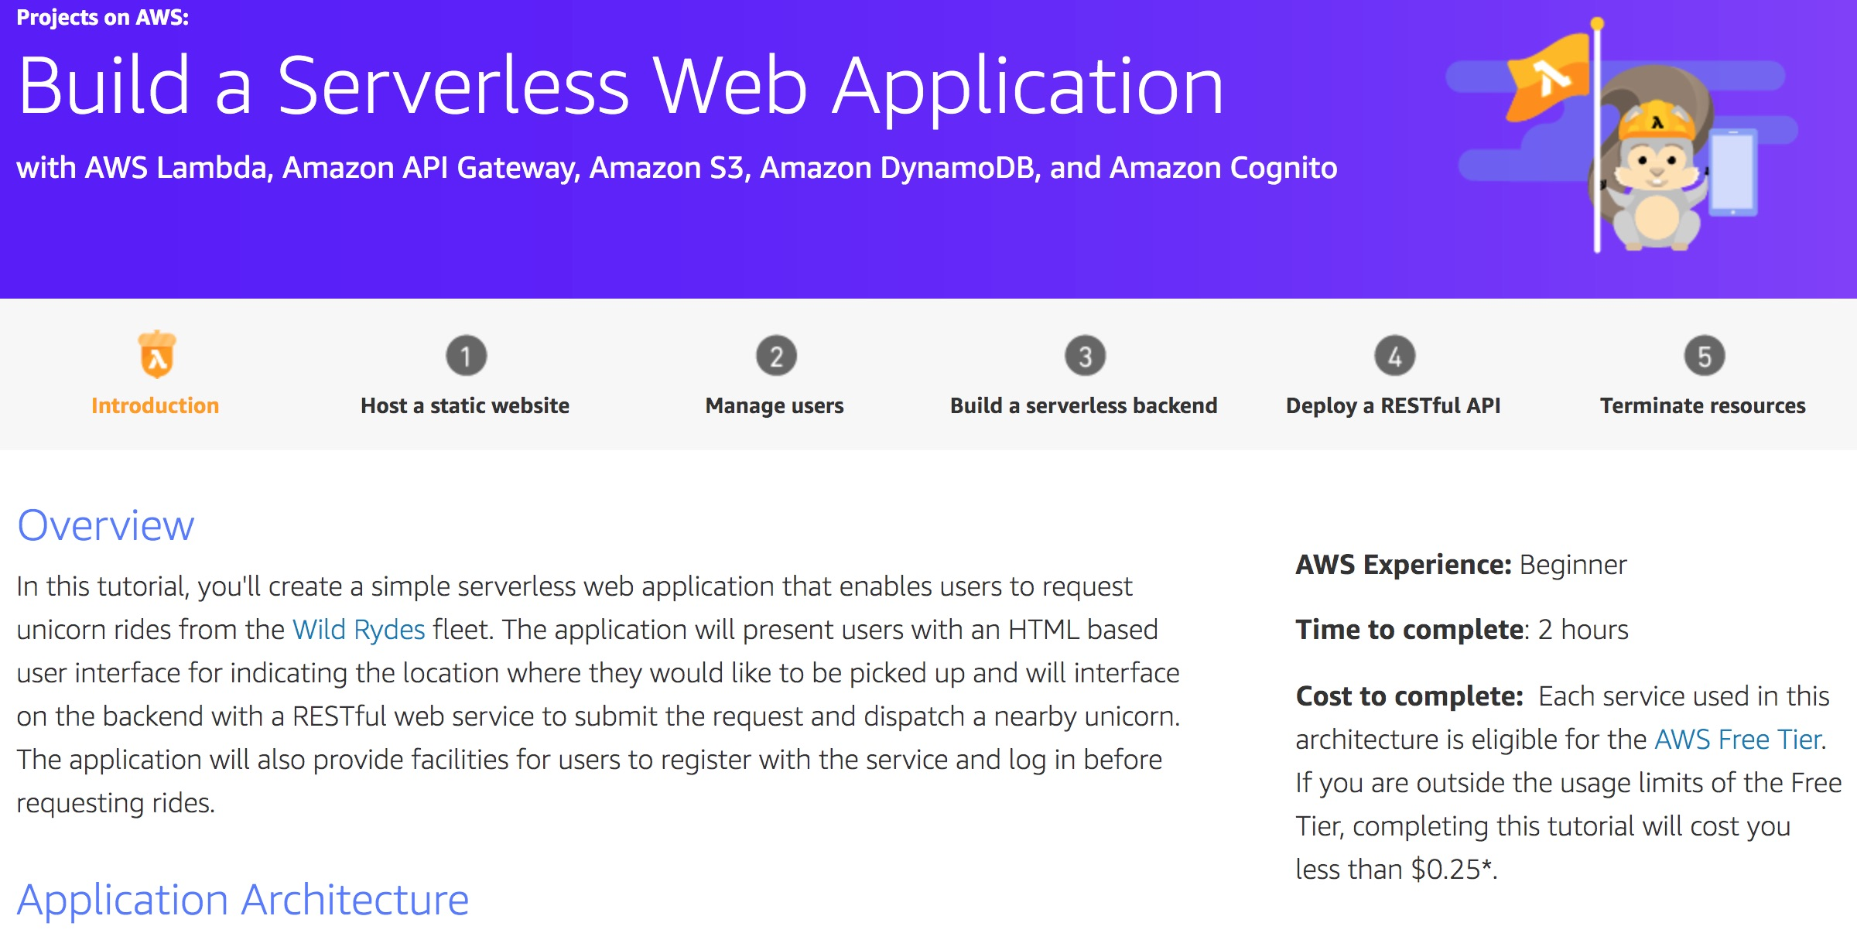
Build a Serverless Web Application
Source: https://aws.amazon.com/getting-started/projects/build-serverless-web-app-lambda-apigateway-s3-dynamodb-cognito/

Slide 100
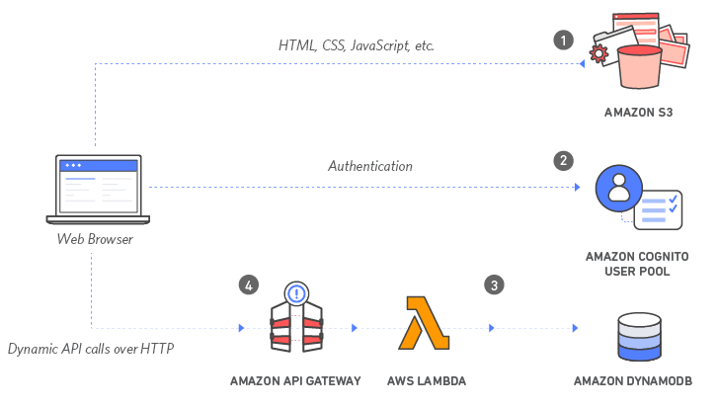
Build a Serverless Web Application with Amazon S3, AWS Lambda, Amazon API Gateway, Amazon DynamoDB, and Amazon Cognito
Source: https://aws.amazon.com/getting-started/projects/build-serverless-web-app-lambda-apigateway-s3-dynamodb-cognito/

Slide 101
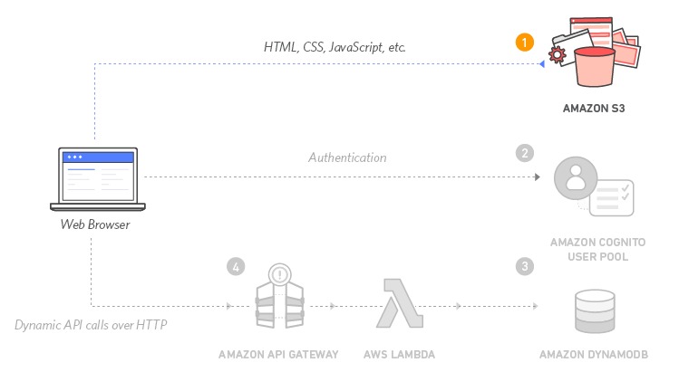
Build a Serverless Web Application with Amazon S3, AWS Lambda, Amazon API Gateway, Amazon DynamoDB, and Amazon Cognito
1
Source: https://aws.amazon.com/getting-started/projects/build-serverless-web-app-lambda-apigateway-s3-dynamodb-cognito/

Slide 102
Build a Serverless Web Application with Amazon S3, AWS Lambda, Amazon API Gateway, Amazon DynamoDB, and Amazon Cognito
1
Static Web Hosting
Amazon S3 hosts static web resources including HTML, CSS, JavaScript, and image files which are loaded in the user's browser.
Source: https://aws.amazon.com/getting-started/projects/build-serverless-web-app-lambda-apigateway-s3-dynamodb-cognito/

Slide 103
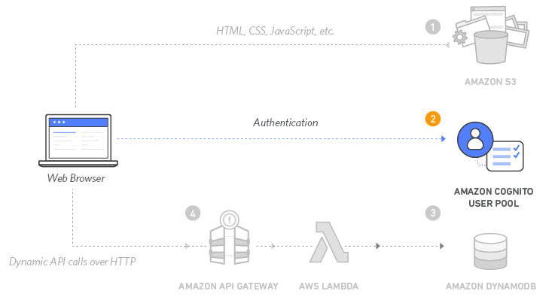
Build a Serverless Web Application with Amazon S3, AWS Lambda, Amazon API Gateway, Amazon DynamoDB, and Amazon Cognito
2
Source: https://aws.amazon.com/getting-started/projects/build-serverless-web-app-lambda-apigateway-s3-dynamodb-cognito/

Slide 104
Build a Serverless Web Application with Amazon S3, AWS Lambda, Amazon API Gateway, Amazon DynamoDB, and Amazon Cognito
2
User Management
Amazon Cognito provides user management and authentication functions to secure the backend API.
Source: https://aws.amazon.com/getting-started/projects/build-serverless-web-app-lambda-apigateway-s3-dynamodb-cognito/

Slide 105
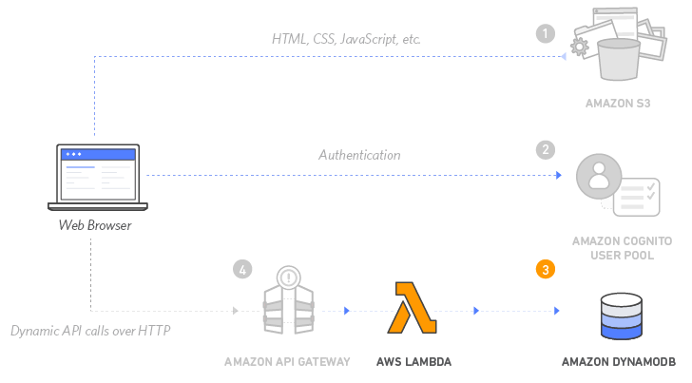
Build a Serverless Web Application with Amazon S3, AWS Lambda, Amazon API Gateway, Amazon DynamoDB, and Amazon Cognito
3
Source: https://aws.amazon.com/getting-started/projects/build-serverless-web-app-lambda-apigateway-s3-dynamodb-cognito/

Slide 106
Build a Serverless Web Application with Amazon S3, AWS Lambda, Amazon API Gateway, Amazon DynamoDB, and Amazon Cognito
3
Serverless Backend
Amazon DynamoDB provides a persistence layer where data can be stored by the API's Lambda function.
Source: https://aws.amazon.com/getting-started/projects/build-serverless-web-app-lambda-apigateway-s3-dynamodb-cognito/

Slide 107
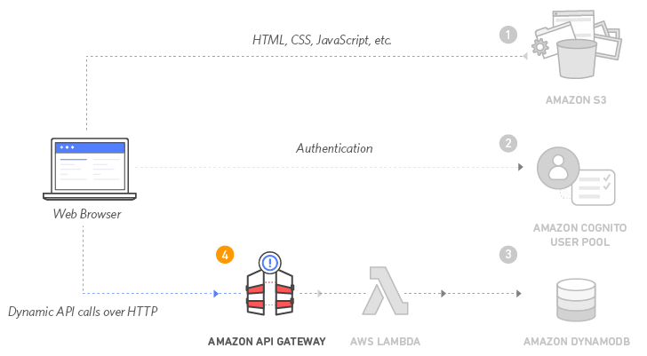
Build a Serverless Web Application with Amazon S3, AWS Lambda, Amazon API Gateway, Amazon DynamoDB, and Amazon Cognito
4
Source: https://aws.amazon.com/getting-started/projects/build-serverless-web-app-lambda-apigateway-s3-dynamodb-cognito/

Slide 108
Build a Serverless Web Application with Amazon S3, AWS Lambda, Amazon API Gateway, Amazon DynamoDB, and Amazon Cognito
4
RESTful API
JavaScript executed in the browser sends and receives data from a public backend API built using Lambda and API Gateway.
Source: https://aws.amazon.com/getting-started/projects/build-serverless-web-app-lambda-apigateway-s3-dynamodb-cognito/

Slide 109
Build a Serverless Web Application with Amazon S3, AWS Lambda, Amazon API Gateway, Amazon DynamoDB, and Amazon Cognito
5
Terminate resources
Resource Cleanup
You will terminate an Amazon S3 bucket, an Amazon Cognito User Pool, an AWS Lambda function, an IAM role, a DynamoDB table, a REST API, and a CloudWatch Log. It is a best practice to delete resources you are no longer using to avoid unwanted charges.
Source: https://aws.amazon.com/getting-started/projects/build-serverless-web-app-lambda-apigateway-s3-dynamodb-cognito/

Slide 110
Summary
Cloud Computing and Cloud Software Architecture
AWS Certified Cloud Practitioner (CLF-C01)
AWS Certified Solutions Architect – Associate (SAA-C02)
Web Application with AWS Core Services
AWS Serverless Architecture
Build a Serverless Web Application with Amazon S3, AWS Lambda, Amazon API Gateway, Amazon DynamoDB, and Amazon Cognito

Slide 111
References
https://aws.amazon.com/certification/
https://www.aws.training/
https://aws.amazon.com/training/awsacademy/
https://aws.amazon.com/education/awseducate/
AWS Certified Cloud Practitioner
https://aws.amazon.com/certification/certified-cloud-practitioner/
AWS Certified Solutions Architect – Associate
https://aws.amazon.com/certification/certified-solutions-architect-associate/
AWS Cloud Practitioner Essentials (Second Edition)
https://aws.amazon.com/training/course-descriptions/cloud-practitioner-essentials/
Architecting on AWS
https://aws.amazon.com/training/course-descriptions/architect/

Slide 112
References
Ian Sommerville (2019), Engineering Software Products: An Introduction to Modern Software Engineering, Pearson.
Ian Sommerville (2015), Software Engineering, 10th Edition, Pearson.
Titus Winters, Tom Manshreck, and Hyrum Wright (2020), Software Engineering at Google: Lessons Learned from Programming Over Time, O'Reilly Media.
Project Management Institute (2021), A Guide to the Project Management Body of Knowledge (PMBOK Guide) – Seventh Edition and The Standard for Project Management, PMI.
Project Management Institute (2017), A Guide to the Project Management Body of Knowledge (PMBOK Guide), Sixth Edition, Project Management Institute.
Project Management Institute (2017), Agile Practice Guide, Project Management Institute.

