Slide 1


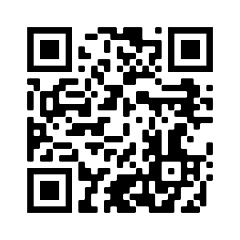





AI in FinTech: Metaverse, Web3, DeFi, NFT,
Financial Services Innovation and Applications
Artificial Intelligence in Finance and Quantitative Analysis
1121AIFQA02
MBA, IM, NTPU (M5276) (Fall 2023)
Tue 2, 3, 4 (9:10-12:00) (B3F17)
Min-Yuh Day, Ph.D,
Associate Professor
Institute of Information Management, National Taipei University
https://web.ntpu.edu.tw/~myday
https://meet.google.com/paj-zhhj-mya
2023-09-19

Slide 2
Syllabus
Week Date Subject/Topics
1 2023/09/12 Introduction to Artificial Intelligence in Finance and
Quantitative Analysis
2 2023/09/19 AI in FinTech: Metaverse, Web3, DeFi, NFT,
Financial Services Innovation and Applications
3 2023/09/26 Investing Psychology and Behavioral Finance
4 2023/10/03 Event Studies in Finance
5 2023/10/10 National Day (Day off)
6 2023/10/17 Case Study on AI in Finance and Quantitative Analysis I

Slide 3
Syllabus
Week Date Subject/Topics
7 2023/10/24 Finance Theory and Data-Driven Finance
8 2023/10/31 Midterm Project Report
9 2023/11/07 Financial Econometrics
10 2023/11/14 AI-First Finance
11 2023/11/21 Industry Practices of AI in Finance and Quantitative
Analysis
12 2023/11/28 Case Study on AI in Finance and Quantitative Analysis II

Slide 4
Syllabus
Week Date Subject/Topics
13 2023/12/05 Deep Learning in Finance;
Reinforcement Learning in Finance
14 2023/12/12 Algorithmic Trading; Risk Management;
Trading Bot and Event-Based Backtesting
15 2023/12/19 Final Project Report I
16 2023/12/26 Final Project Report II

Slide 5
AI in FinTech:
Metaverse,
Web3, DeFi, NFT,
Financial Services
Innovation and Applications

Slide 6
AI in
FinTech

Slide 7
FinTech ABCD
AI
Block Chain
Cloud Computing
Big Data

Slide 8
Decentralized Finance (DeFi)
Block Chain Financial Technology
Block Chain & Bitcoin
(BTC)
Smart Contract & Ethereum
(ETH)
Decentralized Application
(DApp)

Slide 9
Artificial Intelligence
(AI)

Slide 10
AI, Big Data, Cloud Computing
Evolution of Decision Support, Business Intelligence, and Analytics
AI
AI
Cloud Computing
Big Data
DM
BI
Source: Ramesh Sharda, Dursun Delen, and Efraim Turban (2017),
Business Intelligence, Analytics, and Data Science: A Managerial Perspective, 4th Edition, Pearson

Slide 11
AI, ML, DL
Artificial Intelligence (AI)
Machine Learning (ML)
Supervised
Learning
Unsupervised Learning
Deep Learning (DL)
CNN
RNN LSTM GRU
GAN
Semi-supervised Learning
Reinforcement Learning
Source: https://leonardoaraujosantos.gitbooks.io/artificial-inteligence/content/deep_learning.html

Slide 12
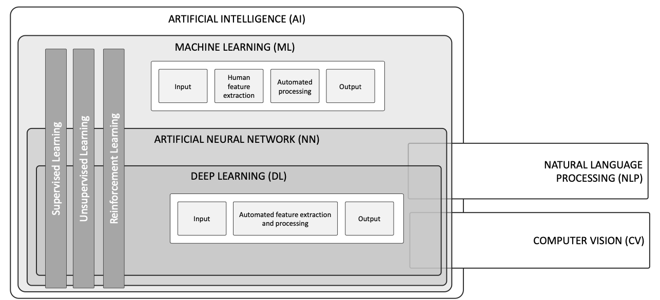
AI, ML, NN, DL
Source: Schoormann, T., Strobel, G., Möller, F., Petrik, D., & Zschech, P. (2023).
Artificial Intelligence for Sustainability—A Systematic Review of Information Systems Literature. Communications of the Association for Information Systems, 52(1), 8.

Slide 13
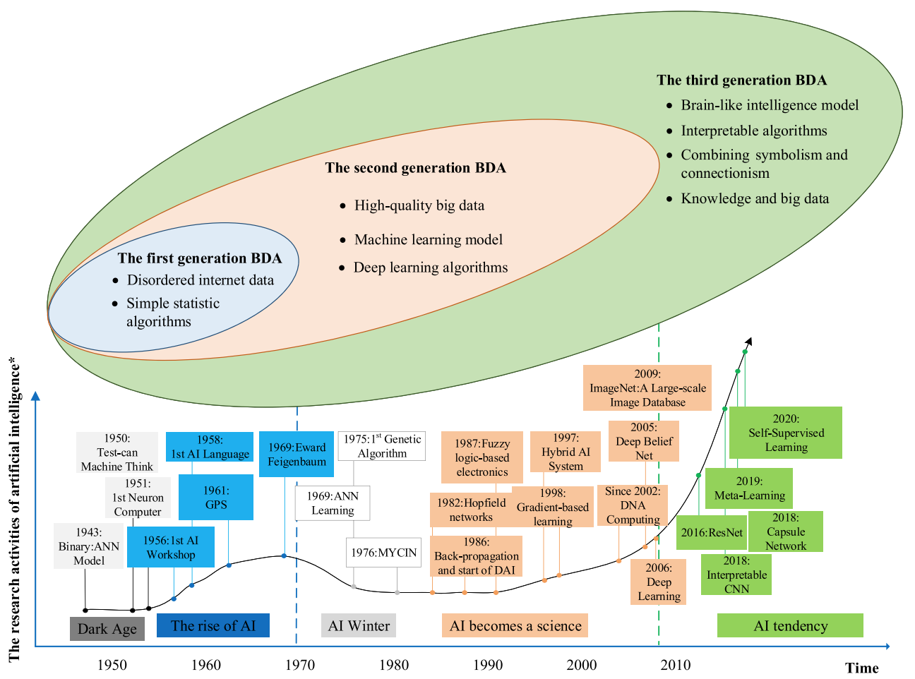
AI and Big Data Analytics (BDA)
Source: Wang, Junliang, Chuqiao Xu, Jie Zhang, and Ray Zhong (2022). "Big data analytics for intelligent manufacturing systems: A review." Journal of Manufacturing Systems 62 (2022): 738-752.

Slide 14
Definition of
Artificial Intelligence (A.I.)

Slide 15
Artificial Intelligence
“… the science and engineering of making intelligent machines”
(John McCarthy, 1955)
Source: https://digitalintelligencetoday.com/artificial-intelligence-defined-useful-list-of-popular-definitions-from-business-and-science/

Slide 16
Artificial Intelligence
“… technology that thinks and acts like humans”
Source: https://digitalintelligencetoday.com/artificial-intelligence-defined-useful-list-of-popular-definitions-from-business-and-science/

Slide 17
Artificial Intelligence
“… intelligence exhibited by machines or software”
Source: https://digitalintelligencetoday.com/artificial-intelligence-defined-useful-list-of-popular-definitions-from-business-and-science/

Slide 18
4 Approaches of AI
Thinking Humanly | Thinking Rationally
Acting Humanly | Acting Rationally
Source: Stuart Russell and Peter Norvig (2020), Artificial Intelligence: A Modern Approach, 4th Edition, Pearson

Slide 19
4 Approaches of AI
2. Thinking Humanly: The Cognitive Modeling Approach | 3. Thinking Rationally: The “Laws of Thought” Approach
1. Acting Humanly: The Turing Test Approach (1950) | 4. Acting Rationally: The Rational Agent Approach
Source: Stuart Russell and Peter Norvig (2020), Artificial Intelligence: A Modern Approach, 4th Edition, Pearson

Slide 20
AI Acting Humanly:
The Turing Test Approach
(Alan Turing, 1950)
Knowledge Representation
Automated Reasoning
Machine Learning (ML)
  Deep Learning (DL)
Computer Vision (Image, Video)
Natural Language Processing (NLP)
Robotics
Source: Stuart Russell and Peter Norvig (2020), Artificial Intelligence: A Modern Approach, 4th Edition, Pearson

Slide 21
FinTech

Slide 22
Financial Technology
FinTech
“providing
financial services
by making use of software and
modern technology”
Source: https://www.fintechweekly.com/fintech-definition

Slide 23
Financial Technology

Slide 24
Financial Services

Slide 25
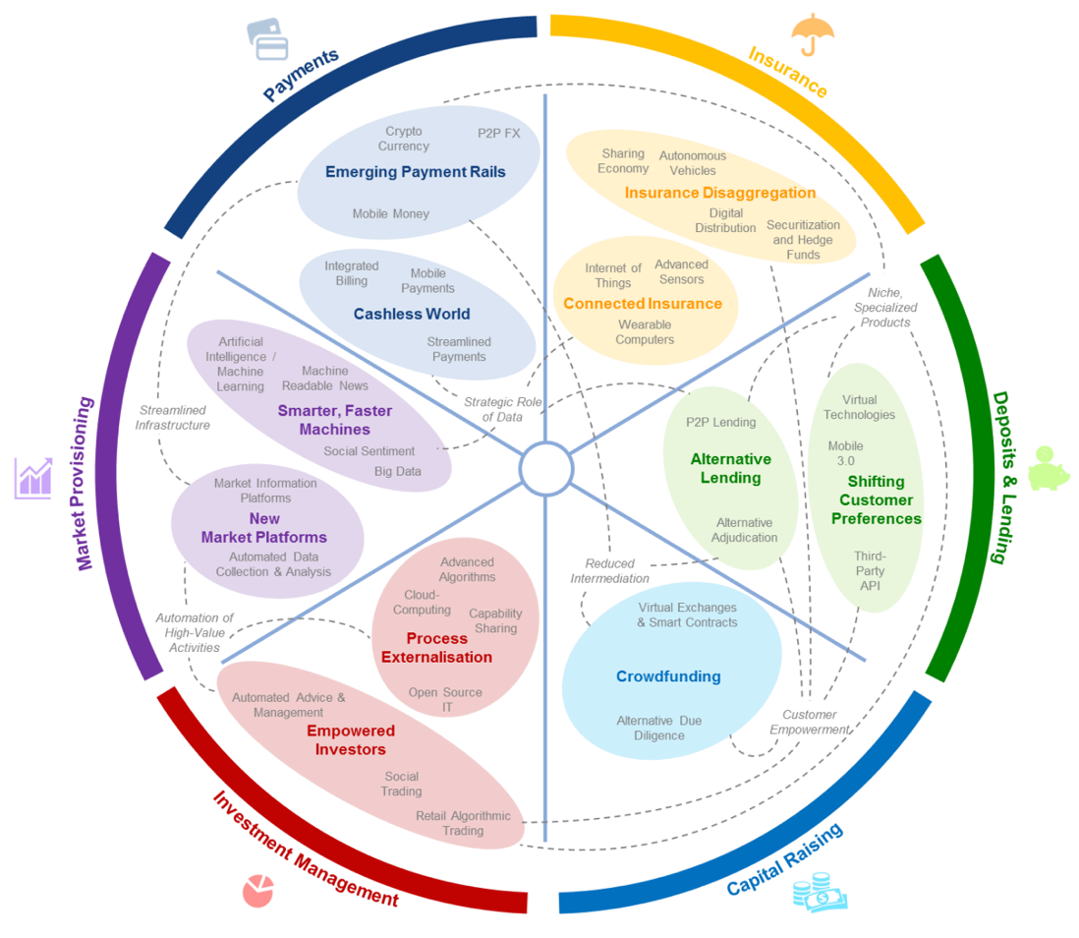
FinTech: Financial Services Innovation
Source: http://www3.weforum.org/docs/WEF_The_future__of_financial_services.pdf

Slide 26
FinTech:
Financial Services Innovation
1. Payments
2. Insurance
3. Deposits & Lending
4. Capital Raising
5. Investment Management
6. Market Provisioning
Source: http://www3.weforum.org/docs/WEF_The_future__of_financial_services.pdf

Slide 27
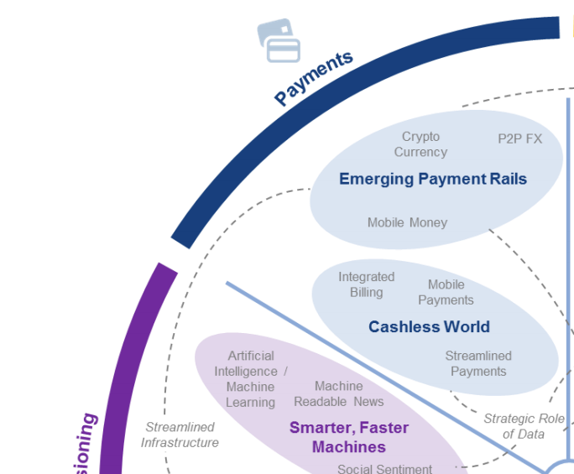
FinTech: Payment
1
Source: http://www3.weforum.org/docs/WEF_The_future__of_financial_services.pdf

Slide 28
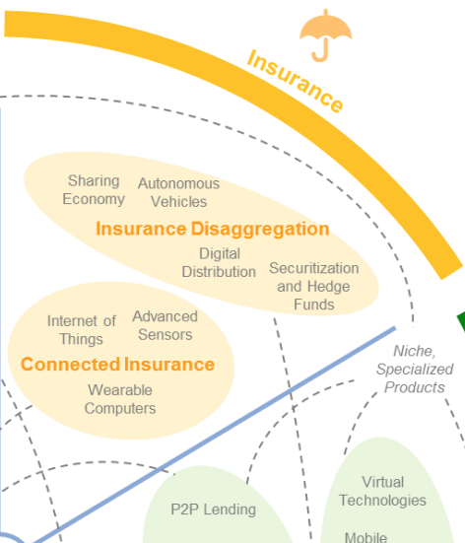
FinTech: Insurance
2
Source: http://www3.weforum.org/docs/WEF_The_future__of_financial_services.pdf

Slide 29
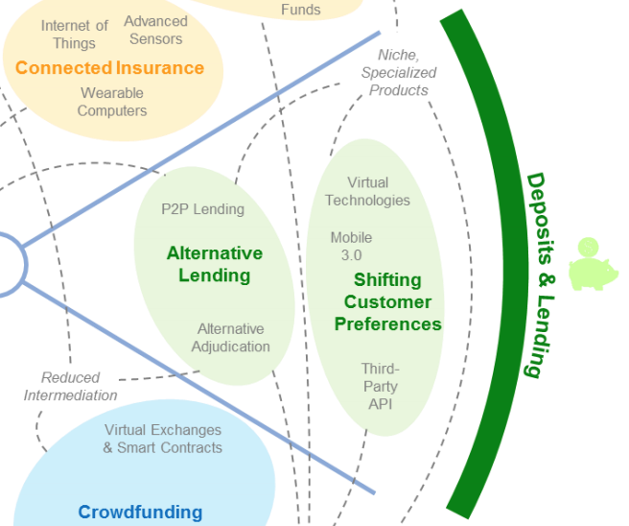
FinTech: Deposits & Lending
3
Source: http://www3.weforum.org/docs/WEF_The_future__of_financial_services.pdf

Slide 30
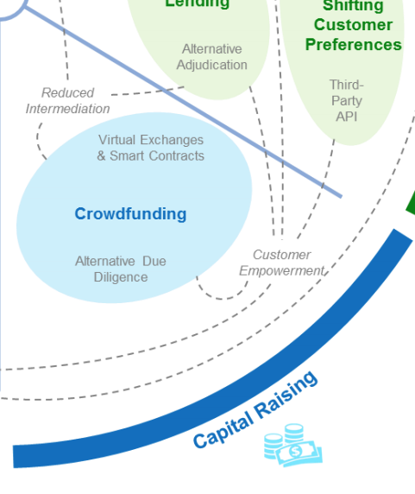
FinTech: Capital Raising
4
Source: http://www3.weforum.org/docs/WEF_The_future__of_financial_services.pdf

Slide 31
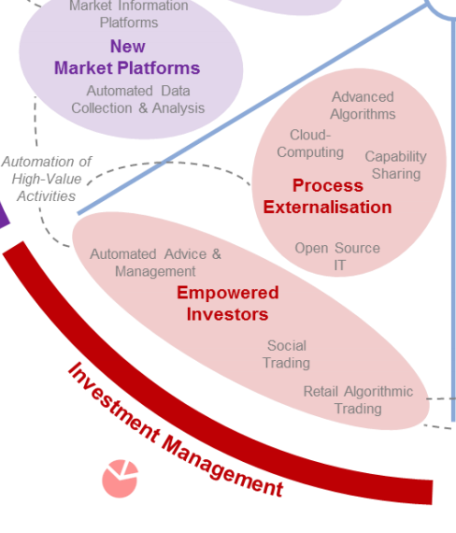
FinTech: Investment Management
5
Source: http://www3.weforum.org/docs/WEF_The_future__of_financial_services.pdf

Slide 32
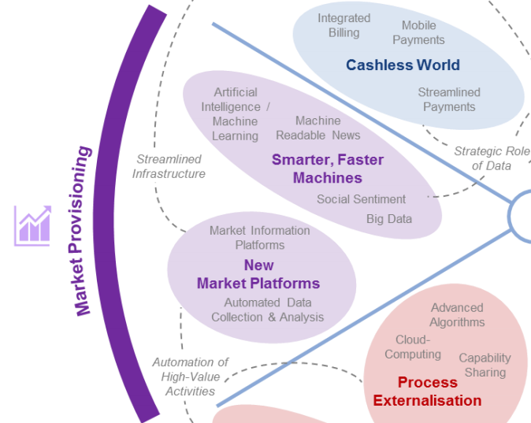
FinTech: Market Provisioning
6
Source: http://www3.weforum.org/docs/WEF_The_future__of_financial_services.pdf

Slide 33
Deep learning for financial applications: Topic-Model Heatmap
Source: Ahmet Murat Ozbayoglu, Mehmet Ugur Gudelek, and Omer Berat Sezer (2020). "Deep learning for financial applications: A survey." Applied Soft Computing (2020): 106384.

Slide 34
Deep learning for financial applications: Topic-Feature Heatmap
Source: Ahmet Murat Ozbayoglu, Mehmet Ugur Gudelek, and Omer Berat Sezer (2020). "Deep learning for financial applications: A survey." Applied Soft Computing (2020): 106384.

Slide 35
Deep learning for financial applications: Topic-Dataset Heatmap
Source: Ahmet Murat Ozbayoglu, Mehmet Ugur Gudelek, and Omer Berat Sezer (2020). "Deep learning for financial applications: A survey." Applied Soft Computing (2020): 106384.

Slide 36
Financial time series forecasting with deep learning: Topic-model heatmap
Source: Omer Berat Sezer, Mehmet Ugur Gudelek, and Ahmet Murat Ozbayoglu (2020), "Financial time series forecasting with deep learning:
A systematic literature review: 2005–2019." Applied Soft Computing 90 (2020): 106181.

Slide 37
Deep learning for financial applications:
Algo-trading applications embedded with time series forecasting models
Source: Ahmet Murat Ozbayoglu, Mehmet Ugur Gudelek, and Omer Berat Sezer (2020). "Deep learning for financial applications: A survey." Applied Soft Computing (2020): 106384.

Slide 38
Deep learning for financial applications:
Algo-trading applications embedded with time series forecasting models
Source: Ahmet Murat Ozbayoglu, Mehmet Ugur Gudelek, and Omer Berat Sezer (2020). "Deep learning for financial applications: A survey." Applied Soft Computing (2020): 106384.

Slide 39
Deep learning for financial applications:
Classification (buy–sell signal, or trend detection) based algo-trading models
Source: Ahmet Murat Ozbayoglu, Mehmet Ugur Gudelek, and Omer Berat Sezer (2020). "Deep learning for financial applications: A survey." Applied Soft Computing (2020): 106384.

Slide 40
Deep learning for financial applications:
Stand-alone and/or other algorithmic models
Source: Ahmet Murat Ozbayoglu, Mehmet Ugur Gudelek, and Omer Berat Sezer (2020). "Deep learning for financial applications: A survey." Applied Soft Computing (2020): 106384.

Slide 41
Deep learning for financial applications:
Credit scoring or classification studies
Source: Ahmet Murat Ozbayoglu, Mehmet Ugur Gudelek, and Omer Berat Sezer (2020). "Deep learning for financial applications: A survey." Applied Soft Computing (2020): 106384.

Slide 42
Deep learning for financial applications:
Financial distress, bankruptcy, bank risk, mortgage risk, crisis forecasting studies.
Source: Ahmet Murat Ozbayoglu, Mehmet Ugur Gudelek, and Omer Berat Sezer (2020). "Deep learning for financial applications: A survey." Applied Soft Computing (2020): 106384.

Slide 43
Deep learning for financial applications:
Fraud detection studies
Source: Ahmet Murat Ozbayoglu, Mehmet Ugur Gudelek, and Omer Berat Sezer (2020). "Deep learning for financial applications: A survey." Applied Soft Computing (2020): 106384.

Slide 44
Deep learning for financial applications:
Portfolio management studies
Source: Ahmet Murat Ozbayoglu, Mehmet Ugur Gudelek, and Omer Berat Sezer (2020). "Deep learning for financial applications: A survey." Applied Soft Computing (2020): 106384.

Slide 45
Deep learning for financial applications:
Asset pricing and derivatives market studies
Source: Ahmet Murat Ozbayoglu, Mehmet Ugur Gudelek, and Omer Berat Sezer (2020). "Deep learning for financial applications: A survey." Applied Soft Computing (2020): 106384.

Slide 46
Deep learning for financial applications:
Cryptocurrency and blockchain studies
Source: Ahmet Murat Ozbayoglu, Mehmet Ugur Gudelek, and Omer Berat Sezer (2020). "Deep learning for financial applications: A survey." Applied Soft Computing (2020): 106384.

Slide 47
Deep learning for financial applications:
Financial sentiment studies coupled with text mining for forecasting
Source: Ahmet Murat Ozbayoglu, Mehmet Ugur Gudelek, and Omer Berat Sezer (2020). "Deep learning for financial applications: A survey." Applied Soft Computing (2020): 106384.

Slide 48
Deep learning for financial applications:
Text mining studies without sentiment analysis for forecasting
Source: Ahmet Murat Ozbayoglu, Mehmet Ugur Gudelek, and Omer Berat Sezer (2020). "Deep learning for financial applications: A survey." Applied Soft Computing (2020): 106384.

Slide 49
Deep learning for financial applications:
Text mining studies without sentiment analysis for forecasting
Source: Ahmet Murat Ozbayoglu, Mehmet Ugur Gudelek, and Omer Berat Sezer (2020). "Deep learning for financial applications: A survey." Applied Soft Computing (2020): 106384.

Slide 50
Deep learning for financial applications:
Financial sentiment studies coupled with text mining without forecasting
Source: Ahmet Murat Ozbayoglu, Mehmet Ugur Gudelek, and Omer Berat Sezer (2020). "Deep learning for financial applications: A survey." Applied Soft Computing (2020): 106384.

Slide 51
Deep learning for financial applications:
Other text mining studies
Source: Ahmet Murat Ozbayoglu, Mehmet Ugur Gudelek, and Omer Berat Sezer (2020). "Deep learning for financial applications: A survey." Applied Soft Computing (2020): 106384.

Slide 52
Deep learning for financial applications:
Other theoretical or conceptual studies
Source: Ahmet Murat Ozbayoglu, Mehmet Ugur Gudelek, and Omer Berat Sezer (2020). "Deep learning for financial applications: A survey." Applied Soft Computing (2020): 106384.

Slide 53
Deep learning for financial applications:
Other financial applications
Source: Ahmet Murat Ozbayoglu, Mehmet Ugur Gudelek, and Omer Berat Sezer (2020). "Deep learning for financial applications: A survey." Applied Soft Computing (2020): 106384.

Slide 54
Stock price forecasting using only raw time series data
Source: Omer Berat Sezer, Mehmet Ugur Gudelek, and Ahmet Murat Ozbayoglu (2020), "Financial time series forecasting with deep learning:
A systematic literature review: 2005–2019." Applied Soft Computing 90 (2020): 106181.

Slide 55
Stock price forecasting using various data
Source: Omer Berat Sezer, Mehmet Ugur Gudelek, and Ahmet Murat Ozbayoglu (2020), "Financial time series forecasting with deep learning:
A systematic literature review: 2005–2019." Applied Soft Computing 90 (2020): 106181.

Slide 56
Stock Market Movement Forecast:
Phases of the stock market modeling
Source: O. Bustos and A. Pomares-Quimbaya (2020), "Stock Market Movement Forecast: A Systematic Review."
Expert Systems with Applications (2020): 113464.

Slide 57
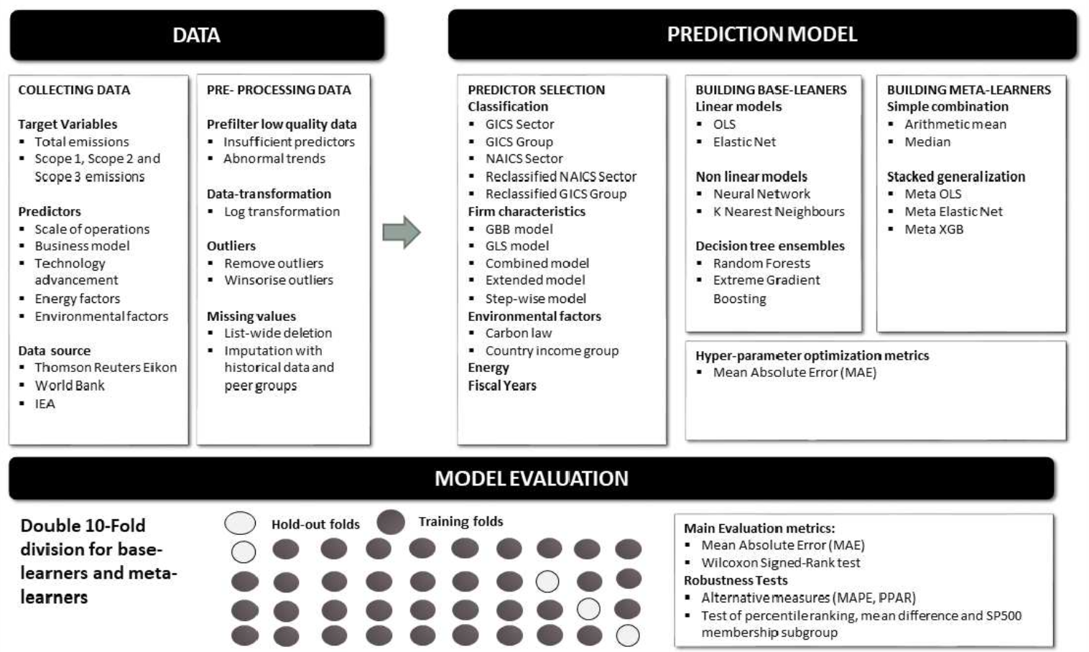
Modelling Strategy to Forecast Carbon Emissions with AI
Source: Brière, M., Keip, M., & Le Berthe, T. (2022). Artificial Intelligence for Sustainable Finance: Why it May Help. Available at SSRN 4252329.
Notes:
Modelling strategy to forecast carbon emisisons with Machine Learning methods
This figure illustrates the modelling framework that is used to train and evaluate the proposed machine learning approach. Block: Data shows the sample selection and data pre-processing process. Block: Prediction Model implements (1) Predictor Selection, where the optimal set of predictors from the listed alternative choices is selected based on OLS regression. (2): Build Base-Learners, where three groups of base-learners are tested, namely linear models, non-linear models, and decision ensembles, and (3) Building Meta-Learners, where predictions are combined using a simple combination or stacked generalization. Finally, block: Model Evaluation: describes the model evaluation with mean absolute error and a set of robustness tests via double-K fold validation.
Source: Nguyen, Diaz-Rainez and Kuruppuarachchi (2021)

Slide 58
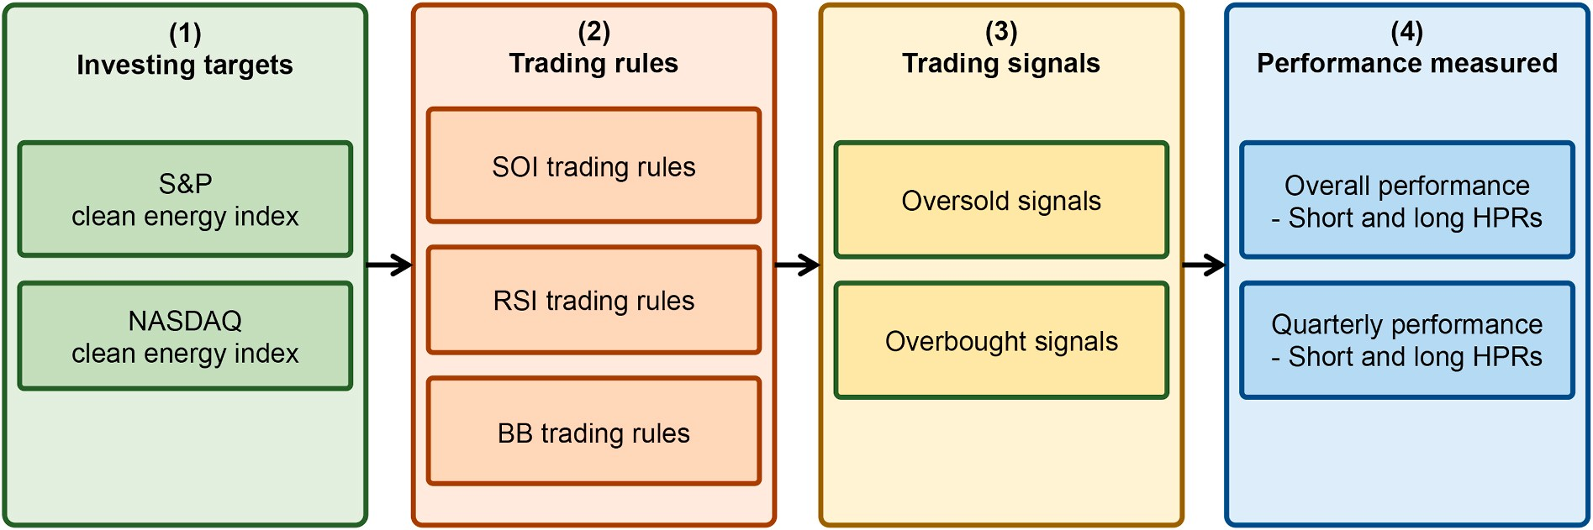
The Research Framework
Do clean energy indices outperform using contrarian strategies
Source, Min-Yuh Day and Yensen Ni (2023), "Do clean energy indices outperform using contrarian strategies based on contrarian trading rules?", Energy, Volume 272, 1 June 2023, 127113.

Slide 59
Artificial Intelligence for Sustainable Finance
Why AI may help sustainable finance?
  Brière, M., Keip, M., & Le Berthe, T. (2022). Artificial Intelligence for Sustainable Finance: Why it May Help. Available at SSRN 4252329.
How does artificial intelligence boost sustainable development?
  Schoormann, T., Strobel, G., Möller, F., Petrik, D., & Zschech, P. (2023). Artificial Intelligence for Sustainability—A Systematic Review of Information Systems Literature. Communications of the Association for Information Systems, 52(1), 8.
Does sustainability generate better financial performance?
  Atz, U., Van Holt, T., Liu, Z. Z., & Bruno, C. C. (2023). Does sustainability generate better financial performance? review, meta-analysis, and propositions. Journal of Sustainable Finance & Investment, 13(1), 802-825.
What are the major research topics in AI for Sustainable finance?
  Kumar, S., Sharma, D., Rao, S., Lim, W. M., & Mangla, S. K. (2022). Past, present, and future of sustainable finance: Insights from big data analytics through machine learning of scholarly research. Annals of Operations Research, 1-44.

Slide 60
Metaverse
Web3
DeFi
NFT

Slide 61
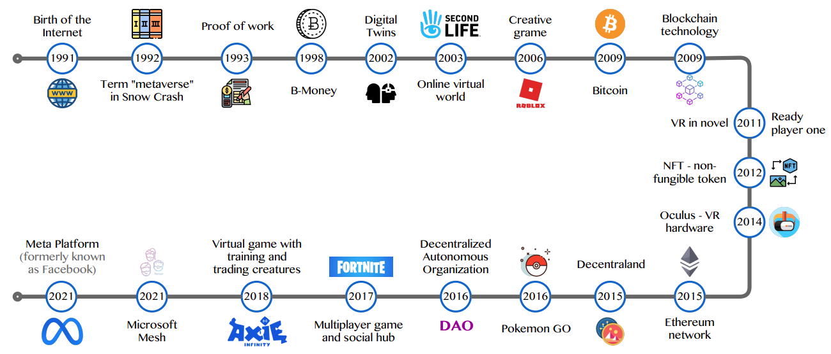
Metaverse Development from 1991 to 2021
Source: Huynh-The, Thien, Quoc-Viet Pham, Xuan-Qui Pham, Thanh Thi Nguyen, Zhu Han, and Dong-Seong Kim (2022).
"Artificial Intelligence for the Metaverse: A Survey." arXiv preprint arXiv:2202.10336.

Slide 62
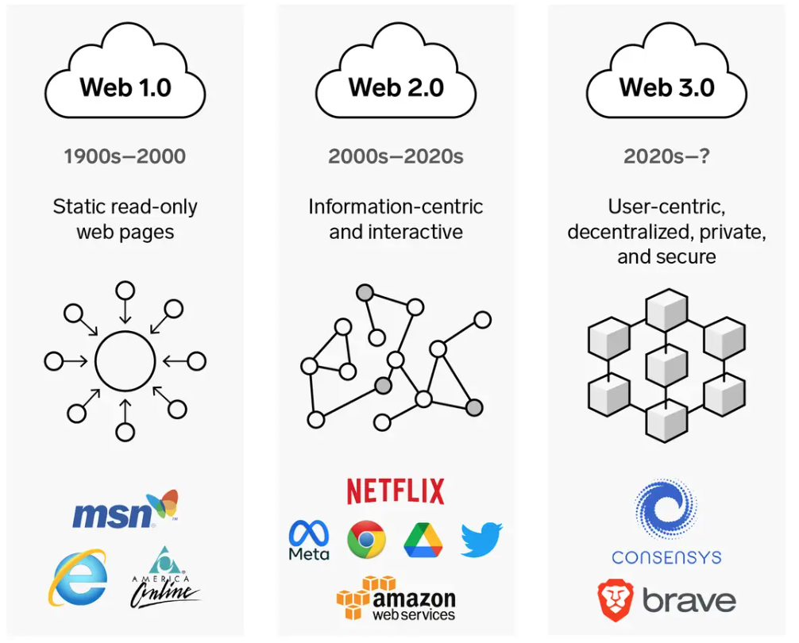
Web3: Decentralized Web
Internet Evolution
1990
2000
2020
Source: https://www.businessinsider.com/personal-finance/what-is-web3

Slide 63
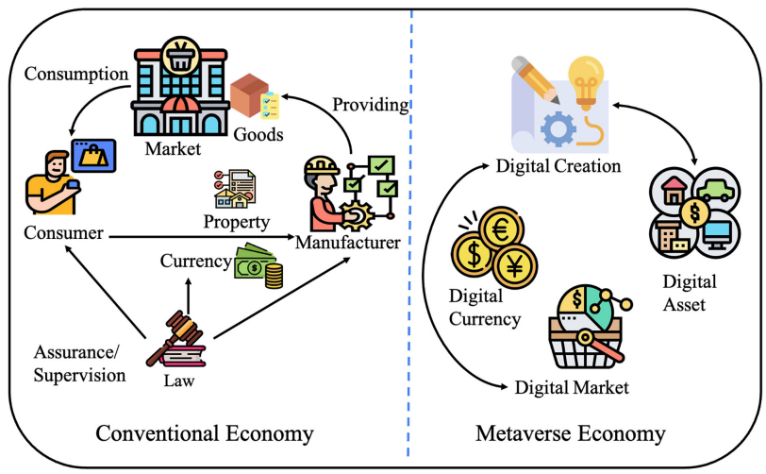
Metaverse Economy
Source: Yang, Qinglin, Yetong Zhao, Huawei Huang, Zehui Xiong, Jiawen Kang, and Zibin Zheng (2022).
"Fusing blockchain and AI with metaverse: A survey." IEEE Open Journal of the Computer Society 3 : 122-136.

Slide 64
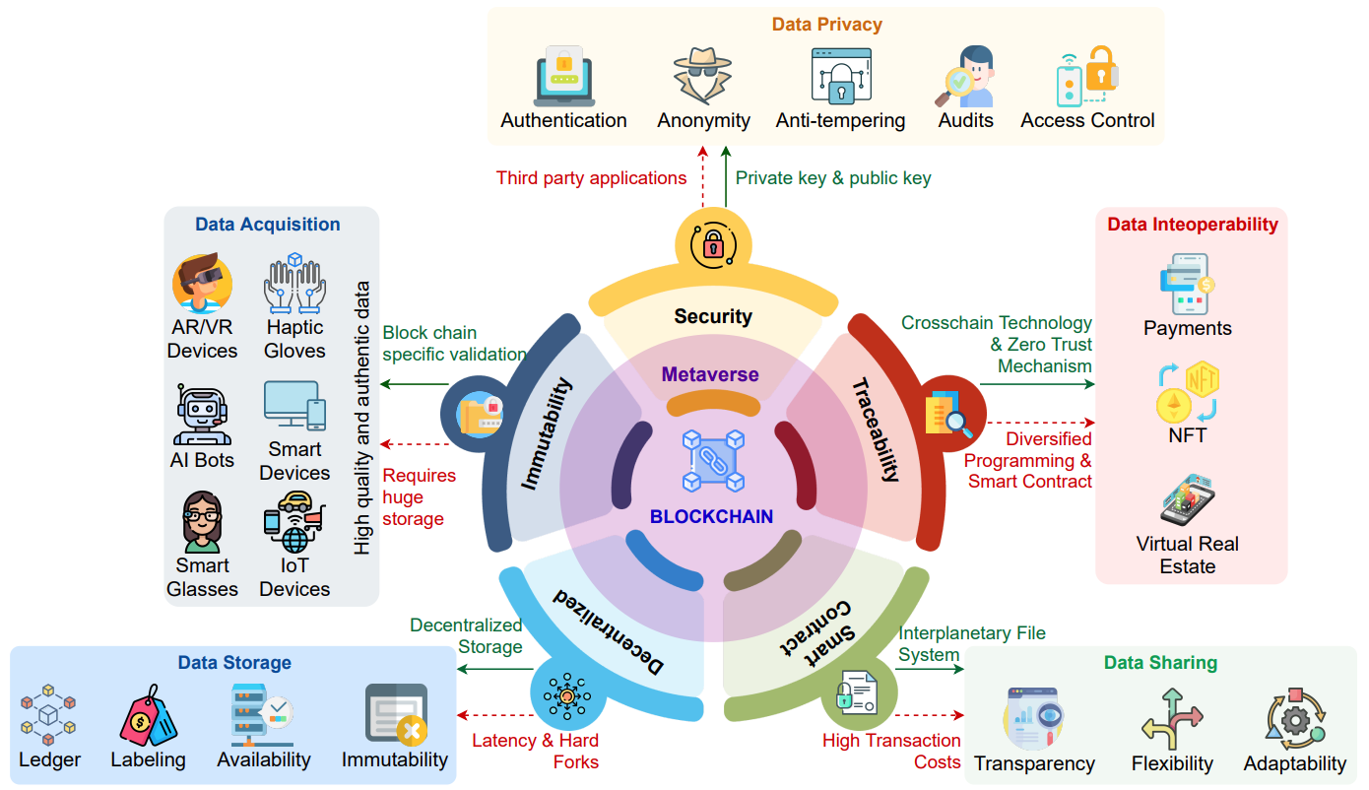
Blockchain in the Metaverse
Source: Gadekallu, Thippa Reddy, Thien Huynh-The, Weizheng Wang, Gokul Yenduri, Pasika Ranaweera, Quoc-Viet Pham, Daniel Benevides da Costa, and Madhusanka Liyanage (2022).
"Blockchain for the Metaverse: A Review." arXiv preprint arXiv:2203.09738..

Slide 65
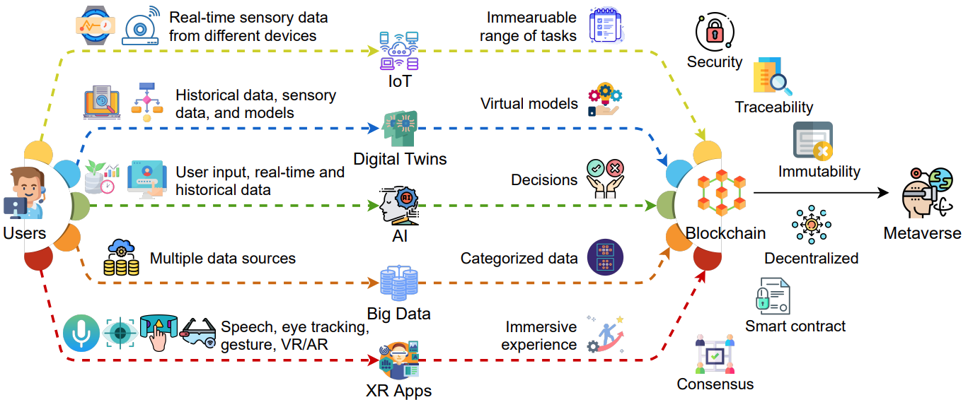
Blockchain for Key Enabling Technologies of the Metaverse
Source: Gadekallu, Thippa Reddy, Thien Huynh-The, Weizheng Wang, Gokul Yenduri, Pasika Ranaweera, Quoc-Viet Pham, Daniel Benevides da Costa, and Madhusanka Liyanage (2022).
"Blockchain for the Metaverse: A Review." arXiv preprint arXiv:2203.09738..

Slide 66
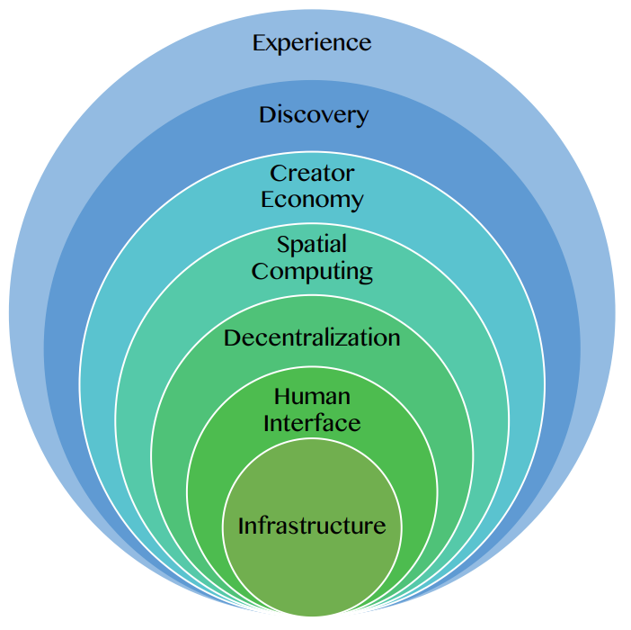
Seven Layers of a Metaverse Platform
Source: Huynh-The, Thien, Quoc-Viet Pham, Xuan-Qui Pham, Thanh Thi Nguyen, Zhu Han, and Dong-Seong Kim (2022).
"Artificial Intelligence for the Metaverse: A Survey." arXiv preprint arXiv:2202.10336.

Slide 67
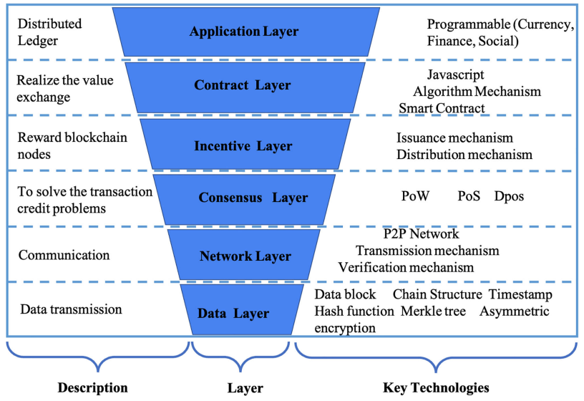
Layered Architecture of Blockchain
Source: Yang, Qinglin, Yetong Zhao, Huawei Huang, Zehui Xiong, Jiawen Kang, and Zibin Zheng (2022).
"Fusing blockchain and AI with metaverse: A survey." IEEE Open Journal of the Computer Society 3 : 122-136.

Slide 68
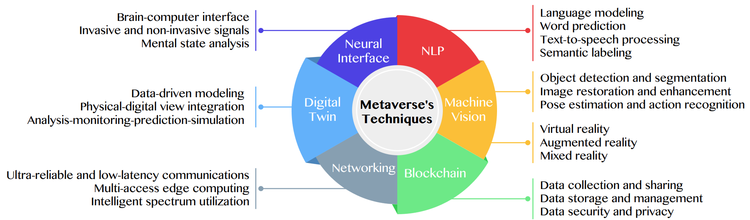
Primary Technical Aspects in the Metaverse
AI with ML algorithms and DL architectures is advancing the user experience in the virtual world
Source: Huynh-The, Thien, Quoc-Viet Pham, Xuan-Qui Pham, Thanh Thi Nguyen, Zhu Han, and Dong-Seong Kim (2022).
"Artificial Intelligence for the Metaverse: A Survey." arXiv preprint arXiv:2202.10336.

Slide 69
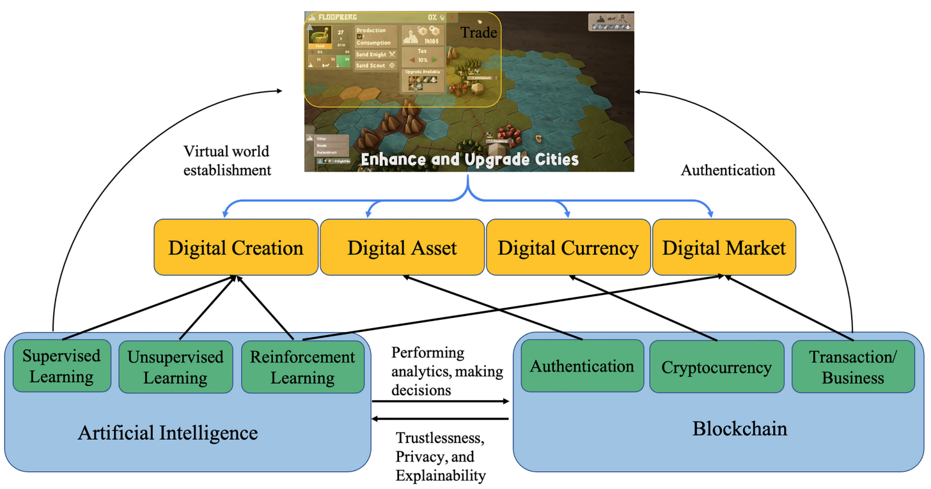
Fusion of AI and Blockchain in Metaverse
Source: Yang, Qinglin, Yetong Zhao, Huawei Huang, Zehui Xiong, Jiawen Kang, and Zibin Zheng (2022).
"Fusing blockchain and AI with metaverse: A survey." IEEE Open Journal of the Computer Society 3 : 122-136.

Slide 70
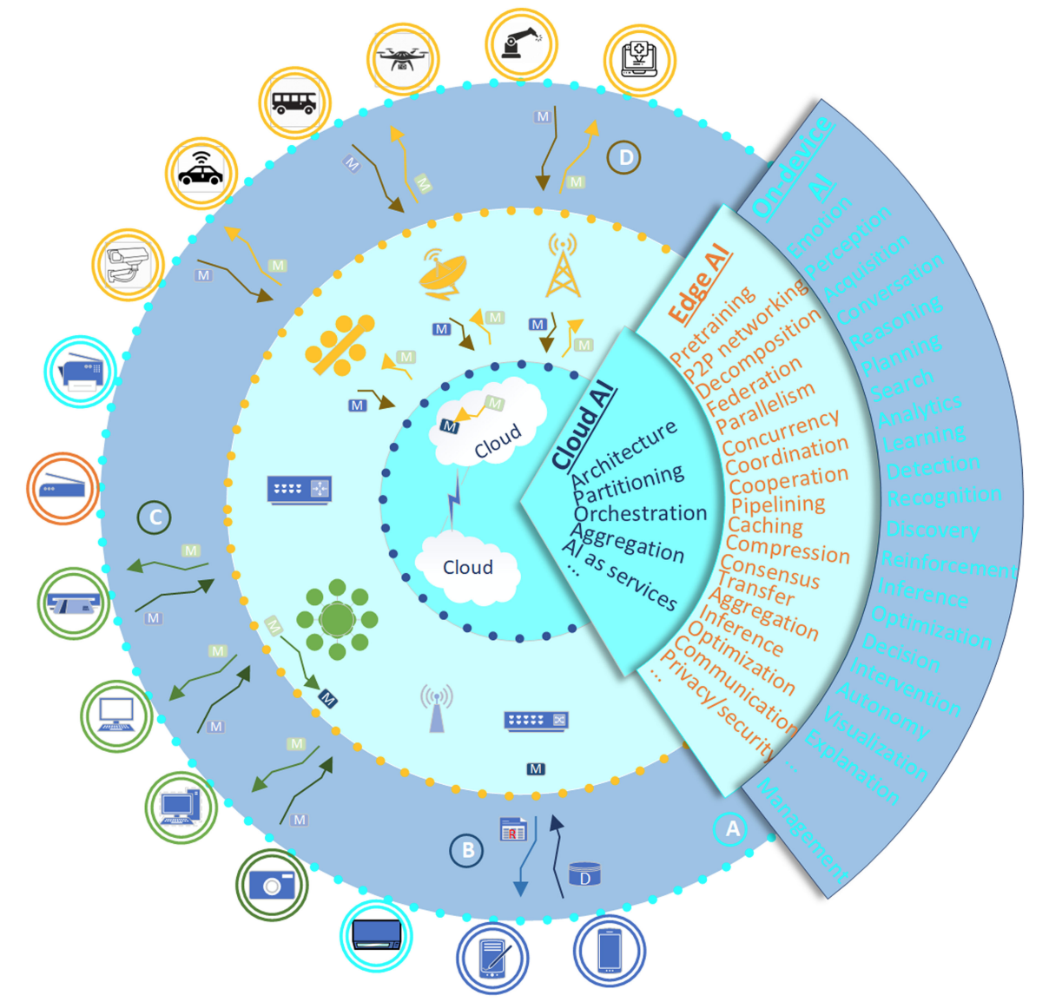
DeAI:
Synthesizing On-device AI, Edge AI, and Cloud AI
Source: Cao, Longbing (2022). "Decentralized ai: Edge intelligence and smart blockchain, metaverse, web3, and desci." IEEE Intelligent Systems 37, no. 3: 6-19.

Slide 71
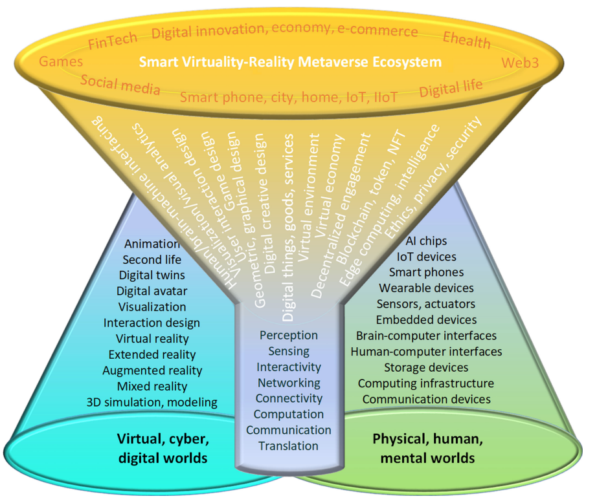
Smart Virtuality-Reality Metaverse Ecosystem: Metasynthesizing DeAI, Metaverse, Blockchain, Web3
Source: Cao, Longbing (2022). "Decentralized ai: Edge intelligence and smart blockchain, metaverse, web3, and desci." IEEE Intelligent Systems 37, no. 3: 6-19.

Slide 72
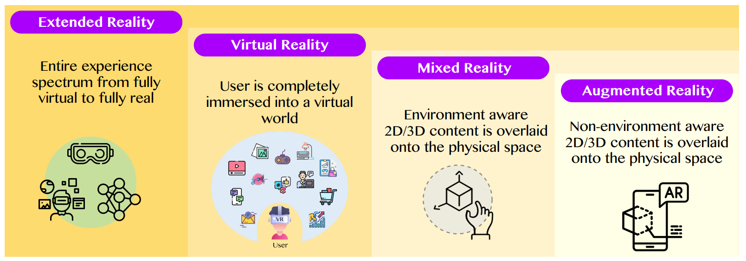
The difference between AR, MR, and VR under the umbrella of XR
XR
VR
MR
AR
Source: Huynh-The, Thien, Quoc-Viet Pham, Xuan-Qui Pham, Thanh Thi Nguyen, Zhu Han, and Dong-Seong Kim (2022).
"Artificial Intelligence for the Metaverse: A Survey." arXiv preprint arXiv:2202.10336.

Slide 73
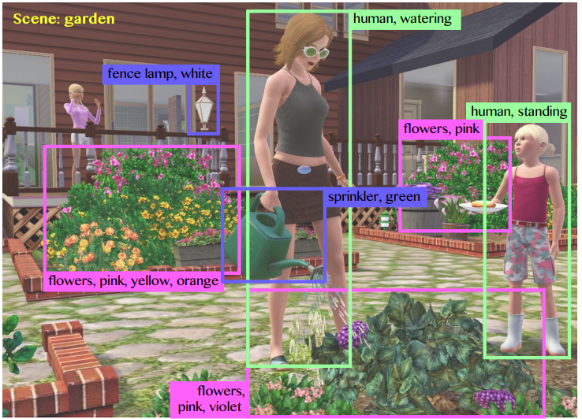
Computer vision in the metaverse with scene understanding, object detection, and human action/activity recognition
Source: Huynh-The, Thien, Quoc-Viet Pham, Xuan-Qui Pham, Thanh Thi Nguyen, Zhu Han, and Dong-Seong Kim (2022).
"Artificial Intelligence for the Metaverse: A Survey." arXiv preprint arXiv:2202.10336.

Slide 74
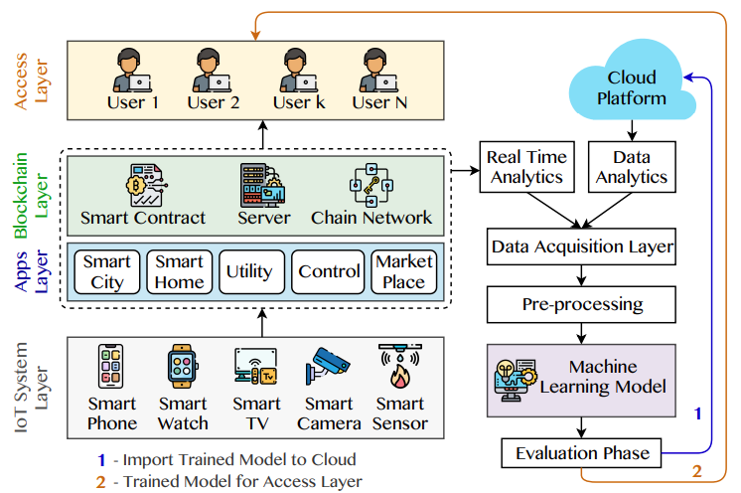
A Blockchain-based IoT Framework with ML to enhance security and privacy
Source: Huynh-The, Thien, Quoc-Viet Pham, Xuan-Qui Pham, Thanh Thi Nguyen, Zhu Han, and Dong-Seong Kim (2022).
"Artificial Intelligence for the Metaverse: A Survey." arXiv preprint arXiv:2202.10336.

Slide 75
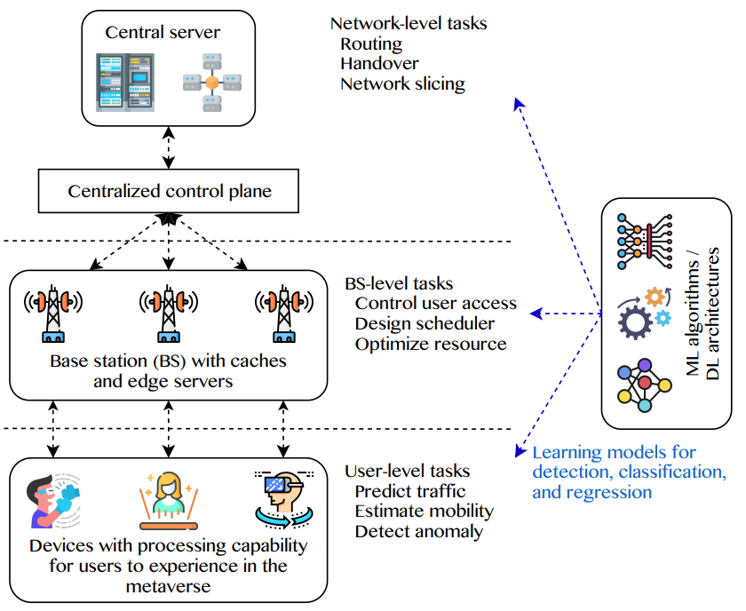
5G and beyond for Metaverse Services
AI with ML algorithms and DL models contribute in multi-level tasks
Source: Huynh-The, Thien, Quoc-Viet Pham, Xuan-Qui Pham, Thanh Thi Nguyen, Zhu Han, and Dong-Seong Kim (2022).
"Artificial Intelligence for the Metaverse: A Survey." arXiv preprint arXiv:2202.10336.

Slide 76
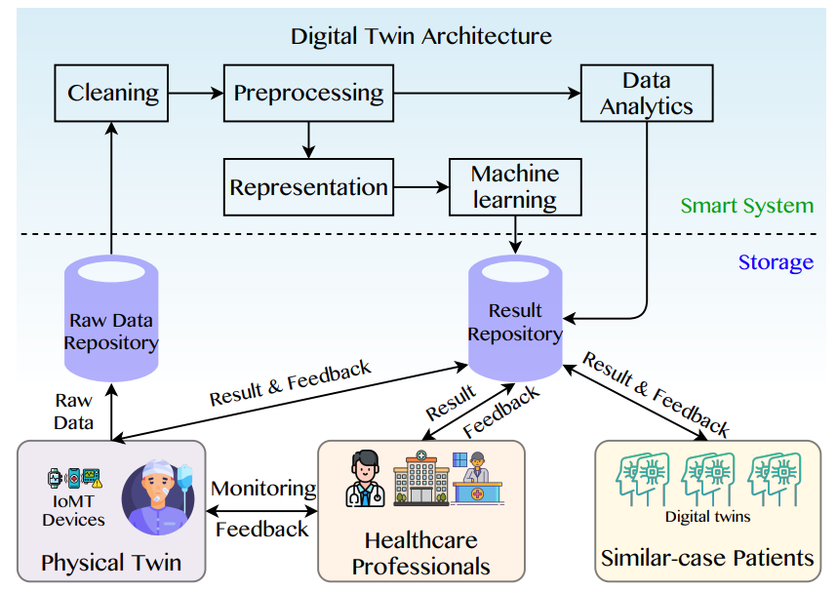
A Data-Driven Digital Twin Architecture for intelligent healthcare systems using ML to process raw data of IoMedicalThings devices
Source: Huynh-The, Thien, Quoc-Viet Pham, Xuan-Qui Pham, Thanh Thi Nguyen, Zhu Han, and Dong-Seong Kim (2022).
"Artificial Intelligence for the Metaverse: A Survey." arXiv preprint arXiv:2202.10336.

Slide 77
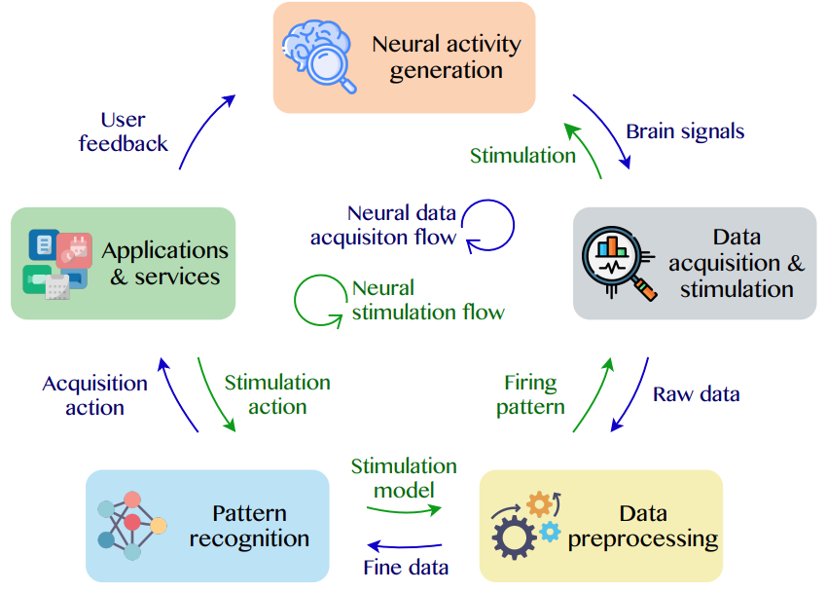
Brain-Machine Interfaces (BMIs) for processing neural signals and responding neural stimulations
Source: Huynh-The, Thien, Quoc-Viet Pham, Xuan-Qui Pham, Thanh Thi Nguyen, Zhu Han, and Dong-Seong Kim (2022).
"Artificial Intelligence for the Metaverse: A Survey." arXiv preprint arXiv:2202.10336.

Slide 78
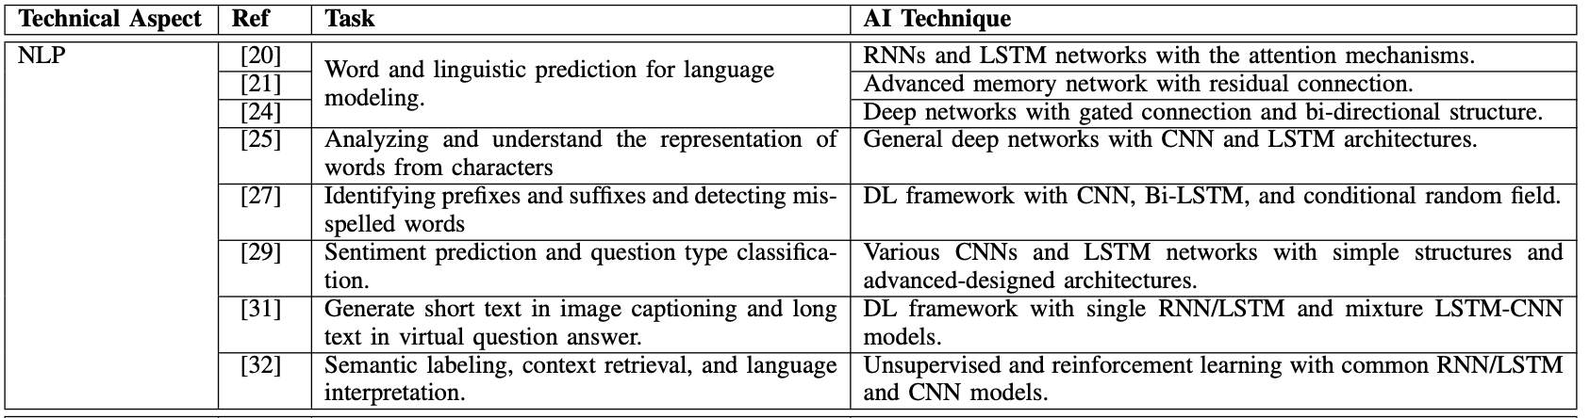
AI for the Metaverse
Source: Huynh-The, Thien, Quoc-Viet Pham, Xuan-Qui Pham, Thanh Thi Nguyen, Zhu Han, and Dong-Seong Kim (2022).
"Artificial Intelligence for the Metaverse: A Survey." arXiv preprint arXiv:2202.10336.

Slide 79
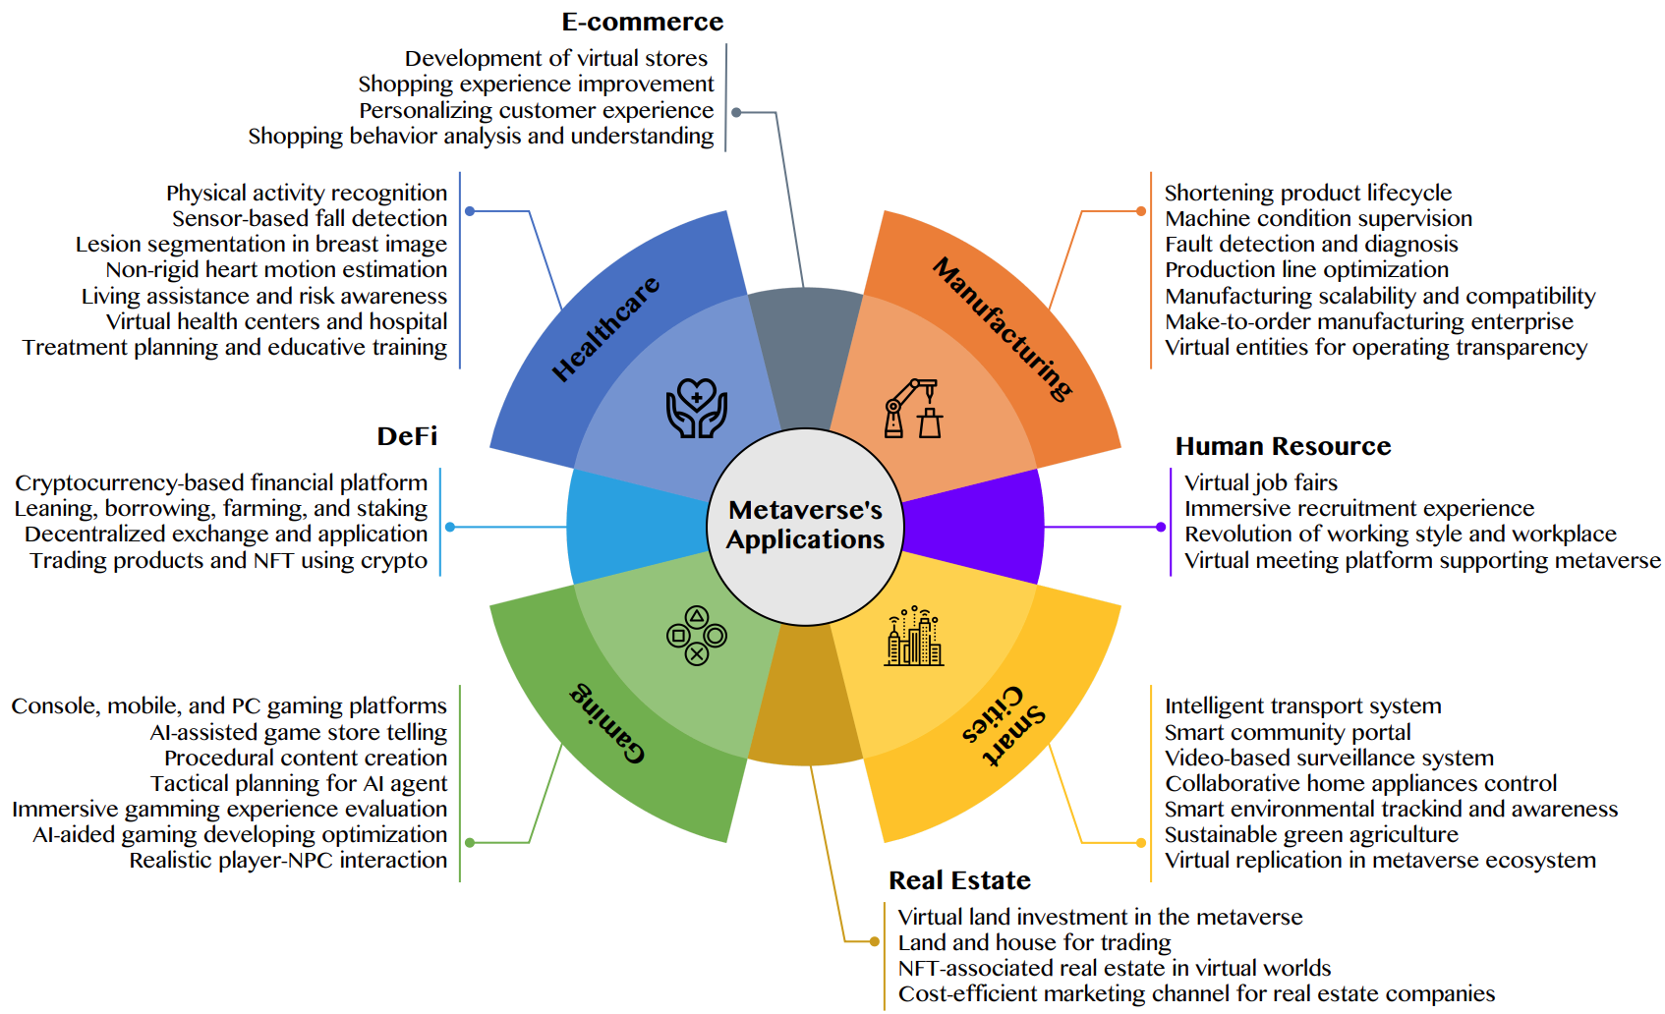
AI for the Metaverse in the Application Aspects healthcare, manufacturing, smart cities, gaming
E-commerce, human resources, real estate, and DeFi
Source: Huynh-The, Thien, Quoc-Viet Pham, Xuan-Qui Pham, Thanh Thi Nguyen, Zhu Han, and Dong-Seong Kim (2022).
"Artificial Intelligence for the Metaverse: A Survey." arXiv preprint arXiv:2202.10336.

Slide 80
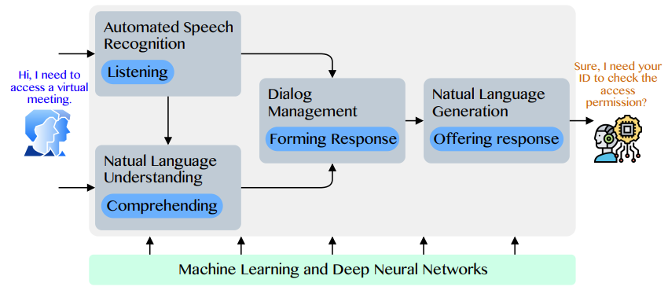
Conversational AI to deliver contextual and personal experience to users
Source: Huynh-The, Thien, Quoc-Viet Pham, Xuan-Qui Pham, Thanh Thi Nguyen, Zhu Han, and Dong-Seong Kim (2022).
"Artificial Intelligence for the Metaverse: A Survey." arXiv preprint arXiv:2202.10336.

Slide 81
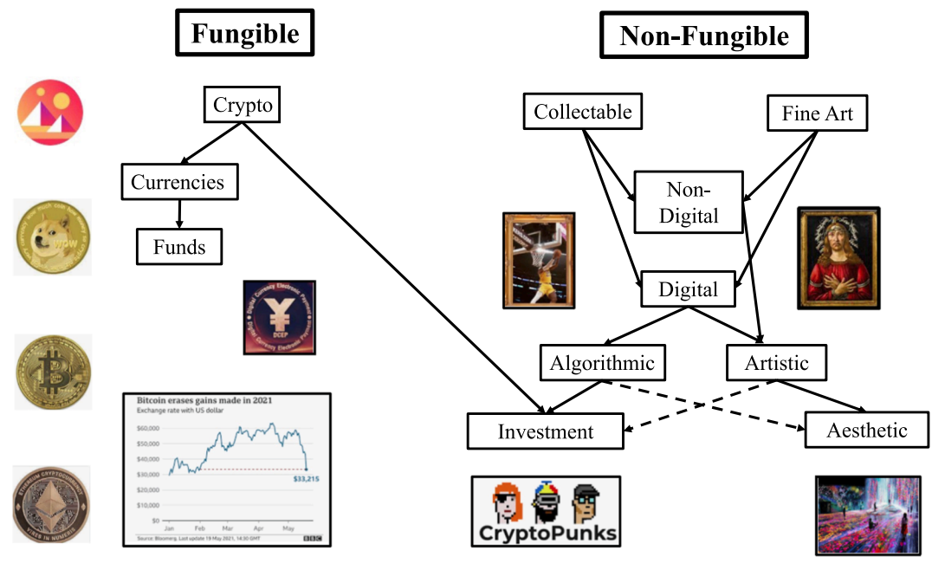
Blockchain-Registered:
Crypto, Collectables, and Art.
Source: Belk, Russell, Mariam Humayun, and Myriam Brouard. (2022)
"Money, possessions, and ownership in the Metaverse: NFTs, cryptocurrencies, Web3 and Wild Markets." Journal of Business Research 153: 198-205.

Slide 82
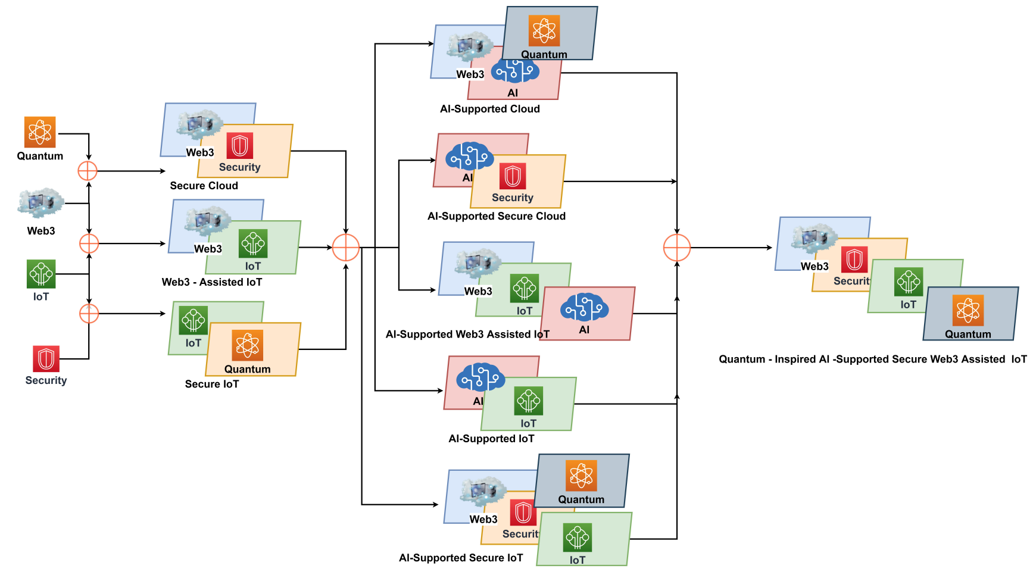
Combination of Web3 with other Technologies
Source: Sheridan, Dan, James Harris, Frank Wear, Jerry Cowell Jr, Easton Wong, and Abbas Yazdinejad. (2022)
"Web3 Challenges and Opportunities for the Market." arXiv preprint arXiv:2209.02446.

Slide 83
Decentralized Finance
(DeFi)
Block Chain FinTech

Slide 84
Decentralized Finance (DeFi)
A global, open alternative to the current financial system.
Products that let you borrow, save, invest, trade, and more.
Based on open-source technology that anyone can program with.
Source: https://ethereum.org/en/defi/

Slide 85
Traditional Finance
Centralized Finance (CeFi)
Some people aren't granted access to set up a bank account or use financial services.
Lack of access to financial services can prevent people from being employable.
Financial services can block you from getting paid.
A hidden charge of financial services is your personal data.
Governments and centralized institutions can close down markets at will.
Trading hours often limited to business hours of specific time zone.
Money transfers can take days due to internal human processes.
There's a premium to financial services because intermediary institutions need their cut.
Source: https://ethereum.org/en/defi/

Slide 86
DeFi vs. CeFi
Decentralized Finance (DeFi) | Traditional Finance (Centralized Finance; CeFi)
You hold your money. | Your money is held by companies.
You control where your money goes and how it's spent. | You have to trust companies not to mismanage your money, like lend to risky borrowers.
Transfers of funds happen in minutes. | Payments can take days due to manual processes.
Transaction activity is pseudonymous. | Financial activity is tightly coupled with your identity.
DeFi is open to anyone. | You must apply to use financial services.
The markets are always open. | Markets close because employees need breaks.
It's built on transparency – anyone can look at a product's data and inspect how the system works. | Financial institutions are closed books: you can't ask to see their loan history, a record of their managed assets, and so on.
Source: https://ethereum.org/en/defi/

Slide 87
(DeFi)
Decentralized Applications (Dapps)
Ethereum-powered tools and services
Dapps are a growing movement of applications that use Ethereum to disrupt business models or invent new ones
Source: https://ethereum.org/en/defi/

Slide 88
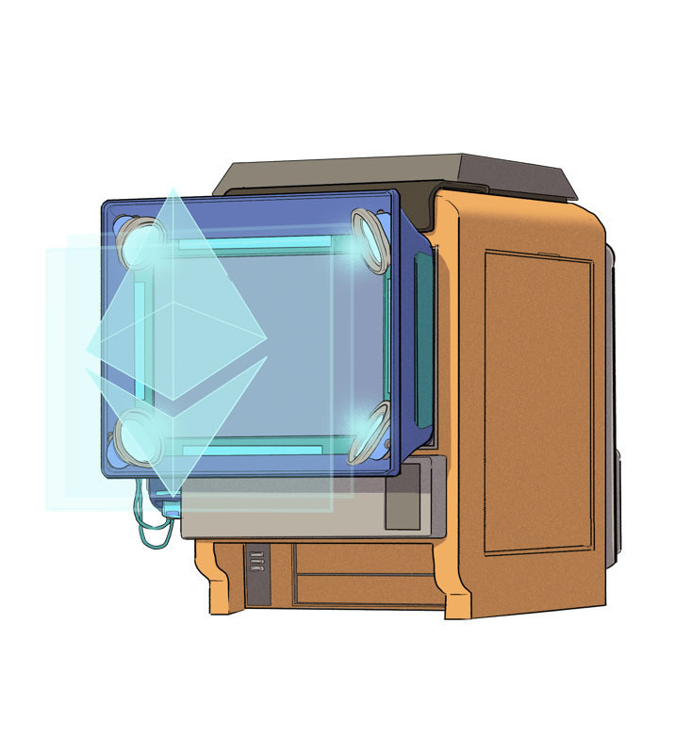
The Internet of Assets
Ethereum isn't just for
digital money.
Anything you can own can be represented,
traded and
put to use as
non-fungible tokens (NFTs).
Source: https://ethereum.org/en/defi/

Slide 89
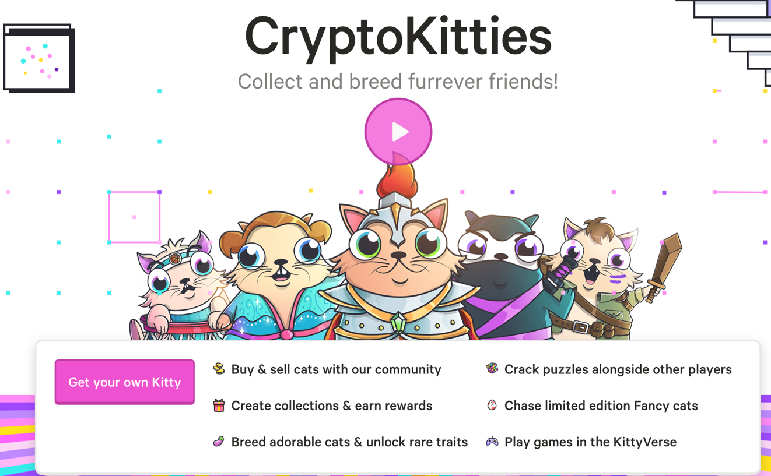
Non-Fungible Tokens (NFT)
CryptoKitties
https://www.cryptokitties.co/
Source: Matt Fortnow and QuHarrison Terry (2021), The NFT Handbook - How to Create, Sell and Buy Non-Fungible Tokens, Wiley

Slide 90
Financial Stability Challenges
Crypto Ecosystem
Operational, cyber, and governance risks
Integrity (market and AML/CFT)
(Anti–Money Laundering / Combating the Financing of Terrorism)
Data availability / reliability
Challenges from cross-boarder activites
Stablecoins
How stable are stablecoins?
Domestic and global regulatory and supervisory
approaches
Macro-Financial
Cryptoization, capital flows, and restrictions
Monetary policy transmission
Bank disintermediation
Source: Parma Bains, Mohamed Diaby, Dimitris Drakopoulos, Julia Faltermeier, Federico Grinberg, Evan Papageorgiou, Dmitri Petrov, Patrick Schneider, and Nobu Sugimoto (2021),
The Crypto Ecosystem and Financial Stability Challenges, International Monetary Fund, October 2021

Slide 91
Financial Services

Slide 92
Technology
Innovation

Slide 93
FinTech Innovation
FinTech high-level classification
Lending
Payments
Robo Advisors
Analytics
Others
Profile
Advice
Re-Balance
Indexing
Source: Paolo Sironi (2016), “FinTech Innovation: From Robo-Advisors to Goal Based Investing and Gamification”, Wiley.

Slide 94
Technology-driven
Financial Industry Development

Slide 95
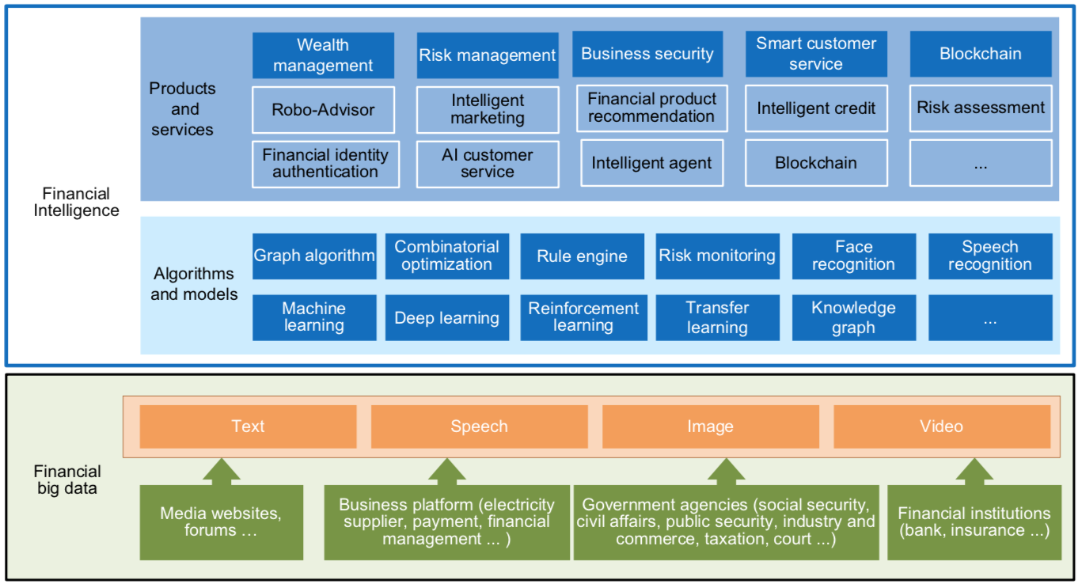
FinBrain: when Finance meets AI 2.0
(Zheng et al., 2019)
Source: Xiao-lin Zheng, Meng-ying Zhu, Qi-bing Li, Chao-chao Chen, and Yan-chao Tan (2019), "Finbrain: When finance meets AI 2.0." Frontiers of Information Technology & Electronic Engineering 20, no. 7, pp. 914-924

Slide 96
AI 2.0
a new generation of AI
based on the
novel information environment of
major changes and
the development of
new goals.
Yunhe Pan (2016), "Heading toward artificial intelligence 2.0." Engineering 2, no. 4, 409-413.

Slide 97
Technology-driven
Financial Industry Development
Development stage | Driving technology | Main landscape | Inclusive finance | Relationship between technology and finance
Fintech 1.0 (financial IT) | Computer | Credit card, ATM, and CRMS | Low | Technology as a tool
Fintech 2.0 (Internet finance) | Mobile Internet | Marketplace lending, third-party payment, crowdfunding, and Internet insurance | Medium | Technology-driven change
Fintech 3.0 (financial intelligence) | AI, Big Data, Cloud Computing, Blockchain | Intelligent finance | High | Deep fusion
Source: Xiao-lin Zheng, Meng-ying Zhu, Qi-bing Li, Chao-chao Chen, and Yan-chao Tan (2019), "Finbrain: When finance meets AI 2.0." Frontiers of Information Technology & Electronic Engineering 20, no. 7, pp. 914-924

Slide 98
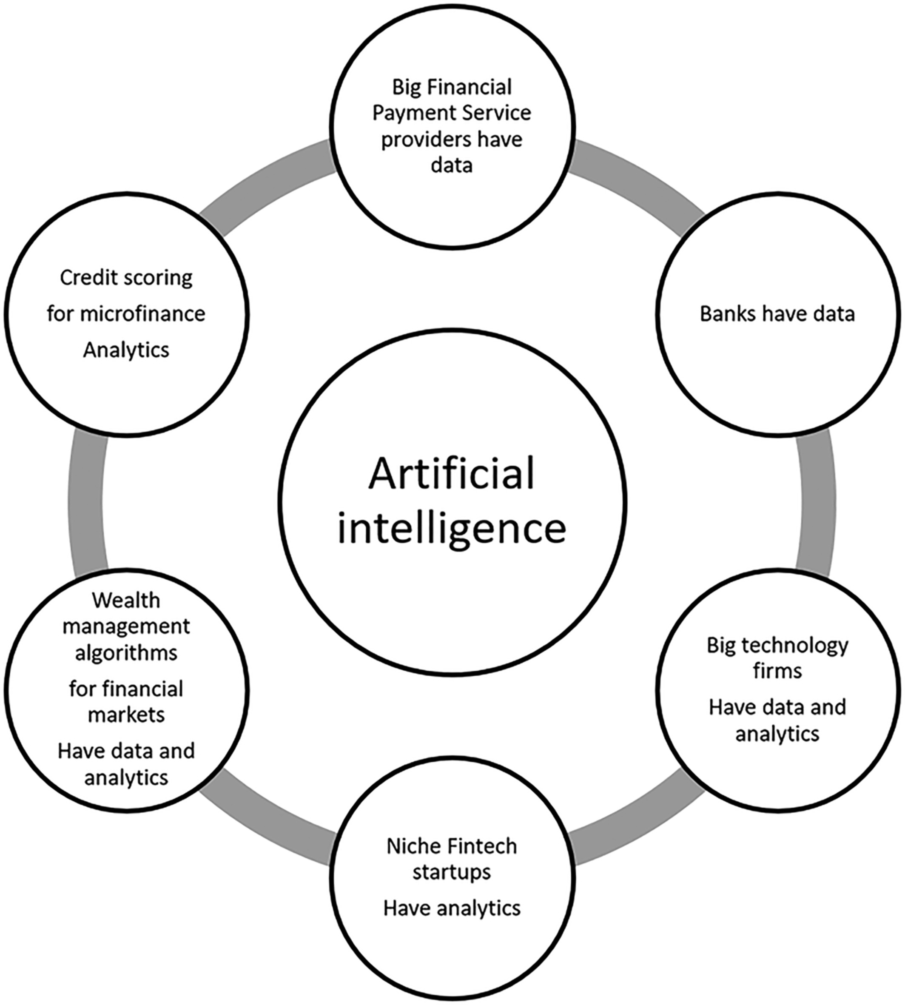
Artificial Intelligence in the Financial Markets
Source: Ashta, Arvind, and Heinz Herrmann (2021). "Artificial intelligence and fintech: An overview of opportunities and risks for banking, investments, and microfinance." Strategic Change 30, no. 3 (2021): 211-222.

Slide 99
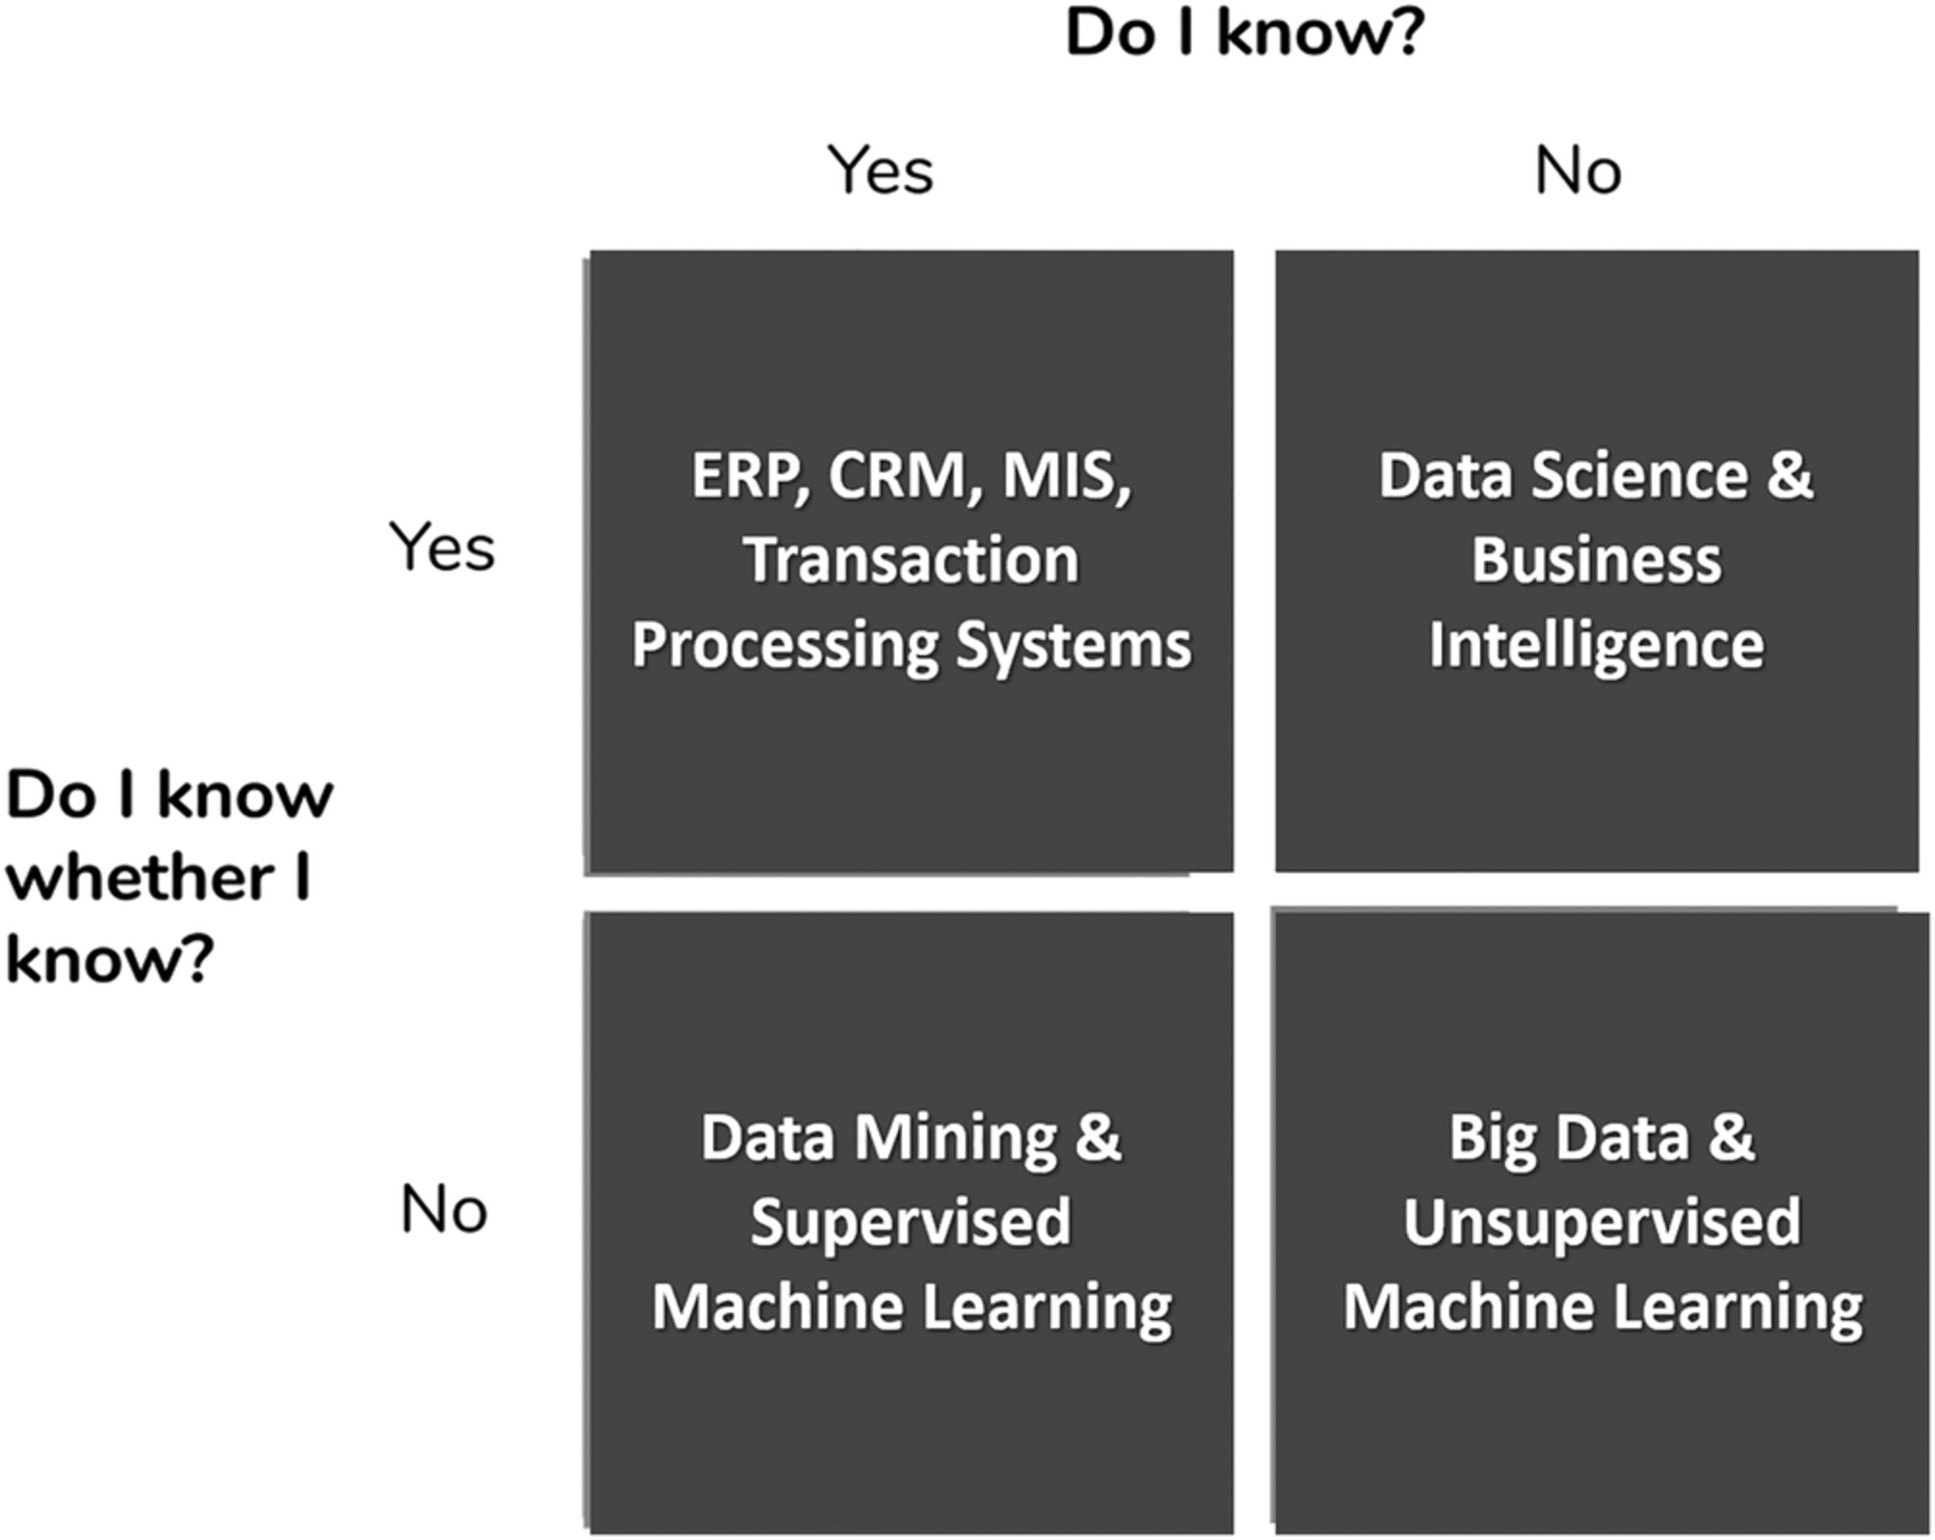
AI in Managerial Blind Spots:
Unknown Knowns and Unknown Unknowns
Source: Ashta, Arvind, and Heinz Herrmann (2021). "Artificial intelligence and fintech: An overview of opportunities and risks for banking, investments, and microfinance." Strategic Change 30, no. 3 (2021): 211-222.

Slide 100
Green Finance and
Sustainable Finance

Slide 101
Evolution of Sustainable Finance Research
Topic
SDGs:
Sustainable Development Goals
SDGs
Innovative Financial Instrument
Impact Investing
ESG: Environmental, Social, and Governance
CSR: Corporate Social Responsibility
Conscious Capitalism
Climate Financing
Carbon Financing
Green Financing
Ethical Investing
Socially Responsible Investing
1986
1995
2005
2015
2020
Source: Kumar, S., Sharma, D., Rao, S., Lim, W. M., & Mangla, S. K. (2022). Past, present, and future of sustainable finance:
Insights from big data analytics through machine learning of scholarly research. Annals of Operations Research, 1-44.

Slide 102
AI for
Environmental,
Social, and
Governance
(AI4ESG)
Source: Nenad Tomašev, Julien Cornebise, Frank Hutter, Shakir Mohamed, Angela Picciariello, Bec Connelly, Danielle Belgrave et al. (2020)
"AI for social good: unlocking the opportunity for positive impact." Nature Communications 11, no. 1: 1-6.

Slide 103
AI for
Social Good
(AI4SG)
Source: Nenad Tomašev, Julien Cornebise, Frank Hutter, Shakir Mohamed, Angela Picciariello, Bec Connelly, Danielle Belgrave et al. (2020)
"AI for social good: unlocking the opportunity for positive impact." Nature Communications 11, no. 1: 1-6.

Slide 104
Sustainability
SDGs
CSR
ESG

Slide 105














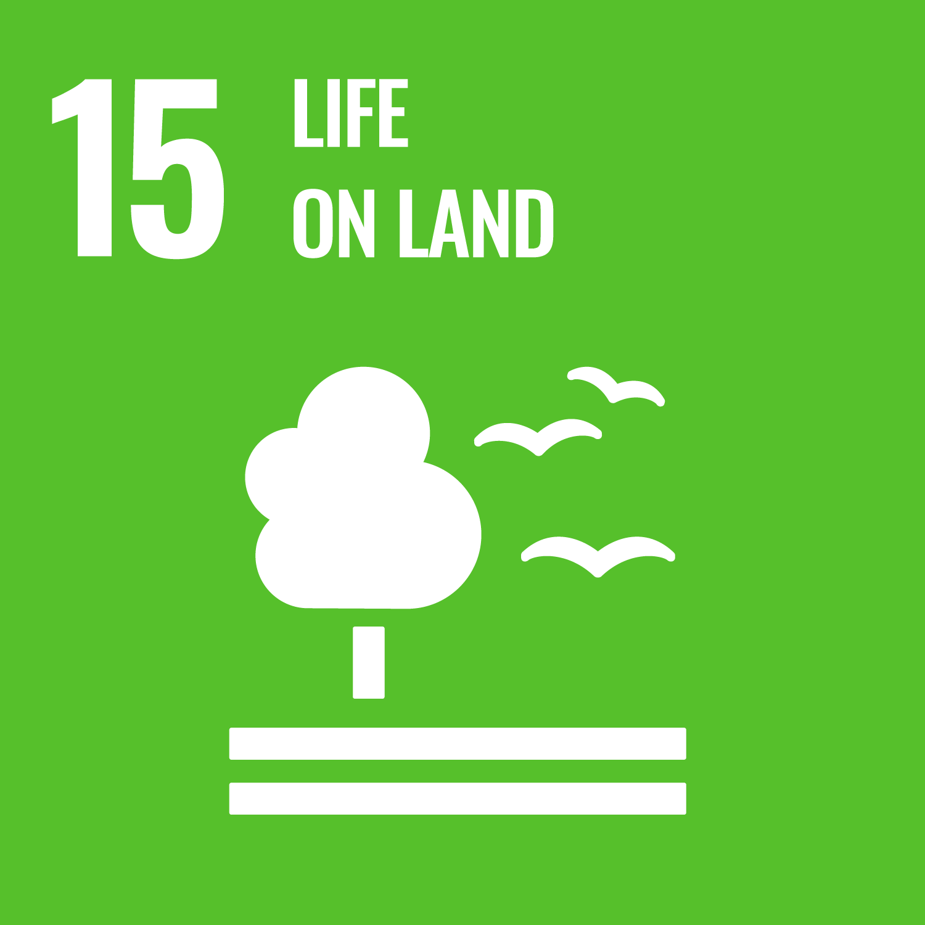



Sustainable Development Goals (SDGs)
Source: https://sdgs.un.org/goals

Slide 106
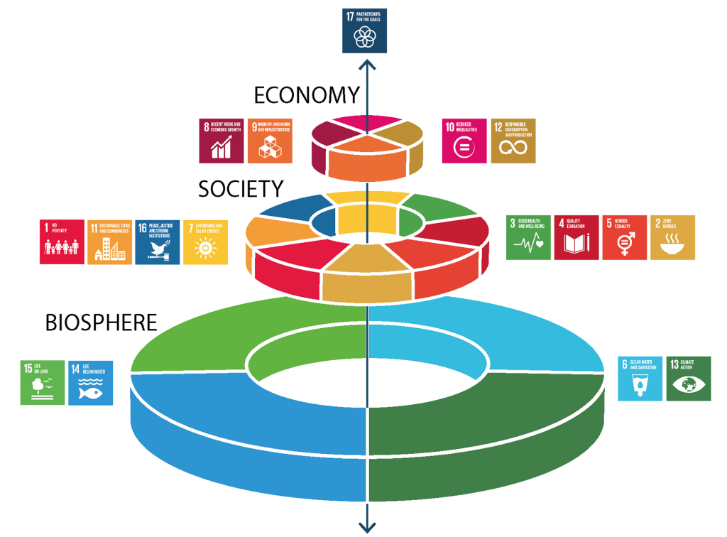
Sustainable Development Goals (SDGs) and 5P
Partnership
Peace
Prosperity
People
Planet
Source: Folke, Carl, Reinette Biggs, Albert V. Norström, Belinda Reyers, and Johan Rockström. "Social-ecological resilience and biosphere-based sustainability science.”Ecology and Society 21, no. 3 (2016).

Slide 107
Green Finance
Generic term implying use or diversion of financial resources to deploy and support projects with long term positive impact on the environment
Source: Bhattacharyya, Rupsha. "Green finance for energy transition, climate action and sustainable development: overview of concepts, applications, implementation and challenges." Green Finance 4, no. 1 (2022): 1-35.

Slide 108
Sustainable Finance
Finances deployed in support of projects that ensure just, sustainable and inclusive growth or attainment of one or more sustainable development goals
Source: Bhattacharyya, Rupsha. "Green finance for energy transition, climate action and sustainable development: overview of concepts, applications, implementation and challenges." Green Finance 4, no. 1 (2022): 1-35.

Slide 109
Carbon Finance
  Financial instruments
  based on
  economic value of carbon emissions
  which an organization cannot avoid but which
  it offsets by funding other compensatory projects that contribute to carbon emissions reduction
Source: Bhattacharyya, Rupsha. "Green finance for energy transition, climate action and sustainable development: overview of concepts, applications, implementation and challenges." Green Finance 4, no. 1 (2022): 1-35.

Slide 110
Climate Finance
  Finances deployed
  in support of low carbon and
  climate resilient projects
  that help in climate change mitigation and adaptation efforts,
  particularly in the
  energy and infrastructure sectors
Source: Bhattacharyya, Rupsha. "Green finance for energy transition, climate action and sustainable development: overview of concepts, applications, implementation and challenges." Green Finance 4, no. 1 (2022): 1-35.

Slide 111
ESG Investing
  Investments considering the broad range of
  environmental (e.g. climate change,
  pollution biodiversity loss),
  social (e.g. working conditions, human rights, salary or compensation structures)
  and governance (e.g. board composition, diversity and inclusion, taxes)
  characteristics of the projects or companies being invested in; ethical and business sustainability considerations are
  integral part of financing
Source: Bhattacharyya, Rupsha. "Green finance for energy transition, climate action and sustainable development: overview of concepts, applications, implementation and challenges." Green Finance 4, no. 1 (2022): 1-35.

Slide 112
Impact Investing
  Investing in projects
  that solve a social or environmental problem;
  the focus is on the positive impact
  rather than the
  means used to produce that impact
Source: Bhattacharyya, Rupsha. "Green finance for energy transition, climate action and sustainable development: overview of concepts, applications, implementation and challenges." Green Finance 4, no. 1 (2022): 1-35.

Slide 113
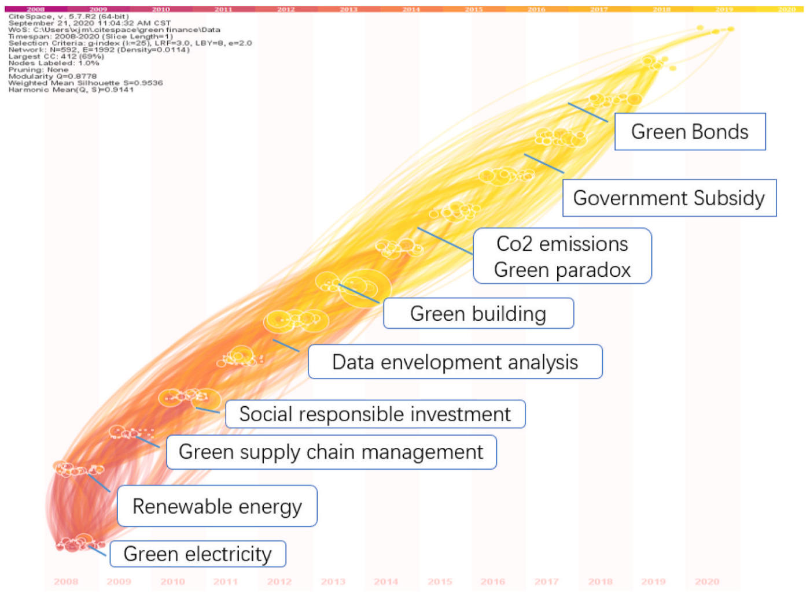
Dynamic Trends of Green Finance and Energy Policy
Source: Wang, Moran, Xuerong Li, and Shouyang Wang. (2021) "Discovering research trends and opportunities of green finance and energy policy: A data-driven scientometric analysis." Energy Policy 154 (2021): 112295.

Slide 114
ESG:
Environmental
Social
Governance

Slide 115
CSR:
Corporate
Social
Responsibility

Slide 116
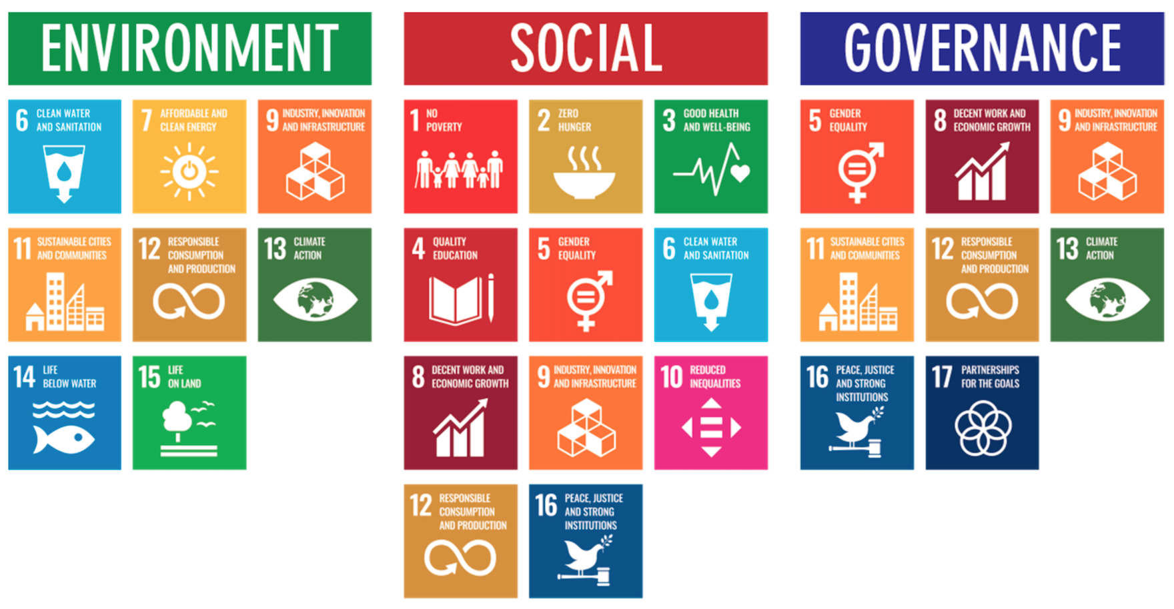
ESG to 17 SDGs
Source: Henrik Skaug Sætra (2021) "A Framework for Evaluating and Disclosing the ESG Related Impacts of AI with the SDGs." Sustainability 13, no. 15 (2021): 8503.

Slide 117
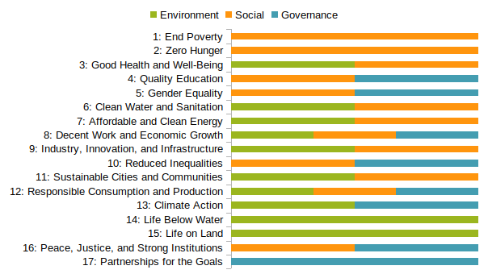
ESG to 17 SDGs
Source: https://sustainometric.com/esg-to-sdgs-connected-paths-to-a-sustainable-future/

Slide 118
Generative AI for
ESG Applications

Slide 119
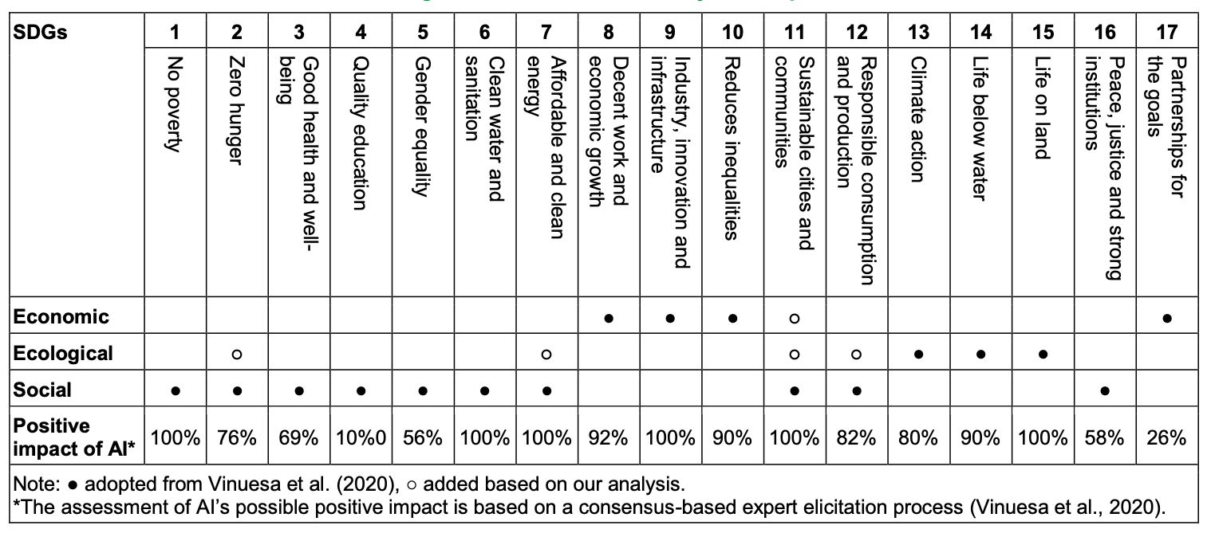
AI and Sustainability Development Goals (SDGs)
Source: Schoormann, T., Strobel, G., Möller, F., Petrik, D., & Zschech, P. (2023).
Artificial Intelligence for Sustainability—A Systematic Review of Information Systems Literature. Communications of the Association for Information Systems, 52(1), 8.

Slide 120
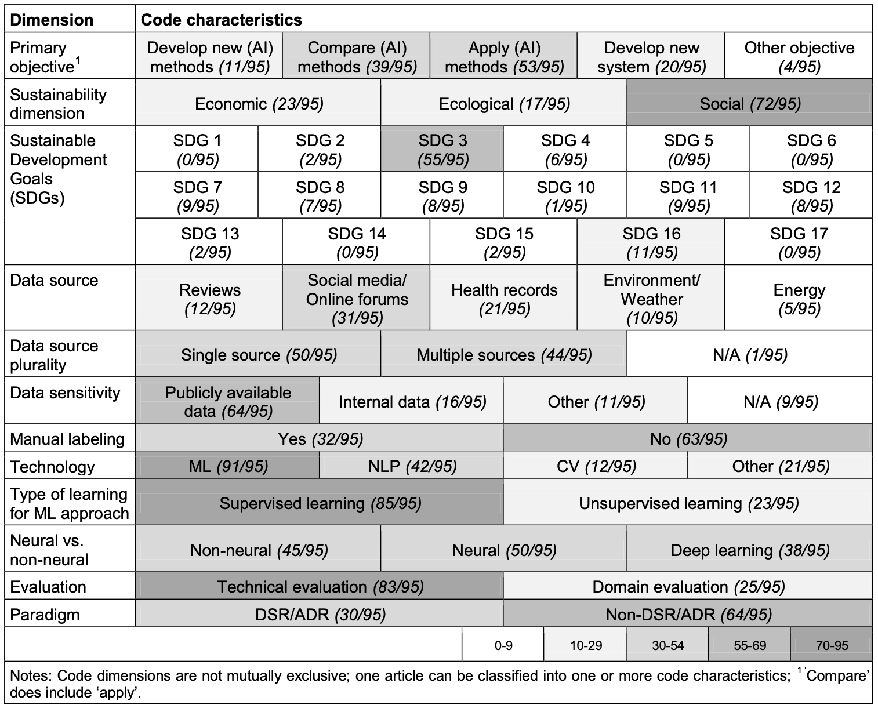
AI for Sustainability
Source: Schoormann, T., Strobel, G., Möller, F., Petrik, D., & Zschech, P. (2023).
Artificial Intelligence for Sustainability—A Systematic Review of Information Systems Literature. Communications of the Association for Information Systems, 52(1), 8.

Slide 121
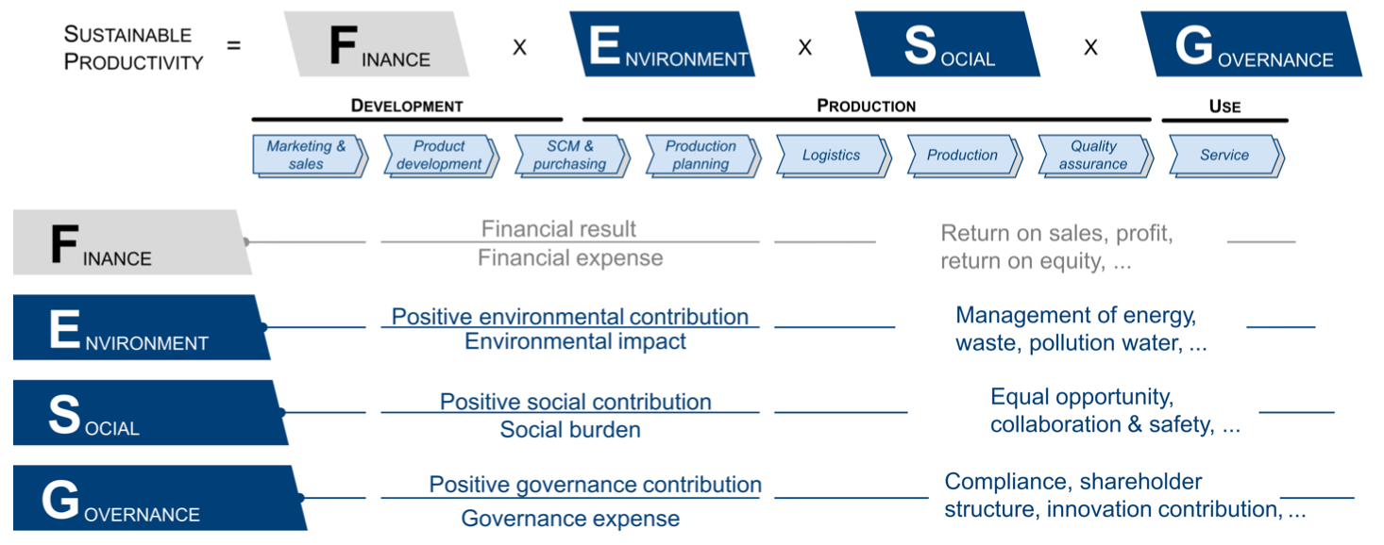
Sustainable Productivity:
Finance ESG
Source: Huang, Ziqi, Yang Shen, Jiayi Li, Marcel Fey, and Christian Brecher (2021). "A survey on AI-driven digital twins in Industry 4.0: Smart manufacturing and advanced robotics." Sensors 21, no. 19: 6340.

Slide 122
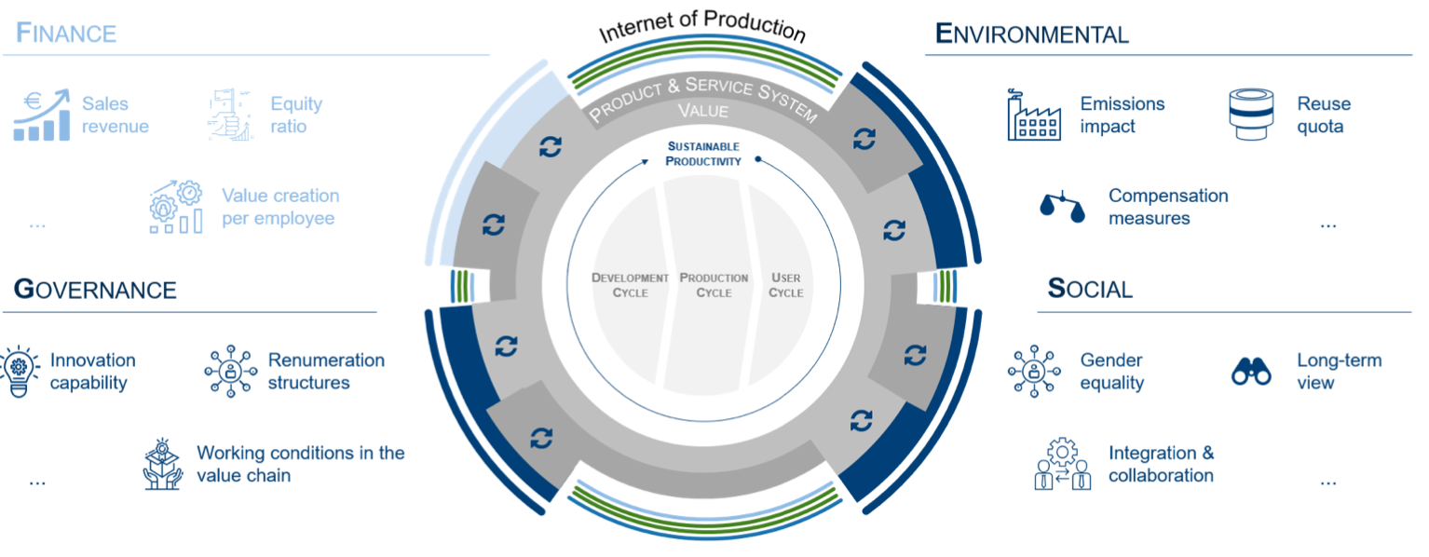
Sustainable Resilient Manufacturing
ESG
Source: Huang, Ziqi, Yang Shen, Jiayi Li, Marcel Fey, and Christian Brecher (2021). "A survey on AI-driven digital twins in Industry 4.0: Smart manufacturing and advanced robotics." Sensors 21, no. 19: 6340.

Slide 123
ESG Indexes
MSCI ESG Index
Dow Jones Sustainability Indices (DJSI)
FTSE ESG Index

Slide 124
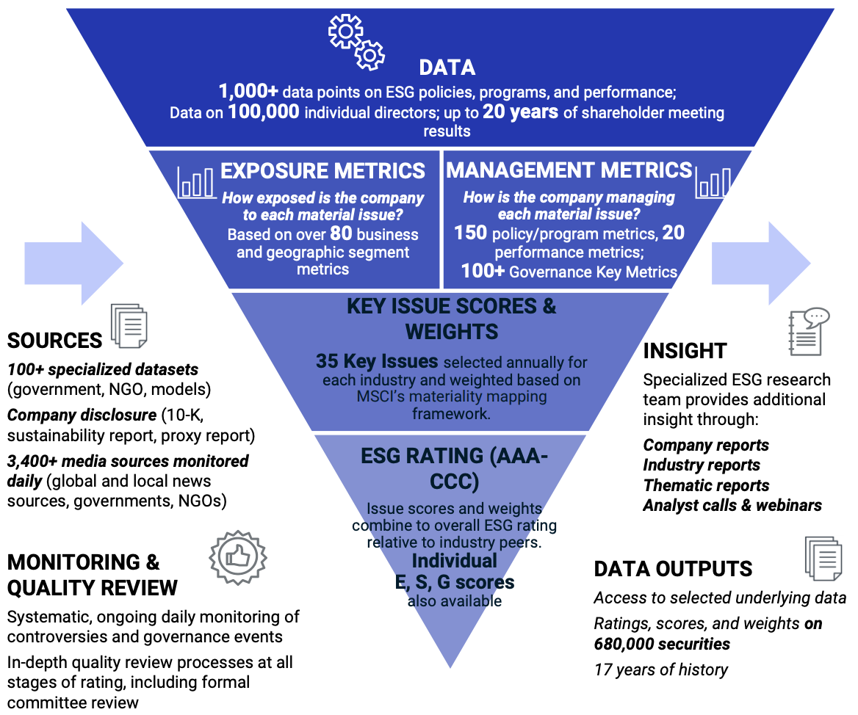
MSCI ESG Rating Framework
Source: https://www.msci.com/documents/1296102/21901542/ESG-Ratings-Methodology-Exec-Summary.pdf

Slide 125
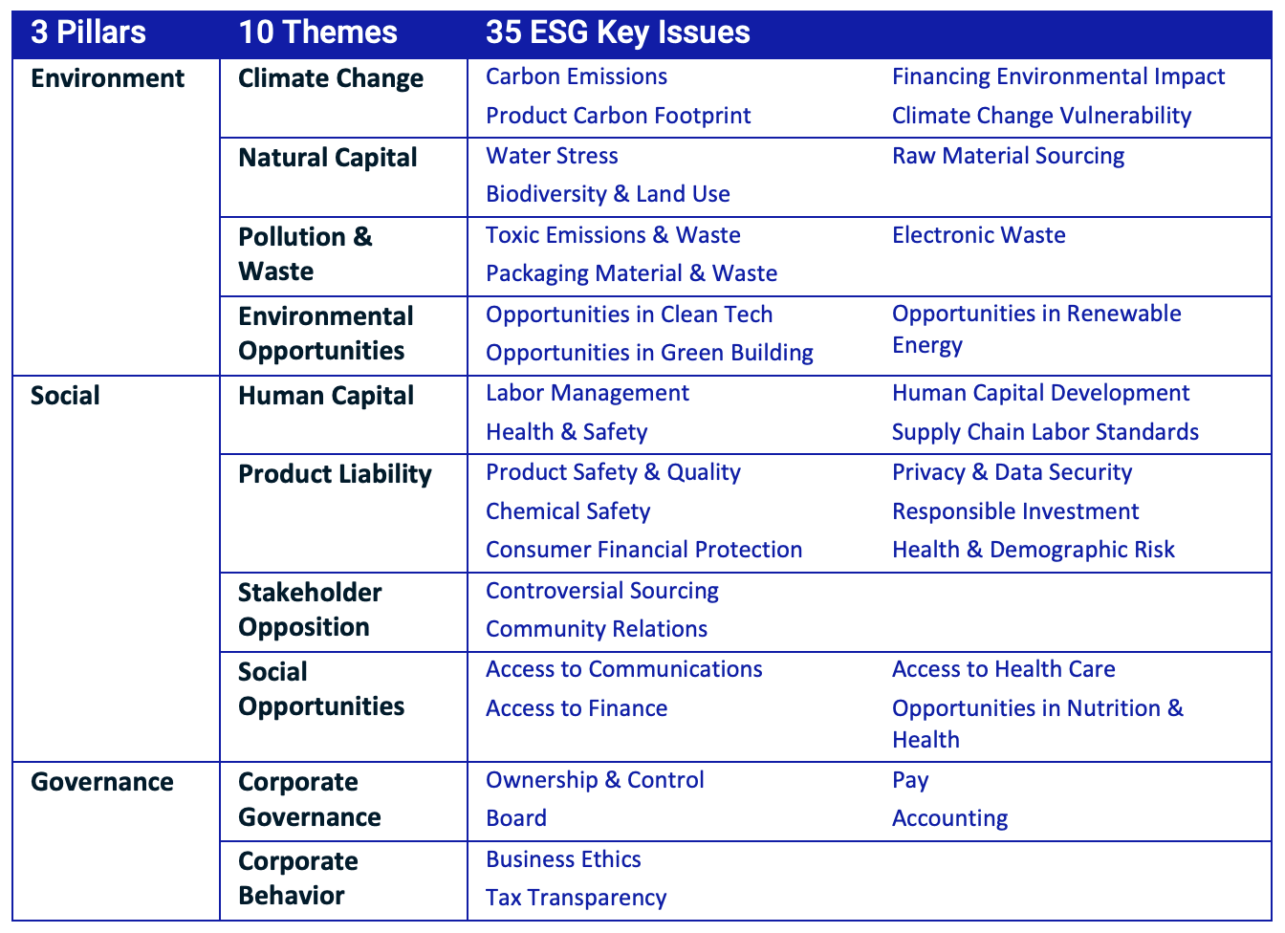
MSCI ESG Key Issue Hierarchy
Source: https://www.msci.com/documents/1296102/21901542/ESG-Ratings-Methodology-Exec-Summary.pdf

Slide 126

MSCI Governance Model Structure
Source: https://www.msci.com/documents/1296102/21901542/ESG-Ratings-Methodology-Exec-Summary.pdf

Slide 127

MSCI Hierarchy of ESG Scores
Source: https://www.msci.com/documents/1296102/21901542/ESG-Ratings-Methodology-Exec-Summary.pdf

Slide 128

DJSI S&P Global ESG Score
Source: DJSI, S&P Global Corporate Sustainability Assessment (CSA), https://www.spglobal.com/esg/solutions/data-intelligence-esg-scores

Slide 129

FTSE Russell ESG Ratings
Source: https://www.ftserussell.com/data/sustainability-and-esg-data/esg-ratings

Slide 130


Sustainalytics
ESG Risk Ratings
Analyst-based
approach
Sustainalytics’ ESG Risk Ratings measure a company’s exposure to industry-specific material ESG risks and how well a company is managing those risks.
Source: https://www.sustainalytics.com/esg-data

Slide 131

Truvalue
ESG Ranks
TruValue Labs
Machine-based approach
Truvalue Labs applies AI to analyze over 100,000 sources and uncover ESG risks and opportunities hidden in unstructured text.
The ESG Ranks data service produces an overall company rank based on industry percentile leveraging the 26 ESG categories defined by the Sustainability Accounting Standards Board (SASB).
The data feed covers 20,000+ companies with more than 13 years of history.
Source: :https://developer.truvaluelabs.com/data/esg-ranks

Slide 132

Analyst-driven vs. AI-driven ESG
Sustainalytics
Truvalue Labs
Source: Mark Tulay (2020), Man vs. machine: A tale of two sustainability ratings systems, GreenBiz, https://www.greenbiz.com/article/man-vs-machine-tale-two-sustainability-ratings-systems

Slide 133

Analyst based
ESG Research
AI based
ESG Research
Source: https://www.esganalytics.io/insights/how-data-is-accelerating-esg

Slide 134

ESG Analytics: NLP Taxonomy
Source: https://www.esganalytics.io/insights/how-data-is-accelerating-esg

Slide 135

Top
ESG Reporting Software
Environmental, Social and Governance (ESG) Reporting software or Sustainability software helps organizations manage their operational data, evaluate their impact on the environment and provide reporting to perform audits.
Source: https://www.softwarereviews.com/categories/environmental-social-and-governance-reporting

Slide 136

ESG Reporting Software: Emitwise
Emitwise is the carbon management platform for companies with complex manufacturing supply chains to confidently understand, track and reduce their complete carbon footprint.
Combining 100 years of carbon accounting experience and machine learning technology, we accelerate climate action by increasing the accuracy of scope 3 emissions.
The platform empowers manufacturers and their supply chains to make carbon-led business decisions that lower risk, increase profitability and deliver ambitious climate action.
Source: https://www.softwarereviews.com/categories/environmental-social-and-governance-reporting

Slide 137

ESG Reporting Software: Workiva ESG
Workiva is a cloud native platform that simplifies the complexities of reporting and compliance.
Workiva ESG is the end-to-end platform that allows you to integrate financial data, nonfinancial data, and XBRL.
Workiva, the platform that streamlines your entire ESG process.
Automate data collection, utilize frameworks, and directly connect to all your ESG reports. in meaningful glossy reports, accurate survey responses, and regulatory filings with integrated XBRL tagging.
Source: https://www.softwarereviews.com/categories/environmental-social-and-governance-reporting

Slide 138
AI for
Social Good
(AI4SG)
Source: Nenad Tomašev, Julien Cornebise, Frank Hutter, Shakir Mohamed, Angela Picciariello, Bec Connelly, Danielle Belgrave et al. (2020)
"AI for social good: unlocking the opportunity for positive impact." Nature Communications 11, no. 1: 1-6.

Slide 139
AI for Social Good (AI4SG)
AI for Sustainable Development
AI4SG 10 Guidelines
AI Technology (G1, G2, G3)
Applications (G4, G5, G6, G7, G8)
Data Handling (G9, G10)
Source: Nenad Tomašev, Julien Cornebise, Frank Hutter, Shakir Mohamed, Angela Picciariello, Bec Connelly, Danielle Belgrave et al. (2020)
"AI for social good: unlocking the opportunity for positive impact." Nature Communications 11, no. 1: 1-6.

Slide 140
AI4SG 10 Guidelines
AI Technology (G1, G2, G3)
G1: Expectations of what is possible with AI need to be well-grounded.
G2: There is value in simple solutions.
G3: Applications of AI need to be inclusive and accessible, and reviewed at every stage for ethics and human rights compliance.
Source: Nenad Tomašev, Julien Cornebise, Frank Hutter, Shakir Mohamed, Angela Picciariello, Bec Connelly, Danielle Belgrave et al. (2020)
"AI for social good: unlocking the opportunity for positive impact." Nature Communications 11, no. 1: 1-6.

Slide 141
AI4SG 10 Guidelines
Applications (G4, G5, G6, G7, G8)
G4: Goals and use cases should be clear and well-defined.
G5: Deep, long-term partnerships are required to solve large problems successfully.
G6: Planning needs to align incentives, and factor in the limitations of both communities.
G7: Establishing and maintaining trust is key to overcoming organisational barriers.
G8: Options for reducing the development cost of AI solutions should be explored.
Source: Nenad Tomašev, Julien Cornebise, Frank Hutter, Shakir Mohamed, Angela Picciariello, Bec Connelly, Danielle Belgrave et al. (2020)
"AI for social good: unlocking the opportunity for positive impact." Nature Communications 11, no. 1: 1-6.

Slide 142
AI4SG 10 Guidelines
Data Handling (G9, G10)
G9: Improving data readiness is key.
G10: Data must be processed securely, with utmost respect for human rights and privacy.
Source: Nenad Tomašev, Julien Cornebise, Frank Hutter, Shakir Mohamed, Angela Picciariello, Bec Connelly, Danielle Belgrave et al. (2020)
"AI for social good: unlocking the opportunity for positive impact." Nature Communications 11, no. 1: 1-6.

Slide 143

AI for Social Good (AI4SG)
Domains and Techniques
Source: Zheyuan Shi, Ryan, Claire Wang, and Fei Fang (2020). "Artificial intelligence for social good: A survey." arXiv preprint arXiv:2001.01818.

Slide 144

NLP for Social Good (NLP4SG)
Source: Fernando Gonzalez, Zhijing Jin, Jad Beydoun, Bernhard Schölkopf, Tom Hope, Rada Mihalcea, and Mrinmaya Sachan (2022).
"How Is NLP Addressing the 17 UN Sustainability Goals? A Challenge Set of Social Good Paper Classification and Information Extraction."

Slide 145

NLP for Social Good (NLP4SG)
Visualization
Source: Fernando Gonzalez, Zhijing Jin, Jad Beydoun, Bernhard Schölkopf, Tom Hope, Rada Mihalcea, and Mrinmaya Sachan (2022).
"How Is NLP Addressing the 17 UN Sustainability Goals? A Challenge Set of Social Good Paper Classification and Information Extraction."

Slide 146
Innovation
Source: https://www.merriam-webster.com/dictionary/innovation

Slide 147
Innovation: a new idea, method, or device
Source: https://www.merriam-webster.com/dictionary/innovation

Slide 148
Innovation: something new
Source: https://www.merriam-webster.com/dictionary/innovation

Slide 149
Novelty : something new or unusual the novelty of a self-driving car
Source: https://www.merriam-webster.com/dictionary/novelty

Slide 150
Creativity is not a new Idea.
Creativity is an old belief you leave behind
Notes:
Creativity is not a new idea. Creativity is an old belief you leave behind.

Slide 151

FinTechs as Service Innovators: Analysing Components of Innovation
Source: Riikkinen, Mikko, Kaisa Still, Saila Saraniemi, and Katri Kallio. "FinTechs as service innovators: analysing components of innovation." In ISPIM Innovation Symposium, The International Society for Professional Innovation Management (ISPIM), 2016.

Slide 152
Innovation
“a process of searching and recombining existing knowledge elements”
Source: Savino, Tommaso, Antonio Messeni Petruzzelli, and Vito Albino. "Search and recombination process to innovate:
A review of the empirical evidence and a research agenda." International Journal of Management Reviews (2017).

Slide 153

Search and recombination process to innovate:
A review of the empirical evidence and a research agenda
Source: Savino, Tommaso, Antonio Messeni Petruzzelli, and Vito Albino. "Search and recombination process to innovate:
A review of the empirical evidence and a research agenda." International Journal of Management Reviews (2017).

Slide 154
Innovation Research in
Economics,
Sociology and Technology Management
Source: Gopalakrishnan, Shanti, and Fariborz Damanpour.
"A review of innovation research in economics, sociology and technology management." Omega 25, no. 1 (1997): 15-28.

Slide 155

Innovation Research in Economics, Sociology and Technology Management
Source: Gopalakrishnan, Shanti, and Fariborz Damanpour.
"A review of innovation research in economics, sociology and technology management." Omega 25, no. 1 (1997): 15-28.

Slide 156
Business,
Innovation, and
Knowledge
Ecosystems
Source: Valkokari, Katri. "Business, innovation, and knowledge ecosystems: how they differ and how to survive and thrive within them." Technology Innovation Management Review 5, no. 8 (2015).

Slide 157

Business, Innovation, and Knowledge Ecosystems
Source: Valkokari, Katri. "Business, innovation, and knowledge ecosystems: how they differ and how to survive and thrive within them." Technology Innovation Management Review 5, no. 8 (2015).

Slide 158
Innovation Ecosystems
Characteristics
 | Business Ecosystems | Innovation Ecosystems | Knowledge Ecosystems
Baseline of Ecosystem | Resource exploitation for customer value | Co-creation of innovation | Knowledge exploration
Relationships and Connectivity | Global business relationships both competitive and co-operative | Geographically clustered actors, different levels of collaboration and openness | Decentralized and disturbed knowledge nodes, synergies through knowledge exchange
Actors and Roles | Suppliers, customers, and focal companies as a core, other actors more loosely involved | Innovation policymakers, local intermediators, innovation brokers, and funding organizations | Research institutes, innovators, and technology entrepreneurs serve as knowledge nodes
Logic of Action | A main actor that operates as a platform sharing resources, assets, and benefits or aggregates other actors together in the networked business operations | Geographically proximate actors interacting around hubs facilitated by intermediating actors | A large number of actors that are grouped around knowledge exchange or a central non-proprietary resource for the benefit of all actors
Source: Valkokari, Katri. "Business, innovation, and knowledge ecosystems: how they differ and how to survive and thrive within them." Technology Innovation Management Review 5, no. 8 (2015).

Slide 159
Diffusion of Innovation Theory
(DOI)
Source: Everett M. Rogers (2003), “Diffusion of Innovations”, Free Press, 5th Edition

Slide 160
Innovation
(Diffusion of Innovation)
1. Relative advantage
2. Compatibility
3. Complexity
4. Trialability
5. Observability
Source: Everett M. Rogers (2003), “Diffusion of Innovations”, Free Press, 5th Edition

Slide 161
Diffusion of Innovation
Source: https://en.wikipedia.org/wiki/Diffusion_of_innovations

Slide 162
Innovation Adoption Process
Initiation
Adoption Decision
Implementation
Source: Pichlak, Magdalena.
"The innovation adoption process: A multidimensional approach." Journal of Management and Organization 22, no. 4 (2016): 476.

Slide 163
Innovation Adoption Process
Initiation
Adoption Decision
Implementation
Environmental Characteristics
Organizational Characteristics
Top Managers Characteristics
Innovation Characteristics
User Acceptance Attributes
TAM=
Technology Acceptance Model
RBV=
Resource-Based View
DOI =
Diffusion of Innovation Theory
Source: Pichlak, Magdalena.
"The innovation adoption process: A multidimensional approach." Journal of Management and Organization 22, no. 4 (2016): 476.

Slide 164

Innovation Adoption Process
TAM=
Technology Acceptance Model
RBV=
Resource-Based View
DOI =
Diffusion of Innovation Theory
Source: Pichlak, Magdalena.
"The innovation adoption process: A multidimensional approach." Journal of Management and Organization 22, no. 4 (2016): 476.

Slide 165

Innovation Adoption Process
Source: Pichlak, Magdalena.
"The innovation adoption process: A multidimensional approach." Journal of Management and Organization 22, no. 4 (2016): 476.

Slide 166

Innovation Adoption Process
Source: Pichlak, Magdalena.
"The innovation adoption process: A multidimensional approach." Journal of Management and Organization 22, no. 4 (2016): 476.

Slide 167
FinTech Innovation
FinTech high-level classification
Lending
Payments
Robo Advisors
Analytics
Others
Profile
Advice
Re-Balance
Indexing
Source: Paolo Sironi (2016), “FinTech Innovation: From Robo-Advisors to Goal Based Investing and Gamification”, Wiley.

Slide 168
Financial Technology (Fintech) Categories
Banking Infrastructure
Business Lending
Consumer and Commercial Banking
Consumer Lending
Consumer Payments
Crowdfunding
Equity Financing
Financial Research and Data
Financial Transaction Security
Institutional Investing
International Money Transfer
Payments Backend and Infrastructure
Personal Finance
Point of Sale Payments
Retail Investing
Small and Medium Business Tools
Source: http://www.venturescanner.com/financial-technology

Slide 169

The Quant Finance PyData Stack
Source: http://nbviewer.jupyter.org/format/slides/github/quantopian/pyfolio/blob/master/pyfolio/examples/overview_slides.ipynb#/5

Slide 170

Python in Google Colab (Python101)
https://tinyurl.com/aintpupython101

Slide 171
References
Thorsten Schoormann, Gero Strobel, Frederik Möller, Dimitri Petrik, and Patrick Zschech (2023). "Artificial Intelligence for Sustainability—A Systematic Review of Information Systems Literature." Communications of the Association for Information Systems 52, no. 1 (2023): 8.
Longbing Cao (2022). "Decentralized ai: Edge intelligence and smart blockchain, metaverse, web3, and desci." IEEE Intelligent Systems 37, no. 3: 6-19.
Qinglin Yang, Yetong Zhao, Huawei Huang, Zehui Xiong, Jiawen Kang, and Zibin Zheng (2022). "Fusing blockchain and AI with metaverse: A survey." IEEE Open Journal of the Computer Society 3 : 122-136.
Russell Belk, Mariam Humayun, and Myriam Brouard (2022). "Money, possessions, and ownership in the Metaverse: NFTs, cryptocurrencies, Web3 and Wild Markets." Journal of Business Research 153: 198-205.
Thien Huynh-The, Quoc-Viet Pham, Xuan-Qui Pham, Thanh Thi Nguyen, Zhu Han, and Dong-Seong Kim (2022). "Artificial Intelligence for the Metaverse: A Survey." arXiv preprint arXiv:2202.10336.
Min-Yuh Day and Yensen Ni (2023), "Do clean energy indices outperform using contrarian strategies based on contrarian trading rules?", Energy, Volume 272, 1 June 2023, 127113.
Thippa Reddy Gadekallu, Thien Huynh-The, Weizheng Wang, Gokul Yenduri, Pasika Ranaweera, Quoc-Viet Pham, Daniel Benevides da Costa, and Madhusanka Liyanage (2022). "Blockchain for the Metaverse: A Review." arXiv preprint arXiv:2203.09738.
Dan Sheridan, James Harris, Frank Wear, Jerry Cowell Jr, Easton Wong, and Abbas Yazdinejad (2022). "Web3 Challenges and Opportunities for the Market." arXiv preprint arXiv:2209.02446.
Yves Hilpisch (2020), Artificial Intelligence in Finance: A Python-Based Guide, O’Reilly Media.
Aurélien Géron (2019), Hands-On Machine Learning with Scikit-Learn, Keras, and TensorFlow: Concepts, Tools, and Techniques to Build Intelligent Systems, 2nd Edition, O’Reilly Media.
Paolo Sironi (2016), FinTech Innovation: From Robo-Advisors to Goal Based Investing and Gamification, Wiley.
Campbell R. Harvey, Ashwin Ramachandran, Joey Santoro, Fred Ehrsam (2021), DeFi and the Future of Finance, Wiley
Matt Fortnow and QuHarrison Terry (2021), The NFT Handbook - How to Create, Sell and Buy Non-Fungible Tokens, Wiley
Parma Bains, Mohamed Diaby, Dimitris Drakopoulos, Julia Faltermeier, Federico Grinberg, Evan Papageorgiou, Dmitri Petrov, Patrick Schneider, and Nobu Sugimoto (2021),
The Crypto Ecosystem and Financial Stability Challenges, International Monetary Fund, October 2021
Ramesh Sharda, Dursun Delen, and Efraim Turban (2017), “Business Intelligence, Analytics, and Data Science: A Managerial Perspective”, 4th Edition, Pearson
Frederic S. Mishkin (2015), “The Economics of Money, Banking and Financial Markets”, 11th Edition, Pearson
Susanne Chishti and Janos Barberis (2016), “The FINTECH Book: The Financial Technology Handbook for Investors, Entrepreneurs and Visionaries”, Wiley.
Paolo Sironi (2016), “FinTech Innovation: From Robo-Advisors to Goal Based Investing and Gamification”, Wiley.
Brett King (2014), “Breaking Banks: The Innovators, Rogues, and Strategists Rebooting Banking”, Wiley.
Brett King (2012), “Bank 3.0: Why banking is no longer somewhere you go, but something you do”, John Wiley & Sons
Gopalakrishnan, Shanti, and Fariborz Damanpour (1997). "A review of innovation research in economics, sociology and technology management." Omega 25, no. 1 : 15-28.
Pichlak, Magdalena (2016). "The innovation adoption process: A multidimensional approach." Journal of Management and Organization 22, no. 4 : 476.
Everett M. Rogers (2003), “Diffusion of Innovations”, Free Press, 5th Edition

