Slide 1








Financial Econometrics and AI-First Finance
Artificial Intelligence in Finance and Quantitative Analysis
1121AIFQA06
MBA, IM, NTPU (M5276) (Fall 2023)
Tue 2, 3, 4 (9:10-12:00) (B3F17)
Min-Yuh Day, Ph.D,
Associate Professor
Institute of Information Management, National Taipei University
https://web.ntpu.edu.tw/~myday
https://meet.google.com/paj-zhhj-mya
2023-11-07; 2023-11--14

Slide 2
Syllabus
Week Date Subject/Topics
1 2023/09/12 Introduction to Artificial Intelligence in Finance and
Quantitative Analysis
2 2023/09/19 AI in FinTech: Metaverse, Web3, DeFi, NFT,
Financial Services Innovation and Applications
3 2023/09/26 Investing Psychology and Behavioral Finance
4 2023/10/03 Event Studies in Finance
5 2023/10/10 National Day (Day off)
6 2023/10/17 Case Study on AI in Finance and Quantitative Analysis I

Slide 3
Syllabus
Week Date Subject/Topics
7 2023/10/24 Finance Theory and Data-Driven Finance
8 2023/10/31 Midterm Project Report
9 2023/11/07 Financial Econometrics
10 2023/11/14 AI-First Finance
11 2023/11/21 Industry Practices of AI in Finance and Quantitative
Analysis
12 2023/11/28 Case Study on AI in Finance and Quantitative Analysis II

Slide 4
Syllabus
Week Date Subject/Topics
13 2023/12/05 Deep Learning in Finance;
Reinforcement Learning in Finance
14 2023/12/12 Algorithmic Trading; Risk Management;
Trading Bot and Event-Based Backtesting
15 2023/12/19 Final Project Report I
16 2023/12/26 Final Project Report II
17 2024/01/02 Self-study
18 2024/01/09 Self-study

Slide 5
Financial Econometrics and
AI-First Finance

Slide 6
Outline
Financial Econometrics
  Financial Theories, OLS Regression
Machine Learning
  Learning, Evaluation, Bias and variance
  Cross-validation
AI-First Finance
  Efficient Markets
  Market Prediction Based on Returns Data
  Market Prediction with More Features
Source: Yves Hilpisch (2020), Artificial Intelligence in Finance: A Python-Based Guide, O’Reilly Media.

Slide 7
Financial Econometrics

Slide 8
Financial Econometrics
Financial Theories
OLS Regression
Source: Yves Hilpisch (2020), Artificial Intelligence in Finance: A Python-Based Guide, O’Reilly Media.

Slide 9
Financial Econometrics
The discipline at the intersection of
mathematics, statistics, and finance
that applies such methods to financial market data
is typically called financial econometrics.
Finance
Mathematics
Statistics
Financial Econometrics
Source: Yves Hilpisch (2020), Artificial Intelligence in Finance: A Python-Based Guide, O’Reilly Media.

Slide 10
Financial Econometrics
(Chris Brooks, 2019)
Financial econometrics
  the application of statistical techniques to problems in finance
Financial econometrics can be useful for
testing theories in finance,
determining asset prices or returns,
testing hypotheses concerning the relationships between variables,
examining the effect on financial markets of changes in economic conditions,
forecasting future values of financial variables and for financial decision-making.
Source: Chris Brooks (2019), Introductory Econometrics for Finance, 4th Edition, Cambridge University Press

Slide 11
Financial Econometrics
[Financial] econometrics is the quantitative application of statistical and mathematical models using [financial] data to develop financial theories or test existing hypotheses in finance and to forecast future trends from historical data.
It subjects real-world [financial] data to statistical trials and then compares and contrasts the results against the [financial] theory or theories being tested.
Source: Yves Hilpisch (2020), Artificial Intelligence in Finance: A Python-Based Guide, O’Reilly Media.

Slide 12
Topics of Financial Econometrics
(Oliver Linton, 2019)
Econometric
Return Predictability and the Efficient Markets Hypothesis
Robust Tests and Tests of Nonlinear Predictability of Returns
Empirical Market Microstructure
Event Study Analysis
Portfolio Choice and Testing the Capital Asset Pricing Model
Multifactor Pricing Models
Source: Oliver Linton (2019), Financial Econometrics: Models and Methods, Cambridge University Press

Slide 13
Topics of Financial Econometrics
(Oliver Linton, 2019)
Present Value Relations
Intertemporal Equilibrium Pricing
Volatility
Continuous Time Processes
Yield Curve
Risk Management and Tail Estimation
Source: Oliver Linton (2019), Financial Econometrics: Models and Methods, Cambridge University Press

Slide 14
Applications of Financial Econometrics
(Chris Brooks, 2019)
Testing whether financial markets are weak-form informationally efficient
Testing whether the capital asset pricing model (CAPM) or arbitrage pricing theory (APT) represent superior models for the determination of returns on risky assets
Measuring and forecasting the volatility of bond returns
Explaining the determinants of bond credit ratings used by the ratings agencies
Modelling long-term relationships between prices and exchange rates
Source: Chris Brooks (2019), Introductory Econometrics for Finance, 4th Edition, Cambridge University Press

Slide 15
Applications of Financial Econometrics
(Chris Brooks, 2019)
Determining the optimal hedge ratio for a spot position in oil
Testing technical trading rules to determine which makes the most money
Testing the hypothesis that earnings or dividend announcements have no effect on stock prices
Testing whether spot or futures markets react more rapidly to news
Forecasting the correlation between the stock indices of two countries
Source: Chris Brooks (2019), Introductory Econometrics for Finance, 4th Edition, Cambridge University Press

Slide 16
Machine Learning and Financial Econometrics
ML and DL methods are able to
discover statistical inefficiencies and even
economic inefficiencies
that are not discoverable by
traditional econometric methods,
such as multivariate OLS regression.
Source: Yves Hilpisch (2020), Artificial Intelligence in Finance: A Python-Based Guide, O’Reilly Media.

Slide 17
Normative Financial Theories
Normative financial theories mostly rely on assumptions and axioms in combination with deduction as the major analytical method to arrive at their central results.
  Expected utility theory (EUT) assumes that agents have the same utility function no matter what state of the world unfolds and that they maximize expected utility under conditions of uncertainty.
  Mean-variance portfolio (MVP) theory describes how investors should invest under conditions of uncertainty assuming that only the expected return and the expected volatility of a portfolio over one period count.
Source: Yves Hilpisch (2020), Artificial Intelligence in Finance: A Python-Based Guide, O’Reilly Media.

Slide 18
Normative Financial Theories
The capital asset pricing model (CAPM) assumes that only the nondiversifiable market risk explains the expected return and the expected volatility of a stock over one period.
Arbitrage pricing theory (APT) assumes that a number of identifiable risk factors explains the expected return and the expected volatility of a stock over time; admittedly, compared to the other theories, the formulation of APT is rather broad and allows for wide-ranging interpretations.
Source: Yves Hilpisch (2020), Artificial Intelligence in Finance: A Python-Based Guide, O’Reilly Media.

Slide 19
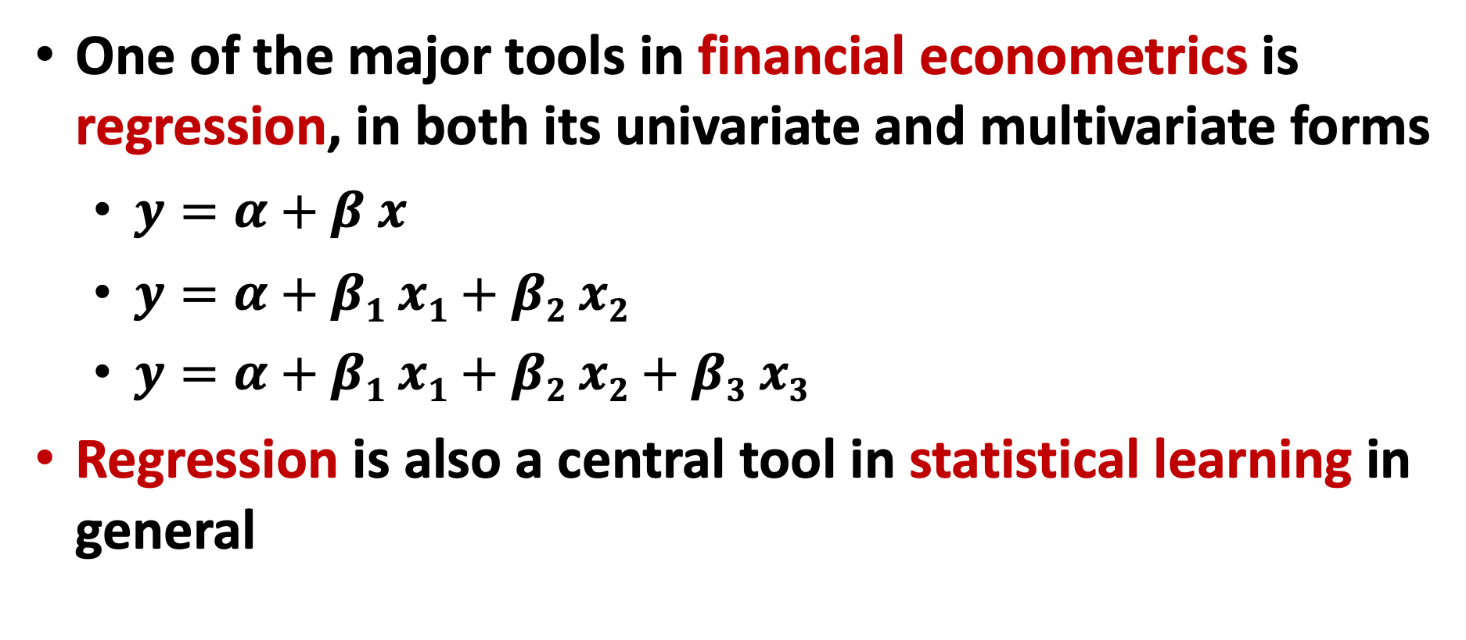
Financial Econometrics and Regression
One of the major tools in financial econometrics is regression, in both its univariate and multivariate forms
  $y=α+β x$
  $y=α+β1 x1+β2 x2$
  $y=α+β1 x1+β2 x2+β3 x3$
Regression is also a central tool in statistical learning in general
Source: Yves Hilpisch (2020), Artificial Intelligence in Finance: A Python-Based Guide, O’Reilly Media.

Slide 20
CAPM and APT
OLS regression
Both the CAPM and the APT
relate the output variables
with the relevant input factors in linear fashion.
From an econometric point of view,
both models are implemented based on
linear ordinary least-squares (OLS) regression.
CAPM: univariate linear OLS regression
APT: multivariate OLS regression
Source: Yves Hilpisch (2020), Artificial Intelligence in Finance: A Python-Based Guide, O’Reilly Media.

Slide 21
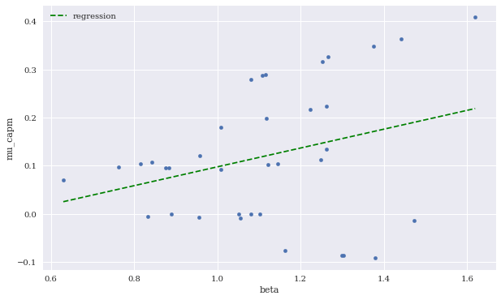
Expected CAPM return versus beta
(including linear regression)
Source: Yves Hilpisch (2020), Artificial Intelligence in Finance: A Python-Based Guide, O’Reilly Media.

Slide 22
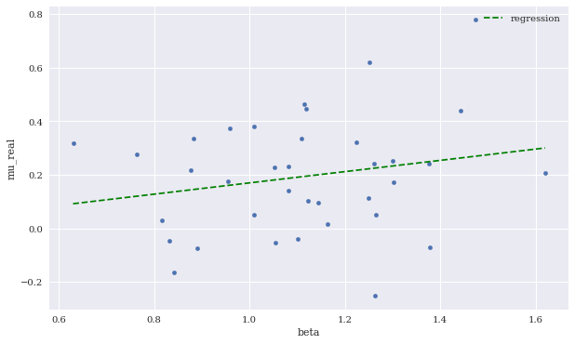
Expected CAPM return versus beta
(including linear regression)
Source: Yves Hilpisch (2020), Artificial Intelligence in Finance: A Python-Based Guide, O’Reilly Media.

Slide 23
Machine Learning

Slide 24
Machine Learning
Learning
Evaluation
Bias and variance
Cross-validation
Source: Yves Hilpisch (2020), Artificial Intelligence in Finance: A Python-Based Guide, O’Reilly Media.

Slide 25
Artificial Intelligence
Machine Learning & Deep Learning
Source: https://blogs.nvidia.com/blog/2016/07/29/whats-difference-artificial-intelligence-machine-learning-deep-learning-ai/

Slide 26
AI, ML, DL
Artificial Intelligence (AI)
Machine Learning (ML)
Supervised
Learning
Unsupervised Learning
Deep Learning (DL)
CNN
RNN LSTM GRU
GAN
Semi-supervised Learning
Reinforcement Learning
Source: https://leonardoaraujosantos.gitbooks.io/artificial-inteligence/content/deep_learning.html

Slide 27
3 Machine Learning Algorithms
Source: Enrico Galimberti, http://blogs.teradata.com/data-points/tree-machine-learning-algorithms/

Slide 28

Machine Learning (ML)
Source: https://www.mactores.com/services/aws-big-data-machine-learning-cognitive-services/

Slide 29
Stock Market Movement Forecast:
ML Phases of the stock market modeling
Source: O. Bustos and A. Pomares-Quimbaya (2020), "Stock Market Movement Forecast: A Systematic Review." Expert Systems with Applications (2020): 113464.

Slide 30
Machine Learning
Learning
Data: Features, Labels
Success (Loss Function): MSE
Capacity (Model Fit)
Evaluation
Bias and variance
Cross-validation
Source: Yves Hilpisch (2020), Artificial Intelligence in Finance: A Python-Based Guide, O’Reilly Media.

Slide 31
Learning
(Mitchell, 1997)
A computer program is said
to learn from experience E
with respect to some class of tasks T
and performance measure P,
if its performance at tasks in T,
as measured by P,
improves with experience E.
Source: Yves Hilpisch (2020), Artificial Intelligence in Finance: A Python-Based Guide, O’Reilly Media.

Slide 32
Machine Learning
Supervised Learning (Classification)
Learning from Examples
y = f(x)
x
y

Slide 33
Machine Learning
Supervised Learning (Classification)
Learning from Examples
y = f(x)
x
y
input
Output
label

Slide 34
Machine Learning
Supervised Learning (Classification)
Learning from Examples
y = f(x)
5.1,3.5,1.4,0.2,Iris-setosa 4.9,3.0,1.4,0.2,Iris-setosa 4.7,3.2,1.3,0.2,Iris-setosa 7.0,3.2,4.7,1.4,Iris-versicolor 6.4,3.2,4.5,1.5,Iris-versicolor 6.9,3.1,4.9,1.5,Iris-versicolor 6.3,3.3,6.0,2.5,Iris-virginica 5.8,2.7,5.1,1.9,Iris-virginica 7.1,3.0,5.9,2.1,Iris-virginica

Slide 35
Machine Learning
Supervised Learning (Classification)
Learning from Examples
y = f(x)
Example
5.1,3.5,1.4,0.2,Iris-setosa 4.9,3.0,1.4,0.2,Iris-setosa 4.7,3.2,1.3,0.2,Iris-setosa 7.0,3.2,4.7,1.4,Iris-versicolor 6.4,3.2,4.5,1.5,Iris-versicolor 6.9,3.1,4.9,1.5,Iris-versicolor 6.3,3.3,6.0,2.5,Iris-virginica 5.8,2.7,5.1,1.9,Iris-virginica 7.1,3.0,5.9,2.1,Iris-virginica

Slide 36
Machine Learning
Supervised Learning (Classification)
Learning from Examples
y = f(x)
Example
5.1,3.5,1.4,0.2,Iris-setosa 4.9,3.0,1.4,0.2,Iris-setosa 4.7,3.2,1.3,0.2,Iris-setosa 7.0,3.2,4.7,1.4,Iris-versicolor 6.4,3.2,4.5,1.5,Iris-versicolor 6.9,3.1,4.9,1.5,Iris-versicolor 6.3,3.3,6.0,2.5,Iris-virginica 5.8,2.7,5.1,1.9,Iris-virginica 7.1,3.0,5.9,2.1,Iris-virginica
y
x

Slide 37
Time Series Data
[10, 20, 30, 40, 50, 60, 70, 80, 90]
X
Y
[10 20 30] 40
[20 30 40] 50
[30 40 50] 60
[40 50 60] 70
[50 60 70] 80
[60 70 80] 90

Slide 38
Time Series Data
[100, 110, 120, 130, 140, 150]
Y
X
Y
[100 110 120 130 140] 150
X_{t1}
X_{t2}
X_{t3}
X_{t4}
X_{t5}

Slide 39
The Theory of Learning
How can we be sure that our learned hypothesis will predict well for previously unseen inputs?
  How do we know that the hypothesis h is close to the target function f
  if we don’t know what is?
How many examples do we need to get a good h?
What hypothesis space should we use?
If the hypothesis space is very complex,
can we even find the best h or do we have to settle for a local maximum?
How complex should h be?
How do we avoid overfitting?

Slide 40
Linear function
y = f(x)
y = w₁x + w₀
h_{w}(x) = w₁x + w₀
Source: Stuart Russell and Peter Norvig (2020), Artificial Intelligence: A Modern Approach, 4th Edition, Pearson

Slide 41
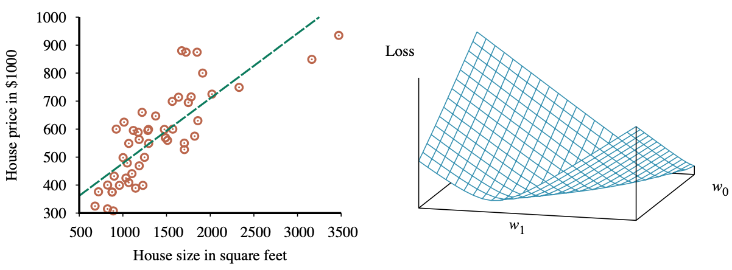
Linear Regression Weight Space
h_{w}(x) = w₁x + w₀
w* = argmin_{w} Loss(h_{w})
y = 0.232 x + 246
Loss function for Weights (w₁, w₀)
Source: Stuart Russell and Peter Norvig (2020), Artificial Intelligence: A Modern Approach, 4th Edition, Pearson

Slide 42
Performance Measure
The measure of success for estimation problems
  mean-squared error (MSE)
Classification problems
  accuracy ratio
Source: Yves Hilpisch (2020), Artificial Intelligence in Finance: A Python-Based Guide, O’Reilly Media.

Slide 43
Evaluation
(Accuracy of Classification Model)

Slide 44
Assessing the Classification Model
Predictive accuracy
  Hit rate
Speed
  Model building; predicting
Robustness
Scalability
Interpretability
  Transparency, explainability
Source: Ramesh Sharda, Dursun Delen, and Efraim Turban (2017), Business Intelligence, Analytics, and Data Science: A Managerial Perspective, 4th Edition, Pearson

Slide 45
Accuracy
Precision
Validity
Reliability

Slide 47
Accuracy vs. Precision
A
B
High Accuracy
High Precision
Low Accuracy
High Precision
C
D
High Accuracy
Low Precision
Low Accuracy
Low Precision

Slide 48
Accuracy vs. Precision
A
B
High Accuracy
High Precision
Low Accuracy
High Precision
High Validity
High Reliability
Low Validity
High Reliability
C
D
High Accuracy
Low Precision
Low Accuracy
Low Precision
High Validity
Low Reliability
Low Validity
Low Reliability

Slide 49
Accuracy vs. Precision
A
B
High Accuracy
High Precision
Low Accuracy
High Precision
High Validity
High Reliability
Low Validity
High Reliability
C
D
High Accuracy
Low Precision
Low Accuracy
Low Precision
High Validity
Low Reliability
Low Validity
Low Reliability

Slide 50
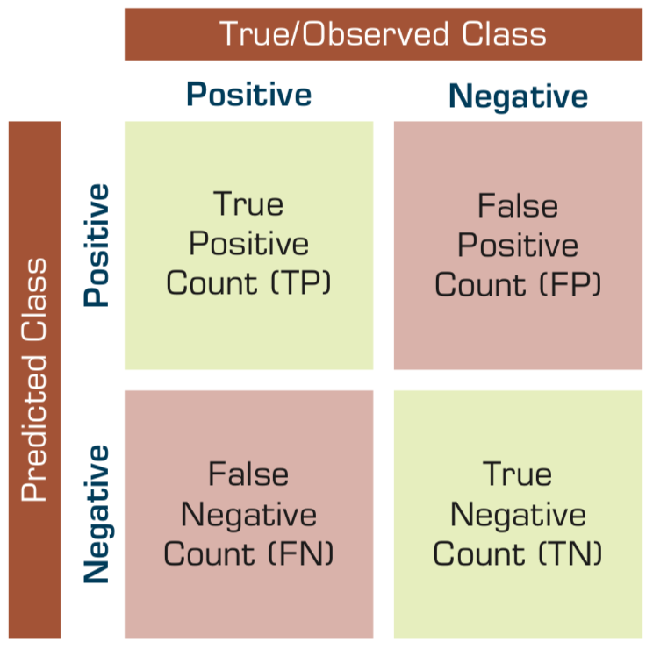
Confusion Matrix for Tabulation of Two-Class Classification Results
Source: Ramesh Sharda, Dursun Delen, and Efraim Turban (2017), Business Intelligence, Analytics, and Data Science: A Managerial Perspective, 4th Edition, Pearson

Slide 51
Sensitivity
Specificity
=True Positive Rate
=True Negative Rate

Slide 52
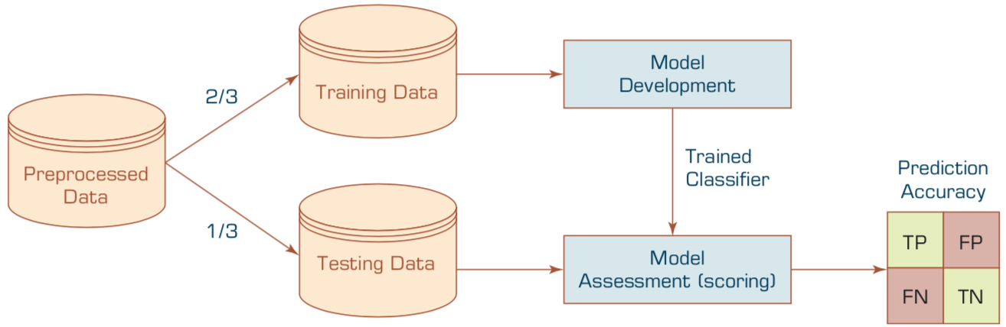
Estimation Methodologies for Classification
Simple split (or holdout or test sample estimation)
  Split the data into 2 mutually exclusive sets
  training (~70%) and testing (30%)
  For ANN, the data is split into three sub-sets
  (training [~60%], validation [~20%], testing [~20%])
Source: Ramesh Sharda, Dursun Delen, and Efraim Turban (2017), Business Intelligence, Analytics, and Data Science: A Managerial Perspective, 4th Edition, Pearson

Slide 53
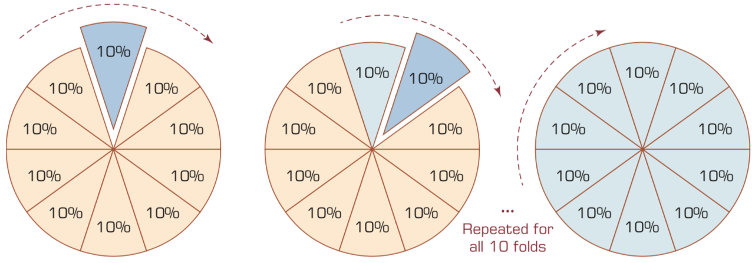
k-Fold Cross-Validation
Source: Ramesh Sharda, Dursun Delen, and Efraim Turban (2017), Business Intelligence, Analytics, and Data Science: A Managerial Perspective, 4th Edition, Pearson

Slide 54
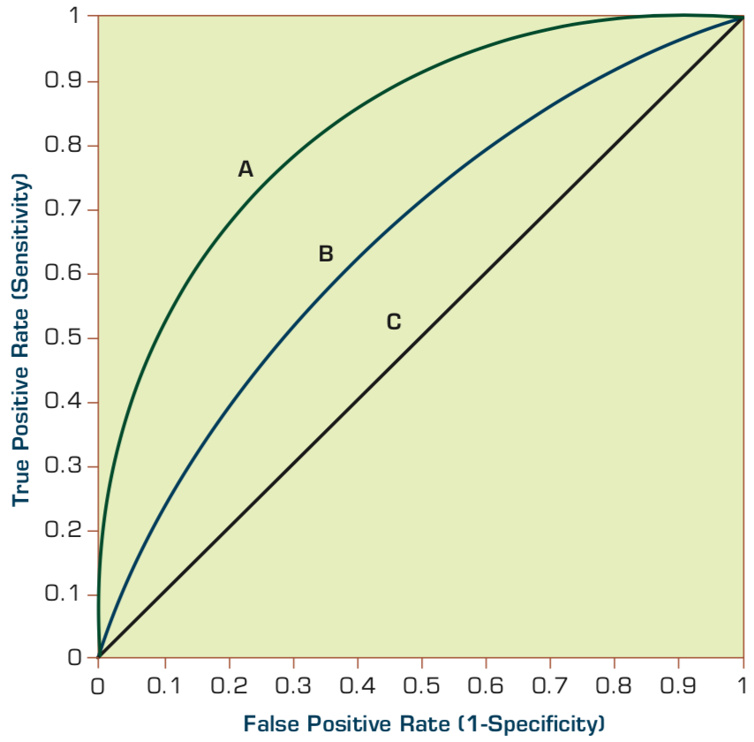
Estimation Methodologies for Classification
Area under the ROC curve
Source: Ramesh Sharda, Dursun Delen, and Efraim Turban (2017), Business Intelligence, Analytics, and Data Science: A Managerial Perspective, 4th Edition, Pearson

Slide 55
True Class
(actual value)
Positive
Negative
total
True
Positive
(TP)
False
Positive
(FP)
Positive
P’
Predictive Class
(prediction outcome)
False
Negative
(FN)
True
Negative
(TN)
Negative
N’
total
P
N
Source: http://en.wikipedia.org/wiki/Receiver_operating_characteristic

Slide 56
True Class
(actual value)
Positive
Negative
total
True
Positive
(TP)
False
Positive
(FP)
Positive
P’
Predictive Class
(prediction outcome)
False
Negative
(FN)
True
Negative
(TN)
Negative
N’
total
P
N
Sensitivity
= True Positive Rate
= Recall
= Hit rate
= TP / (TP + FN)
Source: http://en.wikipedia.org/wiki/Receiver_operating_characteristic

Slide 57
True Class
(actual value)
Positive
Negative
total
True
Positive
(TP)
False
Positive
(FP)
Positive
P’
Predictive Class
(prediction outcome)
False
Negative
(FN)
True
Negative
(TN)
Negative
N’
total
P
N
Specificity
= True Negative Rate
= TN / N
= TN / (TN+ FP)
Source: http://en.wikipedia.org/wiki/Receiver_operating_characteristic

Slide 58
True Class
(actual value)
Precision
= Positive Predictive Value (PPV)
Positive
Negative
total
True
Positive
(TP)
False
Positive
(FP)
Positive
P’
Recall
= True Positive Rate (TPR)
= Sensitivity
= Hit Rate
Predictive Class
(prediction outcome)
False
Negative
(FN)
True
Negative
(TN)
Negative
N’
total
P
N
F1 score (F-score)(F-measure)
is the harmonic mean of precision and recall
= 2TP / (P + P’)
= 2TP / (2TP + FP + FN)
Source: http://en.wikipedia.org/wiki/Receiver_operating_characteristic

Slide 59
A
63
(TP)
28
(FP)
Recall
= True Positive Rate (TPR)
= Sensitivity
= Hit Rate
= TP / (TP + FN)
Specificity
= True Negative Rate
= TN / N
= TN / (TN + FP)
91
37
(FN)
72
(TN)
109
100
100
200
TPR = 0.63
FPR = 0.28
PPV = 0.69
=63/(63+28)
=63/91
Precision
= Positive Predictive Value (PPV)
F1 = 0.66
= 2*(0.63*0.69)/(0.63+0.69)
= (2 * 63) /(100 + 91)
= (0.63 + 0.69) / 2 =1.32 / 2 =0.66
F1 score (F-score)
(F-measure)
is the harmonic mean of precision and recall
= 2TP / (P + P’)
= 2TP / (2TP + FP + FN)
ACC = 0.68
= (63 + 72) / 200
= 135/200 = 67.5
Source: http://en.wikipedia.org/wiki/Receiver_operating_characteristic

Slide 60
A
B
63
(TP)
28
(FP)
77
(TP)
77
(FP)
91
154
37
(FN)
72
(TN)
109
23
(FN)
23
(TN)
46
100
100
200
100
100
200
TPR = 0.63
TPR = 0.77
FPR = 0.77
PPV = 0.50
F1 = 0.61
ACC = 0.50
FPR = 0.28
PPV = 0.69
=63/(63+28)
=63/91
F1 = 0.66
= 2*(0.63*0.69)/(0.63+0.69)
= (2 * 63) /(100 + 91)
= (0.63 + 0.69) / 2 =1.32 / 2 =0.66
Recall
= True Positive Rate (TPR)
= Sensitivity
= Hit Rate
ACC = 0.68
= (63 + 72) / 200
= 135/200 = 67.5
Precision
= Positive Predictive Value (PPV)
Source: http://en.wikipedia.org/wiki/Receiver_operating_characteristic

Slide 61
C
C’
24
(TP)
88
(FP)
76
(TP)
12
(FP)
112
88
76
(FN)
12
(TN)
88
24
(FN)
88
(TN)
112
100
100
200
100
100
200
TPR = 0.24
FPR = 0.88
PPV = 0.21
F1 = 0.22
ACC = 0.18
TPR = 0.76
FPR = 0.12
PPV = 0.86
F1 = 0.81
ACC = 0.82
Recall
= True Positive Rate (TPR)
= Sensitivity
= Hit Rate
Precision
= Positive Predictive Value (PPV)
Source: http://en.wikipedia.org/wiki/Receiver_operating_characteristic

Slide 62
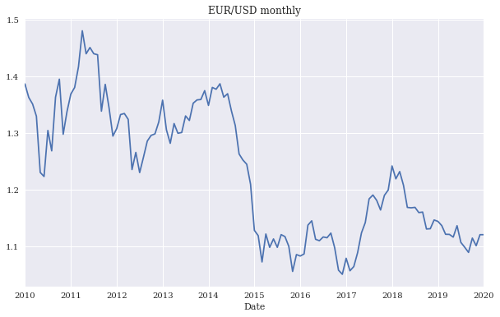
EUR/USD exchange rate as time series
(monthly)
Source: Yves Hilpisch (2020), Artificial Intelligence in Finance: A Python-Based Guide, O’Reilly Media.

Slide 63
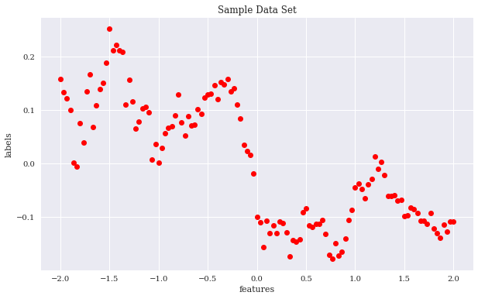
Sample data set
Source: Yves Hilpisch (2020), Artificial Intelligence in Finance: A Python-Based Guide, O’Reilly Media.

Slide 64
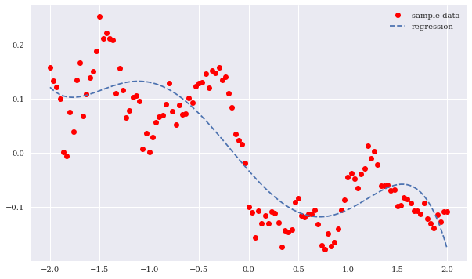
Sample data and cubic regression line
Source: Yves Hilpisch (2020), Artificial Intelligence in Finance: A Python-Based Guide, O’Reilly Media.

Slide 65
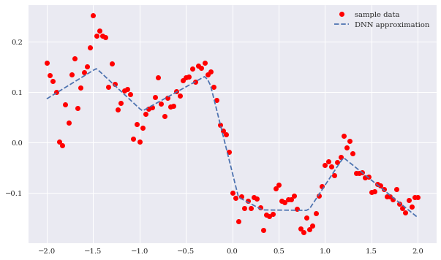
Sample data and neural network approximation
Source: Yves Hilpisch (2020), Artificial Intelligence in Finance: A Python-Based Guide, O’Reilly Media.

Slide 66
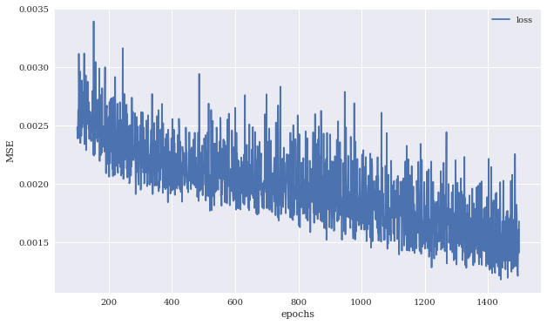
MSE values against number of training epochs
Source: Yves Hilpisch (2020), Artificial Intelligence in Finance: A Python-Based Guide, O’Reilly Media.

Slide 67
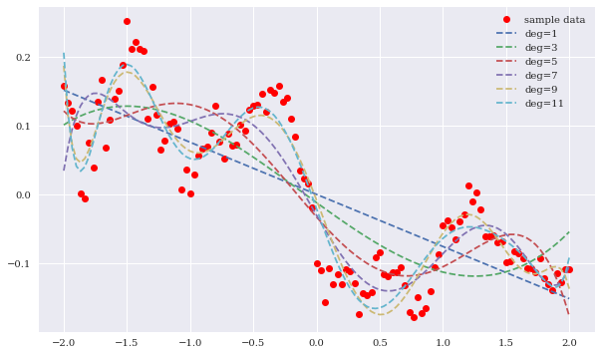
Regression lines for different highest degrees
Source: Yves Hilpisch (2020), Artificial Intelligence in Finance: A Python-Based Guide, O’Reilly Media.

Slide 68
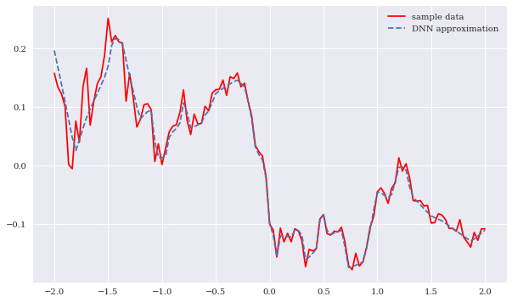
Sample data and DNN approximation
(higher capacity)
Source: Yves Hilpisch (2020), Artificial Intelligence in Finance: A Python-Based Guide, O’Reilly Media.

Slide 69
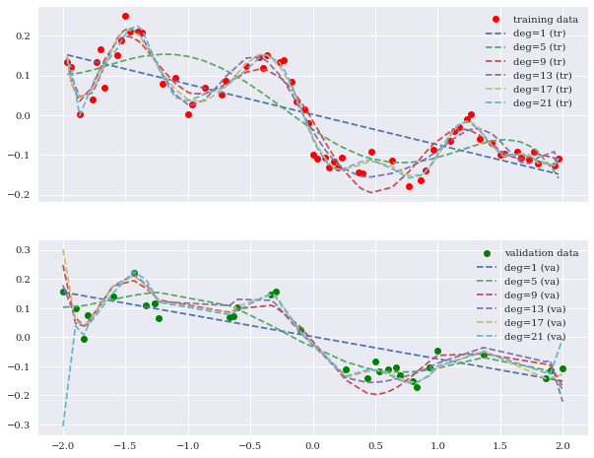
Training and validation data including regression fits
Source: Yves Hilpisch (2020), Artificial Intelligence in Finance: A Python-Based Guide, O’Reilly Media.

Slide 70
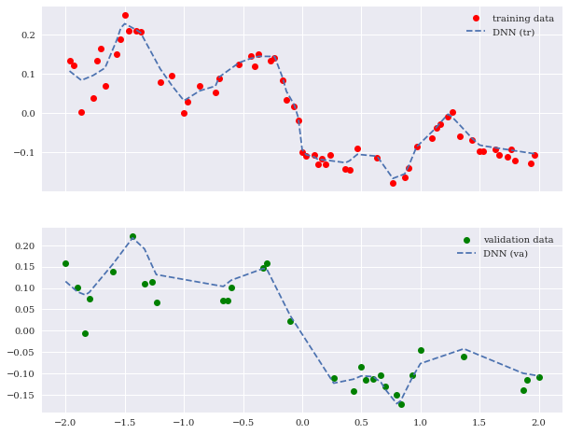
Training and validation data including DNN predictions
Source: Yves Hilpisch (2020), Artificial Intelligence in Finance: A Python-Based Guide, O’Reilly Media.

Slide 71
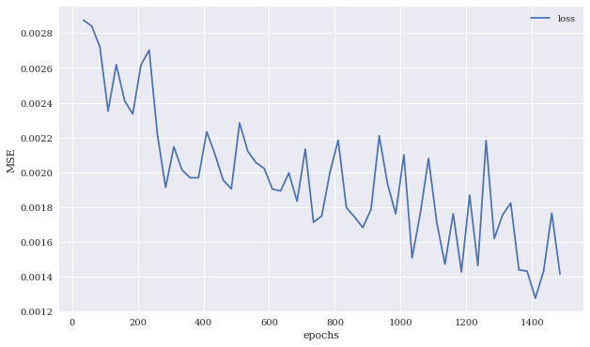
MSE values for DNN model on the training and validation data sets
Source: Yves Hilpisch (2020), Artificial Intelligence in Finance: A Python-Based Guide, O’Reilly Media.

Slide 72
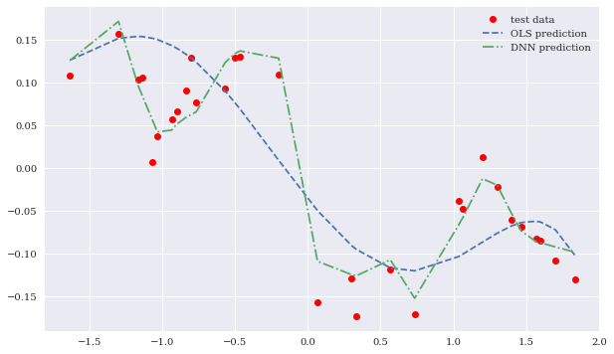
Test data and predictions from OLS regression and the DNN model
Source: Yves Hilpisch (2020), Artificial Intelligence in Finance: A Python-Based Guide, O’Reilly Media.

Slide 73
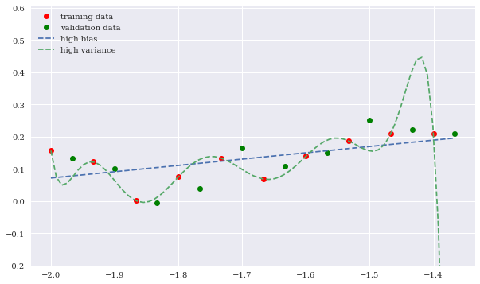
High bias and high variance OLS regression fits
Source: Yves Hilpisch (2020), Artificial Intelligence in Finance: A Python-Based Guide, O’Reilly Media.

Slide 74
AI-First Finance

Slide 75
AI-First Finance
Efficient Markets
Market Prediction Based on Returns Data
Market Prediction with More Features
Market Prediction Intraday
Source: Yves Hilpisch (2020), Artificial Intelligence in Finance: A Python-Based Guide, O’Reilly Media.

Slide 76
Life 3.0:
Being human in the age of artificial intelligence
Max Tegmark (2017)
A computation takes information and transforms it, implementing what mathematicians call a function....
If you’re in possession of a function that
inputs all the world’s financial data and
outputs the best stocks to buy,
you’ll soon be extremely rich.
Source: Yves Hilpisch (2020), Artificial Intelligence in Finance: A Python-Based Guide, O’Reilly Media.

Slide 77
Efficient Markets
Efficient Market Hypothesis (EMH)
  Random Walk Hypothesis (RWH)
Weak form of EMH
  The information set θ_{t} only encompasses
  the past price and return history of the market.
Semi-strong form of EMH
  The information set θ_{t} is taken to be all publicly available information, including not only the past price and return history
  but also financial reports, news articles, weather data, and so on.
Strong form of EMH
  The information set θ_{t} includes all information available to anyone
  (that is, even private information).
Source: Yves Hilpisch (2020), Artificial Intelligence in Finance: A Python-Based Guide, O’Reilly Media.

Slide 78
import numpy as np
import pandas as pd
from pylab import plt, mpl
plt.style.use('seaborn')
mpl.rcParams['savefig.dpi'] = 300
mpl.rcParams['font.family'] = 'serif'
pd.set_option('precision', 4)
np.set_printoptions(suppress=True, precision=4)
url = 'http://hilpisch.com/aiif_eikon_eod_data.csv'
data = pd.read_csv(url, index_col=0, parse_dates=True).dropna()
(data / data.iloc[0]).plot(figsize=(10, 6), cmap='coolwarm')
Source: Yves Hilpisch (2020), Artificial Intelligence in Finance: A Python-Based Guide, O’Reilly Media.

Slide 79
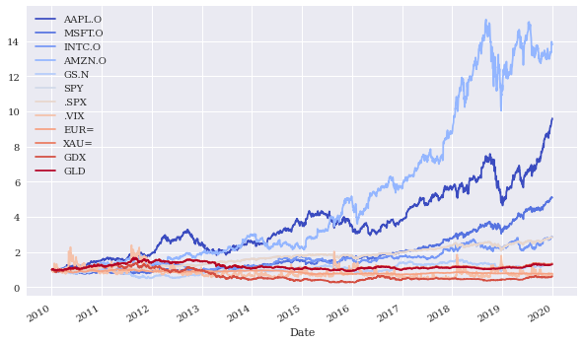
Normalized time series data (end-of-day)
Source: Yves Hilpisch (2020), Artificial Intelligence in Finance: A Python-Based Guide, O’Reilly Media.

Slide 80
lags = 7
def add_lags(data, ric, lags):
  cols = []
  df = pd.DataFrame(data[ric])
  for lag in range(1, lags + 1):
    col = 'lag_{}'.format(lag)
    df[col] = df[ric].shift(lag)
    cols.append(col)
  df.dropna(inplace=True)
  return df, cols
dfs = {}
for sym in data.columns:
  df, cols = add_lags(data, sym, lags)
  dfs[sym] = df
dfs[sym].head(7)
Source: Yves Hilpisch (2020), Artificial Intelligence in Finance: A Python-Based Guide, O’Reilly Media.

Slide 81
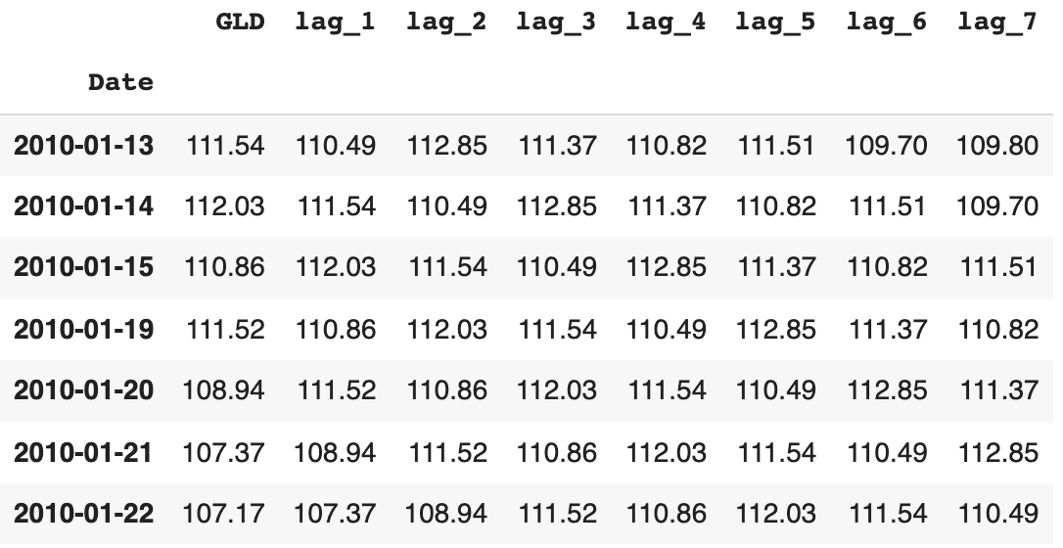
lagged prices
Source: Yves Hilpisch (2020), Artificial Intelligence in Finance: A Python-Based Guide, O’Reilly Media.

Slide 82
regs = {}
for sym in data.columns:
df = dfs[sym]
reg = np.linalg.lstsq(df[cols], df[sym], rcond=-1)[0]
#Return the least-squares solution to a linear matrix equation
regs[sym] = reg
rega = np.stack(tuple(regs.values()))
regd = pd.DataFrame(rega, columns=cols, index=data.columns)
regd
Source: Yves Hilpisch (2020), Artificial Intelligence in Finance: A Python-Based Guide, O’Reilly Media.

Slide 83
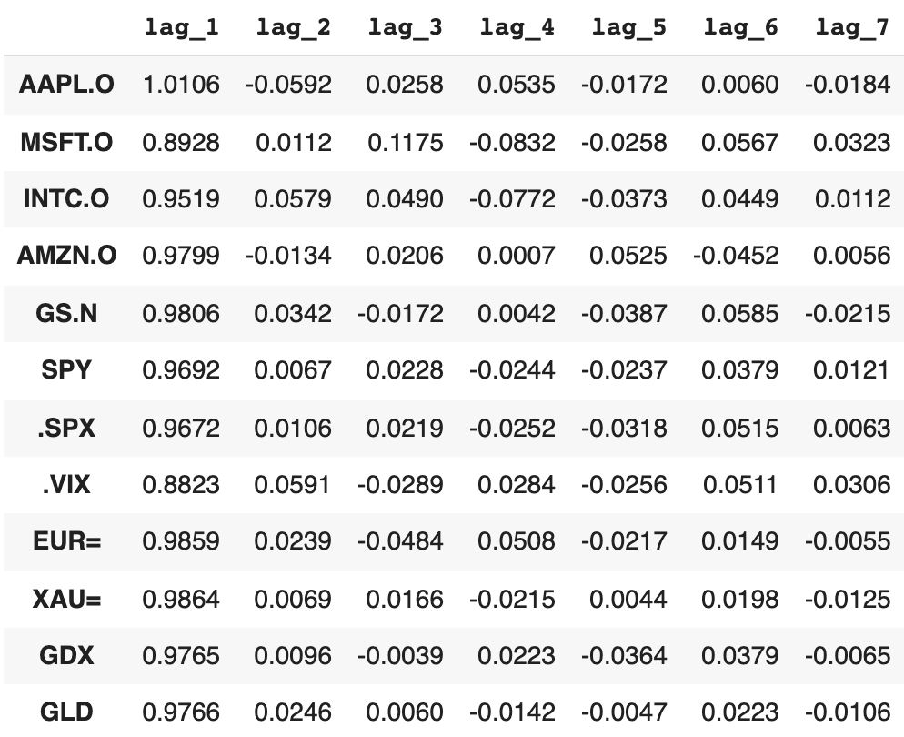
regression analysis
  reg = np.linalg.lstsq(df[cols], df[sym], rcond=-1)[0]
Source: Yves Hilpisch (2020), Artificial Intelligence in Finance: A Python-Based Guide, O’Reilly Media.

Slide 84
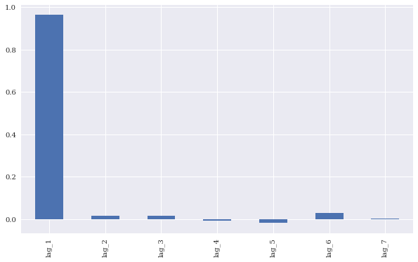
Average optimal regression parameters for the lagged prices
regd.mean().plot(kind='bar', figsize=(10, 6))
Source: Yves Hilpisch (2020), Artificial Intelligence in Finance: A Python-Based Guide, O’Reilly Media.

Slide 85
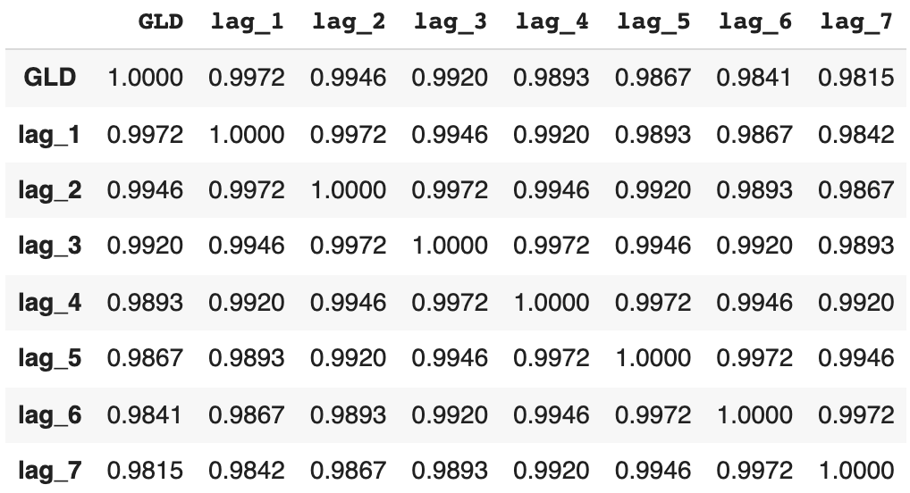
Correlations between the lagged time series
dfs[sym].corr()
Source: Yves Hilpisch (2020), Artificial Intelligence in Finance: A Python-Based Guide, O’Reilly Media.

Slide 86
from statsmodels.tsa.stattools import adfuller
#Tests for stationarity using the Augmented Dickey-Fuller (ADF) test
adfuller(data[sym].dropna())
(-1.9488969577009954,
0.3094193074034718,
0,
2515,
{'1%': -3.4329527780962255,
'10%': -2.567382133955709,
'5%': -2.8626898965523724},
8446.683102944744)
Source: Yves Hilpisch (2020), Artificial Intelligence in Finance: A Python-Based Guide, O’Reilly Media.

Slide 87
Market Prediction Based on Returns Data
Statistical inefficiencies
  are given when a model is able to predict the direction of the future price movement with a certain edge (say, the prediction is correct in 55% or 60% of the cases)
Economic inefficiencies
  would only be given if the statistical inefficiencies can be exploited profitably through a trading strategy that takes into account, for example, transaction costs.
Source: Yves Hilpisch (2020), Artificial Intelligence in Finance: A Python-Based Guide, O’Reilly Media.

Slide 88
Market Prediction Based on Returns Data
Create data sets with lagged log returns data
The normalized lagged log returns data is also tested for stationarity (given)
The features are tested for correlation (not correlated )
Time-series-related data
  weak form market efficiency
Source: Yves Hilpisch (2020), Artificial Intelligence in Finance: A Python-Based Guide, O’Reilly Media.

Slide 89
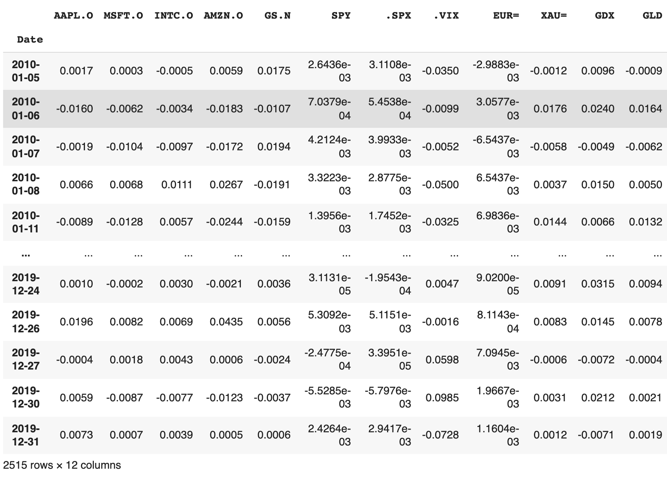
rets = np.log(data / data.shift(1))
rets.dropna(inplace=True)
rets
log returns
Source: Yves Hilpisch (2020), Artificial Intelligence in Finance: A Python-Based Guide, O’Reilly Media.

Slide 90
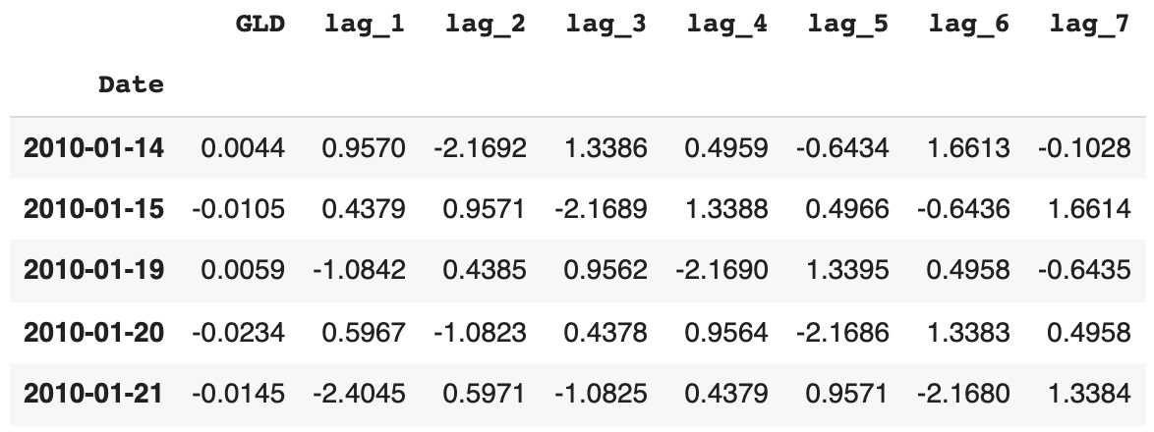
dfs = {}
for sym in data:
  df, cols = add_lags(rets, sym, lags)
  mu, std = df[cols].mean(), df[cols].std()
  df[cols] = (df[cols] - mu) / std
  dfs[sym] = df
dfs[sym].head()
Source: Yves Hilpisch (2020), Artificial Intelligence in Finance: A Python-Based Guide, O’Reilly Media.

Slide 91
Augmented Dickey-Fuller (ADF)
Tests for stationarity of the time series data
adfuller(dfs[sym]['lag_1'])
(-51.568251505825536,
0.0,
0,
2507,
{'1%': -3.4329610922579095,
'10%': -2.567384088736619,
'5%': -2.8626935681060375},
7017.165474260225)
Source: Yves Hilpisch (2020), Artificial Intelligence in Finance: A Python-Based Guide, O’Reilly Media.

Slide 92
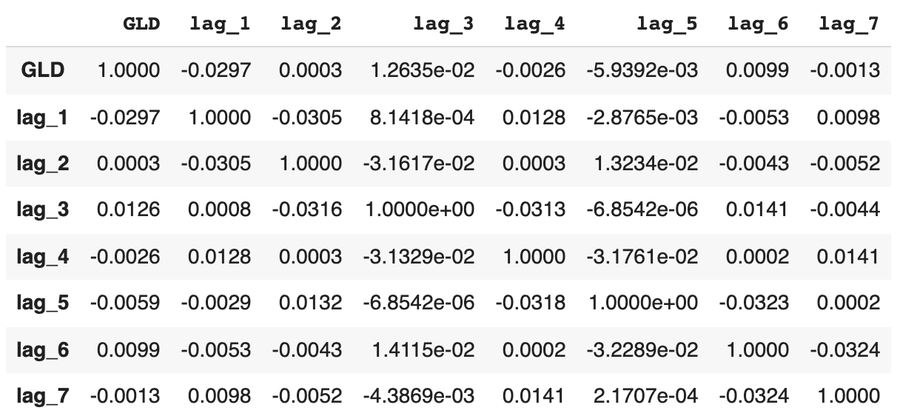
Shows the correlation data for the features
dfs[sym].corr()
Source: Yves Hilpisch (2020), Artificial Intelligence in Finance: A Python-Based Guide, O’Reilly Media.

Slide 93
OLS Regression
from sklearn.metrics import accuracy_score
%%time
for sym in data:
  df = dfs[sym]
  reg = np.linalg.lstsq(df[cols], df[sym], rcond=-1)[0]
  pred = np.dot(df[cols], reg)
  acc = accuracy_score(np.sign(df[sym]), np.sign(pred))
  print(f'OLS | {sym:10s} | acc={acc:.4f}')
Source: Yves Hilpisch (2020), Artificial Intelligence in Finance: A Python-Based Guide, O’Reilly Media.

Slide 94
OLS Regression Accuracy
OLS | AAPL.O | acc=0.5056
OLS | MSFT.O | acc=0.5088
OLS | INTC.O | acc=0.5040
OLS | AMZN.O | acc=0.5048
OLS | GS.N | acc=0.5080
OLS | SPY | acc=0.5080
OLS | .SPX | acc=0.5167
OLS | .VIX | acc=0.5291
OLS | EUR= | acc=0.4984
OLS | XAU= | acc=0.5207
OLS | GDX | acc=0.5307
OLS | GLD | acc=0.5072
Source: Yves Hilpisch (2020), Artificial Intelligence in Finance: A Python-Based Guide, O’Reilly Media.

Slide 95
from sklearn.neural_network import MLPRegressor
%%time
for sym in data.columns:
  df = dfs[sym]
  model = MLPRegressor(hidden_layer_sizes=[512],
                random_state=100,
                max_iter=1000,
                early_stopping=True,
                validation_fraction=0.15,
                shuffle=False)
  model.fit(df[cols].values, df[sym].values)
  pred = model.predict(df[cols].values)
  acc = accuracy_score(np.sign(df[sym].values), np.sign(pred))
  print(f'MLP | {sym:10s} | acc={acc:.4f}')
Source: Yves Hilpisch (2020), Artificial Intelligence in Finance: A Python-Based Guide, O’Reilly Media.

Slide 96
Scikit-learn MLPRegressor Accuracy
MLP | AAPL.O | acc=0.6005
MLP | MSFT.O | acc=0.5853
MLP | INTC.O | acc=0.5766
MLP | AMZN.O | acc=0.5510
MLP | GS.N | acc=0.6527
MLP | SPY | acc=0.5419
MLP | .SPX | acc=0.5399
MLP | .VIX | acc=0.6579
MLP | EUR= | acc=0.5642
MLP | XAU= | acc=0.5522
MLP | GDX | acc=0.6029
MLP | GLD | acc=0.5259
Source: Yves Hilpisch (2020), Artificial Intelligence in Finance: A Python-Based Guide, O’Reilly Media.

Slide 97
import tensorflow as tf
from keras.layers import Dense
from keras.models import Sequential
np.random.seed(100)
tf.random.set_seed(100)
def create_model(problem='regression'):
  model = Sequential()
  model.add(Dense(512, input_dim=len(cols), activation='relu'))
  if problem == 'regression’:
  model.add(Dense(1, activation='linear’))
  model.compile(loss='mse', optimizer='adam')
  else:
  model.add(Dense(1, activation='sigmoid’))
  model.compile(loss='binary_crossentropy', optimizer='adam')
  return model
Source: Yves Hilpisch (2020), Artificial Intelligence in Finance: A Python-Based Guide, O’Reilly Media.

Slide 98
%%time
for sym in data.columns[:]:
  df = dfs[sym]
  model = create_model()
  model.fit(df[cols], df[sym], epochs=25, verbose=False)
  pred = model.predict(df[cols])
  acc = accuracy_score(np.sign(df[sym]), np.sign(pred))
  print(f'DNN | {sym:10s} | acc={acc:.4f}')
Source: Yves Hilpisch (2020), Artificial Intelligence in Finance: A Python-Based Guide, O’Reilly Media.

Slide 99
TF Keras DNN Accuracy
DNN | AAPL.O | acc=0.6069
DNN | MSFT.O | acc=0.6260
DNN | INTC.O | acc=0.6344
DNN | AMZN.O | acc=0.6316
DNN | GS.N | acc=0.6045
DNN | SPY | acc=0.5610
DNN | .SPX | acc=0.5435
DNN | .VIX | acc=0.6096
DNN | EUR= | acc=0.5817
DNN | XAU= | acc=0.6017
DNN | GDX | acc=0.6164
DNN | GLD | acc=0.5973
Source: Yves Hilpisch (2020), Artificial Intelligence in Finance: A Python-Based Guide, O’Reilly Media.

Slide 100
Train Data (0.8): In-Sample
Test Data (0.2): Out-of-Sample
split = int(len(dfs[sym]) * 0.8)
%%time
for sym in data.columns:
  df = dfs[sym]
  train = df.iloc[:split]
  reg = np.linalg.lstsq(train[cols], train[sym], rcond=-1)[0]
  test = df.iloc[split:]
  pred = np.dot(test[cols], reg)
  acc = accuracy_score(np.sign(test[sym]), np.sign(pred))
  print(f'OLS | {sym:10s} | acc={acc:.4f}')
Source: Yves Hilpisch (2020), Artificial Intelligence in Finance: A Python-Based Guide, O’Reilly Media.

Slide 101
OLS Out-of-Sample Accuracy
OLS | AAPL.O | acc=0.5219
OLS | MSFT.O | acc=0.4960
OLS | INTC.O | acc=0.5418
OLS | AMZN.O | acc=0.4841
OLS | GS.N | acc=0.4980
OLS | SPY | acc=0.5020
OLS | .SPX | acc=0.5120
OLS | .VIX | acc=0.5458
OLS | EUR= | acc=0.4482
OLS | XAU= | acc=0.5299
OLS | GDX | acc=0.5159
OLS | GLD | acc=0.5100
Source: Yves Hilpisch (2020), Artificial Intelligence in Finance: A Python-Based Guide, O’Reilly Media.

Slide 102
%%time
for sym in data.columns:
  df = dfs[sym]
  train = df.iloc[:split]
  model = MLPRegressor(hidden_layer_sizes=[512],
              random_state=100,
              max_iter=1000,
              early_stopping=True,
              validation_fraction=0.15,
              shuffle=False)
  model.fit(train[cols].values, train[sym].values)
  test = df.iloc[split:]
  pred = model.predict(test[cols].values)
  acc = accuracy_score(np.sign(test[sym].values), np.sign(pred))
  print(f'MLP | {sym:10s} | acc={acc:.4f}')
Source: Yves Hilpisch (2020), Artificial Intelligence in Finance: A Python-Based Guide, O’Reilly Media.

Slide 103
MLP Out-of-Sample Accuracy
MLP | AAPL.O | acc=0.4920
MLP | MSFT.O | acc=0.5279
MLP | INTC.O | acc=0.5279
MLP | AMZN.O | acc=0.4641
MLP | GS.N | acc=0.5040
MLP | SPY | acc=0.5259
MLP | .SPX | acc=0.5478
MLP | .VIX | acc=0.5279
MLP | EUR= | acc=0.4980
MLP | XAU= | acc=0.5239
MLP | GDX | acc=0.4880
MLP | GLD | acc=0.5000
Source: Yves Hilpisch (2020), Artificial Intelligence in Finance: A Python-Based Guide, O’Reilly Media.

Slide 104
%%time
for sym in data.columns:
  df = dfs[sym]
  train = df.iloc[:split]
  model = create_model()
  model.fit(train[cols], train[sym], epochs=50, verbose=False)
  test = df.iloc[split:]
  pred = model.predict(test[cols])
  acc = accuracy_score(np.sign(test[sym]), np.sign(pred))
  print(f'DNN | {sym:10s} | acc={acc:.4f}')
Source: Yves Hilpisch (2020), Artificial Intelligence in Finance: A Python-Based Guide, O’Reilly Media.

Slide 105
DNN Out-of-Sample Accuracy
DNN | AAPL.O | acc=0.4701
DNN | MSFT.O | acc=0.4960
DNN | INTC.O | acc=0.5040
DNN | AMZN.O | acc=0.4920
DNN | GS.N | acc=0.5538
DNN | SPY | acc=0.5299
DNN | .SPX | acc=0.5458
DNN | .VIX | acc=0.5020
DNN | EUR= | acc=0.5100
DNN | XAU= | acc=0.4940
DNN | GDX | acc=0.4661
DNN | GLD | acc=0.4880
Source: Yves Hilpisch (2020), Artificial Intelligence in Finance: A Python-Based Guide, O’Reilly Media.

Slide 106
Market Prediction with More Features
In trading, there is a long tradition of
using technical indicators to generate,
based on observed patterns, buy or sell signals.
Such technical indicators, basically of any kind,
can also be used as features
for the training of neural networks.
SMA, rolling minimum and maximum values,
momentum, and rolling volatility as features
Source: Yves Hilpisch (2020), Artificial Intelligence in Finance: A Python-Based Guide, O’Reilly Media.

Slide 107
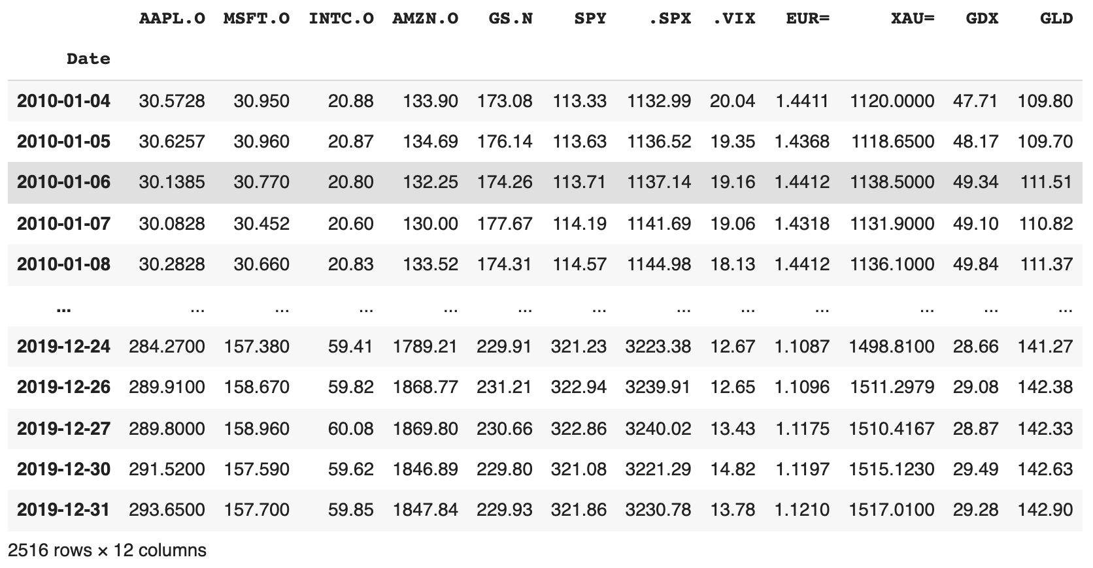
url = 'http://hilpisch.com/aiif_eikon_eod_data.csv'
data = pd.read_csv(url, index_col=0, parse_dates=True).dropna()
data
Source: Yves Hilpisch (2020), Artificial Intelligence in Finance: A Python-Based Guide, O’Reilly Media.

Slide 108
def add_lags(data, ric, lags, window=50):
  cols = []
  df = pd.DataFrame(data[ric])
  df.dropna(inplace=True)
  df['r'] = np.log(df / df.shift())
  df['sma'] = df[ric].rolling(window).mean()
  df['min'] = df[ric].rolling(window).min()
  df['max'] = df[ric].rolling(window).max()
  df['mom'] = df['r'].rolling(window).mean()
  df['vol'] = df['r'].rolling(window).std()
  df.dropna(inplace=True)
  df['d'] = np.where(df['r'] > 0, 1, 0)
  features = [ric, 'r', 'd', 'sma', 'min', 'max', 'mom', 'vol']
  for f in features:
    for lag in range(1, lags + 1):
      col = f'{f}_lag_{lag}'
      df[col] = df[f].shift(lag)
      cols.append(col)
  df.dropna(inplace=True)
  return df, cols
Source: Yves Hilpisch (2020), Artificial Intelligence in Finance: A Python-Based Guide, O’Reilly Media.

Slide 109
lags = 5
dfs = {}
for ric in data:
  df, cols = add_lags(data, ric, lags)
  dfs[ric] = df.dropna(), cols
len(cols)
40
Source: Yves Hilpisch (2020), Artificial Intelligence in Finance: A Python-Based Guide, O’Reilly Media.

Slide 110
from sklearn.neural_network import MLPClassifier
%%time
for ric in data:
  model = MLPClassifier(hidden_layer_sizes=[512],
                random_state=100,
                max_iter=1000,
                early_stopping=True,
                validation_fraction=0.15,
                shuffle=False)
  df, cols = dfs[ric]
  df[cols] = (df[cols] - df[cols].mean()) / df[cols].std()
  model.fit(df[cols].values, df['d'].values)
  pred = model.predict(df[cols].values)
  acc = accuracy_score(df['d'].values, pred)
  print(f'IN-SAMPLE | {ric:7s} | acc={acc:.4f}')
Source: Yves Hilpisch (2020), Artificial Intelligence in Finance: A Python-Based Guide, O’Reilly Media.

Slide 111
MLP In-Sample Accuracy
IN-SAMPLE | AAPL.O | acc=0.5510
IN-SAMPLE | MSFT.O | acc=0.5376
IN-SAMPLE | INTC.O | acc=0.5607
IN-SAMPLE | AMZN.O | acc=0.5559
IN-SAMPLE | GS.N | acc=0.5794
IN-SAMPLE | SPY | acc=0.5729
IN-SAMPLE | .SPX | acc=0.5941
IN-SAMPLE | .VIX | acc=0.6940
IN-SAMPLE | EUR= | acc=0.5766
IN-SAMPLE | XAU= | acc=0.5672
IN-SAMPLE | GDX | acc=0.5847
IN-SAMPLE | GLD | acc=0.5567
Source: Yves Hilpisch (2020), Artificial Intelligence in Finance: A Python-Based Guide, O’Reilly Media.

Slide 112
%%time
for ric in data:
  model = create_model('classification')
  df, cols = dfs[ric]
  df[cols] = (df[cols] - df[cols].mean()) / df[cols].std()
  model.fit(df[cols], df['d'], epochs=50, verbose=False)
  pred = np.where(model.predict(df[cols]) > 0.5, 1, 0)
  acc = accuracy_score(df['d'], pred)
  print(f'IN-SAMPLE | {ric:7s} | acc={acc:.4f}')
Source: Yves Hilpisch (2020), Artificial Intelligence in Finance: A Python-Based Guide, O’Reilly Media.

Slide 113
TF Keras DNN In-Sample Accuracy
IN-SAMPLE | AAPL.O | acc=0.7042
IN-SAMPLE | MSFT.O | acc=0.6928
IN-SAMPLE | INTC.O | acc=0.6969
IN-SAMPLE | AMZN.O | acc=0.6713
IN-SAMPLE | GS.N | acc=0.6924
IN-SAMPLE | SPY | acc=0.6806
IN-SAMPLE | .SPX | acc=0.6920
IN-SAMPLE | .VIX | acc=0.7347
IN-SAMPLE | EUR= | acc=0.6766
IN-SAMPLE | XAU= | acc=0.7038
IN-SAMPLE | GDX | acc=0.6806
IN-SAMPLE | GLD | acc=0.6936
Source: Yves Hilpisch (2020), Artificial Intelligence in Finance: A Python-Based Guide, O’Reilly Media.

Slide 114
def train_test_model(model):
  for ric in data:
  df, cols = dfs[ric]
  split = int(len(df) * 0.85)
  train = df.iloc[:split].copy()
  mu, std = train[cols].mean(), train[cols].std()
  train[cols] = (train[cols] - mu) / std
  model.fit(train[cols].values, train['d'].values)
  test = df.iloc[split:].copy()
  test[cols] = (test[cols] - mu) / std
  pred = model.predict(test[cols].values)
  acc = accuracy_score(test['d'].values, pred)
  print(f'OUT-OF-SAMPLE | {ric:7s} | acc={acc:.4f}')
Source: Yves Hilpisch (2020), Artificial Intelligence in Finance: A Python-Based Guide, O’Reilly Media.

Slide 115
model_mlp = MLPClassifier(hidden_layer_sizes=[512],
                random_state=100,
                max_iter=1000,
                early_stopping=True,
                validation_fraction=0.15,
                shuffle=False)
train_test_model(model_mlp)
Source: Yves Hilpisch (2020), Artificial Intelligence in Finance: A Python-Based Guide, O’Reilly Media.

Slide 116
train_test_model(model_mlp)
OUT-OF-SAMPLE | AAPL.O | acc=0.4432
OUT-OF-SAMPLE | MSFT.O | acc=0.4595
OUT-OF-SAMPLE | INTC.O | acc=0.5000
OUT-OF-SAMPLE | AMZN.O | acc=0.5270
OUT-OF-SAMPLE | GS.N | acc=0.4838
OUT-OF-SAMPLE | SPY | acc=0.4811
OUT-OF-SAMPLE | .SPX | acc=0.5027
OUT-OF-SAMPLE | .VIX | acc=0.5676
OUT-OF-SAMPLE | EUR= | acc=0.4649
OUT-OF-SAMPLE | XAU= | acc=0.5514
OUT-OF-SAMPLE | GDX | acc=0.5162
OUT-OF-SAMPLE | GLD | acc=0.4946
Source: Yves Hilpisch (2020), Artificial Intelligence in Finance: A Python-Based Guide, O’Reilly Media.

Slide 117
from sklearn.ensemble import BaggingClassifier
base_estimator = MLPClassifier(hidden_layer_sizes=[256],
                random_state=100,
                max_iter=1000,
                early_stopping=True,
                validation_fraction=0.15,
                shuffle=False)
model_bag = BaggingClassifier(base_estimator=base_estimator,
                n_estimators=35,
                max_samples=0.25,
                max_features=0.5,
                bootstrap=False,
                bootstrap_features=True,
                n_jobs=8,
                random_state=100
                )
Source: Yves Hilpisch (2020), Artificial Intelligence in Finance: A Python-Based Guide, O’Reilly Media.

Slide 118
train_test_model(model_bag)
OUT-OF-SAMPLE | AAPL.O | acc=0.5000
OUT-OF-SAMPLE | MSFT.O | acc=0.5703
OUT-OF-SAMPLE | INTC.O | acc=0.5054
OUT-OF-SAMPLE | AMZN.O | acc=0.5270
OUT-OF-SAMPLE | GS.N | acc=0.5135
OUT-OF-SAMPLE | SPY | acc=0.5568
OUT-OF-SAMPLE | .SPX | acc=0.5514
OUT-OF-SAMPLE | .VIX | acc=0.5432
OUT-OF-SAMPLE | EUR= | acc=0.5054
OUT-OF-SAMPLE | XAU= | acc=0.5351
OUT-OF-SAMPLE | GDX | acc=0.5054
OUT-OF-SAMPLE | GLD | acc=0.5189
Source: Yves Hilpisch (2020), Artificial Intelligence in Finance: A Python-Based Guide, O’Reilly Media.

Slide 119
Market Prediction Intraday
Weakly efficient on an end-of-day basis
Weakly inefficient intraday
  Intraday Data
  hourly data
Source: Yves Hilpisch (2020), Artificial Intelligence in Finance: A Python-Based Guide, O’Reilly Media.

Slide 120
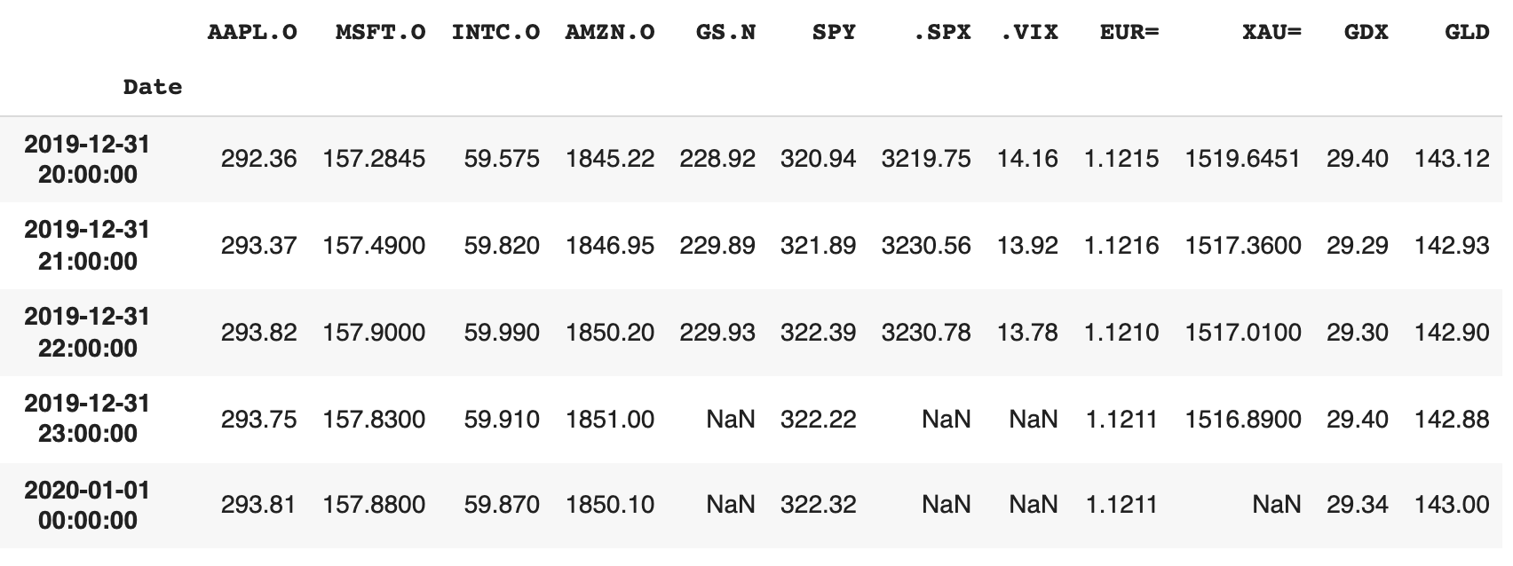
Intraday Data
url = 'http://hilpisch.com/aiif_eikon_id_data.csv'
data = pd.read_csv(url, index_col=0, parse_dates=True) # .dropna()
data.tail()
Source: Yves Hilpisch (2020), Artificial Intelligence in Finance: A Python-Based Guide, O’Reilly Media.

Slide 121
lags = 5
dfs = {}
for ric in data:
  df, cols = add_lags(data, ric, lags)
  dfs[ric] = df, cols
Source: Yves Hilpisch (2020), Artificial Intelligence in Finance: A Python-Based Guide, O’Reilly Media.

Slide 122
train_test_model(model_mlp)
OUT-OF-SAMPLE | AAPL.O | acc=0.5420
OUT-OF-SAMPLE | MSFT.O | acc=0.4930
OUT-OF-SAMPLE | INTC.O | acc=0.5549
OUT-OF-SAMPLE | AMZN.O | acc=0.4709
OUT-OF-SAMPLE | GS.N | acc=0.5184
OUT-OF-SAMPLE | SPY | acc=0.4860
OUT-OF-SAMPLE | .SPX | acc=0.5019
OUT-OF-SAMPLE | .VIX | acc=0.4885
OUT-OF-SAMPLE | EUR= | acc=0.5130
OUT-OF-SAMPLE | XAU= | acc=0.4824
OUT-OF-SAMPLE | GDX | acc=0.4765
OUT-OF-SAMPLE | GLD | acc=0.5455
Source: Yves Hilpisch (2020), Artificial Intelligence in Finance: A Python-Based Guide, O’Reilly Media.

Slide 123
train_test_model(model_bag)
OUT-OF-SAMPLE | AAPL.O | acc=0.5660
OUT-OF-SAMPLE | MSFT.O | acc=0.5551
OUT-OF-SAMPLE | INTC.O | acc=0.5072
OUT-OF-SAMPLE | AMZN.O | acc=0.4830
OUT-OF-SAMPLE | GS.N | acc=0.5020
OUT-OF-SAMPLE | SPY | acc=0.4680
OUT-OF-SAMPLE | .SPX | acc=0.4677
OUT-OF-SAMPLE | .VIX | acc=0.5161
OUT-OF-SAMPLE | EUR= | acc=0.5242
OUT-OF-SAMPLE | XAU= | acc=0.5229
OUT-OF-SAMPLE | GDX | acc=0.5107
OUT-OF-SAMPLE | GLD | acc=0.5475
Source: Yves Hilpisch (2020), Artificial Intelligence in Finance: A Python-Based Guide, O’Reilly Media.

Slide 124
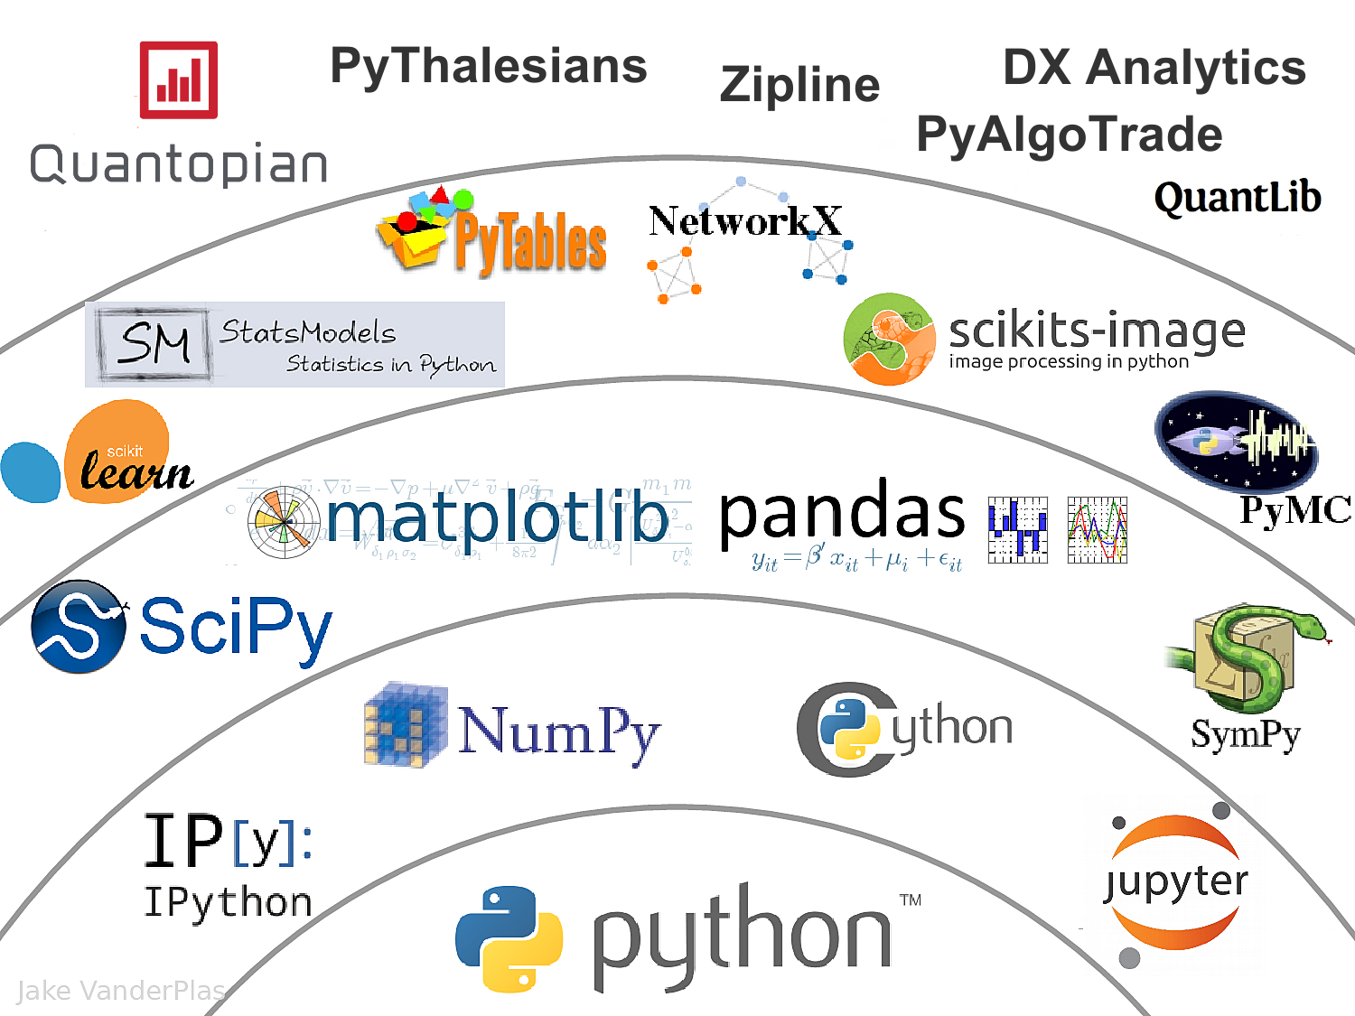
The Quant Finance PyData Stack
Source: http://nbviewer.jupyter.org/format/slides/github/quantopian/pyfolio/blob/master/pyfolio/examples/overview_slides.ipynb#/5

Slide 125
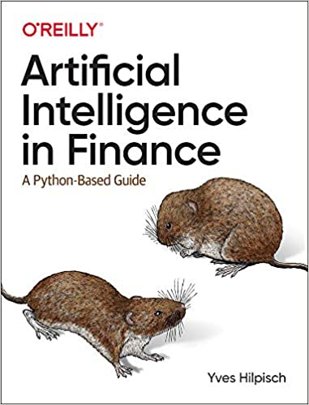
Yves Hilpisch (2020),
Artificial Intelligence in Finance:
A Python-Based Guide,
O’Reilly
Source: https://www.amazon.com/Artificial-Intelligence-Finance-Python-Based-Guide/dp/1492055433

Slide 126
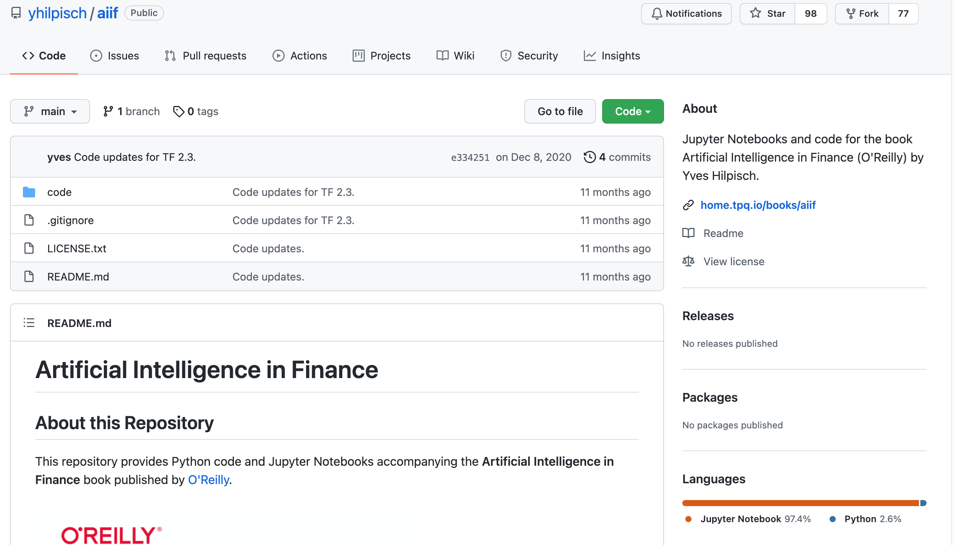
Yves Hilpisch (2020), Artificial Intelligence in Finance: A Python-Based Guide, O’Reilly
https://github.com/yhilpisch/aiif
Source: https://github.com/yhilpisch/aiif

Slide 127
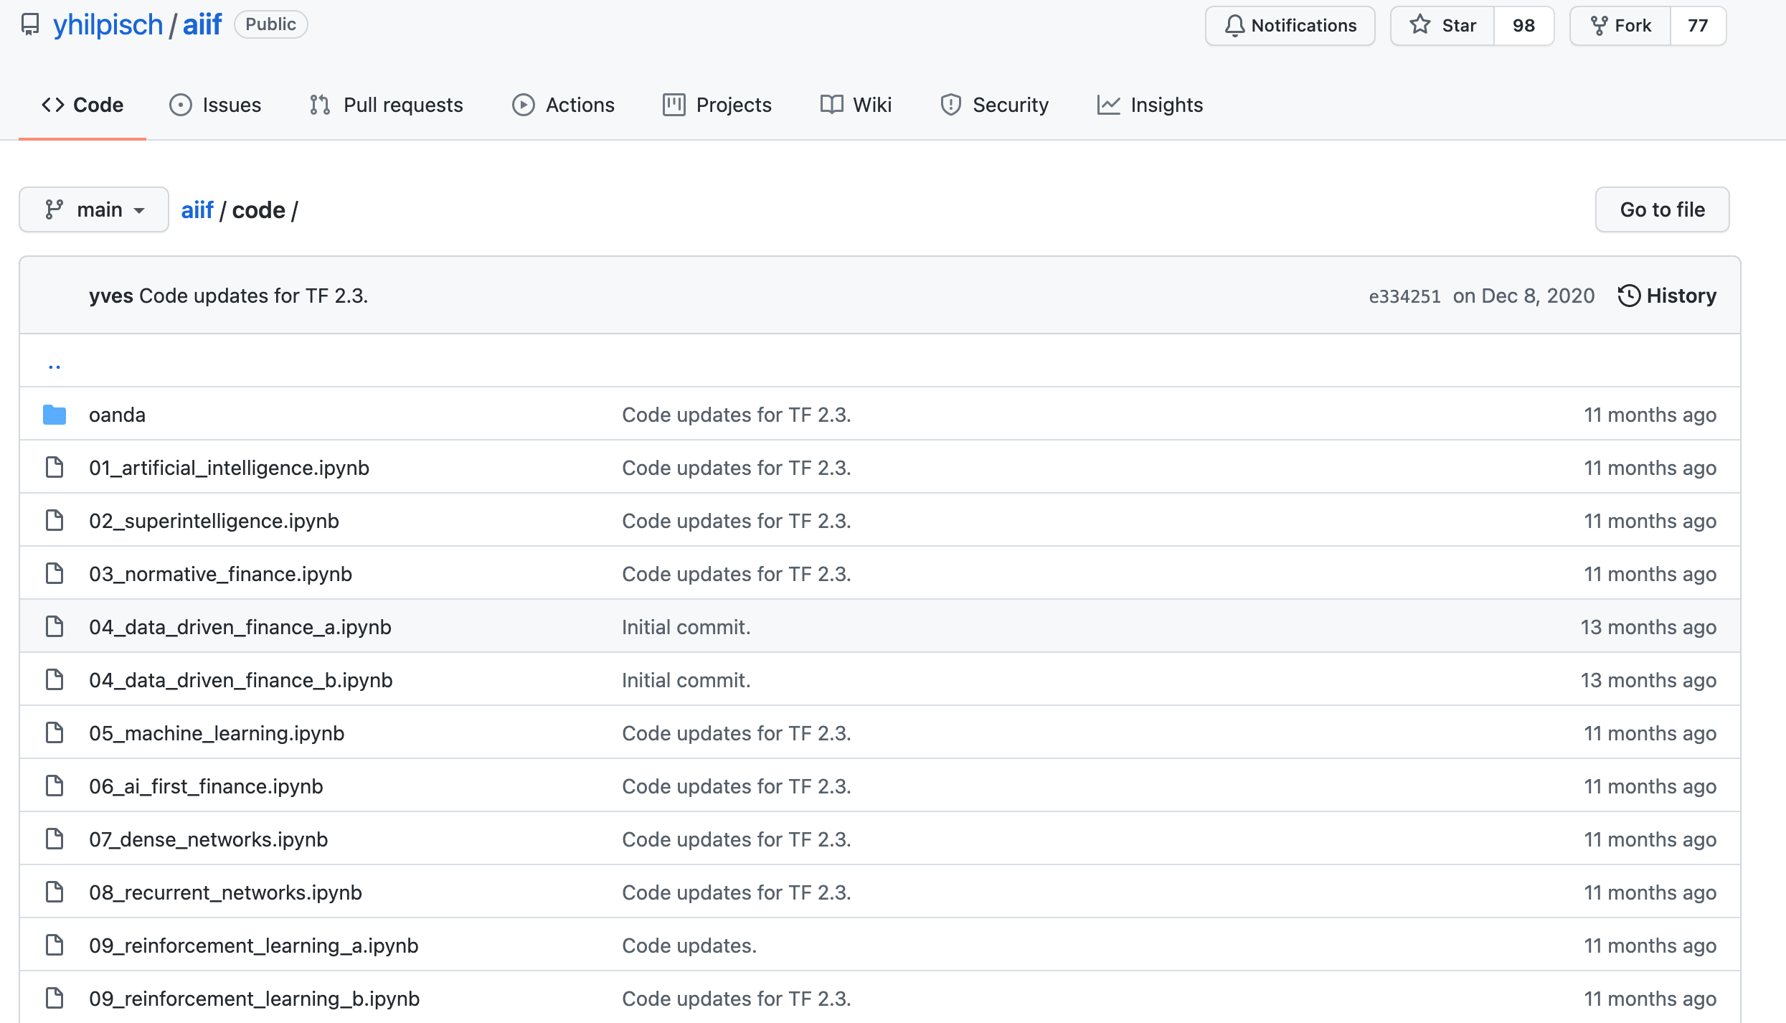
Yves Hilpisch (2020), Artificial Intelligence in Finance: A Python-Based Guide, O’Reilly
https://github.com/yhilpisch/aiif/tree/main/code
Source: https://github.com/yhilpisch/aiif/tree/main/code

Slide 128

Python in Google Colab (Python101)
https://colab.research.google.com/drive/1FEG6DnGvwfUbeo4zJ1zTunjMqf2RkCrT
https://tinyurl.com/aintpupython101

Slide 129
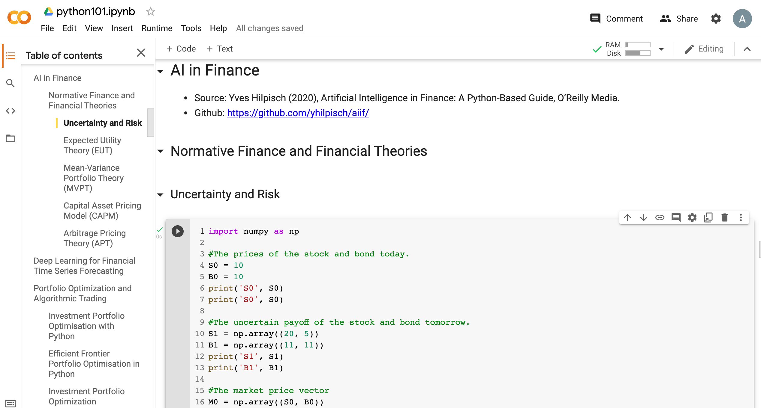
Python in Google Colab (Python101)
https://colab.research.google.com/drive/1FEG6DnGvwfUbeo4zJ1zTunjMqf2RkCrT
AI in Finance
https://tinyurl.com/aintpupython101

Slide 130
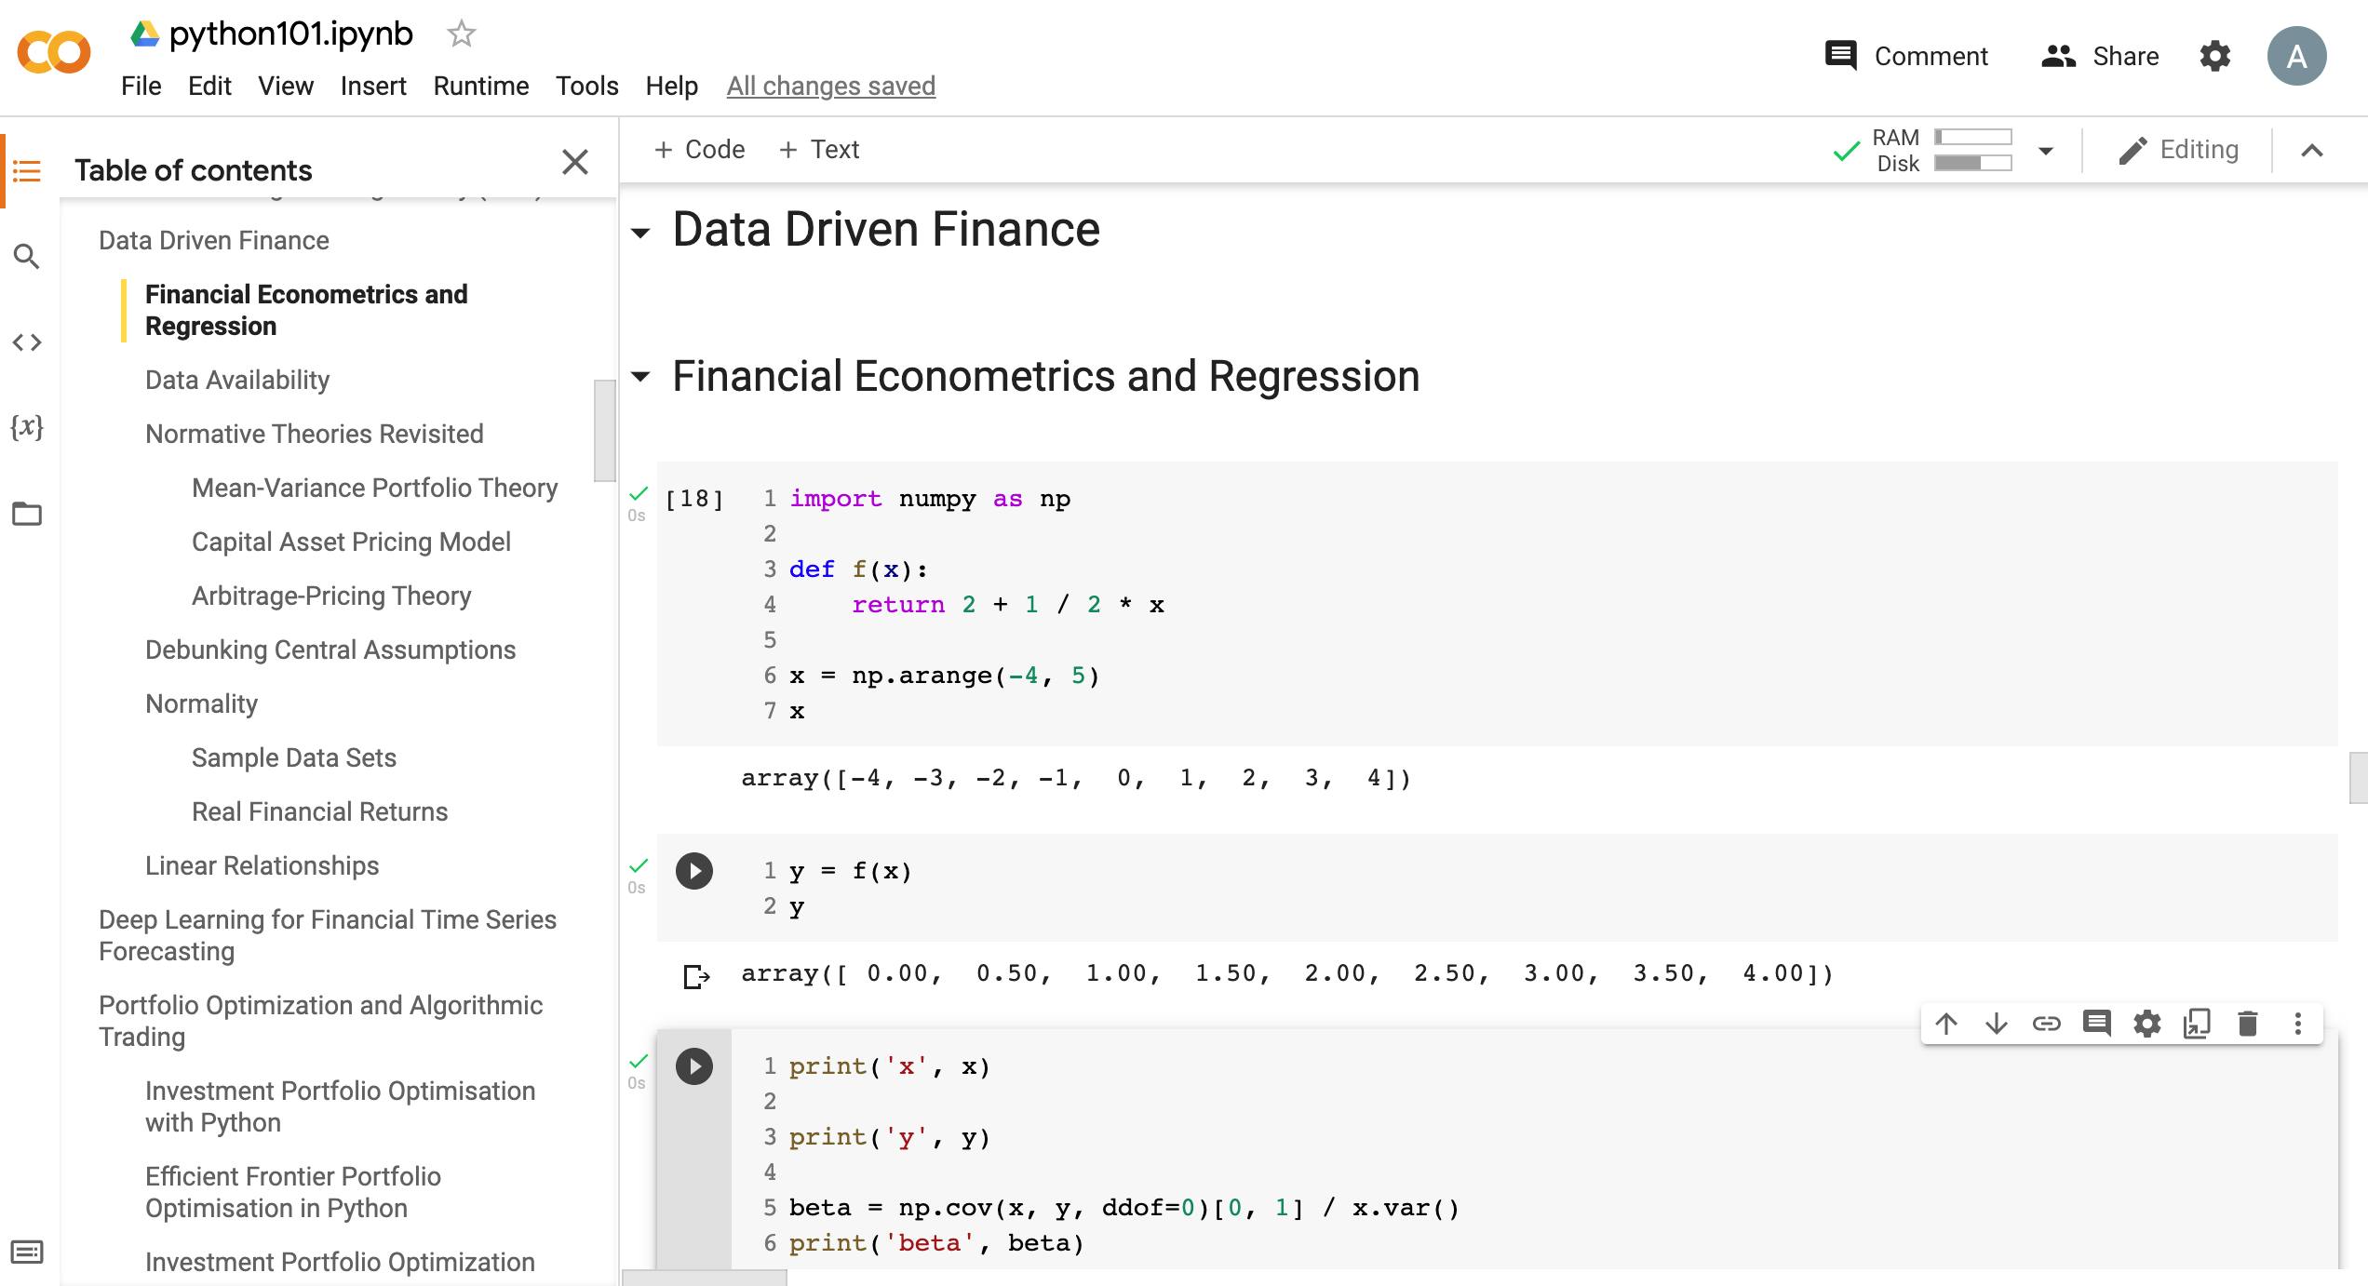
Python in Google Colab (Python101)
Data Driven Finance
https://tinyurl.com/aintpupython101

Slide 131
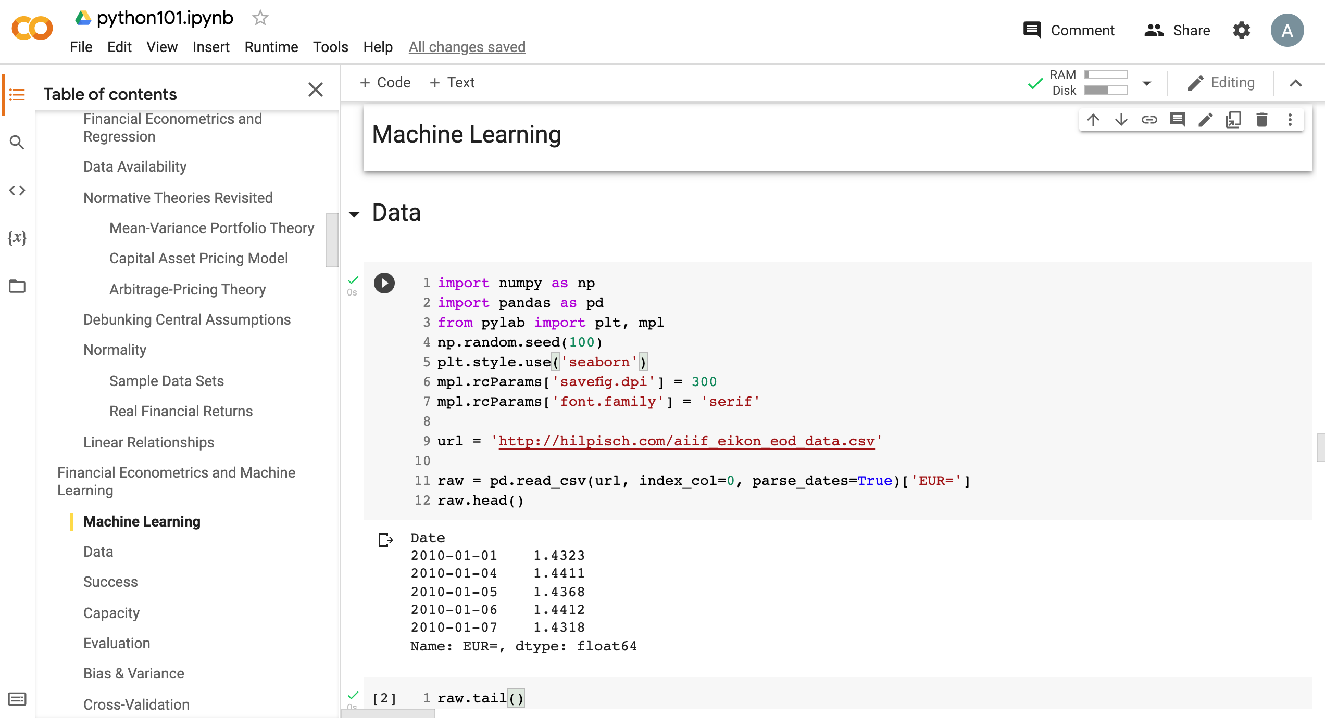
Python in Google Colab (Python101)
Machine Learning
https://tinyurl.com/aintpupython101

Slide 132
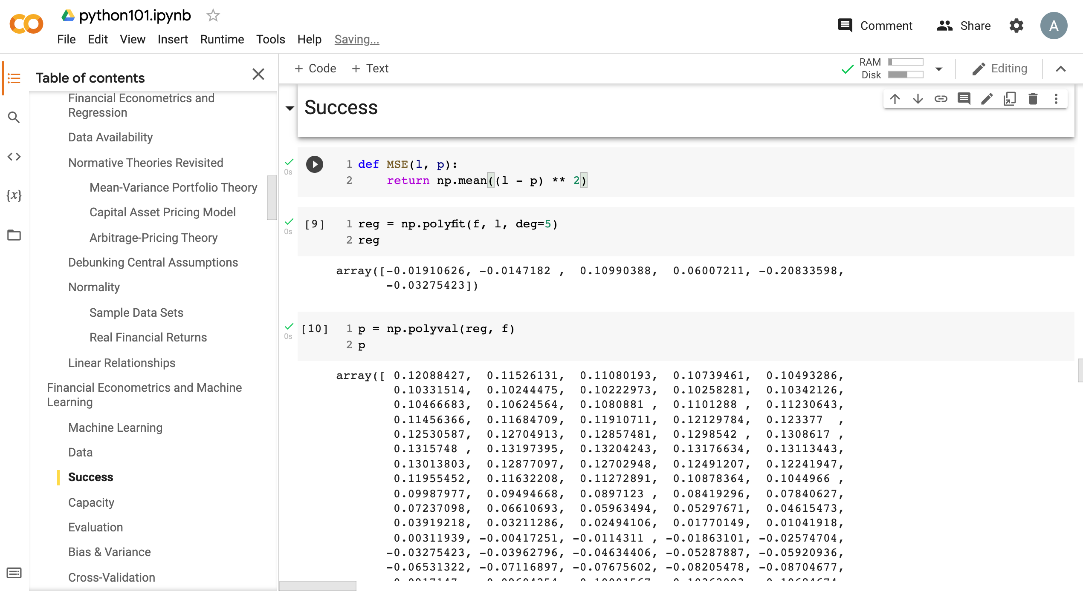
Python in Google Colab (Python101)
https://tinyurl.com/aintpupython101

Slide 133
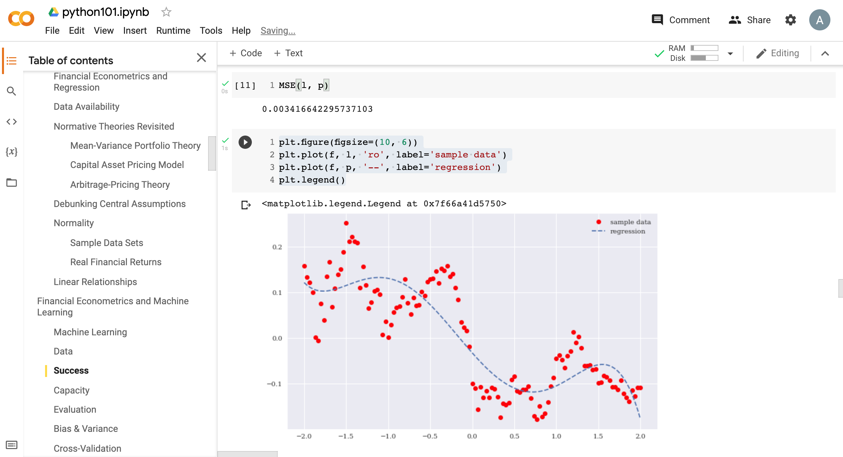
Python in Google Colab (Python101)
https://tinyurl.com/aintpupython101

Slide 134
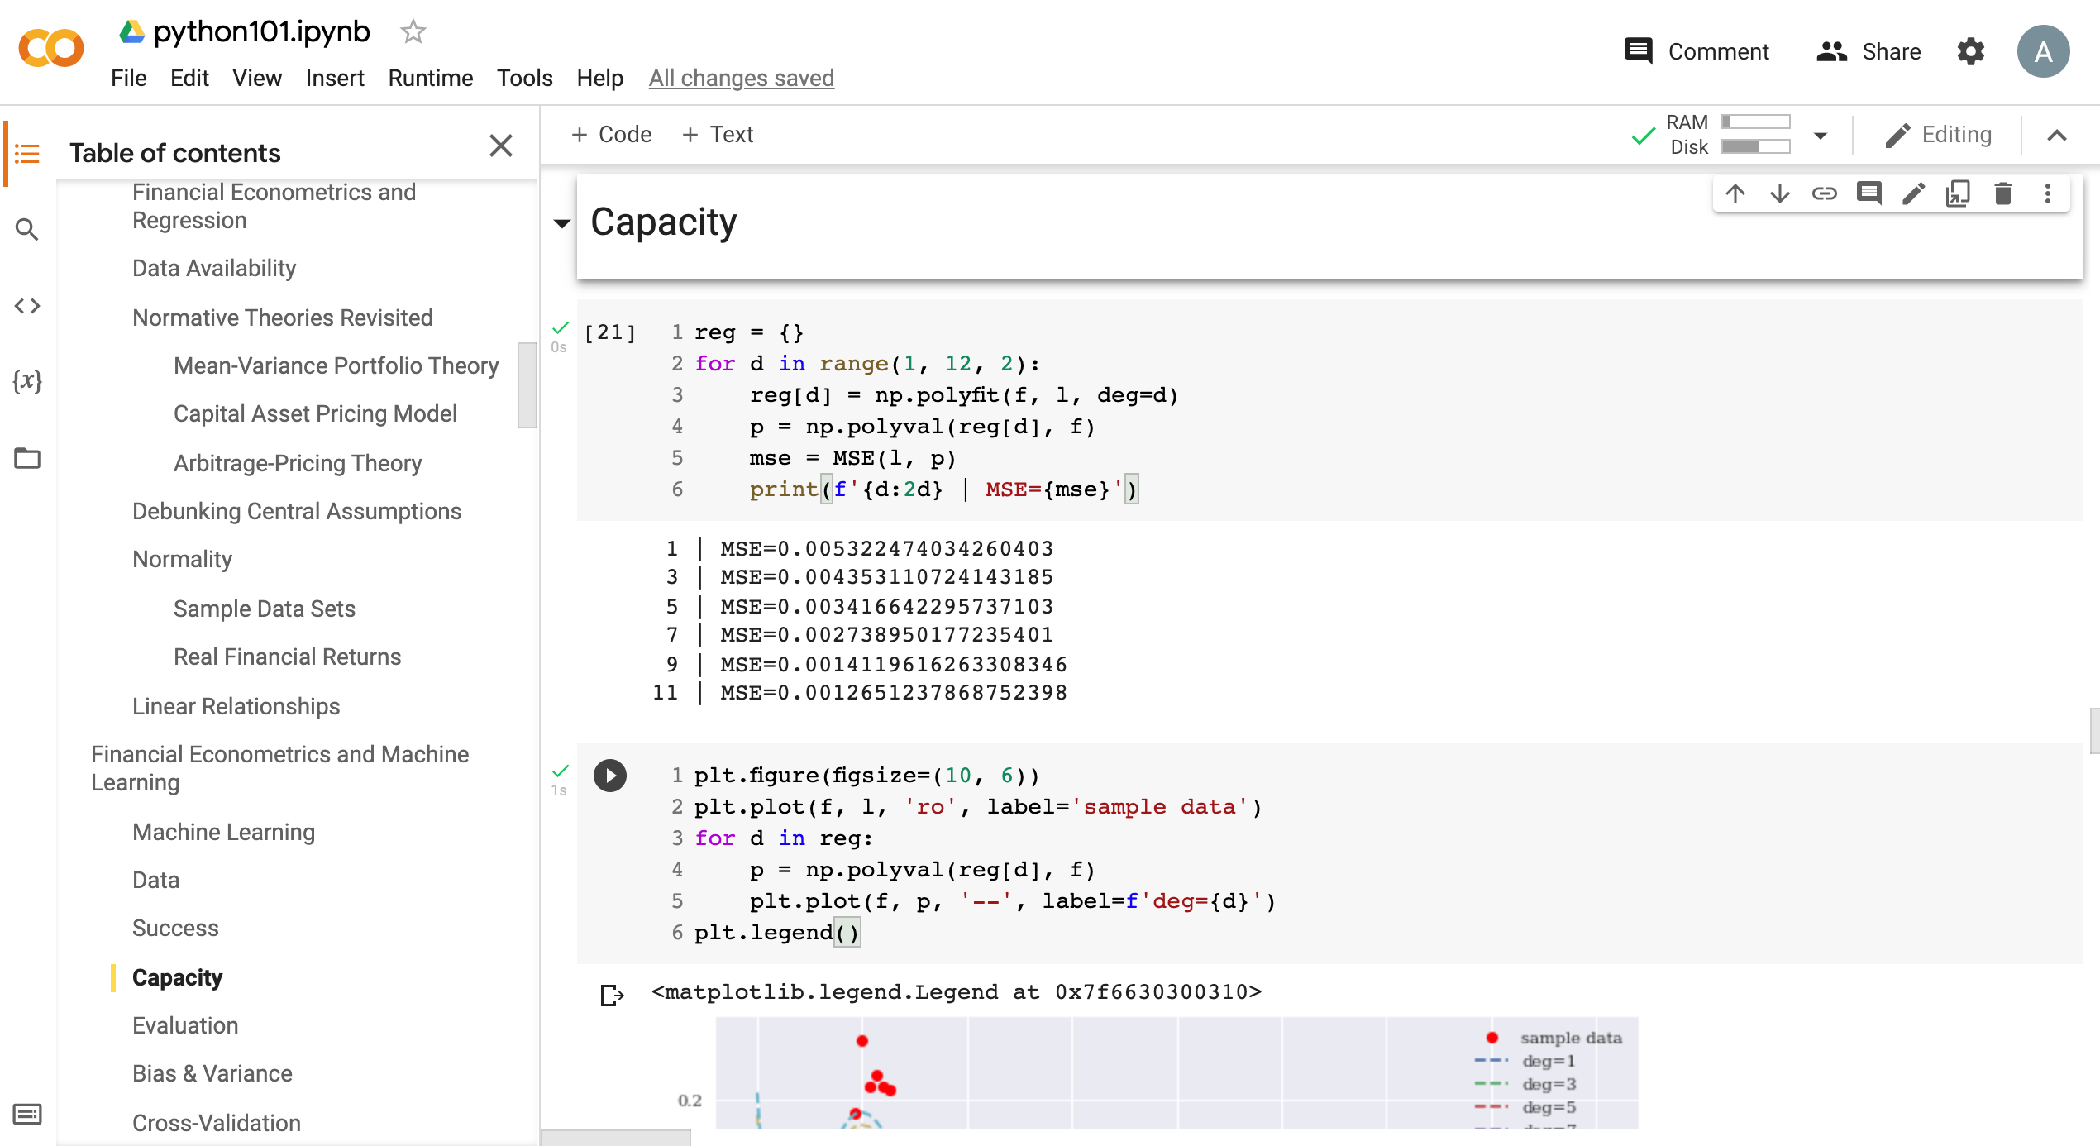
Python in Google Colab (Python101)
https://tinyurl.com/aintpupython101

Slide 135
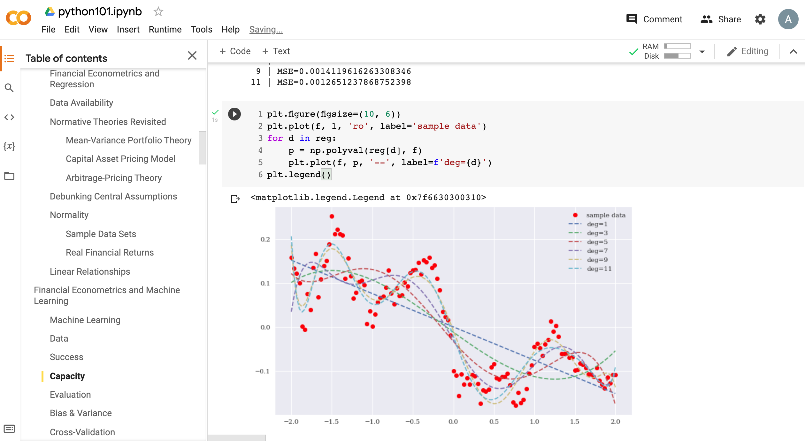
Python in Google Colab (Python101)
https://tinyurl.com/aintpupython101

Slide 136
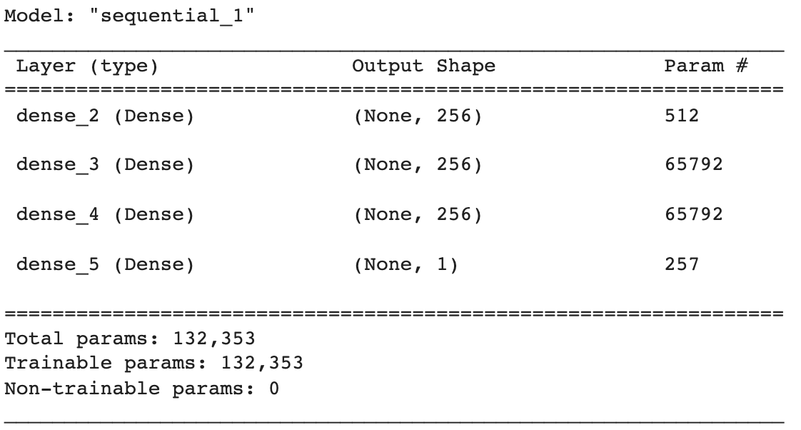
Python in Google Colab (Python101)
def create_dnn_model(hl=1, hu=256):
  ''' Function to create Keras DNN model.
  Parameters
  ==========
  hl: int
  number of hidden layers
  hu: int
  number of hidden units (per layer)
  '''
  model = Sequential()
  for _ in range(hl):
    model.add(Dense(hu, activation='relu', input_dim=1))
  model.add(Dense(1, activation='linear'))
  model.compile(loss='mse', optimizer='rmsprop')
  return model
model = create_dnn_model(3)
model.summary()
https://tinyurl.com/aintpupython101

Slide 137
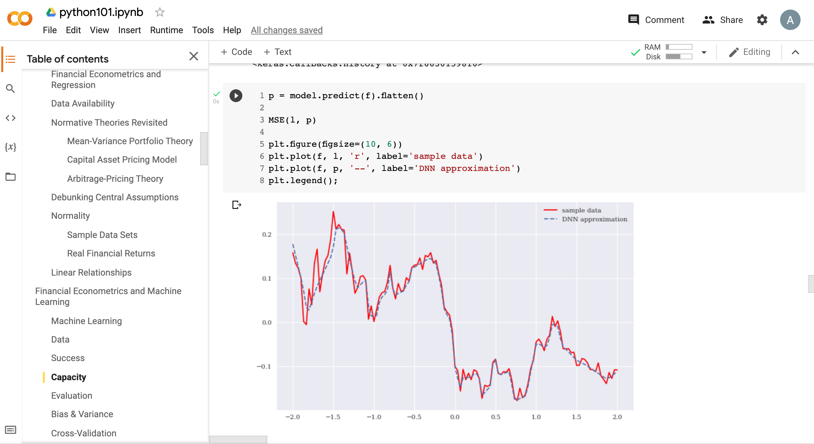
Python in Google Colab (Python101)
https://tinyurl.com/aintpupython101

Slide 138
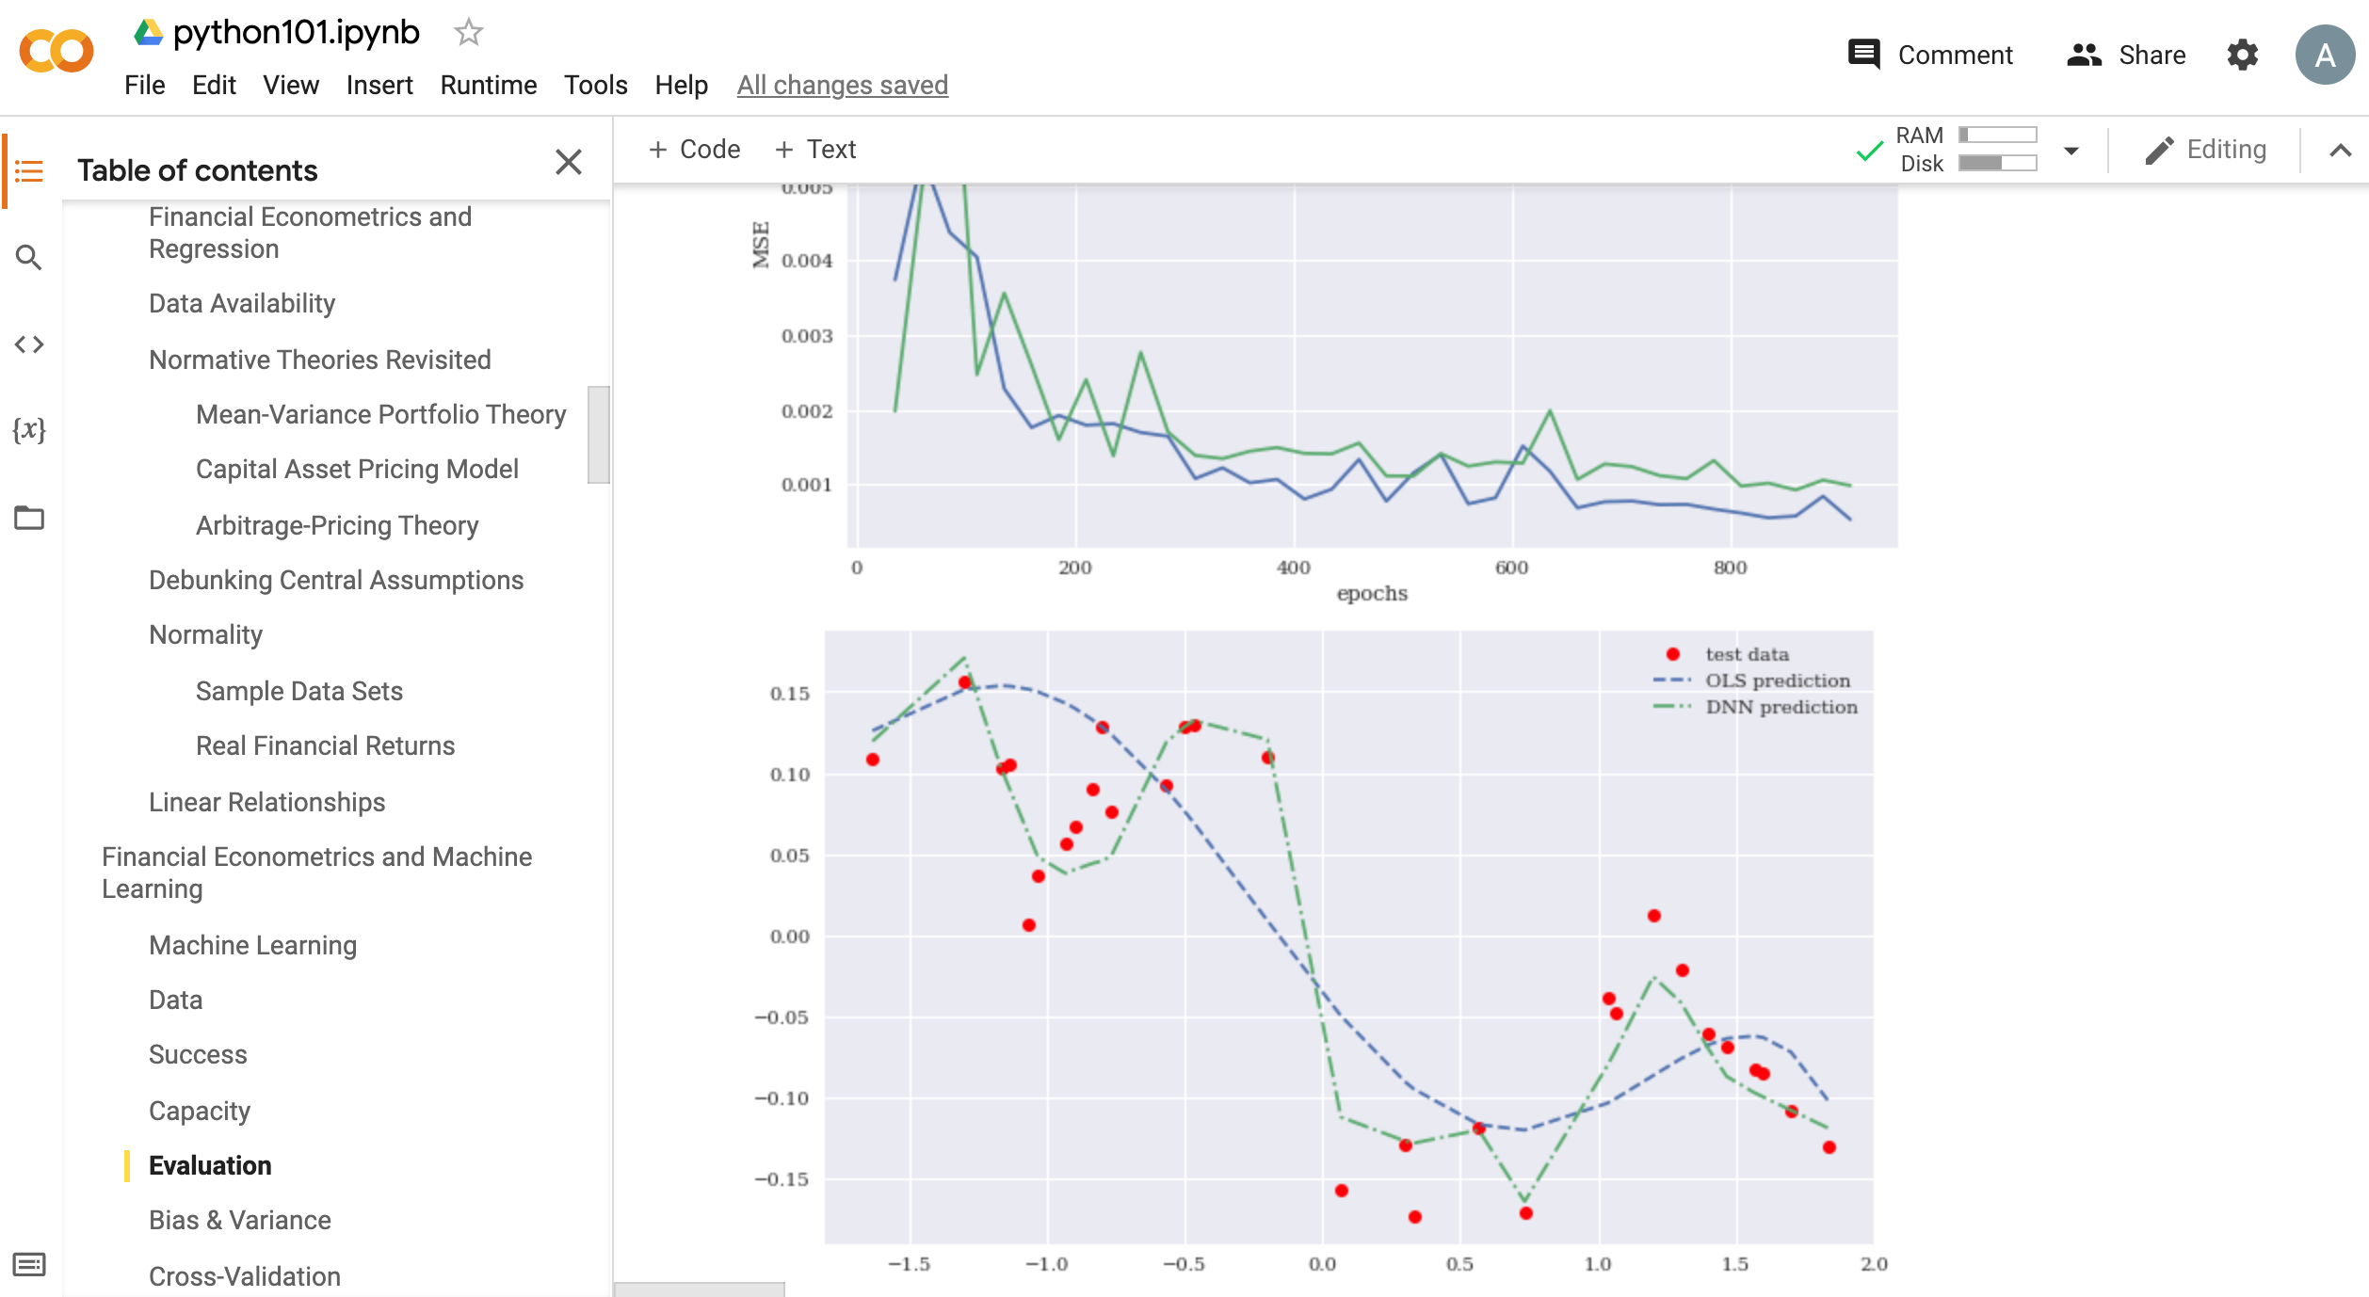
Python in Google Colab (Python101)
https://tinyurl.com/aintpupython101

Slide 139
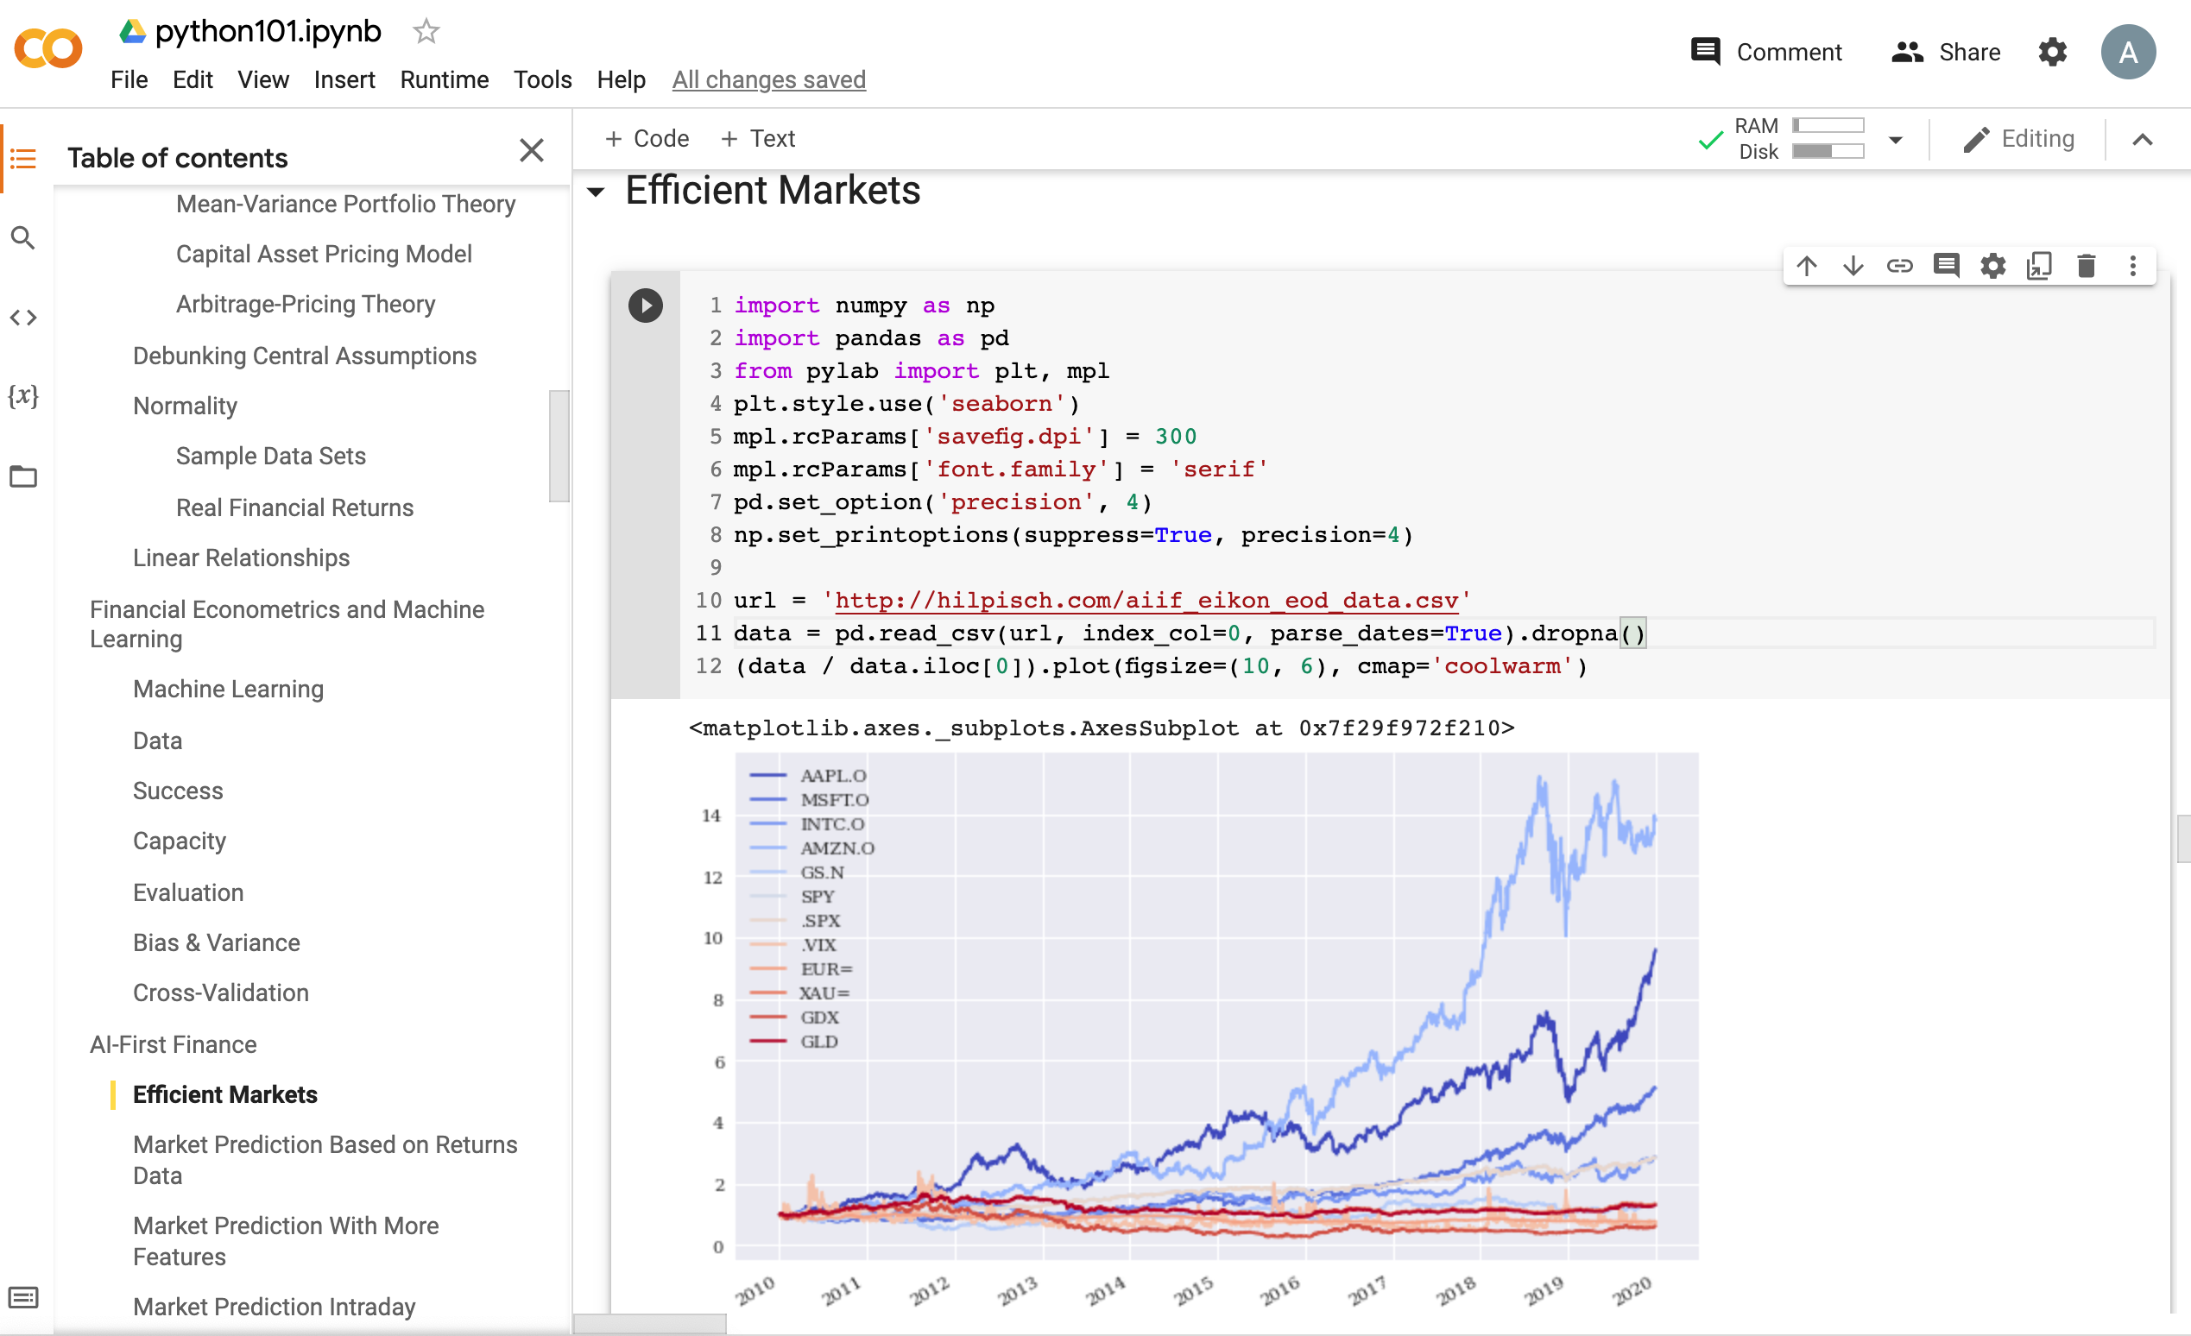
Python in Google Colab (Python101)
Efficient Markets
https://tinyurl.com/aintpupython101

Slide 140
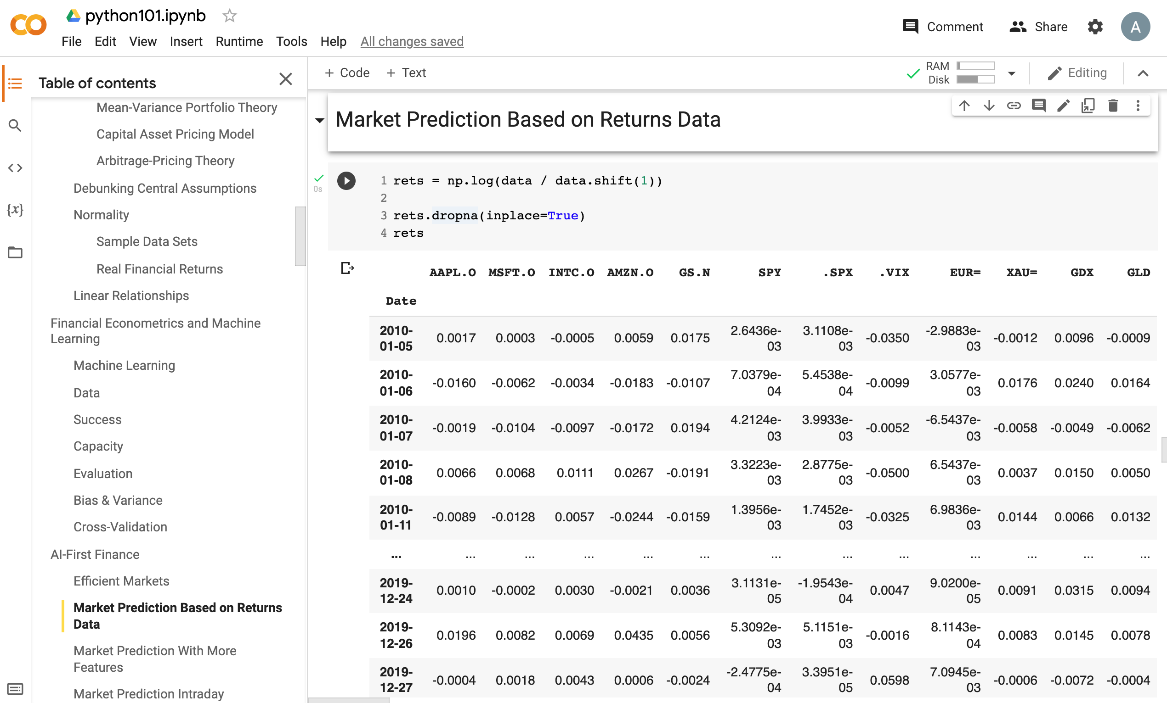
Python in Google Colab (Python101)
Market Prediction
Based on Returns Data
https://tinyurl.com/aintpupython101

Slide 141
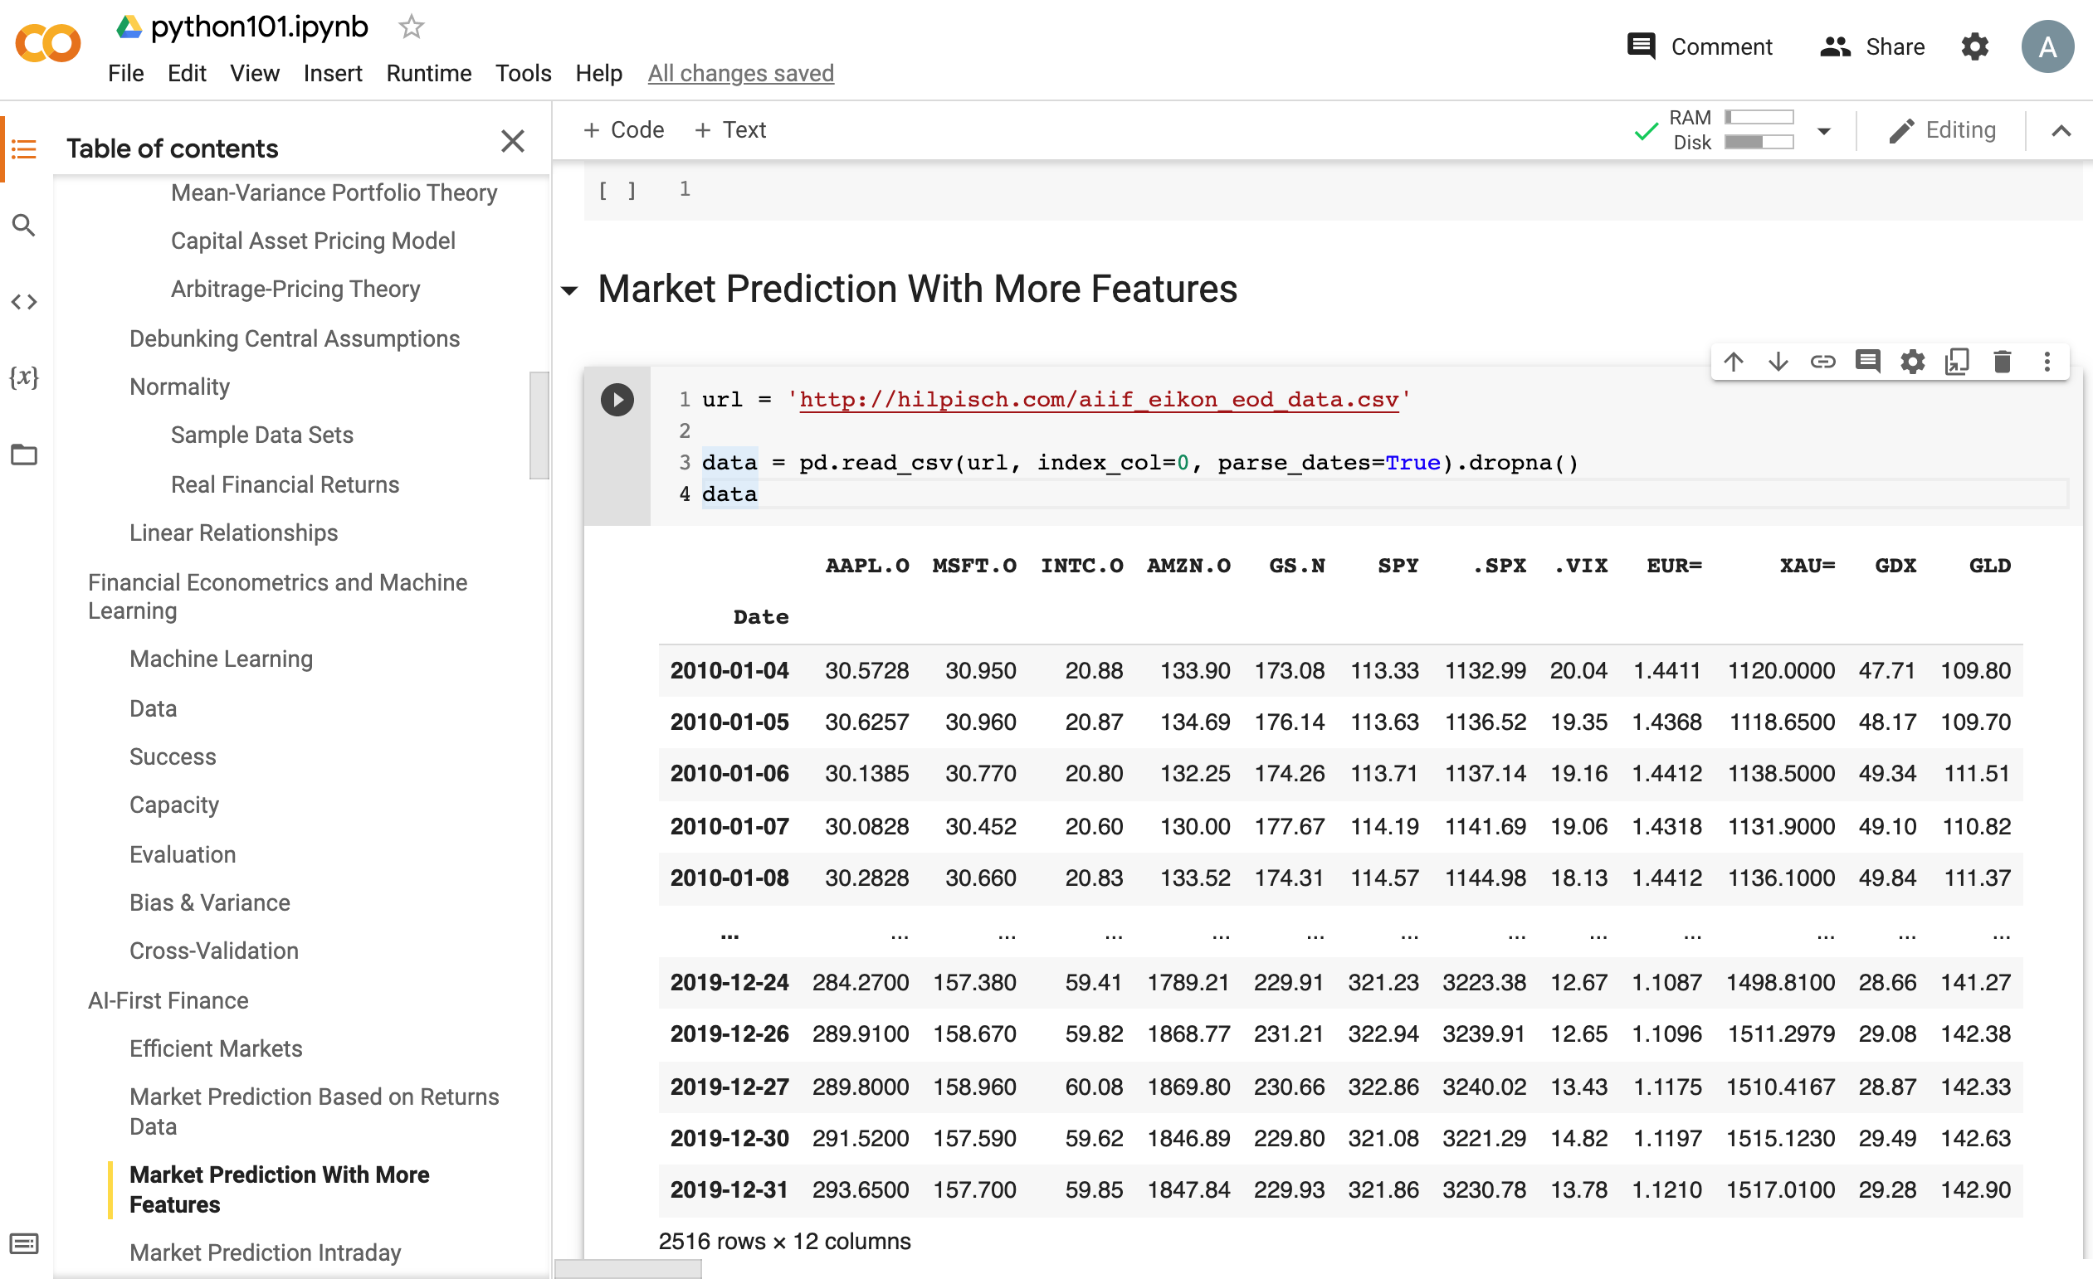
Python in Google Colab (Python101)
Market Prediction
with More Features
https://tinyurl.com/aintpupython101

Slide 142
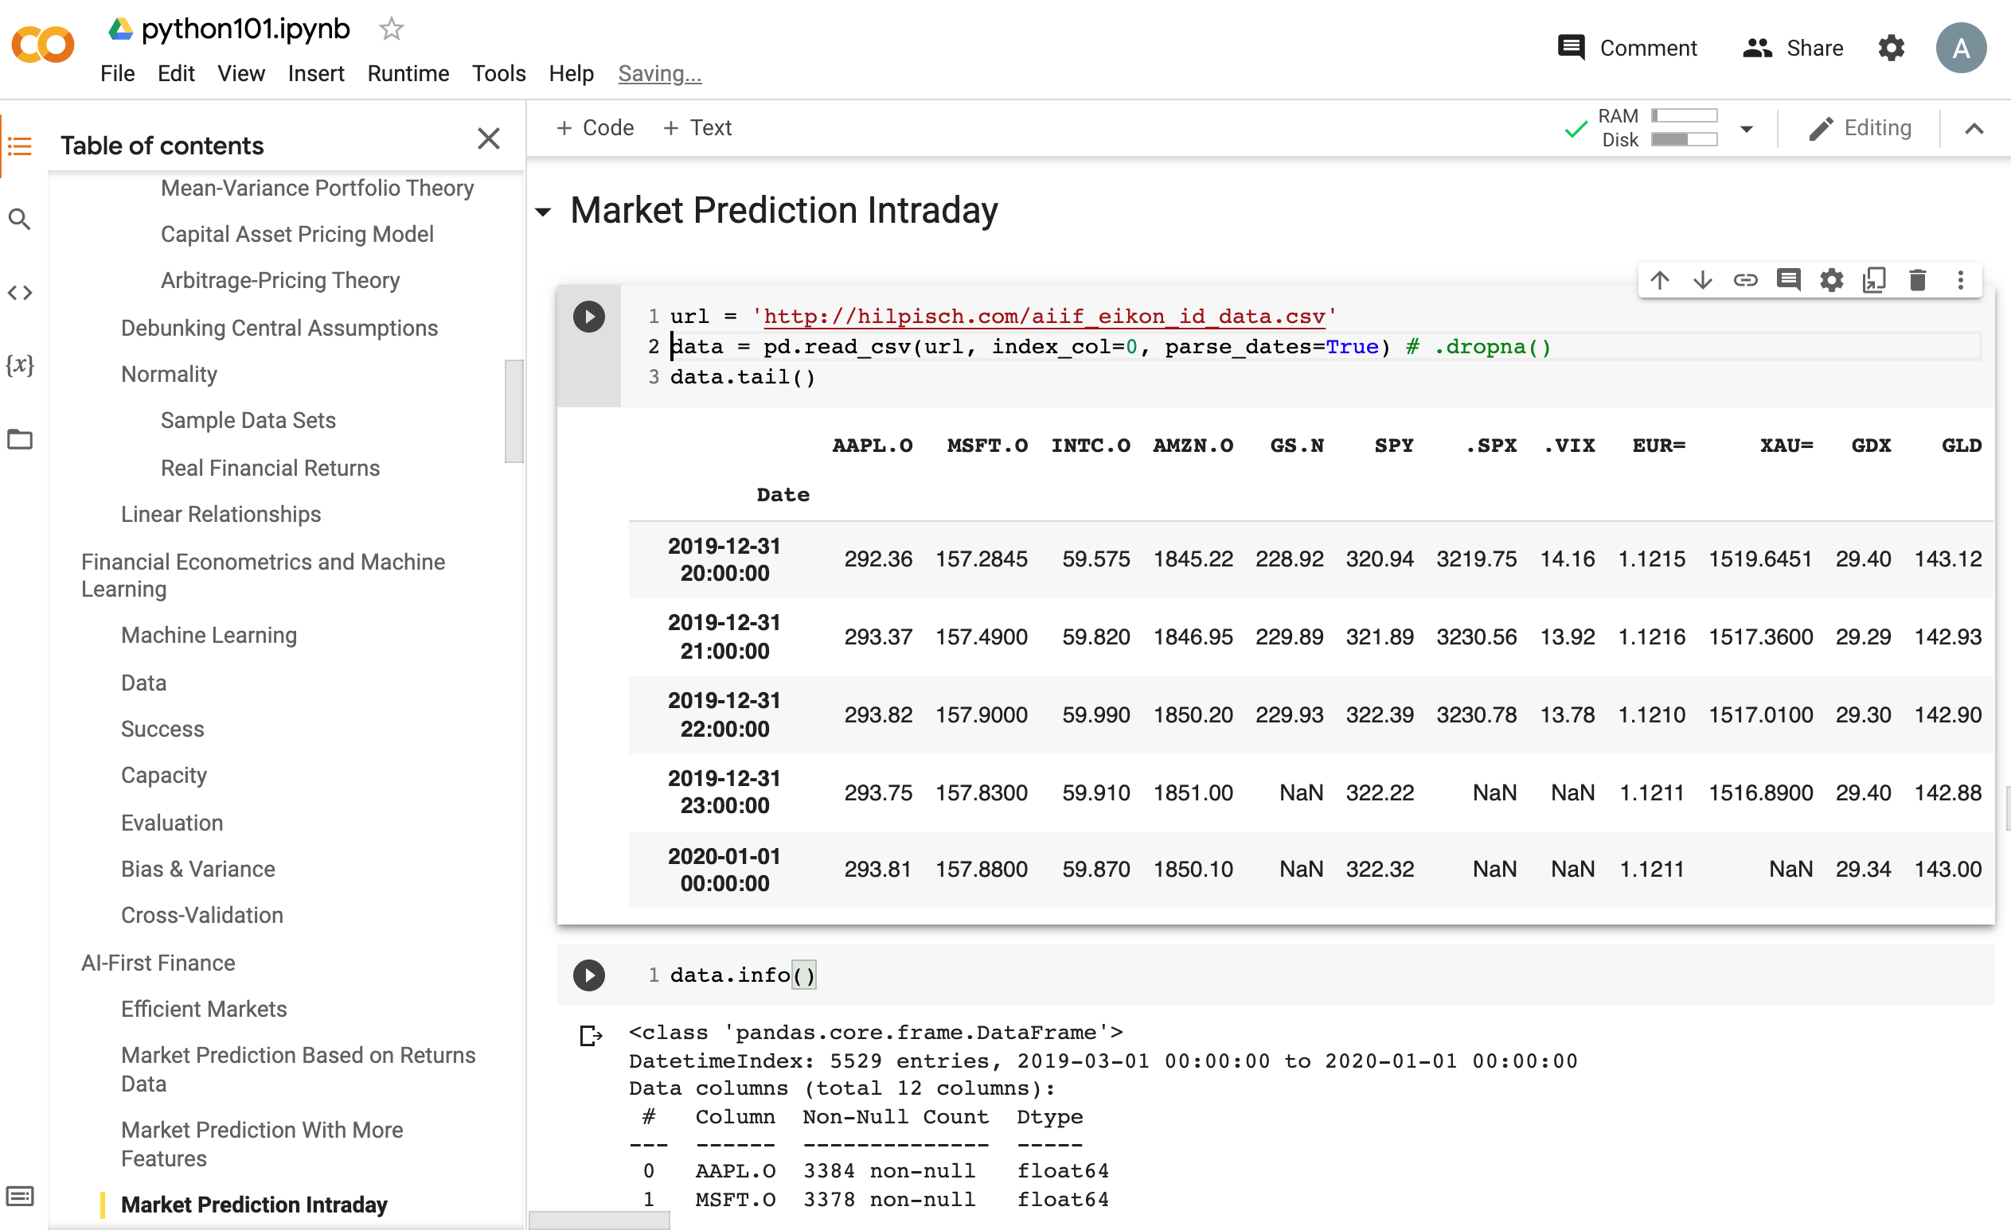
Python in Google Colab (Python101)
Market Prediction Intraday
https://tinyurl.com/aintpupython101

Slide 143
Summary
Financial Econometrics
  Financial Theories, OLS Regression
Machine Learning
  Learning, Evaluation, Bias and variance
  Cross-validation
AI-First Finance
  Efficient Markets
  Market Prediction Based on Returns Data
  Market Prediction with More Features
Source: Yves Hilpisch (2020), Artificial Intelligence in Finance: A Python-Based Guide, O’Reilly Media.

Slide 144
References
Yves Hilpisch (2020), Artificial Intelligence in Finance: A Python-Based Guide, O’Reilly Media, https://github.com/yhilpisch/aiif .
Chris Brooks (2019), Introductory Econometrics for Finance, 4th Edition, Cambridge University Press
Oliver Linton (2019), Financial Econometrics: Models and Methods, Cambridge University Press
Tom Mitchell (1997), Machine Learning, McGraw-Hill.
Max Tegmark (2017), Life 3.0: Being human in the age of artificial intelligence. Vintage.
Ajay Agrawal, Joshua Gans, and Avi Goldfarb (2018). Prediction machines: the simple economics of artificial intelligence. Harvard Business Press.
Eugene F. Fama (1995), "Random walks in stock market prices." Financial Analysts Journal 51, no. 1, 75-80.
Ruey S. Tsay (2005), Analysis of financial time series, Wiley.
Min-Yuh Day (2023), Python 101, https://tinyurl.com/aintpupython101

