Slide 1








Algorithmic Trading; Risk Management; Trading Bot and Event-Based Backtesting
Artificial Intelligence in Finance and Quantitative Analysis
1121AIFQA08
MBA, IM, NTPU (M5276) (Fall 2023)
Tue 2, 3, 4 (9:10-12:00) (B3F17)
Min-Yuh Day, Ph.D,
Associate Professor
Institute of Information Management, National Taipei University
https://web.ntpu.edu.tw/~myday
https://meet.google.com/paj-zhhj-mya
2023-12-19

Slide 2
Syllabus
Week Date Subject/Topics
1 2023/09/12 Introduction to Artificial Intelligence in Finance and
Quantitative Analysis
2 2023/09/19 AI in FinTech: Metaverse, Web3, DeFi, NFT,
Financial Services Innovation and Applications
3 2023/09/26 Investing Psychology and Behavioral Finance
4 2023/10/03 Event Studies in Finance
5 2023/10/10 National Day (Day off)
6 2023/10/17 Case Study on AI in Finance and Quantitative Analysis I

Slide 3
Syllabus
Week Date Subject/Topics
7 2023/10/24 Finance Theory and Data-Driven Finance
8 2023/10/31 Midterm Project Report
9 2023/11/07 Financial Econometrics
10 2023/11/14 AI-First Finance
11 2023/11/21 Deep Learning in Finance;
Reinforcement Learning in Finance
12 2023/11/28 Case Study on AI in Finance and Quantitative Analysis II

Slide 4
Syllabus
Week Date Subject/Topics
13 2023/12/05 Industry Practices of AI in Finance and Quantitative
Analysis
14 2023/12/12 Self-study
15 2023/12/19 Algorithmic Trading; Risk Management;
Trading Bot and Event-Based Backtesting
16 2023/12/26 Final Project Report I
17 2024/01/02 Final Project Report II
18 2024/01/09 Self-study

Slide 5
Algorithmic Trading
Risk Management
Trading Bot
Event-Based Backtesting

Slide 6
Outline
Algorithmic Trading
Risk Management
Trading Bot
Event-Based Backtesting
Source: Yves Hilpisch (2020), Artificial Intelligence in Finance: A Python-Based Guide, O’Reilly Media.

Slide 7
Deep learning for financial applications: Topic-Model Heatmap
Source: Ahmet Murat Ozbayoglu, Mehmet Ugur Gudelek, and Omer Berat Sezer (2020). "Deep learning for financial applications: A survey." Applied Soft Computing (2020): 106384.

Slide 8
Deep learning for financial applications: Topic-Feature Heatmap
Source: Ahmet Murat Ozbayoglu, Mehmet Ugur Gudelek, and Omer Berat Sezer (2020). "Deep learning for financial applications: A survey." Applied Soft Computing (2020): 106384.

Slide 9
Deep learning for financial applications: Topic-Dataset Heatmap
Source: Ahmet Murat Ozbayoglu, Mehmet Ugur Gudelek, and Omer Berat Sezer (2020). "Deep learning for financial applications: A survey." Applied Soft Computing (2020): 106384.

Slide 10
Deep learning for financial applications:
Algo-trading applications embedded with time series forecasting models
Source: Ahmet Murat Ozbayoglu, Mehmet Ugur Gudelek, and Omer Berat Sezer (2020). "Deep learning for financial applications: A survey." Applied Soft Computing (2020): 106384.

Slide 11
Deep learning for financial applications:
Algo-trading applications embedded with time series forecasting models
Source: Ahmet Murat Ozbayoglu, Mehmet Ugur Gudelek, and Omer Berat Sezer (2020). "Deep learning for financial applications: A survey." Applied Soft Computing (2020): 106384.

Slide 12
Algorithmic Trading

Slide 13
Algorithmic Trading
Historical Finance Market Data
Live Finance Market Data
Computer Program
Order Status
Broker API
Order
Backtest Results
Order
Order Status
Broker’s Server
Source: Ernest P. Chan (2017), Machine Trading: Deploying Computer Algorithms to Conquer the Markets, Wiley

Slide 14
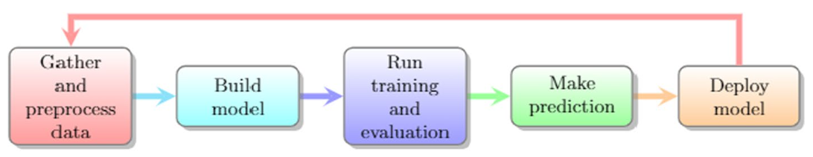
Process of Machine Learning in Predicting Cryptocurrency
Source: Fan Fang, Carmine Ventre, Michail Basios, Leslie Kanthan, David Martinez-Rego, Fan Wu, and Lingbo Li. (2023) "Cryptocurrency trading: a comprehensive survey." Financial Innovation 8, no. 1 (2022): 1-59.

Slide 15
Stock Market Movement Forecast:
Phases of the stock market modeling
Source: O. Bustos and A. Pomares-Quimbaya (2020), "Stock Market Movement Forecast: A Systematic Review."
Expert Systems with Applications (2020): 113464.

Slide 16
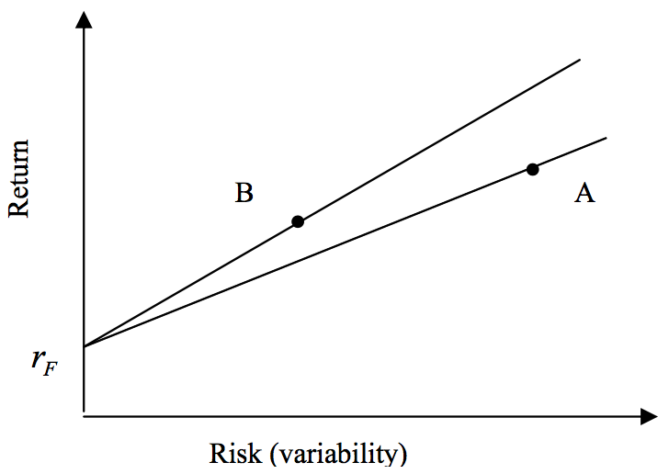
Risk and Return
Source: Bacon, Carl. "How sharp is the Sharpe-ratio?-Risk-adjusted Performance Measures." Statpro White Paper (2000).

Slide 17
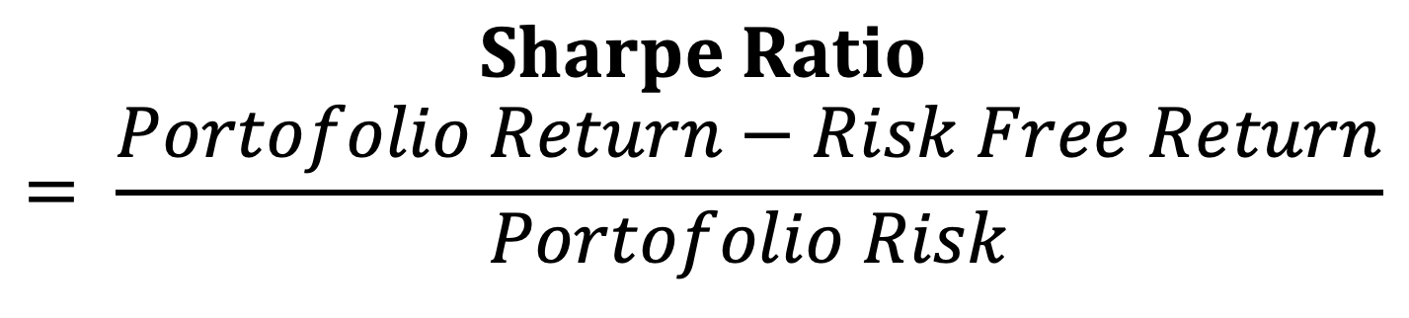
Sharpe Ratio
$$Sharpe Ratio= \frac{Portofolio Return−Risk Free Return}{Portofolio Risk}$$
Source: Bacon, Carl. "How sharp is the Sharpe-ratio?-Risk-adjusted Performance Measures." Statpro White Paper (2000).

Slide 18
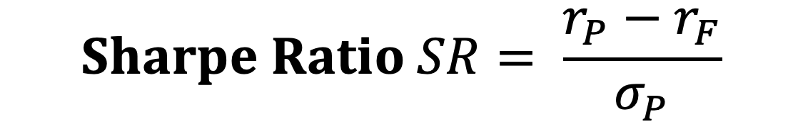
Sharpe Ratio
$$Sharpe Ratio SR= \frac{r_{P}−r_{F}}{σ_{P}}$$
Where
r_{P} = portfolio return
r_{F} = risk free rate
σ_{P} = portfolio risk (variability, standard deviation of return)
Source: Bacon, Carl. "How sharp is the Sharpe-ratio?-Risk-adjusted Performance Measures." Statpro White Paper (2000).

Slide 19
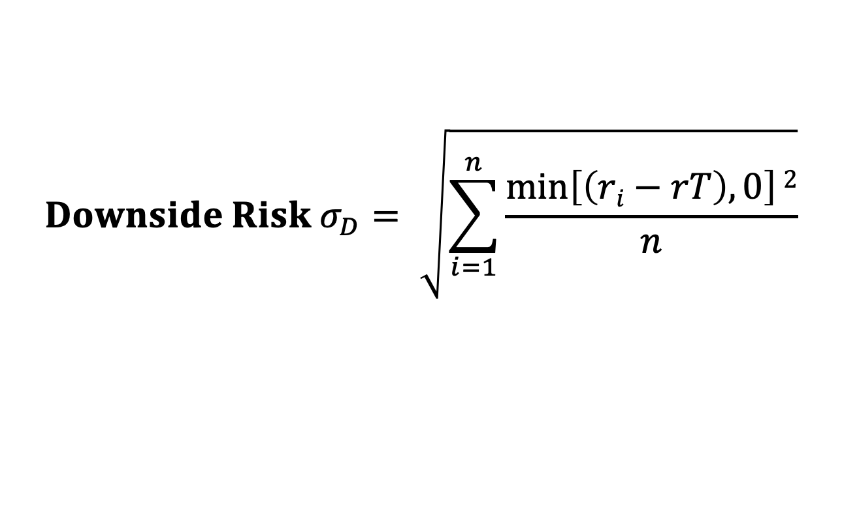
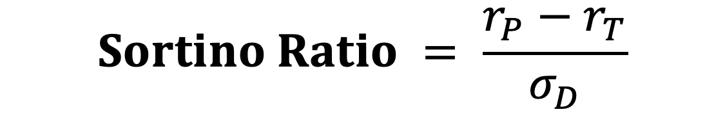
Sortino Ratio
$$Sortino Ratio = \frac{r_{P}−r_{T}}{σ_{D}}$$
Where
r_{P} = portfolio return
r_{T} = Minimum Target Return
σ_{D} = Downside Risk
$$Downside Risk{ σ}_{D}= \sqrt{\sum_{i=1}^{n}{\frac{\min\left[\left(ri−rT\right),0\right]2}{n}}}$$
Source: Bacon, Carl. "How sharp is the Sharpe-ratio?-Risk-adjusted Performance Measures." Statpro White Paper (2000).

Slide 20
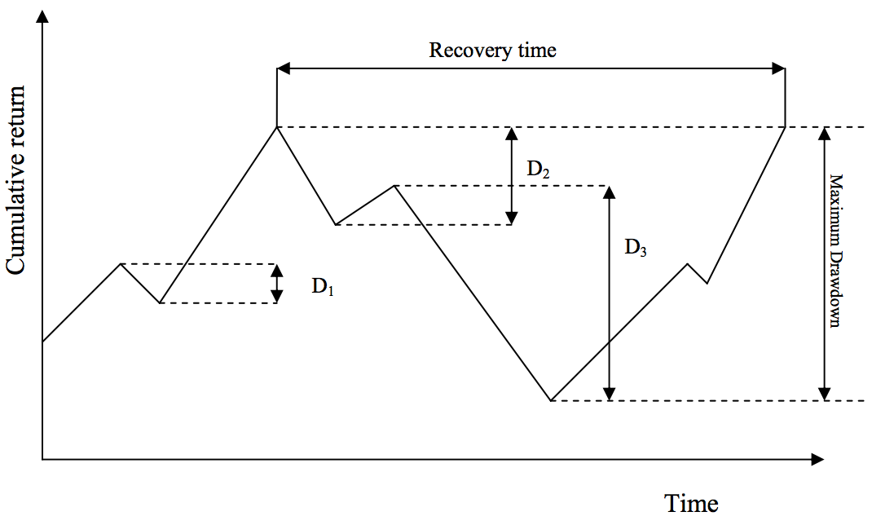
Max Drawdown
Source: Bacon, Carl. "How sharp is the Sharpe-ratio?-Risk-adjusted Performance Measures." Statpro White Paper (2000).

Slide 21
Portfolio Optimization
Efficient Frontier
Efficient Frontier
Return
Risk
Source: Tucker Balch (2012), Investment Science: Portfolio Optimization, https://www.youtube.com/watch?v=5qbMhXXq0vI

Slide 22
Backtesting
Financial Functions (ffn)
  https://pmorissette.github.io/ffn/
backtesting.py
  https://kernc.github.io/backtesting.py/
Visualization
  Plotly Express (px)
    https://plotly.com/python/plotly-express/
  Bokeh
    https://bokeh.org/

Slide 23
!pip install ffn
import ffn
import plotly.express as px
%pylab inline
#BTC-USD Bitcoin USD
df = ffn.get('btc-usd', start='2016-01-01', end='2021-12-31')
print('df')
print(df.head())
print(df.tail())
print(df.describe())
df.plot(figsize=(14,10))
returns = df.to_returns().dropna()
print('returns')
print(returns.head())
print(returns.tail())
print(returns.describe())
#ax = df.plot(figsize=(12,9))
perf = df.calc_stats()
perf.plot(figsize=(14, 10))
print(perf.display())
fig = px.line(df, x=df.index, y="btcusd", title='btcusd')
fig.update_layout(title='btcusd price', xaxis_title='Date', yaxis_title='Price')
#fig.update_traces(mode='markers+lines')
fig.show()
fig = px.line(returns, x=returns.index, y="btcusd", title='btcusd')
fig.update_layout(title='btcusd returns', xaxis_title='Date', yaxis_title='Returns')
fig.show()
fig = px.histogram(returns, x='btcusd', nbins=40, histnorm='probability', width=800, height=400)
fig.update_layout(title='btcusd returns histogram')
fig.show()
fig = px.box(returns, y='btcusd', points = 'all')
fig.update_layout(title='btcusd returns box')
fig.update_traces(boxmean='sd')
fig.show()
Financial Functions (ffn)
plotly.express (px)

Slide 24
Financial Functions (ffn) plotly.express (px)
# Upgrade pandas-datareader
!pip install --upgrade pandas
!pip install --upgrade pandas-datareader
!pip install ffn
import ffn
import plotly.express as px
%pylab inline
#BTC-USD Bitcoin USD
df = ffn.get('btc-usd', start='2016-01-01', end='2021-12-31')
print('df')
print(df.head())
print(df.tail())
print(df.describe())
df.plot(figsize=(14,10))

Slide 25
Financial Functions (ffn) plotly.express (px)
returns = df.to_returns().dropna()
print('returns')
print(returns.head())
print(returns.tail())
print(returns.describe())
#ax = df.plot(figsize=(12,9))

Slide 26
Financial Functions (ffn) plotly.express (px)
perf = df.calc_stats()
perf.plot(figsize=(14, 10))
print(perf.display())
fig = px.line(df, x=df.index, y="btcusd", title='btcusd')
fig.update_layout(title='btcusd price', xaxis_title='Date', yaxis_title='Price')
#fig.update_traces(mode='markers+lines')
fig.show()
fig = px.line(returns, x=returns.index, y="btcusd", title='btcusd')
fig.update_layout(title='btcusd returns', xaxis_title='Date', yaxis_title='Returns')
fig.show()

Slide 27
Financial Functions (ffn) plotly.express (px)
fig = px.histogram(returns, x='btcusd', nbins=40, histnorm='probability', width=800, height=400)
fig.update_layout(title='btcusd returns histogram')
fig.show()
fig = px.box(returns, y='btcusd', points = 'all')
fig.update_layout(title='btcusd returns box')
fig.update_traces(boxmean='sd')
fig.show()

Slide 28
Financial Functions (ffn)
btcusd
Date
2016-01-01 434.334015
2016-01-02 433.437988
2016-01-03 430.010986
2016-01-04 433.091003
2016-01-05 431.959991
btcusd
Date
2021-12-28 47588.855469
2021-12-29 46444.710938
2021-12-30 47178.125000
2021-12-31 46306.445312
2022-01-01 47686.812500
btcusd
count 2193.000000
mean 13025.164562
std 16489.530523
min 364.330994
25% 2589.409912
50% 7397.796875
75% 11358.662109
max 67566.828125

Slide 29
Financial Functions (ffn) calc_stats() display()
Stat btcusd
------------------- ----------
Start 2016-01-01
End 2022-01-01
Risk-free rate 0.00%
Total Return 10879.29%
Daily Sharpe 1.18
Daily Sortino 1.95
CAGR 118.79%
Max Drawdown -83.40%
Calmar Ratio 1.42

Slide 30
Financial Functions (ffn)
calc_stats() display()
MTD 2.98%
3m -0.89%
6m 42.04%
YTD 2.98%
1Y 62.34%
3Y (ann.) 131.46%
5Y (ann.) 116.71%
10Y (ann.) -
Since Incep. (ann.) 118.79%

Slide 31
Financial Functions (ffn)
calc_stats() display()
Daily Sharpe 1.18
Daily Sortino 1.95
Daily Mean (ann.) 74.04%
Daily Vol (ann.) 62.94%
Daily Skew -0.10
Daily Kurt 7.30
Best Day 25.25%
Worst Day -37.17%

Slide 32
Financial Functions (ffn)
calc_stats() display()
Monthly Sharpe 1.38
Monthly Sortino 3.75
Monthly Mean (ann.) 114.20%
Monthly Vol (ann.) 82.59%
Monthly Skew 0.43
Monthly Kurt -0.16
Best Month 69.63%
Worst Month -36.41%

Slide 33
Financial Functions (ffn)
calc_stats() display()
Yearly Sharpe 0.54
Yearly Sortino 9.73
Yearly Mean 292.22%
Yearly Vol 542.38%
Yearly Skew 2.17
Yearly Kurt 4.86
Best Year 1368.90%
Worst Year -73.56%

Slide 34
Financial Functions (ffn)
calc_stats() display()
Avg. Drawdown -10.25%
Avg. Drawdown Days 36.55
Avg. Up Month 25.13%
Avg. Down Month -12.35%
Win Year % 83.33%
Win 12m % 85.48%

Slide 35
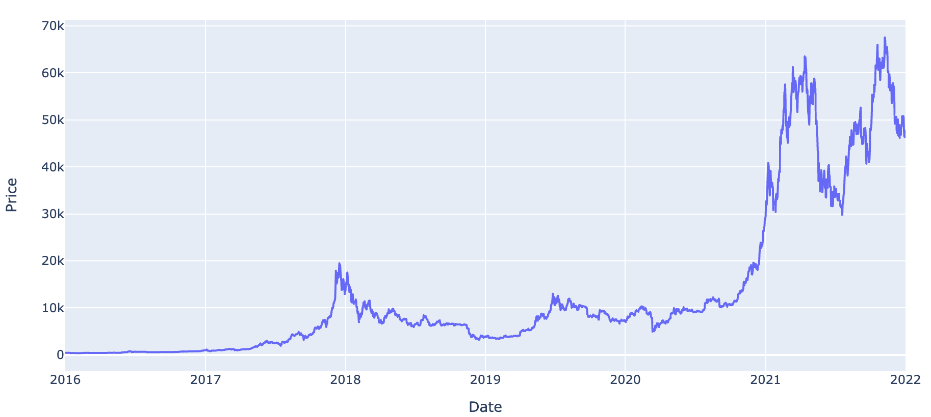
Visualization plotly.express (px)

Slide 36
Backtesting Output
backtesing output
Start 2016-01-01 00:00:00
End 2022-01-01 00:00:00
Duration 2192 days 00:00:00
Exposure Time [%] 97.993616
Equity Final [$] 4237449.058157
Equity Peak [$] 6165339.439633
Return [%] 4137.449058
Buy & Hold Return [%] 10879.294935
Return (Ann.) [%] 86.557668
Volatility (Ann.) [%] 144.748975
Sharpe Ratio 0.597985
Sortino Ratio 1.946086
Calmar Ratio 1.362652
Max. Drawdown [%] -63.521467
Avg. Drawdown [%] -12.142095
Max. Drawdown Duration 557 days 00:00:00
Avg. Drawdown Duration 44 days 00:00:00
# Trades 116
Win Rate [%] 35.344828
Best Trade [%] 119.026467
Worst Trade [%] -23.393531
Avg. Trade [%] 3.291328
Max. Trade Duration 74 days 00:00:00
Avg. Trade Duration 19 days 00:00:00
Profit Factor 2.293983
Expectancy [%] 5.036865
SQN 1.236071
_strategy SmaCross
_equity_curve ...
_trades Size Entry..

Slide 37
describe()
High Low Open Close Volume Adj Close
count 2193.00 2193.00 2193.00 2193.00 2.193000e+03 2193.00
mean 13363.00 12616.08 13005.79 13025.16 1.757591e+10 13025.16
std 16935.24 15960.65 16480.00 16489.53 2.085247e+10 16489.53
min 374.95 354.91 365.07 364.33 2.851400e+07 364.33
25% 2682.26 2510.48 2577.77 2589.41 1.182870e+09 2589.41
50% 7535.72 7233.40 7397.13 7397.80 9.175292e+09 7397.80
75% 11570.79 11018.13 11354.30 11358.66 2.886756e+10 11358.66
max 68789.62 66382.06 67549.73 67566.83 3.509679e+11 67566.83

Slide 38
Backtesting
# Upgrade pandas-datareader
!pip install --upgrade pandas
!pip install --upgrade pandas-datareader
!pip install backtesting
from backtesting import Backtest, Strategy
from backtesting.lib import crossover
from backtesting.test import SMA
import pandas as pd
import pandas_datareader.data as web
df = web.DataReader("BTC-USD", 'yahoo', '2016-01-01', '2021-12-31')
df.to_csv('BTC-USD.csv')
print(df.head().round(2))
print(df.tail().round(2))
print(df.describe().round(2))
class SmaCross(Strategy):
  n1 = 5
  n2 = 20
  def init(self):
    close = self.data.Close
    self.sma1 = self.I(SMA, close, self.n1)
    self.sma2 = self.I(SMA, close, self.n2)
  def next(self):
    if crossover(self.sma1, self.sma2):
    self.buy()
    elif crossover(self.sma2, self.sma1):
    self.sell()
bt = Backtest(df, SmaCross, cash=100000, commission=.002, exclusive_orders=True)
output = bt.run()
print('backtesing output')
print(output)
bt.plot()

Slide 39
Backtesting
#!pip install backtesting
from backtesting import Backtest, Strategy
from backtesting.lib import crossover
from backtesting.lib import plot_heatmaps
from backtesting.test import SMA
import pandas as pd
import pandas_datareader.data as web
from google.colab import files
import time
#BTC-USD ETH-USD
v_symbol = 'BTC-USD'
v_time_start = '2016-01-01'
v_time_end = '2021-12-31'
v_to_csv_filename = v_symbol + '_' + v_time_start + '_' + v_time_end + '.csv'
df = web.DataReader(v_symbol, 'yahoo', v_time_start, v_time_end)
df.to_csv(v_to_csv_filename)
print(df.head().round(2))
print(df.tail().round(2))
print(df.describe().round(2))
v_n1 = 5 #5 #20 #60 #120
v_n2 = 200 #20 #60 #120 #240

Slide 40
Backtesting
class SmaCross(Strategy):
  n1 = v_n1 #5
  n2 = v_n2 #60
  def init(self):
    close = self.data.Close
    self.sma1 = self.I(SMA, close, self.n1)
    self.sma2 = self.I(SMA, close, self.n2)
  def next(self):
    if crossover(self.sma1, self.sma2):
    self.buy()
    elif crossover(self.sma2, self.sma1):
    self.sell()
bt = Backtest(df, SmaCross, cash=100000, commission=.002, exclusive_orders=True)
stats = bt.run()

Slide 41
Backtesting
filename = v_symbol + '_' + v_time_start + '_' + v_time_end + '_' + 'MA_' + str(v_n1) + '_' + str(v_n2) + '.csv'
print('filename:', filename)
stats.to_csv(filename)
print('backtesing stats')
print(stats)
bt.plot()
print('filename:\t', filename)
print("stats._strategy:\t", stats._strategy)
print("# Trades:\t", stats['# Trades'])
print("stats['Equity Final [$]']:\t", round(stats['Equity Final [$]'], 4))
print("stats['Avg. Trade [%]']:\t", round(stats['Avg. Trade [%]'], 4))
print("Sharpe Ratio:\t", round(stats['Sharpe Ratio'], 4))
#download file
time.sleep(1) # time sleep 1 second
files.download(filename)
print('file downloaded:', filename)

Slide 42
Backtesting
print('*****bt.optimize*****')
stats, heatmap = bt.optimize(
  n1 = range(5, 65, 5),
  n2 = range(10, 205, 5),
  constraint = lambda param: param.n1 <param.n2,
  maximize = 'Avg. Trade [%]',
  max_tries = 600,
  random_state = 0,
  return_heatmap = True)
#'Equity Final [$]' 'Avg. Trade [%]'
optimize_strategy = stats._strategy

Slide 43
Backtesting
optimize_filename = v_symbol + '_' + v_time_start + '_' + v_time_end + '_' + 'bt_optimize_strategy' + str(optimize_strategy) + '.csv'
print('optimize_filename:', optimize_filename)
print('backtesing optimize strategy stats')
print(stats)
stats.to_csv(optimize_filename)
plot_heatmaps(heatmap, agg='mean', plot_width = 1800)
print('backtesting optimize strategy heatmap')
print(heatmap)
print('backtesting optimize strategy heatmap Top 10')
print(heatmap.sort_values().iloc[-10:])
hm = heatmap.groupby(['n1', 'n2']).mean().unstack()
print('backtesting optimize strategy heatmap mean')
print(hm)
hm_filename = v_symbol + '_' + v_time_start + '_' + v_time_end + '_' + 'hm_heatmap.csv'
hm.to_csv(hm_filename)

Slide 44
Backtesting
print("filename:\t", optimize_filename)
print("stats._strategy:\t", stats._strategy)
print("# Trades:\t", stats['# Trades'])
print("stats['Equity Final [$]']:\t", round(stats['Equity Final [$]'], 4))
print("stats['Avg. Trade [%]']:\t", round(stats['Avg. Trade [%]'], 4))
print("Sharpe Ratio:\t", round(stats['Sharpe Ratio'], 4))
#download file
time.sleep(1) # time sleep 1 second
files.download(hm_filename)
print('file downloaded:', hm_filename)
files.download(optimize_filename)
print('file downloaded:', optimize_filename)

Slide 45
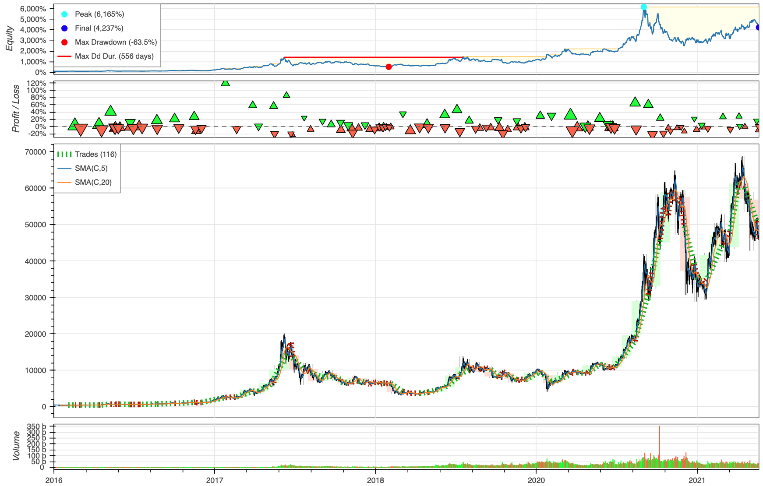
Backtesting

Slide 46
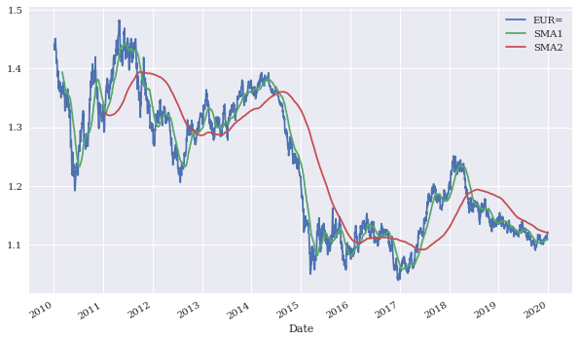
Time series data for EUR/USD and SMAs
Source: Yves Hilpisch (2020), Artificial Intelligence in Finance: A Python-Based Guide, O’Reilly Media.

Slide 47
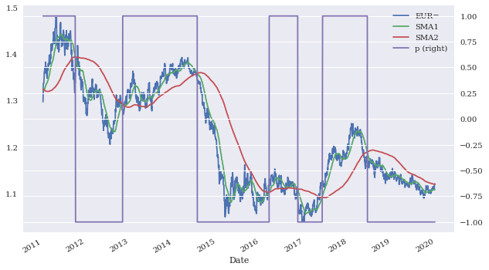
Time series data for EUR/USD, SMAs, and resulting positions
Source: Yves Hilpisch (2020), Artificial Intelligence in Finance: A Python-Based Guide, O’Reilly Media.

Slide 48
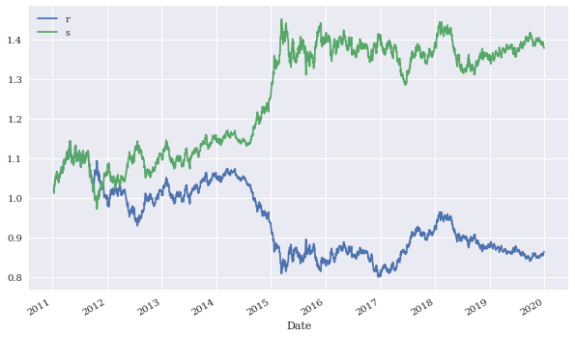
Gross performance of passive benchmark investment and SMA strategy
Source: Yves Hilpisch (2020), Artificial Intelligence in Finance: A Python-Based Guide, O’Reilly Media.

Slide 49
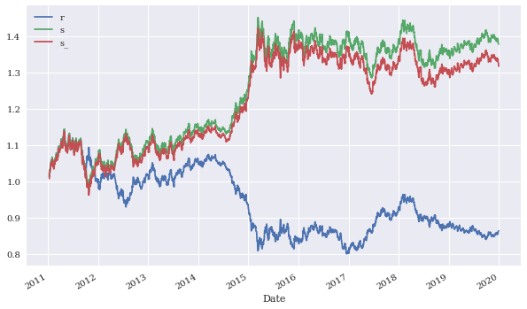
Gross performance of the SMA strategy before and after transaction costs
Source: Yves Hilpisch (2020), Artificial Intelligence in Finance: A Python-Based Guide, O’Reilly Media.

Slide 50
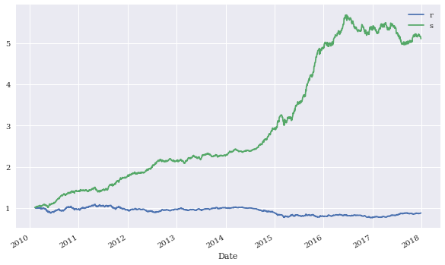
Gross performance of the passive benchmark investment and the daily DNN strategy
(in-sample)
Source: Yves Hilpisch (2020), Artificial Intelligence in Finance: A Python-Based Guide, O’Reilly Media.

Slide 51
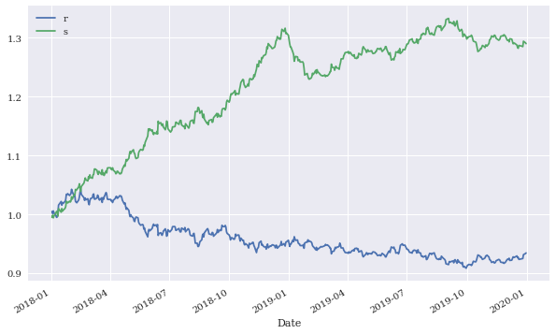
Gross performance of the passive benchmark investment and the daily DNN strategy
(out-of-sample)
Source: Yves Hilpisch (2020), Artificial Intelligence in Finance: A Python-Based Guide, O’Reilly Media.

Slide 52
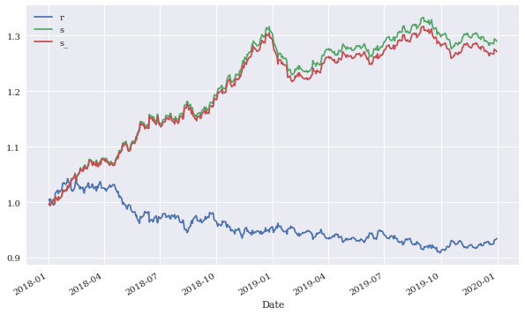
Gross performance of the daily DNN strategy before and after transaction costs
(out-of-sample)
Source: Yves Hilpisch (2020), Artificial Intelligence in Finance: A Python-Based Guide, O’Reilly Media.

Slide 53
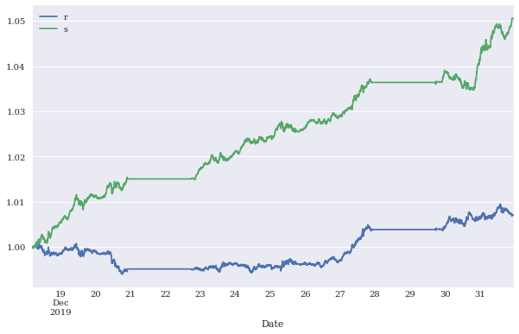
Gross performance of the passive benchmark investment and the DNN intraday strategy
(out-of-sample)
Source: Yves Hilpisch (2020), Artificial Intelligence in Finance: A Python-Based Guide, O’Reilly Media.

Slide 54
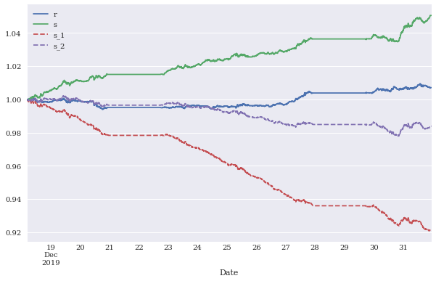
Gross performance of the DNN intraday strategy before and after higher/ lower transaction costs (out-of-sample)
Source: Yves Hilpisch (2020), Artificial Intelligence in Finance: A Python-Based Guide, O’Reilly Media.

Slide 55
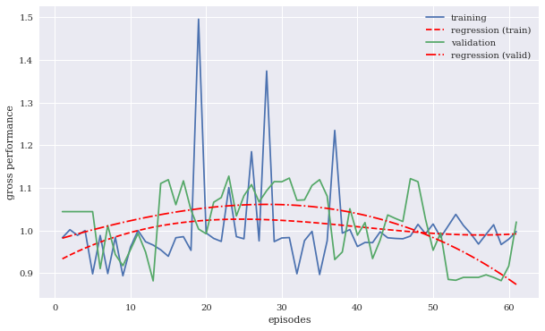
Gross performance on training and validation data set
Source: Yves Hilpisch (2020), Artificial Intelligence in Finance: A Python-Based Guide, O’Reilly Media.

Slide 56
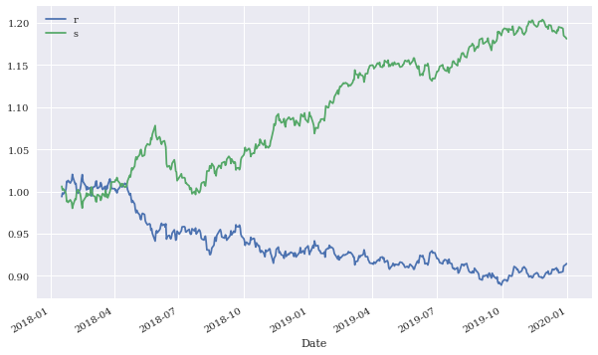
Gross performance of the passive benchmark investment and the trading bot (out-of-sample)
Source: Yves Hilpisch (2020), Artificial Intelligence in Finance: A Python-Based Guide, O’Reilly Media.

Slide 57
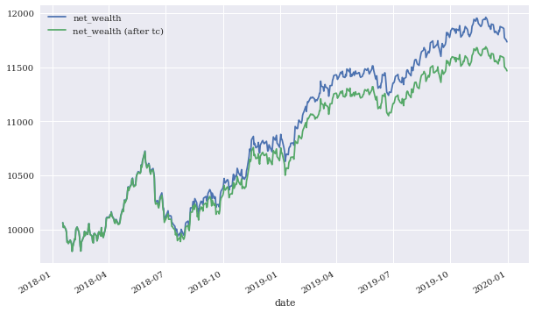
Gross performance of the trading bot before and after transaction costs (in-sample)
Source: Yves Hilpisch (2020), Artificial Intelligence in Finance: A Python-Based Guide, O’Reilly Media.

Slide 58
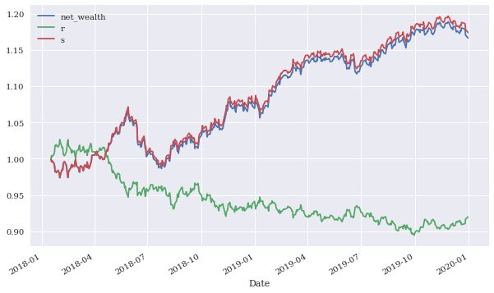
Gross performance of the passive benchmark investment and the trading bot
(vectorized and event-based backtesting)
Source: Yves Hilpisch (2020), Artificial Intelligence in Finance: A Python-Based Guide, O’Reilly Media.

Slide 59
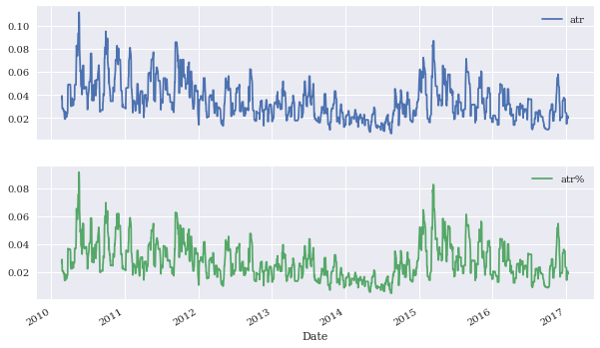
Average true range (ATR) in absolute (price) and relative (%) terms
Source: Yves Hilpisch (2020), Artificial Intelligence in Finance: A Python-Based Guide, O’Reilly Media.

Slide 60
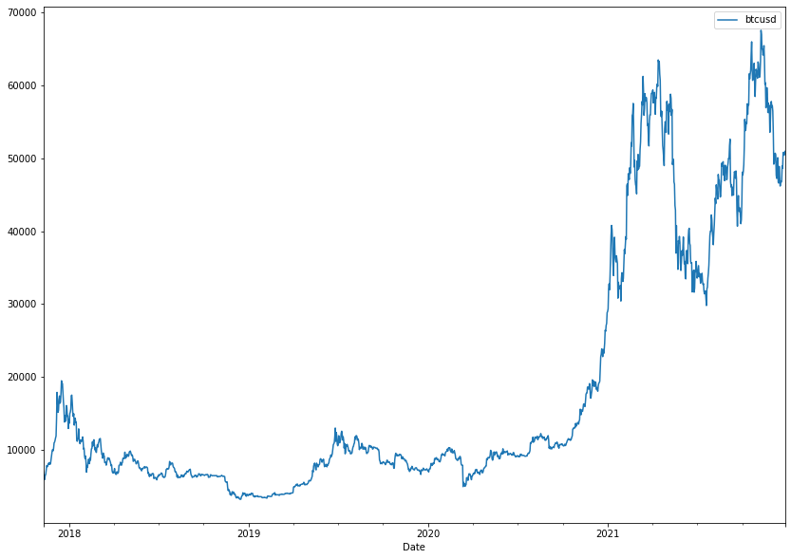
BTC-USD
Source: Yves Hilpisch (2020), Artificial Intelligence in Finance: A Python-Based Guide, O’Reilly Media.

Slide 61
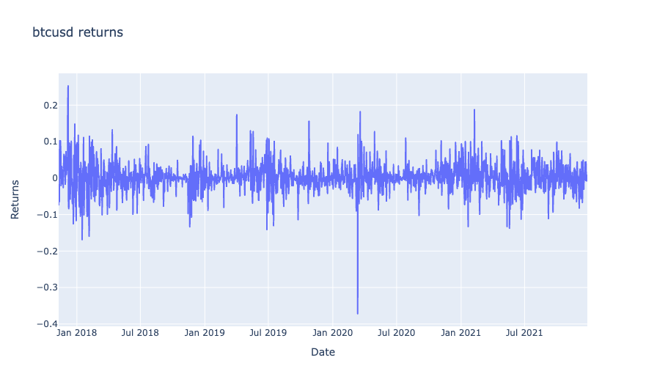
BTC-USD Returns
Source: Yves Hilpisch (2020), Artificial Intelligence in Finance: A Python-Based Guide, O’Reilly Media.

Slide 62
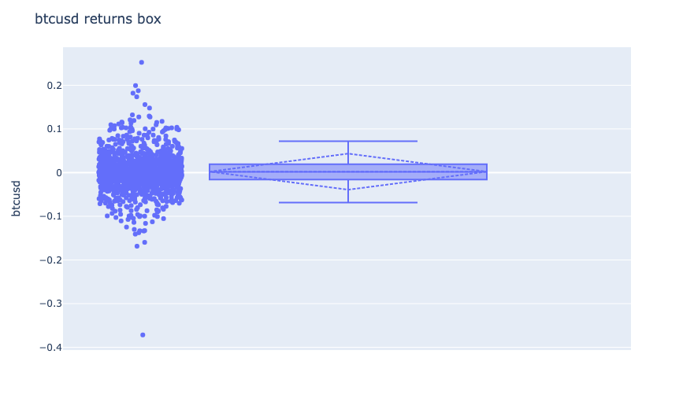
BTC-USD Returns Box
Source: Yves Hilpisch (2020), Artificial Intelligence in Finance: A Python-Based Guide, O’Reilly Media.

Slide 63
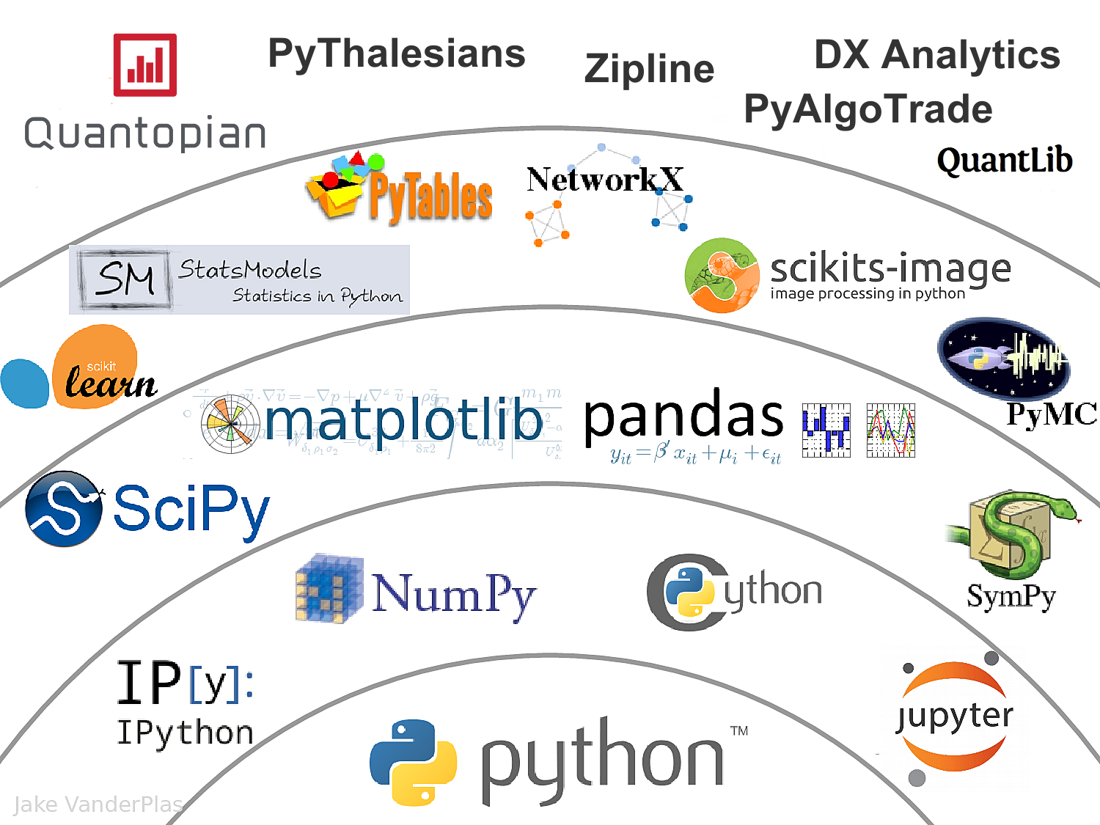
The Quant Finance PyData Stack
Source: http://nbviewer.jupyter.org/format/slides/github/quantopian/pyfolio/blob/master/pyfolio/examples/overview_slides.ipynb#/5

Slide 64
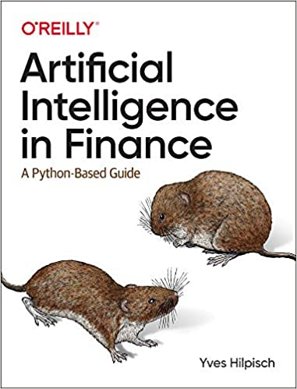
Yves Hilpisch (2020),
Artificial Intelligence in Finance:
A Python-Based Guide,
O’Reilly
Source: https://www.amazon.com/Artificial-Intelligence-Finance-Python-Based-Guide/dp/1492055433

Slide 65
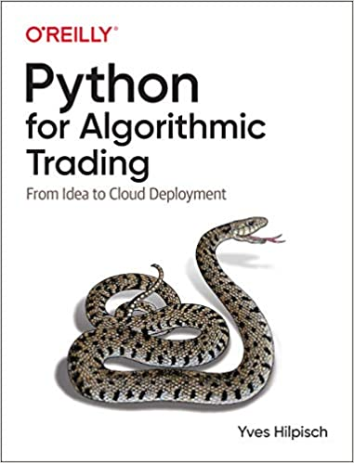
Yves Hilpisch (2020),
Python for Algorithmic Trading:
From Idea to Cloud Deployment,
O’Reilly
Source: https://www.amazon.com/Python-Algorithmic-Trading-Cloud-Deployment/dp/149205335X

Slide 66
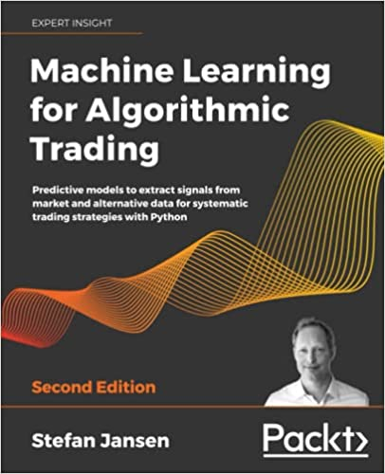
Stefan Jansen (2020),
Machine Learning for Algorithmic Trading:
Predictive models to extract signals from market and alternative data for systematic trading strategies with Python, 2nd Edition,
Packt Publishing.
Source: https://www.amazon.com/Machine-Learning-Algorithmic-Trading-alternative/dp/1839217715/

Slide 67
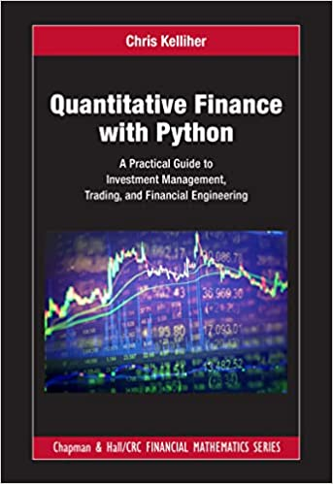
Chris Kelliher (2022),
Quantitative Finance With Python:
A Practical Guide to Investment Management, Trading, and Financial Engineering, Chapman and Hall/CRC.
Source: https://www.amazon.com/Quantitative-Finance-Python-Engineering-Mathematics/dp/1032014431/

Slide 68
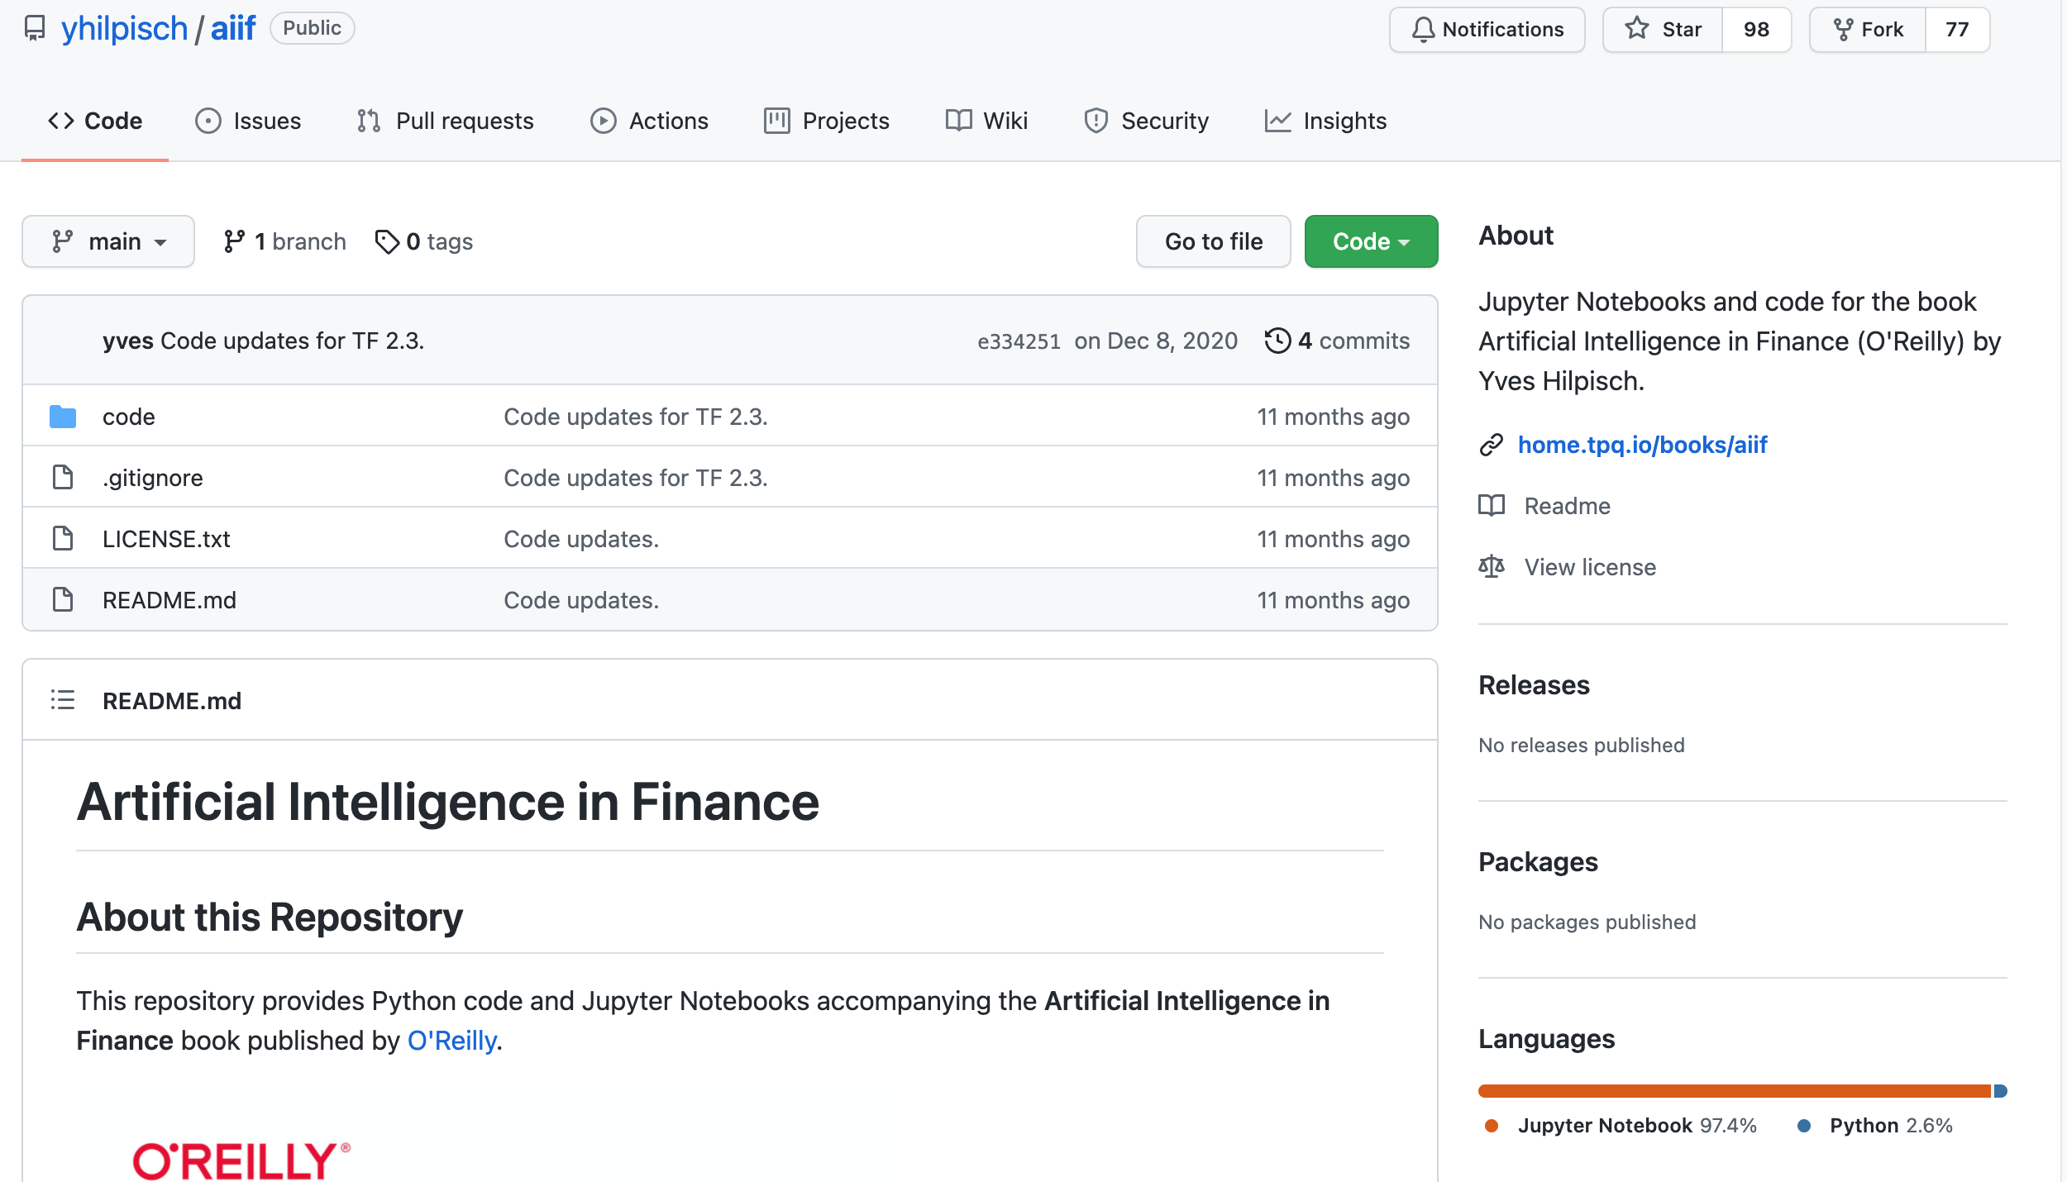
Yves Hilpisch (2020), Artificial Intelligence in Finance: A Python-Based Guide, O’Reilly
https://github.com/yhilpisch/aiif
Source: https://github.com/yhilpisch/aiif

Slide 69
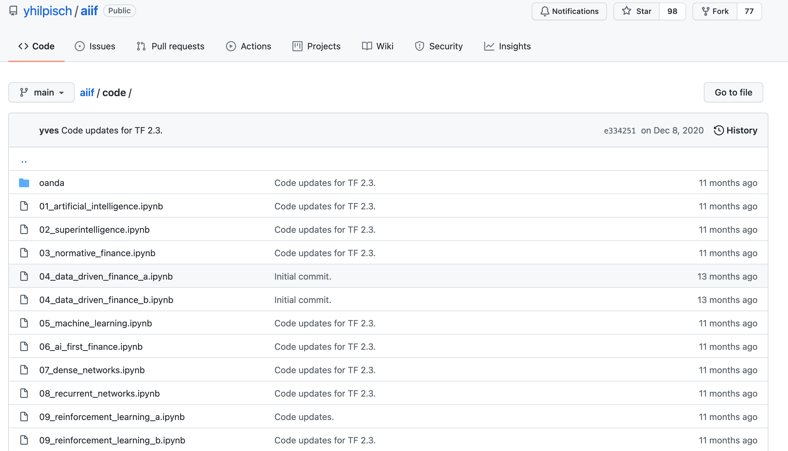
Yves Hilpisch (2020), Artificial Intelligence in Finance: A Python-Based Guide, O’Reilly
https://github.com/yhilpisch/aiif/tree/main/code
Source: https://github.com/yhilpisch/aiif/tree/main/code

Slide 70

Python in Google Colab (Python101)
https://colab.research.google.com/drive/1FEG6DnGvwfUbeo4zJ1zTunjMqf2RkCrT
https://tinyurl.com/aintpupython101

Slide 71
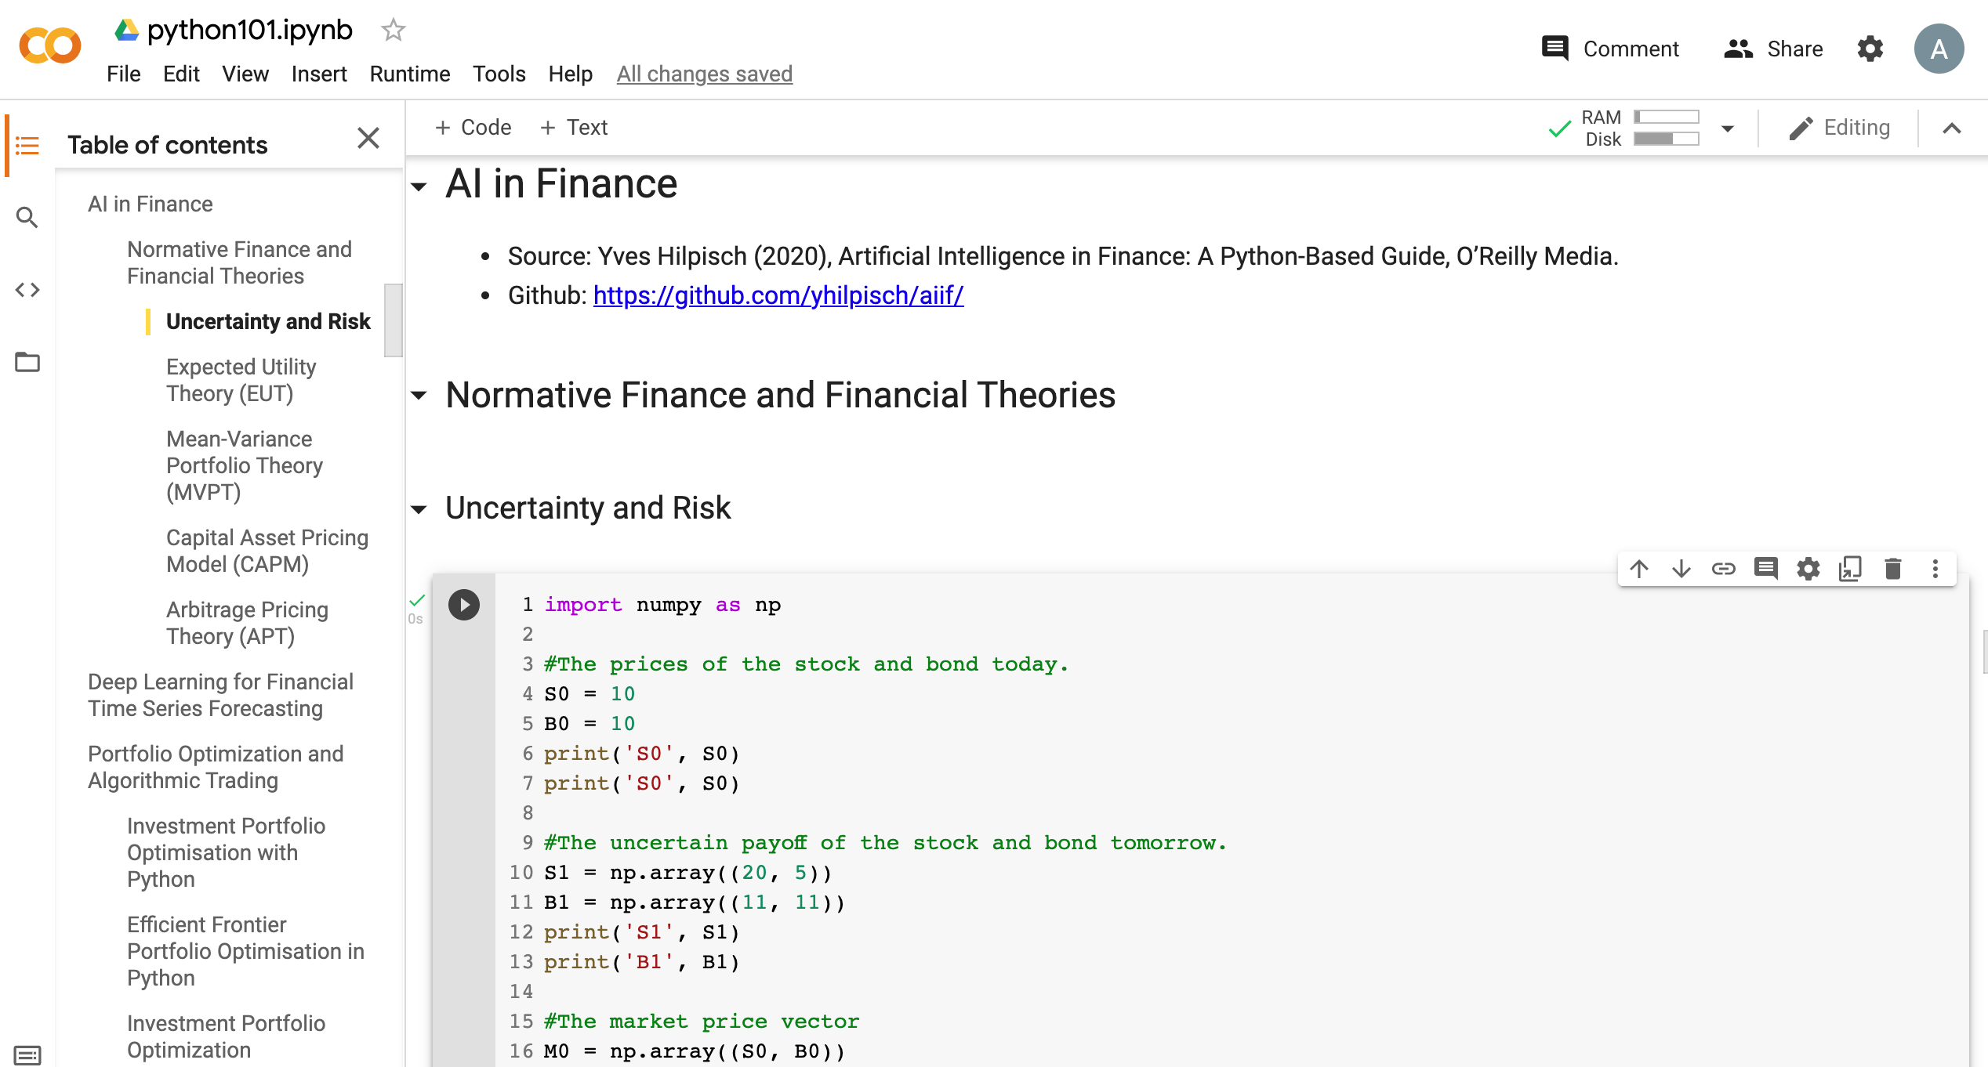
Python in Google Colab (Python101)
https://colab.research.google.com/drive/1FEG6DnGvwfUbeo4zJ1zTunjMqf2RkCrT
https://tinyurl.com/aintpupython101

Slide 72
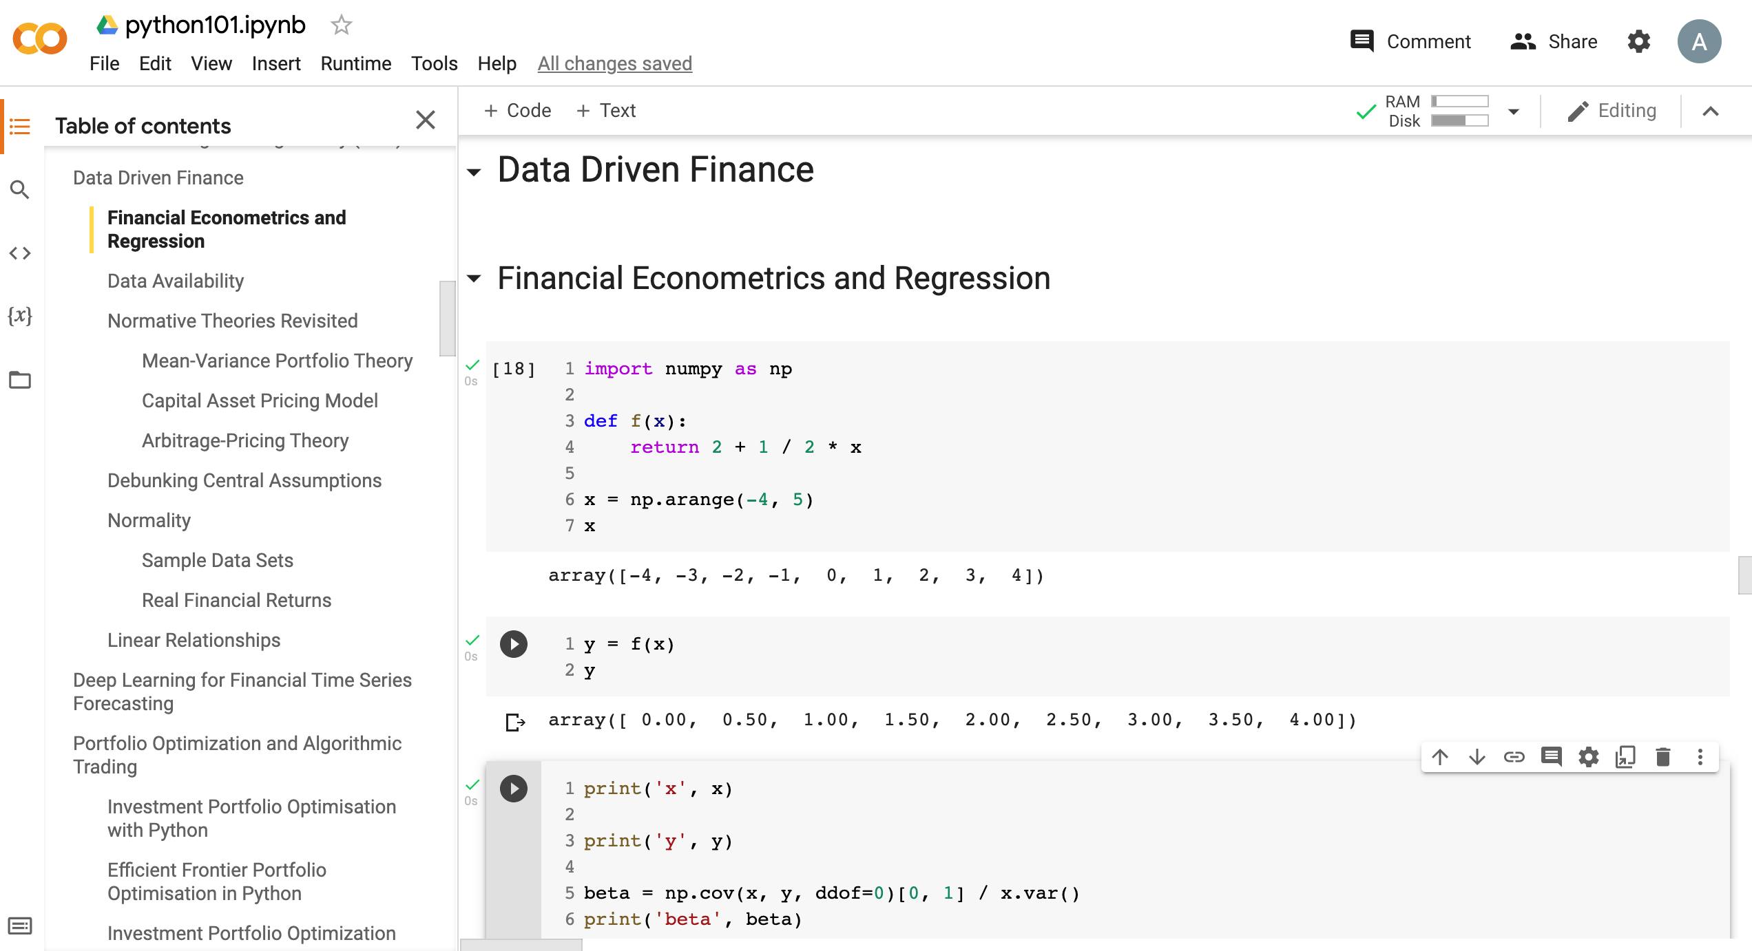
Python in Google Colab (Python101)
https://tinyurl.com/aintpupython101

Slide 73
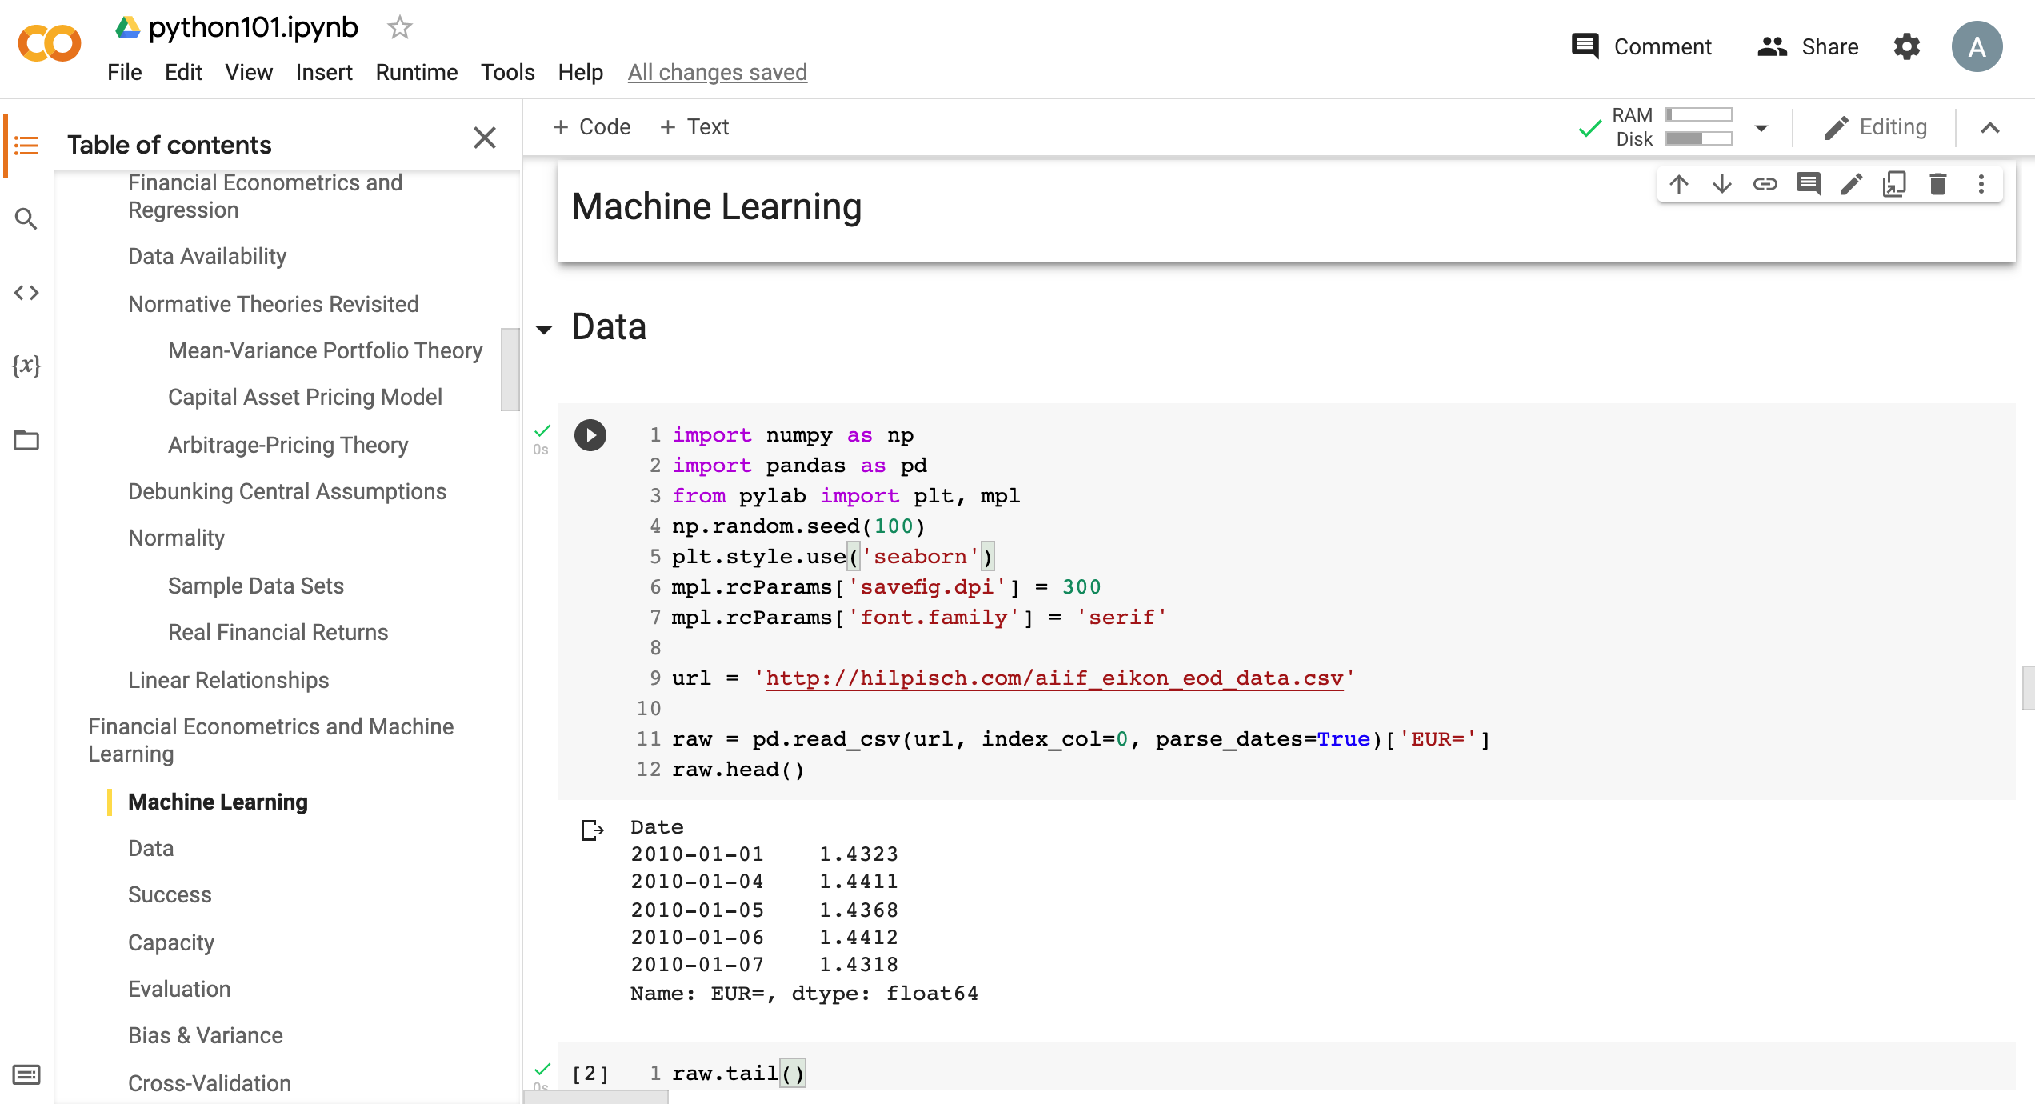
Python in Google Colab (Python101)
https://tinyurl.com/aintpupython101

Slide 74
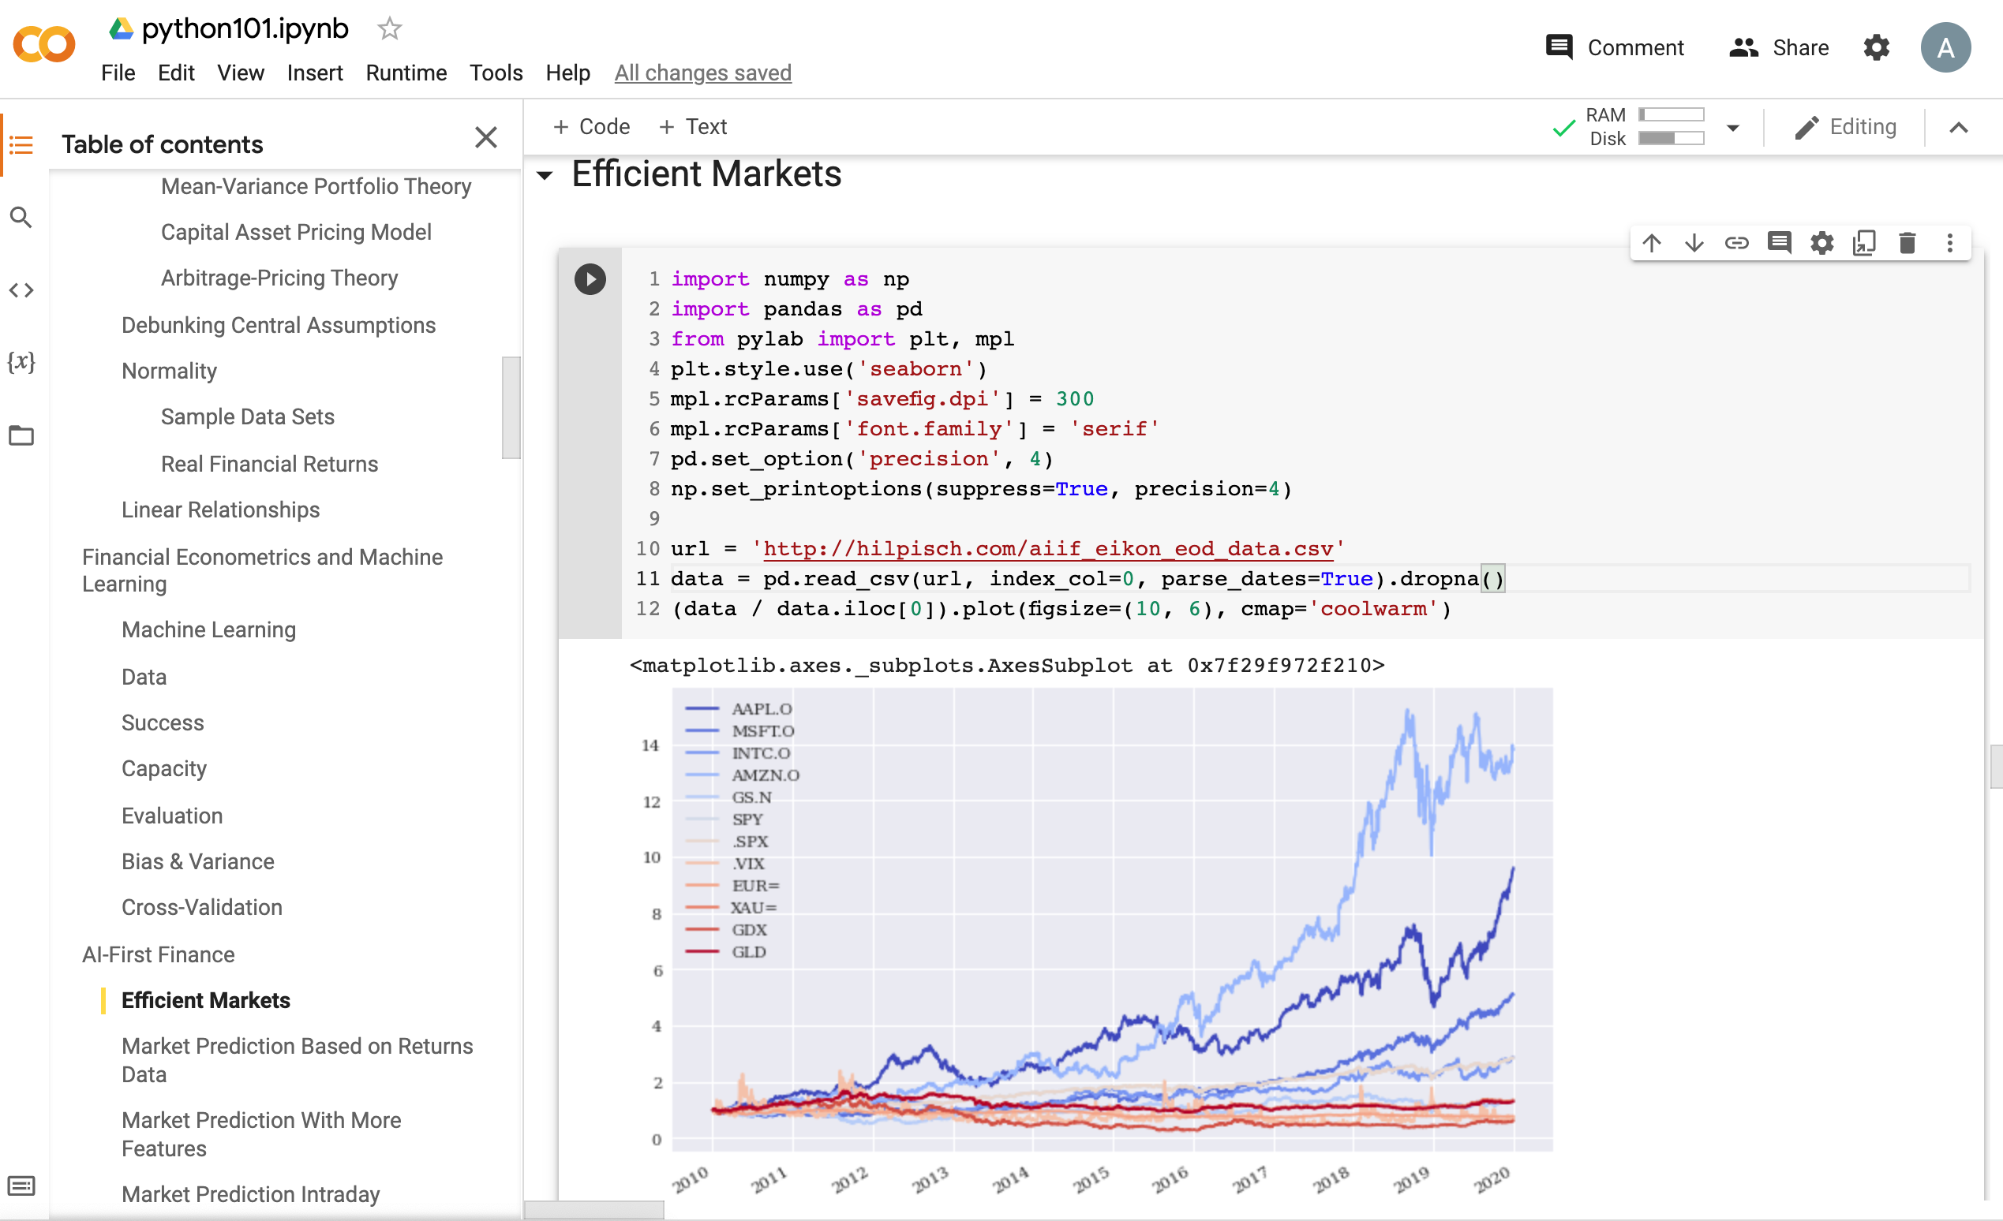
Python in Google Colab (Python101)
https://tinyurl.com/aintpupython101

Slide 75
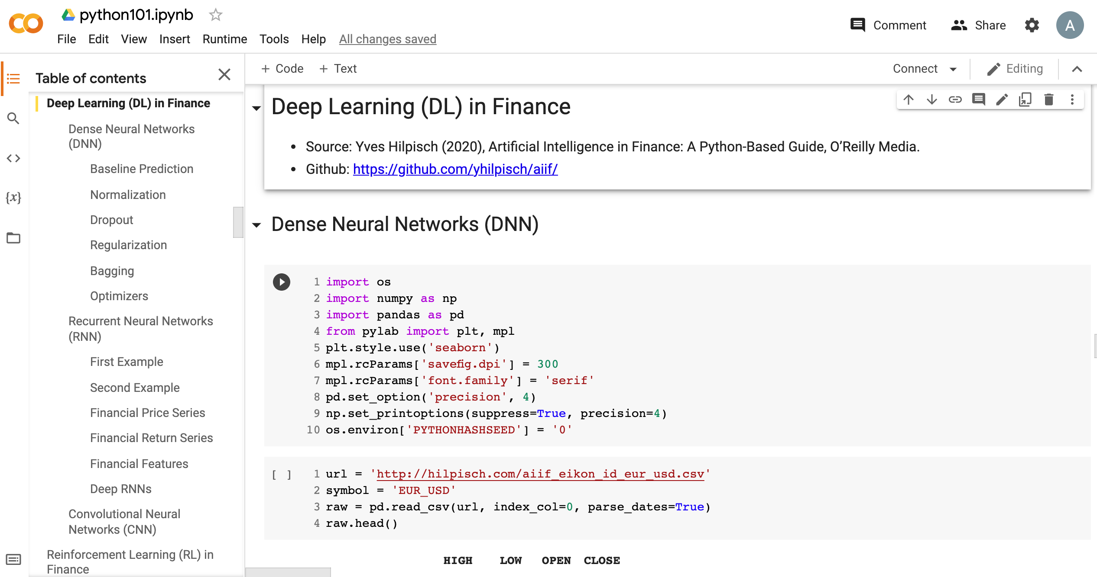
Python in Google Colab (Python101)
https://tinyurl.com/aintpupython101

Slide 76
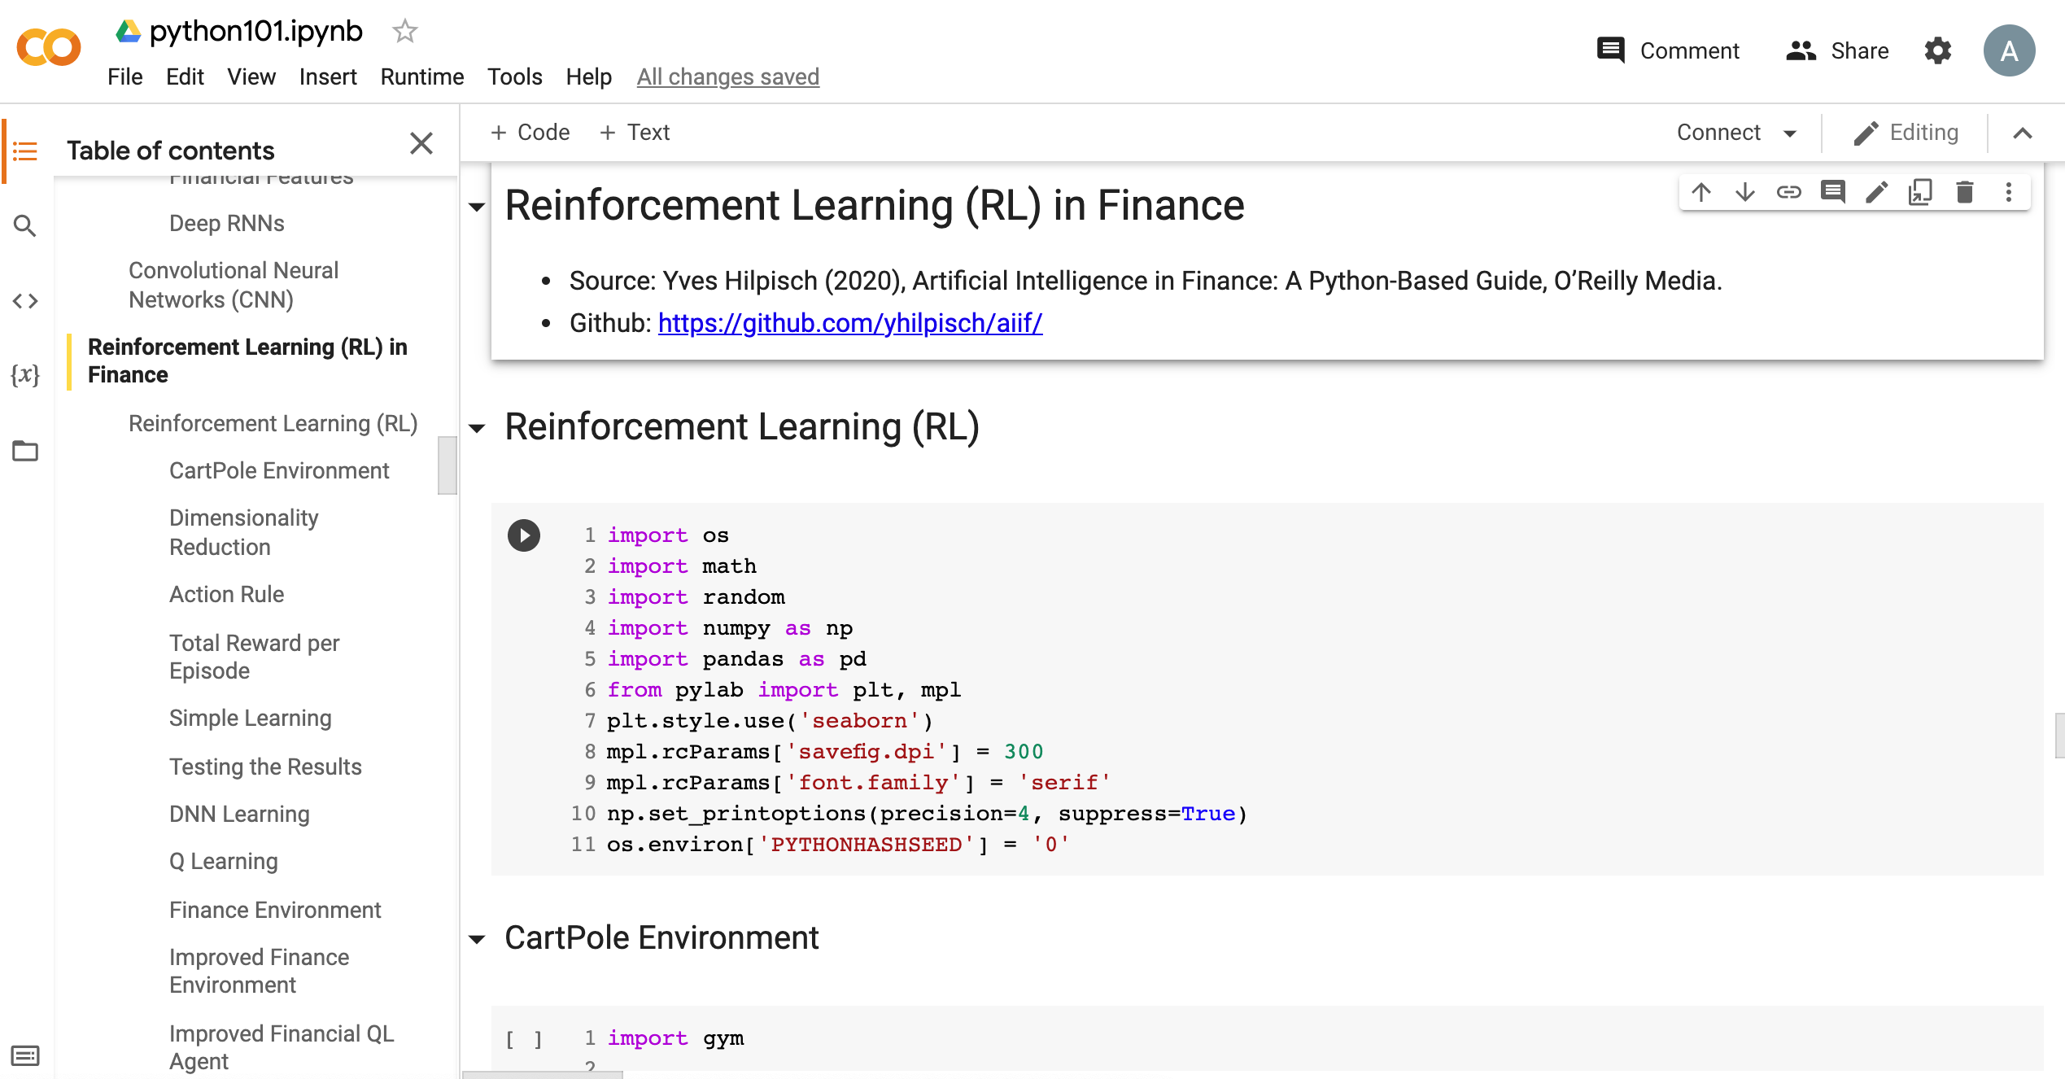
Python in Google Colab (Python101)
https://tinyurl.com/aintpupython101

Slide 77
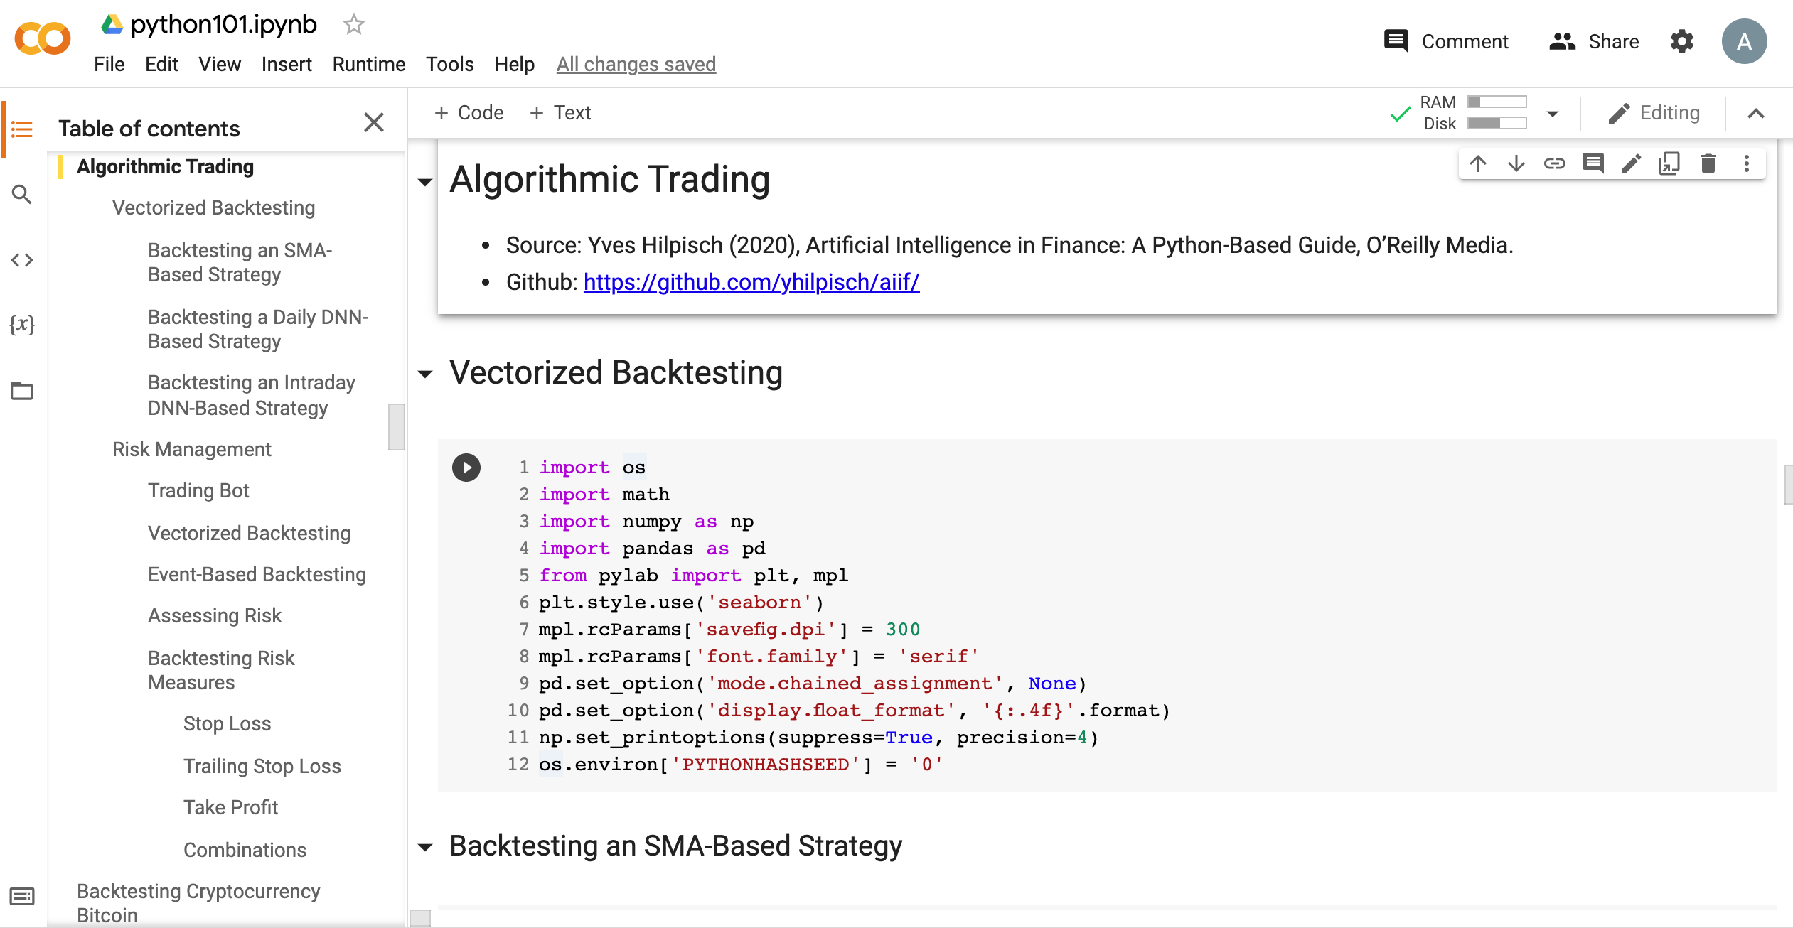
Python in Google Colab (Python101)
https://tinyurl.com/aintpupython101

Slide 78
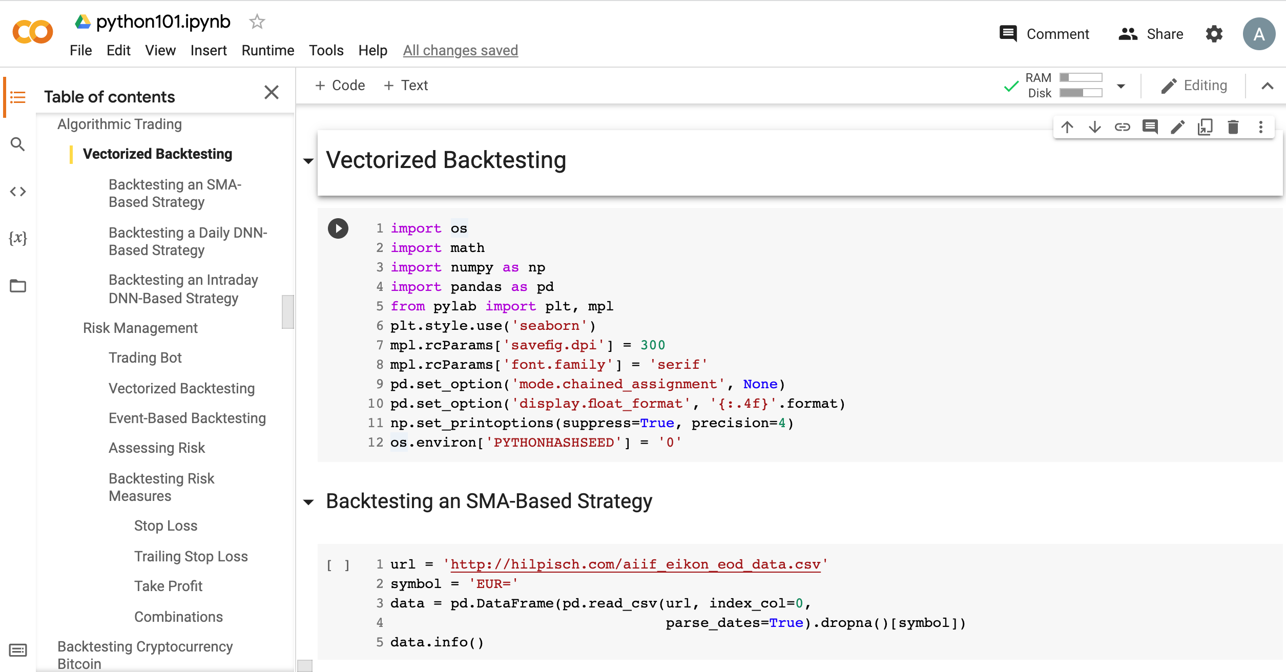
Python in Google Colab (Python101)
https://tinyurl.com/aintpupython101

Slide 79
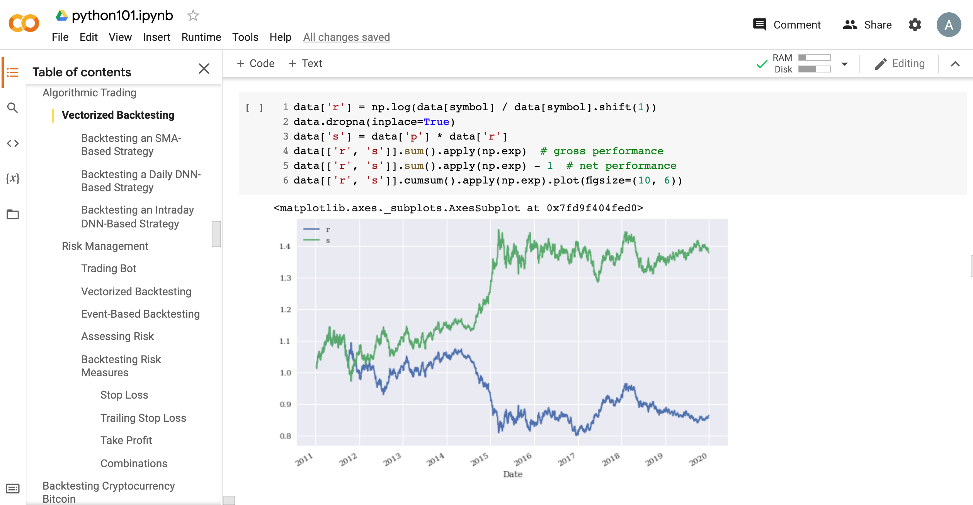
Python in Google Colab (Python101)
https://tinyurl.com/aintpupython101

Slide 80
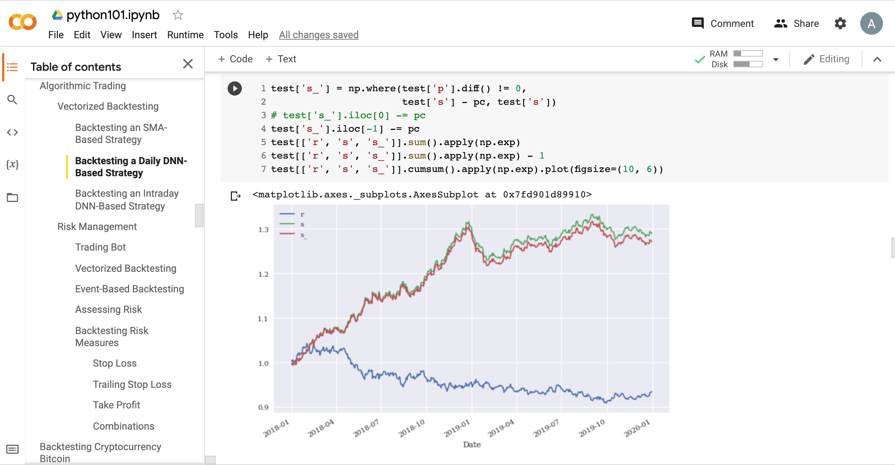
Python in Google Colab (Python101)
https://tinyurl.com/aintpupython101

Slide 81
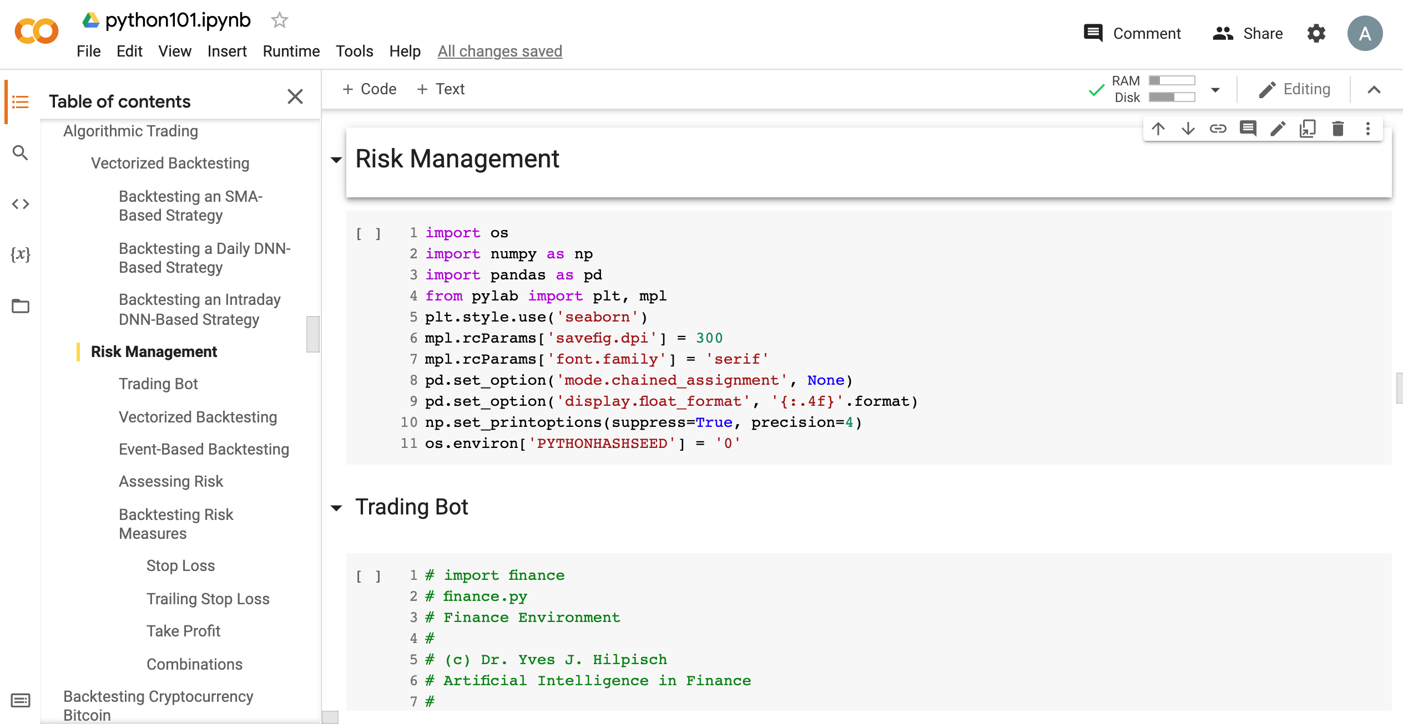
Python in Google Colab (Python101)
https://tinyurl.com/aintpupython101

Slide 82
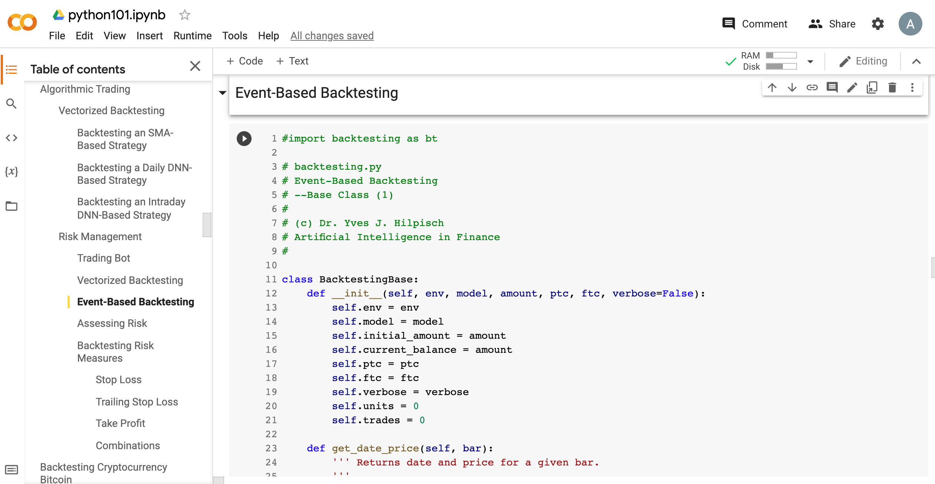
Python in Google Colab (Python101)
https://tinyurl.com/aintpupython101

Slide 83
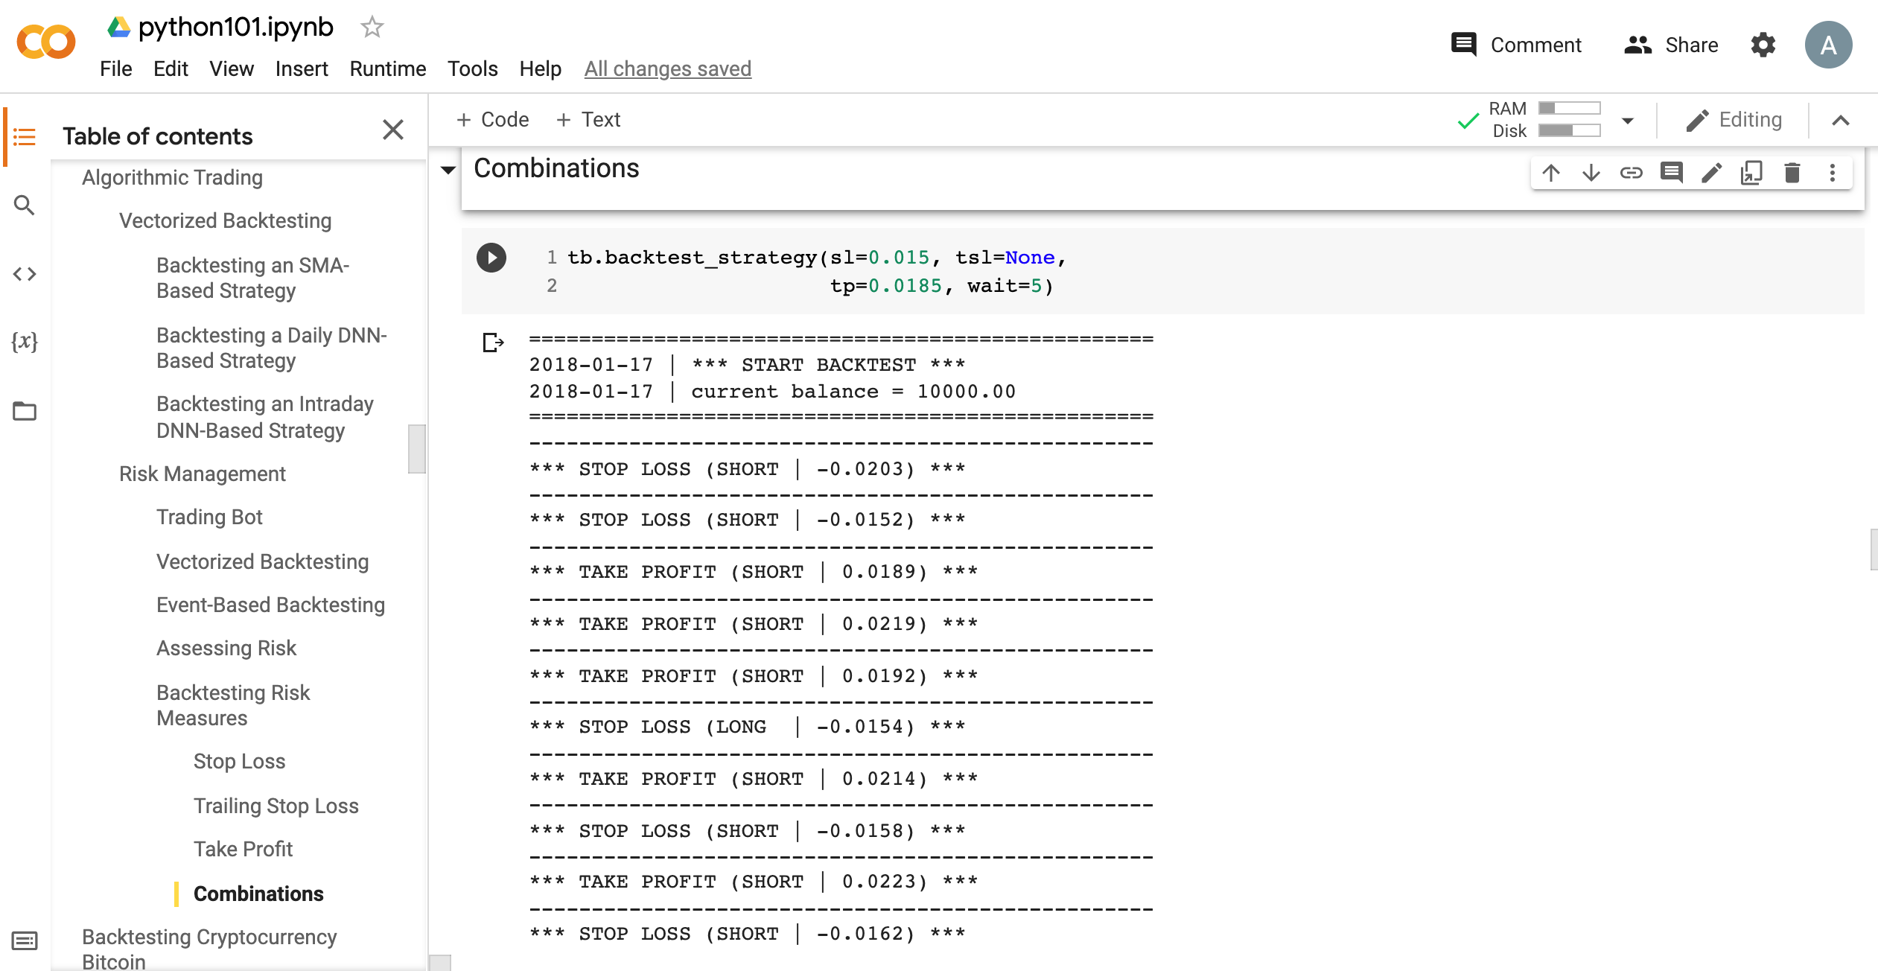
Python in Google Colab (Python101)
https://tinyurl.com/aintpupython101

Slide 84
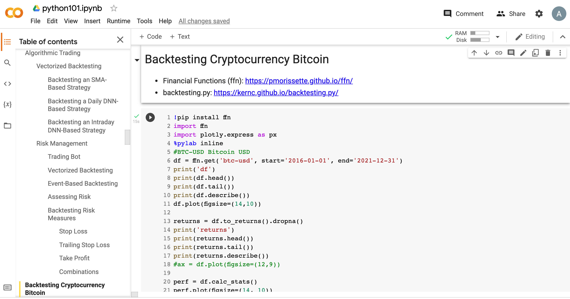
Python in Google Colab (Python101)
https://tinyurl.com/aintpupython101

Slide 85
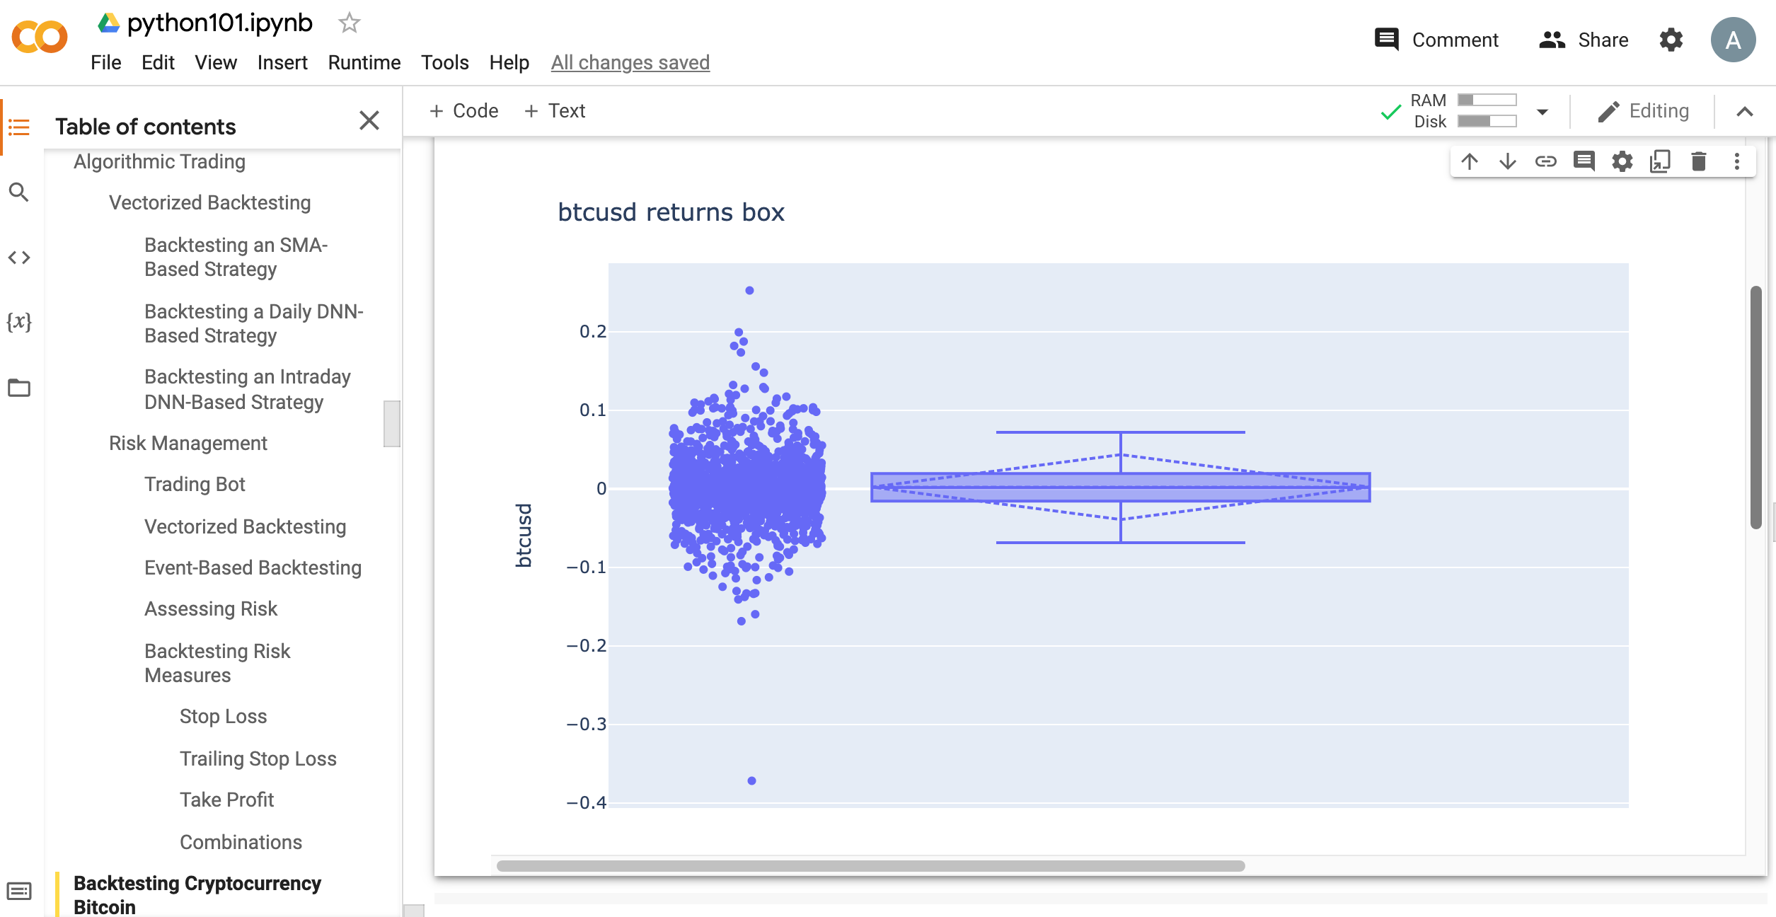
Python in Google Colab (Python101)
https://tinyurl.com/aintpupython101

Slide 86
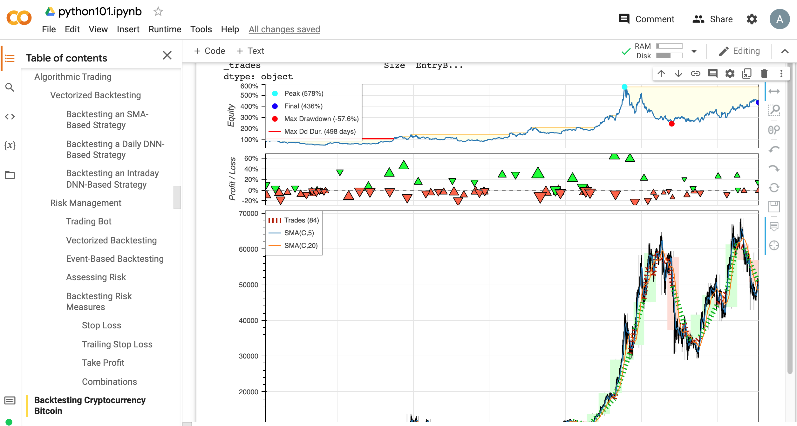
Python in Google Colab (Python101)
https://tinyurl.com/aintpupython101

Slide 87
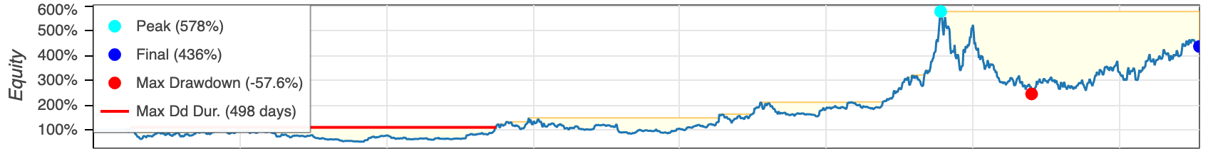



https://tinyurl.com/aintpupython101

Slide 88
Summary
Algorithmic Trading
Risk Management
Trading Bot
Event-Based Backtesting
Source: Yves Hilpisch (2020), Artificial Intelligence in Finance: A Python-Based Guide, O’Reilly Media.

Slide 89
References
Yves Hilpisch (2020), Artificial Intelligence in Finance: A Python-Based Guide, O’Reilly Media, https://github.com/yhilpisch/aiif .
Yves Hilpisch (2020), Python for Algorithmic Trading: From Idea to Cloud Deployment, O’Reilly Media.
Stefan Jansen (2020), Machine Learning for Algorithmic Trading: Predictive models to extract signals from market and alternative data for systematic trading strategies with Python, 2nd Edition, Packt Publishing.
Aurélien Géron (2022), Hands-On Machine Learning with Scikit-Learn, Keras, and TensorFlow: Concepts, Tools, and Techniques to Build Intelligent Systems, 3rd Edition, O’Reilly Media.
Hariom Tatsat, Sahil Puri, Brad Lookabaugh (2020), Machine Learning and Data Science Blueprints for Finance: From Building Trading Strategies to Robo-Advisors Using Python, O'Reilly Media
Chris Kelliher (2022), Quantitative Finance With Python: A Practical Guide to Investment Management, Trading, and Financial Engineering, Chapman and Hall/CRC.
Abdullah Karasan (2021), Machine Learning for Financial Risk Management with Python: Algorithms for Modeling Risk, O’Reilly Media.
Ahmet Murat Ozbayoglu, Mehmet Ugur Gudelek, and Omer Berat Sezer (2020). "Deep learning for financial applications: A survey." Applied Soft Computing (2020): 106384.
Omer Berat Sezer, Mehmet Ugur Gudelek, and Ahmet Murat Ozbayoglu (2020), "Financial time series forecasting with deep learning: A systematic literature review: 2005–2019." Applied Soft Computing 90 (2020): 106181.
Yuanhang Zheng, Zeshui Xu, and Anran Xiao (2023). "Deep learning in economics: a systematic and critical review." Artificial Intelligence Review (2023): 1-43.
Ajitha Kumari Vijayappan Nair Biju, Ann Susan Thomas, and J. Thasneem (2023). "Examining the research taxonomy of artificial intelligence, deep learning & machine learning in the financial sphere—a bibliometric analysis." Quality & Quantity (2023): 1-30.
Min-Yuh Day, Ching-Ying Yang, and Yensen Ni (2023), "Portfolio dynamic trading strategies using deep reinforcement learning." Soft Computing (2023): 1-16.
Ahmet Murat Ozbayoglu, Mehmet Ugur Gudelek, and Omer Berat Sezer (2020), "Deep learning for financial applications: A survey." Applied Soft Computing (2020): 106384.
Omer Berat Sezer, Mehmet Ugur Gudelek, and Ahmet Murat Ozbayoglu (2020), "Financial time series forecasting with deep learning: A systematic literature review: 2005–2019." Applied Soft Computing 90 (2020): 106181.
Fan Fang, Carmine Ventre, Michail Basios, Leslie Kanthan, David Martinez-Rego, Fan Wu, and Lingbo Li. (2023) "Cryptocurrency trading: a comprehensive survey." Financial Innovation 8, no. 1 (2022): 1-59.
Min-Yuh Day (2023), Python 101, https://tinyurl.com/aintpupython101

