Slide 1
Python for Natural Language Processing
Artificial Intelligence for Text Analytics
1121AITA03
MBA, IM, NTPU (M5265) (Fall 2023) Tue 2, 3, 4 (9:10-12:00) (B3F17)
Min-Yuh Day, Ph.D, Associate Professor
Institute of Information Management, National Taipei University
https://web.ntpu.edu.tw/~myday
https://meet.google.com/miy-fbif-max
2023-09-27

Slide 2
Syllabus
Week Date Subject/Topics
1 2023/09/13 Introduction to Artificial Intelligence for Text Analytics
2 2023/09/20 Foundations of Text Analytics: Natural Language Processing (NLP)
3 2023/09/27 Python for Natural Language Processing
4 2023/10/04 Natural Language Processing with Transformers
5 2023/10/11 Case Study on Artificial Intelligence for Text Analytics I
6 2023/10/18 Text Classification and Sentiment Analysis

Slide 3
Syllabus
Week Date Subject/Topics
7 2023/10/25 Multilingual Named Entity Recognition (NER)
8 2023/11/01 Midterm Project Report
9 2023/11/08 Text Similarity and Clustering
10 2023/11/15 Text Summarization and Topic Models
11 2023/11/22 Text Generation with Large Language Models (LLMs)
12 2023/11/29 Case Study on Artificial Intelligence for Text Analytics II

Slide 4
Syllabus
Week Date Subject/Topics
13 2023/12/06 Question Answering and Dialogue Systems
14 2023/12/13 Deep Learning, Generative AI, Transfer Learning, Zero-Shot, and Few-Shot Learning for Text Analytics
15 2023/12/20 Final Project Report I
16 2023/12/27 Final Project Report II

Slide 5
Python for Natural Language Processing

Slide 6
Outline
Python for Natural Language Processing
Python Ecosystem for Data Science
Python
Programming language
Numpy
Scientific computing
SpaCy
Natural Language Processing

Slide 7
Python Programming

Slide 8
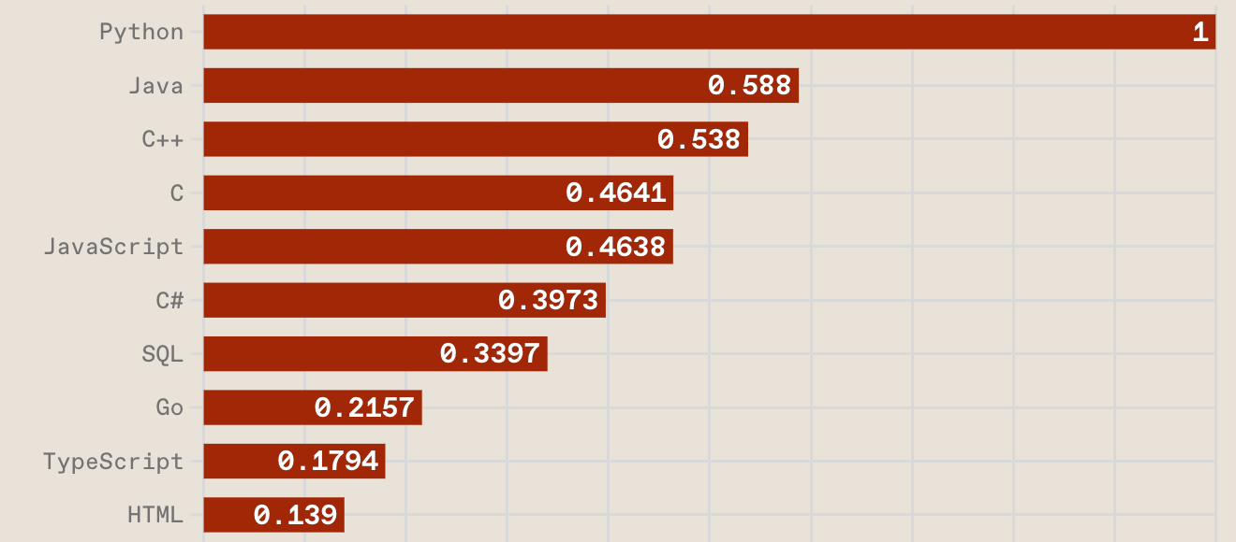
Top Programming Languages
https://spectrum.ieee.org/the-top-programming-languages-2023

Slide 9
Python is an interpreted, object-oriented, high-level programming language with dynamic semantics.
Source: https://www.python.org/doc/essays/blurb/

Slide 10
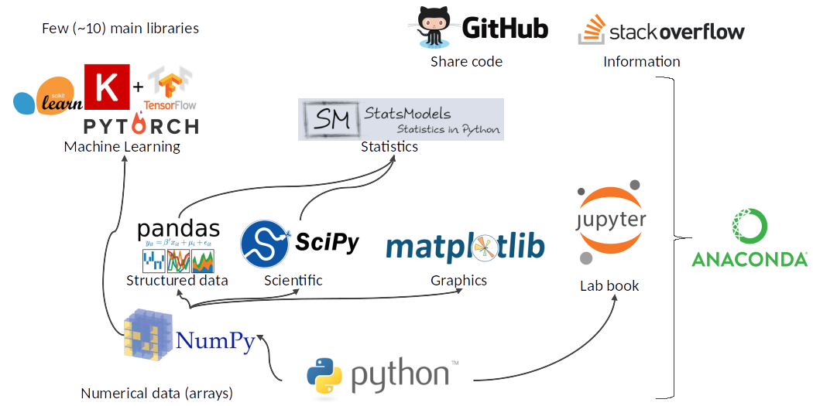
Python Ecosystem for Data Science
Source: https://medium.com/pyfinance/why-python-is-best-choice-for-financial-data-modeling-in-2019-c0d0d1858c45

Slide 11
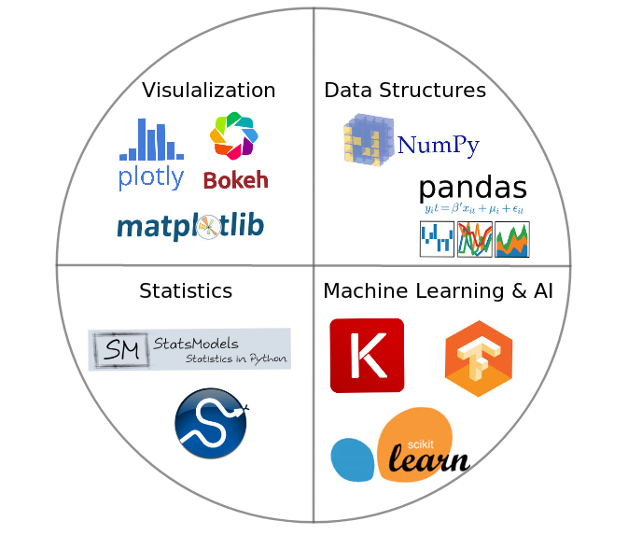
Python Ecosystem for Data Science
Source:https://duchesnay.github.io/pystatsml/introduction/python_ecosystem.html

Slide 12
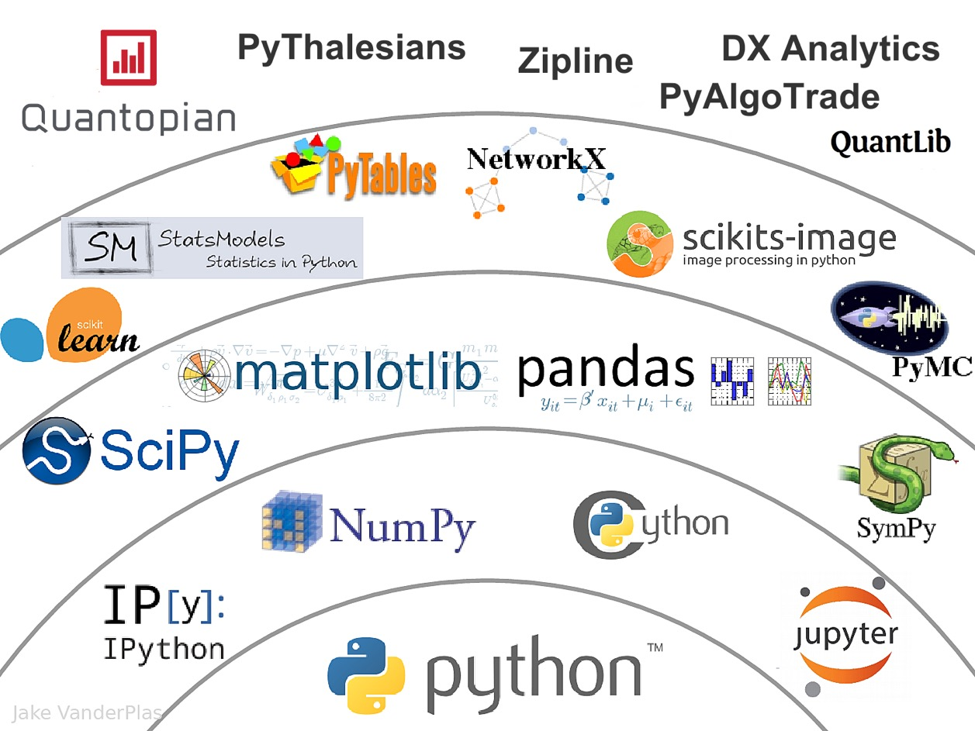
The Quant Finance PyData Stack
Source: http://nbviewer.jupyter.org/format/slides/github/quantopian/pyfolio/blob/master/pyfolio/examples/overview_slides.ipynb#/5

Slide 13
Numpy
NumPy
Base N-dimensional array package

Slide 14
Python matplotlib
Source: https://matplotlib.org/

Slide 15
Python Pandas
http://pandas.pydata.org/

Slide 16
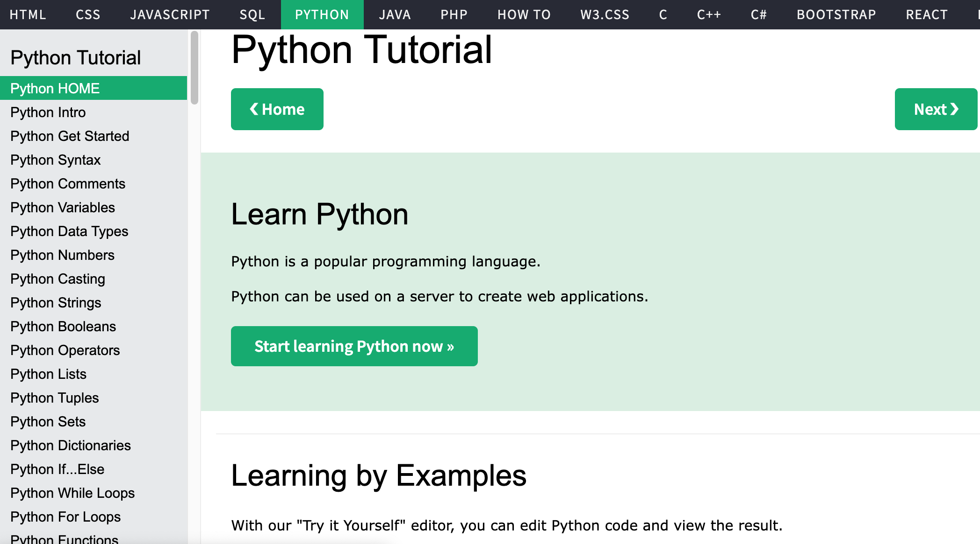
W3Schools Python
https://www.w3schools.com/python/

Slide 17
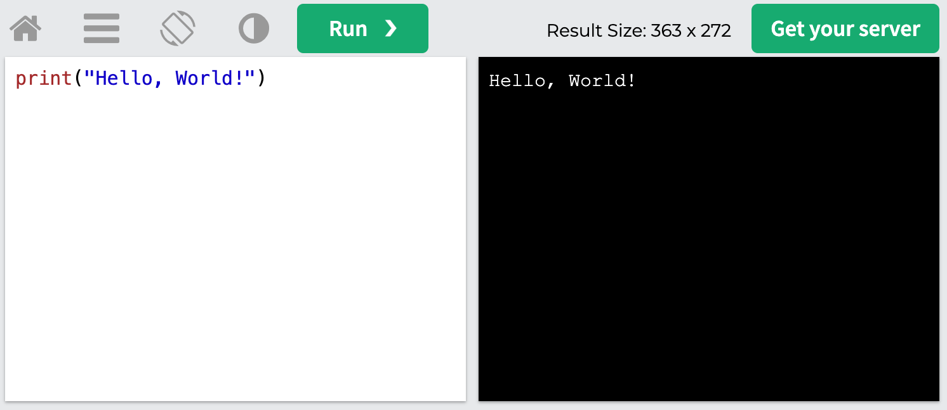
W3Schools Python: Try Python
https://www.w3schools.com/python/trypython.asp?filename=demo_default

Slide 18
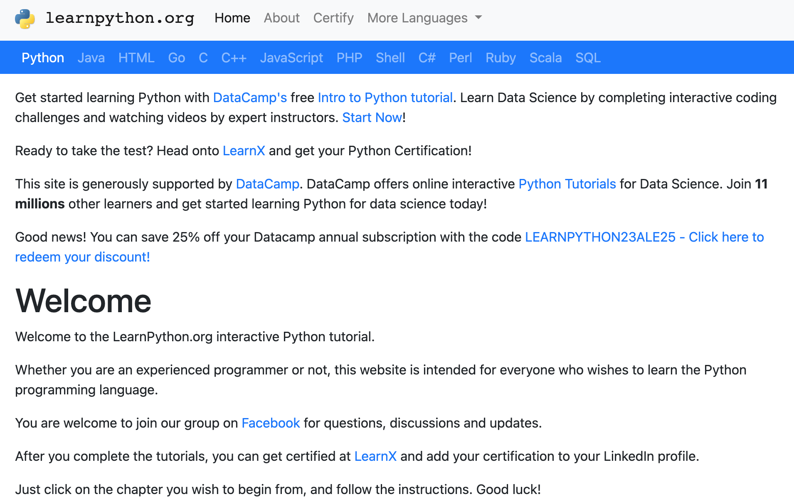
LearnPython.org
https://www.learnpython.org/

Slide 19
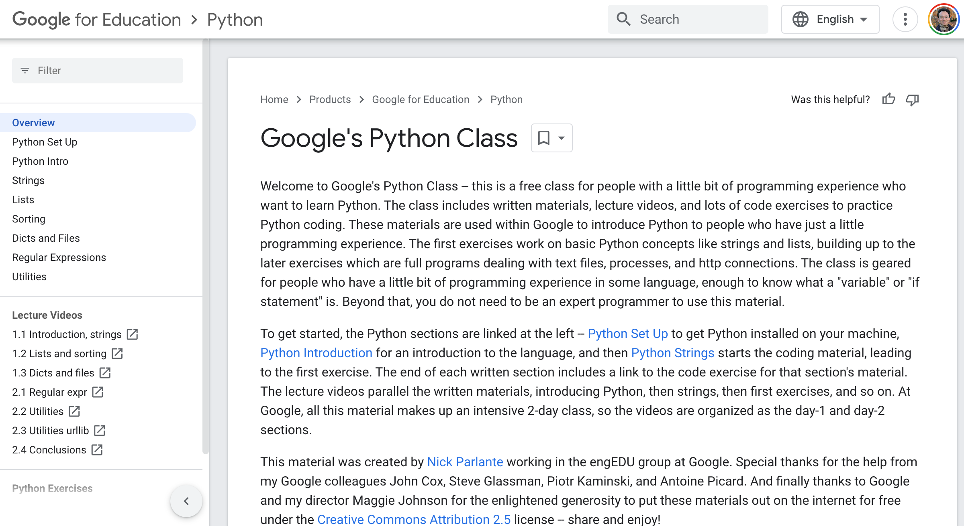
Google’s Python Class
https://developers.google.com/edu/python

Slide 20
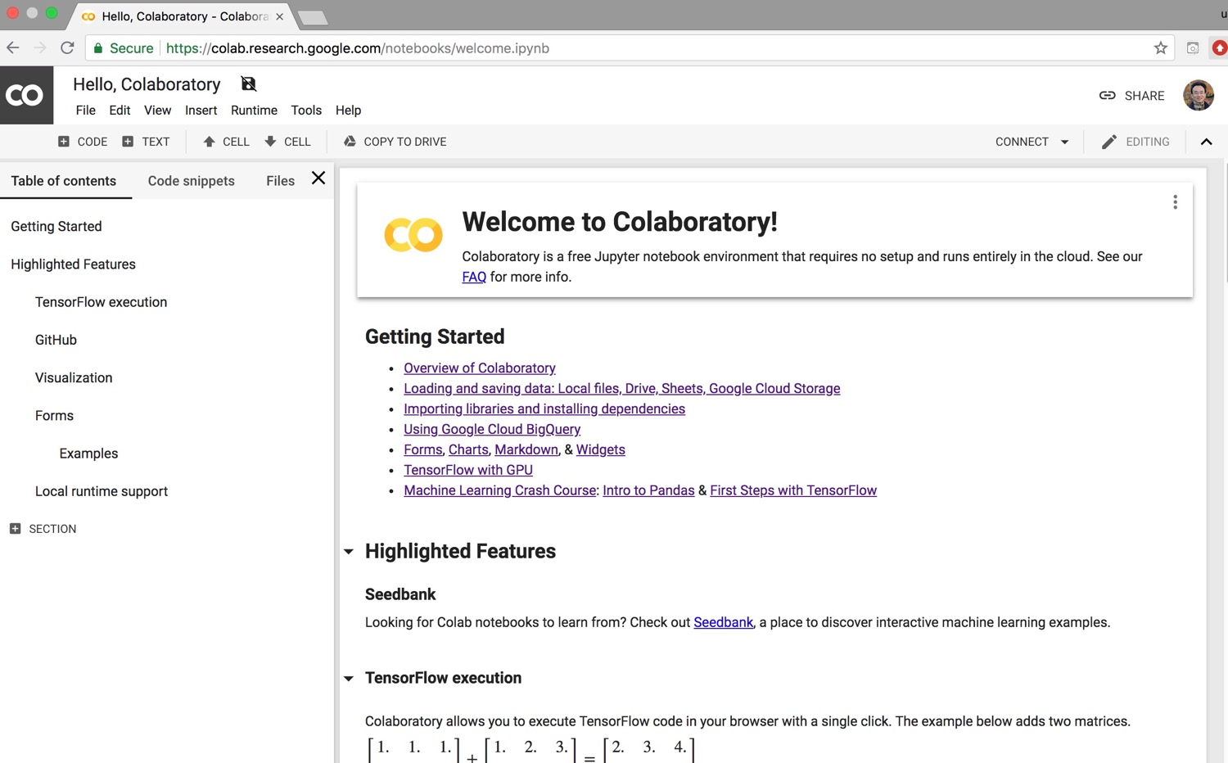
Google Colab
https://colab.research.google.com/notebooks/welcome.ipynb

Slide 21
Connect Google Colab in Google Drive

Slide 22
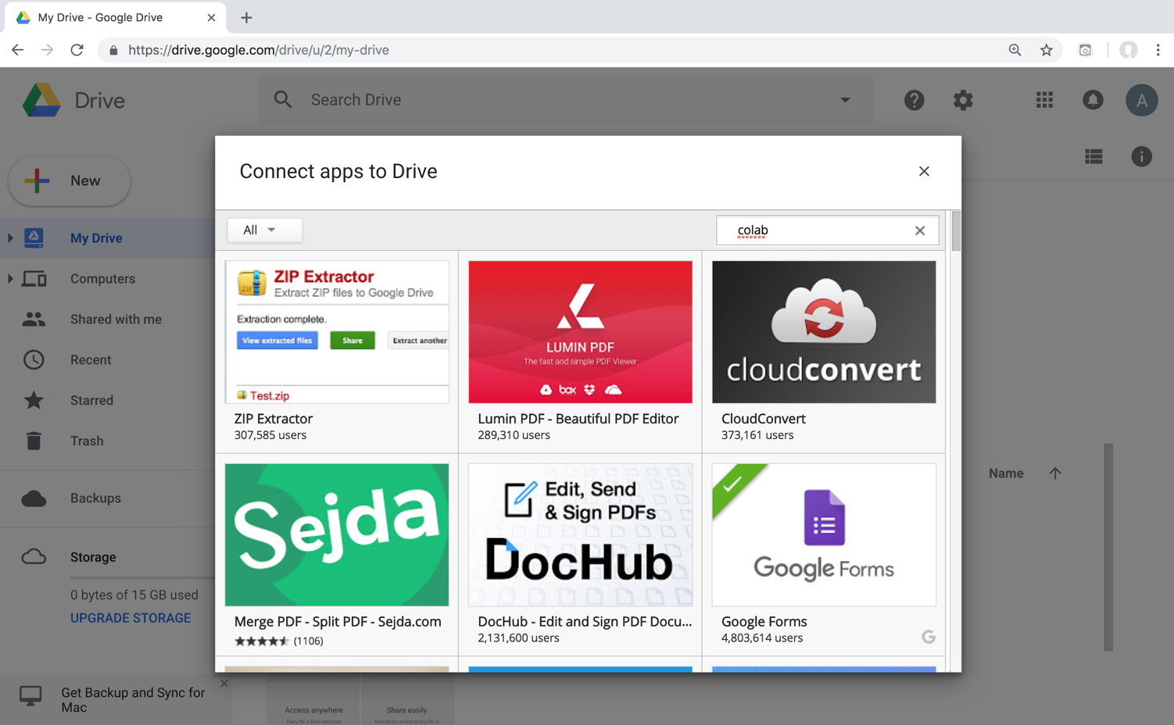
Google Colab

Slide 23
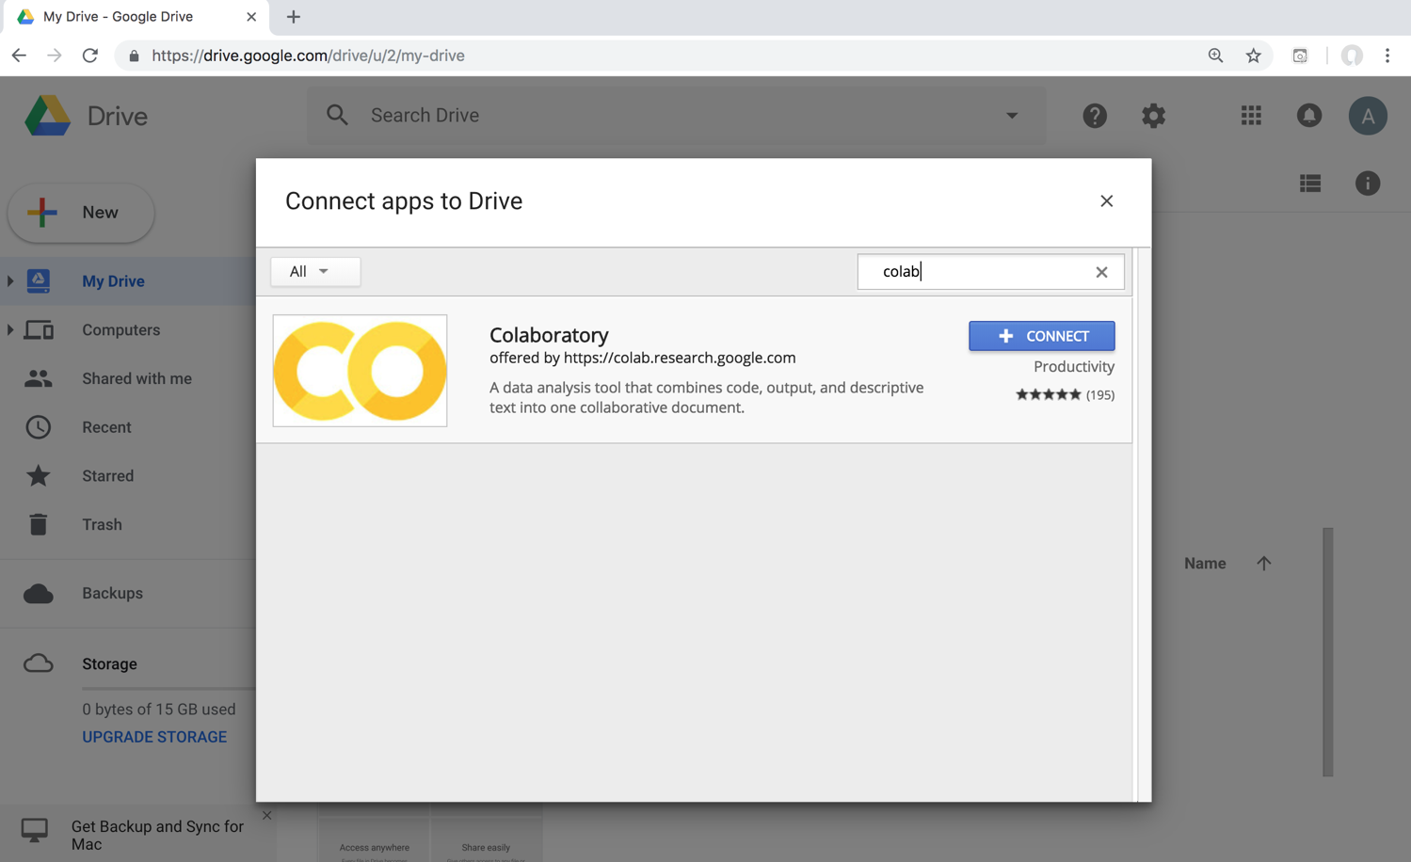
Google Colab

Slide 24
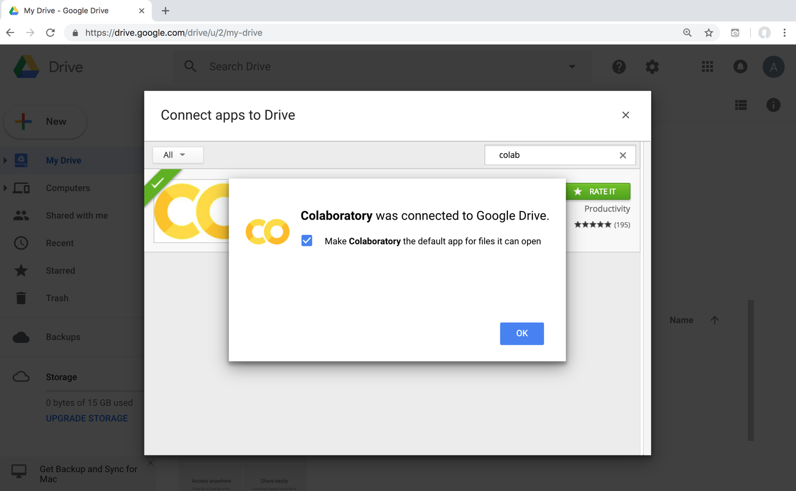
Connect Colaboratory to Google Drive

Slide 25
Google Colab

Slide 26
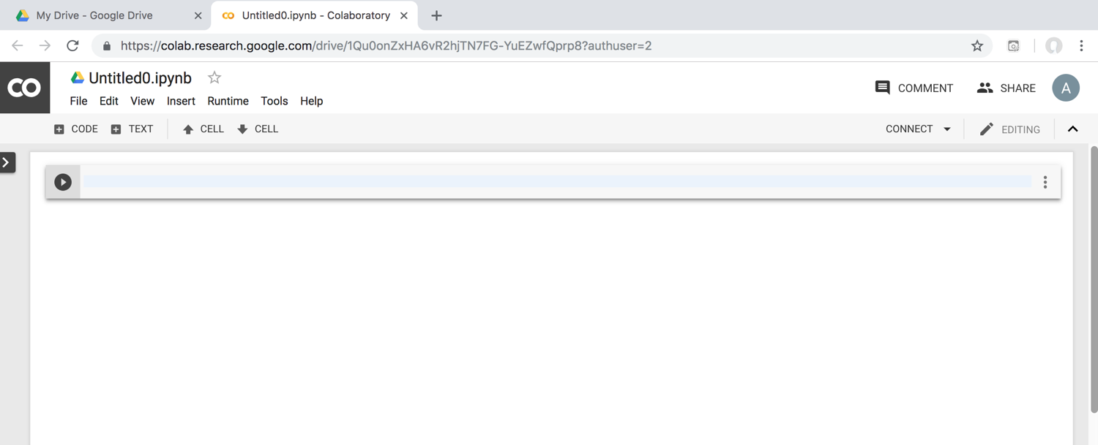
Google Colab

Slide 27
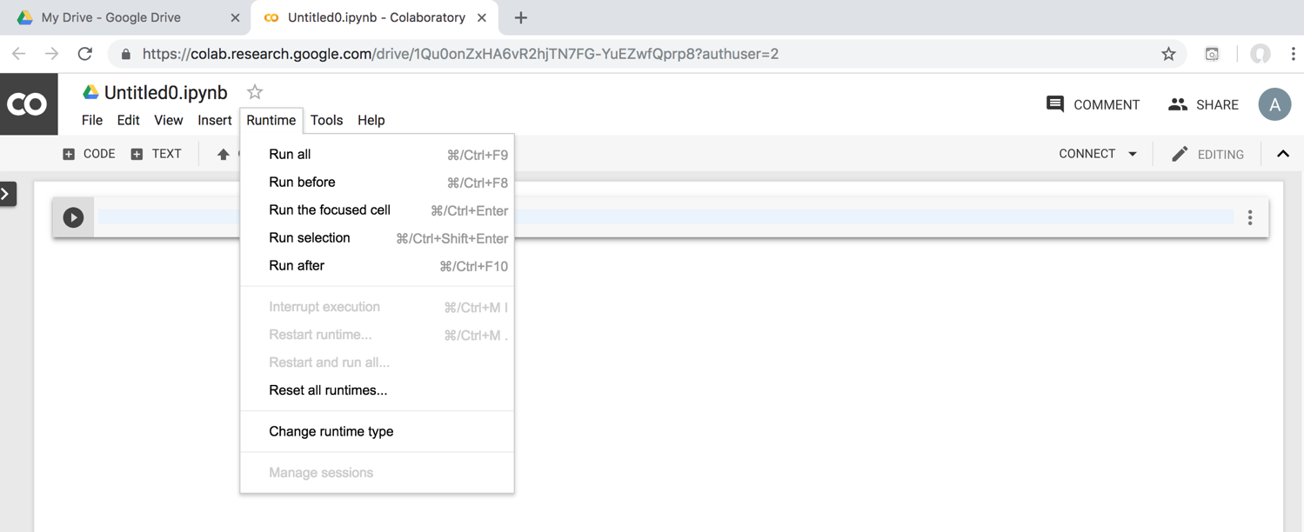
Google Colab

Slide 28
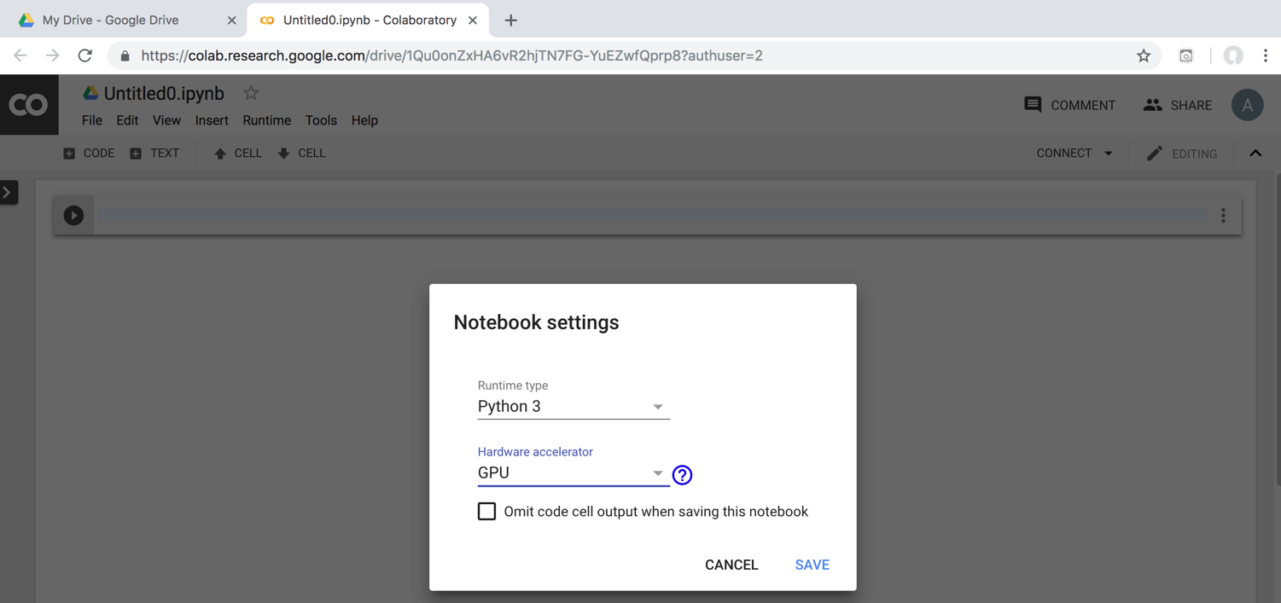
Run Jupyter Notebook Python3 GPU Google Colab

Slide 29
Google Colab Python Hello World print('Hello World')

Slide 30
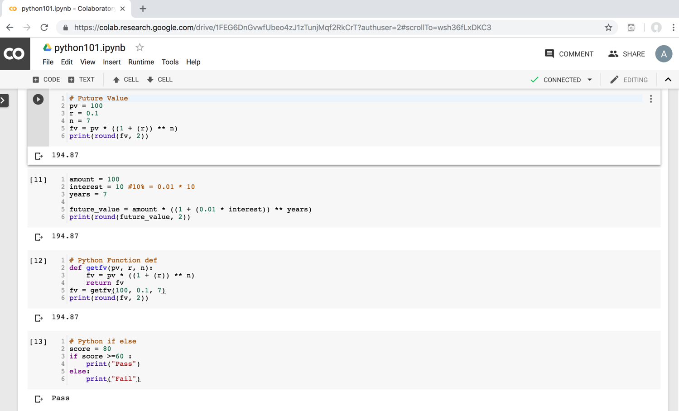
Python in Google Colab (Python101)
https://colab.research.google.com/drive/1FEG6DnGvwfUbeo4zJ1zTunjMqf2RkCrT
https://tinyurl.com/aintpupython101

Slide 31
Anaconda The Most Popular Python Data Science Platform
Source: https://www.anaconda.com/

Slide 32
Download Anaconda
https://www.anaconda.com/download

Slide 33
Python HelloWorld

Slide 34
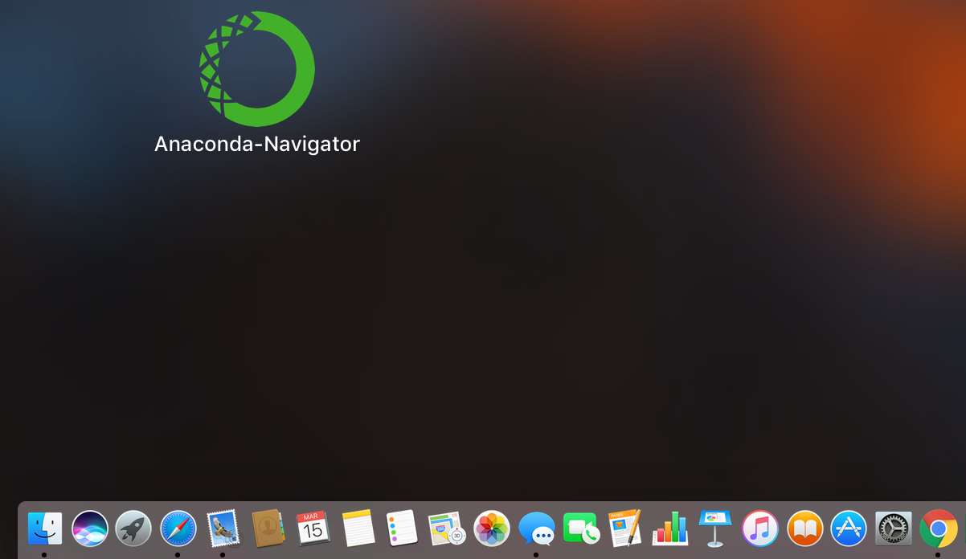
Anaconda-Navigator
Launchpad

Slide 35
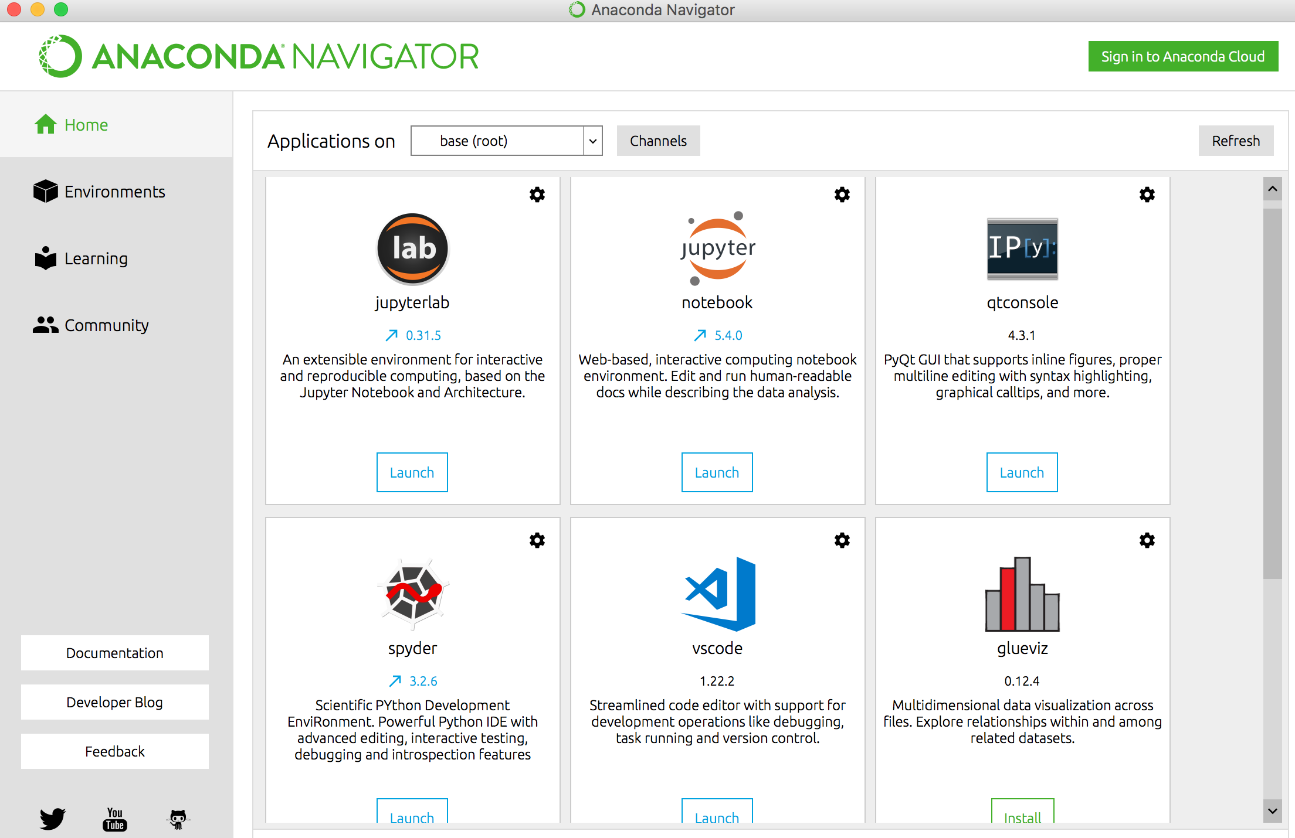
Anaconda Navigator

Slide 36
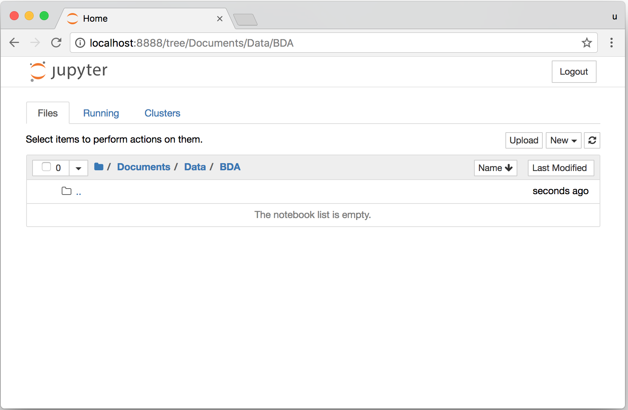
Jupyter Notebook

Slide 37
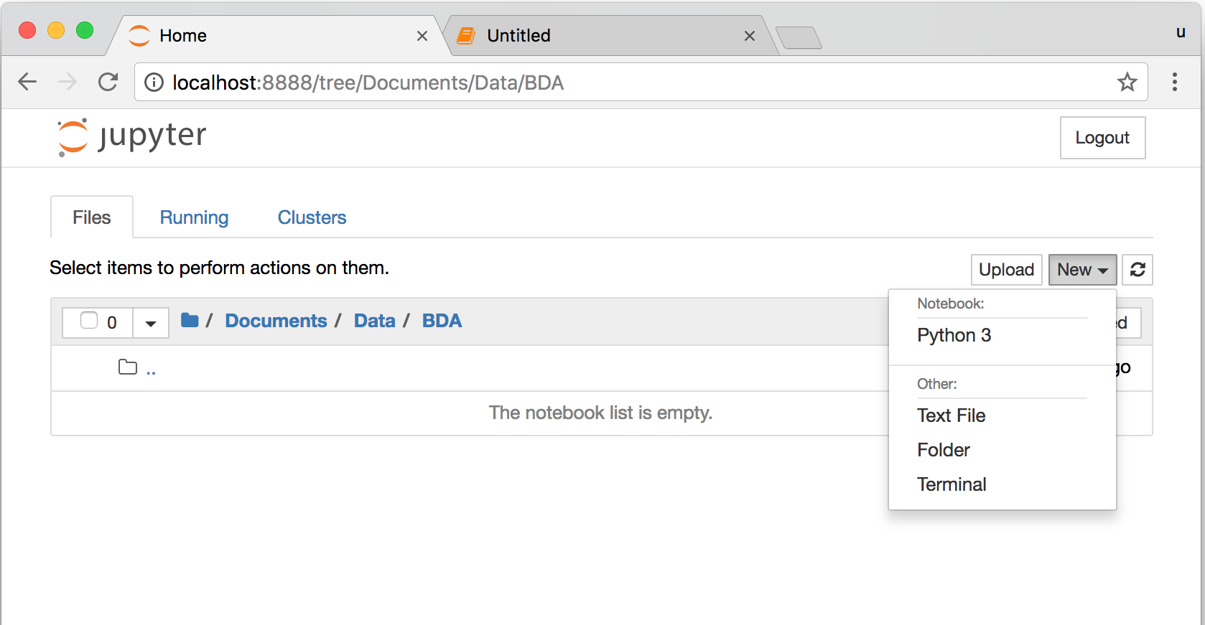
Jupyter Notebook New Python 3

Slide 38
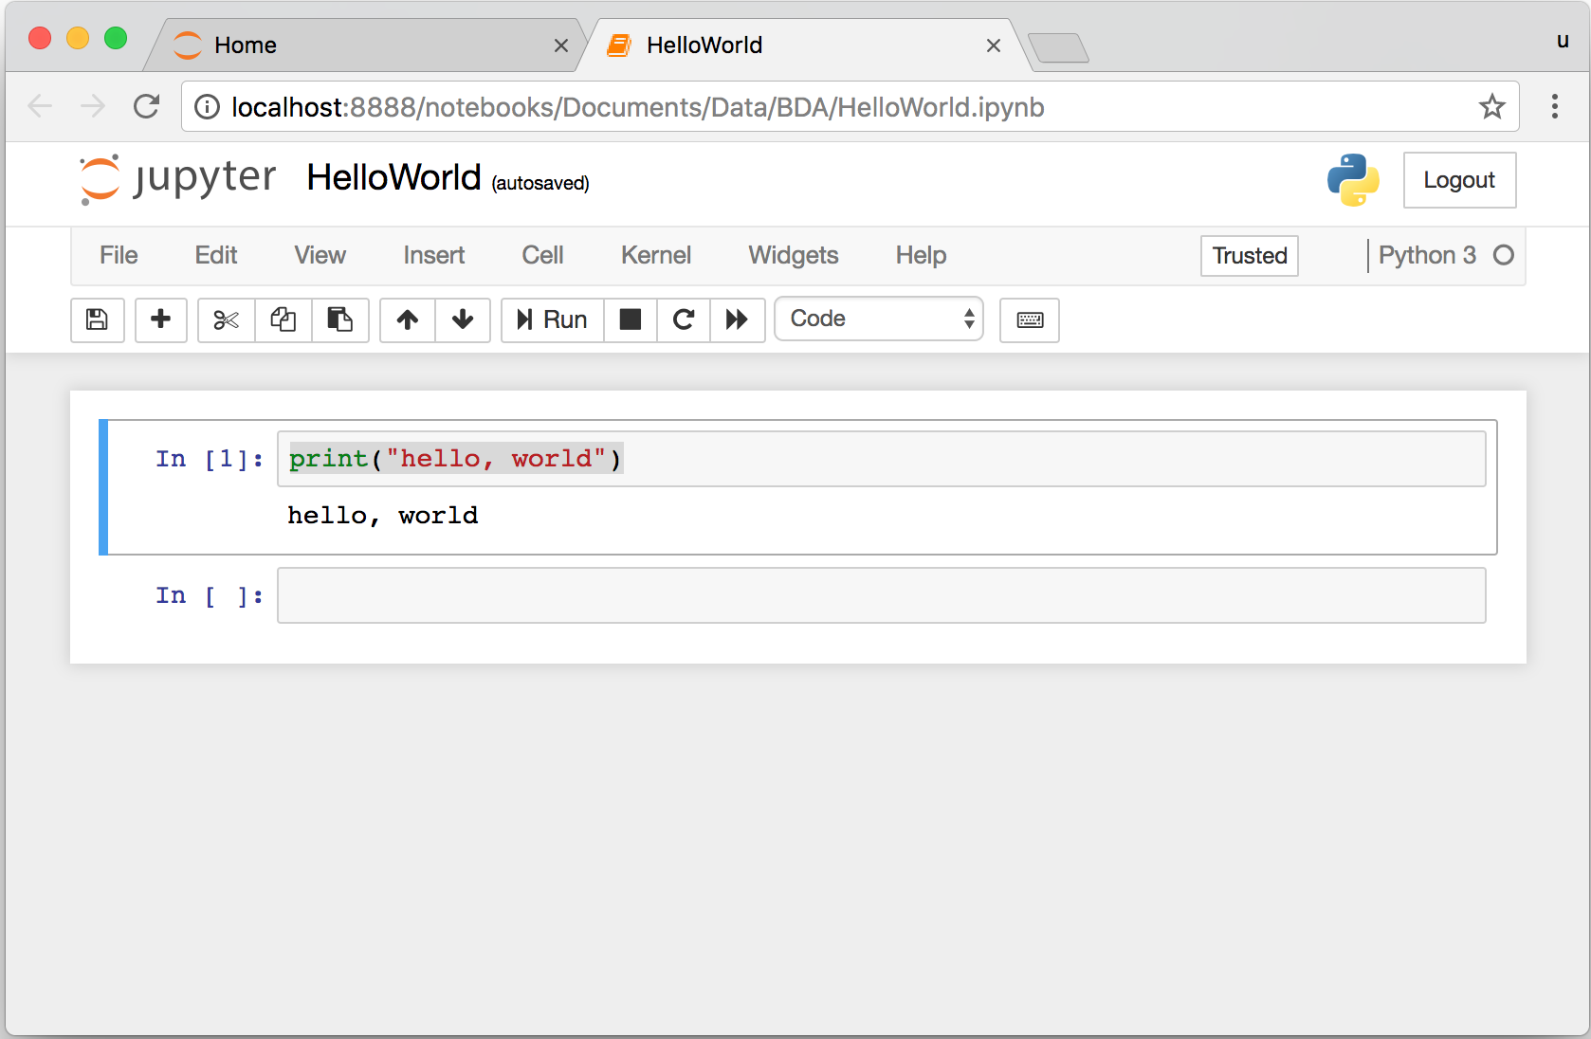
print("hello, world")
Notes:
print("hello, world")

Slide 39
Source: https://www.python.org/community/logos/

Slide 40
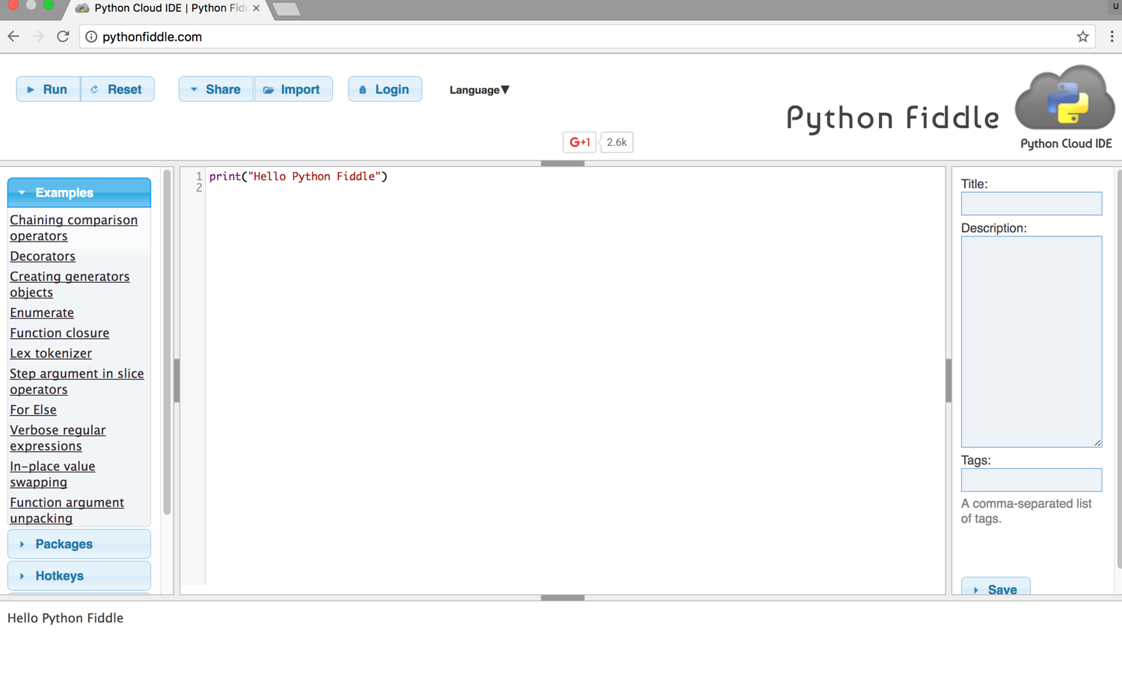
Python Fiddle
http://pythonfiddle.com/

Slide 41
Text input and output
print("Hello World")
print("Hello World\nThis is a message")
x = 3
print(x)
x = 2
y = 3
print(x, ' ', y)
name = input("Enter a name: ")
x = int(input("What is x? "))
x = float(input("Write a number "))
Source: http://pythonprogramminglanguage.com/text-input-and-output/
Notes:
print("Hello World")
print("Hello World\nThis is a message")
x = 3
print(x)
x = 2
y = 3
print(x, ' ', y)
name = input("Enter a name: ")
x = int(input("What is x? "))
x = float(input("Write a number "))

Slide 42
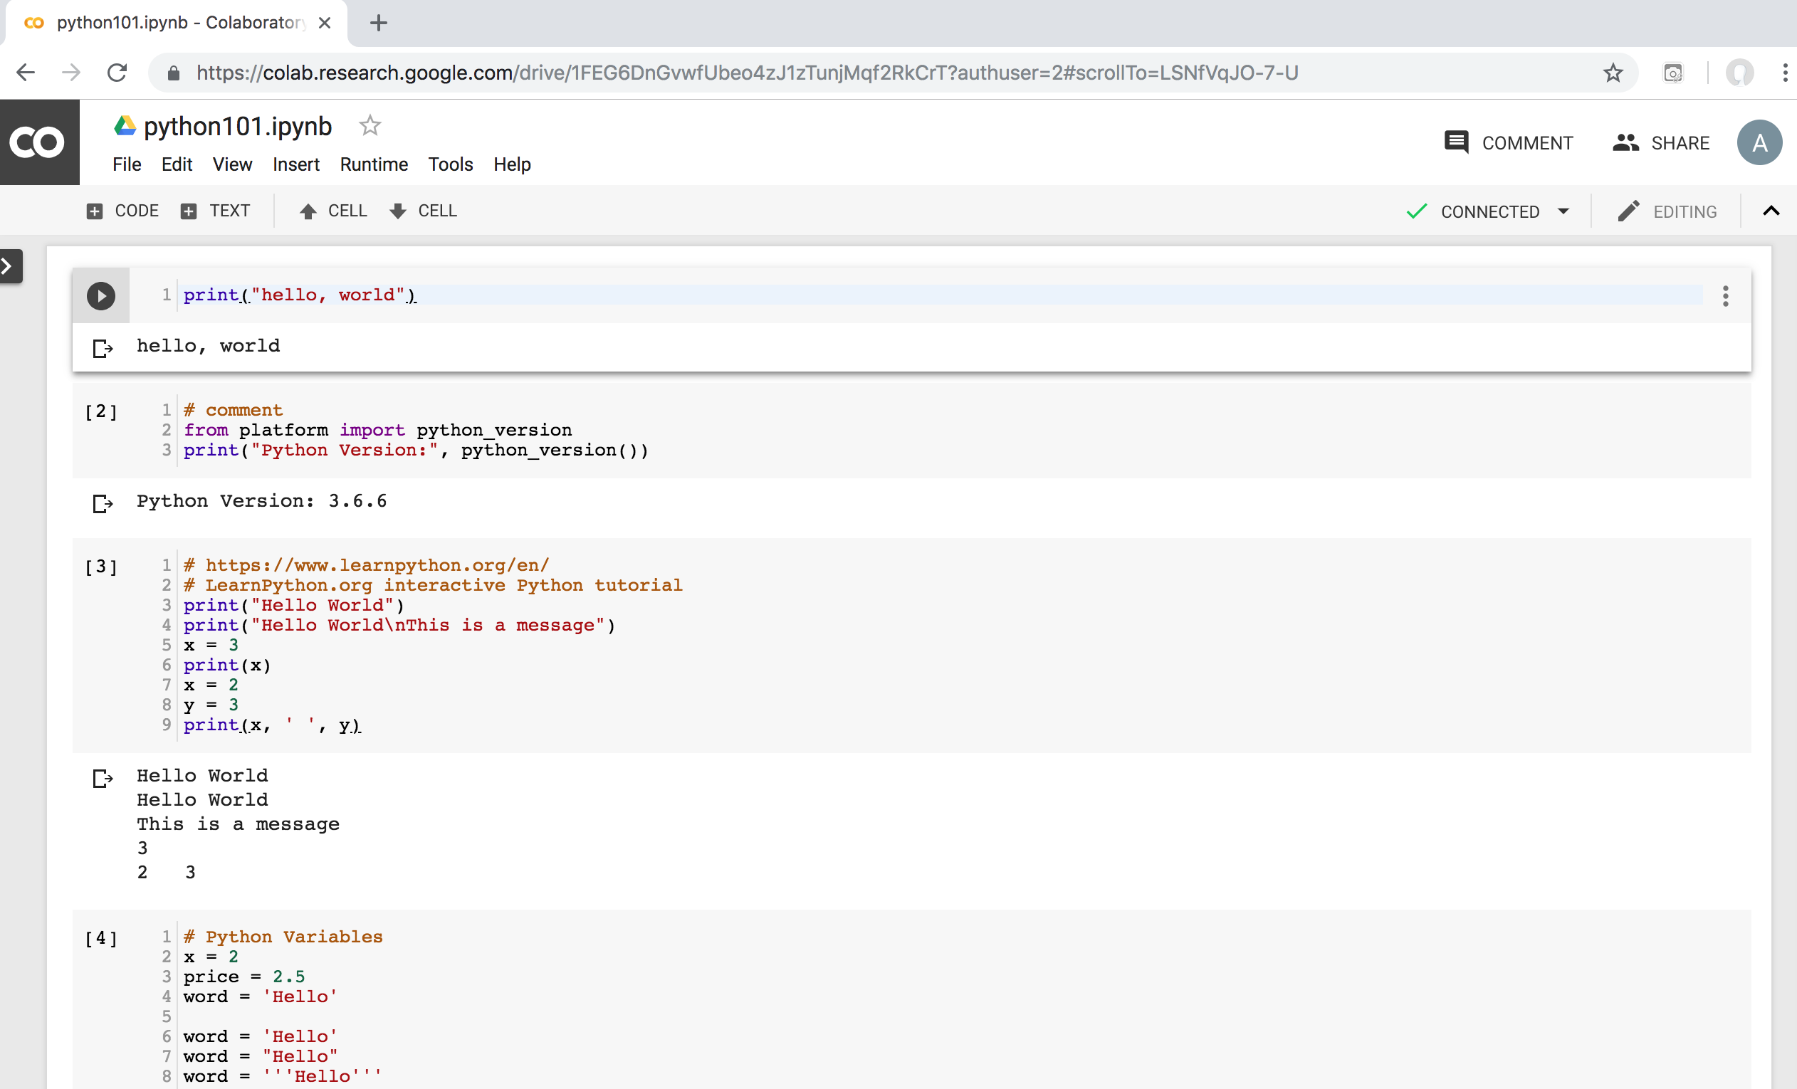
Python in Google Colab
https://colab.research.google.com/drive/1FEG6DnGvwfUbeo4zJ1zTunjMqf2RkCrT
https://tinyurl.com/aintpupython101

Slide 43
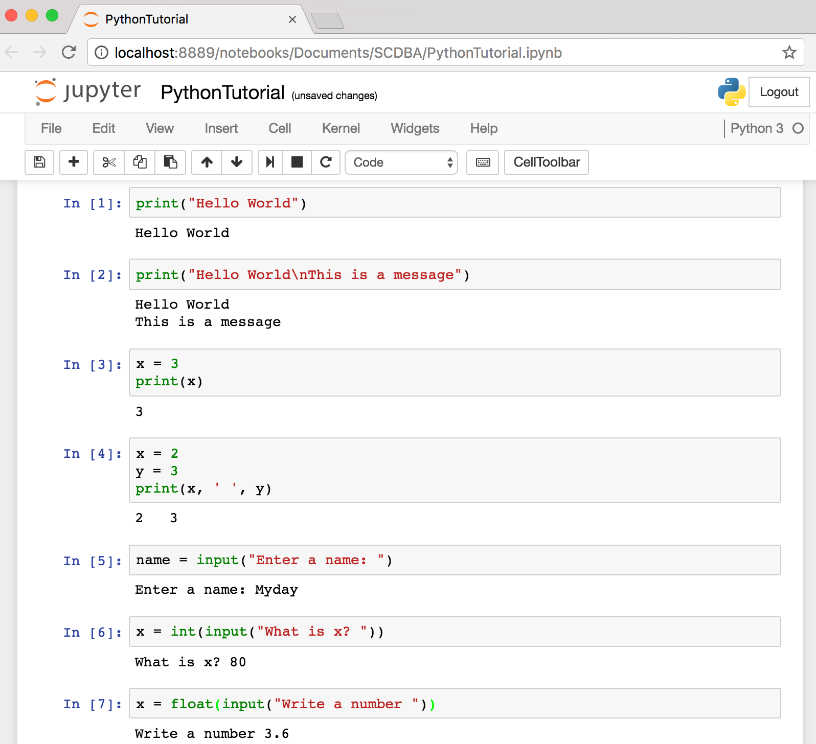
Text input and output
Source: http://pythonprogramminglanguage.com/text-input-and-output/
Notes:
print("Hello World")
print("Hello World\nThis is a message")
x = 3
print(x)
x = 2
y = 3
print(x, ' ', y)
name = input("Enter a name: ")
x = int(input("What is x? "))
x = float(input("Write a number "))

Slide 44
Variables
x = 2
price = 2.5
word = 'Hello'
word = 'Hello'
word = "Hello"
word = '''Hello'''
x = 2
x = x + 1
x = 5
Source: http://pythonprogramminglanguage.com/

Slide 45
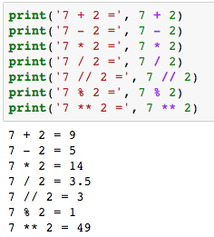
Python Basic Operators
print('7 + 2 =', 7 + 2)
print('7 - 2 =', 7 - 2)
print('7 * 2 =', 7 * 2)
print('7 / 2 =', 7 / 2)
print('7 // 2 =', 7 // 2)
print('7 % 2 =', 7 % 2)
print('7 ** 2 =', 7 ** 2)

Slide 46
BMI Calculator in Python
height_cm = float(input("Enter your height in cm: "))
weight_kg = float(input("Enter your weight in kg: "))
height_m = height_cm/100
BMI = (weight_kg/(height_m**2))
print("Your BMI is: " + str(round(BMI,1)))
Source: http://code.activestate.com/recipes/580615-bmi-code/

Slide 47
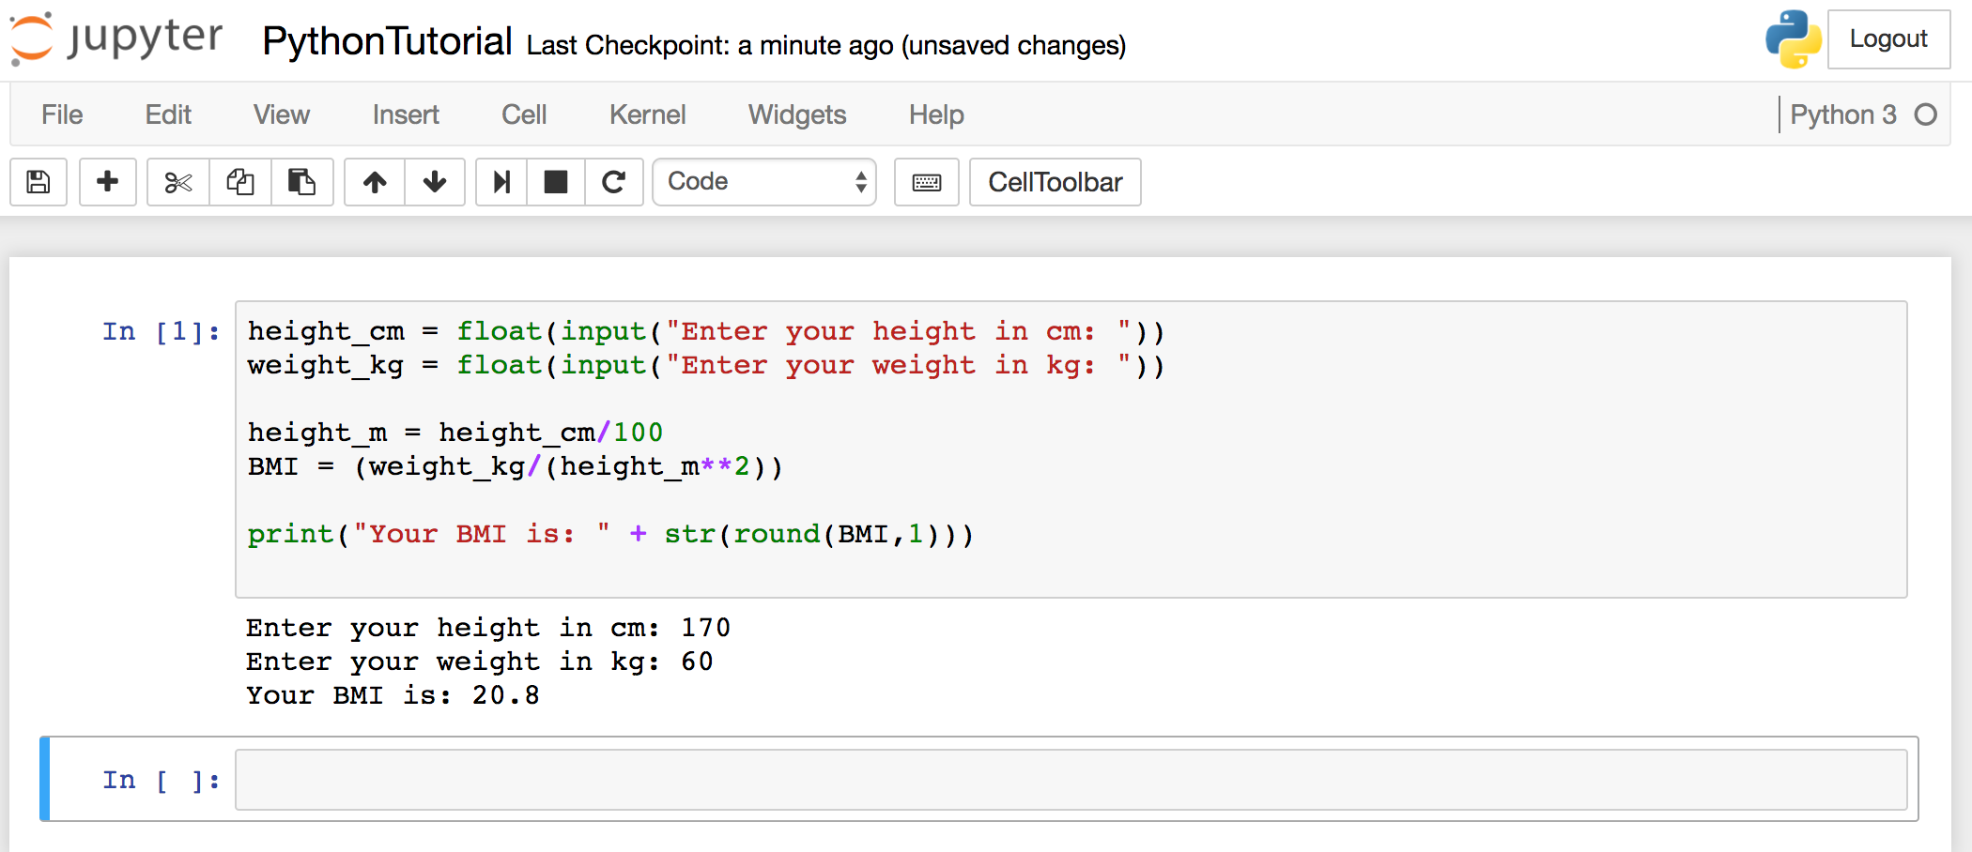
BMI Calculator in Python
Source: http://code.activestate.com/recipes/580615-bmi-code/
Notes:
height_cm = float(input("Enter your height in cm: "))
weight_kg = float(input("Enter your weight in kg: "))
height_m = height_cm/100
BMI = (weight_kg/(height_m**2))
print("Your BMI is: " + str(round(BMI,1)))

Slide 48
Future value of a specified principal amount, rate of interest, and a number of years
Source: https://www.w3resource.com/python-exercises/python-basic-exercise-39.php

Slide 49
Future Value (FV)
# How much is your $100 worth after 7 years?
print(100 * 1.1 ** 7)
# output = 194.87
Source: https://www.w3resource.com/python-exercises/python-basic-exercise-39.php

Slide 50
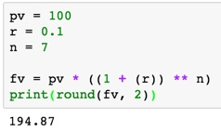
Future Value (FV)
pv = 100
r = 0.1
n = 7
fv = pv * ((1 + (r)) ** n)
print(round(fv, 2))

Slide 51
Future Value (FV)
amount = 100
interest = 10 #10% = 0.01 * 10
years = 7
future_value = amount * ((1 + (0.01 * interest)) ** years)
print(round(future_value, 2))
Source: https://www.w3resource.com/python-exercises/python-basic-exercise-39.php
Notes:
amount = 100
interest = 10 #10% = 0.01 * 10
years = 7
future_value = amount * ((1 + (0.01 * interest)) ** years)
print(round(future_value, 2))

Slide 52
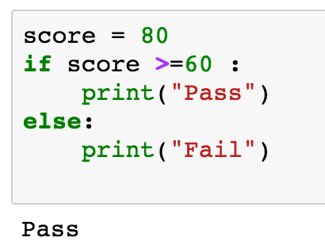
if statements
> greater than
< smaller than
== equals
!= is not
score = 80
if score >=60 :
print("Pass")
else:
print("Fail")
Source: http://pythonprogramminglanguage.com/

Slide 53
if elif else
score = 90
grade = ""
if score >=90:
grade = "A"
elif score >= 80:
grade = "B"
elif score >= 70:
grade = "C"
elif score >= 60:
grade = "D"
else:
grade = "E"
print(grade)
# grade = ”A”
A
http://pythontutor.com/visualize.html
https://goo.gl/E6w5ph
Source: http://pythonprogramminglanguage.com/
Notes:
http://pythontutor.com/visualize.html
https://goo.gl/E6w5ph

Slide 54
for loops
for i in range(1,11):
print(i)
1
2
3
4
5
6
7
8
9
10
Source: http://pythonprogramminglanguage.com/
Notes:
https://goo.gl/YpxMYo

Slide 55
for loops
for i in range(1,10):
for j in range(1,10):
print(i, ' * ' , j , ' = ', i*j)
9 * 1 = 9
9 * 2 = 18
9 * 3 = 27
9 * 4 = 36
9 * 5 = 45
9 * 6 = 54
9 * 7 = 63
9 * 8 = 72
9 * 9 = 81
Source: http://pythonprogramminglanguage.com/
Notes:
for i in range(1,10):
for j in range(1,10):
print(i, ' * ' , j , ' = ', i*j)

Slide 56
while loops
age = 10
while age < 20:
print(age)
age = age + 1
10
11
12
13
14
15
16
17
18
19
Source: https://learnpython.trinket.io/learn-python-part-8-loops#/while-loops/about-while-loops
Notes:
age = 10
while age < 20:
print(age)
age = age + 1

Slide 57
def Functions
def convertCMtoM(xcm):
m = xcm/100
return m
cm = 180
m = convertCMtoM(cm)
print(str(m))
1.8
Notes:
https://goo.gl/6K5qUn

Slide 58
Lists []
x = [60, 70, 80, 90]
print(len(x))
print(x[0])
print(x[1])
print(x[-1])
4
60
70
90

Slide 59
Tuples ()
A tuple in Python is a collection that cannot be modified. A tuple is defined using parenthesis.
x = (10, 20, 30, 40, 50)
print(x[0])
print(x[1])
print(x[2])
print(x[-1])
10
20
30
50
Source: http://pythonprogramminglanguage.com/tuples/

Slide 60
Dictionary {key : value}
k = { 'EN':'English', 'FR':'French' }
print(k['EN'])
English
Source: http://pythonprogramminglanguage.com/dictionary/

Slide 61
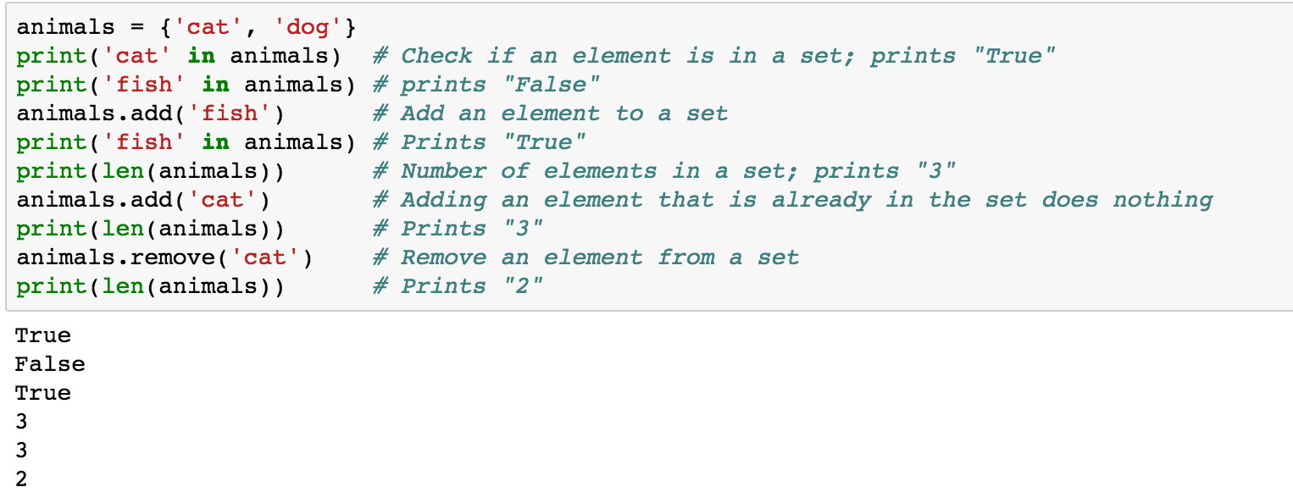
Sets {}
animals = {'cat', 'dog'}
animals = {'cat', 'dog'}
print('cat' in animals)
print('fish' in animals)
animals.add('fish')
print('fish' in animals)
print(len(animals))
animals.add('cat')
print(len(animals))
animals.remove('cat')
print(len(animals))
Source: http://cs231n.github.io/python-numpy-tutorial/
Notes:
#Sets
animals = {'cat', 'dog'}
print('cat' in animals) # Check if an element is in a set; prints "True"
print('fish' in animals) # prints "False"
animals.add('fish') # Add an element to a set
print('fish' in animals) # Prints "True"
print(len(animals)) # Number of elements in a set; prints "3"
animals.add('cat') # Adding an element that is already in the set does nothing
print(len(animals)) # Prints "3"
animals.remove('cat') # Remove an element from a set
print(len(animals)) # Prints "2”
Source: http://cs231n.github.io/python-numpy-tutorial/

Slide 62
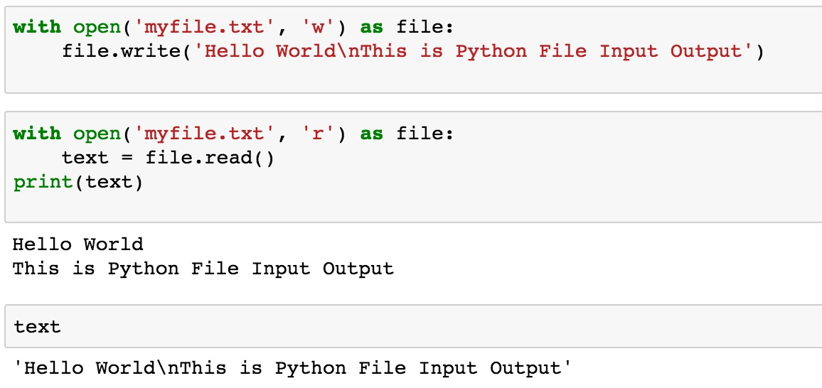
File Input / Output
with open('myfile.txt', 'w') as file:
file.write('Hello World\nThis is Python File Input Output')
with open('myfile.txt', 'r') as file:
text = file.read()
print(text)
Source: https://github.com/TiesdeKok/LearnPythonforResearch/blob/master/0_python_basics.ipynb
Notes:
with open('myfile.txt', 'w') as file:
file.write('Hello World\nThis is Python File Input Output')
with open('myfile.txt', 'r') as file:
text = file.read()
print(text)
with open('myfile.txt', 'a+') as file:
file.write('\n' + 'New line')
with open('myfile.txt', 'r') as file:
text = file.read()
print(text)

Slide 63
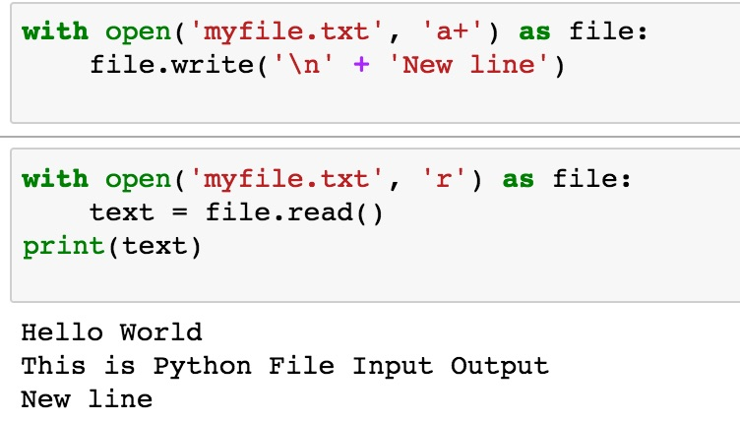
File Input / Output
with open('myfile.txt', 'a+') as file:
file.write('\n' + 'New line')
with open('myfile.txt', 'r') as file:
text = file.read()
print(text)
Source: https://github.com/TiesdeKok/LearnPythonforResearch/blob/master/0_python_basics.ipynb
Notes:
with open('myfile.txt', 'w') as file:
file.write('Hello World\nThis is Python File Input Output')
with open('myfile.txt', 'r') as file:
text = file.read()
print(text)
with open('myfile.txt', 'a+') as file:
file.write('\n' + 'New line')
with open('myfile.txt', 'r') as file:
text = file.read()
print(text)

Slide 64
try except finally
try:
file = open("myfile.txt")
#file = open("myfile.txt", 'w')
file.write("Python write file")
print("file saved")
except:
print("Exception file Error")
finally:
file.close()
print("finally process")
Exception file Error
finally process
Source: https://pythonbasics.org/try-except/
Notes:
try:
file = open("myfile.txt")
#file = open("myfile.txt", 'w')
file.write("Python write file")
print("file saved")
except:
print("Exception file Error")
finally:
file.close()
print("finally process")

Slide 65
class
class Person:
def __init__(self, name, age):
self.name = name
self.age = age
def myfunc(self):
print("Hello my name is " + self.name)
p1 = Person("Alan", 20)
p1.myfunc()
print(p1.name)
print(p1.age)
Hello my name is Alan
Alan
20
Source: https://www.w3schools.com/python/python_classes.asp
Notes:
class Person:
def __init__(self, name, age):
self.name = name
self.age = age
def myfunc(self):
print("Hello my name is " + self.name)
p1 = Person("Alan", 20)
p1.myfunc()
print(p1.name)
print(p1.age)

Slide 66
Big Data Analytics with Numpy in Python

Slide 67
Numpy
NumPy
Base N-dimensional array package

Slide 68
NumPy is the fundamental package for scientific computing with Python.
Source: http://www.numpy.org/

Slide 69
NumPy
NumPy
NumPy provides a multidimensional array object to store homogenous or heterogeneous data; it also provides optimized functions/methods to operate on this array object.
Source: Yves Hilpisch (2014), Python for Finance: Analyze Big Financial Data, O'Reilly

Slide 70
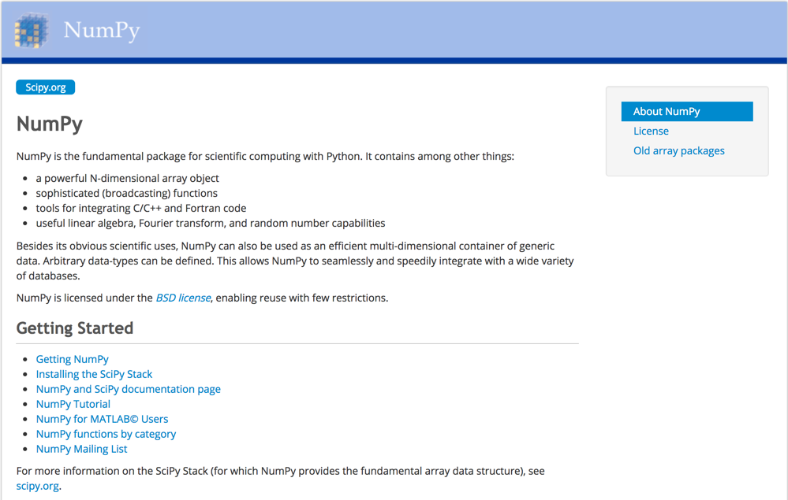
NumPy
http://www.numpy.org/

Slide 71
NumPy ndarray
NumPy
One-dimensional Array (1-D Array)
0 | 1 |  |  | n-1
1 | 2 | 3 | 4 | 5
Two-dimensional Array (2-D Array)
 | 0 | 1 |  |  | n-1
0 | 1 | 2 | 3 | 4 | 5
1 | 6 | 7 | 8 | 9 | 10
 | 11 | 12 | 13 | 14 | 15
m-1 | 16 | 17 | 18 | 19 | 20

Slide 72
v = list(range(1, 6)) v 2 * v import numpy as np v = np.arange(1, 6) v 2 * v
NumPy
NumPy
Source: Yves Hilpisch (2014), Python for Finance: Analyze Big Financial Data, O'Reilly
Notes:
# pip3 install numpy
# pip install numpy
# sudo pip3 install numpy
import numpy as np

Slide 73
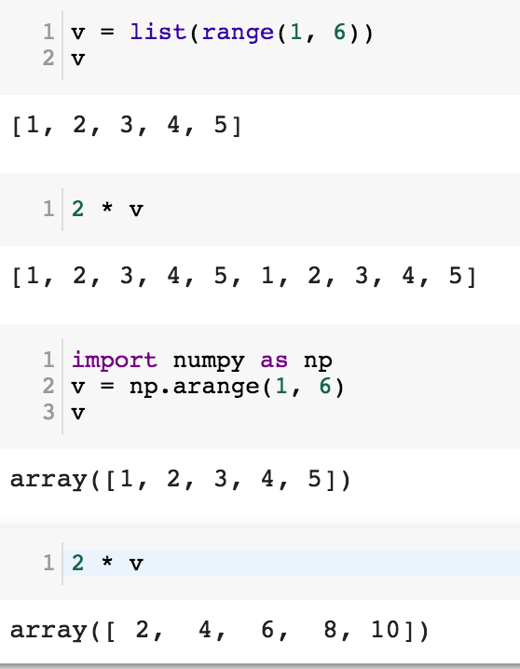
NumPy
Base N-dimensional array package

Slide 74
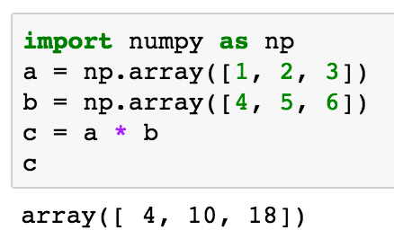
import numpy as np a = np.array([1, 2, 3]) b = np.array([4, 5, 6]) c = a * b c
NumPy Create Array
NumPy
Source: Yves Hilpisch (2014), Python for Finance: Analyze Big Financial Data, O'Reilly

Slide 75
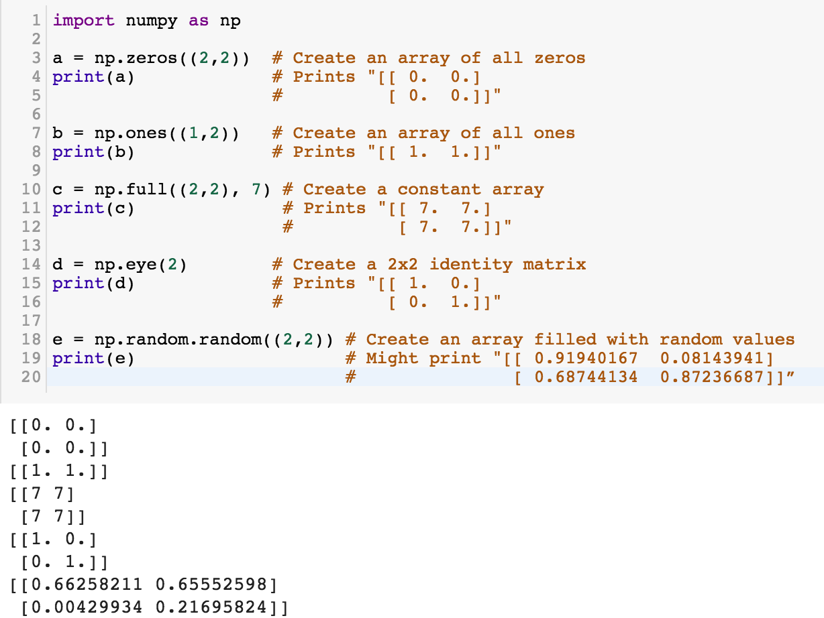
NumPy
NumPy
Source: http://cs231n.github.io/python-numpy-tutorial/
Notes:
import numpy as np
a = np.zeros((2,2)) # Create an array of all zeros
print(a) # Prints "[[ 0. 0.]
# [ 0. 0.]]"
b = np.ones((1,2)) # Create an array of all ones
print(b) # Prints "[[ 1. 1.]]"
c = np.full((2,2), 7) # Create a constant array
print(c) # Prints "[[ 7. 7.]
# [ 7. 7.]]"
d = np.eye(2) # Create a 2x2 identity matrix
print(d) # Prints "[[ 1. 0.]
# [ 0. 1.]]"
e = np.random.random((2,2)) # Create an array filled with random values
print(e) # Might print "[[ 0.91940167 0.08143941]
# [ 0.68744134 0.87236687]]”
Source: http://cs231n.github.io/python-numpy-tutorial/

Slide 76
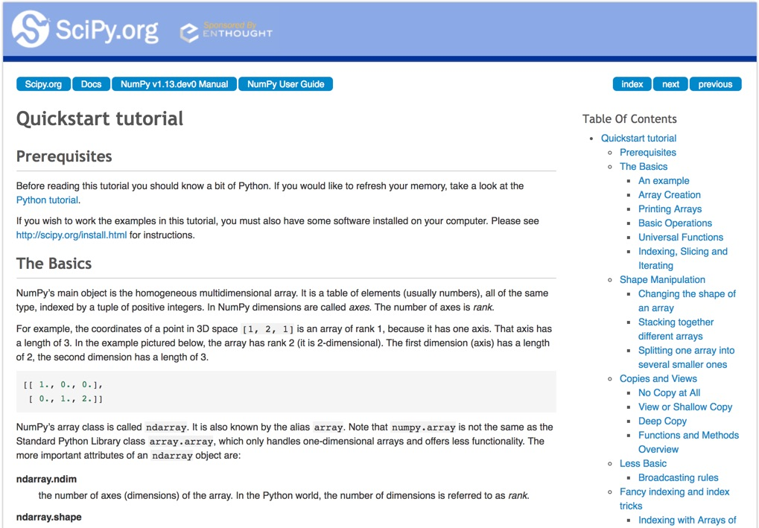
Numpy Quickstart Tutorial
https://docs.scipy.org/doc/numpy-dev/user/quickstart.html

Slide 77
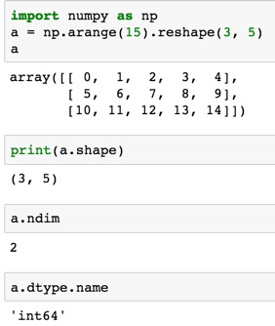
import numpy as np
a = np.arange(15).reshape(3, 5)
a.shape
a.ndim
a.dtype.name
Source: https://docs.scipy.org/doc/numpy-dev/user/quickstart.html
Notes:
Numpy Tutorial
Source: https://docs.scipy.org/doc/numpy-dev/user/quickstart.html
In [1]:
import numpy as np
a = np.arange(15).reshape(3, 5)
a
Out[1]:
array([[ 0, 1, 2, 3, 4],
[ 5, 6, 7, 8, 9],
[10, 11, 12, 13, 14]])
In [2]:
print(a.shape)
(3, 5)
In [3]:
a.ndim
Out[3]:
2
In [4]:
a.dtype.name
Out[4]:
'int64'
In [5]:
a.itemsize
Out[5]:
8
In [6]:
a.size
Out[6]:
15
In [7]:
type(a)
Out[7]:
numpy.ndarray
In [8]:
b = np.array([1, 2, 3])
In [9]:
b
Out[9]:
array([1, 2, 3])
In [10]:
type(b)
Out[10]:
numpy.ndarray

Slide 78
Matrix
Source: https://simple.wikipedia.org/wiki/Matrix_(mathematics)

Slide 79
NumPy ndarray: Multidimensional Array Object

Slide 80
NumPy ndarray
One-dimensional Array (1-D Array)
0 | 1 |  |  | n-1
1 | 2 | 3 | 4 | 5
Two-dimensional Array (2-D Array)
 | 0 | 1 |  |  | n-1
0 | 1 | 2 | 3 | 4 | 5
1 | 6 | 7 | 8 | 9 | 10
 | 11 | 12 | 13 | 14 | 15
m-1 | 16 | 17 | 18 | 19 | 20

Slide 81
import numpy as np a = np.array([1,2,3,4,5])
One-dimensional Array (1-D Array)
0 | 1 |  |  | n-1
1 | 2 | 3 | 4 | 5

Slide 82
a = np.array([[1,2,3,4,5],[6,7,8,9,10],[11,12,13,14,15],[16,17,18,19,20]])
Two-dimensional Array (2-D Array)
 | 0 | 1 |  |  | n-1
0 | 1 | 2 | 3 | 4 | 5
1 | 6 | 7 | 8 | 9 | 10
 | 11 | 12 | 13 | 14 | 15
m-1 | 16 | 17 | 18 | 19 | 20

Slide 83
import numpy as np a = np.array([[0, 1, 2, 3], [10, 11, 12, 13], [20, 21, 22, 23]])
a
0 | 1 | 2 | 3
10 | 11 | 12 | 13
20 | 21 | 22 | 23
Notes:
import numpy as np a = np.array([[0, 1, 2, 3], [10, 11, 12, 13], [20, 21, 22, 23]])
a

Slide 84
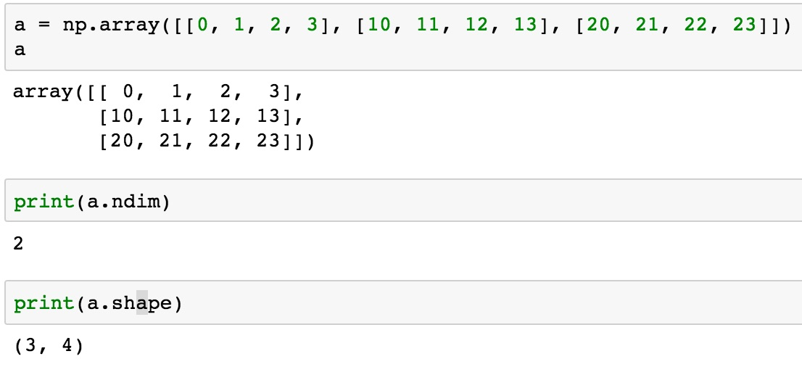
a = np.array([[0, 1, 2, 3], [10, 11, 12, 13], [20, 21, 22, 23]])
0 | 1 | 2 | 3
10 | 11 | 12 | 13
20 | 21 | 22 | 23

Slide 85
NumPy Basics: Arrays and Vectorized Computation
Source: https://www.safaribooksonline.com/library/view/python-for-data/9781449323592/ch04.html

Slide 86
NumPy Array
Source: https://www.safaribooksonline.com/library/view/python-for-data/9781449323592/ch04.html

Slide 87
Numpy Array
Source: https://www.safaribooksonline.com/library/view/python-for-data/9781449323592/ch04.html

Slide 88
Tensor
3
a rank 0 tensor; this is a scalar with shape []
[1. ,2., 3.]
a rank 1 tensor; this is a vector with shape [3]
[[1., 2., 3.], [4., 5., 6.]]
a rank 2 tensor; a matrix with shape [2, 3]
[[[1., 2., 3.]], [[7., 8., 9.]]]
a rank 3 tensor with shape [2, 1, 3]
https://www.tensorflow.org/

Slide 89
Scalar
80
Vector
[50 60 70]
Matrix
50 60 70
55 65 75
[50 60 70] [70 80 90]
[55 65 75] [75 85 95]
Tensor

Slide 90
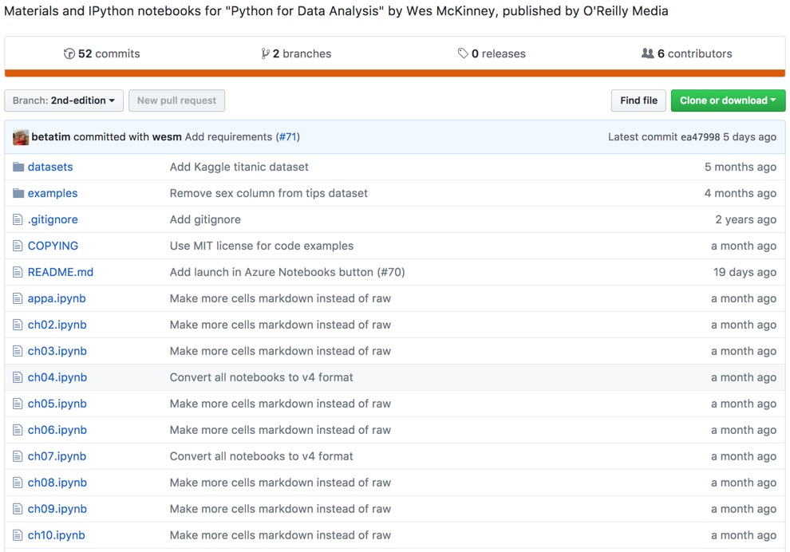
Wes McKinney (2017), "Python for Data Analysis: Data Wrangling with Pandas, NumPy, and IPython", 2nd Edition, O'Reilly Media.
https://github.com/wesm/pydata-book

Slide 91
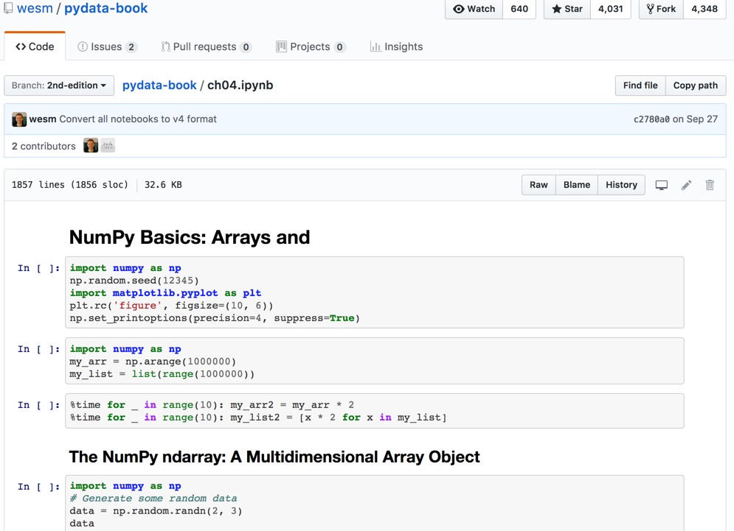
Wes McKinney (2017), "Python for Data Analysis: Data Wrangling with Pandas, NumPy, and IPython", 2nd Edition, O'Reilly Media.
Source: https://github.com/wesm/pydata-book/blob/2nd-edition/ch04.ipynb

Slide 92
Natural Language Processing (NLP) and Text Mining
Raw text
Sentence Segmentation
Tokenization
Part-of-Speech (POS)
Stop word removal
word’s stem
am → am
having → hav
word’s lemma
am → be
having → have
Stemming / Lemmatization
Dependency Parser
String Metrics & Matching
Source: Nitin Hardeniya (2015), NLTK Essentials, Packt Publishing; Florian Leitner (2015), Text mining - from Bayes rule to dependency parsing

Slide 93
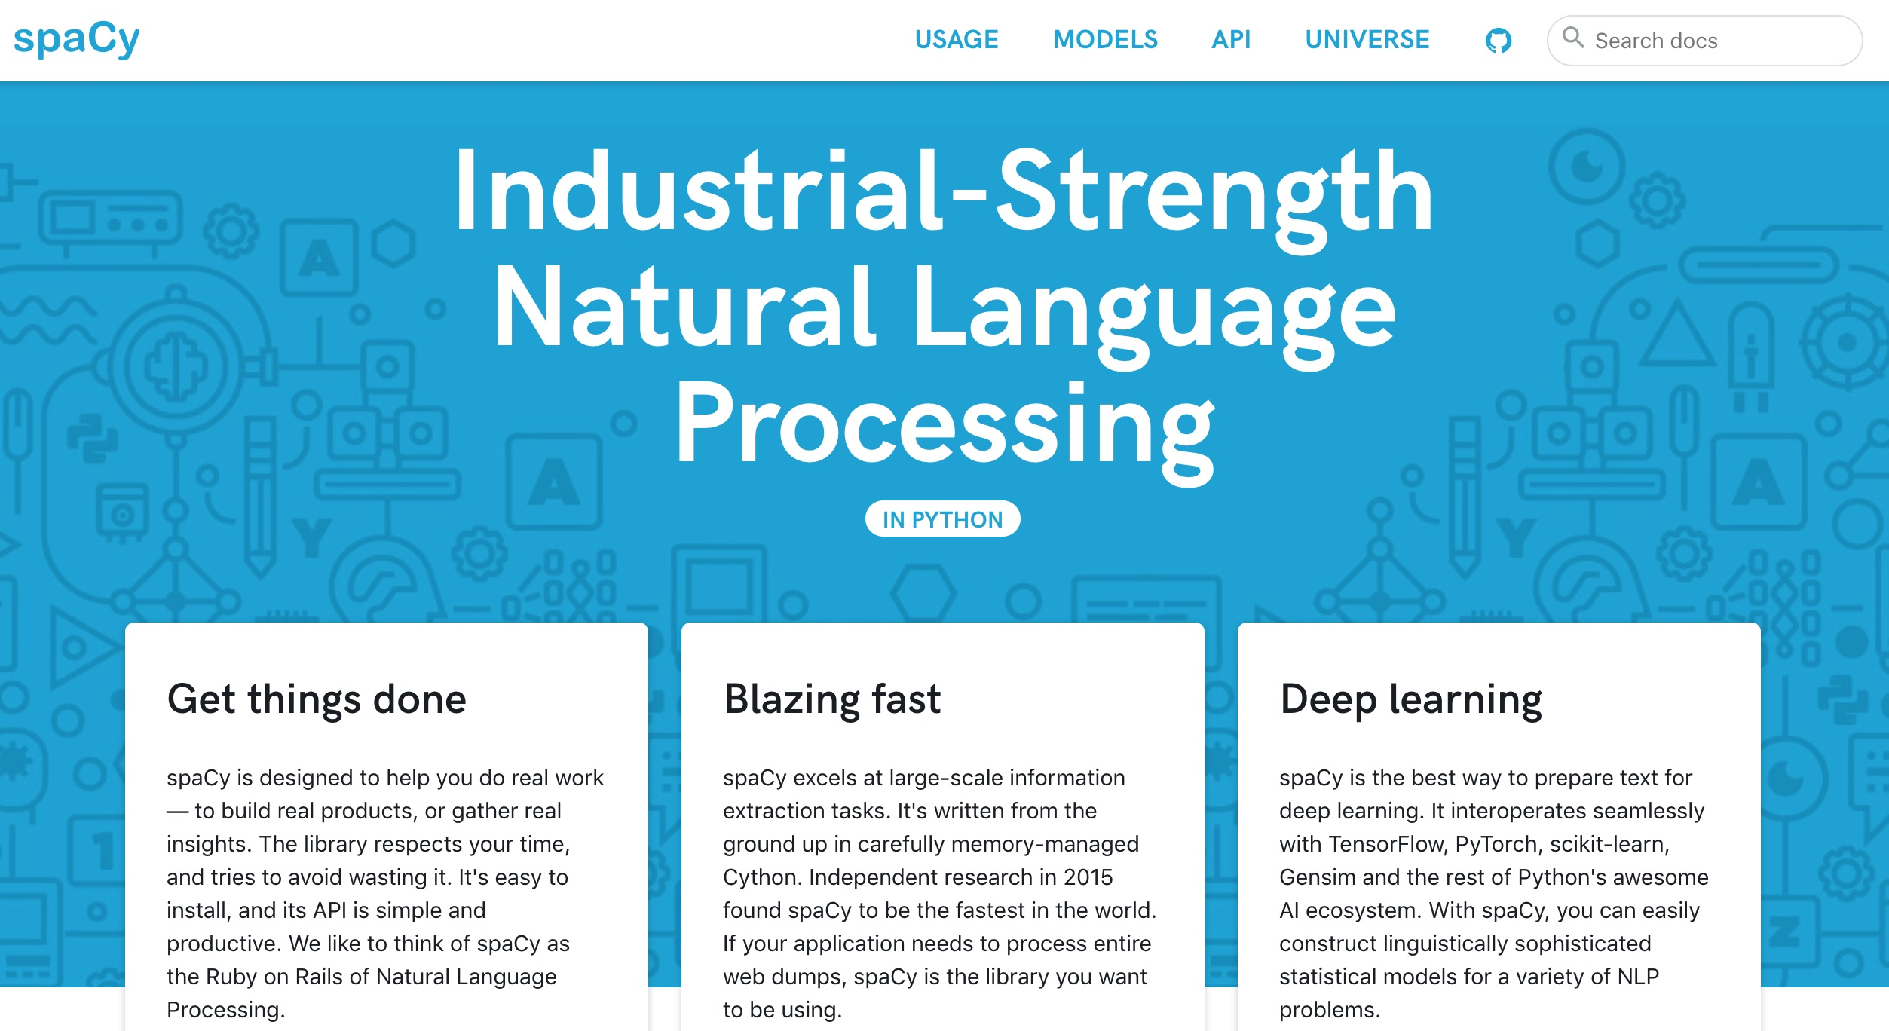
spaCy: Natural Language Processing
https://spacy.io/

Slide 94
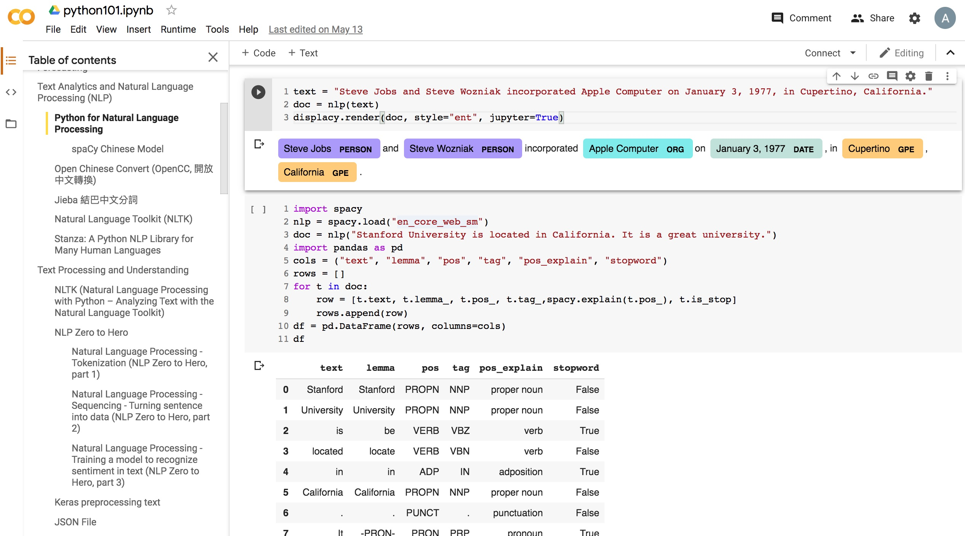
Python in Google Colab (Python101)
https://colab.research.google.com/drive/1FEG6DnGvwfUbeo4zJ1zTunjMqf2RkCrT
https://tinyurl.com/aintpupython101

Slide 95
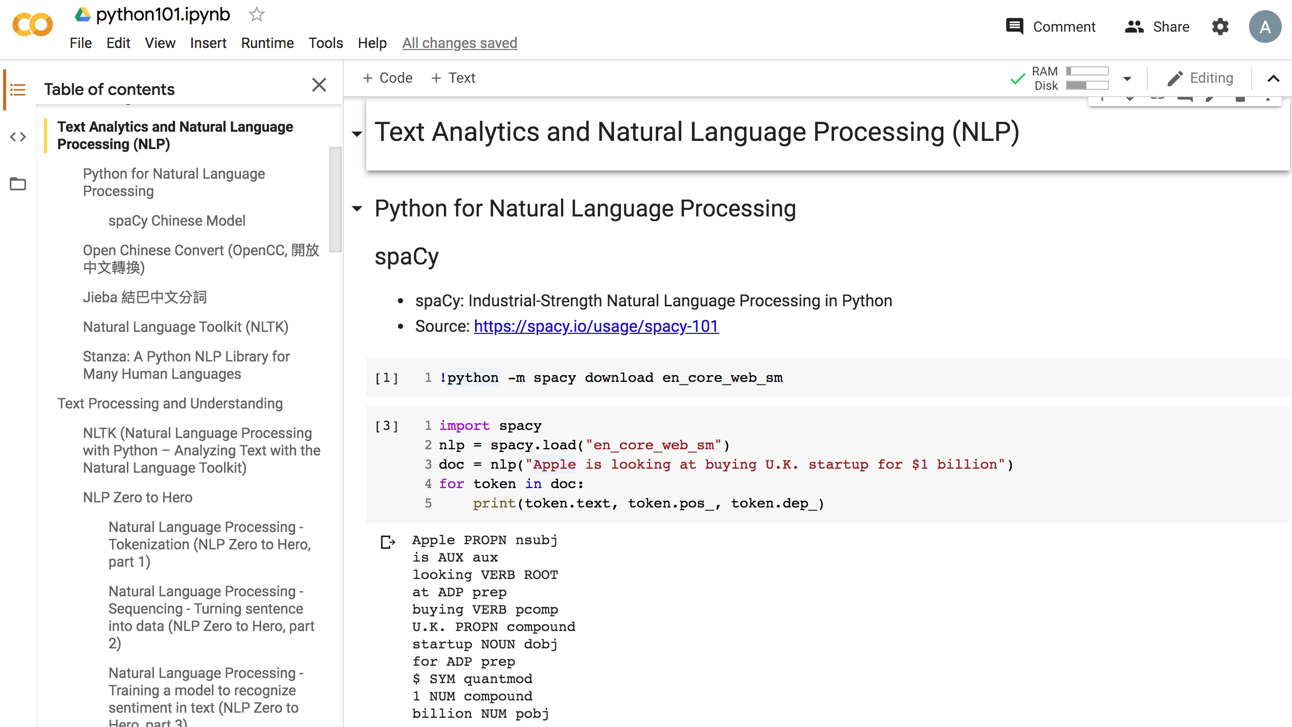
Python in Google Colab (Python101)
https://colab.research.google.com/drive/1FEG6DnGvwfUbeo4zJ1zTunjMqf2RkCrT
https://tinyurl.com/aintpupython101

Slide 96
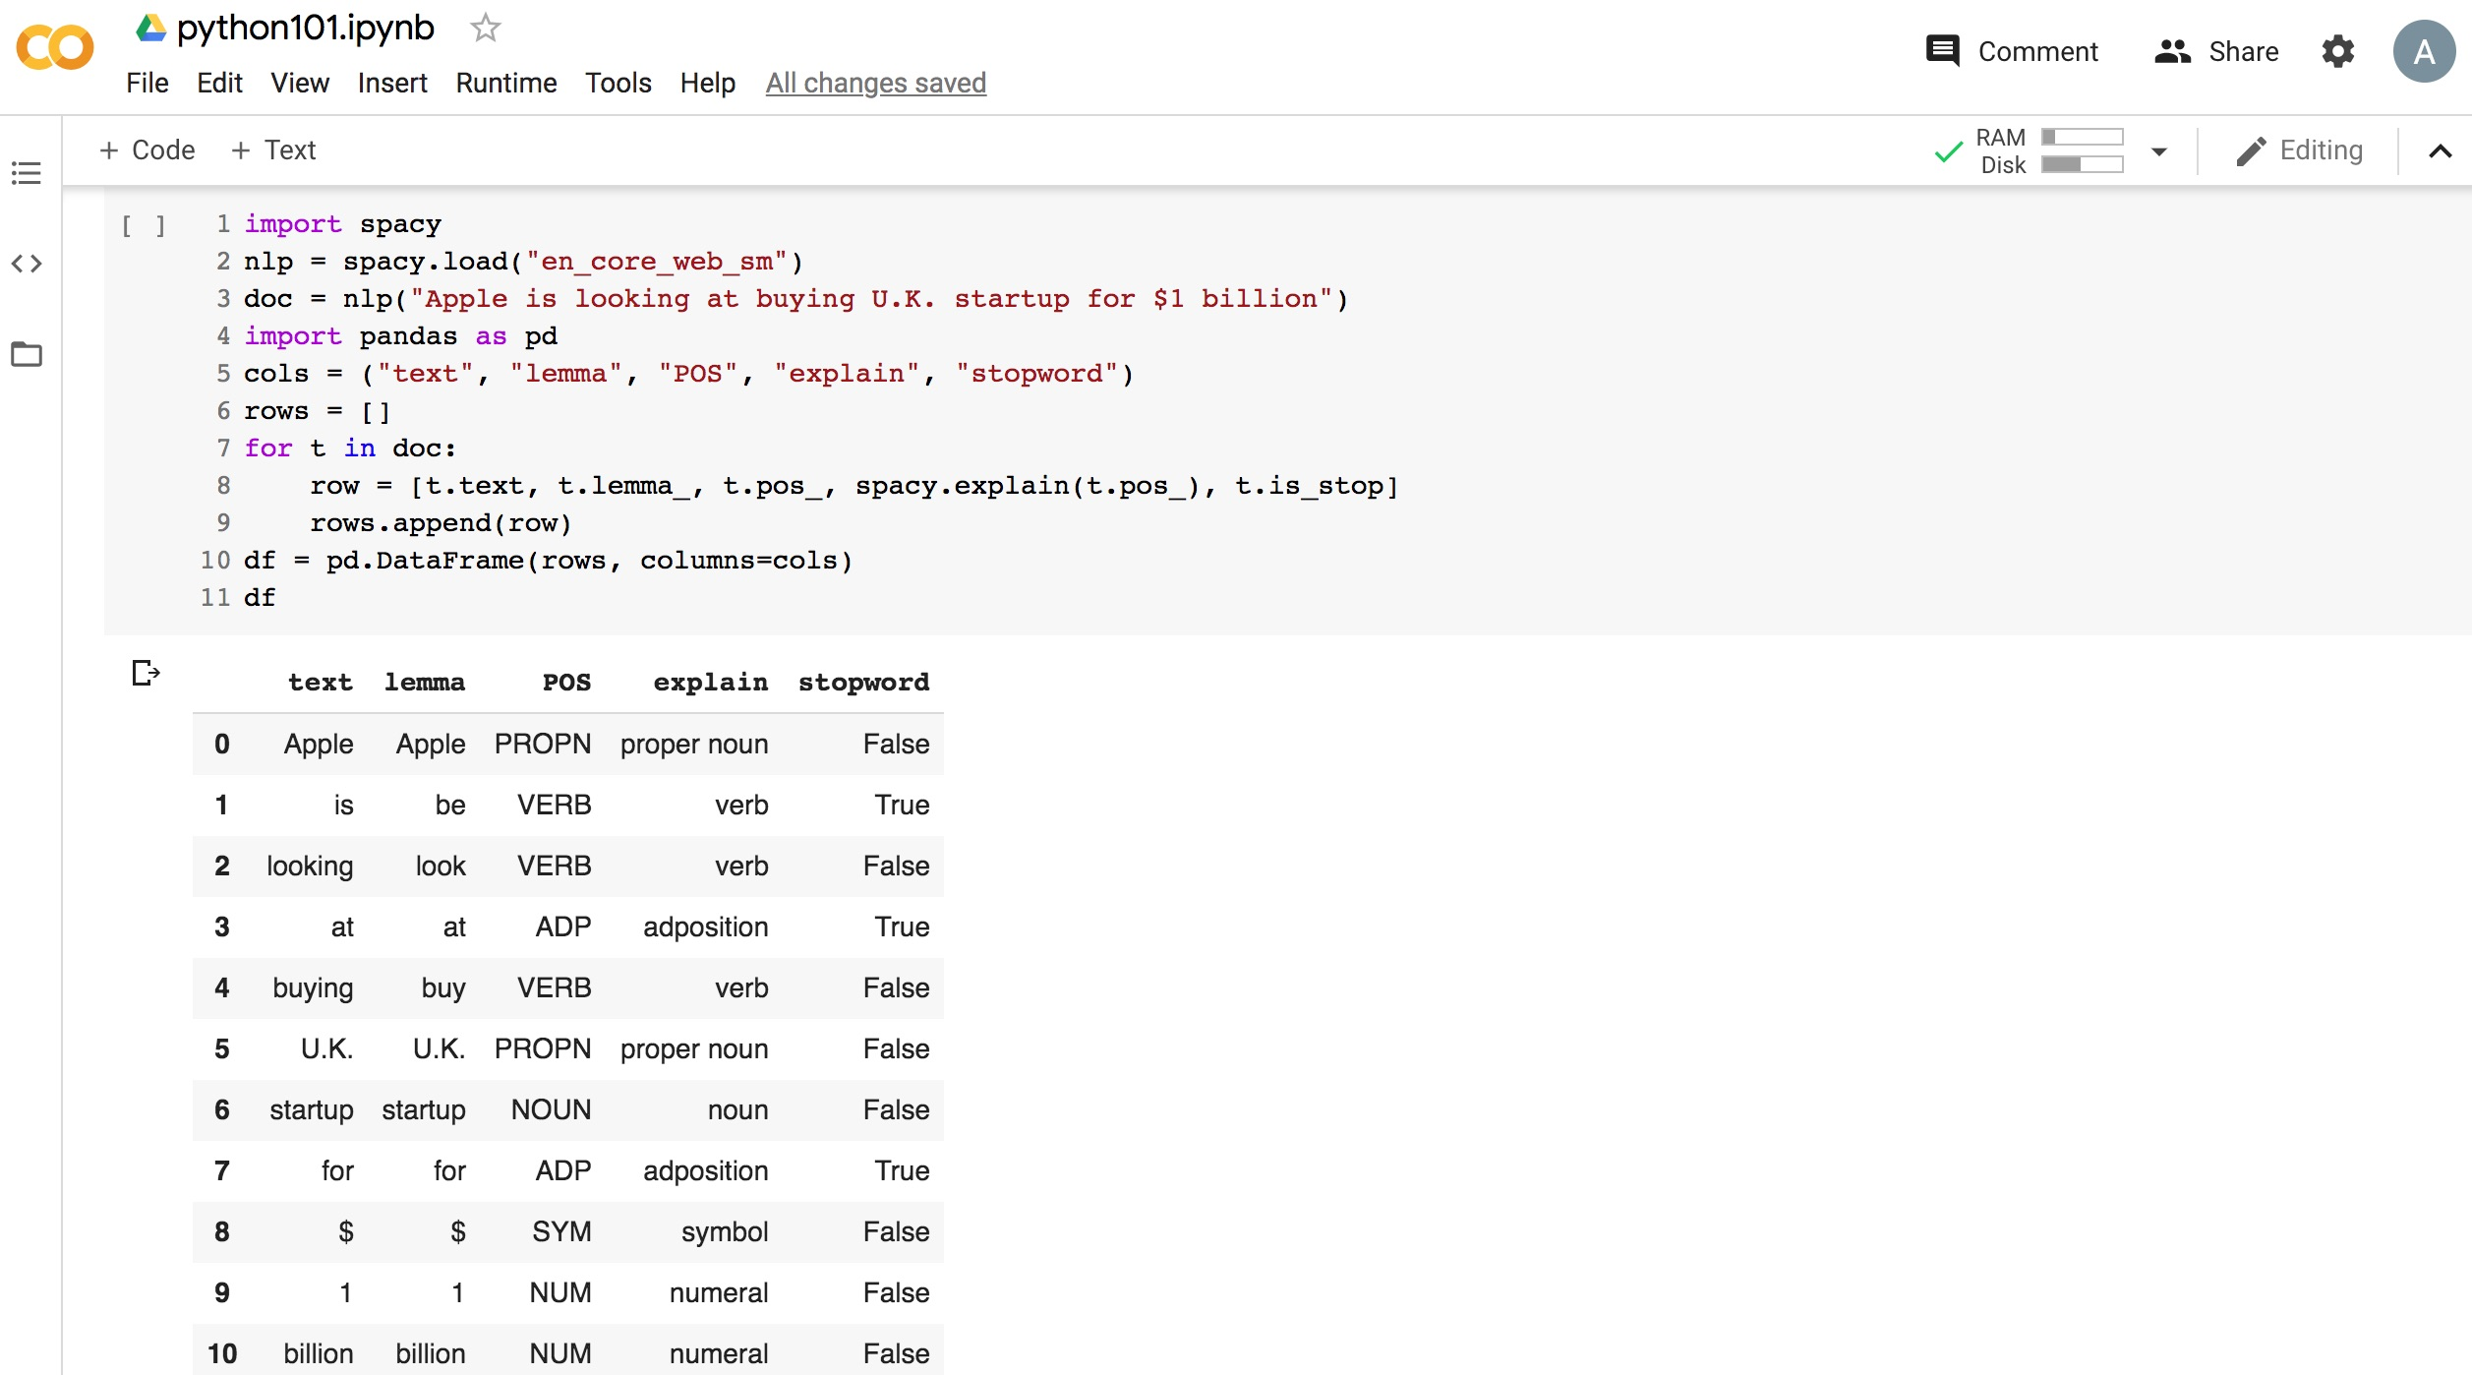
Python in Google Colab (Python101)
https://colab.research.google.com/drive/1FEG6DnGvwfUbeo4zJ1zTunjMqf2RkCrT
https://tinyurl.com/aintpupython101

Slide 97
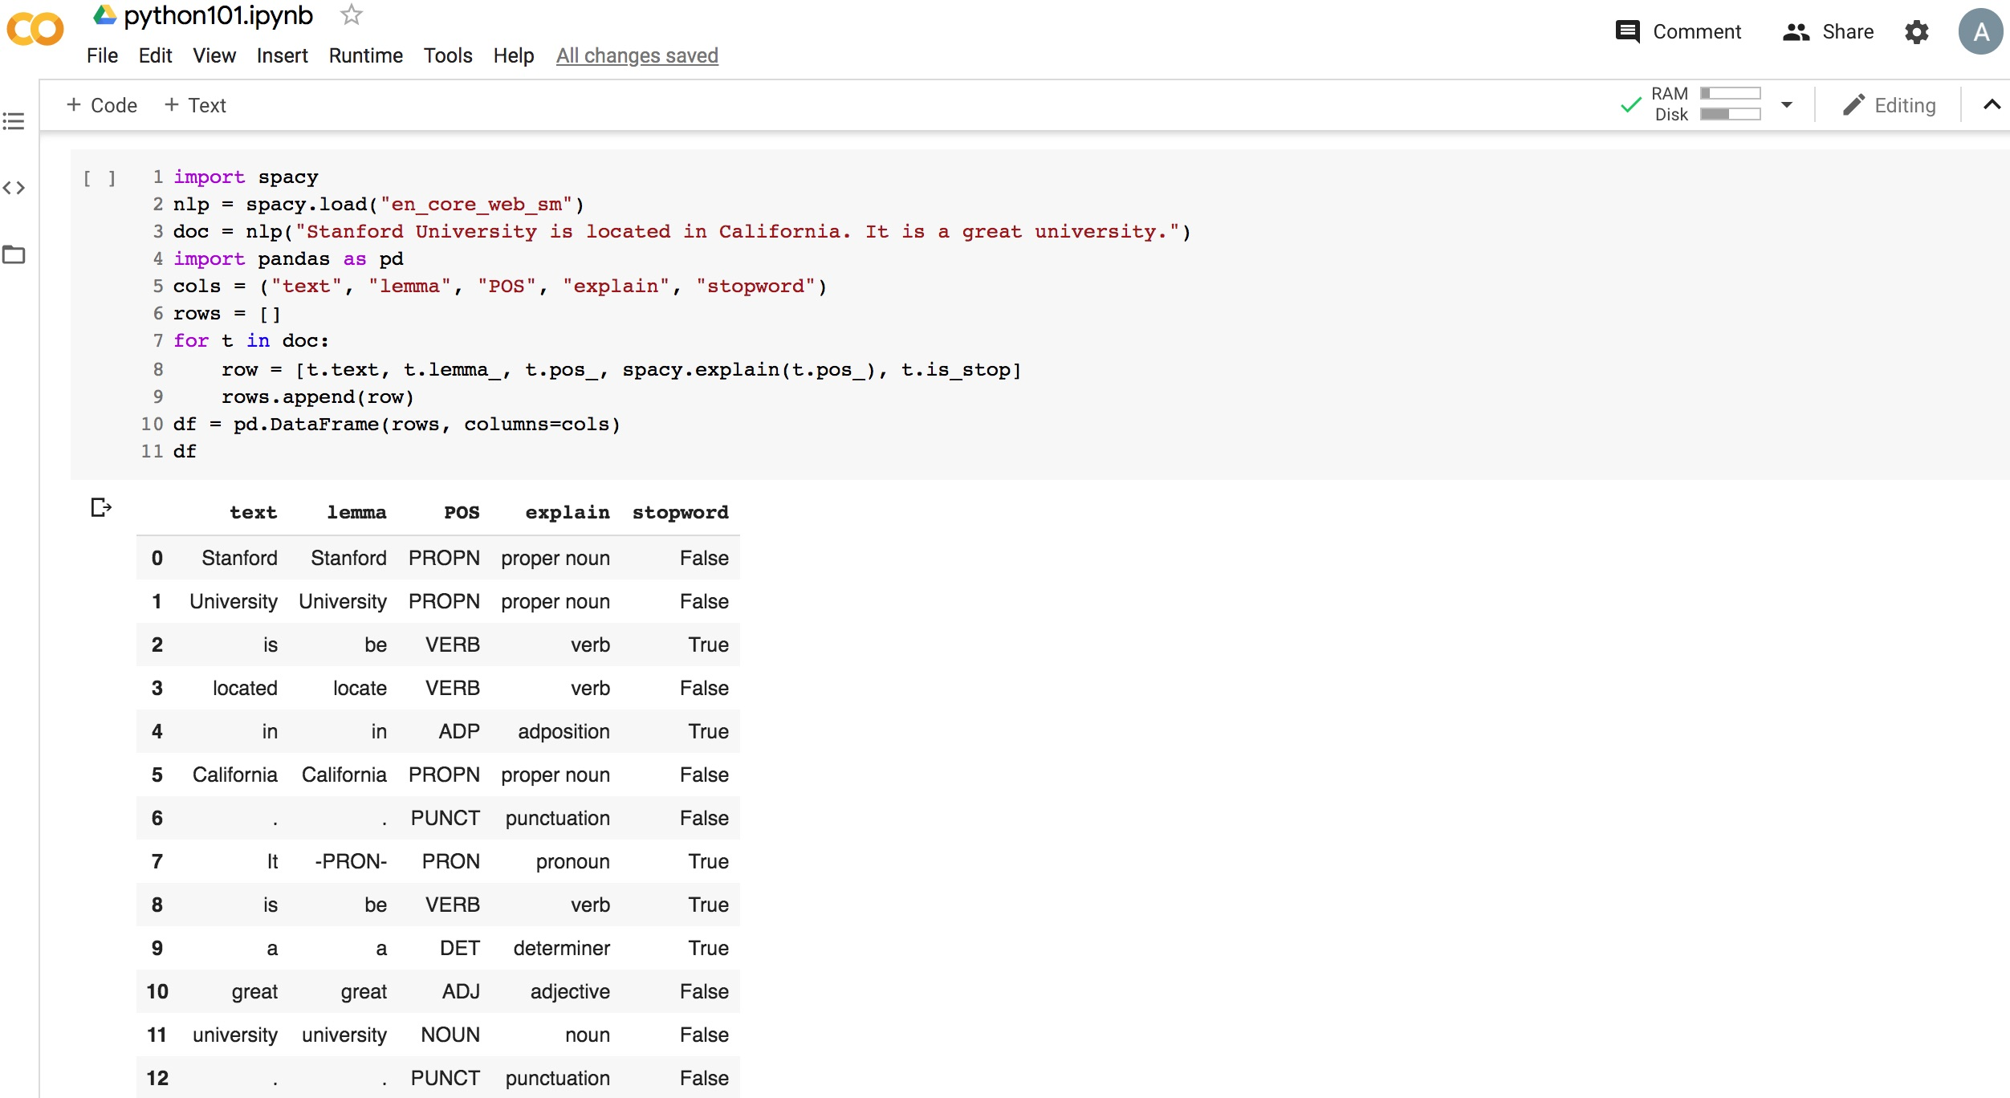
Python in Google Colab (Python101)
https://colab.research.google.com/drive/1FEG6DnGvwfUbeo4zJ1zTunjMqf2RkCrT
https://tinyurl.com/aintpupython101

Slide 98
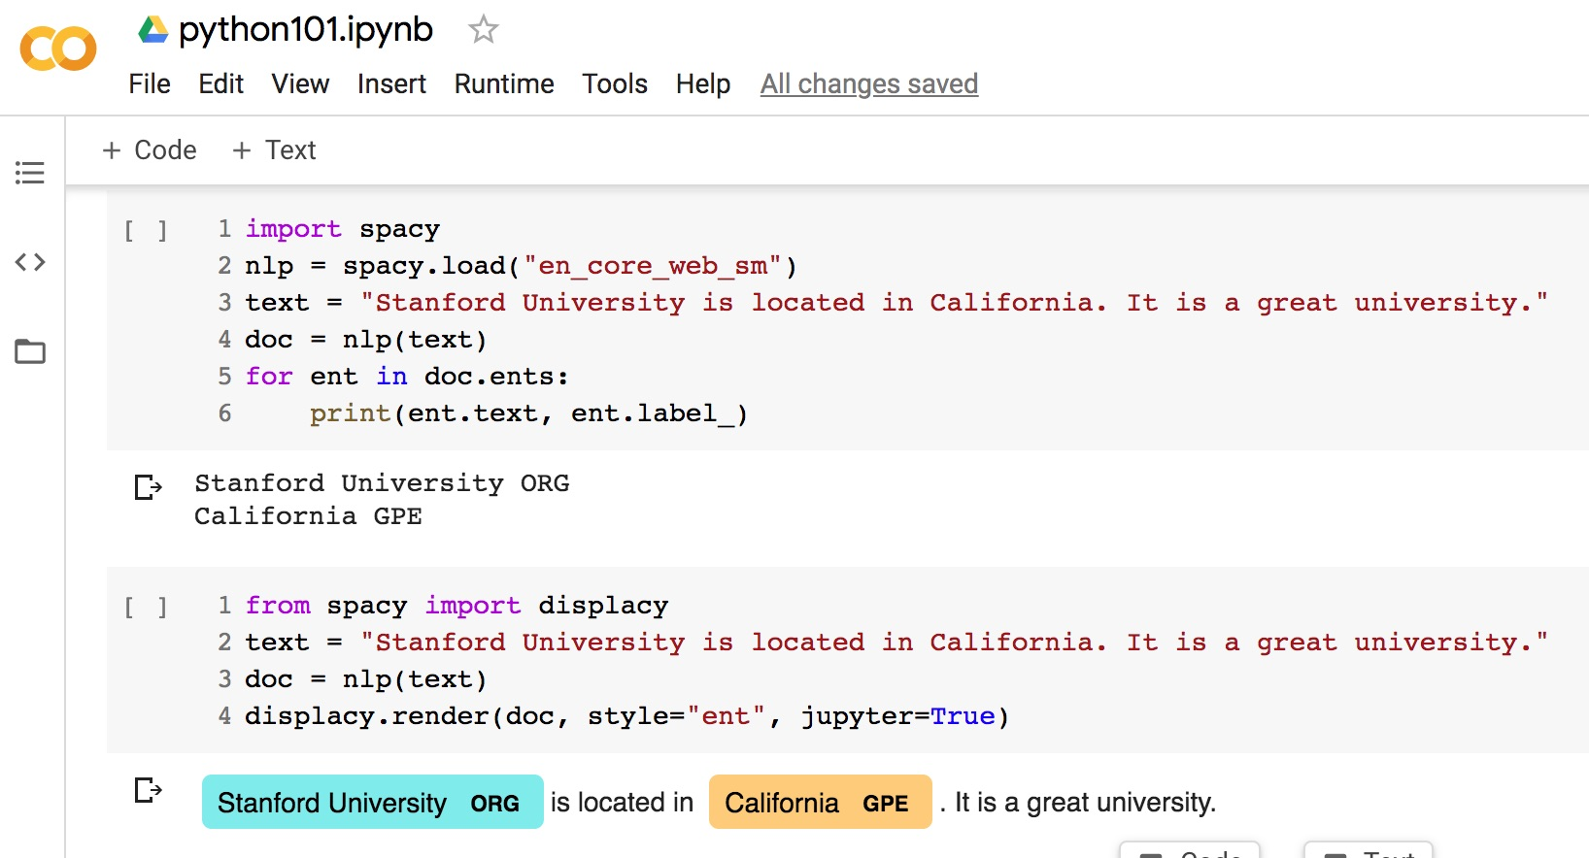
Python in Google Colab (Python101)
https://colab.research.google.com/drive/1FEG6DnGvwfUbeo4zJ1zTunjMqf2RkCrT
https://tinyurl.com/aintpupython101

Slide 99
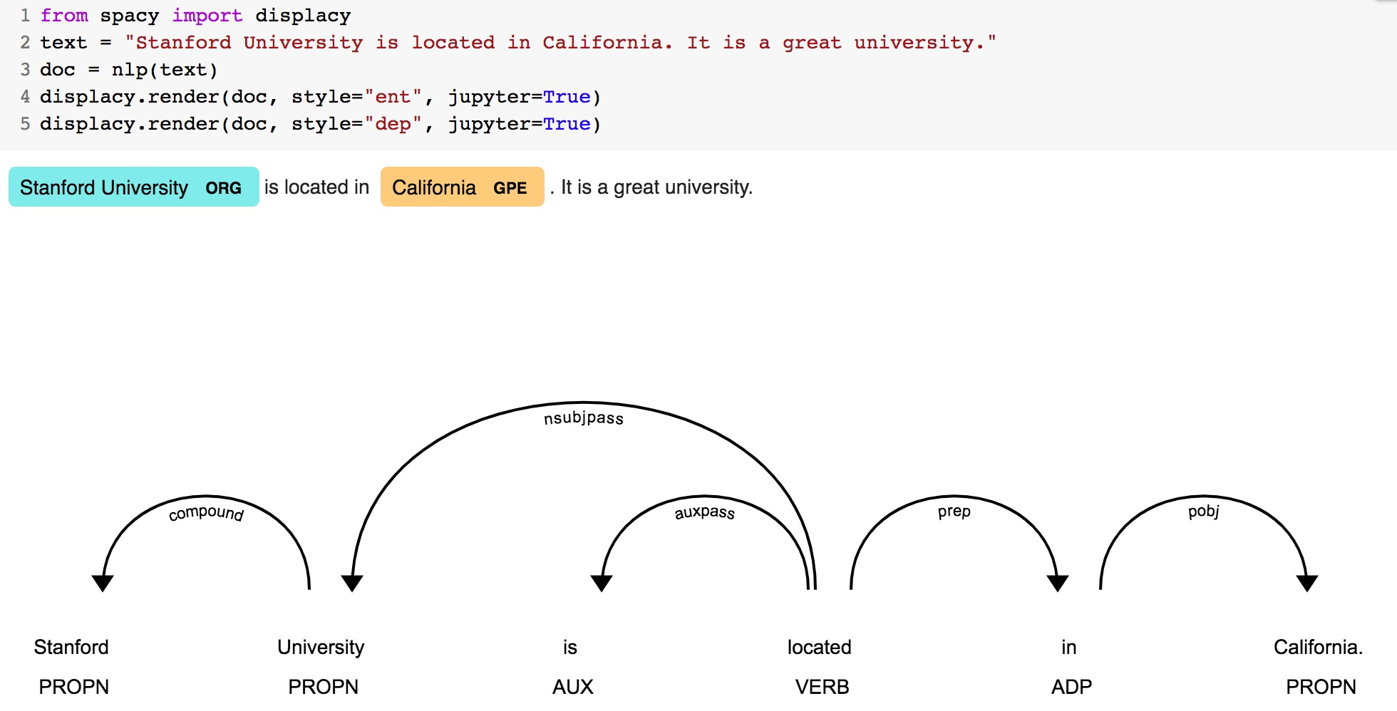
Python in Google Colab (Python101)
https://colab.research.google.com/drive/1FEG6DnGvwfUbeo4zJ1zTunjMqf2RkCrT
https://tinyurl.com/aintpupython101

Slide 100
Python in Google Colab
https://colab.research.google.com/drive/1FEG6DnGvwfUbeo4zJ1zTunjMqf2RkCrT
https://tinyurl.com/aintpupython101

Slide 101
Python in Google Colab (Python101)
https://colab.research.google.com/drive/1FEG6DnGvwfUbeo4zJ1zTunjMqf2RkCrT
https://tinyurl.com/aintpupython101

Slide 102
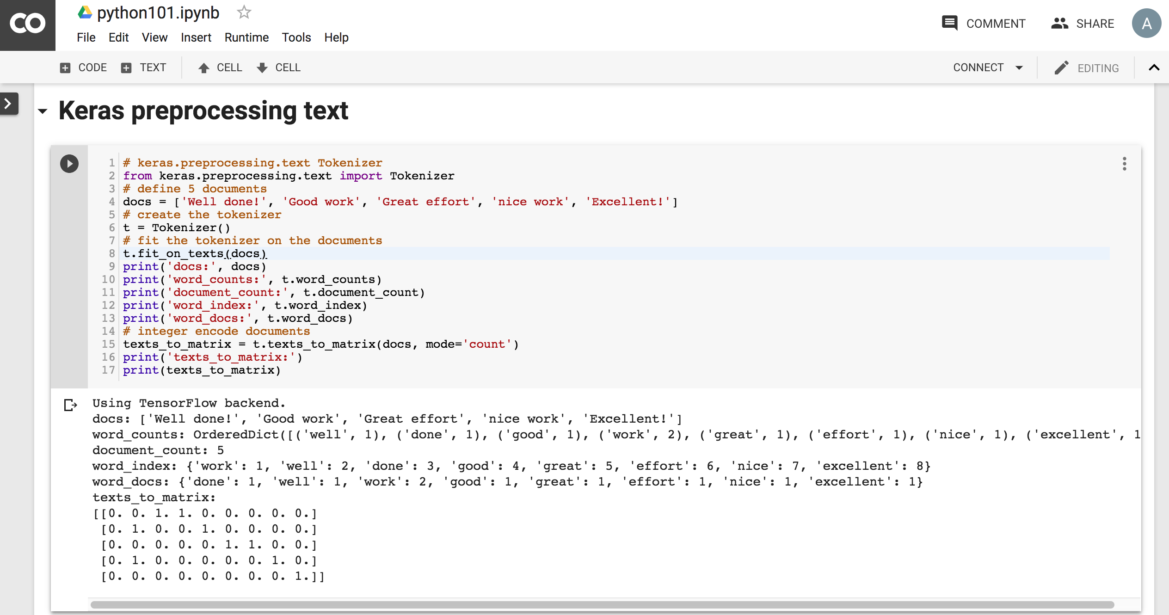
Python in Google Colab (Python101)
https://colab.research.google.com/drive/1FEG6DnGvwfUbeo4zJ1zTunjMqf2RkCrT
https://tinyurl.com/aintpupython101

Slide 103
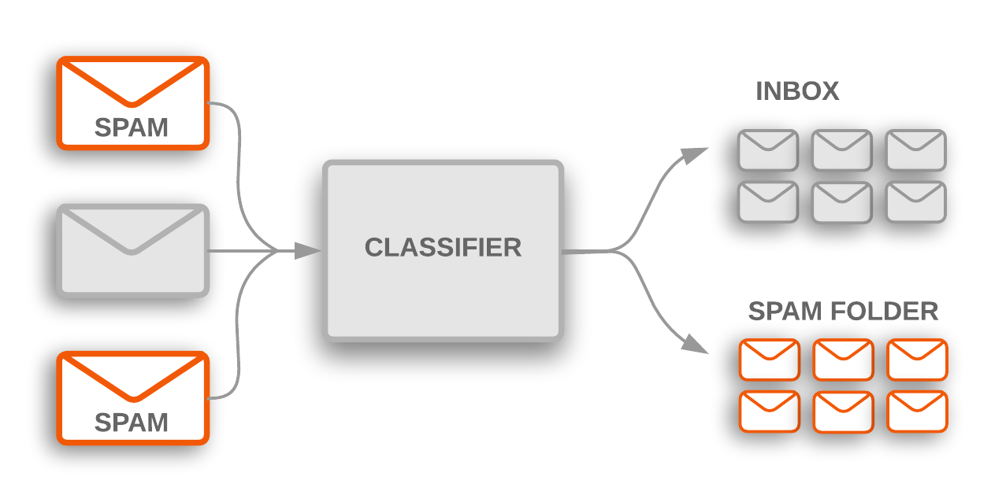
Text Classification
Source: https://developers.google.com/machine-learning/guides/text-classification/

Slide 104
Text Classification Workflow
Step 1: Gather Data
Step 2: Explore Your Data
Step 2.5: Choose a Model*
Step 3: Prepare Your Data
Step 4: Build, Train, and Evaluate Your Model
Step 5: Tune Hyperparameters
Step 6: Deploy Your Model
Source: https://developers.google.com/machine-learning/guides/text-classification/

Slide 105
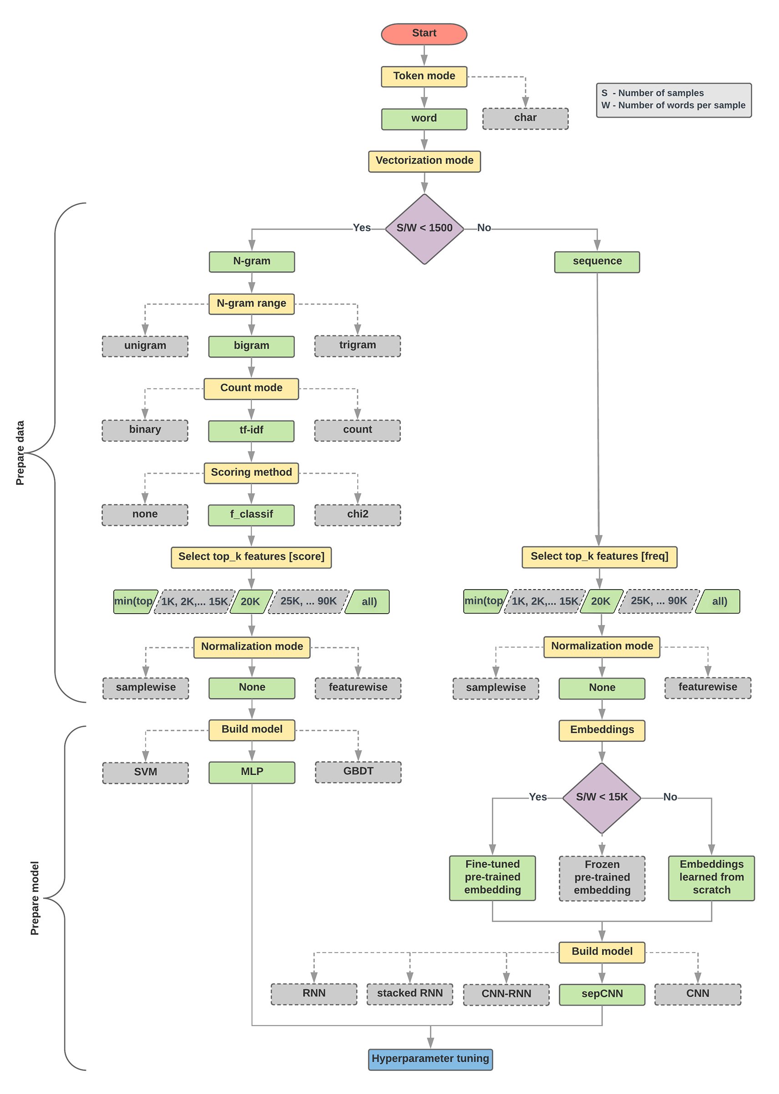
Text Classification Flowchart
Source: https://developers.google.com/machine-learning/guides/text-classification/step-2-5

Slide 106
Text Classification S/W<1500: N-gram
Source: https://developers.google.com/machine-learning/guides/text-classification/step-2-5

Slide 107
Text Classification S/W>=1500: Sequence
Source: https://developers.google.com/machine-learning/guides/text-classification/step-2-5

Slide 108
Step 2.5: Choose a Model Samples/Words < 1500 150,000/100 = 1500
IMDb review dataset, the samples/words-per-sample ratio is ~ 144
Source: https://developers.google.com/machine-learning/guides/text-classification/step-2-5

Slide 109
Step 2.5: Choose a Model Samples/Words < 15,000 1,500,000/100 = 15,000
Source: https://developers.google.com/machine-learning/guides/text-classification/step-2-5

Slide 110
Step 3: Prepare Your Data
Texts: T1: ’The mouse ran up the clock' T2: ’The mouse ran down’
Token Index:
{'the': 1, 'mouse’: 2, 'ran': 3, 'up': 4, 'clock': 5, 'down': 6,}.
NOTE: 'the' occurs most frequently, so the index value of 1 is assigned to it.
Some libraries reserve index 0 for unknown tokens, as is the case here.
Sequence of token indexes: T1: ‘The mouse ran up the clock’ = [1, 2, 3, 4, 1, 5]
T1: ’The mouse ran down’ = [1, 2, 3, 6]
Source: https://developers.google.com/machine-learning/guides/text-classification/step-3

Slide 111
One-hot encoding
'The mouse ran up the clock’ =
[ [0, 1, 0, 0, 0, 0, 0], [0, 0, 1, 0, 0, 0, 0], [0, 0, 0, 1, 0, 0, 0], [0, 0, 0, 0, 1, 0, 0], [0, 1, 0, 0, 0, 0, 0], [0, 0, 0, 0, 0, 1, 0] ]
The mouse ran up the clock
1 2 3 4
1
5
[0, 1, 2, 3, 4, 5, 6]
Source: https://developers.google.com/machine-learning/guides/text-classification/step-3

Slide 112
Word embeddings
Source: https://developers.google.com/machine-learning/guides/text-classification/step-3

Slide 113
Word embeddings
Source: https://developers.google.com/machine-learning/guides/text-classification/step-3

Slide 114
t1 = 'The mouse ran up the clock'
t2 = 'The mouse ran down'
s1 = t1.lower().split(' ')
s2 = t2.lower().split(' ')
terms = s1 + s2
sortedset = sorted(set(terms))
print('terms =', terms)
print('sortedset =', sortedset)
https://colab.research.google.com/drive/1FEG6DnGvwfUbeo4zJ1zTunjMqf2RkCrT
Notes:
t1 = 'The mouse ran up the clock'
t2 = 'The mouse ran down'
s1 = t1.lower().split(' ')
s2 = t2.lower().split(' ')
terms = s1 + s2
sortedset = sorted(set(terms))
print('terms =', terms)
print('sortedset =', sortedset)

Slide 115
t1 = 'The mouse ran up the clock'
t2 = 'The mouse ran down'
s1 = t1.lower().split(' ')
s2 = t2.lower().split(' ')
terms = s1 + s2
print(terms)
tfdict = {}
for term in terms:
if term not in tfdict:
tfdict[term] = 1
else:
tfdict[term] += 1
a = []
for k,v in tfdict.items():
a.append('{}, {}'.format(k,v))
print(a)
https://colab.research.google.com/drive/1FEG6DnGvwfUbeo4zJ1zTunjMqf2RkCrT

Slide 116
sorted_by_value_reverse = sorted(tfdict.items(), key=lambda kv: kv[1], reverse=True)
sorted_by_value_reverse_dict = dict(sorted_by_value_reverse)
id2word = {id: word for id, word in enumerate(sorted_by_value_reverse_dict)}
word2id = dict([(v, k) for (k, v) in id2word.items()])
https://colab.research.google.com/drive/1FEG6DnGvwfUbeo4zJ1zTunjMqf2RkCrT

Slide 117
sorted_by_value = sorted(tfdict.items(), key=lambda kv: kv[1])
print('sorted_by_value: ', sorted_by_value)
sorted_by_value2 = sorted(tfdict, key=tfdict.get, reverse=True)
print('sorted_by_value2: ', sorted_by_value2)
sorted_by_value_reverse = sorted(tfdict.items(), key=lambda kv: kv[1], reverse=True)
print('sorted_by_value_reverse: ', sorted_by_value_reverse)
sorted_by_value_reverse_dict = dict(sorted_by_value_reverse)
print('sorted_by_value_reverse_dict', sorted_by_value_reverse_dict)
id2word = {id: word for id, word in enumerate(sorted_by_value_reverse_dict)}
print('id2word', id2word)
word2id = dict([(v, k) for (k, v) in id2word.items()])
print('word2id', word2id)
print('len_words:', len(word2id))
sorted_by_key = sorted(tfdict.items(), key=lambda kv: kv[0])
print('sorted_by_key: ', sorted_by_key)
tfstring = '\n'.join(a)
print(tfstring)
tf = tfdict.get('mouse')
print(tf)
https://colab.research.google.com/drive/1FEG6DnGvwfUbeo4zJ1zTunjMqf2RkCrT

Slide 118
from keras.preprocessing.text import Tokenizer
Source: https://machinelearningmastery.com/prepare-text-data-deep-learning-keras/
Notes:
from keras.preprocessing.text import Tokenizer
# define 5 documents
docs = ['Well done!', 'Good work', 'Great effort', 'nice work', 'Excellent!']
# create the tokenizer
t = Tokenizer()
# fit the tokenizer on the documents
t.fit_on_texts(docs)
print('docs:', docs)
print('word_counts:', t.word_counts)
print('document_count:', t.document_count)
print('word_index:', t.word_index)
print('word_docs:', t.word_docs)
# integer encode documents
texts_to_matrix = t.texts_to_matrix(docs, mode='count')
print('texts_to_matrix:')
print(texts_to_matrix)

Slide 119
from keras.preprocessing.text import Tokenizer
from keras.preprocessing.text import Tokenizer
# define 5 documents
docs = ['Well done!', 'Good work', 'Great effort', 'nice work', 'Excellent!']
# create the tokenizer
t = Tokenizer()
# fit the tokenizer on the documents
t.fit_on_texts(docs)
print('docs:', docs)
print('word_counts:', t.word_counts)
print('document_count:', t.document_count)
print('word_index:', t.word_index)
print('word_docs:', t.word_docs)
# integer encode documents
texts_to_matrix = t.texts_to_matrix(docs, mode='count')
print('texts_to_matrix:')
print(texts_to_matrix)
Source: https://machinelearningmastery.com/prepare-text-data-deep-learning-keras/

Slide 120
texts_to_matrix = t.texts_to_matrix(docs, mode='count')
docs: ['Well done!', 'Good work', 'Great effort’, 'nice work', 'Excellent!’]
word_counts: OrderedDict([('well', 1), ('done', 1), ('good', 1), ('work', 2), ('great', 1), ('effort', 1), ('nice', 1), ('excellent', 1)])
document_count: 5
word_index: {'work': 1, 'well': 2, 'done': 3, 'good': 4, 'great': 5, 'effort': 6, 'nice': 7, 'excellent': 8}
word_docs: {'done': 1, 'well': 1, 'work': 2, 'good': 1, 'great': 1, 'effort': 1, 'nice': 1, 'excellent': 1}
texts_to_matrix: [[0. 0. 1. 1. 0. 0. 0. 0. 0.] [0. 1. 0. 0. 1. 0. 0. 0. 0.] [0. 0. 0. 0. 0. 1. 1. 0. 0.] [0. 1. 0. 0. 0. 0. 0. 1. 0.] [0. 0. 0. 0. 0. 0. 0. 0. 1.]]
Source: https://machinelearningmastery.com/prepare-text-data-deep-learning-keras/
Notes:
from keras.preprocessing.text import Tokenizer
# define 5 documents
docs = ['Well done!', 'Good work', 'Great effort', 'nice work', 'Excellent!']
# create the tokenizer
t = Tokenizer()
# fit the tokenizer on the documents
t.fit_on_texts(docs)
print('docs:', docs)
print('word_counts:', t.word_counts)
print('document_count:', t.document_count)
print('word_index:', t.word_index)
print('word_docs:', t.word_docs)
# integer encode documents
texts_to_matrix = t.texts_to_matrix(docs, mode='count')
print('texts_to_matrix:')
print(texts_to_matrix)

Slide 121
t.texts_to_matrix(docs, mode='tfidf')
from keras.preprocessing.text import Tokenizer
# define 5 documents
docs = ['Well done!', 'Good work', 'Great effort', 'nice work', 'Excellent!']
# create the tokenizer
t = Tokenizer()
# fit the tokenizer on the documents
t.fit_on_texts(docs)
print('docs:', docs)
print('word_counts:', t.word_counts)
print('document_count:', t.document_count)
print('word_index:', t.word_index)
print('word_docs:', t.word_docs)
# integer encode documents
texts_to_matrix = t.texts_to_matrix(docs, mode='tfidf')
print('texts_to_matrix:')
print(texts_to_matrix)
texts_to_matrix: [[0. 0. 1.25276297 1.25276297 0. 0. 0. 0. 0. ] [0. 0.98082925 0. 0. 1.25276297 0. 0. 0. 0. ] [0. 0. 0. 0. 0. 1.25276297 1.25276297 0. 0. ] [0. 0.98082925 0. 0. 0. 0. 0. 1.25276297 0. ] [0. 0. 0. 0. 0. 0. 0. 0. 1.25276297]]
Source: https://machinelearningmastery.com/prepare-text-data-deep-learning-keras/
Notes:
from keras.preprocessing.text import Tokenizer
# define 5 documents
docs = ['Well done!', 'Good work', 'Great effort', 'nice work', 'Excellent!']
# create the tokenizer
t = Tokenizer()
# fit the tokenizer on the documents
t.fit_on_texts(docs)
print('docs:', docs)
print('word_counts:', t.word_counts)
print('document_count:', t.document_count)
print('word_index:', t.word_index)
print('word_docs:', t.word_docs)
# integer encode documents
texts_to_matrix = t.texts_to_matrix(docs, mode='tfidf')
print('texts_to_matrix:')
print(texts_to_matrix)
###########
‘’’
docs: ['Well done!', 'Good work', 'Great effort', 'nice work', 'Excellent!'] word_counts: OrderedDict([('well', 1), ('done', 1), ('good', 1), ('work', 2), ('great', 1), ('effort', 1), ('nice', 1), ('excellent', 1)]) document_count: 5 word_index: {'work': 1, 'well': 2, 'done': 3, 'good': 4, 'great': 5, 'effort': 6, 'nice': 7, 'excellent': 8} word_docs: {'done': 1, 'well': 1, 'work': 2, 'good': 1, 'great': 1, 'effort': 1, 'nice': 1, 'excellent': 1} texts_to_matrix: [[0. 0. 1.25276297 1.25276297 0. 0. 0. 0. 0. ] [0. 0.98082925 0. 0. 1.25276297 0. 0. 0. 0. ] [0. 0. 0. 0. 0. 1.25276297 1.25276297 0. 0. ] [0. 0.98082925 0. 0. 0. 0. 0. 1.25276297 0. ] [0. 0. 0. 0. 0. 0. 0. 0. 1.25276297]]
‘’’

Slide 122
NLP Libraries and Tools

Slide 123
spaCy: Natural Language Processing
https://spacy.io/

Slide 124
NLTK (Natural Language Toolkit)
http://www.nltk.org/

Slide 125
Natural Language Processing with Python – Analyzing Text with the Natural Language Toolkit
NLTK
http://www.nltk.org/book/

Slide 126
gensim
https://radimrehurek.com/gensim/

Slide 127
TextBlob
https://textblob.readthedocs.io

Slide 128
Polyglot
https://polyglot.readthedocs.io/

Slide 129
scikit-learn
http://scikit-learn.org/

Slide 130
TensorFlow NLP Examples
Basic Text Classification (Text Classification) (46 Seconds)
https://colab.research.google.com/github/tensorflow/docs/blob/master/site/en/tutorials/keras/basic_text_classification.ipynb
NMT with Attention (20-30 minutes)
https://colab.research.google.com/github/tensorflow/tensorflow/blob/master/tensorflow/contrib/eager/python/examples/nmt_with_attention/nmt_with_attention.ipynb

Slide 131
Text Classification IMDB Movie Reviews
https://colab.research.google.com/drive/1x16h1GhHsLIrLYtPCvCHaoO1W-i_gror
Source: https://colab.research.google.com/github/tensorflow/docs/blob/master/site/en/tutorials/keras/basic_text_classification.ipynb

Slide 132
NLP with Transformers Github
https://github.com/nlp-with-transformers/notebooks

Slide 133
NLP with Transformers Github Notebooks
https://github.com/nlp-with-transformers/notebooks

Slide 134
Python in Google Colab (Python101)
https://colab.research.google.com/drive/1FEG6DnGvwfUbeo4zJ1zTunjMqf2RkCrT
https://tinyurl.com/aintpupython101

Slide 135
Summary
Python for Natural Language Processing
Python Ecosystem for Data Science
Python
Programming language
Numpy
Scientific computing
SpaCy
Natural Language Processing

Slide 136
References
Lewis Tunstall, Leandro von Werra, and Thomas Wolf (2022), Natural Language Processing with Transformers: Building Language Applications with Hugging Face, O'Reilly Media.
Denis Rothman (2021), Transformers for Natural Language Processing: Build innovative deep neural network architectures for NLP with Python, PyTorch, TensorFlow, BERT, RoBERTa, and more, Packt Publishing.
Savaş Yıldırım and Meysam Asgari-Chenaghlu (2021), Mastering Transformers: Build state-of-the-art models from scratch with advanced natural language processing techniques, Packt Publishing.
Sowmya Vajjala, Bodhisattwa Majumder, Anuj Gupta (2020), Practical Natural Language Processing: A Comprehensive Guide to Building Real-World NLP Systems, O'Reilly Media.
Ramesh Sharda, Dursun Delen, and Efraim Turban (2017), Business Intelligence, Analytics, and Data Science: A Managerial Perspective, 4th Edition, Pearson.
Dipanjan Sarkar (2019), Text Analytics with Python: A Practitioner’s Guide to Natural Language Processing, Second Edition. APress.
Benjamin Bengfort, Rebecca Bilbro, and Tony Ojeda (2018), Applied Text Analysis with Python: Enabling Language-Aware Data Products with Machine Learning, O’Reilly.
Charu C. Aggarwal (2018), Machine Learning for Text, Springer.
Gabe Ignatow and Rada F. Mihalcea (2017), An Introduction to Text Mining: Research Design, Data Collection, and Analysis, SAGE Publications.
Rajesh Arumugam (2018), Hands-On Natural Language Processing with Python: A practical guide to applying deep learning architectures to your NLP applications, Packt.
Jake VanderPlas (2016), Python Data Science Handbook: Essential Tools for Working with Data, O'Reilly Media.
Devlin, Jacob, Ming-Wei Chang, Kenton Lee, and Kristina Toutanova (2018). "BERT: Pre-training of Deep Bidirectional Transformers for Language Understanding." arXiv preprint arXiv:1810.04805.
Steven Bird, Ewan Klein and Edward Loper (2009), Natural Language Processing with Python, O'Reilly Media, http://www.nltk.org/book/
The Super Duper NLP Repo, https://notebooks.quantumstat.com/
Avinash Jain (2017), Introduction To Python Programming, Udemy, https://www.udemy.com/pythonforbeginnersintro/
Python Programming, https://pythonprogramming.net/
Python, https://www.python.org/
Python Programming Language, http://pythonprogramminglanguage.com/
Numpy, http://www.numpy.org/
Pandas, http://pandas.pydata.org/
W3Schools Python, https://www.w3schools.com/python/
Learn Python, https://www.learnpython.org/
Google’s Python Class, https://developers.google.com/edu/python
Min-Yuh Day (2023), Python 101, https://tinyurl.com/aintpupython101

