Slide 1
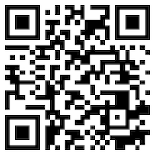
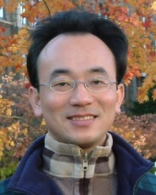
Multilingual Named Entity Recognition (NER)
Artificial Intelligence for Text Analytics
1121AITA06
MBA, IM, NTPU (M5265) (Fall 2023) Tue 2, 3, 4 (9:10-12:00) (B3F17)
Min-Yuh Day, Ph.D, Associate Professor
Institute of Information Management, National Taipei University
https://web.ntpu.edu.tw/~myday
https://meet.google.com/miy-fbif-max
2023-10-25

Slide 2
Syllabus
Week Date Subject/Topics
1 2023/09/13 Introduction to Artificial Intelligence for Text Analytics
2 2023/09/20 Foundations of Text Analytics: Natural Language Processing (NLP)
3 2023/09/27 Python for Natural Language Processing
4 2023/10/04 Natural Language Processing with Transformers
5 2023/10/11 Case Study on Artificial Intelligence for Text Analytics I
6 2023/10/18 Text Classification and Sentiment Analysis

Slide 3
Syllabus
Week Date Subject/Topics
7 2023/10/25 Multilingual Named Entity Recognition (NER)
8 2023/11/01 Midterm Project Report
9 2023/11/08 Text Similarity and Clustering
10 2023/11/15 Text Summarization and Topic Models
11 2023/11/22 Text Generation with Large Language Models (LLMs)
12 2023/11/29 Case Study on Artificial Intelligence for Text Analytics II

Slide 4
Syllabus
Week Date Subject/Topics
13 2023/12/06 Question Answering and Dialogue Systems
14 2023/12/13 Deep Learning, Generative AI, Transfer Learning, Zero-Shot, and Few-Shot Learning for Text Analytics
15 2023/12/20 Final Project Report I
16 2023/12/27 Final Project Report II

Slide 5
Multilingual Named Entity Recognition (NER)

Slide 6
Outline
Named Entities (NE)
represent real-world objects
people, places, organizations
proper names
Named Entity Recognition (NER)
Entity chunking
Entity extraction
Relation Extraction (RE)
Source: Dipanjan Sarkar (2019), Text Analytics with Python: A Practitioner’s Guide to Natural Language Processing, Second Edition. APress.

Slide 7
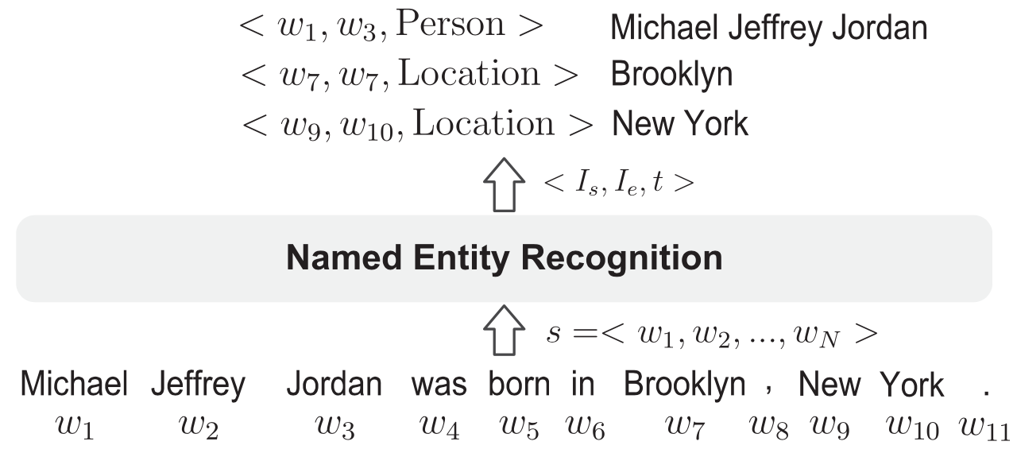
Named Entity Recognition (NER)
Michael Jeffrey Jordan was born in Brooklyn, New York.
Source: Jing Li, Aixin Sun, Jianglei Han, and Chenliang LI (2022). "A survey on deep learning for named entity recognition." IEEE Transactions on Knowledge and Data Engineering 34, no. 1 (2022): 50-70.

Slide 8
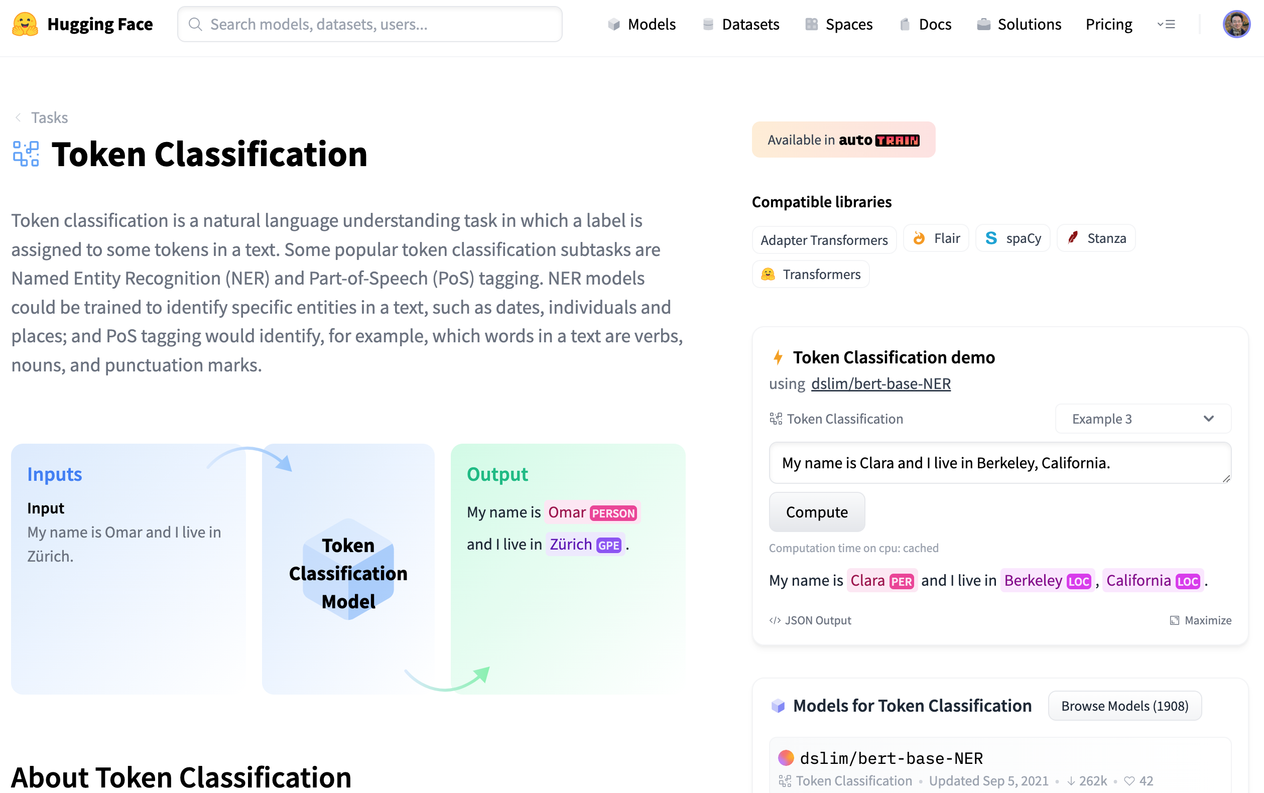
Token Classification (NER)
https://huggingface.co/tasks/token-classification

Slide 9
Named Entity Recognition (NER)
from transformers import pipeline
import pandas as pd
classifier = pipeline("ner")
text = "My name is Michael and I live in Berkeley, California."
outputs = classifier(text)
pd.DataFrame(outputs)
https://tinyurl.com/aintpupython101

Slide 10
Multilingual Named Entity Recognition (NER)
#!pip install transformers
from transformers import pipeline
import pandas as pd
nlp = pipeline('ner', model="Babelscape/wikineural-multilingual-ner")
outputs = nlp("My name is Alan and I live in Taipei.")
pd.DataFrame(outputs)
 | entity | score | index | word | start | end
0 | B-PER | 0.860065 | 4 | Alan | 11 | 15
1 | B-LOC | 0.999816 | 9 | Taipei | 30 | 36
https://tinyurl.com/aintpupython101

Slide 11
Multilingual Named Entity Recognition (NER)
#!pip install transformers
from transformers import pipeline
import pandas as pd
nlp = pipeline('ner', model="Babelscape/wikineural-multilingual-ner")
outputs = nlp("My name is Alan and I live in Taipei. 他是王小明，他住在台南")
pd.DataFrame(outputs)
 | entity | score | index | word | start | end
0 | B-PER | 0.912095 | 4 | Alan | 11 | 15
1 | B-LOC | 0.999747 | 9 | Taipei | 30 | 36
2 | B-PER | 0.994766 | 13 | 王 | 40 | 41
3 | I-PER | 0.992879 | 14 | 小 | 41 | 42
4 | I-PER | 0.982183 | 15 | 明 | 42 | 43
5 | B-LOC | 0.999288 | 20 | 台 | 47 | 48
6 | I-LOC | 0.993408 | 21 | 南 | 48 | 49
https://tinyurl.com/aintpupython101

Slide 12
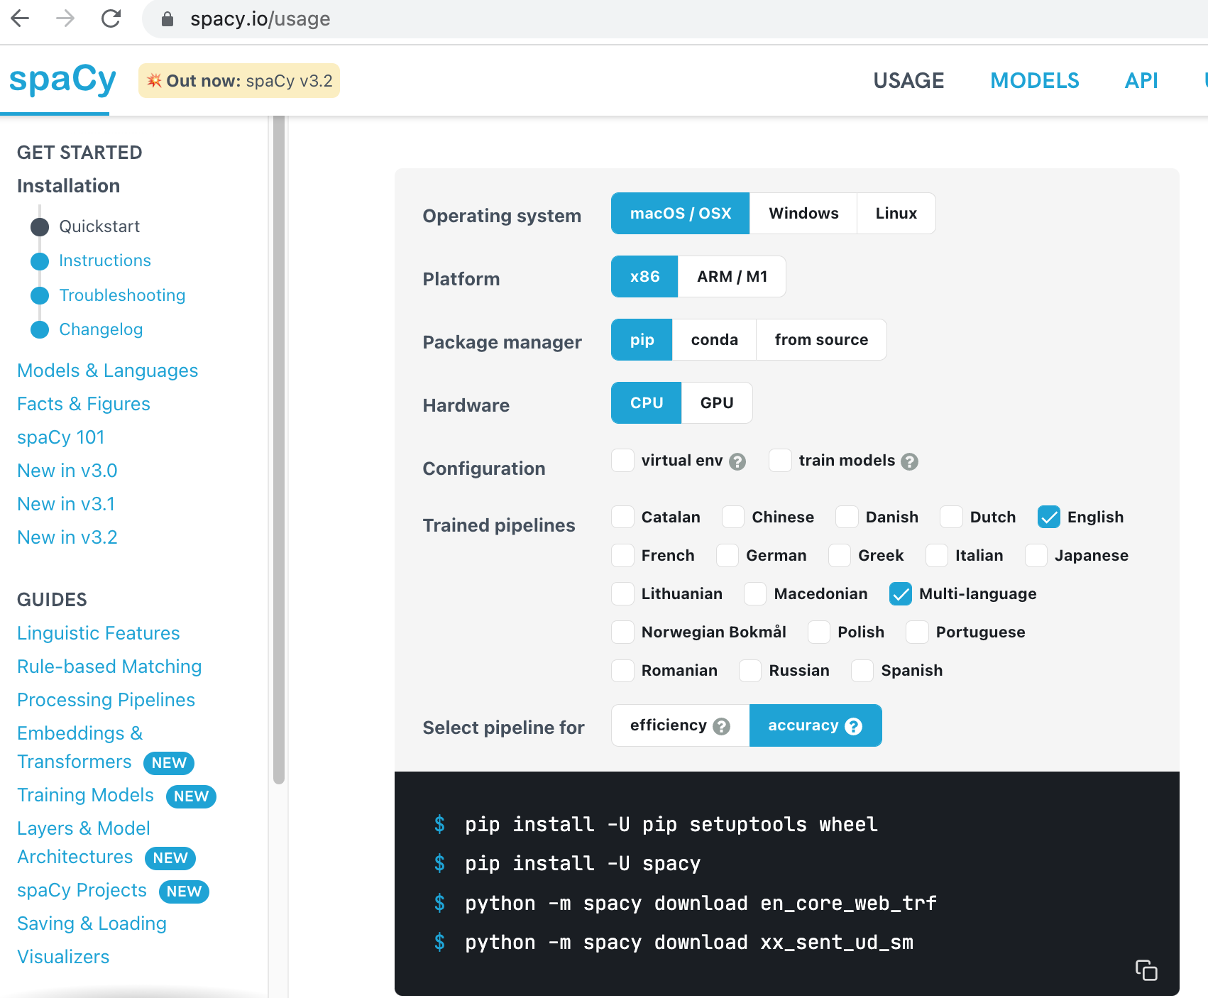
spaCy
https://spacy.io/usage

Slide 13
NER: OntoNotes 5 Named Entities (18)
SID | TYPE | DESCRIPTION
1 | PERSON | People, including fictional.
2 | NORP | Nationalities or religious or political groups.
3 | FAC | Buildings, airports, highways, bridges, etc.
4 | ORG | Companies, agencies, institutions, etc.
5 | GPE | Countries, cities, states.
6 | LOC | Non-GPE locations, mountain ranges, bodies of water.
7 | PRODUCT | Objects, vehicles, foods, etc. (Not services.)
8 | EVENT | Named hurricanes, battles, wars, sports events, etc.
9 | WORK_OF_ART | Titles of books, songs, etc.
10 | LAW | Named documents made into laws.
11 | LANGUAGE | Any named language.
12 | DATE | Absolute or relative dates or periods.
13 | TIME | Times smaller than a day.
14 | PERCENT | Percentage, including ”%“.
15 | MONEY | Monetary values, including unit.
16 | QUANTITY | Measurements, as of weight or distance.
17 | ORDINAL | “first”, “second”, etc.
18 | CARDINAL | Numerals that do not fall under another type.
Source: https://spacy.io/api/annotation#named-entities

Slide 14
NER: Wikipedia Named Entities
SID | TYPE | DESCRIPTION
1 | PER | Named person or family.
2 | LOC | Name of politically or geographically defined location (cities, provinces, countries, international regions, bodies of water, mountains).
3 | ORG | Named corporate, governmental, or other organizational entity.
4 | MISC | Miscellaneous entities, e.g. events, nationalities, products or works of art.
Source: https://spacy.io/api/annotation#named-entities

Slide 15
NER IOB Scheme
TAG | ID | DESCRIPTION
"I" | 1 | Token is inside an entity.
"O" | 2 | Token is outside an entity.
"B" | 3 | Token begins an entity.
"" | 0 | No entity tag is set (missing value).
Source: https://spacy.io/api/annotation#named-entities

Slide 16
NER BILUO Scheme
TAG | DESCRIPTION
BEGIN | The first token of a multi-token entity.
IN | An inner token of a multi-token entity.
LAST | The final token of a multi-token entity.
UNIT | A single-token entity.
OUT | A non-entity token.
Source: https://spacy.io/api/annotation#named-entities

Slide 17
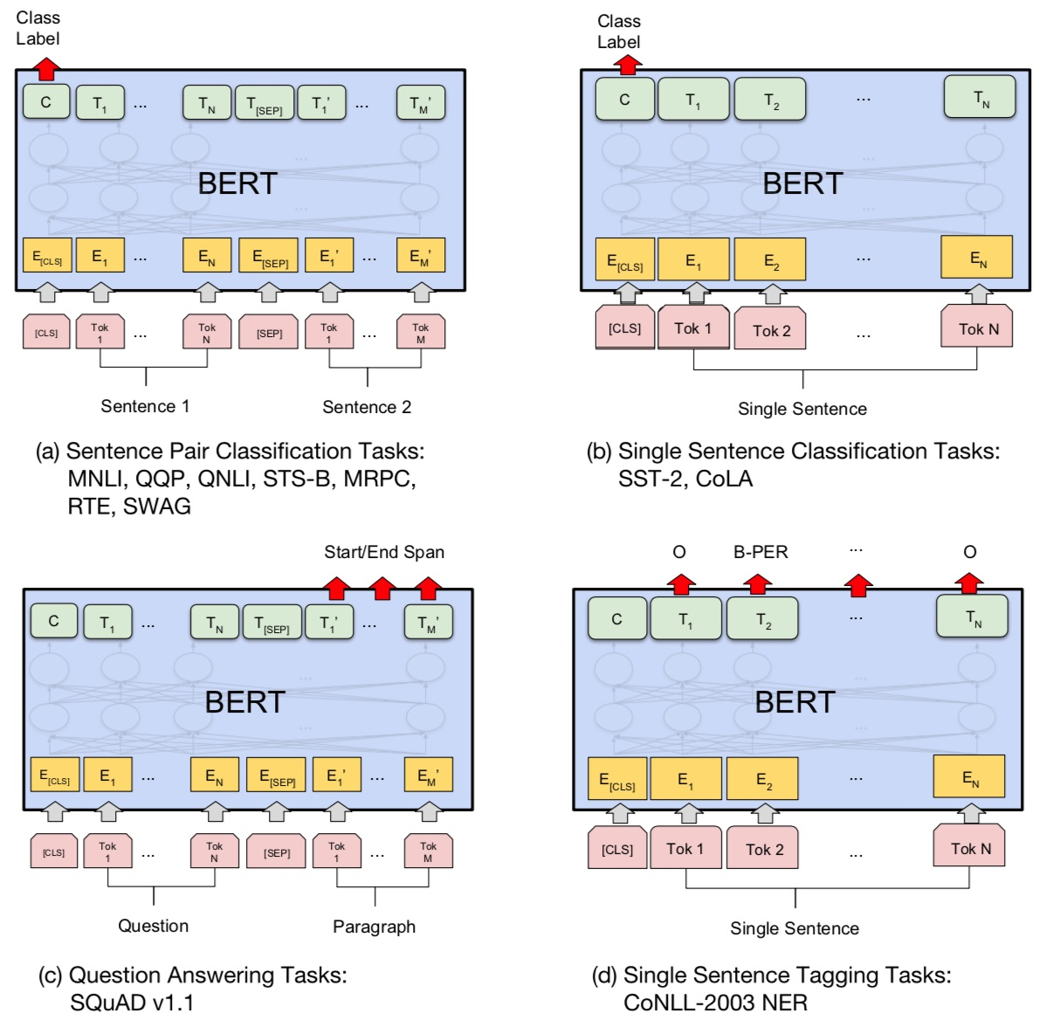
Fine-tuning BERT on NLP Tasks
Source: Devlin, Jacob, Ming-Wei Chang, Kenton Lee, and Kristina Toutanova (2018). "BERT: Pre-training of Deep Bidirectional Transformers for Language Understanding." arXiv preprint arXiv:1810.04805

Slide 18
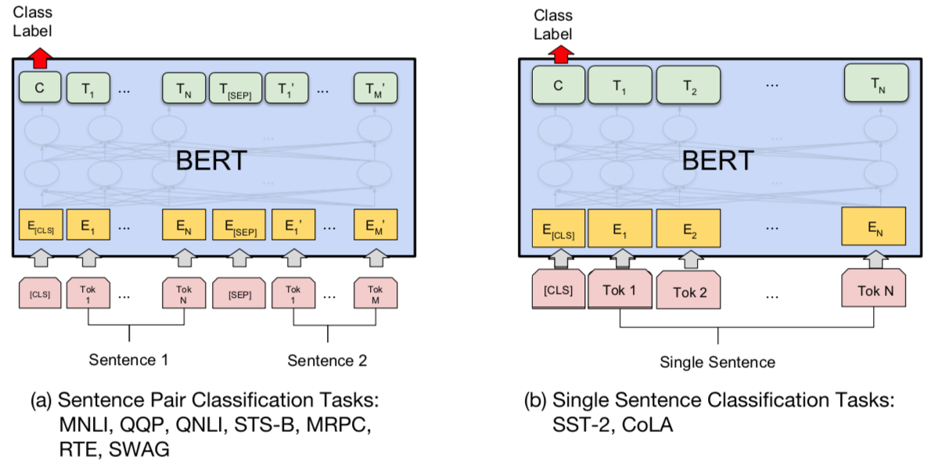
BERT Sequence-level tasks
Source: Devlin, Jacob, Ming-Wei Chang, Kenton Lee, and Kristina Toutanova (2018). "BERT: Pre-training of Deep Bidirectional Transformers for Language Understanding." arXiv preprint arXiv:1810.04805

Slide 19
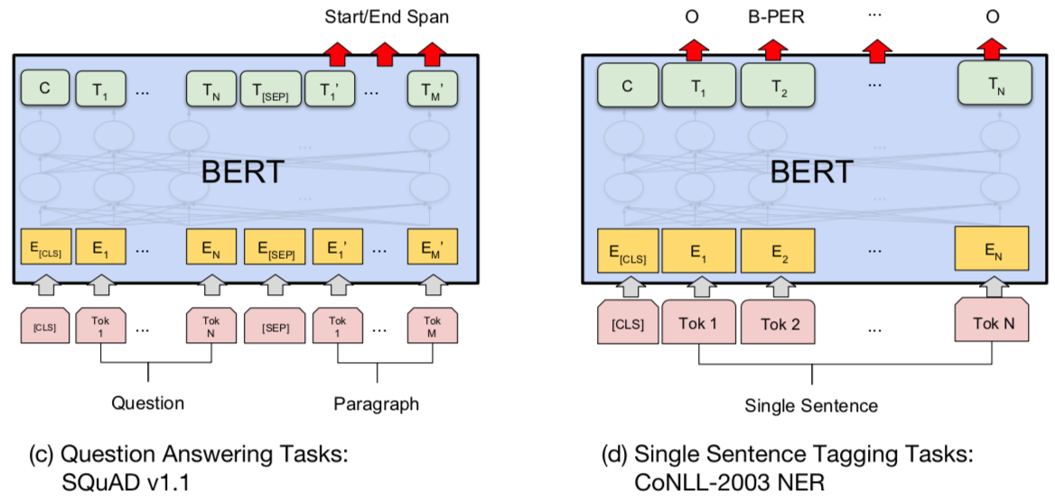
BERT Token-level tasks
Source: Devlin, Jacob, Ming-Wei Chang, Kenton Lee, and Kristina Toutanova (2018). "BERT: Pre-training of Deep Bidirectional Transformers for Language Understanding." arXiv preprint arXiv:1810.04805

Slide 20
Sentiment Analysis: Single Sentence Classification
Source: Devlin, Jacob, Ming-Wei Chang, Kenton Lee, and Kristina Toutanova (2018). "BERT: Pre-training of Deep Bidirectional Transformers for Language Understanding." arXiv preprint arXiv:1810.04805

Slide 21
NER: Single Sentence Tagging
Source: Devlin, Jacob, Ming-Wei Chang, Kenton Lee, and Kristina Toutanova (2018). "BERT: Pre-training of Deep Bidirectional Transformers for Language Understanding." arXiv preprint arXiv:1810.04805

Slide 22
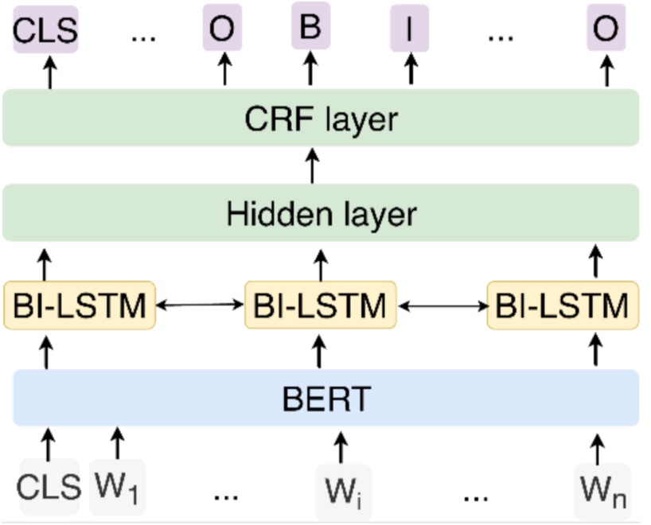
NER: Fine-tuning BERT with Bi-LSTM CRF
Source: Zhang, Xiaohui, Yaoyun Zhang, Qin Zhang, Yuankai Ren, Tinglin Qiu, Jianhui Ma, and Qiang Sun. "Extracting comprehensive clinical information for breast cancer using deep learning methods." International Journal of Medical Informatics 132 (2019): 103985.

Slide 23
Named Entity Recognition (NER) Statistical-based methods and Deep learning-based methods
 | Statistical-based methods | Deep learning-based methods
Character Representations | Handcrafted features (orthographic, prefixes, suffixes, etc.) | Distributed representations (Word2vec, RNN, ELMo, BERT, etc.)
Machine learning models | Statistical-based models (HMM, ME, CRF, SVM, etc.) | Encoder (LSTM, GRU, Transformer, etc.) Decoder (CRF, Transformer, etc.)
Source: Pan Liu, Yanming Guo, Fenglei Wang, and Guohui Li (2022). "Chinese named entity recognition: The state of the art." Neurocomputing 473 (2022): 37-53.

Slide 24
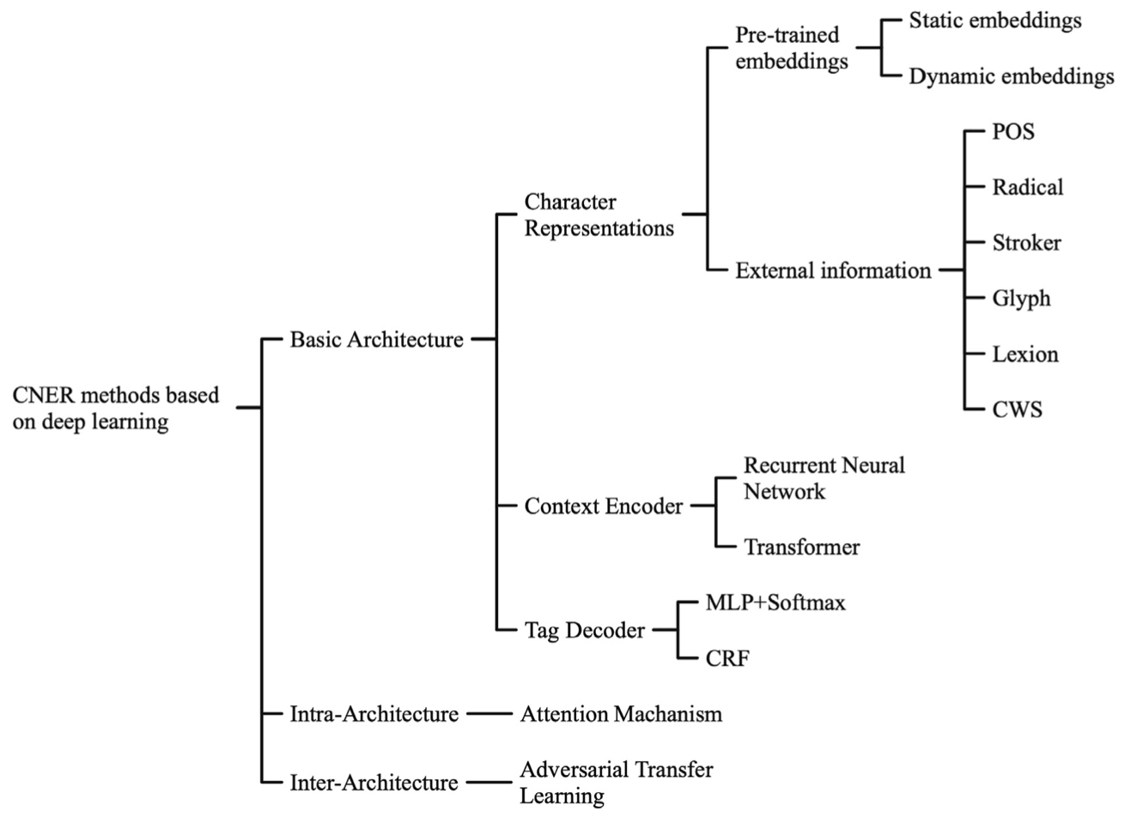
The taxonomy of CNER methods based on deep learning
Source: Pan Liu, Yanming Guo, Fenglei Wang, and Guohui Li (2022). "Chinese named entity recognition: The state of the art." Neurocomputing 473 (2022): 37-53.

Slide 25
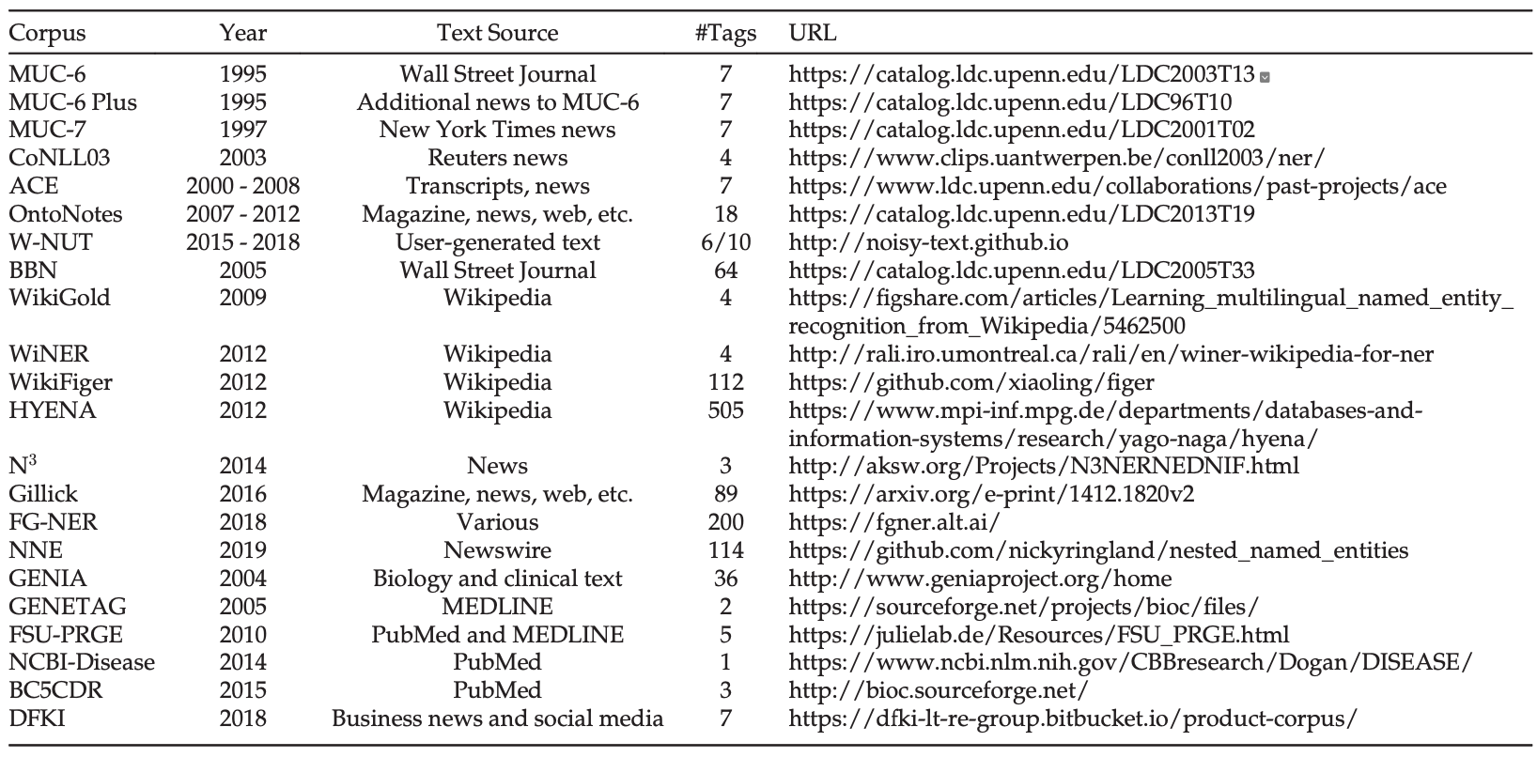
List of Annotated Datasets for English NER
“#Tags” refers to the number of entity types.
Source: Jing Li, Aixin Sun, Jianglei Han, and Chenliang LI (2022). "A survey on deep learning for named entity recognition." IEEE Transactions on Knowledge and Data Engineering 34, no. 1 (2022): 50-70.

Slide 26
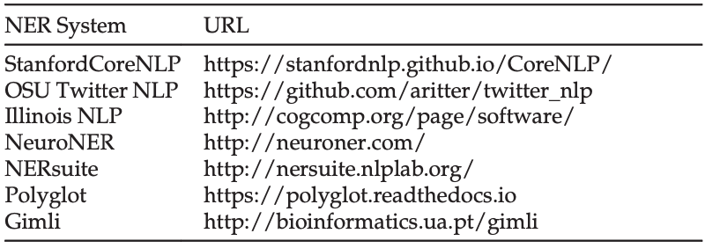
Named Entity Recognition (NER)
Source: Jing Li, Aixin Sun, Jianglei Han, and Chenliang LI (2022). "A survey on deep learning for named entity recognition." IEEE Transactions on Knowledge and Data Engineering 34, no. 1 (2022): 50-70.

Slide 27
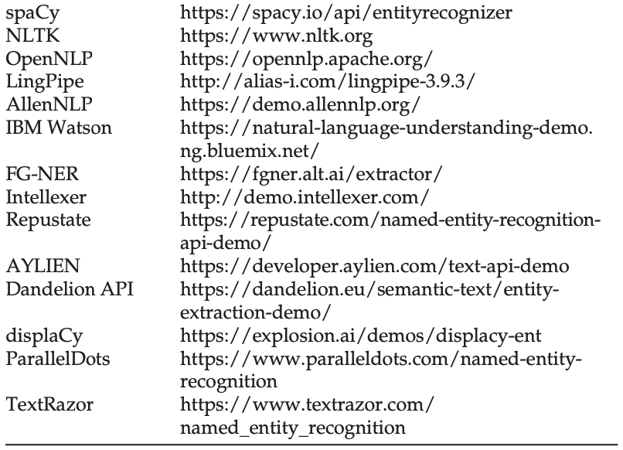
Named Entity Recognition (NER)
Source: Jing Li, Aixin Sun, Jianglei Han, and Chenliang LI (2022). "A survey on deep learning for named entity recognition." IEEE Transactions on Knowledge and Data Engineering 34, no. 1 (2022): 50-70.

Slide 28
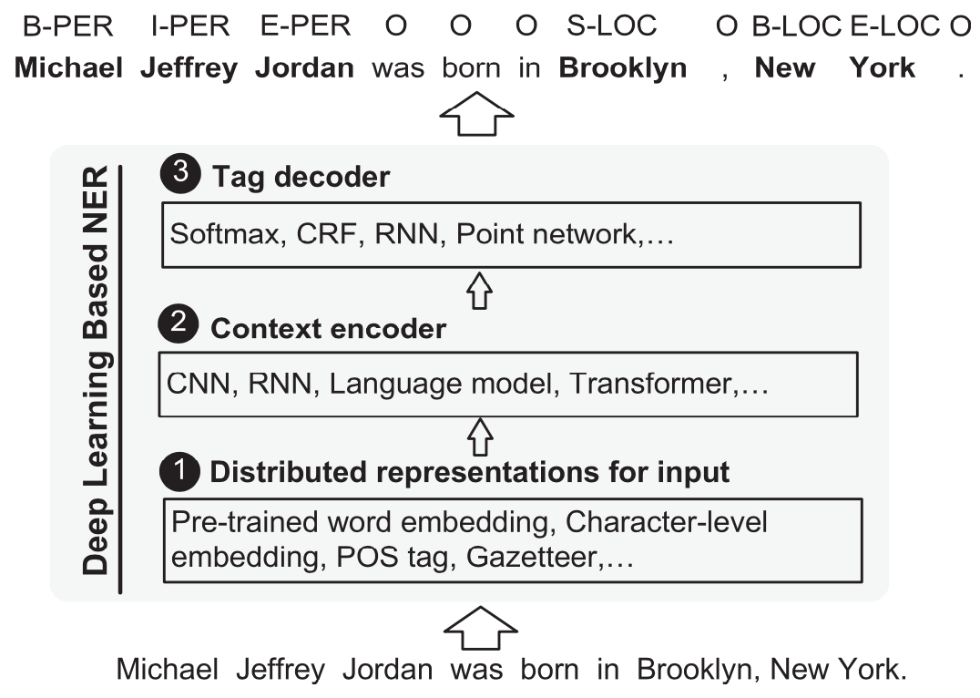
Named Entity Recognition (NER)
Source: Jing Li, Aixin Sun, Jianglei Han, and Chenliang LI (2022). "A survey on deep learning for named entity recognition." IEEE Transactions on Knowledge and Data Engineering 34, no. 1 (2022): 50-70.

Slide 29
Deep Learning for Named Entity Recognition (NER)
Distributed Representations for Input
Hybrid Representation
Context Encoder Architectures
Deep Transformer
Tag Decoder Architectures
Conditional Random Fields (CRF)
Source: Jing Li, Aixin Sun, Jianglei Han, and Chenliang LI (2022). "A survey on deep learning for named entity recognition." IEEE Transactions on Knowledge and Data Engineering 34, no. 1 (2022): 50-70.

Slide 30
Deep Learning for Named Entity Recognition (NER)
Distributed Representations for Input
Word-Level Representation
Character-Level Representation
Hybrid Representation
Source: Jing Li, Aixin Sun, Jianglei Han, and Chenliang LI (2022). "A survey on deep learning for named entity recognition." IEEE Transactions on Knowledge and Data Engineering 34, no. 1 (2022): 50-70.

Slide 31
Deep Learning for Named Entity Recognition (NER)
Context Encoder Architectures
Convolutional Neural Networks
Recurrent Neural Networks
Recursive Neural Networks
Neural Language Models
Deep Transformer
Source: Jing Li, Aixin Sun, Jianglei Han, and Chenliang LI (2022). "A survey on deep learning for named entity recognition." IEEE Transactions on Knowledge and Data Engineering 34, no. 1 (2022): 50-70.

Slide 32
Deep Learning for Named Entity Recognition (NER)
Tag Decoder Architectures
Multi-Layer Perceptron + Softmax
Conditional Random Fields (CRF)
Recurrent Neural Networks
Pointer Networks
Source: Jing Li, Aixin Sun, Jianglei Han, and Chenliang LI (2022). "A survey on deep learning for named entity recognition." IEEE Transactions on Knowledge and Data Engineering 34, no. 1 (2022): 50-70.

Slide 33
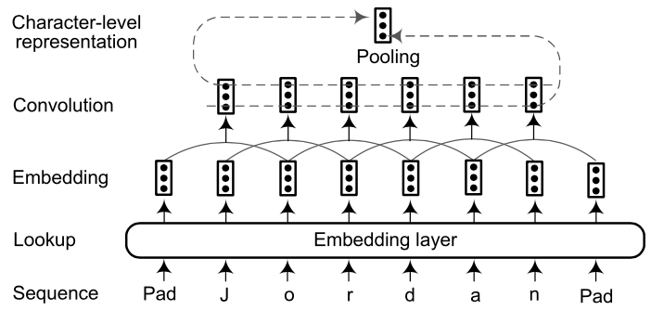
CNN-based character-level representation
Source: Jing Li, Aixin Sun, Jianglei Han, and Chenliang LI (2022). "A survey on deep learning for named entity recognition." IEEE Transactions on Knowledge and Data Engineering 34, no. 1 (2022): 50-70.

Slide 34
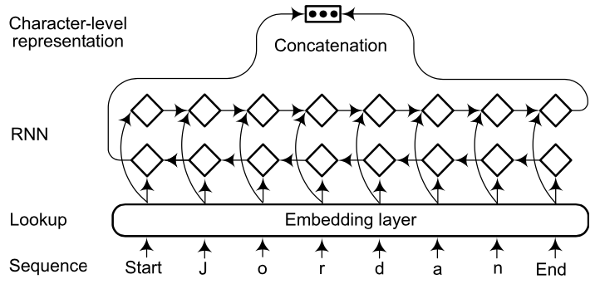
RNN-based character-level representation
Source: Jing Li, Aixin Sun, Jianglei Han, and Chenliang LI (2022). "A survey on deep learning for named entity recognition." IEEE Transactions on Knowledge and Data Engineering 34, no. 1 (2022): 50-70.

Slide 35
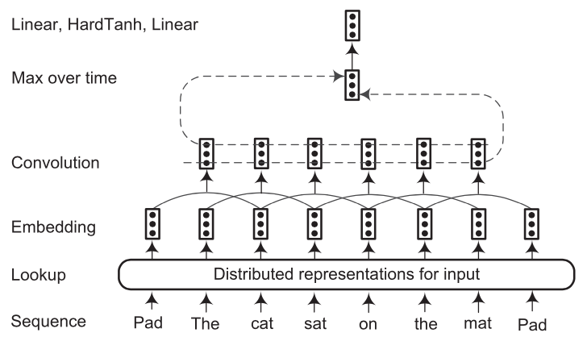
Sentence approach network based on CNN
Source: Jing Li, Aixin Sun, Jianglei Han, and Chenliang LI (2022). "A survey on deep learning for named entity recognition." IEEE Transactions on Knowledge and Data Engineering 34, no. 1 (2022): 50-70.

Slide 36
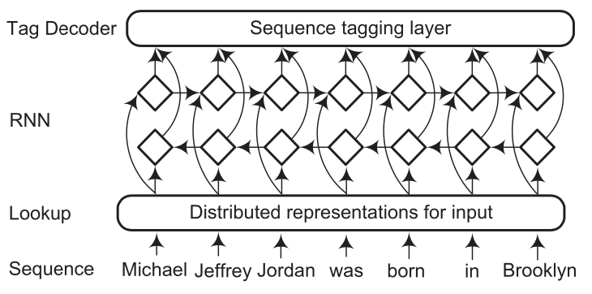
The architecture of RNN-based context encoder
Source: Jing Li, Aixin Sun, Jianglei Han, and Chenliang LI (2022). "A survey on deep learning for named entity recognition." IEEE Transactions on Knowledge and Data Engineering 34, no. 1 (2022): 50-70.

Slide 37
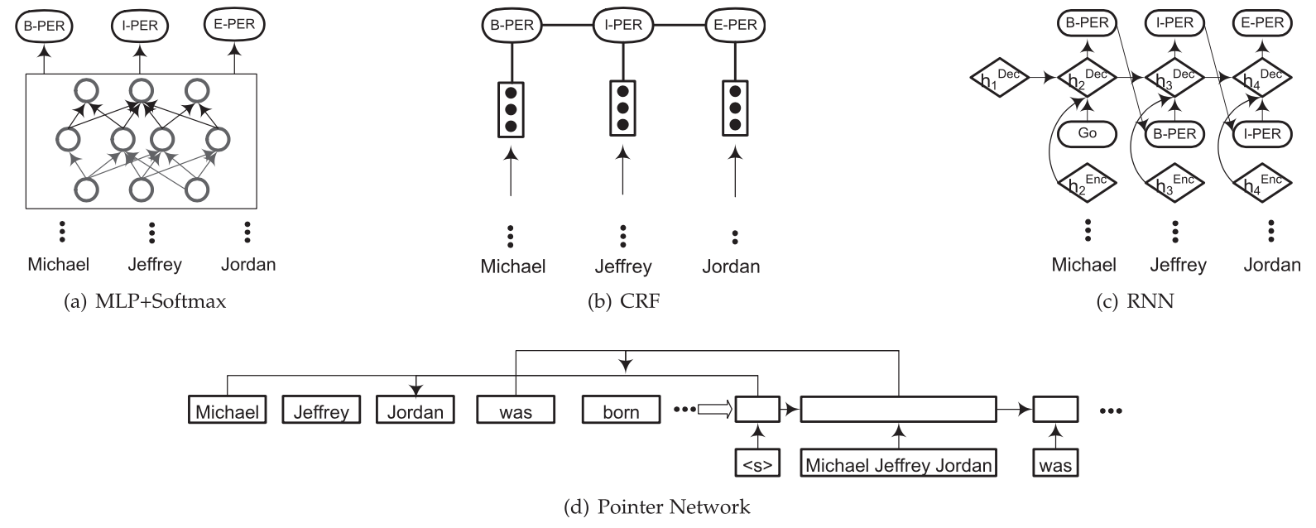
Named Entity Recognition (NER) Four tag decoders: MLP+Softmax, CRF, RNN, and Pointer network
Source: Jing Li, Aixin Sun, Jianglei Han, and Chenliang LI (2022). "A survey on deep learning for named entity recognition." IEEE Transactions on Knowledge and Data Engineering 34, no. 1 (2022): 50-70.

Slide 38
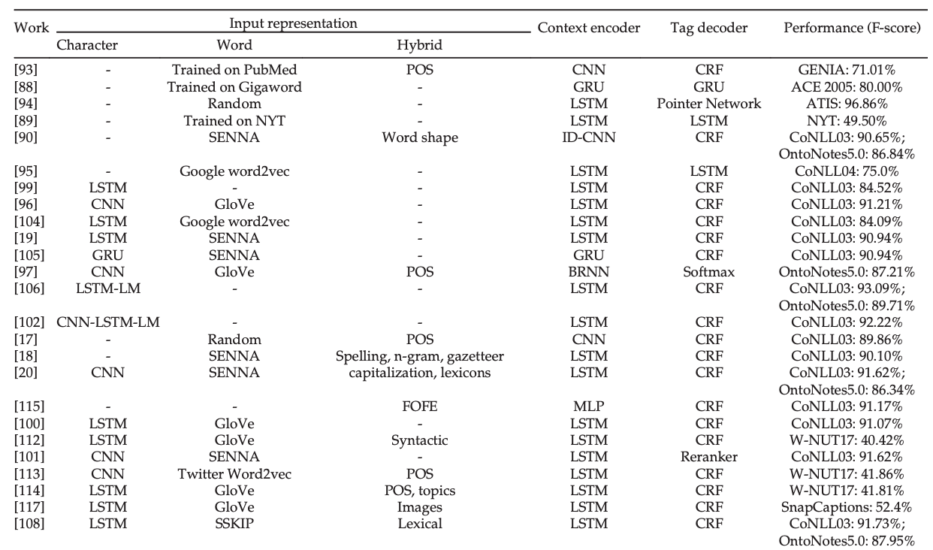
Named Entity Recognition (NER)
Source: Jing Li, Aixin Sun, Jianglei Han, and Chenliang LI (2022). "A survey on deep learning for named entity recognition." IEEE Transactions on Knowledge and Data Engineering 34, no. 1 (2022): 50-70.

Slide 39
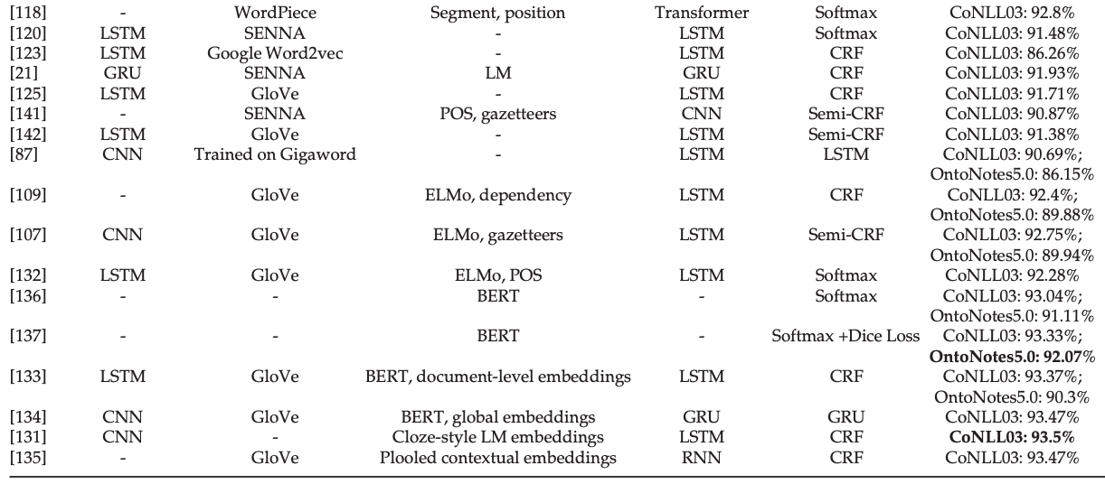
Named Entity Recognition (NER)
Source: Jing Li, Aixin Sun, Jianglei Han, and Chenliang LI (2022). "A survey on deep learning for named entity recognition." IEEE Transactions on Knowledge and Data Engineering 34, no. 1 (2022): 50-70.

Slide 40
Applied Deep Learning for Named Entity Recognition (NER)
Deep Multi-Task Learning for NER
Deep Transfer Learning for NER
Deep Active Learning for NER
Deep Reinforcement Learning for NER
Deep Adversarial Learning for NER
Neural Attention for NER
Source: Jing Li, Aixin Sun, Jianglei Han, and Chenliang LI (2022). "A survey on deep learning for named entity recognition." IEEE Transactions on Knowledge and Data Engineering 34, no. 1 (2022): 50-70.

Slide 41
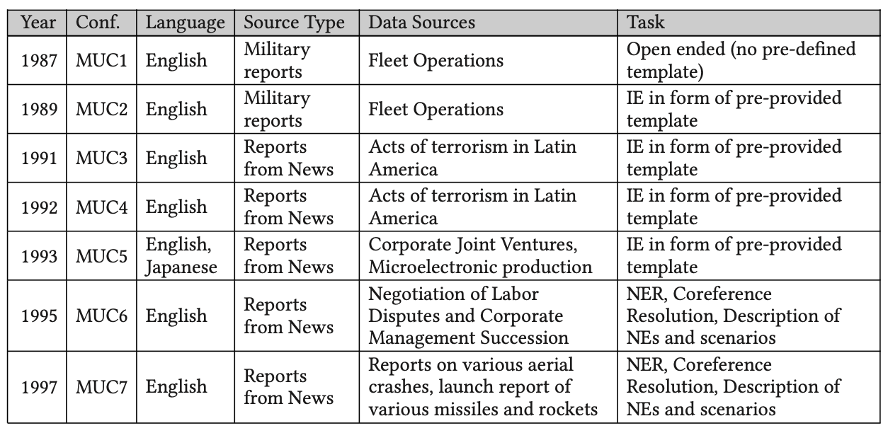
Named Entity Recognition (NER) Message Understanding Conference (MUC) Corpus
Source: Zara Nasar, Syed Waqar Jaffry, and Muhammad Kamran Malik (2022). "Named entity recognition and relation extraction: State-of-the-art." ACM Computing Surveys (CSUR) 54, no. 1 (2022): 1-39.

Slide 42
Named Entity Recognition (NER) Automatic Content Extraction (ACE) corpus
Source: Zara Nasar, Syed Waqar Jaffry, and Muhammad Kamran Malik (2022). "Named entity recognition and relation extraction: State-of-the-art." ACM Computing Surveys (CSUR) 54, no. 1 (2022): 1-39.

Slide 43
Named Entity Recognition (NER) Conference on Computational Natural Language Learning (CoNLL) Corpus
Source: Zara Nasar, Syed Waqar Jaffry, and Muhammad Kamran Malik (2022). "Named entity recognition and relation extraction: State-of-the-art." ACM Computing Surveys (CSUR) 54, no. 1 (2022): 1-39.

Slide 44
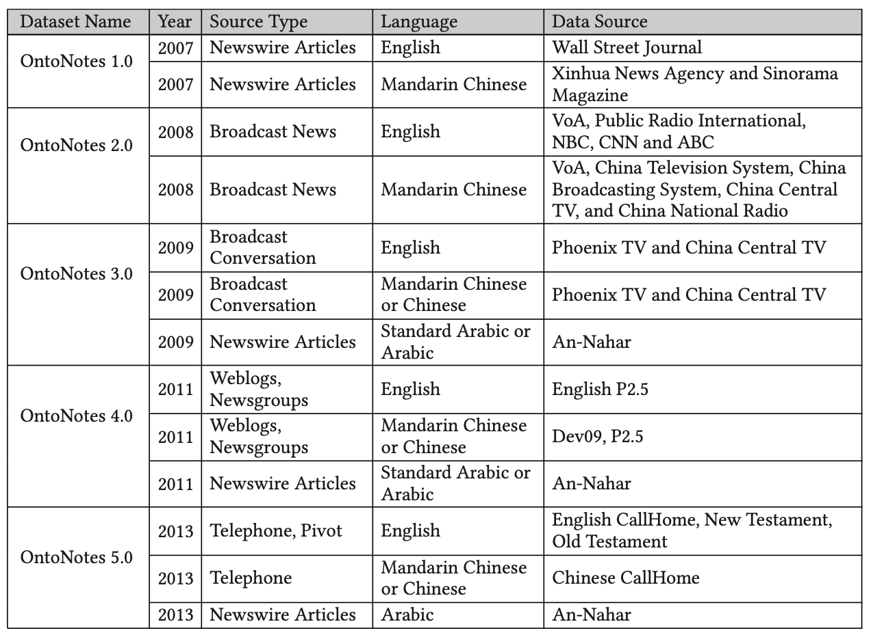
Named Entity Recognition (NER) OntoNotes
Source: Zara Nasar, Syed Waqar Jaffry, and Muhammad Kamran Malik (2022). "Named entity recognition and relation extraction: State-of-the-art." ACM Computing Surveys (CSUR) 54, no. 1 (2022): 1-39.

Slide 45
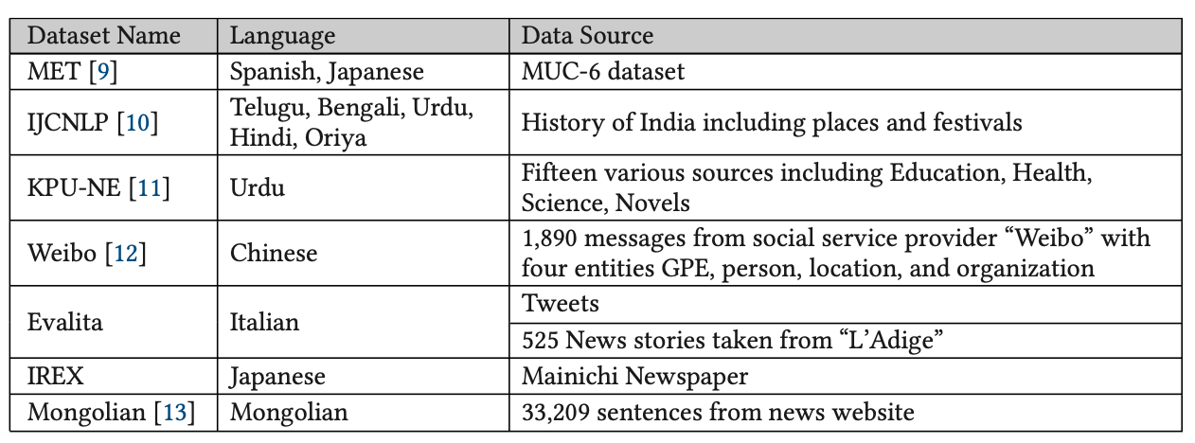
Named Entity Recognition (NER) Other Datasets
Source: Zara Nasar, Syed Waqar Jaffry, and Muhammad Kamran Malik (2022). "Named entity recognition and relation extraction: State-of-the-art." ACM Computing Surveys (CSUR) 54, no. 1 (2022): 1-39.

Slide 46
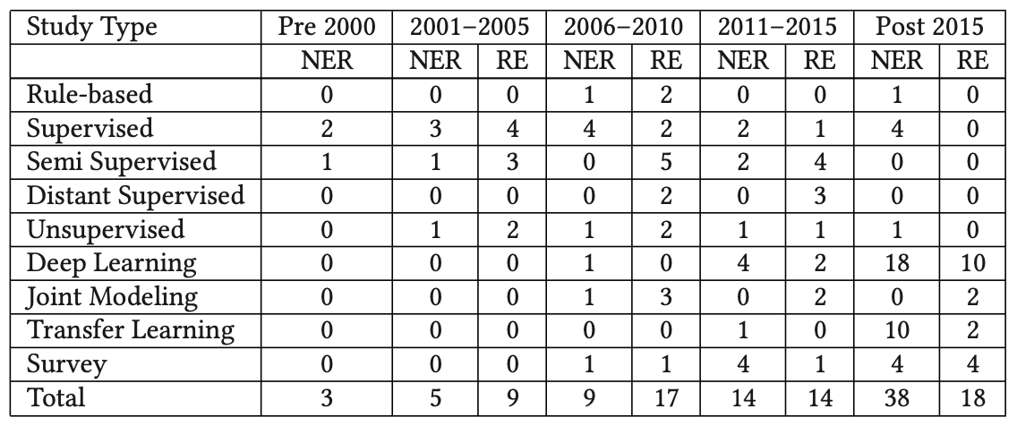
Named Entity Recognition (NER) and Relation Extraction (RE)
Source: Zara Nasar, Syed Waqar Jaffry, and Muhammad Kamran Malik (2022). "Named entity recognition and relation extraction: State-of-the-art." ACM Computing Surveys (CSUR) 54, no. 1 (2022): 1-39.

Slide 47
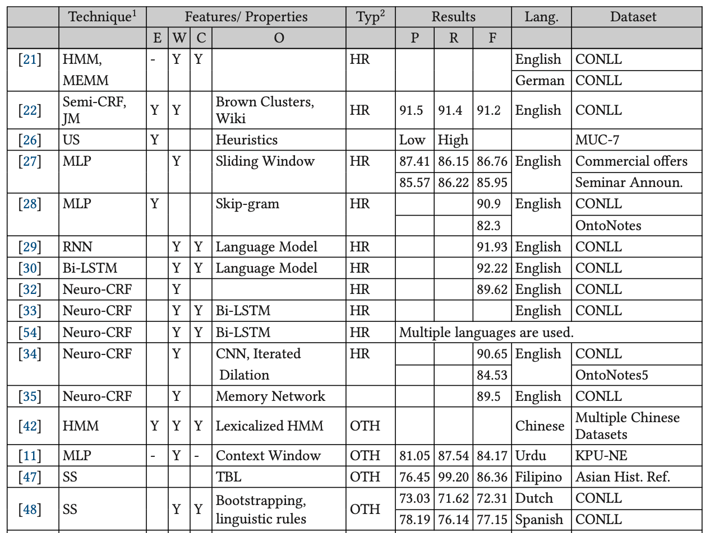
Named Entity Recognition (NER)
Source: Zara Nasar, Syed Waqar Jaffry, and Muhammad Kamran Malik (2022). "Named entity recognition and relation extraction: State-of-the-art." ACM Computing Surveys (CSUR) 54, no. 1 (2022): 1-39.

Slide 48
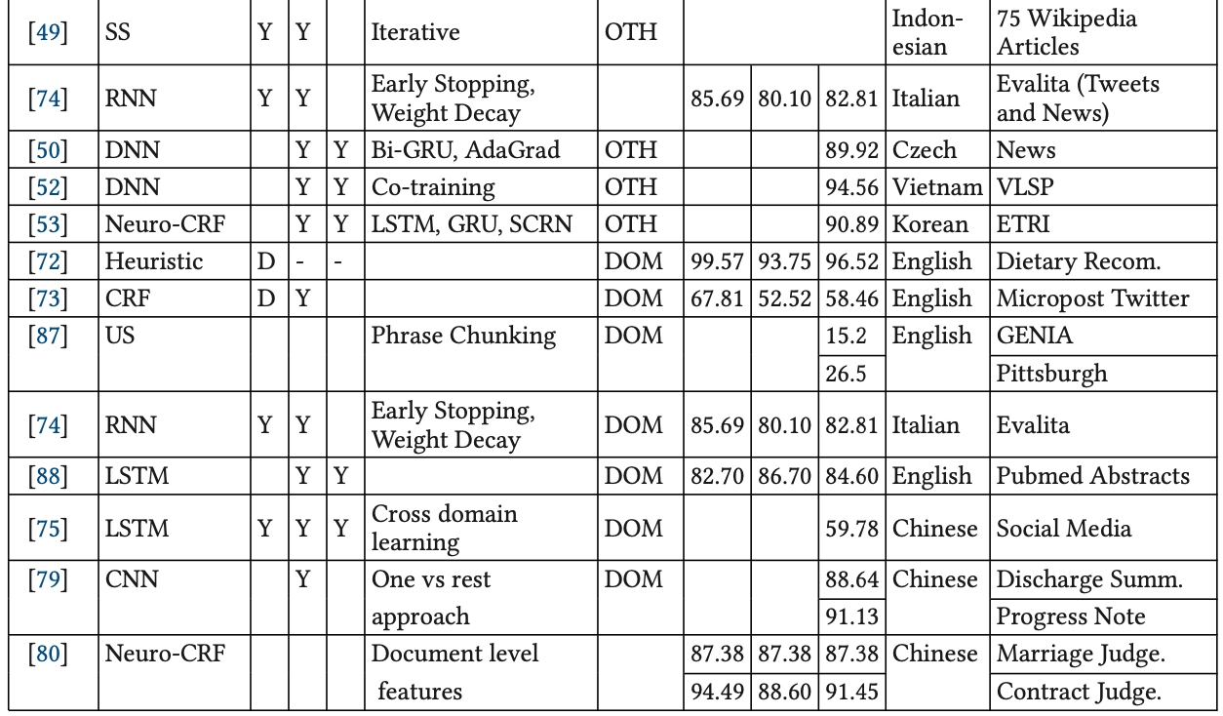
Named Entity Recognition (NER)
Source: Zara Nasar, Syed Waqar Jaffry, and Muhammad Kamran Malik (2022). "Named entity recognition and relation extraction: State-of-the-art." ACM Computing Surveys (CSUR) 54, no. 1 (2022): 1-39.

Slide 49
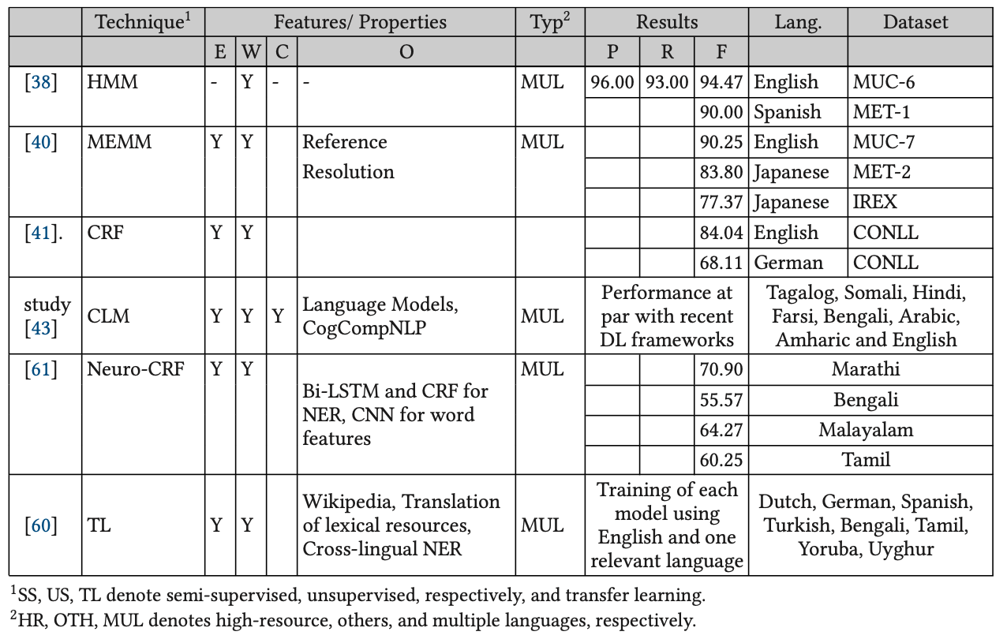
Named Entity Recognition (NER)
Source: Zara Nasar, Syed Waqar Jaffry, and Muhammad Kamran Malik (2022). "Named entity recognition and relation extraction: State-of-the-art." ACM Computing Surveys (CSUR) 54, no. 1 (2022): 1-39.

Slide 50
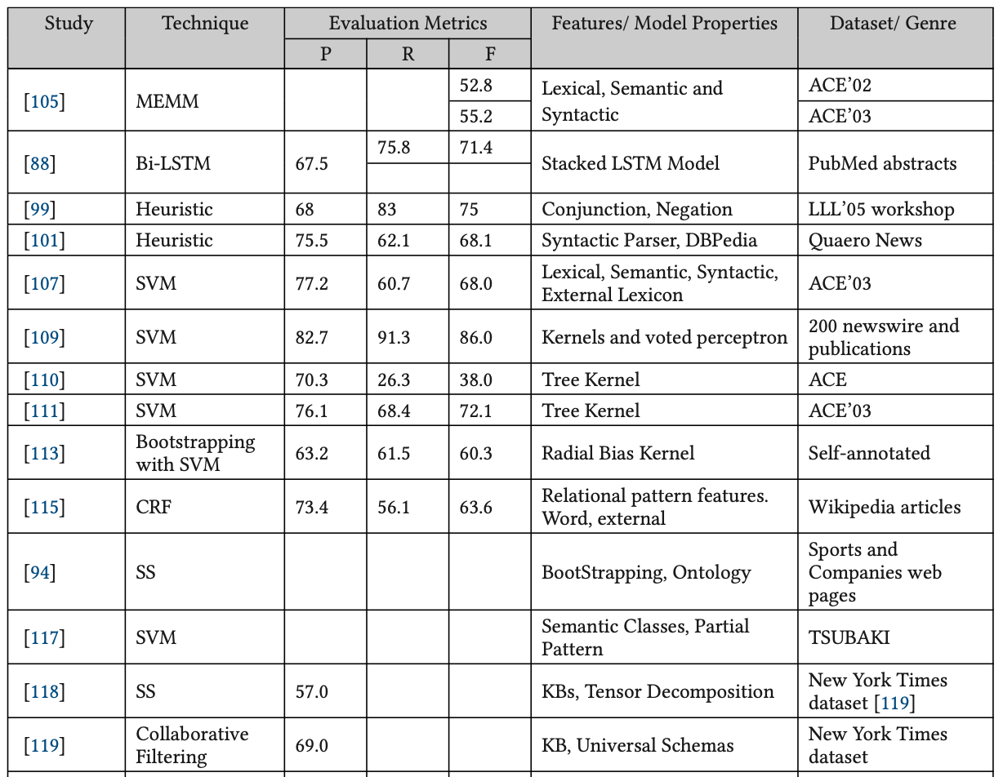
Relation Extraction (RE)
Source: Zara Nasar, Syed Waqar Jaffry, and Muhammad Kamran Malik (2022). "Named entity recognition and relation extraction: State-of-the-art." ACM Computing Surveys (CSUR) 54, no. 1 (2022): 1-39.

Slide 51
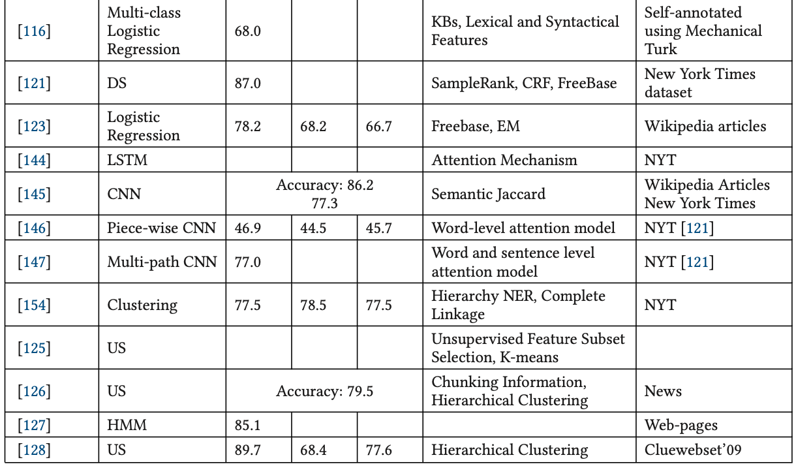
Relation Extraction (RE)
Source: Zara Nasar, Syed Waqar Jaffry, and Muhammad Kamran Malik (2022). "Named entity recognition and relation extraction: State-of-the-art." ACM Computing Surveys (CSUR) 54, no. 1 (2022): 1-39.

Slide 52
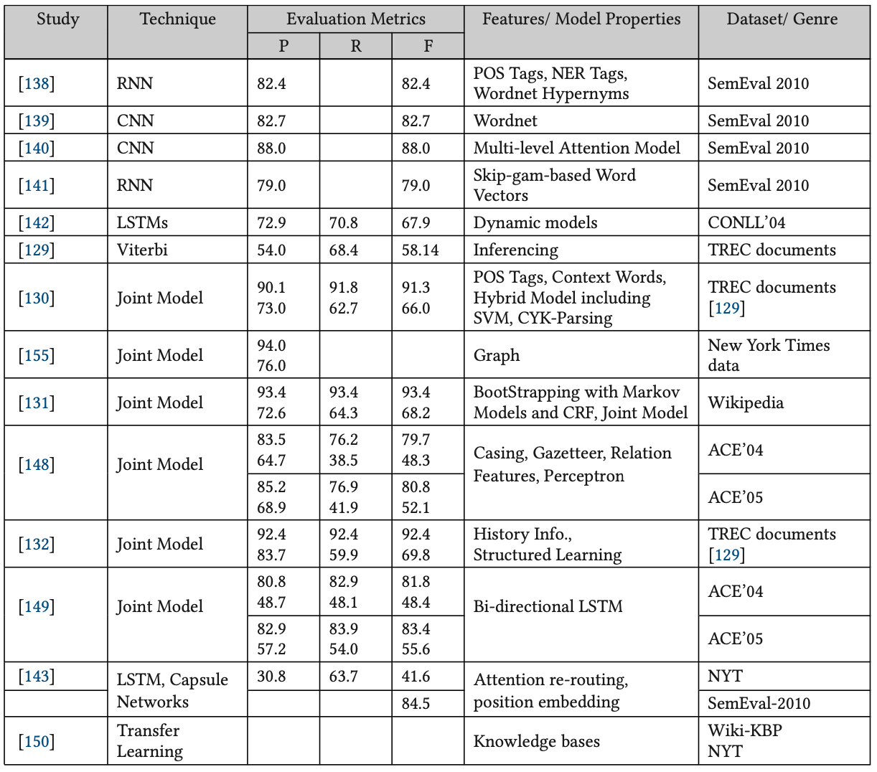
Relation Extraction (RE)
Source: Zara Nasar, Syed Waqar Jaffry, and Muhammad Kamran Malik (2022). "Named entity recognition and relation extraction: State-of-the-art." ACM Computing Surveys (CSUR) 54, no. 1 (2022): 1-39.

Slide 53
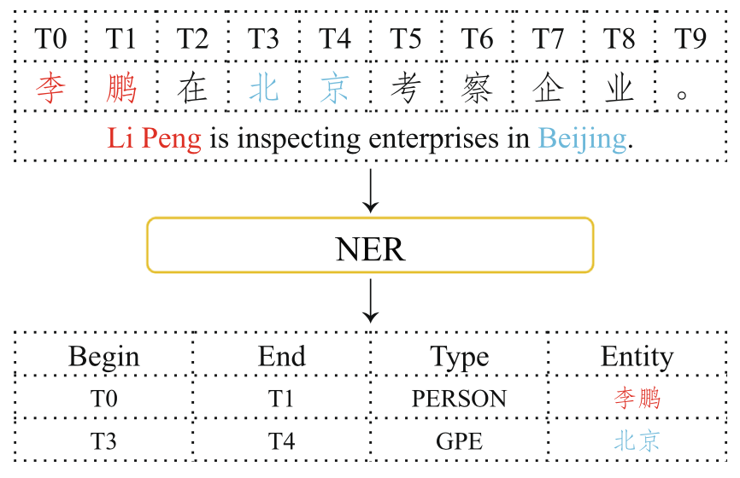
Chinese Named Entity Recognition (CNER)
An illustration of NER task. The sample sentence is from People’s daily dataset, and GPE means Geo-Political Entity.
Source: Pan Liu, Yanming Guo, Fenglei Wang, and Guohui Li (2022). "Chinese named entity recognition: The state of the art." Neurocomputing 473 (2022): 37-53.

Slide 54
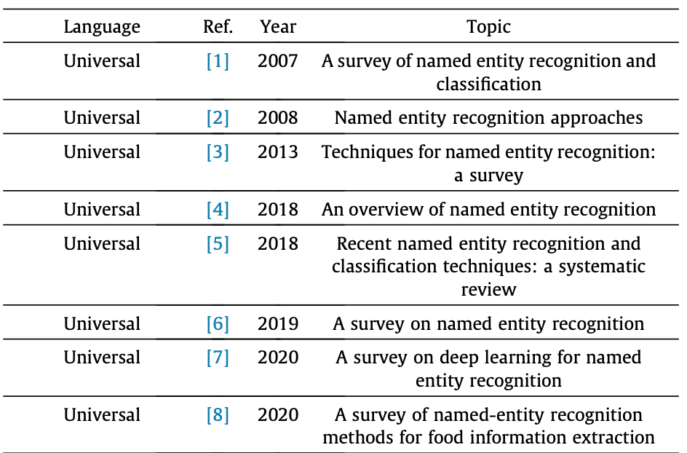
Named Entity Recognition (NER)
Source: Pan Liu, Yanming Guo, Fenglei Wang, and Guohui Li (2022). "Chinese named entity recognition: The state of the art." Neurocomputing 473 (2022): 37-53.

Slide 55
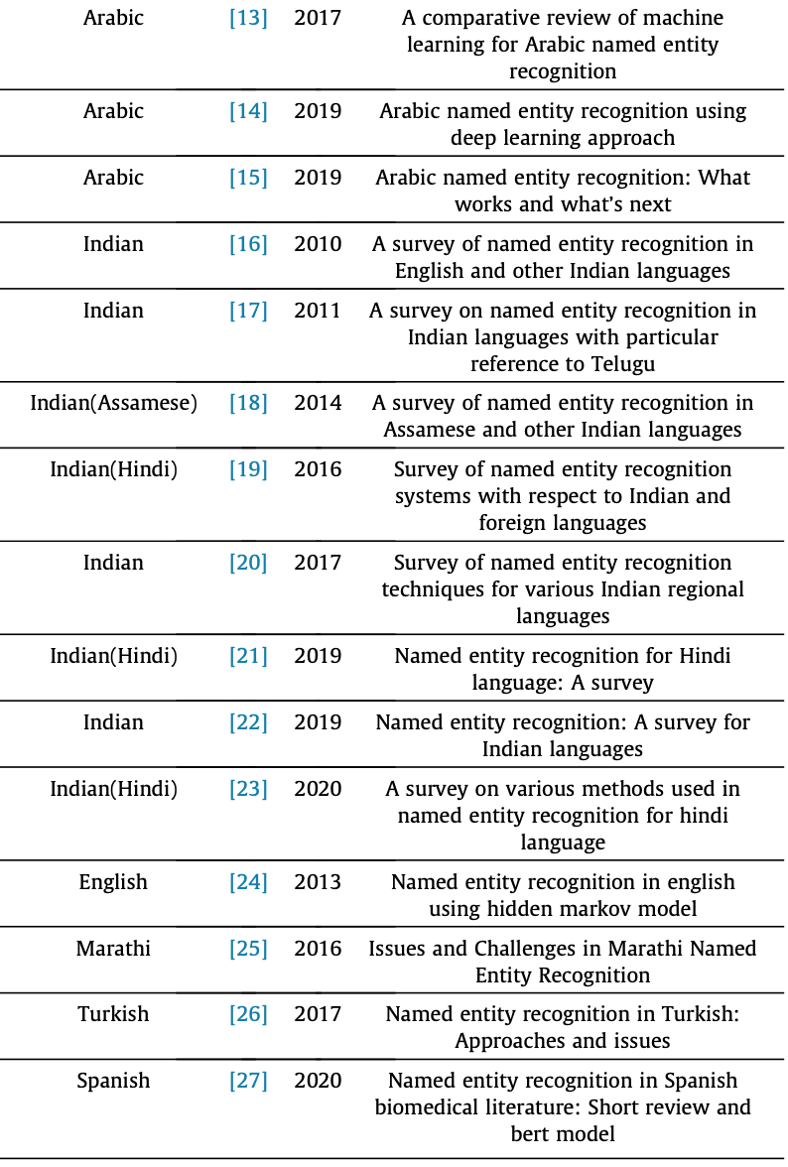
Named Entity Recognition (NER)
Source: Pan Liu, Yanming Guo, Fenglei Wang, and Guohui Li (2022). "Chinese named entity recognition: The state of the art." Neurocomputing 473 (2022): 37-53.

Slide 56
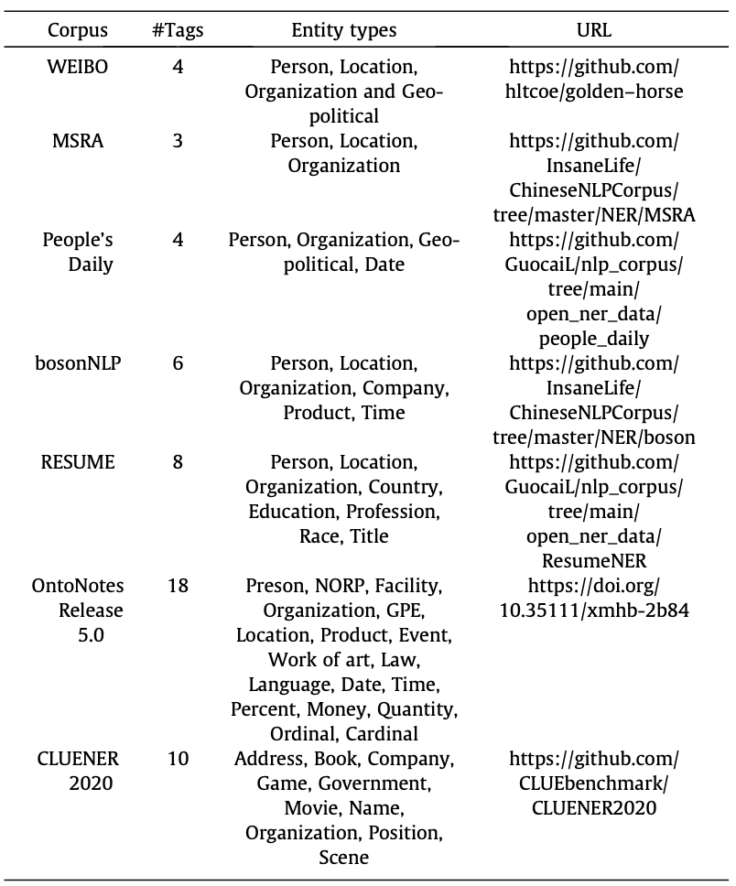
Public datasets of Chinese NER
#Tags: the number of entity types
Source: Pan Liu, Yanming Guo, Fenglei Wang, and Guohui Li (2022). "Chinese named entity recognition: The state of the art." Neurocomputing 473 (2022): 37-53.

Slide 57
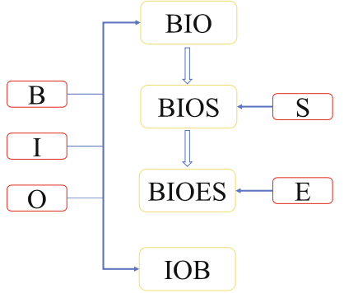
Evolution of four commonly used tag schemes
Source: Pan Liu, Yanming Guo, Fenglei Wang, and Guohui Li (2022). "Chinese named entity recognition: The state of the art." Neurocomputing 473 (2022): 37-53.

Slide 58
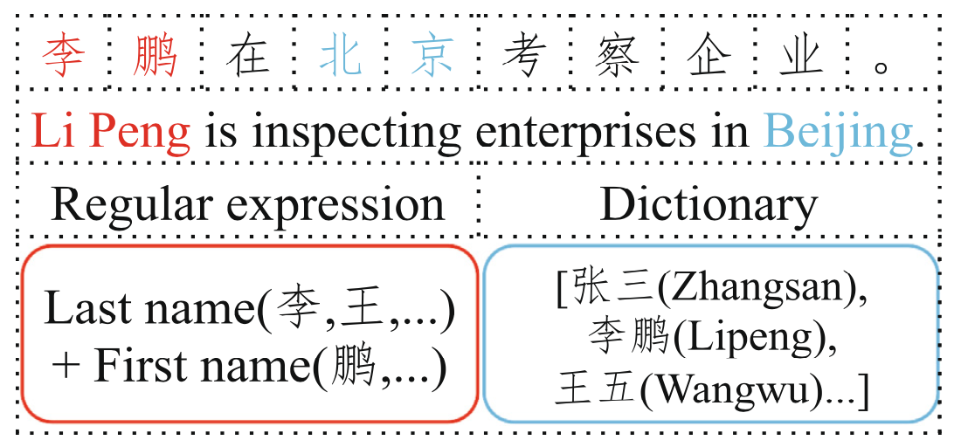
Named Entity Recognition (NER)
An illustration of rule-based methods. A person’s name is matched by a regular expression and a dictionary.
Source: Pan Liu, Yanming Guo, Fenglei Wang, and Guohui Li (2022). "Chinese named entity recognition: The state of the art." Neurocomputing 473 (2022): 37-53.

Slide 59
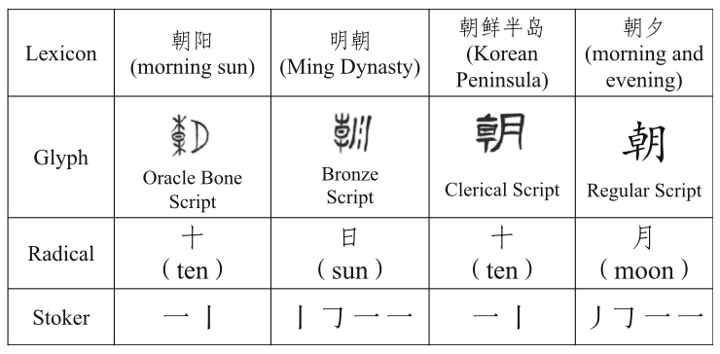
Named Entity Recognition (NER)
The illustration of some external information of the character “朝”
Source: Pan Liu, Yanming Guo, Fenglei Wang, and Guohui Li (2022). "Chinese named entity recognition: The state of the art." Neurocomputing 473 (2022): 37-53.

Slide 60
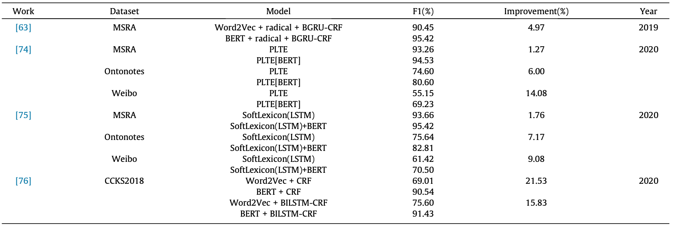
Named Entity Recognition (NER) Improvement brought by BERT in different works
Source: Pan Liu, Yanming Guo, Fenglei Wang, and Guohui Li (2022). "Chinese named entity recognition: The state of the art." Neurocomputing 473 (2022): 37-53.

Slide 61
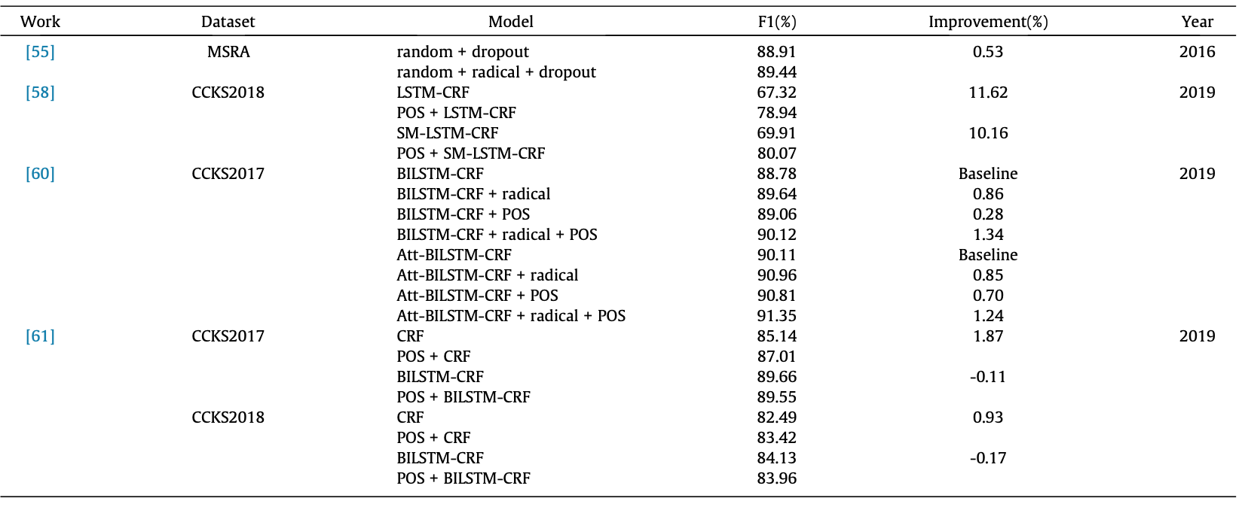
Named Entity Recognition (NER) The effect of POS and radical information
Source: Pan Liu, Yanming Guo, Fenglei Wang, and Guohui Li (2022). "Chinese named entity recognition: The state of the art." Neurocomputing 473 (2022): 37-53.

Slide 62
Named Entity Recognition (NER) Improvement brought by Glyph information
Source: Pan Liu, Yanming Guo, Fenglei Wang, and Guohui Li (2022). "Chinese named entity recognition: The state of the art." Neurocomputing 473 (2022): 37-53.

Slide 63
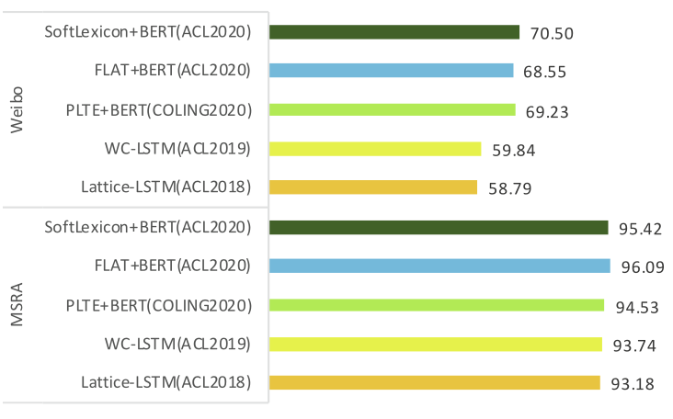
Named Entity Recognition (NER)
Source: Pan Liu, Yanming Guo, Fenglei Wang, and Guohui Li (2022). "Chinese named entity recognition: The state of the art." Neurocomputing 473 (2022): 37-53.

Slide 64
Named Entity Recognition (NER) The illustration of representations of the character “朝”
Source: Pan Liu, Yanming Guo, Fenglei Wang, and Guohui Li (2022). "Chinese named entity recognition: The state of the art." Neurocomputing 473 (2022): 37-53.

Slide 65
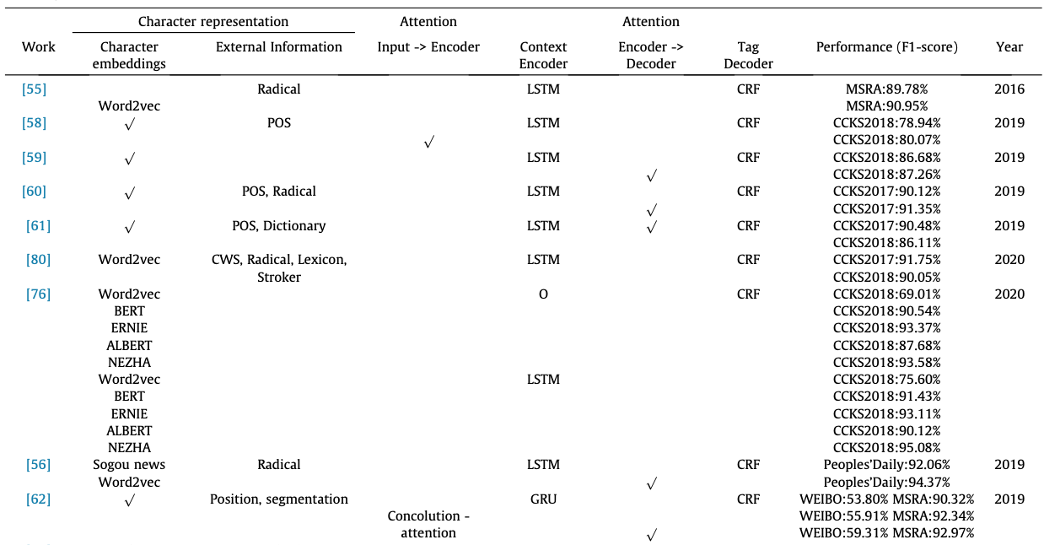
Chinese Named Entity Recognition (CNER)
Source: Pan Liu, Yanming Guo, Fenglei Wang, and Guohui Li (2022). "Chinese named entity recognition: The state of the art." Neurocomputing 473 (2022): 37-53.

Slide 66
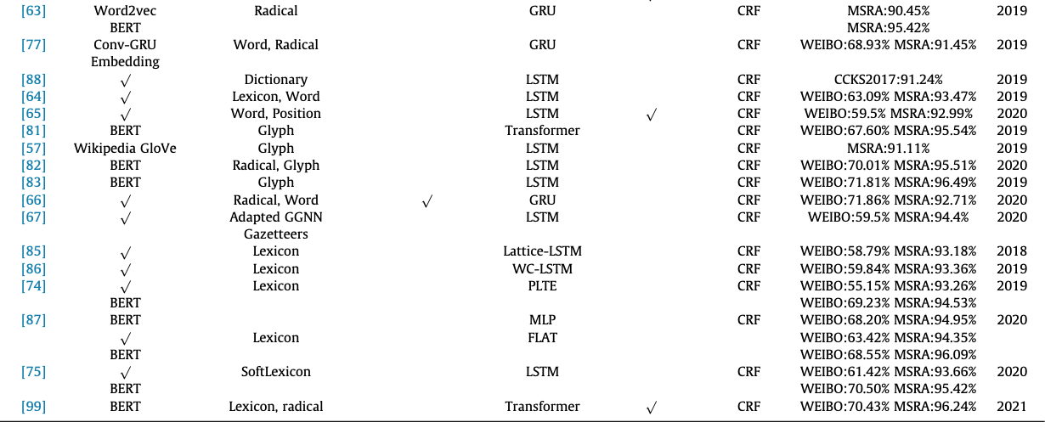
Chinese Named Entity Recognition (CNER)
Source: Pan Liu, Yanming Guo, Fenglei Wang, and Guohui Li (2022). "Chinese named entity recognition: The state of the art." Neurocomputing 473 (2022): 37-53.

Slide 67
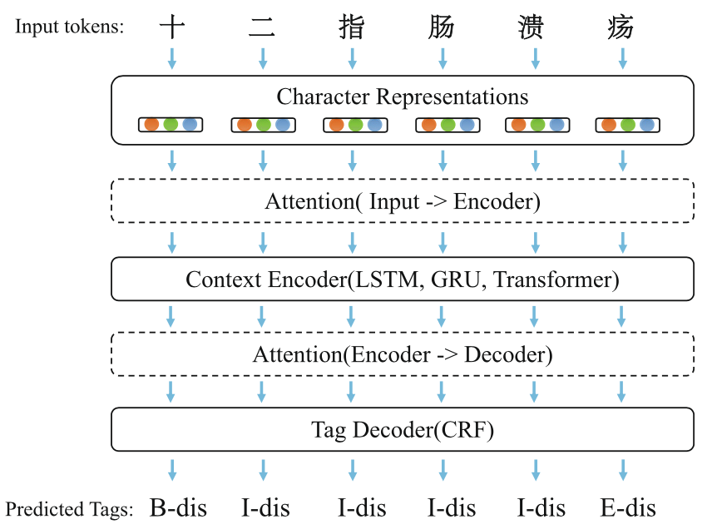
Named Entity Recognition (NER)
Source: Pan Liu, Yanming Guo, Fenglei Wang, and Guohui Li (2022). "Chinese named entity recognition: The state of the art." Neurocomputing 473 (2022): 37-53.

Slide 68
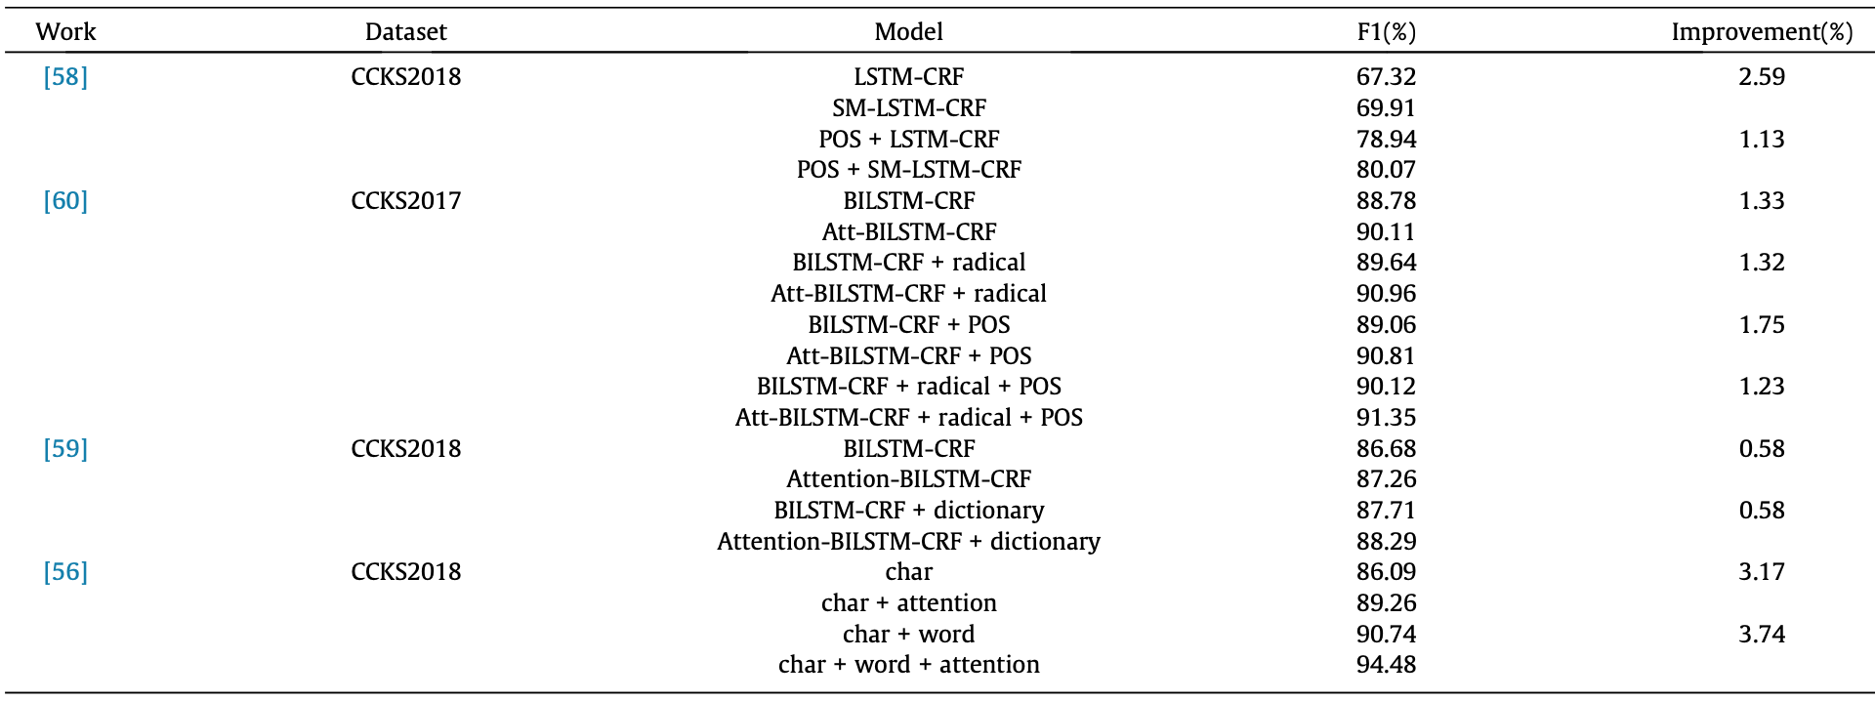
Chinese Named Entity Recognition (CNER) using attention modules
Source: Pan Liu, Yanming Guo, Fenglei Wang, and Guohui Li (2022). "Chinese named entity recognition: The state of the art." Neurocomputing 473 (2022): 37-53.

Slide 69
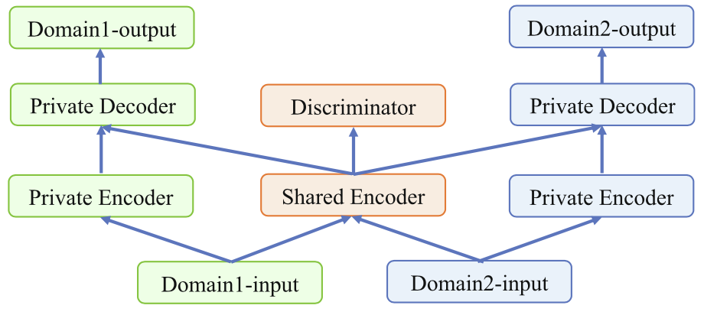
Schematic diagram of cross-domain adversarial transfer learning
Source: Pan Liu, Yanming Guo, Fenglei Wang, and Guohui Li (2022). "Chinese named entity recognition: The state of the art." Neurocomputing 473 (2022): 37-53.

Slide 70
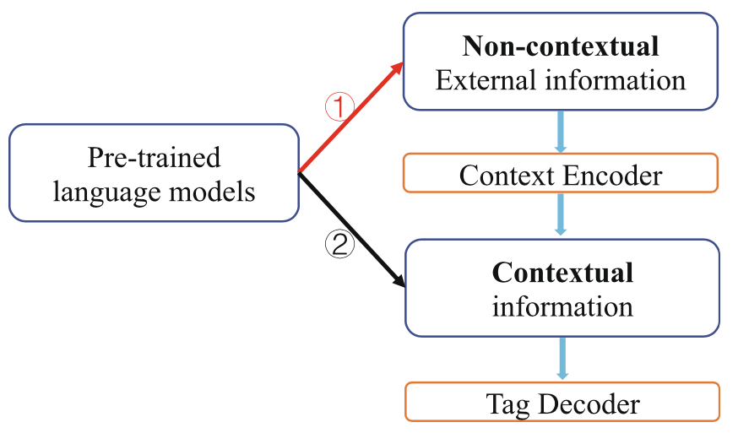
Two ways of concatenating the representations of pre-trained language models and external information
Source: Pan Liu, Yanming Guo, Fenglei Wang, and Guohui Li (2022). "Chinese named entity recognition: The state of the art." Neurocomputing 473 (2022): 37-53.

Slide 71
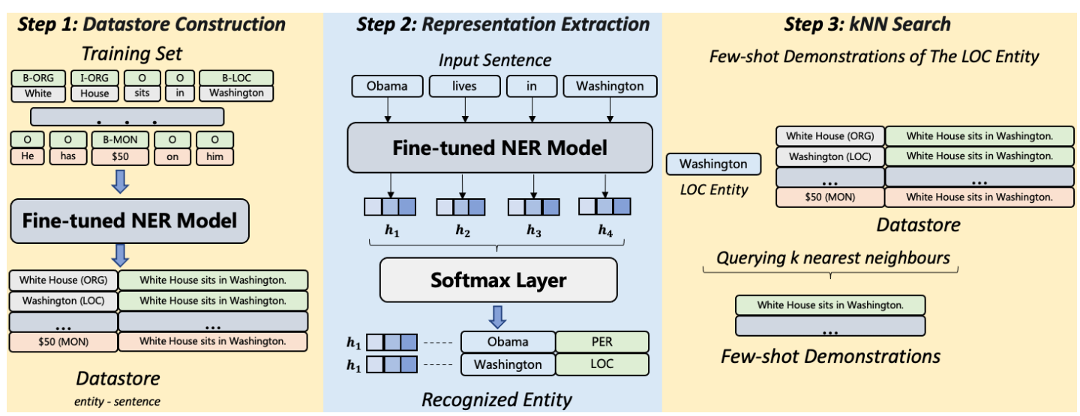
GPT-NER: Named Entity Recognition (NER) via LLM Entity-level embedding to retrieve few-shot demonstrations
Source: Shuhe Wang, Xiaofei Sun, Xiaoya Li, Rongbin Ouyang, Fei Wu, Tianwei Zhang, Jiwei Li, and Guoyin Wang (2023). "Gpt-ner: Named entity recognition via large language models." arXiv preprint arXiv:2304.10428 (2023).

Slide 72
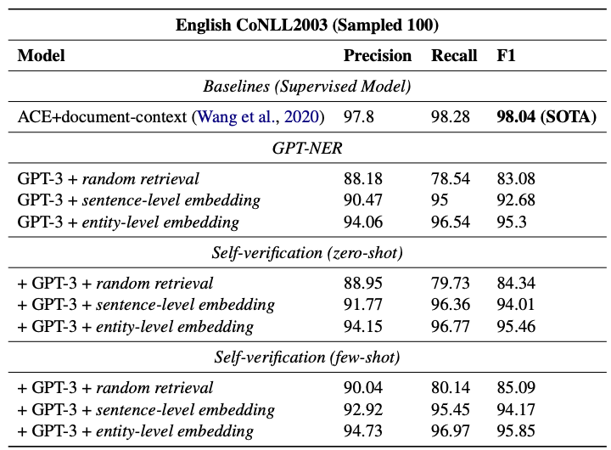
GPT-NER: Named Entity Recognition (NER) via LLM
Source: Shuhe Wang, Xiaofei Sun, Xiaoya Li, Rongbin Ouyang, Fei Wu, Tianwei Zhang, Jiwei Li, and Guoyin Wang (2023). "Gpt-ner: Named entity recognition via large language models." arXiv preprint arXiv:2304.10428 (2023).

Slide 73
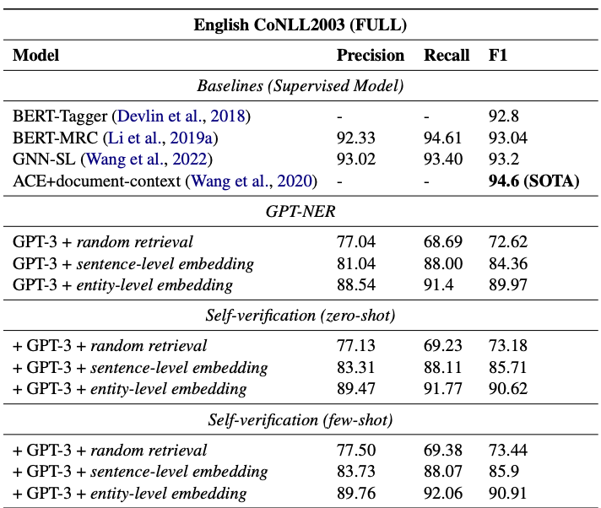
GPT-NER: Named Entity Recognition (NER) via LLM
Source: Shuhe Wang, Xiaofei Sun, Xiaoya Li, Rongbin Ouyang, Fei Wu, Tianwei Zhang, Jiwei Li, and Guoyin Wang (2023). "Gpt-ner: Named entity recognition via large language models." arXiv preprint arXiv:2304.10428 (2023).

Slide 74
GPT-NER: Named Entity Recognition (NER) via LLM
Low-resource comparisons on CoNLL2003 dataset.
Comparisons by varying k-shot demonstrations.
Source: Shuhe Wang, Xiaofei Sun, Xiaoya Li, Rongbin Ouyang, Fei Wu, Tianwei Zhang, Jiwei Li, and Guoyin Wang (2023). "Gpt-ner: Named entity recognition via large language models." arXiv preprint arXiv:2304.10428 (2023).

Slide 75
NLP with Transformers Github
https://github.com/nlp-with-transformers/notebooks

Slide 76
NLP with Transformers Github Notebooks
https://github.com/nlp-with-transformers/notebooks

Slide 77
Python in Google Colab (Python101)
https://colab.research.google.com/drive/1FEG6DnGvwfUbeo4zJ1zTunjMqf2RkCrT
https://tinyurl.com/aintpupython101

Slide 78
Python in Google Colab (Python101)
https://colab.research.google.com/drive/1FEG6DnGvwfUbeo4zJ1zTunjMqf2RkCrT
https://tinyurl.com/aintpupython101

Slide 79
Python in Google Colab (Python101)
https://colab.research.google.com/drive/1FEG6DnGvwfUbeo4zJ1zTunjMqf2RkCrT
https://tinyurl.com/aintpupython101

Slide 80
Python in Google Colab (Python101)
https://colab.research.google.com/drive/1FEG6DnGvwfUbeo4zJ1zTunjMqf2RkCrT
https://tinyurl.com/aintpupython101

Slide 81
Python in Google Colab (Python101)
https://colab.research.google.com/drive/1FEG6DnGvwfUbeo4zJ1zTunjMqf2RkCrT
https://tinyurl.com/aintpupython101

Slide 82
Python in Google Colab (Python101)
https://colab.research.google.com/drive/1FEG6DnGvwfUbeo4zJ1zTunjMqf2RkCrT
https://tinyurl.com/aintpupython101

Slide 83
Python in Google Colab (Python101)
https://colab.research.google.com/drive/1FEG6DnGvwfUbeo4zJ1zTunjMqf2RkCrT
https://tinyurl.com/aintpupython101

Slide 84
Python in Google Colab (Python101)
https://colab.research.google.com/drive/1FEG6DnGvwfUbeo4zJ1zTunjMqf2RkCrT
https://tinyurl.com/aintpupython101

Slide 85
Python in Google Colab (Python101)
https://colab.research.google.com/drive/1FEG6DnGvwfUbeo4zJ1zTunjMqf2RkCrT
https://tinyurl.com/aintpupython101

Slide 86
Named Entity Recognition (NER)
from transformers import pipeline
import pandas as pd
classifier = pipeline("ner")
text = "My name is Michael and I live in Berkeley, California."
outputs = classifier(text)
pd.DataFrame(outputs)
https://tinyurl.com/aintpupython101

Slide 87
Summary
Named Entities (NE)
represent real-world objects
people, places, organizations
proper names
Named Entity Recognition (NER)
Entity chunking
Entity extraction
Relation Extraction (RE)
Source: Dipanjan Sarkar (2019), Text Analytics with Python: A Practitioner’s Guide to Natural Language Processing, Second Edition. APress.

Slide 88
References
Lewis Tunstall, Leandro von Werra, and Thomas Wolf (2022), Natural Language Processing with Transformers: Building Language Applications with Hugging Face, O'Reilly Media.
Denis Rothman (2021), Transformers for Natural Language Processing: Build innovative deep neural network architectures for NLP with Python, PyTorch, TensorFlow, BERT, RoBERTa, and more, Packt Publishing.
Savaş Yıldırım and Meysam Asgari-Chenaghlu (2021), Mastering Transformers: Build state-of-the-art models from scratch with advanced natural language processing techniques, Packt Publishing.
Sowmya Vajjala, Bodhisattwa Majumder, Anuj Gupta (2020), Practical Natural Language Processing: A Comprehensive Guide to Building Real-World NLP Systems, O'Reilly Media.
Jing Li, Aixin Sun, Jianglei Han, and Chenliang LI (2022). "A survey on deep learning for named entity recognition." IEEE Transactions on Knowledge and Data Engineering 34, no. 1 (2022): 50-70.
Zara Nasar, Syed Waqar Jaffry, and Muhammad Kamran Malik (2022). "Named entity recognition and relation extraction: State-of-the-art." ACM Computing Surveys (CSUR) 54, no. 1 (2022): 1-39.
Pan Liu, Yanming Guo, Fenglei Wang, and Guohui Li (2022). "Chinese named entity recognition: The state of the art." Neurocomputing 473 (2022): 37-53.
Shuhe Wang, Xiaofei Sun, Xiaoya Li, Rongbin Ouyang, Fei Wu, Tianwei Zhang, Jiwei Li, and Guoyin Wang (2023). "Gpt-ner: Named entity recognition via large language models." arXiv preprint arXiv:2304.10428 (2023).
Ramesh Sharda, Dursun Delen, and Efraim Turban (2017), Business Intelligence, Analytics, and Data Science: A Managerial Perspective, 4th Edition, Pearson.
Dipanjan Sarkar (2019), Text Analytics with Python: A Practitioner’s Guide to Natural Language Processing, Second Edition. APress.
Benjamin Bengfort, Rebecca Bilbro, and Tony Ojeda (2018), Applied Text Analysis with Python: Enabling Language-Aware Data Products with Machine Learning, O’Reilly.
Charu C. Aggarwal (2018), Machine Learning for Text, Springer.
Gabe Ignatow and Rada F. Mihalcea (2017), An Introduction to Text Mining: Research Design, Data Collection, and Analysis, SAGE Publications.
Rajesh Arumugam (2018), Hands-On Natural Language Processing with Python: A practical guide to applying deep learning architectures to your NLP applications, Packt.
Jake VanderPlas (2016), Python Data Science Handbook: Essential Tools for Working with Data, O'Reilly Media.
Devlin, Jacob, Ming-Wei Chang, Kenton Lee, and Kristina Toutanova (2018). "BERT: Pre-training of Deep Bidirectional Transformers for Language Understanding." arXiv preprint arXiv:1810.04805.
The Super Duper NLP Repo, https://notebooks.quantumstat.com/
Jay Alammar (2018), The Illustrated Transformer, http://jalammar.github.io/illustrated-transformer/
Jay Alammar (2019), A Visual Guide to Using BERT for the First Time, http://jalammar.github.io/a-visual-guide-to-using-bert-for-the-first-time/
NLP with Transformer, https://github.com/nlp-with-transformers/notebooks
Min-Yuh Day (2023), Python 101, https://tinyurl.com/aintpupython101

