Slide 1
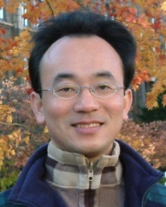
Question Answering and Dialogue Systems
Artificial Intelligence for Text Analytics
1121AITA09
MBA, IM, NTPU (M5265) (Fall 2023) Tue 2, 3, 4 (9:10-12:00) (B3F17)
Min-Yuh Day, Ph.D, Associate Professor
Institute of Information Management, National Taipei University
https://web.ntpu.edu.tw/~myday
https://meet.google.com/miy-fbif-max
2023-12-06

Slide 2
Syllabus
Week Date Subject/Topics
1 2023/09/13 Introduction to Artificial Intelligence for Text Analytics
2 2023/09/20 Foundations of Text Analytics: Natural Language Processing (NLP)
3 2023/09/27 Python for Natural Language Processing
4 2023/10/04 Natural Language Processing with Transformers
5 2023/10/11 Case Study on Artificial Intelligence for Text Analytics I
6 2023/10/18 Text Classification and Sentiment Analysis

Slide 3
Syllabus
Week Date Subject/Topics
7 2023/10/25 Multilingual Named Entity Recognition (NER)
8 2023/11/01 Midterm Project Report
9 2023/11/08 Text Similarity and Clustering
10 2023/11/15 Text Summarization and Topic Models
11 2023/11/22 Text Generation with Large Language Models (LLMs)
12 2023/11/29 Case Study on Artificial Intelligence for Text Analytics II

Slide 4
Syllabus
Week Date Subject/Topics
13 2023/12/06 Question Answering and Dialogue Systems
14 2023/12/13 Deep Learning, Generative AI, Transfer Learning, Zero-Shot, and Few-Shot Learning for Text Analytics
15 2023/12/20 Final Project Report I
16 2023/12/27 Final Project Report II
17 2024/01/03 Self-learning
18 2024/01/10 Self-learning

Slide 5
Question Answering and Dialogue Systems

Slide 6
Outline
Question Answering
Dialogue Systems
Task Oriented Dialogue (TOD) System
Task-Oriented Dialogue System (TDS)
Conversational Dialogue System (CDS)
Question Answering Dialogue System (QADS)

Slide 7
The Development of LM-based Dialogue Systems 1) Early Stage (1966 - 2015) 2) The Independent Development of TOD and ODD (2015 - 2019) 3) Fusions of Dialogue Systems (2019 - 2022) 4) LLM-based DS (2022 - Now)
Task-oriented DS (TOD), Open-domain DS (ODD)
Source: Wang, Hongru, Lingzhi Wang, Yiming Du, Liang Chen, Jingyan Zhou, Yufei Wang, and Kam-Fai Wong. "A Survey of the Evolution of Language Model-Based Dialogue Systems." arXiv preprint arXiv:2311.16789 (2023).

Slide 8
Dialogue System Different types of dialogues in Task-oriented DS (TOD) and Open-domain DS (ODD)
Source: Wang, Hongru, Lingzhi Wang, Yiming Du, Liang Chen, Jingyan Zhou, Yufei Wang, and Kam-Fai Wong. "A Survey of the Evolution of Language Model-Based Dialogue Systems." arXiv preprint arXiv:2311.16789 (2023).

Slide 9
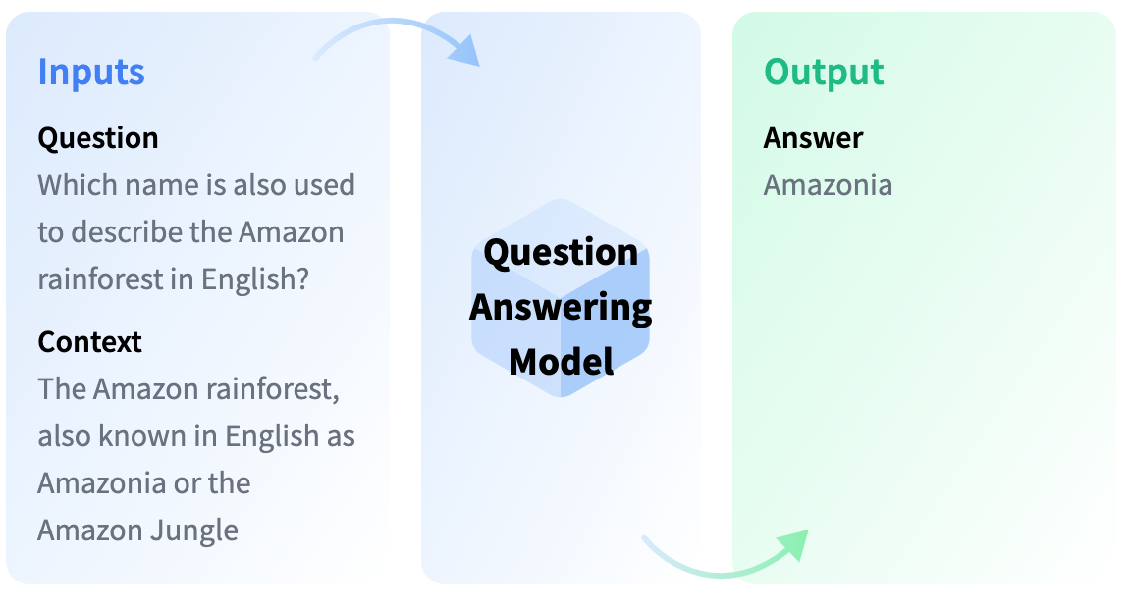
Question Answering
https://huggingface.co/tasks/question-answering

Slide 10
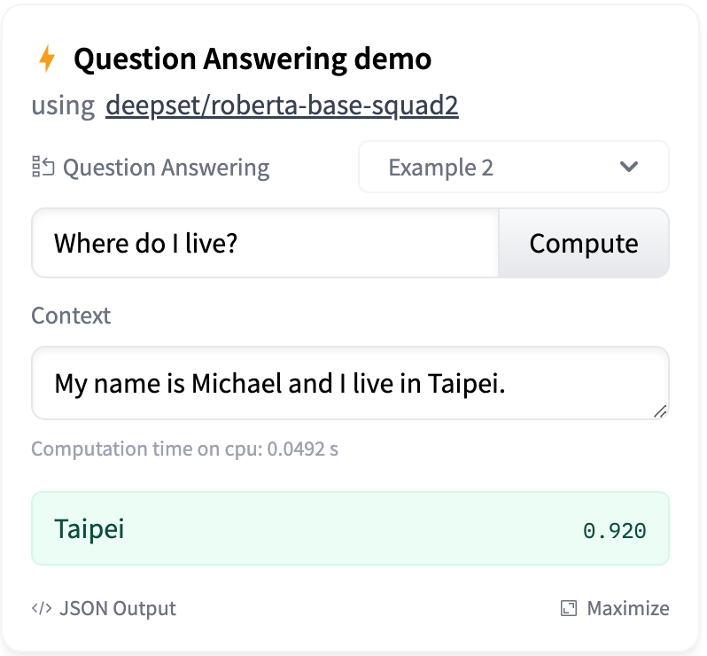
Question Answering
https://huggingface.co/tasks/question-answering

Slide 11
Question Answering
!pip install transformers
from transformers import pipeline
qamodel = pipeline("question-answering")
question = "Where do I live?"
context = "My name is Michael and I live in Taipei."
qamodel(question = question, context = context)
{'answer': 'Taipei', 'end': 39, 'score': 0.9730741381645203, 'start': 33}
https://tinyurl.com/aintpupython101

Slide 12
Question Answering
from transformers import pipeline
qamodel = pipeline("question-answering", model ='deepset/roberta-base-squad2')
question = "Where do I live?"
context = "My name is Michael and I live in Taipei."
output = qamodel(question = question, context = context)
print(output['answer’])
Taipei
https://tinyurl.com/aintpupython101

Slide 13
Question Answering

Slide 14
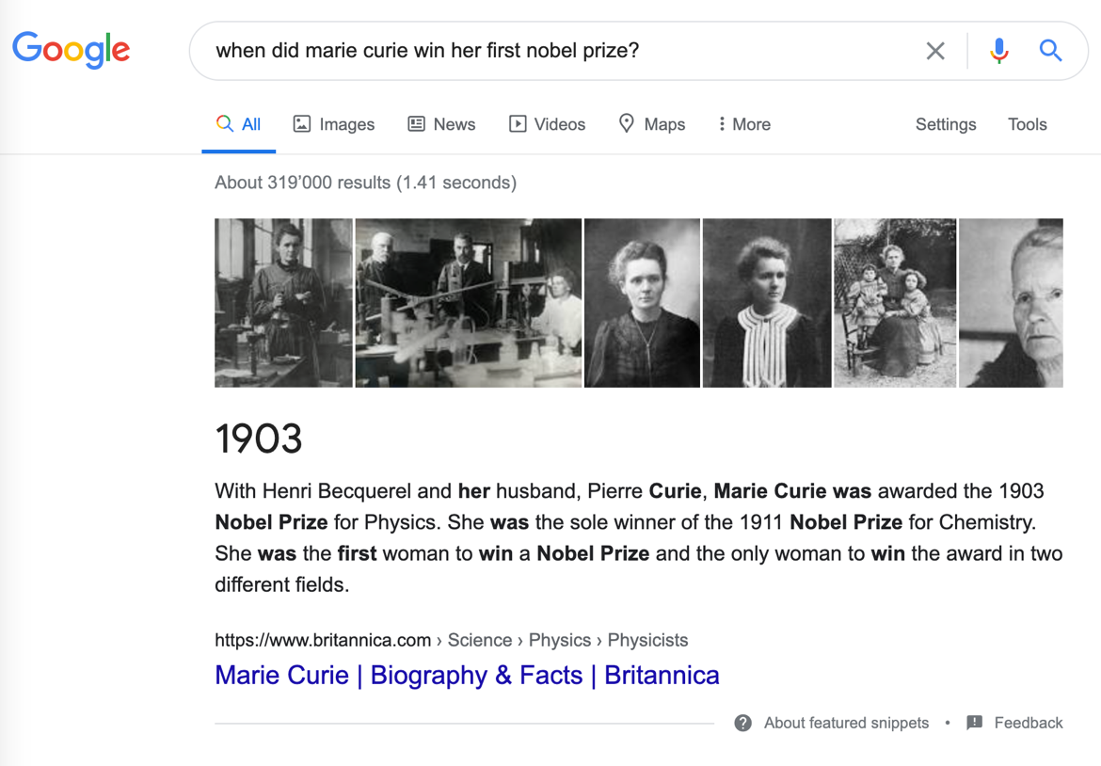
Question Answering
When did Marie Curie win her first Nobel Prize?
1903
Source: Lewis Tunstall, Leandro von Werra, and Thomas Wolf (2022), Natural Language Processing with Transformers: Building Language Applications with Hugging Face, O'Reilly Media.

Slide 15
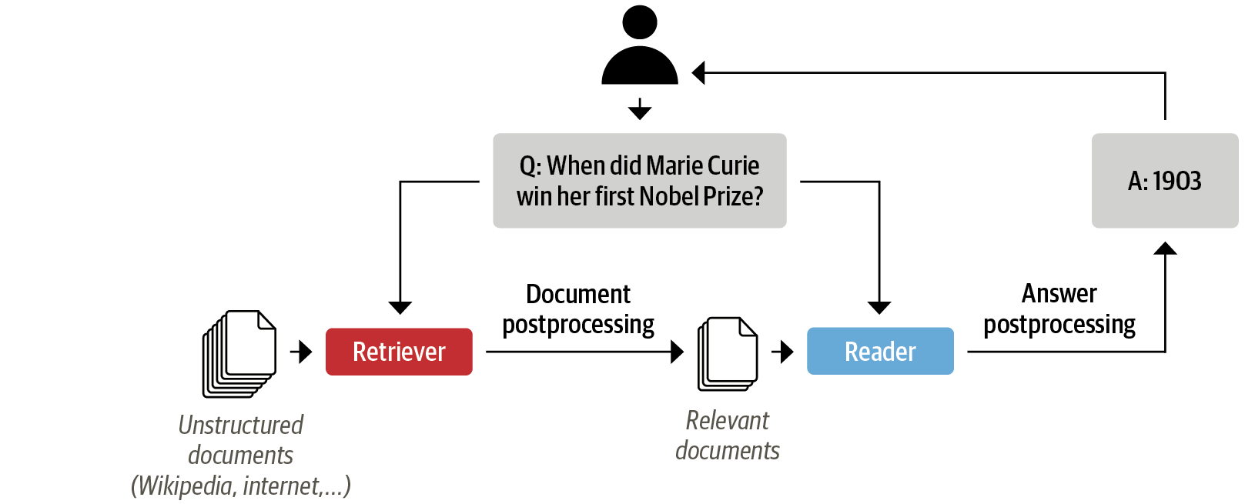
The Retriever-Reader Architecture for Modern QA Systems
When did Marie Curie win her first Nobel Prize?
1903
Source: Lewis Tunstall, Leandro von Werra, and Thomas Wolf (2022), Natural Language Processing with Transformers: Building Language Applications with Hugging Face, O'Reilly Media.

Slide 16
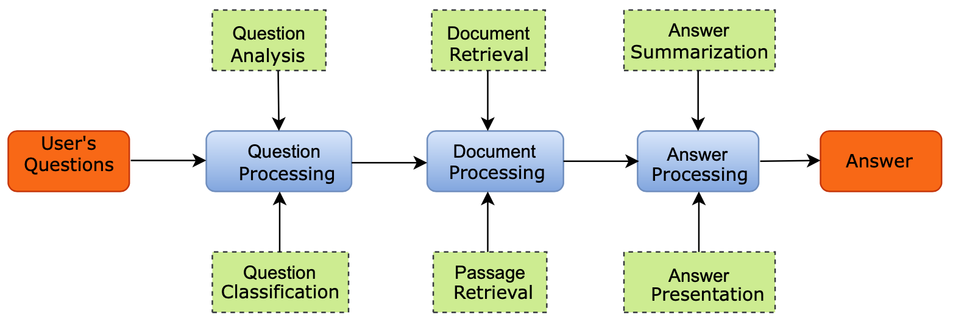
Question Answering System (QAS)
Source: Mutabazi, Emmanuel, Jianjun Ni, Guangyi Tang, and Weidong Cao (2021) "A review on medical textual question answering systems based on deep learning approaches." Applied Sciences 11, no. 12 (2021): 5456.

Slide 17
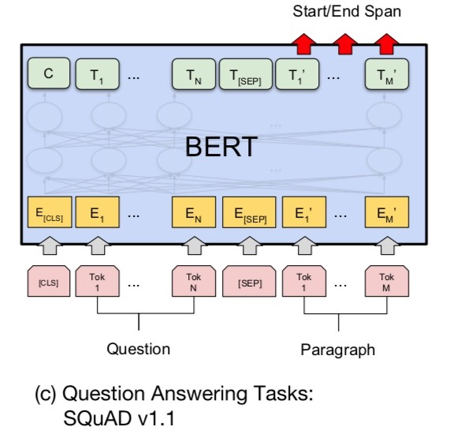
Fine-tuning BERT on Question Answering (QA)
Source: Devlin, Jacob, Ming-Wei Chang, Kenton Lee, and Kristina Toutanova (2018). "Bert: Pre-training of deep bidirectional transformers for language understanding." arXiv preprint arXiv:1810.04805.

Slide 18
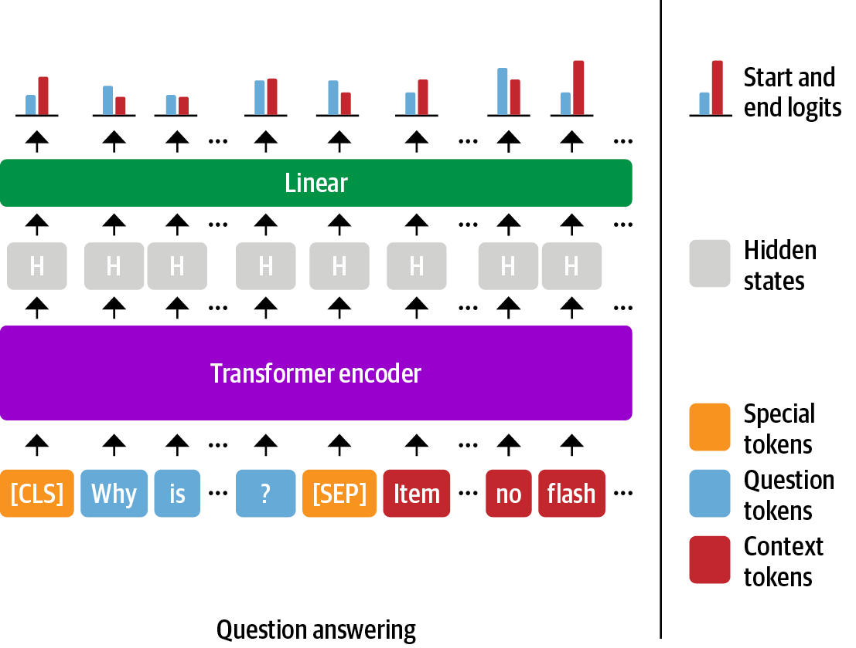
The span classification head for QA tasks
Source: Lewis Tunstall, Leandro von Werra, and Thomas Wolf (2022), Natural Language Processing with Transformers: Building Language Applications with Hugging Face, O'Reilly Media.

Slide 19
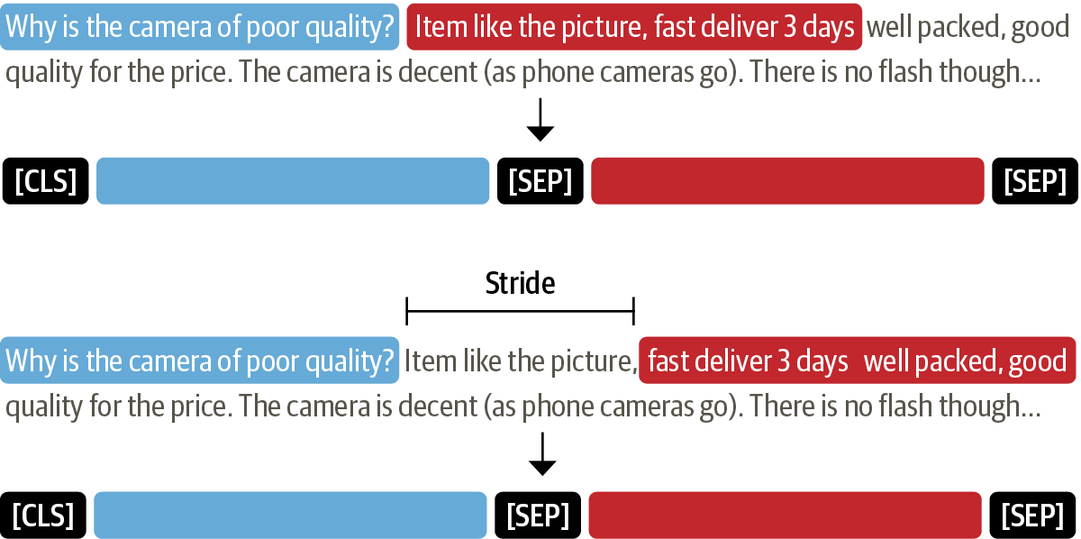
Multiple question-context pairs
Source: Lewis Tunstall, Leandro von Werra, and Thomas Wolf (2022), Natural Language Processing with Transformers: Building Language Applications with Hugging Face, O'Reilly Media.

Slide 20
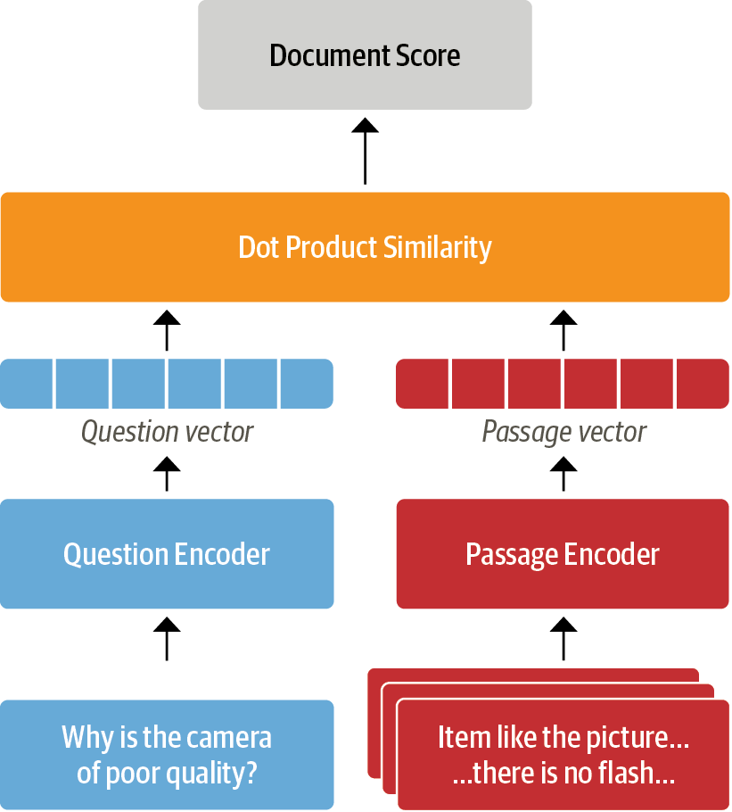
Dense Passage Retrieval (DPR)
Source: Lewis Tunstall, Leandro von Werra, and Thomas Wolf (2022), Natural Language Processing with Transformers: Building Language Applications with Hugging Face, O'Reilly Media.

Slide 21
Going Beyond Extractive QA Retrieval-Augmented Generation (RAG)
The RAG architecture for fine-tuning a retriever and generator end-to-end
Source: Lewis Tunstall, Leandro von Werra, and Thomas Wolf (2022), Natural Language Processing with Transformers: Building Language Applications with Hugging Face, O'Reilly Media.

Slide 22
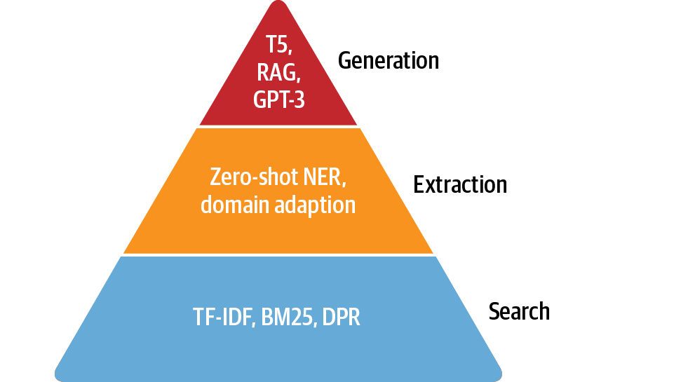
The QA Hierarchy of Needs
Source: Lewis Tunstall, Leandro von Werra, and Thomas Wolf (2022), Natural Language Processing with Transformers: Building Language Applications with Hugging Face, O'Reilly Media.

Slide 23
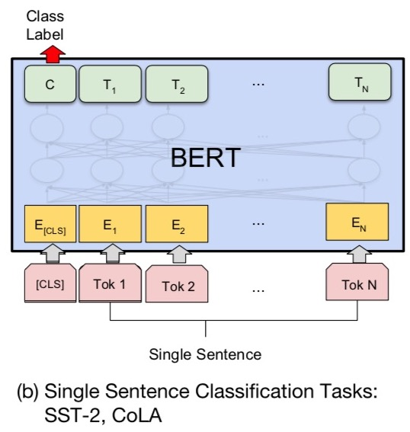
Fine-tuning BERT on Dialogue Intent Detection (ID; Classification)
Source: Devlin, Jacob, Ming-Wei Chang, Kenton Lee, and Kristina Toutanova (2018). "Bert: Pre-training of deep bidirectional transformers for language understanding." arXiv preprint arXiv:1810.04805.

Slide 24
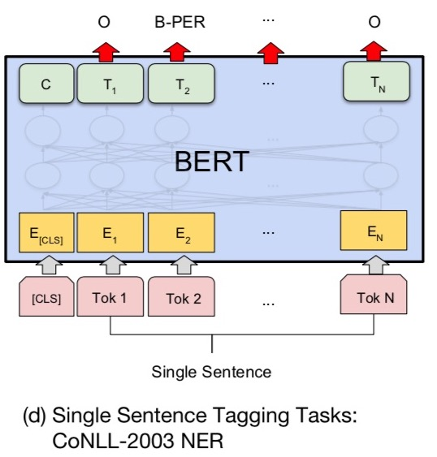
Fine-tuning BERT on Dialogue Slot Filling (SF)
Source: Devlin, Jacob, Ming-Wei Chang, Kenton Lee, and Kristina Toutanova (2018). "Bert: Pre-training of deep bidirectional transformers for language understanding." arXiv preprint arXiv:1810.04805.

Slide 25
Question Answering (QA) SQuAD Stanford Question Answering Dataset

Slide 26
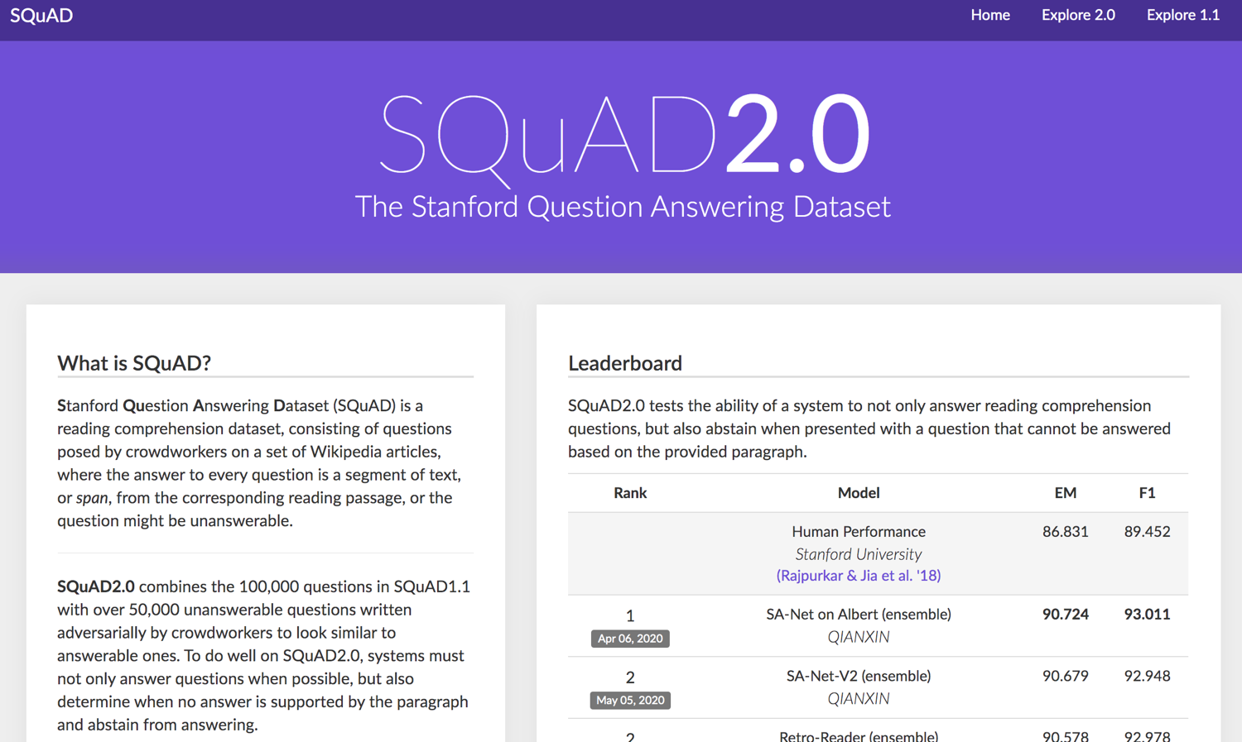
SQuAD
https://rajpurkar.github.io/SQuAD-explorer/

Slide 27
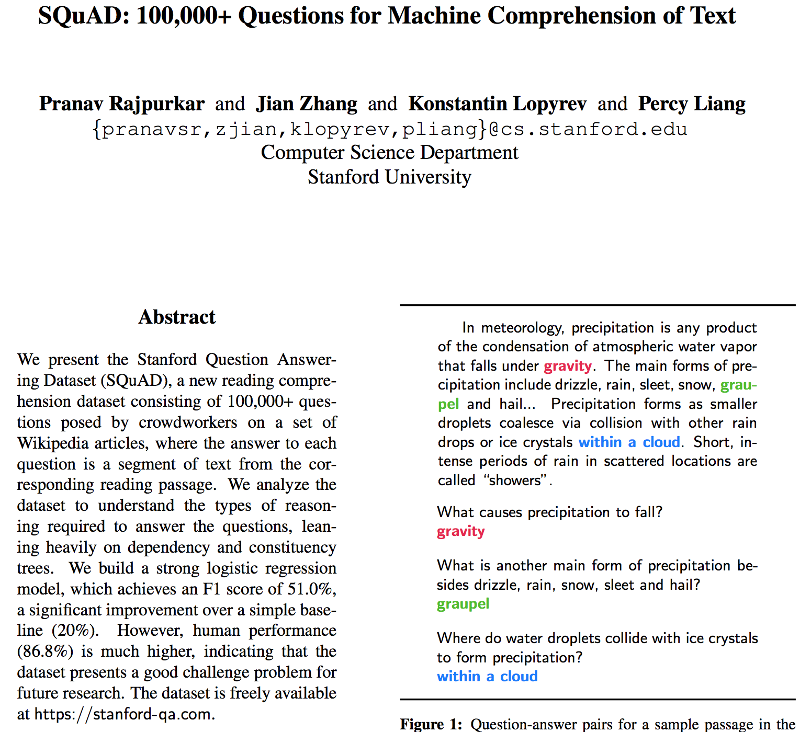
SQuAD
Source: Rajpurkar, Pranav, Jian Zhang, Konstantin Lopyrev, and Percy Liang. "Squad: 100,000+ questions for machine comprehension of text." arXiv preprint arXiv:1606.05250 (2016).

Slide 28
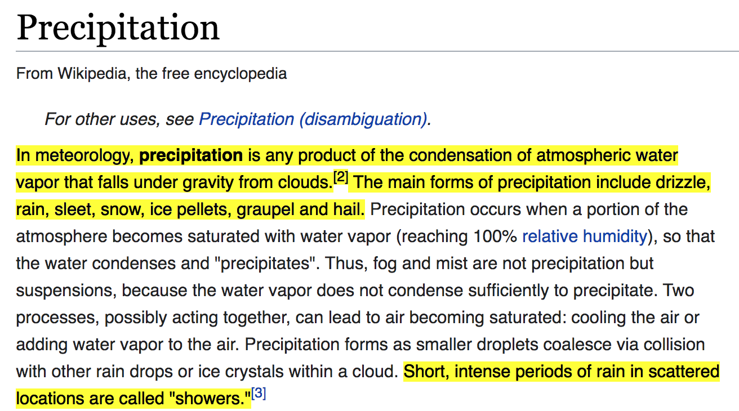
SQuAD (Question Answering)
Q: What causes precipitation to fall?
https://en.wikipedia.org/wiki/Precipitation

Slide 29
SQuAD (Question Answering)
Paragraph
In meteorology, precipitation is any product of the condensation of atmospheric water vapor that falls under gravity. The main forms of precipitation include drizzle, rain, sleet, snow, graupel and hail... Precipitation forms as smaller droplets coalesce via collision with other rain drops or ice crystals within a cloud. Short, intense periods of rain in scattered locations are called “showers”.
Q: What causes precipitation to fall?

Slide 30
SQuAD (Question Answering)
In meteorology, precipitation is any product of the condensation of atmospheric water vapor that falls under gravity. The main forms of precipitation include drizzle, rain, sleet, snow, graupel and hail... Precipitation forms as smaller droplets coalesce via collision with other rain drops or ice crystals within a cloud. Short, intense periods of rain in scattered locations are called “showers”.
Q: What causes precipitation to fall?
A: gravity

Slide 31
SQuAD (Question Answering)
In meteorology, precipitation is any product of the condensation of atmospheric water vapor that falls under gravity. The main forms of precipitation include drizzle, rain, sleet, snow, graupel and hail... Precipitation forms as smaller droplets coalesce via collision with other rain drops or ice crystals within a cloud. Short, intense periods of rain in scattered locations are called “showers”.
Q: What is another main form of precipitation besides drizzle, rain, snow, sleet and hail?
A: graupel

Slide 32
SQuAD (Question Answering)
In meteorology, precipitation is any product of the condensation of atmospheric water vapor that falls under gravity. The main forms of precipitation include drizzle, rain, sleet, snow, graupel and hail... Precipitation forms as smaller droplets coalesce via collision with other rain drops or ice crystals within a cloud. Short, intense periods of rain in scattered locations are called “showers”.
Q: Where do water droplets collide with ice crystals to form precipitation?
A: within a cloud

Slide 33
SQuAD (Question Answering)
In meteorology, precipitation is any product of the condensation of atmospheric water vapor that falls under gravity. The main forms of precipitation include drizzle, rain, sleet, snow, graupel and hail... Precipitation forms as smaller droplets coalesce via collision with other rain drops or ice crystals within a cloud. Short, intense periods of rain in scattered locations are called “showers”.
Q: What causes precipitation to fall?
A: gravity
Q: What is another main form of precipitation besides drizzle, rain, snow, sleet and hail?
A: graupel
Q: Where do water droplets collide with ice crystals to form precipitation?
A: within a cloud

Slide 34
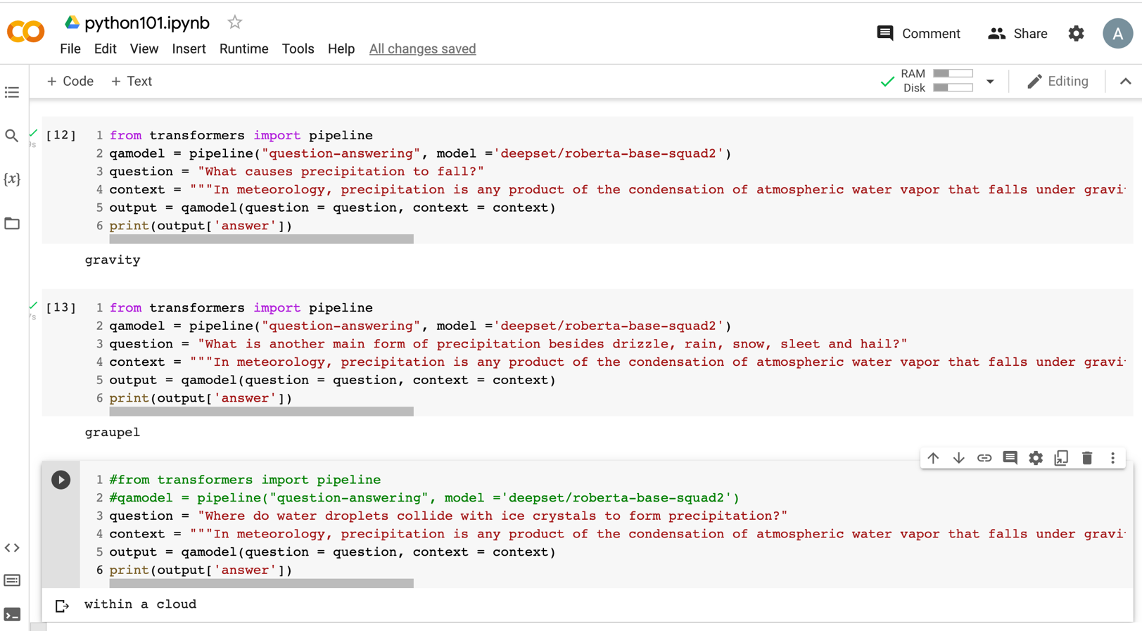
Python in Google Colab (Python101)
https://colab.research.google.com/drive/1FEG6DnGvwfUbeo4zJ1zTunjMqf2RkCrT
Question Answering
https://tinyurl.com/aintpupython101

Slide 35
Question Answering
from transformers import pipeline
qamodel = pipeline("question-answering", model ='deepset/roberta-base-squad2')
question = "What causes precipitation to fall?"
context = """In meteorology, precipitation is any product of the condensation of atmospheric water vapor that falls under gravity. The main forms of precipitation include drizzle, rain, sleet, snow, graupel and hail... Precipitation forms as smaller droplets coalesce via collision with other rain drops or ice crystals within a cloud. Short, intense periods of rain in scattered locations are called "showers"."""
output = qamodel(question = question, context = context)
print(output['answer'])
gravity
https://tinyurl.com/aintpupython101

Slide 36
Question Answering on SQuAD2.0 SQuAD 2.0 benchmark (Papers with Code)
https://paperswithcode.com/sota/question-answering-on-squad20
Source: Lewis Tunstall, Leandro von Werra, and Thomas Wolf (2022), Natural Language Processing with Transformers: Building Language Applications with Hugging Face, O'Reilly Media.

Slide 37
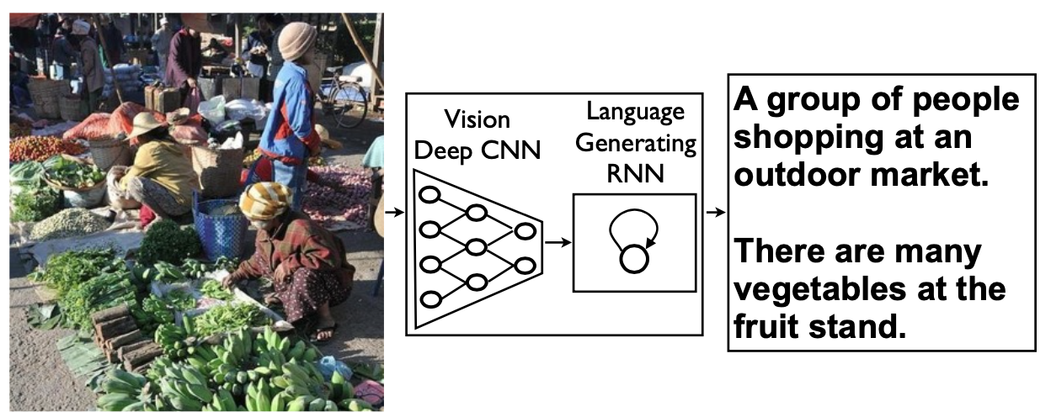
Neural Image Captioning (NIC) image-to-text description generation
Source: Erkut Erdem, Menekse Kuyu, Semih Yagcioglu, Anette Frank, Letitia Parcalabescu, Barbara Plank, Andrii Babii et al (2022). "Neural Natural Language Generation: A Survey on Multilinguality, Multimodality, Controllability and Learning." Journal of Artificial Intelligence Research 73 (2022): 1131-1207.

Slide 38
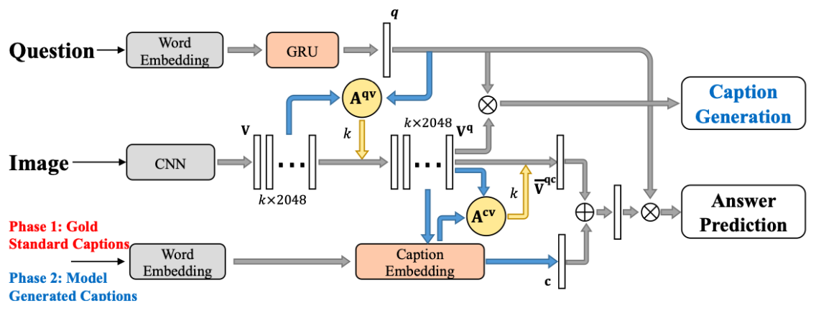
Visual Question Answering Neural caption generation is employed to aid answer prediction
Source: Erkut Erdem, Menekse Kuyu, Semih Yagcioglu, Anette Frank, Letitia Parcalabescu, Barbara Plank, Andrii Babii et al (2022). "Neural Natural Language Generation: A Survey on Multilinguality, Multimodality, Controllability and Learning." Journal of Artificial Intelligence Research 73 (2022): 1131-1207.

Slide 39
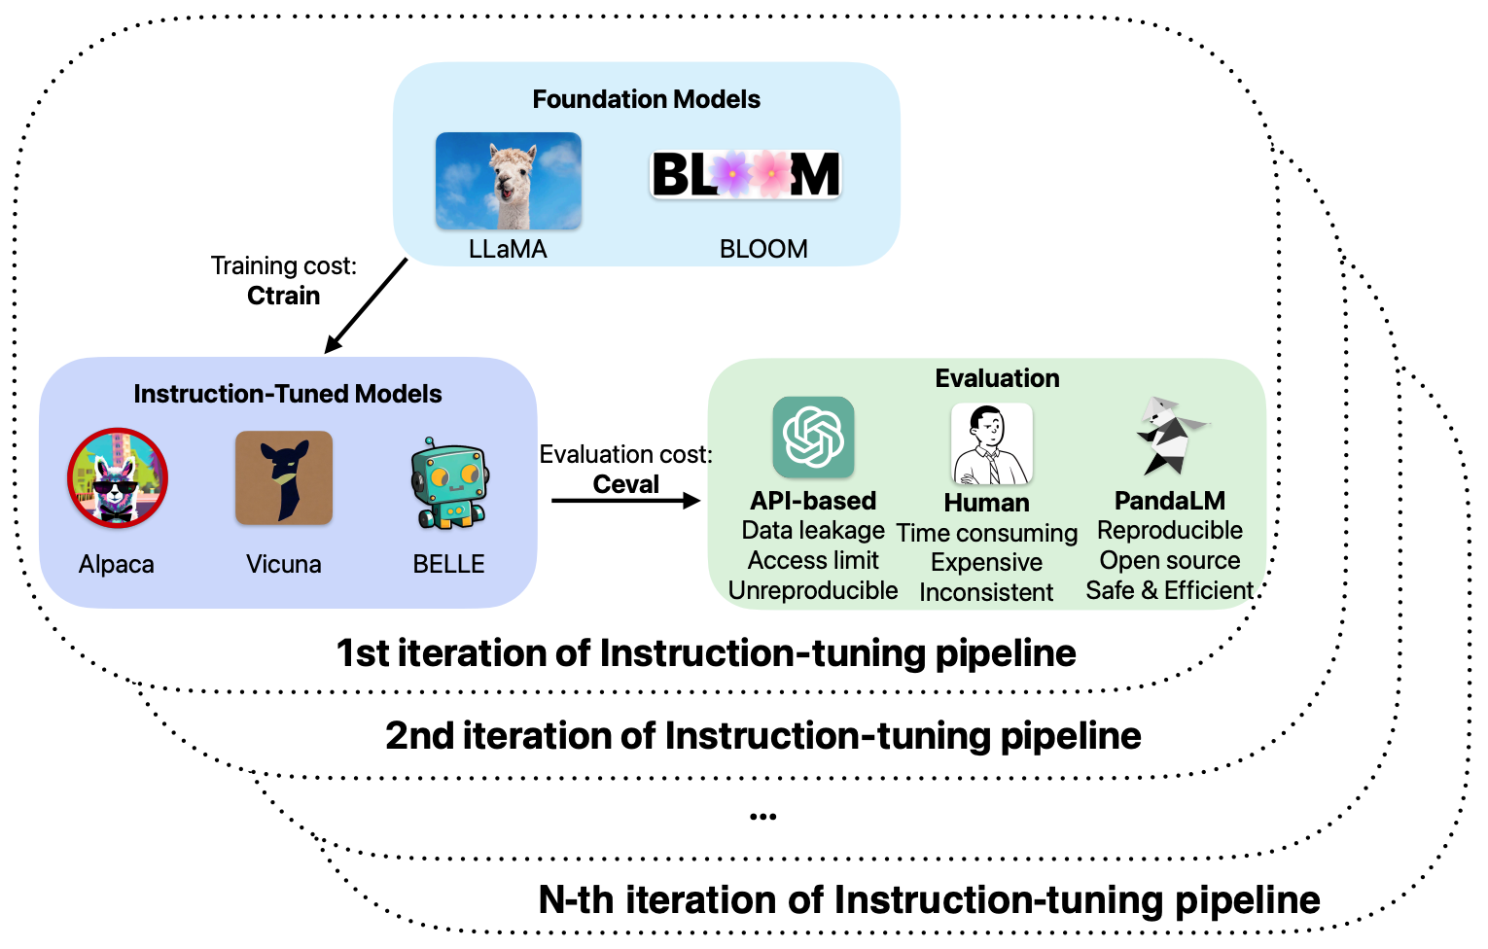
Pipeline of Instruction Tuning LLMs
Source: Wang, Yidong, Zhuohao Yu, Zhengran Zeng, Linyi Yang, Cunxiang Wang, Hao Chen, Chaoya Jiang et al. "PandaLM: An Automatic Evaluation Benchmark for LLM Instruction Tuning Optimization." arXiv preprint arXiv:2306.05087 (2023).

Slide 40
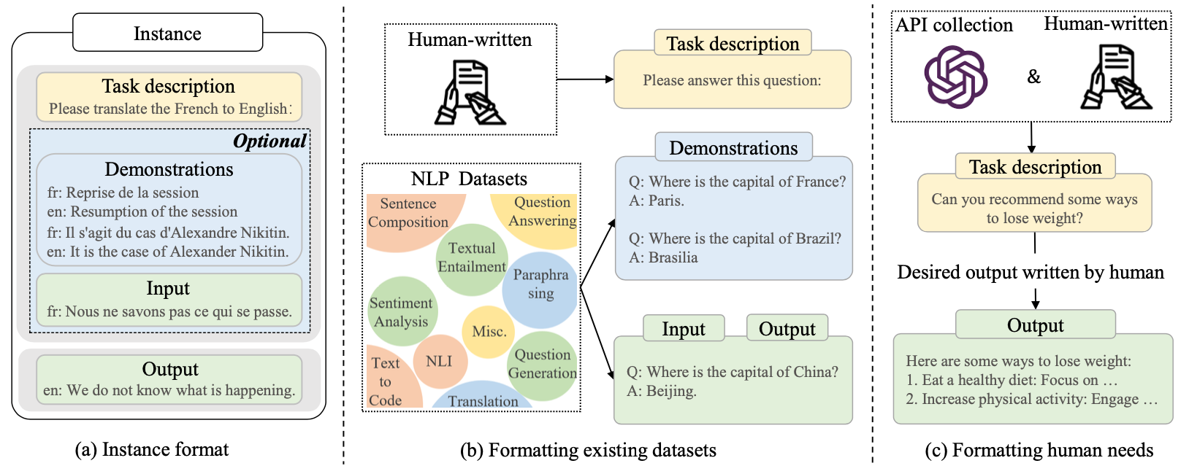
Instance Formatting and Two Different Methods for Constructing the Instruction-formatted Instances
Source: Wayne Xin Zhao, Kun Zhou, Junyi Li, Tianyi Tang, Xiaolei Wang, Yupeng Hou, Yingqian Min et al. (2023) "A Survey of Large Language Models." arXiv preprint arXiv:2303.18223.

Slide 41
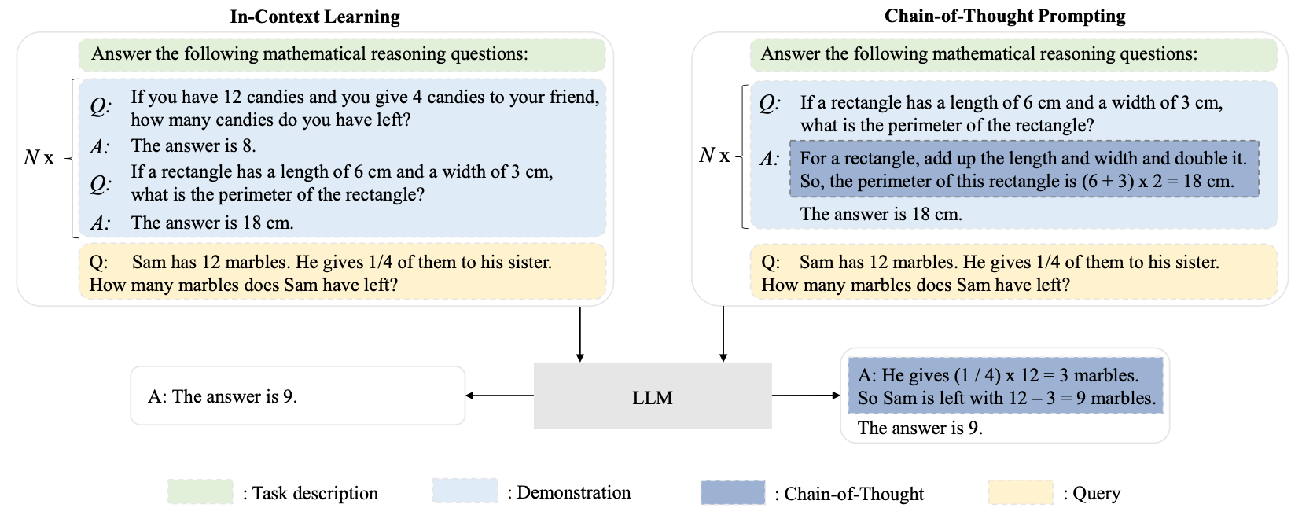
In-context Learning (ICL) and Chain-of-thought (CoT) Prompting
Source: Wayne Xin Zhao, Kun Zhou, Junyi Li, Tianyi Tang, Xiaolei Wang, Yupeng Hou, Yingqian Min et al. (2023) "A Survey of Large Language Models." arXiv preprint arXiv:2303.18223.

Slide 42
Pre-train, Prompt, and Predict: Prompting Methods in Natural Language Processing (LLMs)
Source: Pengfei Liu, Weizhe Yuan, Jinlan Fu, Zhengbao Jiang, Hiroaki Hayashi, and Graham Neubig. (2023) "Pre-train, prompt, and predict: A systematic survey of prompting methods in natural language processing." ACM Computing Surveys 55, no. 9 (2023): 1-35.

Slide 43
Four Paradigms in NLP
Source: Pengfei Liu, Weizhe Yuan, Jinlan Fu, Zhengbao Jiang, Hiroaki Hayashi, and Graham Neubig. (2023) "Pre-train, prompt, and predict: A systematic survey of prompting methods in natural language processing." ACM Computing Surveys 55, no. 9 (2023): 1-35.

Slide 44
Typology of Prompting Methods
Source: Pengfei Liu, Weizhe Yuan, Jinlan Fu, Zhengbao Jiang, Hiroaki Hayashi, and Graham Neubig. (2023) "Pre-train, prompt, and predict: A systematic survey of prompting methods in natural language processing." ACM Computing Surveys 55, no. 9 (2023): 1-35.

Slide 45
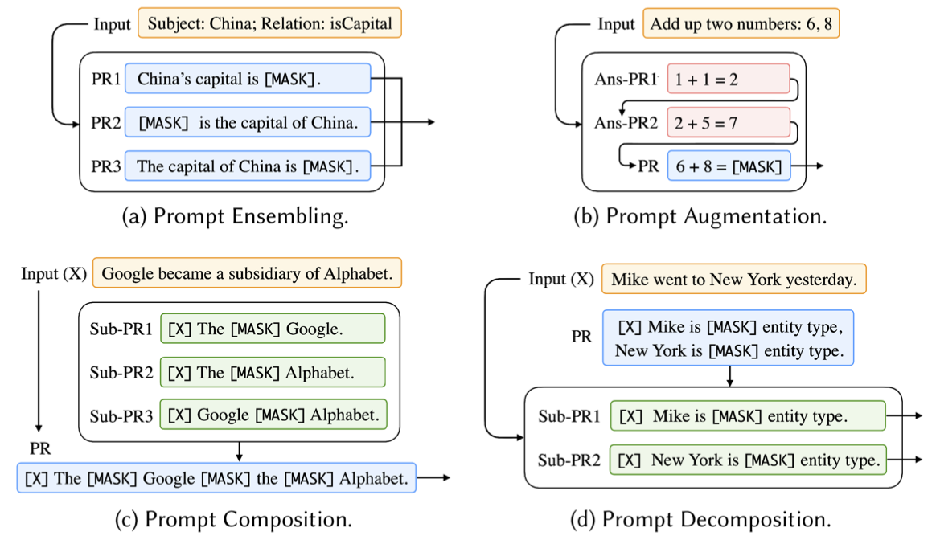
Different Multi-Prompt Learning Strategies
Source: Pengfei Liu, Weizhe Yuan, Jinlan Fu, Zhengbao Jiang, Hiroaki Hayashi, and Graham Neubig. (2023) "Pre-train, prompt, and predict: A systematic survey of prompting methods in natural language processing." ACM Computing Surveys 55, no. 9 (2023): 1-35.

Slide 46
Examples of Input, Template, and Answer for Different Tasks
Source: Pengfei Liu, Weizhe Yuan, Jinlan Fu, Zhengbao Jiang, Hiroaki Hayashi, and Graham Neubig. (2023) "Pre-train, prompt, and predict: A systematic survey of prompting methods in natural language processing." ACM Computing Surveys 55, no. 9 (2023): 1-35.

Slide 47
Characteristics of Different Tuning Strategies
Source: Pengfei Liu, Weizhe Yuan, Jinlan Fu, Zhengbao Jiang, Hiroaki Hayashi, and Graham Neubig. (2023) "Pre-train, prompt, and predict: A systematic survey of prompting methods in natural language processing." ACM Computing Surveys 55, no. 9 (2023): 1-35.

Slide 48
Multi-prompt Learning for Multi-task, Multi-domain, or Multi-lingual Learning
Source: Pengfei Liu, Weizhe Yuan, Jinlan Fu, Zhengbao Jiang, Hiroaki Hayashi, and Graham Neubig. (2023) "Pre-train, prompt, and predict: A systematic survey of prompting methods in natural language processing." ACM Computing Surveys 55, no. 9 (2023): 1-35.

Slide 49
GPT Prompt Engineering for Question Answering
Find the answer to the question from the given context.
When the question cannot be answered with the given context, say "unanswerable".
Just say the answer without repeating the question.
Context: {context}
Question:{question}
Answer:

Slide 50
Prompts and QA Inference For FLAN T5 Question Answering
Prompts and QA Inference For FLAN T5, we follow [41] and use the following prompt:
Context: {context}\nQuestion: {question}\nAnswer:
Context: {context}
Question: {question}
Answer:

Slide 51
Prompt Engineering
Prompts For FLAN models
Longpre, S., Hou, L., Vu, T., Webson, A., Chung, H. W., Tay, Y., ... & Roberts, A. (2023). The flan collection: Designing data and methods for effective instruction tuning. arXiv preprint arXiv:2301.13688.
MNLI, NLI-FEVER, VitaminC:
"Premise: {premise}\n\nHypothesis: {hypothesis}\n\nDoes the premise entail the hypothesis?\n\nA yes\nB it is not possible to tell\nC no"
ANLI:
"{context}\n\nBased on the paragraph above can we conclude that\"{hypothesis}\"?\n\nA Yes\nB It’s impossible to say\nC No"
SNLI:
"If \"{premise}\", does this mean that \"{hypothesis}\"?\n\nA yes\nB it is not possible to tell\nC no"

Slide 52
Dialogue Systems

Slide 53
Fine-tuning LLM for Dialogue System Reinforcement Learning from Human Feedback (RLHF) ChatGPT: Optimizing Language Models for Dialogue

Slide 54
Chatbot Dialogue System Intelligent Agent

Slide 55
The Development of LM-based Dialogue Systems 1) Early Stage (1966 - 2015) 2) The Independent Development of TOD and ODD (2015 - 2019) 3) Fusions of Dialogue Systems (2019 - 2022) 4) LLM-based DS (2022 - Now)
Task-oriented DS (TOD), Open-domain DS (ODD)
Source: Wang, Hongru, Lingzhi Wang, Yiming Du, Liang Chen, Jingyan Zhou, Yufei Wang, and Kam-Fai Wong. "A Survey of the Evolution of Language Model-Based Dialogue Systems." arXiv preprint arXiv:2311.16789 (2023).

Slide 56
Dialogue System Different types of dialogues in Task-oriented DS (TOD) and Open-domain DS (ODD)
Source: Wang, Hongru, Lingzhi Wang, Yiming Du, Liang Chen, Jingyan Zhou, Yufei Wang, and Kam-Fai Wong. "A Survey of the Evolution of Language Model-Based Dialogue Systems." arXiv preprint arXiv:2311.16789 (2023).

Slide 57
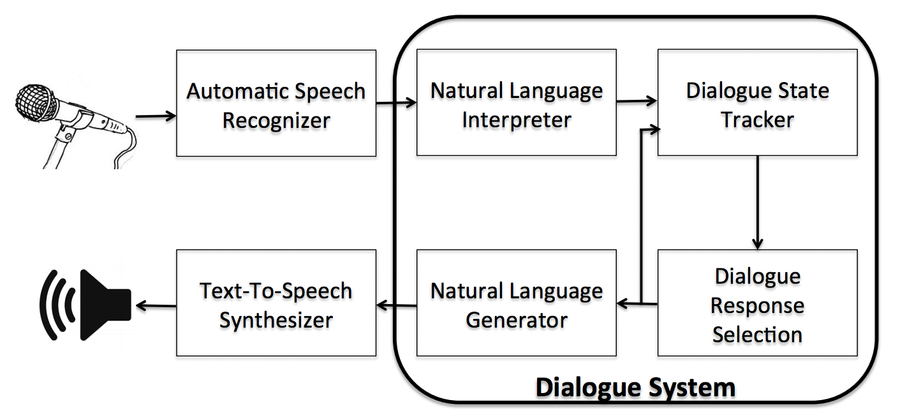
Dialogue System
Source: Serban, I. V., Lowe, R., Charlin, L., & Pineau, J. (2015). A survey of available corpora for building data-driven dialogue systems. arXiv preprint arXiv:1512.05742.

Slide 58
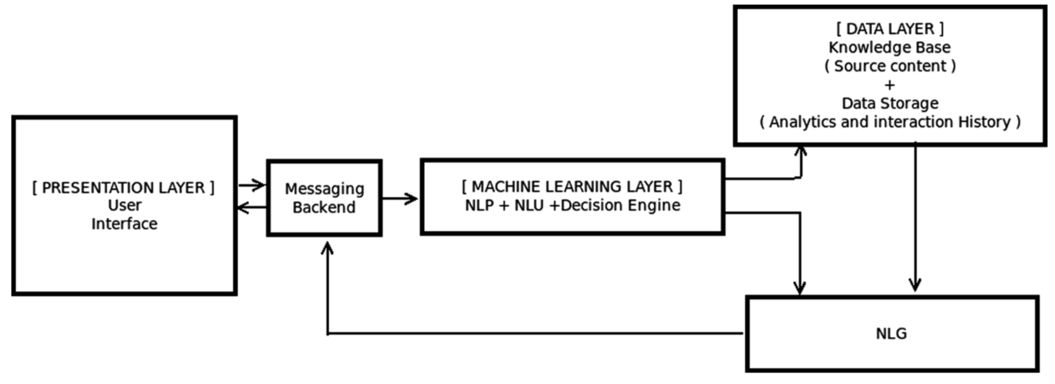
Overall Architecture of Intelligent Chatbot
Source: Borah, Bhriguraj, Dhrubajyoti Pathak, Priyankoo Sarmah, Bidisha Som, and Sukumar Nandi. "Survey of Textbased Chatbot in Perspective of Recent Technologies." In International Conference on Computational Intelligence, Communications, and Business Analytics, pp. 84-96. Springer, Singapore, 2018.

Slide 59
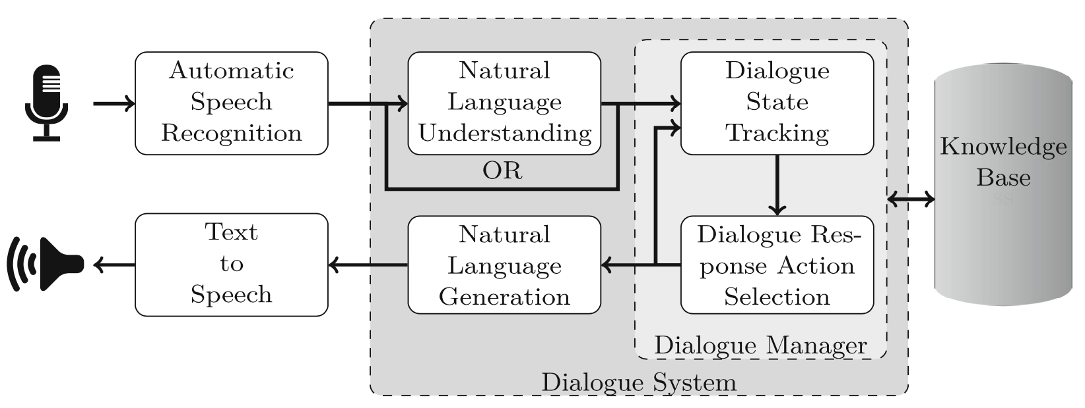
Modular Speech-based Dialogue System
Source: Kath, Hannes, Bengt Lüers, Thiago S. Gouvêa, and Daniel Sonntag. "Lost in Dialogue: A Review and Categorisation of Current Dialogue System Approaches and Technical Solutions." In German Conference on Artificial Intelligence (Künstliche Intelligenz), pp. 98-113. Cham: Springer Nature Switzerland, 2023.

Slide 60
Categories of Dialogue Systems: Task-Oriented Dialogue System (TDS) Conversational Dialogue System (CDS) Question Answering Dialogue System (QADS)
Source: Kath, Hannes, Bengt Lüers, Thiago S. Gouvêa, and Daniel Sonntag. "Lost in Dialogue: A Review and Categorisation of Current Dialogue System Approaches and Technical Solutions." In German Conference on Artificial Intelligence (Künstliche Intelligenz), pp. 98-113. Cham: Springer Nature Switzerland, 2023.

Slide 61
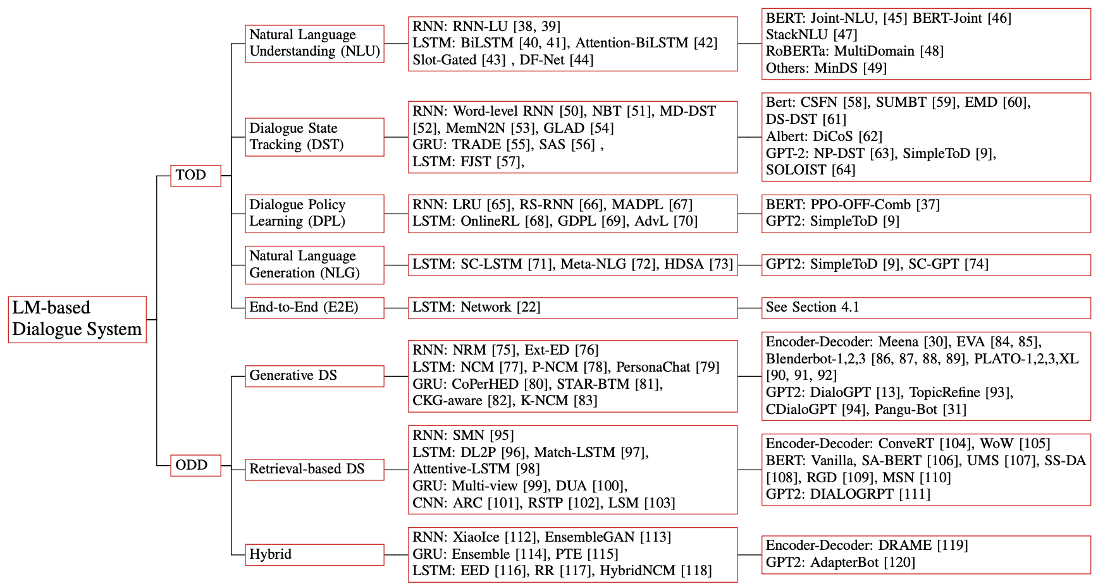
Taxonomy of LM-based Dialogue System
Source: Wang, Hongru, Lingzhi Wang, Yiming Du, Liang Chen, Jingyan Zhou, Yufei Wang, and Kam-Fai Wong. "A Survey of the Evolution of Language Model-Based Dialogue Systems." arXiv preprint arXiv:2311.16789 (2023).

Slide 62
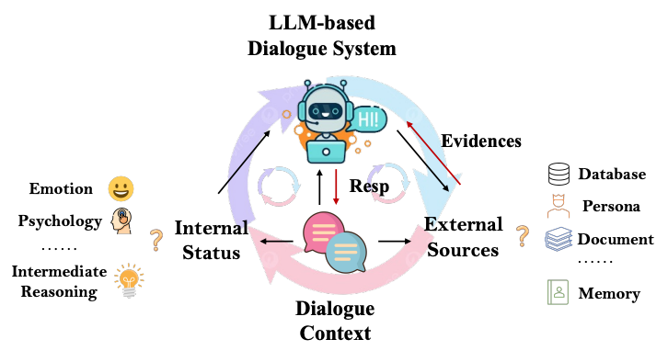
LLM-based Dialogue System
3) response based on internal reasoning, external sources, and dialogue context
1) response based on internal reasoning and dialogue context;
2) response based on external sources and dialogue context
Source: Wang, Hongru, Lingzhi Wang, Yiming Du, Liang Chen, Jingyan Zhou, Yufei Wang, and Kam-Fai Wong. "A Survey of the Evolution of Language Model-Based Dialogue Systems." arXiv preprint arXiv:2311.16789 (2023).

Slide 63
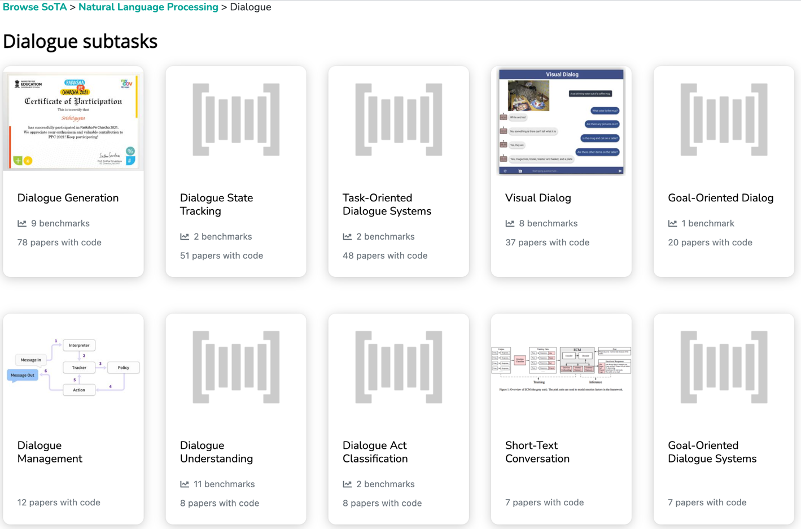
Dialogue Subtasks
Dialogue Generation
Task-Oriented Dialogue Systems
Short-Text Conversation
Source: https://paperswithcode.com/area/natural-language-processing/dialogue

Slide 64
Conversational Commerce: eBay AI Chatbots
Source: https://www.forbes.com/sites/rachelarthur/2017/07/19/conversational-commerce-ebay-ai-chatbot/

Slide 65
Hotel Chatbot
Intent Detection
Slot Filling
Source: https://sdtimes.com/amazon/guest-view-capitalize-amazon-lex-available-general-public/

Slide 66
Fine-tuning BERT on Dialogue Intent Detection (ID; Classification)
Source: Devlin, Jacob, Ming-Wei Chang, Kenton Lee, and Kristina Toutanova (2018). "Bert: Pre-training of deep bidirectional transformers for language understanding." arXiv preprint arXiv:1810.04805.

Slide 67
Fine-tuning BERT on Dialogue Slot Filling (SF)
Source: Devlin, Jacob, Ming-Wei Chang, Kenton Lee, and Kristina Toutanova (2018). "Bert: Pre-training of deep bidirectional transformers for language understanding." arXiv preprint arXiv:1810.04805.

Slide 68
Chatbot Conversation Framework
Source: https://chatbotslife.com/ultimate-guide-to-leveraging-nlp-machine-learning-for-you-chatbot-531ff2dd870c

Slide 69
Chatbots Bot Maturity Model
Customers want to have simpler means to interact with businesses and get faster response to a question or complaint.
Source: https://www.capgemini.com/2017/04/how-can-chatbots-meet-expectations-introducing-the-bot-maturity/

Slide 70
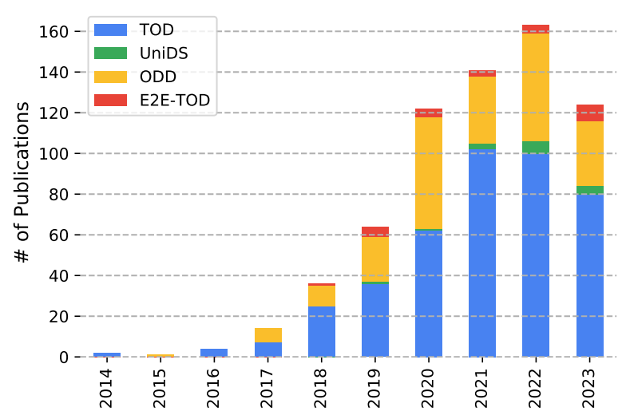
LM-based Dialogue Systems
The number of publication at ACL Anthology conferences of different research directions in LM-based dialogue systems
Source: Wang, Hongru, Lingzhi Wang, Yiming Du, Liang Chen, Jingyan Zhou, Yufei Wang, and Kam-Fai Wong. "A Survey of the Evolution of Language Model-Based Dialogue Systems." arXiv preprint arXiv:2311.16789 (2023).

Slide 71
End-to-End (E2E) Task-oriented Dialogue System
Source: Wang, Hongru, Lingzhi Wang, Yiming Du, Liang Chen, Jingyan Zhou, Yufei Wang, and Kam-Fai Wong. "A Survey of the Evolution of Language Model-Based Dialogue Systems." arXiv preprint arXiv:2311.16789 (2023).

Slide 72
High-level of fusion between TOD and ODD
Task-oriented DS (TOD)
Open-domain DS (ODD)
Source: Wang, Hongru, Lingzhi Wang, Yiming Du, Liang Chen, Jingyan Zhou, Yufei Wang, and Kam-Fai Wong. "A Survey of the Evolution of Language Model-Based Dialogue Systems." arXiv preprint arXiv:2311.16789 (2023).

Slide 73
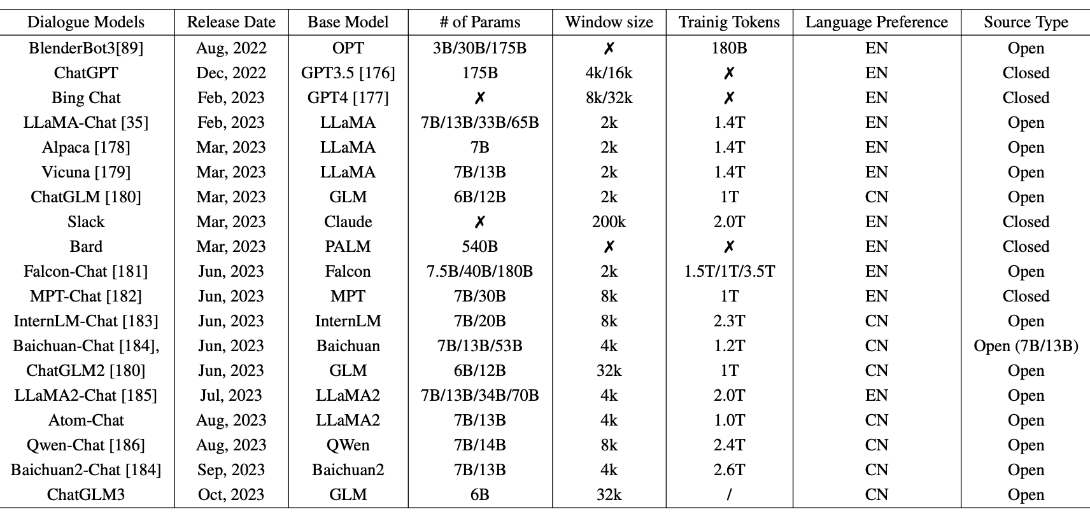
Dialogue Models based on Large Language Models
Source: Wang, Hongru, Lingzhi Wang, Yiming Du, Liang Chen, Jingyan Zhou, Yufei Wang, and Kam-Fai Wong. "A Survey of the Evolution of Language Model-Based Dialogue Systems." arXiv preprint arXiv:2311.16789 (2023).

Slide 74
Dialogue System
Source: Kath, Hannes, Bengt Lüers, Thiago S. Gouvêa, and Daniel Sonntag. "Lost in Dialogue: A Review and Categorisation of Current Dialogue System Approaches and Technical Solutions." In German Conference on Artificial Intelligence (Künstliche Intelligenz), pp. 98-113. Cham: Springer Nature Switzerland, 2023.

Slide 75
Dialogue System Extracted information for the example sentence show restaurant at New York tomorrow by the module natural language understanding
Source: Kath, Hannes, Bengt Lüers, Thiago S. Gouvêa, and Daniel Sonntag. "Lost in Dialogue: A Review and Categorisation of Current Dialogue System Approaches and Technical Solutions." In German Conference on Artificial Intelligence (Künstliche Intelligenz), pp. 98-113. Cham: Springer Nature Switzerland, 2023.

Slide 76
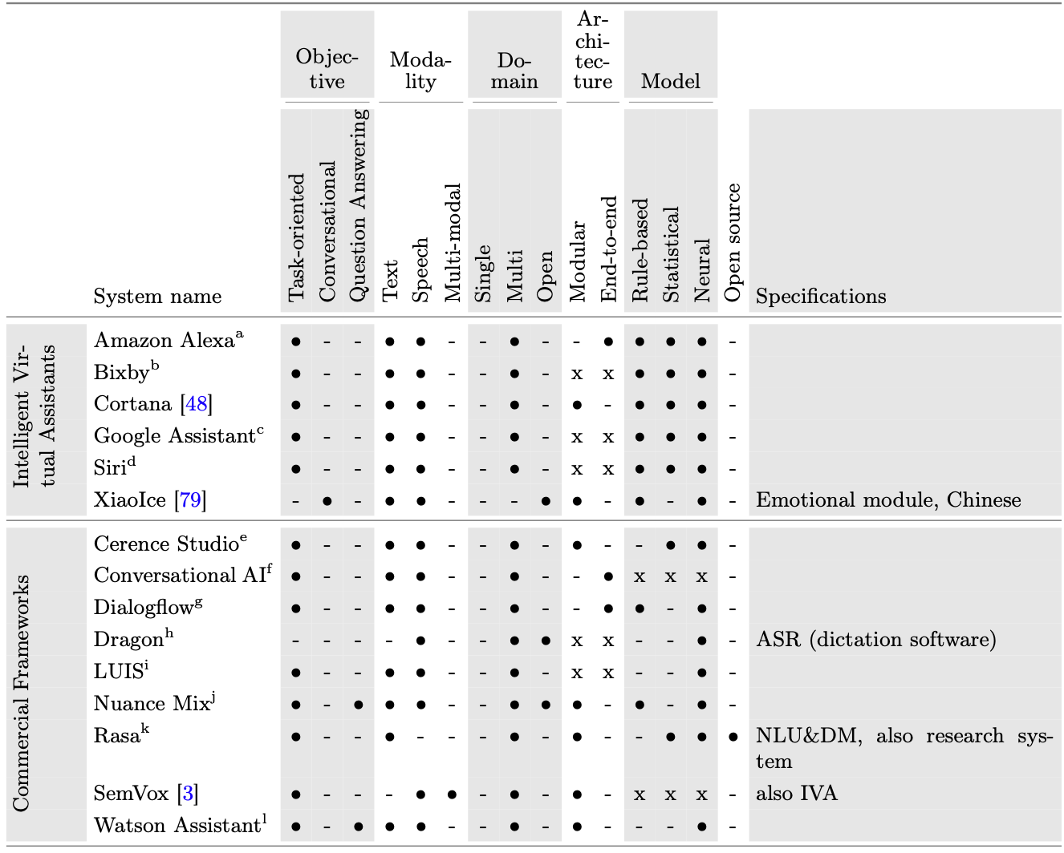
Dialogue System
Dialogue System
Selected intelligent virtual assistants, commercial frameworks and research dialogue systems categorised by objective, modality, domain, architecture and model
Source: Kath, Hannes, Bengt Lüers, Thiago S. Gouvêa, and Daniel Sonntag. "Lost in Dialogue: A Review and Categorisation of Current Dialogue System Approaches and Technical Solutions." In German Conference on Artificial Intelligence (Künstliche Intelligenz), pp. 98-113. Cham: Springer Nature Switzerland, 2023.

Slide 77
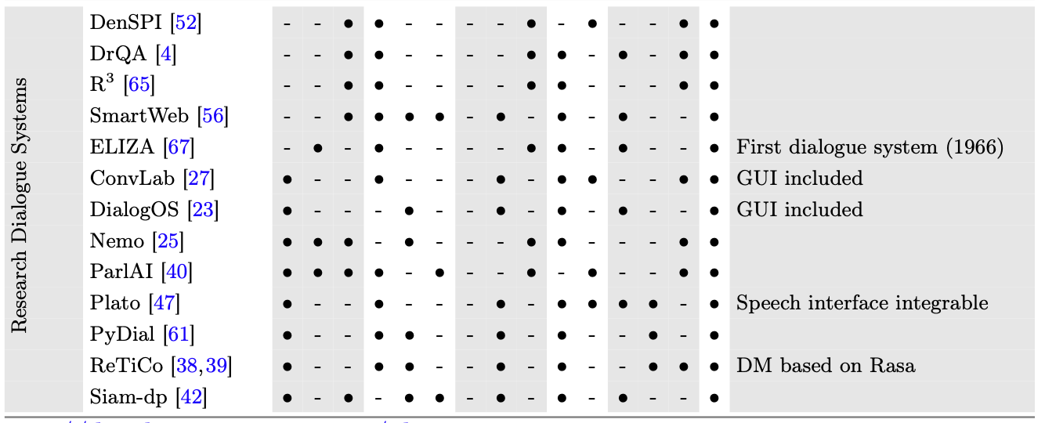
Dialogue System
Selected intelligent virtual assistants, commercial frameworks and research dialogue systems categorised by objective, modality, domain, architecture and model
Source: Kath, Hannes, Bengt Lüers, Thiago S. Gouvêa, and Daniel Sonntag. "Lost in Dialogue: A Review and Categorisation of Current Dialogue System Approaches and Technical Solutions." In German Conference on Artificial Intelligence (Künstliche Intelligenz), pp. 98-113. Cham: Springer Nature Switzerland, 2023.

Slide 78
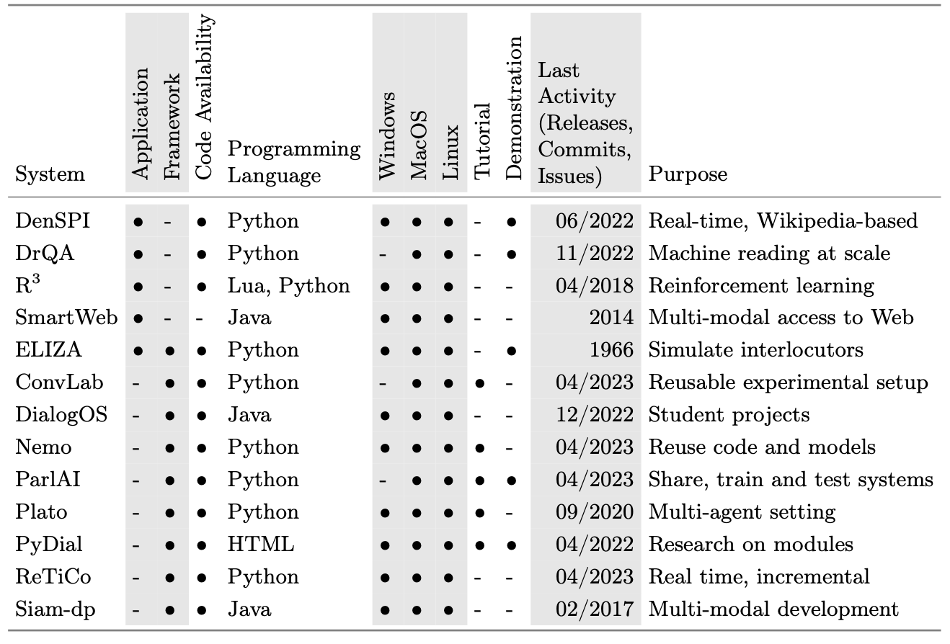
Properties relevant for implementation of research dialogue systems
Source: Kath, Hannes, Bengt Lüers, Thiago S. Gouvêa, and Daniel Sonntag. "Lost in Dialogue: A Review and Categorisation of Current Dialogue System Approaches and Technical Solutions." In German Conference on Artificial Intelligence (Künstliche Intelligenz), pp. 98-113. Cham: Springer Nature Switzerland, 2023.

Slide 79
Task-Oriented Dialogue System

Slide 80
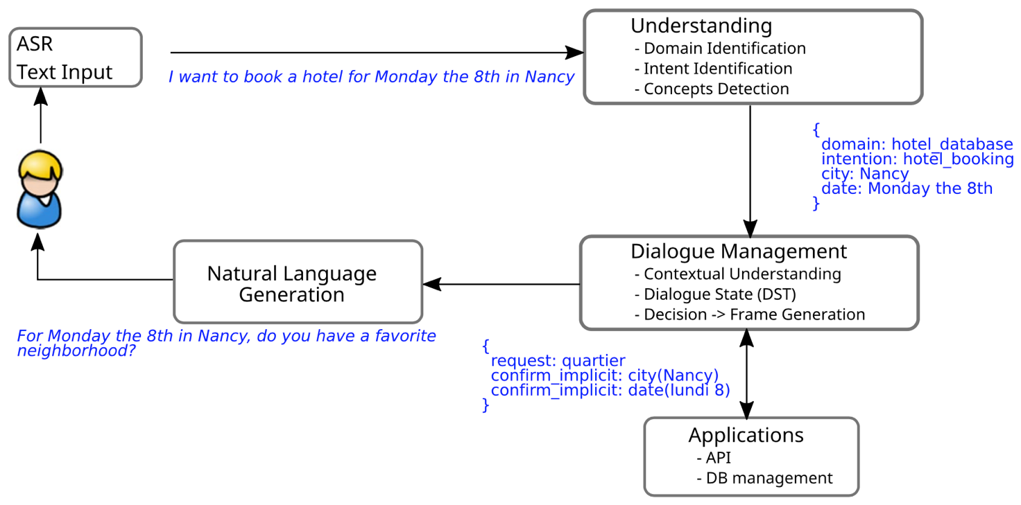
Task-Oriented Dialogue System (Deriu et al., 2021)
Source: Deriu, Jan, Alvaro Rodrigo, Arantxa Otegi, Guillermo Echegoyen, Sophie Rosset, Eneko Agirre, and Mark Cieliebak (2021). "Survey on evaluation methods for dialogue systems." Artificial Intelligence Review 54, no. 1 (2021): 755-810.

Slide 81
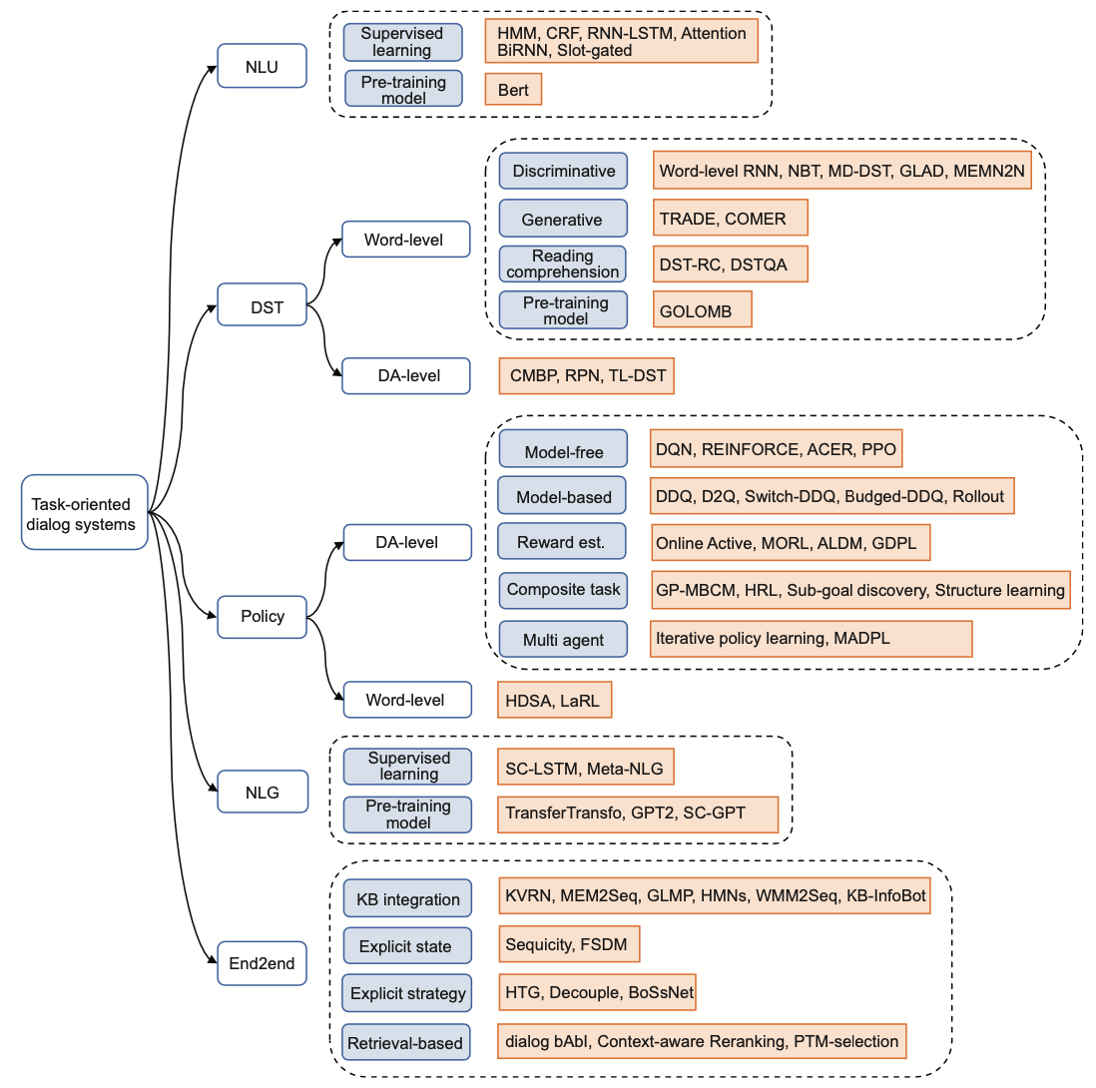
Task-Oriented Dialogue Systems (Zhang et al., 2020)
Source: Zhang, Zheng, Ryuichi Takanobu, Qi Zhu, Minlie Huang, and Xiaoyan Zhu (2020). "Recent advances and challenges in task-oriented dialog systems." Science China Technological Sciences (2020): 1-17.

Slide 82
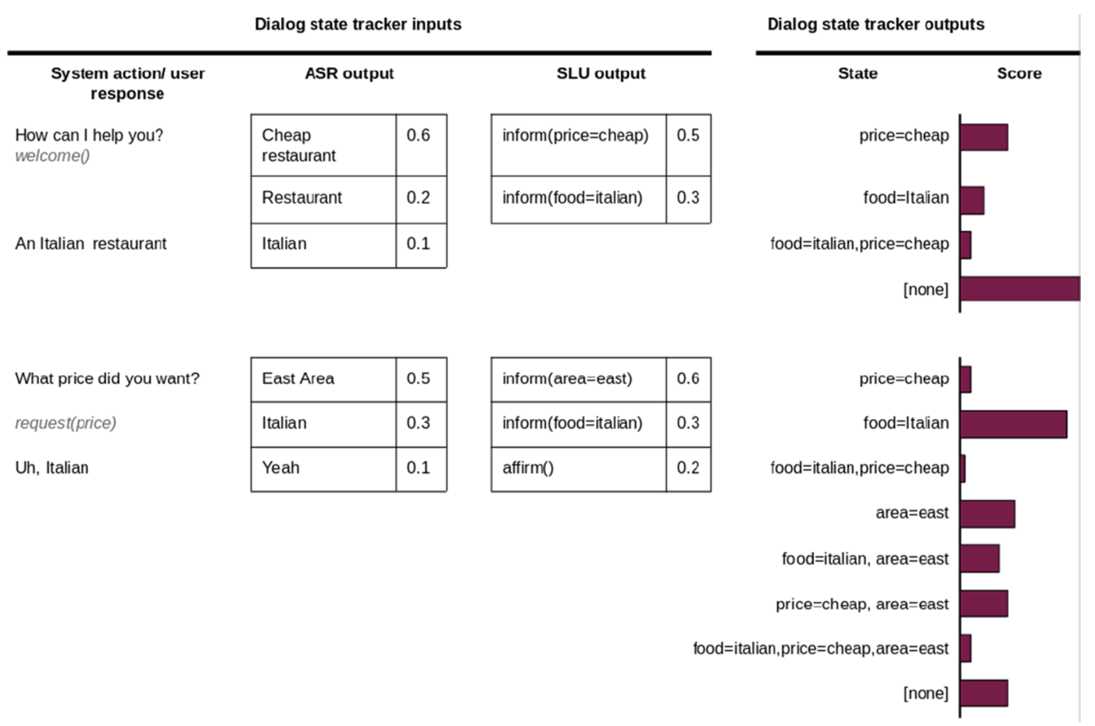
Dialog State Tracker (DST)
Source: Deriu, Jan, Alvaro Rodrigo, Arantxa Otegi, Guillermo Echegoyen, Sophie Rosset, Eneko Agirre, and Mark Cieliebak (2021). "Survey on evaluation methods for dialogue systems." Artificial Intelligence Review 54, no. 1 (2021): 755-810.

Slide 83
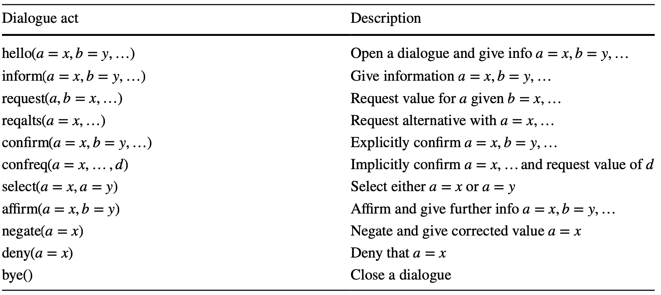
Dialogue Acts (Young et al., 2010)
Source: Deriu, Jan, Alvaro Rodrigo, Arantxa Otegi, Guillermo Echegoyen, Sophie Rosset, Eneko Agirre, and Mark Cieliebak (2021). "Survey on evaluation methods for dialogue systems." Artificial Intelligence Review 54, no. 1 (2021): 755-810.

Slide 84
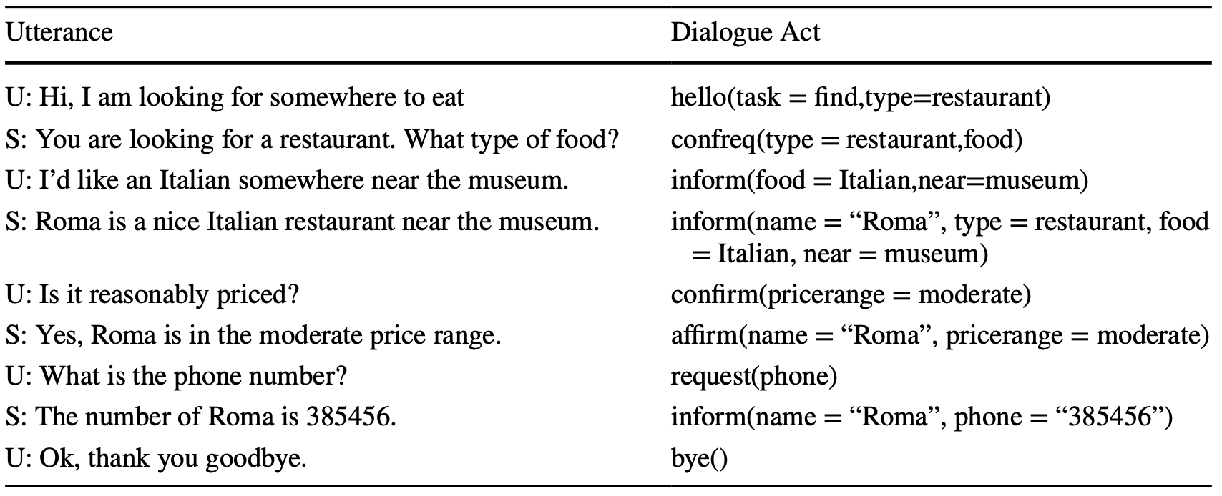
Sample Dialogue Acts
Source: Deriu, Jan, Alvaro Rodrigo, Arantxa Otegi, Guillermo Echegoyen, Sophie Rosset, Eneko Agirre, and Mark Cieliebak (2021). "Survey on evaluation methods for dialogue systems." Artificial Intelligence Review 54, no. 1 (2021): 755-810.

Slide 85
Dialogue on Airline Travel Information System (ATIS)

Slide 86
The ATIS (Airline Travel Information System) Dataset
https://www.kaggle.com/siddhadev/atis-dataset-from-ms-cntk
Training samples: 4978
Testing samples: 893
Vocab size: 943
Slot count: 129
Intent count: 26
Source: Haihong, E., Peiqing Niu, Zhongfu Chen, and Meina Song. "A novel bi-directional interrelated model for joint intent detection and slot filling." In Proceedings of the 57th Annual Meeting of the Association for Computational Linguistics, pp. 5467-5471. 2019.

Slide 87
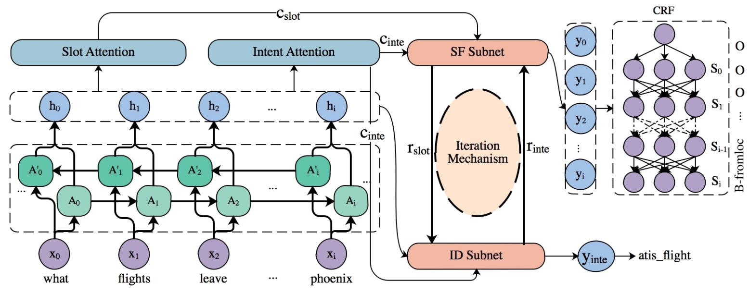
SF-ID Network (E et al., 2019) Slot Filling (SF) Intent Detection (ID)
A Novel Bi-directional Interrelated Model for Joint Intent Detection and Slot Filling
Source: Haihong, E., Peiqing Niu, Zhongfu Chen, and Meina Song. "A novel bi-directional interrelated model for joint intent detection and slot filling." In Proceedings of the 57th Annual Meeting of the Association for Computational Linguistics, pp. 5467-5471. 2019.

Slide 88
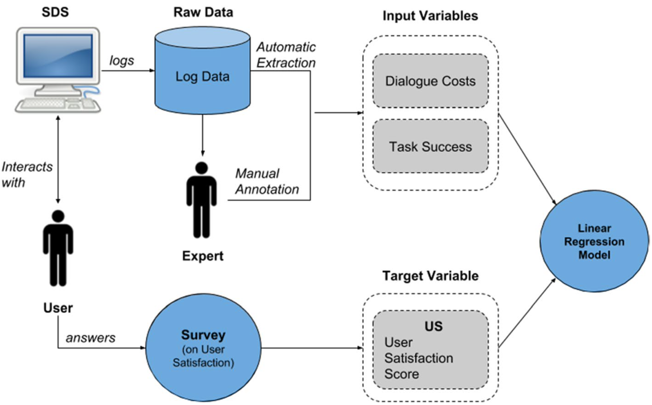
PARAdigm for Dialog System Evaluation PARADISE Framework (Walker et al. 1997)
Source: Deriu, Jan, Alvaro Rodrigo, Arantxa Otegi, Guillermo Echegoyen, Sophie Rosset, Eneko Agirre, and Mark Cieliebak (2021). "Survey on evaluation methods for dialogue systems." Artificial Intelligence Review 54, no. 1 (2021): 755-810.

Slide 89
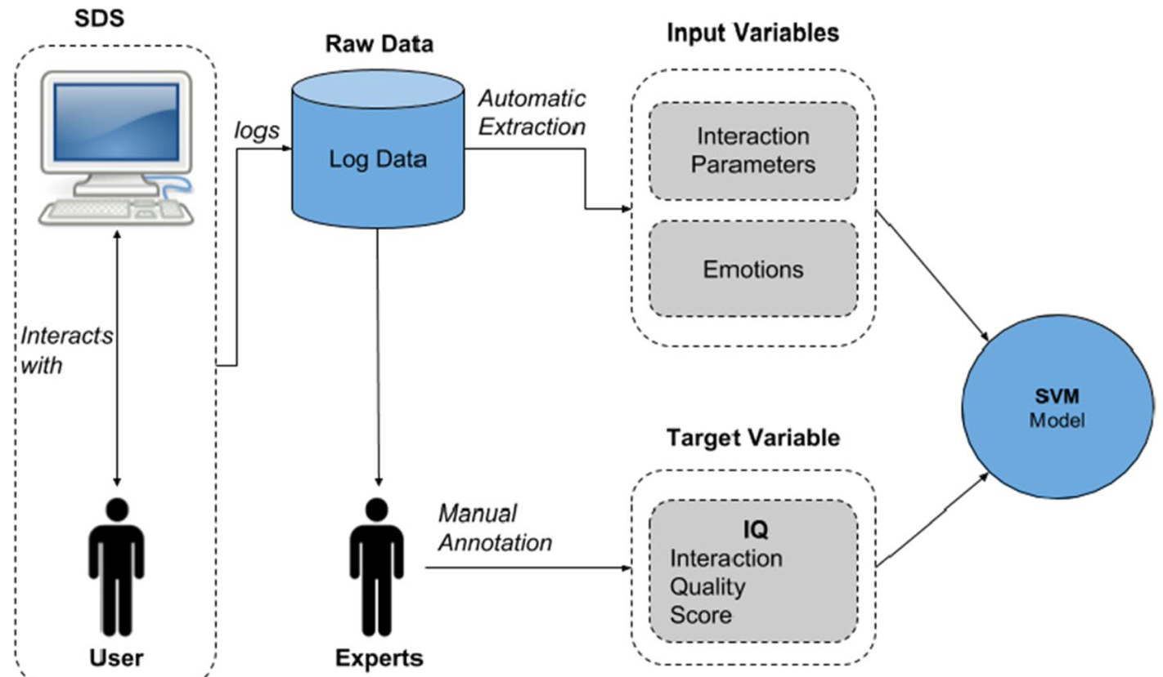
Interaction Quality procedure (Schmitt and Ultes, 2015)
Source: Deriu, Jan, Alvaro Rodrigo, Arantxa Otegi, Guillermo Echegoyen, Sophie Rosset, Eneko Agirre, and Mark Cieliebak (2021). "Survey on evaluation methods for dialogue systems." Artificial Intelligence Review 54, no. 1 (2021): 755-810.

Slide 90
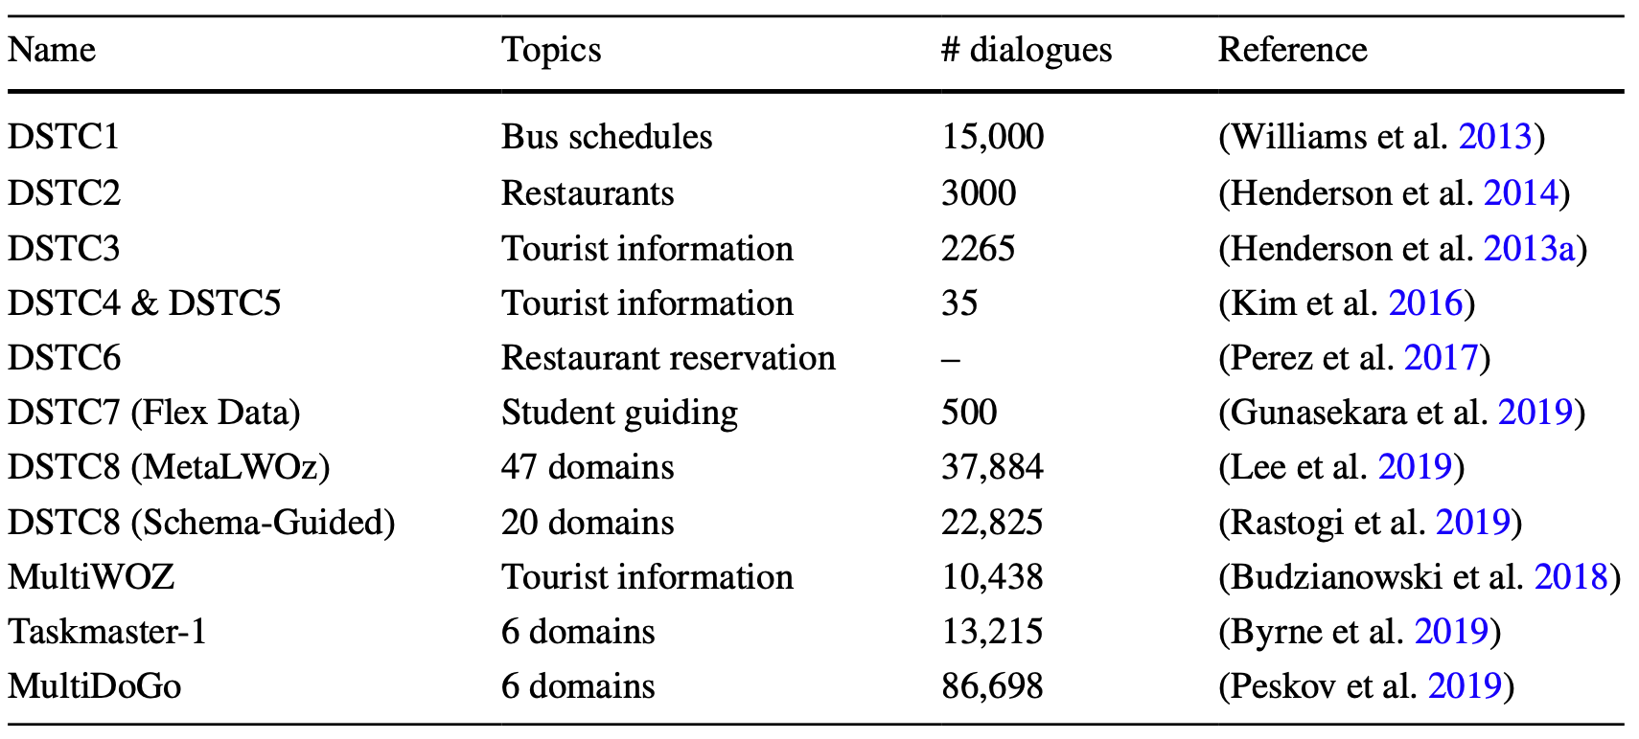
Datasets for task-oriented dialogue systems
Source: Deriu, Jan, Alvaro Rodrigo, Arantxa Otegi, Guillermo Echegoyen, Sophie Rosset, Eneko Agirre, and Mark Cieliebak (2021). "Survey on evaluation methods for dialogue systems." Artificial Intelligence Review 54, no. 1 (2021): 755-810.

Slide 91
Restaurants Dialogue Datasets
MIT Restaurant Corpus
https://groups.csail.mit.edu/sls/downloads/restaurant/
CamRest676 (Cambridge restaurant dialogue domain dataset)
https://www.repository.cam.ac.uk/handle/1810/260970
DSTC2 (Dialog State Tracking Challenge 2 & 3)
http://camdial.org/~mh521/dstc/

Slide 92
CrossWOZ: A Large-Scale Chinese Cross-Domain Task-Oriented Dialogue Dataset
Source: Zhu, Qi, Kaili Huang, Zheng Zhang, Xiaoyan Zhu, and Minlie Huang. "Crosswoz: A large-scale chinese cross-domain task-oriented dialogue dataset." arXiv preprint arXiv:2002.11893 (2020).

Slide 93
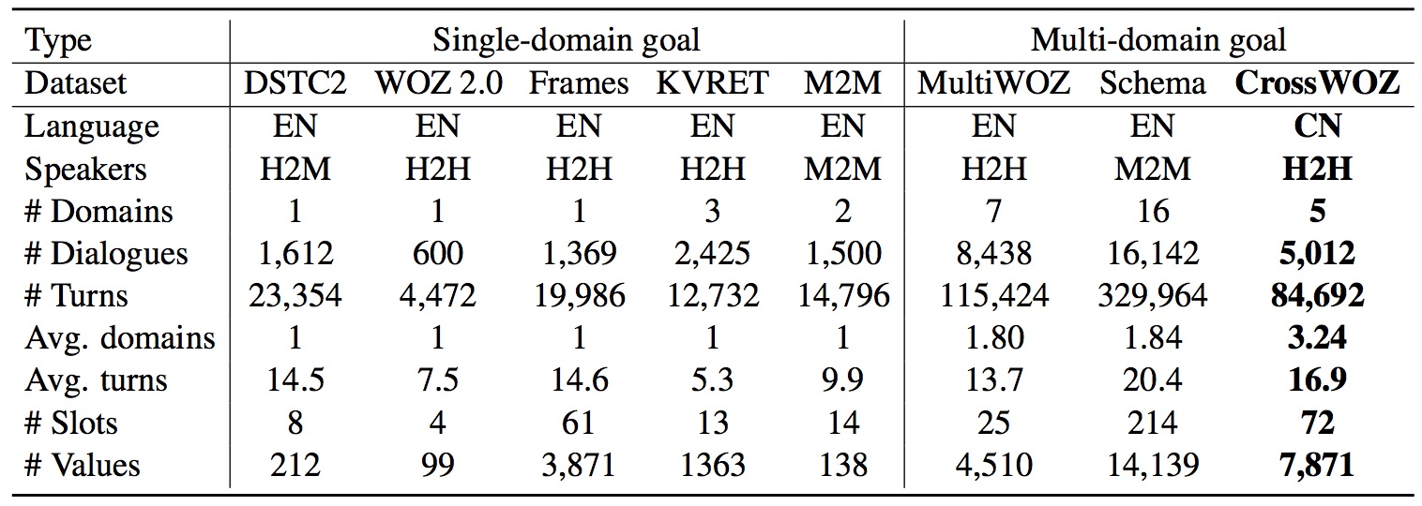
CrossWOZ: A Large-Scale Chinese Cross-Domain Task-Oriented Dialogue Dataset
Source: Zhu, Qi, Kaili Huang, Zheng Zhang, Xiaoyan Zhu, and Minlie Huang. "Crosswoz: A large-scale chinese cross-domain task-oriented dialogue dataset." arXiv preprint arXiv:2002.11893 (2020).

Slide 94
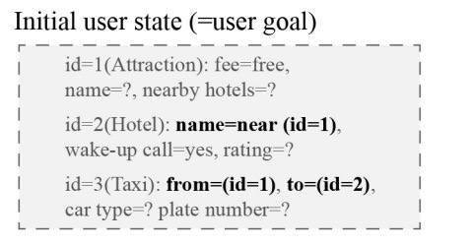
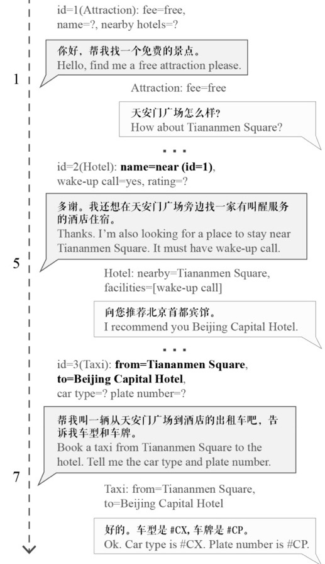
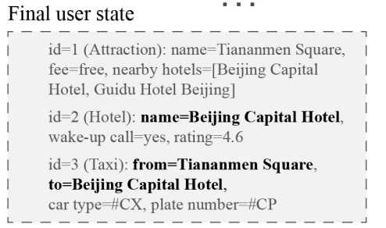
Task-Oriented Dialogue
Source: Zhu, Qi, Kaili Huang, Zheng Zhang, Xiaoyan Zhu, and Minlie Huang. "Crosswoz: A large-scale chinese cross-domain task-oriented dialogue dataset." arXiv preprint arXiv:2002.11893 (2020).

Slide 95
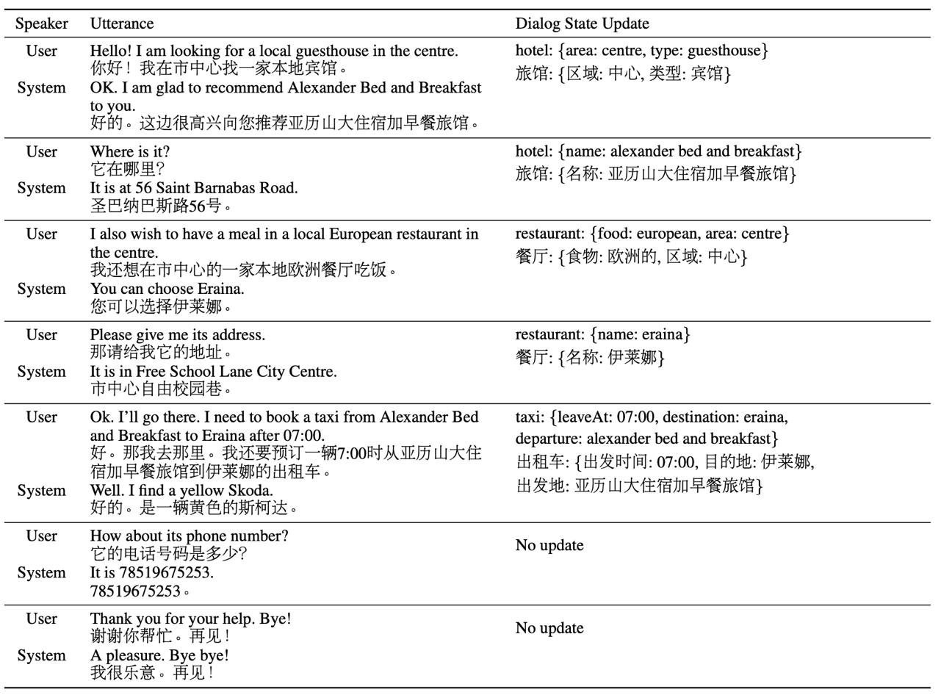
An example dialog from the test set for MultiWOZ (en→zh) sub-task

Slide 96
Reinforcement Learning from Human Feedback (RLHF)

Slide 97
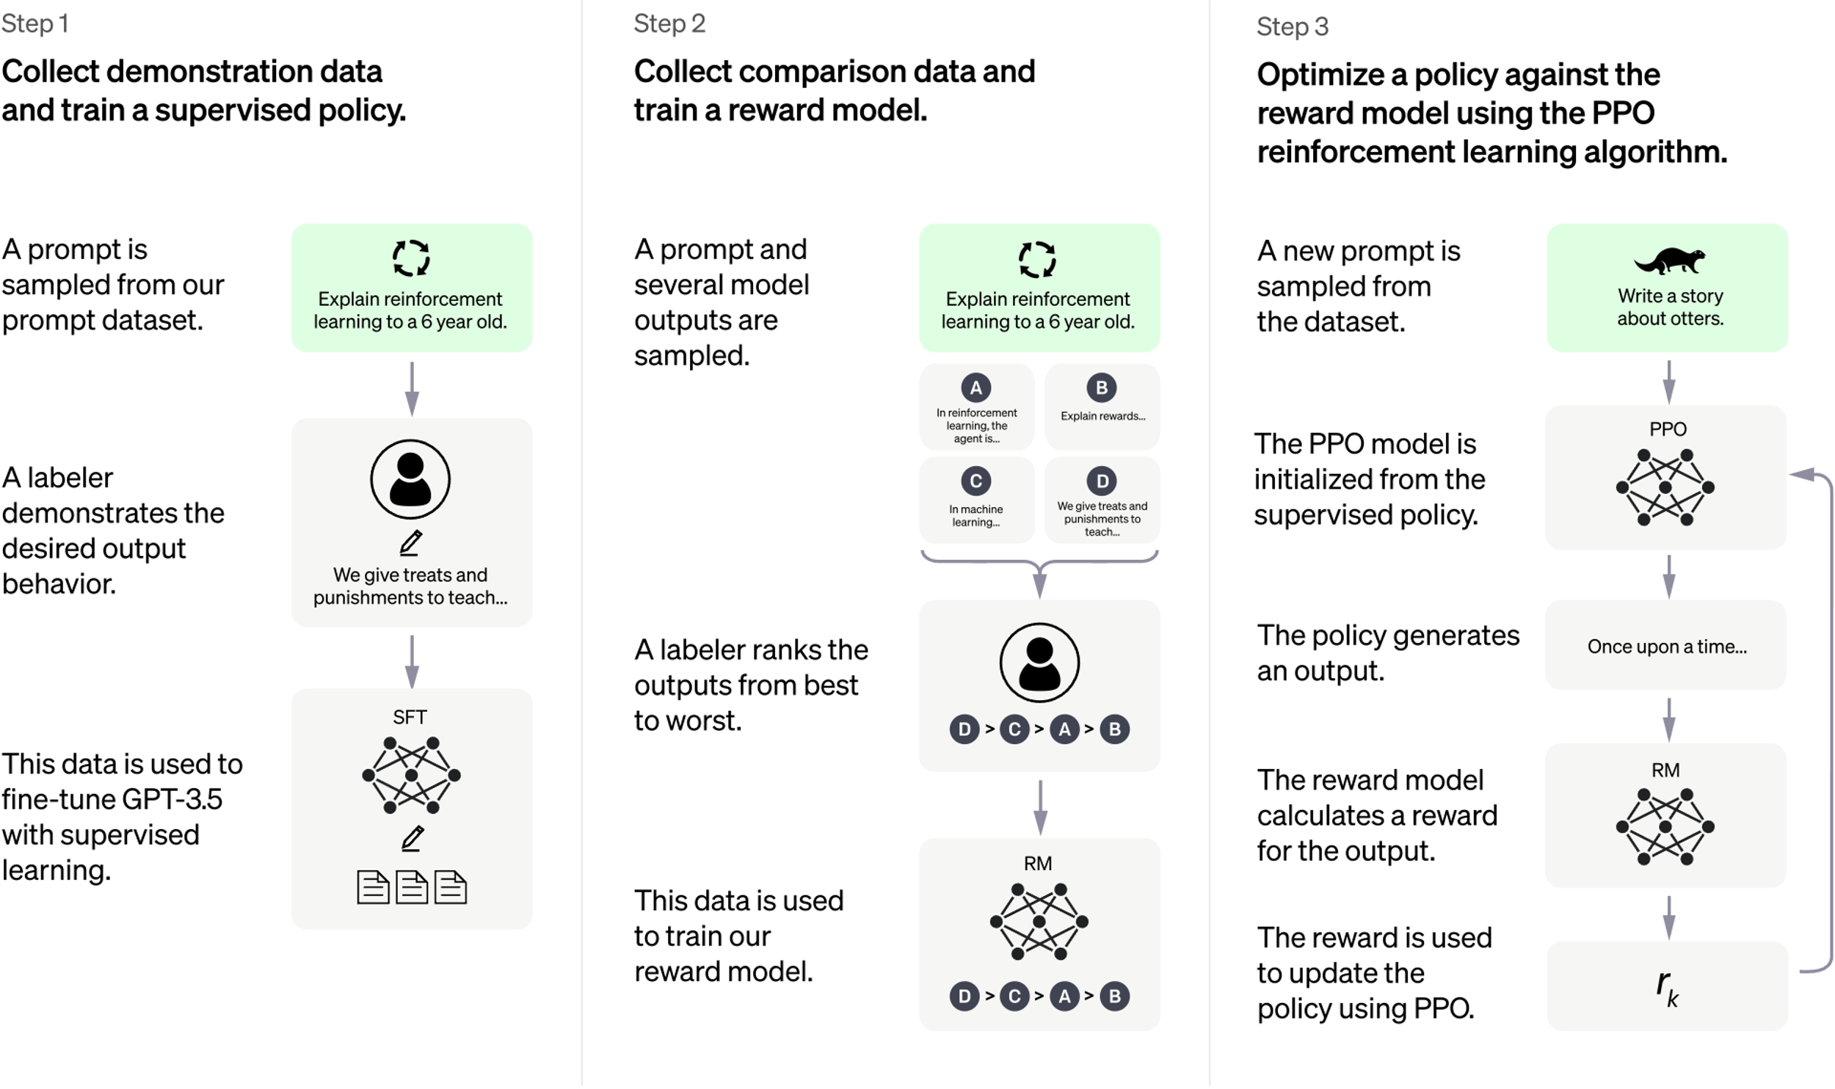
ChatGPT: Optimizing Language Models for Dialogue
Source: https://openai.com/blog/chatgpt/

Slide 98
Training language models to follow instructions with human feedback
InstructGPT and GPT 3.5
Source: Ouyang, L., Wu, J., Jiang, X., Almeida, D., Wainwright, C. L., Mishkin, P., ... & Lowe, R. (2022). Training language models to follow instructions with human feedback. arXiv preprint arXiv:2203.02155.

Slide 99
Reinforcement Learning from Human Feedback (RLHF)
Pretraining a Language Model (LM)
Gathering Data and Training a Reward Model
Fine-tuning the LM with Reinforcement Learning
Source: https://huggingface.co/blog/rlhf

Slide 100
Reinforcement Learning from Human Feedback (RLHF) Step 1. Pretraining a Language Model (LM)
Source: https://huggingface.co/blog/rlhf

Slide 101
Reinforcement Learning from Human Feedback (RLHF) Step 2. Gathering Data and Training a Reward Model
Source: https://huggingface.co/blog/rlhf

Slide 102
Reinforcement Learning from Human Feedback (RLHF) Step 3. Fine-tuning the LM with Reinforcement Learning
Source: https://huggingface.co/blog/rlhf

Slide 103
Llama-2-chat uses RLHF to ensure safety and helpfulness
Source: https://ai.meta.com/resources/models-and-libraries/llama/

Slide 104
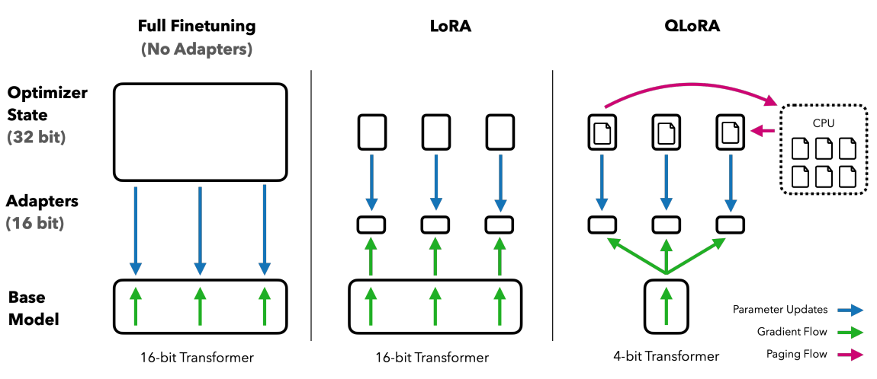
QLoRA: Efficient Finetuning of Quantized LLMs
Source: Dettmers, Tim, Artidoro Pagnoni, Ari Holtzman, and Luke Zettlemoyer. "QLoRA: Efficient Finetuning of Quantized LLMs." arXiv preprint arXiv:2305.14314 (2023).

Slide 105
QLoRA: Efficient Finetuning of Quantized LLMs
QLoRA reduces the average memory requirements of finetuning a 65B parameter model from >780GB of GPU memory to <48GB
Source: Dettmers, Tim, Artidoro Pagnoni, Ari Holtzman, and Luke Zettlemoyer. "QLoRA: Efficient Finetuning of Quantized LLMs." arXiv preprint arXiv:2305.14314 (2023).

Slide 106
QLoRA: Efficient Finetuning of Quantized LLMs
Source: Dettmers, Tim, Artidoro Pagnoni, Ari Holtzman, and Luke Zettlemoyer. "QLoRA: Efficient Finetuning of Quantized LLMs." arXiv preprint arXiv:2305.14314 (2023).

Slide 107
Prompt Engineering with ChatGPT for NLP
Source: https://www.predera.com/blog/prompt-engineering-for-nlp-tasks

Slide 108
Hugging Face Tasks Natural Language Processing
https://huggingface.co/tasks

Slide 109
NLP with Transformers Github
https://github.com/nlp-with-transformers/notebooks

Slide 110
NLP with Transformers Github Notebooks
https://github.com/nlp-with-transformers/notebooks

Slide 111
Python in Google Colab (Python101)
https://colab.research.google.com/drive/1FEG6DnGvwfUbeo4zJ1zTunjMqf2RkCrT
NLP with Transformers
https://tinyurl.com/aintpupython101

Slide 112
Python in Google Colab (Python101)
https://colab.research.google.com/drive/1FEG6DnGvwfUbeo4zJ1zTunjMqf2RkCrT
Text Classification
https://tinyurl.com/aintpupython101

Slide 113
Python in Google Colab (Python101)
https://colab.research.google.com/drive/1FEG6DnGvwfUbeo4zJ1zTunjMqf2RkCrT
Named Entity Recognition (NER)
https://tinyurl.com/aintpupython101

Slide 114
Python in Google Colab (Python101)
https://colab.research.google.com/drive/1FEG6DnGvwfUbeo4zJ1zTunjMqf2RkCrT
Text Summarization
https://tinyurl.com/aintpupython101

Slide 115
Python in Google Colab (Python101)
https://colab.research.google.com/drive/1FEG6DnGvwfUbeo4zJ1zTunjMqf2RkCrT
Text Generation
https://tinyurl.com/aintpupython101

Slide 116
Python in Google Colab (Python101)
https://colab.research.google.com/drive/1FEG6DnGvwfUbeo4zJ1zTunjMqf2RkCrT
Question Answering and Dialogue Systems
https://tinyurl.com/aintpupython101

Slide 117
Python in Google Colab (Python101)
https://colab.research.google.com/drive/1FEG6DnGvwfUbeo4zJ1zTunjMqf2RkCrT
Question Answering
https://tinyurl.com/aintpupython101

Slide 118
Python in Google Colab (Python101)
https://colab.research.google.com/drive/1FEG6DnGvwfUbeo4zJ1zTunjMqf2RkCrT
Question Answering and Dialogue Systems
https://tinyurl.com/aintpupython101

Slide 119
Python in Google Colab (Python101)
https://colab.research.google.com/drive/1FEG6DnGvwfUbeo4zJ1zTunjMqf2RkCrT
https://tinyurl.com/aintpupython101

Slide 120
Python in Google Colab (Python101)
https://colab.research.google.com/drive/1FEG6DnGvwfUbeo4zJ1zTunjMqf2RkCrT
Dialogue Systems
https://tinyurl.com/aintpupython101

Slide 121
Python in Google Colab (Python101)
https://colab.research.google.com/drive/1FEG6DnGvwfUbeo4zJ1zTunjMqf2RkCrT
https://tinyurl.com/aintpupython101

Slide 122
Python in Google Colab (Python101)
https://colab.research.google.com/drive/1FEG6DnGvwfUbeo4zJ1zTunjMqf2RkCrT
https://tinyurl.com/aintpupython101

Slide 123
NLP with Transformers
!git clone https://github.com/nlp-with-transformers/notebooks.git
%cd notebooks
from install import *
install_requirements()
from utils import *
setup_chapter()
Source: Lewis Tunstall, Leandro von Werra, and Thomas Wolf (2022), Natural Language Processing with Transformers: Building Language Applications with Hugging Face, O'Reilly Media.
https://github.com/nlp-with-transformers/notebooks

Slide 124
Text Classification
text = """Dear Amazon, last week I ordered an Optimus Prime action figure \
from your online store in Germany. Unfortunately, when I opened the package, \
I discovered to my horror that I had been sent an action figure of Megatron \
instead! As a lifelong enemy of the Decepticons, I hope you can understand my \
dilemma. To resolve the issue, I demand an exchange of Megatron for the \
Optimus Prime figure I ordered. Enclosed are copies of my records concerning \
this purchase. I expect to hear from you soon. Sincerely, Bumblebee."""
Source: Lewis Tunstall, Leandro von Werra, and Thomas Wolf (2022), Natural Language Processing with Transformers: Building Language Applications with Hugging Face, O'Reilly Media.
https://github.com/nlp-with-transformers/notebooks

Slide 125
Text Classification
text = """Dear Amazon, last week I ordered an Optimus Prime action figure \
from your online store in Germany. Unfortunately, when I opened the package, \
I discovered to my horror that I had been sent an action figure of Megatron \
instead! As a lifelong enemy of the Decepticons, I hope you can understand my \
dilemma. To resolve the issue, I demand an exchange of Megatron for the \
Optimus Prime figure I ordered. Enclosed are copies of my records concerning \
this purchase. I expect to hear from you soon. Sincerely, Bumblebee."""
from transformers import pipeline classifier = pipeline("text-classification")
import pandas as pd outputs = classifier(text)
pd.DataFrame(outputs)
 | label | score
0 | NEGATIVE | 0.901546
Source: Lewis Tunstall, Leandro von Werra, and Thomas Wolf (2022), Natural Language Processing with Transformers: Building Language Applications with Hugging Face, O'Reilly Media.
https://github.com/nlp-with-transformers/notebooks

Slide 126
Text Classification
from transformers import pipeline classifier = pipeline("text-classification")
import pandas as pd outputs = classifier(text)
pd.DataFrame(outputs)
 | label | score
0 | NEGATIVE | 0.901546
Source: Lewis Tunstall, Leandro von Werra, and Thomas Wolf (2022), Natural Language Processing with Transformers: Building Language Applications with Hugging Face, O'Reilly Media.
https://github.com/nlp-with-transformers/notebooks

Slide 127
Named Entity Recognition
ner_tagger = pipeline("ner", aggregation_strategy="simple")
outputs = ner_tagger(text)
pd.DataFrame(outputs)
Source: Lewis Tunstall, Leandro von Werra, and Thomas Wolf (2022), Natural Language Processing with Transformers: Building Language Applications with Hugging Face, O'Reilly Media.
https://github.com/nlp-with-transformers/notebooks

Slide 128
Question Answering
reader = pipeline("question-answering")
question = "What does the customer want?"
outputs = reader(question=question, context=text)
pd.DataFrame([outputs])
 | score | start | end | answer
0 | 0.631292 | 335 | 358 | an exchange of Megatron
Source: Lewis Tunstall, Leandro von Werra, and Thomas Wolf (2022), Natural Language Processing with Transformers: Building Language Applications with Hugging Face, O'Reilly Media.
https://github.com/nlp-with-transformers/notebooks

Slide 129
Summarization
summarizer = pipeline("summarization")
outputs = summarizer(text, max_length=45, clean_up_tokenization_spaces=True)
print(outputs[0]['summary_text'])
Bumblebee ordered an Optimus Prime action figure from your online store in Germany. Unfortunately, when I opened the package, I discovered to my horror that I had been sent an action figure of Megatron instead.
Source: Lewis Tunstall, Leandro von Werra, and Thomas Wolf (2022), Natural Language Processing with Transformers: Building Language Applications with Hugging Face, O'Reilly Media.
https://github.com/nlp-with-transformers/notebooks

Slide 130
Text Summarization
text = """Dear Amazon, last week I ordered an Optimus Prime action figure \
from your online store in Germany. Unfortunately, when I opened the package, \
I discovered to my horror that I had been sent an action figure of Megatron \
instead! As a lifelong enemy of the Decepticons, I hope you can understand my \
dilemma. To resolve the issue, I demand an exchange of Megatron for the \
Optimus Prime figure I ordered. Enclosed are copies of my records concerning \
this purchase. I expect to hear from you soon. Sincerely, Bumblebee."""
from transformers import pipeline
summarizer = pipeline("summarization")
outputs = summarizer(text, max_length=45, clean_up_tokenization_spaces=True)
print(outputs[0]['summary_text'])
Bumblebee ordered an Optimus Prime action figure from your online store in Germany. Unfortunately, when I opened the package, I discovered to my horror that I had been sent an action figure of Megatron instead.
https://tinyurl.com/aintpupython101

Slide 131
Translation
translator = pipeline("translation_en_to_de",
model="Helsinki-NLP/opus-mt-en-de")
outputs = translator(text, clean_up_tokenization_spaces=True, min_length=100)
print(outputs[0]['translation_text'])
Sehr geehrter Amazon, letzte Woche habe ich eine Optimus Prime Action Figur aus Ihrem Online-Shop in Deutschland bestellt. Leider, als ich das Paket öffnete, entdeckte ich zu meinem Entsetzen, dass ich stattdessen eine Action Figur von Megatron geschickt worden war! Als lebenslanger Feind der Decepticons, Ich hoffe, Sie können mein Dilemma verstehen. Um das Problem zu lösen, Ich fordere einen Austausch von Megatron für die Optimus Prime Figur habe ich bestellt. Anbei sind Kopien meiner Aufzeichnungen über diesen Kauf. Ich erwarte, bald von Ihnen zu hören. Aufrichtig, Bumblebee.
Source: Lewis Tunstall, Leandro von Werra, and Thomas Wolf (2022), Natural Language Processing with Transformers: Building Language Applications with Hugging Face, O'Reilly Media.
https://github.com/nlp-with-transformers/notebooks

Slide 132
Text Generation
from transformers import set_seed
set_seed(42) # Set the seed to get reproducible results
generator = pipeline("text-generation")
response = "Dear Bumblebee, I am sorry to hear that your order was mixed up."
prompt = text + "\n\nCustomer service response:\n" + response
outputs = generator(prompt, max_length=200)
print(outputs[0]['generated_text'])
Customer service response:
Dear Bumblebee, I am sorry to hear that your order was mixed up. The order was completely mislabeled, which is very common in our online store, but I can appreciate it because it was my understanding from this site and our customer service of the previous day that your order was not made correct in our mind and that we are in a process of resolving this matter. We can assure you that your order
Source: Lewis Tunstall, Leandro von Werra, and Thomas Wolf (2022), Natural Language Processing with Transformers: Building Language Applications with Hugging Face, O'Reilly Media.
https://github.com/nlp-with-transformers/notebooks

Slide 133
Text Generation
Dear Amazon, last week I ordered an Optimus Prime action figure from your online store in Germany. Unfortunately, when I opened the package, I discovered to my horror that I had been sent an action figure of Megatron instead! As a lifelong enemy of the Decepticons, I hope you can understand my dilemma. To resolve the issue, I demand an exchange of Megatron for the Optimus Prime figure I ordered. Enclosed are copies of my records concerning this purchase. I expect to hear from you soon. Sincerely, Bumblebee.
Customer service response:
Dear Bumblebee, I am sorry to hear that your order was mixed up. The order was completely mislabeled, which is very common in our online store, but I can appreciate it because it was my understanding from this site and our customer service of the previous day that your order was not made correct in our mind and that we are in a process of resolving this matter. We can assure you that your order
Source: Lewis Tunstall, Leandro von Werra, and Thomas Wolf (2022), Natural Language Processing with Transformers: Building Language Applications with Hugging Face, O'Reilly Media.
https://github.com/nlp-with-transformers/notebooks

Slide 134
Question Answering
!pip install transformers
from transformers import pipeline
qamodel = pipeline("question-answering")
question = "Where do I live?"
context = "My name is Michael and I live in Taipei."
qamodel(question = question, context = context)
{'answer': 'Taipei', 'end': 39, 'score': 0.9730741381645203, 'start': 33}
https://tinyurl.com/aintpupython101

Slide 135
Question Answering
from transformers import pipeline
qamodel = pipeline("question-answering", model ='deepset/roberta-base-squad2')
question = "Where do I live?"
context = "My name is Michael and I live in Taipei."
output = qamodel(question = question, context = context)
print(output['answer’])
Taipei
https://tinyurl.com/aintpupython101

Slide 136
Text Generation with LLM (zephyr-7b-beta)
# Install transformers from source - only needed for versions <= v4.34
!pip install git+https://github.com/huggingface/transformers.git
!pip install accelerate
https://huggingface.co/HuggingFaceH4/zephyr-7b-beta

Slide 137
Text Generation with LLM (zephyr-7b-beta)
import torch
from transformers import pipeline
pipe = pipeline("text-generation", model="HuggingFaceH4/zephyr-7b-beta", torch_dtype=torch.bfloat16, device_map="auto")
https://huggingface.co/HuggingFaceH4/zephyr-7b-beta

Slide 138
Text Generation with LLM (zephyr-7b-beta)
# We use the tokenizer's chat template to format each message - see https://huggingface.co/docs/transformers/main/en/chat_templating
messages = [
{
"role": "system",
"content": "You are a friendly chatbot who always responds in the style of a pirate",
},
{"role": "user", "content": "How many helicopters can a human eat in one sitting?"},
]
prompt = pipe.tokenizer.apply_chat_template(messages, tokenize=False, add_generation_prompt=True)
outputs = pipe(prompt, max_new_tokens=256, do_sample=True, temperature=0.7, top_k=50, top_p=0.95)
print(outputs[0]["generated_text"])
https://huggingface.co/HuggingFaceH4/zephyr-7b-beta

Slide 139
Text Generation with LLM (zephyr-7b-beta)
import torch
from transformers import pipeline
pipe = pipeline("text-generation", model="HuggingFaceH4/zephyr-7b-beta", torch_dtype=torch.bfloat16, device_map="auto")
# We use the tokenizer's chat template to format each message - see https://huggingface.co/docs/transformers/main/en/chat_templating
messages = [
{
"role": "system",
"content": "You are a friendly chatbot who always responds in the style of a pirate",
},
{"role": "user", "content": "How many helicopters can a human eat in one sitting?"},
]
prompt = pipe.tokenizer.apply_chat_template(messages, tokenize=False, add_generation_prompt=True)
outputs = pipe(prompt, max_new_tokens=256, do_sample=True, temperature=0.7, top_k=50, top_p=0.95)
print(outputs[0]["generated_text"])
https://huggingface.co/HuggingFaceH4/zephyr-7b-beta

Slide 140
Summary
Question Answering
Dialogue Systems
Task Oriented Dialogue (TOD) System
Task-Oriented Dialogue System (TDS)
Conversational Dialogue System (CDS)
Question Answering Dialogue System (QADS)

Slide 141
References
Lewis Tunstall, Leandro von Werra, and Thomas Wolf (2022), Natural Language Processing with Transformers: Building Language Applications with Hugging Face, O'Reilly Media.
Denis Rothman (2021), Transformers for Natural Language Processing: Build innovative deep neural network architectures for NLP with Python, PyTorch, TensorFlow, BERT, RoBERTa, and more, Packt Publishing.
Savaş Yıldırım and Meysam Asgari-Chenaghlu (2021), Mastering Transformers: Build state-of-the-art models from scratch with advanced natural language processing techniques, Packt Publishing.
Rafailov, R., Sharma, A., Mitchell, E., Ermon, S., Manning, C. D., & Finn, C. (2023). Direct preference optimization: Your language model is secretly a reward model. arXiv preprint arXiv:2305.18290.
Tunstall, Lewis, Edward Beeching, Nathan Lambert, Nazneen Rajani, Kashif Rasul, Younes Belkada, Shengyi Huang et al. "Zephyr: Direct Distillation of LM Alignment." arXiv preprint arXiv:2310.16944 (2023).
Yihan Cao, Siyu Li, Yixin Liu, Zhiling Yan, Yutong Dai, Philip S. Yu, and Lichao Sun (2023). "A Comprehensive Survey of AI-Generated Content (AIGC): A History of Generative AI from GAN to ChatGPT." arXiv preprint arXiv:2303.04226.
Pengfei Liu, Weizhe Yuan, Jinlan Fu, Zhengbao Jiang, Hiroaki Hayashi, and Graham Neubig. (2023) "Pre-train, prompt, and predict: A systematic survey of prompting methods in natural language processing." ACM Computing Surveys 55, no. 9 (2023): 1-35.
Wayne Xin Zhao, Kun Zhou, Junyi Li, Tianyi Tang, Xiaolei Wang, Yupeng Hou, Yingqian Min et al. (2023) "A Survey of Large Language Models." arXiv preprint arXiv:2303.18223.
Touvron, Hugo, Louis Martin, Kevin Stone, Peter Albert, Amjad Almahairi, Yasmine Babaei, Nikolay Bashlykov et al. (2023) "Llama 2: Open Foundation and Fine-Tuned Chat Models." arXiv preprint arXiv:2307.09288 (2023).
Junliang Wang, Chuqiao Xu, Jie Zhang, and Ray Zhong (2022). "Big data analytics for intelligent manufacturing systems: A review." Journal of Manufacturing Systems 62 (2022): 738-752.
Ouyang, L., Wu, J., Jiang, X., Almeida, D., Wainwright, C. L., Mishkin, P., ... & Lowe, R. (2022). Training language models to follow instructions with human feedback. arXiv preprint arXiv:2203.02155.
Gozalo-Brizuela, Roberto, and Eduardo C. Garrido-Merchan (2023). "ChatGPT is not all you need. A State of the Art Review of large Generative AI models." arXiv preprint arXiv:2301.04655 (2023).
Wenliang Dai, Junnan Li, Dongxu Li, Anthony Meng Huat Tiong, Junqi Zhao, Weisheng Wang, Boyang Li, Pascale Fung, and Steven Hoi. (2023) "InstructBLIP: Towards General-purpose Vision-Language Models with Instruction Tuning." arXiv preprint arXiv:2305.06500 (2023).
Shahab Saquib Sohail, Faiza Farhat, Yassine Himeur, Mohammad Nadeem, Dag Øivind Madsen, Yashbir Singh, Shadi Atalla, and Wathiq Mansoor (2023). "The Future of GPT: A Taxonomy of Existing ChatGPT Research, Current Challenges, and Possible Future Directions." Current Challenges, and Possible Future Directions (April 8, 2023) (2023).
Longbing Cao (2022). "Decentralized ai: Edge intelligence and smart blockchain, metaverse, web3, and desci." IEEE Intelligent Systems 37, no. 3: 6-19.
Qinglin Yang, Yetong Zhao, Huawei Huang, Zehui Xiong, Jiawen Kang, and Zibin Zheng (2022). "Fusing blockchain and AI with metaverse: A survey." IEEE Open Journal of the Computer Society 3 : 122-136.
Russell Belk, Mariam Humayun, and Myriam Brouard (2022). "Money, possessions, and ownership in the Metaverse: NFTs, cryptocurrencies, Web3 and Wild Markets." Journal of Business Research 153: 198-205.
Thien Huynh-The, Quoc-Viet Pham, Xuan-Qui Pham, Thanh Thi Nguyen, Zhu Han, and Dong-Seong Kim (2022). "Artificial Intelligence for the Metaverse: A Survey." arXiv preprint arXiv:2202.10336.
Thippa Reddy Gadekallu, Thien Huynh-The, Weizheng Wang, Gokul Yenduri, Pasika Ranaweera, Quoc-Viet Pham, Daniel Benevides da Costa, and Madhusanka Liyanage (2022). "Blockchain for the Metaverse: A Review." arXiv preprint arXiv:2203.09738.
Ouyang, L., Wu, J., Jiang, X., Almeida, D., Wainwright, C. L., Mishkin, P., ... & Lowe, R. (2022). Training language models to follow instructions with human feedback. arXiv preprint arXiv:2203.02155.
Devlin, Jacob, Ming-Wei Chang, Kenton Lee, and Kristina Toutanova (2018). "BERT: Pre-training of Deep Bidirectional Transformers for Language Understanding." arXiv preprint arXiv:1810.04805.
OpenAI (2023), A Survey of Techniques for Maximizing LLM Performance, https://www.youtube.com/watch?v=ahnGLM-RC1Y
The Super Duper NLP Repo, https://notebooks.quantumstat.com/
NLP with Transformer, https://github.com/nlp-with-transformers/notebooks
Min-Yuh Day (2023), Python 101, https://tinyurl.com/aintpupython101

