Slide 1





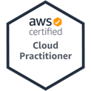

Python Programming and
Data Science
Python for Accounting Applications
1121PAA02
ACC2, NTPU (M5265) (Fall 2023)
Wed 6, 7, 8, (14:10-17:00) (9:10-12:00) (B3F10)
Min-Yuh Day, Ph.D,
Associate Professor
Institute of Information Management, National Taipei University
https://web.ntpu.edu.tw/~myday
2023-09-20

Slide 2
Syllabus
Week Date Subject/Topics
1 2023/09/13 Introduction to Python for Accounting Applications
2 2023/09/20 Python Programming and Data Science
3 2023/09/27 Foundations of Python Programming
4 2023/10/04 Data Structures
5 2023/10/11 Control Logic and Loops
6 2023/10/18 Functions and Modules
7 2023/10/25 Files and Exception Handling
8 2023/11/01 Midterm Project Report

Slide 3
Syllabus
Week Date Subject/Topics
9 2023/11/08 Data Analytics and Visualization with Python
10 2023/11/15 Obtaining Data From the Web with Python
11 2023/11/22 Statistical Analysis with Python
12 2023/11/29 Machine Learning with Python
13 2023/12/06 Text Analytics with Python and
Large Language Models (LLMs)
14 2023/12/13 Applications of Accounting Data Analytics with Python
15 2023/12/20 Applications of ESG Data Analytics with Python
16 2023/12/27 Final Project Report

Slide 4
Python Programming and
Data Science

Slide 5
Outline
Python Programming
Data Science

Slide 6

Python
Programming

Slide 7
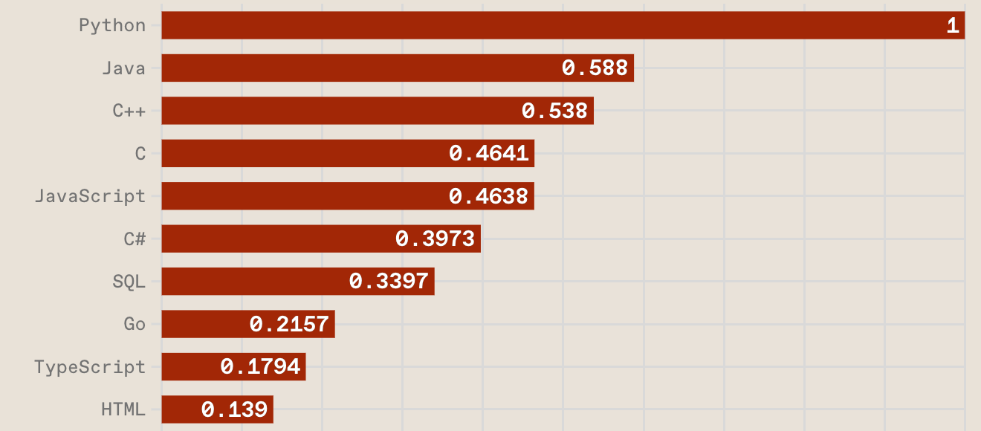
Top Programming Languages
https://spectrum.ieee.org/the-top-programming-languages-2023

Slide 8
Python is an interpreted, object-oriented, high-level programming language with dynamic semantics.
Source: https://www.python.org/doc/essays/blurb/

Slide 9
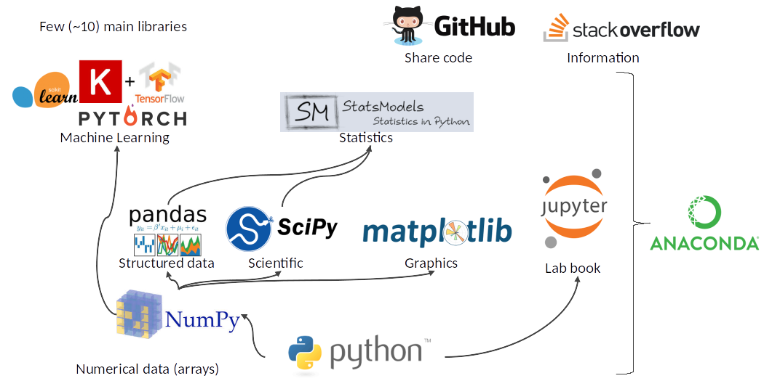
Python Ecosystem for Data Science
Source: https://medium.com/pyfinance/why-python-is-best-choice-for-financial-data-modeling-in-2019-c0d0d1858c45

Slide 10
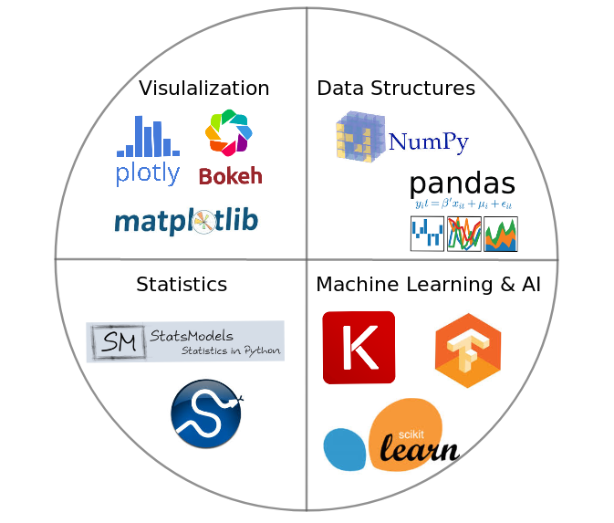

Python Ecosystem for Data Science
Source:https://duchesnay.github.io/pystatsml/introduction/python_ecosystem.html

Slide 11
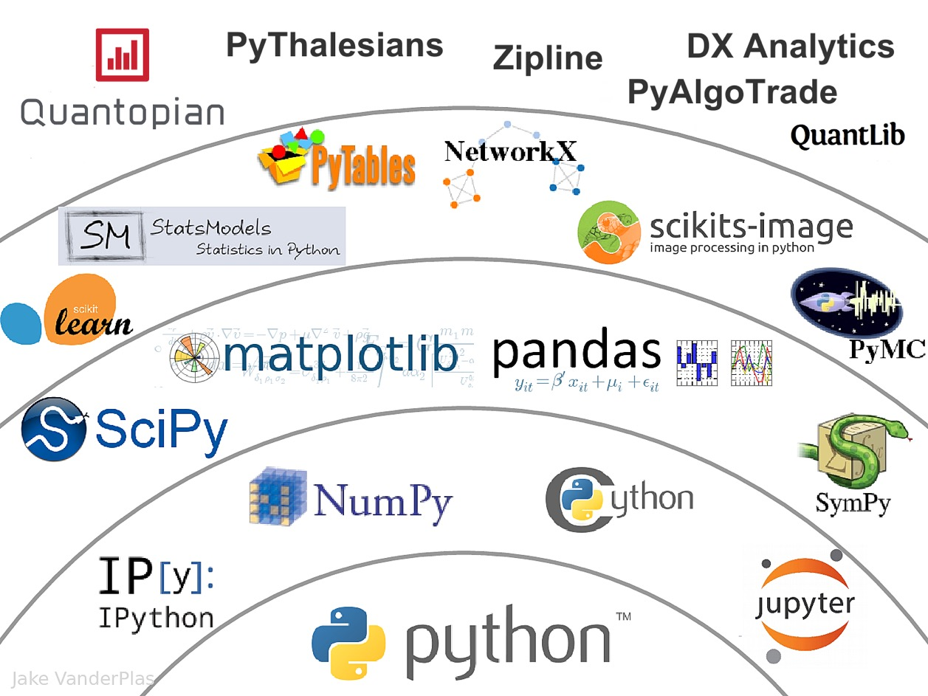

The Quant Finance PyData Stack
Source: http://nbviewer.jupyter.org/format/slides/github/quantopian/pyfolio/blob/master/pyfolio/examples/overview_slides.ipynb#/5

Slide 12
Numpy
NumPy
Base
N-dimensional array package

Slide 13
Python matplotlib
Source: https://matplotlib.org/

Slide 14
Python Pandas
http://pandas.pydata.org/

Slide 15

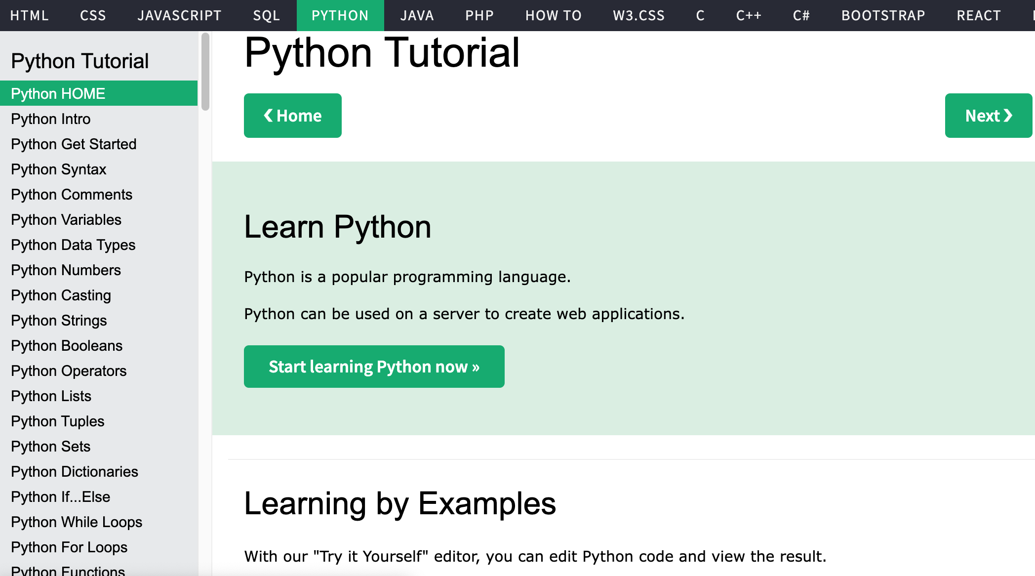
W3Schools Python
https://www.w3schools.com/python/

Slide 16
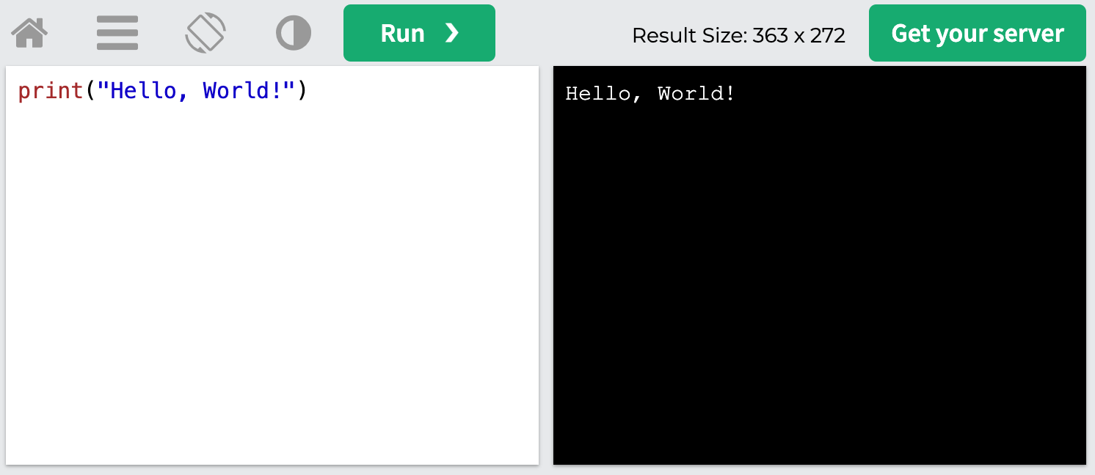
W3Schools Python: Try Python
https://www.w3schools.com/python/trypython.asp?filename=demo_default

Slide 17
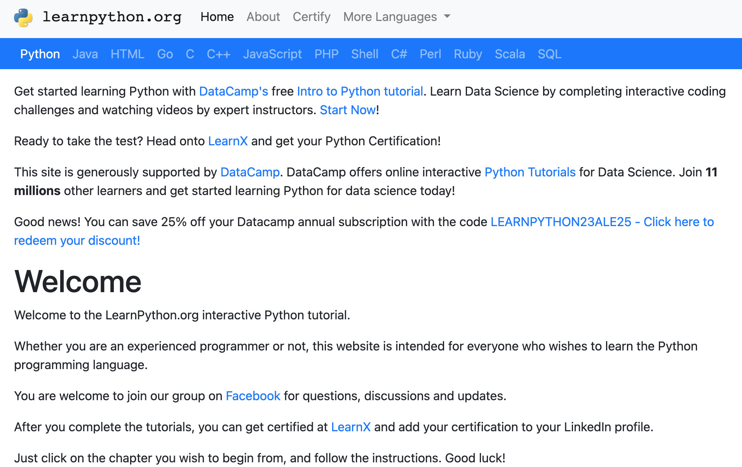
LearnPython.org
https://www.learnpython.org/

Slide 18
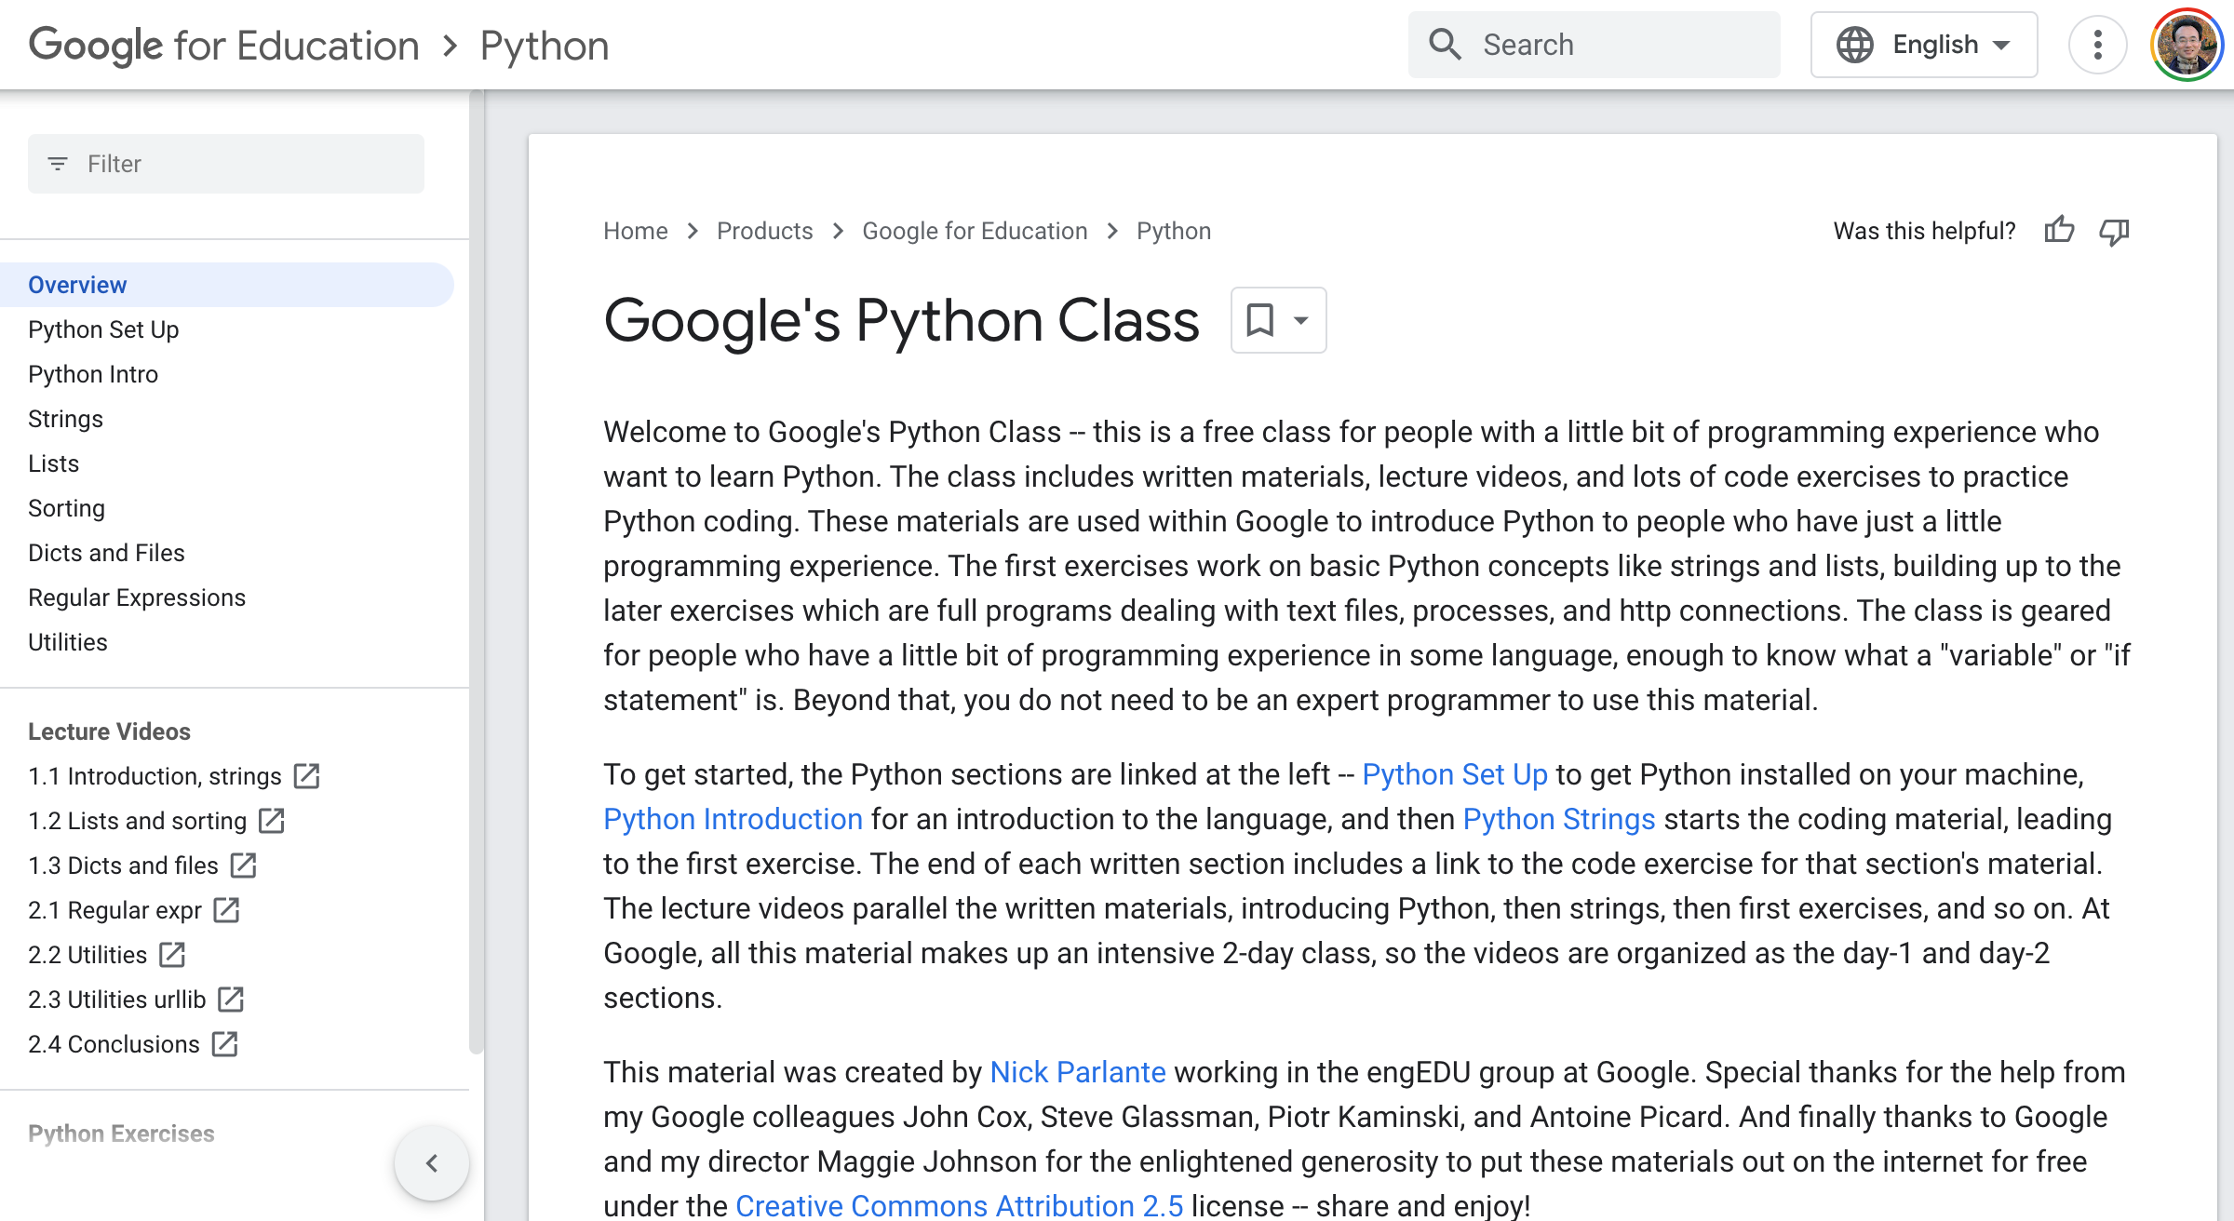
Google’s Python Class
https://developers.google.com/edu/python

Slide 19
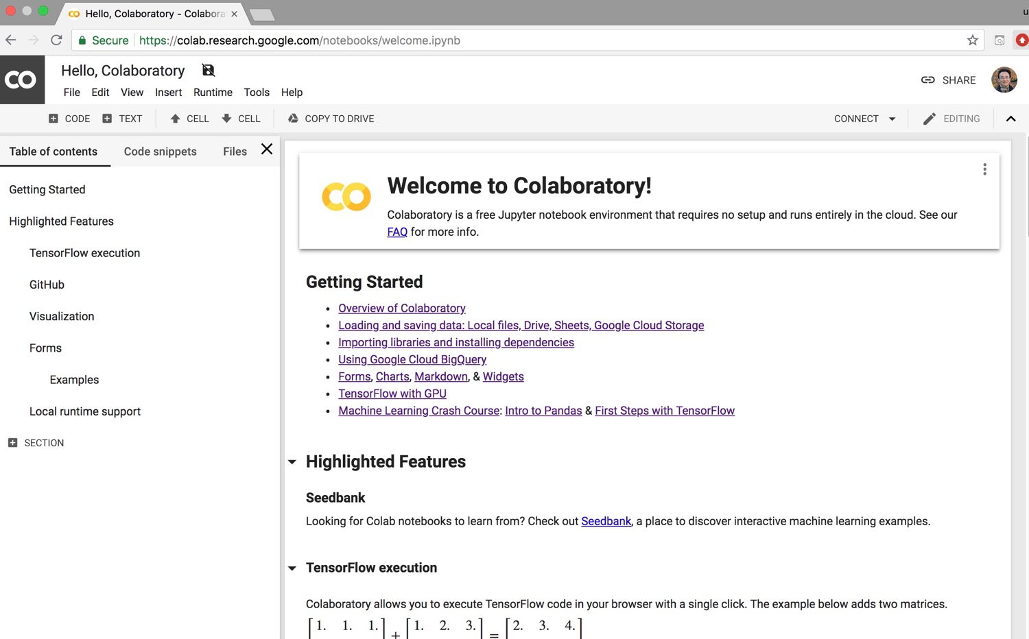
Google Colab
https://colab.research.google.com/notebooks/welcome.ipynb

Slide 20
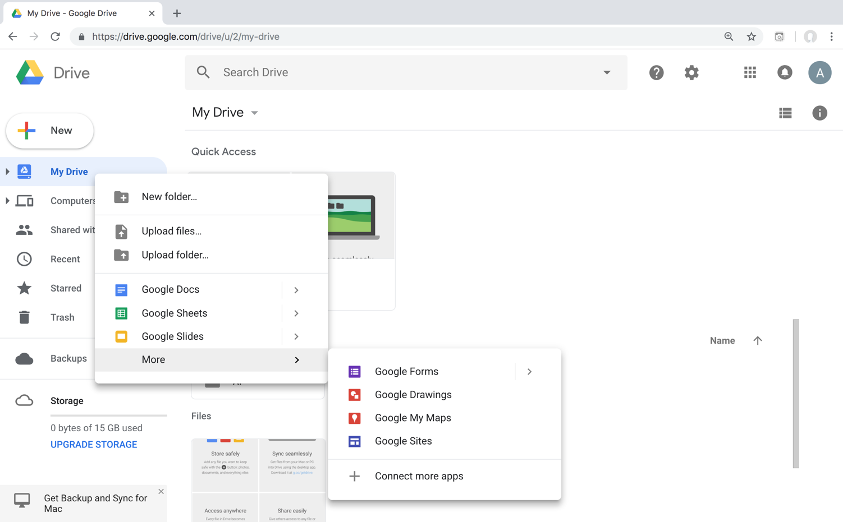
Connect Google Colab in Google Drive

Slide 21
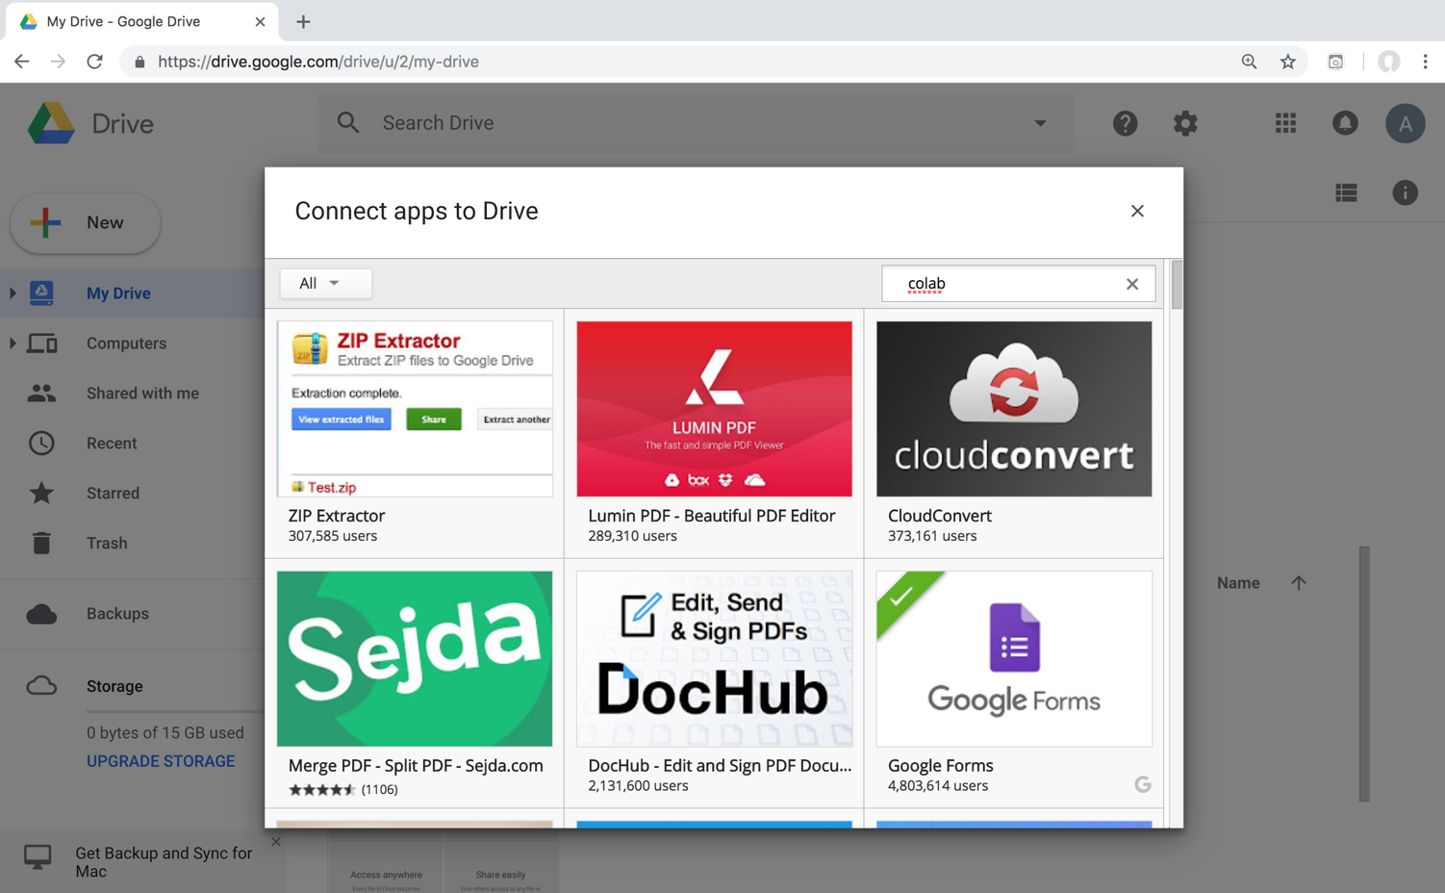
Google Colab

Slide 22
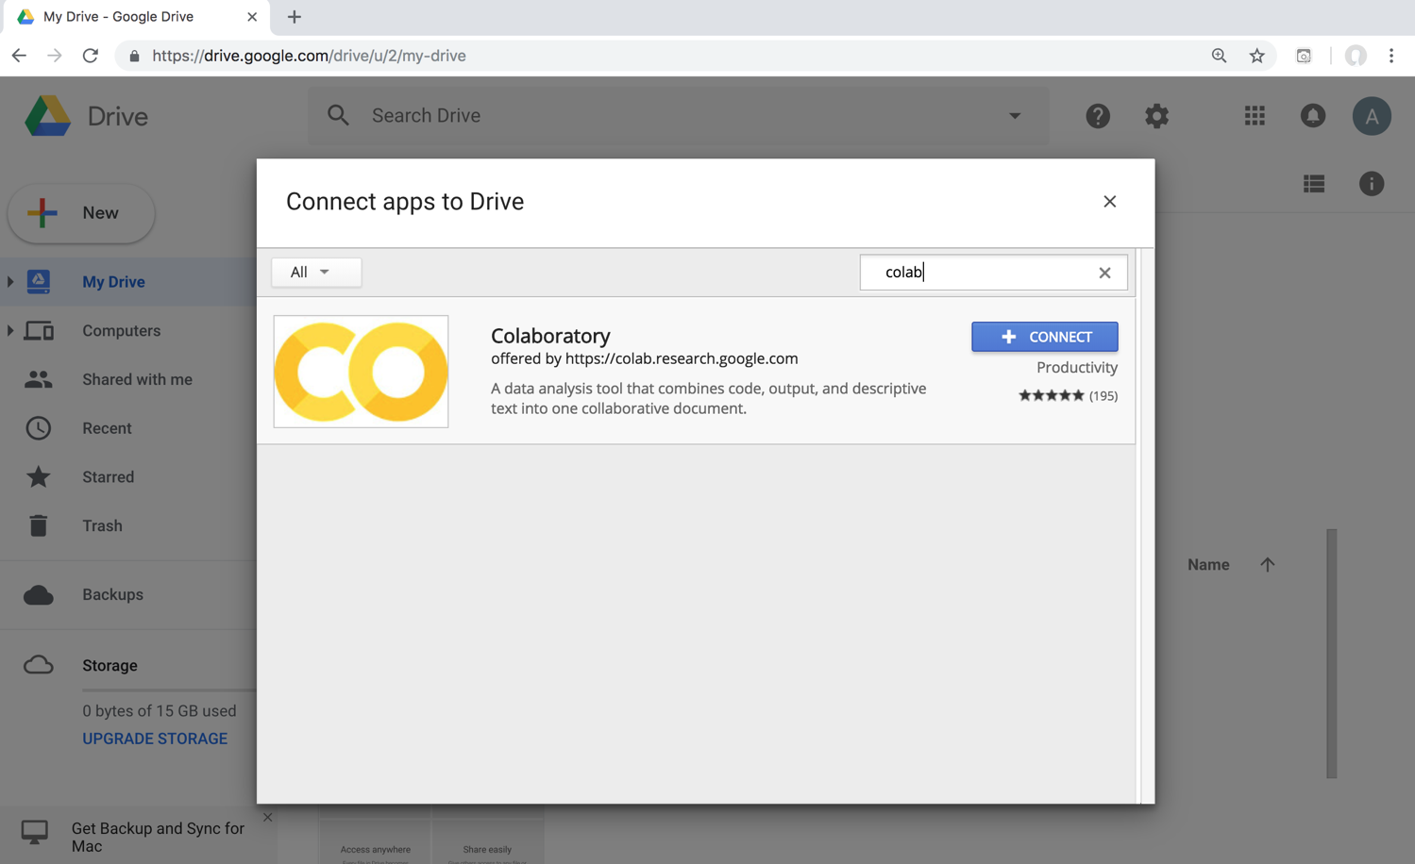
Google Colab

Slide 23
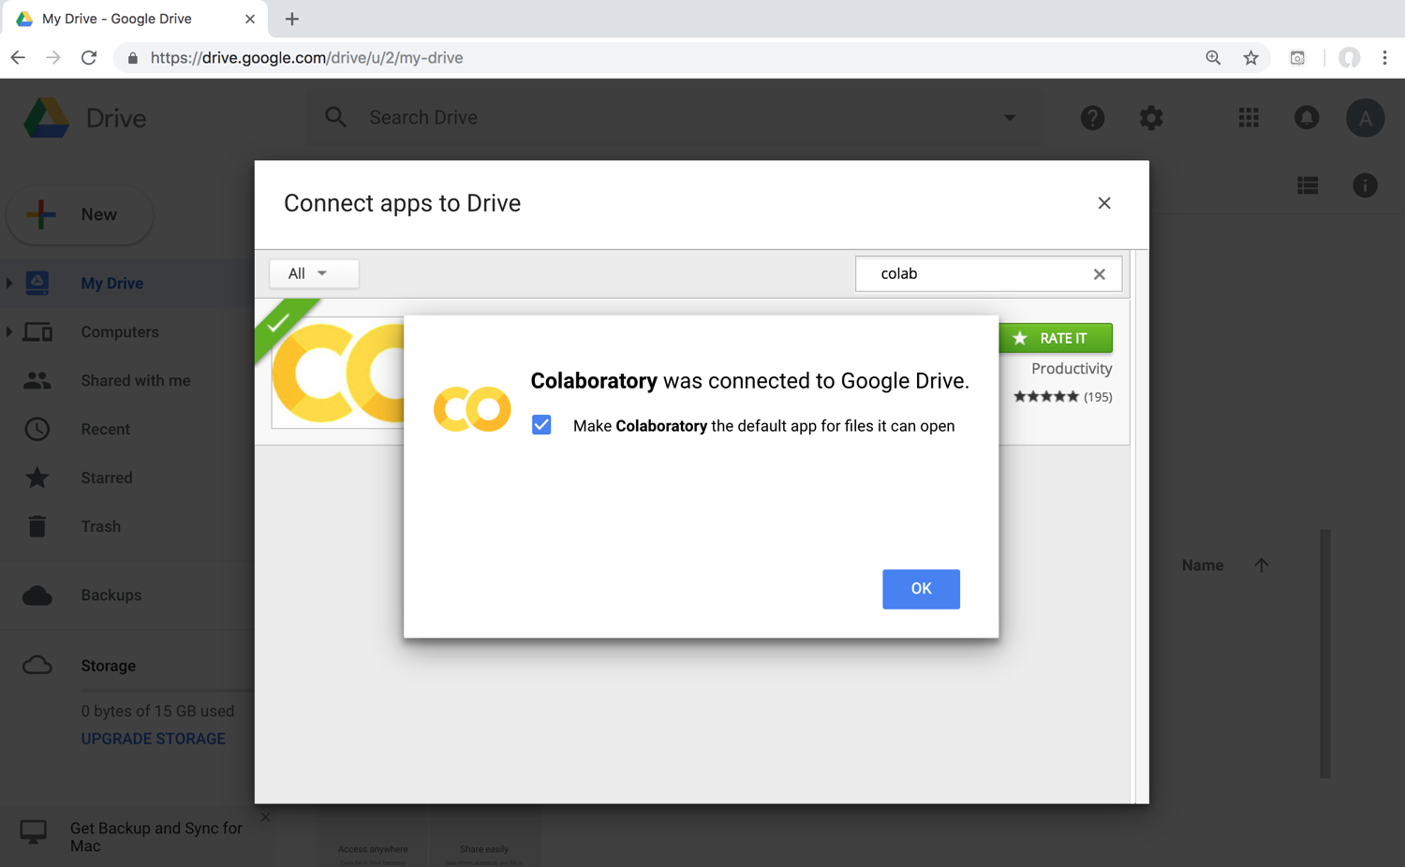
Connect Colaboratory to Google Drive

Slide 24
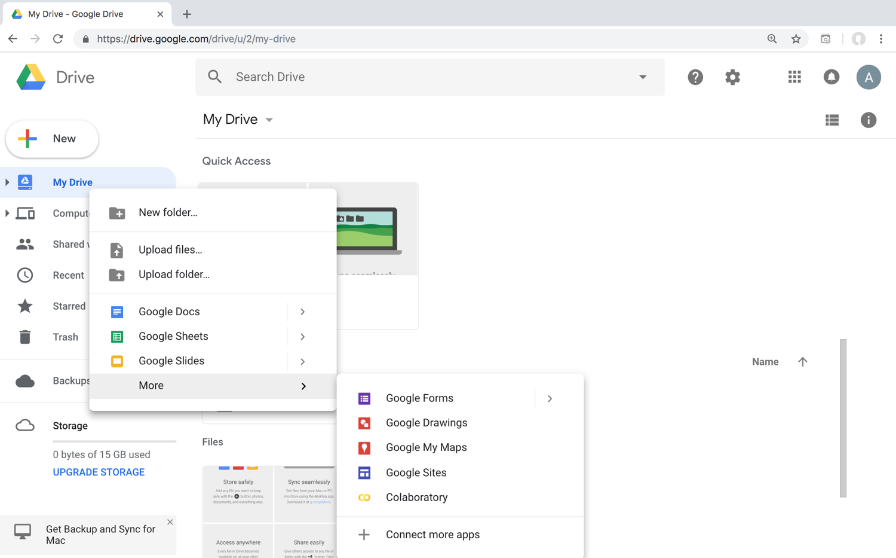
Google Colab

Slide 25
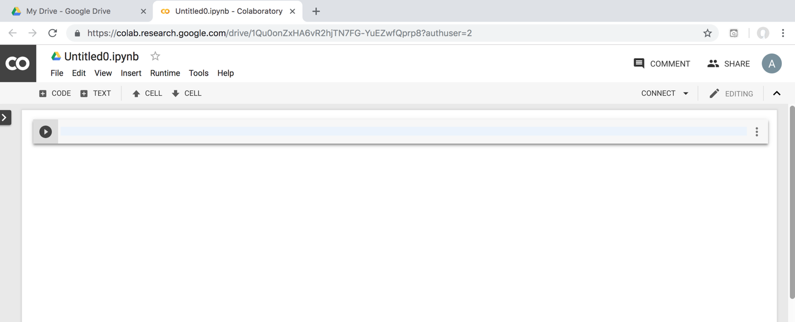
Google Colab

Slide 26
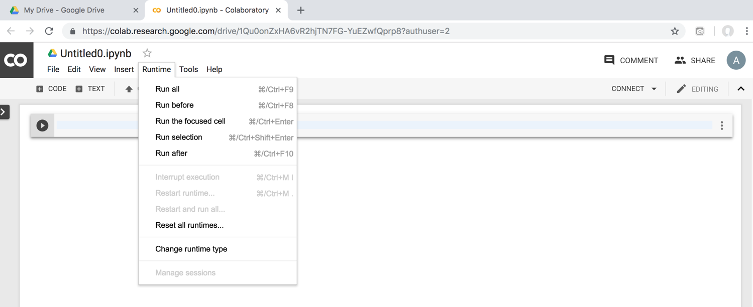
Google Colab

Slide 27
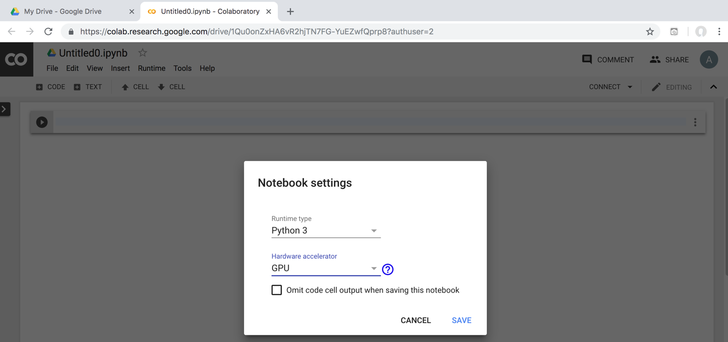
Run Jupyter Notebook
Python3 GPU
Google Colab

Slide 28
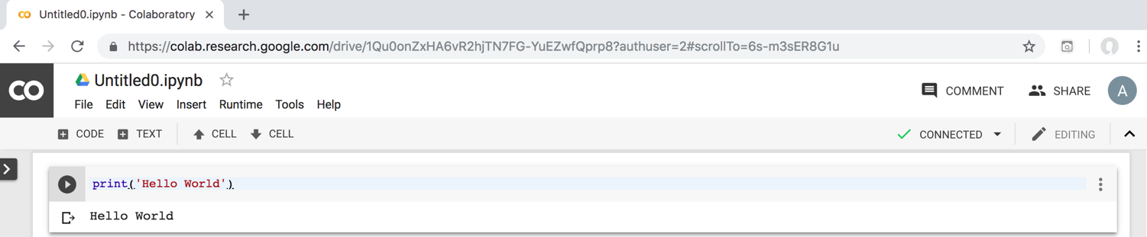
Google Colab Python Hello World print('Hello World')

Slide 29

Python in Google Colab (Python101)
https://colab.research.google.com/drive/1FEG6DnGvwfUbeo4zJ1zTunjMqf2RkCrT
https://tinyurl.com/aintpupython101

Slide 30
Anaconda
The Most Popular Python
Data Science Platform
Source: https://www.anaconda.com/

Slide 31
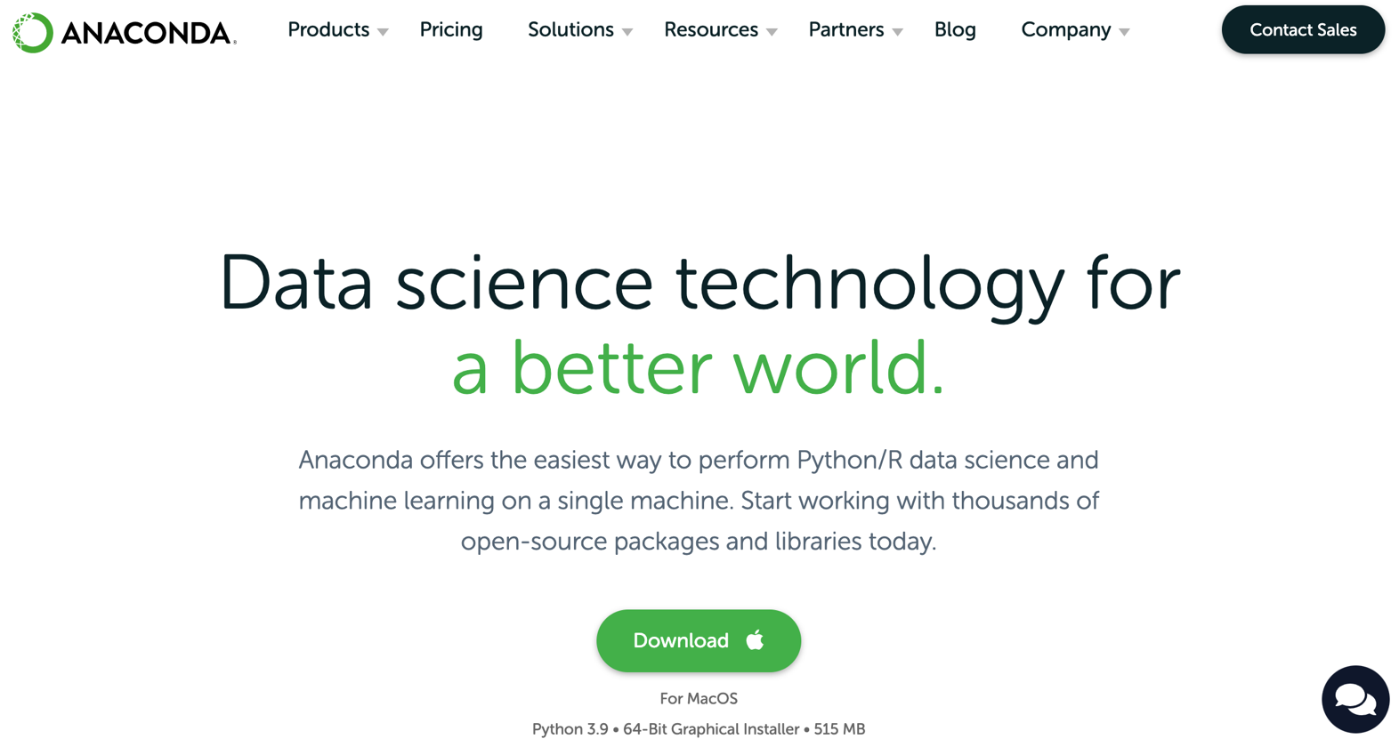

Download Anaconda
https://www.anaconda.com/download

Slide 32
Python
HelloWorld

Slide 33
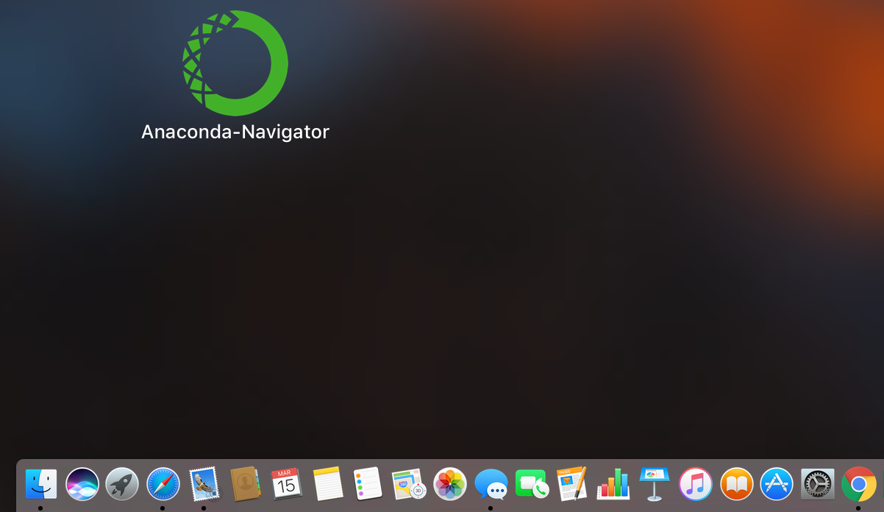
Anaconda-Navigator
Launchpad

Slide 34
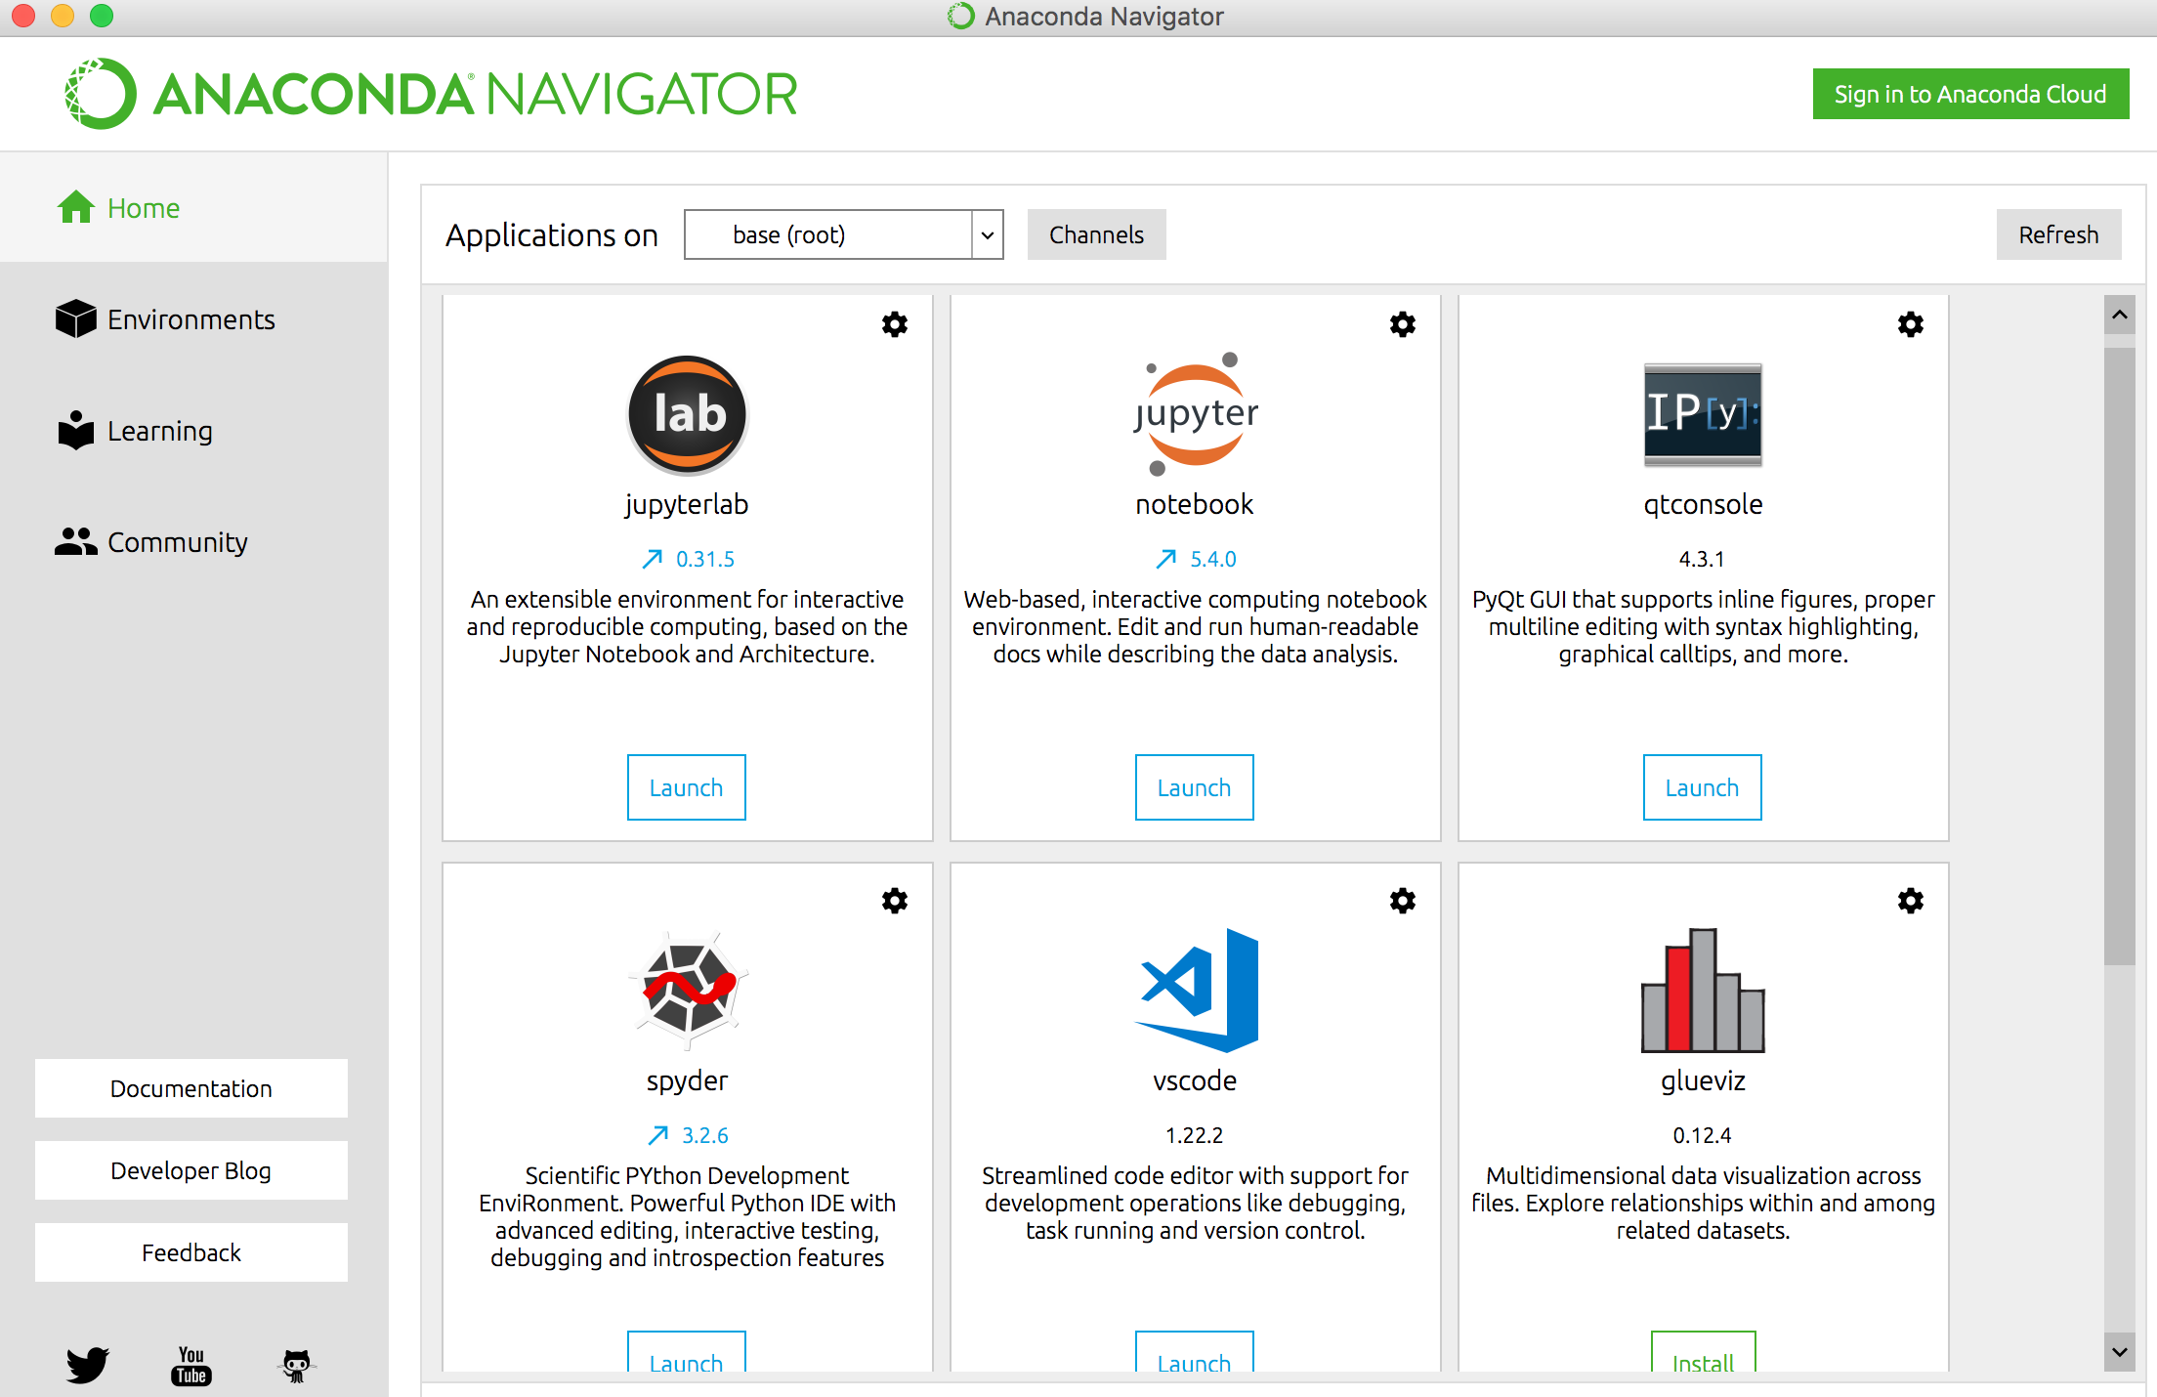
Anaconda Navigator

Slide 35
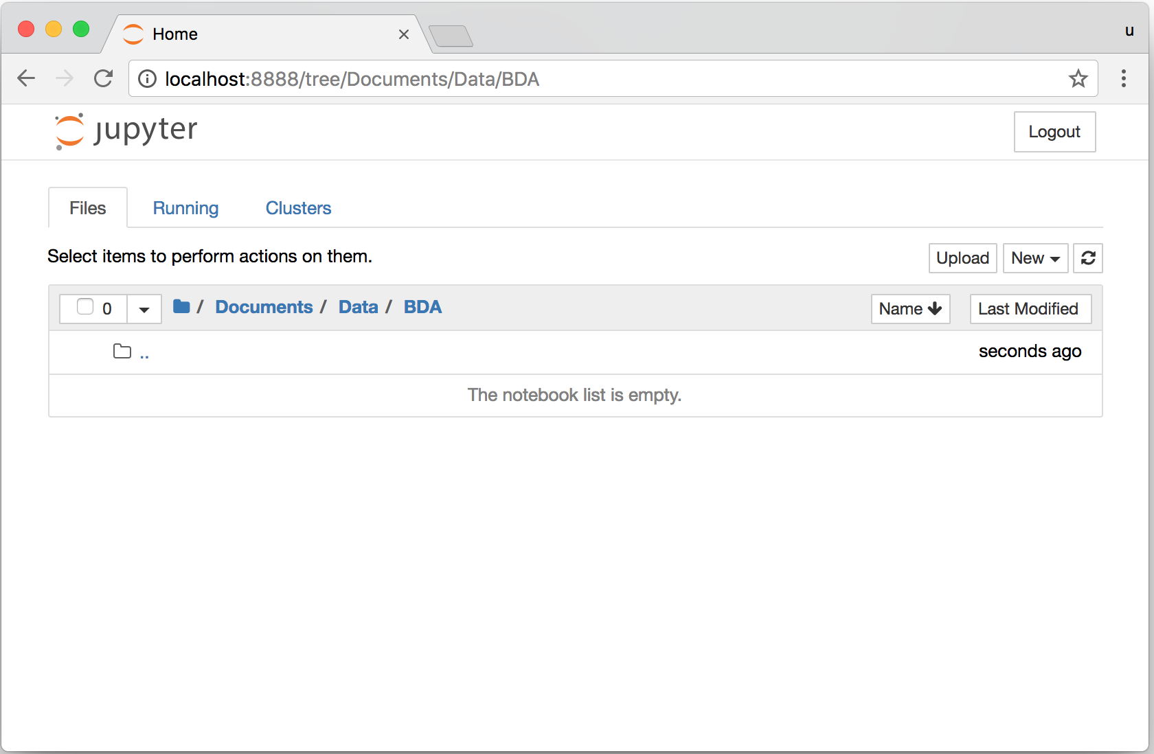
Jupyter Notebook

Slide 36
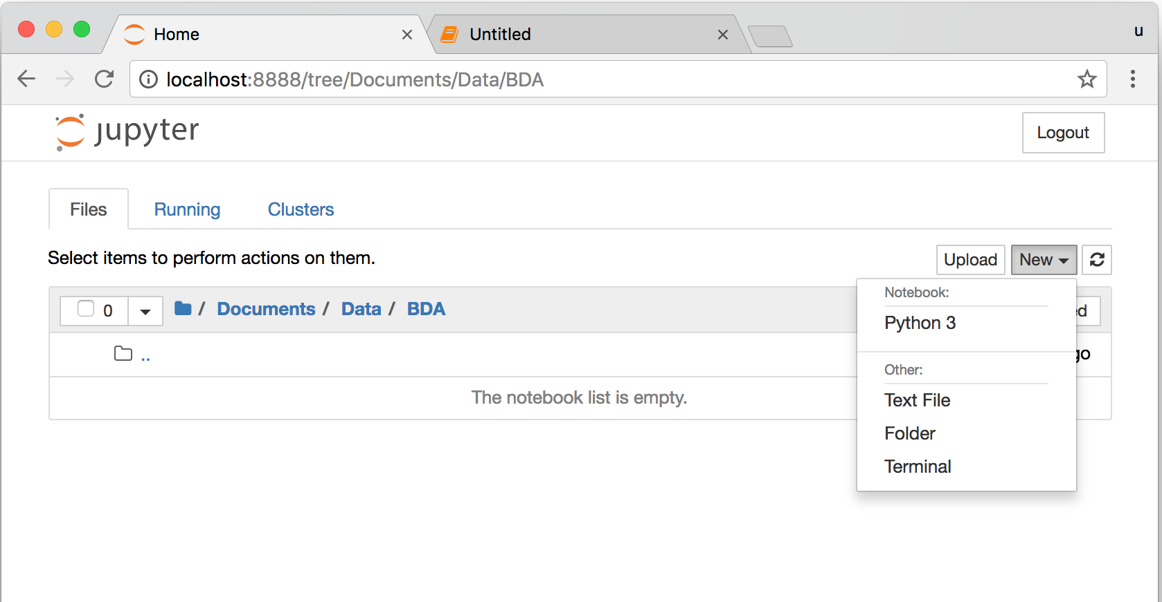
Jupyter Notebook
New Python 3

Slide 37
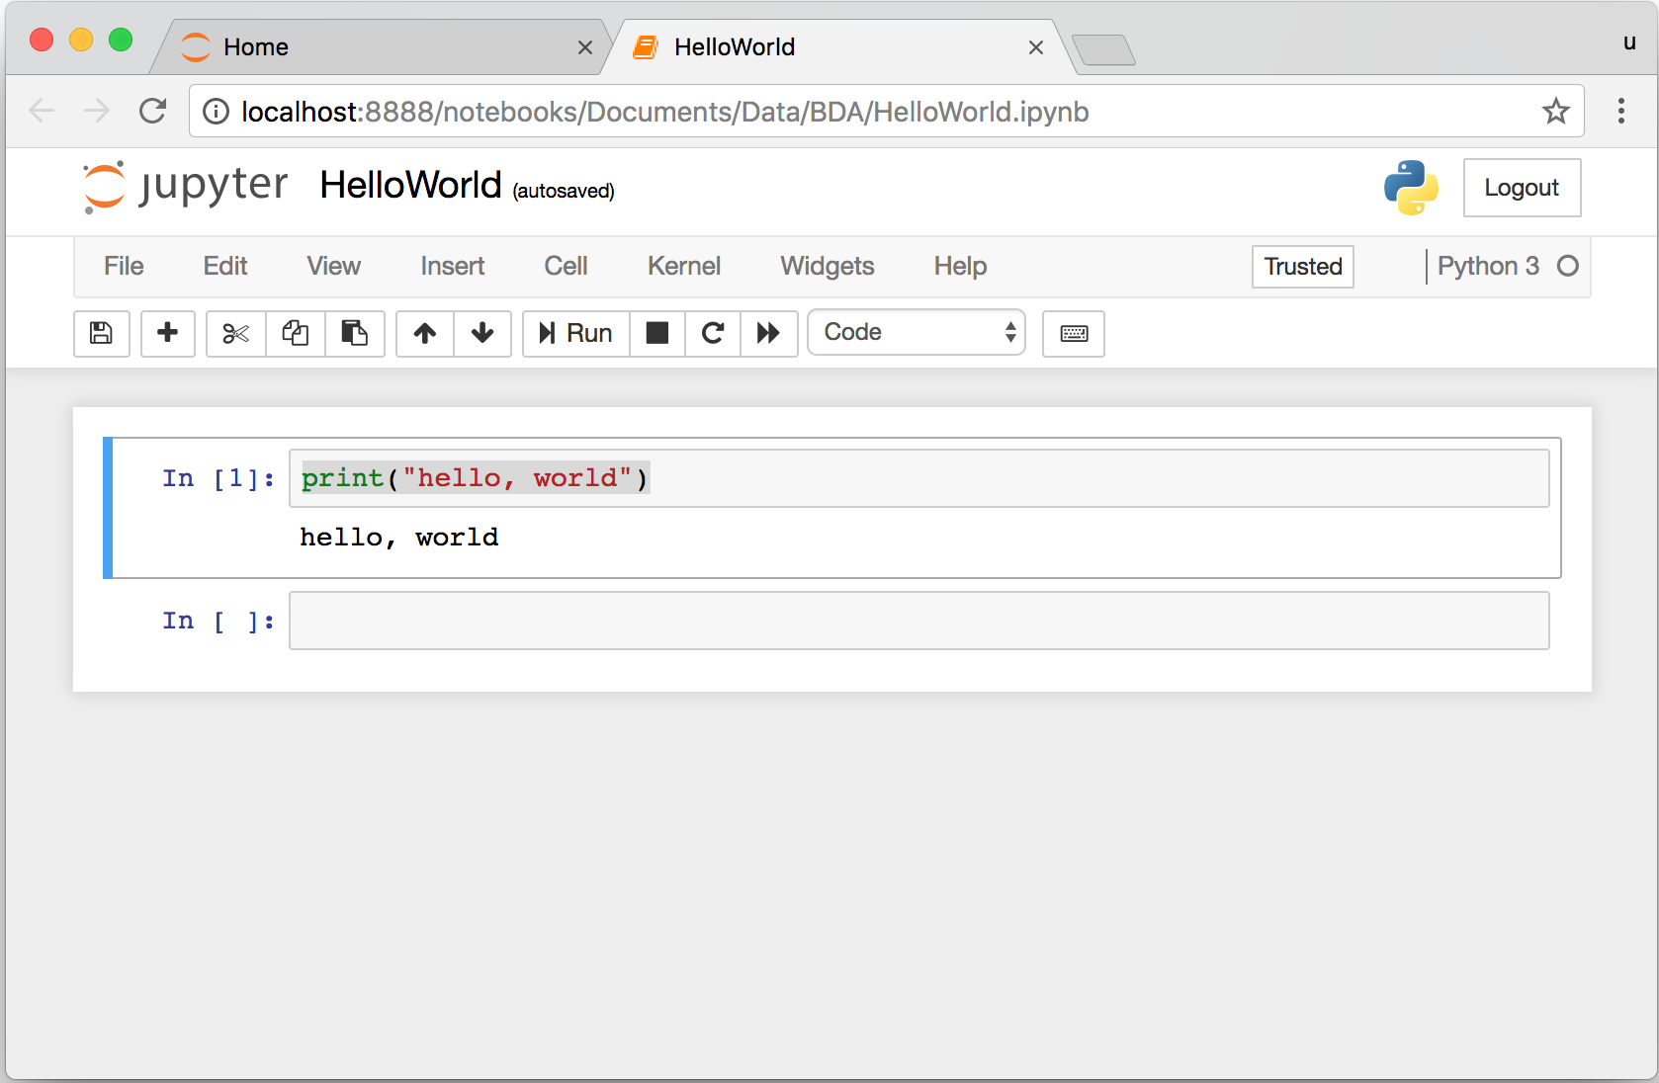
print("hello, world")
Notes:
print("hello, world")

Slide 38

Source: https://www.python.org/community/logos/

Slide 39
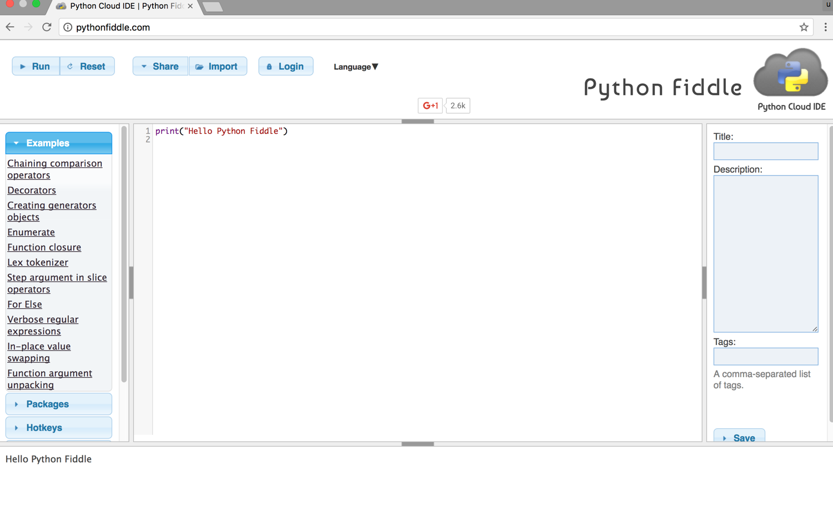
Python Fiddle
http://pythonfiddle.com/

Slide 40
Text input and output
print("Hello World")
print("Hello World\nThis is a message")
x = 3
print(x)
x = 2
y = 3
print(x, ' ', y)
name = input("Enter a name: ")
x = int(input("What is x? "))
x = float(input("Write a number "))
Source: http://pythonprogramminglanguage.com/text-input-and-output/
Notes:
print("Hello World")
print("Hello World\nThis is a message")
x = 3
print(x)
x = 2
y = 3
print(x, ' ', y)
name = input("Enter a name: ")
x = int(input("What is x? "))
x = float(input("Write a number "))

Slide 41
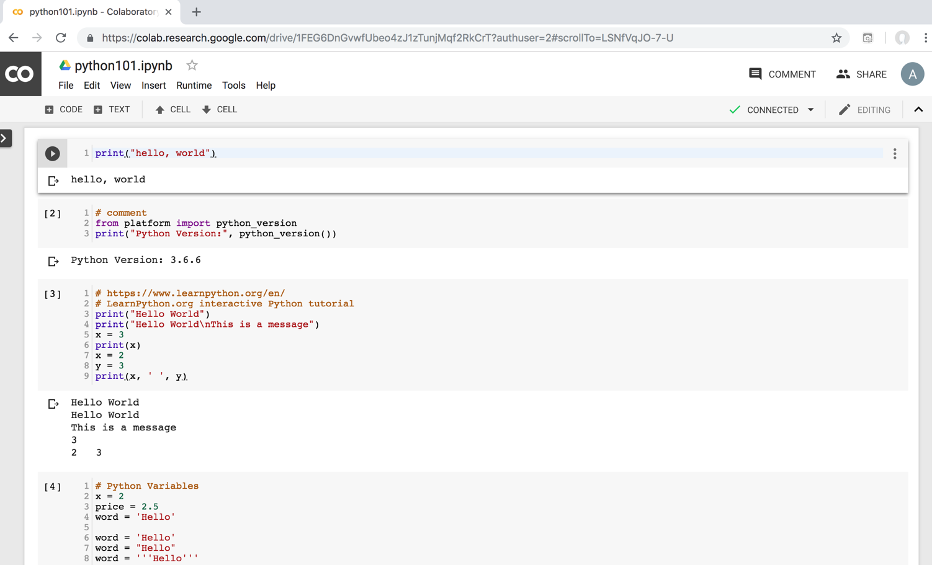
Python in Google Colab
https://colab.research.google.com/drive/1FEG6DnGvwfUbeo4zJ1zTunjMqf2RkCrT
https://tinyurl.com/aintpupython101

Slide 42
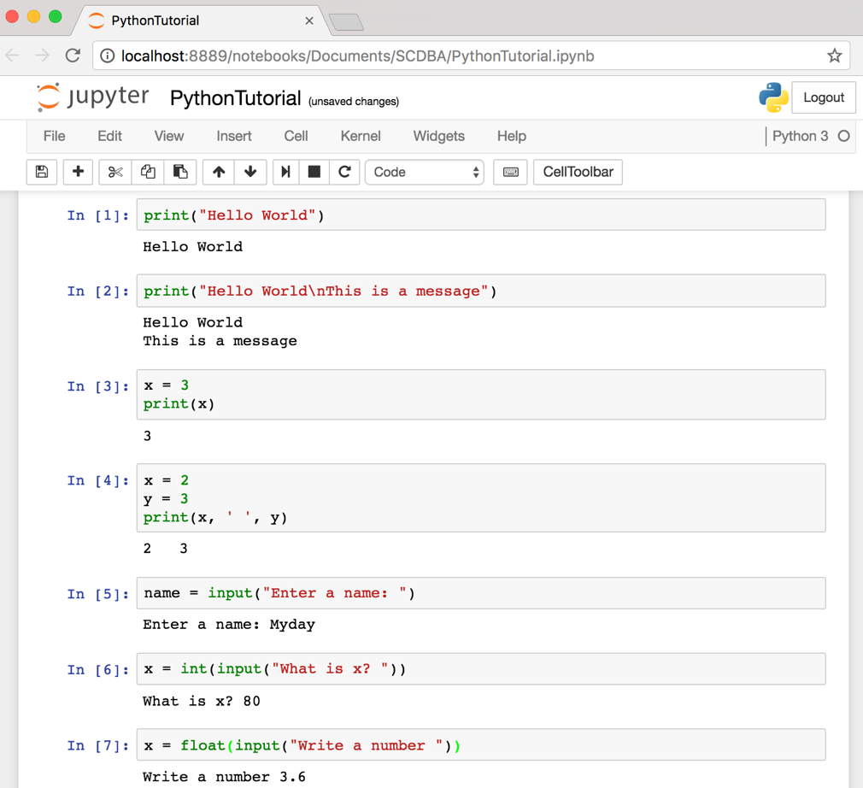
Text input and output
Source: http://pythonprogramminglanguage.com/text-input-and-output/
Notes:
print("Hello World")
print("Hello World\nThis is a message")
x = 3
print(x)
x = 2
y = 3
print(x, ' ', y)
name = input("Enter a name: ")
x = int(input("What is x? "))
x = float(input("Write a number "))

Slide 43
Data Science

Slide 44
AI, Big Data, Cloud Computing
Evolution of Decision Support, Business Intelligence, and Analytics
AI
AI
Cloud Computing
Big Data
DM
BI
Source: Ramesh Sharda, Dursun Delen, and Efraim Turban (2017),
Business Intelligence, Analytics, and Data Science: A Managerial Perspective, 4th Edition, Pearson

Slide 45
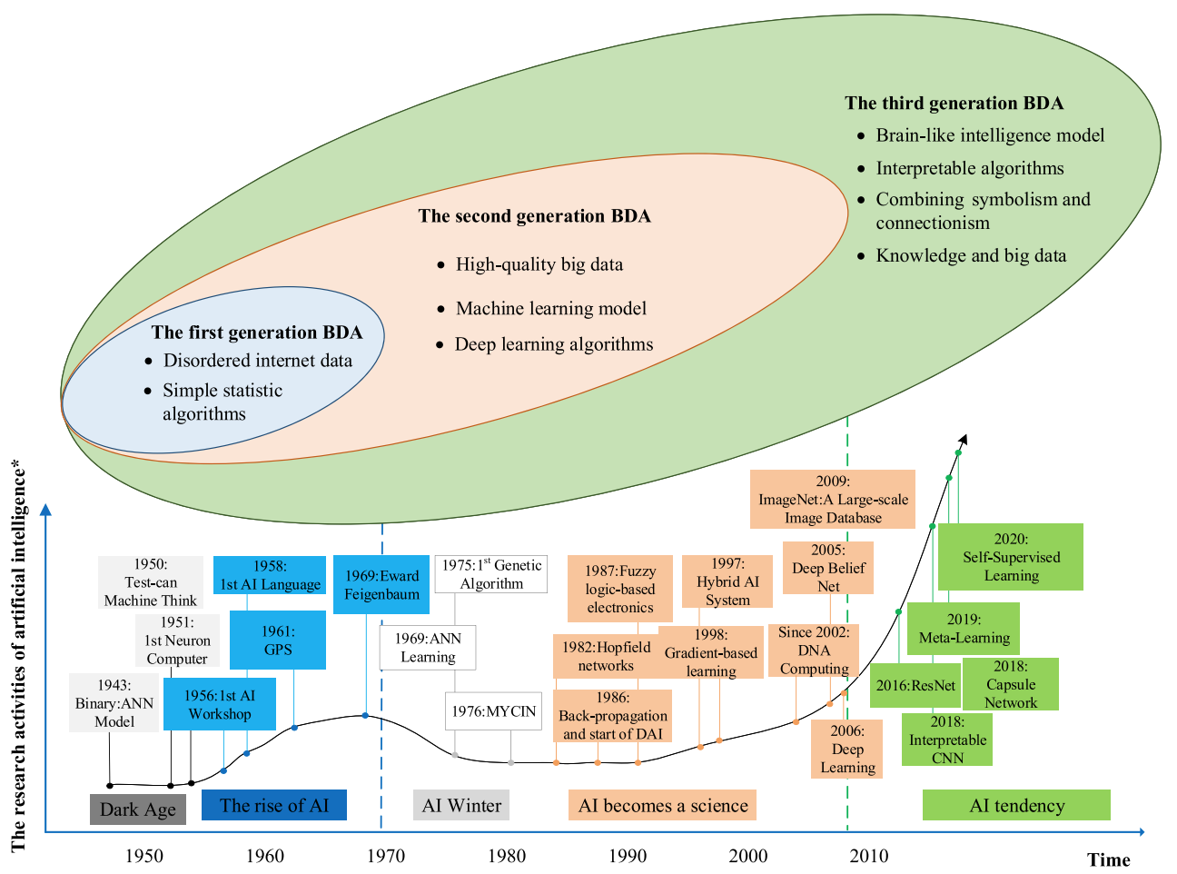
The Development of Big Data Analytics
Source: Wang, Junliang, Chuqiao Xu, Jie Zhang, and Ray Zhong (2022). "Big data analytics for intelligent manufacturing systems: A review." Journal of Manufacturing Systems 62 (2022): 738-752.

Slide 46
Data Analyst
Data analyst is just another term for professionals who were doing BI in the form of data compilation, cleaning, reporting, and perhaps some visualization.
Their skill sets included Excel, some SQL knowledge, and reporting.
You would recognize those capabilities as descriptive or reporting analytics.
Source: Ramesh Sharda, Dursun Delen, and Efraim Turban (2017), Business Intelligence, Analytics, and Data Science: A Managerial Perspective, 4th Edition, Pearson

Slide 47
Data Scientist
Data scientist is responsible for predictive analysis, statistical analysis, and more advanced analytical tools and algorithms.
They may have a deeper knowledge of algorithms and may recognize them under various labels—data mining, knowledge discovery, or machine learning.
Some of these professionals may also need deeper programming knowledge to be able to write code for data cleaning/analysis in current Web-oriented languages such as Java or Python and statistical languages such as R.
Many analytics professionals also need to build significant expertise in statistical modeling, experimentation, and analysis.
Source: Ramesh Sharda, Dursun Delen, and Efraim Turban (2017), Business Intelligence, Analytics, and Data Science: A Managerial Perspective, 4th Edition, Pearson

Slide 48
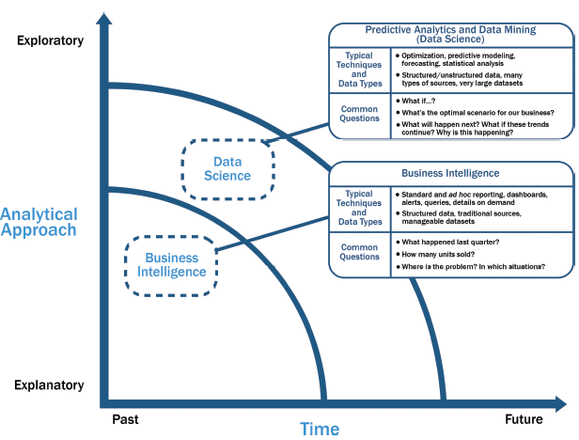
Data Science and
Business Intelligence
Source: EMC Education Services, Data Science and Big Data Analytics: Discovering, Analyzing, Visualizing and Presenting Data, Wiley, 2015

Slide 49
Data Science and
Business Intelligence
Predictive Analytics
and Data Mining
(Data Science)
Source: EMC Education Services, Data Science and Big Data Analytics: Discovering, Analyzing, Visualizing and Presenting Data, Wiley, 2015

Slide 50
Data Science and
Business Intelligence
Predictive Analytics
and Data Mining
(Data Science)
Structured/unstructured data, many types of sources,
very large datasets
Optimization, predictive modeling, forecasting statistical analysis
What if…?
What’s the optimal scenario for our business?
What will happen next?
What if these trends countinue?
Why is this happening?
Source: EMC Education Services, Data Science and Big Data Analytics: Discovering, Analyzing, Visualizing and Presenting Data, Wiley, 2015

Slide 51
Profile of a Data Scientist
Quantitative
  mathematics or statistics
Technical
  software engineering,
  machine learning,
  and programming skills
Skeptical mind-set and critical thinking
Curious and creative
Communicative and collaborative
Source: EMC Education Services, Data Science and Big Data Analytics: Discovering, Analyzing, Visualizing and Presenting Data, Wiley, 2015

Slide 52
Data Scientist Profile
Quantitative
Technical
Curious
and
Creative
Data Scientist
Skeptical
Communicative
and
Collaborative
Source: EMC Education Services, Data Science and Big Data Analytics: Discovering, Analyzing, Visualizing and Presenting Data, Wiley, 2015

Slide 53
Big Data Analytics Lifecycle

Slide 54
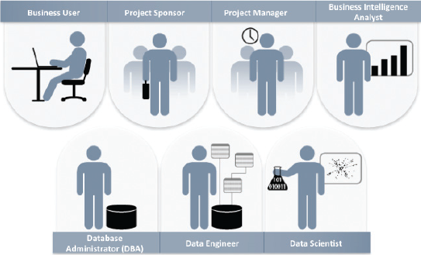
Key Roles for a
Successful Analytics Project
Source: EMC Education Services, Data Science and Big Data Analytics: Discovering, Analyzing, Visualizing and Presenting Data, Wiley, 2015

Slide 55
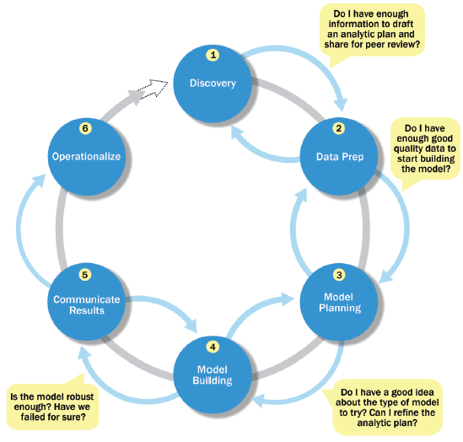
Overview of Data Analytics Lifecycle
Source: EMC Education Services, Data Science and Big Data Analytics: Discovering, Analyzing, Visualizing and Presenting Data, Wiley, 2015

Slide 56
Overview of Data Analytics Lifecycle
1. Discovery
2. Data preparation
3. Model planning
4. Model building
5. Communicate results
6. Operationalize
Source: EMC Education Services, Data Science and Big Data Analytics: Discovering, Analyzing, Visualizing and Presenting Data, Wiley, 2015

Slide 57
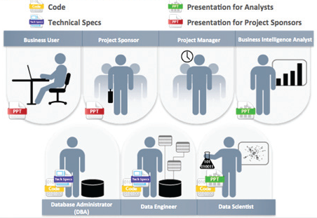
Key Outputs from a
Successful Analytics Project
Source: EMC Education Services, Data Science and Big Data Analytics: Discovering, Analyzing, Visualizing and Presenting Data, Wiley, 2015

Slide 58
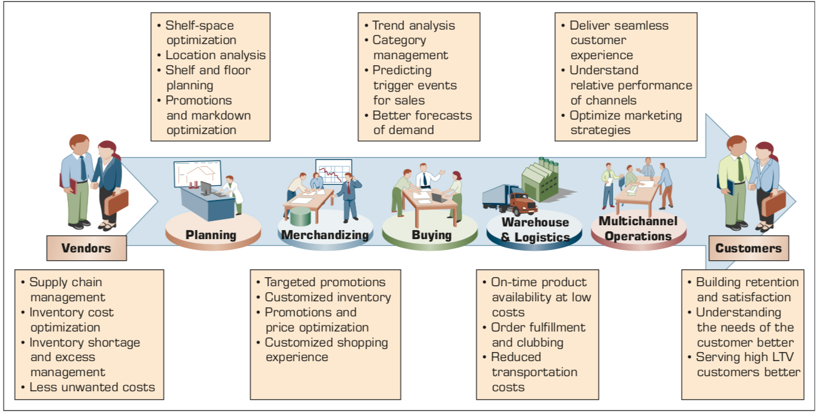
Example of Analytics Applications in a Retail Value Chain
Retail Value Chain
Critical needs at every touch point of the Retail Value Chain
Source: Ramesh Sharda, Dursun Delen, and Efraim Turban (2017), Business Intelligence, Analytics, and Data Science: A Managerial Perspective, 4th Edition, Pearson

Slide 59
Analytics Ecosystem
Source: Ramesh Sharda, Dursun Delen, and Efraim Turban (2017), Business Intelligence, Analytics, and Data Science: A Managerial Perspective, 4th Edition, Pearson

Slide 60
Job Titles of Analytics
Source: Ramesh Sharda, Dursun Delen, and Efraim Turban (2017), Business Intelligence, Analytics, and Data Science: A Managerial Perspective, 4th Edition, Pearson

Slide 61
Three Types of Analytics
Source: Ramesh Sharda, Dursun Delen, and Efraim Turban (2017), Business Intelligence, Analytics, and Data Science: A Managerial Perspective, 4th Edition, Pearson

Slide 62
A Data to Knowledge Continuum
Source: Ramesh Sharda, Dursun Delen, and Efraim Turban (2017), Business Intelligence, Analytics, and Data Science: A Managerial Perspective, 4th Edition, Pearson

Slide 63
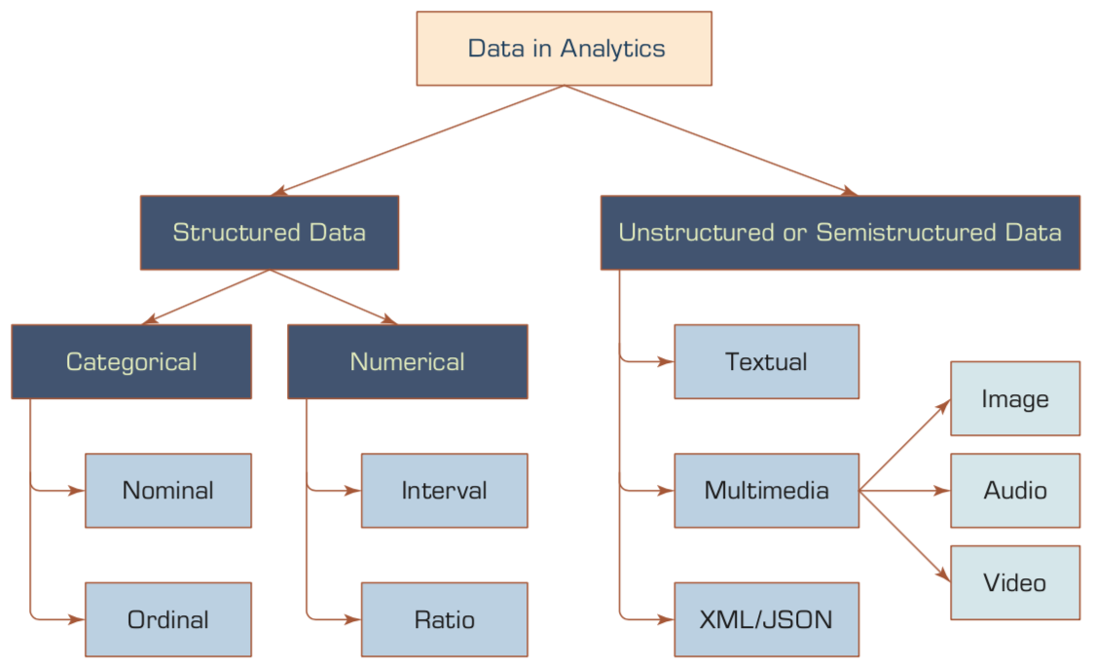
A Simple Taxonomy of Data
Source: Ramesh Sharda, Dursun Delen, and Efraim Turban (2017), Business Intelligence, Analytics, and Data Science: A Managerial Perspective, 4th Edition, Pearson

Slide 64
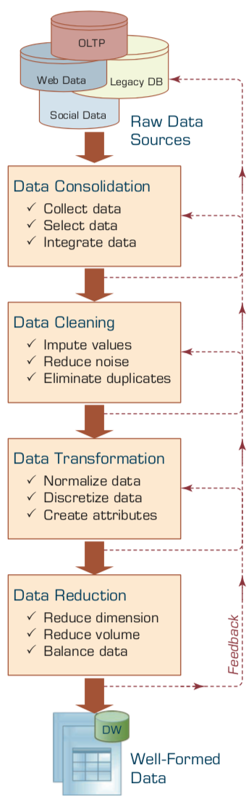
Data Preprocessing Steps
Source: Ramesh Sharda, Dursun Delen, and Efraim Turban (2017), Business Intelligence, Analytics, and Data Science: A Managerial Perspective, 4th Edition, Pearson

Slide 65
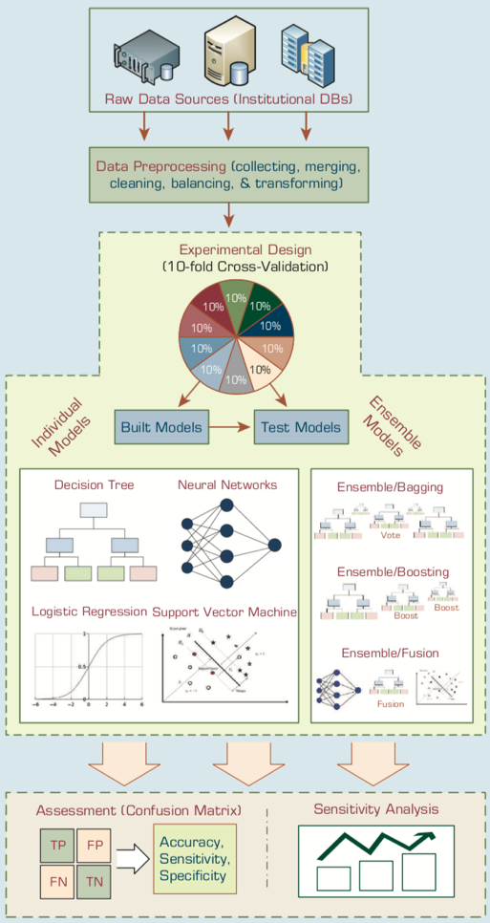
An Analytics Approach to Predicting Student Attrition
Source: Ramesh Sharda, Dursun Delen, and Efraim Turban (2017), Business Intelligence, Analytics, and Data Science: A Managerial Perspective, 4th Edition, Pearson

Slide 66
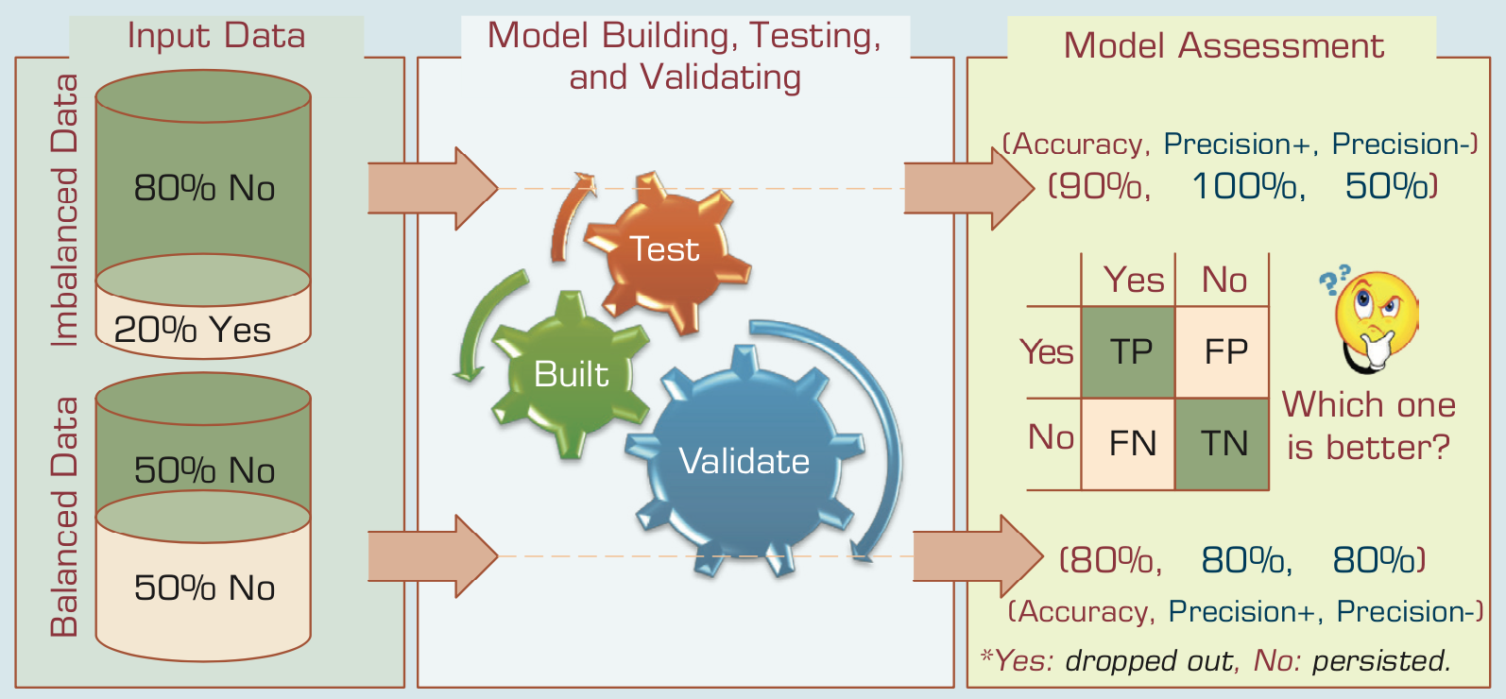
A Graphical Depiction of the
Class Imbalance Problem
Source: Ramesh Sharda, Dursun Delen, and Efraim Turban (2017), Business Intelligence, Analytics, and Data Science: A Managerial Perspective, 4th Edition, Pearson

Slide 67
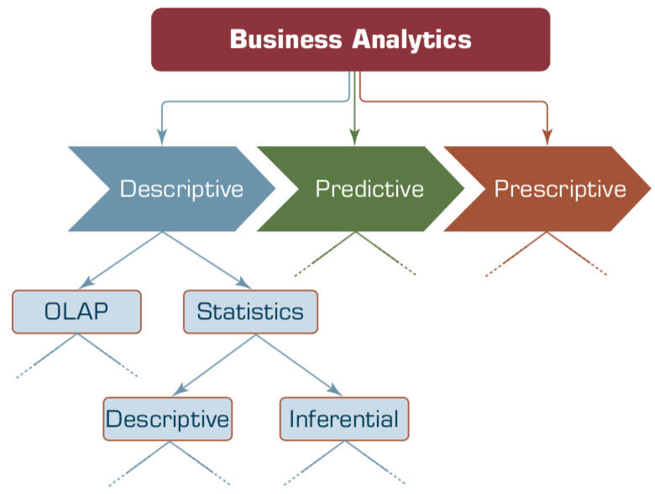
Relationship between Statistics and Descriptive Analytics
Source: Ramesh Sharda, Dursun Delen, and Efraim Turban (2017), Business Intelligence, Analytics, and Data Science: A Managerial Perspective, 4th Edition, Pearson

Slide 68
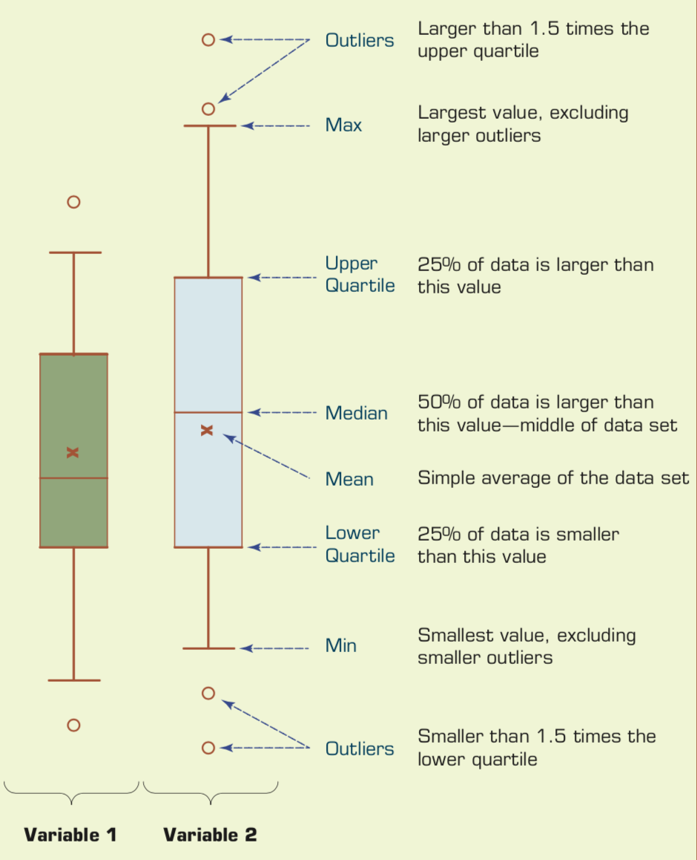
Understanding the Specifics about
Box-and-Whiskers Plots
Source: Ramesh Sharda, Dursun Delen, and Efraim Turban (2017), Business Intelligence, Analytics, and Data Science: A Managerial Perspective, 4th Edition, Pearson

Slide 69
Summary
Python Programming
Data Science

Slide 70
References
Wes McKinney (2022), "Python for Data Analysis: Data Wrangling with pandas, NumPy, and Jupyter", 3rd Edition, O'Reilly Media.
Aurélien Géron (2023), Hands-On Machine Learning with Scikit-Learn, Keras, and TensorFlow: Concepts, Tools, and Techniques to Build Intelligent Systems, 3rd Edition, O’Reilly Media.
Steven D'Ascoli (2022), Artificial Intelligence and Deep Learning with Python: Every Line of Code Explained For Readers New to AI and New to Python, Independently published.
Stuart Russell and Peter Norvig (2020), Artificial Intelligence: A Modern Approach, 4th Edition, Pearson.
Varun Grover, Roger HL Chiang, Ting-Peng Liang, and Dongsong Zhang (2018), "Creating Strategic Business Value from Big Data Analytics: A Research Framework", Journal of Management Information Systems, 35, no. 2, pp. 388-423.
Junliang Wang, Chuqiao Xu, Jie Zhang, and Ray Zhong (2022). "Big data analytics for intelligent manufacturing systems: A review." Journal of Manufacturing Systems 62 (2022): 738-752.
Ramesh Sharda, Dursun Delen, and Efraim Turban (2017), Business Intelligence, Analytics, and Data Science: A Managerial Perspective, 4th Edition, Pearson
Python Programming, https://pythonprogramming.net/
Python, https://www.python.org/
Python Programming Language, http://pythonprogramminglanguage.com/
Numpy, http://www.numpy.org/
Pandas, http://pandas.pydata.org/
Skikit-learn, http://scikit-learn.org/
W3Schools Python, https://www.w3schools.com/python/
Learn Python, https://www.learnpython.org/
Google’s Python Class, https://developers.google.com/edu/python
Min-Yuh Day (2023), Python 101, https://tinyurl.com/aintpupython101

