Slide 1
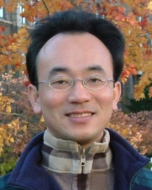
Files and Exception Handling
Python for Accounting Applications
1121PAA07
ACC2, NTPU (M5265) (Fall 2023) Wed 6, 7, 8, (14:10-17:00) (9:10-12:00) (B3F10)
Min-Yuh Day, Ph.D, Associate Professor
Institute of Information Management, National Taipei University
https://web.ntpu.edu.tw/~myday
2023-10-25

Slide 2
Syllabus
Week Date Subject/Topics
1 2023/09/13 Introduction to Python for Accounting Applications
2 2023/09/20 Python Programming and Data Science
3 2023/09/27 Foundations of Python Programming
4 2023/10/04 Data Structures
5 2023/10/11 Control Logic and Loops
6 2023/10/18 Functions and Modules
7 2023/10/25 Files and Exception Handling
8 2023/11/01 Midterm Project Report

Slide 3
Syllabus
Week Date Subject/Topics
9 2023/11/08 Data Analytics and Visualization with Python
10 2023/11/15 Obtaining Data From the Web with Python
11 2023/11/22 Statistical Analysis with Python
12 2023/11/29 Machine Learning with Python
13 2023/12/06 Text Analytics with Python and Large Language Models (LLMs)
14 2023/12/13 Applications of Accounting Data Analytics with Python
15 2023/12/20 Applications of ESG Data Analytics with Python
16 2023/12/27 Final Project Report

Slide 4
Files and Exception Handling

Slide 5
Outline
Python Files (File Handling)
open()
f = open("myfile.txt")
Python Try Except (Exception Handling)
try: except: else: finally:

Slide 6
Python Programming

Slide 7
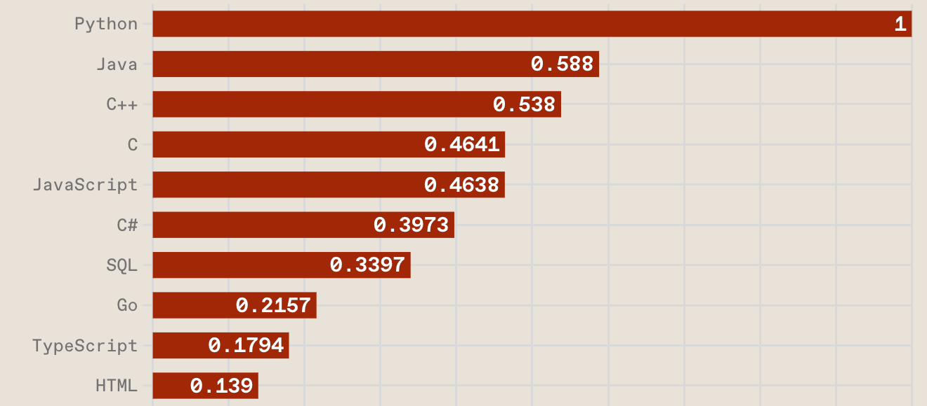
Top Programming Languages
https://spectrum.ieee.org/the-top-programming-languages-2023

Slide 8
Python is an interpreted, object-oriented, high-level programming language with dynamic semantics.
Source: https://www.python.org/doc/essays/blurb/

Slide 9
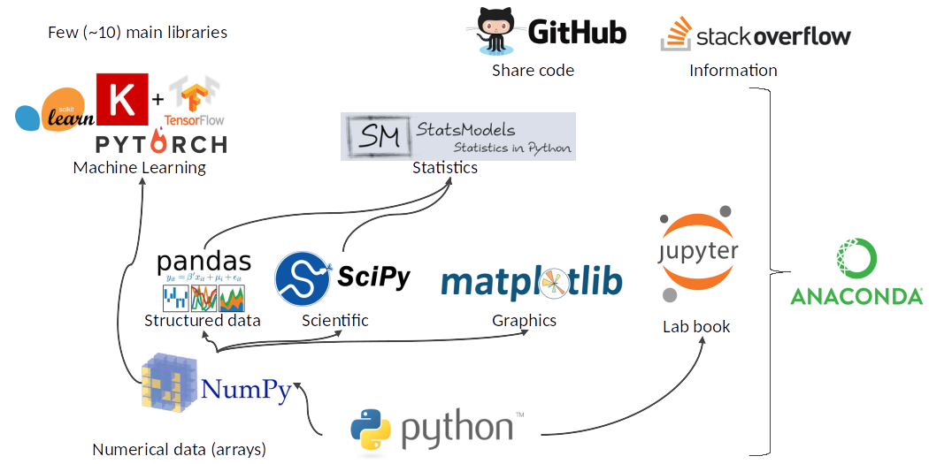
Python Ecosystem for Data Science
Source: https://medium.com/pyfinance/why-python-is-best-choice-for-financial-data-modeling-in-2019-c0d0d1858c45

Slide 10
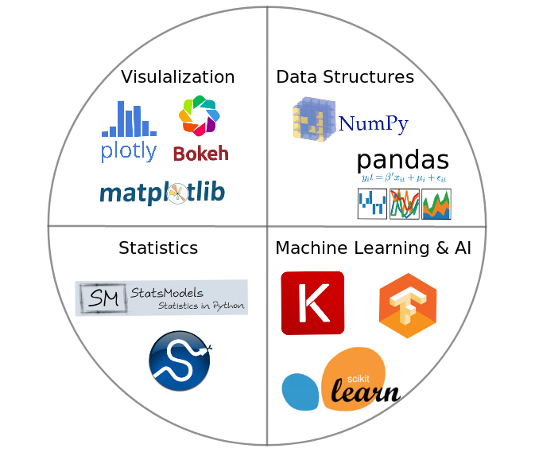
Python Ecosystem for Data Science
Source:https://duchesnay.github.io/pystatsml/introduction/python_ecosystem.html

Slide 11
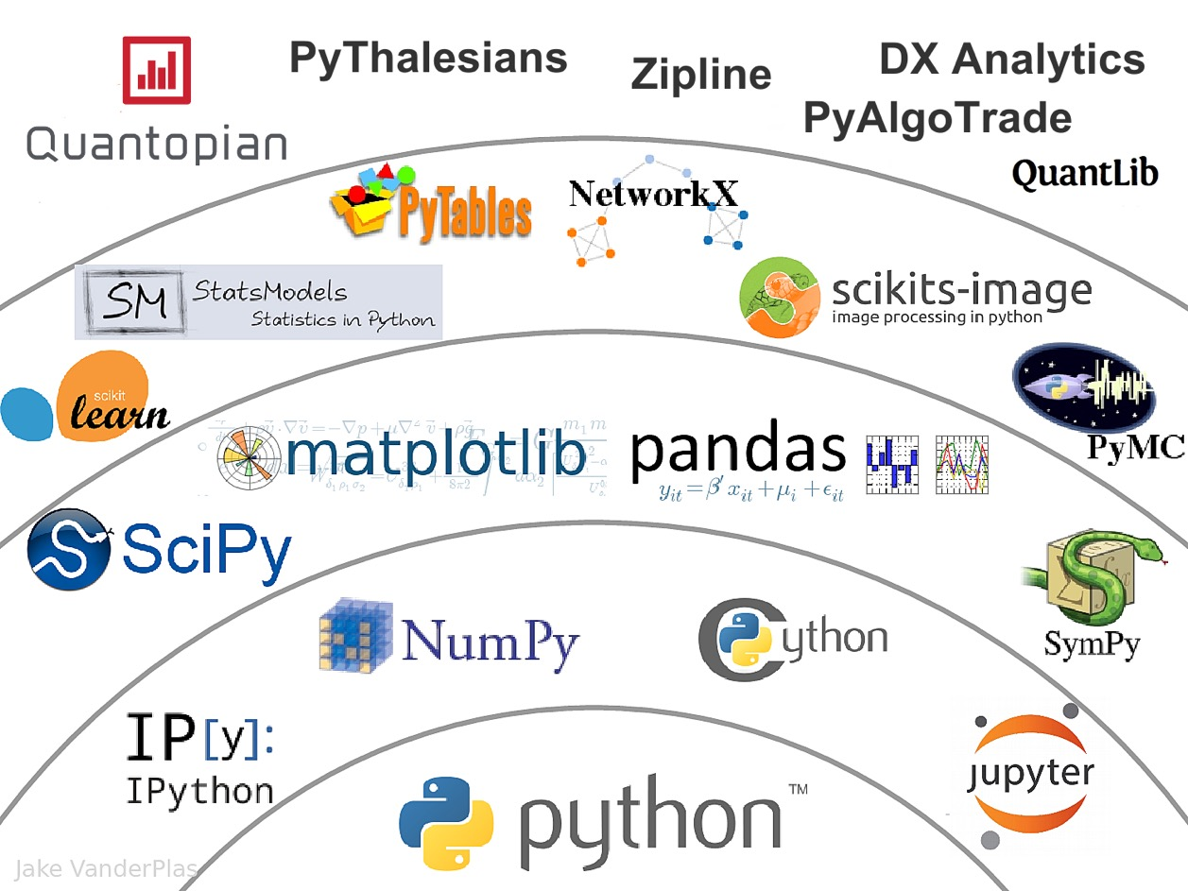
The Quant Finance PyData Stack
Source: http://nbviewer.jupyter.org/format/slides/github/quantopian/pyfolio/blob/master/pyfolio/examples/overview_slides.ipynb#/5

Slide 12
Numpy
NumPy
Base N-dimensional array package

Slide 13
Python matplotlib
Source: https://matplotlib.org/

Slide 14
Python Pandas
http://pandas.pydata.org/

Slide 15
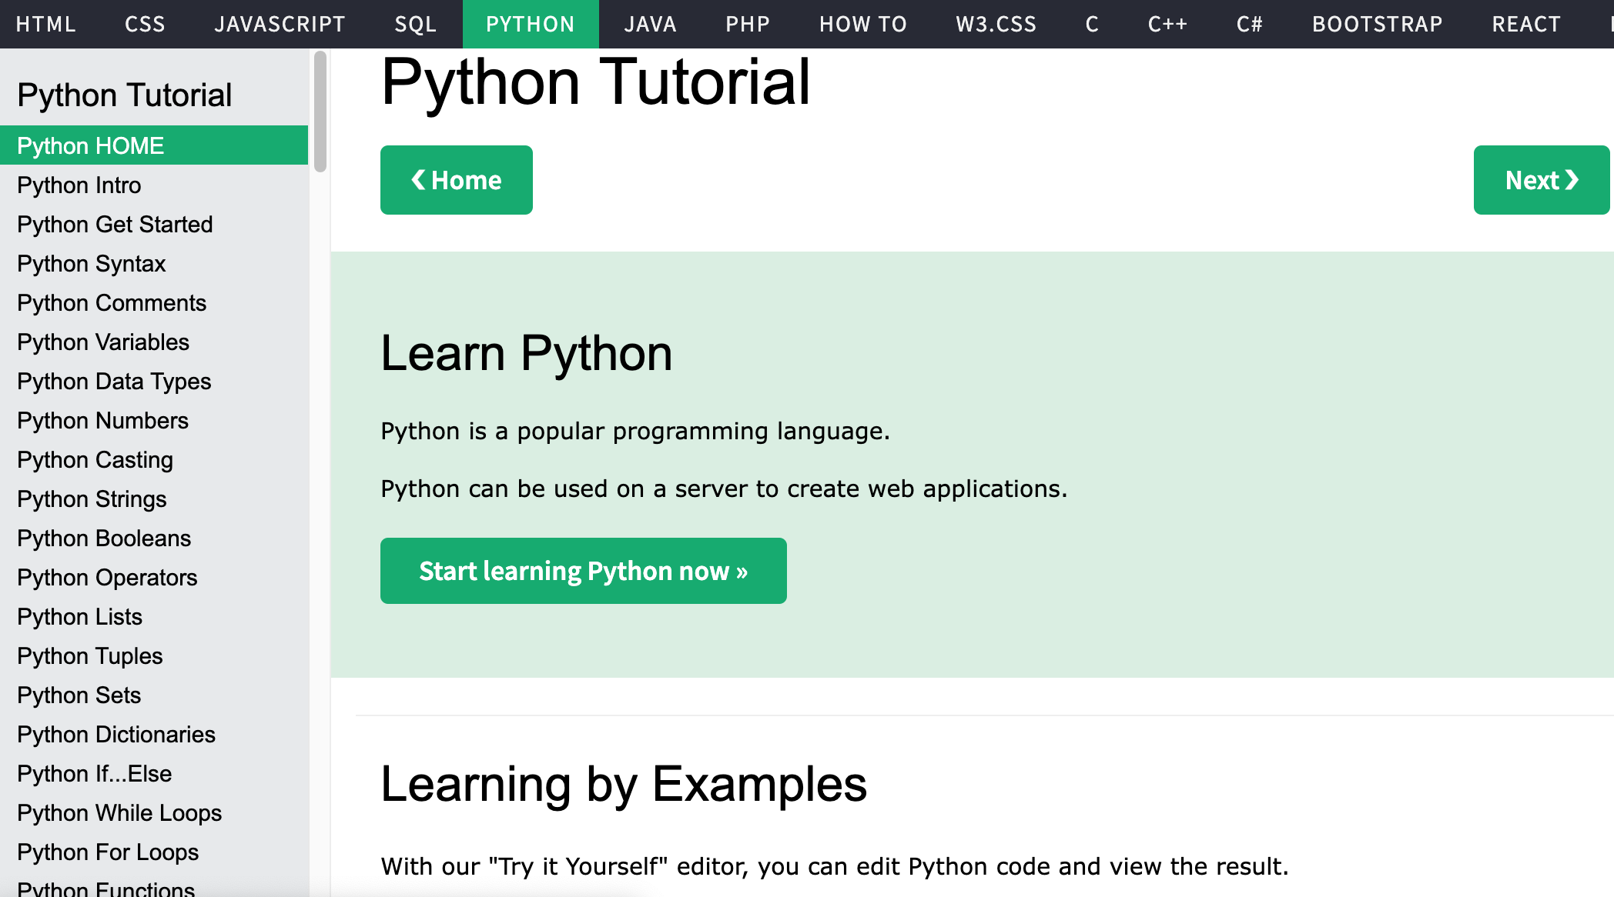
W3Schools Python
https://www.w3schools.com/python/

Slide 16
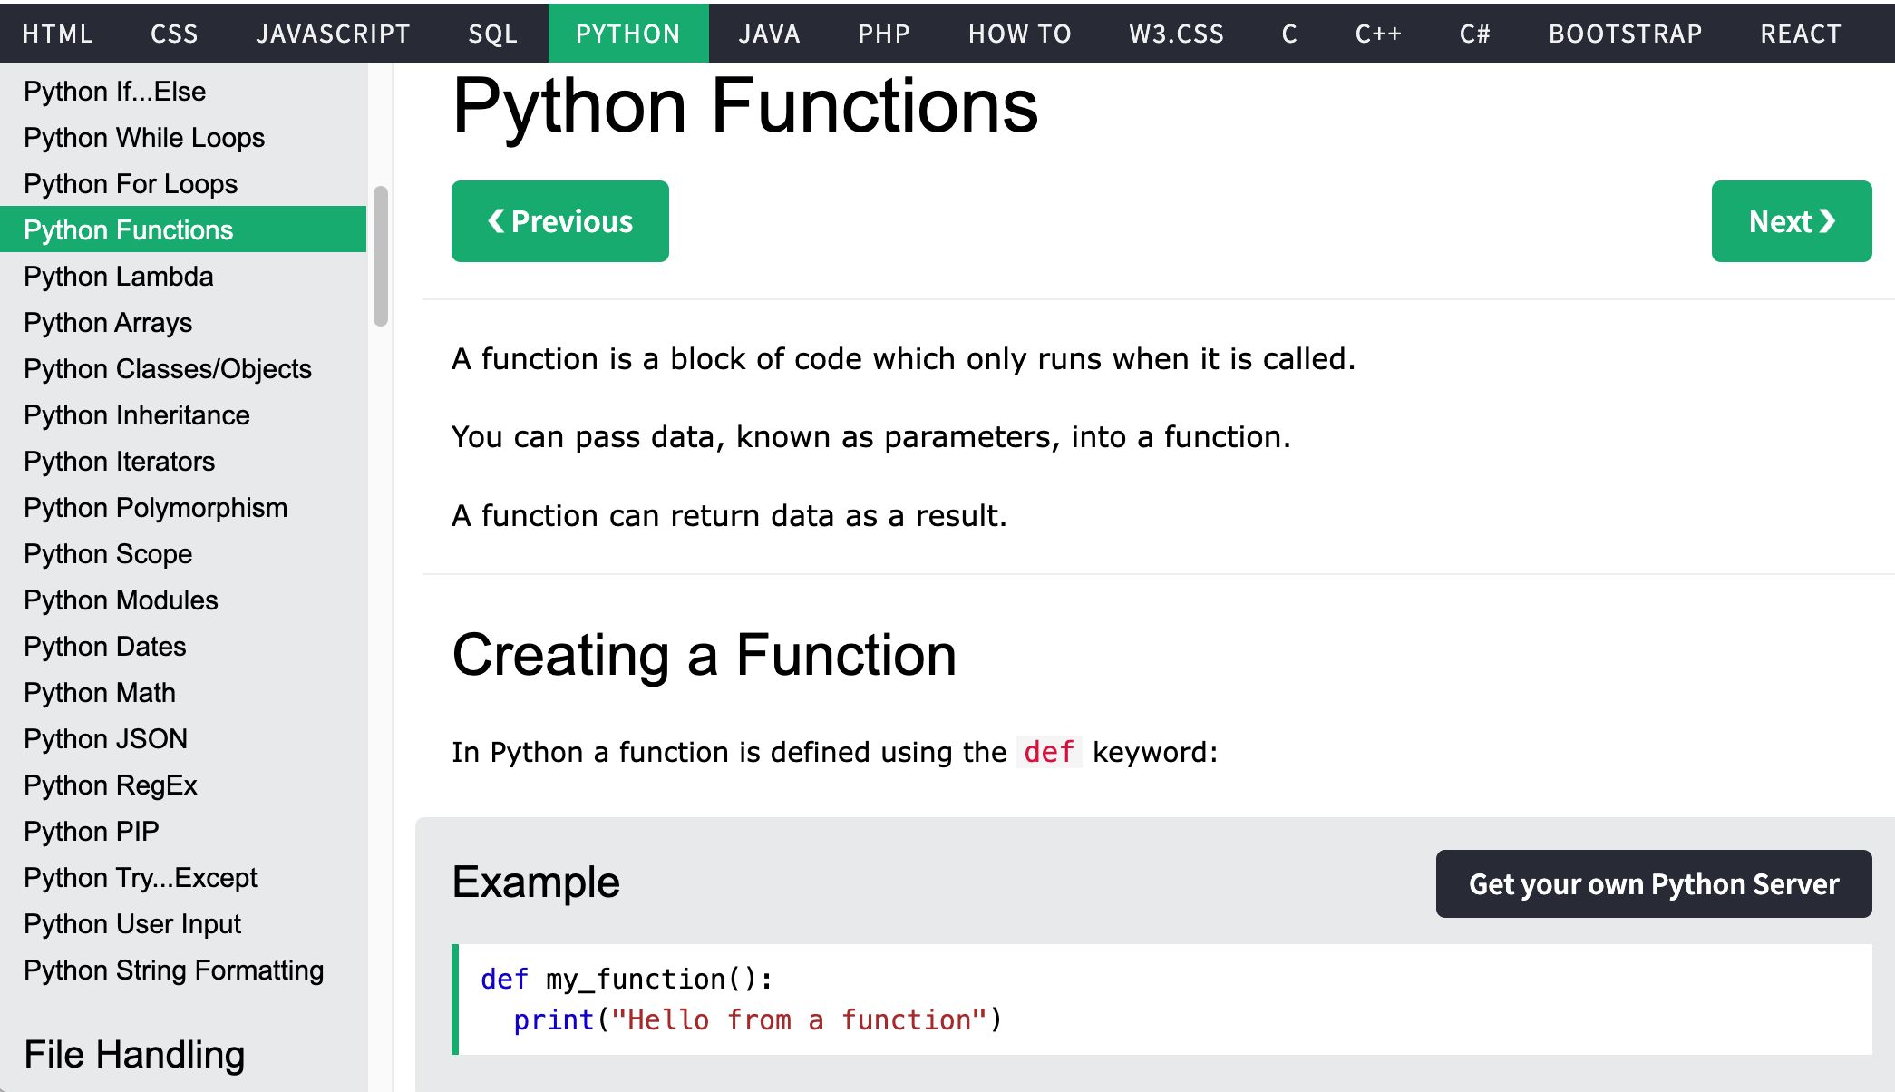
W3Schools Python
https://www.w3schools.com/python/

Slide 17
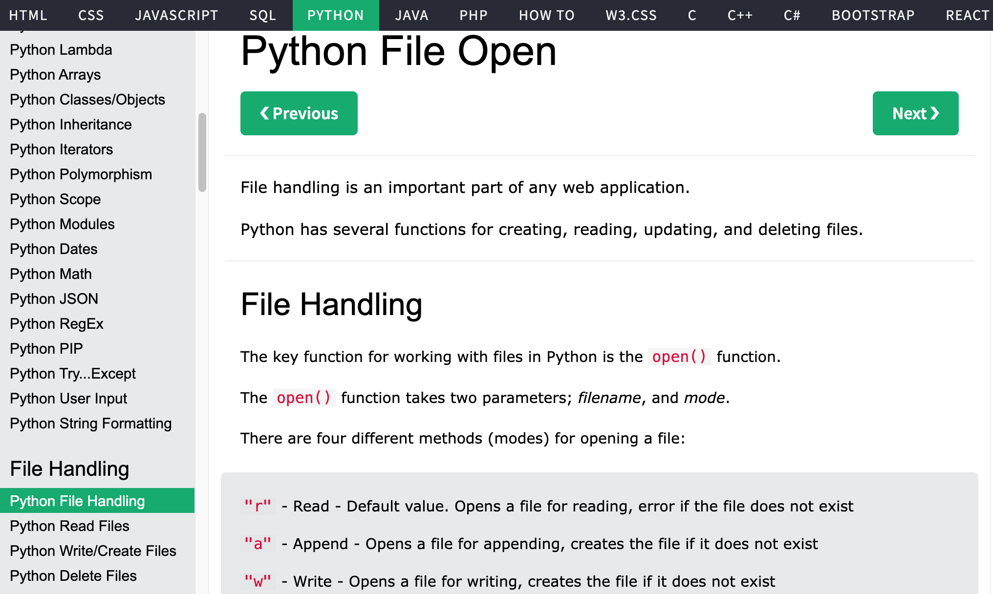
W3Schools Python
https://www.w3schools.com/python/

Slide 18
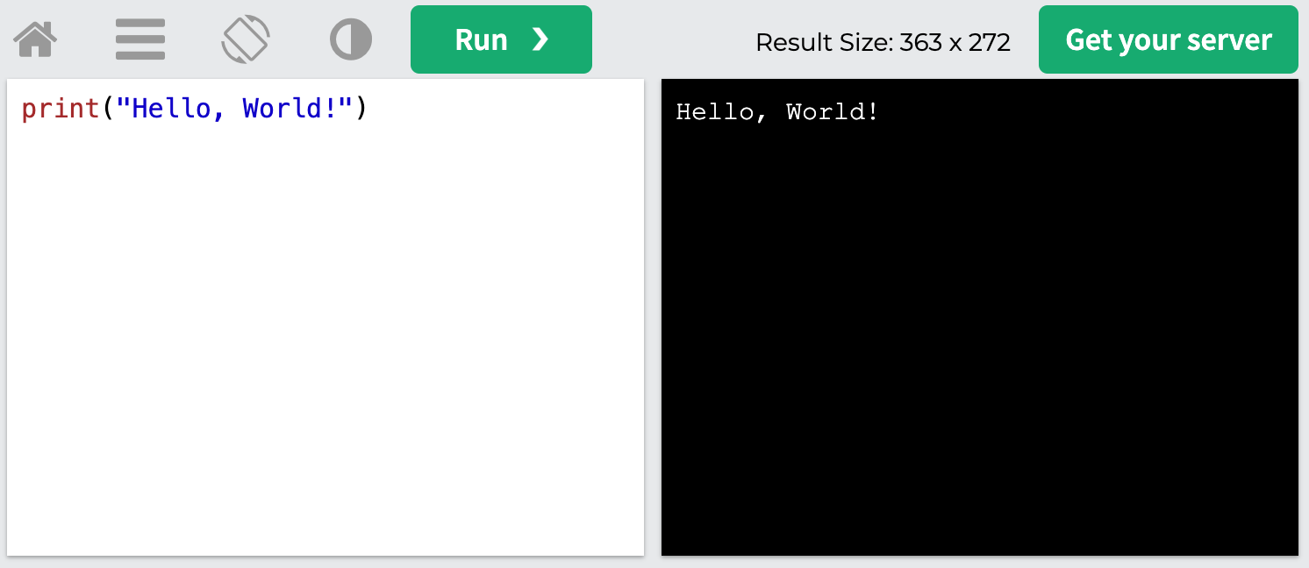
W3Schools Python: Try Python
https://www.w3schools.com/python/trypython.asp?filename=demo_default

Slide 19
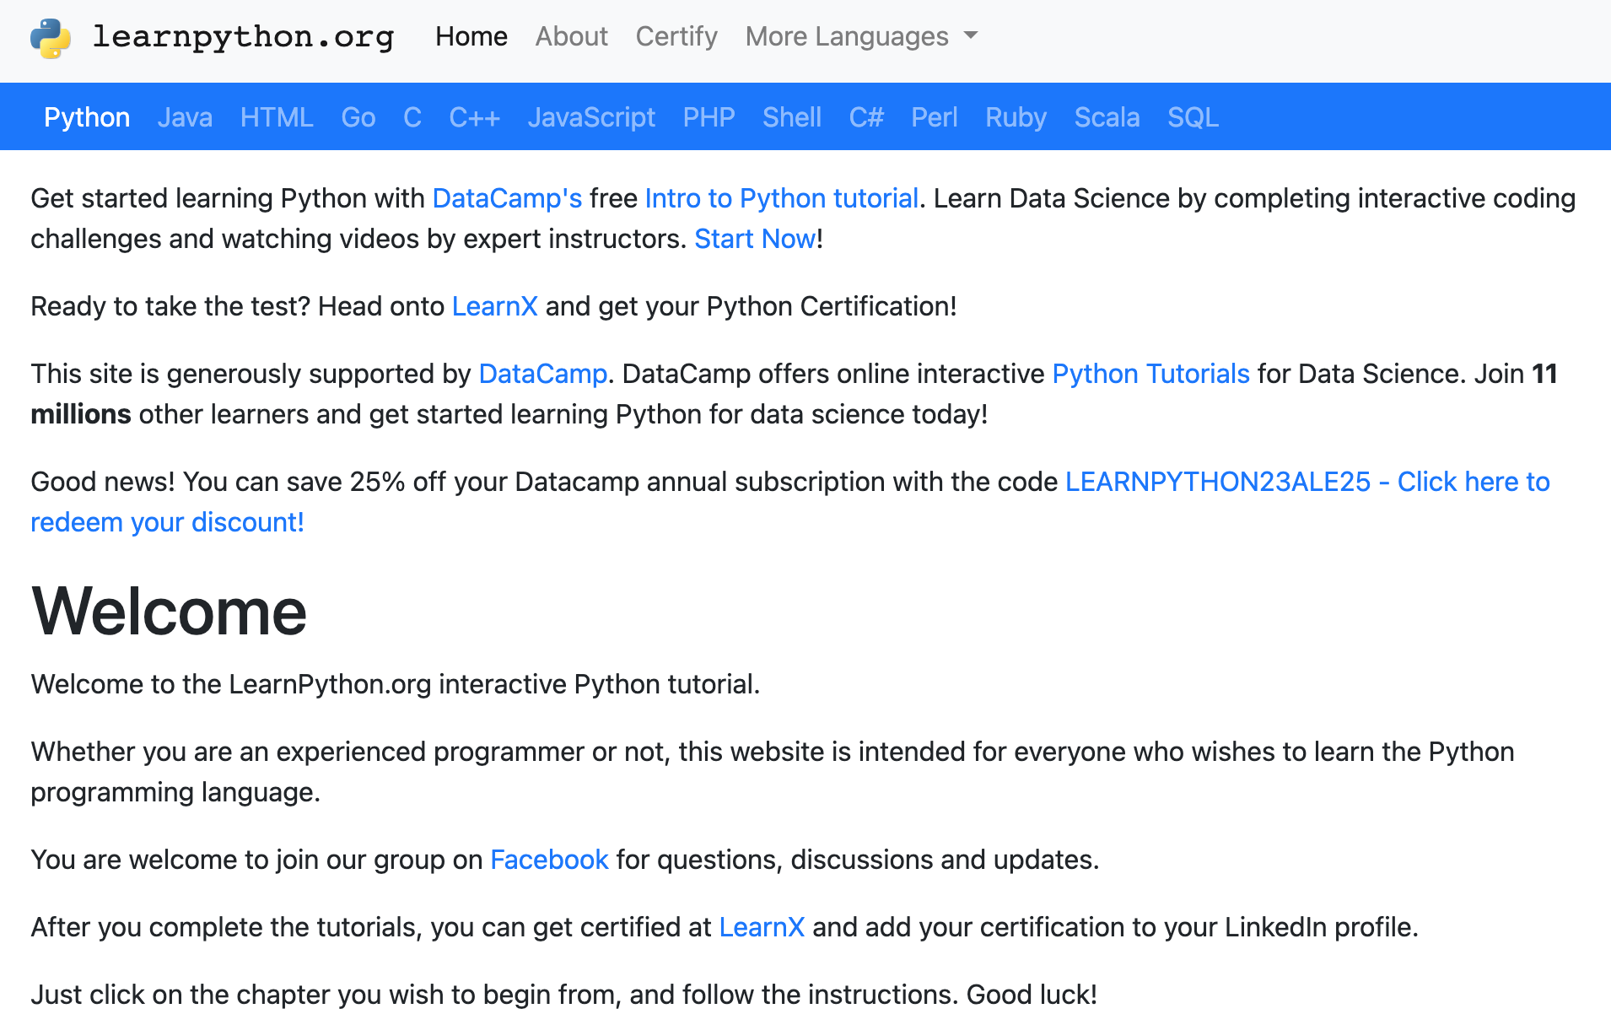
LearnPython.org
https://www.learnpython.org/

Slide 20
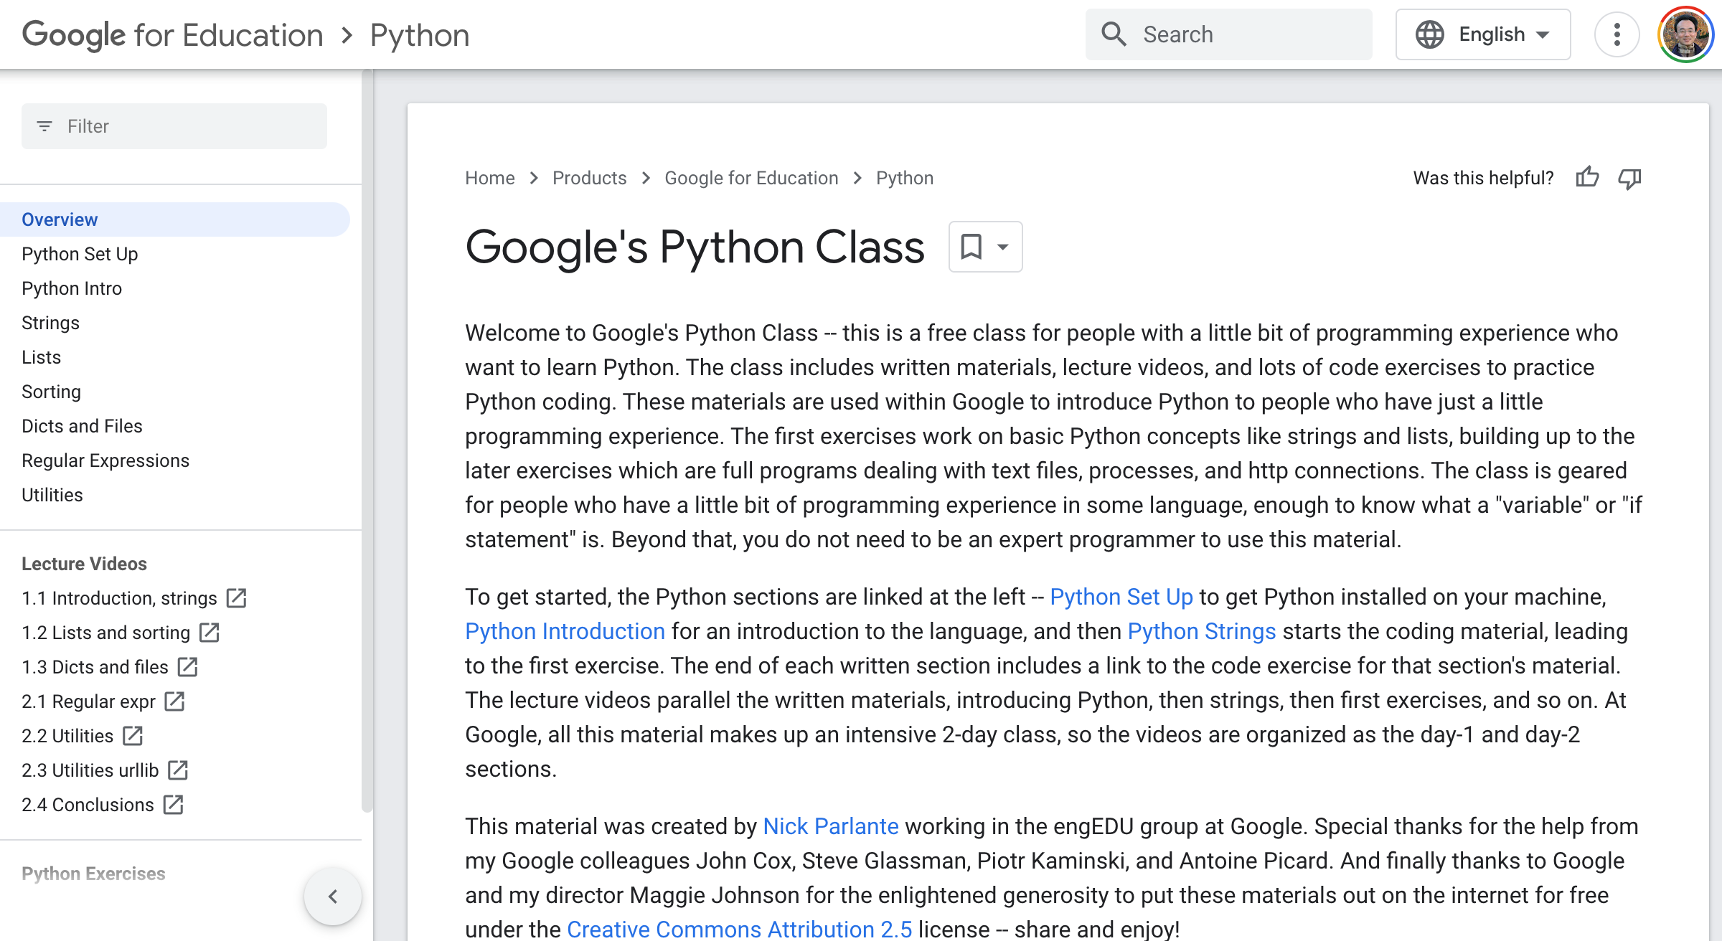
Google’s Python Class
https://developers.google.com/edu/python

Slide 21
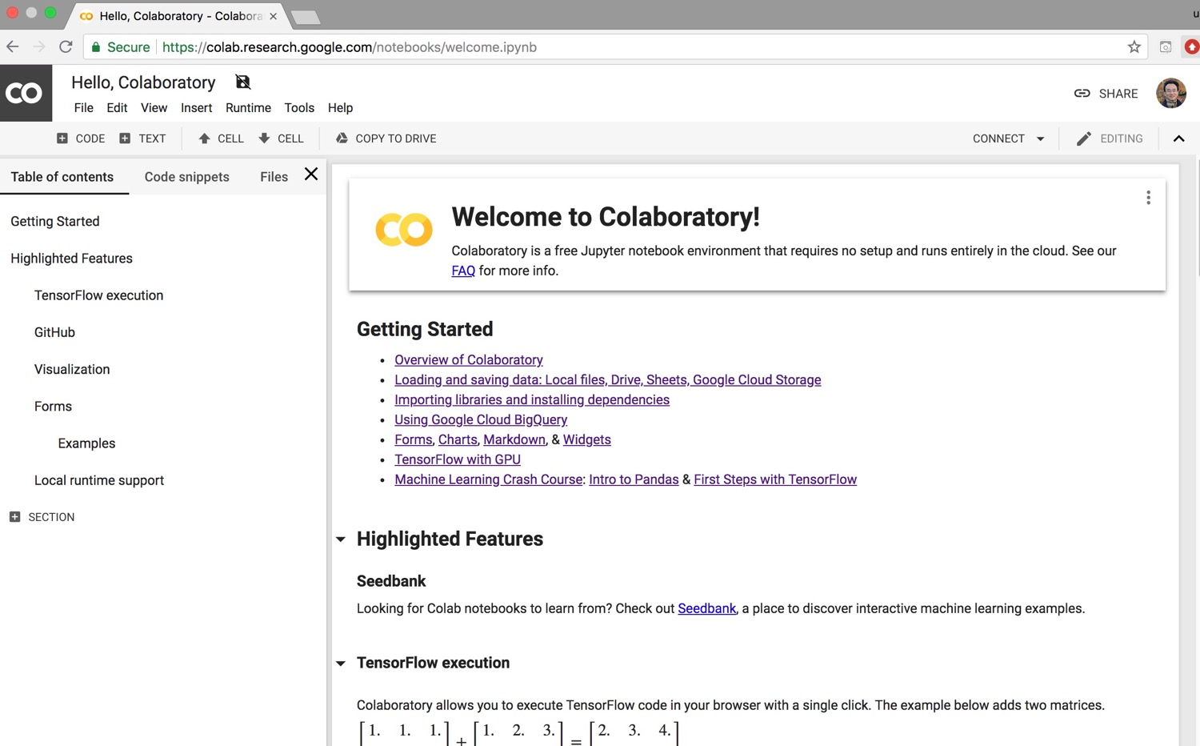
Google Colab
https://colab.research.google.com/notebooks/welcome.ipynb

Slide 22
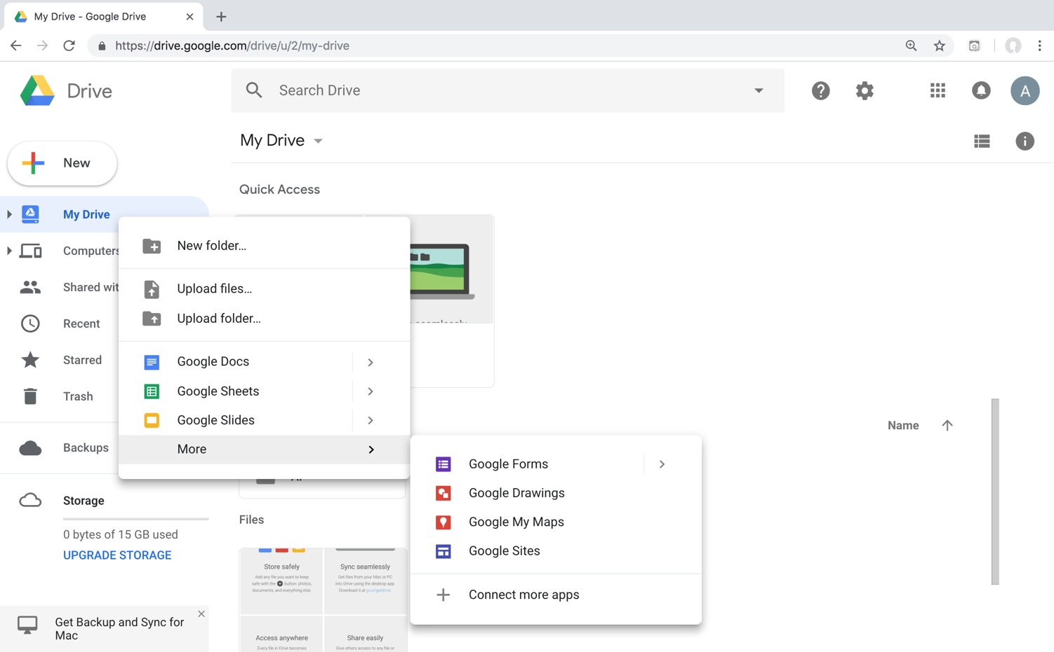
Connect Google Colab in Google Drive

Slide 23
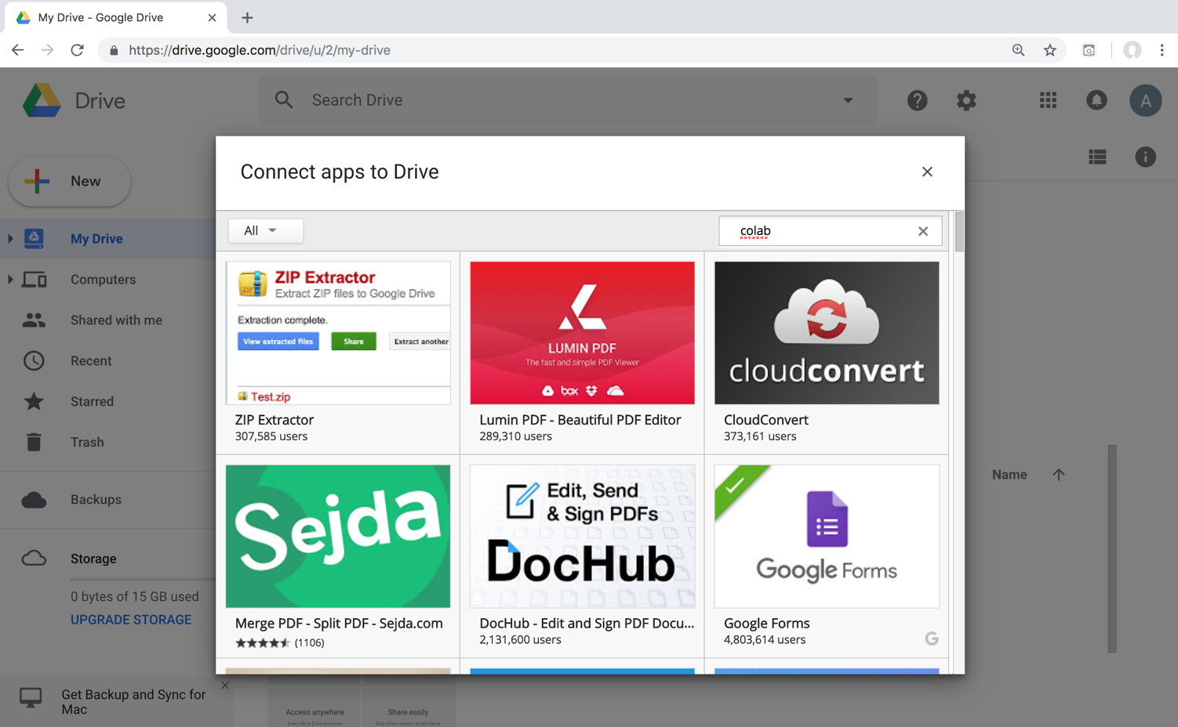
Google Colab

Slide 24
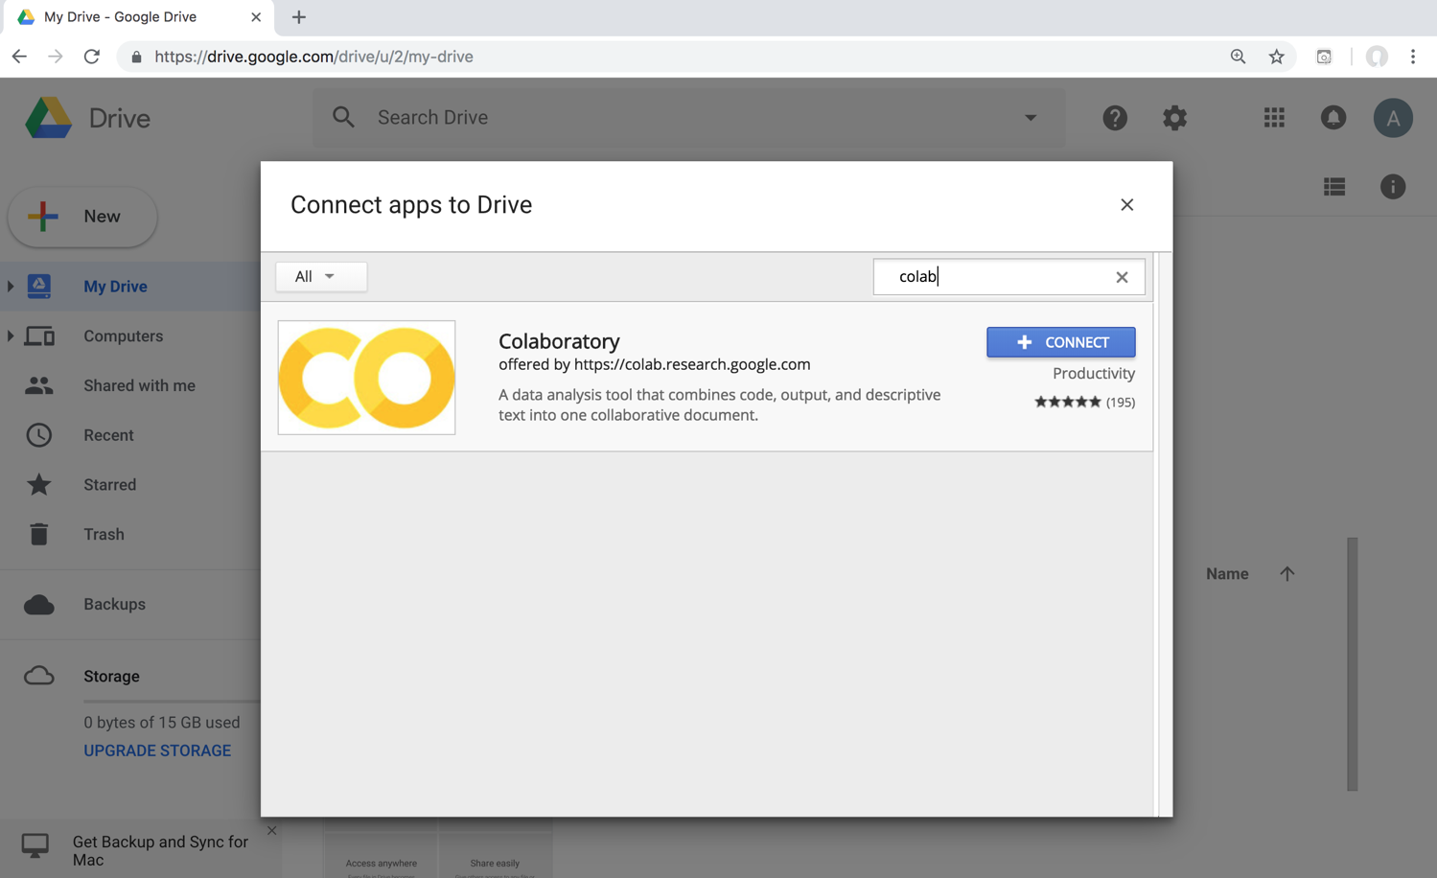
Google Colab

Slide 25
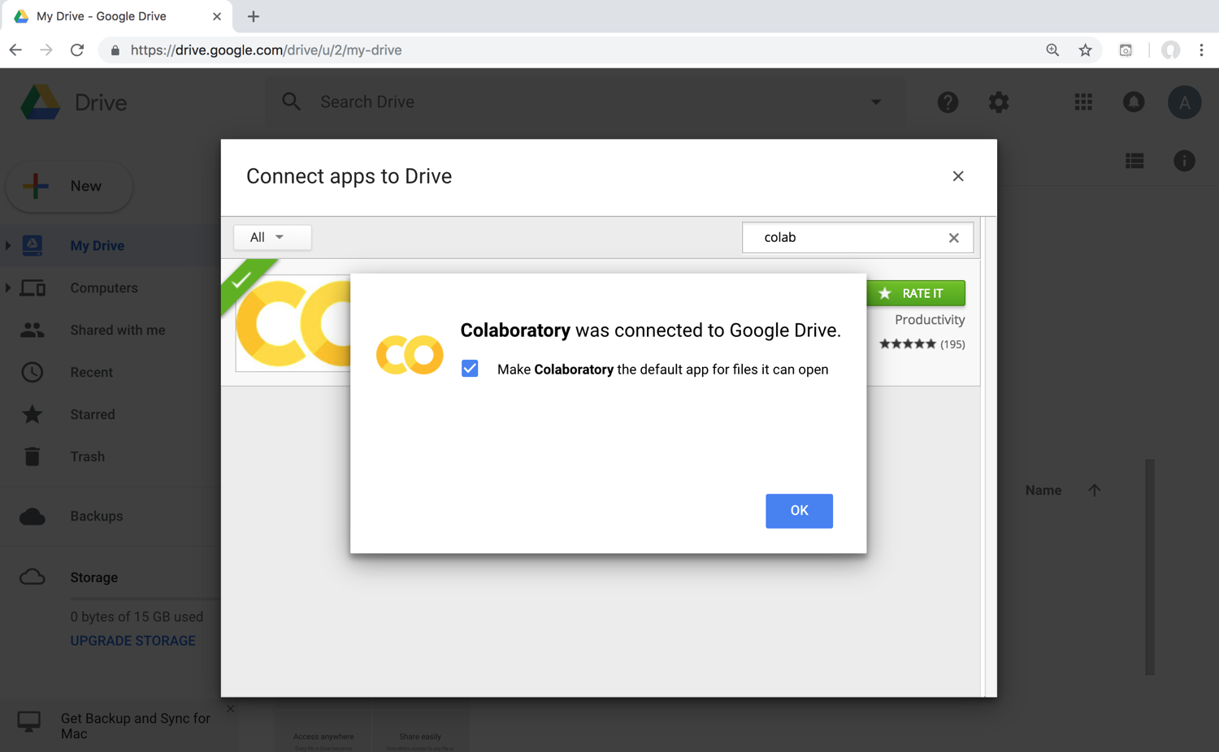
Connect Colaboratory to Google Drive

Slide 26
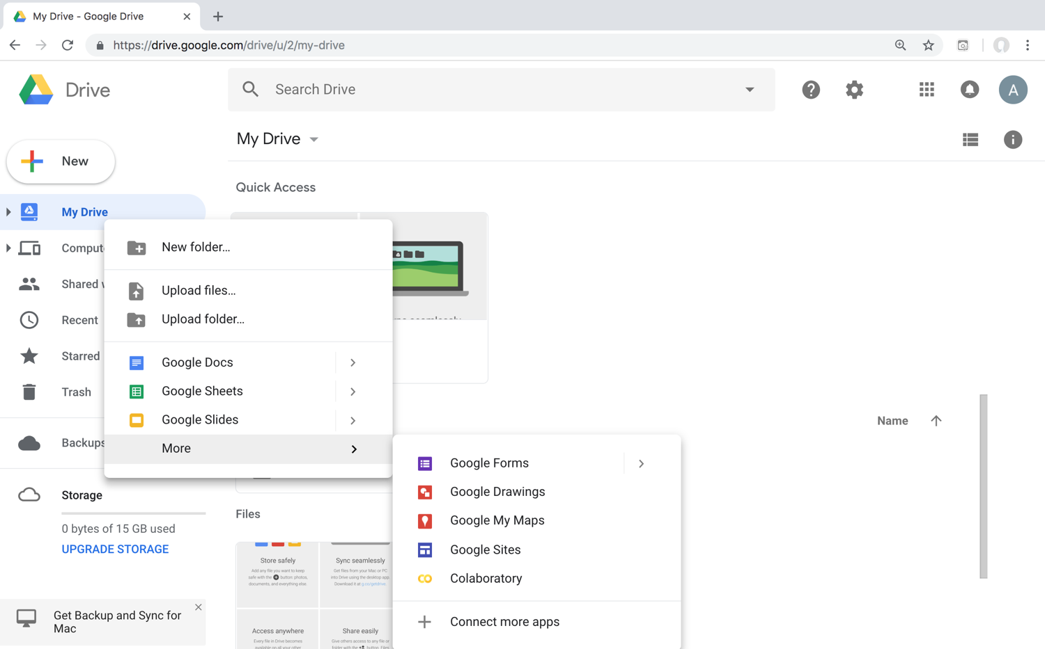
Google Colab

Slide 27
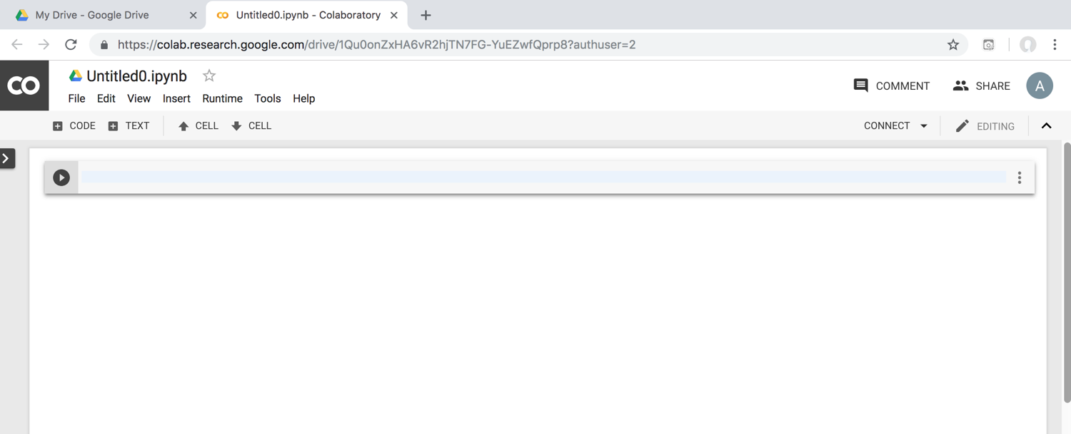
Google Colab

Slide 28
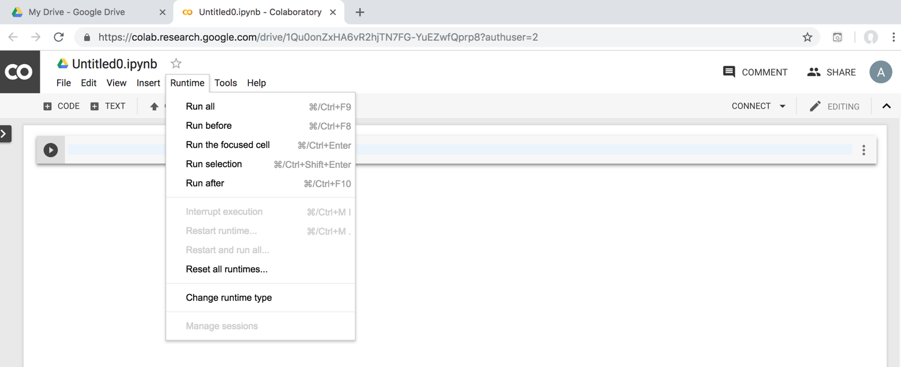
Google Colab

Slide 29
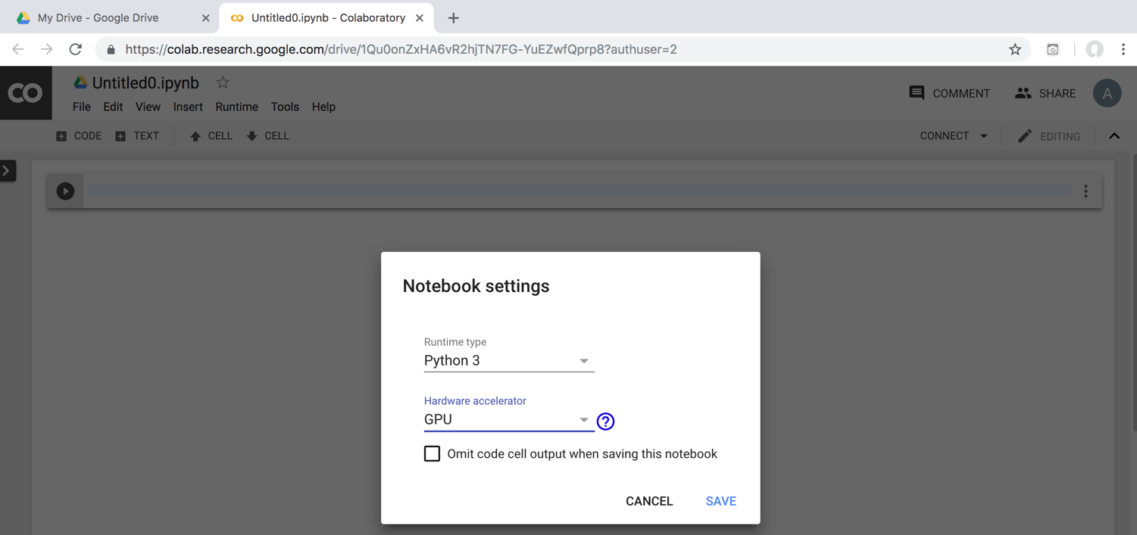
Run Jupyter Notebook Python3 GPU Google Colab

Slide 30
Google Colab Python Hello World print('Hello World')

Slide 31
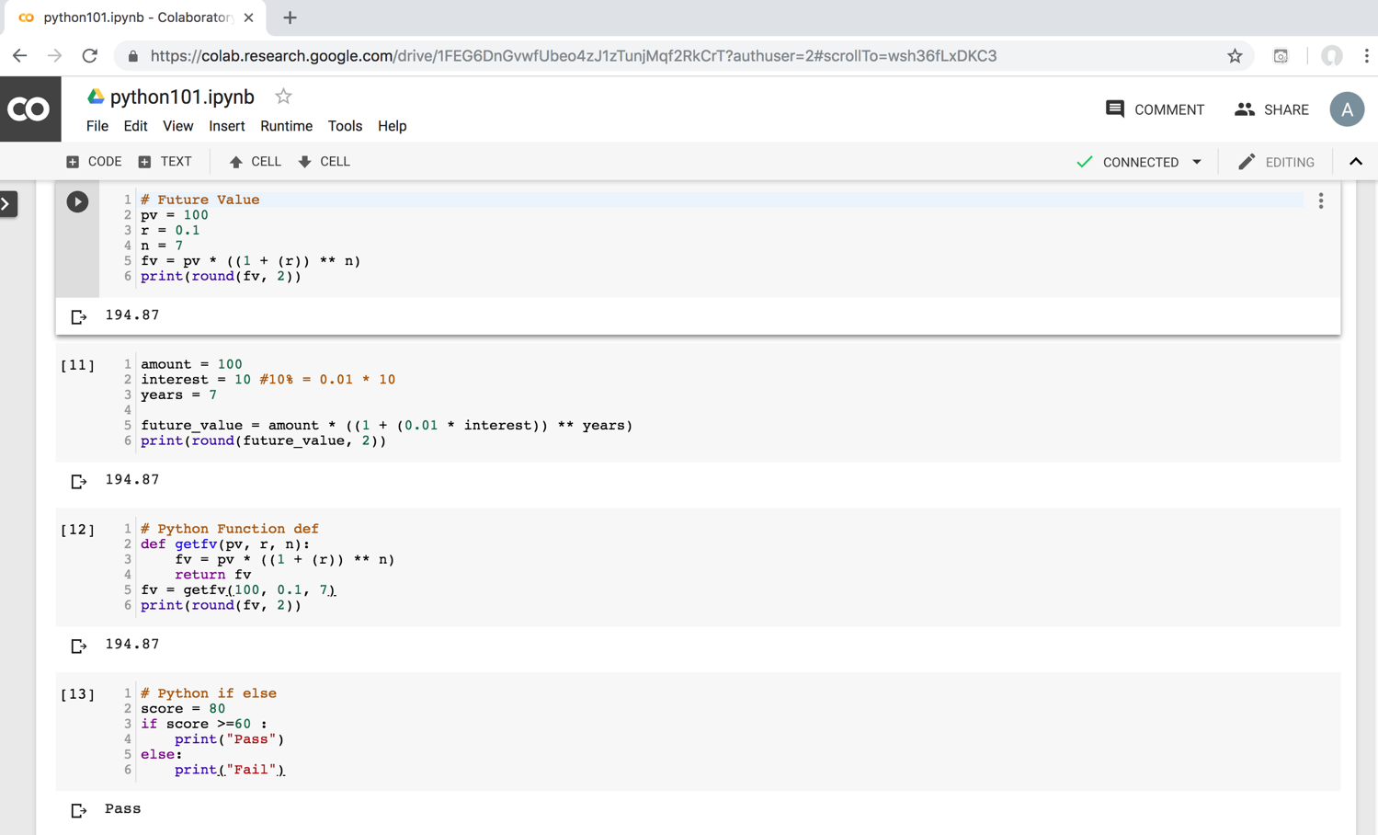
Python in Google Colab (Python101)
https://colab.research.google.com/drive/1FEG6DnGvwfUbeo4zJ1zTunjMqf2RkCrT
https://tinyurl.com/aintpupython101

Slide 32
Source: https://www.python.org/community/logos/

Slide 33
Python Programming

Slide 34
Python Hello World print("Hello World")
print("Hello World")

Slide 35
Python Syntax # comment
# comment

Slide 36
Python Syntax Indentation the spaces at the beginning of a code line 4 spaces
score = 80
if score >=60 :
print("Pass")

Slide 37
Python Variables
# Python Variables
x = 2
price = 2.5
word = 'Hello'
word = 'Hello'
word = "Hello"
word = '''Hello'''

Slide 38
Python Variables
x = 2
y = x + 1

Slide 39
python_version()
# comment
from platform import python_version
print("Python Version:", python_version())
Python Version: 3.10.12

Slide 40
Python Data Types
x = "Hello World" #str
x = 2 #int
x = 2.5 #float
x = 7j #complex

Slide 41
Python Data Types
x = ["apple", "banana", "cherry"] #list
x = ("apple", "banana", "cherry") #tuple
x = range(6) #range
x = {"name" : "Tom", "age" : 20} #dict
x = {"apple", "banana", "cherry"} #set
x = frozenset({"apple", "banana", "cherry"}) #frozenset

Slide 42
Python Data Types
x = True #bool
x = b"Hello" #bytes
x = bytearray(5) #bytearray
x = memoryview(bytes(5)) #memoryview
x = None #NoneType

Slide 43
Python Casting
x = str(3) # x will be '3'
y = int(3) # y will be 3
z = float(3) # z will be 3.0
print(x, type(x))
print(y, type(y))
print(z, type(z))
3 <class 'str’>
3 <class 'int’>
3.0 <class 'float'>

Slide 44
Python Numbers
x = 2 # int
y = 3.4 # float
z = 7j #complex
print(x, type(x))
print(y, type(y))
print(z, type(z))
2 <class 'int’>
3.4 <class 'float’>
7j <class 'complex'>

Slide 45
Python Arithmetic Operators
Operator Name Example
+ Addition 7 + 2 = 9
- Subtraction 7 - 2 = 5
* Multiplication 7 * 2 = 14
/ Division 7 / 2 = 3.5
// Floor division 7 // 2 = 3 (Quotient)
% Modulus 7 % 2 = 1 (Remainder)
** Exponentiation 7 ** 2 = 49

Slide 46
Python Basic Operators
print('7 + 2 =', 7 + 2)
print('7 - 2 =', 7 - 2)
print('7 * 2 =', 7 * 2)
print('7 / 2 =', 7 / 2)
print('7 // 2 =', 7 // 2)
print('7 % 2 =', 7 % 2)
print('7 ** 2 =', 7 ** 2)
7 + 2 = 9
7 - 2 = 5
7 * 2 = 14
7 / 2 = 3.5
7 // 2 = 3
7 % 2 = 1
7 ** 2 = 49

Slide 47
Python Booleans: True or False
# Python Booleans: True or False
print(3 > 2)
print(3 == 2)
print(3 < 2)

Slide 48
Python BMI Calculator
# BMI Calculator in Python
height_cm = 170
weight_kg = 60
height_m = height_cm/100
BMI = (weight_kg/(height_m**2))
print("Your BMI is: " + str(round(BMI,1)))
Your BMI is: 20.8

Slide 49
Future value of a specified principal amount, rate of interest, and a number of years
Source: https://www.w3resource.com/python-exercises/python-basic-exercise-39.php

Slide 50
How much is your $100 worth after 7 years?
# How much is your $100 worth after 7 years?
fv = 100 * 1.1 ** 7
print('fv = ', round(fv, 2))
# output = 194.87
fv = 194.87

Slide 51
Future Value
# Future Value
pv = 100
r = 0.1
n = 7
fv = pv * ((1 + (r)) ** n)
print(round(fv, 2))
194.87

Slide 52
Future Value
# Future Value
amount = 100
interest = 10 #10% = 0.01 * 10
years = 7
future_value = amount * ((1 + (0.01 * interest)) ** years)
print(round(future_value, 2))
194.87

Slide 53
Python Data Structures

Slide 54
Python Data Types
x = ["apple", "banana", "cherry"] #list
x = ("apple", "banana", "cherry") #tuple
x = {"name" : "Tom", "age" : 20} #dict
x = {"apple", "banana", "cherry"} #set

Slide 55
Python Collections
There are four collection data types in the Python programming language
List []
a collection which is ordered and changeable. Allows duplicate members.
Tuple ()
a collection which is ordered and unchangeable. Allows duplicate members.
Set {}
a collection which is unordered, unchangeable, and unindexed. No duplicate members.
Dictionary {k:v}
a collection which is ordered and changeable. No duplicate members.

Slide 56
Python Dictionaries {k:v}
As of Python version 3.7, dictionaries are ordered.
In Python 3.6 and earlier, dictionaries are unordered.

Slide 57
Lists []
x = [60, 70, 80, 90]
print(len(x))
print(x[0])
print(x[1])
print(x[-1])
4
60
70
90

Slide 58
Lists []
len(): how many items
type(): data type
list() constructor: creating a new list

Slide 59
Python List Methods
Method Description
append() Adds an element at the end of the list
clear() Removes all the elements from the list
copy() Returns a copy of the list
count() Returns the number of elements with the specified value
extend() Add the elements of a list (or any iterable), to the end of the current list
index() Returns the index of the first element with the specified value
insert() Adds an element at the specified position
pop() Removes the element at the specified position
remove() Removes the item with the specified value
reverse() Reverses the order of the list
sort() Sorts the list
https://www.w3schools.com/python/python_lists_methods.asp

Slide 60
Tuples ()
A tuple in Python is a collection that cannot be modified. A tuple is defined using parenthesis.
x = (10, 20, 30, 40, 50)
print(x[0])
print(x[1])
print(x[2])
print(x[-1])
10
20
30
50
Source: http://pythonprogramminglanguage.com/tuples/

Slide 61
Sets {}
animals = {'cat', 'dog'}
print('cat' in animals)
print('fish' in animals)
animals.add('fish')
print('fish' in animals) print(len(animals))
animals.add('cat’)
print(len(animals))
animals.remove('cat')
print(len(animals))
True
False
True
3
3
2
Source: http://cs231n.github.io/python-numpy-tutorial/

Slide 62
Dictionary {key : value}
Python Dictionary
Key → Value
'EN’ → 'English’
'FR’ → 'French'
k = { 'EN':'English', 'FR':'French' }
print(k['EN'])
English
Source: http://pythonprogramminglanguage.com/dictionary/

Slide 63
Python Data Structures
fruits = ["apple", "banana", "cherry"] #lists []
colors = ("red", "green", "blue") #tuples ()
animals = {'cat', 'dog'} #sets {}
person = {"name" : "Tom", "age" : 20} #dictionaries {}
https://tinyurl.com/aintpupython101

Slide 64
Python for Accounting Applications
# Python Lists
expenses = [72.50, 80.75, 50.00, 90.25]
total_expenses = sum(expenses)
print("Total expenses:", total_expenses)
Total expenses: 293.5
https://tinyurl.com/aintpupython101

Slide 65
Python for Accounting Applications
# Python Tuples
accounts = (("Cash", 1001), ("Accounts Receivable", 1002), ("Inventory", 1003))
for account in accounts:
print("Account name:", account[0], "Account number:", account[1])
Account name: Cash Account number: 1001
Account name: Accounts Receivable Account number: 1002 Account name: Inventory Account number: 1003
https://tinyurl.com/aintpupython101

Slide 66
Python for Accounting Applications
# Python Sets
account_numbers = {1001, 1002, 1003}
new_account_number = 1004
if new_account_number not in account_numbers:
print("Account number", new_account_number, "is not in use.")
Account number 1004 is not in use.
https://tinyurl.com/aintpupython101

Slide 67
Python for Accounting Applications
# Python Dictionaries
accounts = {"1001": {"name": "Cash", "balance": 500.00, "type": "Asset"},
"1002": {"name": "Accounts Receivable", "balance": 1000.00, "type": "Asset"},
"2001": {"name": "Accounts Payable", "balance": 750.00, "type": "Liability"}}
for account_number, account_info in accounts.items():
print("Account number:", account_number)
print("Account name:", account_info["name"])
print("Account balance:", account_info["balance"])
print("Account type:", account_info["type"])
Account number: 1001
Account name: Cash
Account balance: 500.0
Account type: Asset
Account number: 1002
Account name: Accounts Receivable
Account balance: 1000.0
Account type: Asset
Account number: 2001
Account name: Accounts Payable
Account balance: 750.0
Account type: Liability
https://tinyurl.com/aintpupython101

Slide 68
Python Control Logic and Loops

Slide 69
Python Control Logic and Loops
Python if else
if elif else
Booleans: True, False
Operators: ==, !=, >, <, >=, <=, and, or, not
Python for Loops
for
Python while Loops
While
break
continue

Slide 70
Python if...else
Python if...else
if elif else
Booleans: True, False
Operators: ==, !=, >, <, >=, <=, and, or, not

Slide 71
Python Conditions and If statements
Python supports the usual logical conditions from mathematics:
Equals: a == b
Not Equals: a != b
Less than: a < b
Less than or equal to: a <= b
Greater than: a > b
Greater than or equal to: a >= b

Slide 72
Python Comparison Operators
Operator | Name | Example
== | Equal | x == y
!= | Not equal | x != y
> | Greater than | x > y
< | Less than | x < y
>= | Greater than or equal to | x >= y
<= | Less than or equal to | x <= y
Source: https://www.w3schools.com/python/python_operators.asp

Slide 73
Python Logical Operators
Operator | Description | Example
and | Returns True if both statements are true | x < 5 and x < 10
or | Returns True if one of the statements is true | x < 5 or x < 4
not | Reverse the result, returns False if the result is true | not(x < 5 and x < 10)
Source: https://www.w3schools.com/python/python_operators.asp

Slide 74
Python if
# Python if
score = 80
if score >=60 :
print("Pass")
https://tinyurl.com/aintpupython101

Slide 75
Python if else
# Python if else
score = 80
if score >=60 :
print("Pass")
else:
print("Fail")
https://tinyurl.com/aintpupython101

Slide 76
Python if elif else
score = 95
if score >= 90 :
print("A")
elif score >=60 :
print("Pass")
else:
print("Fail")

Slide 77
Python if elif else
# Python if elif else
score = 90
grade = ""
if score >=90:
grade = "A"
elif score >= 80:
grade = "B"
elif score >= 70:
grade = "C"
elif score >= 60:
grade = "D"
else:
grade = "E"
print(grade)

Slide 78
Python for Loops
for i in range(1,6):
print(i)
1
2
3
4
5
https://tinyurl.com/aintpupython101

Slide 79
Python for loops
# for loops
for i in range(1,10):
for j in range(1,10):
print(i, ' * ' , j , ' = ', i*j)
https://tinyurl.com/aintpupython101

Slide 80
Python while Loops
while
break
continue

Slide 81
Python while loops
# while loops
age = 10
while age < 20:
print(age)
age = age + 1
https://tinyurl.com/aintpupython101

Slide 82
Python Functions and Modules

Slide 83
Python Functions

Slide 84
Python Functions
A function is a block of code which only runs when it is called.
You can pass data, known as parameters, into a function.
A function can return data as a result.
Creating a Function
In Python a function is defined using the def keyword:

Slide 85
Python Function def
# Python Function def
# indentation for blocks. four spaces
def getfv(pv, r, n):
fv = pv * ((1 + (r)) ** n)
return fv
fv = getfv(100, 0.1, 7)
print(round(fv, 2))
194.87
https://tinyurl.com/aintpupython101

Slide 86
Future value of a specified principal amount, rate of interest, and a number of years
Source: https://www.w3resource.com/python-exercises/python-basic-exercise-39.php

Slide 87
How much is your $100 worth after 7 years?
# How much is your $100 worth after 7 years?
fv = 100 * 1.1 ** 7
print('fv = ', round(fv, 2))
# output = 194.87
fv = 194.87

Slide 88
Future Value
# Future Value
pv = 100
r = 0.1
n = 7
fv = pv * ((1 + (r)) ** n)
print(round(fv, 2))
194.87

Slide 89
Future Value
# Future Value
amount = 100
interest = 10 #10% = 0.01 * 10
years = 7
future_value = amount * ((1 + (0.01 * interest)) ** years)
print(round(future_value, 2))
194.87

Slide 90
Python Function def getfv() define get future value function
# Python Function def
# indentation for blocks. four spaces
def getfv(pv, r, n):
fv = pv * ((1 + (r)) ** n)
return fv
fv = getfv(100, 0.1, 7)
print(round(fv, 2))
194.87
https://tinyurl.com/aintpupython101

Slide 91
Python Classes/Objects class MyClass:

Slide 92
Python Classes/Objects
Python is an object oriented programming language.
Almost everything in Python is an object, with its properties and methods.
A Class is like an object constructor, or a "blueprint" for creating objects.
Create a Class:
To create a class, use the keyword class:

Slide 93
Python Classes/Objects class MyClass:
# Python class
class MyClass:
x = 5
c1 = MyClass()
print(c1.x)
https://www.w3schools.com/python/python_classes.asp

Slide 94
Python Classes/Objects
class Person:
def __init__(self, name, age):
self.name = name
self.age = age
p1 = Person("Alan", 20)
print(p1.name)
print(p1.age)
Alan
20
https://tinyurl.com/aintpupython101

Slide 95
Python Classes/Objects
class Person:
def __init__(self, name, age):
self.name = name
self.age = age
def myfunc(self):
print("Hello my name is " + self.name)
p1 = Person("Alan", 20)
p1.myfunc()
https://tinyurl.com/aintpupython101

Slide 96
Python Classes/Objects
class Person:
def __init__(self, name, age):
self.name = name
self.age = age
def myfunc(self):
print("Hello my name is " + self.name)
p1 = Person("Alan", 20)
p1.myfunc()
print(p1.name)
print(p1.age)
Hello my name is Alan
Alan
20
https://tinyurl.com/aintpupython101

Slide 97
Python Classes and Obects
class Vehicle:
name = ""
kind = "car"
color = ""
value = 100.00
def description(self):
desc_str = "%s is a %s %s worth $%.2f." % (self.name, self.color, self.kind, self.value)
return desc_str
https://tinyurl.com/aintpupython101

Slide 98
Python Classes and Objects
car1 = Vehicle()
car1.name = "Fer"
car1.color = "red"
car1.kind = "convertible"
car1.value = 60000.00
car2 = Vehicle()
car2.name = "Jump"
car2.color = "blue"
car2.kind = "van"
car2.value = 10000.00
print(car1.description())
print(car1.name)
print(car2.description())
print(car2.name)
class Vehicle:
name = ""
kind = "car"
color = ""
value = 100.00
def description(self):
desc_str = "%s is a %s %s worth $%.2f." % (self.name, self.color, self.kind, self.value)
return desc_str
Fer is a red convertible worth $60000.00.
Fer
Jump is a blue van worth $10000.00.
Jump
https://www.learnpython.org/en/Classes_and_Objects

Slide 99
Python Modules

Slide 100
Python Modules
Consider a module to be the same as a code library.
A file containing a set of functions you want to include in your application.
Create a Module
To create a module just save the code you want in a file with the file extension .py:
Use a Module
import module

Slide 101
Python Modules
# mymodule.py
def greeting(name):
print("Hello, " + name)
import mymodule
mymodule.greeting("Alan")
mymodule.py
def greeting(name):
print("Hello, " + name)
https://tinyurl.com/aintpupython101

Slide 102
Python File Input / Output
# Python File Input / Output
with open('myfile.txt', 'w') as file:
file.write('Hello World\nThis is Python File Input Output')
with open('myfile.txt', 'r') as file:
text = file.read()
print(text)
Hello World This is Python File Input Output
https://tinyurl.com/aintpupython101

Slide 103
Python File Input / Output
# Python File Input / Output
filename = 'mymodule.py'
with open(filename, 'w') as file:
text = '''def greeting(name):
print("Hello, " + name)
'''
file.write(text)
with open(filename, 'r') as file:
text = file.read()
print(filename)
print(text)
mymodule.py
def greeting(name):
print("Hello, " + name)
https://tinyurl.com/aintpupython101

Slide 104
Python Modules import mymodule
# mymodule.py
def greeting(name):
print("Hello, " + name)
import mymodule
mymodule.greeting("Alan")
Hello, Alan
https://tinyurl.com/aintpupython101

Slide 105
Python main() function
#Python main() function
def main():
print("Hello World!")
if __name__ == "__main__":
main()
https://tinyurl.com/aintpupython101

Slide 106
Files and Exception Handling

Slide 107
Files and Exception Handling
Python Files (File Handling)
open()
f = open("myfile.txt")
Python Try Except (Exception Handling)
try: except: else: finally:

Slide 108
File Handling
The key function for working with files in Python is the open() function.
The open() function takes two parameters; filename, and mode.
There are four different methods (modes) for opening a file:
"r" - Read - Default value. Opens a file for reading, error if the file does not exist
"a" - Append - Opens a file for appending, creates the file if it does not exist
"w" - Write - Opens a file for writing, creates the file if it does not exist
"x" - Create - Creates the specified file, returns an error if the file exists

Slide 109
Python Files (File Handling)
f = open("myfile.txt", "w")
f.write("Hello World")
f.close()
f = open("myfile.txt", "r")
text = f.read()
print(text)
f.close()
Hello World
https://tinyurl.com/aintpupython101

Slide 110
Python Files (File Handling)
# Python File Input / Output
with open('myfile.txt', 'w') as file:
file.write('Hello World')
with open('myfile.txt', 'r') as file:
text = file.read()
print(text)
Hello World
https://tinyurl.com/aintpupython101

Slide 111
Python Files
# Python File Input / Output
with open('myfile.txt', 'w') as file:
file.write('Hello World\nPython File IO')
with open('myfile.txt', 'r') as file:
text = file.read()
print(text)
Hello World
Python File IO
https://tinyurl.com/aintpupython101

Slide 112
Python Files
# Python File Input / Output
with open('myfile.txt', 'a+') as file:
file.write('\n' + 'New line')
with open('myfile.txt', 'r') as file:
text = file.read()
print(text)
Hello World
Python File IO
New line
https://tinyurl.com/aintpupython101

Slide 113
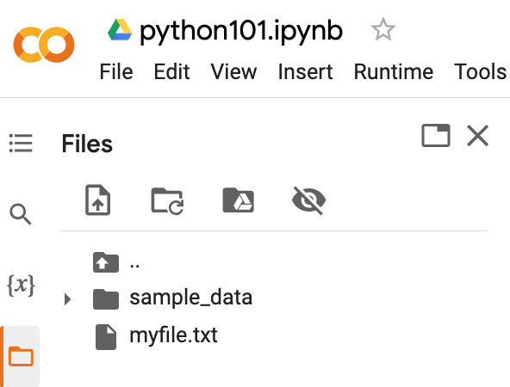
Python Files
# !ls list files
!ls
myfile.txt sample_data
https://tinyurl.com/aintpupython101

Slide 114
Python OS, IO, files, and Google Drive
import os
cwd = os.getcwd()
print(cwd)
/content
https://tinyurl.com/aintpupython101

Slide 115
os.listdir()
os.listdir(cwd)
['.config', 'myfile.txt', 'sample_data']
https://tinyurl.com/aintpupython101

Slide 116
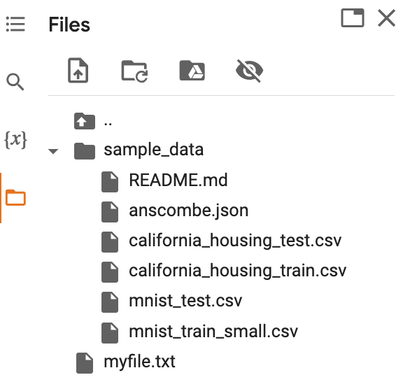
os.path.join()
path = os.path.join(cwd, 'sample_data')
print(path)
os.listdir(path)
/content/sample_data
['README.md', 'anscombe.json', 'mnist_train_small.csv', 'mnist_test.csv', 'california_housing_train.csv', 'california_housing_test.csv']
https://tinyurl.com/aintpupython101

Slide 117
from google.colab import files
from google.colab import files
with open('io_file_myday.txt', 'w') as f:
f.write('Google Colab File Write Text some content Myday')
import time
time.sleep(1) # time sleep 1 second
files.download('io_file_myday.txt')
print('downloaded')
downloaded
https://tinyurl.com/aintpupython101

Slide 118
Python Files
from google.colab import files
uploaded = files.upload()
for fn in uploaded.keys():
print('User uploaded file "{name}" with length {length} bytes'.format(
name=fn, length=len(uploaded[fn])))
User uploaded file "io_file_myday2.txt" with length 47 bytes
https://tinyurl.com/aintpupython101

Slide 119
os.remove()
import os
if os.path.exists("myfile.txt"):
os.remove("myfile.txt")
print("myfile.txt removed")
else:
print("The file does not exist")
myfile.txt removed
https://tinyurl.com/aintpupython101

Slide 120
os.mkdir("myfolder1") os.rmdir("myfolder1")
import os
os.listdir()
os.mkdir("myfolder1")
os.listdir()
os.rmdir("myfolder1")
os.listdir()
https://tinyurl.com/aintpupython101

Slide 121
Python Try Except
The try block lets you test a block of code for errors.
The except block lets you handle the error.
The else block lets you execute code when there is no error.
The finally block lets you execute code, regardless of the result of the try- and except blocks.

Slide 122
Python Try Except (Exception Handling) try: except:
#Python try except
try:
print(x)
except:
print("Exception Error")
https://tinyurl.com/aintpupython101

Slide 123
Python try: except: finally:
#Python try except finally
try:
print("Hello")
except:
print("Exception Error")
finally:
print("Finally process")
Hello
Finally process
https://tinyurl.com/aintpupython101

Slide 124
Python try: except: else:
#Python try except else
try:
print("Hello")
except:
print("Exception Error")
else:
print("No exception")
Hello
No exception
https://tinyurl.com/aintpupython101

Slide 125
Python try: except: else: finally:
try:
print("Hello")
except:
print("Exception Error")
else:
print("No exception")
finally:
print("Finally process")
Hello
No exception
Finally process
https://tinyurl.com/aintpupython101

Slide 126
Python try: except: else: finally:
try:
price = float(input("Enter the price of the stock (e.g. 10):"))
shares = int(input("Enter the number of shares (e.g. 2):"))
total = price * shares
except Exception as e:
print("Exception error:", str(e))
else:
print("The total value of the shares is:", total)
finally:
print("Thank you.")
Enter the price of the stock (e.g. 10):10
Enter the number of shares (e.g. 2):2
The total value of the shares is: 20.0
Thank you.
https://tinyurl.com/aintpupython101

Slide 127
Python try: except: else: finally:
try:
file = open("myfile.txt")
file.write("Python write file")
print("file saved")
except:
print("Exception file Error")
Exception file Error
https://tinyurl.com/aintpupython101

Slide 128
Python try: except: else: finally:
try:
file = open("myfile.txt")
file.write("Python write file")
print("file saved")
except:
print("Exception file Error")
finally:
file.close()
print("Finally process")
Exception file Error
Finally process
https://tinyurl.com/aintpupython101

Slide 129
Python try: except: else: finally:
try:
file = open("myfile.txt", 'w’)
file.write("Python write file")
print("file saved")
except:
print("Exception file Error")
finally:
file.close()
print("Finally process")
file saved
Finally process
https://tinyurl.com/aintpupython101

Slide 130
Summary
Python Files (File Handling)
open()
f = open("myfile.txt")
Python Try Except (Exception Handling)
try: except: else: finally:

Slide 131
References
Wes McKinney (2022), "Python for Data Analysis: Data Wrangling with pandas, NumPy, and Jupyter", 3rd Edition, O'Reilly Media.
Aurélien Géron (2023), Hands-On Machine Learning with Scikit-Learn, Keras, and TensorFlow: Concepts, Tools, and Techniques to Build Intelligent Systems, 3rd Edition, O’Reilly Media.
Steven D'Ascoli (2022), Artificial Intelligence and Deep Learning with Python: Every Line of Code Explained For Readers New to AI and New to Python, Independently published.
Stuart Russell and Peter Norvig (2020), Artificial Intelligence: A Modern Approach, 4th Edition, Pearson.
Varun Grover, Roger HL Chiang, Ting-Peng Liang, and Dongsong Zhang (2018), "Creating Strategic Business Value from Big Data Analytics: A Research Framework", Journal of Management Information Systems, 35, no. 2, pp. 388-423.
Junliang Wang, Chuqiao Xu, Jie Zhang, and Ray Zhong (2022). "Big data analytics for intelligent manufacturing systems: A review." Journal of Manufacturing Systems 62 (2022): 738-752.
Ramesh Sharda, Dursun Delen, and Efraim Turban (2017), Business Intelligence, Analytics, and Data Science: A Managerial Perspective, 4th Edition, Pearson
Python Programming, https://pythonprogramming.net/
Python, https://www.python.org/
Python Programming Language, http://pythonprogramminglanguage.com/
Numpy, http://www.numpy.org/
Pandas, http://pandas.pydata.org/
Skikit-learn, http://scikit-learn.org/
W3Schools Python, https://www.w3schools.com/python/
Learn Python, https://www.learnpython.org/
Google’s Python Class, https://developers.google.com/edu/python
Min-Yuh Day (2023), Python 101, https://tinyurl.com/aintpupython101

