Slide 1
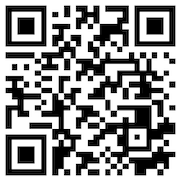
環境、社會與治理 (ESG) 淨零數位轉型 (Environmental, Social, and Governance (ESG) in Net-Zero Digital Transformation)
永續數據分析 (Sustainability and ESG Data Analytics)
1122ESGDA02
DM4, NTPU (N4084) (Spring 2024) Fri, 10, 11, 12 (18:30-21:15) (臺北大學民生校區 305)
戴敏育
Min-Yuh Day, Ph.D, Associate Professor
Institute of Information Management, National Taipei University
https://web.ntpu.edu.tw/~myday
https://meet.google.com/miy-fbif-max
2024-03-01

Slide 2
課程大綱 (Syllabus)
週次 (Week) 日期 (Date) 內容 (Subject/Topics)
1 2024/02/23 永續數據分析概論 (Introduction Sustainability and ESG Data Analytics)
2 2024/03/01 環境、社會與治理 (ESG) 淨零數位轉型 (Environmental, Social, and Governance (ESG) in Net-Zero Digital Transformation)
3 2024/03/08 永續與ESG 資料科學 (Data Science for Sustainability and ESG)
4 2024/03/15 永續數據分析個案研究 I (Case Study on Sustainability and ESG Data Analytics I)
5 2024/03/22 Web 3.0 和大數據分析在金融科技、綠色永續金融 (Web 3.0 and Big Data Analysis in Fintech, Green and Sustainable Finance)

Slide 3
課程大綱 (Syllabus)
週次 (Week) 日期 (Date) 內容 (Subject/Topics)
6 2024/03/29 TCFD 氣候相關財務揭露與En-ROADS 氣候變遷模擬 (Task Force on Climate-Related Financial Disclosures (TCFD) and En-Roads Interactive)
7 2024/04/05 放假 (No Classes)
8 2024/04/12 期中報告 (Midterm Project Report)
9 2024/04/19 ESG數據的收集、分析和視覺化 (ESG Data Gathering, Analysis, and Visualization)
10 2024/04/26 ESG數據報告 (ESG Data Reporting); 企業永續報告書 (Corporate Sustainability Reports)

Slide 4
課程大綱 (Syllabus)
週次 (Week) 日期 (Date) 內容 (Subject/Topics)
11 2024/05/03 ESG數據驗證 (ESG Data Verification)
12 2024/05/10 永續數據分析個案研究 II (Case Study on Sustainability and ESG Data Analytics II)
13 2024/05/17 能源之星報告與數據揭露 (Energy Star Reporting and Data Disclosure)
14 2024/05/24 人工智慧物聯網在ESG永續應用 (Artificial Intelligence of things (AIoT) in ESG and Sustainability Applications)
15 2024/05/31 生成式AI於永續評等和報告生成 (Generative AI for ESG Rating and Reporting Generation)
16 2024/06/07 期末報告 (Final Project Report)

Slide 5
Environmental, Social, and Governance (ESG) in Net-Zero Digital Transformation

Slide 6
Outline
Environmental, Social, and Governance (ESG)
Net-Zero Digital Transformation
Net-Zero Transformation
Digital Transformation
Source: Dipanjan Sarkar (2019), Text Analytics with Python: A Practitioner’s Guide to Natural Language Processing, Second Edition. APress.

Slide 7
衡量企業永續關鍵指標 臺北大學獨創ESG永續評鑑系統
Source: https://www.aacsb.ntpu.edu.tw/twsvi/view.php?id=Nzc=

Slide 8
Sustainability and ESG Data Analytics

Slide 9
ESG: Environmental Social Governance

Slide 10
CSR: Corporate Social Responsibility

Slide 11
ESG in Net-Zero Digital Transformation: Foundations and Frameworks
Environmental, Social, and Governance (ESG)
Net-Zero Transformation
Digital Transformation
Opportunities and responsibilities

Slide 12
Tech for Good – Your Solutions!
Challenge: Most innovative tech solution to an environmental OR social problem

Slide 13
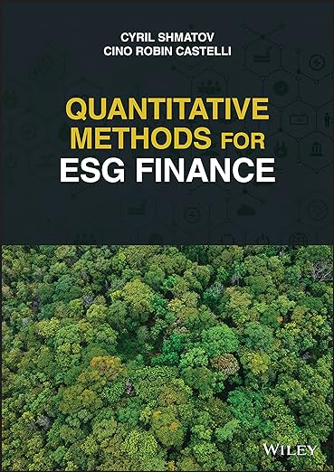
Cino Robin Castelli, Cyril Shmatov (2022), Quantitative Methods for ESG Finance, Wiley
Source: https://www.amazon.com/Quantitative-Methods-Finance-Robin-Castelli/dp/1119903807/

Slide 14
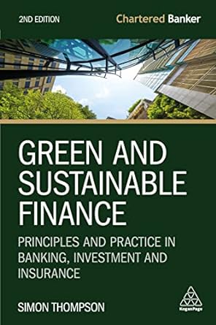
Simon Thompson (2023), Green and Sustainable Finance: Principles and Practice in Banking, Investment and Insurance, 2nd Edition, Kogan Page.
Source: https://www.amazon.com/Green-Sustainable-Finance-Principles-Investment/dp/1398609242/

Slide 15
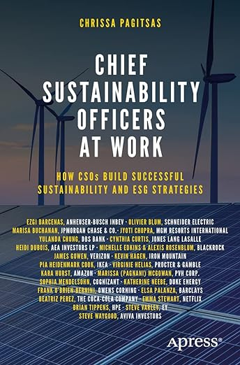
Chrissa Pagitsas (2023), Chief Sustainability Officers At Work: How CSOs Build Successful Sustainability and ESG Strategies, Apress.
Source: https://www.amazon.com/Chief-Sustainability-Officers-Work-Successful/dp/1484278658/

Slide 16
ESG and Net-Zero: The Essentials
Environmental
Climate impact, resource use, pollution, biodiversity
Social
Labor practices, human rights, community impact, diversity & inclusion
Governance
Transparency, ethics, board structure, risk management
Net-Zero
Balancing emissions produced with emissions removed globally

Slide 17
Net-Zero Transformation
Ambition
Aligned to achieving global net zero by no later than 2050 & to limit warming to 1.5°C
Governance
Accountability driven from the top
Strategy
Embedded and aligned net zero into company strategy
Enterprise
Key operating model changes in support of transformation
Supply chains
Transformed net zero supply chains
Innovation
Developed innovation and technologies to deliver net zero
Finance
Financing the net zero transformation
Transparency
Communicating action
Engagement
Enhancing the pace and scale of net zero action
Source: https://www.pwc.com/us/en/services/esg/library/building-blocks-for-net-zero-transformation.html

Slide 18
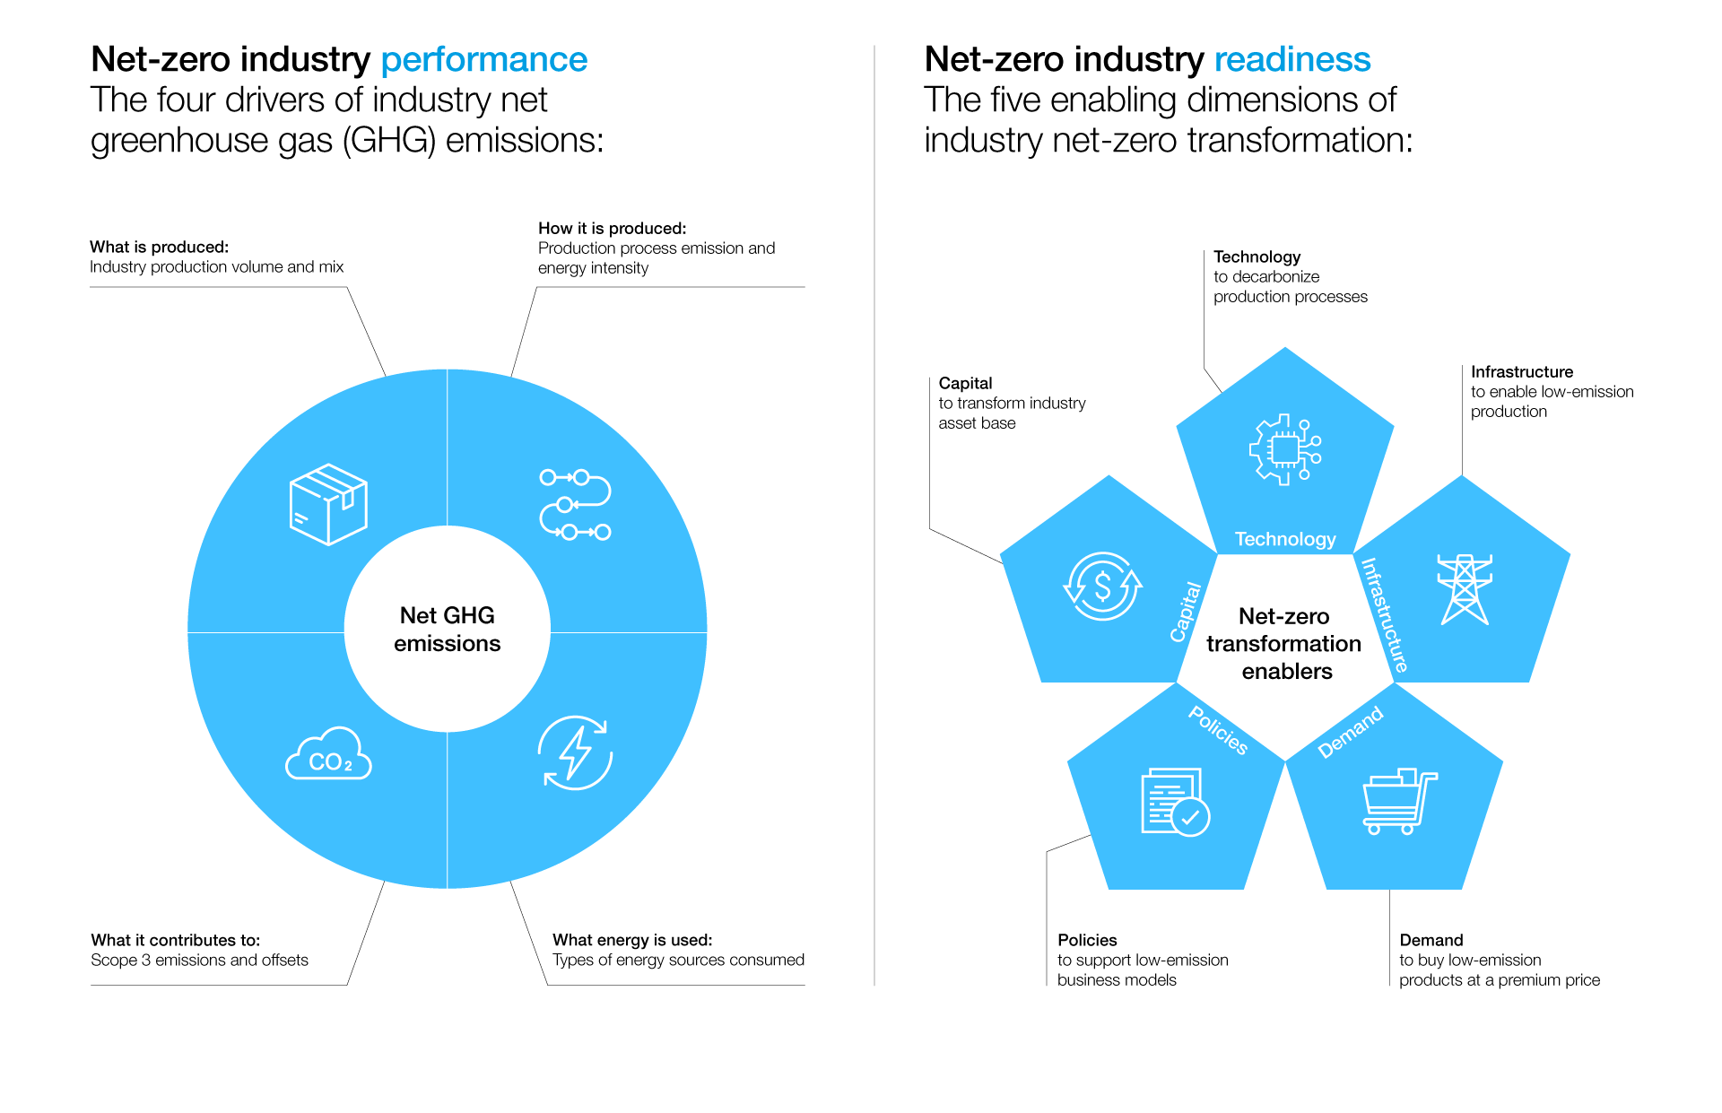
Net-Zero Transformation Enablers
Source: https://www.weforum.org/agenda/2022/07/net-zero-tracker/

Slide 19
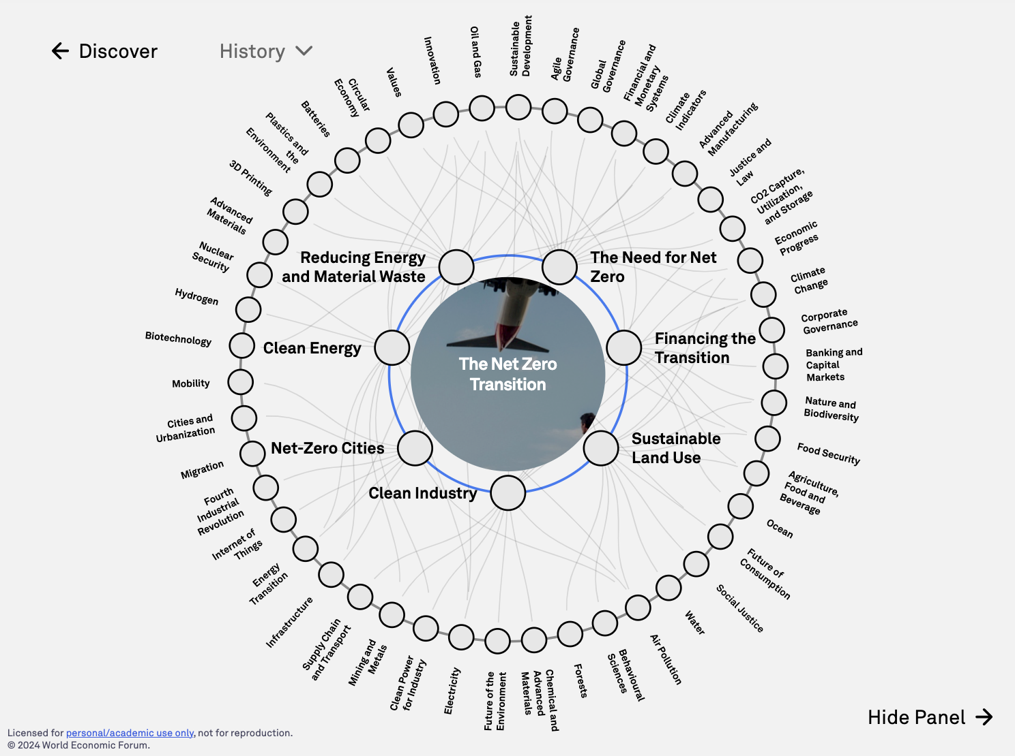
The Net Zero Transition
Source: https://intelligence.weforum.org/topics/a1G680000004C93EAE

Slide 20
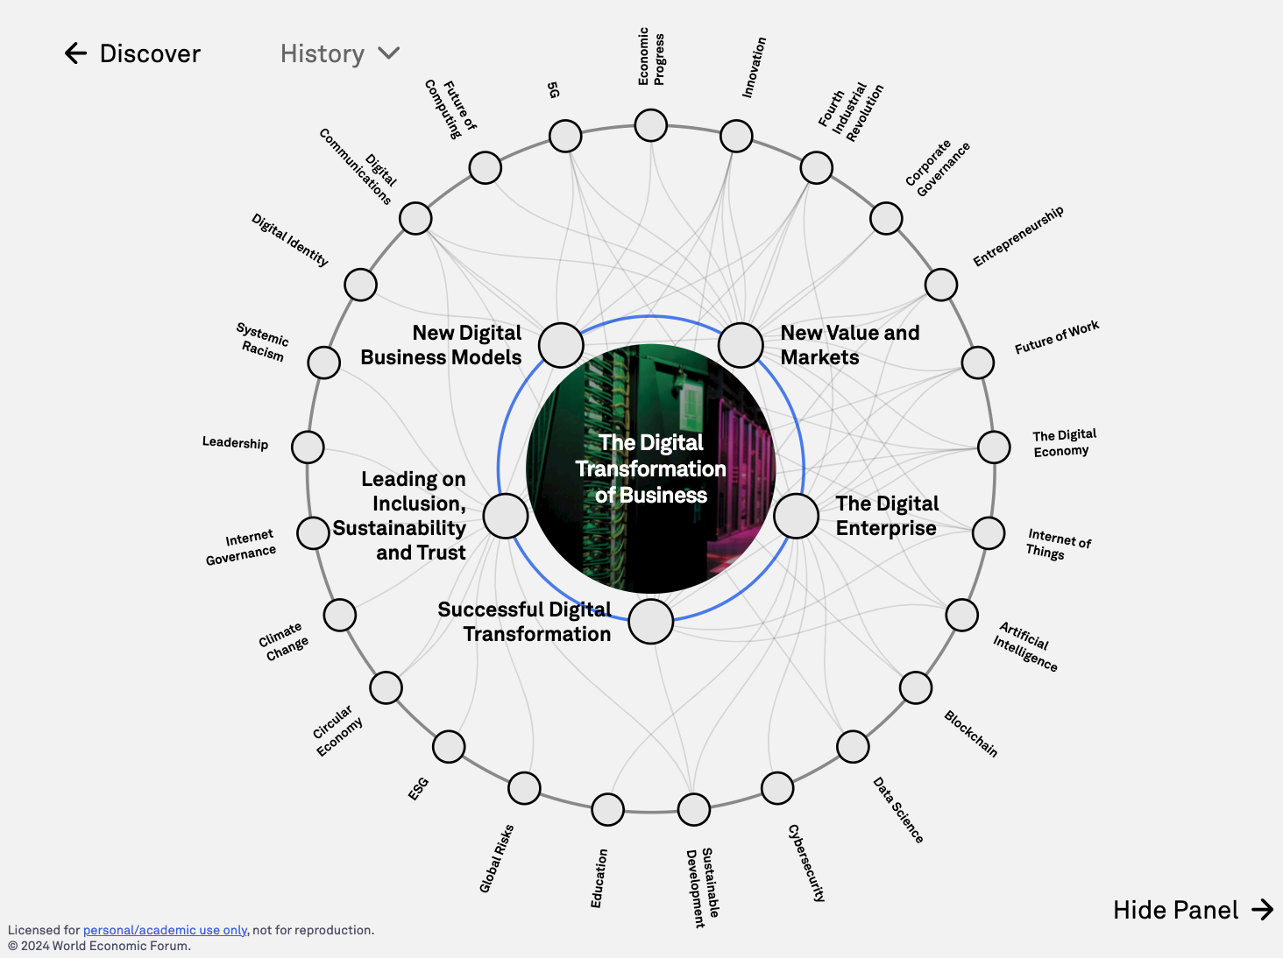
The Digital Transformation of Business
Source: https://intelligence.weforum.org/topics/a1G0X000006DIDZUA4

Slide 21
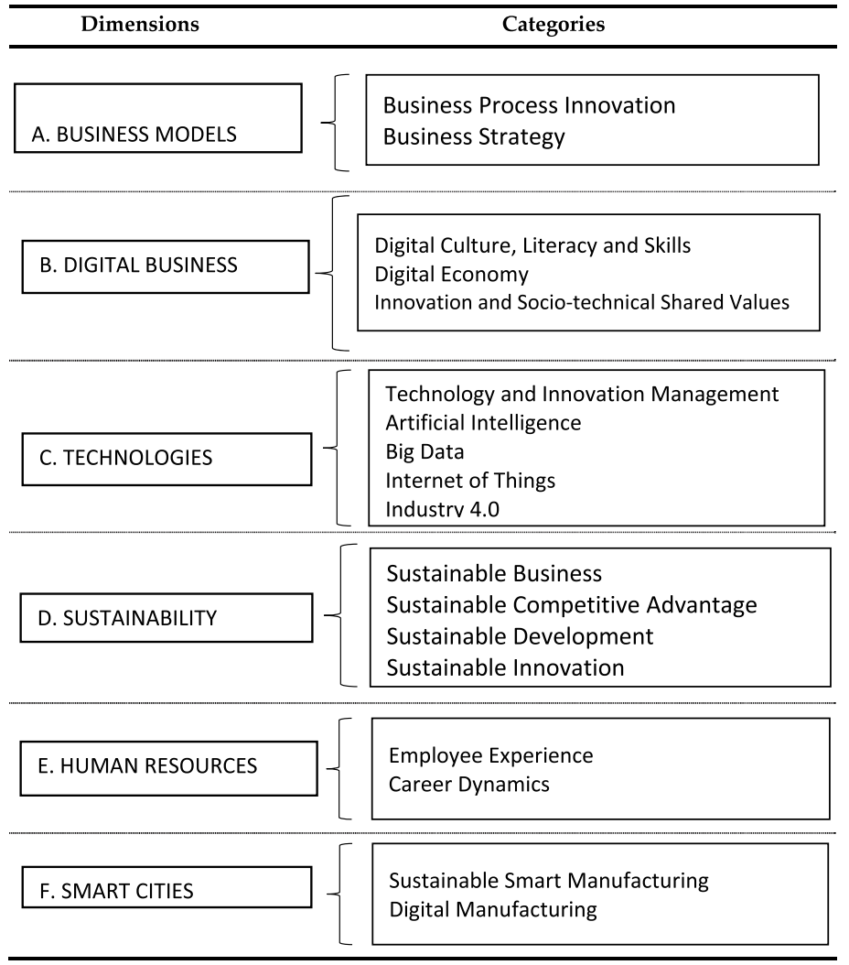
Digital Transformation
Source: Reis, João, and Nuno Melão (2023). "Digital transformation: A meta-review and guidelines for future research." Heliyon (2023).

Slide 22
Sustainable Development Goals (SDGs)
Source: https://sdgs.un.org/goals

Slide 23
Evolution of Sustainable Finance Research
Topic
SDGs: Sustainable Development Goals
SDGs
Innovative Financial Instrument
Impact Investing
ESG: Environmental, Social, and Governance
CSR: Corporate Social Responsibility
Conscious Capitalism
Climate Financing
Carbon Financing
Green Financing
Ethical Investing
Socially Responsible Investing
1986
1995
2005
2015
2020
Source: Kumar, S., Sharma, D., Rao, S., Lim, W. M., & Mangla, S. K. (2022). Past, present, and future of sustainable finance: Insights from big data analytics through machine learning of scholarly research. Annals of Operations Research, 1-44.

Slide 24
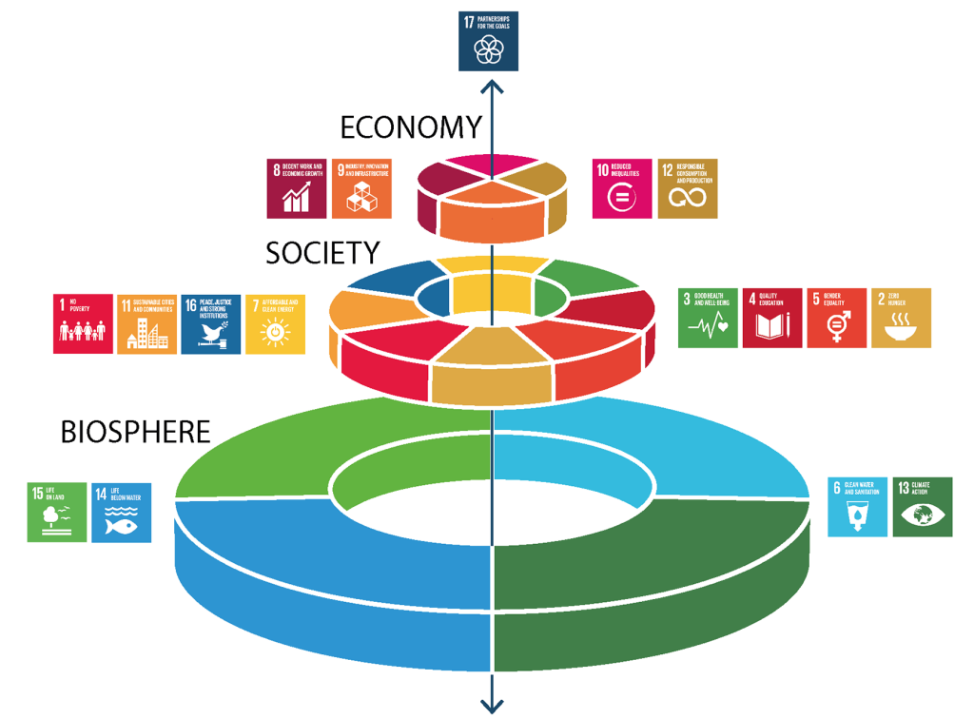
Sustainable Development Goals (SDGs) and 5P
Partnership
Peace
Prosperity
People
Planet
Source: Folke, Carl, Reinette Biggs, Albert V. Norström, Belinda Reyers, and Johan Rockström. "Social-ecological resilience and biosphere-based sustainability science.”Ecology and Society 21, no. 3 (2016).

Slide 25
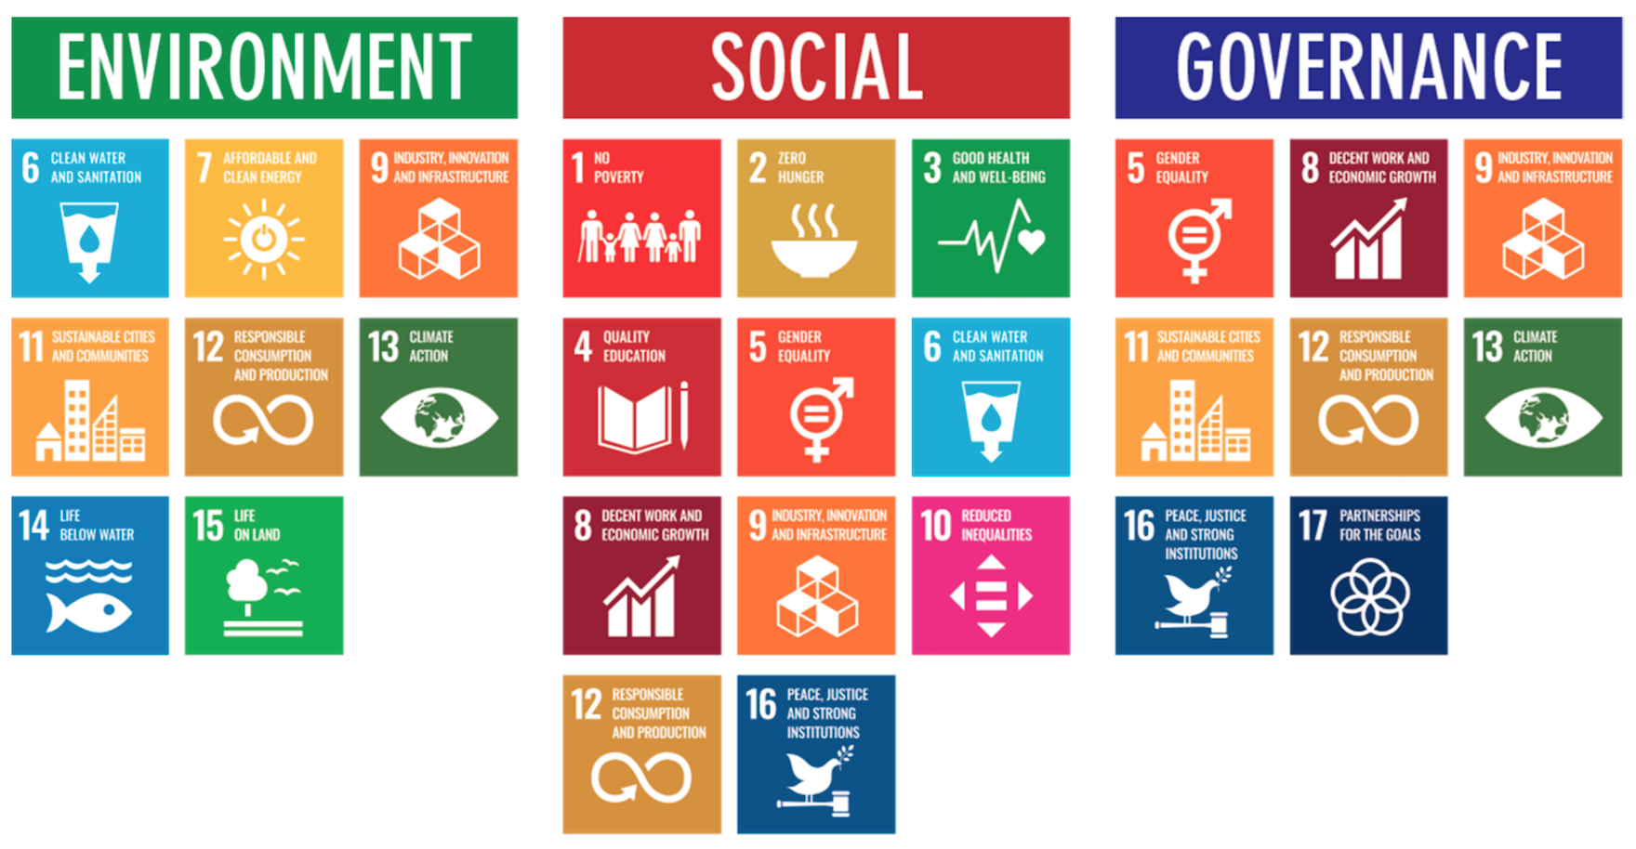
ESG to 17 SDGs
Source: Henrik Skaug Sætra (2021) "A Framework for Evaluating and Disclosing the ESG Related Impacts of AI with the SDGs." Sustainability 13, no. 15 (2021): 8503.

Slide 26
ESG to 17 SDGs
Source: https://sustainometric.com/esg-to-sdgs-connected-paths-to-a-sustainable-future/

Slide 27
Where ESG Meets – It's All Connected
Environmental Justice
Underserved communities disproportionately impacted by pollution, climate hazards
Responsible Tech Supply Chains
Resource extraction, e-waste, labor rights across the tech lifecycle
Inclusive Product Design
Accessibility, addressing digital divides, social impacts of technology.

Slide 28
Digital Transformation: Enabler and Challenge
Enabler
Data-driven decision-making, efficiency gains, new business models, collaboration
AI optimizing renewable energy
Challenge
Energy consumption, e-waste, planned obsolescence, AI ethics
AI servers representing increased energy use

Slide 29
Mapping the ESG Standards Landscape
The most prevalent ESG reporting frameworks
GRI (Global Report Initiative)
CDP (Carbon Disclosure Project)
SASB (Sustainability Accounting Standards Board
ISSB (International Sustainability Standards Board)
TCFD (Task Force on Climate-related Financial Disclosures
How companies choose
Materiality, industry-specific standards, investor alignment

Slide 30
GRI (Global Report Initiative)
https://www.globalreporting.org/

Slide 31
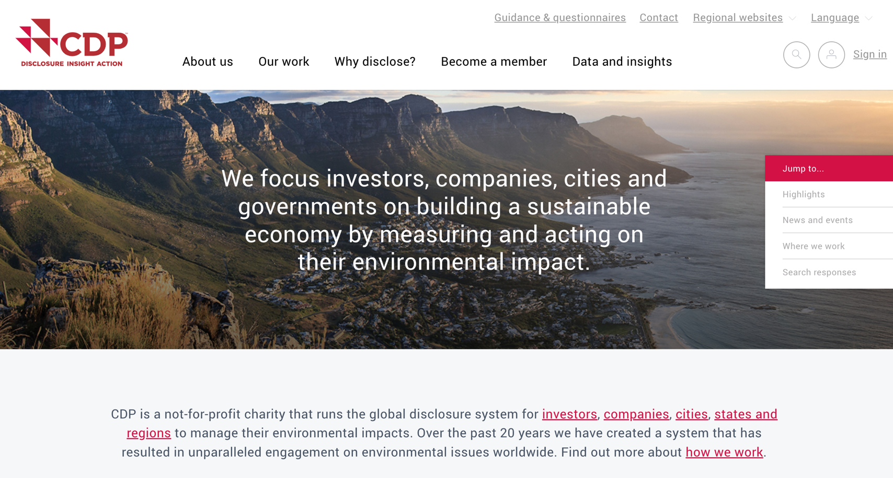
CDP (Carbon Disclosure Project)
https://www.cdp.net/

Slide 32
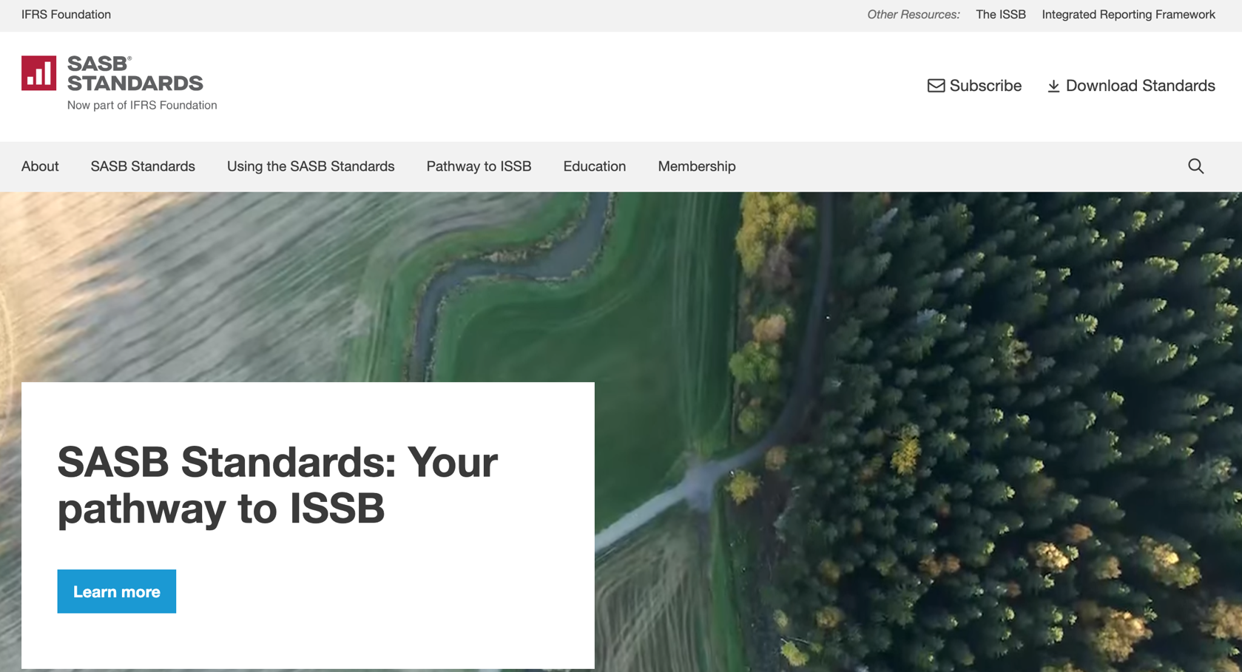
SASB (Sustainability Accounting Standards Board)
https://sasb.org/

Slide 33
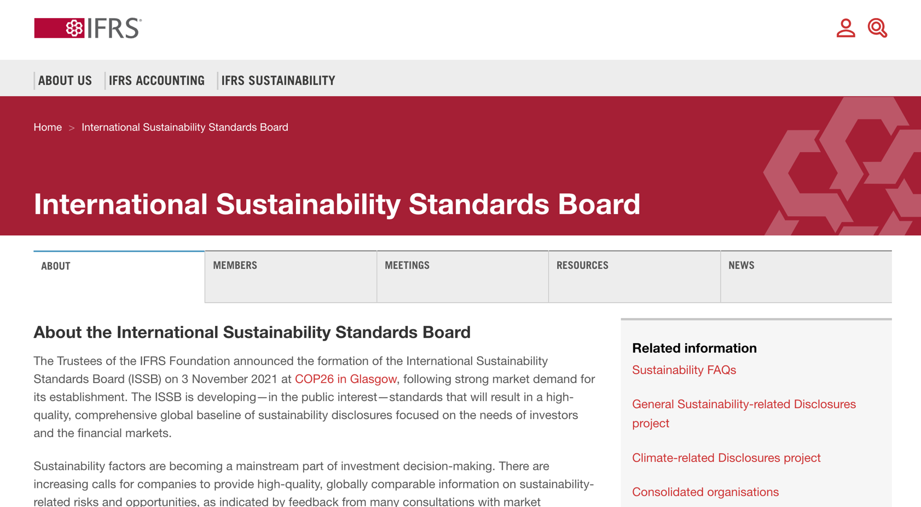
ISSB (International Sustainability Standards Board)
https://www.ifrs.org/groups/international-sustainability-standards-board/

Slide 34
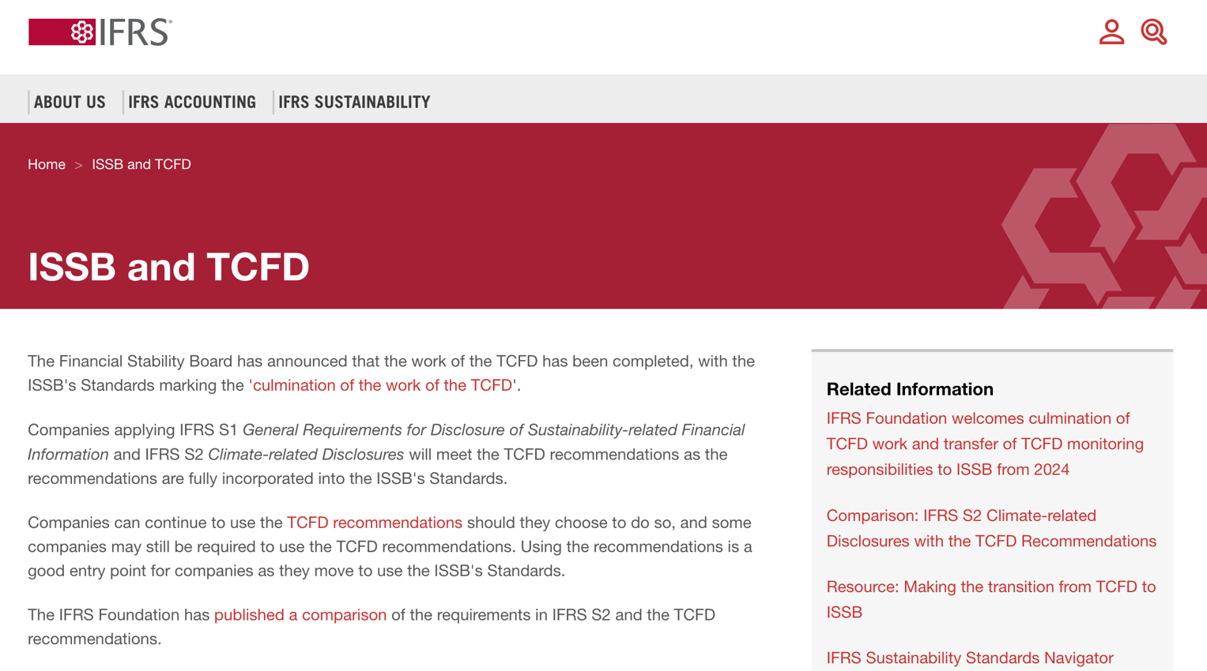
TCFD (Task Force on Climate-related Financial Disclosures)
https://www.ifrs.org/sustainability/tcfd/
https://www.fsb-tcfd.org/

Slide 35
The Human Impact of ESG Choices
Digital Initiatives
This isn't abstract, it's about improving lives
Positive potential when ESG is prioritized

Slide 36
Sustainable Productivity: Finance ESG
Source: Huang, Ziqi, Yang Shen, Jiayi Li, Marcel Fey, and Christian Brecher (2021). "A survey on AI-driven digital twins in Industry 4.0: Smart manufacturing and advanced robotics." Sensors 21, no. 19: 6340.

Slide 37
Sustainable Resilient Manufacturing ESG
Source: Huang, Ziqi, Yang Shen, Jiayi Li, Marcel Fey, and Christian Brecher (2021). "A survey on AI-driven digital twins in Industry 4.0: Smart manufacturing and advanced robotics." Sensors 21, no. 19: 6340.

Slide 38
ESG Indexes
MSCI ESG Index
Dow Jones Sustainability Indices (DJSI)
FTSE ESG Index

Slide 39
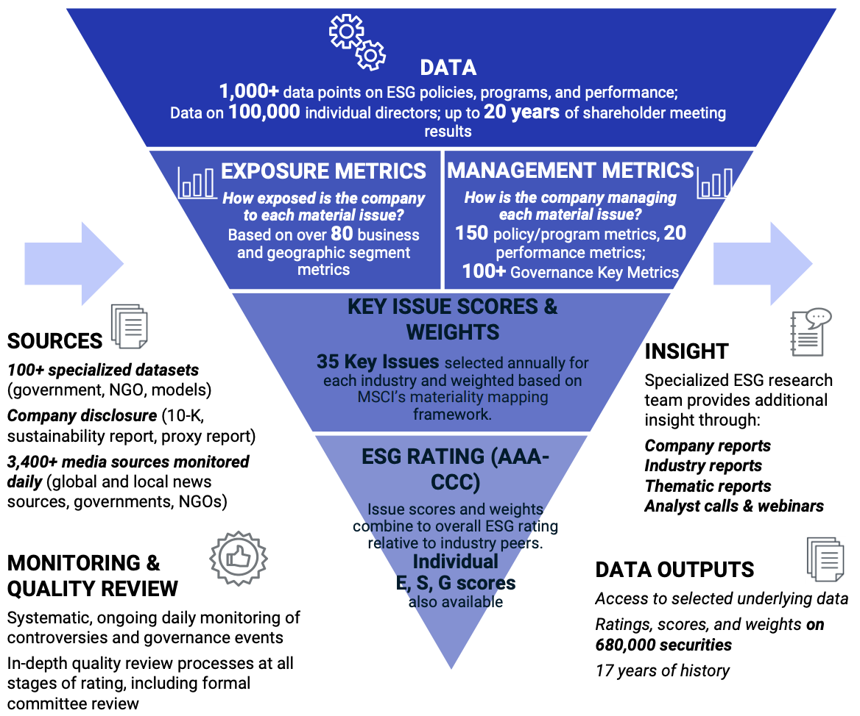
MSCI ESG Rating Framework
Source: https://www.msci.com/documents/1296102/21901542/ESG-Ratings-Methodology-Exec-Summary.pdf

Slide 40
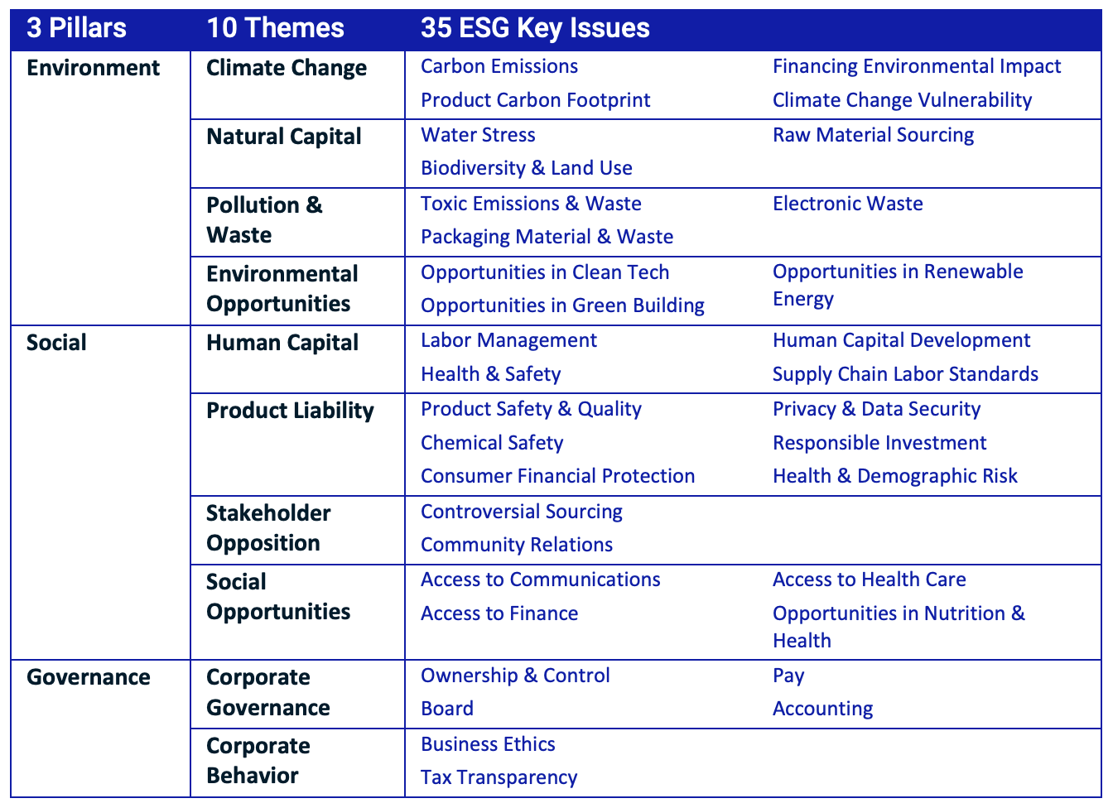
MSCI ESG Key Issue Hierarchy
Source: https://www.msci.com/documents/1296102/21901542/ESG-Ratings-Methodology-Exec-Summary.pdf

Slide 41
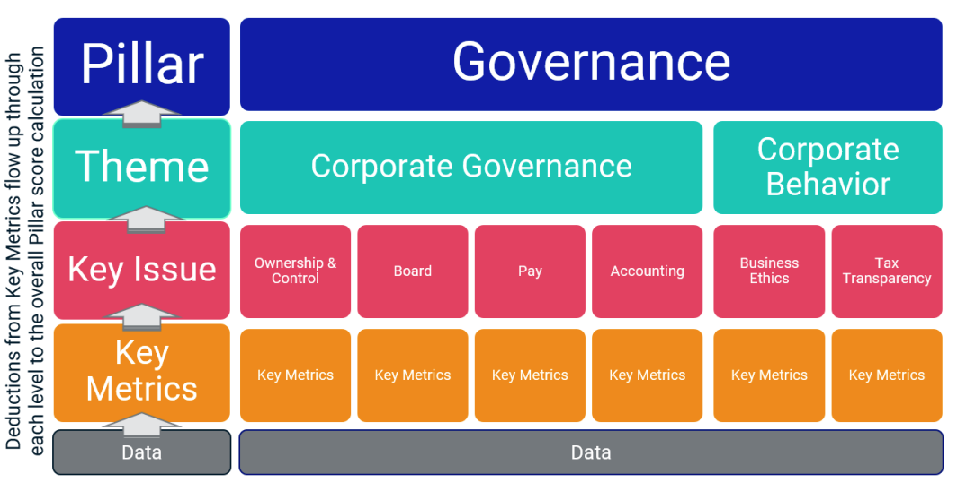
MSCI Governance Model Structure
Source: https://www.msci.com/documents/1296102/21901542/ESG-Ratings-Methodology-Exec-Summary.pdf

Slide 42
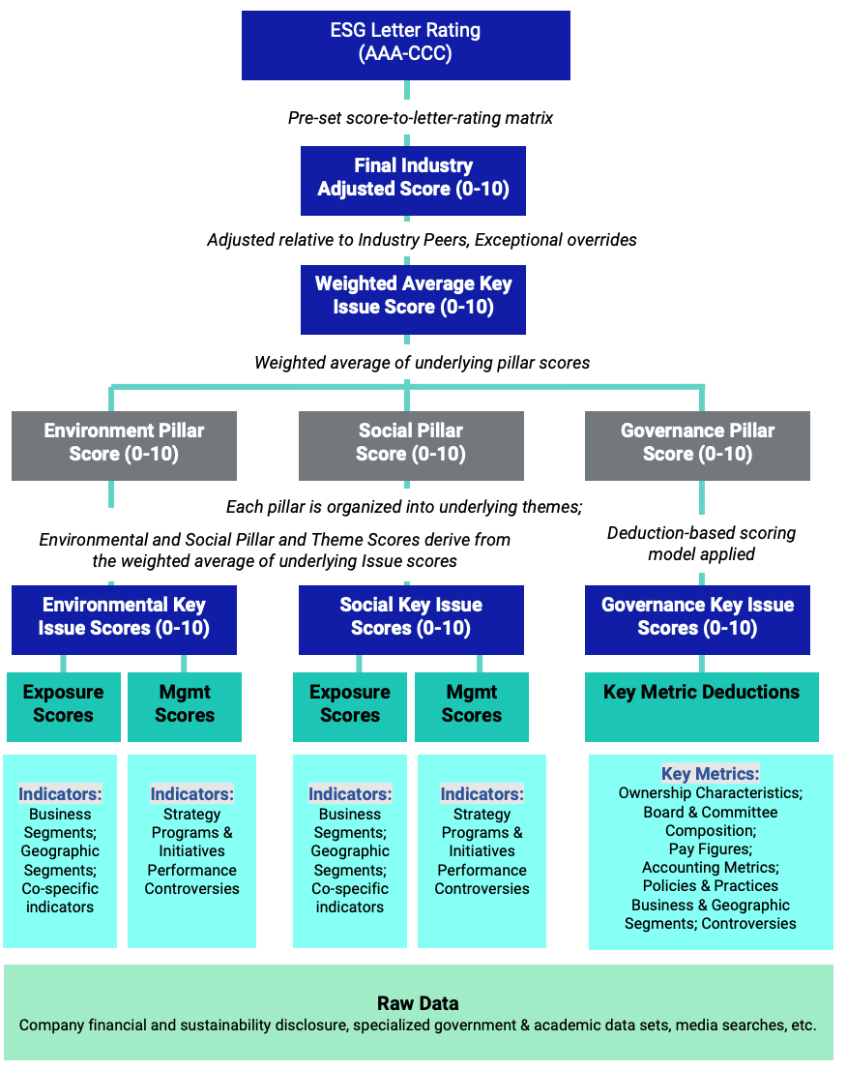
MSCI Hierarchy of ESG Scores
Source: https://www.msci.com/documents/1296102/21901542/ESG-Ratings-Methodology-Exec-Summary.pdf

Slide 43
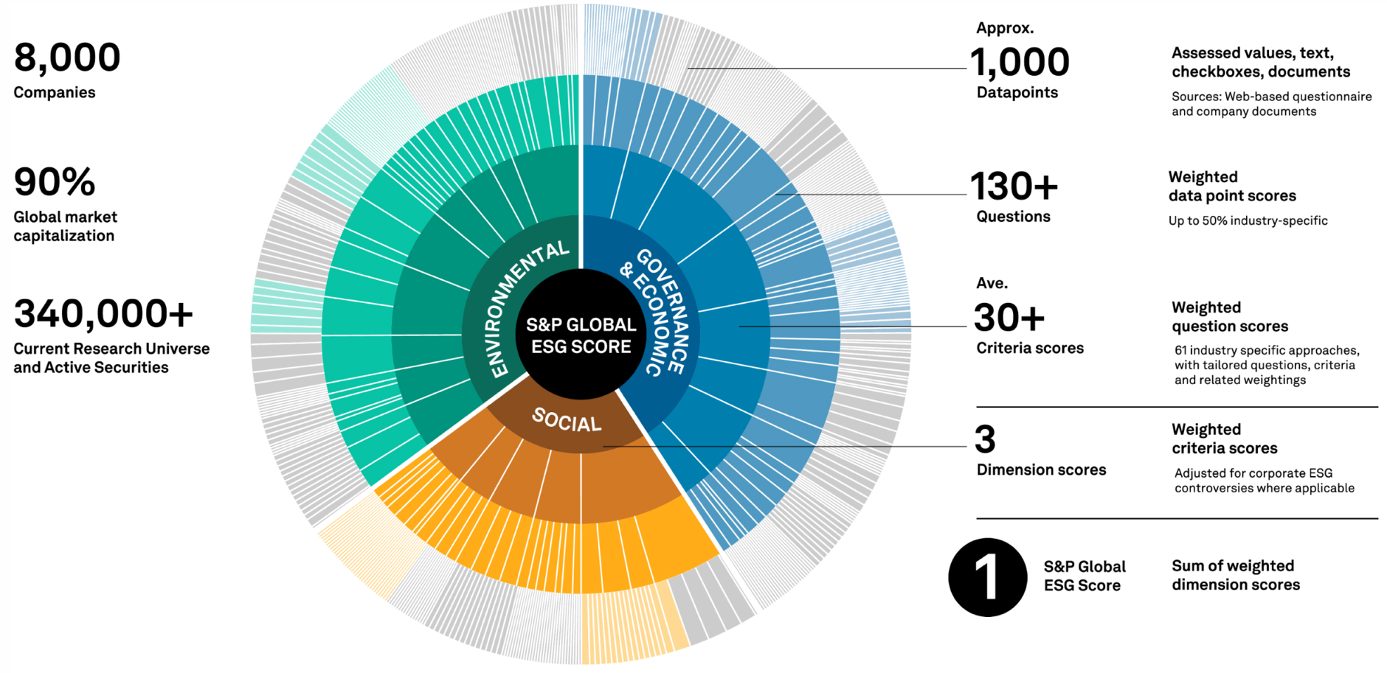
DJSI S&P Global ESG Score
Source: DJSI, S&P Global Corporate Sustainability Assessment (CSA), https://www.spglobal.com/esg/solutions/data-intelligence-esg-scores

Slide 44
FTSE Russell ESG Ratings
Source: https://www.ftserussell.com/data/sustainability-and-esg-data/esg-ratings

Slide 45
Sustainalytics ESG Risk Ratings
Analyst-based approach
Sustainalytics’ ESG Risk Ratings measure a company’s exposure to industry-specific material ESG risks and how well a company is managing those risks.
Source: https://www.sustainalytics.com/esg-data

Slide 46
Truvalue ESG Ranks
TruValue Labs
Machine-based approach
Truvalue Labs applies AI to analyze over 100,000 sources and uncover ESG risks and opportunities hidden in unstructured text.
The ESG Ranks data service produces an overall company rank based on industry percentile leveraging the 26 ESG categories defined by the Sustainability Accounting Standards Board (SASB).
The data feed covers 20,000+ companies with more than 13 years of history.
Source: :https://developer.truvaluelabs.com/data/esg-ranks

Slide 47
Analyst-driven vs. AI-driven ESG
Sustainalytics
Truvalue Labs
Source: Mark Tulay (2020), Man vs. machine: A tale of two sustainability ratings systems, GreenBiz, https://www.greenbiz.com/article/man-vs-machine-tale-two-sustainability-ratings-systems

Slide 48
Analyst based ESG Research AI based ESG Research
Source: https://www.esganalytics.io/insights/how-data-is-accelerating-esg

Slide 49
ESG Analytics: NLP Taxonomy
Source: https://www.esganalytics.io/insights/how-data-is-accelerating-esg

Slide 50
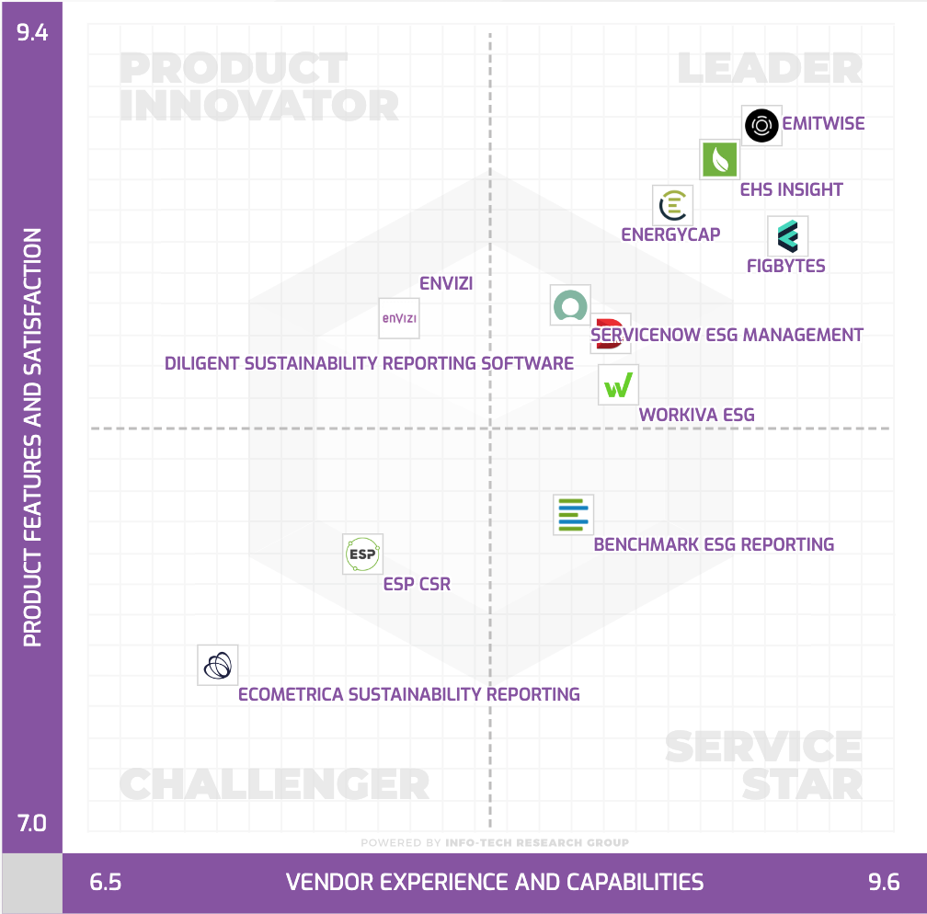
Top ESG Reporting Software
Environmental, Social and Governance (ESG) Reporting software or Sustainability software helps organizations manage their operational data, evaluate their impact on the environment and provide reporting to perform audits.
Source: https://www.softwarereviews.com/categories/environmental-social-and-governance-reporting

Slide 51
Generative AI and LLMs for Sustainability and ESG Data Analytics

Slide 52
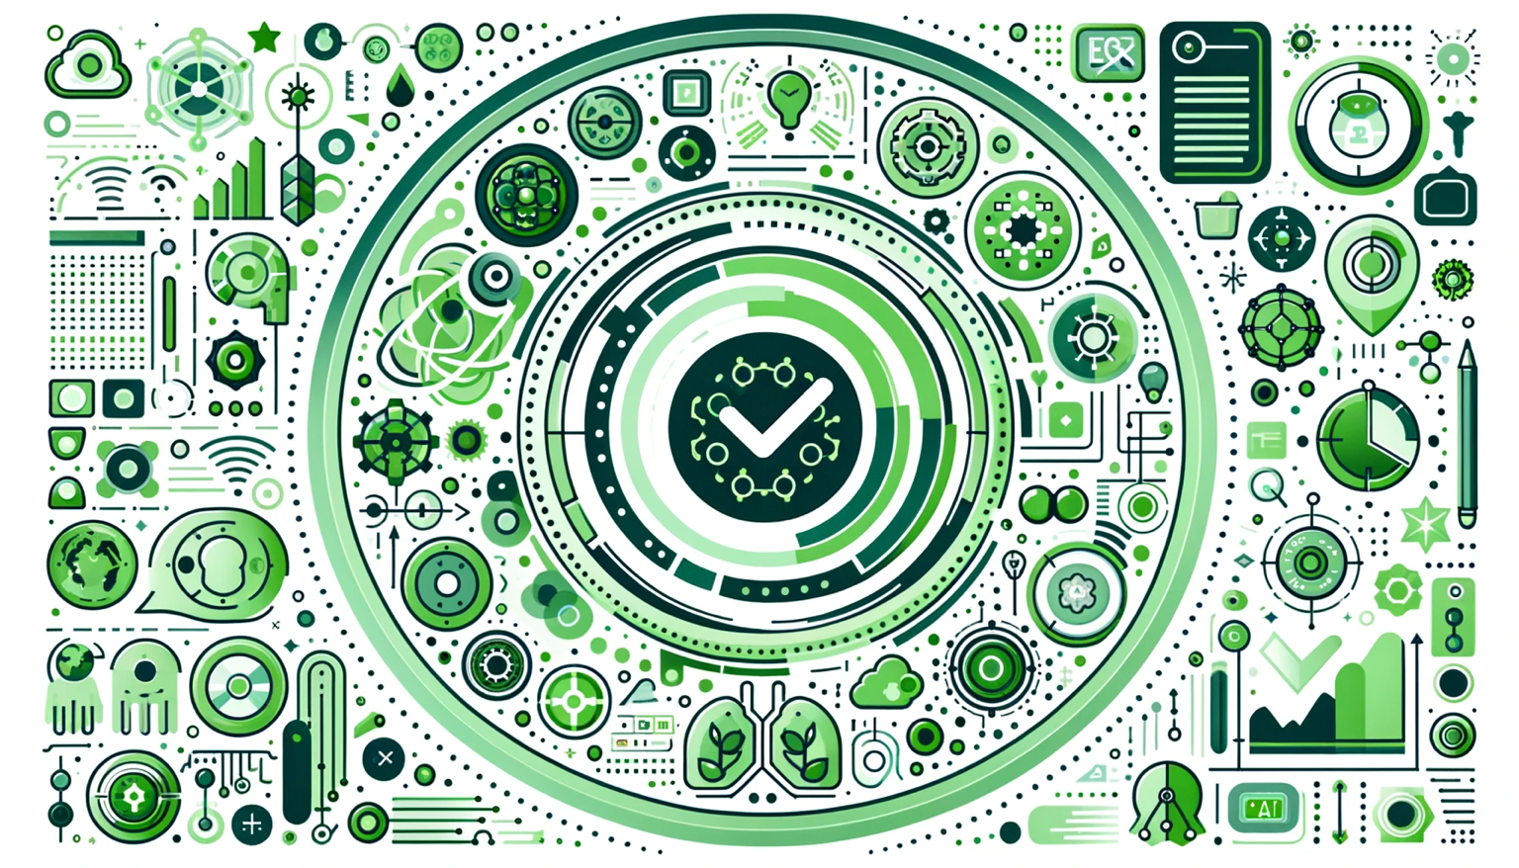
Generative AI for ESG Rating and Reporting Generation

Slide 53
Google Gemini Largest and most capable AI model Making AI more helpful for everyone
Source: https://blog.google/technology/ai/google-gemini-ai

Slide 54
OpenAI Sora Text-to-Video Video generation models as world simulators
Turning visual data into patches
LLMs have text tokens, Sora has visual patches
Source: https://openai.com/research/video-generation-models-as-world-simulators

Slide 55
Summary
Environmental, Social, and Governance (ESG)
Net-Zero Digital Transformation
Net-Zero Transformation
Digital Transformation
Source: Dipanjan Sarkar (2019), Text Analytics with Python: A Practitioner’s Guide to Natural Language Processing, Second Edition. APress.

Slide 56
References
Cino Robin Castelli, Cyril Shmatov (2022), Quantitative Methods for ESG Finance, Wiley
Simon Thompson (2023), Green and Sustainable Finance: Principles and Practice in Banking, Investment and Insurance, 2nd Edition, Kogan Page.
Chrissa Pagitsas (2023), Chief Sustainability Officers At Work: How CSOs Build Successful Sustainability and ESG Strategies, Apress.
GRI (Global Report Initiative): https://www.globalreporting.org/
CDP (Carbon Disclosure Project): https://www.cdp.net/
SASB (Sustainability Accounting Standards Board): https://sasb.org/
ISSB (International Sustainability Standards Board): https://www.ifrs.org/groups/international-sustainability-standards-board/
TCFD (Task Force on Climate-related Financial Disclosures): https://www.fsb-tcfd.org/
Min-Yuh Day (2024), Python 101, https://tinyurl.com/aintpupython101

