Slide 1
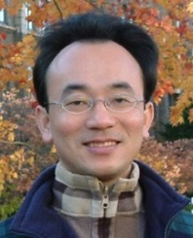
永續與 ESG 資料科學 (Data Science for Sustainability and ESG)
永續數據分析 (Sustainability and ESG Data Analytics)
1122ESGDA03
DM4, NTPU (N4084) (Spring 2024) Fri, 10, 11, 12 (18:30-21:15) (臺北大學民生校區 305)
戴敏育
Min-Yuh Day, Ph.D, Associate Professor
Institute of Information Management, National Taipei University
https://web.ntpu.edu.tw/~myday
https://meet.google.com/miy-fbif-max
2024-03-08

Slide 2
課程大綱 (Syllabus)
週次 (Week) 日期 (Date) 內容 (Subject/Topics)
1 2024/02/23 永續數據分析概論 (Introduction Sustainability and ESG Data Analytics)
2 2024/03/01 環境、社會與治理 (ESG) 淨零數位轉型 (Environmental, Social, and Governance (ESG) in Net-Zero Digital Transformation)
3 2024/03/08 永續與ESG 資料科學 (Data Science for Sustainability and ESG)
4 2024/03/15 永續數據分析個案研究 I (Case Study on Sustainability and ESG Data Analytics I)
5 2024/03/22 Web 3.0 和大數據分析在金融科技、綠色永續金融 (Web 3.0 and Big Data Analysis in Fintech, Green and Sustainable Finance)

Slide 3
課程大綱 (Syllabus)
週次 (Week) 日期 (Date) 內容 (Subject/Topics)
6 2024/03/29 TCFD 氣候相關財務揭露與En-ROADS 氣候變遷模擬 (Task Force on Climate-Related Financial Disclosures (TCFD) and En-Roads Interactive)
7 2024/04/05 放假 (No Classes)
8 2024/04/12 期中報告 (Midterm Project Report)
9 2024/04/19 ESG數據的收集、分析和視覺化 (ESG Data Gathering, Analysis, and Visualization)
10 2024/04/26 ESG數據報告 (ESG Data Reporting); 企業永續報告書 (Corporate Sustainability Reports)

Slide 4
課程大綱 (Syllabus)
週次 (Week) 日期 (Date) 內容 (Subject/Topics)
11 2024/05/03 ESG數據驗證 (ESG Data Verification)
12 2024/05/10 永續數據分析個案研究 II (Case Study on Sustainability and ESG Data Analytics II)
13 2024/05/17 能源之星報告與數據揭露 (Energy Star Reporting and Data Disclosure)
14 2024/05/24 人工智慧物聯網在ESG永續應用 (Artificial Intelligence of things (AIoT) in ESG and Sustainability Applications)
15 2024/05/31 生成式AI於永續評等和報告生成 (Generative AI for ESG Rating and Reporting Generation)
16 2024/06/07 期末報告 (Final Project Report)

Slide 5
Data Science for Sustainability and ESG

Slide 6
Outline
Data Science for Sustainability and ESG: Foundations & Frameworks
Data Science Techniques for ESG Analysis
Real-World ESG Data Science Applications & Impact
ESG Data Science Foundation with Python
Source: Dipanjan Sarkar (2019), Text Analytics with Python: A Practitioner’s Guide to Natural Language Processing, Second Edition. APress.

Slide 7
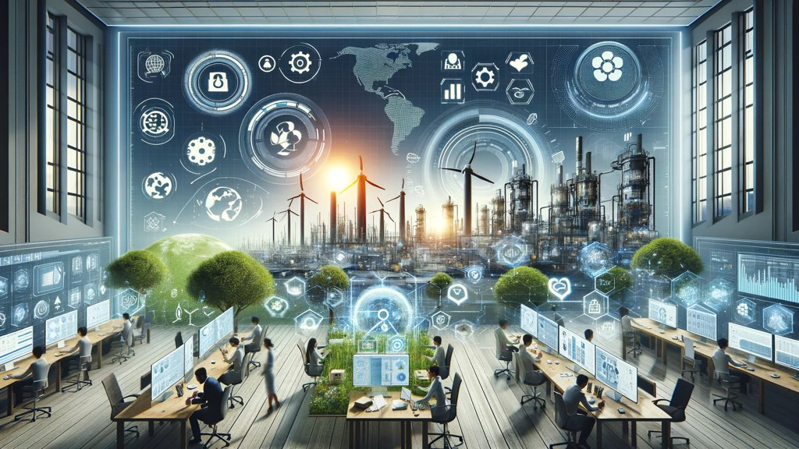
Sustainability and ESG Data Analytics

Slide 8
Data Science for Sustainability and ESG: Transforming Decision-Making for a Better Future

Slide 9
Data Science for Sustainability and ESG: Foundations & Frameworks

Slide 10
The Interconnectedness of Data, Sustainability & ESG
Sustainability encompasses environmental, social, and governance concerns.
ESG provides a framework for measuring and reporting sustainability performance.
Data science offers the tools to collect, analyze, and use ESG data for decision-making.

Slide 11
Understanding ESG Data
Quantitative data: Measurable metrics (e.g., carbon emissions, employee diversity)
Qualitative data: Text-based information (e.g., policies, news articles)
Structured data: Organized in databases
Unstructured data: Requires processing (e.g., social media)

Slide 12
Challenges of ESG Data
Lack of standardization:
Different reporting frameworks and metrics
Reliability:
Concerns about "greenwashing" and accuracy
Availability:
Data gaps, especially for smaller companies and certain sectors

Slide 13
ESG Key Frameworks
Global Reporting Initiative (GRI):
Comprehensive sustainability standards
Sustainability Accounting Standards Board (SASB):
Industry-specific metrics
UN Sustainable Development Goals (SDGs):
Global goals for 2030

Slide 14
ESG: Environmental Social Governance

Slide 15
Sustainable Development Goals (SDGs)
Source: https://sdgs.un.org/goals

Slide 16
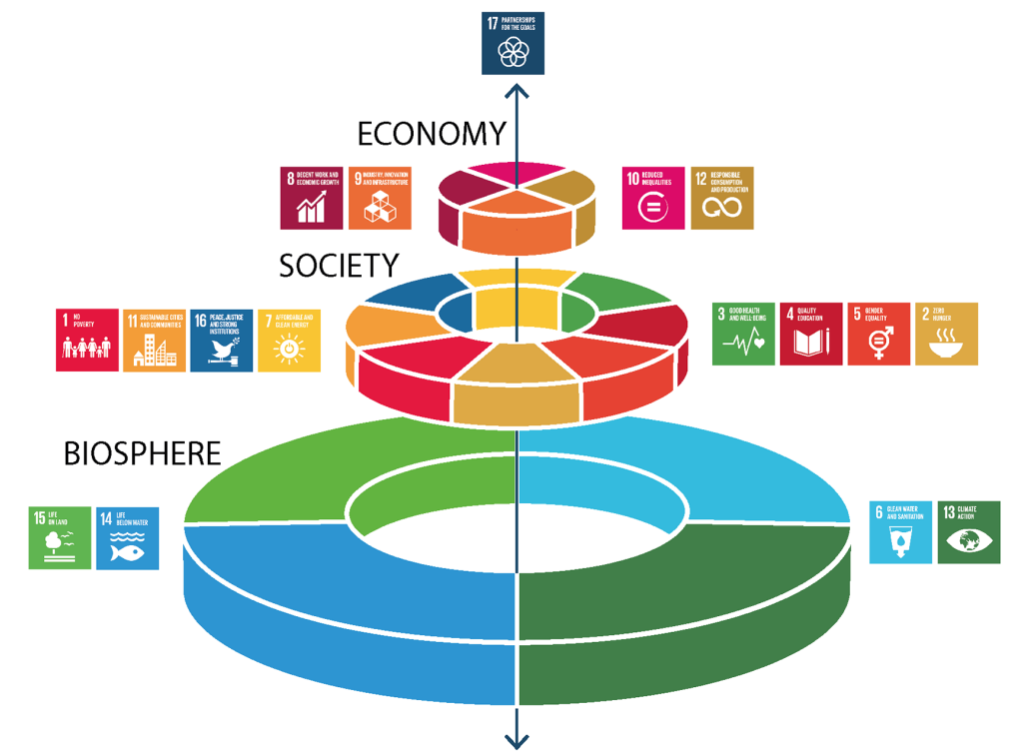
Sustainable Development Goals (SDGs) and 5P
Partnership
Peace
Prosperity
People
Planet
Source: Folke, Carl, Reinette Biggs, Albert V. Norström, Belinda Reyers, and Johan Rockström. "Social-ecological resilience and biosphere-based sustainability science.”Ecology and Society 21, no. 3 (2016).

Slide 17
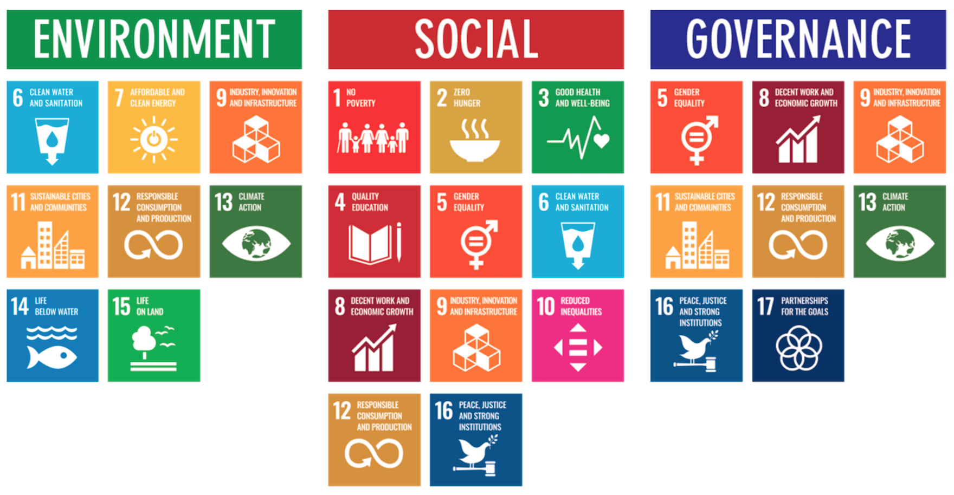
ESG to 17 SDGs
Source: Henrik Skaug Sætra (2021) "A Framework for Evaluating and Disclosing the ESG Related Impacts of AI with the SDGs." Sustainability 13, no. 15 (2021): 8503.

Slide 18
ESG to 17 SDGs
Source: https://sustainometric.com/esg-to-sdgs-connected-paths-to-a-sustainable-future/

Slide 19
GRI (Global Report Initiative)
https://www.globalreporting.org/

Slide 20
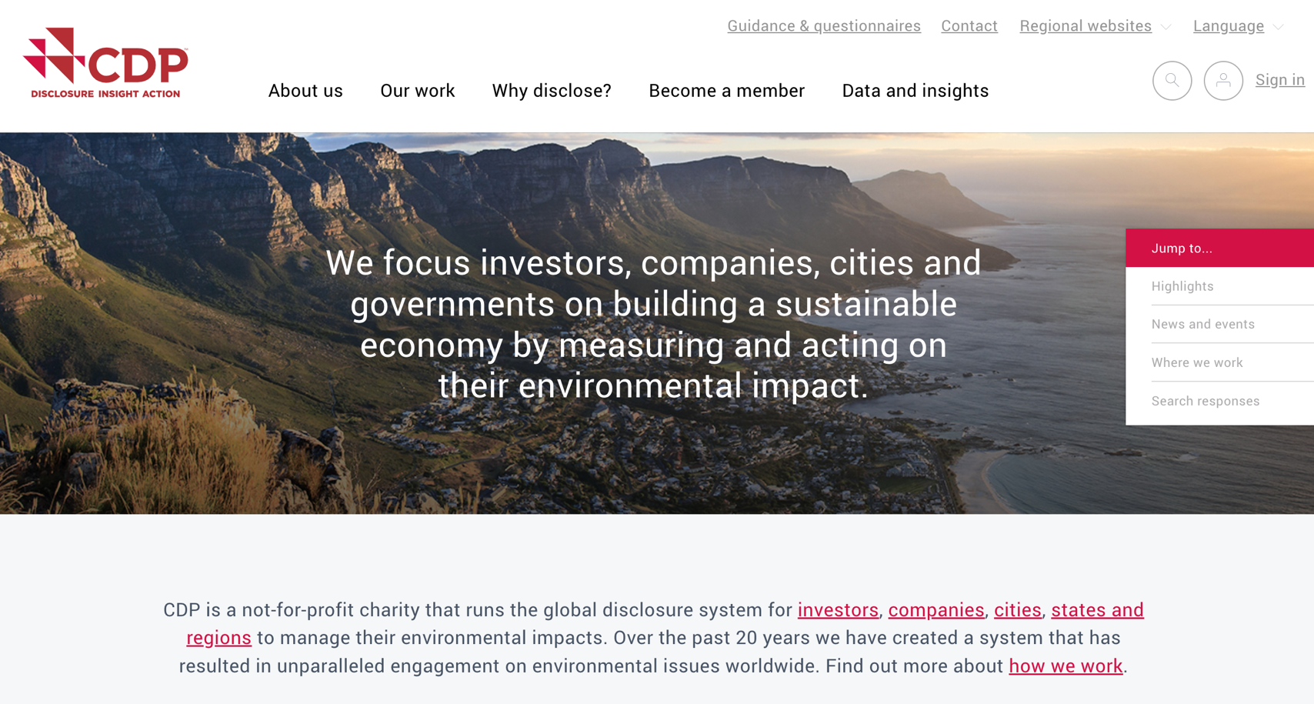
CDP (Carbon Disclosure Project)
https://www.cdp.net/

Slide 21
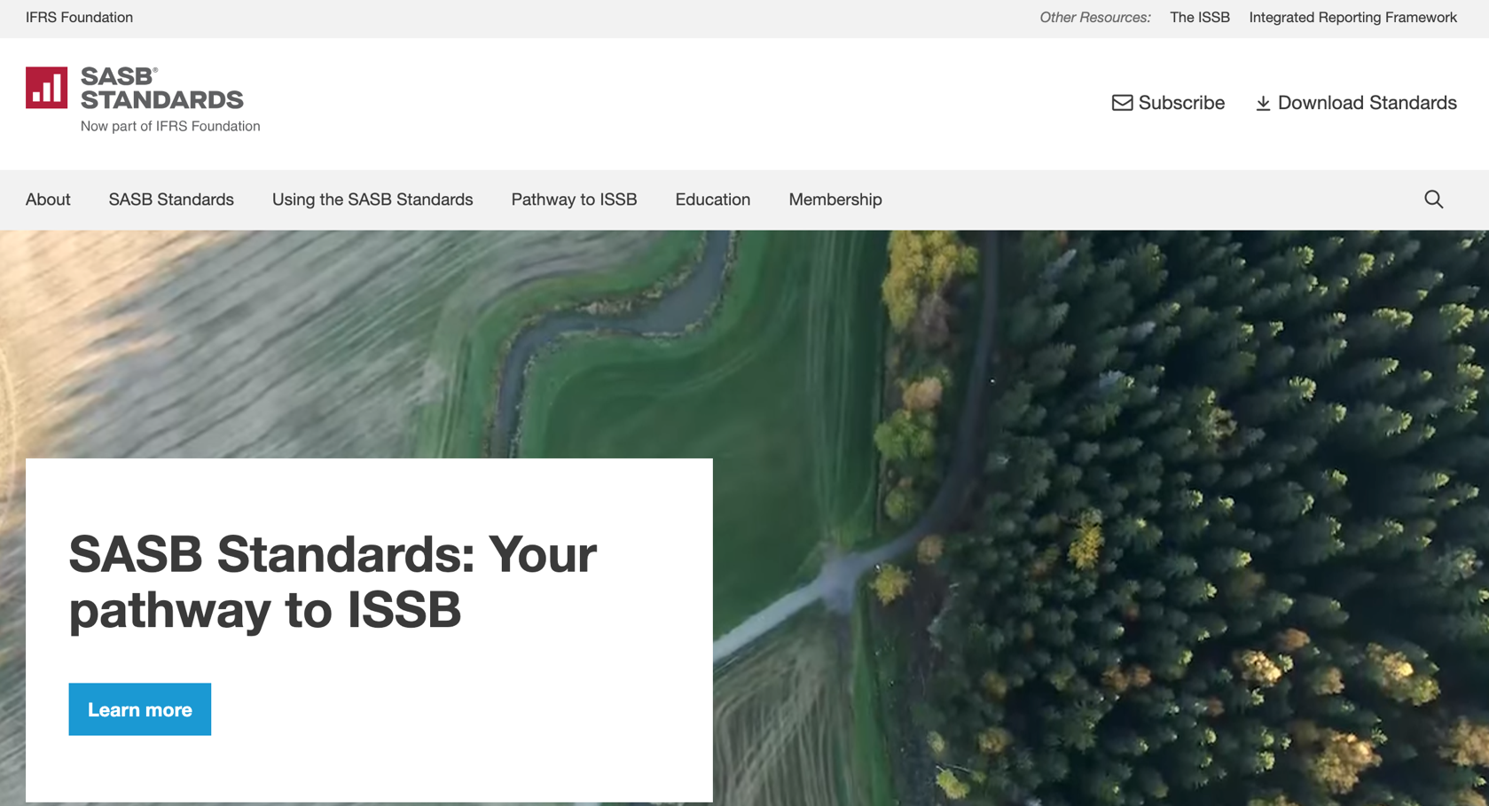
SASB (Sustainability Accounting Standards Board)
https://sasb.org/

Slide 22
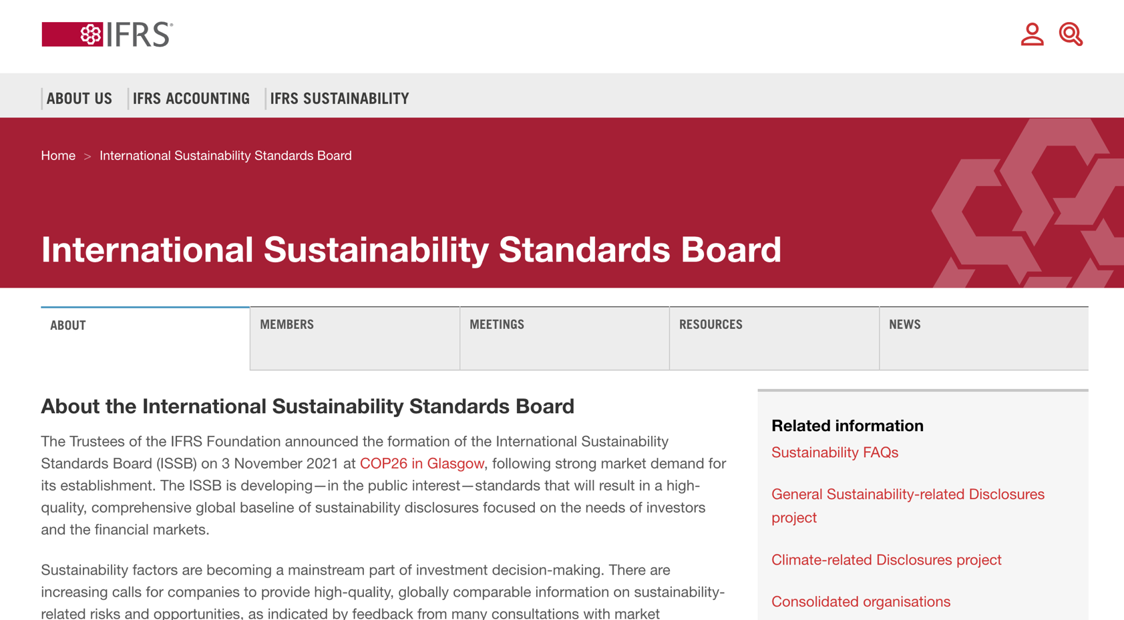
ISSB (International Sustainability Standards Board)
https://www.ifrs.org/groups/international-sustainability-standards-board/

Slide 23
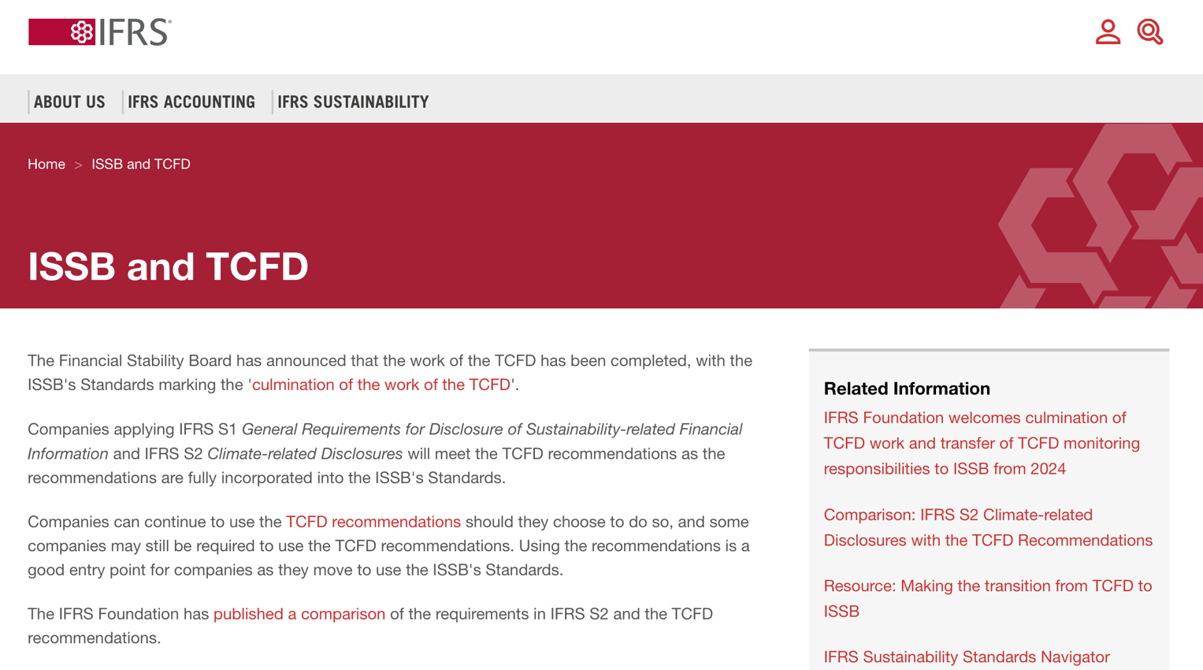
TCFD (Task Force on Climate-related Financial Disclosures)
https://www.ifrs.org/sustainability/tcfd/
https://www.fsb-tcfd.org/

Slide 24
Analyzing Sustainability Reports
Company sustainability report
Identify which framework was used, key ESG metrics, areas of strength and weakness
How the company presents its ESG data and whether it aligns with the ESG key framework identified

Slide 25
Data Science Techniques for ESG Analysis

Slide 26
Data Preparation & Cleaning: Preparing ESG Data for Analysis
Handling missing values:
Imputation, deletion, etc.
Detecting and addressing outliers.
Ensuring data consistency (formatting, units).
Feature engineering:
Creating new metrics based on raw ESG data.

Slide 27
Exploratory Data Analysis (EDA) & Visualization: Uncovering Patterns in ESG Data
Exploratory Data Analysis (EDA)
Using statistical summaries and visualizations.
Identifying trends, correlations, and unusual patterns in ESG data.
Storytelling with data:
Effective visualizations for ESG insights.

Slide 28
ESG Predictive Modeling: Forecasting with ESG Data
Regression
Predicting continuous ESG outcomes (e.g., emissions)
Classification:
Categorizing companies (e.g., high/low ESG risk)
Time Series:
Forecasting ESG metrics over time.

Slide 29
Natural Language Processing (NLP) for Sentiment Analysis: Sentiment Analysis for ESG Insights
Natural Language Processing (NLP):
Enabling computers to understand human language.
Sentiment analysis:
Determining the emotional tone of text (positive, negative, neutral)
Applications for ESG:
Tracking public opinion, identifying ESG risks and opportunities.

Slide 30
Real-World ESG Data Science Applications & Impact

Slide 31
Evolution of Sustainable Finance Research
Topic
SDGs: Sustainable Development Goals
SDGs
Innovative Financial Instrument
Impact Investing
ESG: Environmental, Social, and Governance
CSR: Corporate Social Responsibility
Conscious Capitalism
Climate Financing
Carbon Financing
Green Financing
Ethical Investing
Socially Responsible Investing
1986
1995
2005
2015
2020
Source: Kumar, S., Sharma, D., Rao, S., Lim, W. M., & Mangla, S. K. (2022). Past, present, and future of sustainable finance: Insights from big data analytics through machine learning of scholarly research. Annals of Operations Research, 1-44.

Slide 32
Data-Driven Sustainable Investing: Building ESG-Conscious Portfolios
ESG investing:
Considering environmental, social, and governance factors in investment decisions.
Performance of ESG-focused funds vs. traditional funds.
Building ESG portfolios:
Screening, index funds, impact investing.

Slide 33
ESG Risk Assessment and Mitigation: Managing ESG Risks for Resilience
Identifying ESG risks across the supply chain (environmental impact, labor practices).
Using data to quantify potential financial consequences of ESG risks.
Developing strategies to mitigate ESG risks.
Integrating ESG risk monitoring into decision-making for greater resilience.

Slide 34
Driving Corporate Sustainability: Data-Powered Sustainability Transformations
Setting data-driven ESG targets and tracking progress.
Utilizing dashboards and analytics for real-time ESG insights.
Engaging stakeholders through transparent ESG reporting.

Slide 35
The Future of Data-Driven ESG: A Sustainable Future Powered by Data
Emerging trends in ESG data and analytics
e.g., AI for ESG insights
The potential of data to drive progress towards global sustainability goals.
The role of data scientists in shaping ethical and equitable ESG practices.
Be part of the ESG Data Science solution.

Slide 36
Sustainable Productivity: Finance ESG
Source: Huang, Ziqi, Yang Shen, Jiayi Li, Marcel Fey, and Christian Brecher (2021). "A survey on AI-driven digital twins in Industry 4.0: Smart manufacturing and advanced robotics." Sensors 21, no. 19: 6340.

Slide 37
Sustainable Resilient Manufacturing ESG
Source: Huang, Ziqi, Yang Shen, Jiayi Li, Marcel Fey, and Christian Brecher (2021). "A survey on AI-driven digital twins in Industry 4.0: Smart manufacturing and advanced robotics." Sensors 21, no. 19: 6340.

Slide 38
ESG Indexes
MSCI ESG Index
Dow Jones Sustainability Indices (DJSI)
FTSE ESG Index

Slide 39
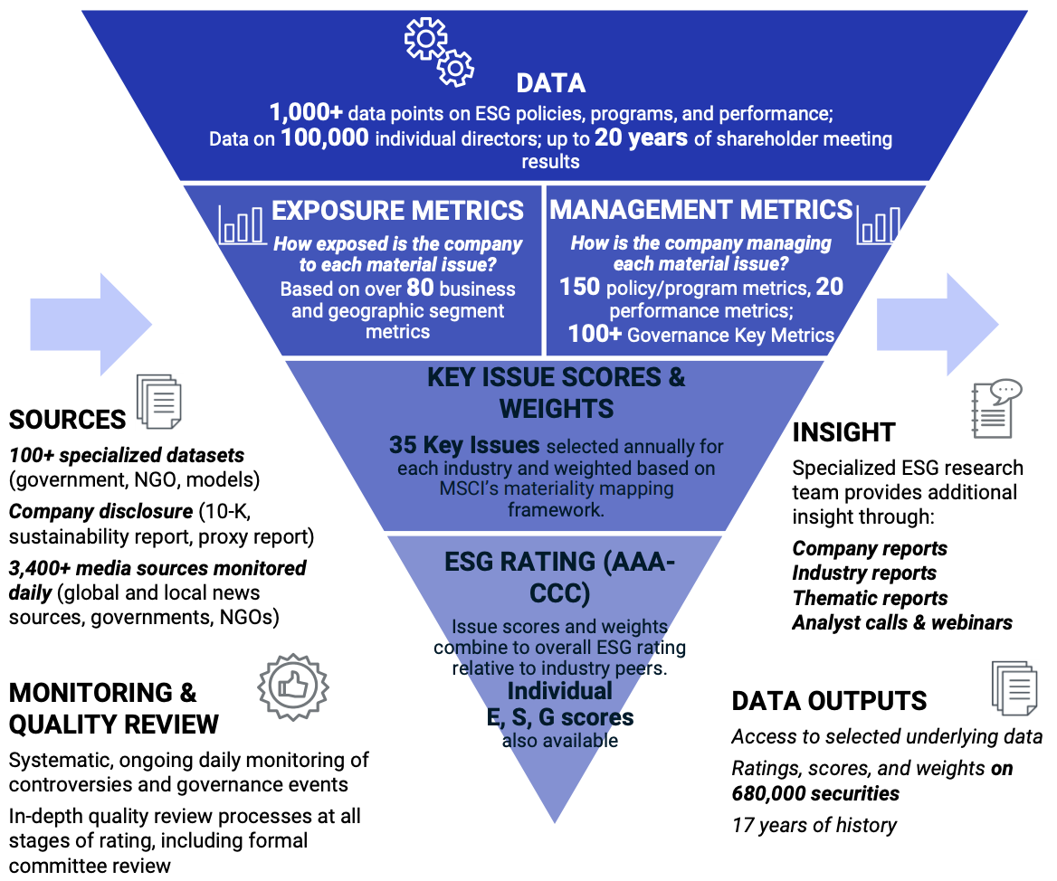
MSCI ESG Rating Framework
Source: https://www.msci.com/documents/1296102/21901542/ESG-Ratings-Methodology-Exec-Summary.pdf

Slide 40
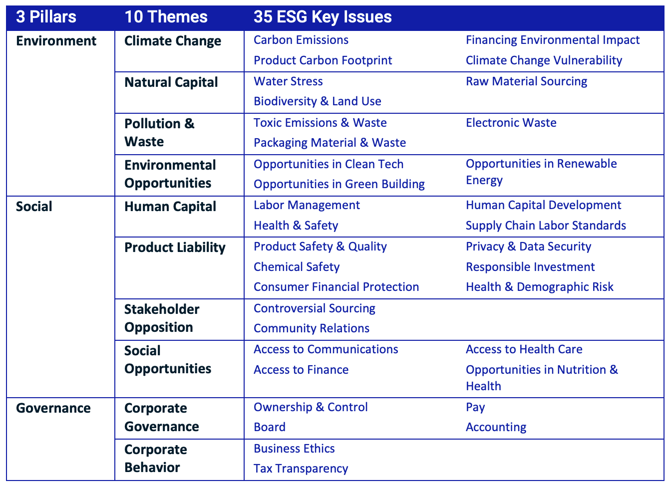
MSCI ESG Key Issue Hierarchy
Source: https://www.msci.com/documents/1296102/21901542/ESG-Ratings-Methodology-Exec-Summary.pdf

Slide 41
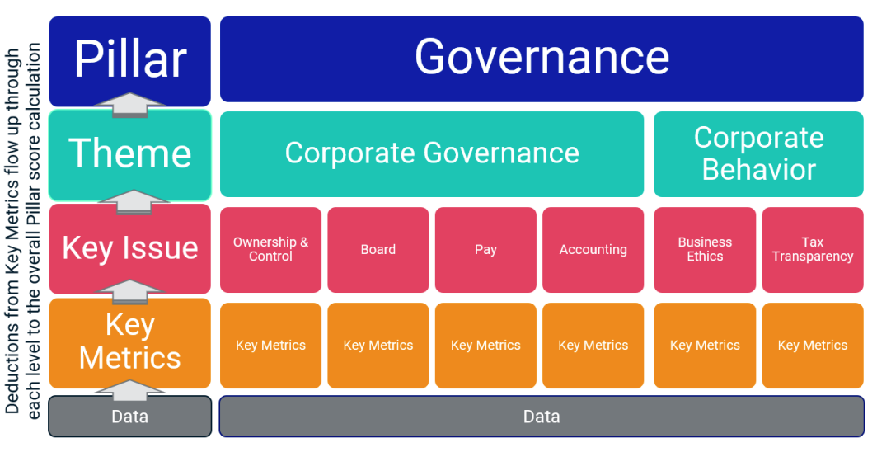
MSCI Governance Model Structure
Source: https://www.msci.com/documents/1296102/21901542/ESG-Ratings-Methodology-Exec-Summary.pdf

Slide 42
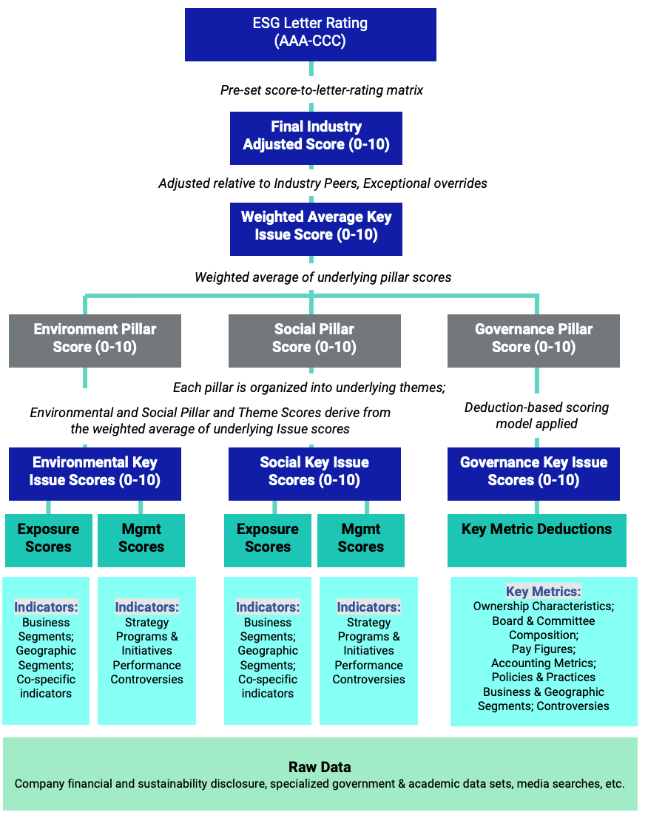
MSCI Hierarchy of ESG Scores
Source: https://www.msci.com/documents/1296102/21901542/ESG-Ratings-Methodology-Exec-Summary.pdf

Slide 43
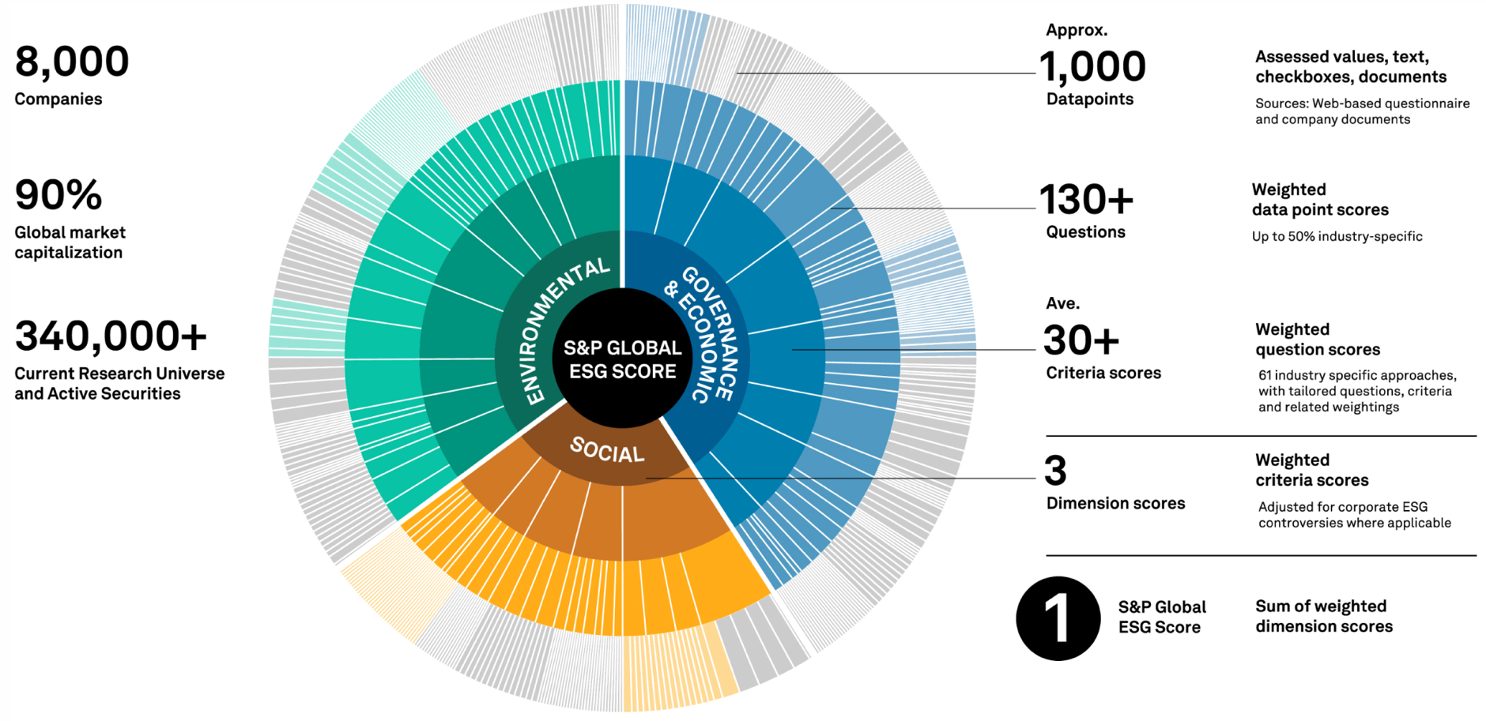
DJSI S&P Global ESG Score
Source: DJSI, S&P Global Corporate Sustainability Assessment (CSA), https://www.spglobal.com/esg/solutions/data-intelligence-esg-scores

Slide 44
FTSE Russell ESG Ratings
Source: https://www.ftserussell.com/data/sustainability-and-esg-data/esg-ratings

Slide 45
Sustainalytics ESG Risk Ratings
Analyst-based approach
Sustainalytics’ ESG Risk Ratings measure a company’s exposure to industry-specific material ESG risks and how well a company is managing those risks.
Source: https://www.sustainalytics.com/esg-data

Slide 46
Truvalue ESG Ranks
TruValue Labs
Machine-based approach
Truvalue Labs applies AI to analyze over 100,000 sources and uncover ESG risks and opportunities hidden in unstructured text.
The ESG Ranks data service produces an overall company rank based on industry percentile leveraging the 26 ESG categories defined by the Sustainability Accounting Standards Board (SASB).
The data feed covers 20,000+ companies with more than 13 years of history.
Source: :https://developer.truvaluelabs.com/data/esg-ranks

Slide 47
Analyst-driven vs. AI-driven ESG
Sustainalytics
Truvalue Labs
Source: Mark Tulay (2020), Man vs. machine: A tale of two sustainability ratings systems, GreenBiz, https://www.greenbiz.com/article/man-vs-machine-tale-two-sustainability-ratings-systems

Slide 48
Analyst based ESG Research AI based ESG Research
Source: https://www.esganalytics.io/insights/how-data-is-accelerating-esg

Slide 49
ESG Analytics: NLP Taxonomy
Source: https://www.esganalytics.io/insights/how-data-is-accelerating-esg

Slide 50
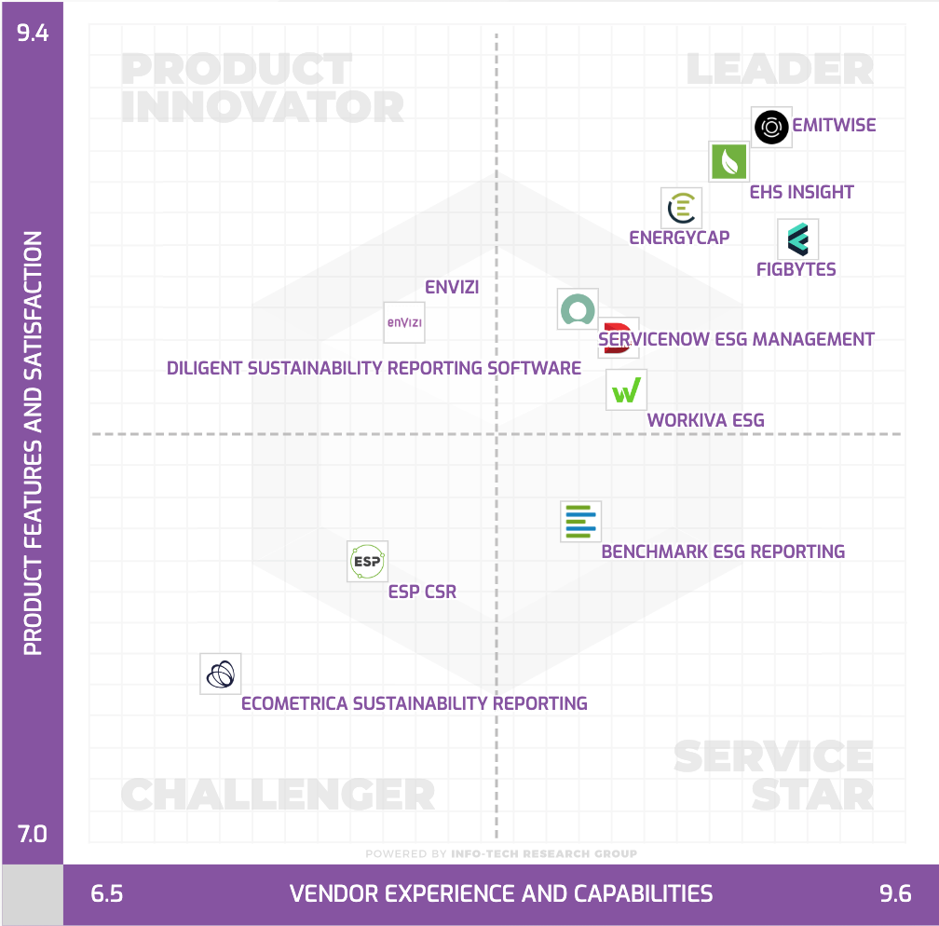
Top ESG Reporting Software
Environmental, Social and Governance (ESG) Reporting software or Sustainability software helps organizations manage their operational data, evaluate their impact on the environment and provide reporting to perform audits.
Source: https://www.softwarereviews.com/categories/environmental-social-and-governance-reporting

Slide 51
Generative AI and LLMs for Sustainability and ESG Data Analytics

Slide 52
Generative AI for ESG Rating and Reporting Generation

Slide 53
Google Gemini Largest and most capable AI model Making AI more helpful for everyone
Source: https://blog.google/technology/ai/google-gemini-ai

Slide 54
OpenAI Sora Text-to-Video Video generation models as world simulators
Turning visual data into patches
LLMs have text tokens, Sora has visual patches
Source: https://openai.com/research/video-generation-models-as-world-simulators

Slide 55
ESG Data Science Foundation with Python

Slide 56
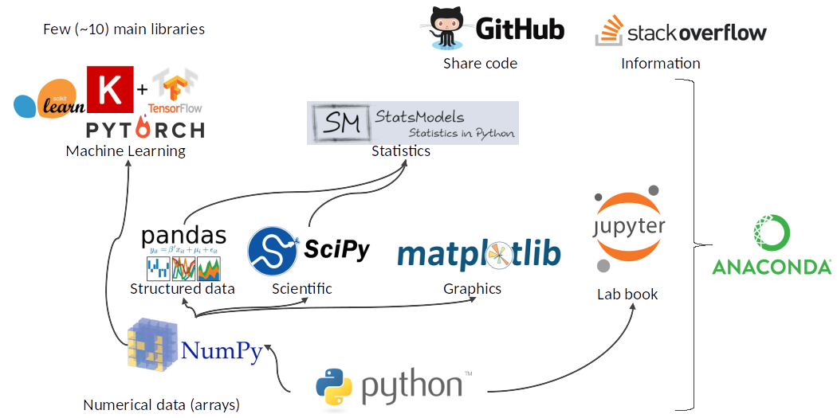
Python Ecosystem for Data Science
Source: https://medium.com/pyfinance/why-python-is-best-choice-for-financial-data-modeling-in-2019-c0d0d1858c45

Slide 57
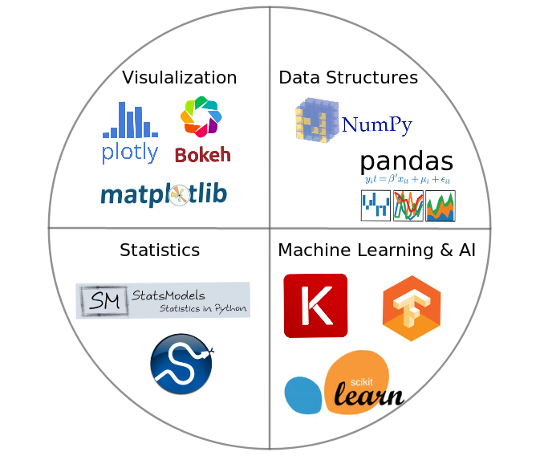
Python Ecosystem for Data Science
Source:https://duchesnay.github.io/pystatsml/introduction/python_ecosystem.html

Slide 58
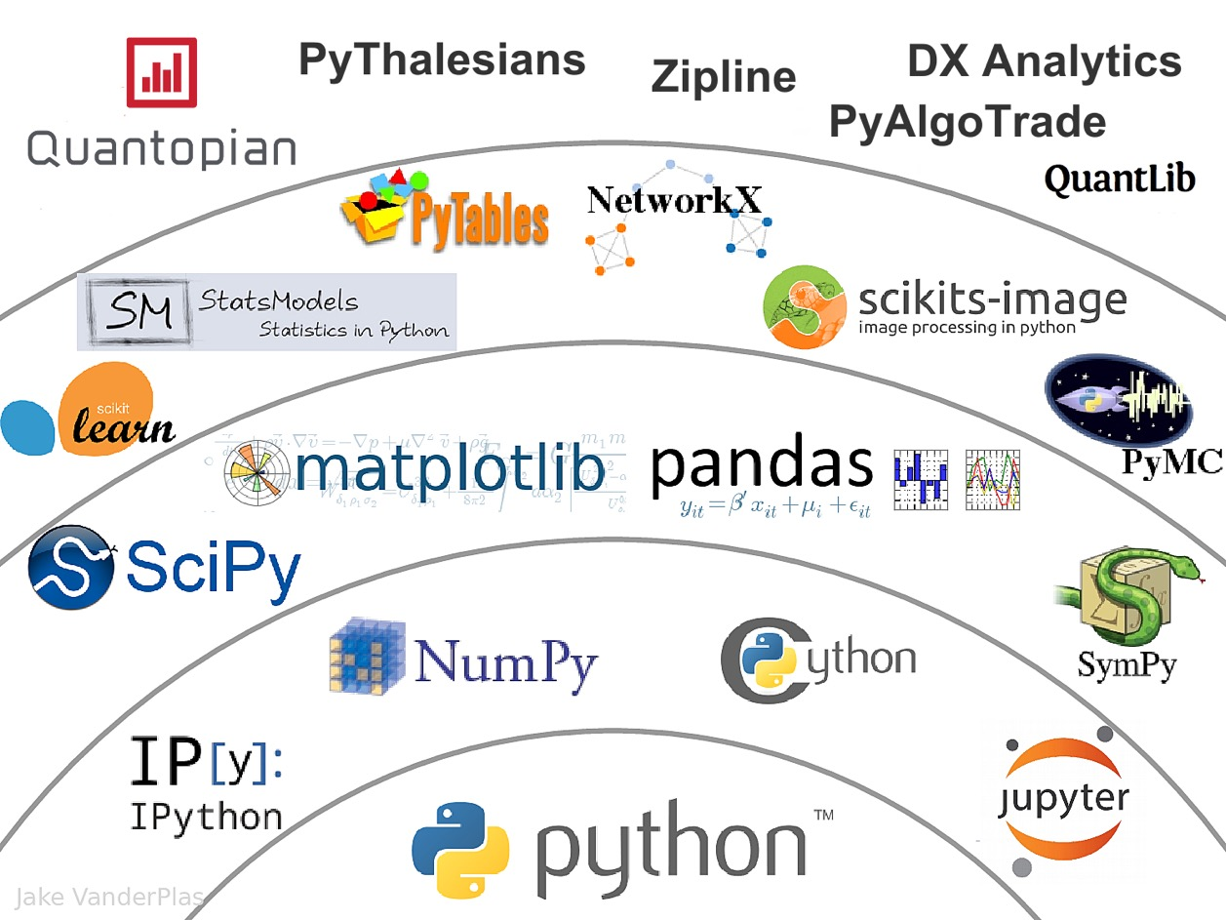
The Quant Finance PyData Stack
Source: http://nbviewer.jupyter.org/format/slides/github/quantopian/pyfolio/blob/master/pyfolio/examples/overview_slides.ipynb#/5

Slide 59
Python Programming

Slide 60
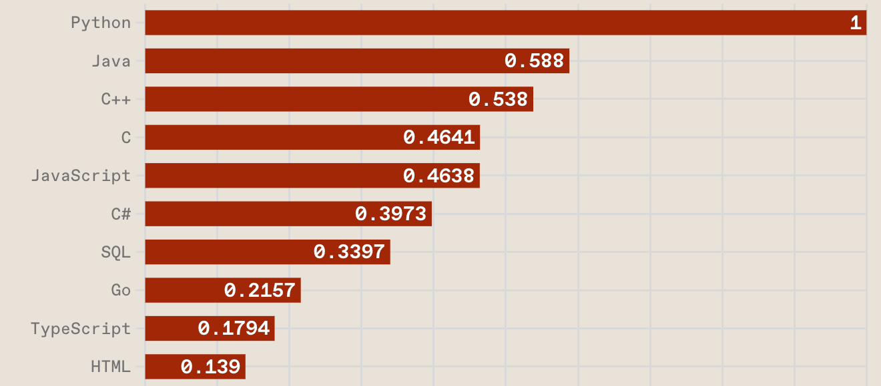
Top Programming Languages
https://spectrum.ieee.org/the-top-programming-languages-2023

Slide 61
Python is an interpreted, object-oriented, high-level programming language with dynamic semantics.
Source: https://www.python.org/doc/essays/blurb/

Slide 62
Numpy
NumPy
Base N-dimensional array package

Slide 63
Python matplotlib
Source: https://matplotlib.org/

Slide 64
Python Pandas
http://pandas.pydata.org/

Slide 65
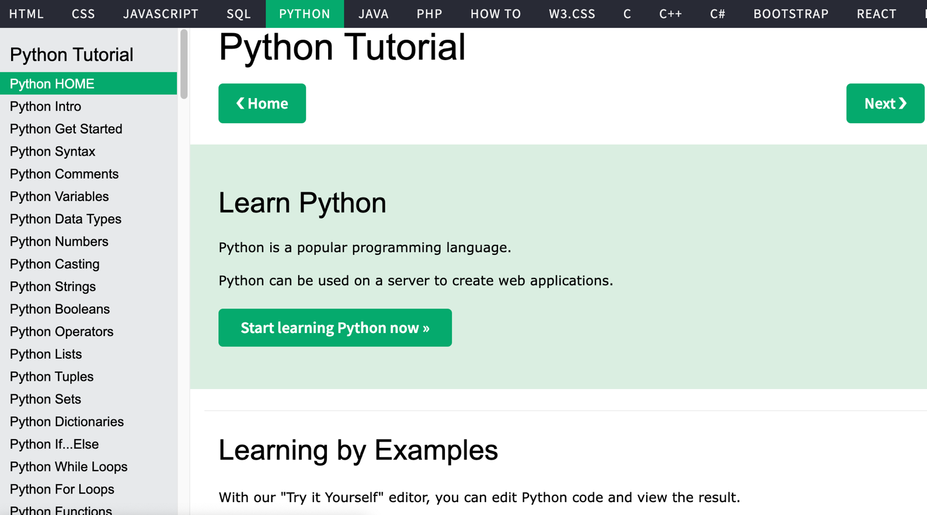
W3Schools Python
https://www.w3schools.com/python/

Slide 66
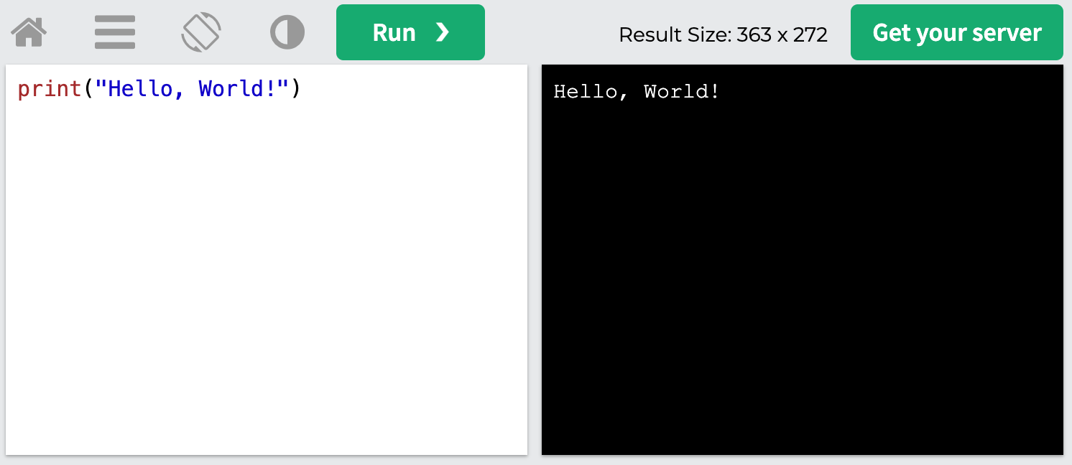
W3Schools Python: Try Python
https://www.w3schools.com/python/trypython.asp?filename=demo_default

Slide 67
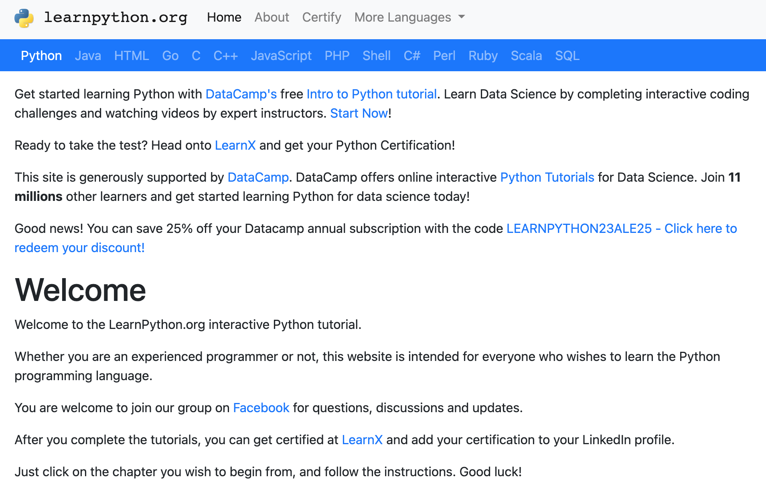
LearnPython.org
https://www.learnpython.org/

Slide 68
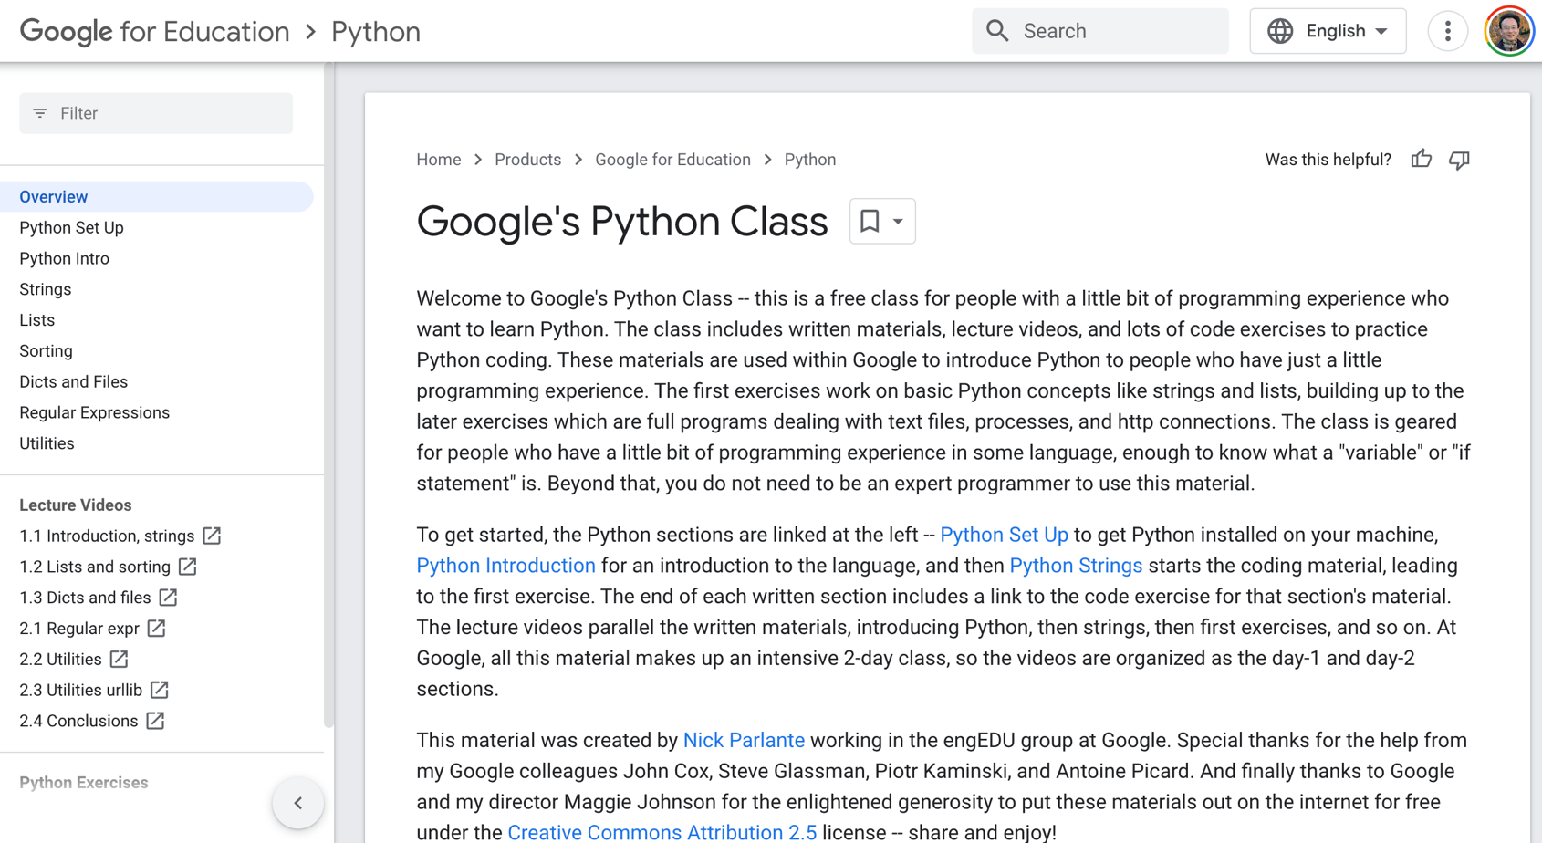
Google’s Python Class
https://developers.google.com/edu/python

Slide 69
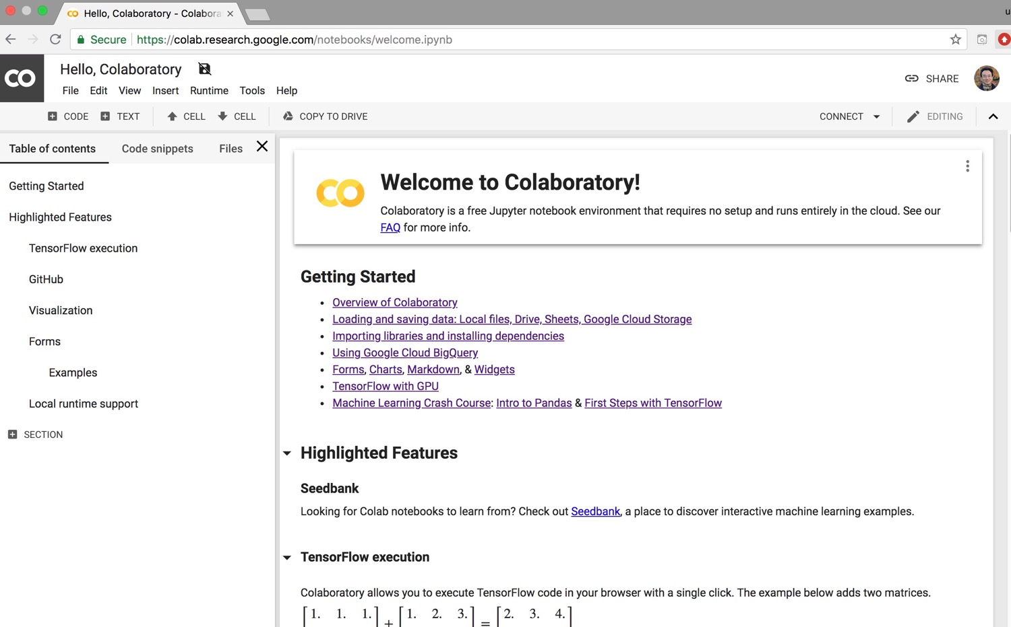
Google Colab
https://colab.research.google.com/notebooks/welcome.ipynb

Slide 70
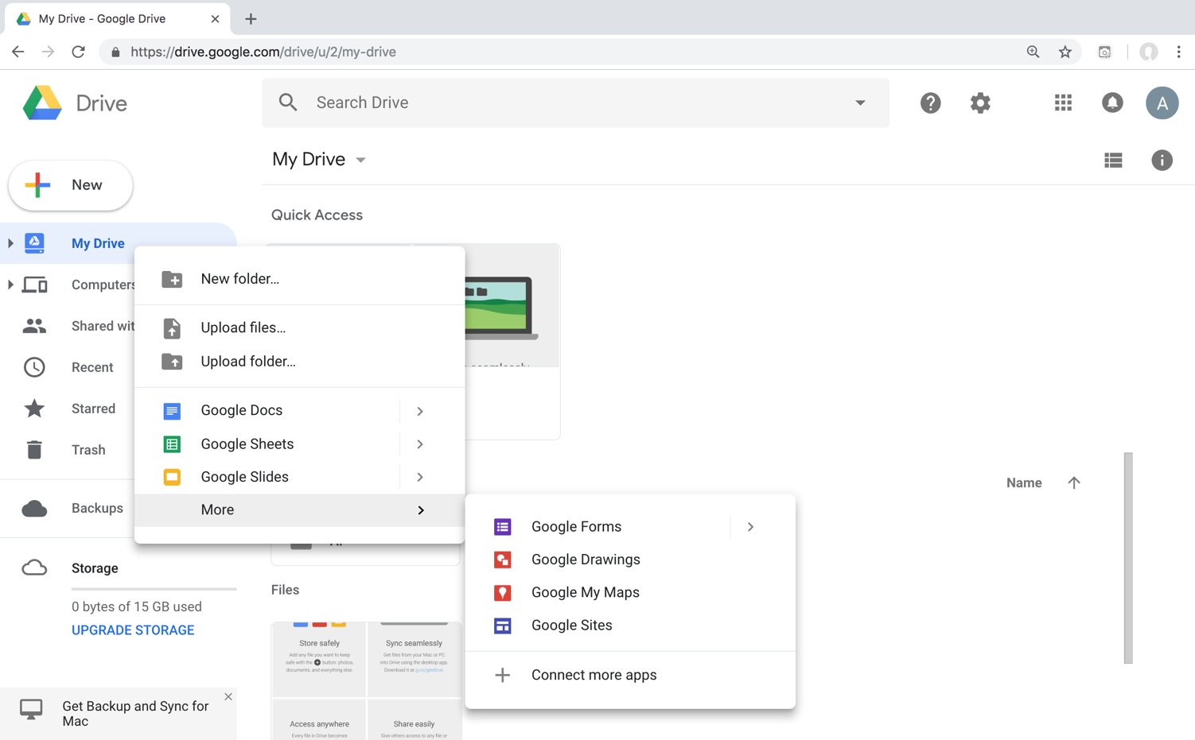
Connect Google Colab in Google Drive

Slide 71
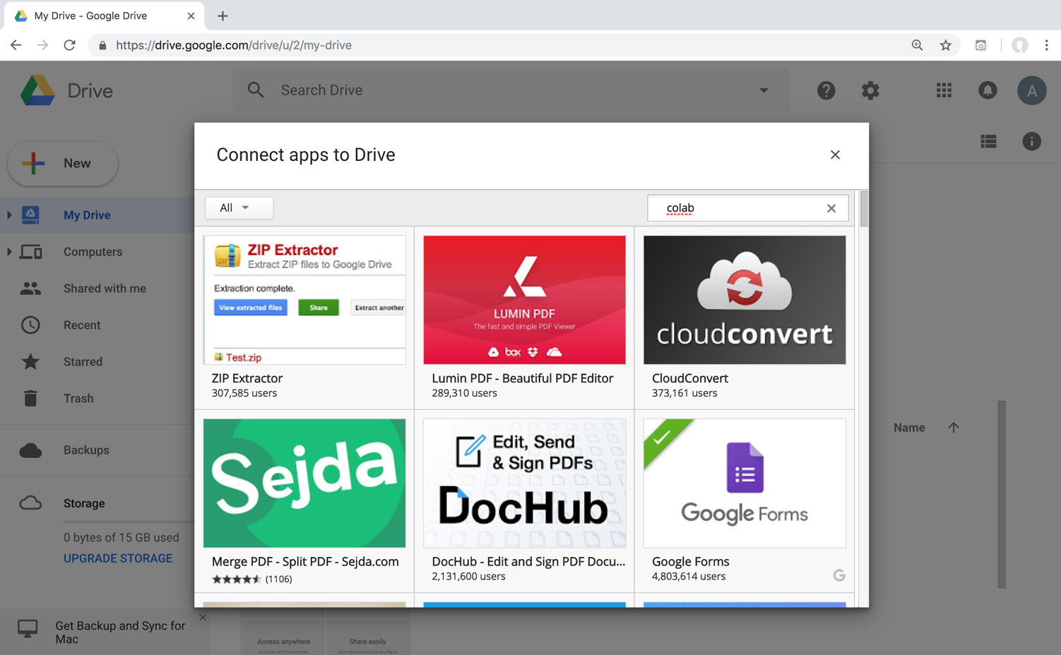
Google Colab

Slide 72
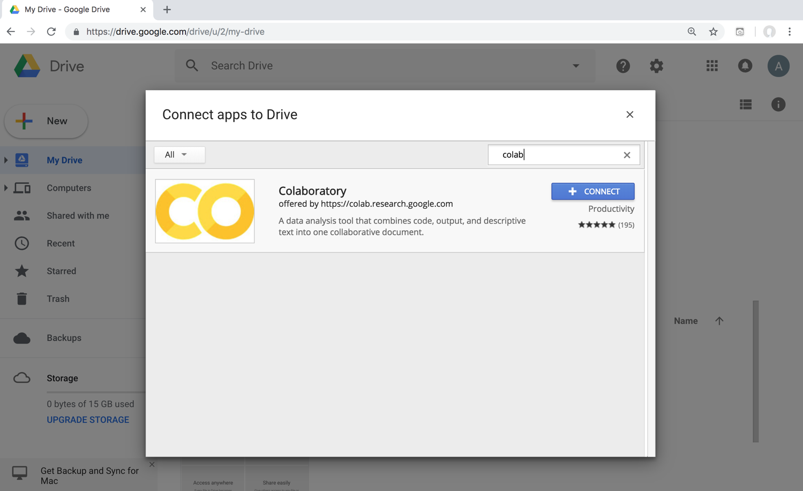
Google Colab

Slide 73
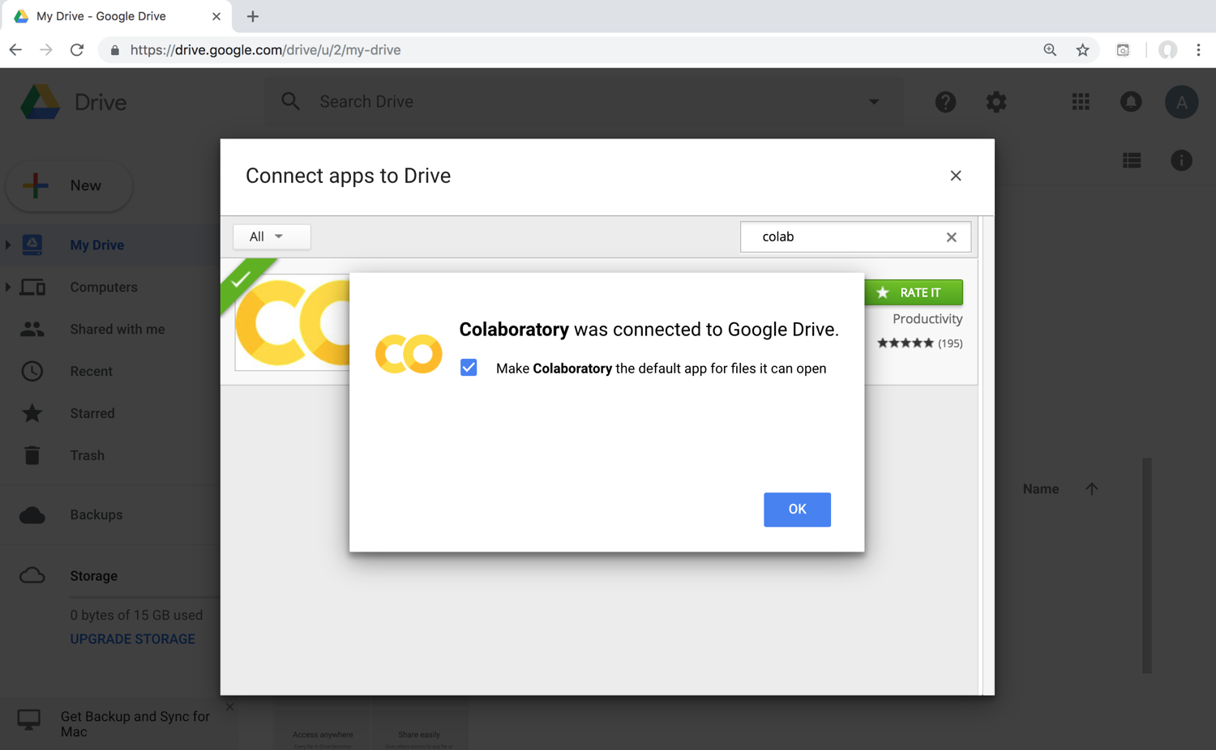
Connect Colaboratory to Google Drive

Slide 74
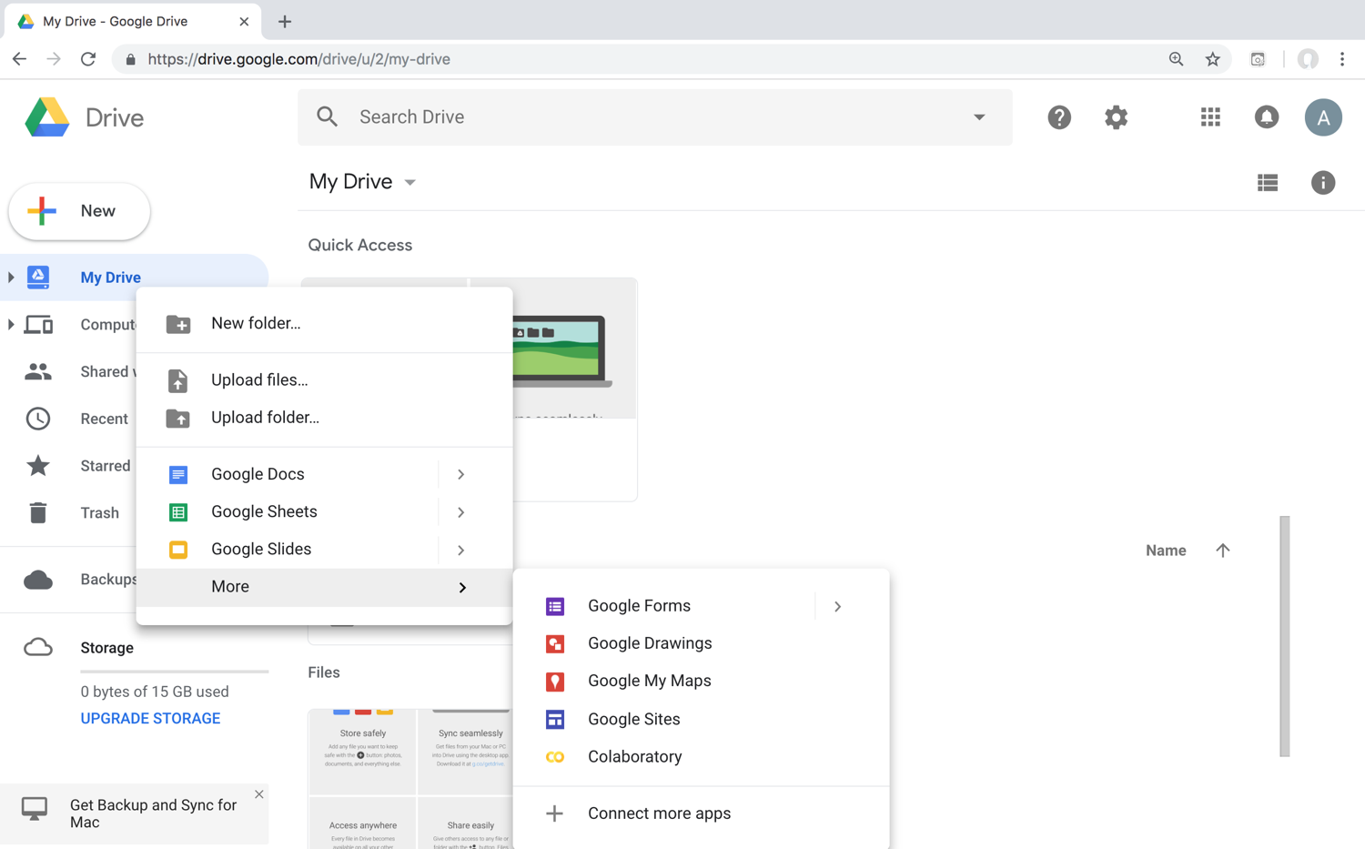
Google Colab

Slide 75
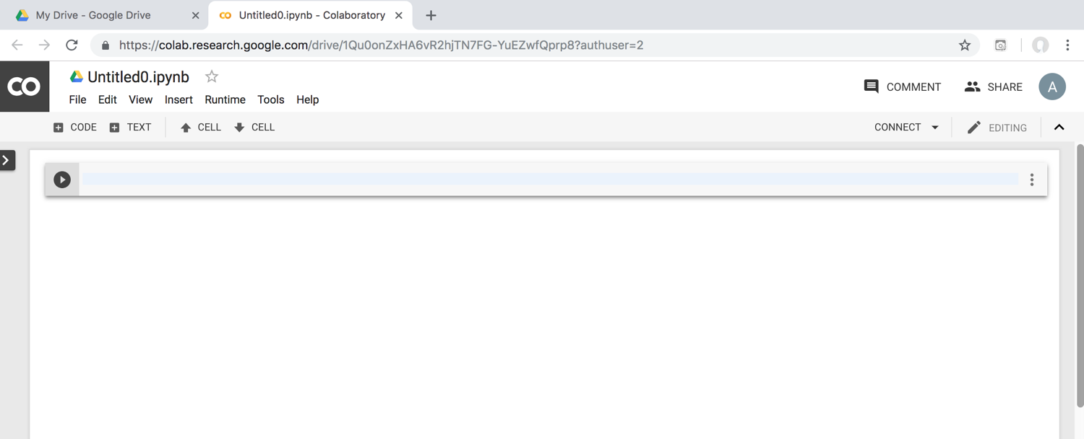
Google Colab

Slide 76
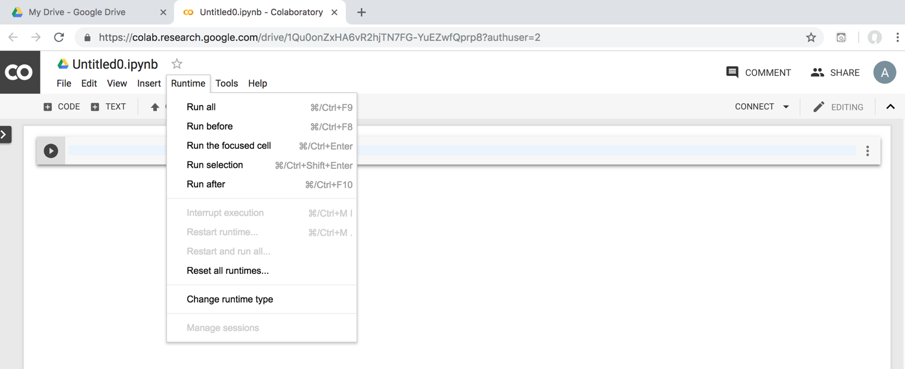
Google Colab

Slide 77
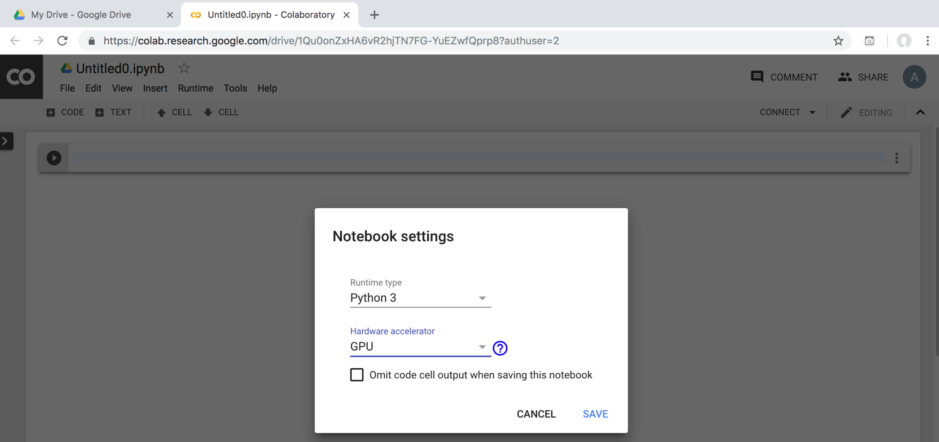
Run Jupyter Notebook Python3 GPU Google Colab

Slide 78
Google Colab Python Hello World print('Hello World')

Slide 79
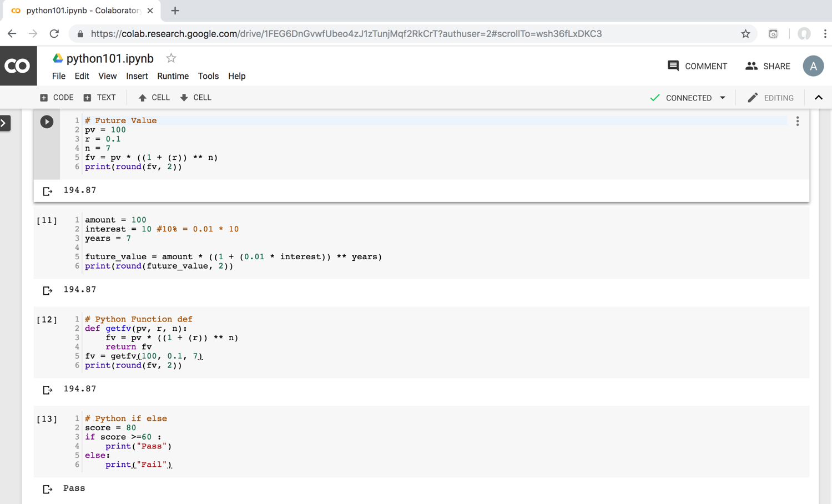
Python in Google Colab (Python101)
https://colab.research.google.com/drive/1FEG6DnGvwfUbeo4zJ1zTunjMqf2RkCrT
https://tinyurl.com/aintpupython101

Slide 80
Anaconda The Most Popular Python Data Science Platform
Source: https://www.anaconda.com/

Slide 81
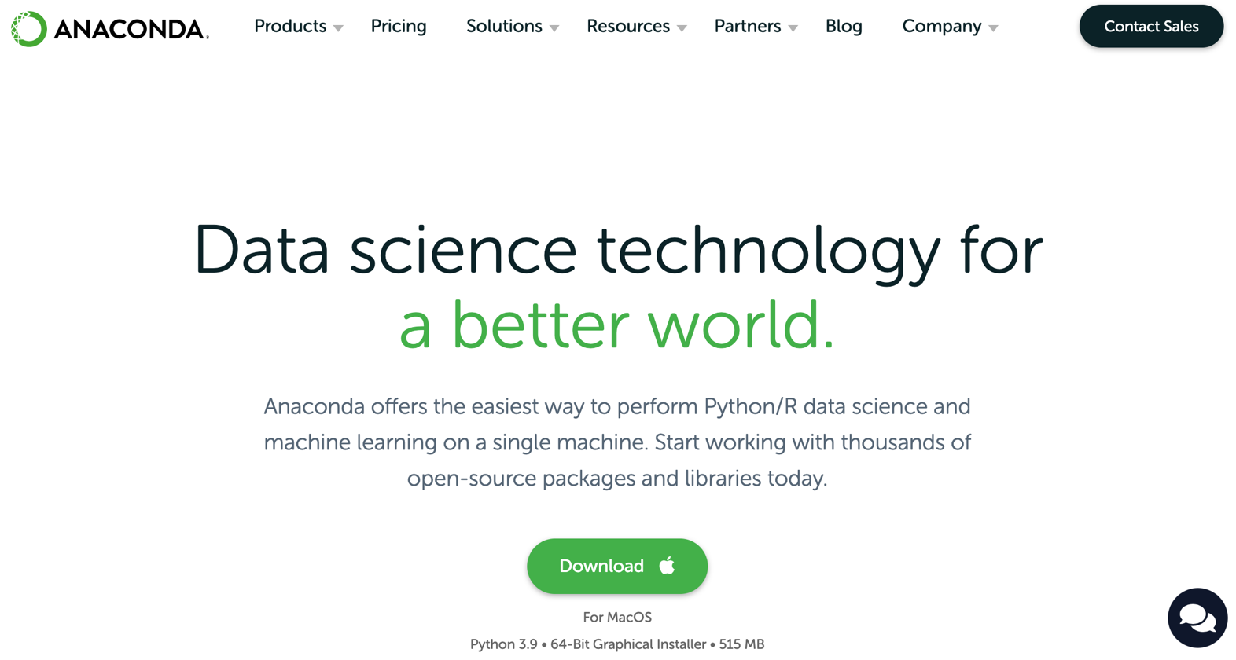
Download Anaconda
https://www.anaconda.com/download

Slide 82
Python HelloWorld

Slide 83
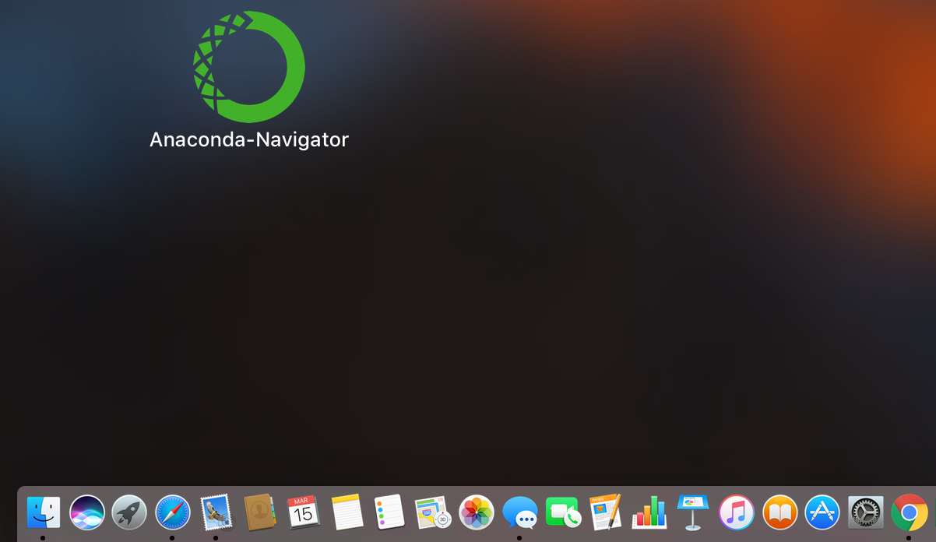
Anaconda-Navigator
Launchpad

Slide 84
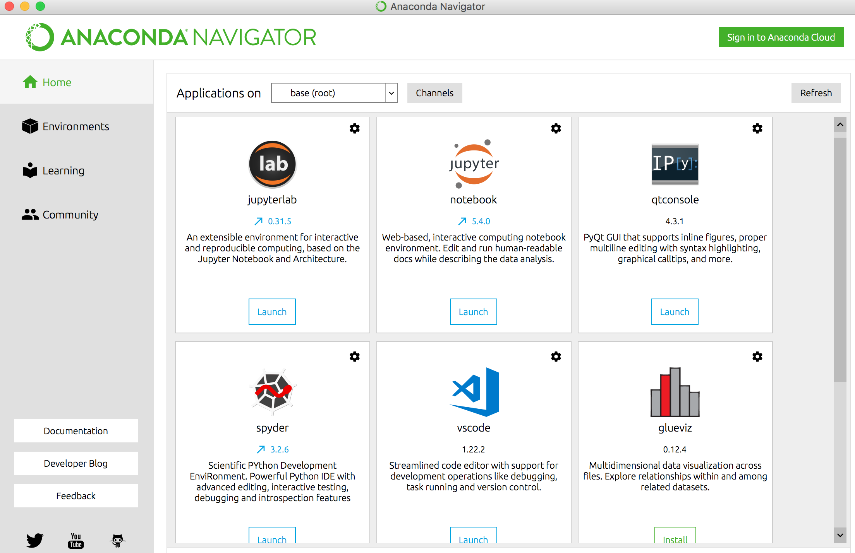
Anaconda Navigator

Slide 85
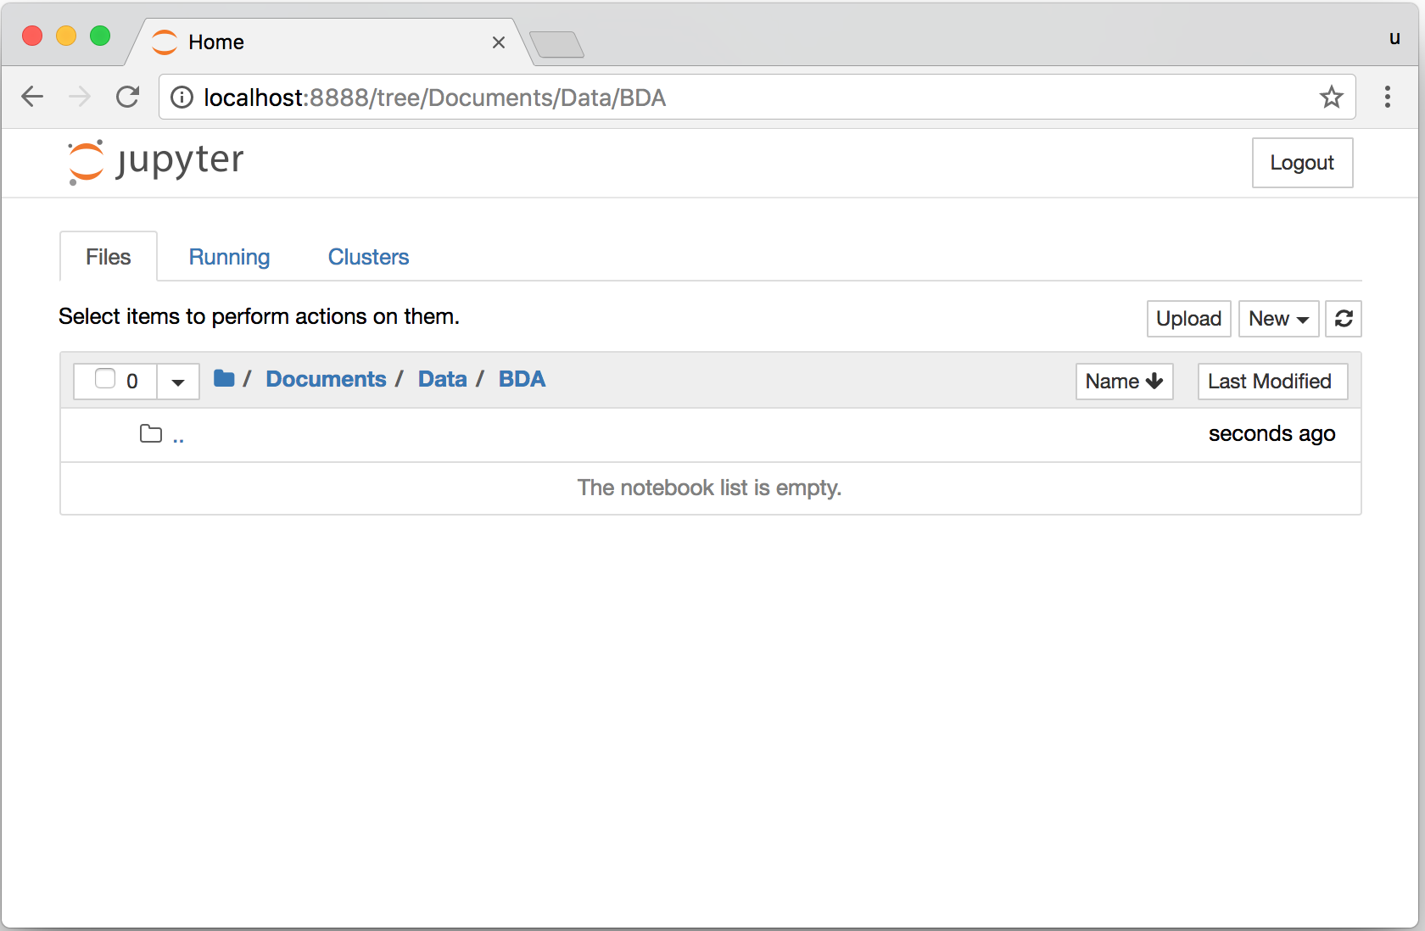
Jupyter Notebook

Slide 86
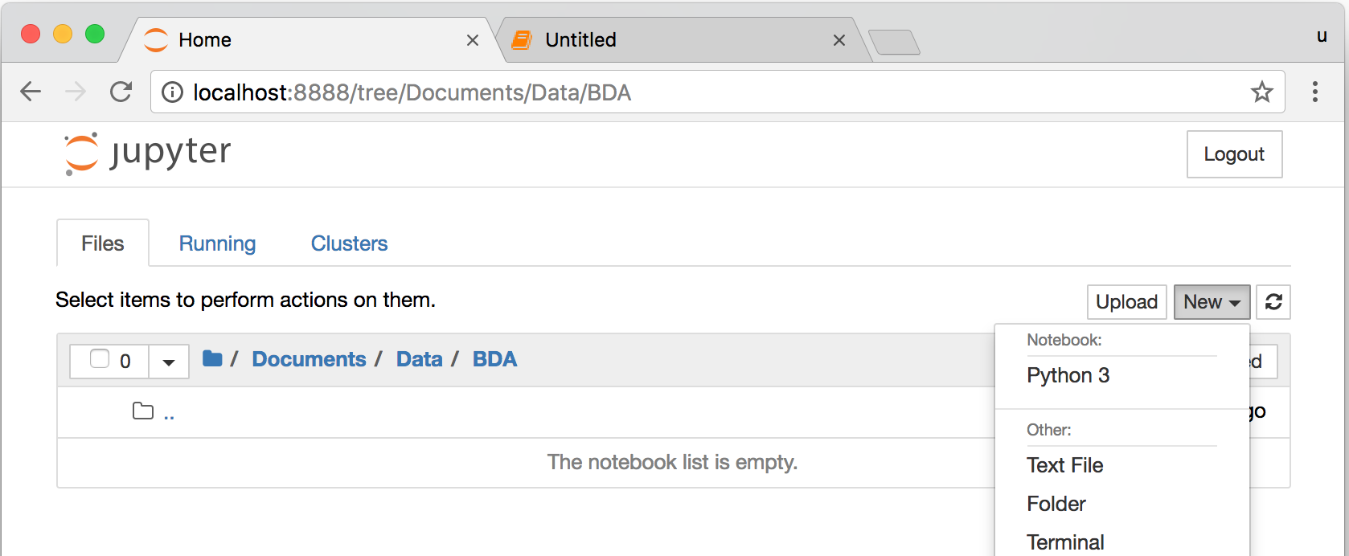
Jupyter Notebook New Python 3

Slide 87
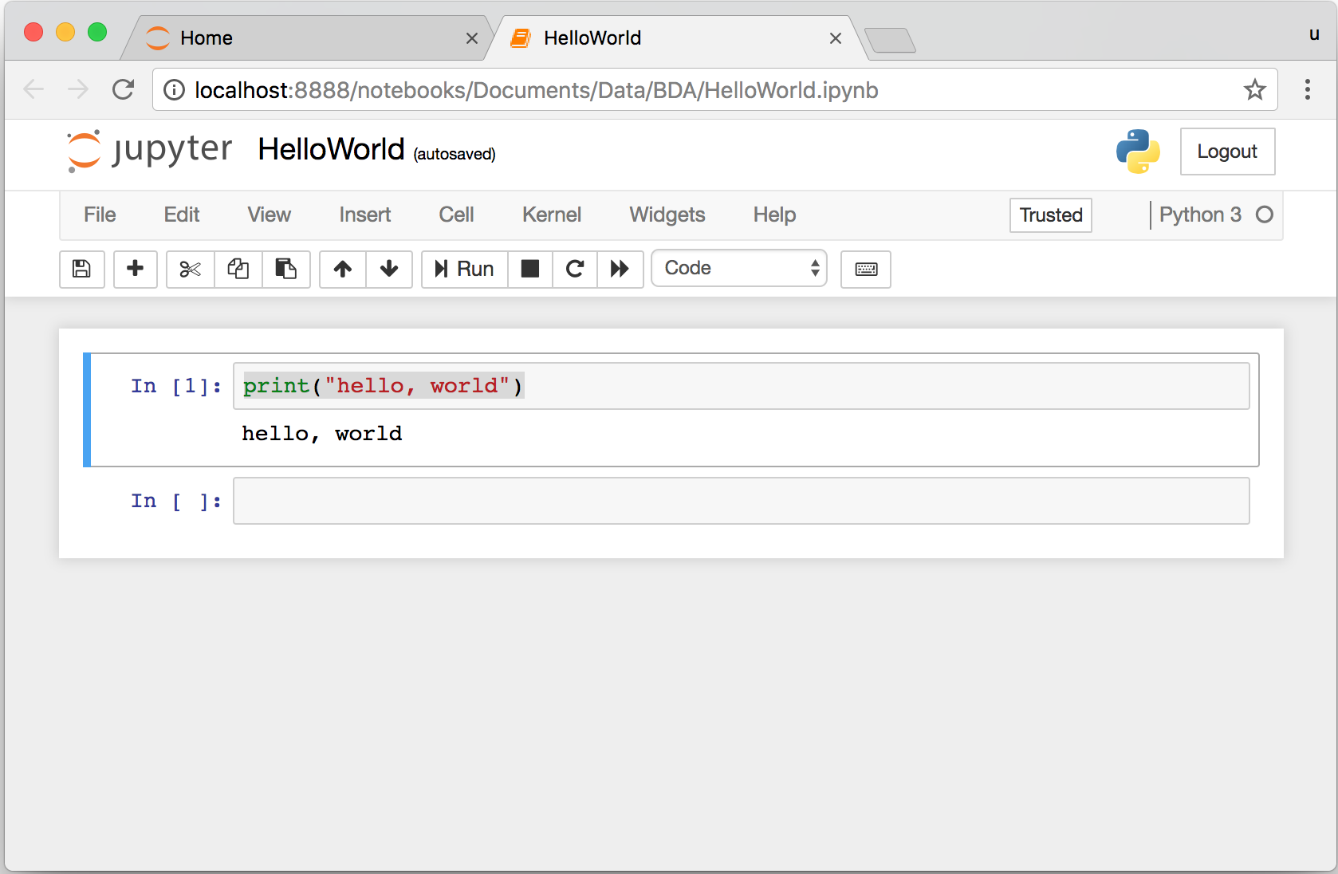
print("hello, world")
Notes:
print("hello, world")

Slide 88
Python Programming

Slide 89
Foundations of Python Programming
Python Syntax
Python Comments
Python Variables
Python Data Types
Python Numbers
Python Casting
Python Strings
Python Operators
Python Booleans

Slide 90
Python Hello World print("Hello World")
print("Hello World")

Slide 91
Python Syntax # comment
# comment

Slide 92
Python Syntax Indentation the spaces at the beginning of a code line 4 spaces
score = 80
if score >=60 :
print("Pass")

Slide 93
Python Variables
# Python Variables
x = 2
price = 2.5
word = 'Hello'
word = 'Hello'
word = "Hello"
word = '''Hello'''

Slide 94
Python Variables
x = 2
y = x + 1

Slide 95
python_version()
# comment
from platform import python_version
print("Python Version:", python_version())
Python Version: 3.10.12

Slide 96
Python Data Types
x = "Hello World" #str
x = 2 #int
x = 2.5 #float
x = 7j #complex

Slide 97
Python Data Types
x = ["apple", "banana", "cherry"] #list
x = ("apple", "banana", "cherry") #tuple
x = range(6) #range
x = {"name" : "Tom", "age" : 20} #dict
x = {"apple", "banana", "cherry"} #set
x = frozenset({"apple", "banana", "cherry"}) #frozenset

Slide 98
Python Data Types
x = True #bool
x = b"Hello" #bytes
x = bytearray(5) #bytearray
x = memoryview(bytes(5)) #memoryview
x = None #NoneType

Slide 99
Python Casting
x = str(3) # x will be '3'
y = int(3) # y will be 3
z = float(3) # z will be 3.0
print(x, type(x))
print(y, type(y))
print(z, type(z))
3 <class 'str’>
3 <class 'int’>
3.0 <class 'float'>

Slide 100
Python Numbers
x = 2 # int
y = 3.4 # float
z = 7j #complex
print(x, type(x))
print(y, type(y))
print(z, type(z))
2 <class 'int’>
3.4 <class 'float’>
7j <class 'complex'>

Slide 101
Python Arithmetic Operators
Operator Name Example
+ Addition 7 + 2 = 9
- Subtraction 7 - 2 = 5
* Multiplication 7 * 2 = 14
/ Division 7 / 2 = 3.5
// Floor division 7 // 2 = 3 (Quotient)
% Modulus 7 % 2 = 1 (Remainder)
** Exponentiation 7 ** 2 = 49

Slide 102
Python Basic Operators
print('7 + 2 =', 7 + 2)
print('7 - 2 =', 7 - 2)
print('7 * 2 =', 7 * 2)
print('7 / 2 =', 7 / 2)
print('7 // 2 =', 7 // 2)
print('7 % 2 =', 7 % 2)
print('7 ** 2 =', 7 ** 2)
7 + 2 = 9
7 - 2 = 5
7 * 2 = 14
7 / 2 = 3.5
7 // 2 = 3
7 % 2 = 1
7 ** 2 = 49

Slide 103
Python Booleans: True or False
# Python Booleans: True or False
print(3 > 2)
print(3 == 2)
print(3 < 2)
True
False
False

Slide 104
Python BMI Calculator
# BMI Calculator in Python
height_cm = 170
weight_kg = 60
height_m = height_cm/100
BMI = (weight_kg/(height_m**2))
print("Your BMI is: " + str(round(BMI,1)))
Your BMI is: 20.8

Slide 105
Future value of a specified principal amount, rate of interest, and a number of years
Source: https://www.w3resource.com/python-exercises/python-basic-exercise-39.php

Slide 106
How much is your $100 worth after 7 years?
# How much is your $100 worth after 7 years?
fv = 100 * 1.1 ** 7
print('fv = ', round(fv, 2))
# output = 194.87
fv = 194.87

Slide 107
Future Value
# Future Value
pv = 100
r = 0.1
n = 7
fv = pv * ((1 + (r)) ** n)
print(round(fv, 2))
194.87

Slide 108
Future Value
# Future Value
amount = 100
interest = 10 #10% = 0.01 * 10
years = 7
future_value = amount * ((1 + (0.01 * interest)) ** years)
print(round(future_value, 2))
194.87

Slide 109
Python Data Structures

Slide 110
Python Data Structures
Python Lists []
Python Tuples ()
Python Sets {}
Python Dictionaries {k:v}

Slide 111
Python Data Structures
fruits = ["apple", "banana", "cherry"] #lists []
colors = ("red", "green", "blue") #tuples ()
animals = {'cat', 'dog'} #sets {}
person = {"name" : "Tom", "age" : 20} #dictionaries {}

Slide 112
Python Data Types
x = ["apple", "banana", "cherry"] #list
x = ("apple", "banana", "cherry") #tuple
x = {"name" : "Tom", "age" : 20} #dict
x = {"apple", "banana", "cherry"} #set

Slide 113
Python Collections
There are four collection data types in the Python programming language
List []
a collection which is ordered and changeable. Allows duplicate members.
Tuple ()
a collection which is ordered and unchangeable. Allows duplicate members.
Set {}
a collection which is unordered, unchangeable, and unindexed. No duplicate members.
Dictionary {k:v}
a collection which is ordered and changeable. No duplicate members.

Slide 114
Python Dictionaries {k:v}
As of Python version 3.7, dictionaries are ordered.
In Python 3.6 and earlier, dictionaries are unordered.

Slide 115
Lists []
x = [60, 70, 80, 90]
print(len(x))
print(x[0])
print(x[1])
print(x[-1])
4
60
70
90

Slide 116
Lists []
len(): how many items
type(): data type
list() constructor: creating a new list

Slide 117
Python List Methods
Method Description
append() Adds an element at the end of the list
clear() Removes all the elements from the list
copy() Returns a copy of the list
count() Returns the number of elements with the specified value
extend() Add the elements of a list (or any iterable), to the end of the current list
index() Returns the index of the first element with the specified value
insert() Adds an element at the specified position
pop() Removes the element at the specified position
remove() Removes the item with the specified value
reverse() Reverses the order of the list
sort() Sorts the list
https://www.w3schools.com/python/python_lists_methods.asp

Slide 118
Tuples ()
A tuple in Python is a collection that cannot be modified. A tuple is defined using parenthesis.
x = (10, 20, 30, 40, 50)
print(x[0])
print(x[1])
print(x[2])
print(x[-1])
10
20
30
50
Source: http://pythonprogramminglanguage.com/tuples/

Slide 119
Sets {}
animals = {'cat', 'dog'}
print('cat' in animals)
print('fish' in animals)
animals.add('fish')
print('fish' in animals) print(len(animals))
animals.add('cat’)
print(len(animals))
animals.remove('cat')
print(len(animals))
True
False
True
3
3
2
Source: http://cs231n.github.io/python-numpy-tutorial/

Slide 120
Dictionary {key : value}
Python Dictionary
Key → Value
'EN’ → 'English’
'FR’ → 'French'
k = { 'EN':'English', 'FR':'French' }
print(k['EN'])
English
Source: http://pythonprogramminglanguage.com/dictionary/

Slide 121
Python Data Structures
fruits = ["apple", "banana", "cherry"] #lists []
colors = ("red", "green", "blue") #tuples ()
animals = {'cat', 'dog'} #sets {}
person = {"name" : "Tom", "age" : 20} #dictionaries {}
https://tinyurl.com/aintpupython101

Slide 122
Python Control Logic and Loops

Slide 123
Python Control Logic and Loops
Python if else
if elif else
Booleans: True, False
Operators: ==, !=, >, <, >=, <=, and, or, not
Python for Loops
for
Python while Loops
While
break
continue

Slide 124
Python if...else
Python if...else
if elif else
Booleans: True, False
Operators: ==, !=, >, <, >=, <=, and, or, not

Slide 125
Python Conditions and If statements
Python supports the usual logical conditions from mathematics:
Equals: a == b
Not Equals: a != b
Less than: a < b
Less than or equal to: a <= b
Greater than: a > b
Greater than or equal to: a >= b

Slide 126
Python Comparison Operators
Operator | Name | Example
== | Equal | x == y
!= | Not equal | x != y
> | Greater than | x > y
< | Less than | x < y
>= | Greater than or equal to | x >= y
<= | Less than or equal to | x <= y
Source: https://www.w3schools.com/python/python_operators.asp

Slide 127
Python Logical Operators
Operator | Description | Example
and | Returns True if both statements are true | x < 5 and x < 10
or | Returns True if one of the statements is true | x < 5 or x < 4
not | Reverse the result, returns False if the result is true | not(x < 5 and x < 10)
Source: https://www.w3schools.com/python/python_operators.asp

Slide 128
Python if
# Python if
score = 80
if score >=60 :
print("Pass")
https://tinyurl.com/aintpupython101

Slide 129
Python if else
# Python if else
score = 80
if score >=60 :
print("Pass")
else:
print("Fail")
https://tinyurl.com/aintpupython101

Slide 130
Python if elif else
score = 95
if score >= 90 :
print("A")
elif score >=60 :
print("Pass")
else:
print("Fail")

Slide 131
Python if elif else
# Python if elif else
score = 90
grade = ""
if score >=90:
grade = "A"
elif score >= 80:
grade = "B"
elif score >= 70:
grade = "C"
elif score >= 60:
grade = "D"
else:
grade = "E"
print(grade)

Slide 132
Python for Loops
for i in range(1,6):
print(i)
1
2
3
4
5
https://tinyurl.com/aintpupython101

Slide 133
Python for loops
# for loops
for i in range(1,10):
for j in range(1,10):
print(i, ' * ' , j , ' = ', i*j)
https://tinyurl.com/aintpupython101

Slide 134
Python while Loops
while
break
continue

Slide 135
Python while loops
# while loops
age = 10
while age < 20:
print(age)
age = age + 1
https://tinyurl.com/aintpupython101

Slide 136
Python Functions, Classes, and Modules

Slide 137
Python Functions, Classes, Modules
Python Functions
def myfunction():
Python Classes/Objects
class MyClass:
Python Modules
mymodule.py
import mymodule

Slide 138
Python Functions

Slide 139
Python Functions
A function is a block of code which only runs when it is called.
You can pass data, known as parameters, into a function.
A function can return data as a result.
Creating a Function
In Python a function is defined using the def keyword:

Slide 140
Python Function def
# Python Function def
# indentation for blocks. four spaces
def getfv(pv, r, n):
fv = pv * ((1 + (r)) ** n)
return fv
fv = getfv(100, 0.1, 7)
print(round(fv, 2))
194.87
https://tinyurl.com/aintpupython101

Slide 141
Future value of a specified principal amount, rate of interest, and a number of years
Source: https://www.w3resource.com/python-exercises/python-basic-exercise-39.php

Slide 142
How much is your $100 worth after 7 years?
# How much is your $100 worth after 7 years?
fv = 100 * 1.1 ** 7
print('fv = ', round(fv, 2))
# output = 194.87
fv = 194.87

Slide 143
Future Value
# Future Value
pv = 100
r = 0.1
n = 7
fv = pv * ((1 + (r)) ** n)
print(round(fv, 2))
194.87

Slide 144
Future Value
# Future Value
amount = 100
interest = 10 #10% = 0.01 * 10
years = 7
future_value = amount * ((1 + (0.01 * interest)) ** years)
print(round(future_value, 2))
194.87

Slide 145
Python Function def getfv() define get future value function
# Python Function def
# indentation for blocks. four spaces
def getfv(pv, r, n):
fv = pv * ((1 + (r)) ** n)
return fv
fv = getfv(100, 0.1, 7)
print(round(fv, 2))
194.87
https://tinyurl.com/aintpupython101

Slide 146
Python Classes/Objects class MyClass:

Slide 147
Python Classes/Objects
Python is an object oriented programming language.
Almost everything in Python is an object, with its properties and methods.
A Class is like an object constructor, or a "blueprint" for creating objects.
Create a Class:
To create a class, use the keyword class:

Slide 148
Python Classes/Objects class MyClass:
# Python class
class MyClass:
x = 5
c1 = MyClass()
print(c1.x)
https://www.w3schools.com/python/python_classes.asp

Slide 149
Python Classes/Objects
class Person:
def __init__(self, name, age):
self.name = name
self.age = age
p1 = Person("Alan", 20)
print(p1.name)
print(p1.age)
Alan
20
https://tinyurl.com/aintpupython101

Slide 150
Python Classes/Objects
class Person:
def __init__(self, name, age):
self.name = name
self.age = age
def myfunc(self):
print("Hello my name is " + self.name)
p1 = Person("Alan", 20)
p1.myfunc()
https://tinyurl.com/aintpupython101

Slide 151
Python Classes/Objects
class Person:
def __init__(self, name, age):
self.name = name
self.age = age
def myfunc(self):
print("Hello my name is " + self.name)
p1 = Person("Alan", 20)
p1.myfunc()
print(p1.name)
print(p1.age)
Hello my name is Alan
Alan
20
https://tinyurl.com/aintpupython101

Slide 152
Python Classes and Obects
class Vehicle:
name = ""
kind = "car"
color = ""
value = 100.00
def description(self):
desc_str = "%s is a %s %s worth $%.2f." % (self.name, self.color, self.kind, self.value)
return desc_str
https://tinyurl.com/aintpupython101

Slide 153
Python Classes and Objects
car1 = Vehicle()
car1.name = "Fer"
car1.color = "red"
car1.kind = "convertible"
car1.value = 60000.00
car2 = Vehicle()
car2.name = "Jump"
car2.color = "blue"
car2.kind = "van"
car2.value = 10000.00
print(car1.description())
print(car1.name)
print(car2.description())
print(car2.name)
class Vehicle:
name = ""
kind = "car"
color = ""
value = 100.00
def description(self):
desc_str = "%s is a %s %s worth $%.2f." % (self.name, self.color, self.kind, self.value)
return desc_str
Fer is a red convertible worth $60000.00.
Fer
Jump is a blue van worth $10000.00.
Jump
https://www.learnpython.org/en/Classes_and_Objects

Slide 154
Python Modules

Slide 155
Python Modules
Consider a module to be the same as a code library.
A file containing a set of functions you want to include in your application.
Create a Module
To create a module just save the code you want in a file with the file extension .py:
Use a Module
import module

Slide 156
Python Modules
# mymodule.py
def greeting(name):
print("Hello, " + name)
import mymodule
mymodule.greeting("Alan")
mymodule.py
def greeting(name):
print("Hello, " + name)
https://tinyurl.com/aintpupython101

Slide 157
Python File Input / Output
# Python File Input / Output
with open('myfile.txt', 'w') as file:
file.write('Hello World\nThis is Python File Input Output')
with open('myfile.txt', 'r') as file:
text = file.read()
print(text)
Hello World This is Python File Input Output
https://tinyurl.com/aintpupython101

Slide 158
Python File Input / Output
# Python File Input / Output
filename = 'mymodule.py'
with open(filename, 'w') as file:
text = '''def greeting(name):
print("Hello, " + name)
'''
file.write(text)
with open(filename, 'r') as file:
text = file.read()
print(filename)
print(text)
mymodule.py
def greeting(name):
print("Hello, " + name)
https://tinyurl.com/aintpupython101

Slide 159
Python Modules import mymodule
# mymodule.py
def greeting(name):
print("Hello, " + name)
import mymodule
mymodule.greeting("Alan")
Hello, Alan
https://tinyurl.com/aintpupython101

Slide 160
Python main() function
#Python main() function
def main():
print("Hello World!")
if __name__ == "__main__":
main()
https://tinyurl.com/aintpupython101

Slide 161
Files and Exception Handling

Slide 162
Files and Exception Handling
Python Files (File Handling)
open()
f = open("myfile.txt")
Python Try Except (Exception Handling)
try: except: else: finally:

Slide 163
File Handling
The key function for working with files in Python is the open() function.
The open() function takes two parameters; filename, and mode.
There are four different methods (modes) for opening a file:
"r" - Read - Default value. Opens a file for reading, error if the file does not exist
"a" - Append - Opens a file for appending, creates the file if it does not exist
"w" - Write - Opens a file for writing, creates the file if it does not exist
"x" - Create - Creates the specified file, returns an error if the file exists

Slide 164
Python Files (File Handling)
f = open("myfile.txt", "w")
f.write("Hello World")
f.close()
f = open("myfile.txt", "r")
text = f.read()
print(text)
f.close()
Hello World
https://tinyurl.com/aintpupython101

Slide 165
Python Files (File Handling)
# Python File Input / Output
with open('myfile.txt', 'w') as file:
file.write('Hello World')
with open('myfile.txt', 'r') as file:
text = file.read()
print(text)
Hello World
https://tinyurl.com/aintpupython101

Slide 166
Python Files
# Python File Input / Output
with open('myfile.txt', 'w') as file:
file.write('Hello World\nPython File IO')
with open('myfile.txt', 'r') as file:
text = file.read()
print(text)
Hello World
Python File IO
https://tinyurl.com/aintpupython101

Slide 167
Python Files
# Python File Input / Output
with open('myfile.txt', 'a+') as file:
file.write('\n' + 'New line')
with open('myfile.txt', 'r') as file:
text = file.read()
print(text)
Hello World
Python File IO
New line
https://tinyurl.com/aintpupython101

Slide 168
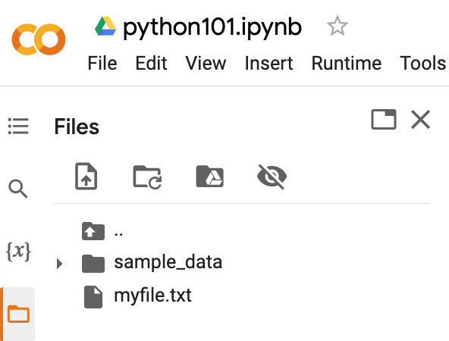
Python Files
# !ls list files
!ls
myfile.txt sample_data
https://tinyurl.com/aintpupython101

Slide 169
Python OS, IO, files, and Google Drive
import os
cwd = os.getcwd()
print(cwd)
/content
https://tinyurl.com/aintpupython101

Slide 170
os.listdir()
os.listdir(cwd)
['.config', 'myfile.txt', 'sample_data']
https://tinyurl.com/aintpupython101

Slide 171
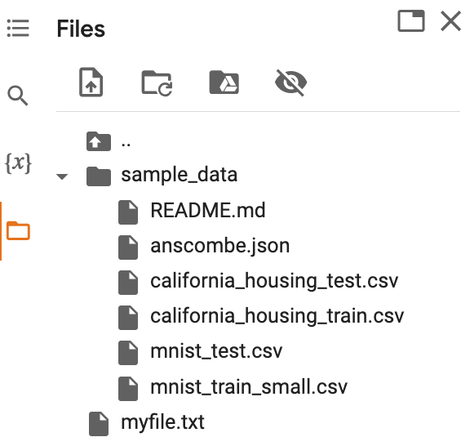
os.path.join()
path = os.path.join(cwd, 'sample_data')
print(path)
os.listdir(path)
/content/sample_data
['README.md', 'anscombe.json', 'mnist_train_small.csv', 'mnist_test.csv', 'california_housing_train.csv', 'california_housing_test.csv']
https://tinyurl.com/aintpupython101

Slide 172
from google.colab import files
from google.colab import files
with open('io_file_myday.txt', 'w') as f:
f.write('Google Colab File Write Text some content Myday')
import time
time.sleep(1) # time sleep 1 second
files.download('io_file_myday.txt')
print('downloaded')
downloaded
https://tinyurl.com/aintpupython101

Slide 173
Python Files
from google.colab import files
uploaded = files.upload()
for fn in uploaded.keys():
print('User uploaded file "{name}" with length {length} bytes'.format(
name=fn, length=len(uploaded[fn])))
User uploaded file "io_file_myday2.txt" with length 47 bytes
https://tinyurl.com/aintpupython101

Slide 174
os.remove()
import os
if os.path.exists("myfile.txt"):
os.remove("myfile.txt")
print("myfile.txt removed")
else:
print("The file does not exist")
myfile.txt removed
https://tinyurl.com/aintpupython101

Slide 175
os.mkdir("myfolder1") os.rmdir("myfolder1")
import os
os.listdir()
os.mkdir("myfolder1")
os.listdir()
os.rmdir("myfolder1")
os.listdir()
https://tinyurl.com/aintpupython101

Slide 176
Python Try Except
The try block lets you test a block of code for errors.
The except block lets you handle the error.
The else block lets you execute code when there is no error.
The finally block lets you execute code, regardless of the result of the try- and except blocks.

Slide 177
Python Try Except (Exception Handling) try: except:
#Python try except
try:
print(x)
except:
print("Exception Error")
https://tinyurl.com/aintpupython101

Slide 178
Python try: except: finally:
#Python try except finally
try:
print("Hello")
except:
print("Exception Error")
finally:
print("Finally process")
Hello
Finally process
https://tinyurl.com/aintpupython101

Slide 179
Python try: except: else:
#Python try except else
try:
print("Hello")
except:
print("Exception Error")
else:
print("No exception")
Hello
No exception
https://tinyurl.com/aintpupython101

Slide 180
Python try: except: else: finally:
try:
print("Hello")
except:
print("Exception Error")
else:
print("No exception")
finally:
print("Finally process")
Hello
No exception
Finally process
https://tinyurl.com/aintpupython101

Slide 181
Python try: except: else: finally:
try:
price = float(input("Enter the price of the stock (e.g. 10):"))
shares = int(input("Enter the number of shares (e.g. 2):"))
total = price * shares
except Exception as e:
print("Exception error:", str(e))
else:
print("The total value of the shares is:", total)
finally:
print("Thank you.")
Enter the price of the stock (e.g. 10):10
Enter the number of shares (e.g. 2):2
The total value of the shares is: 20.0
Thank you.
https://tinyurl.com/aintpupython101

Slide 182
Python try: except: else: finally:
try:
file = open("myfile.txt")
file.write("Python write file")
print("file saved")
except:
print("Exception file Error")
Exception file Error
https://tinyurl.com/aintpupython101

Slide 183
Python try: except: else: finally:
try:
file = open("myfile.txt")
file.write("Python write file")
print("file saved")
except:
print("Exception file Error")
finally:
file.close()
print("Finally process")
Exception file Error
Finally process
https://tinyurl.com/aintpupython101

Slide 184
Python try: except: else: finally:
try:
file = open("myfile.txt", 'w’)
file.write("Python write file")
print("file saved")
except:
print("Exception file Error")
finally:
file.close()
print("Finally process")
file saved
Finally process
https://tinyurl.com/aintpupython101

Slide 185
Data Analytics and Visualization with Python

Slide 186
Data Analytics and Visualization with Python
NumPy
Numerical Python N-dimensional array
Pandas
Data Analytics
Matplotlib
Basic Data Visualization
Seaborn
Advanced Visualization

Slide 187
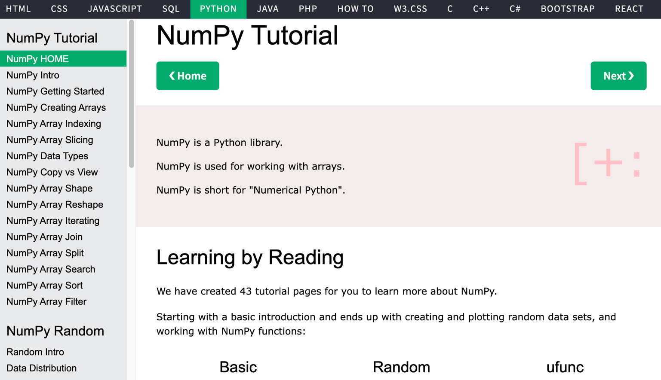
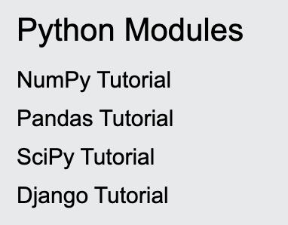
W3Schools Python Numpy
https://www.w3schools.com/python/numpy/default.asp

Slide 188
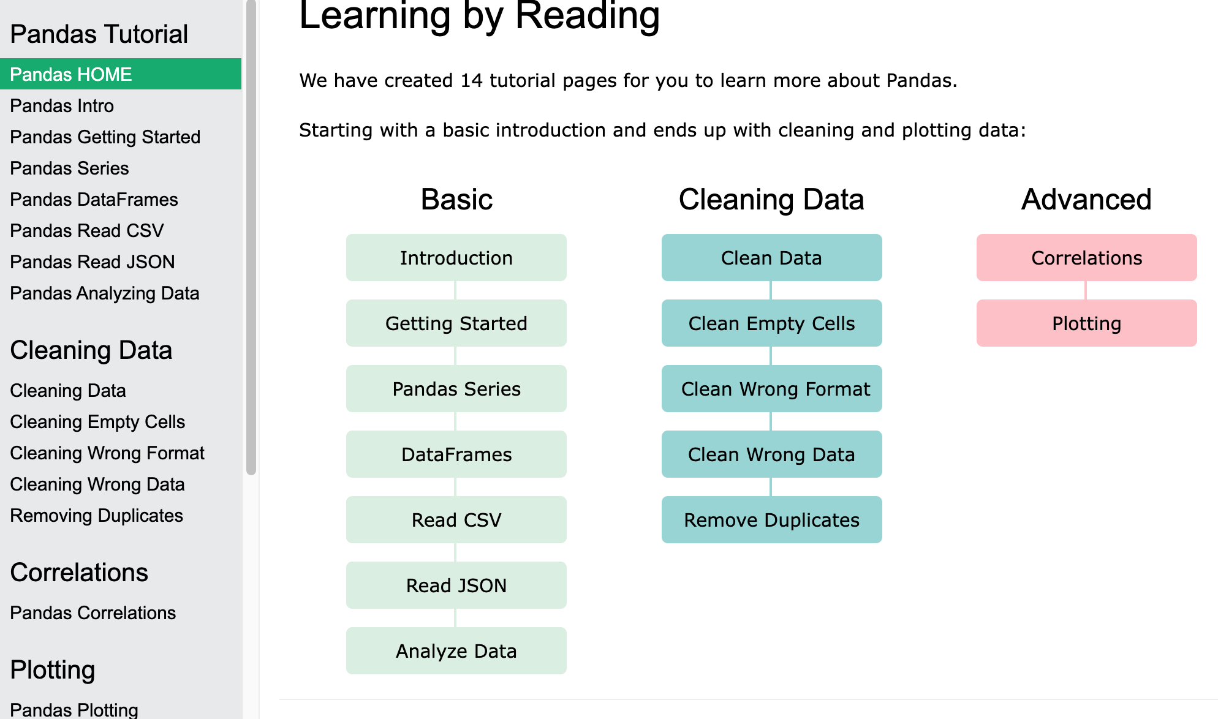
W3Schools Python Pandas
Pandas Tutorial
https://www.w3schools.com/python/pandas/default.asp

Slide 189
W3Schools Python
https://www.w3schools.com/python/

Slide 190
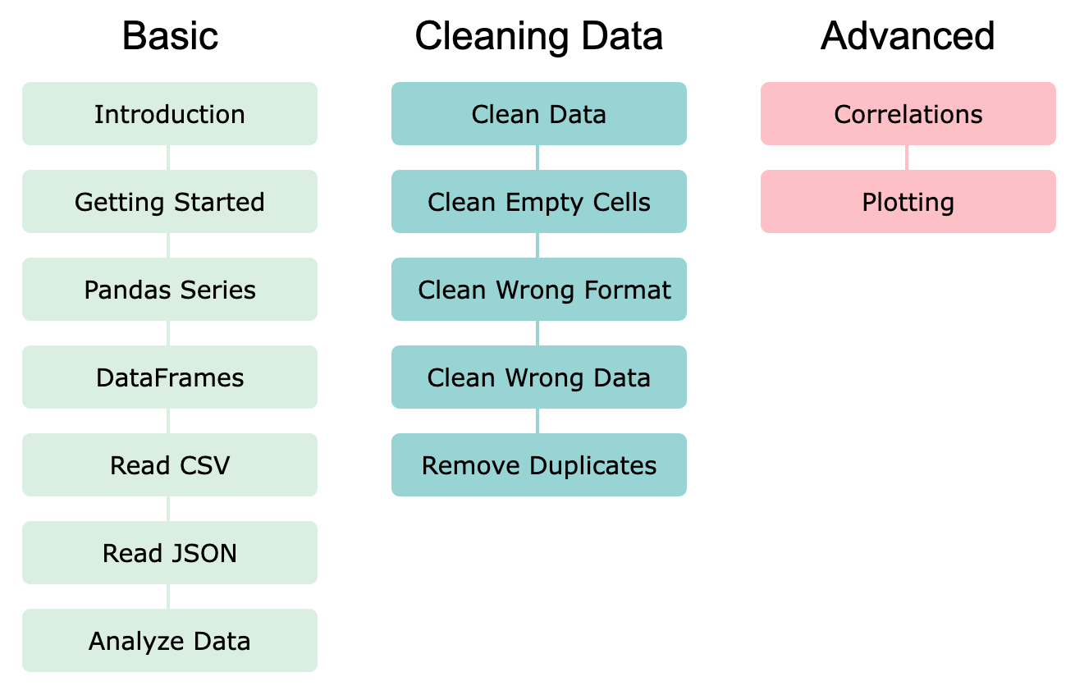
Pandas: Data Analytics and Visualization
https://www.w3schools.com/python/pandas/default.asp

Slide 191
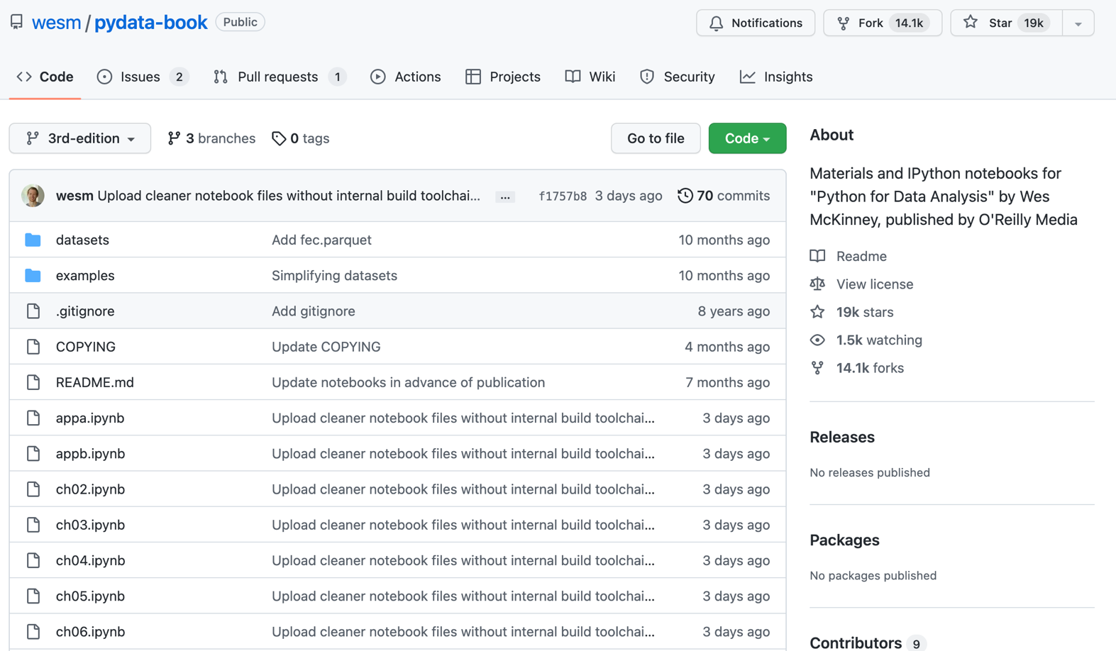
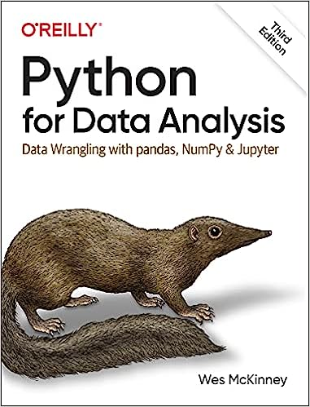
Wes McKinney (2022), "Python for Data Analysis: Data Wrangling with pandas, NumPy, and Jupyter", 3rd Edition, O'Reilly Media.
https://github.com/wesm/pydata-book

Slide 192
Numpy
NumPy
Base N-dimensional array package

Slide 193
NumPy is the fundamental package for scientific computing with Python.
Source: http://www.numpy.org/

Slide 194
NumPy
NumPy
NumPy provides a multidimensional array object to store homogenous or heterogeneous data; it also provides optimized functions/methods to operate on this array object.
Source: Yves Hilpisch (2014), Python for Finance: Analyze Big Financial Data, O'Reilly

Slide 195
NumPy ndarray
NumPy
One-dimensional Array (1-D Array)
0 | 1 |  |  | n-1
1 | 2 | 3 | 4 | 5
Two-dimensional Array (2-D Array)
 | 0 | 1 |  |  | n-1
0 | 1 | 2 | 3 | 4 | 5
1 | 6 | 7 | 8 | 9 | 10
 | 11 | 12 | 13 | 14 | 15
m-1 | 16 | 17 | 18 | 19 | 20

Slide 196
v = list(range(1, 6)) v 2 * v import numpy as np v = np.arange(1, 6) v 2 * v
NumPy
NumPy
Source: Yves Hilpisch (2014), Python for Finance: Analyze Big Financial Data, O'Reilly
Notes:
# pip3 install numpy
# pip install numpy
# sudo pip3 install numpy
import numpy as np

Slide 197
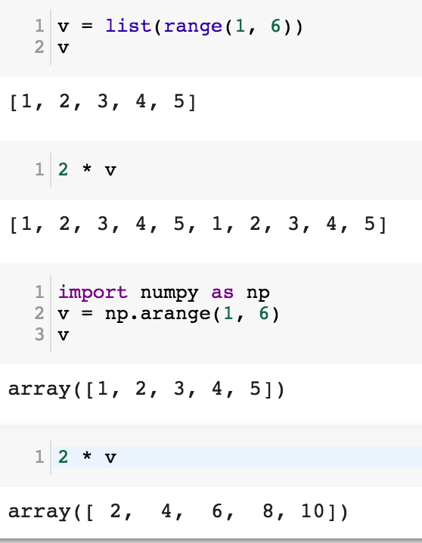
NumPy
Base N-dimensional array package

Slide 198
Python Data Structures
fruits = ["apple", "banana", "cherry"] #lists []
colors = ("red", "green", "blue") #tuples ()
animals = {'cat', 'dog'} #sets {}
person = {"name" : "Tom", "age" : 20} #dictionaries {}
https://tinyurl.com/aintpupython101

Slide 199
Lists []
x = [60, 70, 80, 90]
print(len(x))
print(x[0])
print(x[1])
print(x[-1])
4
60
70
90

Slide 200
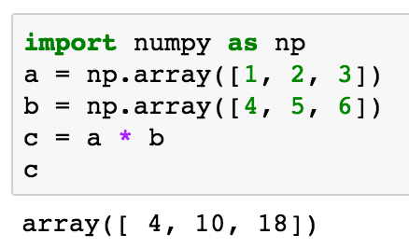
import numpy as np a = np.array([1, 2, 3]) b = np.array([4, 5, 6]) c = a * b c
NumPy Create Array
NumPy
Source: Yves Hilpisch (2014), Python for Finance: Analyze Big Financial Data, O'Reilly

Slide 201
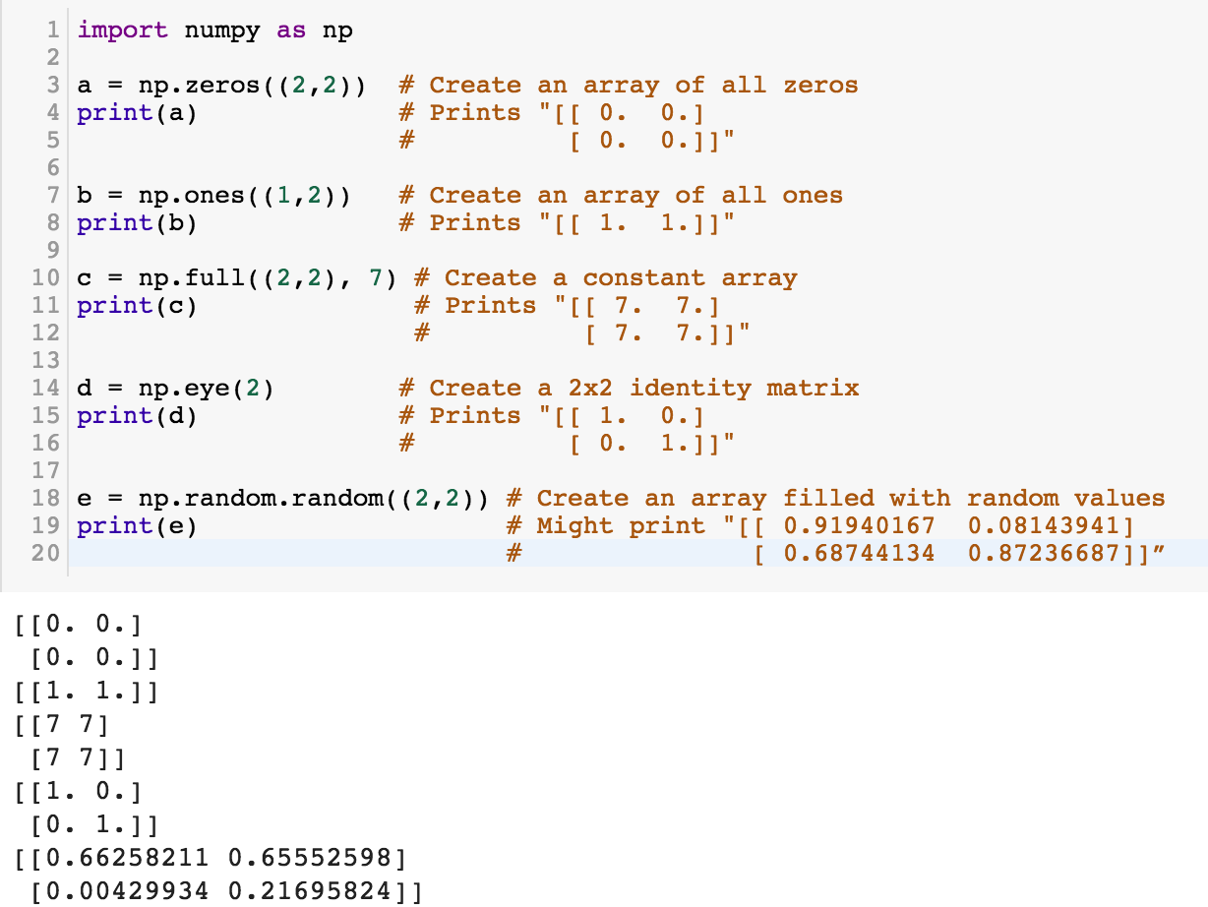
NumPy
NumPy
Source: http://cs231n.github.io/python-numpy-tutorial/
Notes:
import numpy as np
a = np.zeros((2,2)) # Create an array of all zeros
print(a) # Prints "[[ 0. 0.]
# [ 0. 0.]]"
b = np.ones((1,2)) # Create an array of all ones
print(b) # Prints "[[ 1. 1.]]"
c = np.full((2,2), 7) # Create a constant array
print(c) # Prints "[[ 7. 7.]
# [ 7. 7.]]"
d = np.eye(2) # Create a 2x2 identity matrix
print(d) # Prints "[[ 1. 0.]
# [ 0. 1.]]"
e = np.random.random((2,2)) # Create an array filled with random values
print(e) # Might print "[[ 0.91940167 0.08143941]
# [ 0.68744134 0.87236687]]”
Source: http://cs231n.github.io/python-numpy-tutorial/

Slide 202
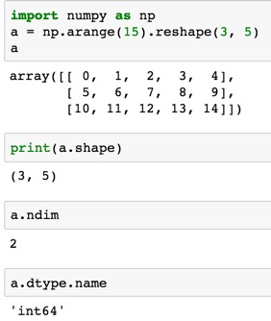
import numpy as np
a = np.arange(15).reshape(3, 5)
a.shape
a.ndim
a.dtype.name
Source: https://docs.scipy.org/doc/numpy-dev/user/quickstart.html
Notes:
Numpy Tutorial
Source: https://docs.scipy.org/doc/numpy-dev/user/quickstart.html
In [1]:
import numpy as np
a = np.arange(15).reshape(3, 5)
a
Out[1]:
array([[ 0, 1, 2, 3, 4],
[ 5, 6, 7, 8, 9],
[10, 11, 12, 13, 14]])
In [2]:
print(a.shape)
(3, 5)
In [3]:
a.ndim
Out[3]:
2
In [4]:
a.dtype.name
Out[4]:
'int64'
In [5]:
a.itemsize
Out[5]:
8
In [6]:
a.size
Out[6]:
15
In [7]:
type(a)
Out[7]:
numpy.ndarray
In [8]:
b = np.array([1, 2, 3])
In [9]:
b
Out[9]:
array([1, 2, 3])
In [10]:
type(b)
Out[10]:
numpy.ndarray

Slide 203
Matrix
Source: https://simple.wikipedia.org/wiki/Matrix_(mathematics)

Slide 204
NumPy ndarray: Multidimensional Array Object

Slide 205
NumPy ndarray
One-dimensional Array (1-D Array)
0 | 1 |  |  | n-1
1 | 2 | 3 | 4 | 5
Two-dimensional Array (2-D Array)
 | 0 | 1 |  |  | n-1
0 | 1 | 2 | 3 | 4 | 5
1 | 6 | 7 | 8 | 9 | 10
 | 11 | 12 | 13 | 14 | 15
m-1 | 16 | 17 | 18 | 19 | 20

Slide 206
import numpy as np a = np.array([1,2,3,4,5])
One-dimensional Array (1-D Array)
0 | 1 |  |  | n-1
1 | 2 | 3 | 4 | 5

Slide 207
a = np.array([[1,2,3,4,5],[6,7,8,9,10],[11,12,13,14,15],[16,17,18,19,20]])
Two-dimensional Array (2-D Array)
 | 0 | 1 |  |  | n-1
0 | 1 | 2 | 3 | 4 | 5
1 | 6 | 7 | 8 | 9 | 10
 | 11 | 12 | 13 | 14 | 15
m-1 | 16 | 17 | 18 | 19 | 20

Slide 208
import numpy as np a = np.array([[0, 1, 2, 3], [10, 11, 12, 13], [20, 21, 22, 23]])
a
0 | 1 | 2 | 3
10 | 11 | 12 | 13
20 | 21 | 22 | 23
Notes:
import numpy as np a = np.array([[0, 1, 2, 3], [10, 11, 12, 13], [20, 21, 22, 23]])
a

Slide 209
a = np.array([[0, 1, 2, 3], [10, 11, 12, 13], [20, 21, 22, 23]])
0 | 1 | 2 | 3
10 | 11 | 12 | 13
20 | 21 | 22 | 23

Slide 210
NumPy Basics: Arrays and Vectorized Computation
Source: https://www.safaribooksonline.com/library/view/python-for-data/9781449323592/ch04.html

Slide 211
NumPy Array
Source: https://www.safaribooksonline.com/library/view/python-for-data/9781449323592/ch04.html

Slide 212
Numpy Array
Source: https://www.safaribooksonline.com/library/view/python-for-data/9781449323592/ch04.html

Slide 213
Tensor
3
a rank 0 tensor; this is a scalar with shape []
[1. ,2., 3.]
a rank 1 tensor; this is a vector with shape [3]
[[1., 2., 3.], [4., 5., 6.]]
a rank 2 tensor; a matrix with shape [2, 3]
[[[1., 2., 3.]], [[7., 8., 9.]]]
a rank 3 tensor with shape [2, 1, 3]
https://www.tensorflow.org/

Slide 214
Scalar
80
Vector
[50 60 70]
Matrix
50 60 70
55 65 75
[50 60 70] [70 80 90]
[55 65 75] [75 85 95]
Tensor

Slide 215
pandas Python Data Analysis Library providing high-performance, easy-to-use data structures and data analysis tools for the Python programming language.
Source: http://pandas.pydata.org/

Slide 216
pandas: powerful Python data analysis toolkit
Tabular data with heterogeneously-typed columns, as in an SQL table or Excel spreadsheet
Ordered and unordered (not necessarily fixed-frequency) time series data.
Arbitrary matrix data (homogeneously typed or heterogeneous) with row and column labels
Any other form of observational / statistical data sets. The data actually need not be labeled at all to be placed into a pandas data structure
Source: http://pandas.pydata.org/pandas-docs/stable/

Slide 217
Series DataFrame
Primary data structures of pandas
Series (1-dimensional)
DataFrame (2-dimensional)
Handle the vast majority of typical use cases in finance, statistics, social science, and many areas of engineering.
Source: http://pandas.pydata.org/pandas-docs/stable/

Slide 218
pandas DataFrame
DataFrame provides everything that R’s data.frame provides and much more.
pandas is built on top of NumPy and is intended to integrate well within a scientific computing environment with many other 3rd party libraries.

Slide 219
pandas Comparison with SAS
pandas | SAS
DataFrame | data set
column | variable
row | observation
groupby | BY-group
NaN | .
Source: http://pandas.pydata.org/pandas-docs/stable/comparison_with_sas.html

Slide 220
Python Pandas Cheat Sheet
Source: https://github.com/pandas-dev/pandas/blob/master/doc/cheatsheet/Pandas_Cheat_Sheet.pdf

Slide 221
Creating pd.DataFrame
 | a | b | c
1 | 4 | 7 | 10
2 | 5 | 8 | 11
3 | 6 | 9 | 12
import pandas as pd
df = pd.DataFrame({"a": [4, 5, 6],
"b": [7, 8, 9],
"c": [10, 11, 12]},
index = [1, 2, 3])
Source: https://github.com/pandas-dev/pandas/blob/master/doc/cheatsheet/Pandas_Cheat_Sheet.pdf
Notes:
import numpy as np
import pandas as pd
df = pd.DataFrame({"a": [4, 5, 6],
"b": [7, 8, 9],
"c": [10, 11, 12]},
index = [1, 2, 3])
df

Slide 222
Pandas DataFrame
type(df)

Slide 223
import numpy as np
import pandas as pd
import matplotlib.pyplot as plt
print('pandas imported')
s = pd.Series([1,3,5,np.nan,6,8])
s
dates = pd.date_range('20181001', periods=6)
dates
Source: http://pandas.pydata.org/pandas-docs/stable/10min.html

Slide 225
df = pd.DataFrame(np.random.randn(6,4), index=dates, columns=list('ABCD'))
df

Slide 226
df = pd.DataFrame(np.random.randn(3,5), index=['student1','student2','student3'], columns=list('ABCDE'))
df

Slide 227
df2 = pd.DataFrame({ 'A' : 1.,
'B' : pd.Timestamp('20181001'),
'C' : pd.Series(2.5,index=list(range(4)),dtype='float32'),
'D' : np.array([3] * 4,dtype='int32'),
'E' : pd.Categorical(["test","train","test","train"]),
'F' : 'foo' })
df2

Slide 228
df2.dtypes

Slide 229
Python Data Analysis and Visualization

Slide 230
Python Pandas
http://pandas.pydata.org/

Slide 231
Python matplotlib
Source: https://matplotlib.org/

Slide 232
Python seaborn
Source: https://seaborn.pydata.org/

Slide 233
Python plotly
Source: https://plotly.com/python/

Slide 234
Python bokeh
Source: https://bokeh.org/

Slide 235
Python matplotlib
https://matplotlib.org/

Slide 236
Python Seaborn
https://seaborn.pydata.org/

Slide 237
Python Plotly Graphing Library
https://plotly.com/python/

Slide 238
Python Plotly Graphing Library
https://plotly.com/python/

Slide 239
Python Plotly Graphing Library
https://plotly.com/python/

Slide 240
Python Plotly Graphing Library
https://plotly.com/python/

Slide 241
Python Plotly Graphing Library
https://plotly.com/python/

Slide 242
Python Plotly Graphing Library
https://plotly.com/python/

Slide 243
Python Bokeh
https://bokeh.org/

Slide 244
Iris flower data set
setosa
versicolor
virginica
Source: https://en.wikipedia.org/wiki/Iris_flower_data_set
Source: http://suruchifialoke.com/2016-10-13-machine-learning-tutorial-iris-classification/

Slide 245
Iris Classfication
Source: http://suruchifialoke.com/2016-10-13-machine-learning-tutorial-iris-classification/

Slide 246
iris.data
https://archive.ics.uci.edu/ml/machine-learning-databases/iris/iris.data
5.1,3.5,1.4,0.2,Iris-setosa 4.9,3.0,1.4,0.2,Iris-setosa 4.7,3.2,1.3,0.2,Iris-setosa 4.6,3.1,1.5,0.2,Iris-setosa 5.0,3.6,1.4,0.2,Iris-setosa 5.4,3.9,1.7,0.4,Iris-setosa 4.6,3.4,1.4,0.3,Iris-setosa 5.0,3.4,1.5,0.2,Iris-setosa 4.4,2.9,1.4,0.2,Iris-setosa 4.9,3.1,1.5,0.1,Iris-setosa 5.4,3.7,1.5,0.2,Iris-setosa 4.8,3.4,1.6,0.2,Iris-setosa 4.8,3.0,1.4,0.1,Iris-setosa 4.3,3.0,1.1,0.1,Iris-setosa 5.8,4.0,1.2,0.2,Iris-setosa 5.7,4.4,1.5,0.4,Iris-setosa 5.4,3.9,1.3,0.4,Iris-setosa 5.1,3.5,1.4,0.3,Iris-setosa 5.7,3.8,1.7,0.3,Iris-setosa 5.1,3.8,1.5,0.3,Iris-setosa 5.4,3.4,1.7,0.2,Iris-setosa 5.1,3.7,1.5,0.4,Iris-setosa 4.6,3.6,1.0,0.2,Iris-setosa 5.1,3.3,1.7,0.5,Iris-setosa 4.8,3.4,1.9,0.2,Iris-setosa 5.0,3.0,1.6,0.2,Iris-setosa 5.0,3.4,1.6,0.4,Iris-setosa 5.2,3.5,1.5,0.2,Iris-setosa 5.2,3.4,1.4,0.2,Iris-setosa 4.7,3.2,1.6,0.2,Iris-setosa 4.8,3.1,1.6,0.2,Iris-setosa 5.4,3.4,1.5,0.4,Iris-setosa 5.2,4.1,1.5,0.1,Iris-setosa 5.5,4.2,1.4,0.2,Iris-setosa 4.9,3.1,1.5,0.1,Iris-setosa 5.0,3.2,1.2,0.2,Iris-setosa 5.5,3.5,1.3,0.2,Iris-setosa 4.9,3.1,1.5,0.1,Iris-setosa 4.4,3.0,1.3,0.2,Iris-setosa 5.1,3.4,1.5,0.2,Iris-setosa 5.0,3.5,1.3,0.3,Iris-setosa 4.5,2.3,1.3,0.3,Iris-setosa 4.4,3.2,1.3,0.2,Iris-setosa 5.0,3.5,1.6,0.6,Iris-setosa 5.1,3.8,1.9,0.4,Iris-setosa 4.8,3.0,1.4,0.3,Iris-setosa 5.1,3.8,1.6,0.2,Iris-setosa 4.6,3.2,1.4,0.2,Iris-setosa 5.3,3.7,1.5,0.2,Iris-setosa 5.0,3.3,1.4,0.2,Iris-setosa 7.0,3.2,4.7,1.4,Iris-versicolor 6.4,3.2,4.5,1.5,Iris-versicolor 6.9,3.1,4.9,1.5,Iris-versicolor 5.5,2.3,4.0,1.3,Iris-versicolor 6.5,2.8,4.6,1.5,Iris-versicolor 5.7,2.8,4.5,1.3,Iris-versicolor 6.3,3.3,4.7,1.6,Iris-versicolor 4.9,2.4,3.3,1.0,Iris-versicolor 6.6,2.9,4.6,1.3,Iris-versicolor 5.2,2.7,3.9,1.4,Iris-versicolor 5.0,2.0,3.5,1.0,Iris-versicolor 5.9,3.0,4.2,1.5,Iris-versicolor 6.0,2.2,4.0,1.0,Iris-versicolor 6.1,2.9,4.7,1.4,Iris-versicolor 5.6,2.9,3.6,1.3,Iris-versicolor 6.7,3.1,4.4,1.4,Iris-versicolor 5.6,3.0,4.5,1.5,Iris-versicolor 5.8,2.7,4.1,1.0,Iris-versicolor 6.2,2.2,4.5,1.5,Iris-versicolor 5.6,2.5,3.9,1.1,Iris-versicolor 5.9,3.2,4.8,1.8,Iris-versicolor 6.1,2.8,4.0,1.3,Iris-versicolor 6.3,2.5,4.9,1.5,Iris-versicolor 6.1,2.8,4.7,1.2,Iris-versicolor 6.4,2.9,4.3,1.3,Iris-versicolor 6.6,3.0,4.4,1.4,Iris-versicolor 6.8,2.8,4.8,1.4,Iris-versicolor 6.7,3.0,5.0,1.7,Iris-versicolor 6.0,2.9,4.5,1.5,Iris-versicolor 5.7,2.6,3.5,1.0,Iris-versicolor 5.5,2.4,3.8,1.1,Iris-versicolor 5.5,2.4,3.7,1.0,Iris-versicolor 5.8,2.7,3.9,1.2,Iris-versicolor 6.0,2.7,5.1,1.6,Iris-versicolor 5.4,3.0,4.5,1.5,Iris-versicolor 6.0,3.4,4.5,1.6,Iris-versicolor 6.7,3.1,4.7,1.5,Iris-versicolor 6.3,2.3,4.4,1.3,Iris-versicolor 5.6,3.0,4.1,1.3,Iris-versicolor 5.5,2.5,4.0,1.3,Iris-versicolor 5.5,2.6,4.4,1.2,Iris-versicolor 6.1,3.0,4.6,1.4,Iris-versicolor 5.8,2.6,4.0,1.2,Iris-versicolor 5.0,2.3,3.3,1.0,Iris-versicolor 5.6,2.7,4.2,1.3,Iris-versicolor 5.7,3.0,4.2,1.2,Iris-versicolor 5.7,2.9,4.2,1.3,Iris-versicolor 6.2,2.9,4.3,1.3,Iris-versicolor 5.1,2.5,3.0,1.1,Iris-versicolor 5.7,2.8,4.1,1.3,Iris-versicolor 6.3,3.3,6.0,2.5,Iris-virginica 5.8,2.7,5.1,1.9,Iris-virginica 7.1,3.0,5.9,2.1,Iris-virginica 6.3,2.9,5.6,1.8,Iris-virginica 6.5,3.0,5.8,2.2,Iris-virginica 7.6,3.0,6.6,2.1,Iris-virginica 4.9,2.5,4.5,1.7,Iris-virginica 7.3,2.9,6.3,1.8,Iris-virginica 6.7,2.5,5.8,1.8,Iris-virginica 7.2,3.6,6.1,2.5,Iris-virginica 6.5,3.2,5.1,2.0,Iris-virginica 6.4,2.7,5.3,1.9,Iris-virginica 6.8,3.0,5.5,2.1,Iris-virginica 5.7,2.5,5.0,2.0,Iris-virginica 5.8,2.8,5.1,2.4,Iris-virginica 6.4,3.2,5.3,2.3,Iris-virginica 6.5,3.0,5.5,1.8,Iris-virginica 7.7,3.8,6.7,2.2,Iris-virginica 7.7,2.6,6.9,2.3,Iris-virginica 6.0,2.2,5.0,1.5,Iris-virginica 6.9,3.2,5.7,2.3,Iris-virginica 5.6,2.8,4.9,2.0,Iris-virginica 7.7,2.8,6.7,2.0,Iris-virginica 6.3,2.7,4.9,1.8,Iris-virginica 6.7,3.3,5.7,2.1,Iris-virginica 7.2,3.2,6.0,1.8,Iris-virginica 6.2,2.8,4.8,1.8,Iris-virginica 6.1,3.0,4.9,1.8,Iris-virginica 6.4,2.8,5.6,2.1,Iris-virginica 7.2,3.0,5.8,1.6,Iris-virginica 7.4,2.8,6.1,1.9,Iris-virginica 7.9,3.8,6.4,2.0,Iris-virginica 6.4,2.8,5.6,2.2,Iris-virginica 6.3,2.8,5.1,1.5,Iris-virginica 6.1,2.6,5.6,1.4,Iris-virginica 7.7,3.0,6.1,2.3,Iris-virginica 6.3,3.4,5.6,2.4,Iris-virginica 6.4,3.1,5.5,1.8,Iris-virginica 6.0,3.0,4.8,1.8,Iris-virginica 6.9,3.1,5.4,2.1,Iris-virginica 6.7,3.1,5.6,2.4,Iris-virginica 6.9,3.1,5.1,2.3,Iris-virginica 5.8,2.7,5.1,1.9,Iris-virginica 6.8,3.2,5.9,2.3,Iris-virginica 6.7,3.3,5.7,2.5,Iris-virginica 6.7,3.0,5.2,2.3,Iris-virginica 6.3,2.5,5.0,1.9,Iris-virginica 6.5,3.0,5.2,2.0,Iris-virginica 6.2,3.4,5.4,2.3,Iris-virginica 5.9,3.0,5.1,1.8,Iris-virginica
setosa
virginica
versicolor

Slide 247
Iris Data Visualization
Source: https://seaborn.pydata.org/generated/seaborn.pairplot.html

Slide 248
Data Visualization in Google Colab
https://tinyurl.com/aintpupython101

Slide 249
import seaborn as sns
sns.set(style="ticks", color_codes=True)
iris = sns.load_dataset("iris")
g = sns.pairplot(iris, hue="species")
Source: https://seaborn.pydata.org/generated/seaborn.pairplot.html

Slide 250
import numpy as np
import pandas as pd
%matplotlib inline
import matplotlib.pyplot as plt
import seaborn as sns
from pandas.plotting import scatter_matrix

Slide 251
url = "https://archive.ics.uci.edu/ml/machine-learning-databases/iris/iris.data"
names = ['sepal-length', 'sepal-width', 'petal-length', 'petal-width', 'class']
df = pd.read_csv(url, names=names)
print(df.head(10))

Slide 252
df.tail(10)

Slide 253
df.describe()

Slide 254
print(df.info())
print(df.shape)

Slide 255
df.groupby('class').size()

Slide 256
plt.rcParams["figure.figsize"] = (10,8)
df.plot(kind='box', subplots=True, layout=(2,2), sharex=False, sharey=False)
plt.show()

Slide 257
df.hist()
plt.show()

Slide 258
scatter_matrix(df)
plt.show()

Slide 259
sns.pairplot(df, hue="class", size=2)

Slide 260
Wes McKinney (2022), "Python for Data Analysis: Data Wrangling with pandas, NumPy, and Jupyter", 3rd Edition, O'Reilly Media.
https://github.com/wesm/pydata-book

Slide 261
Wes McKinney (2022), "Python for Data Analysis: Data Wrangling with pandas, NumPy, and Jupyter", 3rd Edition, O'Reilly Media.
Source: https://github.com/wesm/pydata-book/blob/3rd-edition/ch04.ipynb

Slide 262
Python in Google Colab (Python101)
https://colab.research.google.com/drive/1FEG6DnGvwfUbeo4zJ1zTunjMqf2RkCrT
https://tinyurl.com/aintpupython101

Slide 263
Python in Google Colab (Python101)
https://colab.research.google.com/drive/1FEG6DnGvwfUbeo4zJ1zTunjMqf2RkCrT
https://tinyurl.com/aintpupython101

Slide 264
Papers with Code State-of-the-Art (SOTA)
https://paperswithcode.com/sota

Slide 265
Summary
Data Science for Sustainability and ESG: Foundations & Frameworks
Data Science Techniques for ESG Analysis
Real-World ESG Data Science Applications & Impact
ESG Data Science Foundation with Python
Source: Dipanjan Sarkar (2019), Text Analytics with Python: A Practitioner’s Guide to Natural Language Processing, Second Edition. APress.

Slide 266
References
Cino Robin Castelli, Cyril Shmatov (2022), Quantitative Methods for ESG Finance, Wiley
Simon Thompson (2023), Green and Sustainable Finance: Principles and Practice in Banking, Investment and Insurance, 2nd Edition, Kogan Page.
Chrissa Pagitsas (2023), Chief Sustainability Officers At Work: How CSOs Build Successful Sustainability and ESG Strategies, Apress.
Wes McKinney (2022), "Python for Data Analysis: Data Wrangling with pandas, NumPy, and Jupyter", 3rd Edition, O'Reilly Media.
Aurélien Géron (2023), Hands-On Machine Learning with Scikit-Learn, Keras, and TensorFlow: Concepts, Tools, and Techniques to Build Intelligent Systems, 3rd Edition, O’Reilly Media.
Steven D'Ascoli (2022), Artificial Intelligence and Deep Learning with Python: Every Line of Code Explained For Readers New to AI and New to Python, Independently published.
Python Programming, https://pythonprogramming.net/
Python, https://www.python.org/
Python Programming Language, http://pythonprogramminglanguage.com/
Numpy, http://www.numpy.org/
Pandas, http://pandas.pydata.org/
Skikit-learn, http://scikit-learn.org/
W3Schools Python, https://www.w3schools.com/python/
Learn Python, https://www.learnpython.org/
Google’s Python Class, https://developers.google.com/edu/python
Min-Yuh Day (2024), Python 101, https://tinyurl.com/aintpupython101

